Slide 1
Jotto!
Sophs
JRs
SRs
POM-CMC-SCR-PTZ
other
diner 1
diner 1
diner 1
diner 1
diner 2
about 1
about 3
about 0
about 1
about 1
yearn 2
yearn 2
yearn 0
yearn 2
yearn 1
jotto 0
jotto 2
jotto 0
jotto 1
jotto 1
This term's first class to guess another's word earns 1 problem...
This term's last class to have its word guessed earns 1 problem...

Slide 2
Schedule
Sep 10 Welcome discussion! and DP problems ~ 5 problems
Sep 17 Lab session ~ 5 problems
Sep 24 Discussion session on graph problems ~ 5 problems
Oct 1 Lab session on graph problems ~ 5 problems
Oct 8 Guest speaker Don Chamberlin, author/inventor of SQL = 2 probs
Oct 16 Discussion session on geom+binsrch problems ~ 6 problems
Oct 22 Lab & ACM qualifier ~ 6 problems
Oct 29 Discussion session: problems + project opportunities
Nov 5 Lab session problems or project work…
Nov 9 ACM Regional contest (in Riverside...)
Nov 12 Final lab session problems or project work…
Project demos and problems submitted by the end of the term…

Slide 3
10/22: Local "contest" + lab…
Location: CS Labs
Start at 8pm?
All students invited
Lab until 10pm
Indiv. or teams up to 3
Contest until midnight
Goals:
(1) Top four teams using Java/C/C++ qualify to go to Riverside
(2) A chance to solve problems - including the "lab" incentive
(3) Probably the least-conflicting time the rest of the term…

Slide 4
ACM Today: "Don's" algorithms
when hard to solve but easy to check…
Binary Search
2d points' smallest convex polygon
Convex Hull

Slide 5
Problem D from the 2009 World Finals in Stockholm: Pipe Packing
Given a set of four wire diameters:
What is the minimum diameter of pipe that can contain all four wires?
(Constraint: pipes only come in millimeter sizes)

Slide 6
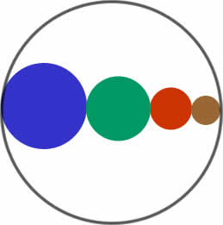
Intuition: Solve this problem by binary search
A lower bound: sum of largest two wire-diameters
An upper bound: sum of all four wire-diameters
Binary search between lower bound and upper bound
Given a pipe diameter and four wire diameters, can you pack the wires inside the pipe?
Choose the smallest integer pipe diameter that fits

Slide 7
This week: binary search
If a desired value is
difficult to compute but easy to check
1d (or broken into 1d subproblems)
and
monotonic (true for all x < t or x > t)
and
then we can binary search across all the possible values for it, checking as we go... !

Slide 8
This week: aggr
Input
Number of cows to house in the new barn…
5 3
1
2
8
4
9
The largest minimum spacing possible after placing all the cows
3
Number of stalls in which cows can be placed
Output
The locations of stalls
1
2
4
8
9

Slide 9
This week: aggr
Input
Number of cows to house in the new barn…
5 3
1
2
8
4
9
The largest minimum spacing possible after placing all the cows
Number of stalls in which cows can be placed
3
Output
The locations of stalls
The interval is from 1 to 9.
Try a spacing of 5. (fails)
Try a spacing of 2. (success).
Try a spacing of 4. (fails)
Try a spacing of 3. (success) End.
1
2
4
8
9

Slide 10
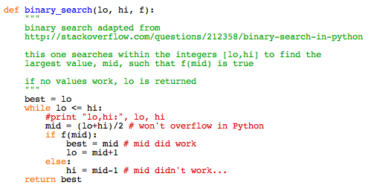
Python example
What's still needed here is the "check" function f …

Slide 11
The function to check: aggr
returns True if C cows can be placed, all >= n apart
f(n)
returns False if C cows cannot be placed, all >= n apart
(1) place a cow at the lowest-numbered spot
(2) find the closest spot that is >= n away
(3) place a cow there and go back to (2)
- if the list runs out return False, else True
1
2
4
8
9

Slide 12
Another example: cowset
# of cows available, up to 34
The number of subsets whose IDs sum between min and max
Input
minimum ID sum
5
3 -1 2
1
-2
3
maximum ID sum
Output
ID # for 1st cow
ID # for 2nd cow
Try all subsets...?
ID # for 3rd cow
Farmer Ran is willing to play frisbee (on MIT's quad) with any subset of cows whose IDs sum to any value between the min and max...

Slide 13
Another example: cowset
# of cows available, up to 34
The number of subsets whose IDs sum between min and max
Input
minimum ID sum
5
3 -1 2
1
-2
3
maximum ID sum
Output
ID # for 1st cow
BinSearch?
ID # for 2nd cow
How many sums for half the cows?
ID # for 3rd cow
Could you check both halves?
Farmer Ran is willing to play frisbee (on MIT's quad) with any subset of cows whose IDs sum to any value between the min and max...

Slide 14
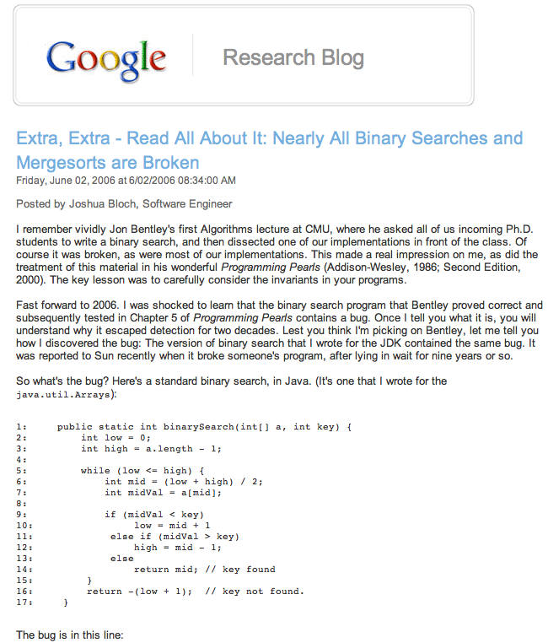

Slide 15
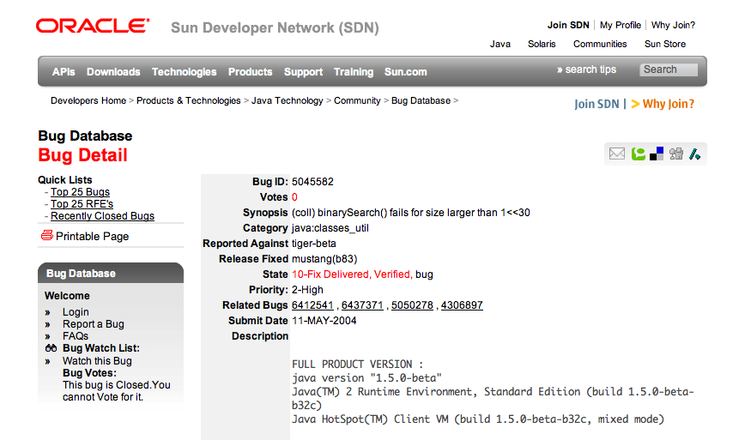
This bug went undetected in Java's libraries for years...

Slide 16
Aside… programming contest travel
Write problems!?

Slide 17
Fall '04 Problem #6: Find the area of a polygon, given its vertices.
HMC Hammer
# Solved Runs Time
1 - 2 4:57:38
2 * 2 2:55:41
3 * 2 3:37:58
4 - 0 0:00:00
5 * 2 1:20:42
6 * 4 4:41:57
7 * 1 2:32:44
Per-Problem Statistics
Problem Solved Submitted
1 3 60
2 11 72
3 3 12
4 0 0
5 19 58
6 7 10
7 10 64
Geometric algorithms
Matt Beaumont, Dan Halperin, Jonah Cohen
contestwide
Monte Carlo geometry…
63 teams total, Fall 04 ACM Contest

Slide 18
Fall '04 Problem #6: Find the area of a polygon, given its vertices.
HMC Hammer
# Solved Runs Time
1 - 2 4:57:38
2 * 2 2:55:41
3 * 2 3:37:58
4 - 0 0:00:00
5 * 2 1:20:42
6 * 4 4:41:57
7 * 1 2:32:44
Per-Problem Statistics
Problem Solved Submitted
1 3 60
2 11 72
3 3 12
4 0 0
5 19 58
6 7 10
7 10 64
Matt Beaumont, Dan Halperin, Jonah Cohen
contestwide
Monte Carlo geometry…
63 teams total, Fall 04 ACM Contest

Slide 19
Geometric algorithms
Turning direction: CW or CCW
B
(0,2)
Right-hand rule:
left turns are positive
right turns are negative
(1,1)
A
Convex hull
(0,0)
O
(2,0)
B'
applications: diameter
Monotone chains algorithm
Area and centroid

Slide 20
Turning direction
B
(0,2)
(1,1)
A
(0,0)
O
(2,0)
B'
A
O
B
def turningDirection( pt1, pt2, pt3 ):
""" returns 1 if pt1 -> pt2 -> pt3 is a CCW (left) turn
returns -1 if pt1 -> pt2 -> pt3 is a CW turn
returns 0 if they are collinear
"""
x1, y1 = pt1; x2, y2 = pt2; x3, y3 = pt3;
# the signed magnitude of the cross product
CP = (x2-x1)*(y3-y1)-(y2-y1)*(x3-x1)
if CP > 0: return 1
if CP < 0: return -1
return 0
x2*y3 – y2*x3
1*2 – 1*0
2
Notes:
PERL stories
- use in ACM
- creating scripts
- LTS, BOT

Slide 21
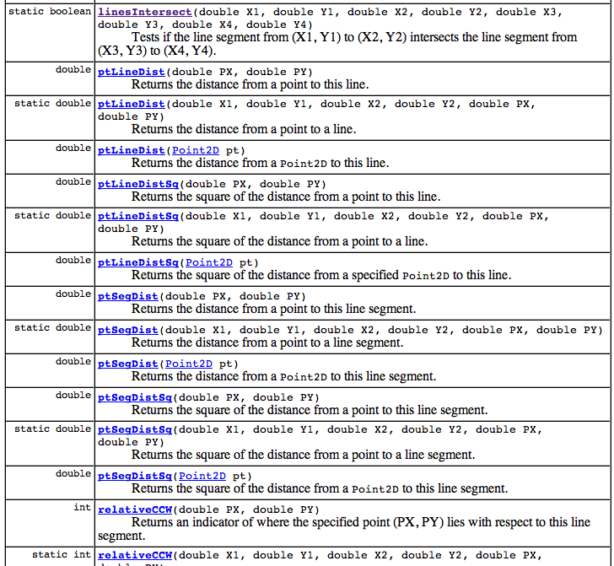
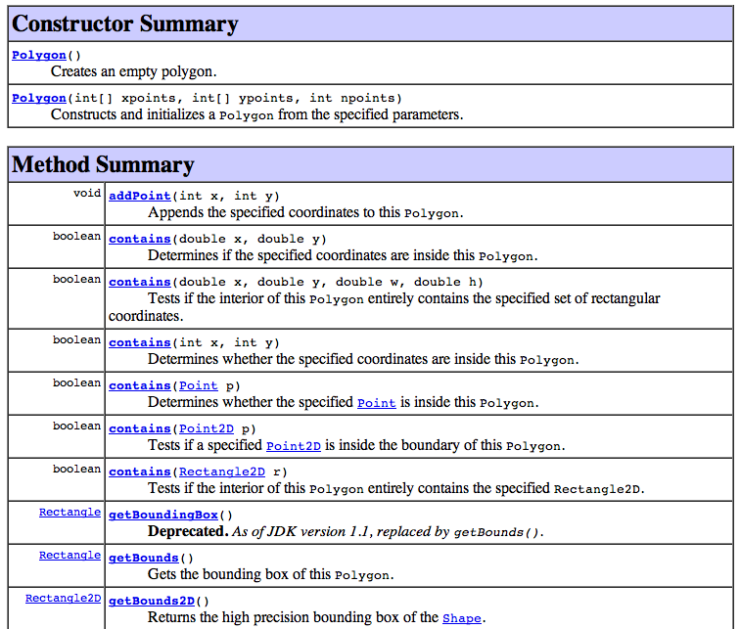
Java's libraries!
Java has its advantages…
Line2d.linesIntersect(x1, y1, x2, y2, x3, y3, x4, y4);
Polygon().contains(x,y);
Line2D
Polygon
Notes:
PERL stories
- use in ACM
- creating scripts
- LTS, BOT

Slide 22
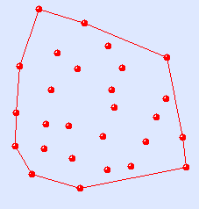
Convex Hull
Application: point-set diameter
What is the pair of points with the greatest separation among a collection in the plane?
the segments surrounding the exterior of a point set.
Notes:
PERL stories
- use in ACM
- creating scripts
- LTS, BOT

Slide 23
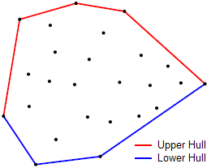
"Monotone-chain" Convex Hull
vertices of the smallest convex polygon containing all points
Note that, looking , all turns are left turns!
Notes:
PERL stories
- use in ACM
- creating scripts
- LTS, BOT

Slide 24
Monotone-chain Convex Hull
Let's find the "BOTTOM chain" for this set of points…
Start by sorting them by x-coordinate, then look for left turns.
Notes:
PERL stories
- use in ACM
- creating scripts
- LTS, BOT

Slide 25
Monotone-chain Convex Hull
Let's find the "BOTTOM chain" for this set of points…
Start by sorting them by x-coordinate, then look for left turns.
Notes:
PERL stories
- use in ACM
- creating scripts
- LTS, BOT

Slide 26
Monotone-chain Convex Hull
Idea: find the upper hull and lower hull...
(Start-up) sort the point-list P by x-coordinate (then y)
Let P be all the points (sorted)
Let L=[] start the list of lower hull points…
(Lower hull)
for each point P[0]..P[i]..P[N]:
P[i]
while L[-2], L[-1], P[i] are not CCW:
remove L[-1]
append P[i] to L
(Upper hull)
same – but in reverse direction!
http://www.algorithmist.com/index.php/Monotone_Chain_Convex_Hull
Notes:
PERL stories
- use in ACM
- creating scripts
- LTS, BOT

Slide 27
Code...
def convex_hull(points):
"""
Input: an iterable sequence of (x, y) pairs representing the points.
Output: a list of vertices of the convex hull in counter-clockwise order,
starting from the vertex with the lexicographically smallest coordinates.
Implements Andrew's monotone chain algorithm. O(n log n) complexity.
"""
points = sorted(set(points))
if len(points) <= 1:
return points
def cross(o, a, b):
return (a[0] - o[0]) * (b[1] - o[1]) - (a[1] - o[1]) * (b[0] - o[0])
# Build lower hull
lower = []
for p in points:
while len(lower) >= 2 and cross(lower[-2], lower[-1], p) <= 0:
lower.pop()
lower.append(p)
# Build upper hull
upper = []
for p in reversed(points):
while len(upper) >= 2 and cross(upper[-2], upper[-1], p) <= 0:
upper.pop()
upper.append(p)
return lower[:-1] + upper[:-1]
# Example: convex hull of a 10-by-10 grid.
assert convex_hull([(i/10, i%10) for i in range(100)]) == [(0, 0), (9, 0), (9, 9), (0, 9)]
http://www.algorithmist.com/index.php/Monotone_Chain_Convex_Hull.py
Notes:
PERL stories
- use in ACM
- creating scripts
- LTS, BOT

Slide 28
This week's problems…
aggr
cowcar
moat
dna
cowset
aliens
city
Carry-overs from last week
New problems for this week
Notes:
PERL stories
- use in ACM
- creating scripts
- LTS, BOT

