Slide 1
Requirements & Requirements Modeling

Slide 2
Review
Software dev Is hard
Software dev processes
Waterfall vs. agile
Started on iteration 1 goals based on project risks …

Slide 3
Goals for iteration 1
Complete first ipad dev tutorial
Figure out what is expected …
We’ll make this more concrete after we talk about requirements.

Slide 4
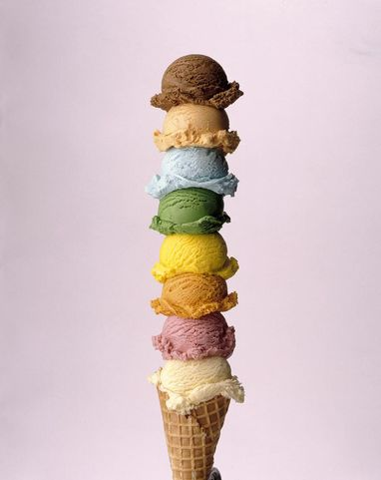
What are requirements?
FURPS+
Functional: features, capabilities
Usability: human factors, aesthetics, consistency, documentation
Reliability: frequency of failure, recoverability, predictability
Performance: response times, throughput, accuracy, availability, resource usage
Supportability: adaptability, maintainability, configurability
+: others
given an example of each for a sudoku game

Slide 5
Software requirements specification
Display grid
  Should have unique solution

Slide 6
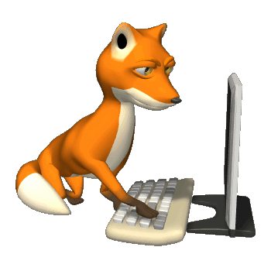
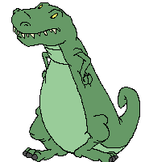
Core functional requirements
Display grid
  Should have unique solution
NOT
SRS is lookin’ good

Slide 7
Changes
Waterfall
Large teams organized by function
  Requirement engineers
  Software architects
  Etc.
Written documents are primary models
Majority of testing at end
Agile
Small cross-functional self-organizing teams that include customer and other stakeholders
Effective use of models including working software
Test/assess continuously (quality baked in)

Slide 8
Agile goal: produce working software as soon as possible (using disciplined approach).
What is the simplest thing you could produce that would be considered a sudoku game?
Considered by whom?

Slide 9
Agile goal: produce working software as soon as possible (using disciplined approach).
What is the simplest thing you can produce that stakeholders will agree is a sudoku game?
How can you express your vision to the stakeholders?

Slide 10
Tools for modeling (primarily functional) requirements
Storyboards
Flow charts
State diagrams
Use cases
Prototypes
Text documents
etc.

Slide 11
Storyboard for tic tac toe
X
START
Player starts game
Grid appears
Player selects square
X appears
X
Congratulations!
You won!
X
X
Stalemate …
O
Repeat until
O
O
Computer selects square and O appears
3 in a row
Player or computer wins
OR
stalemate

Slide 12
Software specification documents (SRS)
Precise
Hard to produce
Hard to assess
Storyboard
Fuzzy
Easy/quick to produce
Easy/quick to assess
Software is the most precise model

Slide 13
Flow chart
Player selects square
Square empty?
N
Y
X appears
Three in a row?
Y
Player wins
N
Any empty squares?
N
Stalemate
Y
O appears
Etc.

Slide 14
Pac-man State diagrams for playing level
Play level: initialize n=3 (#lives), k=0 (level score)
Hits dot:
Sound effect
k increased by 50
Pac Man has n lives,
score k
moves left, right, up,
down
Moves to
empty spot
k<MAX
k>=MAX
n>0
Win level
Hits ghost:
Sound effect
n reduced by 1
Lose level
n=0

Slide 15
Use Case
Describe how a user interacts with the system to achieve a goal.
Pac-man use case: Play game

Slide 16
Pac man “play game” use case
Play game:
Player start game
First level is displayed with player having 3 lives and 0 score
Player moves Pac Man left, right, up, or down
Pac Man moves to empty space, return to step 3
How can we describe alterative paths?

Slide 17
Pac man “play game” use case
Play game:
Player start game
First level is displayed with player having 3 lives and 0 score
Player moves Pac Man left, right, up, or down
Pac Man moves to empty space, return to step 3
4.a. Pac Man hits dot, 50 points awarded, total score is less than 1000, return to step 3
4.b. Pac Man hits dot, 50 points awarded, total score is 1000 or more, new level starts (see start new level use case)
We can embed other use cases to reduce complexity.

Slide 18
Pac man “play game” use case
Play game:
Player start game
First level is displayed with player having 3 lives and 0 score
Player moves Pac Man left, right, up, or down
Pac Man moves to empty space, return to step 3
4.a. Pac Man hits dot, 50 points awarded, total score is less than 1000, return to step 3
4.b. Pac Man hits dot, 50 points awarded, total score is 1000 or more, new level starts (see start new level use case)
4.c. Pac Man hits ghost (see hits ghost use case)
4.d. Pac Man hits a wall, can’t move any in that direction, returns to step 3
etc.

Slide 19
Pac Man Use Cases
Goal setter | Goal | Priority
Player | Play game | 1
Player | Initialize game | 1
Player | View high scores | 3
Player | Set level | 3
Player | Pause game | 2
Player | Exit game | 2
Player | Save game | 3
Player | Change Controls | 4
Player | Play saved game | 3

Slide 20
A product typically has a variety of goal-setters (stakeholders)
I want a web site to sell my beautiful jewelry
I want to find a cool ring on sale
Client
Customer of client

Slide 21
Tools for modeling (primarily functional) requirements
Storyboards
Flow charts
State diagrams
Use cases
Prototypes
Text documents
etc.
Most widely used
Use the best for your situation – and more than one when appropriate

Slide 22
Developer focused
User focused
Software specification documents (SRS)
Precise
Hard to produce
Hard to assess
Agile models
Fuzzy
Easy/quick to produce
Easy/quick to assess

Slide 23
Goals for iteration 1
Complete first ipad dev tutorial
Figure out what is expected …
by whom
customer
instructor

Slide 24
Goals for iteration 1
Complete first ipad dev tutorial
Figure out what is expected … and by whom
The instructor wants you to make your customer happy.

Slide 25
Goals for iteration 1
Complete first ipad dev tutorial
Figure out what is expected … and by whom
The instructor wants you to make your customer happy.
Ultimately, I am your customer. But you’ll also work for your peers.

Slide 26
Goals for iteration 1
Complete first ipad dev tutorial
Start working on requirements
  Determine the rules of sudoku
  Analyze your competitors’ products
  Decide what you think constitutes the core game functionality, rationalize your decisions, and express your vision via
    Storyboard
    Flow chart or state diagram
    Use cases
  Create a prioritized wish list of additional features

Slide 27
You will work with a partner.
Let me know who you are working with before lab ends.

