Slide 1
Design models

Slide 2
Last time
Software dev is hard
Processes of software dev: reqs, design, implementation, test, maintenance
Software methodologies: waterfall vs. agile
Requirements (FURPS+)
Requirement modeling: use cases, storyboards, …
Risk-driven goal-setting

Slide 3
Goals for iteration 1
Complete first ipad dev tutorial
Start working on requirements
Determine the rules of sudoku
Analyze your competitors’ products
Decide what you think constitutes the core game functionality, rationalize your decisions, and express your vision via
Storyboard
Flow chart or state diagram
Use cases
Create a prioritized wish list of additional features

Slide 4
Let’s have a demo

Slide 5
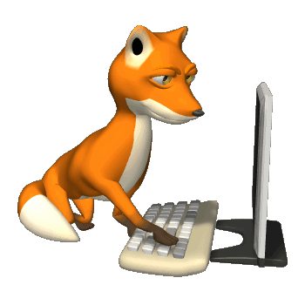
Goal Stack (aka requirements stack)
Project inception:
Identify high level scope
Key requirements
Initial “goal stack”
highest priority, best modeled
goals
Well modeled means we understand what to do
and how long it will take.
lowest priority, least modeled goals

Slide 6
Goal Stack (aka requirements stack)
At the start of each iteration:
Incorporate new goals (produced by last iteration)
Remove completed or obsolete goals
Reprioritize
Clarify goals at top of stack
Plan iteration
highest priority, best modeled
goal
Who prioritizes?
Customer driven
Risk driven
lowest priority, least modeled goal

Slide 7
Goal stack (aka requirements stack)
Build core Sudoku app
Additional feature 1
Build Sudoku app
Uses cases
Additional feature 2
Additional feature 2

Slide 8
Goal stack (aka requirements stack)
Play game use case
Play game use case
Valid Sudoku grid appears
Player selects empty cell in Sudoku grid
2a. Player selects non-empty cell: error, return to step 2
Player selects number in [1,9]
Number is consistent: number appears in cell
4a. Number is inconsistent: Error message, go to step 2
Not done, still consistent moves: go to step 2
5a. Not done, no consistent move: Player loses
5b. Done: Player wins
Additional feature 1
Build Sudoku app
Additional feature 2
Additional feature 2

Slide 9
Goal stack (aka requirements stack)
Play game use case
Erase cell
Build Sudoku app
Additional feature 2
Erase use case
Player selects non-empty cell in Sudoku grid
Player indicates cell should be erased
2a. Player changes mind, nothing changed
Cell is erased
Additional feature 2

Slide 10
Goal stack (aka requirements stack)
Play game use case
Play game use case
Valid Sudoku grid appears
Player selects empty cell in Sudoku grid
2a. Player selects non-empty cell:
erase cell use case, return to 2
Player selects number in [1,9]
Number is consistent: number appears in cell
4a. Number is inconsistent: Error message, go to step 2
Not done, still consistent moves: go to step 2
5a. Not done, no consistent move: Player loses
5b. Done: Player wins
Additional feature 1
Build Sudoku app
Additional feature 2
Additional feature 2

Slide 11
Goal stack (aka requirements stack)
Our first major deliverable is an app that realizes the play game use case (no erasing necessary).
Play game use case
Erase cell
Build Sudoku app
Show invalid entries
Show guides
Keep track of cell options

Slide 12
We need to break this goal down into more manageable steps (tasks). Two
approaches:
Top down
Bottom up
Top down: Develop design model
Bottom up: Develop “proofs of concept”, prototypes
Play game use case
Valid Sudoku grid appears
Player selects empty cell in Sudoku grid
2a. Player selects non-empty cell:
erase cell use case, return to 2
Player selects number in [1,9]
Number is consistent: number appears in cell
4a. Number is inconsistent: Error message, go to step 2
Not done, still consistent moves: go to step 2
5a. Not done, no consistent move: Player loses
5b. Done: Player wins
Play game use case

Slide 13
Fruit Salad
Today we’ll work on a simpler game!
ranoeg
lemno
rechyr
eplpa
capeh
meil
mlup
nabana
orange
melon or lemon
cherry
apple
peach
lime
plum
banana
Chopped
fruit

Slide 14
plaep

Slide 15
Core use case: play game
Chopped fruit appears
Player enters guess
Right/wrong message appears
Return to 1
Additional features:
Quit
Score
Timed mode
High score record
Help

Slide 16
Core use case: play game
Chopped fruit appears
Player enters guess
Right/wrong message appears
Return to 1
Proofs of concepts/prototypes
What we need to be able to do (starting with most obvious):
Display text
Let player enter text
Read that text
…
We know how to do this!

Slide 17
Core use case: play game
Chopped fruit appears
Player enters guess
Right/wrong message appears
Return to 1
Proofs of concepts/prototypes
What we need to be able to do (starting with most obvious):
Display text
Let player enter text
Read that text
…
You have the basic skills you need.

Slide 18
Core use case: play game
Chopped fruit appears
Player enters guess
Right/wrong message appears
Return to 1
Design model
What you need is a design.

Slide 19
Unified Modeling Language
UML is a standard language for visualizing, specifying, constructing, and documenting the artifacts of a software system.
USE CASES are part of UML
Today we’ll talk about design models

Slide 20
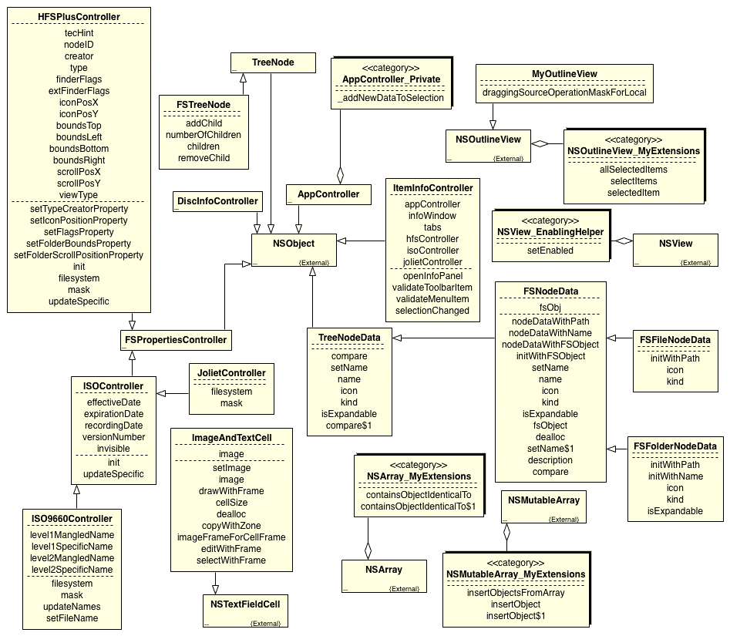
SAMPLE UML Class Diagram

Slide 21
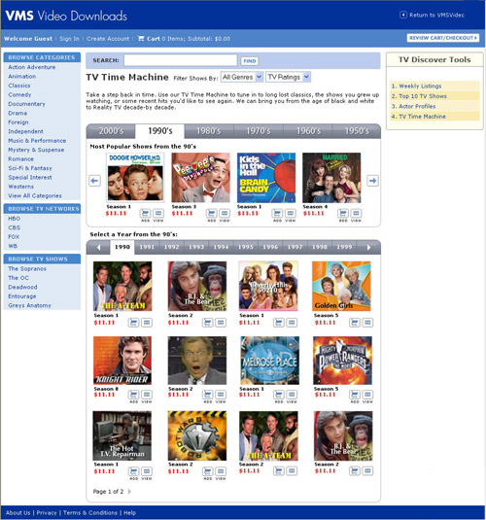
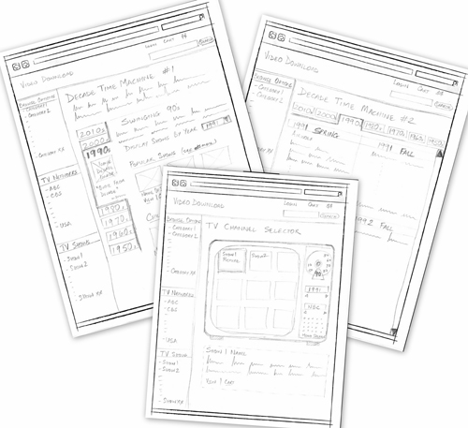
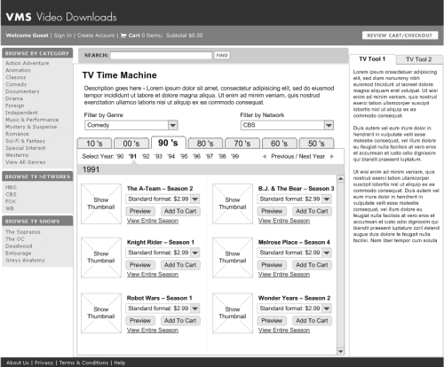
Agile strategy
Simple design models Working software

Slide 22
Design Goals
Make it easy to build
Make it easy to test
Make it easy to maintain
Make it easy to change
SIMPLE
INTUITIVE
FLEXIBLE

Slide 23
Best Practices approach to developing design
Develop a “domain diagram”
Captures key objects in our domain and their relationships/interactions.

Slide 24
collegeSim domain model
Blocks represent nouns, links represent verbs
Room
Building
Instructor
Department
College
Course Offering
Meeting
Course
Major
uses
Time Slot
Textbook
Class List
Student
written by
Semester
Author

Slide 25
Best Practices approach
Develop a “domain diagram”
Initially defined by our core use cases
Nouns
Captures key objects in our domain and their relationships/interactions.

Slide 26
Nouns
Chopped fruit appears
Player enters guess
Right or wrong message appears
Return to 2

Slide 27
Best Practices approach
Develop a “domain diagram”
Initially defined by our core use cases
Nouns
Captures key objects in our domain and their relationships/interactions.
Player
Chopped fruit
Guess
Right/wrong message
Uses cases are fuzzy. Some domain objects may not explicitly appear.

Slide 28
Nouns
Chopped fruit appears
Player enters guess
Right or wrong message appears
Return to 2
There is a screen.
The screen contains certain “labels’ and
“text boxes.” In general, at this point we don’t want to commit to specific UI elements. In a domain diagram, we assume the screen has any UI capabilities we might decide we need.
(We’ll talk about UI design next time.)

Slide 29
Nouns
Chopped fruit appears
Player enters guess
Right or wrong message appears
Return to 2
There is a screen.
There is a collection of “unchopped” fruit.
The chopped fruit is a chopped version of a fruit selected from the collection.

Slide 30
NOTE: This is an iterative process, you don’t usually get it “right” the first time.
Best Practices approach
Develop a “domain diagram”
Initially defined by our core use cases
Nouns
Captures key objects in our domain and their relationships/interactions.
Player
Chopped fruit
Guess
Right/wrong message
Screen
Fruit bowl
Current fruit

Slide 31
Best Practices approach
Develop a “domain diagram”
Captures key objects in our domain and their relationships/interactions.
Player
Chopped fruit
Guess
Right/wrong message
Screen
Bowl of fruit
Current fruit
Verbs

Slide 32
Many relationships are not explicit in the use cases.
Chopped fruit appears
Player enters guess
Right/wrong message appears
Return to 1
Screen
Player
Displays
Enters
Bowl of fruit
Right/wrong message
Guess
The guess should appear
Current fruit
Chopped fruit

Slide 33
Augment domain diagram to “realize” use cases
Chopped fruit appears
Player enters guess
Right/wrong message appears
Return to 1
Screen
Player
Displays
What about “Return to 1”?
Enters
Bowl of fruit
Right/wrong message
Guess
Current fruit
Chopped fruit

Slide 34
Best Practices approach
Develop a “domain diagram”
Augment domain diagram to “realize” use cases
Identify “responsibilities” in use cases
Add (abstract) classes as needed
Responsibility: Overall control

Slide 35
Chopped fruit appears
Player enters guess
Right/wrong message appears
Return to 1
Should we have given the responsibility of overall control to the screen? To the bowl of fruit?
What about “Return to 1”?
Has
Game controller
Screen
Player
Displays
Has
Makes
Bowl of fruit
Right/wrong message
Guess
Current fruit
Chopped fruit

Slide 36
Best Practices approach
Develop a “domain diagram”
Augment domain diagram to “realize” use cases
Identify “responsibilities” in use cases
Add (abstract) classes as needed
Use cases are fuzzy. Responsibilities may be implicit.

Slide 37
Core use case: play game
Chopped fruit appears
Player enters guess
Right/wrong message appears
Return to 1
Select current fruit
Chop it
Display it

Slide 38
Select current fruit
Has
Game controller
Screen
Player
Displays
Has
Enters
Bowl of fruit
Right/wrong message
Guess
Selects
Current fruit
Chopped fruit

Slide 39
Select current fruit
Chop it
Display it
Has
Game controller
Screen
Player
Displays
Has
Makes
Bowl of fruit
Right/wrong message
Guess
Selects
Creates
Current fruit
Chopped fruit

Slide 40
Select current fruit
Chop it
Display it
Has
Game controller
Screen
Player
Displays
Tells bowl to select new fruit & chop it
Makes
Bowl of fruit
Right/wrong message
Guess
Selects
Creates
Current fruit
Chopped fruit

Slide 41
Core use case: play game
Chopped fruit appears
Player enters guess
Right/wrong message appears
Return to 1
Select current fruit
Chop it
Display it
Compare guess to current fruit
Display right or wrong message

Slide 42
Compare guess to current fruit
Has
Game controller
Screen
Player
Displays
Tells bowl to select new fruit & chop it
Enters
Bowl of fruit
Right/wrong message
Guess
Selects
Compares to current fruit
Creates
Current fruit
Chopped fruit

Slide 43
Best Practices approach
Develop a “domain diagram”
Augment domain diagram to “realize” use cases
Identify “responsibilities” in use cases
Add (abstract) classes as needed
Use sequence diagrams to clarify responsibilities & control

Slide 44
Game
controller
Bowl of fruit
View
Select current fruit
Chop fruit
Display chopped fruit
Get guess
Guess
This is a UML Sequence Diagram.

Slide 45
Guidelines for decisions
Design principles – essentially simple, intuitive, flexible
Design patterns – good solutions to common problems

Slide 46
Key design principles
Classes should have
high cohesion – low coupling
How can this principles make our software simpler, more intuitive, and more flexible?
Focused on a single responsibility
Doesn’t know about, care about, depend on too many other classes

Slide 47
Key design principles
Single responsibility principle
Each class should have a single responsibility and that responsibility should be entirely encapsulated within the class.

Slide 48
Model-View-Controller (MVC) design pattern
Model and View do not interact directly
Model
View
Data
UI elements
Controller
Logic

Slide 49
Model-View-Controller (MVC)
Model
View
Data (pretty dumb)
UI elements (pretty dumb)
Controller
Keep it simple
Logic

Slide 50
Model-View-Controller (MVC)
Model
View 1
View 2
Controller1
Controller2

Slide 51
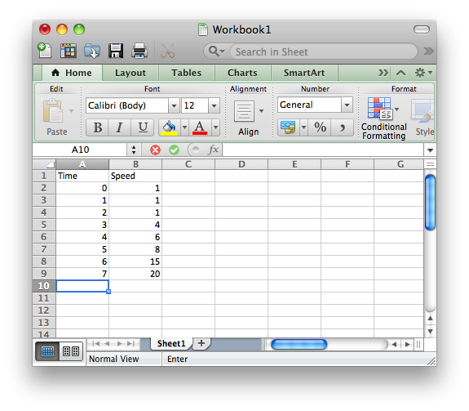
Classic example

Slide 52
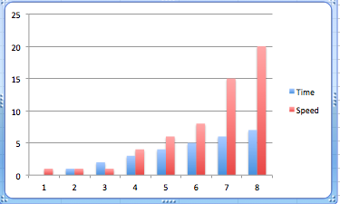
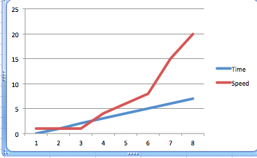
Table view
Data
Chart view
Graph view

Slide 53
Table controller
Table view
Data
Chart controller
Chart view
Graph controller
Graph view

Slide 54
Interactive Graph view
Data
Graph controller
User can change data
by manipulating graph

Slide 55
Adding new views is easy!
(Don’t need to change existing code.)
Higgs Boson view
Data
Higgs Boson controller

Slide 56
Table controller
Changing underlying data models does not affect UI.
Table view
Data
Chart controller
Chart view
Graph controller
Graph view

Slide 57
Fruit salad
Remember all fruit
Remember current fruit
Select random fruit to be current fruit
Chop current fruit
Test guess against current fruit
Display chopped fruit
Get & display guess
Display win/lose message
Model
View
Controller
Everything else

Slide 58
It’s not the only way
Remember all fruit
Provide a fruit when asked
Display chopped fruit
Get & hold guess
Display win/lose message
Model
View
Controller
Everything else

Slide 59
View
Game
controller
Bowl of fruit
Select fruit
Chop fruit
Chopped fruit
Display chopped fruit
Get guess
Guess
Test guess
Right or Wrong
Display right/wrong message

Slide 60
Best Practices approach
Develop a “domain diagram”
Augment domain diagram to “realize” use cases
Identify “responsibilities” in use cases
Add (abstract) classes as needed
Demote objects to attribute status as needed
Use sequence diagrams to clarify control
Iterate

Slide 61
Game controller
Current chopped fruit
Current guess
Current right/wrong msg
Bowl of fruit
View
Game loop
These will be class members
This will be the class method
Bowl of fruit
List of fruit
Current fruit
Select fruit
Chop fruit
Test fruit
View
Chopped fruit label
Guess text field
Right/wrong msg label
This is a UML Class Diagram.

Slide 62
Game controller
Current chopped fruit
Current guess
Current right/wrong msg
Bowl of fruit
View
Game loop
These will be class members. (Some have been demoted to simple attributes rather than objects.)
This will be the class method
This means has a
Bowl of fruit
List of fruit
Current fruit
Select fruit
Chop fruit
Test fruit
View
Chopped fruit label
Guess text field
Right/wrong msg label
This is a UML Class Diagram.

Slide 63
Game controller
Current chopped fruit
Current guess
Current right/wrong msg
Bowl of fruit
View
Game loop
Control game
Manage fruit
Display stuff
Bowl of fruit
List of fruit
Current fruit
Select fruit
Chop fruit
Test fruit
View
Chopped fruit label
Guess text field
Right/wrong msg label
What are the “single” responsibilities of each class?

Slide 64
Bowl of fruit
NSArray theFruit;
NSString* currentFruit;
-(void) selectCurrentFruit;
-(NSString) chopCurrentFruit;
-(Bool) checkGuess: (NSString*) toCompare;
Bowl of fruit
List of fruit
Current fruit
Select fruit
Chop fruit
Test fruit
Elaborate
1
NSArray (theFruit)
Foundation objects –
We don’t have to define their interfaces here.
*
NSString* (aFruit)

Slide 65
Bowl of fruit
NSArray theFruit;
NSString* currentFruit;
-(void) selectCurrentFruit;
-(NSString) chopCurrentFruit;
-(Bool) checkGuess: (NSString*) toCompare;
PROBLEM:
Objective-c methods cannot return objects. They can return basic data types (int, float, char) and pointers.
1
theFruit (NSArray*)
*
aFruit (NSString*)

Slide 66
Game controller
Pointer to chopped fruit
Current guess
Current right/wrong msg
Bowl of fruit
View
Game loop
Bowl of fruit
List of fruit
Current fruit
Chopped fruit
Select fruit
Chop fruit
Test fruit
View
Chopped fruit label
Guess text field
Right/wrong msg label
Bowl of fruit creates & remembers chopped fruit
Returns pointer to chopped fruit to Game controller

Slide 67
Bowl of fruit
NSArray theFruit;
NSString* currentFruit;
NSString* choppedFruit;
-(void) selectCurrentFruit;
-(NSString*) chopCurrentFruit;
-(Bool) compareCurrentFruit: (NSString*) toCompare;
Time for more bottom up activities.
iOS tutorial 2.
Another problem: Objective-c
doesn’t allow statically defined objects as
class members
1
theFruit (NSArray*)
*
aFruit (NSString*)

Slide 68
UML Diagrams
Communication tools
Include as much detail as needed for your current purpose – and no more
Start with use cases and domain diagrams then evolve your design using “responsibilities”
Makes design simpler, more intuitive, and more flexible
Ensures design realizes use cases

Slide 69
Your Goal stack
Develop preliminary
design model for sudoku
Top down
Goals for iteration 2
Learn more iOS dev,
particularly Objective-c
Bottom up
Sudoku: Play game use case
Sudoku: Erase cell
Your desired/prioritized features go here.
Sudoku:Show invalid entries
Sudoku: Show guides
Sudoku: Keep track of cell options

Slide 70
This is the right level of detail to achieve in your sudoku design model.
Game controller
Pointer to chopped fruit
Current guess
Current right/wrong msg
Bowl of fruit
View
Game loop
Control game
Manage fruit
Display stuff
Bowl of fruit
List of fruit
Current fruit
Chopped fruit
Select fruit
Chop fruit
Test fruit
View
Chopped fruit label
Guess text field
Right/wrong msg label
Be explicit about the “single” responsibility of each class

Slide 71
Next time
A random team will present their design.

