Slide 1
Your Goal stack for iteration 3
Done
Tutorial 3: graphics
Goals for iteration 3 due Thursday
UI prototype
Usability test
In-class exercise on Thursday
Define prototype
HW 4: Usability test results
Goals for iteration 4 due Tuesday (you’ll set preliminary goals today)
Tutorial 4: views & interaction
HW 4: Prototype
Alpha
Beta

Slide 2
Your Goal stack for iteration 4
Define prototype
In-class today
HW 4: Usability test results
Goals for iteration 4 due Tuesday
Tutorial 4: views & interaction
HW 4: Prototype
Alpha
Beta

Slide 3
Last time we decided this was low priority.
Model
View
Controller
Focus on back end

Slide 4
Model
View
Controller
Focus on front end

Slide 5
Model
View
Controller
Focus on functionality

Slide 6
Model
View
Controller
Do several small “proofs
of concept”

Slide 7
Some combination?
Do several small “proofs
of concept”
Model
View
Controller
Focus on functionality
Focus on front end

Slide 8
Core game
What is the essential functionality you all provide in your core game model?
Do we know how to do this?
Grid appears
Player selects number
Player selects cell
Number appears in cell
Sort of. (Graphics and text labels?)
Sort of. (Button?)
Sort of. (Button?)
Sort of. (Changing text label?)

Slide 9
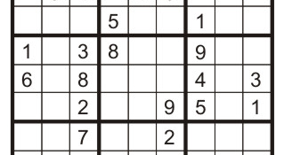
Do you want to drag 81 buttons onto the IB screen ?
Then do you want to connect each of them to some controller code through the IB interface?

Slide 10
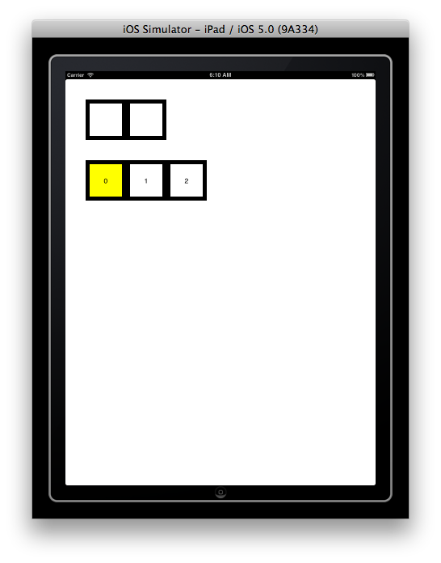
Grid
Use case:
Grid and number pad appear
Number pad

Slide 11
Use case:
Grid and number pad appear
0 cell in number pad is highlighted

Slide 12
Use case:
Grid and number pad appear
0 key in number pad is highlighted
Player touches number pad key

Slide 13
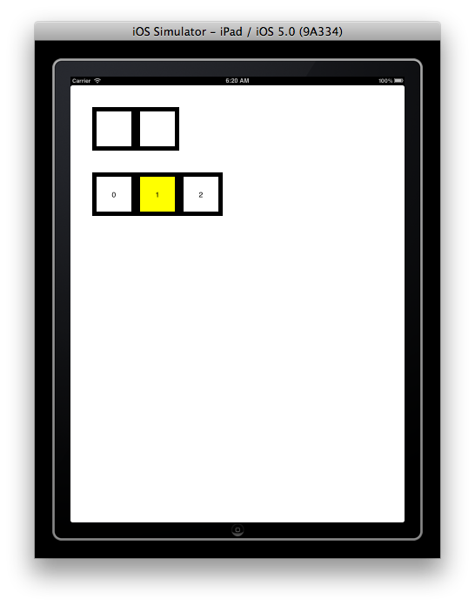
Use case:
Grid and number pad appear
0 cell in number pad is highlighted
Player touches number pad cell
That cell becomes the highlighted cell (i.e. exactly one cell is highlighted at any time)

Slide 14
Use case:
Grid and number pad appear
0 cell in number pad is highlighted
Player touches number pad cell
That cell becomes the highlighted cell
Player touches grid cell

Slide 15
Use case:
Grid and number pad appear
0 cell in number pad is highlighted
Player touches number pad cell
That cell becomes the highlighted cell
Player touches grid cell
The grid cell darkens

Slide 16

Use case:
Grid and number pad appear
0 cell in number pad is highlighted
Player touches number pad cell
That cell becomes the highlighted cell
Player touches grid cell
The grid cell darkens briefly
Number from highlighted number pad cell appears in grid cell

Slide 17
Let’s develop a domain diagram.

Slide 18
Cell
What are the responsibilities?
Number Pad Cell
Grid Cell
Number Pad
Grid

Slide 19
Common:
Display number
Recognize touch
Cell
Display number
Recognize touch
Highlight
De-highlight
Remember number
Display number
Recognize touch
Darken briefly when touched
Number Pad Cell
Grid Cell
Number Pad
Grid

Slide 20
Which responsibilities belong to
a. Model-controller
b. View-controller
Common:
Display number
Recognize touch
Cell
Model-controller
Display number
Recognize touch
Highlight
De-highlight
Remember number
Display number
Recognize touch
Darken briefly when touched
Number Pad Cell
Grid Cell
Number Pad
Grid
We don’t need a model class!

Slide 21
Common:
Display number
Recognize touch
Cell
Display number
Recognize touch
Highlight
De-highlight
Remember number
Display number
Recognize touch
Darken briefly when touched
Number Pad Cell
Grid Cell
Number Pad
Grid

Slide 22
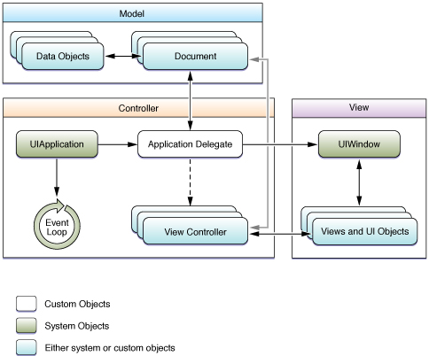

Slide 23
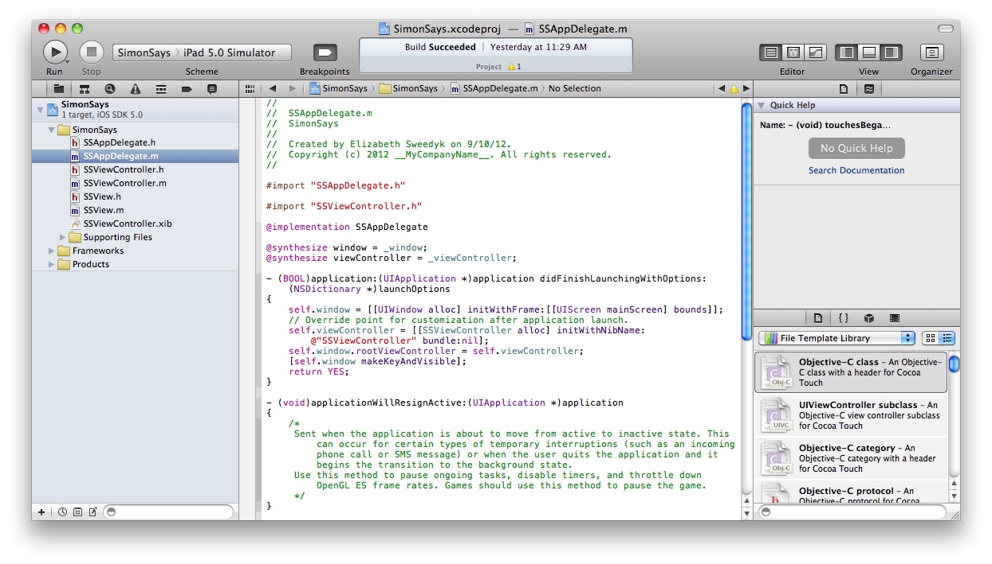
Tutorial 4 covers the AppDelegate and UIWindow

Slide 24
Tutorial 4 also covers Views and how to control them!

Slide 25
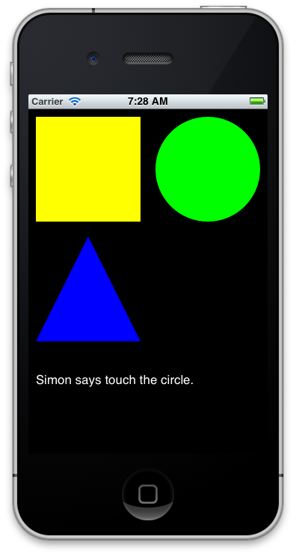
All views (i.e. derived from UIView)
Tutorial 4: Simon Says

Slide 26
The background screen is also a view.
Tutorial 4: Simon Says

Slide 27
Touch
Responder chain
YES!
Circle:
Can you handle?
Fine, then we’re done.
Tutorial 4: Simon Says

Slide 28
Touch
Responder chain
No
Circle:
Can you handle?
Background screen:
Can you handle?
Tutorial 4: Simon Says

Slide 29
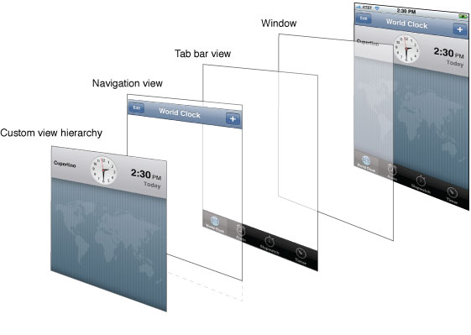
You set the ordering.

Slide 30
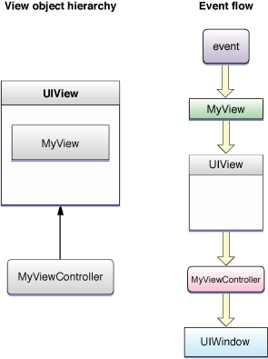
Our custom views are here in the order we specify.
This view is created by the IB editor. We can’t change its behavior programmatically.
We can programmatically handle events involving our custom views. Events for elements created in IB are specified through the IB interface.

Slide 31
Our custom views are here in the order we specify.
We won’t use the IB editor for the tutorial or prototype so you can ignore the UIView for now.
This view is created by the IB editor. We can’t change its behavior programmatically.
We can programmatically handle events involving our custom views. Events for elements created in IB are specified through the IB interface.

Slide 32
What are our views?

Slide 33
Recognize touch
Background color
UIView
Common:
Display number
Recognize touch
Cell
Display number
Recognize touch
Highlight
De-highlight
Remember number
Display number
Recognize touch
Darken briefly when touched
Number Pad Cell
Grid Cell
Number Pad
Grid

Slide 34
Recognize touch
Background color
UIView
Common:
Display number
Recognize touch
UILabel
Cell
Display number
Recognize touch
Highlight
De-highlight
Remember number
Display number
Recognize touch
Darken briefly when touched
Number Pad Cell
Grid Cell
Number Pad
Grid

Slide 35
Recognize touch
Background color
UIView
Common:
Display number
Recognize touch
UILabel
Cell
Display number
Recognize touch
Highlight
De-highlight
Remember number
Display number
Recognize touch
Darken briefly when touched
Number Pad Cell
Grid Cell
ViewController
Number Pad
Grid

Slide 36
Use case:
Grid and number pad appear
Create the views.
Draw views.

Slide 37
Recognize touch
Background color
UIView
Display label
Common:
Display number
Recognize touch
UILabel
Cell
Display number
Recognize touch
Highlight
De-highlight
Remember number
Display number
Recognize touch
Darken briefly when touched
Number Pad Cell
Grid Cell
ViewController
Number Pad
Grid
Create views

Slide 38
Recognize touch
Background color
UIView
Display label
Common:
Display number
Recognize touch
UILabel
Cell
Display number
Recognize touch
Highlight
De-highlight
Remember number
Display number
Recognize touch
Darken briefly when touched
Number Pad Cell
Grid Cell
ViewController
Number Pad
Grid
Create views
Create initial labels

Slide 39
Use case:
Grid and number pad appear
Create the views.
Draw views.
What about formatting?

Slide 40
0
View has origin and width/height

Slide 41
There are more elegant ways to do this – but this is fast and easy.
Cell has black background

Slide 42
There are more elegant ways to do this – but this is fast and easy.
Cell has black background, label has white background
Label has smaller “frame”
0

Slide 43
Use case:
Grid and number pad appear
0 cell in number pad is highlighted

Slide 44
Recognize touch
Background color
UIView
Common:
Display number
Recognize touch
UILabel
Cell
Display number
Recognize touch
Highlight
De-highlight
Remember number
Display number
Recognize touch
Darken briefly when touched
Number Pad Cell
Grid Cell
ViewController
Number Pad
Grid
Create views
Create initial labels
Remember current number selection

Slide 45
There are more elegant ways to do this – but this is fast and easy.
Cell has black background, label has white background as default but yellow when highlighted.
Label has smaller “frame”
0

Slide 46
Use case:
Grid and number pad appear
0 cell in number pad is highlighted
Player touches number pad key

Slide 47
Use case:
Grid and number pad appear
0 cell in number pad is highlighted
Player touches number pad cell
That cell becomes the highlighted cell (i.e. exactly one cell is highlighted at any time)
Current selected number changes
Previous cell de-highlights
New cell highlights

Slide 48
Current selected number changes
Previous cell de-highlights
New cell highlights
How does responder chain work?
1
UILabel:
Do you want to handle?
These could respond to event and highlight.
Cell:
Do you want to handle?
ViewController:
Do you want to handle?
ViewController

Slide 49
Current selected number changes
Previous cell de-highlights
New cell highlights
How does responder chain work?
1
UILabel:
Do you want to handle?
Cell:
Do you want to handle?
View controller can take event, update its number, tell the previous highlighted cell to de-highlight and new cell to highlight
ViewController:
Do you want to handle?
ViewController

Slide 50
Recognize touch
Background color
UIView
Common:
Display number
Recognize touch
UILabel
Cell
Display number
Recognize touch
Highlight
De-highlight
Remember number
Display number
Recognize touch
Darken briefly when touched
Number Pad Cell
Grid Cell
ViewController
Number Pad
Grid
Create views
Remember current number
selection & controls highlights
Recognizes touch

Slide 51
Use case:
Grid and number pad appear
0 cell in number pad is highlighted
Player touches number pad cell
That cell becomes the highlighted cell (i.e. only one cell is highlighted at any time)
Player touches grid cell
The grid cell darkens briefly
BONUS PROBLEM!

Slide 52
Use case:
Grid and number pad appear
0 cell in number pad is highlighted
Player touches number pad cell
That cell becomes the highlighted cell (i.e. only one cell is highlighted at any time)
Player touches grid cell
The grid cell darkens briefly
Number from highlighted number pad cell appears in grid cell

Slide 53
Recognize touch
Background color
UIView
Common:
Display number
Recognize touch
UILabel
Cell
Display number
Recognize touch
Highlight
De-highlight
Remember number
Display number
Recognize touch
Darken briefly when touched
Number Pad Cell
Grid Cell
ViewController
Number Pad
Grid
Create views
Remember current number
selection & controls highlights
Recognizes touch

Slide 54
Recognize touch
Background color
UIView
Common:
Display number
Recognize touch
UILabel
Cell
Display number
Recognize touch
Highlight
De-highlight
Update label
Display number
Recognize touch
Darken briefly when touched
Number Pad Cell
Grid Cell
ViewController
Create views
Remember current number
selection & controls highlights
Tells grid cell to update label
Recognizes touch
Number Pad
Grid

Slide 55
View controller
Recognize touch
A touch was generated in the view V.
You will learn how to handle touches in the tutorial. But UIViews have a very convenient field called tag that holds an integer. You might well take advantage of it!

Slide 56
Start early
Ask for help when needed
I can be available on Friday and Monday. Send me an email to
arrange a time.
Grutor office hours will be announced

