Slide 1
Software quality

Slide 2
What do we mean by software quality?
Functionality
Usability
Reliability
Performance
Supportability

Slide 3
Model Hierarchy
Use cases
Non-functional requirements
Design goals
Component architecture
Data models
Analytical models
User interface
design
Class interfaces
Code
Quality

Slide 4
Model Hierarchy
Use cases
Non-functional requirements
Design goals
Component architecture
Data models
Analytical models
User interface
design
Class interfaces
Code
Today
Quality

Slide 5
Class interface & code quality
Functionality
Usability
Reliability
Performance
Supportability
You’ve learned much of this already. I want to connect what you know to the theme of CS121

Slide 6
Class interface & code quality
Functionality
Usability
Reliability
Performance
Supportability
Context: sudoku alpha

Slide 7
Alpha requirements
Play game use case (one of the following)
Select number, select cell
Select cell, select number

Slide 8
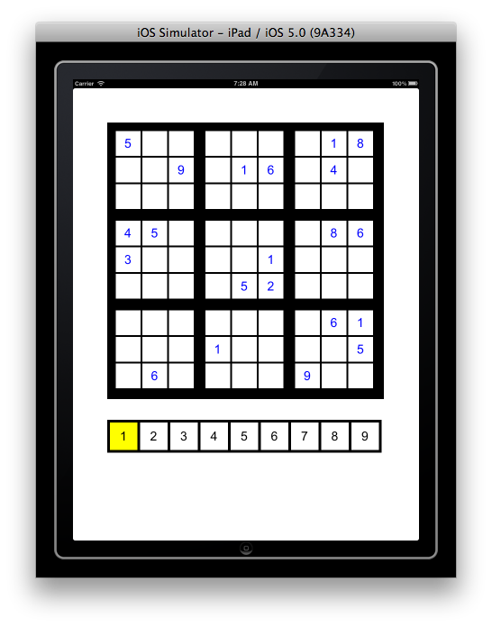
Play game use case (number/cell)
Play game use case:
Valid sudoku grid and number pad appear.
Numbers in sudoku grid are blue.
Cell “1” in number pad is highlighted; 1 is the current number
Player touches cell.
Cell is number pad cell: see Select number pad cell use case.
Cell is sudoku grid cell: see Select sudoku grid cell use case.

Slide 9
Select number pad cell use case:
Player selects number pad cell.
Player select cell “9”.

Slide 10
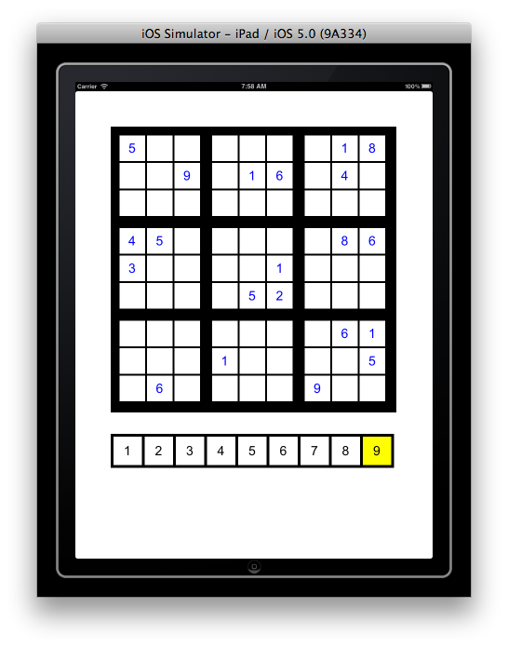
Select number pad cell use case:
Player select number pad cell.
Previous highlighted cell de-highlights.
Selected cell highlights.
Selected cell’s number is now current number.
Player select cell “9”.
After selection “9” is only cell highlighted. Current number is 9.

Slide 11
Select sudoku grid cell use case:
Player selects sudoku grid cell.
Player selects sudoku grid cell.

Slide 12
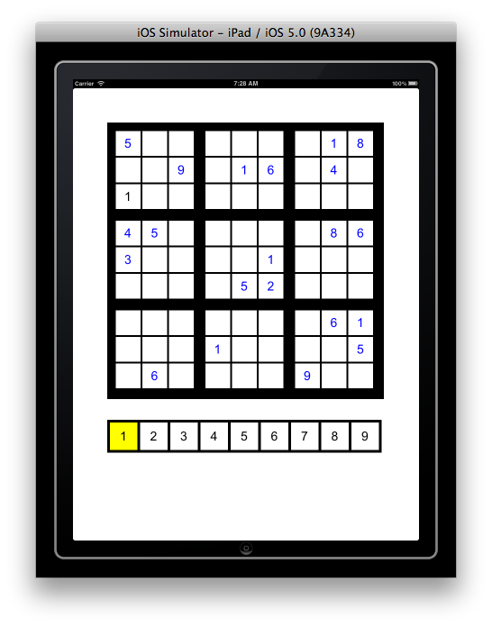
Select sudoku grid cell use case:
Player selects sudoku grid cell.
Cell is empty and current number is consistent for cell: current number appears in cell in black.
Player selects sudoku grid cell.
Cell is empty and current number is consistent for cell.

Slide 13
Select sudoku grid cell use case:
Player selects sudoku grid cell.
Cell is empty and current number is consistent for cell: current number appears in cell in black.
2a. Cell is empty and current
number is inconsistent:
nothing happens.
Player selects sudoku grid cell.
Cell is empty but current number is inconsistent for cell.

Slide 14
Select sudoku grid cell use case:
Player selects sudoku grid cell.
Cell is empty and current number is consistent for cell: current number appears in cell in black.
2a. Cell is empty and current
number is inconsistent:
nothing happens.
2b. Cell contains blue number:
nothing happens.
Player selects sudoku grid cell. Cell contains blue number. Nothing happens.

Slide 15
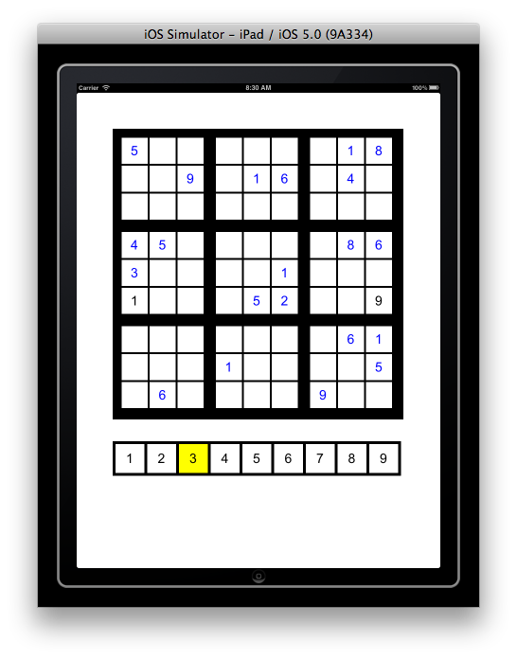
Select sudoku grid cell use case:
Player selects sudoku grid cell.
Cell is empty and current number is consistent for cell: current number appears in cell in black.
2a. Cell is empty and current
number is inconsistent:
nothing happens.
2b. Cell contains blue number:
nothing happens.
2c. Cell contains black number and
current number is inconsistent
for cell: nothing happens.
Player selects sudoku grid cell. Cell contains black number and current number is inconsistent for cell.

Slide 16
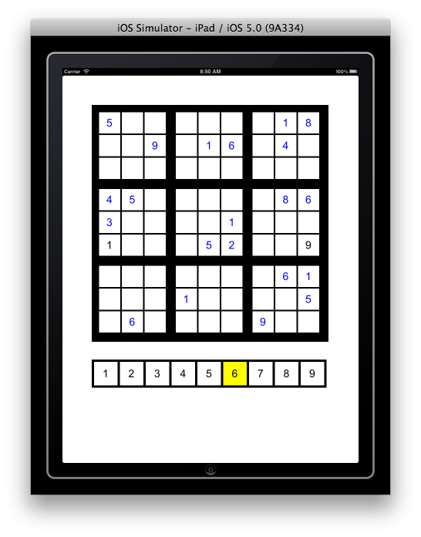
Select sudoku grid cell use case:
Player selects sudoku grid cell.
Cell is empty and current number is consistent for cell: current number appears in cell in black.
2a. Cell is empty and current
number is inconsistent:
nothing happens.
2b. Cell contains blue number:
nothing happens.
2c. Cell contains black number and
current number is inconsistent
for cell: nothing happens.
2d. Cell contains black number and
current number is consistent for
cell: ???
Player selects sudoku grid cell. Cell contains black number and cell is consistent for cell.
YOU DECIDE

Slide 17
Alpha requirements
Play game use case (one of the following)
Select number, select cell
Select cell, select number
Similar use case:
grid must stay consistent, original values can’t be erased.

Slide 18
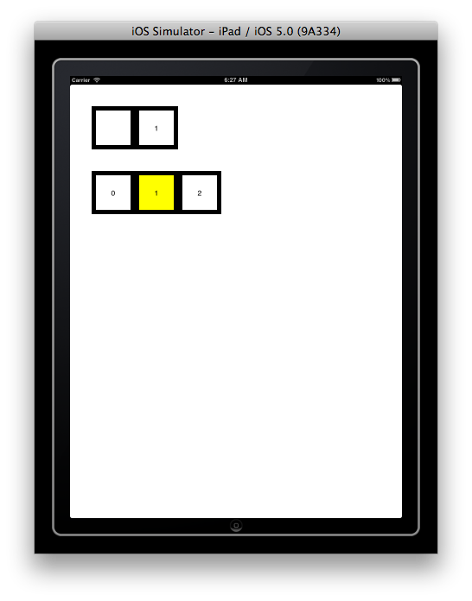
Use case:
Grid and number pad appear
0 cell in number pad is highlighted
Player touches number pad cell
That cell becomes the highlighted cell
Player touches grid cell
The grid cell darkens briefly
Number from highlighted number pad cell appears in grid cell
Alpha play game use case is very similar to prototype use case.

Slide 19
Prototype design can be easily adapted for alpha front end design!
Recognize touch
Background color
UIView
Common:
Display number
Recognize touch
UILabel
Cell View
Display number
Recognize touch
Highlight
De-highlight
Update label
Display number
Recognize touch
Darken briefly when touched
Number Pad Cell View
Grid Cell View
ViewController
Create views
Remember current number
selection & controls highlights
Tells grid cell to update label
Recognizes touch
Number Pad
Grid

Slide 20
Game controller
Grid
View
Selected number
Selected cell
Error message
Game loop
Show invalid
Grid (model)
Solution
Cells
Check cell empty
Check cell mutable
Check consistency
Add number
Erase number
Create grid & solution
Find valid number to enter
View
Display grid
Display grid with invalid highlighted
Display number pad
Display error message
Get number
Get cell
Display/test invalid button
Display/test hint button
Cell (model)
Value
Row
Column
Block
Mutable
ValueSet
Valid
Your initial design model (HW2) looked something like this.

Slide 21
Game controller
Grid
Number Pad Cell View
Grid Cell View
Selected number
Selected cell
Control highlights
Recognize touch
Game loop
Grid (model)
Solution
Cells
Check cell empty
Check cell mutable
Check consistency
Add number
Erase number
Create grid & solution
Find valid number to enter
Number Pad Cell View
Label
Highlight
De-highlight
Grid Cell View
Label
Update label text
Cell (model)
Value
Row
Column
Block
Mutable
ValueSet
Valid
The view-controller is coming into shape.
UILabel

Slide 22
Game controller
Grid
Number Pad Cell View
Grid Cell View
Selected number
Selected cell
Control highlights
Recognize touch
Game loop
Grid (model)
Solution
Cells
Check cell empty
Check cell mutable
Check consistency
Add number
Erase number
Create grid & solution
Find valid number to enter
Now we need to focus on the model/controller interaction.
Cell (model)
Value
Row
Column
Block
Mutable
ValueSet
Valid

Slide 23
Your Goal stack for iteration 4
Done!
HW 4: Usability test results
Goals for iteration 4 due Tuesday
Tutorial 4: views & interaction
HW 4: Prototype
Alpha
Beta

Slide 24
Your Goal stack for iteration 5
Alpha
Goals for iteration 6 due Tuesday
Beta

Slide 25
Your Goal stack for iteration 5
We’ll make this more concrete before class ends.
Design model/controller interface
Goals for iteration 5 due Thursday
Prototype
Alpha
Goals for iteration 6 due Tuesday
Beta

Slide 26
Game controller
Grid
Grid (model)
Interface design goals:
Simple
Intuitive
Provide flexibility
We don’t want flexible interfaces. We want interfaces that make our code easy to change.

Slide 27
Class interface design: Simple, Intuitive, flexible
Form consistent abstractions
Encapsulate implementation details
This is our abstraction.
Everything else should be encapsulated (hidden).

Slide 28
Game controller
Grid
Grid (model)
Interface design goals:
Simple
Intuitive
Provide flexibility
Define responsibilities based on use cases.

Slide 29
Game controller
Grid
Controls game.
Grid (model)
Play game use case:
Valid sudoku grid and number pad appear.
Numbers in sudoku grid are blue.
Cell “1” in number pad is highlighted; 1 is the current number
Player touches cell.
Cell is number pad cell: see Select number pad cell use case.
Cell is sudoku grid cell: see Select sudoku grid cell use case.
Create valid sudoku grid
Get value of cell
What are model responsibilities?

Slide 30
Game controller
Grid
Controls game.
Grid (model)
Select sudoku grid cell use case:
Player selects sudoku grid cell.
Cell is empty and current number is consistent for cell: current number appears in cell in black.
Create valid sudoku grid
Get value of cell
Create valid sudoku grid
Get value of cell
Determine if cell is empty or not
Determine if number is consistent for cell
Change value of cell
What are model responsibilities?

Slide 31
Game controller
Grid
Controls game.
Controls game.
Enforces rules.
Grid (model)
Select sudoku grid cell use case:
Player selects sudoku grid cell.
Cell is empty and current number is consistent for cell: current number appears in cell in black.
2a. Cell is empty and current
number is inconsistent:
nothing happens.
Create valid sudoku grid
Get value of cell
Determine if cell is empty or not
Determine if number is consistent for cell
Change value of cell
What are model responsibilities?
Whose job is it to enforce this constraint?

Slide 32
Game controller
Grid
Controls game.
Enforces rules.
Grid (model)
Select sudoku grid cell use case:
Player selects sudoku grid cell.
Cell is empty and current number is consistent for cell: current number appears in cell in black.
2a. Cell is empty and current
number is inconsistent:
nothing happens.
2b. Cell contains blue number:
nothing happens.
Create valid sudoku grid
Get value of cell
Determine if cell is empty or not
Determine if number is consistent for cell
Change value of cell
What are model responsibilities?

Slide 33
Game controller
Grid
Controls game.
Enforces rules.
Grid (model)
Select sudoku grid cell use case:
Player selects sudoku grid cell.
Cell is empty and current number is consistent for cell: current number appears in cell in black.
2a. Cell is empty and current
number is inconsistent:
nothing happens.
2b. Cell contains blue number:
nothing happens.
Create valid sudoku grid
Get value of cell
Determine if cell is empty or not
Determine if number is consistent for cell
Change value of cell
Determine if cell is “mutable”
What are model responsibilities?

Slide 34
Game controller
Grid
Controls game.
Enforces rules.
Grid (model)
Select sudoku grid cell use case:
Player selects sudoku grid cell.
Cell is empty and current number is consistent for cell: current number appears in cell in black.
2a. Cell is empty and current
number is inconsistent:
nothing happens.
2b. Cell contains blue number:
nothing happens.
2c. Cell contains black number and
current number is inconsistent
for cell: nothing happens.
2d. Cell contains black number and
current number is consistent for
cell: ???
Create valid sudoku grid
Get value of cell
Determine if cell is empty or not
Determine if number is consistent for cell
Change value of cell
Determine if cell is “mutable”
What are model responsibilities?

Slide 35
Grid (model)
grid
createGrid
getValueOfCell
setValueOfCell
cellIsEmpty
cellIsMutable
numberIsConsistentForCell
Create valid sudoku grid
Get value of cell
Determine if cell is empty or not
Determine if number is consistent for cell
Change value of cell
Determine if cell is “mutable”

Slide 36
Let’s elaborate!
Grid (model)
grid
createGrid
getValueOfCell
setValueOfCell
cellIsEmpty
cellIsMutable
numberIsConsistentForCell
Public or private?

Slide 37
Grid (model)
grid
createGrid
getValueOfCell
setValueOfCell
cellIsEmpty
cellIsMutable
numberIsConsistentForCell
Game controller
Grid
message
message
Low coupling and high cohesion
Controller should know as little about the grid as possible.
Grid should know as little about the rest of world as possible.

Slide 38
Grid (model)
createGrid
getValueOfCell
setValueOfCell
cellIsEmpty
cellIsMutable
numberIsConsistentForCell
This is public interface. This is all that the controller needs to know.

Slide 39
What are its parameters?
What does it return?
Grid (model)
createGrid
getValueOfCell
setValueOfCell
cellIsEmpty
cellIsMutable
numberIsConsistentForCell
createGrid
(void) createGrid()
I’m using C-like syntax in the design process. We want to stay language-independent as long as possible.
WHY?

Slide 40
What are its parameters?
What does it return?
Grid (model)
grid
createGrid
getValueOfCell
setValueOfCell
cellIsEmpty
cellIsMutable
numberIsConsistentForCell
getValueOfCell
(int) getValueOfCell( int row, int column);

Slide 41
What are its parameters?
What does it return?
Grid (model)
grid
createGrid
getValueOfCell
setValueOfCell
cellIsEmpty
cellIsMutable
numberIsConsistentForCell
setValueOfCell
(void) setValueOfCell(int value, int row, int column);

Slide 42
What are its parameters?
What does it return?
Grid (model)
createGrid
getValueOfCell
setValueOfCell
cellIsEmpty
cellIsMutable
numberIsConsistentForCell
cellIsEmpty
(bool) cellIsEmpty( int row, int column);

Slide 43
What are its parameters?
What does it return?
Grid (model)
createGrid
getValueOfCell
setValueOfCell
cellIsEmpty
cellIsMutable
numberIsConsistentForCell
cellIsMutable
(bool) cellIsMutable( int row, int column);

Slide 44
What are its parameters?
What does it return?
Grid (model)
createGrid
getValueOfCell
setValueOfCell
cellIsEmpty
cellIsMutable
numberIsConsistentForCell
numberIsConsistentForCell
(bool) numberIsConsistentForCell( int number, int row, int column);

Slide 45
Let’s critique our design!
Grid (model)
(void) createGrid()
(void) setValueOfCell (int value, int row, int column)
(int) getValueOfCell (int row, int column)
(bool) cellIsEmpty(int row, int column)
(bool) cellIsMutable(int row, int column)
(bool) numberIsConsistentForCell(int number, int row, int column)

Slide 46
Imagine someone else is going to use your class:
Is it simple, intuitive?
What can go wrong? What can be improved?
Did we use good names?
Grid (model)
(void) createGrid()
(void) setValueOfCell (int value, int row, int column)
(int) getValueOfCell (int row, int column)
(bool) cellIsEmpty(int row, int column)
(bool) cellIsMutable(int row, int column)
(bool) numberIsConsistentForCell(int number, int row, int column)

Slide 47
Properties of good names
Intention-revealing
(void) createGrid()
Better?
(void) getNewGrid()

Slide 48
Properties of good names
Intention-revealing
Consistent
(bool) numberIsConsistentForCell(int number, int row, int column)
(void) setValueOfCell (int value, int row, int column)
better
(bool valueIsConsistentForCell(int value, int row, int column)(void) setValueOfCell (int value, int row, int column)

Slide 49
Properties of good names
Intention-revealing
Consistent
(bool) numberIsConsistentForCell(int number, int row, int column)
(void) setValueOfCell (int value, int row, int column)
Much worse
(bool valueIsConsistentforCell(int value, int row, int column)(void) setValueOfCell (int value, int row, int column)

Slide 50
Properties of good names
Intention-revealing
Consistent
Pronounceable, readable, recognizable
(bool) cellIsEmpty(int row, int column)
better
(bool) isEmpty( int row, int column )

Slide 51
Properties of good names
Intention-revealing
Consistent
Pronounceable, readable, recognizable
Use problem domain names
Not unnecessarily long

Slide 52
Our revised design
Grid (model)
(void) getNewGrid()
(void) setValueOfCell (int value, int row, int column)
(int) getValueOfCell (int row, int column)
(bool) isEmpty(int row, int column)
(bool) isMutable(int row, int column)
(bool) valueIsConsistentForCell(int value, int row, int column)

Slide 53
Method/parameter names in objective-c
-(void) getNewGrid;
Use:
[self getNewGrid];

Slide 54
Method/parameter names in objective-c
-(void) getNewGrid
-(void) setValue: (int) x
Use:
[self getNewGrid];
Use:
[self setValue: x];

Slide 55
Method/parameter names in objective-c
Definition
-(void) getNewGrid
-(void) setValue: (int) x
-(void) getValueAtRow: (int) row andColumn: (int) column
Use:
[self getNewGrid];
Use:
[self setValue: x];
Use:
[self getValueAtRow: row andColumn: column];

Slide 56
Our re-revised design
Grid (model)
-(void) getNewGrid;
-(void) setValue: (int) value atRow: (int) row andColumn: (int) column;
-(int) getValueAtRow: (int) row andColumn: (int) column;
-(bool) isEmptyAtRow: (int) row andColumn: (int) column;
-(bool) isMutableAtRow: (int) row andColumn: (int) column;
(bool) isValue: (int) value consistentAtRow: (int) row andColumn: (int) column;

Slide 57
Our re-revised design
Grid (model)
-(void) getNewGrid;
-(void) setValue: (int) value atRow: (int) row andColumn: (int) column;
-(int) getValueAtRow: (int) row andColumn: (int) column;
-(bool) isEmptyAtRow: (int) row andColumn: (int) column;
-(bool) isMutableAtRow: (int) row andColumn: (int) column;
(bool) isValue: (int) value consistentAtRow: (int) row andColumn: (int) column;
Objective-c method names are called selectors
[self setValue: value atRow: 7 atCol:6} is a message for self’s selector
setValue:atRow:andColumn

Slide 58
Is it simple, intuitive, flexible?
Grid (model)
-(void) getNewGrid;
-(void) setValue: (int) value atRow: (int) row andColumn: (int) column;
-(int) getValueAtRow: (int) row andColumn: (int) column;
-(bool) isEmptyAtRow: (int) row andColumn: (int) column;
-(bool) isMutableAtRow: (int) row andColumn: (int) column;
(bool) isValue: (int) value consistentAtRow: (int) row andColumn: (int) column;
It does everything it needs to do but no more
What methods do are clear from their names
How is it flexible?

Slide 59
Grid
Controller
messages
Controller only uses public interface. Underlying data & algorithms of Grid can be changed without affecting controller.
Grid knows nothing about game rules, how data is displaayed. That can be changed without affecting Grid.

Slide 60
Objective-c does not support private methods but that doesn’t mean that you can’t enforce your own rules about access.
Grid (model)
-(void) makeNewGrid;
-(bool) isEmptyAtRow: (int) row andColumn: (int) column
-(bool) isMutableAtRow: (int) row andColumn: (int) column
-(bool) value: (int) value IsConsistentForRow: (int) row, andColumn: (int) column)
-(void) setValue: (int) value atRow: (int) row andColumn: (int)column
-(int) getValueAtRow: (int) row andColmn: (int) column)
// private methods
What is this?
The rest of the world
shouldn’t know
shouldn’t care
shouldn’t feel the effects of change

Slide 61
Code: Method/function design
Simple
Intuitive
Flexible

Slide 62
More design principles:
Methods should have high cohesion and low coupling.
Methods should have a single responsibility.
Grid (model)
-(void) getNewGrid;
-(void) setValue: (int) value atRow: (int) row andColumn: (int) column;
-(int) getValueAtRow: (int) row andColumn: (int) column;
-(bool) isEmptyAtRow: (int) row andColumn: (int) column;
-(bool) isMutableAtRow: (int) row andColumn: (int) column;
(bool) isValue: (int) value consistentAtRow: (int) row andColumn: (int) column;
In what ways are these methods “coupled?”
They all depend on the underlying data structure for the grid.

Slide 63
Data structures
Our public interface should be based on what the outside world needs. Is int the right thing?
Our underlying data structure should be based on the simplest thing that works for now.
Array:
NSMutableArray
NSArray
C array
Array values:
NSNumber
int
NSString
NSMutableString
char []
Grid (model)
-(void) getNewGrid;
-(void) setValue: (int) value atRow: (int) row andColumn: (int) column;
-(int) getValueAtRow: (int) row andColumn: (int) column;
-(bool) isEmptyAtRow: (int) row andColumn: (int) column;
-(bool) isMutableAtRow: (int) row andColumn: (int) column;
(bool) isValue: (int) value consistentAtRow: (int) row andColumn: (int) column;
Did we already decide?

Slide 64
More design principles
Separate interface from implementation!

Slide 65
We’ve already talked about this aspect.
Grid
Controller
messages
Controller only uses public interface. Underlying data & algorithms of Grid can be changed without affecting controller.
Grid knows nothing about game rules, how data is displaayed. That can be changed without affecting Grid.

Slide 66
Grid implementation
Grid public interface
requirements
How is up to meet the requirements is up to the grid designer/developers.

Slide 67
More design principles
Separate interface from implementation!
Agile Just in time(JIT) approach: use the simplest approach that works for now (and maybe a little in the future).
Because requirements will change!

Slide 68
Data structures
Array:
NSMutableArray
NSArray
C array
Array values:
NSNumber
int
NSString
NSMutableString
char []
Recommended

Slide 69
More design principles:
Methods should have high cohesion and low coupling.
Methods should have a single responsibility.
Methods should have good names & short parameter lists.
Grid (model)
-(void) getNewGrid;
-(void) setValue: (int) value atRow: (int) row andColumn: (int) column;
-(int) getValueAtRow: (int) row andColumn: (int) column;
-(bool) isEmptyAtRow: (int) row andColumn: (int) column;
-(bool) isMutableAtRow: (int) row andColumn: (int) column;
(bool) isValue: (int) value consistentAtRow: (int) row andColumn: (int) column;
What can we do to shorten the # of parameters for our methods?
Tradeoffs:
Creating a class/struct for row, column Increases coupling between our model & controller.
It increases implementation complexity; we’ll need to pack and unpack.
It reduces conceptual complexity.

Slide 70
Module design
Short
Operates at one level of abstraction
Functions step down in level of abstraction
isValue: consistentAtRow: andColumn:
isValue: inRow:
isValue: inColumn:
isValue: inBlock:

Slide 71
isValue: inBlock:
Block 0
row,col block
Converting row,col from/to block is at a lower level of abstraction than searching a block for a value.

Slide 72
isValue: inBlock:
Block 0
row,col block
Also because of:
D.R.Y. (Don’t Repeat Yourself)
Single responsibility principle

Slide 73
Class interface & code quality
Functionality
Usability
Reliability
Performance
Supportability
Practice good design/coding principles.
Use iterative design!
Do it.
Do it right.

Slide 74
Class interface & code quality
Functionality
Usability
Reliability
Performance
Supportability
Practice good design/coding principles.
Test/assess.
Next time

Slide 75
Your Goal stack for iteration 5
In the lab/homework, you will do a couple of readings, revisit the the model interface design, the prototype it.
Hint 1: Hard code a sudoku puzzle.
Design model/controller interface
Goals for iteration 5 due Thursday
Prototype
Alpha
Goals for iteration 6 due Tuesday
Beta

Slide 76
Your Goal stack for iteration 5
In the lab/homework, you will do a couple of readings, revisit the the model interface design, the prototype it.
Hint 2: You can use your prototype for today to view the model-viewer interaction.
Design model/controller interface
Goals for iteration 5 due Thursday
Prototype
Alpha
Goals for iteration 6 due Tuesday
Beta

Slide 77
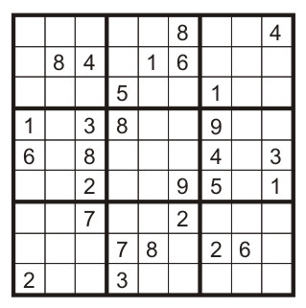
Hardcode the controller to show two
adjacent cells of grid.
Move the cells displayed to test model-
controller functionality.

