Slide 1
CS 60
Prolog Quiz (mini-review)
PhotoEditor (Hw7)
2013-10-23
Wednesday – Week 7
Lecture 13

Slide 2
“YET” Survey
If you did poorly on the Prolog quiz, you shouldn't do computer science
  (FALSE)
If you did poorly on the Prolog quiz, you will never learn Prolog
  (FALSE)
If you did poorly on the Prolog quiz, you will probably fail the class
  (FALSE - it is only 3% of your grade!)
If you did poorly on the Prolog quiz, you should study more (or do something different) for the final
  (TRUE)

Slide 3
Survey: Should fall break be longer?
Yes
Maybe
Perhaps
I guess
Nah

Slide 4
Administrative Stuff
There are extra lecture notes in front of Colleen’s office! Organized by date (new on the top)
Colleen’s Office Hours (this week only)
  Thursday 2:00-4:00 pm in the LAC
  Thursday 5:40-7:00 pm in the LAC

Slide 5
Inheritance & Casting

Slide 6
Inheritance Lingo
A Dog is an Animal
Dog extends Animal
Dog is the subclass of Animal
Animal is the superclass of
Dog
Animal
Dog
Dalmatian
Cat
A Dalmation is a Dog
A Dalmation is an Animal
Dalmation extends Dog
Dalmation is the subclass of Dog and Animal

Slide 7
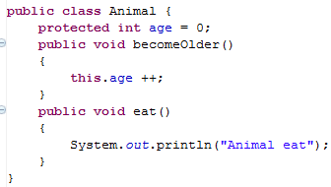
Animal
age
0
Animal myAnimal= new Animal();
myAnimal.becomeOlder();
myAnimal.eat();

Slide 8
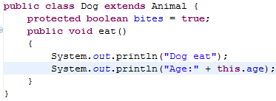
We can override the parent’s eat method
We can access the variable age, even though we didn’t include it in the Dog class directly
Dog
age
bites
Animal
age
0
true
0

Slide 9
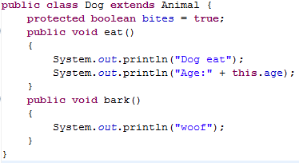
Dog myDog = new Dog();
myDog.eat();
myDog.bark(); // ↓ does this work? ___
myDog.becomeOlder();

Slide 10
Subclasses (Children) Can
Declare new instance/class variables
Declare new methods
Override old implementations with new implementations
Access instance/class variables of the superclass (parent) *
Access methods of the superclass*
* only public, protected or default ones

Slide 11
Prolog Quiz
Review

Slide 12
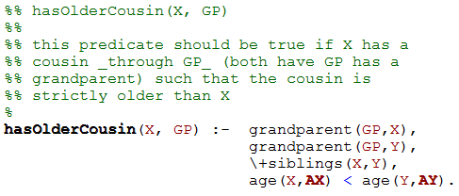
This isn’t legal Prolog – Why?
Prolog Practice hasOlderCousin
from Simpson’s HW3

Slide 13
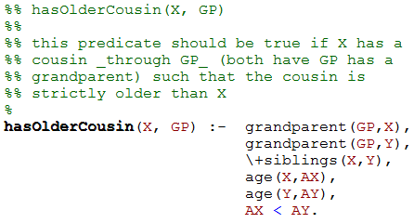
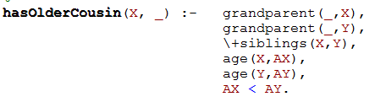
Prolog Practice hasOlderCousin from Simpson’s HW3
Can we replace GP with _?
A) Yes
B) No
C) Stuck

Slide 14
Common Mistakes on the Prolog Quiz
Mistake: Assuming Prolog queries “return” something like Racket functions
  Note: Any Prolog “output” has to be an argument to the query
Mistake: Using _ when you need a consistent variable binding

Slide 15
Homework 7 grayscale
(use it as an example)

Slide 16
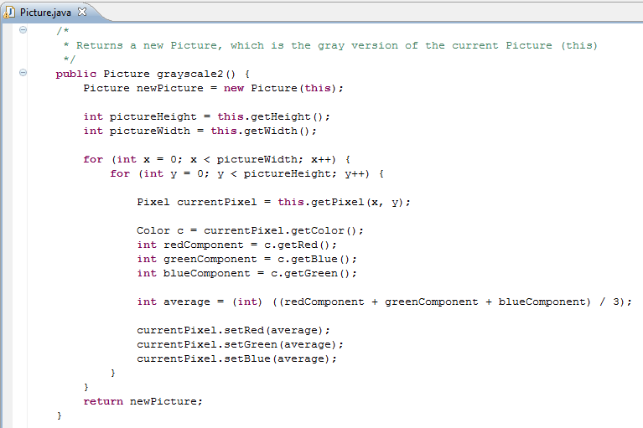
Based upon this code,
what types of Objects are there?
And what methods do they have?
Does this method modify this?
A)Yes
B)No
C)Stuck

Slide 18
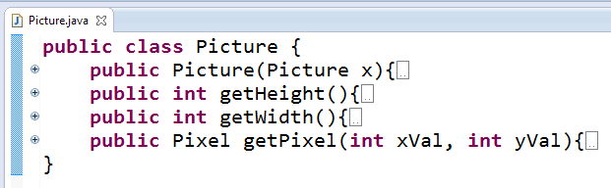
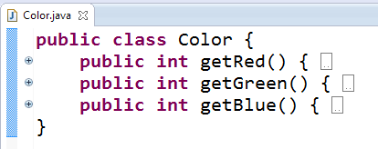
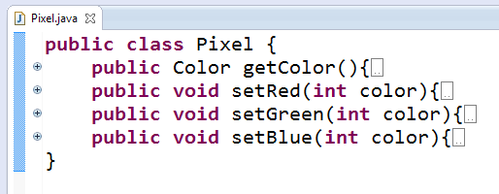
These are reasonable hypotheses about what Classes and methods must exist based upon the grayscale2 method.

Slide 19
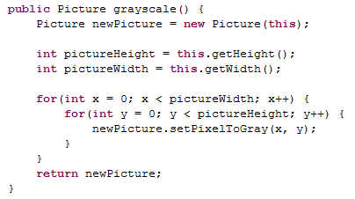
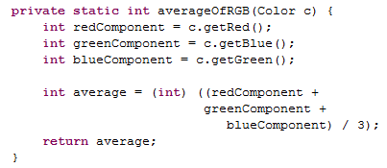
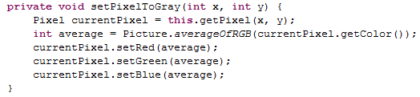
Avoid redundancy with helpers (not shown here)
Helper methods should be private
Make methods short/understandable with helpers

Slide 20
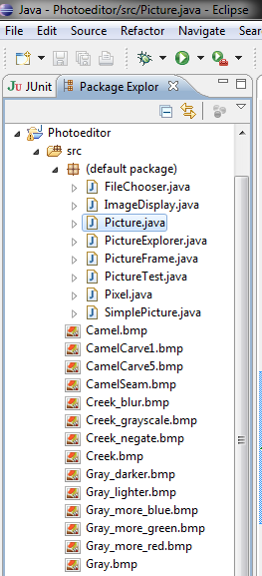
There are
a LOT of files in hw7.zip
What is this assignment about?
Making something cool
Practice:
  Conditionals/Loops
  Working with Objects
  Working with a large code base
Challenges:
  Debugging!!!
  Using Eclipse

Slide 21
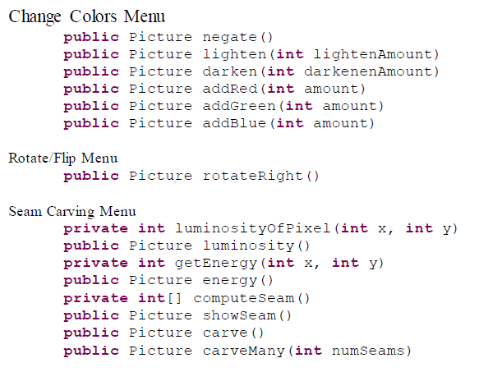
Methods to Write
Style requirement:
Avoid redundancy with helpers

Slide 22
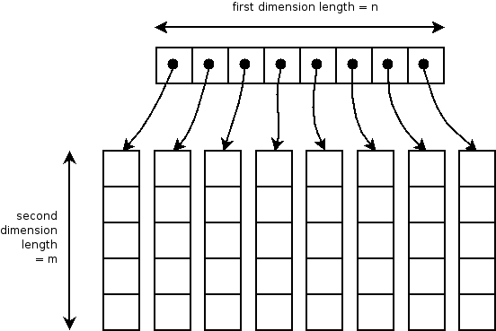
int [][] table = new int[8][5];
Two dimensional arrays – Array of arrays

Slide 23
Seam Carving

Slide 24
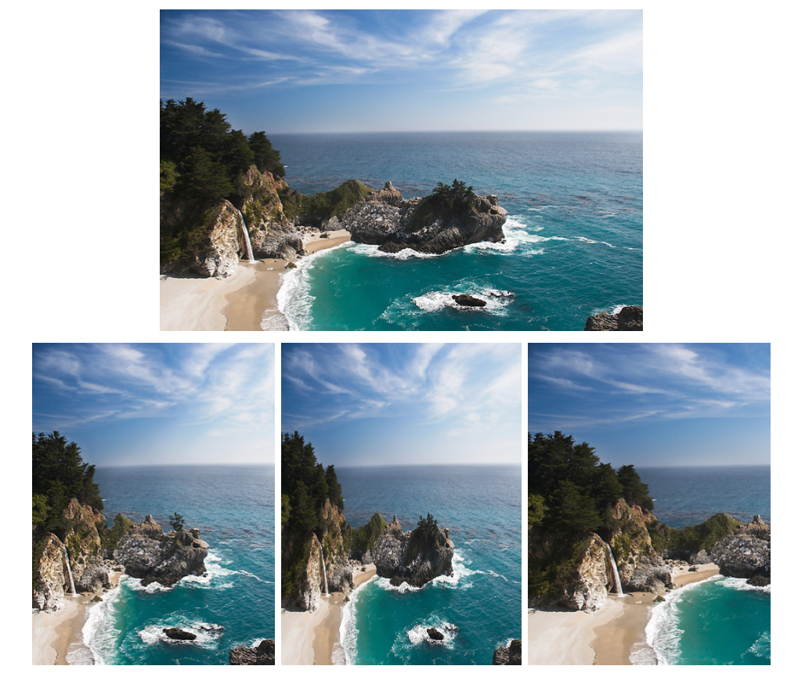
The problem
original image
?
device size

Slide 25
Three possible solutions
original image
Seam Carving
1
2
3
What happened in each case?

Slide 26

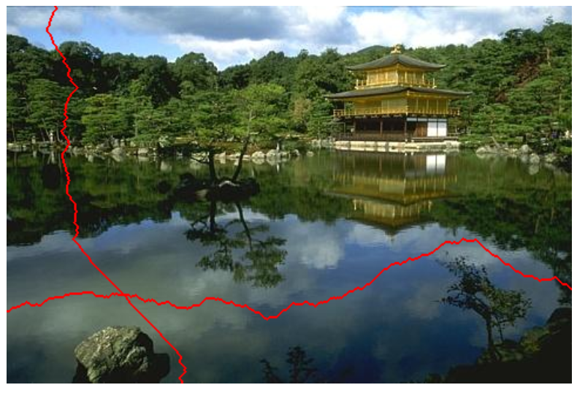
Remove less important seams
to make the picture smaller!
seams
original image
2007 !
you're encouraged to use the original paper as a guide...

Slide 27
Definition of Seams (+ Demo)
Seams
Go from the top row to the bottom row
Connect by an edge or a corner
Seams are the lowest “energy” path

Slide 28





Seam Carving:
The Big Picture
Original
Luminosity
Energy
Seam
Seam Removed

Slide 29
Background:
How
pictures are represented
 | x = 0 | x = 1 | x = 2 | x = 3 | x = 4 | x = 5 | x = 6 | x = 7
y = 0 | R:144 G:189 B:254 | R:143 G:185 B:245 | R:147 G:184 B:236 | R:168 G:197 B:231 | R:110 G:128 B:140 | R:121 G:130 B:127 | R:82 G:81 B:78 | R:76 G:70 B:64
y = 1 | R:142 G:187 B:252 | R:148 G:190 B:250 | R:157 G:194 B:246 | R:158 G:186 B:223 | R:126 G:144 B:158 | R:112 G:121 B:120 | R:14 G:15 B:10 | R:73 G:70 B:64
y = 2 | R:146 G:192 B:254 | R:143 G:185 B:243 | R:152 G:189 B:242 | R:153 G:181 B:220 | R:54 G:71 B:87 | R:112 G:122 B:124 | R:75 G:77 B:71 | R:34 G:34 B:25
y = 3 | R:147 G:193 B:252 | R:152 G:194 B:252 | R:159 G:196 B:249 | R:138 G:167 B:209 | R:23 G:41 B:63 | R:156 G:165 B:170 | R:51 G:53 B:48 | R:89 G:91 B:79
y = 4 | R:149 G:194 B:251 | R:156 G:199 B:254 | R:153 G:190 B:245 | R:166 G:194 B:241 | R:40 G:57 B:82 | R:79 G:89 B:98 | R:73 G:79 B:71 | R:68 G:72 B:58
y = 5 | R:148 G:194 B:246 | R:154 G:197 B:250 | R:159 G:196 B:251 | R:162 G:193 B:240 | R:95 G:114 B:146 | R:47 G:59 B:70 | R:64 G:71 B:64 | R:99 G:106 B:88
y = 6 | R:155 G:199 B:246 | R:157 G:199 B:249 | R:159 G:196 B:251 | R:164 G:194 B:244 | R:176 G:196 B:231 | R:94 G:107 B:123 | R:70 G:80 B:71 | R:54 G:64 B:43
y = 7 | R:156 G:200 B:245 | R:158 G:200 B:248 | R:165 G:202 B:255 | R:165 G:195 B:245 | R:182 G:202 B:239 | R:157 G:170 B:186 | R:62 G:72 B:64 | R:61 G:69 B:48
Original

Slide 30
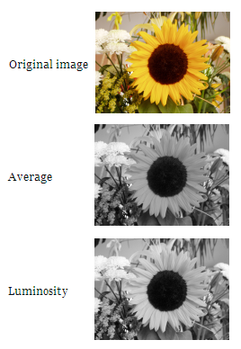
Step 1: Convert to Luminosity
Original
Luminosity
Red, Green, and Blue are all this:
 | x = 0 | x = 1 | x = 2 | x = 3 | x = 4 | x = 5 | x = 6 | x = 7
y = 0 | R:144 G:189 B:254 | R:143 G:185 B:245 | R:147 G:184 B:236 | R:168 G:197 B:231 | R:110 G:128 B:140 | R:121 G:130 B:127 | R:82 G:81 B:78 | R:76 G:70 B:64
y = 1 | R:142 G:187 B:252 | R:148 G:190 B:250 | R:157 G:194 B:246 | R:158 G:186 B:223 | R:126 G:144 B:158 | R:112 G:121 B:120 | R:14 G:15 B:10 | R:73 G:70 B:64
y = 2 | R:146 G:192 B:254 | R:143 G:185 B:243 | R:152 G:189 B:242 | R:153 G:181 B:220 | R:54 G:71 B:87 | R:112 G:122 B:124 | R:75 G:77 B:71 | R:34 G:34 B:25
y = 3 | R:147 G:193 B:252 | R:152 G:194 B:252 | R:159 G:196 B:249 | R:138 G:167 B:209 | R:23 G:41 B:63 | R:156 G:165 B:170 | R:51 G:53 B:48 | R:89 G:91 B:79
y = 4 | R:149 G:194 B:251 | R:156 G:199 B:254 | R:153 G:190 B:245 | R:166 G:194 B:241 | R:40 G:57 B:82 | R:79 G:89 B:98 | R:73 G:79 B:71 | R:68 G:72 B:58
y = 5 | R:148 G:194 B:246 | R:154 G:197 B:250 | R:159 G:196 B:251 | R:162 G:193 B:240 | R:95 G:114 B:146 | R:47 G:59 B:70 | R:64 G:71 B:64 | R:99 G:106 B:88
y = 6 | R:155 G:199 B:246 | R:157 G:199 B:249 | R:159 G:196 B:251 | R:164 G:194 B:244 | R:176 G:196 B:231 | R:94 G:107 B:123 | R:70 G:80 B:71 | R:54 G:64 B:43
y = 7 | R:156 G:200 B:245 | R:158 G:200 B:248 | R:165 G:202 B:255 | R:165 G:195 B:245 | R:182 G:202 B:239 | R:157 G:170 B:186 | R:62 G:72 B:64 | R:61 G:69 B:48
 | x = 0 | x = 1 | x = 2 | x = 3 | x = 4 | x = 5 | x = 6 | x = 7
y = 0 | 184 | 180 | 179 | 193 | 125 | 127 | 81 | 70
y = 1 | 182 | 185 | 189 | 182 | 141 | 119 | 14 | 70
y = 2 | 186 | 180 | 184 | 177 | 68 | 120 | 76 | 33
y = 3 | 187 | 189 | 191 | 163 | 38 | 163 | 52 | 89
y = 4 | 188 | 193 | 186 | 191 | 55 | 87 | 77 | 70
y = 5 | 187 | 191 | 192 | 189 | 112 | 57 | 69 | 103
y = 6 | 193 | 193 | 192 | 191 | 194 | 105 | 77 | 60
y = 7 | 193 | 194 | 197 | 192 | 200 | 168 | 69 | 65

Slide 31

Step 2: Calculate Energy
Luminosity
Energy
 | x = 0 | x = 1 | x = 2 | x = 3 | x = 4 | x = 5 | x = 6 | x = 7
y = 0 | 184 | 180 | 179 | 193 | 125 | 127 | 81 | 70
y = 1 | 182 | 185 | 189 | 182 | 141 | 119 | 14 | 70
y = 2 | 186 | 180 | 184 | 177 | 68 | 120 | 76 | 33
y = 3 | 187 | 189 | 191 | 163 | 38 | 163 | 52 | 89
y = 4 | 188 | 193 | 186 | 191 | 55 | 87 | 77 | 70
y = 5 | 187 | 191 | 192 | 189 | 112 | 57 | 69 | 103
y = 6 | 193 | 193 | 192 | 191 | 194 | 105 | 77 | 60
y = 7 | 193 | 194 | 197 | 192 | 200 | 168 | 69 | 65
 | x = 0 | x = 1 | x = 2 | x = 3 | x = 4 | x = 5 | x = 6 | x = 7
y = 0 | 6 | 6 | 24 | 79 | 18 | 54 | 78 | 11
y = 1 | 7 | 9 | 12 | 46 | 95 | 106 | 118 | 93
y = 2 | 7 | 13 | 14 | 123 | 82 | 87 | 67 | 99
y = 3 | 3 | 6 | 33 | 153 | 142 | 187 | 62 | 56
y = 4 | 6 | 9 | 11 | 138 | 89 | 40 | 15 | 40
y = 5 | 10 | 3 | 3 | 79 | 137 | 60 | 42 | 77
y = 6 | 0 | 2 | 6 | 4 | 95 | 91 | 25 | 22
y = 7 | 1 | 4 | 10 | 9 | 38 | 162 | 12 | 9

Slide 32

Step 2: Calculate Energy
Luminosity
Energy
Check that these are right.
 | x = 0 | x = 1 | x = 2
y = 0 | 184 | 180 | 179
y = 1 | 182 | 185 | 189
y = 2 | 186 | 180 | 184
 | x = 0 | x = 1
y = 0 | 6 | 6
y = 1 | 7 | 9

Slide 33
Step 2: Calculate Energy
These are just numbers, but we CAN visualize them as grayscale values.
Luminosity
Energy
 | x = 0 | x = 1 | x = 2 | x = 3 | x = 4 | x = 5 | x = 6 | x = 7
y = 0 | 184 | 180 | 179 | 193 | 125 | 127 | 81 | 70
y = 1 | 182 | 185 | 189 | 182 | 141 | 119 | 14 | 70
y = 2 | 186 | 180 | 184 | 177 | 68 | 120 | 76 | 33
y = 3 | 187 | 189 | 191 | 163 | 38 | 163 | 52 | 89
y = 4 | 188 | 193 | 186 | 191 | 55 | 87 | 77 | 70
y = 5 | 187 | 191 | 192 | 189 | 112 | 57 | 69 | 103
y = 6 | 193 | 193 | 192 | 191 | 194 | 105 | 77 | 60
y = 7 | 193 | 194 | 197 | 192 | 200 | 168 | 69 | 65
 | x = 0 | x = 1 | x = 2 | x = 3 | x = 4 | x = 5 | x = 6 | x = 7
y = 0 | 6 | 6 | 24 | 79 | 18 | 54 | 78 | 11
y = 1 | 7 | 9 | 12 | 46 | 95 | 106 | 118 | 93
y = 2 | 7 | 13 | 14 | 123 | 82 | 87 | 67 | 99
y = 3 | 3 | 6 | 33 | 153 | 142 | 187 | 62 | 56
y = 4 | 6 | 9 | 11 | 138 | 89 | 40 | 15 | 40
y = 5 | 10 | 3 | 3 | 79 | 137 | 60 | 42 | 77
y = 6 | 0 | 2 | 6 | 4 | 95 | 91 | 25 | 22
y = 7 | 1 | 4 | 10 | 9 | 38 | 162 | 12 | 9

Slide 34

Step 3: Find the minimum path
(from top to bottom)
This is the interesting step. We’ll come back to this!
Energy
Seam
 | x = 0 | x = 1 | x = 2 | x = 3 | x = 4 | x = 5 | x = 6 | x = 7
y = 0 | 6 | 6 | 24 | 79 | 18 | 54 | 78 | 11
y = 1 | 7 | 9 | 12 | 46 | 95 | 106 | 118 | 93
y = 2 | 7 | 13 | 14 | 123 | 82 | 87 | 67 | 99
y = 3 | 3 | 6 | 33 | 153 | 142 | 187 | 62 | 56
y = 4 | 6 | 9 | 11 | 138 | 89 | 40 | 15 | 40
y = 5 | 10 | 3 | 3 | 79 | 137 | 60 | 42 | 77
y = 6 | 0 | 2 | 6 | 4 | 95 | 91 | 25 | 22
y = 7 | 1 | 4 | 10 | 9 | 38 | 162 | 12 | 9
 | x = 0 | x = 1 | x = 2 | x = 3 | x = 4 | x = 5 | x = 6 | x = 7
y = 0 | 6 | 6 | 24 | 79 | 18 | 54 | 78 | 11
y = 1 | 7 | 9 | 12 | 46 | 95 | 106 | 118 | 93
y = 2 | 7 | 13 | 14 | 123 | 82 | 87 | 67 | 99
y = 3 | 3 | 6 | 33 | 153 | 142 | 187 | 62 | 56
y = 4 | 6 | 9 | 11 | 138 | 89 | 40 | 15 | 40
y = 5 | 10 | 3 | 3 | 79 | 137 | 60 | 42 | 77
y = 6 | 0 | 2 | 6 | 4 | 95 | 91 | 25 | 22
y = 7 | 1 | 4 | 10 | 9 | 38 | 162 | 12 | 9

Slide 35




Step 4: Remove the pixels from the minimum path (2 carvings shown)

Slide 36
Seam Carving:
The Big Picture
(End)
?
Original
Luminosity
Energy
Seam
Seam Removed

Slide 37
Debugging Tip
To debug your code,
sometimes
you have to write additional code!
(True/False)

Slide 38
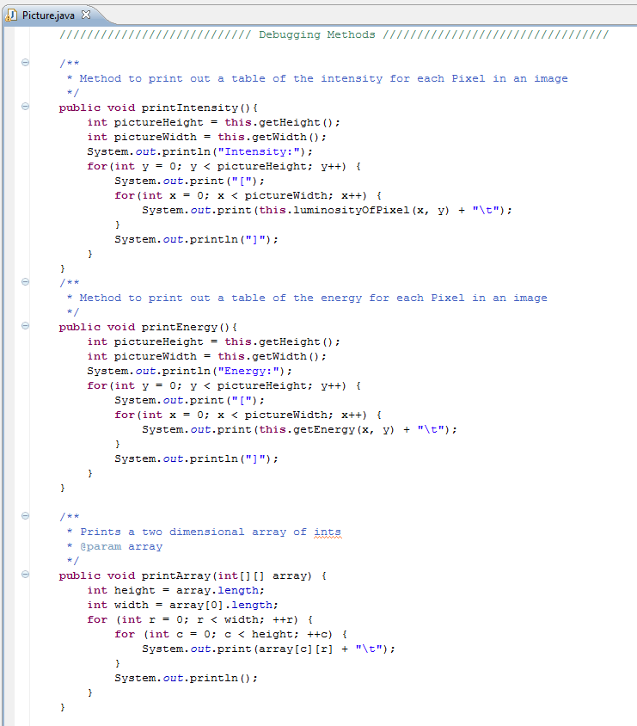
Colleen wrote you some debugging code

Slide 39
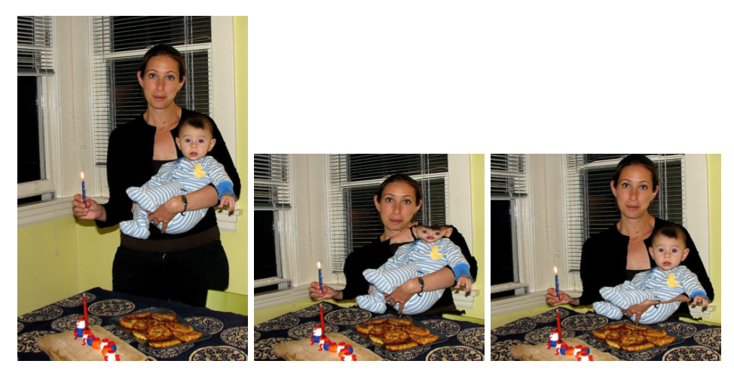
Not perfect…
Straightforward seam carving does not always work!
Target size
What's conspiring against the algorithm here?

Slide 40
Problems?
Straightforward seam carving does not always work!
What's conspiring against the algorithm here?

Slide 41
Not the face!
Protecting the results from a face-detector makes a huge difference…
What's been lost instead?

Slide 42
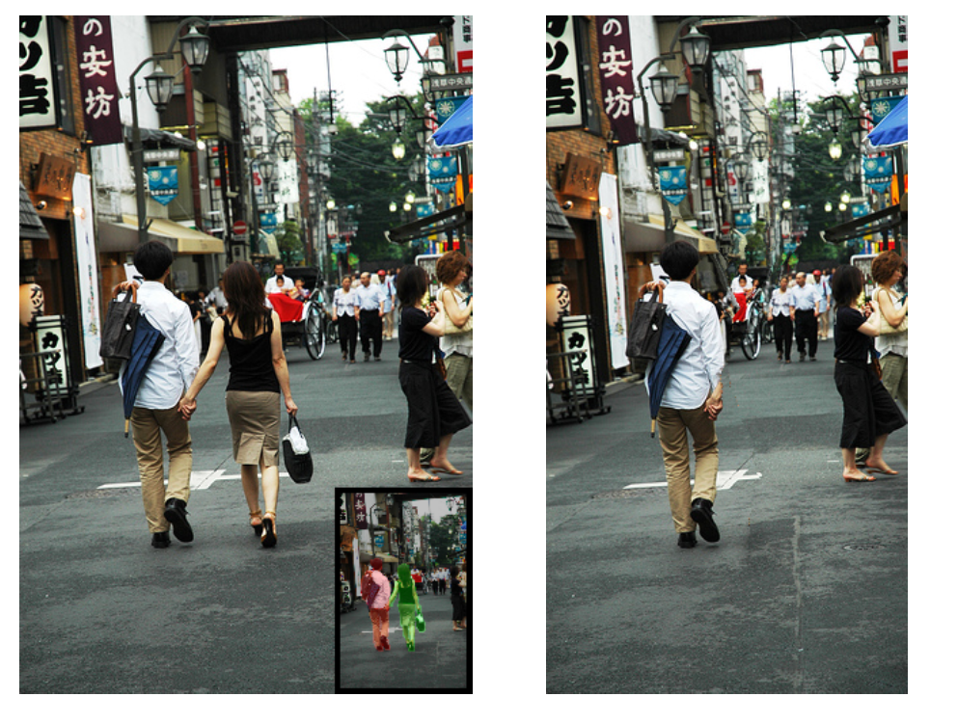
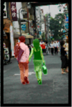
Applications: Seams can remove people!

Slide 43
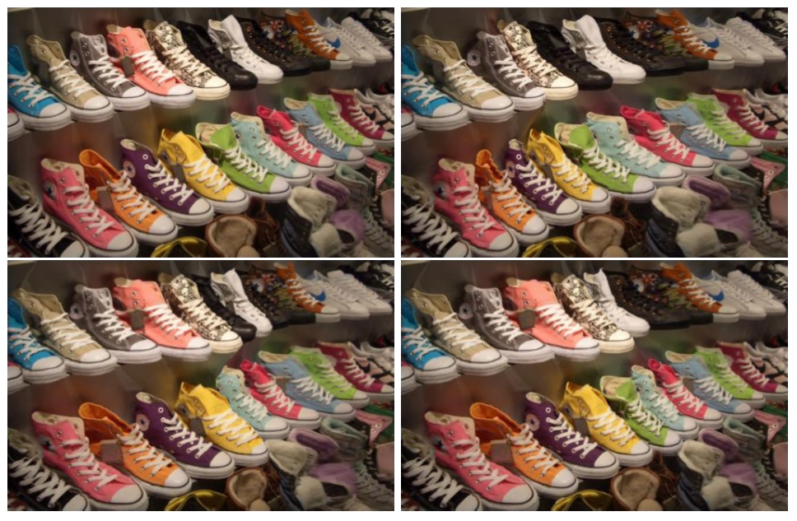
All others had 1 shoe removed! Which shoe?
Applications: Lost a shoe?
Original

Slide 44
Dynamic Programming Intro

Slide 45
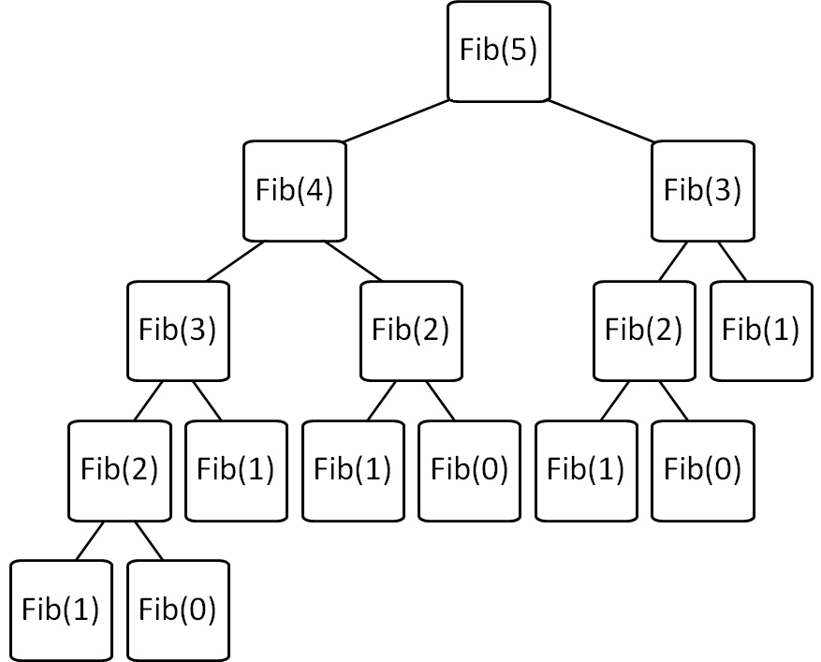
Consider: Fibonacci fib(X) = fib(X-1) + fib(X-2)
Brute force Fib(N)
is O(2^{N}) ☹
Can we improve this?

Slide 46
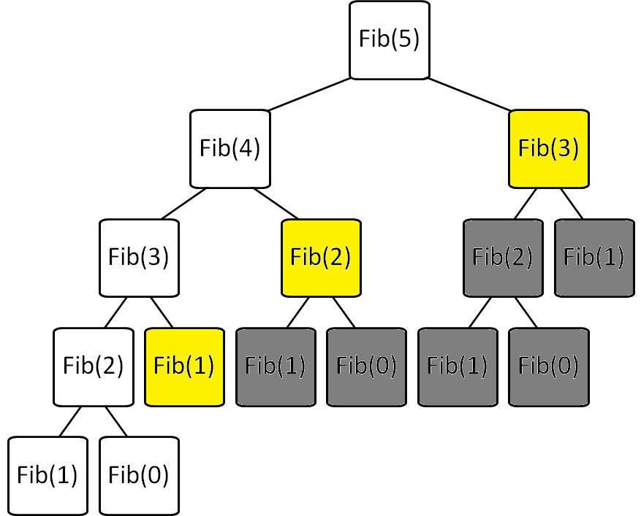
Fibonacci with Memoization
Keep track of recursive calls you’ve made and store the result!
Before you make a recursive call, check to see if you already know the answer.
Top-down (just like the regular recursive version)
Before I make the calls shown in yellow, I find that I already know the answer!

Slide 47
Fibonacci with Dynamic Programming
Work from the bottom-up!
Instead of doing the recursion, work from the bottom-up to create a table of answers of all recursive calls that might be made
We will NEVER make a recursive call, because we will always have already calculated the required components (e.g. fib(n-1) + fib(n-2))
Fib(0) | Fib(1) | Fib(2) | Fib(3) | Fib(4) | Fib(5)
0 | 1 | 1 | 2 | 3 | 5

Slide 48
Consider: Fibonacci
Brute force of Fib(N)
  is O(2^{N}) ☹
Memoization of Fib(N)
  is O(N) + overhead for keeping track of what recursive calls have been made
Dynamic Programming of Fib(N)
  is O(N) + overhead for making a table of size N

Slide 49
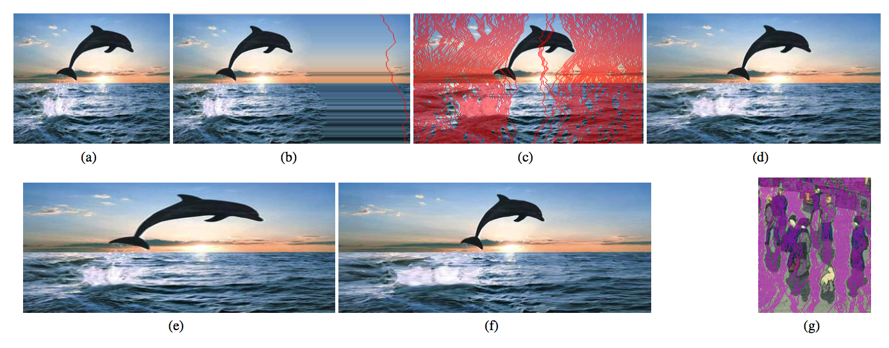
Expanding the image?
original image
Will this work?
I want to add 42 pixels in width
for (int i=0; i<42; i++){
(1) find a seam
(2) duplicate the seam
}

Slide 50
Expanding the image?
original image
best-seam (least-energy) expansion
The best 50% of seams used for more uniform expansion

Slide 51
Expanding the image?
200% of original (scaling)
200% of original (seam-insertion)

Slide 52
Write Recursive Pseudocode to find the min path cost based upon getEnergy
 | x = 0 | x = 1 | x = 2 | x = 3 | x = 4 | x = 5 | x = 6 | x = 7
y = 0 | 6 | 6 | 24 | 79 | 18 | 54 | 78 | 11
y = 1 | 7 | 9 | 12 | 46 | 95 | 106 | 118 | 93
y = 2 | 7 | 13 | 14 | 123 | 82 | 87 | 67 | 99
y = 3 | 3 | 6 | 33 | 153 | 142 | 187 | 62 | 56
y = 4 | 6 | 9 | 11 | 138 | 89 | 40 | 15 | 40
y = 5 | 10 | 3 | 3 | 79 | 137 | 60 | 42 | 77
y = 6 | 0 | 2 | 6 | 4 | 95 | 91 | 25 | 22
y = 7 | 1 | 4 | 10 | 9 | 38 | 162 | 12 | 9

Slide 53
Write Recursive Pseudocode to find the min path cost based upon getEnergy
 | x = 0 | x = 1 | x = 2 | x = 3 | x = 4 | x = 5 | x = 6 | x = 7
y = 0 | 6 | 6 | 24 | 79 | 18 | 54 | 78 | 11
y = 1 | 7 | 9 | 12 | 46 | 95 | 106 | 118 | 93
y = 2 | 7 | 13 | 14 | 123 | 82 | 87 | 67 | 99
y = 3 | 3 | 6 | 33 | 153 | 142 | 187 | 62 | 56
y = 4 | 6 | 9 | 11 | 138 | 89 | 40 | 15 | 40
y = 5 | 10 | 3 | 3 | 79 | 137 | 60 | 42 | 77
y = 6 | 0 | 2 | 6 | 4 | 95 | 91 | 25 | 22
y = 7 | 1 | 4 | 10 | 9 | 38 | 162 | 12 | 9
That’s THREE recursive calls!
For each cell in the top row
  Return:
  energy at that cell +
  minimum path cost of 3 cells below
YUCK! There aren’t always 3 cells below!

Slide 54
How do we pick a seam?
?
Original
Luminosity
Energy
Seam
Seam Removed
We’ll discuss one possible method using dynamic programming, and later look at benefits of this over a recursive use-it-or-lose-it
Seams
Go from the top row to the bottom row
Connect by an edge or a corner
Seams are the lowest “energy” path

Slide 55
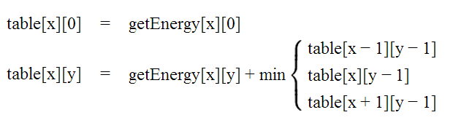
Identify Minimal Paths
Store Information in int[][] table
getEnergy
table
 | x = 0 | x = 1 | x = 2 | x = 3 | x = 4 | x = 5 | x = 6 | x = 7
y = 0 | 6 | 6 | 24 | 79 | 18 | 54 | 78 | 11
y = 1 | 7 | 9 | 12 | 46 | 95 | 106 | 118 | 93
y = 2 | 7 | 13 | 14 | 123 | 82 | 87 | 67 | 99
y = 3 | 3 | 6 | 33 | 153 | 142 | 187 | 62 | 56
y = 4 | 6 | 9 | 11 | 138 | 89 | 40 | 15 | 40
y = 5 | 10 | 3 | 3 | 79 | 137 | 60 | 42 | 77
y = 6 | 0 | 2 | 6 | 4 | 95 | 91 | 25 | 22
y = 7 | 1 | 4 | 10 | 9 | 38 | 162 | 12 | 9
 | x = 0 | x = 1 | x = 2 | x = 3 | x = 4 | x = 5 | x = 6 | x = 7
y = 0
y = 1
y = 2
y = 3
y = 4
y = 5
y = 6
y = 7

Slide 56
Fill out the y=0 row of table based upon the base case
getEnergy
table
 | x = 0 | x = 1 | x = 2 | x = 3 | x = 4 | x = 5 | x = 6 | x = 7
y = 0 | 6 | 6 | 24 | 79 | 18 | 54 | 78 | 11
y = 1 | 7 | 9 | 12 | 46 | 95 | 106 | 118 | 93
y = 2 | 7 | 13 | 14 | 123 | 82 | 87 | 67 | 99
y = 3 | 3 | 6 | 33 | 153 | 142 | 187 | 62 | 56
y = 4 | 6 | 9 | 11 | 138 | 89 | 40 | 15 | 40
y = 5 | 10 | 3 | 3 | 79 | 137 | 60 | 42 | 77
y = 6 | 0 | 2 | 6 | 4 | 95 | 91 | 25 | 22
y = 7 | 1 | 4 | 10 | 9 | 38 | 162 | 12 | 9
 | x = 0 | x = 1 | x = 2 | x = 3 | x = 4 | x = 5 | x = 6 | x = 7
y = 0 | 6 | 6 | 24 | 79 | 18 | 54 | 78 | 11
y = 1
y = 2
y = 3
y = 4
y = 5
y = 6
y = 7

Slide 57
Fill out each row of table based upon the 2nd rule
getEnergy
table
 | x = 0 | x = 1 | x = 2 | x = 3 | x = 4 | x = 5 | x = 6 | x = 7
y = 0 | 6 | 6 | 24 | 79 | 18 | 54 | 78 | 11
y = 1 | 7 | 9 | 12 | 46 | 95 | 106 | 118 | 93
y = 2 | 7 | 13 | 14 | 123 | 82 | 87 | 67 | 99
y = 3 | 3 | 6 | 33 | 153 | 142 | 187 | 62 | 56
y = 4 | 6 | 9 | 11 | 138 | 89 | 40 | 15 | 40
y = 5 | 10 | 3 | 3 | 79 | 137 | 60 | 42 | 77
y = 6 | 0 | 2 | 6 | 4 | 95 | 91 | 25 | 22
y = 7 | 1 | 4 | 10 | 9 | 38 | 162 | 12 | 9
 | x = 0 | x = 1 | x = 2 | x = 3 | x = 4 | x = 5 | x = 6 | x = 7
y = 0 | 6 | 6 | 24 | 79 | 18 | 54 | 78 | 11
y = 1
y = 2
y = 3
y = 4
y = 5
y = 6
y = 7

Slide 58
Fill out each row of table based upon the 2nd rule (cont.)
getEnergy
table
 | x = 0 | x = 1 | x = 2 | x = 3 | x = 4 | x = 5 | x = 6 | x = 7
y = 0 | 6 | 6 | 24 | 79 | 18 | 54 | 78 | 11
y = 1 | 7 | 9 | 12 | 46 | 95 | 106 | 118 | 93
y = 2 | 7 | 13 | 14 | 123 | 82 | 87 | 67 | 99
y = 3 | 3 | 6 | 33 | 153 | 142 | 187 | 62 | 56
y = 4 | 6 | 9 | 11 | 138 | 89 | 40 | 15 | 40
y = 5 | 10 | 3 | 3 | 79 | 137 | 60 | 42 | 77
y = 6 | 0 | 2 | 6 | 4 | 95 | 91 | 25 | 22
y = 7 | 1 | 4 | 10 | 9 | 38 | 162 | 12 | 9
 | x = 0 | x = 1 | x = 2 | x = 3 | x = 4 | x = 5 | x = 6 | x = 7
y = 0 | 6 | 6 | 24 | 79 | 18 | 54 | 78 | 11
y = 1 | 13
y = 2
y = 3
y = 4
y = 5
y = 6
y = 7

Slide 59
What do the cells in getEnergy and table mean?
This is the cost of including this pixel in the path
getEnergy
table
 | x = 0 | x = 1 | x = 2 | x = 3 | x = 4 | x = 5 | x = 6 | x = 7
y = 0 | 6 | 6 | 24 | 79 | 18 | 54 | 78 | 11
y = 1 | 7 | 9 | 12 | 46 | 95 | 106 | 118 | 93
y = 2 | 7 | 13 | 14 | 123 | 82 | 87 | 67 | 99
y = 3 | 3 | 6 | 33 | 153 | 142 | 187 | 62 | 56
y = 4 | 6 | 9 | 11 | 138 | 89 | 40 | 15 | 40
y = 5 | 10 | 3 | 3 | 79 | 137 | 60 | 42 | 77
y = 6 | 0 | 2 | 6 | 4 | 95 | 91 | 25 | 22
y = 7 | 1 | 4 | 10 | 9 | 38 | 162 | 12 | 9
 | x = 0 | x = 1 | x = 2 | x = 3 | x = 4 | x = 5 | x = 6 | x = 7
y = 0 | 6 | 6 | 24 | 79 | 18 | 54 | 78 | 11
y = 1 | 13 | 15 | 18 | 64 | 113 | 124 | 129 | 104
y = 2
y = 3
y = 4
y = 5
y = 6
y = 7
This is the cost of the shortest path that includes this pixel

Slide 60
Final version of table
How do we find the shortest path from this?
getEnergy
table
 | x = 0 | x = 1 | x = 2 | x = 3 | x = 4 | x = 5 | x = 6 | x = 7
y = 0 | 6 | 6 | 24 | 79 | 18 | 54 | 78 | 11
y = 1 | 7 | 9 | 12 | 46 | 95 | 106 | 118 | 93
y = 2 | 7 | 13 | 14 | 123 | 82 | 87 | 67 | 99
y = 3 | 3 | 6 | 33 | 153 | 142 | 187 | 62 | 56
y = 4 | 6 | 9 | 11 | 138 | 89 | 40 | 15 | 40
y = 5 | 10 | 3 | 3 | 79 | 137 | 60 | 42 | 77
y = 6 | 0 | 2 | 6 | 4 | 95 | 91 | 25 | 22
y = 7 | 1 | 4 | 10 | 9 | 38 | 162 | 12 | 9
 | x = 0 | x = 1 | x = 2 | x = 3 | x = 4 | x = 5 | x = 6 | x = 7
y = 0 | 6 | 6 | 24 | 79 | 18 | 54 | 78 | 11
y = 1 | 13 | 15 | 18 | 64 | 113 | 124 | 129 | 104
y = 2 | 20 | 26 | 29 | 141 | 146 | 200 | 171 | 203
y = 3 | 23 | 26 | 59 | 182 | 283 | 333 | 233 | 227
y = 4 | 29 | 32 | 37 | 197 | 271 | 273 | 242 | 267
y = 5 | 39 | 32 | 35 | 116 | 334 | 302 | 284 | 319
y = 6 | 32 | 34 | 38 | 39 | 211 | 375 | 309 | 306
y = 7 | 33 | 36 | 44 | 47 | 77 | 373 | 318 | 315
This is the cost of the shortest path that includes this pixel

Slide 61
Keep track of the parent
 | x = 0 | x = 1 | x = 2 | x = 3 | x = 4 | x = 5 | x = 6 | x = 7
y = 0 | N/A | N/A | N/A | N/A | N/A | N/A | N/A | N/A
y = 1
y = 2
y = 3
y = 4
y = 5
y = 6
y = 7
parent
table
 | x = 0 | x = 1 | x = 2 | x = 3 | x = 4 | x = 5 | x = 6 | x = 7
y = 0 | 6 | 6 | 24 | 79 | 18 | 54 | 78 | 11
y = 1 | 13 | 15 | 18 | 64 | 113 | 124 | 129 | 104
y = 2 | 20 | 26 | 29 | 141 | 146 | 200 | 171 | 203
y = 3 | 23 | 26 | 59 | 182 | 283 | 333 | 233 | 227
y = 4 | 29 | 32 | 37 | 197 | 271 | 273 | 242 | 267
y = 5 | 39 | 32 | 35 | 116 | 334 | 302 | 284 | 319
y = 6 | 32 | 34 | 38 | 39 | 211 | 375 | 309 | 306
y = 7 | 33 | 36 | 44 | 47 | 77 | 373 | 318 | 315

Slide 62

Keep track of the parent
 | x = 0 | x = 1 | x = 2 | x = 3 | x = 4 | x = 5 | x = 6 | x = 7
y = 0 | N/A | N/A | N/A | N/A | N/A | N/A | N/A | N/A
y = 1 | x=0 | x=1 | x=1 | x=4 | x=4 | x=4 | x=7 | x=7
y = 2 | x=0 | x=0 | x=1 | x=2 | x=3 | x=4 | x=7 | x=7
y = 3 | x=0 | x=0 | x=1 | x=2 | x=3 | x=4 | x=6 | x=6
y = 4 | x=0 | x=0 | x=1 | x=2 | x=3 | x=6 | x=7 | x=7
y = 5 | x=0 | x=0 | x=1 | x=2 | x=3 | x=6 | x=6 | x=6
y = 6 | x=1 | x=1 | x=1 | x=2 | x=3 | x=6 | x=6 | x=6
y = 7 | x=0 | x=0 | x=1 | x=2 | x=3 | x=4 | x=7 | x=7
parent
table
 | x = 0 | x = 1 | x = 2 | x = 3 | x = 4 | x = 5 | x = 6 | x = 7
y = 0 | 6 | 6 | 24 | 79 | 18 | 54 | 78 | 11
y = 1 | 13 | 15 | 18 | 64 | 113 | 124 | 129 | 104
y = 2 | 20 | 26 | 29 | 141 | 146 | 200 | 171 | 203
y = 3 | 23 | 26 | 59 | 182 | 283 | 333 | 233 | 227
y = 4 | 29 | 32 | 37 | 197 | 271 | 273 | 242 | 267
y = 5 | 39 | 32 | 35 | 116 | 334 | 302 | 284 | 319
y = 6 | 32 | 34 | 38 | 39 | 211 | 375 | 309 | 306
y = 7 | 33 | 36 | 44 | 47 | 77 | 373 | 318 | 315
You can backtrack to find the path from the smallest total path
(in the last row)

Slide 63
How do we pick a seam?
(SUMMARY)
Fill out a 2D array “table” based upon the rules below
Fill out a 2D array “parent” based upon which x value has the minimum path in the row above.
Pick the path with the minimum weight (in the last row) and backtrack through parent to find the path.

Slide 64
What do the cells in getEnergy and table mean?
SOLUTION
This is the cost of including this pixel in the path
getEnergy
table
 | x = 0 | x = 1 | x = 2 | x = 3 | x = 4 | x = 5 | x = 6 | x = 7
y = 0 | 6 | 6 | 24 | 79 | 18 | 54 | 78 | 11
y = 1 | 7 | 9 | 12 | 46 | 95 | 106 | 118 | 93
y = 2 | 7 | 13 | 14 | 123 | 82 | 87 | 67 | 99
y = 3 | 3 | 6 | 33 | 153 | 142 | 187 | 62 | 56
y = 4 | 6 | 9 | 11 | 138 | 89 | 40 | 15 | 40
y = 5 | 10 | 3 | 3 | 79 | 137 | 60 | 42 | 77
y = 6 | 0 | 2 | 6 | 4 | 95 | 91 | 25 | 22
y = 7 | 1 | 4 | 10 | 9 | 38 | 162 | 12 | 9
 | x = 0 | x = 1 | x = 2 | x = 3 | x = 4 | x = 5 | x = 6 | x = 7
y = 0 | 6 | 6 | 24 | 79 | 18 | 54 | 78 | 11
y = 1 | 13 | 15 | 18 | 64 | 113 | 124 | 129 | 104
y = 2
y = 3
y = 4
y = 5
y = 6
y = 7
This is the cost of the shortest path that includes this pixel

Slide 65
Fib(1)
Fib(3)
Fib(0)
Fib(2)
Fib(1)
Fib(5)
Fib(0)
Fib(2)
Fib(1)
Fib(4)
Fib(1)
Fib(3)
Fib(0)
Fib(2)
Fib(1)

Slide 66
Fib(5)
Fib(3)
Fib(1)
Fib(2)
Fib(4)
Fib(2)
Fib(3)
Fib(0)
Fib(1)
Fib(0)
Fib(1)
Fib(1)
Fib(2)
Fib(0)
Fib(1)

