Slide 1
CS 60
BSTNode,
Big-O &
Floyd Warshall’s
2013-10-28
Monday – Week 8
Lecture 14

Slide 2
Survey
How comfortable are you feeling with Java?
Terrible
I know some of the vocab (e.g. class, instance variables)
I know some vocab and can do some things
I feel pretty comfortable
I already knew java

Slide 3
BSTNode Class
Short Version: Do NOT Modify BSTNodes!
Long Version: This is a strange class for Java because we will not modify our BSTNode Objects (This is to be like Racket and to help you to better understand how Racket behaved)

Slide 4
BSTNode Class
BSTNode
key
value
left
right
“Lewis”
“1241”
emptyNode
class BSTNode {
private String key;
private Object value;
private BSTNode left;
private BSTNode right;
public static BSTNode emptyNode = new BSTNode(null,null,null,null);
BSTNode
key
value
left
right

Slide 5
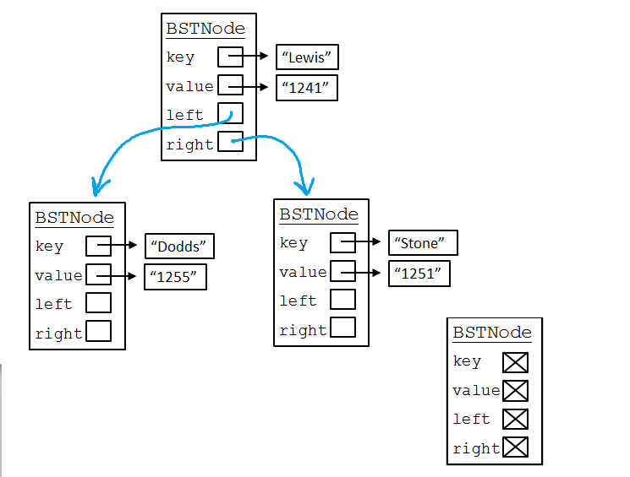
Racket: '(Lewis (Dodds () ()) (Stone () ()))
Prolog:
[lewis, [dodds,[],[]]
[stone,[],[]]]
Although now we have a key (what you search with) PLUS some other information (the value)
Big Idea: Key & Value

Slide 6
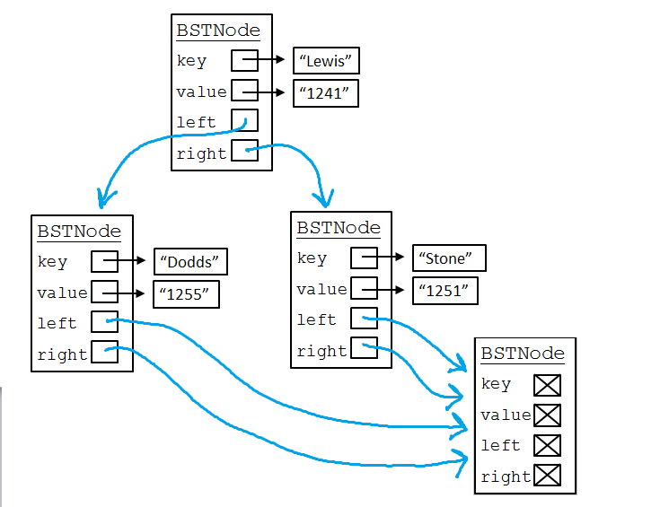
Instead of using '() or [], we’ll make an Object to represent the empty list. To save space, we’ll use just one of them!
Big Idea: empty BST

Slide 7
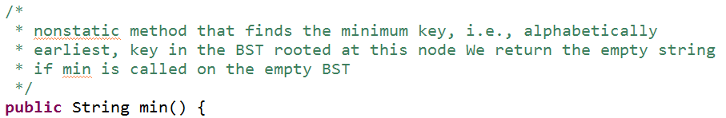
Write min() – in handout!

Slide 8
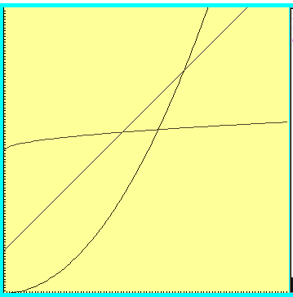
Big-O
“Woah! One of these is WAY better after this point. Let’s call that point N”

Slide 9

Big-O definition
T(n) ∈ O(f(n)) means
(∃c) (∃N) (∀n > N) T(n) < c*f(n)
+ threshold N
there exists a constant c
for all input sizes bigger than that threshold, N
42n² + 100n ∈ O(n²) ← Helpful
42n² + 100n ∈ O(n³) ← True & Not helpful
42n² + 100n ∈ O(2^{n}) ← True & Not helpful
Notes:
n > 1001 = k, c = 1001
n > 1 = k, c = 42

Slide 10
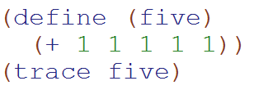
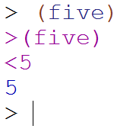
Big-O: Constant Time O(1)
O(1)
The runtime does not depend upon the magnitude of the input

Slide 11
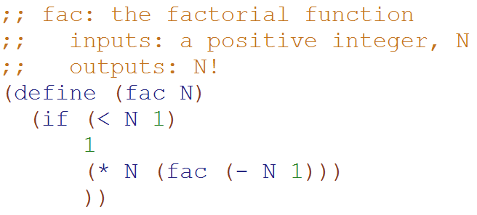
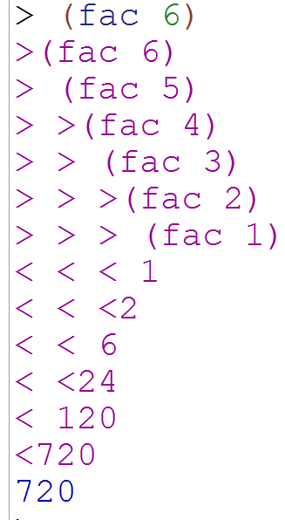
Big-O: Linear Time O(N)
O(N)
The runtime is bounded above by an equation proportional to the magnitude of the input

Slide 12
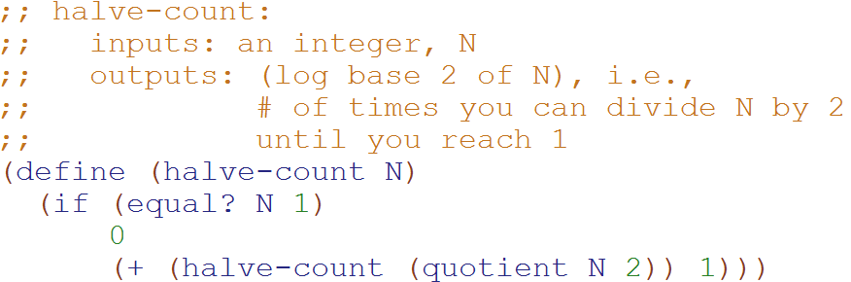
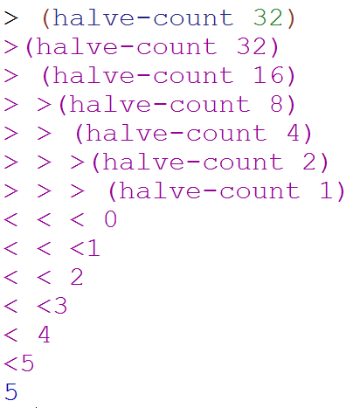
Big-O: Logarithmic Time O(log₂N)
O(log₂N)
Why does cutting the magnitude of the input in half each time produce O(log₂N) runtime?
The magnitude of the input is cut in half with each recursive call

Slide 13
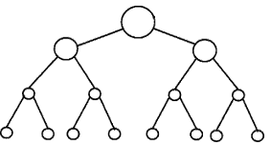
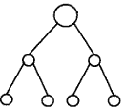


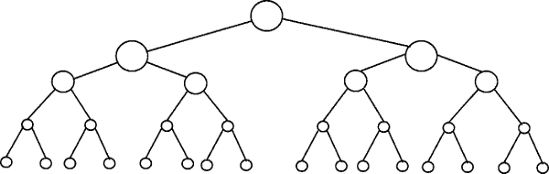
Perfectly Balanced Trees
h = 0
n = 1
h = 1
n = 3
h = 2
n = 7
h = 3
n = 15

Slide 14



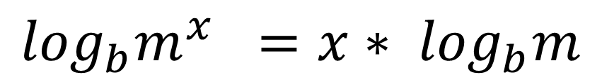
// Take the log of both sides
// Remember:
Ignore the minus 1
$$\log_{b}m^{x} ={x∗ log}_{b}m$$

Slide 15
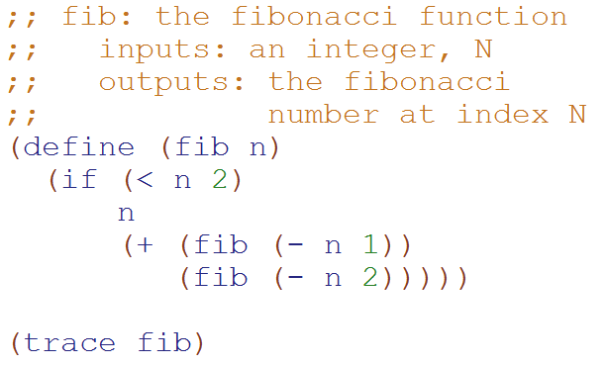
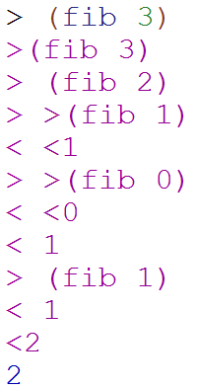
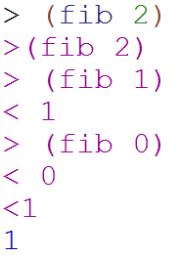
Big-O: Exponential Time O(2^{N})
You make two slightly smaller recursive calls each time
O(2^{N})

Slide 16
Perfectly Balanced Trees
h = 0
n = 1
h = 1
n = 3
h = 2
n = 7
h = 3
n = 15

Slide 17
Loop Counting (calculate runtime by counting each step)

Slide 18
Example 1: Count the total # of constant-time operations?
for ( int i=0 ; i < N ; i++){
// constant-time operation
}
i=0
i=1
i=2
…
i=N-1
i=N
# ops per row
1
1
1
…
1
1
O(N)
Total
of N
Technically 3 operations!

Slide 19
Example 2: Count the total # of constant-time operations?
for ( int i=1 ; i < N ; i=i*2){
// constant-time operation
}
i=1
i=2
i=4
…
i=N/2
i=N
# ops per row
1
1
1
…
1
1
O(log₂(N))
Total
of log₂(N)

Slide 20
Example 3: Count the total # of constant-time operations?
for ( int i=N ; i > 0 ; i=i/2){
// constant-time operation
}
i=N
i=N/2
…
i=4
i=2
i=1
# ops per row
1
1
1
…
1
1
O(log₂(N))
Total
of log₂(N)

Slide 21
Example 4: Count the total # of constant-time operations?
for ( int i=0 ; i < N ; i++){
for ( int z=0 ; z < N ; z++){
// constant-time operation
}
}
i=0
i=1
i=2
…
i=N-1
i=N
# ops per row
N
N
N
…
N
N
O(N²)
Total
of N²

Slide 22
Example 5: Count the total # of constant-time operations?
for ( int i=0 ; i < N ; i++){
for ( int z=0 ; z < M ; z++){
// constant-time operation
}
}
i=0
i=1
i=2
…
i=N-1
i=N
# ops per row
M
M
M
…
M
M
O(N*M)
Total of N*M
Is this in O(N²)?
A) Yes B) No C)??

Slide 23
Example 6: Count the total # of constant-time operations?
for ( int i=0 ; i < N ; i++){
for ( int z=0 ; z < i ; z++){
// constant-time operation
}
}
i=0
i=1
i=2
…
i=N-1
i=N
# ops per row
0
1
2
…
N-1
N
O(N²)
Total of N(N+1)/2

Slide 24

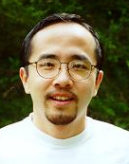
http://www.math.hmc.edu/funfacts/
REALLY COMMON SERIES (Test Yourself!!!)
1 + 2 + 3 + … + (N-2) + (N-1) + N =
1 + 2 + 4 + … + N/4 + N/2 + N =
1 + 2 + 4 + … + 2^{N-2} + 2^{N-1} + 2^{N} =

Slide 25
http://www.math.hmc.edu/funfacts/
REALLY COMMON SERIES (you should recognize these after today)
1 + 2 + 3 + … + (N-2) + (N-1) + N = N(N+1)/2 ∈ O(N²)
1 + 2 + 4 + … + N/4 + N/2 + N = 2N -1 ∈ O(N)
1 + 2 + 4 + … + 2^{N-2} + 2^{N-1} + 2^{N} = 2^{N+1} -1 ∈ O(2^{N})

Slide 26
Dynamic Programming Intro

Slide 27
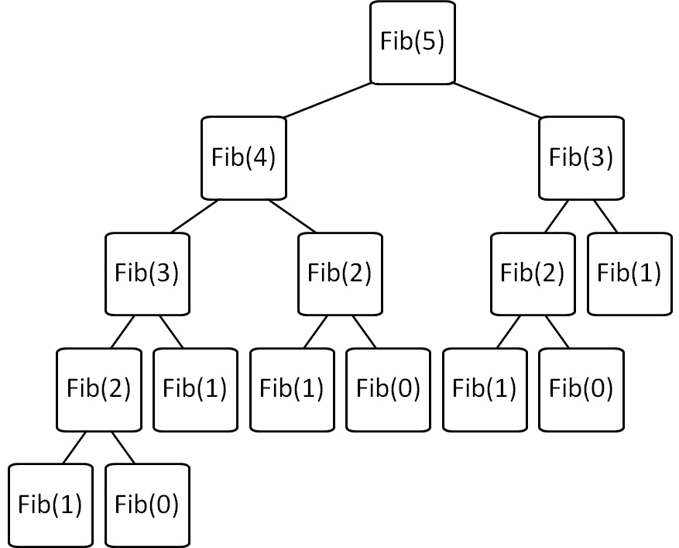
Consider: Fibonacci fib(X) = fib(X-1) + fib(X-2)
Brute force Fib(N)
is O(2^{N}) ☹
Can we improve this?

Slide 28
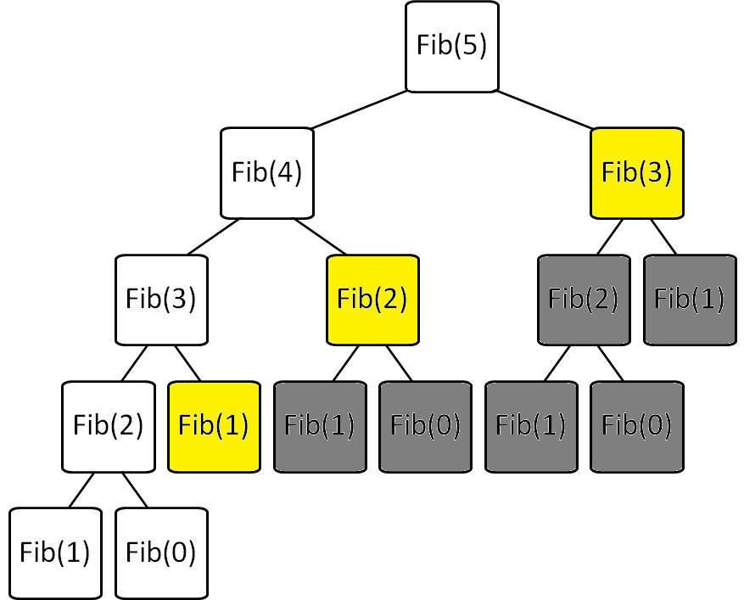
Fibonacci with Memoization Keep track of recursive calls you’ve made and store the result!
Before you make a recursive call, check to see if you already know the answer.
Top-down (just like the regular recursive version)
Before I make the calls shown in yellow, I find that I already know the answer!

Slide 29
Fibonacci with Dynamic Programming Work from the bottom-up!
Instead of doing the recursion, work from the bottom-up to create a table of answers of all recursive calls that might be made
We will NEVER make a recursive call, because we will always have already calculated the required components (e.g. fib(n-1) + fib(n-2))
Fib(0) | Fib(1) | Fib(2) | Fib(3) | Fib(4) | Fib(5)
0 | 1 | 1 | 2 | 3 | 5

Slide 30
Consider: Fibonacci
Brute force of Fib(N)
is O(2^{N}) ☹
Memoization of Fib(N)
is O(N) + overhead for keeping track of what recursive calls have been made
Dynamic Programming of Fib(N)
is O(N) + overhead for making a table of size N

Slide 31
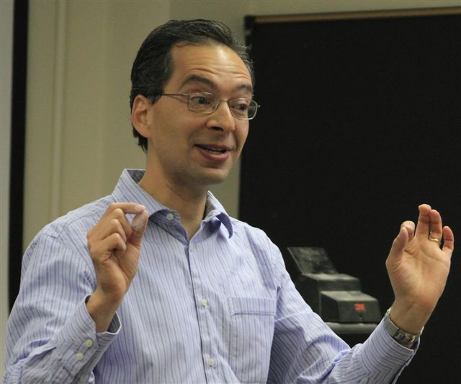
We learned:
To always start DP by writing recursion
That the DP table should include the possible inputs to the recursive call
In the DP table to look at:
What do the cells mean?
What cells are easy to fill in?
What cells do we want?
What rule fills in the cells?
What do you remember about Dynamic Programming (DP)
from CS60?

Slide 32
What do the cells mean?
What cells are easy to fill in?
What cells do we want?
What rule fills in the cells?
Fib(0) | Fib(1) | Fib(2) | Fib(3) | Fib(4) | Fib(5)
0 | 1 | 1 | 2 | 3 | 5

Slide 33
Write Recursive Pseudocode to find the min path cost based upon getEnergy
 | x = 0 | x = 1 | x = 2 | x = 3 | x = 4 | x = 5 | x = 6 | x = 7
y = 0 | 6 | 6 | 24 | 79 | 18 | 54 | 78 | 11
y = 1 | 7 | 9 | 12 | 46 | 95 | 106 | 118 | 93
y = 2 | 7 | 13 | 14 | 123 | 82 | 87 | 67 | 99
y = 3 | 3 | 6 | 33 | 153 | 142 | 187 | 62 | 56
y = 4 | 6 | 9 | 11 | 138 | 89 | 40 | 15 | 40
y = 5 | 10 | 3 | 3 | 79 | 137 | 60 | 42 | 77
y = 6 | 0 | 2 | 6 | 4 | 95 | 91 | 25 | 22
y = 7 | 1 | 4 | 10 | 9 | 38 | 162 | 12 | 9
That’s THREE recursive calls!
For each cell in the top row
Return:
energy at that cell +
minimum path cost of 3 cells below
YUCK! There aren’t always 3 cells below!

Slide 34
Path from Hw 7:
What do the cells mean?
What cells are easy to fill in?
What cells do we want?
What rule fills in the cells?

Slide 35
Floyd-Warshall (all-pairs shortest path)

Slide 36
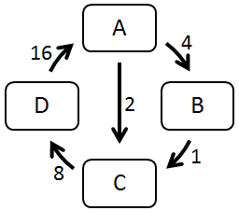
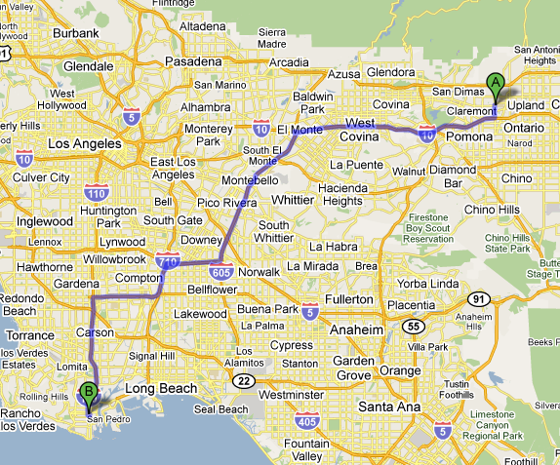

Finding all Paths
A directed graph:
Suppose we'd like the
shortest route from
any city to any other city.
How is this path different than the paths in the directed graph above?

Slide 37
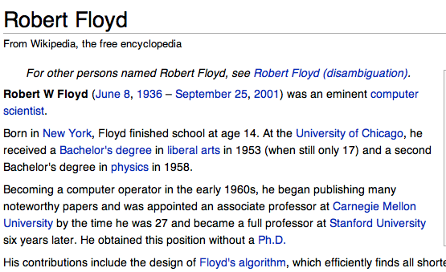
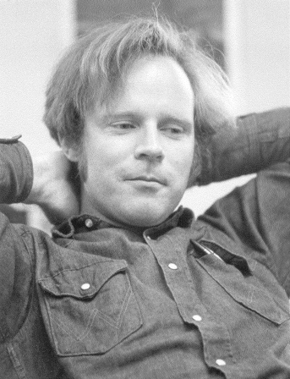
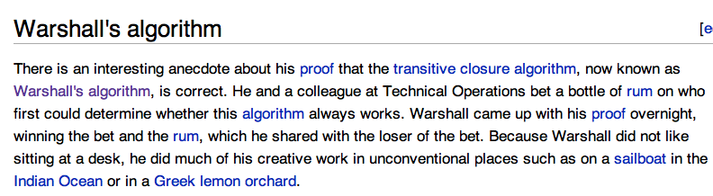
Floyd-Warshall algorithm
All-pairs shortest paths!
“Floyd may have been the first advocate of refactoring -- the rewriting of working programs from scratch, re-using only the essential ideas. Refactoring is now standard practice among computer programmers. By continuously looking for simpler ways to do the same thing, Floyd aimed to improve not only programs but also programmers' abilities and understanding...
He also was a passionate hiker and mountain climber who loved the wilderness country in the High Sierra…”
Stephen Warshall
What would a reasonable big-O running time be (N = # nodes)

Slide 38
Shortest Paths in CS60
O(N³)
O(2^{N})
min-dist
(Brute Force)
Floyd-Warshall
(Dynamic programming)
ALL PATHS
Hw2 part 1 Problem 9
ONE PATH

Slide 39
Graph Representations (adjacency matrix)

Slide 40
Cost:
0 if self-edge
Edge | Cost
A → A | 0
A → B | 4
A → C | 2
A → D | ∞
B → A | ∞
B → B | 0
B → C | 1
B → D | ∞
C → A | ∞
C → B | ∞
C → C | 0
C → D | 8
D → A
D → B
D → C
D → D
Graph Representations
(cont.)
This is a non-standard representation that we’ll use today.
Cost:
∞ if no edge
Cost:
Otherwise just the edge weight
A
4
16
Fill these out
D
2
B
1
8
C
A) 0 B) 1 C) 2 D) ∞ E) ??

Slide 41
Graph Representation:
Adjacency Matrix
Edge | Cost
A → A | 0
A → B | 4
A → C | 2
A → D | ∞
B → A | ∞
B → B | 0
B → C | 1
B → D | ∞
C → A | ∞
C → B | ∞
C → C | 0
C → D | 8
D → A | 16
D → B | ∞
D → C | ∞
D → D | 0
A
4
16
A → A | A → B | A → C | A → D
0 | 4 | 2 | ∞
B → A | B → B | B → C | B → D
∞ | 0 | 1 | ∞
C → A | C → B | C → C | C → D
∞ | ∞ | 0 | 8
D → A | D → B | D → C | D → D
16 | ∞ | ∞ | 0
D
2
B
1
8
C
This is the source (src)
 | A | B | C | D
A | 0 | 4 | 2 | ∞
B | ∞ | 0 | 1 | ∞
C | ∞ | ∞ | 0
D | 16 | ∞ |  | 0
This is the destination (dest)
A) 2 B) 4 C) 8 D) ∞

Slide 42
Adjacency Matrix
Cost:
0 if self-edge
Cost:
Edge weight
Cost:
∞ if no edge
A (1) → A (1) 0 | A (1) → B (2) 4 | A (1) → C (3) 2 | A (1) → D (4) ∞
B (2) → A (1) ∞ | B (2) → B (2) 0 | B (2) → C (3) 1 | B (2) → D (4) ∞
C (3) → A (1) ∞ | C (3) → B (2) ∞ | C (3) → C (3) 0 | C (3) → D (4) 8
D (4) → A (1) 16 | D (4) → B (2) ∞ | D (4) → C (3) ∞ | D (4) → D (4) 0

Slide 43
Adjacency Matrix (Floyd-Warshall implementation detail): Use a int[][] and number the nodes starting with 1
 | dest = 0 | dest = 1 | dest = 2 | dest = 3 | dest = 4
src = 0
src = 1 |  | A (1) → A (1) 0 | A (1) → B (2) 4 | A (1) → C (3) 2 | A (1) → D (4) ∞
src = 2 |  | B (2) → A (1) ∞ | B (2) → B (2) 0 | B (2) → C (3) 1 | B (2) → D (4) ∞
src = 3 |  | C (3) → A (1) ∞ | C (3) → B (2) ∞ | C (3) → C (3) 0 | C (3) → D (4) 8
src = 4 |  | D (4) → A (1) 16 | D (4) → B (2) ∞ | D (4) → C (3) ∞ | D (4) → D (4) 0

Slide 44
Tracing Floyd-Warshall

Slide 45
Floyd-Warshall algorithm
For each node K:
For each pair of nodes (X →Y):
See if using an intermediate node K can reduce the cost of that path:
min[cost(X →Y),
cost(X →K) + cost(K →Y)]
{A, B, C, D}
{A→A, A→B, A→C, A→D,
B→A, B→B, B→C, B→D,
C→A, C→B, C→C, C→D,
D→A, D→B, D→C, D→D}

Slide 46
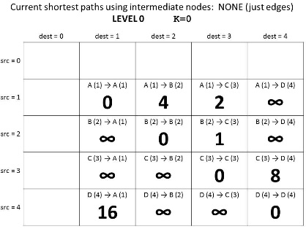
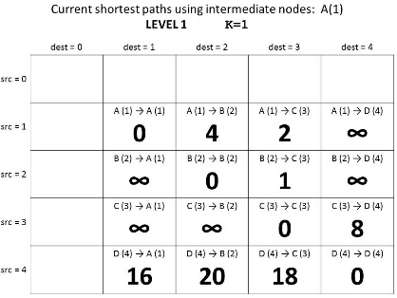
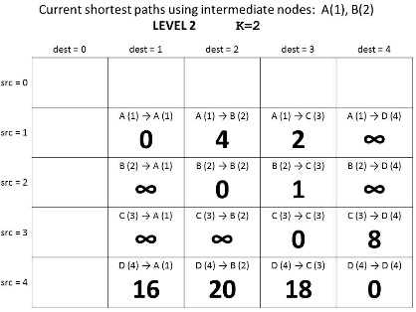
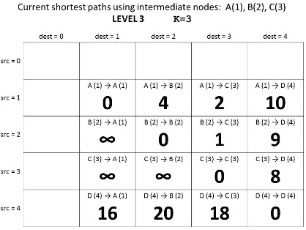
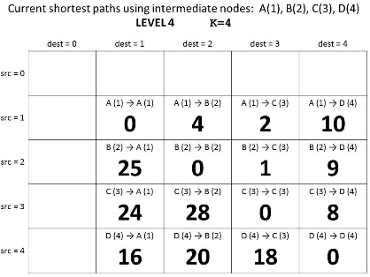
Guaranteed shortest path using NO intermediate nodes.
K = 0
Why does this give us the shortest path?
Guaranteed shortest path using only A as an intermediate node.
K = 1
Guaranteed shortest path using only A & B as intermediate nodes.
K = 2
Guaranteed shortest path using
only A, B, & C
as intermediate nodes.
K = 3
Guaranteed shortest path using
only A, B, C, & D
as intermediate nodes.
K = 4

Slide 47
Floyd-Warshall Pseudocode
We don’t use index 0, so we need N+1
int[][] cost = new int[N+1][N+1];
// set initial values = edge weights
for(int K=0; K<N; K++){
for(int src=0; src<N; src++){
for(int dest=0; dest<N; dest++){
int prevCost = cost[src][dest];
int newCost = cost[src] [K] + cost [K] [dest];
cost[src][dest] = min(prevCost, newCost);
}
}
}
min[cost(X →Y),
cost(X →K) +
cost(K →Y)]

Slide 48
Guaranteed shortest path using NO intermediate nodes.
K = 0
If we keep a separate N+1xN+1 table
for each K…
Guaranteed shortest path using only A as an intermediate node.
K = 1
Guaranteed shortest path using only A & B as intermediate nodes.
K = 2
Guaranteed shortest path using
only A, B, & C
as intermediate nodes.
K = 3
Guaranteed shortest path using
only A, B, C, & D
as intermediate nodes.
K = 4

Slide 49
One N+1xN+1 array for each possible intermediate node
int[][][] cost = new int[N+1][N+1][N+1];
// set initial values = edge weights
for(int K=1; K<=N; K++){
for(int src=1; src<=N; src++){
for(int dest=1; dest<=N; dest++){
int prevCost = cost[K-1][src][dest];
int newCost = cost[K-1][src] [K] + cost[K-1] [K] [dest];
cost[k][src][dest]=min(prevCost, newCost);
}
}
}
Look at the “current” shortest path
Floyd-Warshall Pseudocode (Layers)

Slide 50
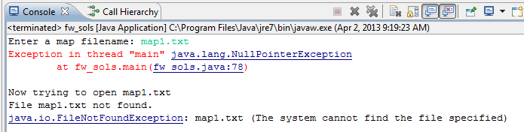
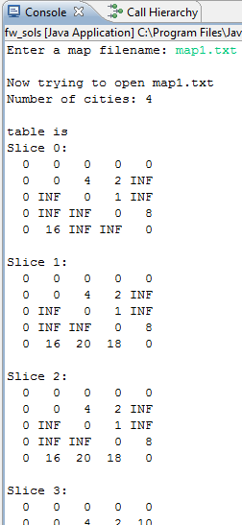
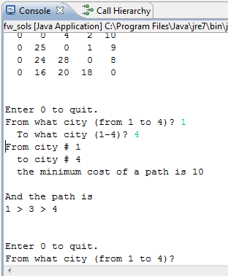
Shows each “layer” of the table cost
If you get this error (on this or Change) review the homework instructions
HOMEWORK 8
FILE INPUT!
You can query for ANY Path!

Slide 51
Discuss in your group (then fill out K=1 table)
What is in cost?
int[][][] cost = new int[N+1][N+1][N+1];
What is in layer 0 (cost[0]) and layer N
int[][] start = cost[0];
int[][] done = cost[N+1];
Why will this give ALL shortest paths?

Slide 52
Current shortest paths using intermediate nodes: NONE (just edges) LEVEL 0 K=0
 | dest = 0 | dest = 1 | dest = 2 | dest = 3 | dest = 4
src = 0
src = 1 |  | A (1) → A (1) 0 | A (1) → B (2) 4 | A (1) → C (3) 2 | A (1) → D (4) ∞
src = 2 |  | B (2) → A (1) ∞ | B (2) → B (2) 0 | B (2) → C (3) 1 | B (2) → D (4) ∞
src = 3 |  | C (3) → A (1) ∞ | C (3) → B (2) ∞ | C (3) → C (3) 0 | C (3) → D (4) 8
src = 4 |  | D (4) → A (1) 16 | D (4) → B (2) ∞ | D (4) → C (3) ∞ | D (4) → D (4) 0

Slide 53
Current shortest paths using intermediate nodes: A(1) LEVEL 1 K=1
 | dest = 0 | dest = 1 | dest = 2 | dest = 3 | dest = 4
src = 0
src = 1 |  | A (1) → A (1) | A (1) → B (2) | A (1) → C (3) | A (1) → D (4)
src = 2 |  | B (2) → A (1) | B (2) → B (2) | B (2) → C (3) | B (2) → D (4)
src = 3 |  | C (3) → A (1) | C (3) → B (2) | C (3) → C (3) | C (3) → D (4)
src = 4 |  | D (4) → A (1) | D (4) → B (2) | D (4) → C (3) | D (4) → D (4)

Slide 54
Current shortest paths using intermediate nodes: A(1), B(2) LEVEL 2 K=2
 | dest = 0 | dest = 1 | dest = 2 | dest = 3 | dest = 4
src = 0
src = 1 |  | A (1) → A (1) | A (1) → B (2) | A (1) → C (3) | A (1) → D (4)
src = 2 |  | B (2) → A (1) | B (2) → B (2) | B (2) → C (3) | B (2) → D (4)
src = 3 |  | C (3) → A (1) | C (3) → B (2) | C (3) → C (3) | C (3) → D (4)
src = 4 |  | D (4) → A (1) | D (4) → B (2) | D (4) → C (3) | D (4) → D (4)

Slide 55
Current shortest paths using intermediate nodes: A(1), B(2), C(3) LEVEL 3 K=3
 | dest = 0 | dest = 1 | dest = 2 | dest = 3 | dest = 4
src = 0
src = 1 |  | A (1) → A (1) | A (1) → B (2) | A (1) → C (3) | A (1) → D (4)
src = 2 |  | B (2) → A (1) | B (2) → B (2) | B (2) → C (3) | B (2) → D (4)
src = 3 |  | C (3) → A (1) | C (3) → B (2) | C (3) → C (3) | C (3) → D (4)
src = 4 |  | D (4) → A (1) | D (4) → B (2) | D (4) → C (3) | D (4) → D (4)

Slide 56
Current shortest paths using intermediate nodes: A(1), B(2), C(3), D(4) LEVEL 4 K=4
 | dest = 0 | dest = 1 | dest = 2 | dest = 3 | dest = 4
src = 0
src = 1 |  | A (1) → A (1) | A (1) → B (2) | A (1) → C (3) | A (1) → D (4)
src = 2 |  | B (2) → A (1) | B (2) → B (2) | B (2) → C (3) | B (2) → D (4)
src = 3 |  | C (3) → A (1) | C (3) → B (2) | C (3) → C (3) | C (3) → D (4)
src = 4 |  | D (4) → A (1) | D (4) → B (2) | D (4) → C (3) | D (4) → D (4)

Slide 57
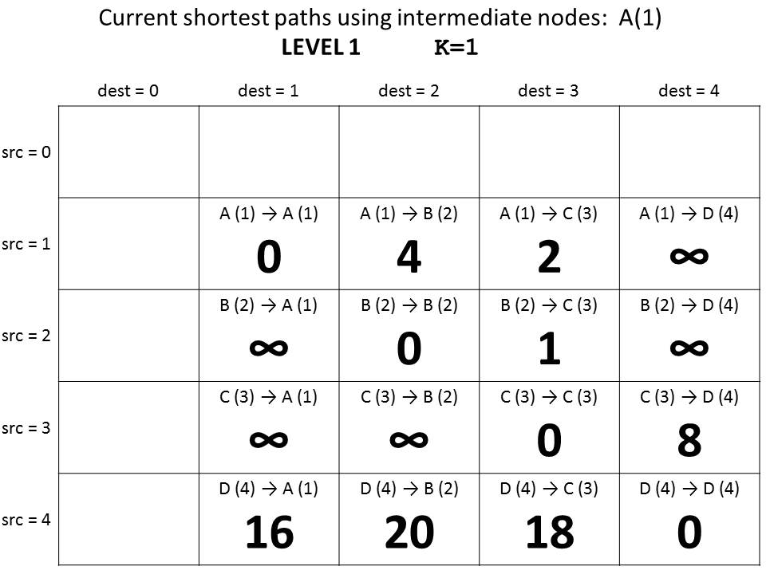
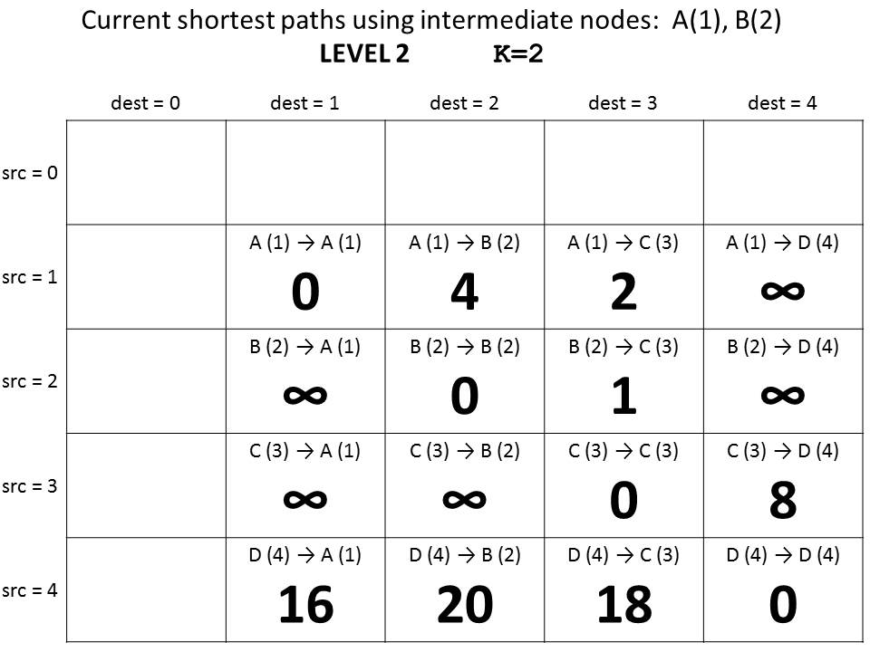
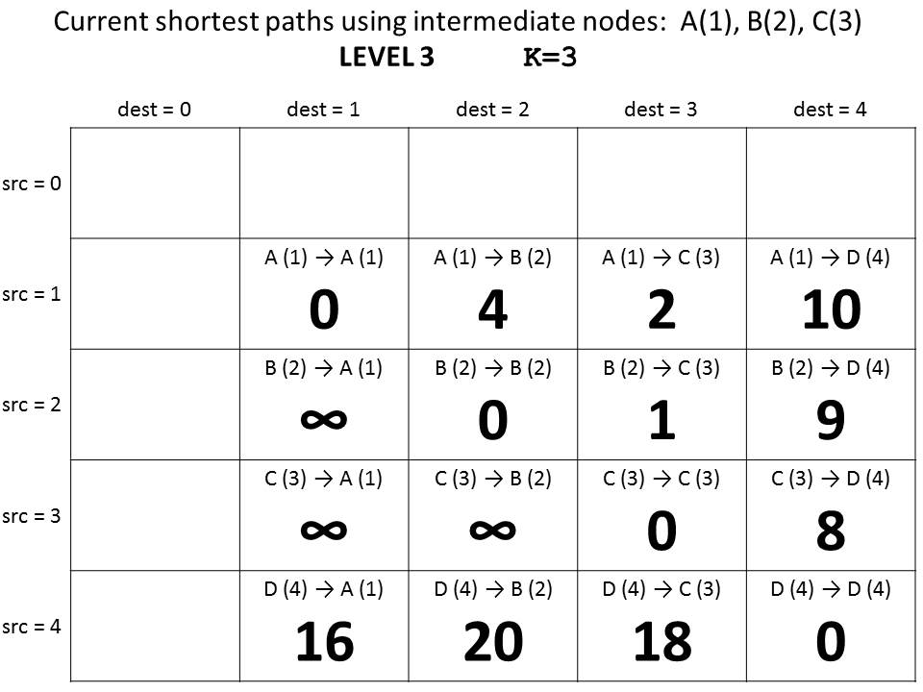
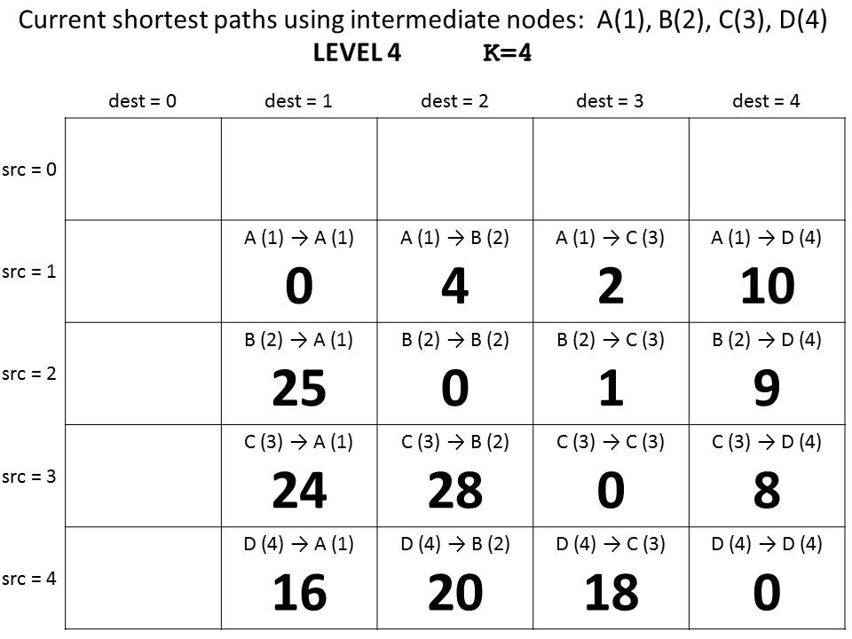

Slide 58
Runtimes (why we only care about the largest term)

Slide 59

How Fast Are Computers?
1 Hz = 1 operation /sec
2.9GHz = 2.9 x 10⁹ op / sec

Slide 60
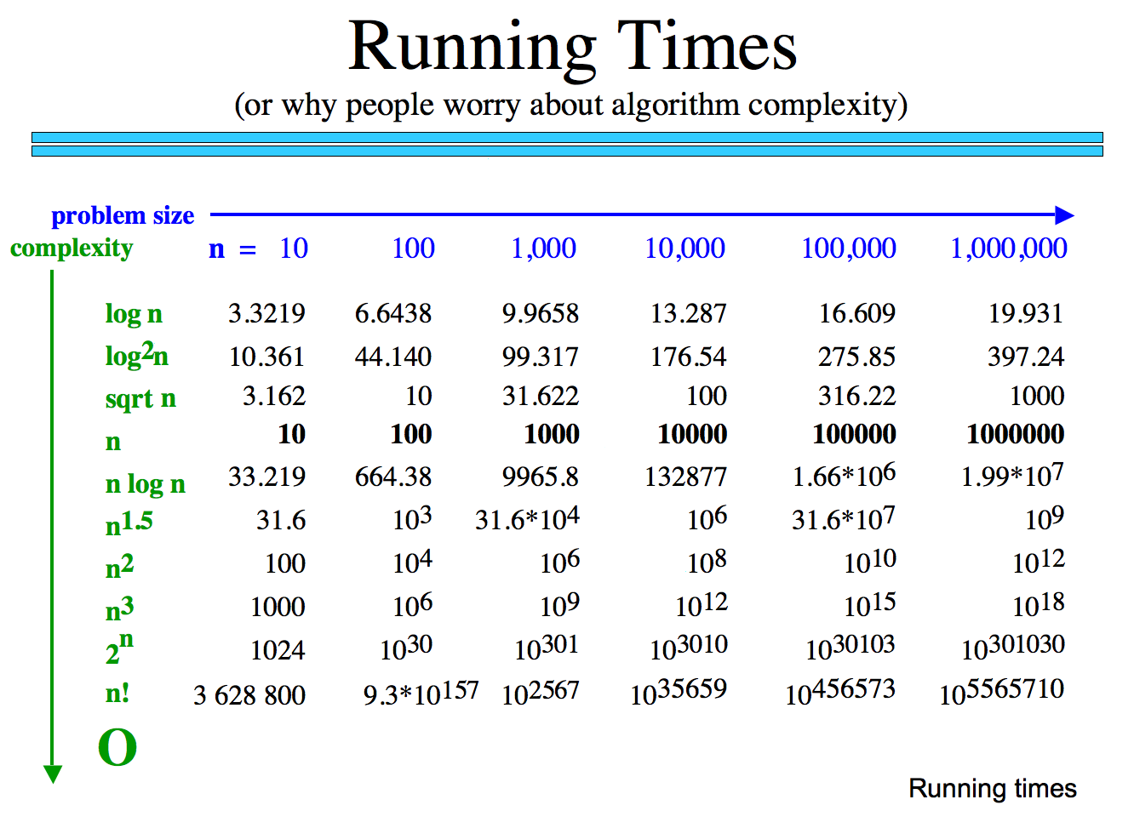
How many operations are required?
How long would these take if you have a 10 GHz Processor?

Slide 61
Why we only care about the largest term
How many operations are required?
Polynomial
Exp.
How big is n!
How long would these take if you have a 10 GHz Processor?

Slide 62
Classes of Problems
Big-O Order
n
n
n!
Intractable Problems (Exponential)
n
2
3
n
2
n
Tractable Problems (Polynomial)
n log(n)
Instead of using measured time – reason about the complexity of the problem
n
√n
log(n)
No Problem!
1

Slide 63
BONUS

Slide 64
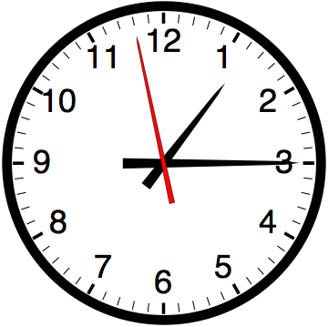

Slide 65


Computer
Science
&
= AWESOME

Slide 66
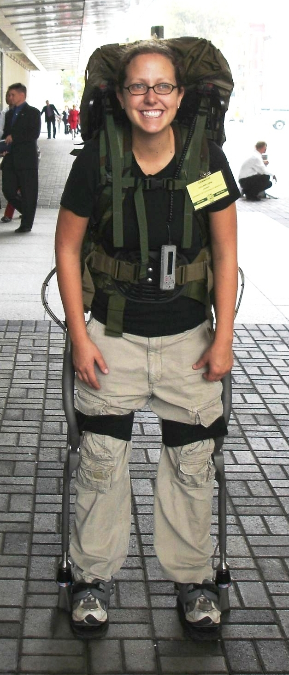
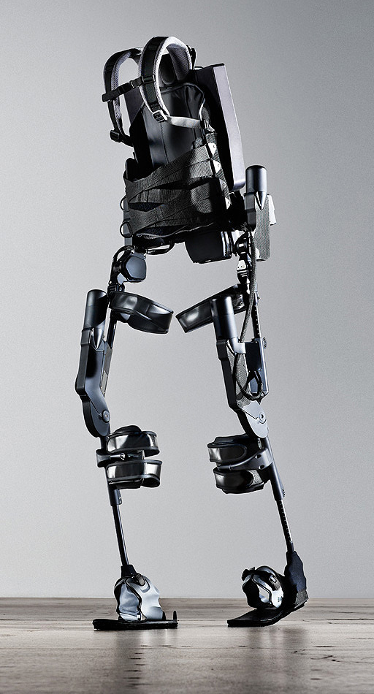
http://www.youtube.com/watch?v=pzRmNYA8LlY

Slide 67


ClickStart

Slide 68


Slide 69
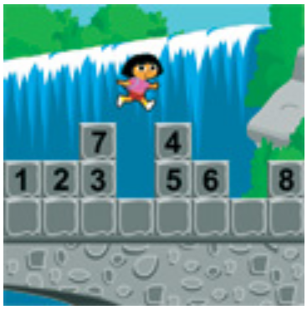
How should we represent the blocks in the computer?
Independent variables
2D Array
OpenList
I don’t know

Slide 70
The value in the array tells me what art asset to use
Each level is really a 3x10 vector!
0 | 0 | 7 | 0 | 4 | 0 | 0 | 0
1 | 2 | 3 | -4 | 5 | 6 | -7 | 8
B | B | B | B | B | B | B | B
Negative values tell me what block needs to go here to win!

Slide 71
0 | 0 | 7 | 0 | 4 | 0 | 0 | 0
1 | 2 | 3 | -4 | 5 | 6 | -7 | 8
0 | 0 | 0 | B | 0 | 0 | 0 | 0

Slide 72
BUGS!

Slide 73


Slide 74

It is really sad when stuff you’ve made is on sale!

Slide 75

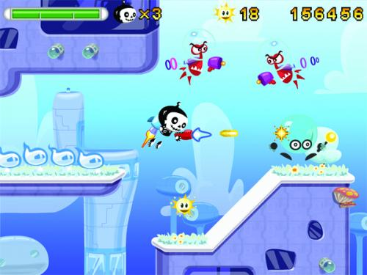

Which image is fake?
A. Top Left
B. Bottom Left
C. Bottom Right

Slide 76
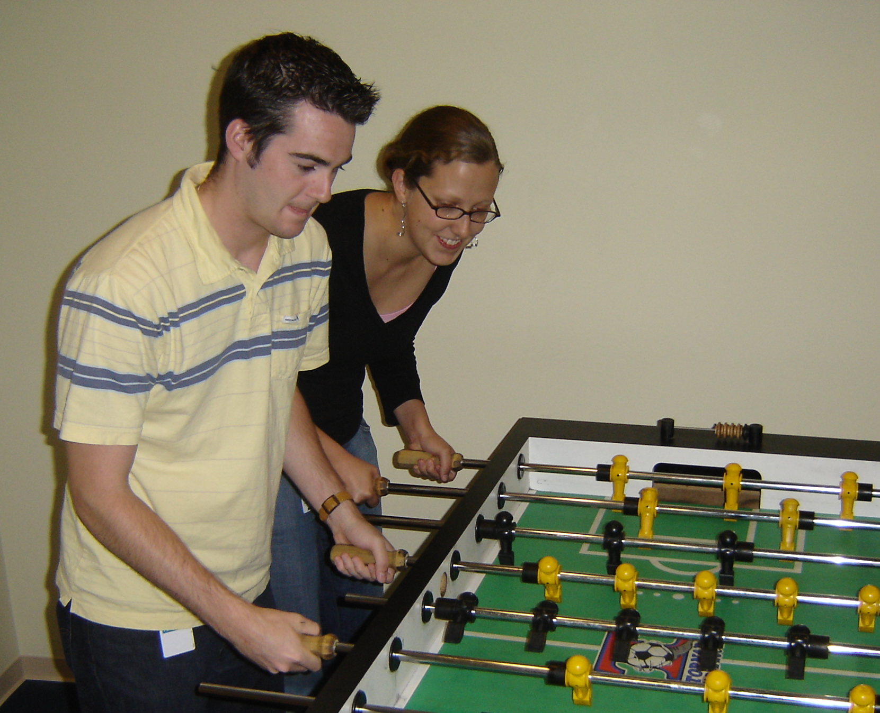

Slide 77
