Slide 1
Requirements

Slide 2
Review
Software dev Is hard
Managing complexity: abstraction, tools, software processes, principles & patterns
Waterfall vs. agile
Iteration 1: 1st iOS dev tutorial

Slide 3
Sudoku Rules
Amazing consensus
Last semester – amazing lack of consensus

Slide 4
Important features
Write yours on the board on the continuum most important (left) to least important (right).

Slide 5
Today
Requirements
Requirements modeling
Sudoku: iteration 2

Slide 6
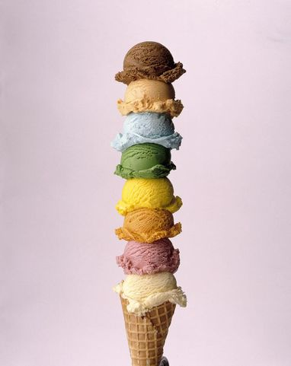
What are requirements?
FURPS+
Functional: features, capabilities
Usability: human factors, aesthetics, consistency, documentation
Reliability: frequency of failure, recoverability, predictability
Performance: response times, throughput, accuracy, availability, resource usage
Supportability: adaptability, maintainability, configurability
+: others
given an example of each for a sudoku game

Slide 7
Software requirements specification
Display grid
Should have unique solution

Slide 8
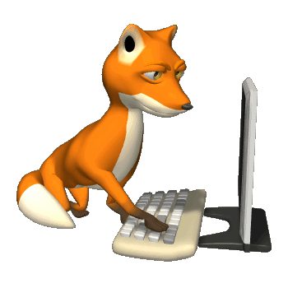
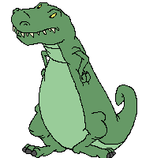
Software requirements specification
Display grid
Should have unique solution
NOT
SRS is lookin’ good

Slide 9
Waterfall
Requirements up front
Written documents are primary models
Stakeholders approve when SRS completed
Agile
Focus on most important behavior to add in the next iteration
Effective use of models including working software
Stakeholders drive priorities for next iteration

Slide 10
Tools for modeling (primarily functional) requirements
Storyboards
Flow charts
State diagrams
Use cases
User stories
Prototypes
Text documents
etc.

Slide 11
Storyboard for tic tac toe
X
START
Player starts game
Grid appears
Player selects square
X appears
X
Congratulations!
You won!
X
X
Stalemate …
O
Repeat until
O
O
Computer selects square and O appears
3 in a row
Player or computer wins
OR
stalemate

Slide 12
Software specification documents (SRS)
Precise
Hard to produce
Hard to assess
Storyboard
Informal but conveys look and feel
Easy/quick to produce
Easy/quick to assess

Slide 13
Flow chart
Player selects square
Square empty?
N
Y
X appears
Three in a row?
Y
Player wins
N
Any empty squares?
N
Stalemate
Y
O appears
Etc.

Slide 14
Tic-tac-toe state diagrams
3 X’s in a row
Player wins
No 3 in a row
Grid has blank cell
Player’s turn
No 3 in a row
Grid full
Stalemate
3 O’s in a row
Computer wins
No 3 in a row
Grid has blank cell
Computer’s turn

Slide 15
Use Case
Describe how a user interacts with the system to achieve a goal.
Tic tac toe use case: Play game

Slide 16
Tic tac toe “play game” use case
Play game:
Player start game
Empty grid appears
Player selects blank cell
X appears in cell
Computer places 0 in a cell
Return to step 3
Augment with alternative paths

Slide 17
Tic tac toe “play game” use case
Play game:
Player start game
Empty grid appears
Player selects blank cell
3a. Player selects non-blank cell, return to step 3
X appears in cell
4a. X appears in cell, 3 X’s in a row, player wins
4b. X appears in cell, Grid full, stalemate
Computer places 0 in a cell
5a. Computer places 0 in a cell, 3 O’s in a row, computer wins
5b Computer places 0 in a cell, Grid full, stalemate
Return to step 3

Slide 18
Tic tac toe “play game” use case
Play game:
Player start game
Empty grid appears
Player selects blank cell
3a. Player selects non-blank cell, return to step 3
X appears in cell
4a. X appears in cell, 3 X’s in a row, player wins use case
4b. X appears in cell, Grid full, stalemate use case
Computer places 0 in a cell
5a. Computer places 0 in a cell, 3 O’s in a row, computer wins use case
5b Computer places 0 in a cell, Grid full, stalemate use case
Return to step 3
We can embed other use cases

Slide 19
Tic Tac Toe Use Cases
Goal setter | Goal | Priority
Player | Play game | 1
Player | Player wins | 2
Player | Computer wins | 2
Player | Stalemate | 2
Player | Start new game | 2
Player | Exit game | 4
Player | Show stats | 5
Player | Save game | 6
Player | Load existing game | 6

Slide 20
Fully dressed use case
Title
Primary actor
Goal in context
Scope
Level
Stakeholders and interests
Precondition
Minimal guarantees
Success guarantees
Trigger
Main Success Scenario
Extensions
Technology & data variations list
Related information

Slide 21
User story
As a player, I want to view the current configuration of the grid so I can figure out my next move.

Slide 22
User focused- users can understand/produce, make clear priorities
Developer focused
Software specification documents (SRS)
Precise
Hard to produce
Hard to assess
Agile models
Informal
Easy to produce
Easy to assess

Slide 23
User stories for sudoku
You’ve launched Sudoku. What next?
As a player I want to
Do this ___________________
In order to achieve this goal _______________
Confer with a partner then offer up your suggestion.

Slide 24
Do we have consensus?

Slide 25
INVEST user stories
Independent
Negotiable
Valuable
Estimable
Small
Testable
Should be independent of other stories
Captures essence but not details; not a formal contract
Add value to the project
We can estimate how long it will take
Can be implemented in one iteration
We can write a test for it

Slide 26
User story
Feature: Display initial grid
User story: As a player I want to view the initial Sudoku grid in order to figure out my first move. The initial grid should have blanks and should have a unique solution.
Indepdendent? Negotiable? Valuable? Estimable? Small? Testable?
Would showing a picture of sudoku grid suffice?

Slide 27
User stories for sudoku
You’ve launched Sudoku. A valid grid with blanks appears. What is next?
As a player I want to
Do this ___________________
In order to achieve this goal _______________
Confer with a partner then offer up your suggestion.

Slide 28
User story
Feature: Enter number in blank cell
User story: As a player I want to enter a number in a blank cell in order to solve the puzzle.

Slide 29
UI Design
We are going to need to decide on a UI design
We’ll do that next Tuesday

Slide 30
Backlog
List of features to be implemented
Our current backlog:
View initial grid
Enter number in blank cell
This is the goal of our next iteration.

Slide 31
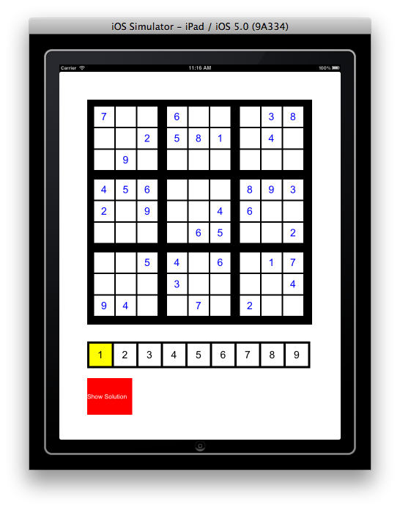
HW 1: pair programming
Before you leave class
Find a partner
Set a 6 hour block of time to work over the weekend

Slide 32
Requirements
FURPS+
Agile vs. Waterfall
Modeling requirements
Backlog

