Slide 1
Software quality

Slide 2

But first …

Slide 3
But first … a recap of what you learned (and a few things you didn’t) about Objective-C

Slide 4
C++ vs. Objective-C
Methods

Slide 5
Syntax: method calls
C++ method calls | Objective-C message passing
myObject->doSomething() | [myObject doSomething]

Slide 6
Syntax: method calls
C++ method calls | Objective-C message
myObject->doSomething() | [myObject doSomething]
myObject->doSomething(x) | [myObject doSomething:x]

Slide 7
Syntax: method calls
C++ method calls | Objective-C message
myObject->doSomething() | [myObject doSomething]
myObject->doSomething(x) | [myObject doSomething:x]
myObject->doSomething(x,y) | [myObject doSomething:x :y]

Slide 8
Method signatures
C++
void createCell( (int) row, (int) column);
Objective-C
-(void) createCell: (int) row : (int) column
Each argument preceded by a colon

Slide 9

Method signatures
C++
void createCell( (int) row, (int) column);
Objective-C
-(void) createCell: (int) row : (int) column;
Perfectly legal
Vastly superior
-(void) createCellAtRow: (int) row andColumn: (int) column;
Why?
Description of argument

Slide 10
Objective-C
-(void) createCellAtRow: (int) row andColumn: (int) column;
The name of a method is called a selector:
createCellAtRow: andColumn:
A message contains the object pointer, its selector, and the arguments passed
[grid createCellAtRow: row andColumn: column]
Tutorial2:
[theButton addTarget:self action:@selector(buttonPressed:) forControlEvents:UIControlEventTouchUpInside];

Slide 11
C++ vs. Objective-C
Method
Accessor Methods

Slide 12
Objective-C Accessor methods
@interface Grid: UIView
{
int numberCells;
}
-(int) getNumberCells;
-(void) setNumberCells: (int) newNumberCells;
@end

Slide 13
Objective-C Accessor methods
@interface Grid: UIView
{
int numberCells;
}
-(int) getNumberCells;
-(void) setNumberCells: (int) newNumberCells;
@end
@implementation Grid
-(int) getNumberCells
{
return numberCells;
}
-(void) setNumberCells: (int) newNumberCells
{
numberCells=newNumberCells;
}
@end

Slide 14
Objective-C Accessor methods
@interface Grid: UIView
{
int numberCells;
}
-(int) getNumberCells;
-(void) setNumberCells: (int) newNumberCells;
@end
@interface Grid: UIView
@property int numberCells;
@end
Xcode 4.4 and later synthesizes automatically
@implementation Grid
-(int) getNumberCells
{
return numberCells;
}
-(void) setNumberCells: (int) newNumberCells
{
numberCells=newNumberCells;
}
@end
@implementation
@synthesize numberCells;
@end

Slide 15
Objective-C Accessor methods
@interface Grid: UIView
{
int numberCells;
}
-(int) getNumberCells;
-(void) setNumberCells: (int) newNumberCells;
@end
@interface Grid: UIView
@property int numberCells;
@end
@implementation Grid
-(int) getNumberCells
{
return numberCells;
}
-(void) setNumberCells: (int) newNumberCells
{
numberCells=newNumberCells;
}
@end
@implementation
@synthesize numberCells;
@end
Tutorial 2:
theButton.backgroundColor = [UIColor whiteColor]

Slide 16


Objective-C Accessor methods
@interface Grid: UIView
{
int numberCells;
}
-(int) getNumberCells;
-(void) setNumberCells: (int) newNumberCells;
@end
@interface Grid: UIView
@property int numberCells;
@end
@implementation Grid
-(int) getNumberCells
{
return numberCells;
}
-(void) setNumberCells: (int) newNumberCells
{
numberCells=newNumberCells;
}
@end
@implementation
@synthesize numberCells;
@end
PUBLIC data member?
Tutorial 2:
theButton.backgroundColor = [UIColor whiteColor]

Slide 17
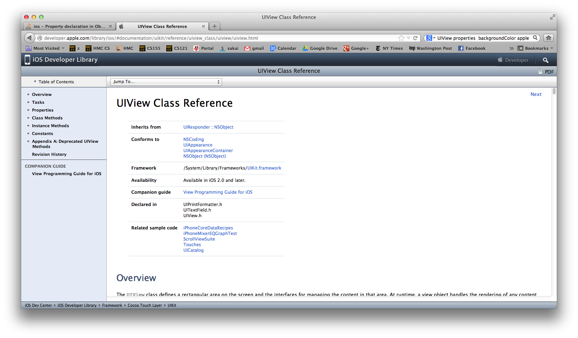
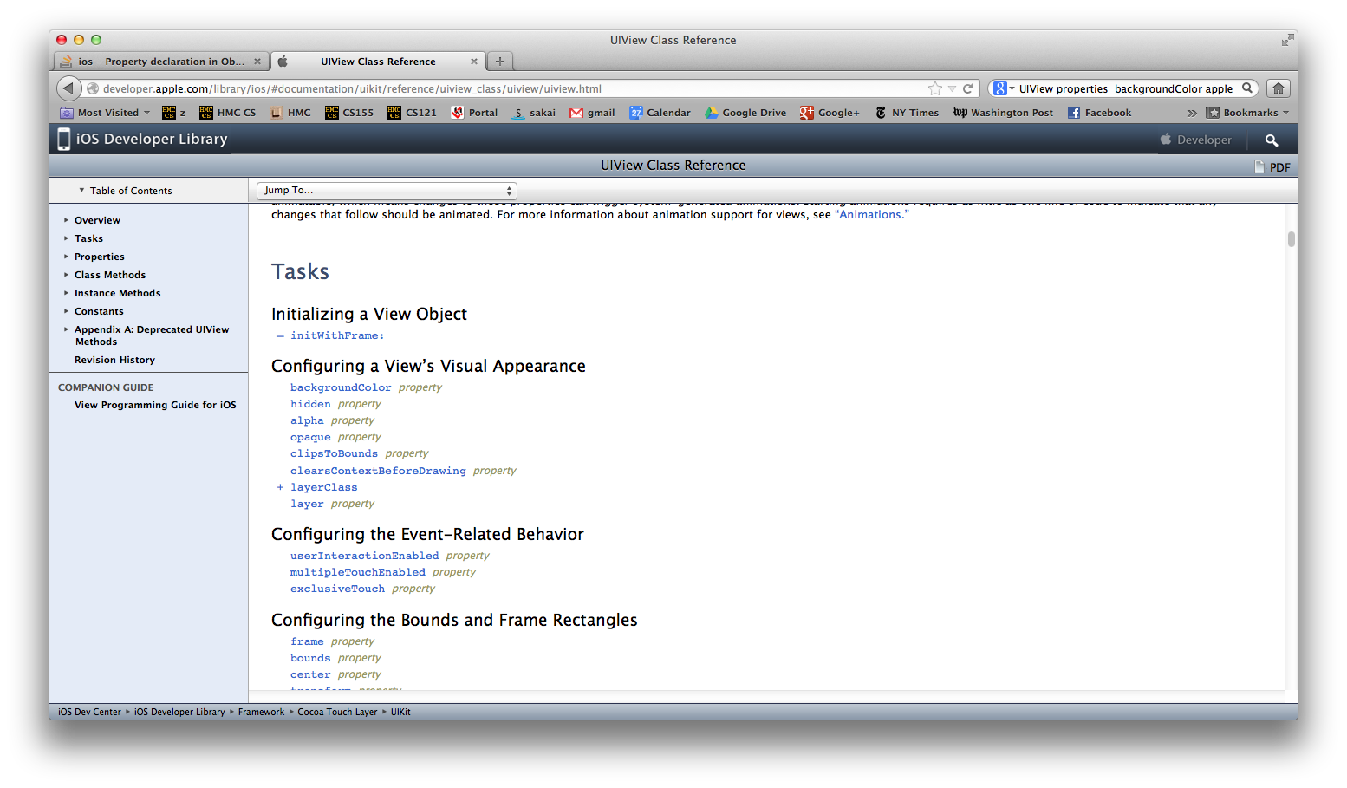
Objective-C Accessor methods
@interface Grid: UIView
{
int numberCells;
}
-(int) getNumberCells;
-(void) setNumberCells: (int) newNumberCells;
@end
@interface Grid: UIView
@property int numberCells;
@end
@implementation Grid
-(int) getNumberCells
{
return numberCells;
}
-(void) setNumberCells: (int) newNumberCells
{
numberCells=newNumberCells;
}
@end
@implementation
@synthesize numberCells;
@end
Tutorial 2:
theButton.backgroundColor = [UIColor whiteColor]

Slide 18
Objective-C Accessor methods
READ ONLY
@interface Grid: UIView
{
int numberCells;
}
-(int) getNumberCells;
@end
@interface Grid: UIView
@property (readonly) int numberCells;
@end
@implementation Grid
-(int) getNumberCells
{
return numberCells;
}
@end
@implementation
@synthesize numberCells;
@end

Slide 19
C++ vs. Objective-C
Method
Accessor methods
Objects

Slide 20
C++ vs. Objective-C
C++: static & dynamic objects | Objective-C: dynamic objects
Grid grid;
Grid* grid = new Grid; | Grid* grid = [[Grid alloc] init];
Objective-C is a superset of C. Structs can be created statically.

Slide 21
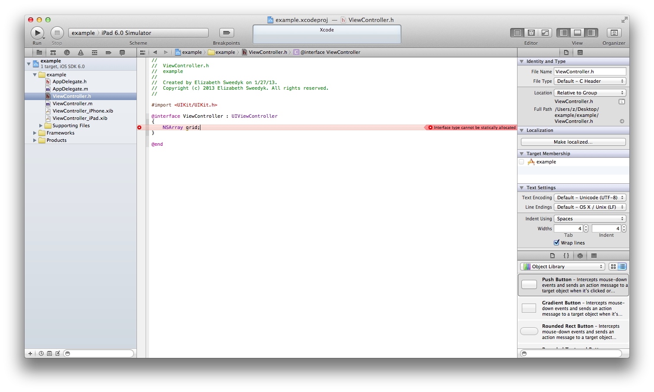
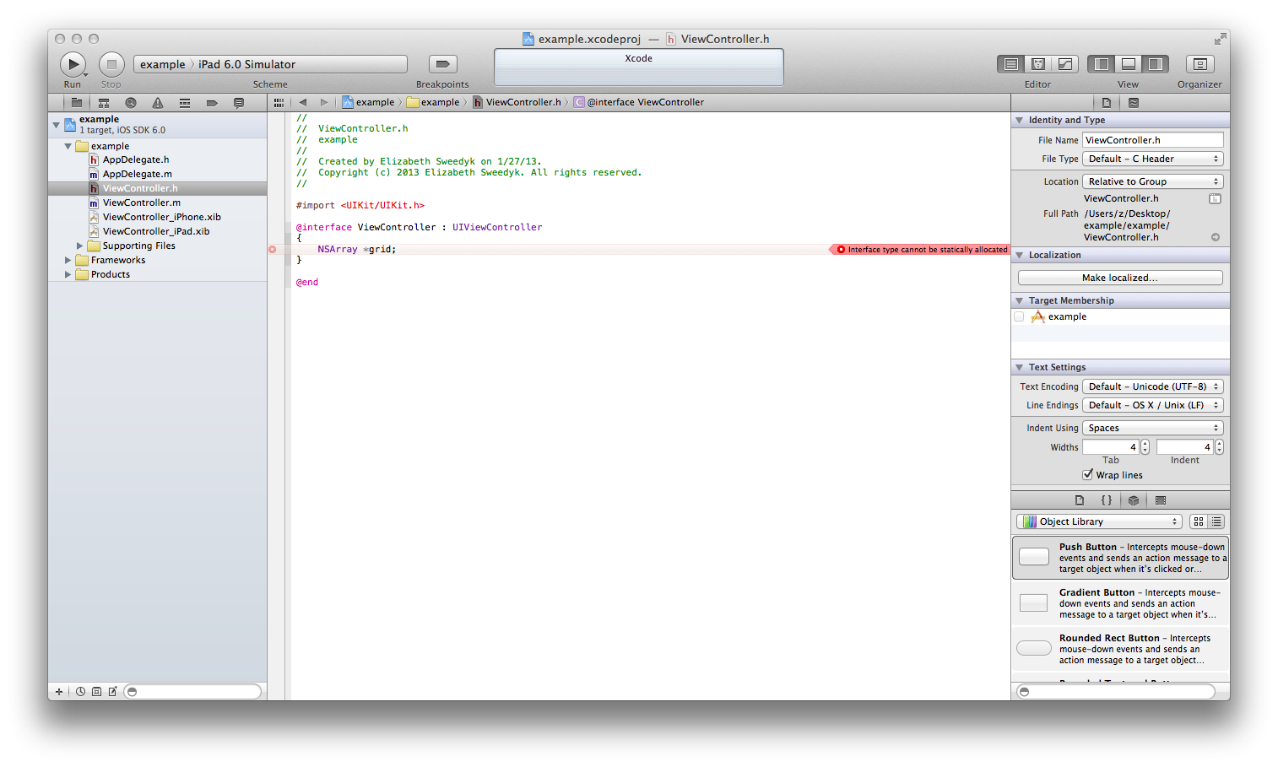

C++ vs. Objective-C
C++: static & dynamic objects | Objective-C: dynamic objects
Grid grid;
Grid* grid = new Grid; | Grid* grid = [[Grid alloc] init];

Slide 22
C++ vs. Objective-C
Method
Data members
Objects
Constructors

Slide 23
C++
Grid* grid = new Grid(numberCells);
Objective-C:
Grid* grid = [[Grid alloc] initWithNumberCells: numberCells];
You provide constructor methods for your classes.
You provide initialization methods for
your classes.

Slide 24
C++ vs. Objective-C
Method
Data members
Objects
Constructors
Destructors

Slide 25
C++
delete grid;
Objective-C:
?
You provide destructors for your classes.
Let’s do a brief review of memory allocation

Slide 26
Memory allocation
Static
Dynamic

Slide 27
Static Memory Allocation (space determined at compile time)
Space allocated when doSomething is called.
Released when doSomething returns.
void doSomething
{
int myArray[81];
…
}
Space for myArray
Used space
STACK

Slide 28
Static Memory Allocation (space determined at compile time)
Space allocated when doSomething is called.
Released when doSomething returns.
int* doSomething
{
int myArray[81];
…
return myArray;
}
Space for myArray
Used space
BIG PROBLEM
STACK

Slide 29
Dynamic Memory Allocation (run time)
void doSomething((int) arraySize)
{
int* myArray = new int[arraySize];
…
}
Used space
Space for myArray
Used space
HEAP

Slide 30
Dynamic Memory Allocation (run time)
(int*) doSomething((int) arraySize)
{
int* myArray = new int[arraySize];
…
return myArray;
}
Used space
Space for myArray
myArray may be used outside of doSomething
-- you must tell system when it is ok to release it!
Used space
HEAP

Slide 31
C++: Releasing dynamically allocated memory:
delete[] myArray;

Slide 32
C++: Releasing dynamically allocated memory:
delete[] myArray;
delete grid;
You provide class destructor method.

Slide 33
C++: Releasing dynamically allocated memory:
delete[] myArray;
delete grid;
Objective-C: Releasing dynamically allocated memory:
??
You provide class destructor method.

Slide 34
C++: Releasing dynamically allocated memory:
delete[] myArray;
delete grid;
Objective-C: Releasing dynamically allocated memory:
??
You provide class destructor method.
In iOS

Slide 35
NSObject
NSObject is the root class of iOS class hierarchies.
NSArray
UIView
NSString
ViewController
AppDelegate

Slide 36
iOS: reference count
NSObject
retainCount: 3
When retainCount=0 memory is released

Slide 37
MyClass* A =[ [MyClass alloc] init];
If MyClass is derived from NSObject then
NSobject’s init initializes retainCount
Provided you call the init of the superclass NSObject
A
MyClass
object
Tutorial 2:
- (id)initWithFrame:(CGRect)frame
{
self = [super initWithFrame:frame];
if (self) {
// Initialization code
[self setBackgroundColor:[UIColor blackColor]];
}
return self;
}
retainCount=1

Slide 38
MyClass* A =[ [MyClass alloc] init];
[A release];
…
Release causes retain count to decrement
A
MyClass
object
retainCount=1
retainCount=0

Slide 39
MyClass* A =[ [MyClass alloc] init];
MyClass* B = A;
Does not cause retain count to increement.
PROBLEM
A
B
retainCount=1

Slide 40

MyClass* A=[ [MyClass alloc] init]
MyClass* B = A
[A release]
PROBLEM
May work until memory re-used
B
Zombie: pointer to de-allocated memory

Slide 41
MyClass* A =[ [MyClass alloc] init];
MyClass* B = A;
[B retain];
Causes retain count to increment
A
B
retainCount=1
retainCount=2

Slide 42
Automatic Reference Counting (ARC) inserts retains and releases for you.
GOOD NEWS:

Slide 43

Is it magic?
No – ARC is fallible

Slide 44
Automatic Reference Counting (ARC) inserts retains and releases for you.
GOOD NEWS:
BAD NEWS:
Doesn’t always work
GOOD NEWS:
Xcode tools help track down memory problems.

Slide 45
To recap our recap
Method
Data members
Objects
Constructors
Destructors
No big diff YET
(Dynamic typing & reflection to come.)

Slide 46

Software quality
We’ll talk a lot about software quality and how to ensure it as well as assess it.

Slide 47


How can we assess the quality of software?
Users/Customers’ perspective
Developers’ perspective

Slide 48
How can we assess the quality of software?
Users/Customers’ perspective
Does it do what it is supposed to?
Does it do anything it shouldn’t?
How should we improve it?
Developers’ perspective
Is the code correct?
Is the code clear, readable?
Is the code extensible?

Slide 49
Sudoku.v1: User/customer perspective
Does it do what it is supposed to do?
Does it do anything it shouldn’t do?
How can we improve it?
Demo to customer
User tests
QA test

Slide 50
Does it do what it is supposed to do?
Feature: Display initial grid
User story: As a player I want to view the initial Sudoku grid in order to figure out my first move. The initial grid should have blanks and should have a unique solution.
Feature: cells can be tapped

Slide 51
Sudoku.v1
Does it do what it is supposed to do?
Does it display a grid?
Is It a valid grid with blanks?
Can we tap cells?
Let’s critique Z’s v1!

Slide 52
Sudoku.v1
Does it do what it is supposed to do?
Does it display a grid?
Is It a valid grid with blanks?
Can we tap cells?
Does it do anything it shouldn’t?
Let’s try to break Z’s v1!

Slide 53
Sudoku.v1
Does it do what it is supposed to do?
Does it display a grid?
Is It a valid grid with blanks?
Can we tap cells?
Does it do anything it shouldn’t do?
What ways could it be improved?

Slide 54
Improvements
Aesthetics (not very pretty)
More interesting grids to solve
Add user stories as appropriate to backlog.

Slide 55
How can we assess the quality of software?
Users/Customers’ perspective
Does it do what it is supposed to?
Does it do anything it shouldn’t?
How should we improve it?
Developers’ perspective
Is the code correct?
Is the code clear, readable?
Is the code extensible?

Slide 56
Sudoku.v1: Developer’s perspective
Is the code correct?
Is the code clear, readable?
Is the code extensible?
Tests
Code reviews

Slide 57
Lab
Part A:
Instrumentation tutorial – test for zombies, memory leaks
Instrumentation tests on tutorial 1 & Sudoku v1

Slide 58
Sudoku.v1: Developer’s perspective
Is the code clear and readable?
Is the code extensible?
Is the code correct?
Tests
Code reviews

Slide 59
Code review
Other professional look at and critique your code
Formal
Informal
Pair programming
Over the shoulder review
Walkthrough
Etc.
Developer walks through code
Reviewers ask question, critique, evaluate
Produce recommended changes

Slide 60
Sudoku v1 code walkthrough
Correct
Clear and readable
Names
Formatting
Comments
Method length, parameters, level of abstraction
Extensible
Let’s do a walkthrough Z’s v1!
http://www.codinghorror.com/blog/2006/05/the-ten-commandments-of-egoless-programming.html

Slide 61
Lab
Part A:
Instrumentation tutorial
Instrumentation tests on tutorial 1 & Sudoku v1
Part B:
Demo & test your v1
Walkthrough of your v1
Develop coding standards proposal
Part C: refactor to address recommendations as you deem appropriate

Slide 62
Coding standards
We’ll decide as a class next time
Today in lab you create a proposal
This is a good place to start:
https://developer.apple.com/library/mac/#documentation/Cocoa/Conceptual/CodingGuidelines/Articles/NamingBasics.html#//apple_ref/doc/uid/20001281-BBCHBFAH

Slide 63
Logistics for Part B
Find 2 other teams to work with
Write your names on the board
Group 1
Group 4
Team 1
Team 2
Team 10
Team 11
…
Team 3
Team 12

Slide 64
Logistics for Part B
Find 2 other teams to work with
Write your names on the board
Every team will be assigned a grutor or two
Every team will be assigned a place to work
Group 1
Group 4
Team 1
Team 2
Team 10
Team 11
…
Team 3
Team 12

Slide 65

Logistics

Slide 66
Where | OS | Xcode | iOS
LSC | 10.6.8 Lion | 4.2 | 5.0
CS Labs | 10.8.1 Mountain Lion | 4.4.1 | 5.1
Z’s new air | 10.8.2 Mountain Lion | 4.5.2 | 6.0
Sudoku project: Make sure you can demo on your own machine, the LSC machines, or the CS Labs machines. To install on iPad you need to develop for the CS Lab machines (or maybe later).
Armstrong game project: Each team will have a workstation on the 2nd floor of
Sprague + a laptop. Both consistent with CS Labs.

Slide 67
Demo & walkthrough
Group i: take turns presenting, reviewing
(~15 minutes each)
Team k
Team j
Reviewing teams complete
quality rubric
Team m

Slide 68
Coding standards proposal
Work together to produce a single word document of recommendations
Team k
Team j
Team m

Slide 69
Next time
User story 2 (initial UI Design)
User story 3 (initial archiecture design)

Slide 70
Summary
C++ vs. Objective-C
syntax, memory management
Code quality – Sudoku.v1
User/customer’s perspective
Does it do what it should?
Does it do anything it shouldn’t?
How can it be improved?
Developer’s perspective
Is the code clear, readable?
Is the code extensible?
Is the code correct?
Demo, QA test
Instrumentation tests,
Code walkthrough

