Slide 1
Design Practice & Models

Slide 2
Today
Decide on code standards
Revisit/refine user stories
Design quick & dirty UI
Design Sudoku architecture
Plan next iteration

Slide 3
Today
Decide on code standards
Revisit/refine user stories
Design quick & dirty UI
Design Sudoku architecture
Plan next iteration

Slide 4
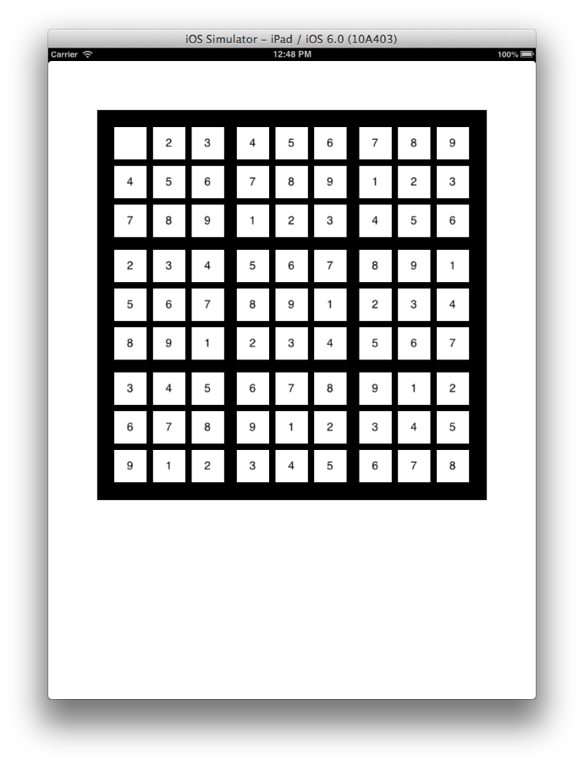
User stories
Feature: Display initial grid
User story: As a player I want to view the initial Sudoku grid in order to figure out my first move. The initial grid should have blanks and should have a unique solution.
Feature: Enter number in blank cell
User story: As a player I want to enter a number in a blank cell in order to solve the puzzle.

Slide 5
New user story
Feature: Generate grids
User story: As a player I want different grids of varying difficulty in order to be entertained and challenged.

Slide 6
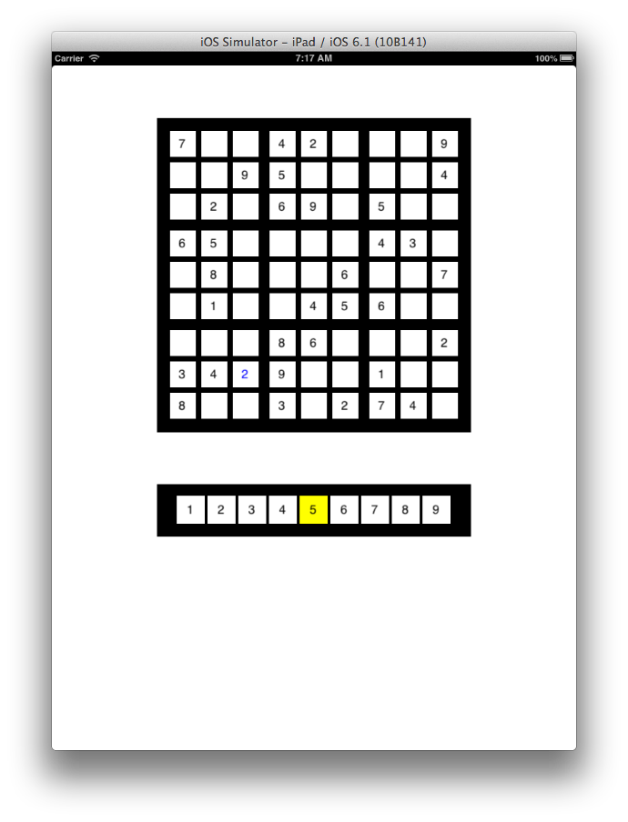
Inconsistent input
Can I enter a 2 here?
Feature: Enter number in blank cell
User story: As a player I want to enter a number in a blank cell in order to solve the puzzle.
Can I enter a 5 here?
(It should be a 3.)
Incorrect input

Slide 7
Inconsistent input
Can I enter a 2 here?
Feature: Enter number in blank cell
User story: As a player I want to enter a number in a blank cell in order to solve the puzzle.
Can I change values?
Can I change an initial value?
Can I change a value I entered?
Can I delete a value I entered?
Can I enter a 5 here?
(It should be a 3.)
Can I change this to a 5?
Changing values
Incorrect input

Slide 8
Inconsistent input
Can I enter a 2 here?
Feature: Enter number in blank cell
User story: As a player I want to enter a number in a blank cell in order to solve the puzzle.
How will the I distinguish initial values from ones I entered??
Can I change values?
Can I change an initial value?
Can I change a value I entered?
Can I delete a value I entered?
Can I enter a 5 here?
(It should be a 3.)
Can I change this to a 5?
Changing values
Incorrect input

Slide 9
Agile
Choose simple rules to start
Build flexibility into design provided it doesn’t cost too much
Feature: Enter number in cell
User story: As a player I want to enter a number in a cell in order to solve the puzzle.
Scenario 1: Cell is blank and new number is consistent.
    Number appears in cell in a way distinguishable from initial grid values.
  Scenario 2: Cell has number I previously entered and new number is consistent.
    Number appears in cell in a way distinguishable from initial grid values.
In any other case we’ll reject for now.
I knows this will be fine. In practice you’d do some initial software design to understand the implications of this kind of decision.

Slide 10
Note: we can augment user stories with scenarios
As a ______________
I want to do this ___________
In order to achieve this goal _________
Scenario 1: …
Scenario 2: …

Slide 11
Let’s generalize our user story to display the grid throughout game
Feature: Display initial grid
User story: As a player I want to view the initial Sudoku grid in order to figure out my first move. The initial grid should have blanks and should have a unique solution.
Feature: Display grid
User story: As a player I want to view the Sudoku grid in order to figure out my next move. The grid should show but distinguish the initial values and my current entries. The initial grid should have blanks and a unique solution. The grid should always be consistent.

Slide 12
Current stories
Feature: Display grid
User story: As a player I want to view the Sudoku grid in order to figure out my next move. The grid should show the initial values and my current entries. The initial grid should have blanks and a unique solution. The grid should always be consistent.
Feature: Generate grids
User story: As a player I want different grids of varying difficulty in order to be entertained and challenged.
Feature: Enter number in cell
User story: As a player I want to enter a number in a cell in order to solve the puzzle.
Scenario 1: Cell is blank and new number is consistent.
    Number appears in cell in a way distinguishable from initial grid values.
  Scenario 2: Cell has number previously entered by player and new number is consistent.
    Number appears in cell in a way distinguishable from initial grid values.
Independent? Negotiable? Valuable? Estimable? Small? Testable?
If not independent are they at least consistent?

Slide 13
Today
Decide on code standards
Revisit/refine user stories
Design quick & dirty UI
Design Sudoku architecture
Plan next iteration

Slide 14
UI Design
UI Design
  User/Task models
  Prototype (usually paper at first)
  Usability test
  Refine design & repeat
“Growing” a UI Design is difficult
We’ll do a quick & dirty design for our next iteration

Slide 15
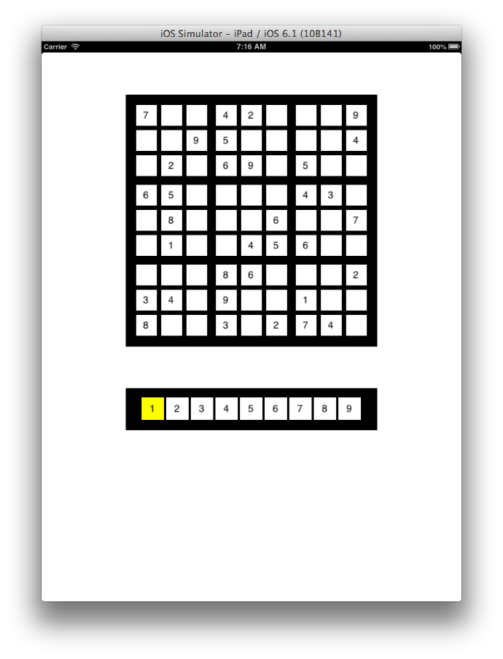
Initial grid and number pad appear.
Original entries are black. Current number “1” is highlighted in number pad.

Slide 16
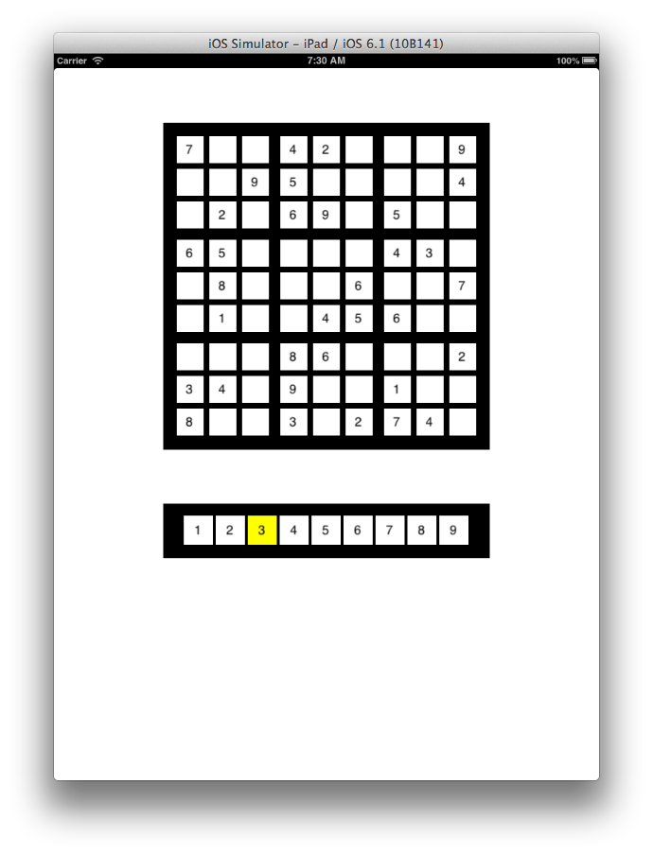
1
1
User clicks on number pad cell.
Current number de-highlighted. New number is highlighted.

Slide 17
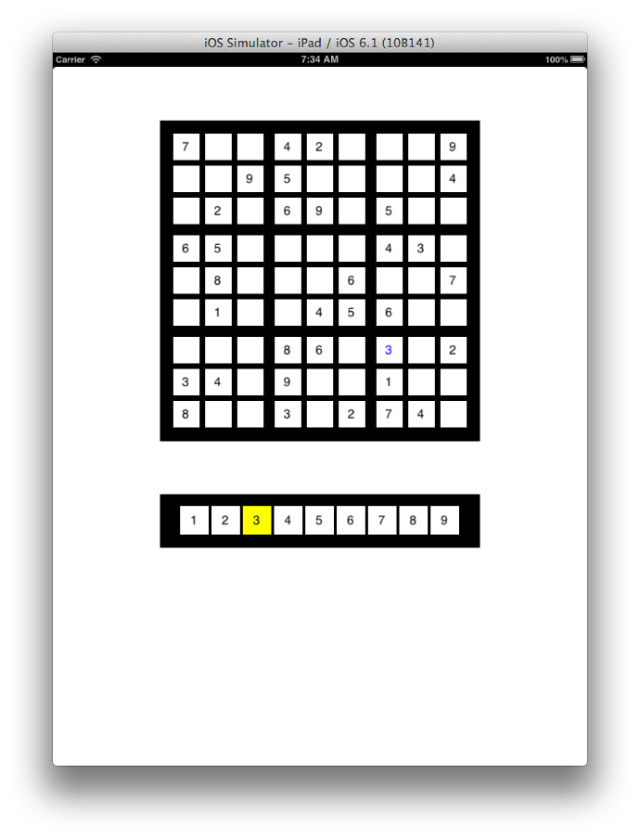
User clicks on cell. Cell is blank or has a value entered by user. Current number is consistent for that cell.
Current number appears in that cell in blue.

Slide 18
Today
Decide on code standards
Revisit/refine user stories
Design quick & dirty UI
Design Sudoku architecture
Plan next iteration

Slide 19
Unified Modeling Language
UML is a standard language for visualizing, specifying, constructing, and documenting the artifacts of a software system.

Slide 20
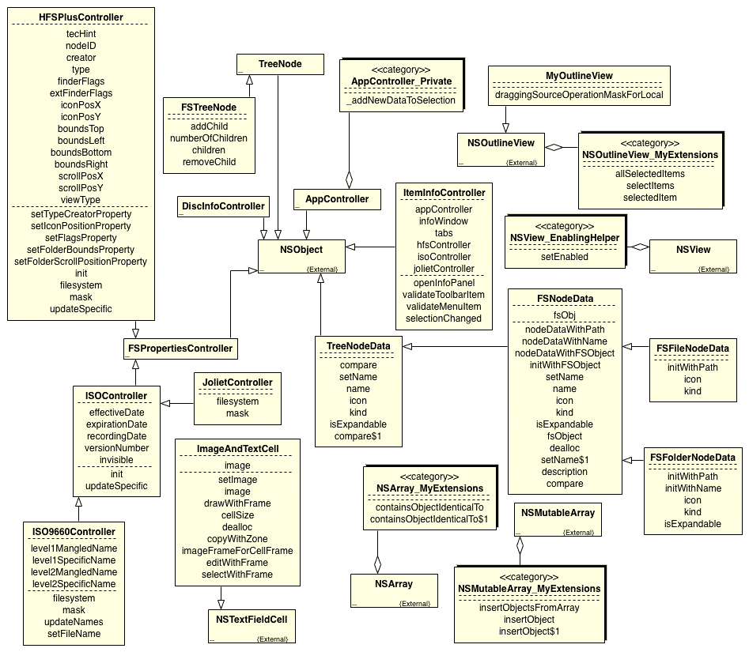
SAMPLE UML Class Diagram

Slide 21
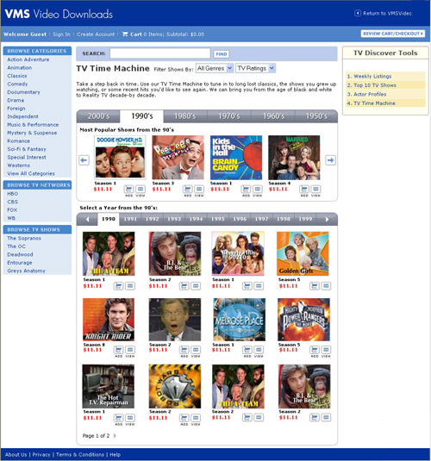
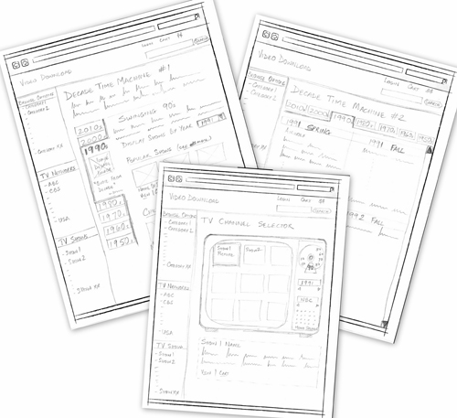
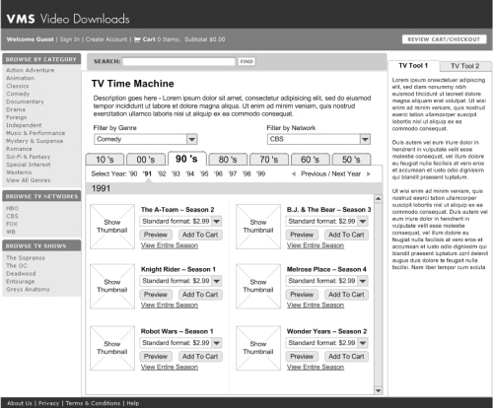
Agile strategy
Simple design models Working software

Slide 22
Design Goals
Make it easy to build
Make it easy to test
Make it easy to maintain
Make it easy to change
SIMPLE
INTUITIVE
FLEXIBLE

Slide 23
Best Practices approach to developing design
Develop a “domain diagram”
Captures key objects in our domain and their relationships/interactions.

Slide 24
collegeSim domain model
Blocks represent nouns, links represent verbs
Room
Building
Instructor
Department
College
Course Offering
Meeting
Course
Major
uses
Time Slot
Textbook
Class List
Student
written by
Semester
Author

Slide 25
Best Practices approach
Develop a “domain diagram”
Initially defined by our core user stories
Nouns
Captures key objects in our domain and their relationships/interactions.

Slide 26
Current stories
Feature: Display grid
User story: As a player I want to view the Sudoku grid in order to figure out my next move. The grid should show the initial values and my current entries. The initial grid should have blanks and a unique solution. The grid should always be consistent.
Feature: Generate grids
User story: As a player I want different grids of varying difficulty in order to be entertained and challenged.
Feature: Enter number in cell
User story: As a player I want to enter a number in a cell in order to solve the puzzle.
Scenario 1: Cell is blank and new number is consistent.
    Number appears in cell in a way distinguishable from initial grid values.
  Scenario 2: Cell has number previously entered by player and new number is consistent.
    Number appears in cell in a way distinguishable from initial grid values.

Slide 27
Nouns
Player
Grid
Cell
Value, entry, number
Solution
Are there any nouns that implied?

Slide 28
Nouns
Player
Grid
Cell
Value, entry, number
Solution
Screen
NumPad
Grid generator
Are there any nouns that implied?

Slide 29
How about adjectives…
Player
Grid
Cell
Value, entry, number
Solution
Screen
NumPad
Grid generator
Initial, current, solved, consistent
Blank, filled

Slide 30
What are the relationships, how do they interact?
Player
Grid
Cell
Value, entry, number
Solution
Screen
NumPad
Grid generator
Initial, current, solved, consistent
Blank, filled

Slide 31
Current stories
Let’s act out the user stories. I need 7 volunteers to start.
Feature: Display grid
User story: As a player I want to view the Sudoku grid in order to figure out my next move. The grid should show the initial values and my current entries. The initial grid should have blanks and a unique solution. The grid should always be consistent.
Feature: Generate grids
User story: As a player I want different grids of varying difficulty in order to be entertained and challenged.
Feature: Enter number in cell
User story: As a player I want to enter a number in a cell in order to solve the puzzle.
Scenario 1: Cell is blank and new number is consistent.
    Number appears in cell in a way distinguishable from initial grid values.
  Scenario 2: Cell has number previously entered by player and new number is consistent.
    Number appears in cell in a way distinguishable from initial grid values.

Slide 32
Actors:
Player
Grid generator
Grid
Grid cell row=0, col=0
Grid cell row=6, col=7
NumberPad
NumPad cell “1”
Initial grid and number pad appear.
Original entries are black. Current number “1” is highlighted in number pad.
How should initial grid display work?

Slide 33
Grid generator
Grid generator
generates
generates
Initial values
getValue
generates
setValue
setColor
Grid
cells
Grid Cell
row, column, value, color
setValue, setColor
getValue
Grid
cells, initalValues
setValue
setColor
Grid Cell
row, column, value, color
setValue, setColor
displays
Screen
displays
Screen

Slide 34
Key design principles
Single responsibility principle
Each class should have a single responsibility and that responsibility should be entirely encapsulated within the class.

Slide 35
Grid generator
Grid generator
generates
generates
Initial values
getValue
generates
setValue
setColor
Grid
cells
Grid Cell
row, column, value, color
setValue, setColor
getValue
setValue
setColor
Grid
cells, initalValues
Grid Cell
row, column, value, color
setValue, setColor
displays
Screen
displays
Screen

Slide 36
Actors:
Player
Grid generator
Initial Values
Grid
Grid cell row=0, col=0
Grid cell row=6, col=7
NumberPad
NumPad cell “1”
Initial grid and number pad appear.
Original entries are black. Current number “1” is highlighted in number pad.
How should initial number pad display work?

Slide 37
Grid generator
Who should create the number pad? We’ll come back to that.
generates
Initial values
getValue
getsValue
setsValue
setColor
highlight
Grid
cells, initalValues
Grid Cell
row, column, value
setValue, setColor
NumPad Cell
value, background color
setHighlight
Number Pad
cells, currentNumber
Screen
displays
displays

Slide 38
Actors:
Player
NumberPad
NumPad cell “1”
NumPad cell “3”
1
1
User clicks on number pad cell.
Current number de-highlighted. New number is highlighted.

Slide 39
Grid generator
generates
Player
Initial values
getValue
selects
getsValue
highlight
de-highlight
setsValue
setColor
Number Pad
cells, currentNumber
cellClicked
Grid
cells, initialValues
Grid Cell
row, column, value,color
setValue, setColor
NumPad Cell
value, backgroundColor
setHighlight, clicked
clicked
Screen
displays
displays

Slide 40
Actors:
Player
Grid
Grid cell row=6, col=7
NumPad
User clicks on cell. Cell is blank or has user-entered value. Current number is consistent for that cell.
Current number appears in that cell in blue.

Slide 41
Grid generator
generates
Player
Initial values
getValue
selects
getsValue
setsValue
setColor
highlight
de-highlight
Grid
cells, initialValues
checkConsistency
cellClicked
Grid Cell
row, column, value, color
setValue, setColor, getValue, clicked
NumPad Cell
value, backgroundColor
setHighlight, clicked
Number Pad
cells, currentNumber
cellClicked, getNumber
getValue,
clicked
clicked
getCurrentNumber
Screen
displays
displays

Slide 42
Key design principles
Single responsibility principle
Each class should have a single responsibility and that responsibility should be entirely encapsulated within the class.
What is responsibility of Grid?
What is responsibility of Grid Cell?
Maintain data, coordinate display
Hold data, UI: display/click

Slide 43
Model-View-Controller (MVC) design pattern
Model and View do not interact directly
Model
View
Data
UI elements
Controller
Logic

Slide 44
Model-View-Controller (MVC)
Model
View
Data (pretty dumb)
UI elements (pretty dumb)
Controller
Keep it simple
Logic

Slide 45
Model-View-Controller (MVC)
Model
View 1
View 2
Controller1
Controller2

Slide 46
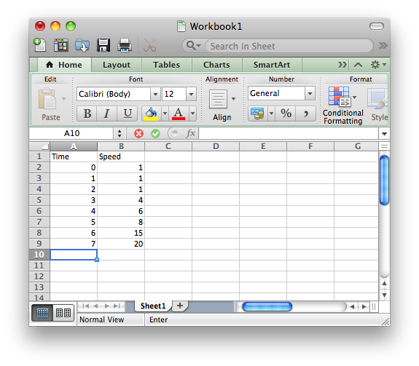
Classic example

Slide 47
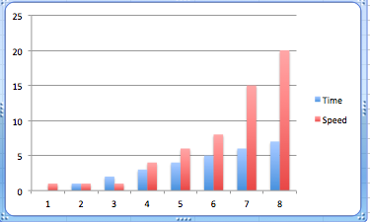
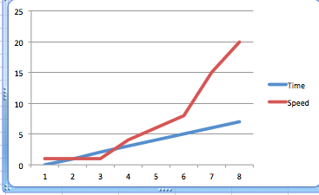
Table controller
Table view
Data
Chart controller
Chart view
Graph controller
Graph view

Slide 48
Interactive Graph view
Data
Graph controller
User can change data
by manipulating graph

Slide 49
Adding new views is easy!
(Don’t need to change existing code.)
Higgs Boson view
Data
Higgs Boson controller

Slide 50
Table controller
Changing underlying data models does not affect UI.
Table view
Data
Chart controller
Chart view
Graph controller
Graph view

Slide 51
Sudoku
Know initial value, current value,
Solved value, answer questions about
consistency, correctness
GridModel
GridView
Displays current grid
Has clickable cells
NumPadView
ViewController
Mediate between the Views and the GridModel
Displays current numPad
Has clickable cells

Slide 52
UML Diagrams
Communication tools
Include as much detail as needed for your current purpose – and no more
Start with user story and domain diagrams then evolve your design using “responsibilities”
Makes design simpler, more intuitive, and more flexible
Ensures design realizes user stories

Slide 53
Assignment
Revise our design to conform to model view controller (MVC) architecture (produce pdf)
Refactor your code
Support the following scenarios. If the user does anything else, there should be no change.
1
1
Initial grid and number pad appear.
Original entries are black. Current number “1” is highlighted in number pad.
User clicks on number pad cell.
Current number de-highlighted. New number is highlighted.
User clicks on cell. Cell is blank or has user-entered value. Current number is consistent for that cell.
Current number appears in that cell in blue.

