Slide 1
Design principles and patterns

Slide 2
Design Goals
Make it easy to build
Make it easy to test
Make it easy to maintain
Make it easy to change
SIMPLE
INTUITIVE
FLEXIBLE

Slide 3
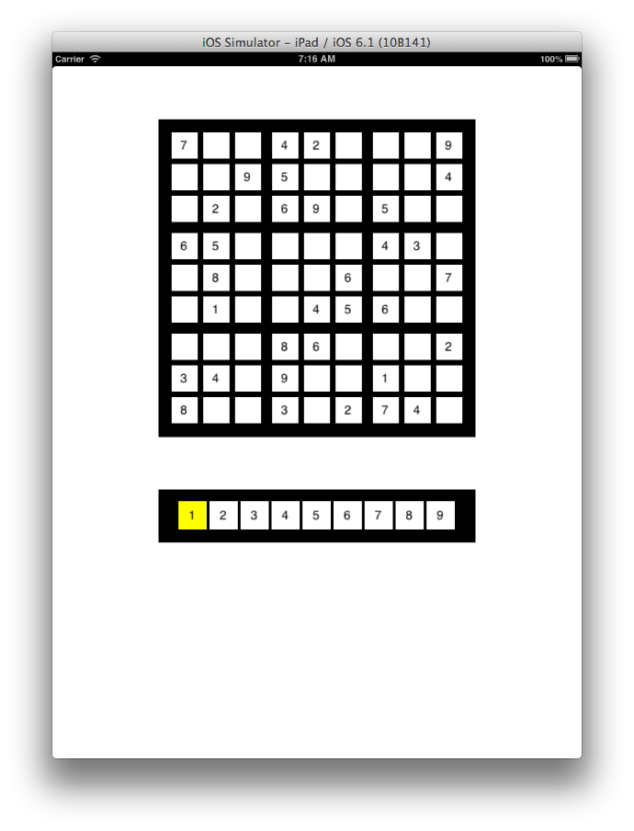
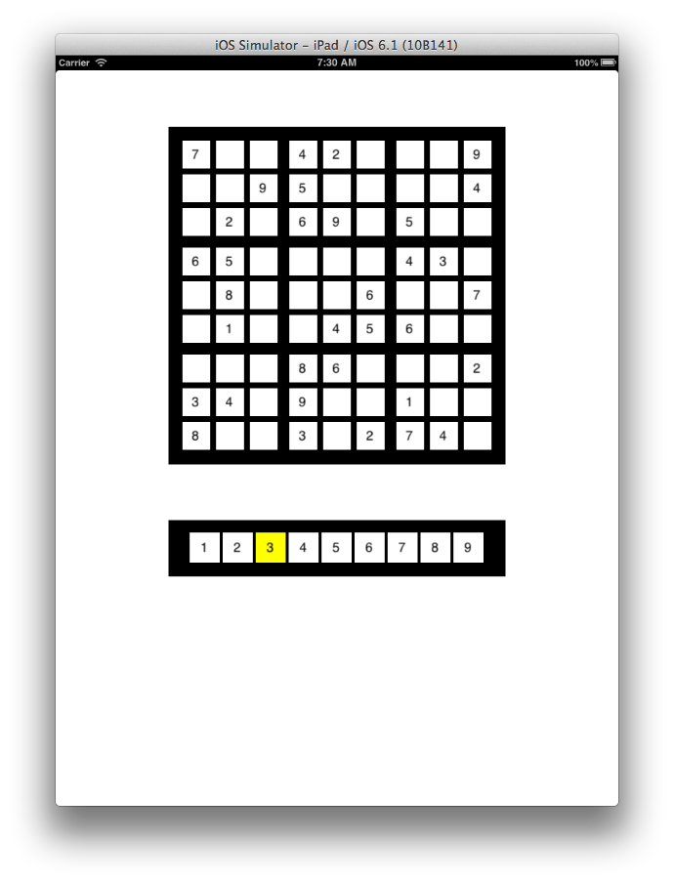
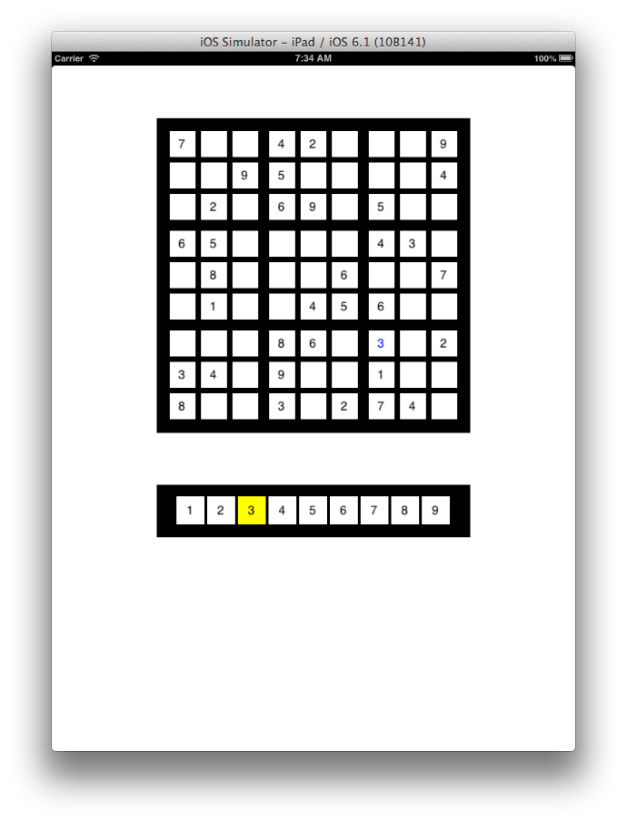
User stories
1
1
Initial grid and number pad appear.
Original entries are black. Current number “1” is highlighted in number pad.
User clicks on number pad cell.
Current number de-highlighted. New number is highlighted.
User clicks on cell. Cell is blank or has user-entered value. Current number is consistent for that cell.
Current number appears in that cell in blue.

Slide 4
Let’s develop this design using good design principles
ViewController
GridModel
GridView
NumPadView

Slide 5
Key design principle
Single responsibility principle:
classes and methods should have a single, focused responsibility.

Slide 6
ViewController
What is the responsibility of this class?
GridModel
GridView
NumPadView
Creates and stores grid values
Answers questions about data e.g. consistency

Slide 7
ViewController
What is the responsibility of this class?
GridModel
GridView
NumPadView
Creates and stores grid values
Answers questions about data e.g. consistency
Creates and stores grid cells (buttons)
Responds to clicks
Updates button titles

Slide 8
ViewController
What is the responsibility of this class?
GridModel
GridView
NumPadView
Creates and stores grid values
Answers questions about data e.g. consistency
Creates and stores grid cells (buttons)
Responds to clicks
Updates button titles
Creates and stores numpad cells (buttons)
Responds to clicks
Controls highlights

Slide 9
Creates model & views
Mediates input
What is the responsibility of this class?
ViewController
GridModel
GridView
NumPadView
Creates and stores grid values
Answers questions about data e.g. consistency
Creates and stores grid cells (buttons)
Responds to clicks
Updates button titles
Creates and stores numpad cells (buttons)
Responds to clicks
Controls highlights

Slide 10
Key design principle
Law of Demeter – or Law of Least Knowledge
Classes should know as little as possible about anything beyond themselves.

Slide 11
Knows about the model and views. Doesn’t know or care about how they do their job.
ViewController
GridModel
GridView
NumPadView
Knows about its data.
Doesn’t know or care about how its data is used.
Knows about its cells.
Doesn’t know or care how what its data “means”, how it is generated or managed
Knows about its cells. Understand when cells are highlighted. Doesn’t know or care about what highlighting “means”.

Slide 12
Key design principles
Classes and methods should have
high cohesion – low coupling
Focused on a single responsibility,
Uniform level of abstraction
Doesn’t know or care about many other classes

Slide 13
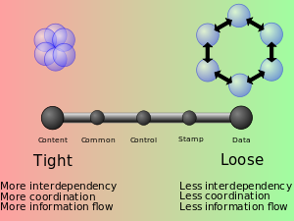
Key design principles
Classes and methods should have
high cohesion – low coupling
Focused on a single responsibility,
Uniform level of abstraction
Doesn’t know or care about many other classes

Slide 14
Initial grid and number pad appear.
Original entries are black. Current number “1” is highlighted in number pad.

Slide 15
Sequence diagram: display
GridModel
ViewController
GridView
NumPadView
initialize
Initialize with frame
Who has initial data?
Initialize with frame
Who needs initial data?

Slide 16
Sequence diagram: display
GridModel
ViewController
GridView
NumPadView
initialize
Initialize with frame
get value at row,column
set value at row,column
What type is value?
Initialize with frame

Slide 17
Sequence diagram: display
GridModel
ViewController
GridView
NumPadView
initialize
Initialize with frame
get value at row,column
set value at row,column
Initialize with frame
Return values are often implicit

Slide 18
Creates model & views
Mediates input
ViewController: UIViewcontroller
GridModel* gridModel
GridView* gridView
NumPadView* numPadView
GridModel: NSObject
int cells[9][9]
(void) generateGrid
(int) getValueAtRow: column
GridView: UIView
NSMutableArray* cells
(void) setValueAtRow: column: to:
NumPadView: UIView
NSMutableArray* cells
Creates and stores grid values
Answers questions about data e.g. consistency
Creates and stores grid cells (buttons)
Responds to clicks
Updates button titles
Creates and stores numpad cells (buttons)
Responds to clicks
Controls highlights

Slide 19
1
1
User clicks on number pad cell.
Current number de-highlighted. New number is highlighted.

Slide 20
NumPadView: UIView
NSMutableArray* cells
UIButton
9

Slide 21
UML Notation
A
B
A has a B
A
B
A has one or more Bs
*
A
B
n
A has a n Bs

Slide 22
NumPadView: UIView
NSMutableArray* cells
(void) cellSelected:
UIButton
addTarget: action:
9
buttonPressed?
buttonTapped?
cellTapped?
cellSelected?
Who should know that numPad cells are buttons?

Slide 23
Law of least knowledge. NumPadView should not reveal implementation details. ViewController should not care about implementation details.
Creates model & views
Mediates input
ViewController: UIViewcontroller
GridModel* gridModel
GridView* gridView
NumPadView* numPadView
GridModel: NSObject
int cells[9][9]
(void) generateGrid
(int) getValueAtRow: column
GridView: UIView
NSMutableArray* cells
(void) setValueAtRow: column: to:
NumPadView: UIView
NSMutableArray* cells
Creates and stores grid values
Answers questions about data e.g. consistency
Creates and stores grid cells (buttons)
Responds to clicks
Updates button titles
Creates and stores numpad cells (buttons)
Responds to clicks
Controls highlights

Slide 24
NumPadView: UIView
NSMutableArray* cells
(void) cellSelected:
UIButton
addTarget: action:
9
buttonPressed?
buttonTapped?
cellTapped?
cellSelected?
I chose this!
Who should know that numPad cells are buttons?

Slide 25
Design principle
INTUITIVE
Use real world objects
Is a number pad a collection of buttons?
Is a sudoko grid a collection of buttons?

Slide 26
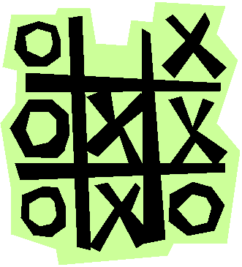
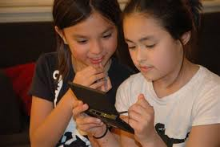
Design principle
INTUITIVE
Use real world objects
Domain
model
Design
model

Slide 27
NumPadView: UIView
NSMutableArray* cells
(void) cellSelected:
UIButton
addTarget: action:
9
buttonPressed?
buttonTapped?
cellTapped?
cellSelected?
I chose this!
Who should know that numPad cells are buttons?

Slide 28
Sequence diagram: numPad cell tapped
NumPadView
UIButton
cellSelected
setBackgroundColor to white (old cell)
setBackgroundColor to yellow (new cell)

Slide 29
Creates model & views
Mediates input
ViewController: UIViewcontroller
GridModel* gridModel
GridView* gridView
NumPadView* numPadView
GridModel: NSObject
int cells[9][9]
(void) generateGrid
(int) getValueAtRow: column
GridView: UIView
NSMutableArray* cells
(void) setValueAtRow: column: to:
NumPadView: UIView
NSMutableArray* cells
Int currentValue
(void) cellSelected:
Creates and stores grid values
Answers questions about data e.g. consistency
Creates and stores grid cells (buttons)
Responds to clicks
Updates button titles
Creates and stores numpad cells (buttons)
Responds to clicks
Controls highlights

Slide 30
User clicks on cell. Cell is blank or has user-entered value. Current number is consistent for that cell.
Current number appears in that cell in blue.

Slide 31
GridView: UIView
NSMutableArray* cells
(void) setValueAtRow: column: to:
(void) cellSelected
UIButton
addTarget: action
9x9

Slide 32
Sequence diagram: gridCell tapped
GridView
UIButton
cellSelected
GridView: now what?

Slide 33
Sequence diagram: gridCell tapped
ViewController
GridView
UIButton
cellSelected
cell Selected

Slide 34
Sequence diagram: gridCell tapped
GridModel
ViewController
GridView
UIButton
NumPadView
cellSelected
cell Selected
Check if cell mutable
Cell is mutable
Get current value
Current value is m
Check if value m consistent
Value m is consistent

Slide 35
Sequence diagram: gridCell tapped
GridModel
ViewController
GridView
UIButton
NumPadView
cellSelected
cell Selected
Check if cell mutable
Cell is mutable
Get current value
Current value is m
Check if value m consistent
Value m is consistent
Set value to m
Set value to m

Slide 36
Creates model & views
Mediates input
ViewController: UIViewcontroller
GridModel* gridModel
GridView* gridView
NumPadView* numPadView
(void) gridCellSelected:
GridModel: NSObject
int cells[9][9]
(void) generateGrid
(int) getValueAtRow: column
(void) setValueAtRow: column: to:
(bool) isMutableAtRow: column:
(bool) isConsistentAtRow:column:for:
GridView: UIView
NSMutableArray* cells
(void) setValueAtRow: column to:
(void) cellSelected:
NumPadView: UIView
NSMutableArray* cells
Int currentValue
(void) cellSelected:
(int) getCurrentValue:
Creates and stores grid values
Answers questions about data e.g. consistency
Creates and stores grid cells (buttons)
Responds to clicks
Updates button titles
Creates and stores numpad cells (buttons)
Responds to clicks
Controls highlights

Slide 37
Design Goals
Make it easy to build
Make it easy to test
Make it easy to maintain
Make it easy to change
SIMPLE
INTUITIVE
FLEXIBLE

Slide 38
Key design principle
Single responsibility principle:
classes and methods should have a single, focused responsibility.

Slide 39
Coordinates view & model
ViewController: UIViewcontroller
GridModel* gridModel
GridView* gridView
NumPadView* numPadView
(void) gridCellSelected:
GridModel: NSObject
int cells[9][9]
(void) generateGrid
(int) getValueAtRow: column
(void) setValueAtRow: column: to:
(bool) isMutableAtRow: column:
(bool) isConsistentAtRow:column:for:
GridView: UIView
NSMutableArray* cells
(void) setValueAtRow: column to:
(void) cellSelected:
NumPadView: UIView
NSMutableArray* cells
Int currentValue
(void) cellSelected:
(int) getCurrentValue:
Manage grid data
Manage grid cell UI
Manage numPad cell UI

Slide 40
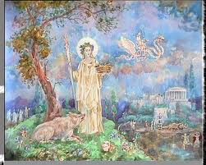
Design principle
Law of Demeter
Principle of Least Knowledge

Slide 41
Knows about its objects but doesn’t know or care about other they do their jobs.
ViewController: UIViewcontroller
GridModel* gridModel
GridView* gridView
NumPadView* numPadView
(void) gridCellSelected:
GridModel: NSObject
int cells[9][9]
(void) generateGrid
(int) getValueAtRow: column
(void) setValueAtRow: column: to:
(bool) isMutableAtRow: column:
(bool) isConsistentAtRow:column:for:
GridView: UIView
NSMutableArray* cells
(void) setValueAtRow: column to:
(void) cellSelected:
NumPadView: UIView
NSMutableArray* cells
Int currentValue
(void) cellSelected:
(int) getCurrentValue:
Knows about its data.
Doesn’t know or care about how its data is used.
Knows about its cells.
Doesn’t know or care about how clicks are handled other than to pass the message along.
Knows about its cells and current value.
Doesn’t know or care about how current value is used.

Slide 42
Key design principles
Classes should have
high cohesion – low coupling
Focused on a single responsibility
Doesn’t know about, care about, depend on too many other classes

Slide 43
Knows about its objects: gridModel, gridView, numPadView
But doesn’t know or care about how they do their job.
ViewController: UIViewcontroller
GridModel* gridModel
GridView* gridView
NumPadView* numPadView
(void) gridCellSelected:
GridModel: NSObject
int cells[9][9]
(void) generateGrid
(int) getValueAtRow: column
(void) setValueAtRow: column: to:
(bool) isMutableAtRow: column:
(bool) isConsistentAtRow:column:for:
GridView: UIView
NSMutableArray* cells
(void) setValueAtRow: column to:
(void) cellSelected:
NumPadView: UIView
NSMutableArray* cells
Int currentValue
(void) cellSelected:
(int) getCurrentValue:
Knows about its data.
Doesn’t know or care about how its data is used.
Knows about its cells.
Doesn’t know or care about how clicks are handled other than to pass the message along.
Knows about its cells and current value.
Doesn’t know or care about how current value is used.

Slide 44
Design principle
INTUITIVE
Use real world objects
Domain
model
Design
model

Slide 45
Our design often augments domain classes with controller and utilities classes; e.g. viewController
Creates model & views
Mediates input
ViewController: UIViewcontroller
GridModel* gridModel
GridView* gridView
NumPadView* numPadView
(void) gridCellSelected:
GridModel: NSObject
int cells[9][9]
(void) generateGrid
(int) getValueAtRow: column
(void) setValueAtRow: column: to:
(bool) isMutableAtRow: column:
(bool) isConsistentAtRow:column:for:
GridView: UIView
NSMutableArray* cells
(void) setValueAtRow: column to:
(void) cellSelected:
NumPadView: UIView
NSMutableArray* cells
Int currentValue
(void) cellSelected:
(int) getCurrentValue:
Creates and stores grid values
Answers questions about data e.g. consistency
Creates and stores grid cells (buttons)
Responds to clicks
Updates button titles
Creates and stores numpad cells (buttons)
Responds to clicks
Controls highlights

Slide 46
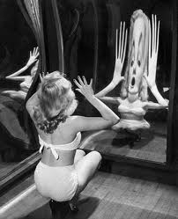
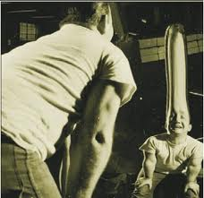
Design principle
SIMPLE, INTUITIVE, FLEXIBLE
Don’t repeat yourself (D.R.Y.)
data/code should occur once and only once

Slide 47
Creates model & views
Mediates input
ViewController: UIViewcontroller
GridModel* gridModel
GridView* gridView
NumPadView* numPadView
(void) gridCellSelected:
GridModel: NSObject
int cells[9][9]
(void) generateGrid
(int) getValueAtRow: column
(void) setValueAtRow: column: to:
(bool) isMutableAtRow: column:
(bool) isConsistentAtRow:column:for:
GridView: UIView
NSMutableArray* cells
(void) setValueAtRow: column to:
(void) cellSelected:
NumPadView: UIView
NSMutableArray* cells
Int currentValue
(void) cellSelected:
(int) getCurrentValue:
Creates and stores grid values
Answers questions about data e.g. consistency
Creates and stores grid cells (buttons)
Responds to clicks
Updates button titles
Creates and stores numpad cells (buttons)
Responds to clicks
Controls highlights

Slide 48
sudokuView: UIView
NSMutableArray* cells
(id) initWithFrame:
Is a
gridView: sudokuView
numPadView: sudokuView
Is this better?

Slide 49
Design principle
Law of Demeter
only talk to your friends
Principle of Least Knowledge
no no no: [gridView.cells getObjectAtIndex: m]

Slide 50
Design Principle
INTUITIVE
SIMPLE
FLEXIBLE

Slide 51
Summary
Single responsibility principle
Law of demeter (talk only to your friends)
High cohesion/low coupling
Use real world objects
Don’t repeat yourself (D.R.Y)

Slide 52
Cs121 motto
UNDER-PROMISE
and
OVER-DELIVER

Slide 53
Sequence diagram: gridCell tapped
GridModel
ViewController
GridView
UIButton
NumPadView
cellSelected
cell Selected
Check if cell mutable
PROBLEM
Cell is mutable
Get current value
Current value is m
Check if value consistent
Value is consistent
Set value to m
Set value to m

Slide 54
Sequence diagram: gridCell tapped
GridView
UIButton
cellSelected
What does a button need to know to identify itself?
Ans. Its row and column.

Slide 55
UIButton
Cell
int row, colum
UIButton
has a
inheritance
isa
composition
Cell
int row, column

Slide 56
Design principle
Favor composition over inheritance to reduce cohesion
A
A
B
has a
inheritance
isa
composition
B
BLACK box reuse
WHITE box reuse

Slide 57
Design principle
Favor composition over inheritance
A
A
B
has a
inheritance
isa
composition
B
Caveat: sometime inheritance is the right thing
(i.e. gives us polymorphism)

Slide 58
Sequence diagram: gridCell tapped
GridView
UIButton
SIMPLE
cellSelected
What does a button need to know to identify itself?
Ans. Its row and column.
We can use the button tag to give each button and identifier. (Map row, column to button id.)

Slide 59
Sequence diagram: gridCell tapped
GridModel
ViewController
GridView
UIButton
NumPadView
cellSelected
cell Selected
Check if cell mutable
PROBLEM
Cell is mutable
Get current value
Current value is m
Check if value consistent
Value is consistent
Set value to m
Set value to m

Slide 60
Sequence diagram: gridCell tapped
GridModel
ViewController
GridView
UIButton
NumPadView
cellSelected
ONE SOLUTION: have buttons report to view controller.
Increases cohesion:
ViewController knows cells are implemented as buttons.
Check if cell mutable
Cell is mutable
Get current value
Current value is m
Check if value consistent
Value is consistent
Set value to m
Set value to m

Slide 61
Another solution:
ViewController
GridView* gridView
GridView
ViewController* viewController
Now GridView has to know about ViewController and its interface

Slide 62
Design Principle
Dependency-inversion principle:
Abstraction should not depend on details, details should depend on abstraction.
Interface should not depend on implementation, implementation should realize interface.

Slide 63
Sequence diagram: gridCell tapped
GridModel
ViewController
GridView
UIButton
NumPadView
cellSelected
cell Selected
Check if cell mutable
This is what we want to do. Can we do it?
Cell is mutable
TARGET-ACTION design pattern
Get current value
Current value is m
Check if value consistent
Value is consistent
Set value to m
Set value to m

Slide 64
Design patterns are good solutions to common problems.

Slide 65
Observer design pattern
Objects A₁, A₂, … A_{n} need to know about B’s state
B
-(void) registerObserver: (id) observer
A
-(void) notify: (id) sender
B notifies all observers when its state changes.
B doesn’t need to know what the A’s are, why they care, or what they do in response.

Slide 66
iOS Observers
iOS has a few ways to implement the observer-like design pattern:
Target-action
Delegation
Notification
UIControl (incl. UIButton) uses target-action

Slide 67
Target-action
GridView
UIButton: UIControl
Button doesn’t know anything about its context. During run-time it is told where to send messages for certain events.
addTarget: action: forUIEvent:
cellSelected

Slide 68
ViewController
GridView
UIButton
setTarget: action:
cellSelected
cell Selected

Slide 69
ViewController: UIViewcontroller
GridModel* gridModel
GridView* gridView
NumPadView* numPadView
(void) gridCellSelected:
GridModel: NSObject
int cells[9][9]
(void) generateGrid
(int) getValueAtRow: column
(void) setValueAtRow: column: to:
(bool) isMutableAtRow: column:
(bool) isConsistentAtRow:column:for:
GridView: UIView
NSMutableArray* cells
(void) setValueAtRow: column to:
(void) cellSelected:
(void) setTarget: action:
NumPadView: UIView
NSMutableArray* cells
Int currentValue
(void) cellSelected:
(int) getCurrentValue:

Slide 70
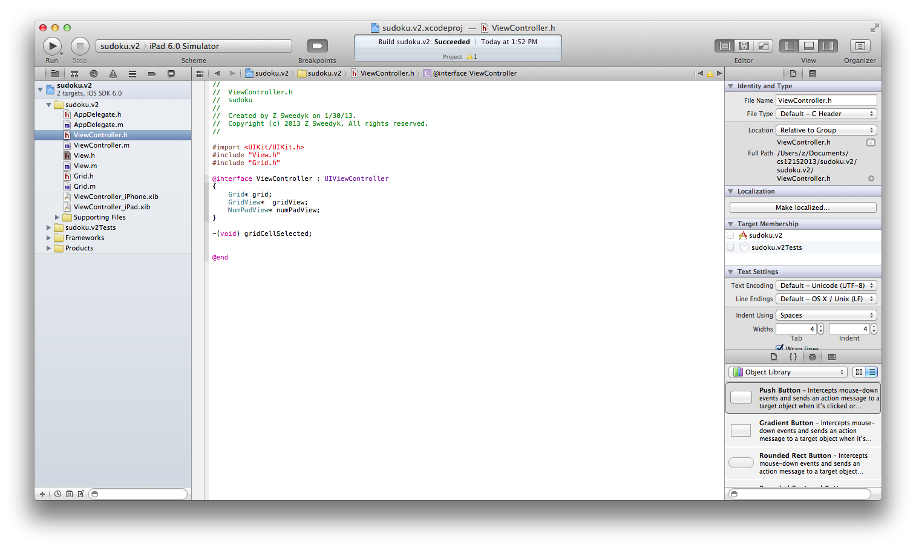
Implementation details
UIViewController has a cellSelected method
(I called my gridCellSelected!)

Slide 71
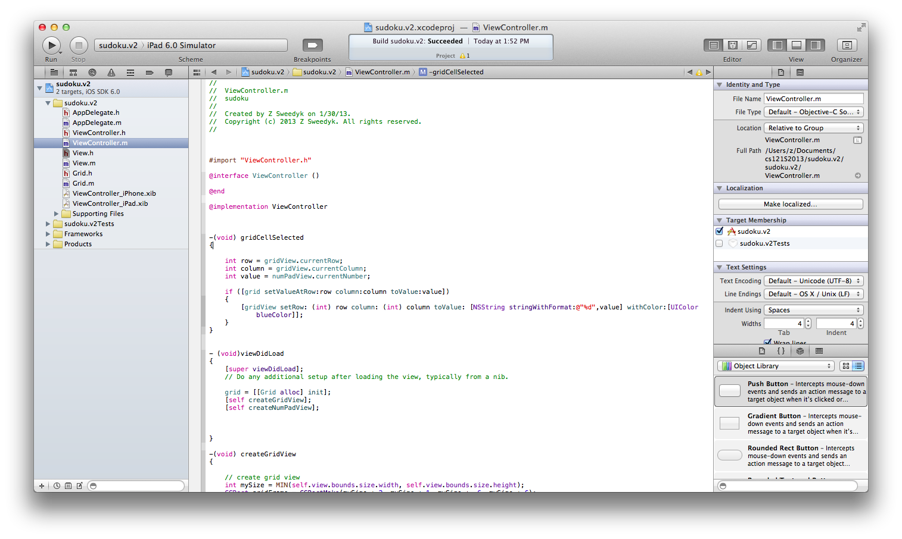
Implementation details
We can pass objects to this method but not ints. I chose to get the current row and column from gridView.

Slide 72
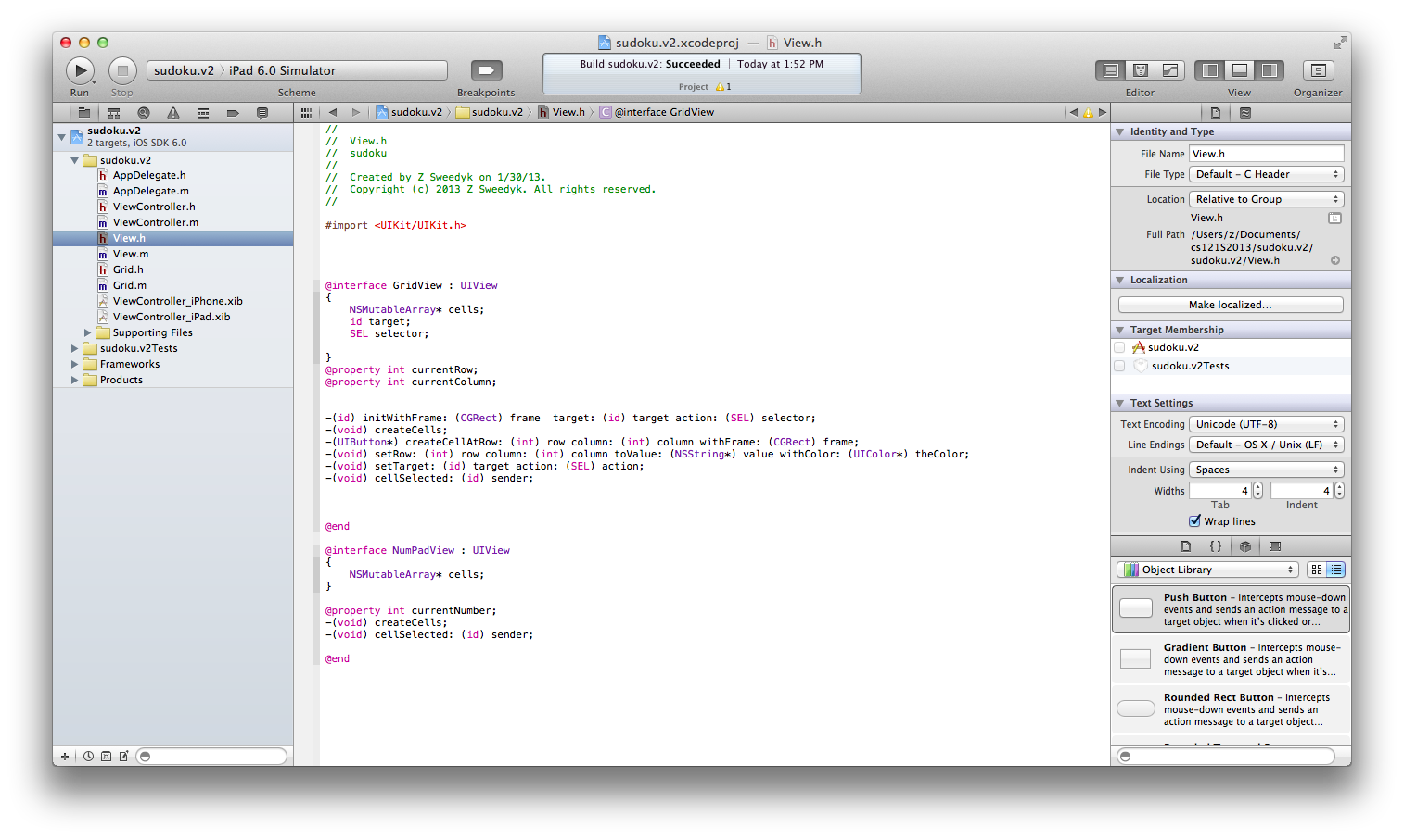
Implementation details
GridView has data members to store the object and selectory to notify when a cell is selected.
GridView has a setTarget: action: method.

Slide 73
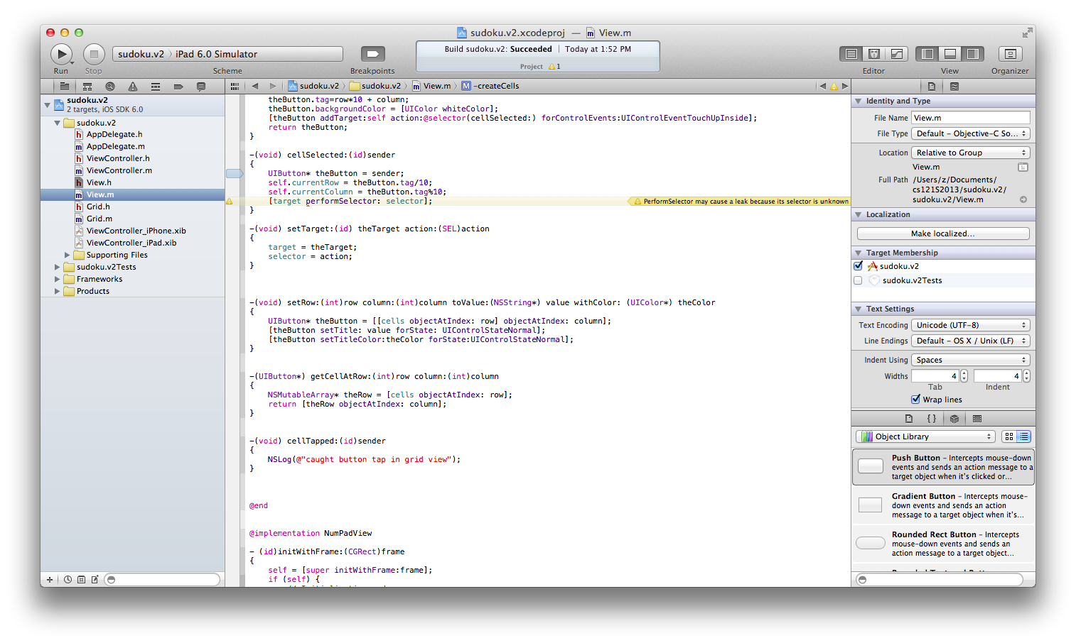
Implementation details
This is the call that notifies the ViewController that a grid cell has been selected.
This is the setTarget:action: method.

Slide 74
More design principles and patterns to come

Slide 75
Summary: design principles
Single responsibility principle
Law of demeter (principle of least knowledge)
High cohesion/low coupling
Use real world objects
Don’t repeat yourself (D.R.Y)
Favor composition over inheritance
Dependency-inversion principle

Slide 76
Summary: design patterns
Observer (Target-Action)

