Slide 1
UI Design & Usability

Slide 2
Usability
Usability is a measure of how easy it is to use a piece of software to perform a task.
To design for usability you need to understand and prioritize the user tasks.

Slide 3
Sudoku tasks
View grid
Select number to enter into grid
Enter selected number into grid
Change user-entered number in grid

Slide 4
From Lab 1: important features
Erase a user-entered number
Undo/redo move
Turn off consistency checking
Error checking
Report when player wins, loses, or can’t enter a number because there are no remaining consistent options
Provide feedback when a cell is pressed (e.g. changing background color or text color while depressed)
Timer
Highlighting all instances of the current number in the grid
Counting how many of any number still need to be placed in grid
Support entry by choosing a grid cell and then the number to be entered
New game
Save/load game
Provide the rules of Sudoku
Provide varying levels of difficulty
Provide some mechanism for entering guesses
Provide hints
What are most important? Let’s vote. Let’s each vote for our top five features.

Slide 5
Usability
Usability is a measure of how easy it is to use a piece of software to perform a task.
To design for usability you need to understand and prioritize the user tasks.
Develop design that is simple, intuitive, consistent, …

Slide 6
Usability Metric
Learnability: How easy is it to learn how to use?
Efficiency: How easy is for users to perform common tasks?
Accuracy: How difficult is it for users to make mistakes? How easy is it to recover from a mistake?
Emotional response: How enjoyable is it to use?

Slide 7

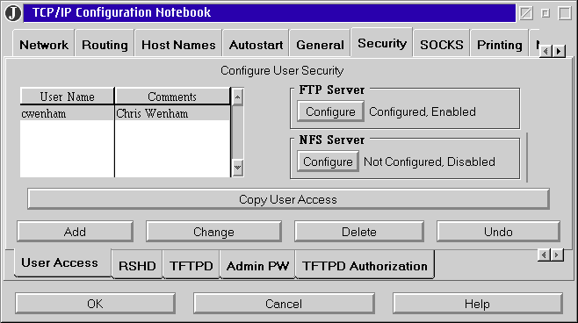
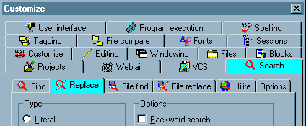
Properties of good design
Simple and convenient
user doesn’t have to remember too much
doesn’t overwhelm user with info
anticipates needs but doesn’t force down path

Slide 8

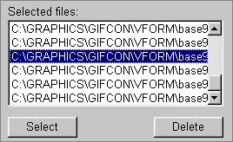
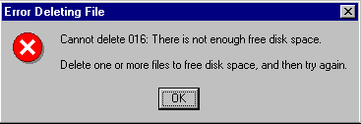
Properties of good design
Intuitive and understandable
current context is clear
available actions obvious
all important information is obvious

Slide 9
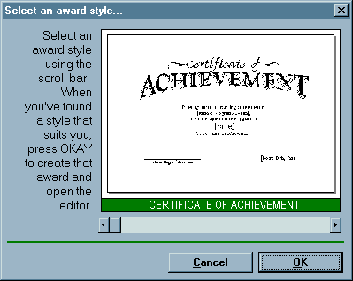
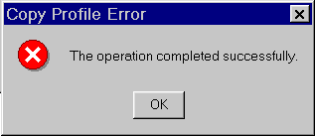
Properties of good design
Familiar and consistent
familiar contexts, objects, actions
consistent icons, positions, styles, metaphors

Slide 10
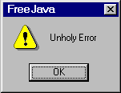
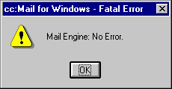
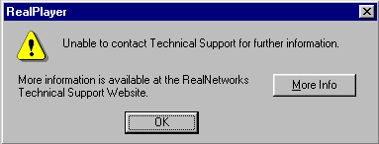
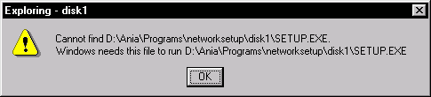
Properties of good design
Helpful and robust
error response meaningful
help when user is lost

Slide 11
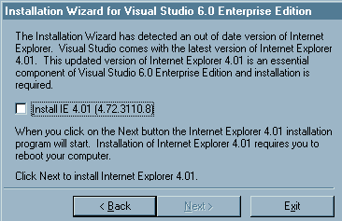
Properties of good design
Adaptable and configurable
supports different users/goals

Slide 12
Apple IOS Usability principles
http://developer.apple.com/library/ios/#documentation/userexperience/conceptual/mobilehig/Introduction/Introduction.html
Aesthetic integrity
Direct manipulation
Immediate Feedback
Metaphor

Slide 13
And then there is
JUICE:
http://www.youtube.com/watch?v=Fy0aCDmgnxg

Slide 14
Usability
Usability is a measure of how easy it is to use a piece of software to perform a task.
To design for usability you need to understand and prioritize the user tasks.
Develop design that is simple, intuitive, consistent, …
Test, refine, test, refine …

Slide 15
Usability test
Assess
Learnability
Efficiency
Accuracy
Emotional response
By asking users to complete tasks with your UI prototype

Slide 16
The intro:
http://www.youtube.com/watch?v=QckIzHC99Xc
Testing a paper prototype:
http://www.youtube.com/watch?v=QckIzHC99Xc

Slide 17
Sudoku beta
Teams of 4: current teams merge
Plan next week of work
Usability testing on Thursday

