Slide 1
Game Project

Slide 2
Game Project
Schedule
Project management
Game design
Customer elicitation

Slide 3
Schedule
Project meetings every Tuesday
Major deliverables:
Alpha
Beta
V!
School visits (tentative)
Customer elicitition: 2/2
Alpha user test: 3/29
Beta user test: 4/19

Slide 4
Game Project
Schedule
Project management
Game design
Customer elicitation

Slide 5
Project management
Trac/git
Work meetings (set times, post to trac)
Tuesday meetings produce
Meeting notes
Status reports
Tickets
Other team meetings produce meeting notes
Individual accountability
Work logs (during week)
Individual status reports (due at start of class on Tuesday)

Slide 6
Trac/git
http://trac.edgewall.org/wiki/TracGuide
http://sixrevisions.com/resources/git-tutorials-beginners/
We have a pro git account that you must use – I need your git id to set up

Slide 7
Project management
Trac/git
Work meetings (set times, post to trac)
Tuesday meetings produce
Meeting notes
Status reports
Tickets
Other team meetings produce meeting notes
Individual accountability
Work logs (during week)
Individual status reports (due at start of class on Tuesday)

Slide 8
Doodle
Create a doodle poll for a typical week
Find common times
Post to trac
Set regular work meeting sessions

Slide 9
Project management
Trac/git
Work meetings (set times, post to trac)
Tuesday meetings produce
Meeting notes
Status reports
Tickets
Other team meetings produce meeting notes
Individual accountability
Work logs (during week)
Individual status reports (due at start of class on Tuesday)

Slide 10
Example of (almost) great meeting notes
Week 9 Meeting Notes
Tuesday, December 4
We started by performing time profiling on our game. Everything looked good!
We then created our survey for the kids on SurveyMonkey in preparation for the user test.
We've tried to get a mix of open-ended questions (which get the most valuable feedback) and radio button-based questions (which are good for evaluating overall performance).
Student X spent a good chunk of time refactoring level functionality into a separate class. However, that task hasn't been too successful, so we're back at square 1 there.
We have decided that we will not refactor level in time for the code freeze. Our reasoning is that we need the game fully functional on Friday for the user test, so we may not have enough time to get a solution to this issue that is elegant enough to be consistent with the rest of our design.
Now, we are at the point where we have to be putting final touches on the game. We don't want to add any major features. Rather, we want to make sure that what we have is as good as possible for the kids come Friday.
Here's what we plan to finish up over the next week:
Student Y will finish up and implement the level 2 art. Everything should work just fine, but this is our first major test of art for multiple levels.
Student Y will attend the user test.
UML is up-to-date, which is awesome.
We will do use cases as a team this weekend.
We are intentionally leaving our weekend workload empty so that we can make any last-minute changes from the kids' feedback.
We will meet next on Thursday at 2:30-ish on Sprague 2nd floor so that we can make sure everything is in order for the user test on Friday.
Describes decisions, plans and rationale for them!
Doesn’t explain the problems with refactoring.

Slide 11
Status report
Progress report
Critique
Risk analysis
Major goals
Task estimation, assignments
Re-groom backlog
Work should be done in pairs, tickets should be issued

Slide 12
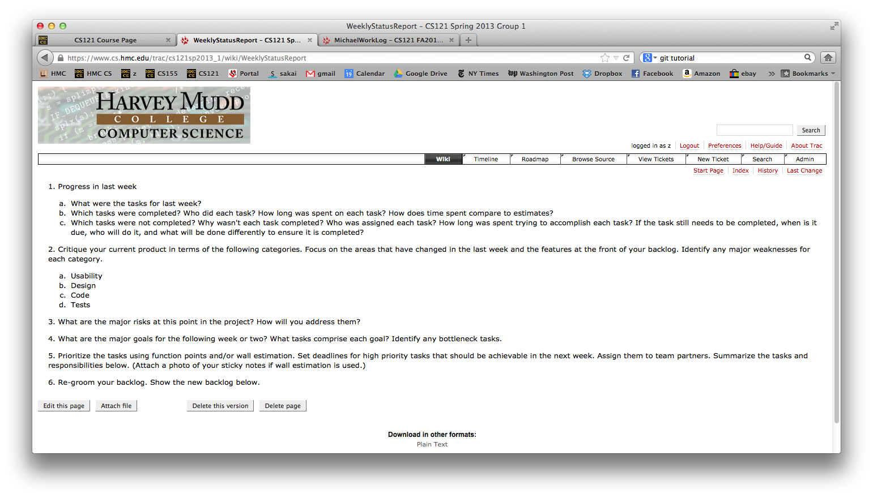

Slide 13
Project management
Trac/git
Work meetings (set times, post to trac)
Tuesday meetings produce
Meeting notes
Status reports
Tickets
Other team meetings produce meeting notes
Individual accountability
Work logs (during week)
Individual status reports (due at start of class on Tuesday)
Trac feature

Slide 14
Project management
Trac/git
Work meetings (set times, post to trac)
Tuesday meetings produce
Meeting notes
Status reports
Tickets
Other team meetings produce meeting notes
Individual accountability
Work logs (during week)
Individual status reports (due at start of class on Tuesday)

Slide 15
Project management
Trac/git
Work meetings (set times, post to trac)
Tuesday meetings produce
Meeting notes
Status reports
Tickets
Other team meetings produce meeting notes
Individual accountability
Work logs (during week)
Individual status reports (due at start of class on Tuesday)

Slide 16
Individual accountability
Work logs
Weekly individual status report

Slide 17
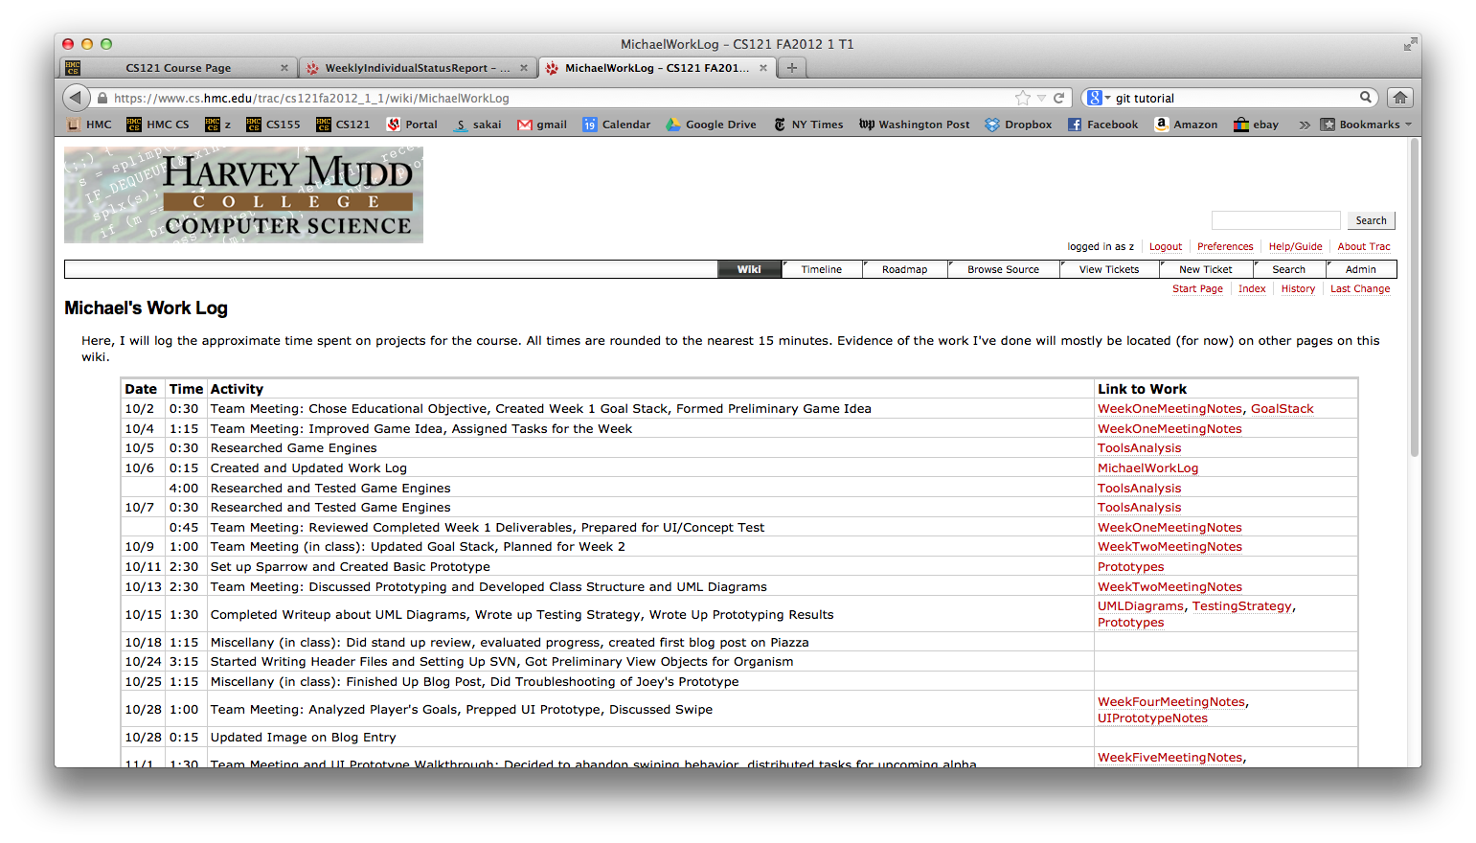

Slide 18
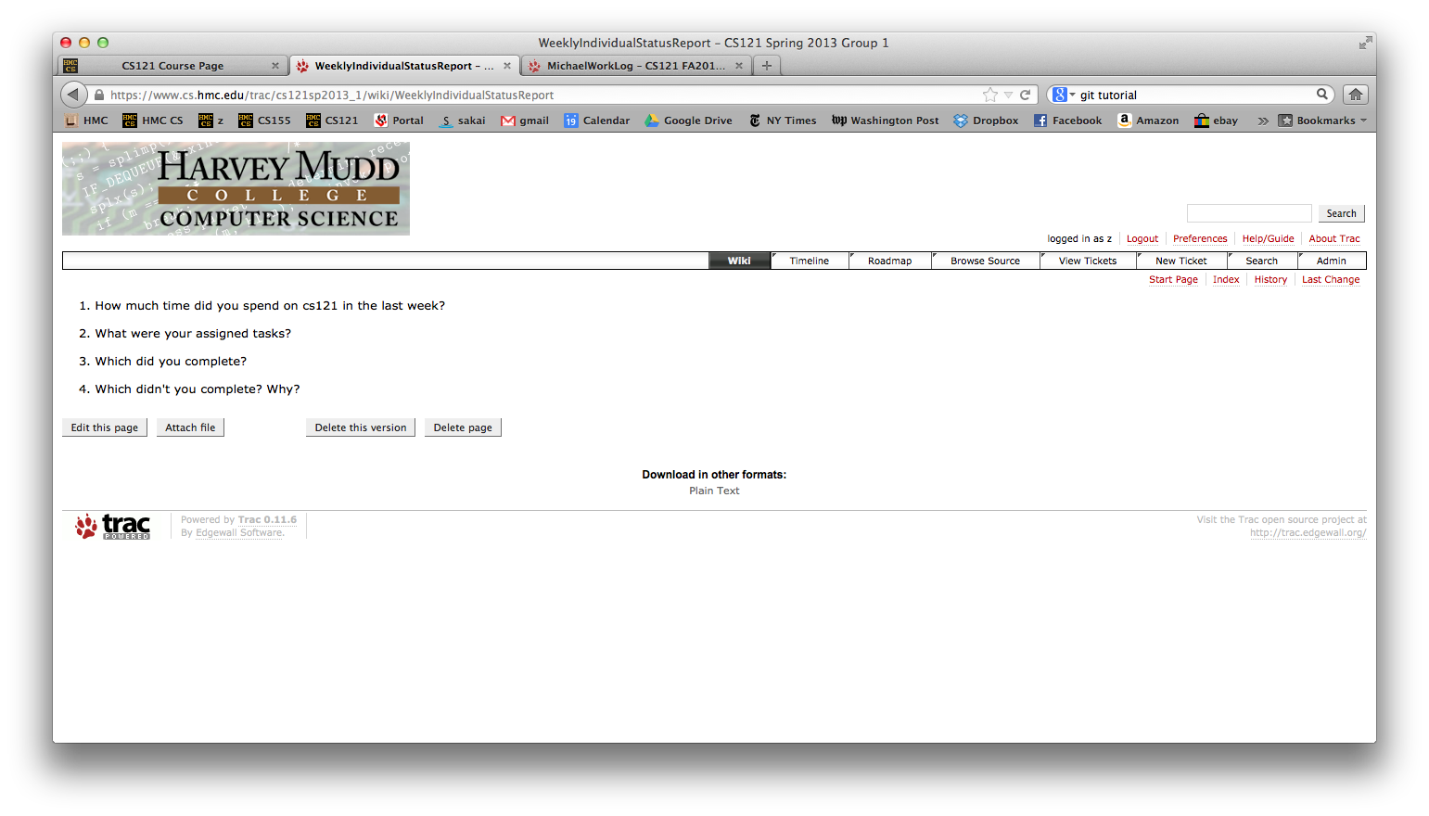

Slide 19
Game Project
Schedule
Project management
Game design
Customer elicitation

Slide 20
Game Design
Math
Look at prior games
Talk to grutors Jane & Mark who worked on fractions last time
Talk to students/teachers about what is hard
Science & Social science
Look at texts
Talk to grutor Michael who worked on food web last time
Talk to students/teachers about what is hard
Physics
Talk to teacher today! Almost now!

Slide 21
Game concept
Define concrete learning objectives
How will game achieve learning objective?
Why will game be fun/engaging?
Model game:
Story boards
Flow charts
User stories
Use cases

Slide 22
Customer elicitation
Open-ended questions on
Students
Learning objectives
Specific questions
How game will be used in curriculum
Logistical constraints
Etc.

