Slide 1
Architecture design review

Slide 2
Software Design/Development
Top down
Sudoku:
Requirement models (e.g. core user stories), domain diagram, MVC
Software
Bottom up
Sudoku:
Tutorials, built “proofs of concepts” (e.g. view, buttons)

Slide 3
Software Design/Development
Top down
Game project:
Requirement models (e.g. core user stories), domain diagram, MVC
Software
You should have started on both of these already
Bottom up
Game project:
Tutorials, built “proofs of concepts” (e.g. view, buttons)

Slide 4
Software Design/Development
Top down
Game project:
Requirement models (e.g. core user stories), domain diagram, MVC
Today I want to talk about …

Slide 5
Top down design
Define “core” game
Develop architectural model

Slide 6
What is core game?
Essential behavior
Resolves high risks
Illustrates gameplay mechanics
Can be implemented for alpha

Slide 7
Defining core game
User stories, use cases, flow chart, story board
Must concretely describe several minutes of gameplay

Slide 8
Architecture
Architecture: system structure
For example:
Client
(browser)
Internet
Server
(application)

Slide 9
Architecture
Architecture: system structure
Views from different levels
Client
(browser)
Internet
Server
(application)
For example:
Web server
Application
Database

Slide 10
Architecture
Architecture: system structure
Views from different levels
Client
(browser)
Internet
Server
(application)
Web server
Application
Database
And:
Model
View
Controller

Slide 11
Architecture
Architecture: system structure
Views from different levels
Style (perspective): means of abstracting a system into independent components that communicate through defined protocols/interfaces

Slide 12
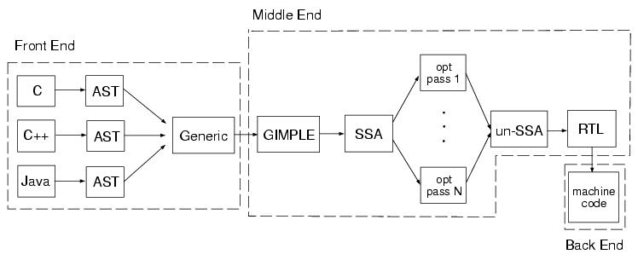
Architecture
Architecture: system structure
Views from different levels
Style (perspective): means of abstracting a system into independent components that communicate through defined protocols/interfaces
Pipes and Filters (GCC)
For example data flow:

Slide 13
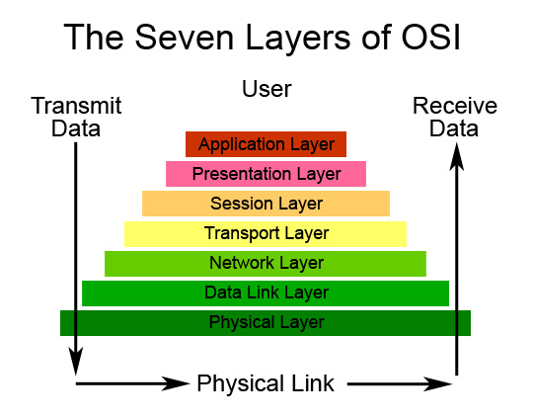
Architecture
Architecture: system structure
Views from different levels
Style perspective: means of abstracting a system into independent components that communicate through defined protocols/interfaces
Layered system (OSI)
Or concerns:

Slide 14
Architecture
Architecture: system structure
Views from different levels
Style: means of abstracting a system into independent components that communicate through defined protocols/interfaces
Or responsibilities:
Object-oriented
Model
View
Controller

Slide 15
Architecture
Architecture: system structure
Views from different levels
Style: means of abstracting a system into independent components that communicate through defined protocols/interfaces
Systems can conform to several architectural styles.

Slide 16
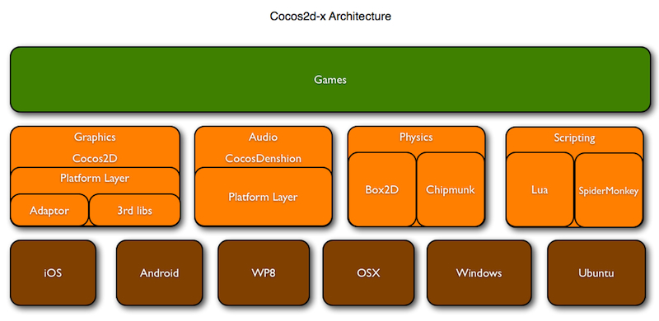

Slide 17
CC Director
Gameplay Scene
Background
Layer
Main
Layer
Controls
Layer
Sprite
Sprite
Sprite
Label

Slide 18
Your architectural model
What are your main classes?
What are their (single) responsibilities?
How do they collaborate to realize your use cases/user stories?

Slide 19
Developing your architectural model
Define core uses cases, user stories
Define domain model
Organize according to MVC
Act out use cases
Lather, rinse, repeat

Slide 20
Architectural Design Review
(next week Thursday)
Design Review Package – due next week Tuesday
For “core” game

Slide 21
Review
What: Have skilled people assess your work
Why: Find problems early

Slide 22
Types of reviews
Requirements review
Architectural review
UI design review
Component design review
Test plan review
Code review

Slide 23
Architectural review
Is it capable of meeting the requirements?
Is it practical to build, test, and support?
Does it satisfy good design principles?

Slide 24
Preparation
Author
(from Team being reviewed)
Moderator
(from team doing review)
Reviewers
(team doing review)
prepare work
products
examine work
products
read package
ready for
review?
study work
products
Y
N
prepare review
package
prepare
comments
schedule review
send out packages

Slide 25
Work products
Requirements models (use cases, user stories, etc.)
Domain model
Class diagram
Class responsibilities
Sequence diagrams
Self-critique/assessment
Etc.

Slide 26
Self-critique/assessment
Architectural Design
Overall assessment: How do you think your proposed architecture measures up against the rubric?
Rationale: What trade-offs did you have to make in the design? What were your key decisions? What is your rationale for your those decisions?
Weaknesses: What are the weaknesses of the design?

Slide 27
Self-critique/assessment
Architectural Design
Feasibility: Why do you think your design is feasible in the alpha timeframe?
Extensibility: Is your design extensible for your full game? In what ways is it? In what ways do your foresee problems?
Testability: Is your design testable? What seems easy to test? What seems hard?

Slide 28
Preparation
Author
(from Team being reviewed)
Moderator
(from team doing review)
Reviewers
(team doing review)
prepare work
products
examine work
products
read package
Process completed before start of class Tuesday 3/5. Author and moderator agree on deadline for work products.
ready for
review?
study work
products
Y
N
prepare review
package
prepare
comments
schedule review
send out packages

Slide 29
Preparation
Author
Moderator
Reviewers
prepare work
products
examine work
products
read package
ready for
review?
study work
products
Y
N
prepare review
package
prepare
comments
In class Tuesday 3/5
schedule review
send out packages

Slide 30
Review package (hyperlinked)
Intro
Agenda
Criteria
Work products
Reviewer assignments

Slide 31
Review package - Intro
Background
  What project are we discussing
  What do reviewers need to know about it
    history, key problems, important decisions, etc.
  Where can reviewers find more info
    requirements, designs, analysis
Goals for review
  specific work products to be reviewed
  scope (what is in/out of bounds)
  what approval means

Slide 32
Review package (hyperlinked)
Intro
Agenda
Criteria
Work products
Reviewer assignments
Agenda: Order materials will be reviewed.

Slide 33
Review package (hyperlinked)
Intro
Agenda
Criteria
Work products
Reviewer assignments
Criteria: I will provide basic rubric. You should augment it for specifics of your project; i.e. what is important for reviewers to look at

Slide 34
Review package (hyperlinked)
Intro
Agenda
Criteria
Work products
Reviewer assignments
What each reviewer is responsible for;
e.g. give each reviewer responsibility for a subset of the classes or subset of use cases.
Do not divide by work product!

Slide 35
Preparation
Author
Moderator
Reviewers
prepare work
products
examine work
products
read package
ready for
review?
study work
products
Y
N
prepare review
package
prepare
comments
The review is next week Thursday!
schedule review
send out packages

Slide 36
Preparation
Author
Moderator
Reviewers
In class Tuesday 3/5
prepare work
products
examine work
products
read package
ready for
review?
study work
products
Y
N
prepare review
package
prepare
comments
schedule review
send out packages

Slide 37
Preparation
Author
Moderator
Reviewers
prepare work
products
examine work
products
read package
ready for
review?
study work
products
Y
N
prepare review
package
prepare
comments
schedule review
send out packages
DESIGN REVIEW

Slide 38
Review process
Moderator
  keeps review moving
  ensures all voices are heard and key points covered
  ensures decisions are made: accepted, major/minor revisions, further review
Recorder
  takes notes, records all issues raised and decisions reached, all questions, suggestions, and action items
  publishes a report of the review

Slide 39
Review process cont.
Reviewers
  Discuss project as detailed in agenda
  Provide expertise on assigned aspect of project
  Raise questions, concerns
Author and design team
  Answers questions but is otherwise silent

Slide 40
Review cont.
Stick to specified level
Avoid re-specifying/designing system
Avoid getting sidetracked

Slide 41
Reviewers Responsibilities
Participate!
Participate!
Participate!
No one reviewer will thoroughly understand everything. But collectively you should. During the discussion you should contribute based on your expertise so that the group can, collectively, assess the work.

