Slide 1
CS155 – Z Sweedyk
Digital Images

Slide 2
Objectives
Color models
Digital images

Slide 3
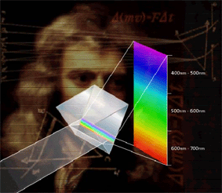
Light

Slide 4
Reflection

Slide 5
Perception

Slide 6
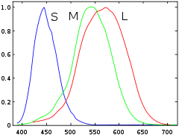
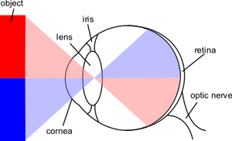
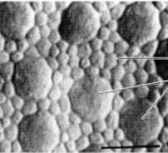
Sensation
cones
rods
You’re a real trichromat!

Slide 7
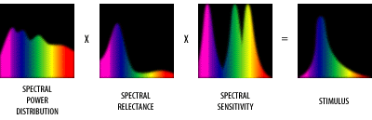
Light, Reflection, Sensation
Color is in the eye of the beholder

Slide 8
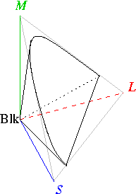
Human vision
Tristimulus color space
3-paramater, additive color models

Slide 9
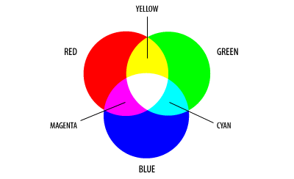
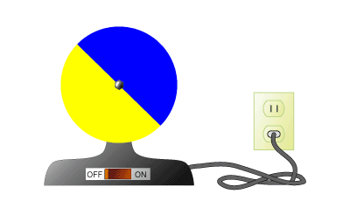
RGB

Slide 10

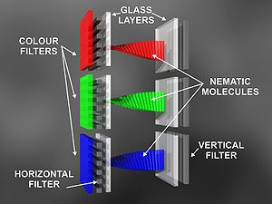
RGB Displays (LCD, CRT)
LCD technology
LCD Display

Slide 11
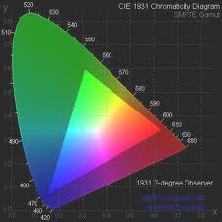
RGB Gamut

Slide 12
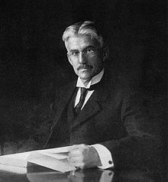
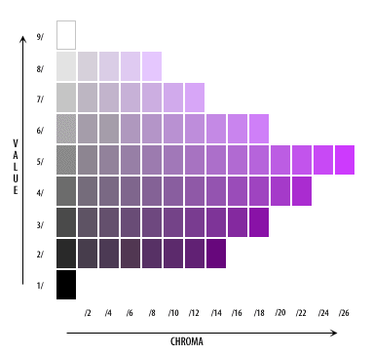
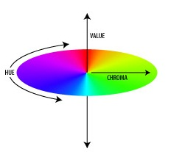
HSV
Henry Albert Munsell 1898
Gamut same as RGB

Slide 13
Models
RGB
HSV
HSB/HLS
CIE
CIEXYZ
CIELUB
CIELAB
We’ll use RGB

Slide 14
Objectives
✓
Color models
Digital images

Slide 15
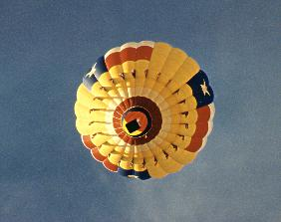
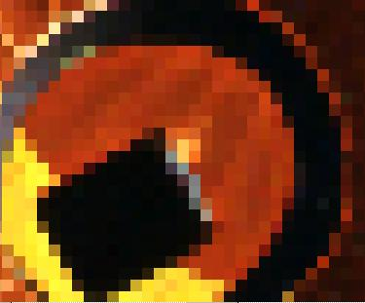
Digital image
A digital image is a rectilinear array of sample values. Each sample is a pixel; i.e. a location and a color value

Slide 16
Digital image fidelity
spatial sampling
color quantization

Slide 17
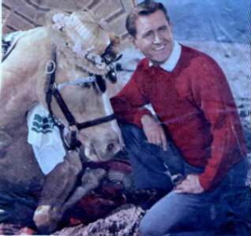
Spatial sampling
• | • | • | •
• | • | • | •
• | • | • | •
• | • | • | •
How closely do our samples have to be to spaced in order to realistically represent a continuous image?

Slide 18
Nyquist criteria
Sample at more than twice the highest frequency to avoid aliasing

Slide 19

Jaggies

Slide 20
Digital image fidelity
spatial sampling
color quantization
✓

Slide 21
Color quantization
bits per pixels
• | • | • | •
• | • | • | •
• | • | • | •
• | • | • | •

Slide 22
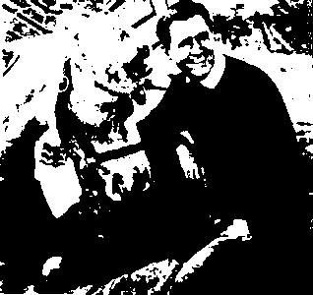
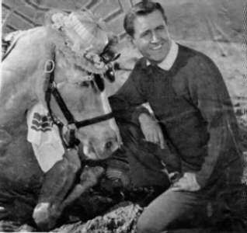
Bits per pixel
1 bit per pixel, grayscale
2¹ = 2 colors
8 bits per pixel, grayscale
2⁸ = 256 colors
24 bits per pixel, RGB
(8 bits per pixel per channel)
2²⁴ colors

Slide 23
cs155 conventions
IMAGE FILES
IMAGE CLASS
DISPLAY DEVICES

Slide 24
cs155 conventions
IMAGE FILES
IMAGE CLASS
DISPLAY DEVICES
24 bit bmp/no compression

Slide 25
bmp files
file header
info header
optional palette
image data

Slide 26
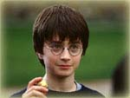
harry24.bmp
bfType: 4d42 Magic number
bfSize: 51130 File size
bfReserved1:0
bfReserved2:0
bfOffBits: 54 Offset to image data
file header
info header
optional palette
image data

Slide 27

harry24.bmp
Size: 40 Size of header (always 40 bytes)
Width: 150 Image width in pixels
Height: 113 Image height in pixels
Planes: 1
BitCount: 24 Bits per pixel
Compression: 0 0= no compression
SizeImage: 16950 Size of image in pixels
etc.
file header
info header
optional palette
image data

Slide 28
harry24.bmp
file header
info header
optional palette
image data
None
24bit RGB

Slide 29
harry24.bmp image data
R_{i,0} | G_{i,0} | B_{i,0} | ... | R_{i,width-1} | G_{i,width-1} | B_{i,width-1} | padding
R_{i+1,0} | G_{i+1,0} | B_{i+1,0} | ... | R_{i+1,width-1} | G_{i+1,width-1} | B_{i+1,width-1} | padding
row i
row i+1

Slide 30
cs155 conventions
IMAGE FILES
IMAGE CLASS
DISPLAY DEVICES
Support RGB, 8 bits per channel

Slide 31
Color values: 8 bit
Option 0: 0, 1, 2, ..., 254,255
Option 1: 0, 1/255, 2/255, ... , 254/255, 1
we use this convention

Slide 32
Objectives
✓
Color models: RGB, HSV
Digital images: bmp file format, cs155 image class conventions
✓

Slide 33
Next
Project 1

