Slide 1
cs155 – z sweedyk
Digital image processing I

Slide 2
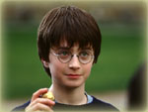
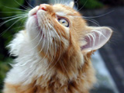
digital image processing
input image
ip algorithm
output image

Slide 3
digital image processing
avoid/correct errors
restore
enhance
analyze
synthesize

Slide 4
types of techniques
simple pixel modification
interpolation/extrapolation
compositing
convolution
dithering
warping
morphing
misc. effects
today

Slide 5
simple pixel modification
f:[0,1]³ -> [0,1]³
input image
output image
 | v
 | f(v)
apply function f to each pixel of input image

Slide 6

threshold
User inputs threshold T ε [0,1]
k bits per pixel per channel
1 bit per pixel per channel
pixel: (r,g,b)
pixel: (r’,g’,b’)
r’=0 if r≤T r’=1 else
etc.

Slide 7
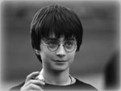
convert to gray
pixel (r,g,b)
pixel (r’,g’,b’)
r’=c_{r}•r + c_{g} • g + c_{b} • b g’=c_{r}•r + c_{g} • g + c_{b} • b b’=c_{r}•r + c_{g} • g + c_{b} • b

Slide 8
convert to gray
grey value: c_{r}•r + c_{g} • g + c_{b} • b
c_{r} = .2126, c_{g} = .7152, c_{b} = .0722

Slide 9


invert
pixel (r,g,b)
pixel (r’,g’,b’)
r’=1-r
etc.

Slide 10


brighten/darken
User inputs ____
pixel (r,g,b)
pixel (r’,g’,b’)

Slide 11
types of techniques for today
✓
simple pixel modification
interpolation/extrapolation
compositing
convolution

Slide 12
interpolation/extrapolation
input α
note: all images have same dimensions and bits per pixel
 | v
input image I₀
 | αv + (1-α)w
 | w
input image I₁
output image

Slide 13

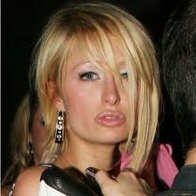
Interpolation example
α=0
α=1
interpolation:
α(paris)+(1-α)(geoff)
α=.5
not appropriate for polite company

Slide 14
Interpolation: α in [0,1]
output image αI₀ + (1-α)I₁
input image I₀
interpolation blends I₀ and I₁
input image I₁

Slide 15
Extrapolation: α < 0 or α > 1
output image aI₀ + (1-a)I₁
input image I₀
?
input image I₁

Slide 16
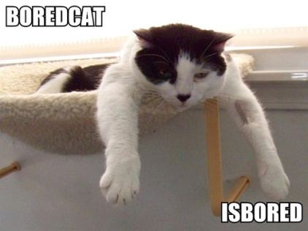
Extrapolation: α <0
output image αI₀ + (1-α)I₁
input image I₀
ho hum
input image I₁

Slide 17
Extrapolation: α > 1
extrapolation with α>1 creates an image that moves I₀ away from I₁
output image αI₀ + (1-α)I₁
input image I₀
whatever
input image I₁

Slide 18

Interpolation/extrapolation
We can use interpolation/extrapolation to brighten/darken

Slide 19


change contrast
What happens in the extreme?

Slide 20
Change contrast
output image αI₀ + (1-α)I₁
input image I₀
?
input image I₁
constant gray image with avg. intensity of I₀

Slide 21


change saturation

Slide 22
decrease
What happens in the extreme?
saturation
contrast

Slide 23
Change the saturation
output image αI₀ + (1-α)I₁
input image I₀
?
input image I₁
Grayscale version of I₀

Slide 24
Invert
output image αI₀ + (1-α)I₁
input image I₀
?
hint 1: I₁ is a constant gray image
hint 2: α is constant
input image I₁

Slide 25
a little computation
interpolate/extrapolate:
f(v) = αv + (1-α)x
invert: f(v)=1-v
What should α and x be?
v is color of pixel in I₀
x is color of pixel in I₁
α=-1 and x=1/2

Slide 26
interpolation/extrapolation
blend
brighten/darken
change contrast
change saturation
noisify
invert

Slide 27
type of techniques for today
✓
simple pixel modification
interpolation/extrapolation
compositing
convolution
✓

Slide 28
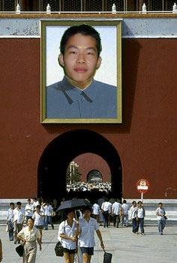
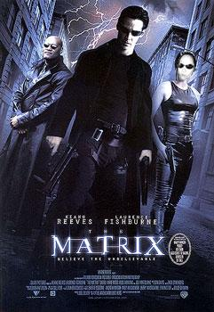
compositing
Steve Yan
Joanna Wu

Slide 29
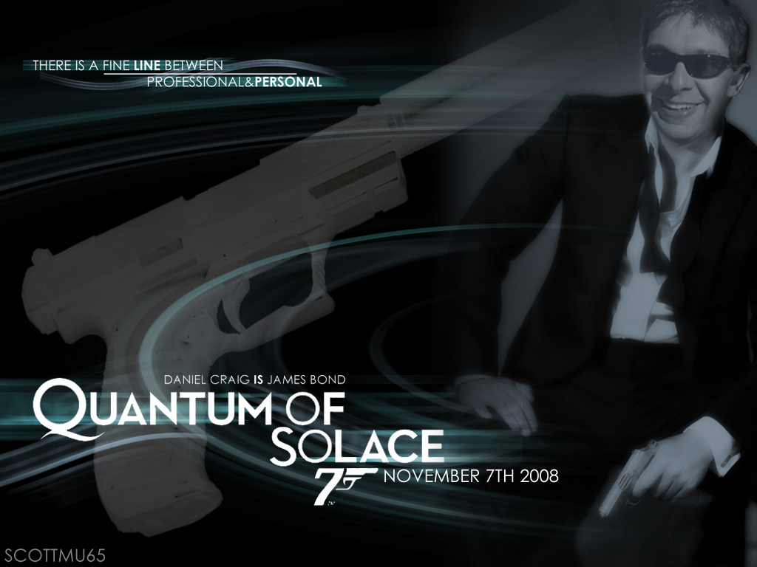
More composites
Shawn Wallace

Slide 30
compositing
generalization of interpolation in which a varies depending on pixel location
 | v
 | α_{ij} v + (1-α_{ij})w
 | w

Slide 31
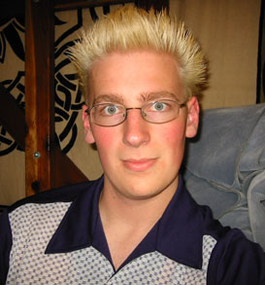
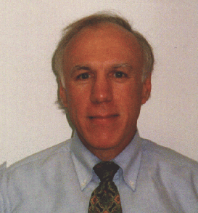
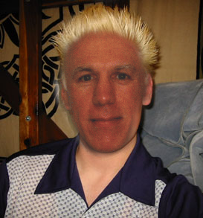

compositing
typically α ∈ [0,1] so the array of α values can represented by a single channel image called a mask

Slide 32
type of techniques for today
✓
simple pixel modification
interpolation/extrapolation
compositing
convolution
✓
✓

Slide 33
convolution
v’ is a weighted sum of v and its neighbors
input
output
 |  | v
 |  | v’

Slide 34
weights given by “kernel"
w_{-i,-i} |  | w_{-i,i}
w_{-i,i} |  | w_{i,i}
…
…
…
…

Slide 35
convolution
w_{-1,-1} | w_{0,-1} | w_{1,-1}
w_{-1,0} | w_{0,0} | w_{1,0}
w_{-1,1} | w_{0,1} | w_{1,1}
 | v_{-1,-1} | v_{0,-1} | v_{1,-1}
 | v_{-1,0} | v_{0,0} | v_{0,1}
 | v_{-1,1} | v_{0,1} | v_{1,1}
 |  | Σw_{ij}v_{ij}

Slide 36
boundaries?

Slide 37
____________ kernel
-1 | -1 | -1
-1 | 8 | -1
-1 | -1 | -1

Slide 38

edge detect
-1 | -1 | -1
-1 | 8 | -1
-1 | -1 | -1

Slide 39
_________kernel
1/9 | 1/9 | 1/9
1/9 | 1/9 | 1/9
1/9 | 1/9 | 1/9

Slide 40

blur kernel
1/9 | 1/9 | 1/9
1/9 | 1/9 | 1/9
1/9 | 1/9 | 1/9
3x3 blox blur kernel
why blur?

Slide 41


jaggies

Slide 42
5x5 box blur
What values should we use?

Slide 43
nXn box blur
…
w |  | w
w |  | w
…
…
w=1/n²
…
why is it important that the sum of the weights is 1?

Slide 44



box, triangle and guassian blurs

Slide 45
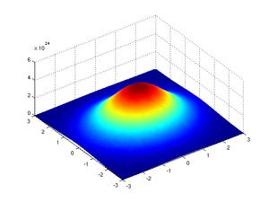
Gaussian blur
Kernel is based on 2d Gaussian function
3x3 Example
G(-1,-1)
G(0,-1)
G(1,-1)
G(-1,0)
G(0,0)
G(1,0)
G(-1,1)
G(0,1)
G(1,1)
G(i,j) = e^{-(i2} ⁺ ^{j2)/2σ2}

Slide 46
Gaussian blur
Kernel is based on 2d Gaussian function
3x3 Example
G(-1,-1)
G(0,-1)
G(1,-1)
G(-1,0)
G(0,0)
G(1,0)
G(-1,1)
G(0,1)
G(1,1)
σ is a parameter that determines how quickly the function falls off
G(i,j) = e^{-(i2} ⁺ ^{j2)/2σ2}
ANY PROBLEMS?

Slide 47
Normalize: B=Σ G(i,j)
G(-1,-1)/B
G(0,-1)/B
G(1,-1)/B
G(-1,0)/B
G(0,0)/B
G(1,0)/B
G(-1,1)/B
G(0,1)/B
G(1,1)/B

Slide 48
Summary
Interpolation/Extrapolation
Used to change brightness, contrast, saturation, to negate, to noisify, …
Convolution
Used to edge detect, blur …
Composite
Used to synthesize new images from old

Slide 49

Next time
Warping
Dithering
Now: implementation details

Slide 50
threshold
User inputs threshold T ε [0,1]
k bits per pixel per channel
1 bit per pixel per channel
pixel: (r,g,b)
pixel: (r’,g’,b’)
r’=0 if r≤T r’=1 else
etc.

Slide 51
threshold pseudo code
Image* threshold(Image* I, float T)

Slide 52
threshold pseudo code
Image* threshold(Image* I, float T)
# Create image I’ that has the same dimensions as I and 1 bit per pixel
Image constructor takes width, height, bits per pixel per channel
accessor functions:
I->getWidth()
I-getHeight()

Slide 53
threshold pseudo code
Image* threshold(Image* I,float T)
#Create image I’ that has the same dimensions as I and 1 bit per pixel
for each pixel (i,j)
# get (r,g,b) values of pixel (i,j) in I
# compute (r’,g’,b’)
# set pixel (i,j) in output image to (r’,g’, b’)
accessor functions:
I->getPixel(i,j)
I’->setPixel(i,j,newPixel)

Slide 54
threshold pseudo code
Image* threshold(Image* I, float T)
# Create image I’ that has the same dimensions as I and 1 bit per pixel
for each pixel (i,j) in I
# get (r,g,b) values of pixel (i,j) in I
# compute thresholded values (r’,g’,b’)
# set pixel (i,j) in output image
#Return ptr to I’
We take care of memory management!

Slide 55
color values
Wait!
n bits per pixel per channel
setPixel chooses the closest admissible value provided you give it values in [0,1]
0, 1, 2, ..., 2^{n} – 1
0, 1/(2^{n}-1), 2/(2^{n}-1), ... , 1
we use this convention
Is c_{r}•r + c_{g} • g + c_{b} • b a valid color?

Slide 56
brighten
User inputs α>1
pixel (r’,g’,b’)
r’=αr
etc.
pixel (r,g,b)
Image class chooses closest admissible value provided it is between 0 and 1! If outside [0,1] #@!&
clamp to [0,1], there is a built in clamp function

Slide 57



Project 1

