Slide 1
cs155 – z sweedyk
digital image processing

Slide 2
types of techniques
simple pixel modification
interpolation/extrapolation
compositing
convolution
dithering
warping
misc. effects
morphing

Slide 3
morphing
morphVideo

Slide 4
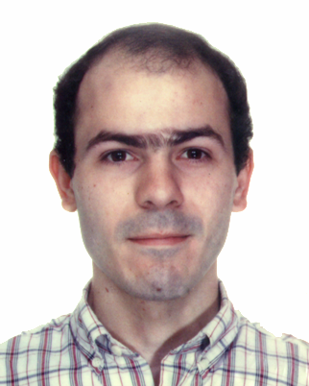
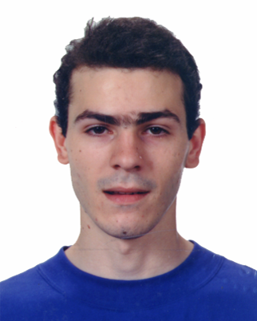
Morphing
transform image 1 into image 2

Slide 5
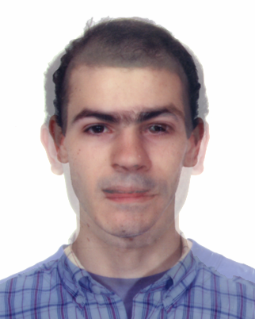
Blending
αI₀+(1-αI₁
α
1
0
t
t₀
t₁

Slide 6
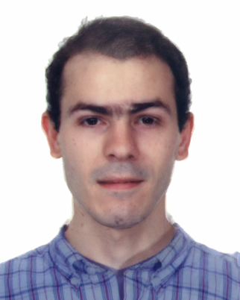
Blend
Morph=Warp+Blend

Slide 7
Morph = Warp + Blend
Warp features

Slide 8
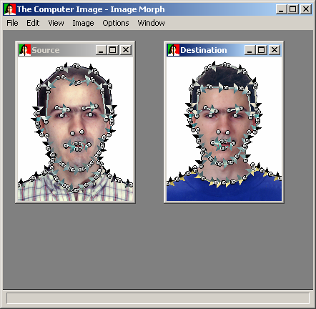
specifying the warp
matching directed line segments

Slide 9
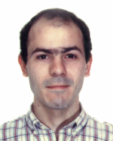
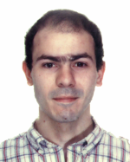
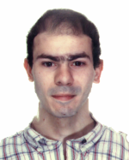
0%
50%
100%
warp 1

Slide 10



warp 2
100%
50%
0%

Slide 11
blend: α(t), output = α(t)I₀ + (1-α(t))I₁
a=1
a=.5
a=0

Slide 12
50%

Slide 13
computing the warps

Slide 14
computing the warps: one feature
image 1
features specified by directed line segments
image 2

Slide 15
feature moves in time
0%
50%
100%
Interpolate endpoints

Slide 16
computing warped image
source
warped image

Slide 17
computing warped image at p
p
source
warped image

Slide 18
computing warped image at p
p
source
warped image

Slide 19
computing warped image at p
u is fraction along line containing feature (tail=0, head=1)
v is distance to line containing feature
u
v
p
source
warped image

Slide 20
computing warped image at p
u is fraction along line containing feature (tail=0, head=1)
v is distance to line containing feature
u
u’
v
p’
v
p
source
warped image

Slide 21
computing the warps: multiple feature
image 1
features specified by directed line segments
image 2

Slide 22
features move in time
0%
50%
100%
Interpolate endpoints

Slide 23
Computing the warped image
compute p’ for each feature using one-feature algorithm
p’₁
p
source
destination

Slide 24
Computing the warped image
compute p’ for each feature using one-feature algorithm
p
p’₂
source
destination

Slide 25
Computing the warped image
take weighted average
p’
p
source
destination

Slide 26
Computing the warped image
compute p’ for each feature using one feature algorithm
take weighted average
p’
p
source
destination

Slide 27
Lab today
Morphing lab: construct features for class morph film

