Slide 1
OpenGL tricks

Slide 2
transparency
reflections
mirror
shadows
billboards
textures
bump mapping
Today

Slide 3
OpenGL tricks
There is lots of sample code online for many of the OpenGL tricks. You are not allowed to use any of it unless I give the okay (and I probably won’t).

Slide 4
Mirrors
Mirrors are just reflections!
Reflect about the mirror plane, as opposed to the ground plane!

Slide 5
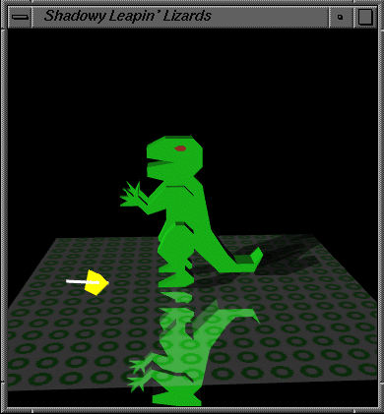
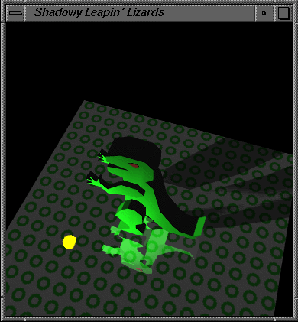
Shadows
Shadows are not reflections!

Slide 6
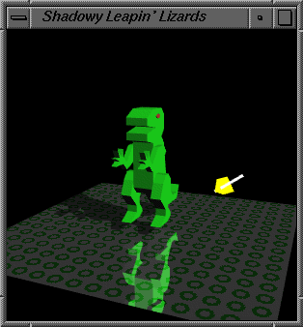
Shadows
Shadows are projections
In our case, the project plane is the ground

Slide 7
Algorithm
Project triangle onto ground plane
Draw projected triangle
Deal with problems!

