Slide 1
Pipeline rendering

Slide 2
Pipeline vs. Ray tracing
OpenGL, DirectX
Pipeline: Fast, low quality
Ray tracing: Slow, high quality
A little clunky by today’s standards

Slide 3

Pipeline
principles
API
(OpenGL)
lecture
labs, proj3, a little lecture
“The Red Book” (online)

Slide 4
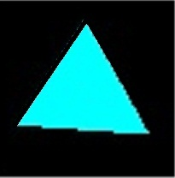
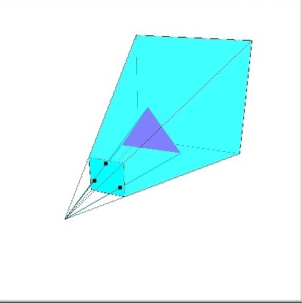
Pipeline rendering overview
Project vertices
Scan convert
Frame buffer
3D world

Slide 5
Scan conversion
Frame buffer
Projected vertices

Slide 6
Scan conversion
For each row of pixels,
find intersection with triangle edges,
switch between pixel off and pixel on

Slide 7
Scan conversion
Color=c₀
Color=c₁
Color=c₂
For each row of pixels,
find intersection with triangle edges,
switch between pixel off and pixel on,
Interpolate color based on vertex color

Slide 8
Scan conversion
Color=c₀
Interpolate c_{L} and c_{R} to find color at pixel
Interpolate c₀ and c₁ to find color=c_{L}
Interpolate c₀ and c₂ to find color=c_{R}
Color=c₁
Color=c₂
For each row of pixels,
find intersection with triangle edges,
switch between pixel off and pixel on

Slide 9
Pipeline rendering overview
Project vertices
Scan convert
Frame buffer
3D world

Slide 10
Projection
3D world
Projected vertices

Slide 11
view volume: frustum
view window
viewpoint
(0,0,0)
+z
frustum centerline aligned with z axis

Slide 12
view volume: frustum
view window
viewpoint
far
(0,0,0)
near
+z
frustum centerline aligned with z axis

Slide 13
Projection on view plane
x,y,z
?, ?,near
(0,0,0)

Slide 14
Projection on view plane
x,y,z
x*near/z, y*near/z,near
(0,0,0)

Slide 15
Pipeline rendering overview
Project vertices
Scan convert
Frame buffer
3D world
HIDDEN SURFACE REMOVAL

Slide 16
Pipeline rendering overview
Project vertices
Scan convert
Frame buffer
3D world
Z-coordinate corresponding to location on the triangle in 3D world (sort of)
Z buffer

Slide 17
Projection on view plane
x,y,z
x*near/z, y*near/z,near
Depth: z
(0,0,0)

Slide 18
Scan conversion
Depth=z₀
Depth=z₁
Depth=z₂

Slide 19
Scan conversion
Depth=z₀
Interpolate z₀ and z₁ to find depth=z_{L}
Interpolate z₀ and z₂ to find depth=z_{R}
Depth=z₁
Depth=z₂

Slide 20
Scan conversion
Depth=z₀
Interpolate z_{L} and z_{R} to find depth=z
Interpolate z₀ and z₁ to find depth=z_{L}
Interpolate z₀ and z₂ to find depth=z_{R}
Depth=z₁
Depth=z₂
If depth is less than what is in the z-buffer write to the frame buffer & the z-buffer, otherwise ignore

Slide 21
Pipeline rendering overview
While rendering the red triangle, only write the pixel to frame buffer if its depth is smaller than what is already in the z buffer.
Project vertices
Scan convert
Frame buffer
3D world
When a pixel is rendered to the frame buffer, update the z buffer accordingly.
Z buffer

Slide 22
Pipeline rendering overview
Project vertices
Scan convert
Frame buffer
3D world
Z buffer

Slide 23
Clipping
Throw this part away

Slide 24
Pipeline rendering overview
Write
1. Project vertices
2. Scan convert
Screen
Frame buffer
3D world
Z buffer

Slide 25
User resize
Window in
Screen

Slide 26
Window in
Screen
Re-size view window and re-render scene

Slide 27
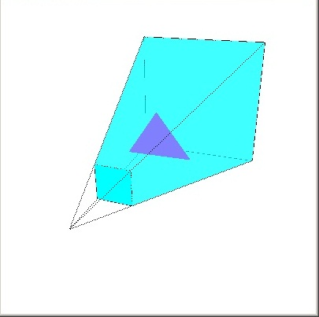
Pipeline rendering overview
Frustum
Resize action
How to map fb to screen
Triangle vertices/colors
project vertices
scan convert
write to screen
When it some time to draw…
…
YOU
Pipeline System

Slide 28
Pipeline
Lab: Now it’s time to look at the API!
principles
API
(OpenGL)
lecture
labs, proj3, a little lecture
“The Red Book” (online)

