Slide 1
cs155 – z sweedyk
ray tracing

Slide 2
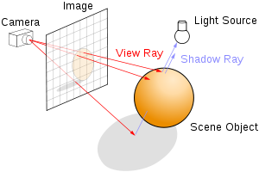
Ray tracing
s
cast ray into scene through pixel
find intersection point (if any)
determine color at intersection
recursively cast rays from intersection point
today

Slide 3
color
color at intersection point depends on
lights in scene
material properties of surface
geometry of lights, viewer, surface
other objects in scene
ray casting
recursive ray tracing

Slide 4

recursive ray tracing
Shadows
Inter-object specular reflection
Transmission through objects with refraction
NEXT TIME

Slide 5
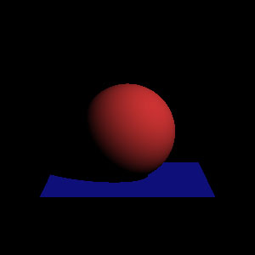
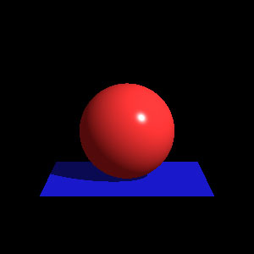
color
color at intersection point depends on
lights in scene
material properties of surface
geometry of lights, viewer, surface
other objects in scene
ray casting
recursive ray tracing

Slide 6
lights
ambient light
directional light
point light
spot light
Hold on for a quick preview of lights

Slide 7

ambient light
uniform from every direction in scene
Ray file specification: #ambient 1.0 1.0 1.0 //ambient light color

Slide 8

directional light
intensity and angle of incidence constant across scene
#light_dir -n DirectionalLight1 --
1.0 1.0 1.0 // color
-1.0 -1.0 -1.0 // direction of light

Slide 9
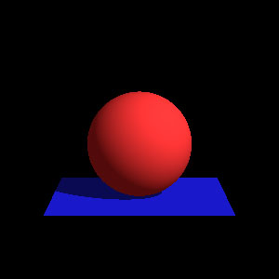
directional light with ambient
Directional light
Directional light with ambient

Slide 10
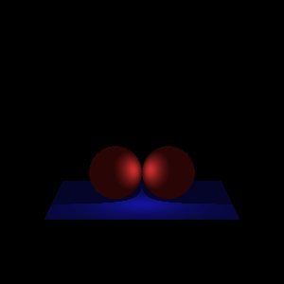

point (or positional) light
light positioned in scene emanates uniformly in all directions; intensity falls off with distance
#light_point -n PointLight1 --
1.0 1.0 1.0 // light color
0.0 0.0 0.0 // light position
1.0 0.5 0.0 //const, linear, quad attenuation

Slide 11
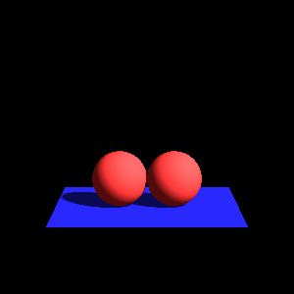
directional vs. point
Directional light
Point light

Slide 12
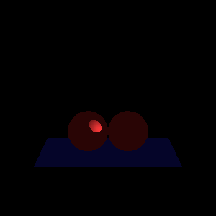
spot light
point light with focused beam
#light_spot -n SpotLight1 --
1.0 1.0 1.0 // light color
-10.0 0.0 0.0 // light position
1.0 0.0 0.0 // center of beam
1.0 0.0 0.0 // const, linear, quad attenuation
20.0 0.0 // cutoff (degrees) dropoff

Slide 13
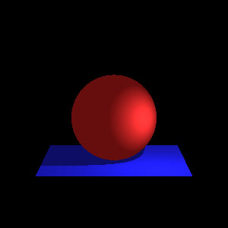
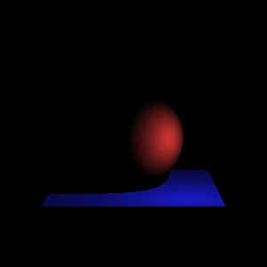

Light comparison (lab)

Slide 14
color
color at intersection point depends on
lights in scene
material properties of surface
geometry of lights, viewer, surface
other objects in scene
ray casting
recursive ray tracing

Slide 15
material properties
ambient response
diffuse response
specular response
Hold on for a quick preview of material properties

Slide 16
ambient response
How does the surface respond to ambient light?
Don’t blame me – it all started with Phong

Slide 17
diffuse reflections
rough/matte surface: light reflects uniformly in all directions
diffuse reflections provide the surface “color”

Slide 18
specular reflections
n
θ
θ
specular reflections provide highlights

Slide 19
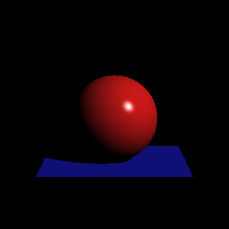
diffuse and specular
diffuse
diffuse and specular

Slide 20
Material spec in ray file
#material -n mShinyRed --
0.0 0.0 0.0 // ambient response
0.8 0.1 0.1 // diffuse response
1.0 1.0 1.0 // specular response
0.0 0.0 0.0 // emission
0.5 0.0 1.0 // kspec ktrans refInd
surface “emits” light
“shininess” in [0,1] – controls specular highlight

Slide 21
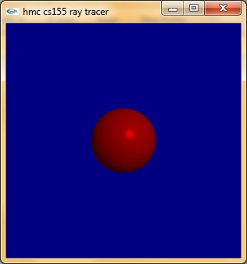
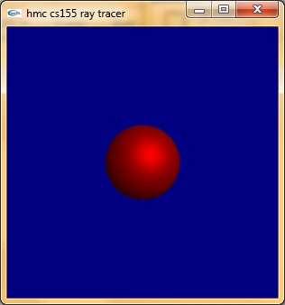
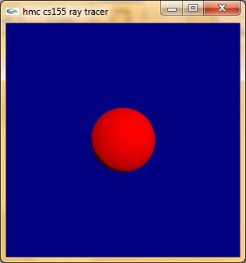
kspec
specular response: .6 0 0
kspec=1
kspec=0

Slide 22
Material spec in ray file
#material -n mShinyRed --
0.0 0.0 0.0 // ambient response
0.8 0.1 0.1 // diffuse response
1.0 1.0 1.0 // specular response
0.0 0.0 0.0 // emission
0.5 0.0 1.0 // kspec ktrans refInd
“transparency”

Slide 23
Material spec in ray file
#material -n mShinyRed --
0.0 0.0 0.0 // ambient response
0.8 0.1 0.1 // diffuse response
1.0 1.0 1.0 // specular response
0.0 0.0 0.0 // emission
0.5 0.0 1.0 // kspec ktrans refInd
“refractive index”

Slide 24
Material spec in ray file
#material -n mShinyRed --
0.0 0.0 0.0 // ambient response
0.8 0.1 0.1 // diffuse response
1.0 1.0 1.0 // specular response
0.0 0.0 0.0 // emission
0.5 0.0 1.0 // kspec ktrans refInd
We’ll talk about these when we get to recursive ray tracing

Slide 25
color
color at intersection point depends on
lights in scene
material properties of surface
geometry of lights, viewer, surface
other objects in scene
ray casting
recursive ray tracing

Slide 26
Geometry of scene
Direction of light
Distance between light and intersection point (attenuation)
Direction of ray
Normal of surface
n
Ray

Slide 27
color
color at intersection point depends on
lights in scene
material properties of surface
geometry of scene
color at the intersection point is the sum of four terms
ambient reflection
diffuse reflection
specular reflection
recursive term
We’ll develop the red channel as an example.

Slide 28
ambient reflection
ambient light in scene
response of surface to ambient light

Slide 29
red channel
Red ambient reflection ar * mar
ar is the ambient red light
mar is the material response of surface to ambient red light

Slide 30
red channel
Red ambient reflection ar * mar
ar is the ambient red light
mar is the material response of surface to ambient red light
#ambient ar ag ab // ambientlight color

Slide 31
red channel
Red ambient reflection ar * mar
ar is the ambient red light
mar is the material response of surface to ambient red light
#ambient ar ag ab // ambientlight color
#material -n mShinyRed --
mar mag mab // ambient response
mdr mdg mdb // diffuse response
msr msb msb // specular response
mer meb meg // emission
kspec ktrans refind

Slide 32
color
color at intersection point depends on
lights in scene
material properties of surface
geometry of scene
color at the intersection point is the sum of four terms
ambient reflection
diffuse reflection
specular reflection
recursive term
✓
We’ll develop the red channel as an example.

Slide 33
diffuse reflection
lights in scene
(directional, point, spot)
diffuse response of material
geometry of scene

Slide 34
diffuse reflection
rough/matte surface: light reflects uniformly in all directions independent of viewer location
diffuse reflections provide the surface “color”

Slide 35
red diffuse reflection for each light L: R_{L,D}
R_{L,D} = 0 if L is occluded
R_{L,D} = A •SP • mdr • lr • max(0,(n • -ld)) else
no occlusion
light occluded; i.e. shadow
We’ll talk about shadow computation next time.

Slide 36
red diffuse reflection for each light L: R_{L,D}
R_{L,D} = 0 if L is occluded
R_{L,D} = A •SP • mdr • lr • max(0,(n • -ld)) else
material response to diffuse red light
#material -n mShinyRed --
mar mag mab // ambient response
mdr mdg mdb // diffuse response
msr msb msb // specular response
mer meb meg // emission
kspec ktrans refind

Slide 37
red diffuse reflection for each light L: R_{L,D}
R_{L,D} = 0 if L is occluded
R_{L,D} = A •SP • mdr • lr • max(0,(n • -ld)) else
light red intensity
#light_point -n PointLight1 --
lr lg lb // color
px py pz // position
ca la qa //const, linear, quad attenuation
All lights (directional, point, spot) define color intensity

Slide 38
red diffuse reflection for each light L: R_{L,D}
R_{L,D} = 0 if L is occluded
R_{L,D} = A •SP • mdr • lr • max(0,(n • -ld)) else
n is normal of surface at intersection point p
ld is the direction the light falls on the intersection point p

Slide 39
max(0 , n • -ld) term
the closer the angle between the light direction vector and surface normal is to 180, the more concentrated the light on the surface
none
max
less

Slide 40
red diffuse reflection for each light L: R_{L,D}
R_{L,D} = 0 if L is occluded
R_{L,D} = A •SP • mdr • lr • max(0,(n • -ld)) else
n is normal of surface at intersection point p
ld is the direction the light falls on the intersection point p
Computed by shape in intersection test.
Depends on type of light.

Slide 41
red diffuse reflection for each light L: R_{L,D}
R_{L,D} = 0 if L is occluded
R_{L,D} = A •SP • mdr • lr • max(0,(n • -ld)) else
ld is the direction the light falls on the intersection point p
Directional light: ld = lightDirection/||lightDirection||
#light_dir -n DirectionalLight1 --
lr lg lb // color
ld_{x} ld_{y} ld_{z} // lightDirection

Slide 42
red diffuse reflection for each light L: R_{L,D}
R_{L,D} = 0 if L is occluded
R_{L,D} = A •SP • mdr • lr • max(0,(n • -ld)) else
ld is direction light falls on intersection point p
For point/spot lights and intersection point p: ld = (p-lightPosition)/||p-lightPosition||
#light_point -n PointLight1 --
lr lg lb // color
px py pz // lightPosition
ca la qa //const, linear, quad attenuation

Slide 43
red diffuse reflection for each light L: R_{L,D}
R_{L,D} = 0 if L is occluded
R_{L,D} = A •SP • mdr • lr • max(0,(n • -ld)) else
Each light L compute R_{L,D} based on its properties and the Intersection information!
n is normal of surface at intersection point p
ld is the direction the light falls on the intersection point p
Computed by shape in intersection test.
Depends on type of light.

Slide 44
red diffuse reflection for each light L: R_{L,D}
R_{L,D} = 0 if L is occluded
R_{L,D} = A •SP • mdr • lr • max(0,(n • -ld)) else
computed during intersection test and stored in
intersection structure

Slide 45
sphere intersection
C
info.normal= (q-C)/||(q-C)||
q
n
store normal in intersection structure
ray

Slide 46
sphere intersection
ray
C
n
q
n
what about this case?
ray
we want the normal in the direction of the ray!

Slide 47
sphere intersection
C
info.normal= (q-C)/||(q-C)||
if info.normal.dot(v)>0
info.normal *=-1
q
n
ray = (P₀,v)

Slide 48
triangle intersection
One normal is pre-computed for you
info.normal=n
if info.normal.dot(v)>0
info.normal *=-1
ray = (P₀,v)
n
Don’t change the triangle’s normal. Just change the normal you put in the Intersection structure.

Slide 49
red diffuse reflection for each light L: R_{L,D}
R_{L,D} = 0 if L is occluded
R_{L,D} = A •SP • mdr • lr • max(0,(n • -ld)) else
any questions about this term?

Slide 50
red diffuse reflection for each light L: R_{L,D}
R_{L,D} = 0 if L is occluded
R_{L,D} = A •SP • mdr • lr • max(0,(n • -ld)) else
Attenuation factor
A=1 for directional light

Slide 51
red diffuse reflection for light L: R_{L,D}
R_{L,D} = 0 if L is occluded
R_{L,D} = A •SP • mdr • lr • max(0,(n • -ld)) else
Attenuation factor
For point & spot lights:
A=1/(ca + la*dist + a*dist²) where dist= ||p – lightPosition||
#light_point -n PointLight1 --
lr lg lb // color
px py pz // lightPosition
ca la qa //const, linear, quad attenuation

Slide 52
Attenuation
Directional light
Point light

Slide 53
red diffuse reflection for light L: R_{L,D}
R_{L,D} = 0 if L is occluded
R_{L,D} = A •SP • mdr • lr • max(0,(n • -ld)) else
Spot factor
SP=1 for directional and point lights
For spot lights:

Slide 54
spot light
point light with focused beam
#light_spot -n SpotLight1 --
lr lg lb // light color
lpx lpy lpz // light position
bcx bcy bcz // center of beam
ca la lz // const, linear, quad attenuation
co do // cutoff (degrees) dropoff

Slide 55
red diffuse reflection for light L: R_{L,D}
R_{L,D} = 0 if L is occluded
R_{L,D} = A •SP • mdr • lr • max(0,(n • -ld)) else
Spot factor
SP=1 for directional and point lights
For spot lights:
SP=0 if angle between beam center (bc) and ld is greater than CO
SP = max(0,ld • bc)^{128*DO} otherwise
Ray file: CO in degrees, DO in [0,1]

Slide 56
color
color at intersection point depends on
lights in scene
material properties of surface
geometry of scene
color at the intersection point is the sum of four terms
ambient reflection
diffuse reflection
specular reflection
recursive term
✓
✓
We’ll develop the red channel as an example.

Slide 57
red specular reflection for each light L: R_{L,S}
R_{L,S} = 0 if L is occluded
R_{L,S} = A •SP • msr • lr • max(0,(-v • dr))^{kshine} else
light red intensity
material specular red
spot light effect (SP=1 for directional and point lights)
point/spot light attenuation (A=1 for directional light)

Slide 58
Term: max(0,(-v • dr))^{kshine}
max(0,(-v • dr))^{kshine}
v is direction of the ray
dr is direction of specular reflection

Slide 59
vector of specular reflection
n
dr
ld
θ
θ
compute dr given n and ld
(all unit vectors)

Slide 60
vector of specular reflection
(-ld•n)n
(-ld•n)n + ld
n
dr
-ld
θ

Slide 61
vector of specular reflection
2((-ld•n)n + ld)
n
dr
-ld
-ld + 2((-ld•n)n + ld)
θ

Slide 62
vector of specular reflection
dr = -ld + 2((-ld•n)n + ld) = ld + 2(-ld•n)n
n
dr
-ld
θ

Slide 63
Term: max(0,(-v • dr))^{kshine}
max(0,(-v • dr))^{kshine}
Note: the material class stores kshine = 128*kspec
“shininess”
v is direction of the ray
dr is direction of specular reflection
#material -n mShinyRed --
mar mag mab // ambient response
mdr mdg mdb // diffuse response
msr msb msb // specular response
mer meb meg // emission
kspec ktrans refind // 0 ≤ kspec ≤ 1

Slide 64
Summary specular for each light L: R_{L,S}
direction of the ray
direction of specular reflection
R_{L,S} = 0 if L is occluded
R_{L,S} = A •SP • msr • lr • max(0,(-v • dr))^{kshine} else
light intensity
material specular red
material shininess
= 128*kspec
spot light effect (SP=1 for directional and point lights)
positional/spot light attenuation (A=1 for directional light)

Slide 65
color
color at intersection point depends on
lights in scene
material properties of surface
geometry of scene
color at the intersection point is the sum of four terms
ambient reflection
diffuse reflection
specular reflection
recursive term
✓
✓
✓

Slide 66
recursive ray tracing
Shadows
Inter-object specular reflection
Transmission through objects with refraction
NEXT TIME

Slide 67
Implementation road map
shape intersection: Fill in Intersection material field; each shape has a material defined in the ray file
getColor: step through lights and ask each for their diffuse and specular contributions
(lights get intersection info which has material at intersection point)
Make these changes now and you should get color! Then run tests for today. Upload images to sakai before end of class for 5 points.

