Slide 1
cs155 – z sweedyk
ray tracing

Slide 2
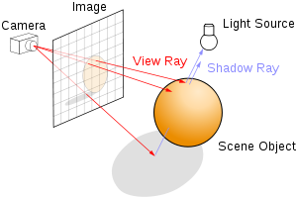
Ray tracing
s
cast ray into scene through pixel
find intersection point (if any)
determine color at intersection
recursively cast rays from intersection point
today

Slide 3

recursive ray tracing
Shadows
Inter-object specular reflection
Transmission through objects with refraction

Slide 4
recursive ray tracing
cast ray
reflection
shadow
p
transmission

Slide 5
shadows
cast ray
shadow
p
R_{L,D} = 0 if L is occluded
Last time
R_{L,S} = 0 if L is occluded

Slide 6
shadows
cast ray
shadow
p
shoot ray in direction of light and check position of intersecting object, if any, relative to light position
R_{L,D} = 0 if L is occluded
Last time
R_{L,S} = 0 if L is occluded

Slide 7
shadows
cast ray
Occluding object
shadow
p
shoot ray in direction of light and check position of intersecting object, if any, relative to light position
R_{L,D} = 0 if L is occluded
Last time
R_{L,S} = 0 if L is occluded

Slide 8
Implementation note
cast ray
P’
Recursively cast ray
P
We don’t want to find P again!

Slide 9
Implementation note
Recursively cast ray
cast ray
P’
n
P
Offset starting position of recursively cast ray:
P + n*Epsilon

Slide 10
recursive ray tracing
Shadows
Inter-object specular reflection
Transmission through objects with refraction
shadow

Slide 11
recursive ray tracing
cast ray
reflection
shadow
✔
p
transmission

Slide 12
recursive ray tracing
Shadows
Inter-object specular reflection
Transmission through objects with refraction
Reflection of die in glass

Slide 13
inter-object specular reflection
normal
θ
incident ray with direction v
p
If surface at p is specularly reflective, light reflecting off of other objects may be visible at p.

Slide 14
recursive ray tracing
Shadows
Inter-object specular reflection
Transmission through objects with refraction
Floor is not specularly reflective so we don’t see reflection of die in floor.

Slide 15
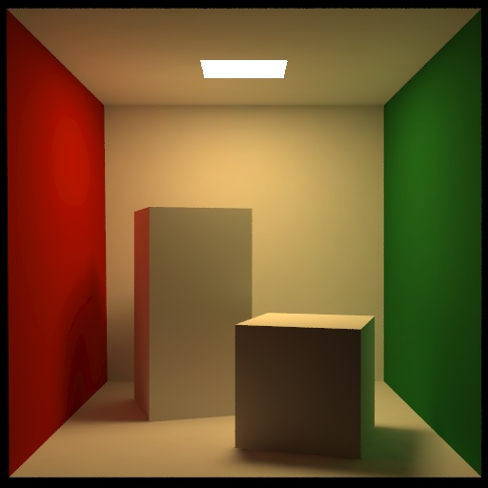
We ignore color bleeding
Notes:
Here is an example of inter-object diffuse reflection. The color of the wall bleeds onto the boxes and floor.
To capture these effects we need a more sophisticated approach such as radiosity.

Slide 16
inter-object specular reflection
P’
normal
θ
θ
incident ray with direction v
R’
p

Slide 17
inter-object specular reflection
P’
normal
compute color at p’: r’, g’, b’
add msr*r’, msg*g’, and msb*b’ to color at p
where msr (msg, msb) is the material specular red (green, blue) at p
θ
θ
incident ray with direction v
R’
p

Slide 18
inter-object specular reflection
P’
normal
compute color at p’: r’, g’, b’
add msr*r’, msg*g’, and msb*b’ to color at p
where msr (msg, msb) is the material specular red (green, blue) at p
θ
θ
incident ray with direction v
R’
p
What about specular reflections at P’?

Slide 19

recursive depth
P’
rDepth=2
rDepth=1
rDepth=0
p

Slide 20
recursive depth
Ray tracer menu
Render ->
Set recursive depth
Recursive depth=0: simple ray casting (with shadows)

Slide 21
recursive ray tracing
cast ray
reflection
✓
shadow
✓
p
transmission

Slide 22
recursive ray tracing
Shadows
Inter-object specular reflection
Transmission through objects with refraction
Transmission with refraction

Slide 23
transparency

Slide 24
transmission
compute color at p’: r’, g’, b’
add: ktrans* msr*r’, ktrans*msg*g’, ktrans*msb*b’ to color at p
where:
  msr (msg, msb) is the material specular red (green, blue) at p
  ktrans is the transmission coefficient at p
incident ray
normal
θ
p
transmitted ray
p’

Slide 25
transmission
compute color at p’: r’, g’, b’
add: ktrans* msr*r’, ktrans*msg*g’, ktrans*msb*b’ to color at p
where:
  msr (msg, msb) is the material specular red (green, blue) at p
  ktrans is the transmission coefficient at p
incident ray
normal
θ
p
transmitted ray
p’

Slide 26
transmitted ray
incoming ray direction v
p
ray bends due to refraction
transmitted ray (p+nEPSILON,v’)

Slide 27
Snell’s law
n
incoming ray with direction v
θ_{in}
refractive index η_{in}
p
refractive index η_{out}
θ_{out}
θ_{out} satisfies: η_{out} sin θ_{out} = η_{in} sin θ_{in}
Note: θ_{in} = arcos(v●-n)
As long as you use the correct normal 0 ≤ θ_{in} ≤ π/2

Slide 28
Snell’s law
n
incoming ray with direction v
θ_{in}
refractive index η_{in}
p
refractive index η_{out}
θ_{out}
θ_{out} satisfies: η_{out} sin θ_{out} = η_{in} sin θ_{in}
sin θ_{out} = β sin θ_{in} where β=η_{in}/η_{out} provided 0 ≤ β sin θ_{in} ≤ 1

Slide 29
What if βsinθ_{in} > 1 ?
θ_{out} > 90° : no transmission
n
incoming ray with direction v
refractive index η_{in}
θ_{in}
θ_{out}
refractive index η_{out}

Slide 30
What if βsinθ_{in} < 0 ?
Can’t happen if you compute θ_{in} appropriately since refractive indices are non-negative
n
incoming ray with direction v
θ_{in}
refractive index η_{in}
refractive index η_{out}
θ_{out}

Slide 31
Snell’s law
incoming ray with direction v_{in}
n
θ_{in}
refractive index η_{in}
p
v_{s}
refractive index η_{out}
transmitted ray: (p-nEPSILON,v_{out})
θ_{out}
  sin θ_{out} = β sin θ_{in}
  cos θ_{out} = (1-sin² θ_{out} )^{1/2} = (1-β²sin² θ_{in})^{1/2}
  v_{s} = v_{in} - (-n•v_{in}) n = v_{in} + cos(θ_{in}) n
  v_{out} = cos θ_{out} (-n) + sin θ_{out} v_{s}/||v_{s}||
normalize

Slide 32
Implementation details
normals
in vs. out

Slide 33
Reminder: computing normals
intersection structure:
find n at p
info.normal =n
if (info.normal.dot(n)>0)
  info.normal =-1*m
r=(p,v)

Slide 34
in vs. out: thin surfaces
any thin surface should have a material
with a refind of 1
#material -n mNonRefractingRed --
0.0 0.0 0.0 // ambient response
0.8 0.1 0.1 // diffuse response
1.0 1.0 1.0 // specular response
0.0 0.0 0.0 // emission
0.5 0.8 1.0 // kspec ktrans refind
#triangle –m NonRefractingRed
…

Slide 35
in vs. out: thick objects
boxes
sphere
cone
torus
cylinder

Slide 36
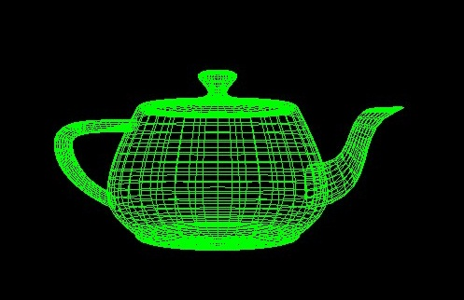
thick objects
objects made from triangles

Slide 37
in vs. out for spheres
η_{sphere}=refind≥1
intersection structure:
find n at p
info.normal =n
info.entering = true
if info.normal.dot(n)>0
  info.normal =-1*m
  info.entering=false
η_{air}=1
β=refind/1
β=1/refind
you need to know whether you are entering or leaving object!

Slide 38
thick objects
the others are left to you to figure out if you decide to implement
boxes
sphere
torus
cylinder
cone

Slide 39
thick objects
objects made from ORIENTED triangles

Slide 40
oriented triangles
graphics convention: from the front the vertices are order counter-clockwise
t₂
the normal computed in
triangle object is outward facing normal
n
t₀
t₁

Slide 41
thick objects made of triangles
define your triangles so that the normals computed in the triangle object are outward facing

Slide 42
oriented triangles
graphics convention: from the front the vertices are order counter-clockwise
t₂
info.normal=this->n
entering=true
if info.normal.dot(v)>0
info.normal *=-1
info.entering=false
(p,v)
n
t₀
t₁
this is why you never want to change the normals in the triangle

Slide 43
getColor
getColor(R,rDepth)
if rDepth <0 return black
compute intersection
if no intersection return background color
compute color due to direct illumination with shadows
if rDepth>0
  recursively call get color with reflected and transmited rays
  scale the result and add to current color

Slide 44
clamping
getColor(ray,rDepth,cVal)
Return color.clampTo(0,1);
…
Be sure to clamp!

Slide 45
implementation problem
incoming ray R
recursive ray R’
p
Because of numerical inaccuracy we will (sometimes) re-discover p.

Slide 46
implementation problem
incoming ray R
recursive ray R’
n
p
Because of numerical inaccuracy we will re-discover p.
Offset R’: start at p+nEPSILON
Constant defined in skeleton code

Slide 47
implementation problem
incoming ray R
p
start at p-nEPSILON
recursive ray R’
make sure to offset in the correct direction depending on
recursive type (reflection, shadow, transmission)

Slide 48
Next time
Bells & whistles

