Slide 1
CS155
Ray tracer road map

Slide 2
raytrace loops through the image:
computes direction of ray for current pixel
calls getColor for that ray
rayfile
getColor
determines if the ray intersects an object in the scene
if so – computes the color at the intersection point
if not – computes the background color
3. returns the computed color
raytrace(Image* )
getColor(Ray, int , int)
raytrace :
sets the color of the pixel
returns the raytraced image

Slide 3
getColor
determines if the ray intersects an object in the scene
rayfile
raytrace(Image* )
getColor(Ray, int , int)
Group* root
“root” is the root of the scene graph!

Slide 4
ShapeGroup
Shape
Group
Sphere
Triangle
intersect(Rayd ray, Intersect info)
etc.
YOU
implement intersect algorithm

Slide 5
ShapeGroup
Shape
Group
intersect(Rayd ray, Intersect info)
Sphere
Triangle
YOU
implement intersect algorithm
Use algorithm given in class

Slide 6
ShapeGroup
Shape
Group
Transform ray, collect intersection points from
children, choose closest, transform info
Sphere
Triangle
intersect(Rayd ray, Intersect info)
YOU
implement intersect algorithm

Slide 7
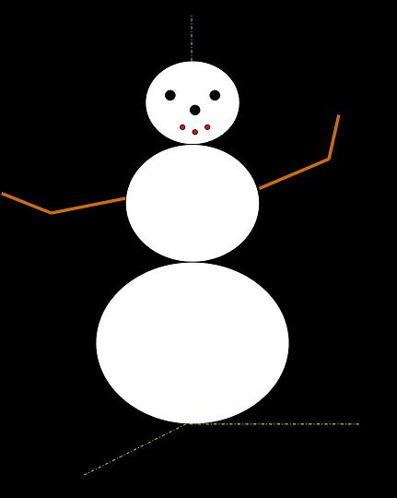
Group “root”
linked list
Group “headAssembly”
Group
“middle”
Group
“bottom”

Slide 8
Group “root”
Group “headAssembly”
Group
“middle”
Group
“bottom”
Group
“head”
Group
“leftEye”
Group “rightEye”

Slide 9
Group “root”
Group “headAssembly”
Group
“middle”
Group
“bottom”
Group
“head”
Group
“leftEye”
Group “rightEye”
Sphere
“headSphere”

Slide 10
Group “root”
root->intersect(ray, info)

Slide 11
Group “root”
root->intersect(ray, info)
“headAssembly”->intersect(ray, info)
Group “headAssembly”
Group
“middle”
Group
“bottom”
“head Assembly”
computes a version of ray in its local coordinate system

Slide 12
Group “root”
root->intersect(ray, info)
“headAssembly”->intersect(ray, info)
Group “headAssembly”
Group
“middle”
Group
“bottom”
“head”->intersect(ray’, info)
Group
“head”
Group
“leftEye”
Group “rightEye”
“head” computes a version of ray’ in its local coordinate system

Slide 13
Group “root”
root->intersect(ray, info)
“headAssembly”->intersect(ray, info)
Group “headAssembly”
Group
“middle”
Group
“bottom”
“head”->intersect(ray’, info)
Group
“head”
Group
“leftEye”
Group “rightEye”
“headSphere”->intersect(ray’’, info)
Sphere
“headSphere” computes intersection pt.
-fills in info (if intersection pt found)
-returns distance d to intersection pt or d=-1

Slide 14
Note: a group has a transform that converts from its coordinate system it to its
parent’s and the inverse transform that goes the other way
Group “root”
root->intersect(ray, info)
“headAssembly”->intersect(ray, info)
Group “headAssembly”
Group
“middle”
Group
“bottom”
“head”->intersect(ray’, info)
Group
“head”
Group
“leftEye”
Group “rightEye”
“head” converts info and distance d into parent’s coordinate
system and returns

Slide 15
Group “root”
root->intersect(ray, info)
“headAssembly”->intersect(ray, info)
Group “headAssembly”
Group
“middle”
Group
“bottom”
“leftEye”->intersect(ray’, info)
Group
“head”
Group
“leftEye”
Group “rightEye”

Slide 16
Group “root”
root->intersect(ray, info)
“headAssembly”->intersect(ray, info)
Group “headAssembly”
Group
“middle”
Group
“bottom”
“rightEye”->intersect(ray’, info)
Group
“head”
Group
“leftEye”
Group “rightEye”

Slide 17
Group “root”
root->intersect(ray, info)
“headAssembly”->intersect(ray, info)
Group “headAssembly”
Group
“middle”
Group
“bottom”
“headAssembly” determines the intersection point found
by its children that is closest the start of ray’
transforms the corresponding distance d and info into its
parents coordinate system
returns

Slide 18
Group “root”
root->intersect(ray, info)
“middle”->intersect(ray, info)
Group “headAssembly”
Group
“middle”
Group
“bottom”
etc.
Note: “root”’s transform is the identity

Slide 19
raytrace loops through the image:
computes direction of ray for current pixel
calls getColor for that ray
rayfile
getColor
determines if the ray intersects an object in the scene
if so – computes the color at the intersection point
if not – computes the background color
3. returns the computed color
raytrace(Image* )
getColor(Ray, int , int)
raytrace :
sets the color of the pixel
returns the raytraced image

Slide 20
raytrace loops through the image:
computes direction of ray for current pixel
calls getColor for that ray
rayfile
getColor
determines if the ray intersects an object in the scene
if so – computes the color at the intersection point
if not – computes the background color
3. returns the computed color
raytrace(Image* )
getColor(Ray, int , int)
raytrace :
sets the color of the pixel
returns the raytraced image
We’ll talk about color
computation next time

