Slide 1
cs155 – z sweedyk
ray tracing

Slide 2
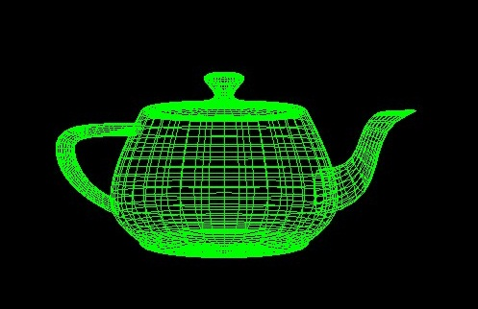

Last time:
Scale, rotate, and translate models

Slide 3
Last time: ray intersection with transformed objects
M⁻¹
R’
R
object coordinates
world coordinates
M
intersection point p
intersection point p’

Slide 4
Now: scene graphs
Your snowman is going to star in a movie.
As any good actor she needs to move her head.

Slide 5
Today: scene graphs
Your snowman is going to star in a movie.
As any good actor she needs to be able to move her head … and body.

Slide 6
transformations
animate: change transforms in real time

Slide 7
transformations
rotate head as one piece

Slide 8
a scene graph makes it easy!! (much easier than talking without a mouth)

Slide 9
scene graph
the subtree rooted at any a node represents a subpart
body assembly
bottom
middle
head assembly

Slide 10
scene graph
the subtree rooted at any a node represents a subpart
body assembly
middle
head assembly
bottom
left eye
right eye
head

Slide 11
scene graph
the subtree rooted at any a node represents a subpart
body assembly
middle
head assembly
bottom
left eye
right eye
head
each node has its own coordinate system

Slide 12
Local coordinate systems
left eye coordinate system
(one that make sense for the left eye)
left eye

Slide 13
Local coordinate systems
head coordinate system
(one that makes sense for the head)
head

Slide 14
Local coordinate systems
Head assembly coordinate system
(one that makes sense for the head assembly)
Head assembly

Slide 15
Hierarchical coordinate systems
Head assembly
head
left eye
Specify transform from node to parent

Slide 16
Hierarchical coordinate systems
Head assembly
M: scale and translate
I
head
left eye
Specify transform from node to parent

Slide 17
hierarchical coordinate systems
body assembly coordinate system
body assembly
M’: scale and translate
head assembly
I
M: scale and translate
head
Left eye

Slide 18
Hierarchical coordinate systems
whole body transformation
body assembly
bottom
middle
head assembly
head
l. eye
r. eye

Slide 19
whole head transformation
body assembly
bottom
middle
head assembly
head
l. eye
r. eye

Slide 20
whole head transformation
M’’: rotate
head assembly
I
M: scale and translate
head
l. eye

Slide 21
coordinate systems
head rotate M’’ occurs in head assembly coordinate system before M’ is applied
body assembly
M’ : scale and rotate
bottom
middle
head assembly
head
l. eye
r. eye

Slide 22
coordinate systems
body rotate, scale, translate occurs in body assembly coordinate system
body assembly
bottom
middle
head assembly
head
l. eye
r. eye

Slide 23
parent coordinate system
parent
transformation to parent’s coordinate system
child coordinate system
child

Slide 24
lab for today
do it yourself!
build a scene graph for the snowman

