Slide 1
cs155 – z sweedyk
ray tracing

Slide 2
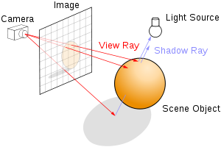
Last time
world coordinates
y
s
x
z
ray tracing overview
camera specs
ray casting
sphere, triangle intersection
Today: specifying scene object geometry

Slide 3
Specifying scene object geometry
y
center, radius
-z
x
vertices
What else is there to say?

Slide 4
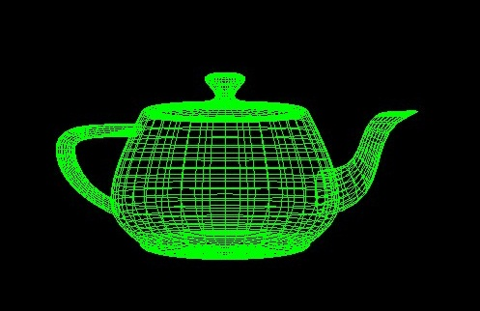
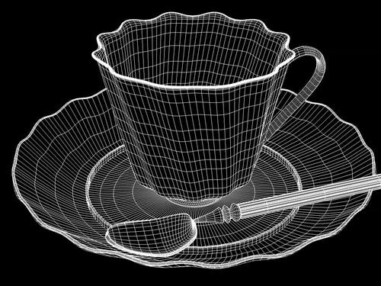
Triangles
need easy ways to manipulate to fit a specific scene
objects typically specified in “object coordinates”

Slide 5
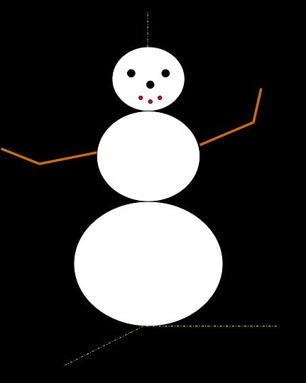
Specify changing scene geometry
make the snowman shake and nod her head

Slide 6
transforms
scale
rotate
translate
Can we render transformed objects in the ray tracer?
triangles
spheres

Slide 7
triangle
scale
rotate
translate

Slide 8
triangle
What happens to the vertices?

Slide 9
point
scale
rotate
translate

Slide 10
point
we need some linear algebra
scale
rotate
translate

Slide 11
scalar multiplication
y
v
2v
v = <v_{x}, v_{y}, v_{z}>
2v = <2v_{x}, 2v_{y}, 2v_{z}>
x
z

Slide 12
vector addition
y
v = <v_{x}, v_{y}, v_{z}>
w = <w_{x}, w_{y}, w_{z}>
w
v+w
v
w
v+w = <v_{x}+w_{x}, v_{y}+w_{y}, v_{z}+w_{z}>
x
z

Slide 13
triangle
transform triangle by transforming vectors!

Slide 14
triangle scale

Slide 15
triangle scale

Slide 16
triangle scale

Slide 17
triangle scale

Slide 18
scale
s 0 0 0 t 0 0 0 u
xyz
sx ty uz
=
where s, t, u are non-zero

Slide 19
triangle rotate

Slide 20
triangle rotate

Slide 21
triangle rotate

Slide 22
triangle rotate

Slide 23
rotating a vector
y
v = <v_{x}, v_{y}, v_{z}>
v’= ______________
v
v’:
v rotated 90° about
z axis
x

Slide 24
rotation 90◦ about z
cos 90 -sin 90 0
sin 90 cos 90 0
0 0 1
v_{x} v_{y}
v_{z}
v_{x} cos 90 - v_{y} sin 90 v_{x} sin 90 + v_{y} cos 90
v_{z}
=

Slide 25
rotate about z axis
column 0: specifies what happens to (1,0,0)
cos φ -sin φ 0
sin φ cos φ 0 0 0 1
y
<1,0,0> rotated by φ about z
sin φ
φ
<1,0,0>
x
cos φ

Slide 26
rotate about z axis
column 0: specifies what happens to (1,0,0)
column 1: specifies what happens to (0,1,0)
cos φ -sin φ 0
sin φ cos φ 0 0 0 1

Slide 27
rotate about z axis
column 0: specifies what happens to (1,0,0)
column 1: specifies what happens to (0,1,0)
column 2: specifies what happens to (0,0,1)
cos φ -sin φ 0
sin φ cos φ 0 0 0 1

Slide 28
linear transform
column 0: specifies what happens to (1,0,0)
column 1: specifies what happens to (0,1,0)
column 2: specifies what happens to (0,0,1)
X_{x} Y_{x} Z_{x}
X_{y} Y_{y} Z_{y}
X_{z} Y_{z} Z_{z}
the z component of transformed unit Y vector

Slide 29
triangle translate

Slide 30
translating a point is easy
y
p
translate p 2 units to the right
v
v’
x
v=<p_{x},p_{y},p_{z}>
add <2,0,0>
v’=<p_{x}+2,p_{y},p_{z}>
this is a non-linear operation

Slide 31
linear transformation
linear f:
f(u)+f(v) = f(u+v)
scale and rotate are linear
e.g. s(u+v) = su + sv
translation is not linear:
( v+w₀ )+(u+w₀) ≠ (u+v)+w₀ (unless w₀ =<0,0,0>)

Slide 32
transforms
scale
rotate
translate
has matrix transform
linear
doesn’t
non-linear
SO WHAT?

Slide 33
Composing linear transform
v
M₁v
M₂(M₁v)
(M₂M₁)v

Slide 34
transform polygon mesh
1,000,000 vertices
1,000,000,000 computations
1000 transforms

Slide 35
transform polygon mesh
1,000,000
1,000,000 vertices
1,000,000,000 computations
1000 transforms
1 composite transform

Slide 36
operators
scale
rotate
translate
linear
grand theft auto at 1 fps
non-linear

Slide 37
operators
but someone figured it out – right?
scale
rotate
translate
linear
non-linear

Slide 38
let’s step back into 2D for a moment

Slide 39
hold onto your hat ...
(x+x₀,y+y₀)
(x+x₀,y+y₀,1)
(x,y)
(x,y,1)
translation by (x₀,y₀) is not a 2D linear
3D linear xfm

Slide 40
linear transform
1 0 x₀
0 1 y₀
0 0 1
x
y
1
x+x₀
y+y₀
1
=
(x+x₀,y+y₀,1)
(x,y,1)
NOTE: this only works as a translate for points in the plane z=1!

Slide 41
2D homogenous coordinates
(x,y) (x,y,1)
Can we do scale and rotate in homogenous coordinates?

Slide 42
scale
s 0 0 0 t 0 0 0 1
xy1
sx ty 1
=

Slide 43
rotate
cos φ -sin φ 0 sin φ cos φ 0 0 0 1
xy1
x cos φ - y sin φ x sin φ + y cos φ 1
=

Slide 44
translate
1 0 x₀ 0 1 y₀ 0 0 1
xy1
x+x₀ y+y₀ 1
=

Slide 45
transform form
these are 0 for scale and rotate and equal to the offset for translate
? ? ? ? ? ? 0 0 1
xy1
x’ y’ 1
=

Slide 46
we are not alone…
the parallel universe view of homogenous coordinates
(x’,y’)
(x,y)
we live in this universe

Slide 47
we are not alone…
the parallel universe view of homogenous coordinates
(x’,y’)
(x’,y’,1)
(x,y)
(x,y,1)
we live in this universe
it’s not the only one

Slide 48
we are not alone…
the parallel universe view of homogenous coordinates
(x’,y’)
(x’,y’,1)
(x,y)
(x,y,1)
we live in this universe
it’s not the only one,
but it’s the only one we need to think about

Slide 49
3d and 3d homogenous
(x,y,z)
(x,y,z,1)
our universe
our universe when it comes to computing modeling transforms

Slide 50
scale
s 0 0 0 0 t 0 0 0 0 u 0 0 0 0 1
xyz1
sx ty uz 1
=

Slide 51
rotate about z axis
cos φ -sin φ 0 0 sin φ cos φ 0 0 0 0 1 0 0 0 0 1
xyz 1
x cos φ - y sin φ x sin φ + y cos φ z 1
=
rotate about x & y axes are similar

Slide 52
translate
1 0 0 x₀ 0 1 0 y₀ 0 0 1 z₀ 0 0 0 1
xyz1
x+x₀ y+y₀ z+z₀ 1
=

Slide 53
transform form
these are 0 for scale and rotate and are equal to the offset for translate
? ? ? ? ? ? ? ? ? ? ? ? 0 0 0 1
xyz1
x’ y’ z’ 1
=

Slide 54
3d and 3d homogenous
(x,y,z)
(x,y,z,1)
our universe
our universe when it comes to computing modeling transforms

Slide 55
Transforming vertices
Mp will mean the homogenous transform of the point p and we’ll omit the details

Slide 56
Composing transforms
M₁M₂p ≠ M₂M₁p
p is transformed by M₂
and then M₁
p is transformed by M₁
and then M₂
last matrix is first applied!

Slide 57
transforms
scale
rotate
translate
TA DA!
Ray tracer input: transformed triangles
# translate dx, dy, dz
# scale sx, sy, sz
# rotate theta, vx, vy, vz
# triangle …

Slide 58
Rotate # rotate Θ, vx, vy, vz
v
P
v is the normal for infinitely many parallel planes. One of those planes contains P.

Slide 59
Rotate # rotate Θ, vx, vy, vz
v
P
v is the normal for infinitely many parallel planes. One of those planes contains P. Rotations of P about v form a circle in that plane.

Slide 60
Rotate # rotate Θ, vx, vy, vz
v
P
P’
Note the effect of rotating P 180° about v. This will be useful for today’s lab!

Slide 61
transforms
scale
rotate
translate
Can we render transformed objects in the ray tracer?
triangles
spheres
TA DA!

Slide 62

sphere transform
create triangle mesh then transform triangles
this is the way pipeline renderers handle spheres

Slide 63
Ray tracer: can we find intersection of ray with transformed sphere?
intersection test hard
R
world coordinates

Slide 64
Ray tracer: can we find intersection of ray with transformed sphere?
intersection test hard
intersection test easy
R
R’
world coordinates
object coordinates

Slide 65
Ray tracer: can we find intersection of ray with transformed sphere?
intersection test hard
intersection test easy
M
R
R’
M⁻¹
world coordinates
object coordinates

Slide 66
ray tracer: find intersection point
M⁻¹
R’’
R
object coordinates
world coordinates
M
intersection point p
intersection point p’
Question 1: Does M have an inverse?
Question 2: Can we transform a ray?

Slide 67
Scale
What operation inverts a scale by s (s≠0) in the x-direction?
For s≠0, scale by 1/s in the x-direction.
s⁻¹ 0 0 0 0 t⁻¹ 0 0 0 0 u⁻¹ 0 0 0 0 1
s 0 0 0 0 t 0 0 0 0 u 0 0 0 0 1
= I

Slide 68
Rotate
What operation inverts a rotate by θ about the x-axis?
Rotate by -θ about the x-axis.
cos -φ -sin -φ 0 0 sin -φ cos -φ 0 0 0 0 1 0 0 0 0 1
cos φ -sin φ 0 0 sin φ cos φ 0 0 0 0 1 0 0 0 0 1
= I

Slide 69
Translate
What operation inverts a translate by dx in the x-direction?
Translate by -dx in the x-direction.
1 0 0 -x₀ 0 1 0 -y₀ 0 0 1 -z₀ 0 0 0 1
1 0 0 x₀ 0 1 0 y₀ 0 0 1 z₀ 0 0 0 1
=I

Slide 70
Composite transforms
What is the inverse of M = M₁M₂... M_{n}
Answer: M⁻¹ = M_{n}⁻¹ ... M₂⁻¹ M₁⁻¹
Note reverse order!

Slide 71
find intersection point
M⁻¹
R’
R
object coordinates
world coordinates
M
intersection point p
intersection point p’
Question 1: Does M have an inverse? YES
Question 2: Can we transform a ray?

Slide 72
Ray translate example
direction vector shown un-normalized for simplicity
Translate R((2,2,0),<-1,-1,0>) by ( ½ , 0 ,0)
Starting point translated, direction unchanged
R
R’=(( 5/2 , 2, 0),<-1,-1,0>)
unit cube at origin shown for reference
unit cube at origin translated by ( ½ , 0, 0)

Slide 73
Ray translate example
Translate R((2,2,0),<-1,-1,0>) by ( ½ , 0 ,0)
1 0 0 ½ 0 1 0 0 0 0 1 0 0 0 0 1
2201
5/2 2 0 1
=
R’=(( 5/2 , 2, 0),<-1,-1,0>)

Slide 74
Ray (p,v) translate
Transform starting point p
Do not transform direction vector v

Slide 75
Ray scale example
direction vector shown un-normalized for simplicity
Scale R = ((2,2,0),<-1,-1,0>) by (2,1,1)
needs to be normalized
R’ = ((4,2,0) ,<-2,-1,0> )
R
R’
unit cube at origin

Slide 76
Ray (p,v) scale
Transform starting point p
Transform direction vector v

Slide 77
Ray rotate example
Rotate R((1,1,0),<1,0,0>) by 90◦ about z
R’=((-1,1,0),<0,1,0>)
R
R’
1x2x1 box at origin

Slide 78
Ray (p,v) Rotate
Transform starting point p
Transform direction vector v

Slide 79
Ray transform algorithm
Transform R=(p, v) by M
R’= (Mp, Mv/||Mv||)
Transform algorithm
homogenous
regular 3x3
The matrix class in the skeleton code has:
multPoint, multVector, and multRay functions

Slide 80
find intersection point
M⁻¹
R=(p₀,v)
R’
object coordinates
world coordinates
M
intersection point p_{I}
intersection point p_{I}’
Where the transform is applied appropriately to ray’s point and direction.

Slide 81
surface normal
is the normal to a transformed surface the transformed normal?

Slide 82
Let n be normal to a sphere at point s. Assume Qn is normal at Ms on the transformed surface.
Qn
n
M
s
Ms

Slide 83
Let n be normal to a sphere at point s. Assume Qn is normal at Ms on the transformed surface.
Qn
n
M
s
Ms
For any points p and q in the tangent plane at s: n•(p-q) = 0.

Slide 84
Let n be normal to a sphere at point s. Assume Qn is normal at Ms on the transformed surface.
Qn
n
M
s
Ms
For any points p and q in the tangent plane at s: n•(p-q) = 0.
For any points Mp and Mq in the tangent plane at Ms: Qn•(Mp-Mq) = 0.

Slide 85
Let n be normal to a sphere at point s. Assume Qn is normal at Ms on the transformed surface.
Qn
n
M
s
Ms
For any points p and q in the tangent plane at s: n•(p-q) = 0.
n^{T} (p-q) = [0]
For any points Mp and Mq in the tangent plane at Ms: Qn•(Mp-Mq) = 0.
(Qn)^{T} (Mp-Mq) = [0]
So n^{T}Q^{T}M(p-q)=[0] and Q=(M⁻¹)^{T}

Slide 86
The skeleton matrix class has a built in inverse transpose method!
Let n be normal to a sphere at point s. Assume Qn is normal at Ms on the transformed surface.
Qn
n
M
s
Ms
For any points p and q in the tangent plane at s: n•(p-q) = 0.
n^{T} (p-q) = [0]
For any points Mp and Mq in the tangent plane at Ms: Qn•(Mp-Mq) = 0.
(Qn)^{T} (Mp-Mq) = [0]
So n^{T}Q^{T}M(p-q)=[0] and Q=(M⁻¹)^{T}

Slide 87
The matrix class has a built in inverse transpose method!
Let n be normal to a sphere at point s. Assume Qn is normal at Ms on the transformed surface.
Qn
n
M
s
Ms
For any points p and q in the tangent plane at s: n•(p-q) = 0.
n^{T} (p-q) = [0]
For any points Mp and Mq in the tangent plane at Ms: Qn•(Mp-Mq) = 0.
(Qn)^{T} (Mp-Mq) = [0]
So n^{T}Q^{T}M(p-q)=[0] and Q=(M⁻¹)^{T}

