Slide 1
Summary of MyCS (and this week…)
Mon: CS + programming
Tue: Data
Wed: Algorithms
All together?
Notes:
robotics in Atlanta… show research videos…

Slide 2
Summary of MyCS (and this week…)
Mon: CS + programming
Tue: Data
Wed: Algorithms
Picobot
All together?
Notes:
robotics in Atlanta… show research videos…

Slide 3
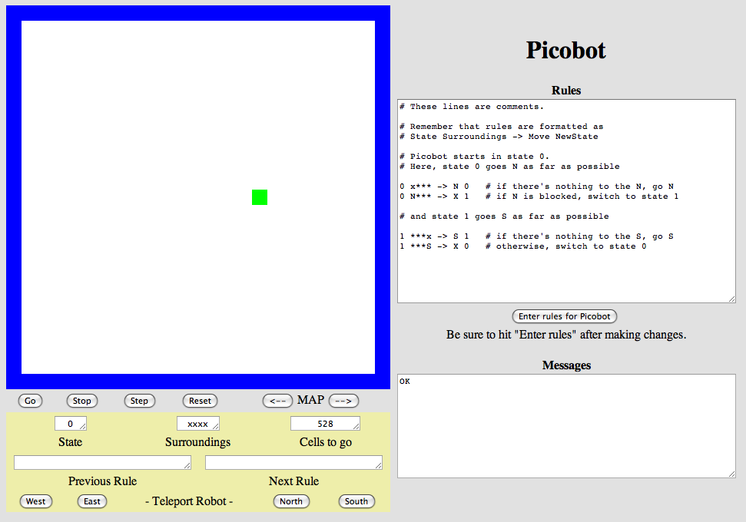
Picobot
Open this site: www.cs.hmc.edu/picobot

Slide 4
Another language?
Python
Scratch
Picobot
General-purpose language
General-purpose language
Special-purpose language
you might see 5% by the end of a semester
you might see 50% by the end of a semester
you'll see 100% in the next 20 minutes
less of its libraries!
self-contained
but not simplistic

Slide 5
Picobot?
An extreme close-up of Picobot in action...
walls
Picobot
area not covered (yet!)
area already covered
inspiration?
Goal: whole-environment coverage with only local sensing…

Slide 6
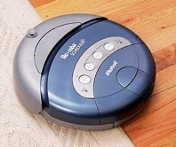
Picobot's inspiration
walls
Picobot
area not covered (yet!)
Picobot ~ robot vacuum
may re-cover an area
can't tell "vacuumed" from "unvacuumed" area
area already covered
Goal: whole-environment coverage with only local sensing…

Slide 7
Surroundings
N
Picobot can only sense things directly to the N, E, W, and S
W
E
S
For example, here its surroundings are
NxWx
N E W S
Surroundings are always in NEWS order and always 4 letters

Slide 8
Surroundings are always in NEWS order and always 4 letters
What are these surroundings?
N E W S
NxWx
Wow - this one is disgusting!

Slide 9
Surroundings
N
How many distinct surroundings are there?
W
E
S

Slide 10
Surroundings
N
How many distinct surroundings are there?
W
E
S
2⁴
== 16 possible …
xxxx
Nxxx
xExx
xxWx
xxxS
NExx
NxWx
NxxS
xEWx
xExS
xxWS
NEWx
NExS
NxWS
xEWS
NEWS
(won’t happen)

Slide 11
State
I am in state 0.
My surroundings
are xxWS.
Picobot's memory is a single number, called its state.
State is the internal context of a computation, i.e., the subtask.
0
Picobot always starts in state 0.
State and surroundings represent everything Picobot knows about the world
self-contained
but not simplistic

Slide 12
Rules
I am in state 0.
My surroundings
are xxWS.
Picobot moves according to a set of rules:
state
surroundings
direction
new state
0
xxWS
N
0

Slide 13
Rules
I am in state 0.
My surroundings
are xxWS.
Aha!
I should move N.
I should enter state 0.
Picobot moves according to a set of rules:
state
surroundings
direction
new state
0
xxWS
N
0
If I'm in state 0 seeing xxWS,
Then I move North, and "change" to state 0.

Slide 14
Wildcards
I am in state 0.
My surroundings
are xxWS.
Aha!
This matches the
surroundings x***
Asterisks * are wild cards. They match walls or empty space:
state
surroundings
direction
new state
0
x***
N
0
EWS may be wall or empty space
N must be empty

Slide 15
(A) What is a program that sends Picobot to the North (top) of the empty room ?
state
surroundings
direction
new state
(B) stop, don’t crash!
(C) How could we get back down?
(D) And continue…?

Slide 16
(A) What is a program that sends Picobot to the North (top) of the empty room ?
state
surroundings
direction
new state
0
x***
->
N
0
0
N***
->
X
1
(B) stop, don’t crash!
1
***x
->
S
1
1
***S
->
X
0
(C) How could we get back down?
(D) And continue…?
Picobot checks its rules from the top each time.
Model
When it finds a matching rule, that rule runs.
Only one rule is allowed per state and surroundings.

Slide 17
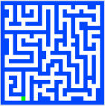
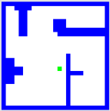
Thought experiment 1…
Create a program that will initially get picobot to the SOUTHEAST corner of the empty room.
Your rules should work regardless of Picobot's starting position… !
How could you combine the previous example with this one to cover the whole room from any starting position?
Extras!
How few states could be used?
How few total rules can be used?
How would you solve these rooms?

Slide 18
Thought experiment 2…
Create a program that will get picobot to the COMPLETELY COVER the empty room.
complete!
Your rules should work regardless of Picobot's starting position… !
Hint: combine the up-and-down example with the previous one!
Extra challenge: how FEW rules can you use? The current record is six rules…

Slide 19
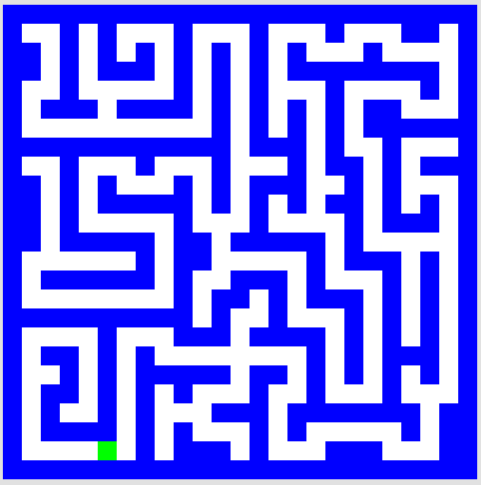
Thought experiment 3…
Algorithm:
States:
What different set of rules would guide Picobot through this "maze" environment?
Thinking about the CS questions before diving into the programming will help!

Slide 20
· Suppose Picobot want to traverse a maze with its right hand always on the wall.
· Suppose the starting state, state 0, will represent the fact that “Picobot is facing North”
(A) Write a single rule that tells Picobot:
“Continue North as long as there’s room to move and a wall on your right”
0
(A)
(B) Write a single rule that tells Picobot:
“If you lose the wall when facing North, return to it immediately!”
0
(B)
(C) Write 1-2 rules to tell Picobot to do the right thing if it hits a dead end.
0
(C)

Slide 21
Try it!
www.cs.hmc.edu/picobot

Slide 22
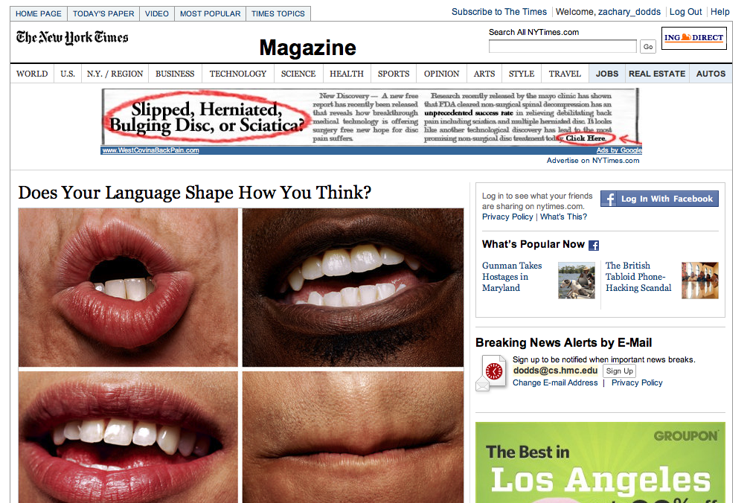
Seventy years ago, in 1940, a popular science magazine published a short article that set in motion one of the trendiest intellectual fads of the 20th century. At first glance, there seemed little about the article to augur its subsequent celebrity. Neither the title, “Science and Linguistics,” nor the magazine, M.I.T.’s Technology Review, was most people’s idea of glamour. And the author, a chemical engineer who worked for an insurance company and moonlighted as an anthropology lecturer at Yale University, was an unlikely candidate for international superstardom. And yet Benjamin Lee Whorf let loose an alluring idea about language’s power over the mind, and his stirring prose seduced a whole generation into believing that our mother tongue restricts what we are able to think.

Slide 23
and I thought my language was alien!
Seventy years ago, in 1940, a popular science magazine published a short article that set in motion one of the trendiest intellectual fads of the 20th century. At first glance, there seemed little about the article to augur its subsequent celebrity. Neither the title, “Science and Linguistics,” nor the magazine, M.I.T.’s Technology Review, was most people’s idea of glamour. And the author, a chemical engineer who worked for an insurance company and moonlighted as an anthropology lecturer at Yale University, was an unlikely candidate for international superstardom. And yet Benjamin Lee Whorf let loose an alluring idea about language’s power over the mind, and his stirring prose seduced a whole generation into believing that our mother tongue restricts what we are able to think.

