Slide 1
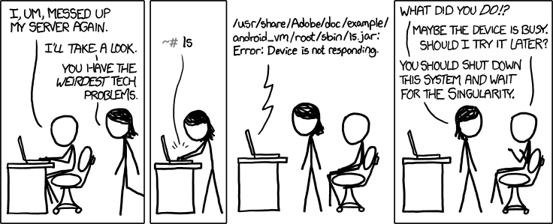
CS Today
OR
Minterm Expansion Principle
using the singularity as a problem-solving strategy!
hw#5: Circuit design in Logisim
A circuit for any binary function can be built from three components:
That's minterm, NOT midterm
w
wxyz
w
w+x+y+z
x
x
OR
y
AND
y
z
"w and x and y and z"
z
"w or x or y or z"
x
NOT
x
"not x"

Slide 2
Jotto Corner
Lani C.
am guess
bagel: 2
first: 0
hound: 2
my guess
diner: 1
ghost: 2
plumb: 1
omega: ?
words remaining: 1771
2320 words remaining
words remaining: 433
761 words remaining
words remaining: 138
369 words remaining
sigma?
Madi M.
pm guess
alien: 0
slope: 2
truck: 2
my guess
diner: 2
sassy: 0
thumb: 1
cruel: ?
words remaining: 650
1917 words remaining
words remaining: 240
667 words remaining
words remaining: 72
310 words remaining
booed?

Slide 3
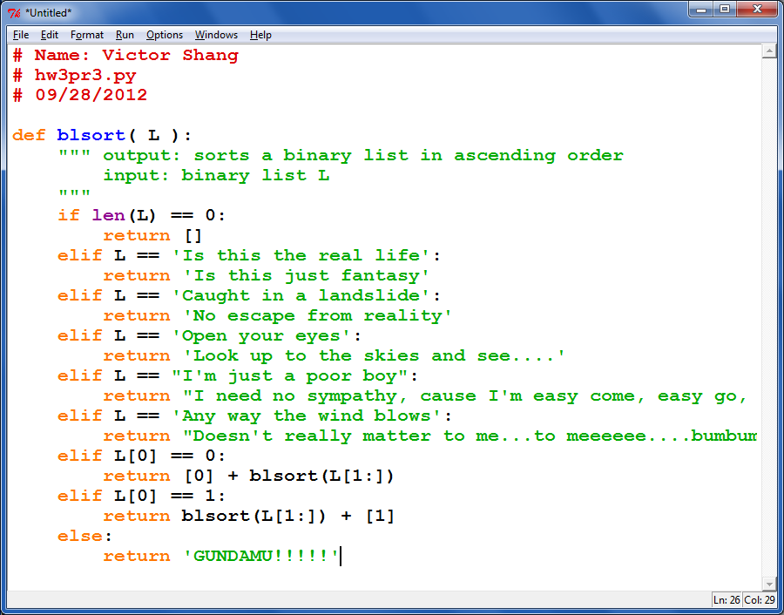
Creativity of a sort…

Slide 4
Cookies!
K. Kohl

Slide 5
Creativity with Caesar...
def decipher( S ):
""" TESIJHYDW - je tusyfxuh
jxyi tesijhydw, zkij hkd
tusyfxuh ed yj. """
… code here …

Slide 6
Creativity with Caesar...
def decipher( S ):
""" DOCSTRING - to decipher
this docstring, just run
decipher on it. """
… code here …

Slide 7
Creativity with Caesar...
def decipher( S ):
""" This works sometimes """

Slide 8
Computation is simply the deliberate combination of those voltages!
In a computer, each bit is represented as a voltage (1 is +5v and 0 is 0v)
101010
set input voltages
42
perform computation
ADDER circuit
51
110011
read output voltages
9
What's in that green box?
001001

Slide 9
Part 1: Represent your f'n as bits…
IN
OUT
x
y
z
circuit output
0
0
0
0
0
0
1
1
0
1
0
1
0
1
1
0
1
0
0
1
1
0
1
0
1
1
0
0
1
1
1
1
Truth table for the "odd-parity" function
This is odd, but it's also f'n!

Slide 10
Part 2: Use building blocks ~ logic gates
input
output
input
output
x
y
AND(x,y)
x
y
OR(x,y)
input
output
x
NOT(x)
0
0
0
0
0
0
0
1
0
0
1
1
0
1
1
0
0
1
0
1
1
0
1
1
1
1
1
1
AND outputs 1 only if ALL inputs are 1
OR outputs 1 if ANY input is 1
NOT reverses its input
AND
OR
NOT

Slide 11
Physical Logic Gates...
Hex NOT gate
Notes:
these quotes are important to yahoo… !

Slide 12
Better-than-physical Logic Gates...
Notes:
these quotes are important to yahoo… !

Slide 13
Outrageous Claim!
I need proof!
We need only these three building blocks to compute anything at all
AND outputs 1 only if ALL its inputs are 1
AND
OR outputs 1 if ANY input is 1
OR
NOT
NOT reverses its input

Slide 14
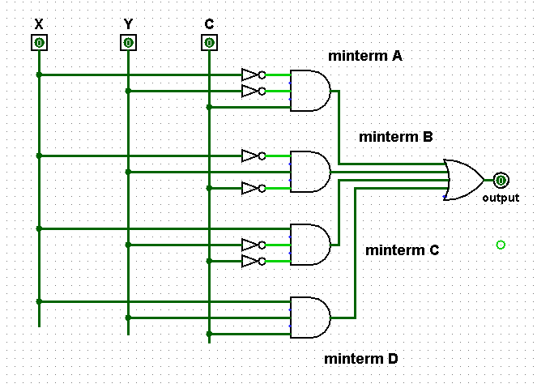
A circuit with four minterms
A minterm is an AND gate connected to all input bits - directly or through a NOT gate

Slide 15
A circuit with four minterms
What 3-bit input makes this AND gate output a 1?
A minterm is an input selector!

Slide 16
Outrageous Claim!
I need proof!
We need only these three building blocks to compute anything at all
We prove this constructively using what's called the minterm expansion principle.
AND outputs 1 only if ALL its inputs are 1
AND
OR outputs 1 if ANY input is 1
OR
NOT
NOT reverses its input

Slide 17
A constructive proof… !
i
Specify a truth table defining any function you want
For each input row whose output needs to be 1, build an AND circuit that outputs 1 only for that specific input!
ii
input
output
x
y
f(x,y)
0
0
0
Hey! This is a 3-i'ed proof!
0
1
1
iii
OR them all together
1
0
1
1
1
0

Slide 18
A constructive proof…
i
Specify a truth table defining any function you want
For each input row whose output needs to be 1, build an AND circuit that outputs 1 only for that specific input!
ii
input
output
x
y
f(x,y)
0
0
0
0
1
1
iii
OR them all together
1
0
1
1
1
0
We ensure this outputs zero by default.
x
y
TWO rows ALREADY work – with NO connections at all !
OR
x
y

Slide 19
A constructive proof…
i
Specify a truth table defining any function you want
For each input row whose output needs to be 1, build an AND circuit that outputs 1 only for that specific input!
ii
input
output
x
y
f(x,y)
0
0
0
0
1
1
iii
OR them all together
1
0
1
1
1
0
x
y
NOT
AND
OR
Does this wire turn on for the red input row?
x
y
Does this wire turn on for any other input rows?

Slide 20
A constructive proof…
i
Specify a truth table defining any function you want
For each input row whose output needs to be 1, build an AND circuit that outputs 1 only for that specific input!
ii
input
output
x
y
f(x,y)
0
0
0
0
1
1
iii
OR them all together
1
0
1
1
1
0
x
y
NOT
AND
OR
AND
NOT
blue row?
other rows?
x
y

Slide 21
A constructive proof…
i
Specify a truth table defining any function you want
For each input row whose output needs to be 1, build an AND circuit that outputs 1 only for that specific input!
ii
input
output
x
y
This is a constructive proof that AND, OR, NOT suffice to build any function of bits!
f(x,y)
0
0
0
0
1
1
iii
OR them all together
1
0
1
1
1
0
x
y
NOT
AND
OR
AND
NOT
blue row?
other rows?
x
y

Slide 22
A constructive proof…
i
Specify a truth table defining any function you want
For each input row whose output needs to be 1, build an AND circuit that outputs 1 only for that specific input!
ii
But... ALL functions are just functions of bits! (via binary)
input
output
x
y
This is a constructive proof that AND, OR, NOT suffice to build any function of bits!
f(x,y)
0
0
0
0
1
1
iii
OR them all together
1
0
1
1
1
0
x
y
NOT
AND
OR
AND
NOT
blue row?
other rows?
x
y

Slide 23
Another example
Specify a truth table defining any function you want
For each input row whose output needs to be 1, build an AND circuit that outputs 1 only for that specific input!
1
2
input
output
x
y
fn(x,y)
0
0
1
3
OR them all together
0
1
0
1
0
0
1
1
1
x
y
1 OR
x
y
2 ANDs

Slide 24
"Rails"
What are the differences between these two circuits?
Any advantages of the "rails" approach?
using rails for Not X and Not Y

Slide 25
Odd parity
IN
OUT
x
y
z
circuit output
0
0
0
0
0
0
1
1
0
1
0
1
1, exactly when the number of input bits is odd
0
1
1
0
1
0
0
1
1
0
1
0
1
1
0
0
1
1
1
1
Truth table for the "odd-parity" f'n
This is odd, but it's also f'n!

Slide 26
Odd parity vs. odd parody
with Python ties!
IN
OUT
x
y
z
circuit output
0
0
0
0
0
0
1
1
0
1
0
1
1, if the number of input bits is odd
0
1
1
0
1
0
0
1
1
0
1
0
1
1
0
0
1
1
1
1
Truth table for the "odd-parity" function

Slide 27
Name(s):
Quiz
Here are the truth table and circuit defining the odd parity f'n:
x
y
c
input
output
x
y
c
oddpar
Row 1
outputs 1 when xyc ==
001
0
0
0
0
Row 0
AND
0
0
1
1
Row 1
0
1
0
1
outputs 1 when xyc ==
Row 2
AND
0
1
1
0
Row 3
1
0
0
1
OR
Row 4
1
0
1
0
Row 5
AND
1
1
0
0
Row 6
outputs 1 when xyc ==
1
1
1
1
Row 7
AND
x
y
c
not
not
not
x
y
c
(1) Label the AND gates with the 3 input bits and row # that make it output 1. (They're not in order.)
(2) Which row does the unwired AND gate need to be? Draw the correct upstream wires for that one.
(3) When the input is from rows 0, 3, 5, or 6, what are the outputs of all the AND gates?
Notes:
27

Slide 28
Quiz, part 2
2
Sketch a circuit for this function using ANDs and NOTs, then combined with an OR.
1
Here's the truth table defining an "mj" function
x
y
c
input
output
x
y
c
mj
0
0
0
0
0
0
1
0
0
1
0
0
0
1
1
1
1
0
0
0
1
0
1
1
1
1
0
1
1
1
1
1
x
y
c
not
not
not
x
y
c
(4) Hmmm… Could this circuit be built without an OR gate at all by using only ANDs and NOTs? This is a thought experiment – not something to do on the circuit above…. .
(5) Wow! How could the the odd parity and mj circuits be replicated and combined in order to build a circuit that adds any two binary numbers at all!?!
Notes:
28

Slide 29
input
output
OR else ?!
x
y
OR(x,y)
0
0
0
0
1
1
Can you get rid of ORs by using only NOTs and ANDs?
1
0
1
1
1
1
x
x OR y
y
OR
Notes:
29

Slide 30
A full adder
A full adder sums three input bits to create a 2-bit binary output
x
y
c_{in}
c_{out} sum
0 0 0
0 0
0 0 1
0 1
0 1 0
0 1
(A 3-bit adder is a full adder)
0 1 1
1 0
(A 2-bit adder is a half adder)
1 0 0
0 1
1 0 1
1 0
1 1 0
1 0
1 1 1
1 1
3 individual bits of input
2 bits of output: a binary #
You'll build this in Lab 5…
these columns look familiar!

Slide 31
Building a Full Adder
Create a separate circuit for each output bit !
3 input bits
Full Adder
input
output
x
y
c_{in}
x
y
c_{in}
c_{out} sum
0 0 0
0 0
0 0 1
0 1
sum output bit
0 1 0
0 1
0 1 1
1 0
1 0 0
0 1
2 output bits
1 0 1
1 0
1 1 0
1 0
You'll build this in Lab!
c_{out} output bit
1 1 1
1 1
"Carry-out" Circuit
"Rails" of each bit and its inverse
Remember: this is addition in silicon !

Slide 32
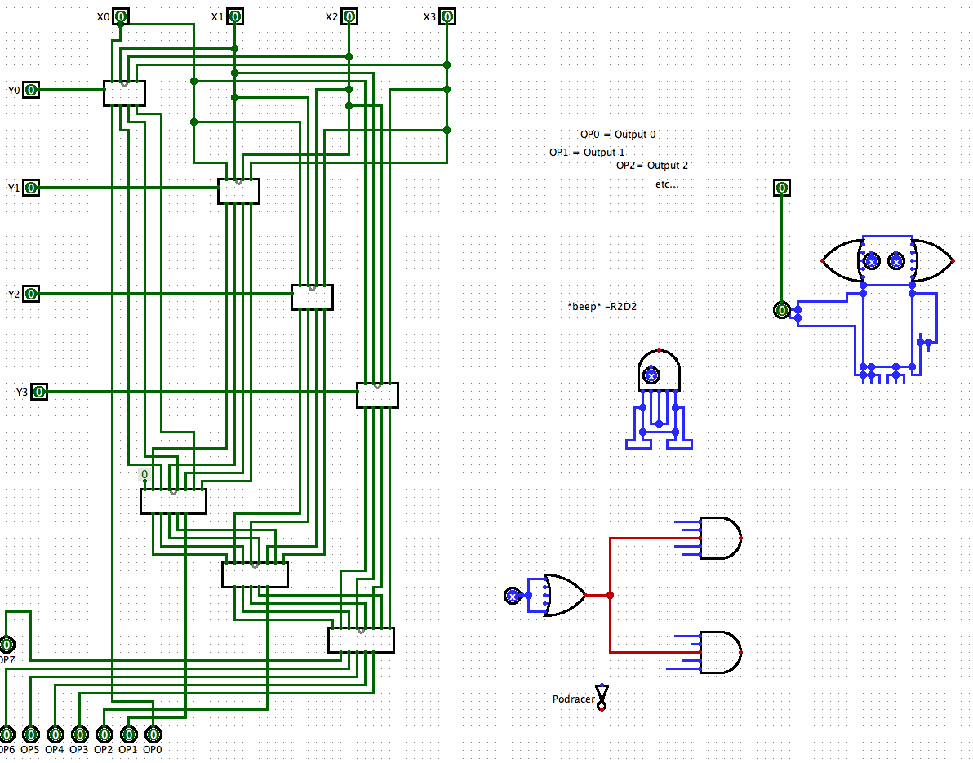
Your "canvas"

Slide 33
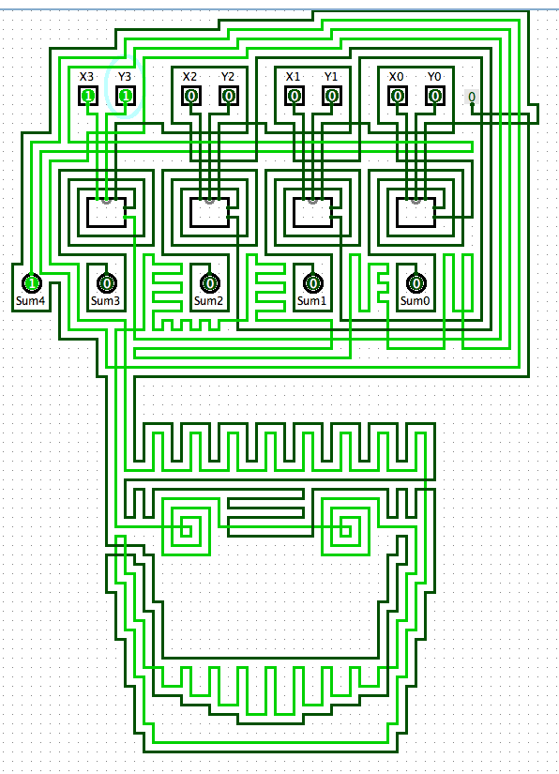
Two Adders…
Zombie ripple-carry adder
an actual adder…
It does look fairly wiry to me!

Slide 34
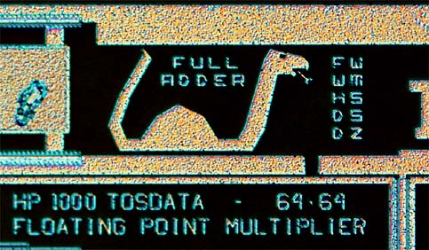
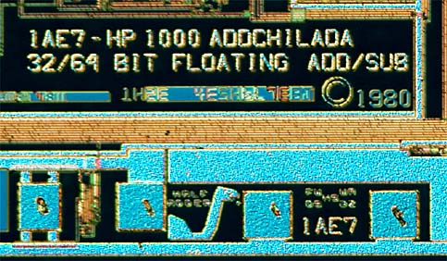
Adders!

Slide 35
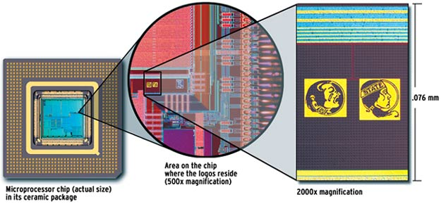
relative scale…

Slide 36
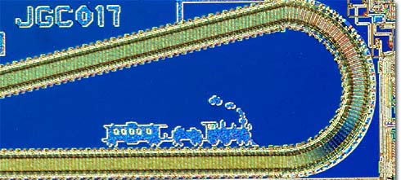
chugging right along…
"Rails" ?

Slide 37
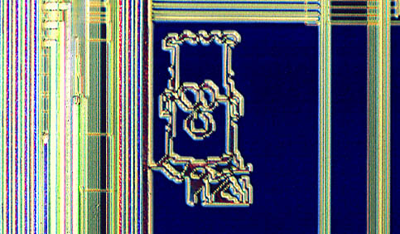
What to do with all that extra silicon?

Slide 38
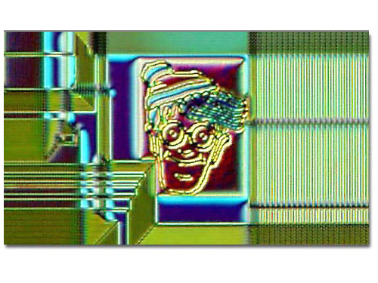
What to do with all that extra silicon?
The "silicon zoo": micro.magnet.fsu.edu/creatures/index.html

Slide 39
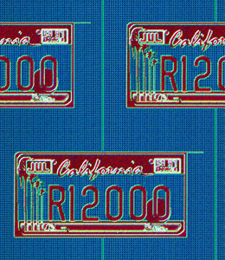
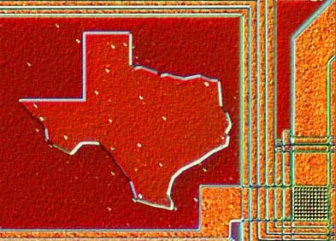
Homestate pride…

Slide 40
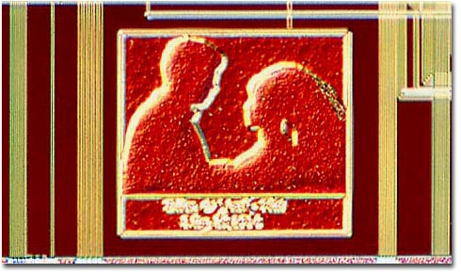
Marriage proposals?

Slide 41
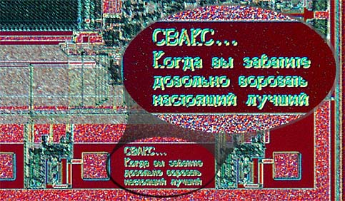
and "secret" messages…

Slide 42
Composing circuits
x
y
c_{in}
FA
sum
4-bit Ripple-carry Adder
c_{out}
Could we use pieces we already have?
0 1 1 1
1 1 0 1
8 input bits
+
5 output bits

Slide 43
Composing circuits
4-bit Ripple-carry Adder
0 1 1 1
1 1 0 1
8 input bits
+
1 0 1 0 0
5 output bits
Now let's make lots of them!!

Slide 44
hw5pr2: A 4-bit multiplier
1 1 0 1 Multiplicand
x 0 1 1 0 Multiplier
0 0 0 0 4 partial products
1 1 0 1
1 1 0 1
+ 0 0 0 0
1 0 0 1 1 1 0 Final answer…
0
(Q1) How could you use 4-bit ripple-carry adders above?
(Q2) How many of them do you need? Where?
(Q3) What circuits can you use to yield those four "partial products" ??

Slide 45
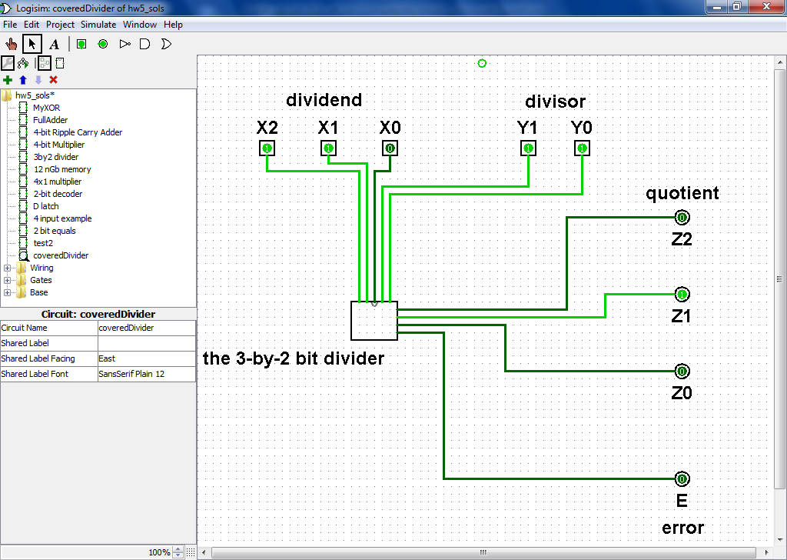
Division? hw5pr3
Ideas?

Slide 46
See you in Lab!

Slide 47
Composing circuits
4-bit Ripple-carry Adder
two 4-bit inputs
Could we use pieces we already have?
0 1 1 1
1 1 0 1
x
y
c_{in}
+
FA
sum
c_{out}
How many output bits?

Slide 48
Transistors, computationally
Transistors are current switches:
A low voltage here
allows current here
A high voltage here
allows current here

Slide 49
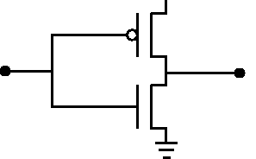
Transistors, computationally
POWER
Transistors are current switches:
+5 v power
A low voltage here
input (0 or 1)
allows current here
SIGNAL
Ground
A high voltage here
NOT
allows current here
input
output
Building a NOT gate from transistors…

Slide 50
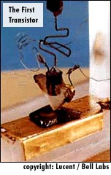
Transistors: a disruptive technology
point contact transistor
1947: Bell Labs
seeking cheaper amplifiers for phone lines
team of scientists: Walter Brattain, William Shockley, and John Bardeen
1948: junction transistor
much more robust design
1956: Shockley semiconductor corp.
the start of Silicon Valley…
1957: Fairchild semiconductor corp.
the "traitorous eight" - ICs

Slide 51
Quiz
Build separate circuits for each output-1 row using ANDs and NOTs
Name(s):
2
Combine them with an OR.
1
Here's the truth table defining a function
x
y
c
input
output
x
y
c
odd(x,y,c)
0
0
0
0
0
0
1
1
0
1
0
1
0
1
1
0
1
0
0
0
1
0
1
1
1
1
0
1
1
1
1
0
Create NOT "rails" ... if you want to...
Using multiplication for AND and addition for OR, what formula represents this circuit?
3
ExCr
Can you get rid of the ANDs by using only NOTs and ORs?
Notes:
51

Slide 52
input
output
Getting rid of ANDs ?
x
y
AND(x,y)
0
0
0
0
1
0
Can you get rid of the ANDs by using only NOTs and ORs?
1
0
0
1
1
1
x
xy
y
AND
Notes:
52

Slide 53
Jotto !
morning class's
our guesses
2047 words remaining
smile 2
bacon 1
2749 words remaining
938 words remaining
happy 1
shyly 2
630 words remaining
462 words remaining
tower 1
trump 1
285 words remaining
bunch 1
deify 1
afternoon class's
our guesses
1844 words remaining
hairy 2
wasps 2
1361 words remaining
784 words remaining
plane 1
credo 2
303 words remaining
339 words remaining
gumbo 1
thumb 0
206 words remaining
154 words remaining
front 1

Slide 54
The LogiSketch circuit simulator
http://www.cs.hmc.edu/~alvarado/research/sketch/release/LogiSketchFun2011.m4v

Slide 55
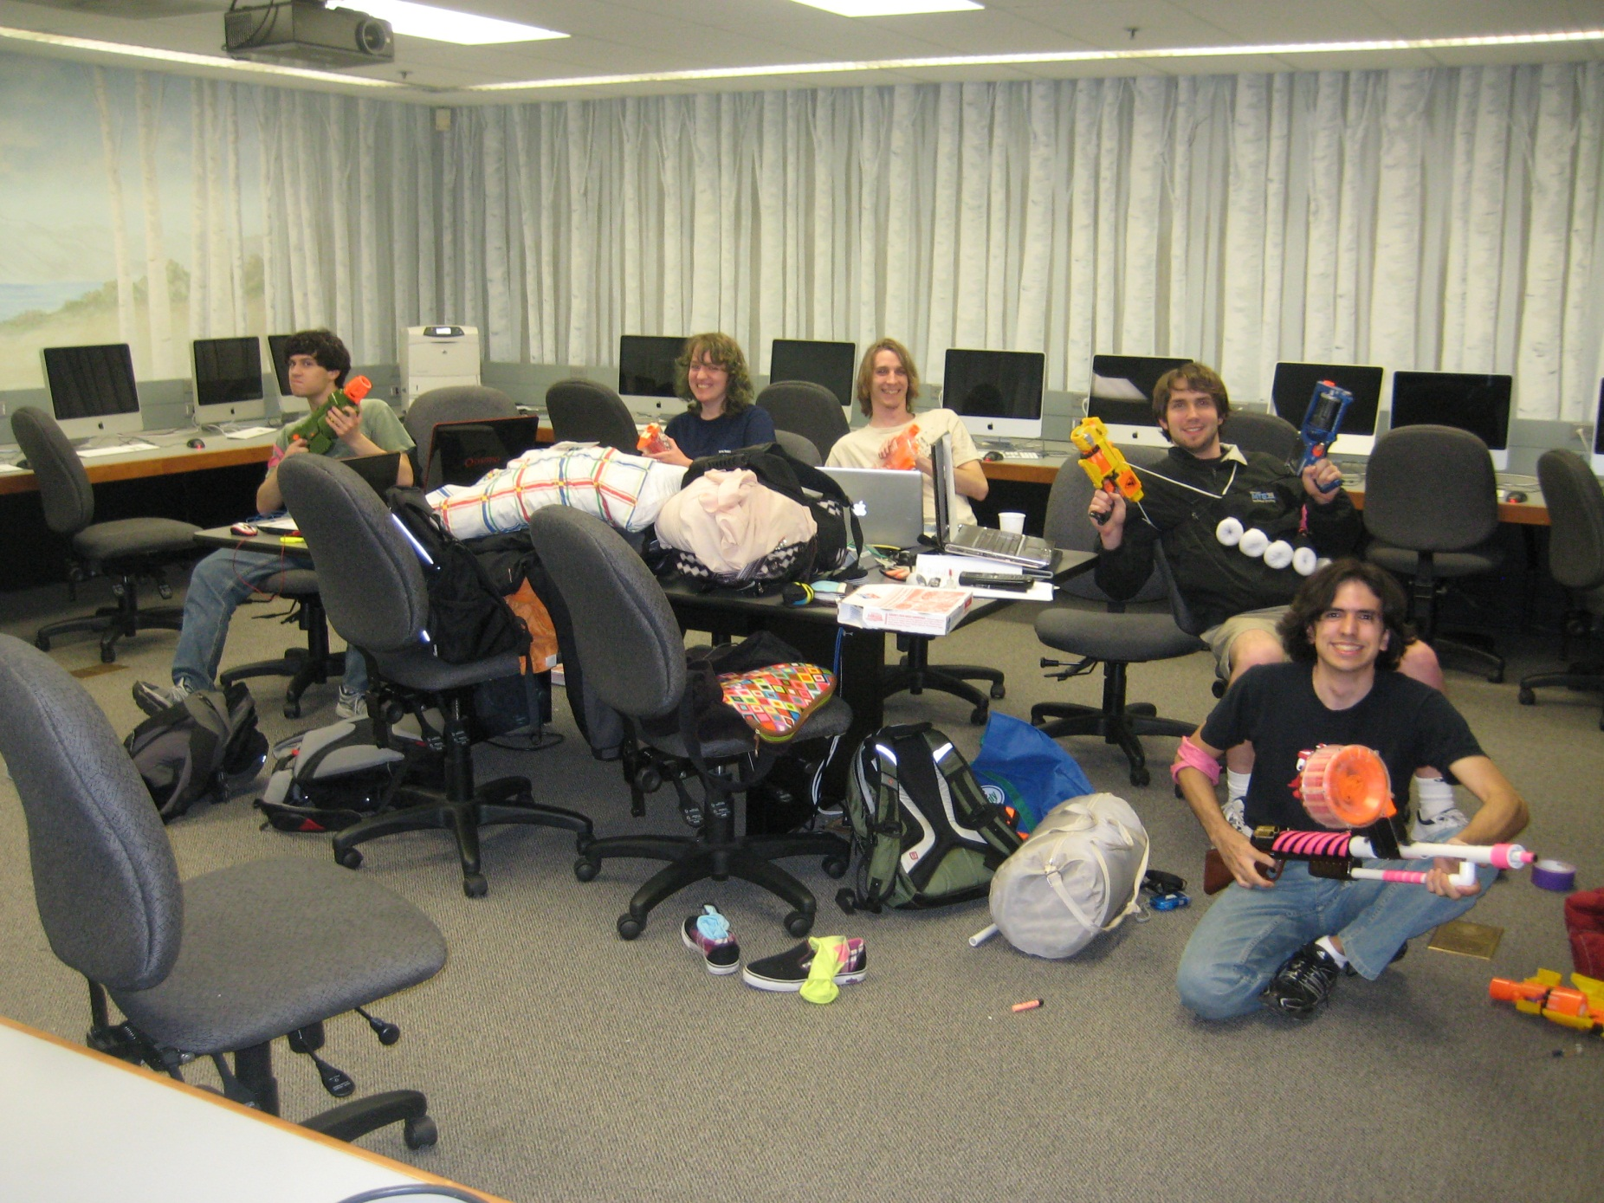
CS labs: safe from zombies!

Slide 56
For systems, a face-lift is to add an edge that creates a cycle, not just an additional node.
input
output
S
Q
NOR
R
input
NOR's Truth Table

Slide 57
For systems, a face-lift is to add an edge that creates a cycle, not just an additional node.
input
output
S
Q
NOR
feedback loop

Slide 58
Take a look at this circuit.
If S is 1, what will Q be?
What happens if S becomes 0?
input
output
S
Q
NOR
feedback loop
Reminders
NOR outputs 1 only if both inputs are 0
NOR outputs 0 if either inputs is 1
NOR's Truth Table

Slide 59
The SR latch
Is it currently stable or oscillating?
SET
input
S
0
1
NOR
What will happen if input S is set to 1?
0
Follow how the signals will change…
1
output
input
0
Q
RESET
R
NOR
0
What will happen if input S is then set back to 0?
Which signals will change?
What will happen if input R is then set to 1?
how do R and S affect Q in general?
How could we change this circuit so that it takes 1 bit of DATA as input?
NOR's Truth Table

Slide 60
The D latch
The SR latch
D
data
S
0
1
NOR
inputs
0
1
output
0
Q
R
NOR
0
S sets Q to 1.
only one of S or R is high
R resets Q to 0.
How could we change this circuit so that it takes 1 bit of DATA as input?
We might want to deliberately trigger the memory of our 1 bit of data.

Slide 61
The D latch
The SR latch
D
data
inputs
S
0
AND
1
"strobe"
NOR
0
tells when to remember the data!
1
output
0
Q
R
NOR
AND
0
S sets Q to 1.
mutually exclusive ANDs
R resets Q to 0.
We might want to deliberately trigger the memory of our 1 bit of data.

Slide 62
The D latch
The SR latch
D
data
inputs
S
0
AND
1
"strobe"
NOR
0
The data can be ready any time (or NOT!) But nothing will happen until the strobe says so!
1
output
0
Q
R
NOR
AND
0
S sets Q to 1.
These ANDs ensure
R resets Q to 0.
if D == 1, S is 1
if D == 0, R is 1
1 bit of memory!
"flip-flop"

Slide 63
The D latch
The SR latch
D
data
inputs
0
AND
1
"strobe"
NOR
0
1
output
0
Q
NOR
AND
0
D
the circuit element
Q
1 bit of memory!
strobe
"flip-flop"

Slide 64
Random Access Memory
"on-chip"
We can use data latches to create a 12 nG bit RAM !
Inputs
Outputs
3 data input bits
Simplified
Prototype for
Accessing
Memory
3 data output bits
write enable line
read enable line
2 data address bits
12 bits of RAM
3 bits stored at location 00
3 bits stored at location 01
3 bits stored at location 10
3 bits stored at location 11

Slide 65
Random Access Memory
"on-chip"
We can use data latches to create a 12 nG bit RAM !
Inputs
Outputs
3 data input bits
Simplified
Prototype for
Accessing
Memory
3 data output bits
write enable line
read enable line
2 data address bits
12 bits of RAM
3 bits stored at location 00
3 bits stored at location 01
3 bits stored at location 10
3 bits stored at location 11

Slide 66
"QUIZ"
3 data input bits
STORE
5 into memory location #1
0. Make data input bits 101
1. Give 01 to the decoder (the 1 goes on)
2. Make the "Write Enable" high
3. How does it all work?
4. How do the * AND gates help?
D
Q
D
Q
D
Q
memory location
strobe
strobe
strobe
0
Address Decoder
*
D
Q
D
Q
D
Q
IN: data address, in binary
strobe
strobe
strobe
1
*
2
3
write enable line
OR
read enable line
OR
OR
two other memory lines and their flip-flops are not drawn
3 data output bits

Slide 67
"QUIZ"
3 data input bits
LOAD
data from mem. location #1
0. Suppose 101 is in Location #1
1. Give 01 to the decoder (the 1 goes on)
2. Make the "Read Enable" high
3. Which gates ensure data from memory location #1 is read?
4. Which gates ensure data from memory location #0 is not read?
memory location
D
Q
D
Q
D
Q
strobe
strobe
strobe
Address Decoder
0
D
Q
D
Q
D
Q
IN: data address, in binary
strobe
strobe
strobe
1
2
3
write enable line
OR
read enable line
OR
OR
two other memory lines and their flip-flops are not drawn
3 data output bits

Slide 68
See you in Lab…

Slide 69
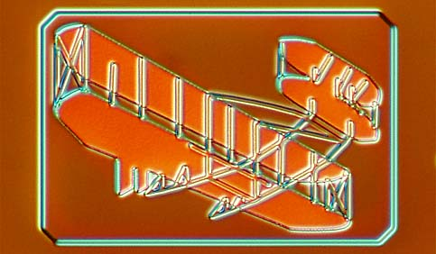
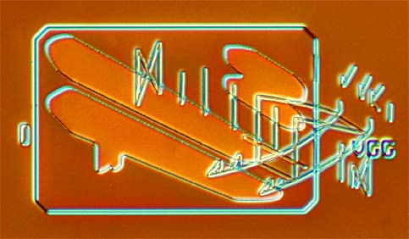
What to do with all that extra silicon?
The "silicon zoo": micro.magnet.fsu.edu/creatures/index.html

Slide 70
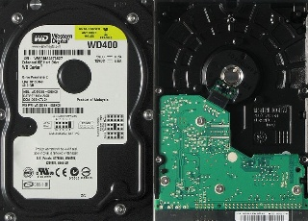
Memorable media…
CPU = "on-chip"
Main Memory
(replaceable RAM)
Disk Drive
magnetic storage
Central Processing Unit
An 8-bit register: 8 flip-flops
D
Q
D
Q
D
Q
D
Q
D
Q
D
Q
D
Q
D
Q
s
s
s
s
s
s
s
s
50 Registers of 8-64 bits each
< 10,000 bits
~ 1 billion bits +
~1 trillion bits (or more)
120 gigabyte drive
"640K ought to be enough for anybody"
- not Bill Gates!

Slide 71
Memorable media…
CPU = "on-chip"
Main Memory
(replaceable RAM)
Disk Drive
magnetic storage
Central Processing Unit
An 8-bit register: 8 flip-flops
D
Q
D
Q
D
Q
D
Q
D
Q
D
Q
D
Q
D
Q
s
s
s
s
s
s
s
s
50 Registers of 8-64 bits each
< 10,000 bits
~ 1 billion bits +
~1 trillion bits (or more)
120 gigabyte drive
Not Bill Gates, Logic Gates!
"Leaky Bucket" capacitors
remagnetizing surfaces
strategies for storage

Slide 72
A Memorable Aside…
CPU = "on-chip"
Main Memory
("real" RAM)
Disk Drive
magnetic storage
Central Processing Unit
An 8-bit register: 8 flip-flops
D
Q
D
Q
D
Q
D
Q
D
Q
D
Q
D
Q
D
Q
s
s
s
s
s
s
s
s
~50 Registers of 8-32 bits each
8 billion bits
800 billion bits (or more)
1 billion bytes
100 billion bytes (or more)
Price
~$100
~$100
~$100

Slide 73
A Memorable Aside…
CPU = "on-chip"
Main Memory
("real" RAM)
Disk Drive
magnetic storage
Central Processing Unit
An 8-bit register: 8 flip-flops
D
Q
D
Q
D
Q
D
Q
D
Q
D
Q
D
Q
D
Q
s
s
s
s
s
s
s
s
~50 Registers of 8-32 bits each
8 billion bits
800 billion bits (or more)
1 billion bytes
100 billion bytes (or more)
Price
~$100
~$100
~$100
Time
1 clock cycle
100 cycles
10⁷ cycles

Slide 74
A Memorable Aside…
CPU = "on-chip"
Main Memory
("real" RAM)
Disk Drive
magnetic storage
Central Processing Unit
An 8-bit register: 8 flip-flops
D
Q
D
Q
D
Q
D
Q
D
Q
D
Q
D
Q
D
Q
s
s
s
s
s
s
s
s
~50 Registers of 8-32 bits each
8 billion bits
800 billion bits (or more)
1 billion bytes
100 billion bytes (or more)
Price
~$100
~$100
~$100
Time
1 clock cycle
100 cycles
10⁷ cycles
10⁻⁹ sec
10⁻⁷ sec
10⁻² sec
If “cycle”
were 1 min
1 min
1.5 hours
?

Slide 75
A Memorable Aside…
CPU = "on-chip"
Main Memory
("real" RAM)
Disk Drive
magnetic storage
Central Processing Unit
An 8-bit register: 8 flip-flops
D
Q
D
Q
D
Q
D
Q
D
Q
D
Q
D
Q
D
Q
s
s
s
s
s
s
s
s
~50 Registers of 8-32 bits each
8 billion bits
800 billion bits (or more)
1 billion bytes
100 billion bytes (or more)
Price
~$100
~$100
~$100
Time
1 clock cycle
100 cycles
10⁷ cycles
10⁻⁹ sec
10⁻⁷ sec
10⁻² sec
If “cycle”
were 1 min
1 min
1.5 hours
19 YEARS

Slide 76
See you in Lab!

Slide 77
Optimization hinders Evolution
- A Perlis

Slide 78
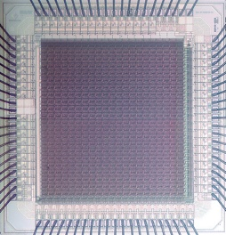
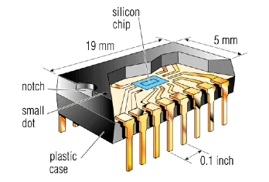
Integrated Circuits
3mm
http://personalpages.manchester.ac.uk/staff/p.dudek/projects/scamp
http://www.helicon.co.uk

Slide 79
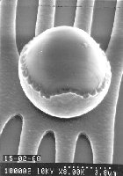
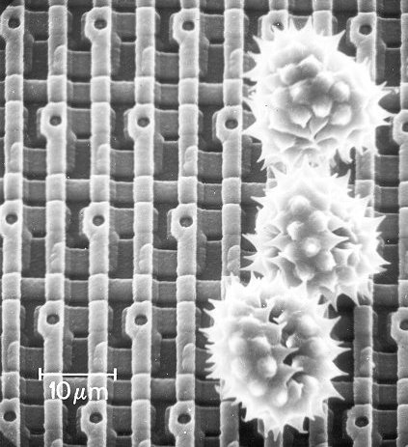
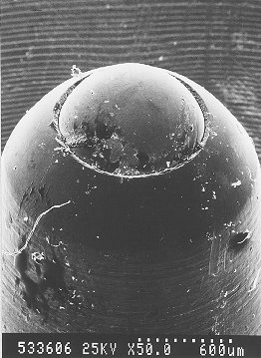
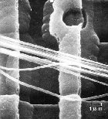
Ouch!
The enemy ...
Keeping particles out of the fabrication process is paramount!
Pollen on a memory chip
A ruthless invader...
Nature still impresses...

Slide 80
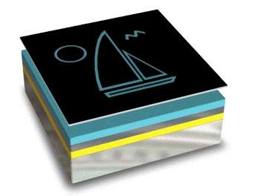
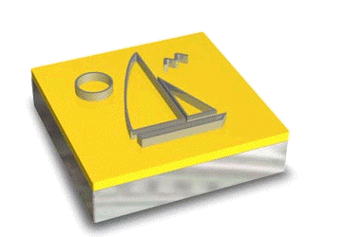
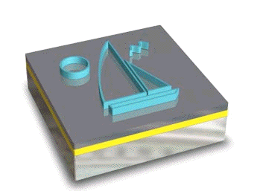
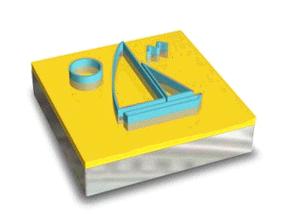
It’s totally FAB
http://www.techfak.uni-kiel.de/matwis/amat/elmat_en/makeindex.html
How are all of these gates actually realized?
Layering
mask w/ circuit (or sailboat)
photoresist
conductor
silicon dioxide
silicon wafer
Cleaning
Lithography
Etching
x 200 or so

Slide 81
CS 101 Today
Welcome Back!
to all Grace Hopper-ers
Minterm Expansion Principle
Any circuit for any binary function can be built from three components:
Too many inputs !?
w
wxyz
x
y
AND
z
"w and x and y and z"
Gallery
w
w+x+y+z
x
OR
y
z
"w or x or y or z"
Hw #5:
due 10/11 @ 11:59 pm
Circuit design in Logisim
x
NOT
x
Extra credit: memory design
"not x"
start it in lab (perhaps finish!)

Slide 82
Logic Gates
input
output
input
output
x
y
AND(x,y)
x
y
OR(x,y)
input
output
0
0
0
0
0
0
x
NOT(x)
0
1
0
0
1
1
0
1
1
0
0
1
0
1
1
0
1
1
1
1
1
1
input
x
x
y
x
y
NOT
AND
OR
xy
x + y
x
output
"x and y"
"x or y"
"not x"

Slide 83
Universal set
input
output
Any function of bits can be built from these three gates:
AND
OR
NOT
“Hex NOT gate"
Notes:
these quotes are important to yahoo… !

Slide 84
Minterm Expansion
Truth Table
… is a proof that AND, OR, and NOT suffice to construct any function!
input
output
x
y
XOR(x,y)
0
0
0
0
1
1
1
0
1
1
1
0
Process
Build circuits of NOTs and AND that computes each "1" row.
OR them together.
Notes:
84

Slide 85
Minterm Expansion
1
Specify the Truth Table defining the function
2
Build separate circuits for each output-1 row using ANDs and NOTs
Combine them with OR.
input
output
x
y
XOR(x,y)
0
0
0
0
1
1
1
0
1
1
1
0
input x
KEY
AND
input y
This circuit always outputs 0 - except for the second row!
Notes:
85

Slide 86
Minterm Expansion
1
Specify the Truth Table defining the function
2
Build separate circuits for each output-1 row using ANDs and NOTs
Combine them with OR.
input
output
x
y
XOR(x,y)
0
0
0
0
1
1
1
0
1
1
1
0
input x
AND
KEY
input y
This circuit always outputs 0 - except for the third row!
AND
These are not bubbles, they’re NOT bubbles
Notes:
86

Slide 87
Minterm Expansion
1
Specify the Truth Table defining the function
2
Build separate circuits for each output-1 row using ANDs and NOTs
Combine them with OR.
input
output
x
y
XOR(x,y)
0
0
0
0
1
1
1
0
1
1
1
0
input x
AND
input y
output
OR
AND
These are not bubbles, they’re NOT bubbles
Notes:
87

Slide 88
Minterm Expansion
1
Specify the Truth Table defining the function
2
Build separate circuits for each output-1 row using ANDs and NOTs
Combine them with OR.
input
output
x
y
XOR(x,y)
Or you can start here…
0
0
0
0
1
1
"the formula"
1
0
1
3
xy + xy
1
1
0
input x
AND
input y
output
OR
AND
Notes:
88

Slide 89
"Rails"
1
Specify the Truth Table defining the function
2
Build separate circuits for each output-1 row using ANDs and NOTs
Combine them with OR.
input
output
x
y
x
y
XOR(x,y)
x
y
0
0
0
0
1
1
1
0
1
AND
1
1
0
OR
AND
This wire ("rail") carries x's value.
This wire ("rail") carries y's value.
Notes:
89

Slide 90
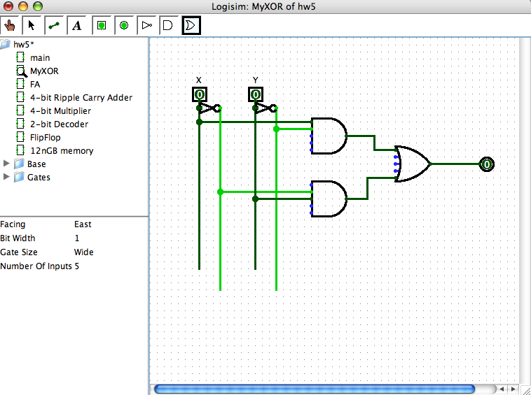
The Logisim circuit simulator
The XOR circuit in Logisim
Rails for circuit cleanliness!
http://ozark.hendrix.edu/~burch/logisim/
It's no coincidence that the "high-power" lines are lime green!

Slide 91
3
What is the "formula" for this boolean function?
1
Specify the Truth Table defining the function
2
Build separate circuits for each output-1 row using ANDs and NOTs
input
output
Combine them with OR.
x
y
<=(x,y)
How many ANDs will there be?
0
0
1
x
y
0
1
0
x
y
1
0
1
1
1
1
The "less than or equal to" function…
Use these "rails" to help draw your circuit
Notes:
91

Slide 92
I'm chomping at the bit to find out…
Minterm expansion proves that you need only AND, OR, and NOT gates in order to construct any boolean function.
Can we do without some of the 3? Which?
4
5
How could we create functions with two bits, or N bits, of output?

Slide 93
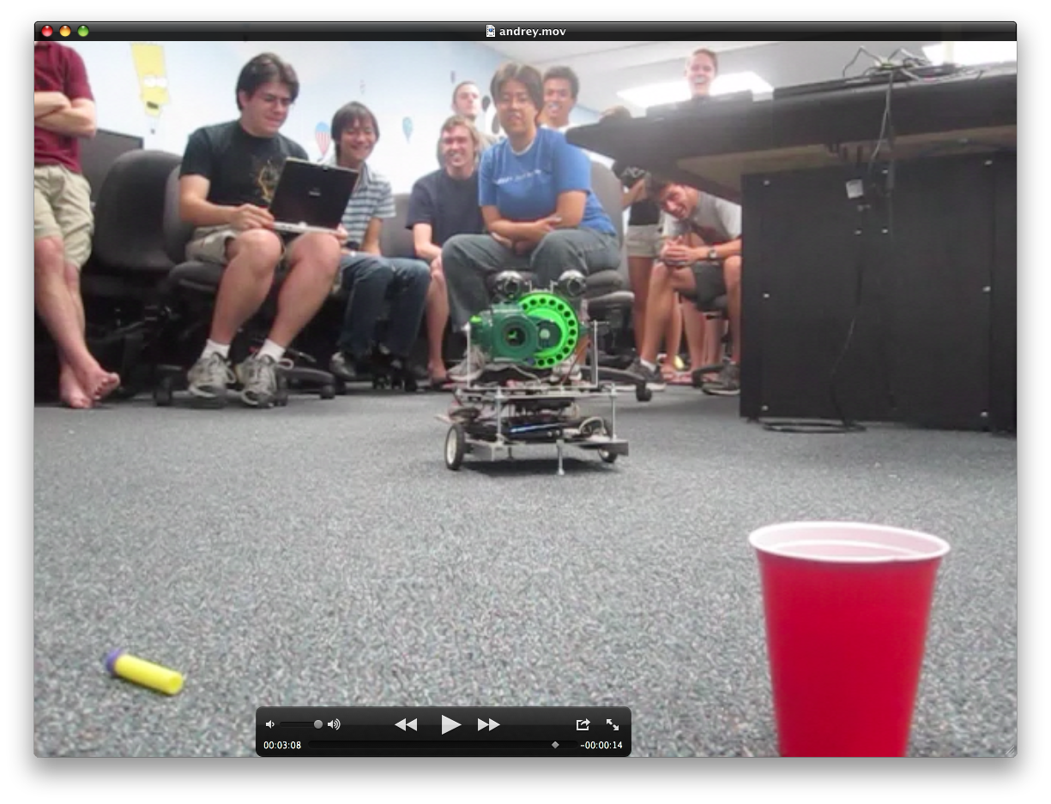
or maybe not so safe…

