Slide 1

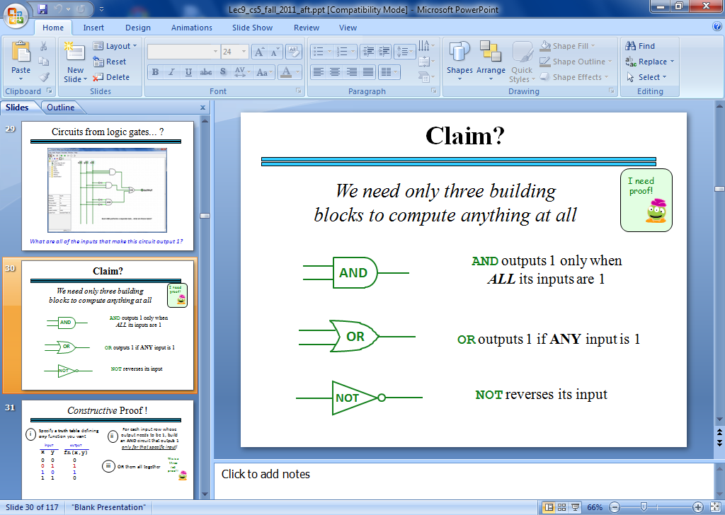
CS Today
Recursion ~ OK?
OKer than before?
Hw#5: Circuit design in Logisim
Not enough Sakai? Recurse!
Thanks, Julio!
Minterm Expansion Principle
A circuit for any binary function can be built from
only these three logic gates!
That's minterm, NOT midterm
am guesses
alien: 2
chord: 2
bumps: 1
161 words left…
my guesses
diner: 0
ghost: 2
plumb: 1
213 words left…
Jotto ~ no letter left behind!
Notes:
jazzy!

Slide 2

Enjoy GHC!
… as these folks (and 40 other HMCers) did!
Needed: pictures from the 2014 GHC bus!

Slide 3
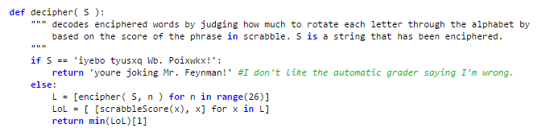
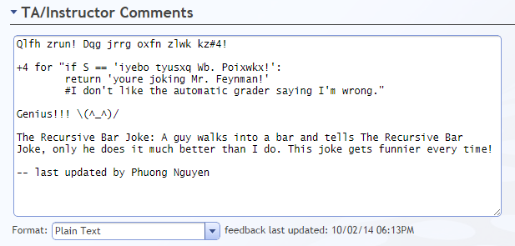
Creativity with Caesar...
def decipher( S ):

Slide 4
Creativity with Caesar...
def decipher( S ):
""" TESIJHYDW - je tusyfxuh
jxyi tesijhydw, zkij hkd
tusyfxuh ed yj. """
… code here …

Slide 5
Creativity with Caesar...
def decipher( S ):
""" DOCSTRING - to decipher
this docstring, just run
decipher on it. """
… code here …
my favorite not-fully-working decipher…

Slide 6
Creativity with Caesar...
def decipher( S ):
""" This works sometimes """
return encipher( S, 3 )
and this docstring is 100% correct!

Slide 7
This week
Circuits!
def decipher( S ):
""" This works sometimes """
return encipher( S, 3 )
Designing physical devices that work all the time!

Slide 8
In a computer, each bit is represented as a voltage (1 is +5v and 0 is 0v)
Computation is simply the deliberate combination of those voltages!
101010
(1) set input voltages
42
(2) perform computation
ADDER circuit
51
110011
(3) read output voltages
9
001001
What's in that green box?
Richard Feynman: "Computation is just a physics experiment that always works!"

Slide 9
Part 1: Represent your f'n as bits…
IN
OUT
x
y
c
circuit output
0
0
0
0
0
0
1
1
0
1
0
1
0
1
1
0
1
0
0
1
1
0
1
0
1
1
0
0
1
1
1
1
Any function can be represented using only bits…

Slide 10
All computations…
…are simply f'ns of bits
binary inputs A and B
output, A+B
A
B
sum
00
00
000
00
01
001
00
10
010
00
11
011
01
00
001
01
01
010
01
10
011
01
11
bitwise
addition function
100
10
00
010
10
01
011
10
10
100
10
11
101
11
00
011
11
01
100
11
10
You'll build this f'n in Logisim this week… !
101
11
11
110
You already built it in Python last week…

Slide 11
Part 2: Arrange logic gates to match…
input
output
input
output
x
y
AND(x,y)
x
y
OR(x,y)
input
output
x
NOT(x)
0
0
0
0
0
0
0
1
0
0
1
1
0
1
1
0
0
1
0
1
1
0
1
1
1
1
1
1
AND outputs 1 only if ALL inputs are 1
OR outputs 1 if ANY input is 1
NOT reverses its input
AND
OR
NOT
not just theoretical models!

Slide 12
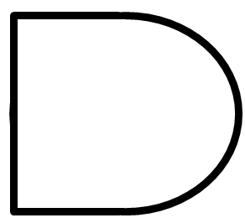
AND
inputs
AND
output
How many different input combinations yield an output of 0 here?
AND outputs 1 when ALL inputs are 1
otherwise it outputs 0

Slide 13
AND
x
y
inputs
z
AND
output
output
w
input
output
x
y
z
w
AND(xyzw)
AND's truth table:
0
0
0
0
0
0
0
0
1
0
fifteen 0s
…12 more rows not shown…
0
1
1
1
0
0
1
1
1
1
1
one 1

Slide 14
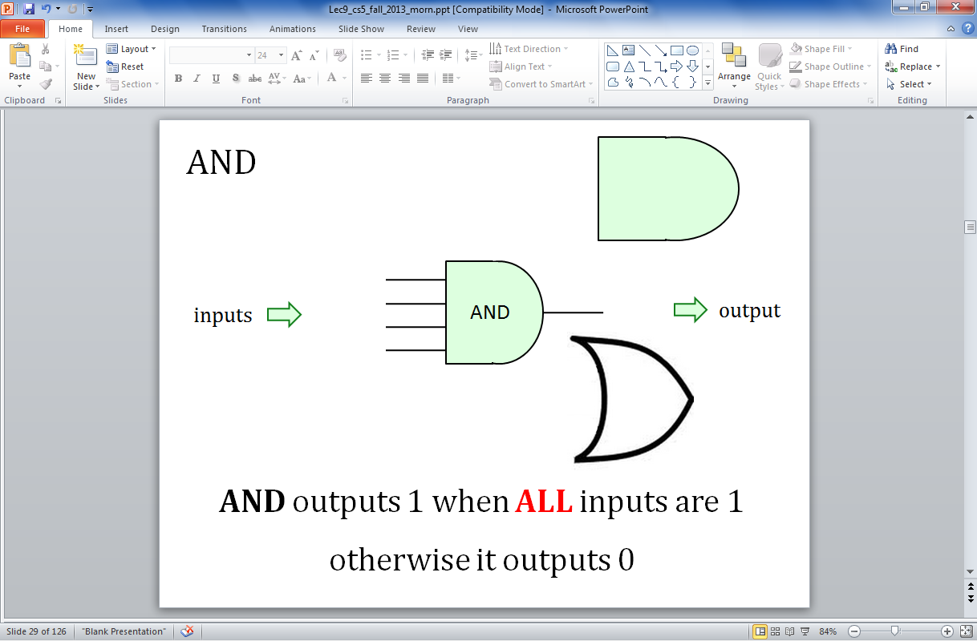
OR
inputs
OR
output
How many different input combinations yield an output of 1 here?
OR outputs 1 when ANY input is 1
It outputs 0 only if all inputs are 0.

Slide 15
OR
x
y
inputs
z
OR
output
output
w
input
output
x
y
z
w
OR(xyzw)
OR's truth table:
0
0
0
0
0
one 0
0
0
0
1
1
…12 more rows not shown…
1
1
1
1
0
1
fifteen 1s
1
1
1
1
1

Slide 16
NOT
"NOT bubble" (optional)
inputs
x
NOT
output
NOT's function:
input
output
x
NOT(x)
0
1
one 1
1
0
one 0

Slide 17

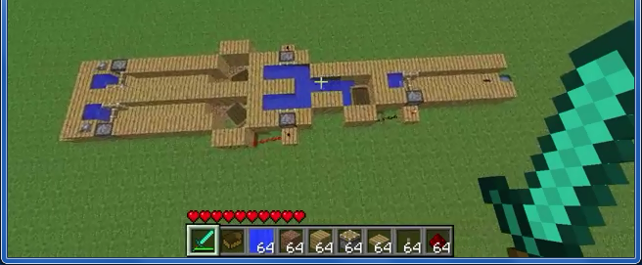
Real logic gates
"It's not real unless it can be done in Minecraft."
- perhaps not a real quote
1:31
https://www.youtube.com/watch?v=P7E4K5D834g "Minecraft Logi Gates"
https://www.youtube.com/watch?v=r7N3K8ulEEM "Minecraft Logic Gates Water"
:41
Notes:
these quotes are important to yahoo… !

Slide 18
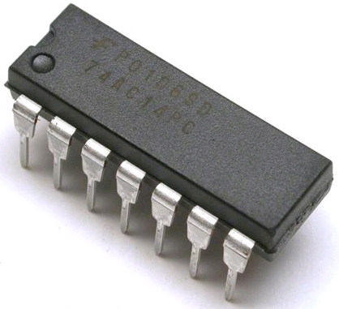
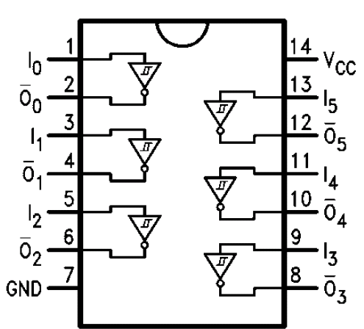
Real! logic gates...
Hex NOT gate
Notes:
these quotes are important to yahoo… !

Slide 19
Our building blocks: logic gates
input
output
input
output
x
y
AND(x,y)
x
y
OR(x,y)
input
output
x
NOT(x)
0
0
0
0
0
0
0
1
0
0
1
1
0
1
1
0
0
1
0
1
1
0
1
1
1
1
1
1
AND outputs 1 only if ALL inputs are 1
OR outputs 1 if ANY input is 1
NOT reverses its input
AND
OR
NOT

Slide 20
The claim!
AND outputs 1 only if ALL its inputs are 1
AND
OR outputs 1 if ANY input is 1
OR
NOT
NOT reverses its input
We need only these three building blocks to compute anything at all
I need proof!

Slide 21
The claim!
AND outputs 1 only if ALL its inputs are 1
AND
We prove this constructively using the minterm expansion principle.
OR outputs 1 if ANY input is 1
OR
NOT
NOT reverses its input
We need only these three building blocks to compute anything at all
I need proof!

Slide 22
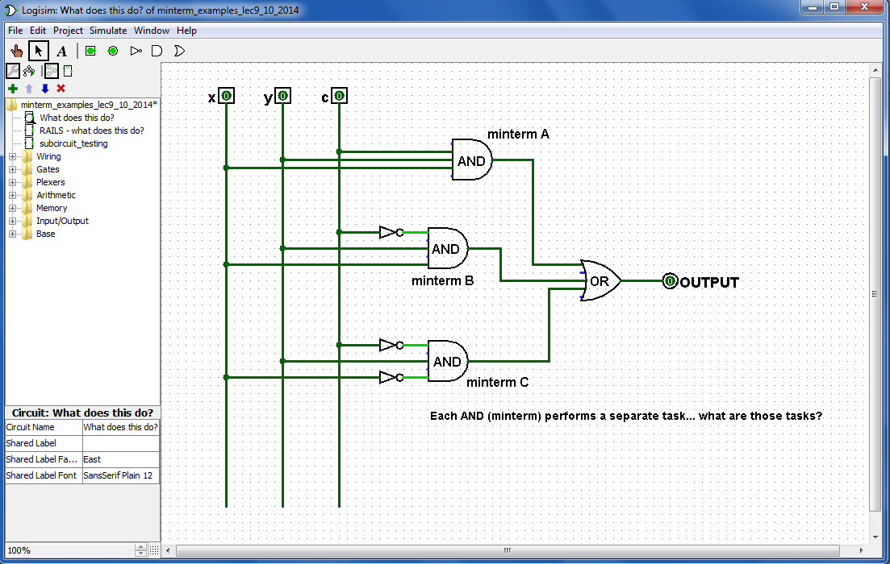
Designing circuits
What inputs make this circuit output 1?
Logisim
What inputs make this circuit output 0?

Slide 23
Minterm?
A minterm is an AND gate connected to all input bits - either directly or inverted

Slide 24
Each minterm selects one input:
What 3-bit input makes this AND gate output a 1?
minterm == AND gate that "selects" a single input

Slide 25
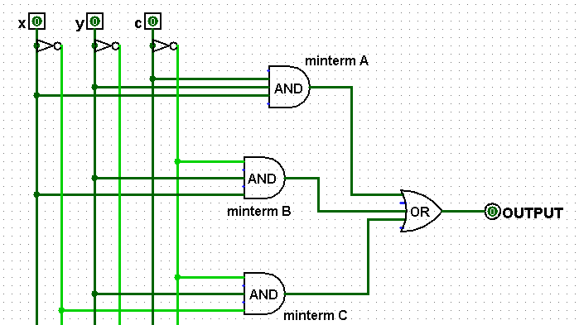
Rails
What are the differences between these two circuits?
using rails for Not X and Not Y
Any advantages of this "rails" approach?
disadvantages?

Slide 26
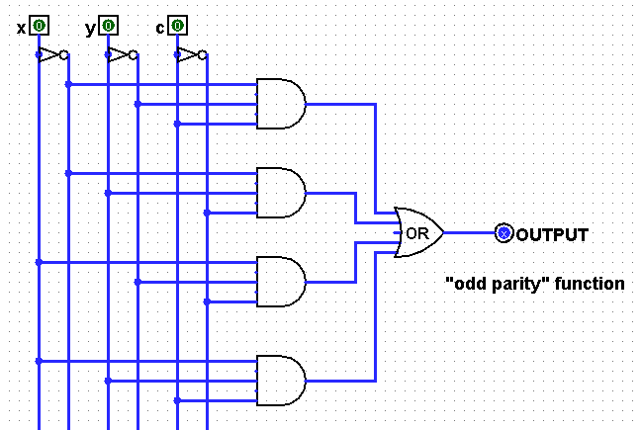
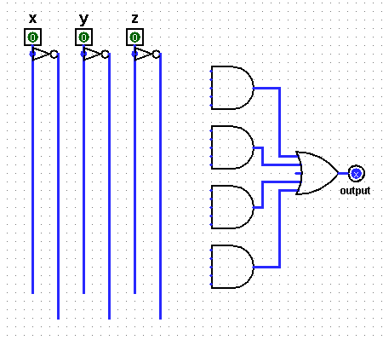
Name(s)
Quiz
input
output
A
x
y
c
0
0
0
(1) Fill in the function values (the truth table) for this circuit…
B
0
0
1
0
1
0
C
0
1
1
(2) Which line does each AND gate (each minterm) A, B, C, D - implement?
1
0
0
1
0
1
D
1
1
0
1
1
1
(3) Draw the upstream wires that will implement this function as a circuit.
c
(4) The second circuit has four ANDs (minterms). Could it use fewer ANDs?
input
output
x
y
c
A
0
0
0
0
(5) Could you replace the OR gate with ANDs and NOTs -- so ORs aren't needed at all?!
0
0
1
0
B
0
1
0
0
0
1
1
1
C
1
0
0
0
1
0
1
1
(EC) Do you see how these two circuits can implement all binary additions !?
1
1
0
1
D
1
1
1
1

Slide 27
Name(s)
Quiz
input
output
A
x
y
z
0
0
0
(1) Fill in the function values (the truth table) for this circuit…
B
0
0
1
0
1
0
C
0
1
1
(2) Which line does each AND gate (each minterm) A, B, C, D - implement?
1
0
0
1
0
1
D
1
1
0
Let's go over these… in a moment
1
1
1
(3) Draw the upstream wires that will implement this function as a circuit.
(4) The second circuit has four ANDs (minterms). Could it use fewer ANDs?
input
output
x
y
z
A
0
0
0
0
(5) Could you replace the OR gate with ANDs and NOTs -- so ORs aren't needed at all?!
0
0
1
0
B
0
1
0
0
0
1
1
1
C
1
0
0
0
1
0
1
1
(EC) Do you see how these two circuits can implement all binary additions !?
1
1
0
1
D
1
1
1
1

Slide 28
Our claim!
AND outputs 1 only if ALL its inputs are 1
AND
We prove this constructively using the minterm expansion principle.
OR outputs 1 if ANY input is 1
OR
NOT
NOT reverses its input
We need only these three building blocks to compute anything at all
I need proof!

Slide 29
A constructive proof… !
i
Specify a truth table defining any function you want
For each input row whose output needs to be 1, build an AND circuit that outputs 1 only for that specific input!
ii
input
output
x
y
f(x,y)
0
0
0
Hey! This is a 3-i'ed proof!
0
1
1
iii
OR them all together
1
0
1
1
1
0

Slide 30
A constructive proof…
i
Specify a truth table defining any function you want
For each input row whose output needs to be 1, build an AND circuit that outputs 1 only for that specific input!
ii
input
output
x
y
f(x,y)
0
0
0
0
1
1
iii
OR them all together
1
0
1
1
1
0
We ensure this OR outputs zero by default.
x
y
The ZERO rows ALREADY work – with no connections at all !
0
OR
x
y

Slide 31
A constructive proof…
i
Specify a truth table defining any function you want
For each input row whose output needs to be 1, build an AND circuit that outputs 1 only for that specific input!
ii
input
output
x
y
f(x,y)
0
0
0
0
1
1
iii
OR them all together
1
0
1
1
1
0
x
y
NOT
AND
OR
Does this wire turn on for the red input row?
x
y
Does this wire turn on for any other input rows?

Slide 32
A constructive proof…
i
Specify a truth table defining any function you want
For each input row whose output needs to be 1, build an AND circuit that outputs 1 only for that specific input!
ii
input
output
x
y
f(x,y)
0
0
0
0
1
1
iii
OR them all together
1
0
1
1
1
0
x
y
NOT
AND
OR
AND
NOT
blue row?
other rows?
x
y

Slide 33
A constructive proof…
i
Specify a truth table defining any function you want
For each input row whose output needs to be 1, build an AND circuit that outputs 1 only for that specific input!
ii
input
output
x
y
This is a constructive proof that AND, OR, NOT suffice to build any function of bits!
f(x,y)
0
0
0
0
1
1
iii
OR them all together
1
0
1
1
1
0
x
y
NOT
AND
OR
AND
NOT
blue row?
other rows?
x
y

Slide 34
A constructive proof…
but ALL functions are just functions of bits !
i
Specify a truth table defining any function you want
For each input row whose output needs to be 1, build an AND circuit that outputs 1 only for that specific input!
ii
input
output
x
y
This is a constructive proof that AND, OR, NOT suffice to build any function of bits!
f(x,y)
0
0
0
0
1
1
iii
OR them all together
1
0
1
1
1
0
x
y
NOT
AND
OR
AND
NOT
blue row?
other rows?
x
y

Slide 35
Another example
Specify a truth table defining any function you want
For each input row whose output needs to be 1, build an AND circuit that outputs 1 only for that specific input!
1
2
input
output
x
y
fn(x,y)
0
0
1
3
OR them all together
0
1
0
1
0
0
1
1
1
x
y
1 OR
x
y
2 ANDs

Slide 36
Quiz
input
output
A
x
y
c
0
0
0
0
B
0
0
1
1
0
1
0
1
C
0
1
1
0
1
0
0
1
1
0
1
0
D
1
1
0
0
1
1
1
1
(1) Fill in the function values (the truth table) for this circuit…
(2) Which truth-table line does each AND gate - i.e., each minterm A, B, C, and D - implement?

Slide 37
Odd parity
IN
OUT
x
y
c
circuit output
0
0
0
0
0
0
1
1
0
1
0
1
1, exactly when the number of input bits is odd
0
1
1
0
1
0
0
1
1
0
1
0
1
1
0
0
1
1
1
1
Truth table for the "odd-parity" f'n
This is odd, but it's also f'n!

Slide 38


Odd parity vs. odd parody
with Python ties!
IN
OUT
x
y
z
circuit output
0
0
0
0
0
0
1
1
0
1
0
1
1, if the number of input bits is odd
0
1
1
0
1
0
0
1
1
0
1
0
1
1
0
0
1
1
1
1
Truth table for the "odd-parity" function

Slide 39
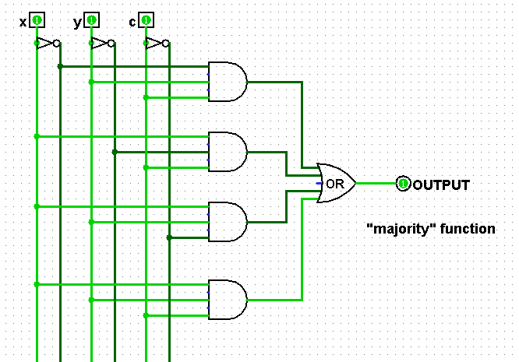
Quiz
(3) Draw the upstream wires that will implement this function as a circuit.
input
output
x
y
z
A
0
0
0
0
0
0
1
0
0
1
0
0
B
0
1
1
1
1
0
0
0
C
1
0
1
1
1
1
0
1
1
1
1
1
D
(5) Could you replace the OR gate with ANDs and NOTs -- so ORs aren't needed at all?!
(4) This second circuit has four ANDs (minterms). Could it use fewer ANDs?
(EC) Do you see how these two circuits can implement all binary additions !?

Slide 40
input
output
OR else ?!
x
y
OR(x,y)
0
0
0
0
1
1
Can you get rid of ORs by using only NOTs and ANDs?
1
0
1
1
1
1
x
x OR y
y
OR
Notes:
40

Slide 41
Name(s)
Quiz
input
output
A
x
y
z
0
0
0
(1) Fill in the function values (the truth table) for this circuit…
B
0
0
1
0
1
0
C
0
1
1
(2) Which line does each AND gate (each minterm) A, B, C, D - implement?
1
0
0
Please hand these in…
1
0
1
D
1
1
0
1
1
1
(3) Draw the upstream wires that will implement this function as a circuit.
(4) The second circuit has four ANDs (minterms). Could it use fewer ANDs?
input
output
x
y
z
A
0
0
0
0
(5) Could you replace the OR gate with ANDs and NOTs -- so ORs aren't needed at all?!
0
0
1
0
B
0
1
0
0
0
1
1
1
C
1
0
0
0
1
0
1
1
(EC) Do you see how these two circuits can implement all binary additions !?
1
1
0
1
D
1
1
1
1

Slide 42
Lab5: full adder
A full adder sums three input bits to create a 2-bit binary output
x
y
c_{in}
c_{out} sum
0 0 0
0 0
0 0 1
0 1
0 1 0
0 1
(A 3-bit adder is a full adder)
0 1 1
1 0
(A 2-bit adder is a half adder)
1 0 0
0 1
1 0 1
1 0
1 1 0
1 0
the full adder
1 1 1
1 1
x
y
c_{in}
3 individual bits of input
2 bits of output: a binary #
FA
sum
c_{out}
these columns look familiar!

Slide 43
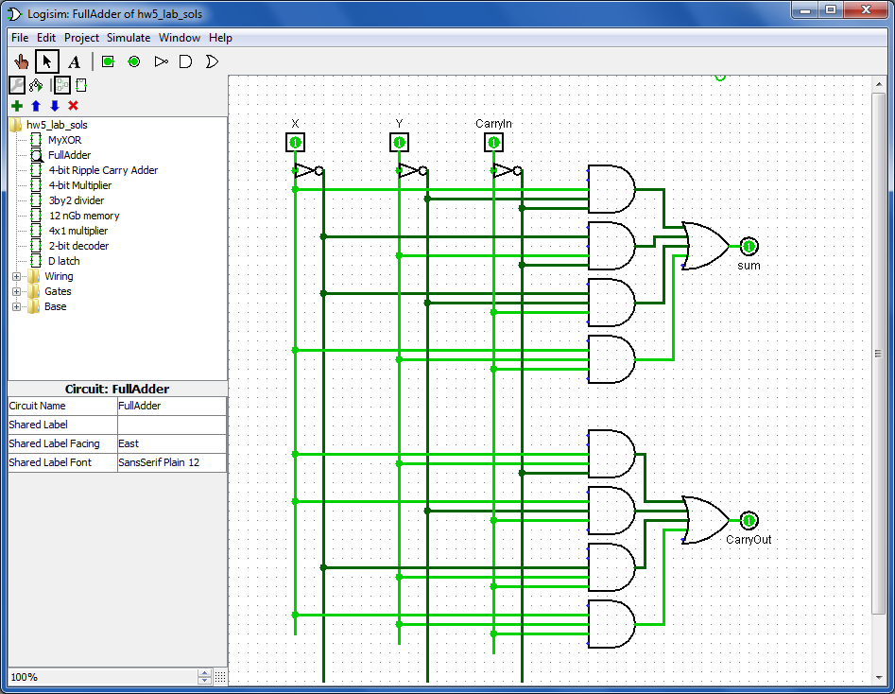
Building a Full Adder
A separate circuit for each output bit
3 input bits
Full Adder
input
output
x
y
c_{in}
x
y
c_{in}
c_{out} sum
0 0 0
0 0
0 0 1
0 1
sum output bit
0 1 0
0 1
0 1 1
1 0
1 0 0
0 1
2 output bits
1 0 1
1 0
1 1 0
1 0
You'll build both of these in Lab!
c_{out} output bit
1 1 1
1 1
"Carry-out" Circuit
"Rails" of each bit and its inverse

Slide 44
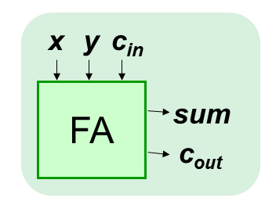
Compose!
Any binary addition at all?
0 1 1 1
1 1 0 1
8 bits in
+
5 bits out
Do you see how to use full adders here?

Slide 45
Compose!
4-bit Ripple-carry Adder
This may be less clear than before!
0 1 1 1
1 1 0 1
8 bits in
+
5 bits out
We've used four full adders here… .

Slide 46
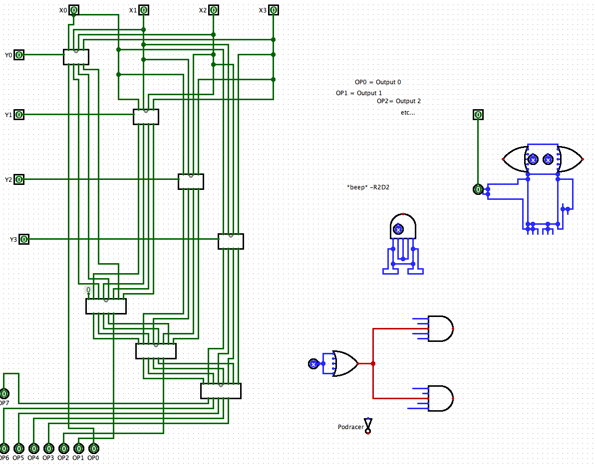
The "canvas"
These are circuit-based compositions!

Slide 47

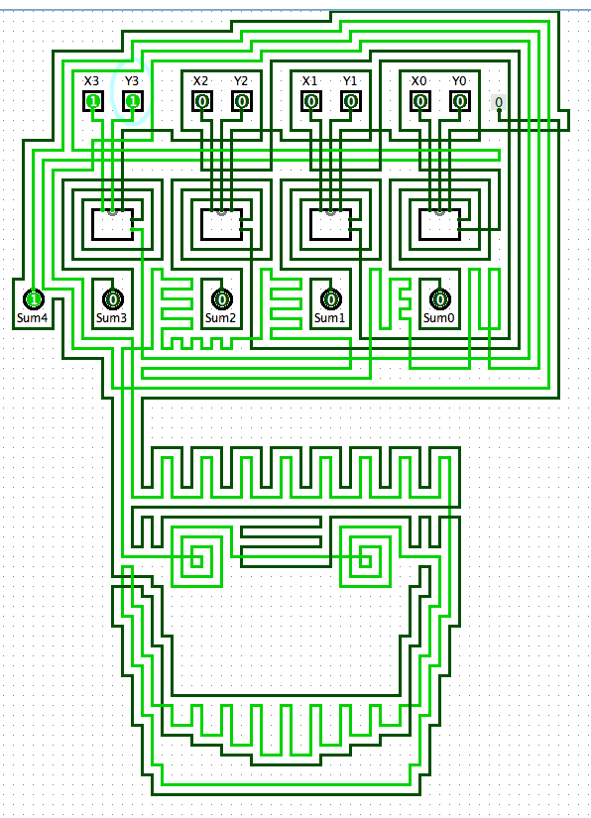

an "official" adder…
A zombie-themed ripple-carry adder
It looks pretty wiry to me!

Slide 48
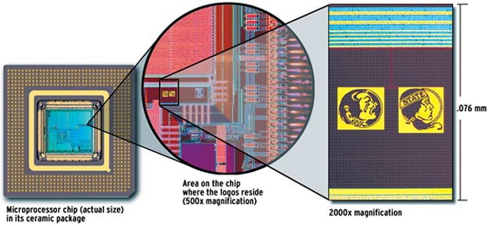
relative scale…

Slide 49
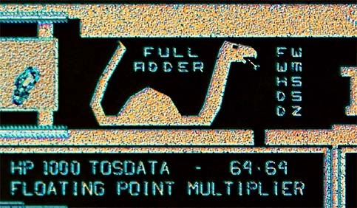
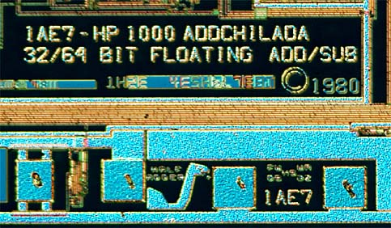
Many adders!
These aren't Easter Eggs, they're adder eggs!

Slide 50
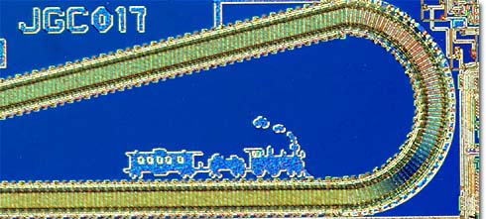
chugging right along…
Ridin' the Rails !

Slide 51
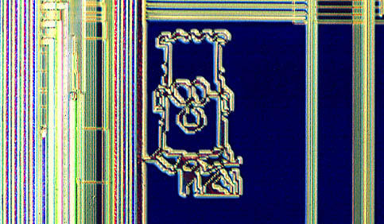
What to do with all that extra silicon?

Slide 52
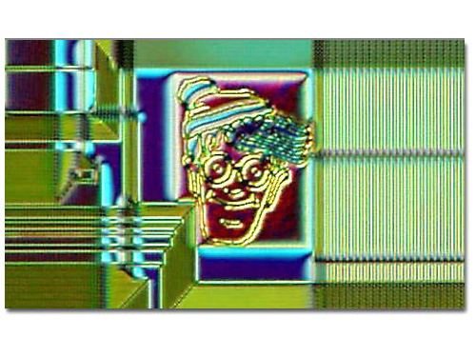
What to do with all that extra silicon?
The "silicon zoo": micro.magnet.fsu.edu/creatures/index.html

Slide 53
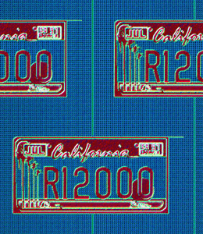
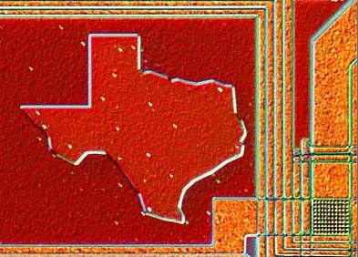
Homestate pride…

Slide 54
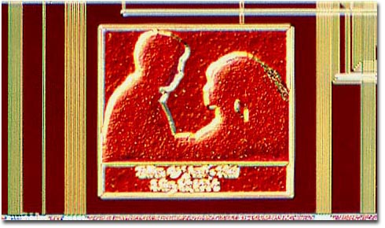
Marriage proposals?

Slide 55
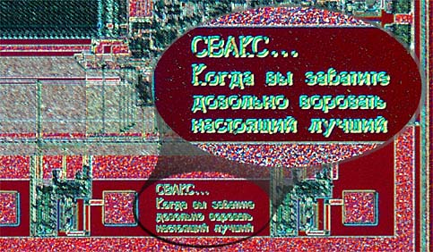
and secret? messages…

Slide 56
Composing circuits ~ hw5
4-bit "Ripple-Carry" Adder
4-bit Multiplier
3x2-bit Divider

Slide 57
x
y
c_{in}
Composing circuits
FA
sum
4-bit Ripple-carry Adder
c_{out}
We reuse pieces we already have… !
0 1 1 1
1 1 0 1
8 bits in
+
abstract these details away…
5 bits out

Slide 58
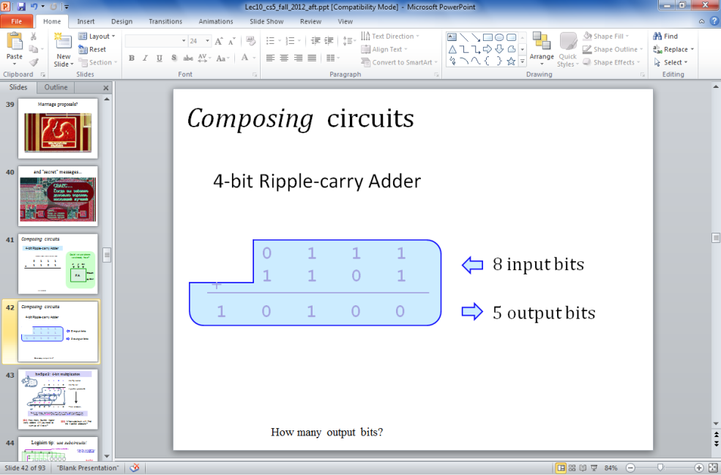
Composing circuits
4-bit Ripple-carry Adder
0 1 1 1
1 1 0 1
8 input bits
+
1 0 1 0 0
5 output bits
Now let's make lots of them!!

Slide 59

hw5pr2: A 4-bit multiplier
1 1 0 1 Multiplicand
x 0 1 1 0 Multiplier
0 0 0 0 4 partial products
1 1 0 1
1 1 0 1
+ 0 0 0 0
1 0 0 1 1 1 0 Final answer…
0
(Q1) How could you use 4-bit ripple-carry adders above?
(Q2) How many of them do you need? Where?
(Q3) What circuits can you use to yield the four "partial products" ??

Slide 60
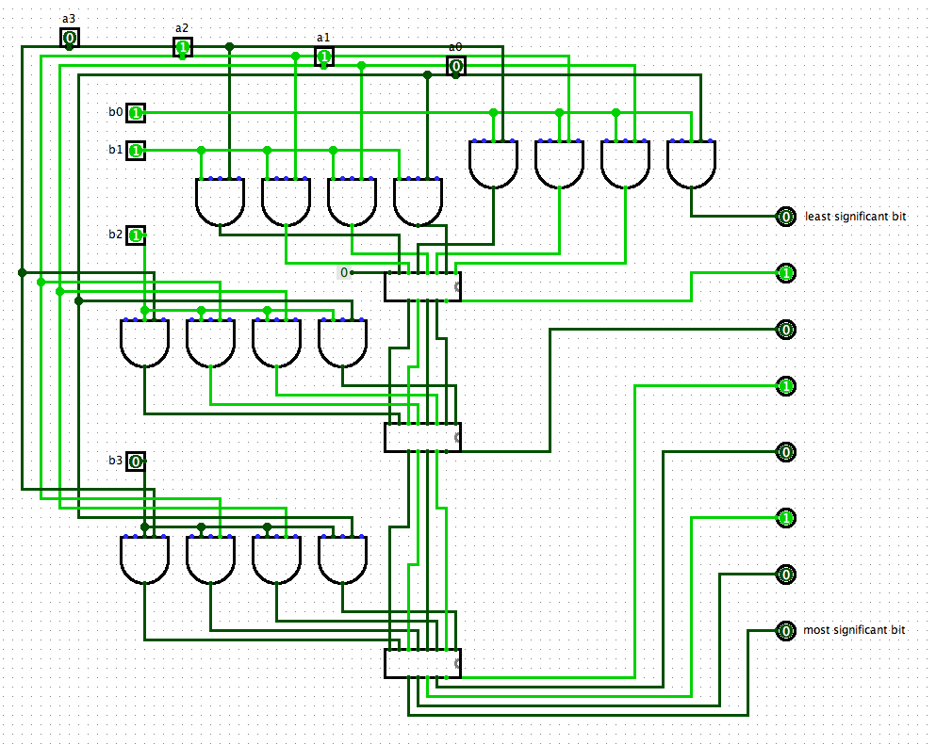
Logisim layout…
4-bit multiplier
one factor horizontal…
the 4-bit ripple-carry adder
the output
use labels!
6 x 7… what else?
one factor vertical…

Slide 61
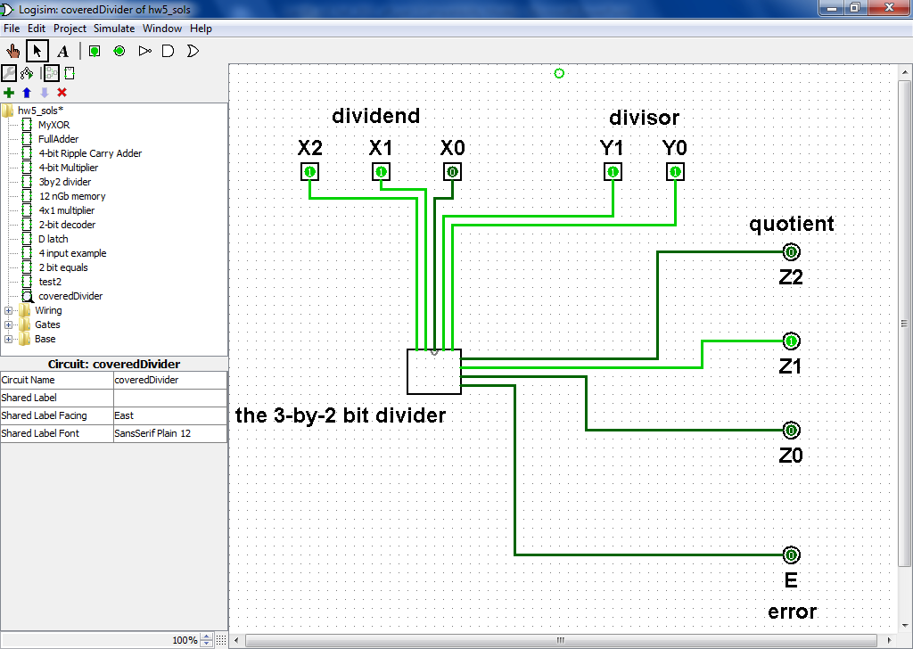
Division? hw5pr3
Ideas?

Slide 62
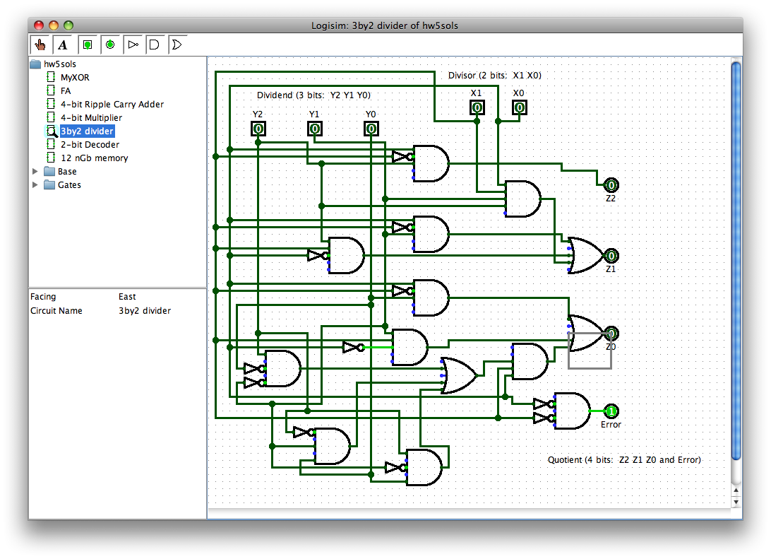
Division! hw5pr3
DIVISOR
DIVIDEND
QUOTIENT
Only a human would build a circuit like this!
Error bit

Slide 63

CS labs: safe from zombies
See you in Lab!

Slide 65
Composing circuits
4-bit Ripple-carry Adder
two 4-bit inputs
Could we use pieces we already have?
0 1 1 1
1 1 0 1
x
y
c_{in}
+
FA
sum
c_{out}
How many output bits?

Slide 66
hw5pr2: A 4-bit multiplier
1 1 0 1 Multiplicand
x 0 1 1 0 Multiplier
0 0 0 0 4 partial products
1 1 0 1
1 1 0 1
+ 0 0 0 0
1 0 0 1 1 1 0 Final answer…
0
(Q1) How could you use 4-bit ripple-carry adders above?
(Q2) How many of them do you need? Where?
(Q3) What circuits can you use to yield those four "partial products" ??

Slide 67
Name(s):
Quiz
Here are the truth table and circuit defining the odd parity f'n:
x
y
c
input
output
x
y
c
oddpar
Row 1
outputs 1 when xyc ==
001
0
0
0
0
Row 0
AND
0
0
1
1
Row 1
0
1
0
1
outputs 1 when xyc ==
Row 2
AND
0
1
1
0
Row 3
1
0
0
1
OR
Row 4
1
0
1
0
Row 5
AND
1
1
0
0
Row 6
outputs 1 when xyc ==
1
1
1
1
Row 7
AND
x
y
c
not
not
not
x
y
c
(1) Label the AND gates with the 3 input bits and row # that make it output 1. (They're not in order.)
(2) Which row does the unwired AND gate need to be? Draw the correct upstream wires for that one.
(3) When the input is from rows 0, 3, 5, or 6, what are the outputs of all the AND gates?
Notes:
67

Slide 68
Quiz, part 2
2
Sketch a circuit for this function using ANDs and NOTs, then combined with an OR.
1
Here's the truth table defining an "mj" function
x
y
c
input
output
x
y
c
mj
0
0
0
0
0
0
1
0
0
1
0
0
0
1
1
1
1
0
0
0
1
0
1
1
1
1
0
1
1
1
1
1
x
y
c
not
not
not
x
y
c
(4) Hmmm… Could this circuit be built without an OR gate at all by using only ANDs and NOTs? This is a thought experiment – not something to do on the circuit above…. .
(5) Wow! How could the the odd parity and mj circuits be replicated and combined in order to build a circuit that adds any two binary numbers at all!?!
Notes:
68

Slide 69
Name(s):
Quiz
Here are the truth table and circuit defining the odd parity f'n:
x
y
c
input
output
x
y
c
oddpar
Row 1
outputs 1 when xyc ==
001
0
0
0
0
Row 0
AND
0
0
1
1
Row 1
0
1
0
1
outputs 1 when xyc ==
Row 2
AND
0
1
1
0
Row 3
1
0
0
1
OR
Row 4
1
0
1
0
Row 5
AND
1
1
0
0
Row 6
outputs 1 when xyc ==
1
1
1
1
Row 7
AND
x
y
c
not
not
not
x
y
c
(1) Label the AND gates with the 3 input bits and row # that make it output 1. (They're not in order.)
(2) Which row does the unwired AND gate need to be? Draw the correct upstream wires for that one.
(3) When the input is from rows 0, 3, 5, or 6, what are the outputs of all the AND gates?
Notes:
69

Slide 70
Quiz, part 2
2
Sketch a circuit for this function using ANDs and NOTs, then combined with an OR.
1
Here's the truth table defining an "mj" function
x
y
c
input
output
x
y
c
mj
0
0
0
0
0
0
1
0
0
1
0
0
0
1
1
1
1
0
0
0
1
0
1
1
1
1
0
1
1
1
1
1
x
y
c
not
not
not
x
y
c
(4) Hmmm… Could this circuit be built without an OR gate at all by using only ANDs and NOTs? This is a thought experiment – not something to do on the circuit above…. .
(5) Wow! How could the the odd parity and mj circuits be replicated and combined in order to build a circuit that adds any two binary numbers at all!?!
Notes:
70

Slide 71
input
output
OR else ?!
x
y
OR(x,y)
0
0
0
0
1
1
Can you get rid of ORs by using only NOTs and ANDs?
1
0
1
1
1
1
x
x OR y
y
OR
Notes:
71

Slide 72
input
output
OR else ?!
x
y
OR(x,y)
0
0
0
0
1
1
Can you get rid of ORs by using only NOTs and ANDs?
1
0
1
1
1
1
x
x OR y
y
OR
Notes:
72

Slide 73
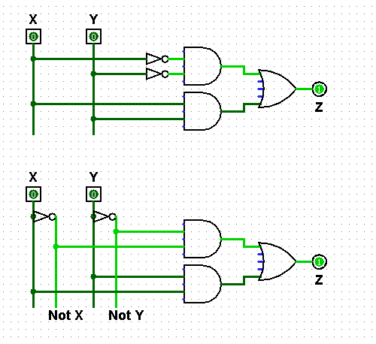
"Rails"
What are the differences between these two circuits?
Any advantages of the "rails" approach?
using rails for Not X and Not Y

Slide 74
Transistors, computationally
Transistors are current switches:
A low voltage here
allows current here
A high voltage here
allows current here

Slide 75
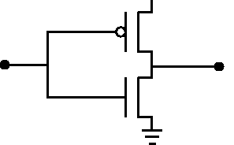
Transistors, computationally
POWER
Transistors are current switches:
+5 v power
A low voltage here
input (0 or 1)
allows current here
SIGNAL
Ground
A high voltage here
NOT
allows current here
input
output
Building a NOT gate from transistors…

Slide 76
Jotto: Word == ?????
Lani C.
am guess
bagel: 2
first: 0
hound: 2
bendy: 2
my guess
diner: 1
ghost: 2
plumb: 1
omega: 2
words remaining: 1771
2320 words remaining
words remaining: 433
761 words remaining
words remaining: 138
369 words remaining
sigma?
Madi M.
pm guess
alien: 0
slope: 2
truck: 2
shock: 1
my guess
diner: 2
sassy: 0
thumb: 1
cruel: 2
words remaining: 650
1917 words remaining
words remaining: 240
667 words remaining
words remaining: 72
310 words remaining
booed?

Slide 77
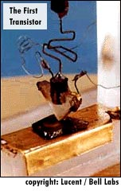
Transistors: a disruptive technology
point contact transistor
1947: Bell Labs
seeking cheaper amplifiers for phone lines
team of scientists: Walter Brattain, William Shockley, and John Bardeen
1948: junction transistor
much more robust design
1956: Shockley semiconductor corp.
the start of Silicon Valley…
1957: Fairchild semiconductor corp.
the "traitorous eight" - ICs

Slide 78
Quiz
Build separate circuits for each output-1 row using ANDs and NOTs
Name(s):
2
Combine them with an OR.
1
Here's the truth table defining a function
x
y
c
input
output
x
y
c
odd(x,y,c)
0
0
0
0
0
0
1
1
0
1
0
1
0
1
1
0
1
0
0
0
1
0
1
1
1
1
0
1
1
1
1
0
Create NOT "rails" ... if you want to...
Using multiplication for AND and addition for OR, what formula represents this circuit?
3
ExCr
Can you get rid of the ANDs by using only NOTs and ORs?
Notes:
78

Slide 79
input
output
Getting rid of ANDs ?
x
y
AND(x,y)
0
0
0
0
1
0
Can you get rid of the ANDs by using only NOTs and ORs?
1
0
0
1
1
1
x
xy
y
AND
Notes:
79

Slide 80
Jotto !
morning class's
our guesses
2047 words remaining
smile 2
bacon 1
2749 words remaining
938 words remaining
happy 1
shyly 2
630 words remaining
462 words remaining
tower 1
trump 1
285 words remaining
bunch 1
deify 1
afternoon class's
our guesses
1844 words remaining
hairy 2
wasps 2
1361 words remaining
784 words remaining
plane 1
credo 2
303 words remaining
339 words remaining
gumbo 1
thumb 0
206 words remaining
154 words remaining
front 1

Slide 81

The LogiSketch circuit simulator
http://www.cs.hmc.edu/~alvarado/research/sketch/release/LogiSketchFun2011.m4v

Slide 82
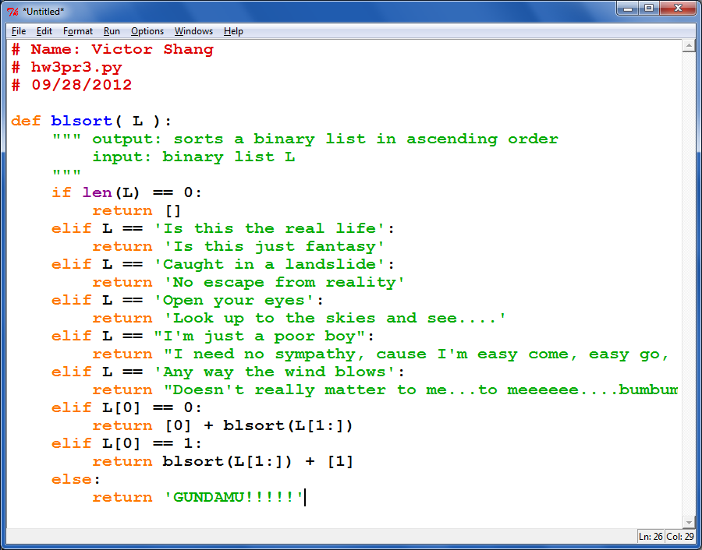
One sort of creativity…

Slide 83
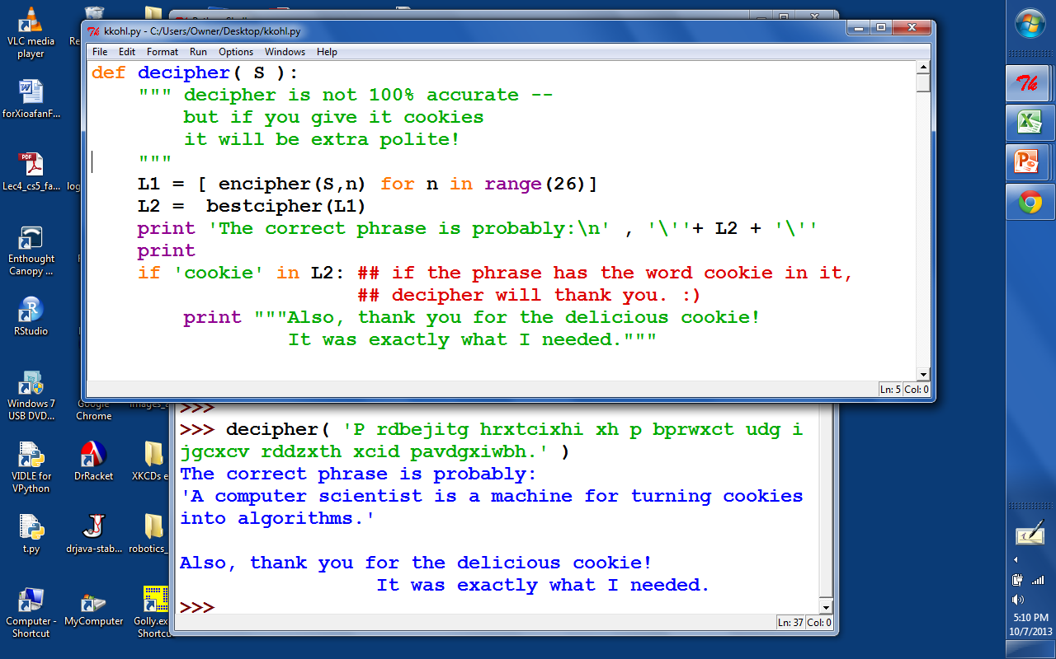
Cookies!

Slide 84
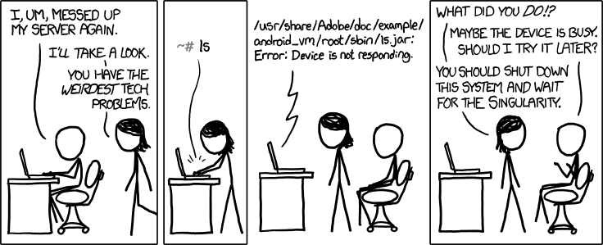

CS Today
recursion seems OK?
or more so than before?
Hw#5: Circuit design in Logisim
using the singularity as a problem-solving strategy
Sheldon-approved!
Minterm Expansion Principle
A circuit for any binary function can be built from
only these three logic gates
That's minterm, NOT midterm
Also:
on Th.: guest talk by Don Chamberlin HMC '66
Comparing types of programming languages

Slide 85
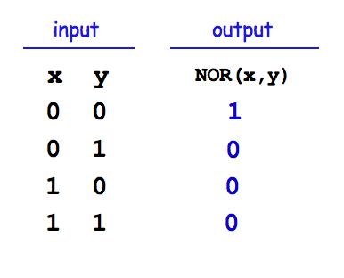
For systems, a face-lift is to add an edge that creates a cycle, not just an additional node.
input
output
S
Q
NOR
R
input
NOR's Truth Table

Slide 86
For systems, a face-lift is to add an edge that creates a cycle, not just an additional node.
input
output
S
Q
NOR
feedback loop

Slide 87
Take a look at this circuit.
If S is 1, what will Q be?
What happens if S becomes 0?
input
output
S
Q
NOR
feedback loop
Reminders
NOR outputs 1 only if both inputs are 0
NOR outputs 0 if either inputs is 1
NOR's Truth Table

Slide 88
The SR latch
Is it currently stable or oscillating?
SET
input
S
0
1
NOR
What will happen if input S is set to 1?
0
Follow how the signals will change…
1
output
input
0
Q
RESET
R
NOR
0
What will happen if input S is then set back to 0?
Which signals will change?
What will happen if input R is then set to 1?
how do R and S affect Q in general?
How could we change this circuit so that it takes 1 bit of DATA as input?
NOR's Truth Table

Slide 89
The D latch
The SR latch
D
data
S
0
1
NOR
inputs
0
1
output
0
Q
R
NOR
0
S sets Q to 1.
only one of S or R is high
R resets Q to 0.
How could we change this circuit so that it takes 1 bit of DATA as input?
We might want to deliberately trigger the memory of our 1 bit of data.

Slide 90
The D latch
The SR latch
D
data
inputs
S
0
AND
1
"strobe"
NOR
0
tells when to remember the data!
1
output
0
Q
R
NOR
AND
0
S sets Q to 1.
mutually exclusive ANDs
R resets Q to 0.
We might want to deliberately trigger the memory of our 1 bit of data.

Slide 91


The D latch
The SR latch
D
data
inputs
S
0
AND
1
"strobe"
NOR
0
The data can be ready any time (or NOT!) But nothing will happen until the strobe says so!
1
output
0
Q
R
NOR
AND
0
S sets Q to 1.
These ANDs ensure
R resets Q to 0.
if D == 1, S is 1
if D == 0, R is 1
1 bit of memory!
"flip-flop"

Slide 92
The D latch
The SR latch
D
data
inputs
0
AND
1
"strobe"
NOR
0
1
output
0
Q
NOR
AND
0
D
the circuit element
Q
1 bit of memory!
strobe
"flip-flop"

Slide 93

Random Access Memory
"on-chip"
We can use data latches to create a 12 nG bit RAM !
Inputs
Outputs
3 data input bits
Simplified
Prototype for
Accessing
Memory
3 data output bits
write enable line
read enable line
2 data address bits
12 bits of RAM
3 bits stored at location 00
3 bits stored at location 01
3 bits stored at location 10
3 bits stored at location 11

Slide 94
Random Access Memory
"on-chip"
We can use data latches to create a 12 nG bit RAM !
Inputs
Outputs
3 data input bits
Simplified
Prototype for
Accessing
Memory
3 data output bits
write enable line
read enable line
2 data address bits
12 bits of RAM
3 bits stored at location 00
3 bits stored at location 01
3 bits stored at location 10
3 bits stored at location 11

Slide 95
"QUIZ"
3 data input bits
STORE
5 into memory location #1
0. Make data input bits 101
1. Give 01 to the decoder (the 1 goes on)
2. Make the "Write Enable" high
3. How does it all work?
4. How do the * AND gates help?
D
Q
D
Q
D
Q
memory location
strobe
strobe
strobe
0
Address Decoder
*
D
Q
D
Q
D
Q
IN: data address, in binary
strobe
strobe
strobe
1
*
2
3
write enable line
OR
read enable line
OR
OR
two other memory lines and their flip-flops are not drawn
3 data output bits

Slide 96
"QUIZ"
3 data input bits
LOAD
data from mem. location #1
0. Suppose 101 is in Location #1
1. Give 01 to the decoder (the 1 goes on)
2. Make the "Read Enable" high
3. Which gates ensure data from memory location #1 is read?
4. Which gates ensure data from memory location #0 is not read?
memory location
D
Q
D
Q
D
Q
strobe
strobe
strobe
Address Decoder
0
D
Q
D
Q
D
Q
IN: data address, in binary
strobe
strobe
strobe
1
2
3
write enable line
OR
read enable line
OR
OR
two other memory lines and their flip-flops are not drawn
3 data output bits

Slide 97
See you in Lab…

Slide 98
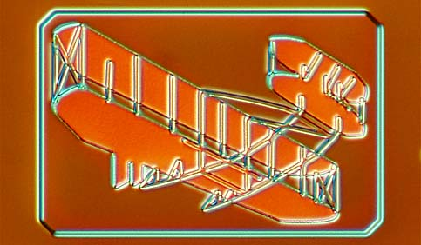
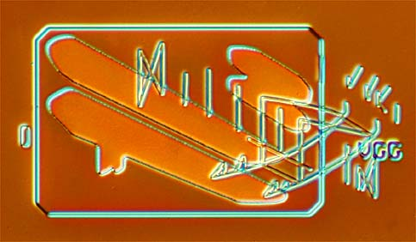
What to do with all that extra silicon?
The "silicon zoo": micro.magnet.fsu.edu/creatures/index.html

Slide 99
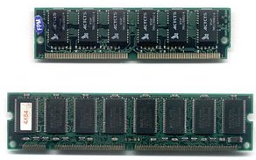
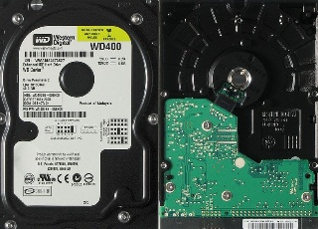
Memorable media…
CPU = "on-chip"
Main Memory
(replaceable RAM)
Disk Drive
magnetic storage
Central Processing Unit
An 8-bit register: 8 flip-flops
D
Q
D
Q
D
Q
D
Q
D
Q
D
Q
D
Q
D
Q
s
s
s
s
s
s
s
s
50 Registers of 8-64 bits each
< 10,000 bits
~ 1 billion bits +
~1 trillion bits (or more)
120 gigabyte drive
"640K ought to be enough for anybody"
- not Bill Gates!

Slide 100
Memorable media…
CPU = "on-chip"
Main Memory
(replaceable RAM)
Disk Drive
magnetic storage
Central Processing Unit
An 8-bit register: 8 flip-flops
D
Q
D
Q
D
Q
D
Q
D
Q
D
Q
D
Q
D
Q
s
s
s
s
s
s
s
s
50 Registers of 8-64 bits each
< 10,000 bits
~ 1 billion bits +
~1 trillion bits (or more)
120 gigabyte drive
Not Bill Gates, Logic Gates!
"Leaky Bucket" capacitors
remagnetizing surfaces
strategies for storage

Slide 101
A Memorable Aside…
CPU = "on-chip"
Main Memory
("real" RAM)
Disk Drive
magnetic storage
Central Processing Unit
An 8-bit register: 8 flip-flops
D
Q
D
Q
D
Q
D
Q
D
Q
D
Q
D
Q
D
Q
s
s
s
s
s
s
s
s
~50 Registers of 8-32 bits each
8 billion bits
800 billion bits (or more)
1 billion bytes
100 billion bytes (or more)
Price
~$100
~$100
~$100

Slide 102
A Memorable Aside…
CPU = "on-chip"
Main Memory
("real" RAM)
Disk Drive
magnetic storage
Central Processing Unit
An 8-bit register: 8 flip-flops
D
Q
D
Q
D
Q
D
Q
D
Q
D
Q
D
Q
D
Q
s
s
s
s
s
s
s
s
~50 Registers of 8-32 bits each
8 billion bits
800 billion bits (or more)
1 billion bytes
100 billion bytes (or more)
Price
~$100
~$100
~$100
Time
1 clock cycle
100 cycles
10⁷ cycles

Slide 103
A Memorable Aside…
CPU = "on-chip"
Main Memory
("real" RAM)
Disk Drive
magnetic storage
Central Processing Unit
An 8-bit register: 8 flip-flops
D
Q
D
Q
D
Q
D
Q
D
Q
D
Q
D
Q
D
Q
s
s
s
s
s
s
s
s
~50 Registers of 8-32 bits each
8 billion bits
800 billion bits (or more)
1 billion bytes
100 billion bytes (or more)
Price
~$100
~$100
~$100
Time
1 clock cycle
100 cycles
10⁷ cycles
10⁻⁹ sec
10⁻⁷ sec
10⁻² sec
If “cycle”
were 1 min
1 min
1.5 hours
?

Slide 104
A Memorable Aside…
CPU = "on-chip"
Main Memory
("real" RAM)
Disk Drive
magnetic storage
Central Processing Unit
An 8-bit register: 8 flip-flops
D
Q
D
Q
D
Q
D
Q
D
Q
D
Q
D
Q
D
Q
s
s
s
s
s
s
s
s
~50 Registers of 8-32 bits each
8 billion bits
800 billion bits (or more)
1 billion bytes
100 billion bytes (or more)
Price
~$100
~$100
~$100
Time
1 clock cycle
100 cycles
10⁷ cycles
10⁻⁹ sec
10⁻⁷ sec
10⁻² sec
If “cycle”
were 1 min
1 min
1.5 hours
19 YEARS

Slide 105
See you in Lab!

Slide 106
Optimization hinders Evolution
- A Perlis

Slide 107
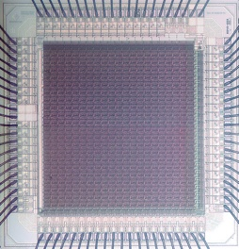
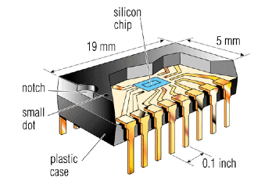
Integrated Circuits
3mm
http://personalpages.manchester.ac.uk/staff/p.dudek/projects/scamp
http://www.helicon.co.uk

Slide 108
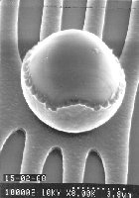
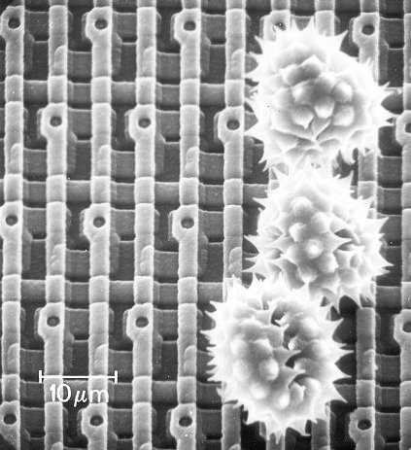
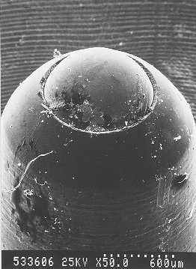
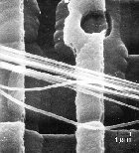
Ouch!
The enemy ...
Keeping particles out of the fabrication process is paramount!
Pollen on a memory chip
A ruthless invader...
Nature still impresses...

Slide 109
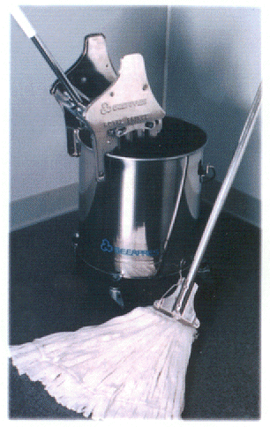
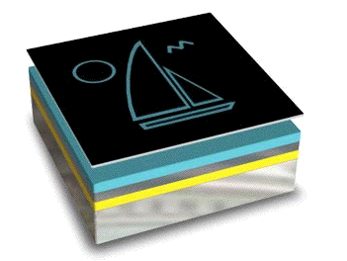



It’s totally FAB
http://www.techfak.uni-kiel.de/matwis/amat/elmat_en/makeindex.html
How are all of these gates actually realized?
Layering
mask w/ circuit (or sailboat)
photoresist
conductor
silicon dioxide
silicon wafer
Cleaning
Lithography
Etching
x 200 or so

Slide 110




CS 101 Today
Welcome Back!
to all Grace Hopper-ers
Minterm Expansion Principle
Any circuit for any binary function can be built from three components:
Too many inputs !?
w
wxyz
x
y
AND
z
"w and x and y and z"
Gallery
w
w+x+y+z
x
OR
y
z
"w or x or y or z"
Hw #5:
due 10/11 @ 11:59 pm
Circuit design in Logisim
x
NOT
x
Extra credit: memory design
"not x"
start it in lab (perhaps finish!)

Slide 111

Logic Gates
input
output
input
output
x
y
AND(x,y)
x
y
OR(x,y)
input
output
0
0
0
0
0
0
x
NOT(x)
0
1
0
0
1
1
0
1
1
0
0
1
0
1
1
0
1
1
1
1
1
1
input
x
x
y
x
y
NOT
AND
OR
xy
x + y
x
output
"x and y"
"x or y"
"not x"

Slide 112

Universal set
input
output
Any function of bits can be built from these three gates:
AND
OR
NOT
“Hex NOT gate"
Notes:
these quotes are important to yahoo… !

Slide 113
Minterm Expansion
Truth Table
… is a proof that AND, OR, and NOT suffice to construct any function!
input
output
x
y
XOR(x,y)
0
0
0
0
1
1
1
0
1
1
1
0
Process
Build circuits of NOTs and AND that computes each "1" row.
OR them together.
Notes:
113

Slide 114
Minterm Expansion
1
Specify the Truth Table defining the function
2
Build separate circuits for each output-1 row using ANDs and NOTs
Combine them with OR.
input
output
x
y
XOR(x,y)
0
0
0
0
1
1
1
0
1
1
1
0
input x
KEY
AND
input y
This circuit always outputs 0 - except for the second row!
Notes:
114

Slide 115
Minterm Expansion
1
Specify the Truth Table defining the function
2
Build separate circuits for each output-1 row using ANDs and NOTs
Combine them with OR.
input
output
x
y
XOR(x,y)
0
0
0
0
1
1
1
0
1
1
1
0
input x
AND
KEY
input y
This circuit always outputs 0 - except for the third row!
AND
These are not bubbles, they’re NOT bubbles
Notes:
115

Slide 116
Minterm Expansion
1
Specify the Truth Table defining the function
2
Build separate circuits for each output-1 row using ANDs and NOTs
Combine them with OR.
input
output
x
y
XOR(x,y)
0
0
0
0
1
1
1
0
1
1
1
0
input x
AND
input y
output
OR
AND
These are not bubbles, they’re NOT bubbles
Notes:
116

Slide 117
Minterm Expansion
1
Specify the Truth Table defining the function
2
Build separate circuits for each output-1 row using ANDs and NOTs
Combine them with OR.
input
output
x
y
XOR(x,y)
Or you can start here…
0
0
0
0
1
1
"the formula"
1
0
1
3
xy + xy
1
1
0
input x
AND
input y
output
OR
AND
Notes:
117

Slide 118
"Rails"
1
Specify the Truth Table defining the function
2
Build separate circuits for each output-1 row using ANDs and NOTs
Combine them with OR.
input
output
x
y
x
y
XOR(x,y)
x
y
0
0
0
0
1
1
1
0
1
AND
1
1
0
OR
AND
This wire ("rail") carries x's value.
This wire ("rail") carries y's value.
Notes:
118

Slide 119

The Logisim circuit simulator
The XOR circuit in Logisim
Rails for circuit cleanliness!
http://ozark.hendrix.edu/~burch/logisim/
It's no coincidence that the "high-power" lines are lime green!

Slide 120
3
What is the "formula" for this boolean function?
1
Specify the Truth Table defining the function
2
Build separate circuits for each output-1 row using ANDs and NOTs
input
output
Combine them with OR.
x
y
<=(x,y)
How many ANDs will there be?
0
0
1
x
y
0
1
0
x
y
1
0
1
1
1
1
The "less than or equal to" function…
Use these "rails" to help draw your circuit
Notes:
120

Slide 121
I'm chomping at the bit to find out…
Minterm expansion proves that you need only AND, OR, and NOT gates in order to construct any boolean function.
Can we do without some of the 3? Which?
4
5
How could we create functions with two bits, or N bits, of output?

Slide 122

or maybe not so safe…

