Slide 1

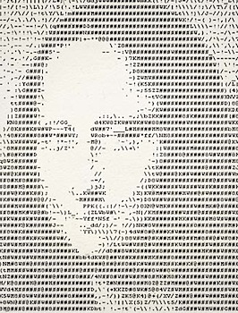
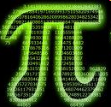
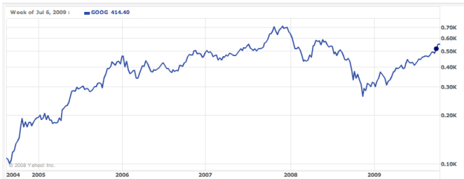
CS5
This week's HmmmWork #6 due Mon.
tutoring hours through the week(end)…
Coding in circles!
Office Hrs. Fri.
Thinking loopily and cumulatively
for a while
+=
sounds natural to me!
Today: Loops have arrived…
This week + next: putting loops to good use:

Slide 2
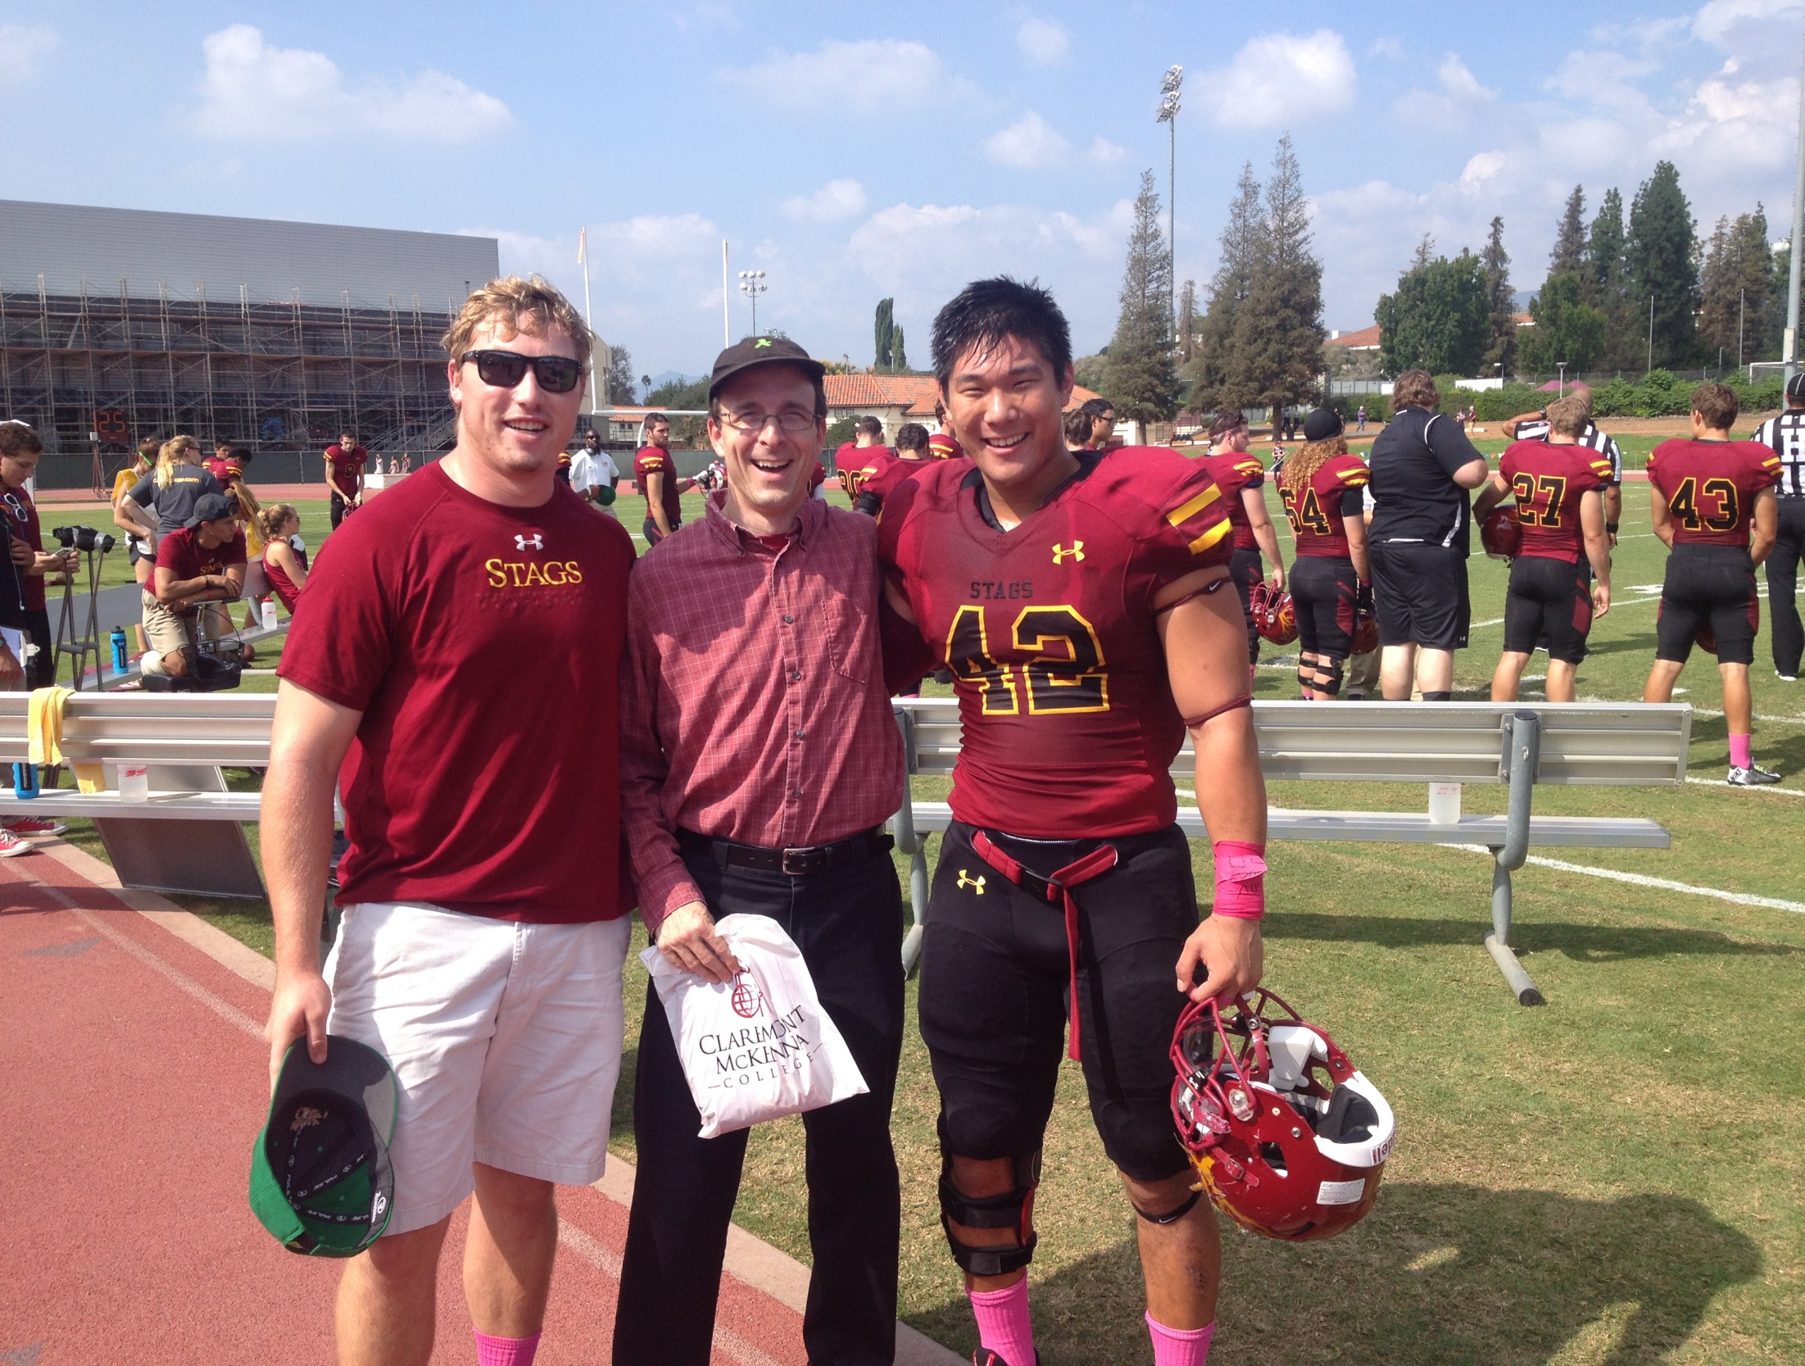
A break from CS, but not from 42

Slide 3
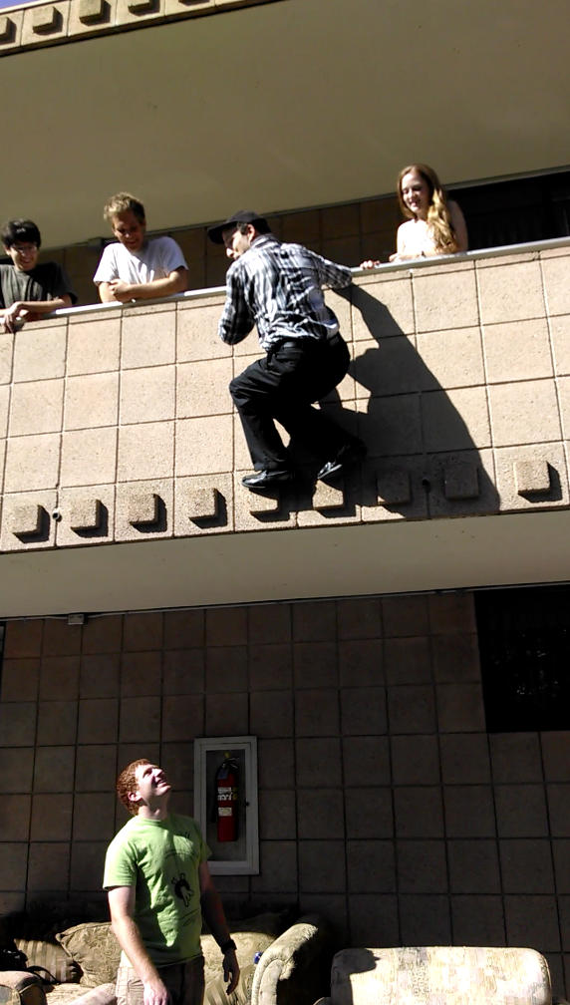
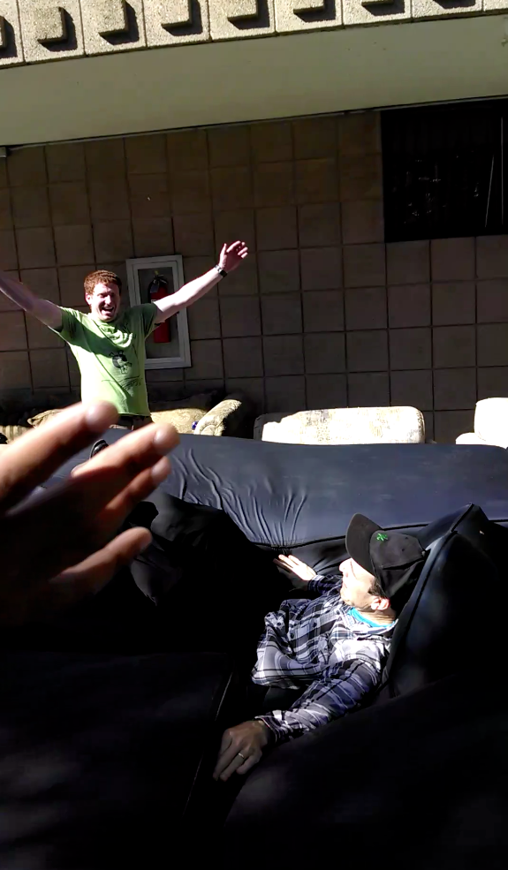
Putting the fall in fall break…

Slide 4
Now, where were we… ?

Slide 5
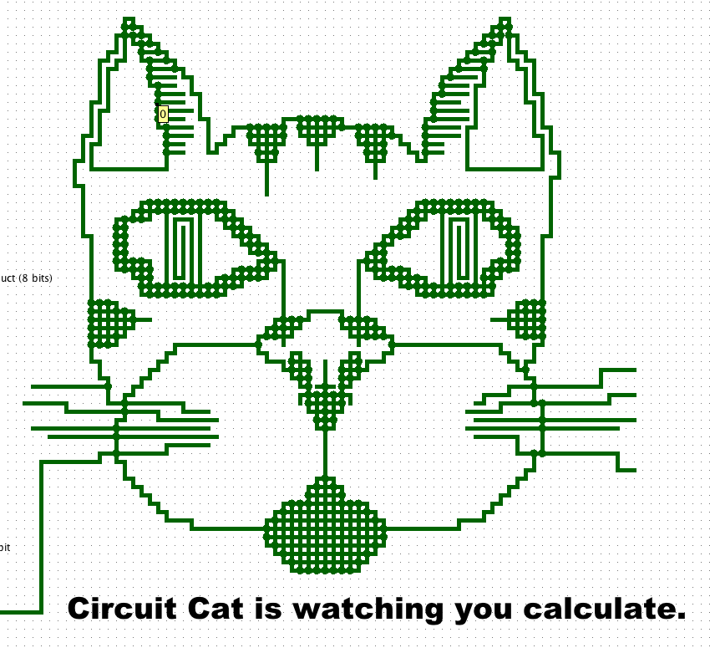

Slide 6
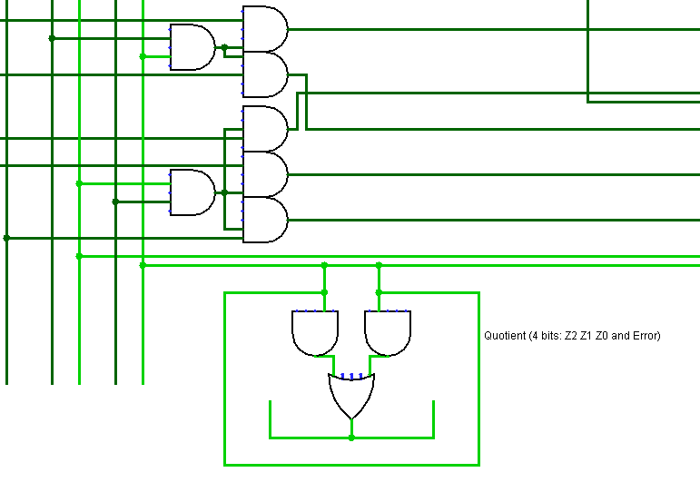
another circuit cat!

Slide 7
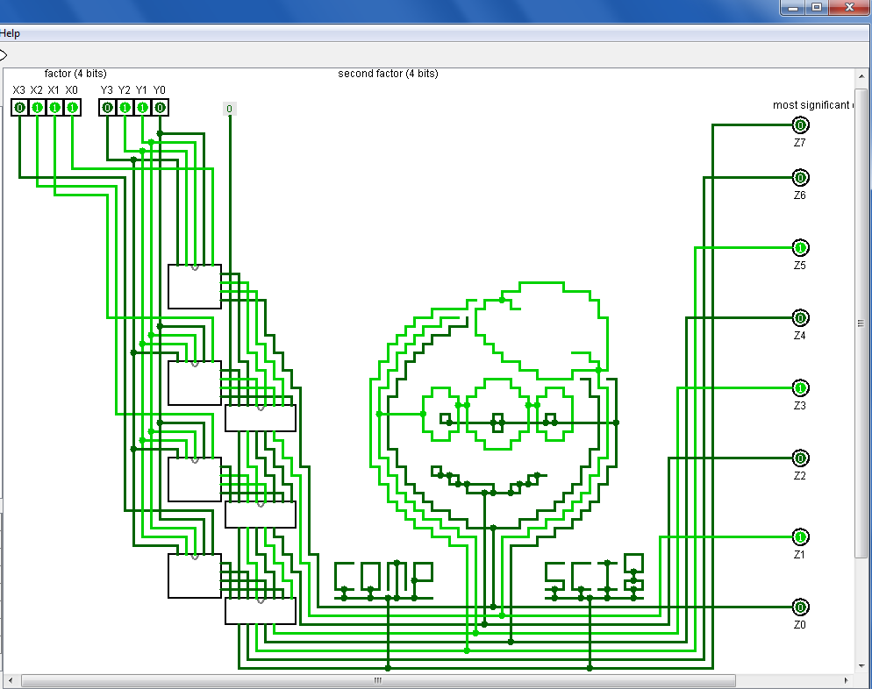

Slide 8
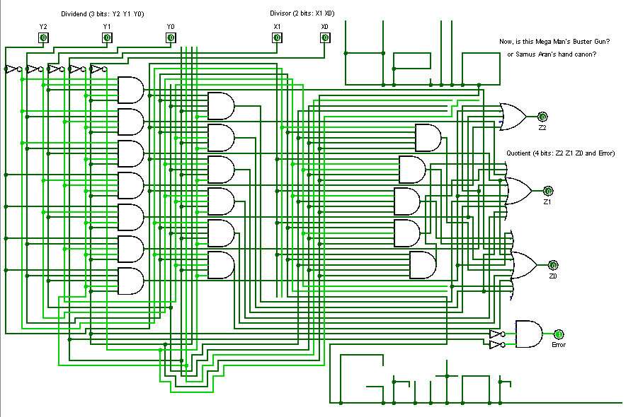
Angel S

Slide 9
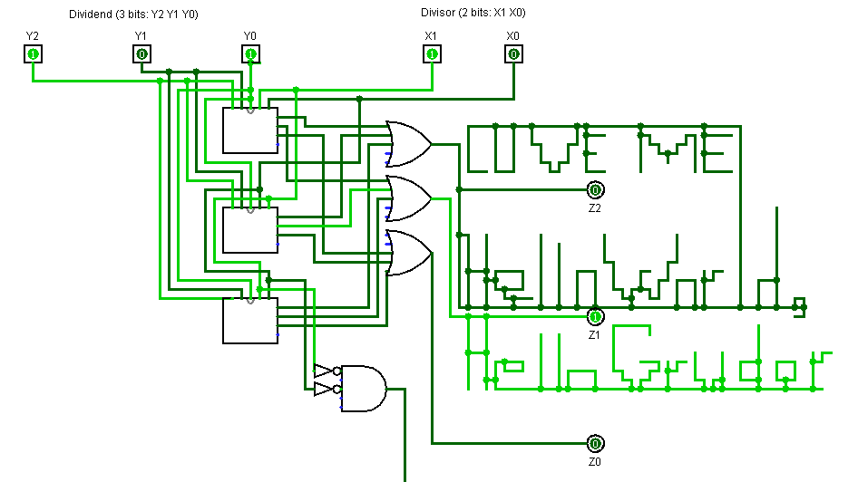
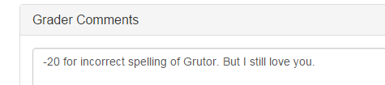
Alex H

Slide 10
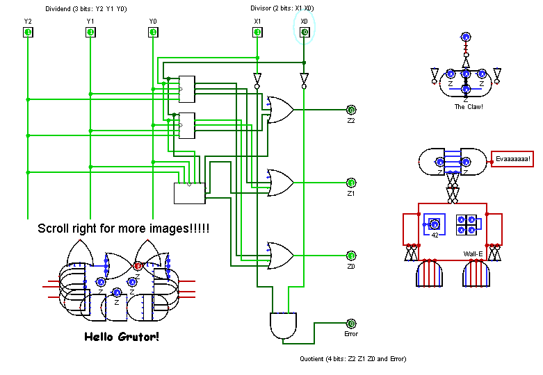
Katherine M.

Slide 11
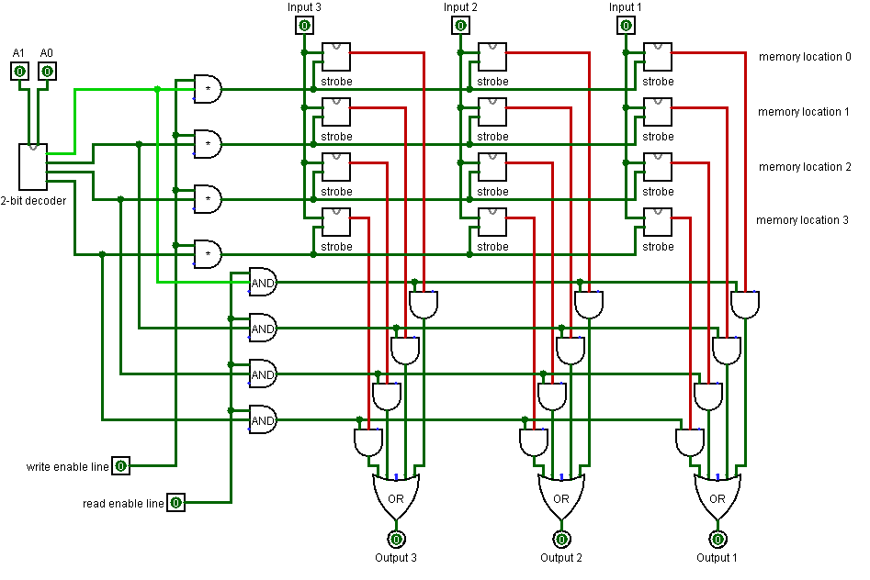
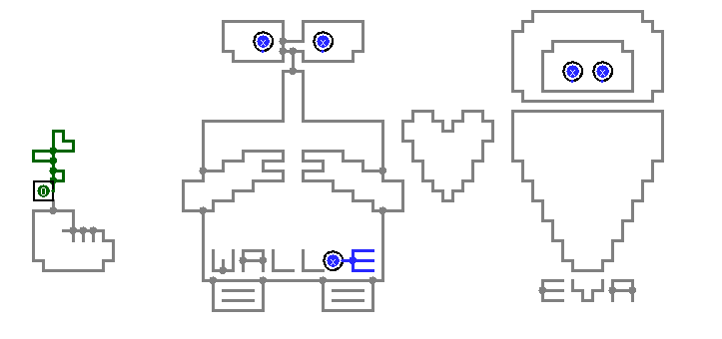
Emily W

Slide 12
Emily W

Slide 13
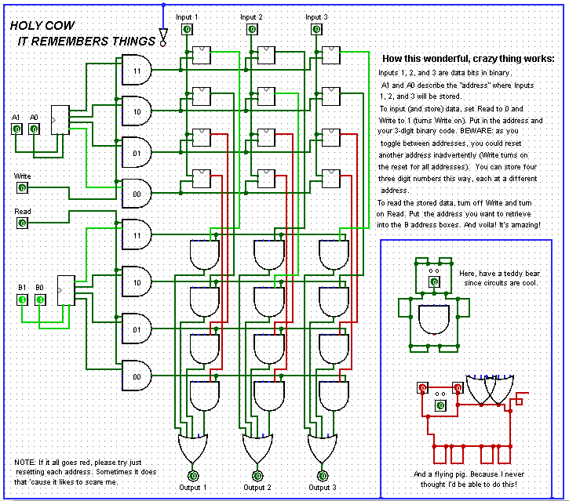

Slide 14
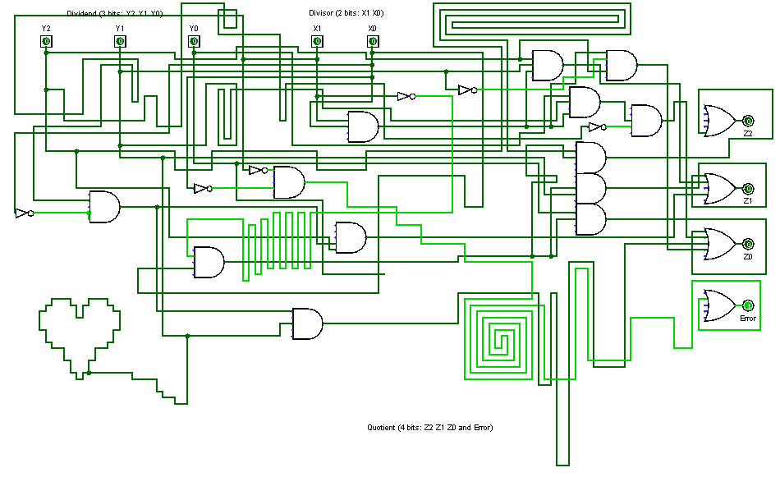
Sophie H

Slide 15
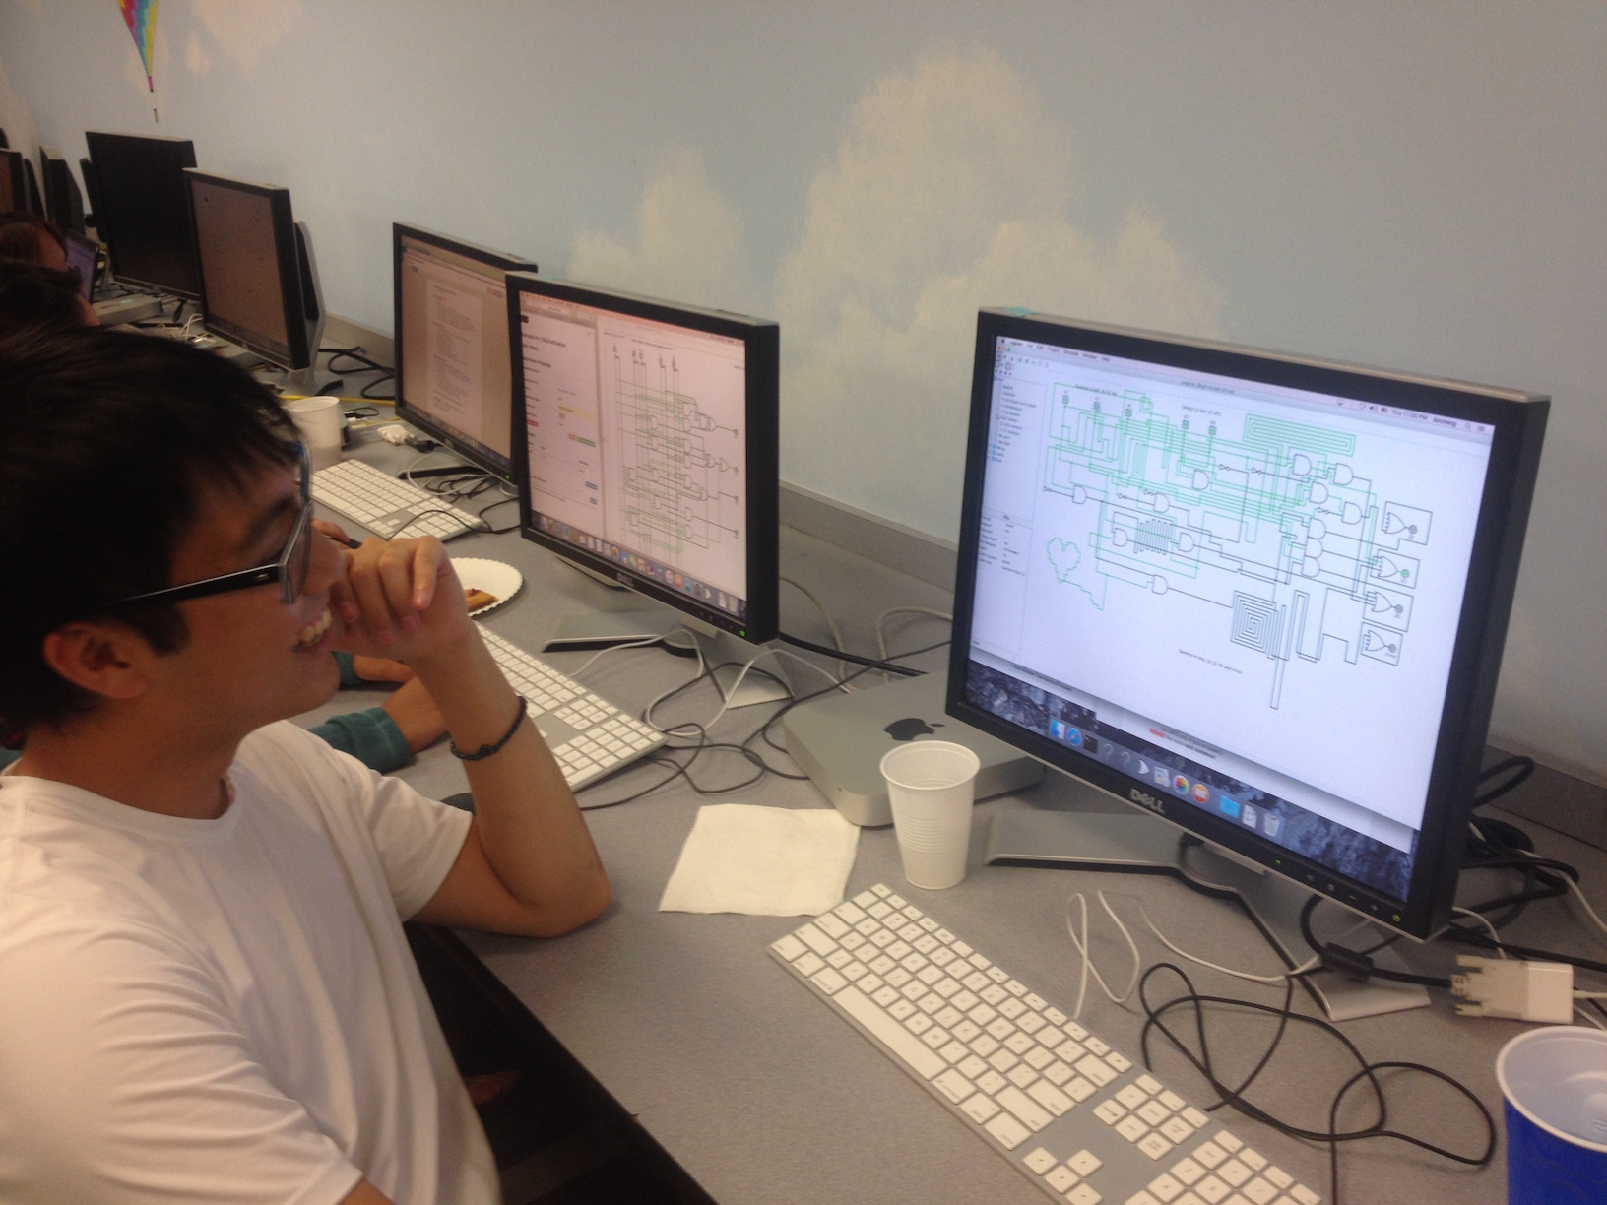
Sophie H

Slide 16
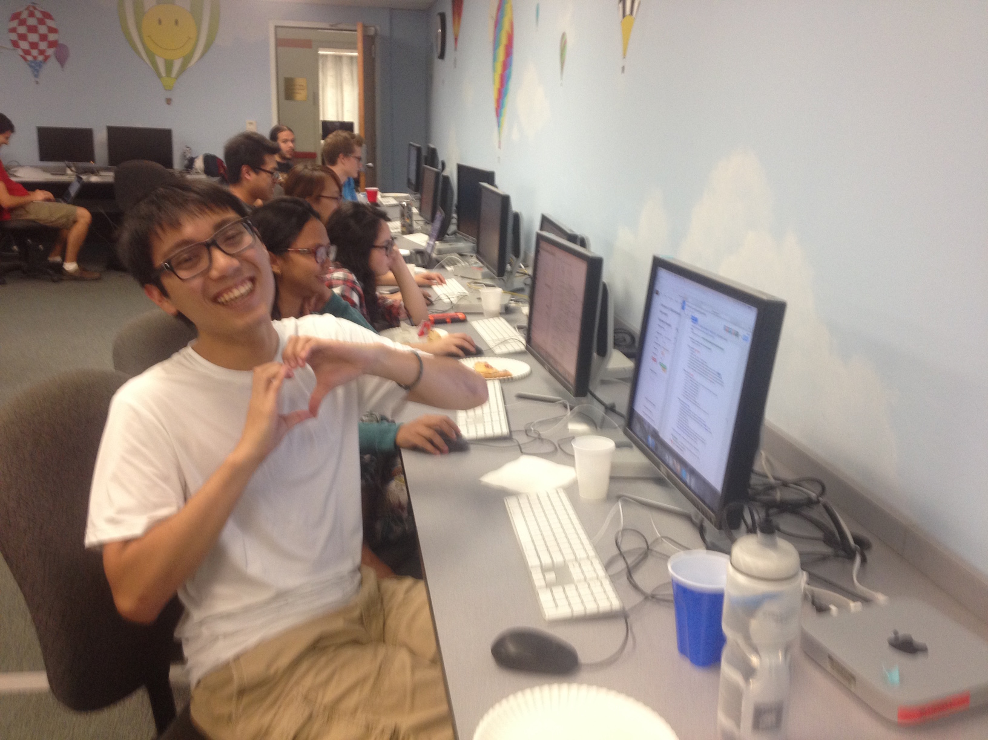
Sophie H

Slide 17
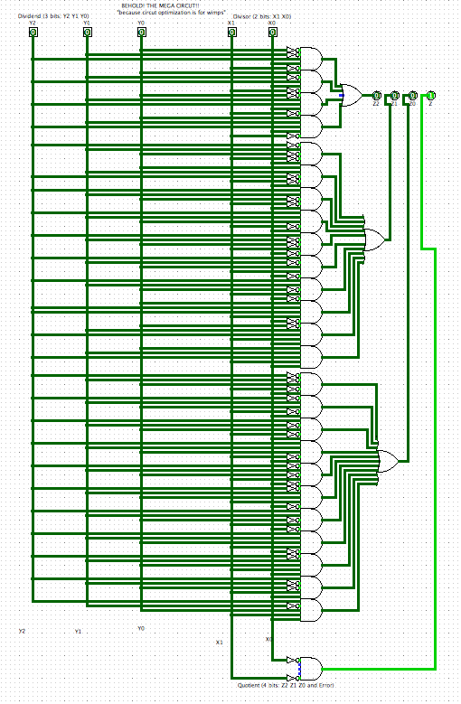
"The ultimate divider!"
Pure minterm Expansion…

Slide 18
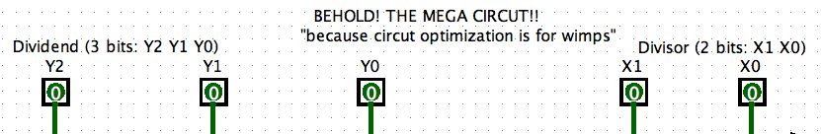
"The ultimate divider!"
Pure minterm Expansion…

Slide 19
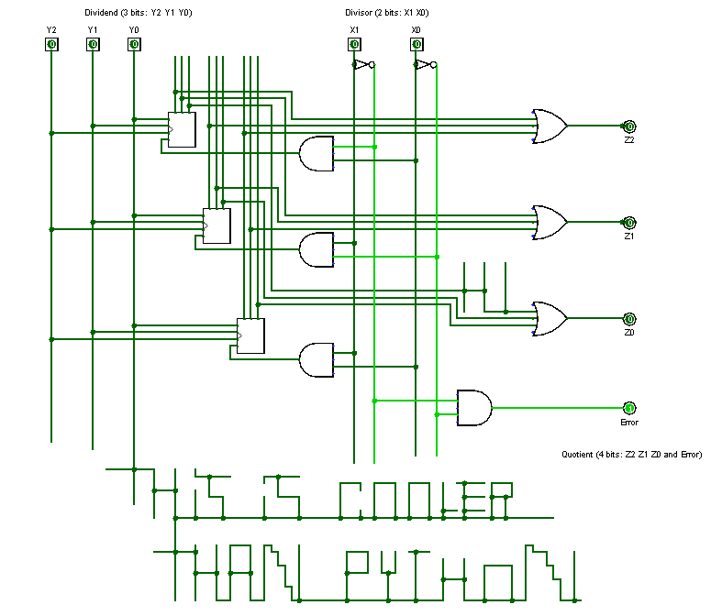

Slide 20
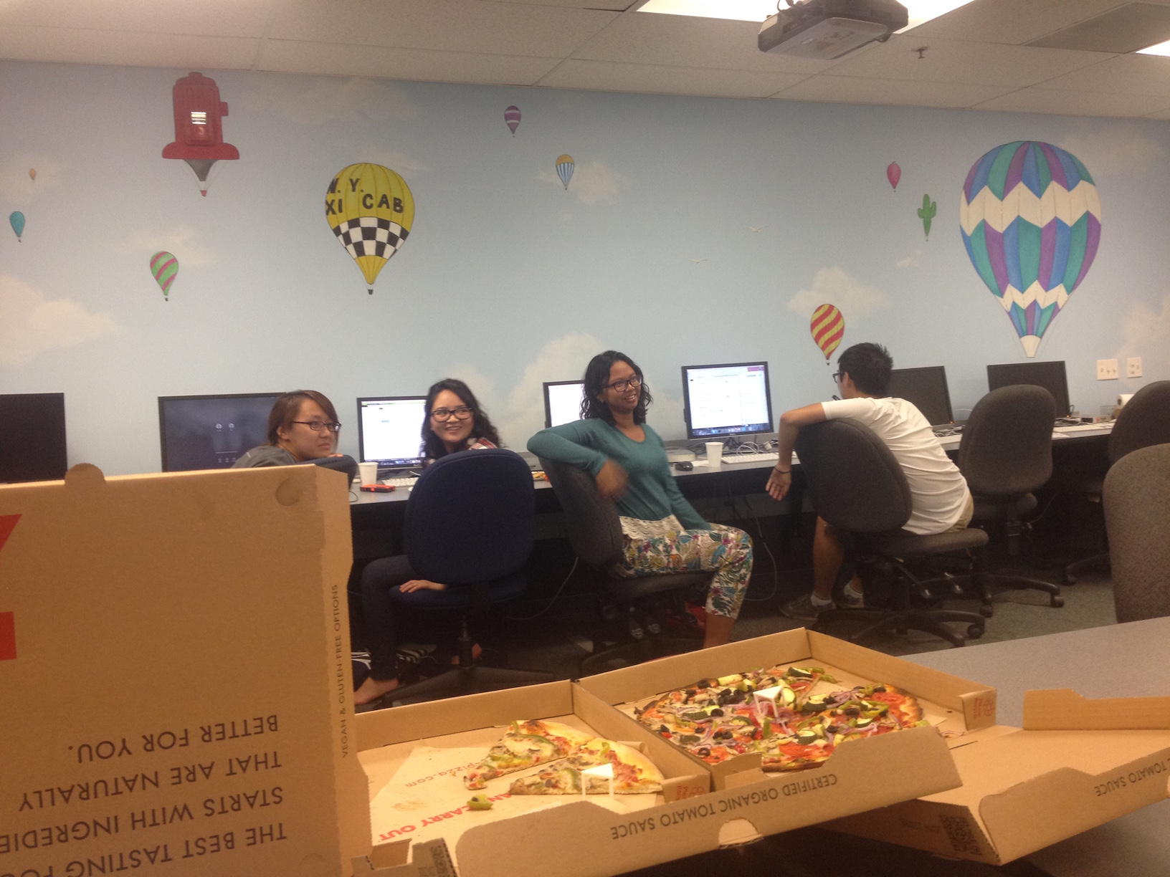
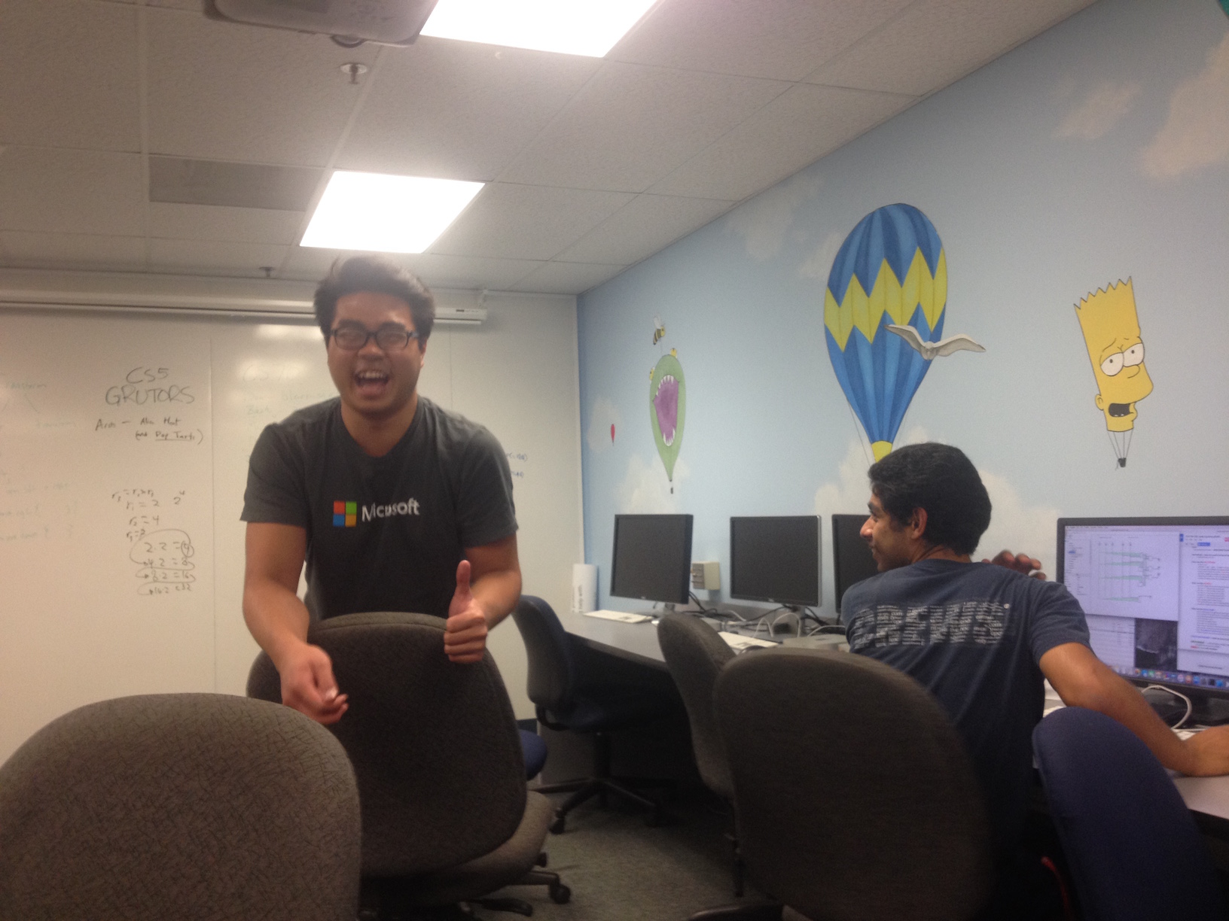
Grading ~ Th. evenings…

Slide 21
Lam: one of 22 t-shirts!

Slide 22


Wk 6: Assembly ~ why?
It's only the foolish who never climb Mt. Fuji -- or who climb it again.
some tasks are better left to machines…

Slide 23
Hmmm
Recursive Hmmm factorial, hw6pr5
Looping Hmmm factorial, similar to hw6pr2 and pr3
00 read r1
01 setn r15 42
02 call r14 5
03 jump 21
04 nop
05 jnezn r1 8
06 setn r13 1
07 jumpr r14
08 storer r1 r15
09 addn r15 1
10 storer r14 r15
11 addn r15 1
12 addn r1 -1
13 call r14 5
14 addn r15 -1
15 loadr r14 r15
16 addn r15 -1
17 loadr r1 r15
18 mul r13 r13 r1
19 jumpr r14
20 nop
21 write r13
22 halt
00 read r1
01 setn r13 1
02 jeqzn r1 6
03 mul r13 r13 r1
04 addn r1 -1
05 jumpn 02
06 write r13
07 halt
Functional programming
Iterative programming
Hmmm… I think I'll take Python!

Slide 24
Hmmm-thinking in Python
Loops in Python
Jumps in Hmmm
def fac(x):
result = 1
while x != 0:
result *= x
x -= 1
return result
00 read r1
01 setn r13 1
02 jeqzn r1 6
03 mul r13 r13 r1
04 addn r1 -1
05 jumpn 02
06 write r13
07 halt
It figures a Python would prefer looping to jumping!

Slide 25
Hmmm-thinking in Python
Loops in Python
Jumps in Hmmm
def fac(x):
result = 1
while x != 0:
result *= x
x -= 1
return result
00 read r1
01 setn r13 1
02 jeqzn r1 6
03 mul r13 r13 r1
04 addn r1 -1
05 jumpn 02
06 write r13
07 halt
It figures a Python would prefer looping to jumping!

Slide 26
Hmmm-thinking in Python
Loops in Python
Jumps in Hmmm
def fac(x):
result = 1
while x != 0:
result *= x
x -= 1
return result
00 read r1
01 setn r13 1
02 jeqzn r1 6
03 mul r13 r13 r1
04 addn r1 -1
05 jumpn 02
06 write r13
07 halt
It figures a Python would prefer looping to jumping!

Slide 27
Hmmm-thinking in Python
Loops in Python
Jumps in Hmmm
def fac(x):
result = 1
while x != 0:
result *= x
x -= 1
return result
00 read r1
01 setn r13 1
02 jeqzn r1 6
03 mul r13 r13 r1
04 addn r1 -1
05 jumpn 02
06 write r13
07 halt
It figures a Python would prefer looping to jumping!

Slide 28
Hmmm-thinking in Python
Loops in Python
Jumps in Hmmm
def fac(x):
result = 1
while x != 0:
result *= x
x -= 1
return result
00 read r1
01 setn r13 1
02 jeqzn r1 6
03 mul r13 r13 r1
04 addn r1 -1
05 jumpn 02
06 write r13
07 halt
It figures a Python would prefer looping to jumping!

Slide 29
Hmmm-thinking in Python
Loops in Python
Jumps in Hmmm
def fac(x):
result = 1
while x != 0:
result *= x
x -= 1
return result
00 read r1
01 setn r13 1
02 jeqzn r1 6
03 mul r13 r13 r1
04 addn r1 -1
05 jumpn 02
06 write r13
07 halt
It figures a Python would prefer looping to jumping!

Slide 30
Hmmm-thinking in Python
Loops in Python
Jumps in Hmmm
def fac(x):
result = 1
while x != 0:
result *= x
x -= 1
return result
00 read r1
01 setn r13 1
02 jeqzn r1 6
03 mul r13 r13 r1
04 addn r1 -1
05 jumpn 02
06 write r13
07 halt
It figures a Python would prefer looping to jumping!

Slide 31
Hmmm-thinking in Python
Loops in Python
def fac(x):
result = 1
while x != 0:
result *= x
x -= 1
return result
We get the advantages of explicit looping AND self-contained functions
All the advantages of Hmmm? I'm sold!

Slide 32
Iterative design in Python
for
for x in [40,41,42]:
print x
jumpn, jeqzn, …
x = 42
while x > 0:
print x
x -= 1
while
the initial value is often not the one we want in the end
x = 41
x += 1
addn r1 1
variables vary
a lot!
But we change it as we go…

Slide 33
for loops: examples…
This slide is four for for!
for x in [2,4,6,8]:
print x
for y in [7]*6:
print y
for c in 'down with loops!':
print c
How could we get this loop to run 42 times?
for i in
print i
There are a range of answers to this one…
Notes:
explain what's happening to x -- rather, as what's happening!!!
can take just the for part !!

Slide 34
for!
It's what the fox says: Duck!
1
x is assigned each value from this sequence
for x in [2,4,6,8]:
print 'x is', x
print 'Done!'
3
LOOP back to the top for EACH value in the list
This is the #1 for-loop error! (what? why?)
2
the BODY or BLOCK of the for loop runs with that x
4
Code AFTER the loop will not run until the loop is finished.
anatomy?
empty?
x unused?
Notes:
the programmer takes on more responsibility -- for keeping track of what's happening to the variables
throughout the program's execution
part of the elegance of recursion is that you can specify how to obtain the result, and the machine will
make sure to change values as needed -- while storing and loading old values so that nothing is lost…

Slide 35
That's why they're called variables
Only in code can one's newer age be older than one's older age… !
age = 41
age = age + 1
The "old" value (41)
age += 1
The "new" value (42)
Echoes from Hmmm:
42 addn r1 1
Truth-in-powerpoint disclosure: all of this is true, in base 11

Slide 36
That's why they're called variables
Only in code can one's newer age be older than one's older age… !
age = 41
age = age + 1
The "old" value (41)
age += 1
The "new" value (42)
Python shortcuts
hwToGo = 7
hwToGo = hwToGo - 1
amoebas = 100000
amoebas = amoebas * 2
u235 = 10000000000000;
u235 = u235 / 2
hwToGo -= 1
amoebas *= 2
u235 /= 2

Slide 37
four questions for for
for x in [1,2,3,4,5,6,7]:
print 'x is', x
avoid writing the whole list?
find the sum of the list?
showing partial sums?
factorial function?
Notes:
the programmer takes on more responsibility -- for keeping track of what's happening to the variables
throughout the program's execution
part of the elegance of recursion is that you can specify how to obtain the result, and the machine will
make sure to change values as needed -- while storing and loading old values so that nothing is lost…

Slide 38
fac with for
def fac( N ):
result = 1
for x in range(1,N+1):
result = result * x
return result
Hey!? This is not the right answer… YET
Notes:
the programmer takes on more responsibility -- for keeping track of what's happening to the variables
throughout the program's execution
part of the elegance of recursion is that you can specify how to obtain the result, and the machine will
make sure to change values as needed -- while storing and loading old values so that nothing is lost…

Slide 39
Warning: no one else uses this term…
Laddering for loops
result
x
def fac( N ):
result = 1
for x in range(1,N+1):
result = result * x
return result
meets up with Jacob's ladder
Notes:
the programmer takes on more responsibility -- for keeping track of what's happening to the variables
throughout the program's execution
part of the elegance of recursion is that you can specify how to obtain the result, and the machine will
make sure to change values as needed -- while storing and loading old values so that nothing is lost…

Slide 40
Name(s): ________________
Quiz
Bday(s): ________________
What does the loop say?
res.
x
x
i
result = 1
for x in [2,5,1,4]:
result *= x
print result
x = 0
for i in range(4):
x += 10
print x
L = ['golf','fore!','club','tee']
for i in range(len(L)):
if i%2 == 1:
print L[i]
S = 'time to think this over! '
result = ''
for i in range(len(S)):
if S[i-1] == ' ':
result += S[i]
print result
make a better ladder!
i
i%2
L[i]
These seem unexpected, but only at first… !?
Notes:
the programmer takes on more responsibility -- for keeping track of what's happening to the variables
throughout the program's execution
part of the elegance of recursion is that you can specify how to obtain the result, and the machine will
make sure to change values as needed -- while storing and loading old values so that nothing is lost…

Slide 41
Quiz
What does the loop say?
result
x
result = 1
for x in [2,5,1,4]:
result *= x
print result
1
2
Notes:
the programmer takes on more responsibility -- for keeping track of what's happening to the variables
throughout the program's execution
part of the elegance of recursion is that you can specify how to obtain the result, and the machine will
make sure to change values as needed -- while storing and loading old values so that nothing is lost…

Slide 42
Quiz
What does the loop say?
x
i
x = 0
for i in range(4):
x += 10
print x
0
0
Notes:
the programmer takes on more responsibility -- for keeping track of what's happening to the variables
throughout the program's execution
part of the elegance of recursion is that you can specify how to obtain the result, and the machine will
make sure to change values as needed -- while storing and loading old values so that nothing is lost…

Slide 43
Quiz
What does the loop say?
L = ['golf','fore!','club','tee']
for i in range(len(L)):
if i%2 == 1:
print L[i]
L[i]
i%2
i
0
0
'golf'
1
1
'fore!'
0
2
'club'
1
3
'tee'
Notes:
the programmer takes on more responsibility -- for keeping track of what's happening to the variables
throughout the program's execution
part of the elegance of recursion is that you can specify how to obtain the result, and the machine will
make sure to change values as needed -- while storing and loading old values so that nothing is lost…

Slide 44
Quiz
What does the loop say?
res.
S[i-1]
S[i]
i
S = 'time to think this over! '
result = ''
for i in range(len(S)):
if S[i-1] == ' ':
result += S[i]
print result
't'
0
'i'
1
'm'
2
'e'
3
' '
4
't'
5
'o'
6
' '
7
't'
8
Notes:
the programmer takes on more responsibility -- for keeping track of what's happening to the variables
throughout the program's execution
part of the elegance of recursion is that you can specify how to obtain the result, and the machine will
make sure to change values as needed -- while storing and loading old values so that nothing is lost…

Slide 45
Quiz
What does the loop say?
res.
S[i-1]
S[i]
i
S = 'time to think this over! '
result = ''
for i in range(len(S)):
if S[i-1] == ' ':
result += S[i]
print result
' '
't'
0
't'
'i'
1
'i'
'm'
2
'm'
'e'
3
'e'
' '
4
' '
't'
5
't'
'o'
6
'o'
' '
7
' '
't'
8
Notes:
the programmer takes on more responsibility -- for keeping track of what's happening to the variables
throughout the program's execution
part of the elegance of recursion is that you can specify how to obtain the result, and the machine will
make sure to change values as needed -- while storing and loading old values so that nothing is lost…

Slide 46
Quiz
What does the loop say?
res.
S[i-1]
S[i]
i
S = 'time to think this over! '
result = ''
for i in range(len(S)):
if S[i-1] == ' ':
result += S[i]
print result
't'
' '
't'
0
't'
'i'
1
'i'
'm'
2
'm'
'e'
3
'e'
' '
4
'tt'
' '
't'
5
't'
'o'
6
'o'
' '
7
'ttt'
' '
't'
8
Notes:
the programmer takes on more responsibility -- for keeping track of what's happening to the variables
throughout the program's execution
part of the elegance of recursion is that you can specify how to obtain the result, and the machine will
make sure to change values as needed -- while storing and loading old values so that nothing is lost…

Slide 47
for: two types
L = [3, 15, 17, 7]
x
for x in L:
print x
element-based loops

Slide 48
for: two types
L[0]
L[1]
L[2]
L[3]
L = [3, 15, 17, 7]
0
1
2
3
i
for i in range(len(L))
print L[i]
index-based loops
for x in L:
print x
element-based loops

Slide 49
simpler vs. flexibler
L = [3, 15, 17, 7]
x
def sum(L):
total = 0
for x in L:
total += x
return total
element-based loops

Slide 50
simpler vs. flexibler
L = [3, 15, 17, 7]
0
1
2
3
i
def sum(L):
total = 0
for x in L:
total += x
return total
def sum(L):
total = 0
for i in range(len(L))
total += _____
return total
element-based loops
index-based loops

Slide 51
for perspective
At the top of a CS5 project file …
// Author: Matt Beaumont-Gay
// Purpose: To get me out of CS5...
// ...no, really...
// Purpose: To create and maintain a list
// of films and directors
/* Notes:
* I haven't liked for-loops since the day I met them.
* They bother me for some reason. Hence, no for-loops…
*/
… and it is possible to avoid them entirely

Slide 52
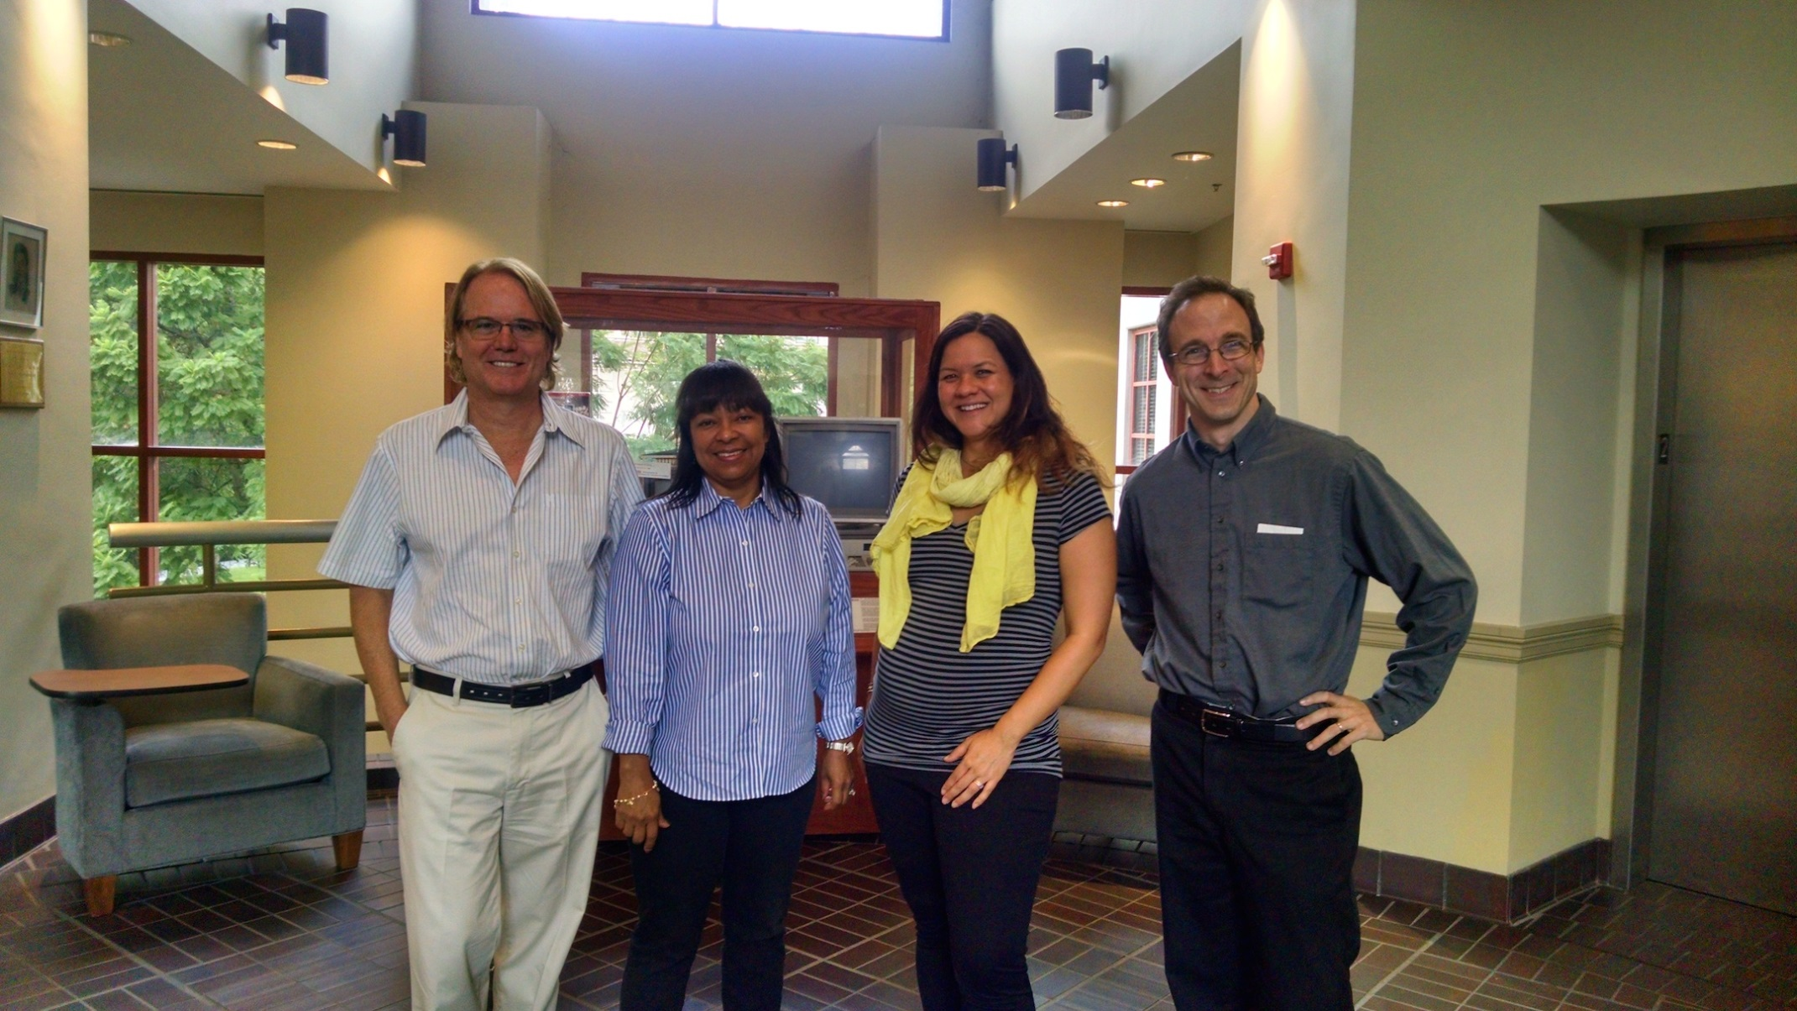
Perspective on for loops
Lisa Fowler
At the top of a CS5 project file …
// Author: Matt Beaumont
// Purpose: To get me out of CS5...
// ...no, really...
// Purpose: To create and maintain a list
// of films and directors
/* Notes:
* I haven't liked for-loops since the day I met them.
* They bother me for some reason. Hence, no for-loops…
*/
… and it is possible to avoid them entirely

Slide 53
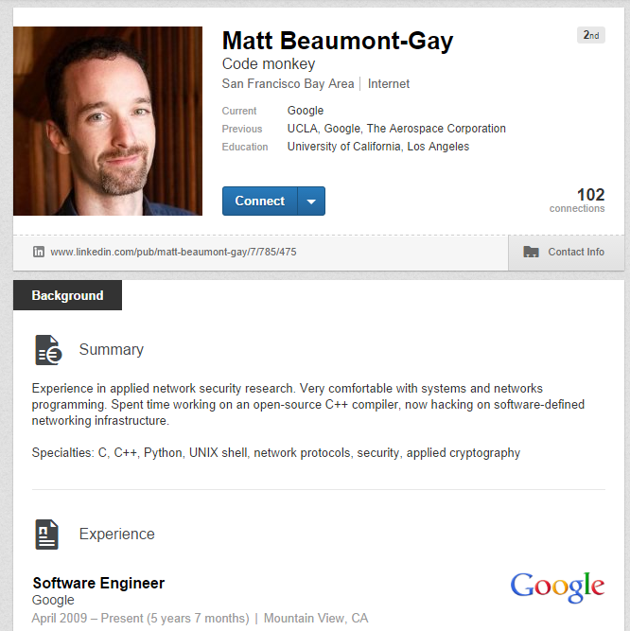
Perspective on for loops
Lisa Fowler
At the top of a CS5 project file …
// Author: Matt Beaumont
// Purpose: To get me out of CS5...
// ...no, really...
// Purpose: To create and maintain a list
// of films and directors
/* Notes:
* I haven't liked for-loops since the day I met them.
* They bother me for some reason. Hence, no for-loops…
*/
… and it is possible to avoid them entirely

Slide 54
Extreme Looping
What does this code do?
print 'It keeps on'
while 41+1 == 42:
print 'going and'
print 'Phew! I\'m done!'
I'm whiling away my time with this one!

Slide 55
Extreme Looping
Anatomy of a while
print 'It keeps on'
while 41+1 == 42:
print 'going and'
print 'Phew! I\'m done!'
the loop keeps on running as long as this test is True
while loop body
other tests we could use here?
This won't print until the while loop finishes - In this case, it never prints!
I'm whiling away my time with this one!

Slide 56
Extreme Looping
lots of different tests…
print 'It keeps on'
while 42 == 42:
print 'going and'
print 'Phew! I\'m done!'
others?
I'm whiling away my time with this one!

Slide 57
Extreme Looping
lots of different tests…
print 'It keeps on'
while True:
print 'going and'
print 'Phew! I\'m done!'
I'm whiling away my time with this one!

Slide 58
Escape ?!
import random
escape = 0
while escape != 42:
print 'Help! Let me out!'
escape = random.choice([41,42,43])
print 'At last!'
starting value, not the final or desired value!
test to see if we keep looping
watch out for infinite loops!
after the loop ends
how could we count the number of loops we run?
how could we make it easier/harder to escape?
random.uniform!

Slide 59
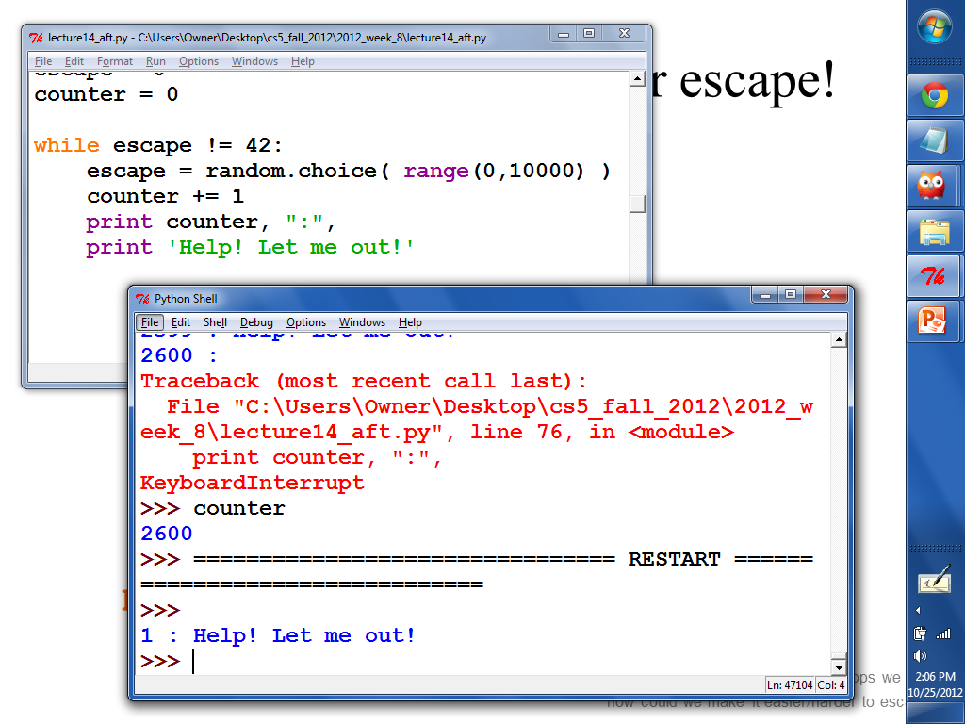
screenshot from '12

Slide 60
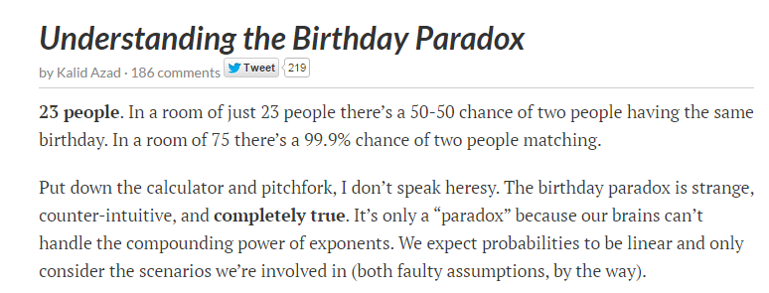
How long til a repeat?
Sooner than you might think…
http://betterexplained.com/articles/understanding-the-birthday-paradox/
birthday paradox!

Slide 61
How long til a repeat?
import random
LoBs = [] # List of BDays
while
b = random.choice(range(365))
LoBs += [b]
print "Repeat! # tries:", len(LoBs)
start w/ an empty list
What should this test be?
get a new birthday
add a new birthday – need to add list + list!
birthday paradox!

Slide 62
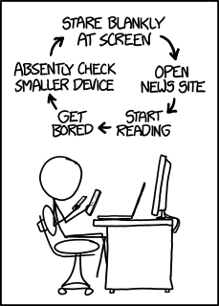
XKCD's loop
and this was before there were watches!

Slide 63
Try these…
What do these two loops return?
Finish this loop to find and return the min of a list, L
L will be a non-empty list of numbers.
Let WORD = 'forty-two'
def min( L ):
result = L[0]
for x in L:
if
return result
What to check about x?
def count( WORD ):
n = 0
for c in WORD:
if c not in 'aeiou':
n += 1
return n
:
What to do?
Extra: Write a loop so that this function returns True if the input n is prime and False otherwise
Let n = 12
Let n = 8
def mystery( n ):
while n != 1:
if n%2 == 0:
n = n/2
else:
return False
return True
n will be a positive integer >= 2
12
8
def isPrime( n ):
Challenge: for what inputs n does mystery return True?
Hint: check all possible divisors to see if they "work"…

Slide 64
What do these two loops return?
Let n = 12 (then 8)
Let WORD = 'forty-two'
def mystery( n ):
while n != 1:
if n%2 == 0:
n = n/2
else:
return False
return True
def count( WORD ):
n = 0
for c in WORD:
if c not in 'aeiou':
n += 1
return n
n
c
0
12
8
'f'
1
'o'
1
6
4
'r'
2
't'
3
'y'
3
False
2
4
5
'-'
't'
1
True
6
7
'w'
7
'o'
Challenge: what are inputs for which mystery returns True?

Slide 65
L will be a non-empty list of numbers.
n will be a positive integer >= 2
def min( L ):
def isPrime( n ):
result = L[0]
for x in L:
if x < result:
return result
result = True
for d in range(2,n/2):
min so far
result so far
min so far
if n%d == 0:
return
return
min so far
[50,55,43,99,45,42]
Where's result?
An example list to consider…
Hint: check all possible divisors to see if they "work"…

Slide 66
Good luck with Hmmmwork #6!
Challenge:
use Hmmm code somewhere on this week's final math 30 exam …

Slide 67
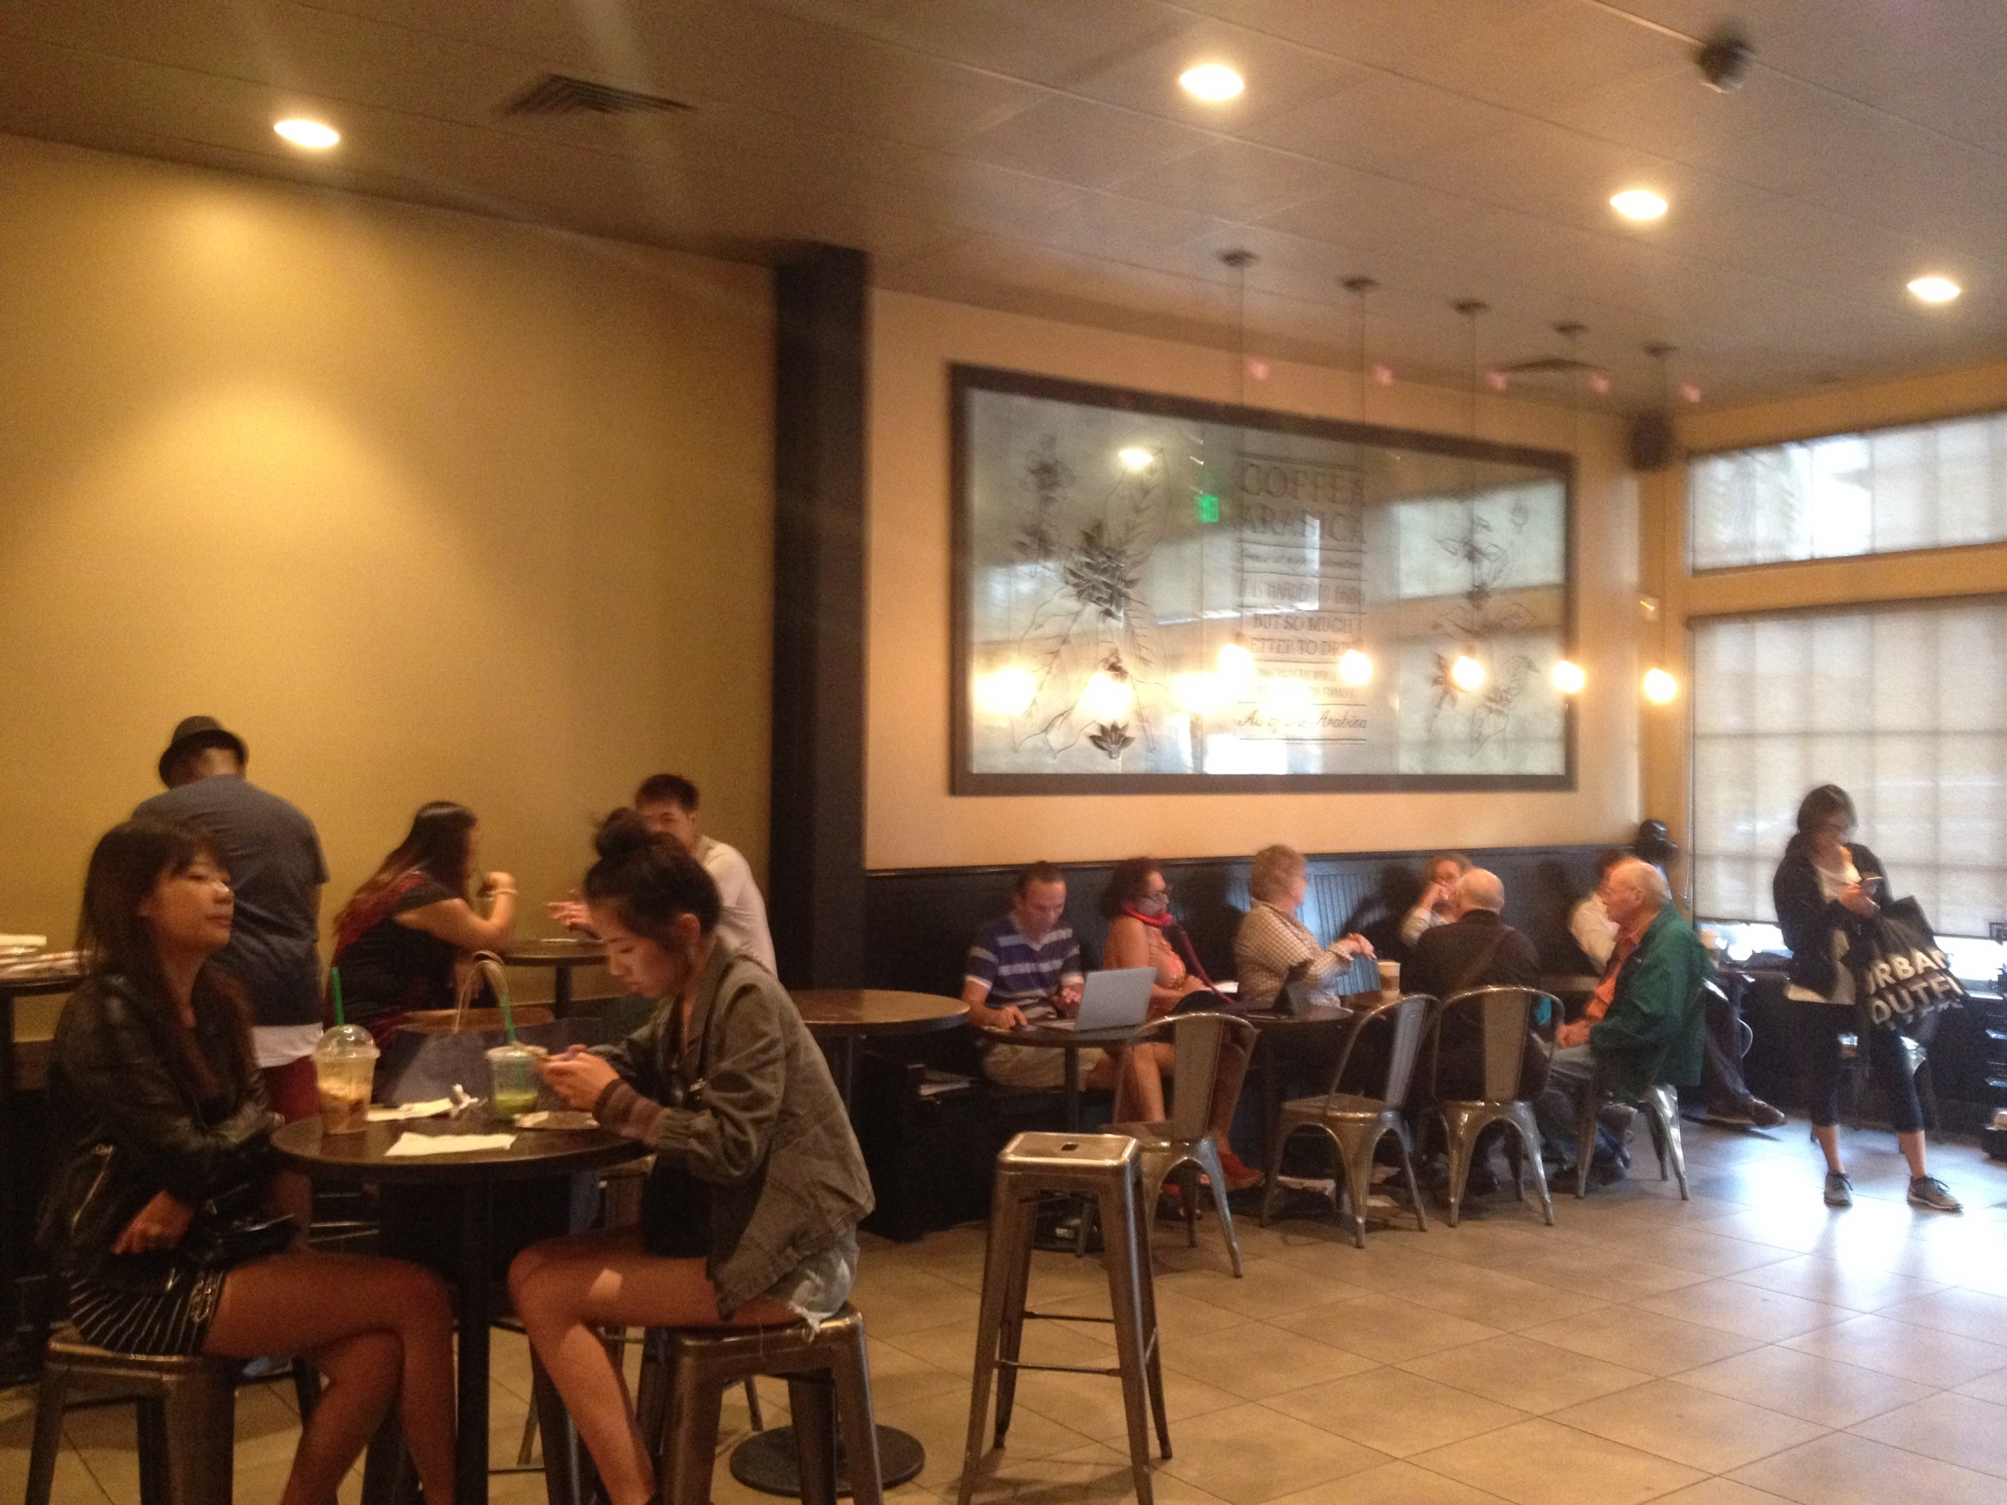
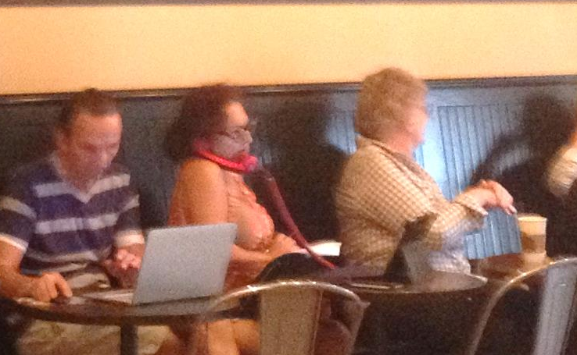
Good luck with Hmmmwork #6!
Challenge:
use Hmmm code somewhere on this week's final math 30 exam …

Slide 68
Warning: no one else uses this term…
Laddering for loops
result
x
def fac( N ):
result = 1
for x in range(1,N+1):
result = result * x
return result
meets up with Jacob's ladder
Notes:
the programmer takes on more responsibility -- for keeping track of what's happening to the variables
throughout the program's execution
part of the elegance of recursion is that you can specify how to obtain the result, and the machine will
make sure to change values as needed -- while storing and loading old values so that nothing is lost…

Slide 69
Quiz
What does the loop say?
Name(s): __________________________
R
x
x
i
result = 1
for x in [2,5,1,4]:
result *= x
print result
x = 0
for i in range(4):
x += 10
print x
L = ['golf','fore!','club','tee']
for i in range(len(L)):
if i%2 == 1:
print L[i]
S = 'time to think this over! '
result = ''
for i in range(len(S)):
if S[i-1] == ' ':
result += S[i]
print result
i%2
i
make a better ladder!
These answers seem unexpected, but still somehow familiar… !?
Notes:
the programmer takes on more responsibility -- for keeping track of what's happening to the variables
throughout the program's execution
part of the elegance of recursion is that you can specify how to obtain the result, and the machine will
make sure to change values as needed -- while storing and loading old values so that nothing is lost…

Slide 70
Quiz
What does the loop say?
result
x
result = 1
for x in [2,5,1,4]:
result *= x
print result
1
2
Notes:
the programmer takes on more responsibility -- for keeping track of what's happening to the variables
throughout the program's execution
part of the elegance of recursion is that you can specify how to obtain the result, and the machine will
make sure to change values as needed -- while storing and loading old values so that nothing is lost…

Slide 71
Quiz
What does the loop say?
x
i
x = 0
for i in range(4):
x += 10
print x
0
0
Notes:
the programmer takes on more responsibility -- for keeping track of what's happening to the variables
throughout the program's execution
part of the elegance of recursion is that you can specify how to obtain the result, and the machine will
make sure to change values as needed -- while storing and loading old values so that nothing is lost…

Slide 72
Quiz
What does the loop say?
L = ['golf','fore!','club','tee']
for i in range(len(L)):
if i%2 == 1:
print L[i]
L[i]
i%2
i
0
1
2
3
Notes:
the programmer takes on more responsibility -- for keeping track of what's happening to the variables
throughout the program's execution
part of the elegance of recursion is that you can specify how to obtain the result, and the machine will
make sure to change values as needed -- while storing and loading old values so that nothing is lost…

Slide 73
Quiz
What does the loop say?
res
S[i-1]
S[i]
i
S = 'time to think this over! '
result = ''
for i in range(len(S)):
if S[i-1] == ' ':
result += S[i]
print result
' '
't'
0
't'
'i'
1
'i'
'm'
2
'm'
'e'
3
'e'
' '
4
' '
't'
5
't'
'o'
6
'o'
' '
7
' '
't'
8
Notes:
the programmer takes on more responsibility -- for keeping track of what's happening to the variables
throughout the program's execution
part of the elegance of recursion is that you can specify how to obtain the result, and the machine will
make sure to change values as needed -- while storing and loading old values so that nothing is lost…

Slide 74
What do these two loops return?
Let n = 12
Let WORD = 'forty-two'
def mystery( n ):
while n != 1:
if n%2 == 0:
n = n/2
else:
return False
return True
def count( WORD ):
n = 0
for c in WORD:
if c not in 'aeiou':
n += 1
return n
12
8
Challenge: what are inputs for which mystery returns True?

Slide 75
Quiz
What does the loop say?
result
x
result = 1
for x in [2,5,1,4]:
result *= x
print result
1
2
Notes:
the programmer takes on more responsibility -- for keeping track of what's happening to the variables
throughout the program's execution
part of the elegance of recursion is that you can specify how to obtain the result, and the machine will
make sure to change values as needed -- while storing and loading old values so that nothing is lost…

Slide 76
Quiz
What does the loop say?
x
i
x = 0
for i in range(4):
x += 10
print x
0
0
Notes:
the programmer takes on more responsibility -- for keeping track of what's happening to the variables
throughout the program's execution
part of the elegance of recursion is that you can specify how to obtain the result, and the machine will
make sure to change values as needed -- while storing and loading old values so that nothing is lost…

Slide 77
Quiz
What does the loop say?
L = ['golf','fore!','club','tee']
for i in range(len(L)):
if i%2 == 1:
print L[i]
i
0
1
2
3
Notes:
the programmer takes on more responsibility -- for keeping track of what's happening to the variables
throughout the program's execution
part of the elegance of recursion is that you can specify how to obtain the result, and the machine will
make sure to change values as needed -- while storing and loading old values so that nothing is lost…

Slide 78
Quiz
What does the loop say?
S = 'time to think this over! '
result = ''
for i in range(len(S)):
if S[i-1] == ' ':
result += S[i]
print result
S[i]
S[i-1]
i
't'
0
'i'
1
'm'
2
.
.
.
.
.
.
Notes:
the programmer takes on more responsibility -- for keeping track of what's happening to the variables
throughout the program's execution
part of the elegance of recursion is that you can specify how to obtain the result, and the machine will
make sure to change values as needed -- while storing and loading old values so that nothing is lost…

Slide 79
while power?
start the answer at a reasonable value
def pow( b, p ):
""" finds b**p """
result =
while
return result
create a loop that ACCUMULATES the correct answer
and return it...

Slide 80
What do these two loops return?
Let n = 12
Let WORD = 'forty-two'
def mystery( n ):
while n != 1:
if n%2 == 0:
n = n/2
else:
return False
return True
def count( WORD ):
n = 0
for c in WORD:
if c not in 'aeiou':
n += 1
return n
Challenge: what are inputs for which mystery returns True?

Slide 81
What do these two loops return?
Let n = 12
Let WORD = 'forty-two'
def mystery( n ):
while n != 1:
if n%2 == 0:
n = n/2
else:
return False
return True
def count( WORD ):
n = 0
for c in WORD:
if c not in 'aeiou':
n += 1
return n
Challenge: what are inputs for which mystery returns True?

Slide 82
L will be a non-empty list of numbers.
n will be a positive integer >= 2
def min( L ):
def isPrime( n ):
[50,55,43,99,45,42]
An example list to consider…
Hint: write a loop to check all possible divisors to see if they "work"…
index?

Slide 83
"Quiz"
in which you already know what all the correct answers will be…
Name(s): __________________________
result = 1
for x in [2,5,1,4]:
result *= x
print result
x = 0
for i in range(4):
x += 10
print x
L = ['golf','fore!','club','tee']
for i in range(len(L)):
if i%2 == 1:
print L[i]
S = 'time to think this over! '
result = ''
for i in range(len(S)):
if S[i-1] == ' ':
result += S[i]
print result
Extra: Use a loop to finish this sum function:
def sum( L ):
result = 0
for
result +=
return result
What do these four loops print out?
Notes:
the programmer takes on more responsibility -- for keeping track of what's happening to the variables
throughout the program's execution
part of the elegance of recursion is that you can specify how to obtain the result, and the machine will
make sure to change values as needed -- while storing and loading old values so that nothing is lost…

Slide 84
What do these two loops do?
Let n = 12
Let WORD = 'forty-two'
def mystery( n ):
while n != 1:
if n%2 == 0:
n = n/2
else:
return False
return True
def count( WORD ):
n = 0
for c in WORD:
if c not in 'aeiou':
n += 1
return n
Challenge: what are all the inputs for whch mystery returns True?

Slide 85
L will be a non-empty list of numbers.
n will be a positive integer > 1
def min( L ):
def isPrime( n ):
Challenge: how could you return the index (location) of the min instead?

Slide 86
which is more flexible?
L = [3, 15, 17, 7]
0
1
2
3
i
def sum(L):
total = 0
for x in L:
total += x
return total
def sum(L):
total = 0
for i in range(len(L))
total += _____
return total
element-based loops
index-based loops

Slide 87
while power?
start the answer at a reasonable value
def pow( b, p ):
result = 1
while
return
create a loop that ACCUMULATES the correct answer
and return it...

Slide 88
Looping over strings
for c in 'down with CS!':
print c

Slide 89
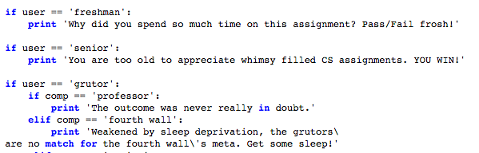
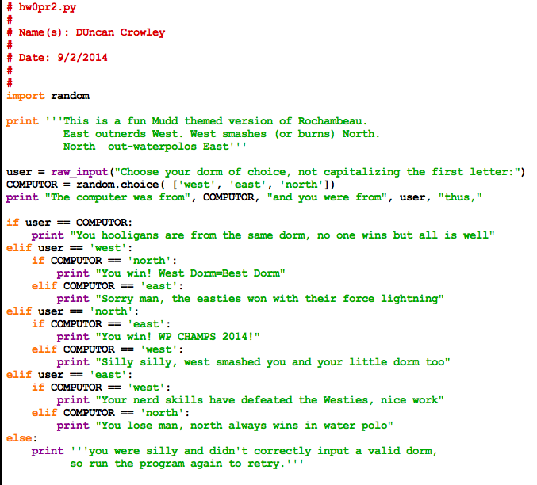
Sara S.
RPS variations!

Slide 90
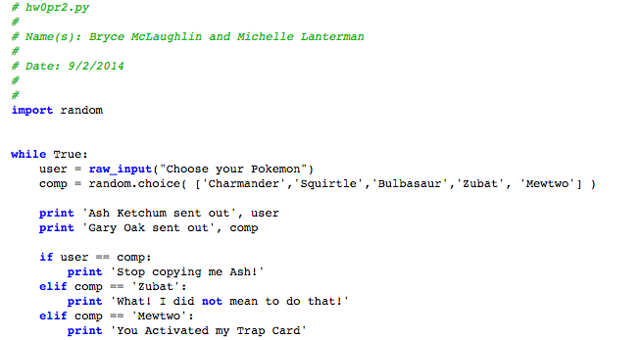
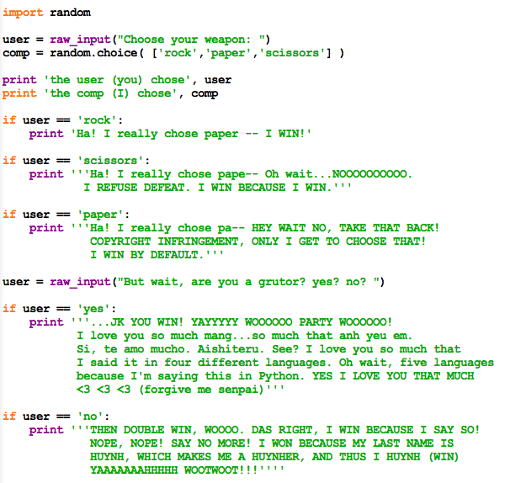
Lam H.
RPS variations

Slide 91
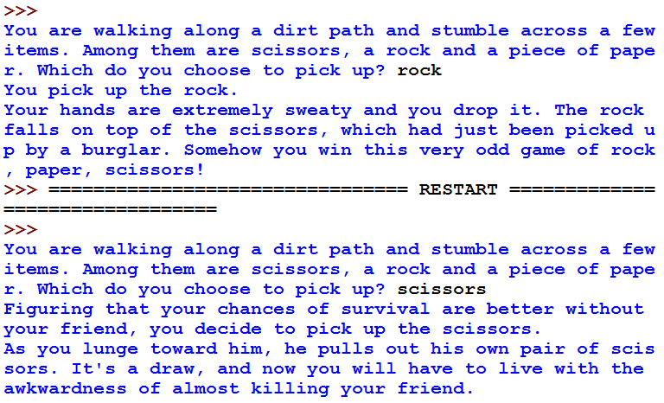
other circuits

Slide 92
hw8, pr2
from pie to π
An engineering challenge:
to estimate π using everyday items...

Slide 93
Easy as π
(1,1)
Visualize:
Pie
Pi ?
(-1,-1)

Slide 94
What do these two loops do?
Let n = 12
Let WORD = 'forty-two'
def mystery( n ):
while n != 1:
if n%2 == 0:
n = n/2
else:
return False
return True
def count( WORD ):
n = 0
for c in WORD:
if c not in 'aeiou':
n += 1
return n

Slide 95
L will be a non-empty list of numbers.
n will be a positive integer > 1
def min( L ):
def isPrime( n ):

Slide 96
while power?
I haven't liked for-loops since the day I met them.
start the answer at a reasonable value
def pow( b, p ):
while :
return
create a loop that ACCUMULATES the correct answer
and return it...

Slide 97
while we're here…
What numbers will this loop print out?
x = 39
while x < 44:
if x%2 == 0:
print x
x += 1

Slide 98
"Quiz"
Write a loop to find and return the min of a list, L
def min( L ):
L will be a non-empty list of numbers.
What do these two loops do?
Let WORD = 'forty-two'
def count( WORD ):
n = 0
for c in WORD:
if c not in 'aeiou':
n += 1
return n
Challenge: how could you return the index (location) of the min instead?
Write a loop so that this function returns True if its input is prime and False otherwise:
def isPrime( n ):
n will be a positive integer > 1
Let n = 12
def mystery( n ):
while n != 1:
if n%2 == 0:
n = n/2
else:
return False
return True

Slide 99
strobe for next instruction
D in
strobe
PC
0
0
0
0
0
1
0
1
Q out
8 address bits
read enable
flip-flop
RAM
strobe for all IR bits
1
0
0
1
1
1
0
0
IR
8 bit instruction
Travis's machine?!
1
decode instruction
clock
2
3
4
5
old value of Reg3 = 7
0
1
1
1
Reg3
strobe to finish instruction (to all bits)
ripple4
7+4
IR
1
0
0
1
1
1
0
0
8 output bits
The instruction
Argument 1
Argument 2
1
0
1
1
the same Reg3
the register
the constant
new value of Reg3 = 11
Reg3
4
10 = add a constant (addn)
Instruction Decoding Guide
a Von Neumann machine

Slide 100

Input and typing trouble!
print 'Please input a number of meters'
meters = raw_input() # get input from user
cm = meters * 100 # convert to centimeters
print 'That is', cm, 'cm.' # print out the result
What is python thinking ?!?

Slide 101
Fix #1: use a type converter
print 'Please input a number of meters'
meters = int(raw_input())
cm = meters * 100
print 'That is', cm, 'cm.'
check out my newly installed int converter!
1
100
The type of variable (box) matters!
name: meters type: int
name: cm
type: int
Notes:
Electric: from www.staticfreesoftware.com
My tutorial is at:
http://odin.ac.hmc.edu/~harris/class/chipdesign/electric.pdf
Lasergene (a molecular biology suite of programs for aligning and comparing
DNA sequences, etc.)
Statview (statistical analysis)
KaleidaGraph (plotting & graphing)
Populus (programs that simulate ecological and evolutionary processes)

Slide 102
Fix #1: use a type converter
print 'Please input a number of meters'
meters = int(raw_input()) # get int input from user
cm = meters * 100
print 'That is', cm, 'cm.'
print 'Please input a number of meters'
meters = float(raw_input()) # get float input from user
cm = meters * 100
print 'That is', cm, 'cm.'
str converts to string type
Notes:
Electric: from www.staticfreesoftware.com
My tutorial is at:
http://odin.ac.hmc.edu/~harris/class/chipdesign/electric.pdf
Lasergene (a molecular biology suite of programs for aligning and comparing
DNA sequences, etc.)
Statview (statistical analysis)
KaleidaGraph (plotting & graphing)
Populus (programs that simulate ecological and evolutionary processes)

Slide 103
Fix #2: use input()
print 'Please input a number of meters'
meters = input() # get processed input from user
cm = meters * 100
print 'That is', cm, 'cm.'
Why not ALWAYS use input() ?
Notes:
Electric: from www.staticfreesoftware.com
My tutorial is at:
http://odin.ac.hmc.edu/~harris/class/chipdesign/electric.pdf
Lasergene (a molecular biology suite of programs for aligning and comparing
DNA sequences, etc.)
Statview (statistical analysis)
KaleidaGraph (plotting & graphing)
Populus (programs that simulate ecological and evolutionary processes)

Slide 104
Fix #2: use input()
print 'Please input a number of meters'
meters = input() # get processed input from user
cm = meters * 100
print 'That is', cm, 'cm.'
Why not ALWAYS use input() ?
raw_input always returns input as a string!
input processes the input as if typed into Python
both allow you to input a prompt string
Notes:
Electric: from www.staticfreesoftware.com
My tutorial is at:
http://odin.ac.hmc.edu/~harris/class/chipdesign/electric.pdf
Lasergene (a molecular biology suite of programs for aligning and comparing
DNA sequences, etc.)
Statview (statistical analysis)
KaleidaGraph (plotting & graphing)
Populus (programs that simulate ecological and evolutionary processes)

Slide 105
input vs. raw_input
reply = raw_input('Enter a string and I\'ll tell you what I see.')
for c in reply:
print 'I see a(n) ', c
interprets what the user types as a string of characters
reply = input('Enter any list and I\'ll tell you what I see.')
for c in reply:
print 'I see a(n) ', c
processes what the user types just as python would

Slide 106
# "Hmmm" program of the day
00 jeqHMCFrosh rYou YourRoom
01 nop
02 nop
03 jeq1:45 rHere
04 call cs5
Translation:
CS 5 has been postponed until 1:45.
If you are an HMC Frosh, you might want to visit your room.
Otherwise you're free to do whatever you want for 30 mins.
But either way be sure to "jump" back here by 1:45.
Thursday, Oct 22
Thanks, Prof. Alvarado!

Slide 107
Accumulating an answer…
def sum( L ):
""" returns the sum of L's elements """
sum = 0
for x in L:
sum = sum + x
return sum
Liar! That's not the sum!
Accumulator!
shortcuts?
vs. recursion?
sum every OTHER element?
Notes:
shortcut is sum += x
another shortcut is sum(L) !!

Slide 108
Two kinds of for loops
Element-based Loops
sum = 0
for x in L:
sum += x
L = [ 42, -5, 10 ]
x
"selfless"
Notes:
Electric: from www.staticfreesoftware.com
My tutorial is at:
http://odin.ac.hmc.edu/~harris/class/chipdesign/electric.pdf
Lasergene (a molecular biology suite of programs for aligning and comparing
DNA sequences, etc.)
Statview (statistical analysis)
KaleidaGraph (plotting & graphing)
Populus (programs that simulate ecological and evolutionary processes)

Slide 109
Two kinds of for loops
Element-based Loops
Index-based Loops
sum = 0
for x in L:
sum += x
sum = 0
for i in :
sum +=
i
0
1
2
L = [ 42, -5, 10 ]
L = [ 42, -5, 10 ]
x
these index-based loops seem so egocentric
Notes:
ask for two parts of the index-based loop!
why is this the egocentric loop?

Slide 110
Two kinds of for loops
Element-based Loops
Index-based Loops
sum = 0
for x in L:
sum += x
sum = 0
for i in range(len(L)):
sum += L[i]
i
0
1
2
L = [ 42, -5, 10 ]
L = [ 42, -5, 10 ]
x
L[i]

Slide 111
Jotto!

Slide 112
Midterm feedback…
Don't put your name
We'd love to know any thoughts you have about Bio/CS6 thus far in the term… in partcular, how you feel about the time and effort Bio/CS6 expects:
On average how much time per week do you spend on Bio/CS6?
How does Bio/CS6's workload compare to other classes you're taking this term?
How would you judge the pace of Bio/CS6?
much lighter
about the same
much heavier
much too slow
about right
much too fast
What is something you'd keep about Bio/CS6 …?
What is something you'd change about / get rid of / add to Bio/CS6 …?
Other thoughts are optional, but 142% welcome:

Slide 113
for a challenge…
for x in range(1,5):
print x
x += 1
A
1
3
B
1
2
3
C
1
3
5
D
1
2
3
4
E
1
2
3
4
5

Slide 114
Remaining words…
achor - orach roach 2
achos - chaos 1
achrt - chart ratch 2
achst - chats tachs 2
acors - orcas 1
acrst - carts scart 2
adhor - hoard 1
adhst - hadst 1
adors - dorsa roads sarod 3
adrst - darts drats 2
ahory - hoary 1
ahrty - rhyta 1
ahsty - hasty 1
akort - tarok troak 2
arstu - sutra 1
arsty - satyr stray trays 3
dehrs - herds sherd shred 3
ehkos - hokes okehs 2
ehrsu - usher 1
ehrsy - shyer 1
ekrst - treks 1
hikst - kiths 1
hklos - holks kohls 2
hknos - honks 1
hlrsu - hurls 1
ikrst - skirt stirk 2

Slide 115
Loopy thinking
0
1
2
3
4
5
6
7
8
9
10
11
12
13
14
15
16
17
18
s = 'gattacaaggtaaaatgca'
How could we find the number of 'a's ? How about 'a's and 't's?
How could we find the number of 'ta's ?
How could we find the longest sequence of 'a's ?
Notes:
Electric: from www.staticfreesoftware.com
My tutorial is at:
http://odin.ac.hmc.edu/~harris/class/chipdesign/electric.pdf
Lasergene (a molecular biology suite of programs for aligning and comparing
DNA sequences, etc.)
Statview (statistical analysis)
KaleidaGraph (plotting & graphing)
Populus (programs that simulate ecological and evolutionary processes)

Slide 116
Loopy thinking
0
1
2
3
4
5
6
7
8
9
10
11
12
13
14
15
16
17
18
s = 'gattacaaggtaaaatgca'
s = 'gattacaaggtaaaatgca'
N = 0
for i in range(0,len(s)):
if s[i] == 'a':
N = N + 1
print 'N is', N
How could we find the number of 'a's ? How about 'a's and 't's?
How could we find the number of 'ta's ?
How could we find the longest sequence of 'a's ?
Notes:
Electric: from www.staticfreesoftware.com
My tutorial is at:
http://odin.ac.hmc.edu/~harris/class/chipdesign/electric.pdf
Lasergene (a molecular biology suite of programs for aligning and comparing
DNA sequences, etc.)
Statview (statistical analysis)
KaleidaGraph (plotting & graphing)
Populus (programs that simulate ecological and evolutionary processes)

Slide 117
Loopy thinking
0
1
2
3
4
5
6
7
8
9
10
11
12
13
14
15
16
17
18
s = 'gattacaaggtaaaatgca'
s = 'gattacaaggtaaaatgca'
N = 0
for i in range(0,len(s)):
if s[i] == 'a' or s[i] == 't':
N = N + 1
print 'N is', N
How could we find the number of 'a's ? How about 'a's and 't's?
How could we find the number of 'ta's ?
How could we find the longest sequence of 'a's ?
Notes:
Electric: from www.staticfreesoftware.com
My tutorial is at:
http://odin.ac.hmc.edu/~harris/class/chipdesign/electric.pdf
Lasergene (a molecular biology suite of programs for aligning and comparing
DNA sequences, etc.)
Statview (statistical analysis)
KaleidaGraph (plotting & graphing)
Populus (programs that simulate ecological and evolutionary processes)

Slide 118
Loopy thinking
0
1
2
3
4
5
6
7
8
9
10
11
12
13
14
15
16
17
18
s = 'gattacaaggtaaaatgca'
s = 'gattacaaggtaaaatgca'
N = 0
for i in range(1,len(s)):
if s[i] == 'a' and s[i-1] == 't':
N = N + 1
print 'N is', N
How could we find the number of 'a's ? How about 'a's and 't's?
How could we find the number of 'ta's ?
How could we find the longest sequence of 'a's ?
Notes:
Electric: from www.staticfreesoftware.com
My tutorial is at:
http://odin.ac.hmc.edu/~harris/class/chipdesign/electric.pdf
Lasergene (a molecular biology suite of programs for aligning and comparing
DNA sequences, etc.)
Statview (statistical analysis)
KaleidaGraph (plotting & graphing)
Populus (programs that simulate ecological and evolutionary processes)

Slide 119
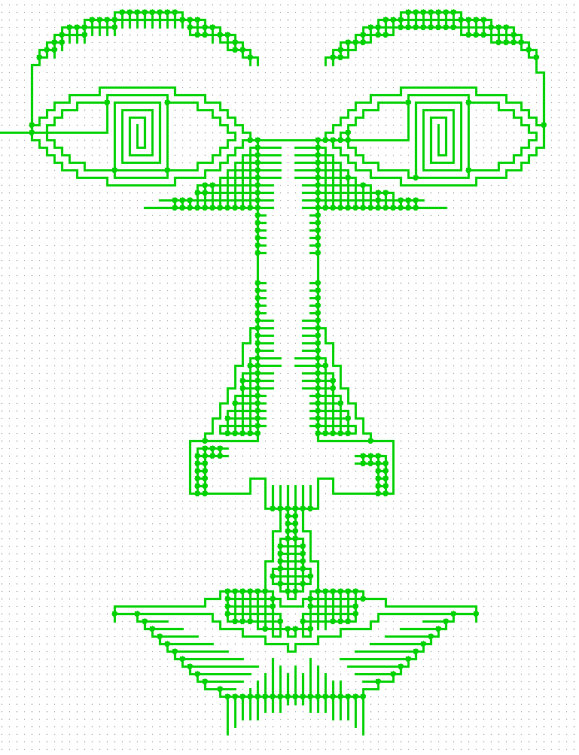
oweissblum

Slide 120
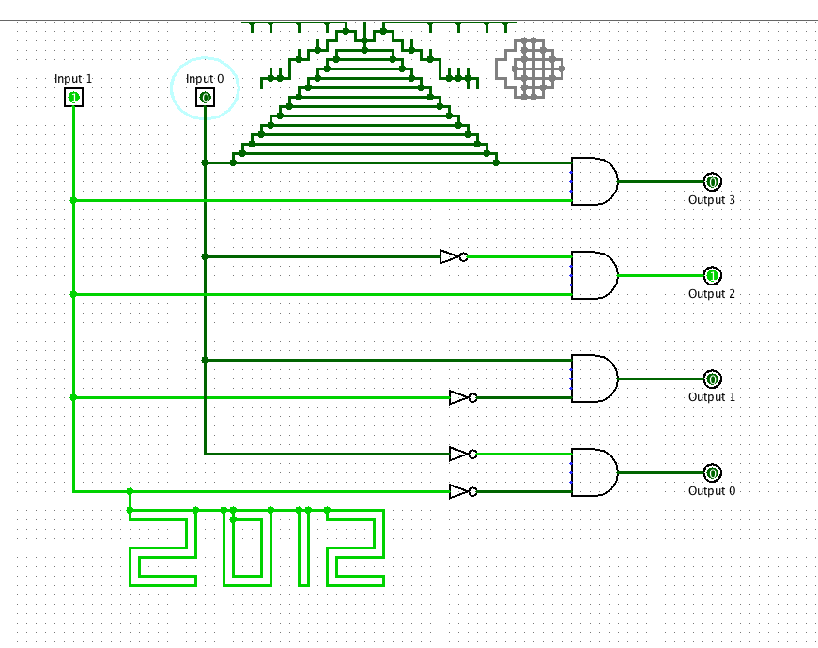
Watch out!
oweissblum

Slide 121
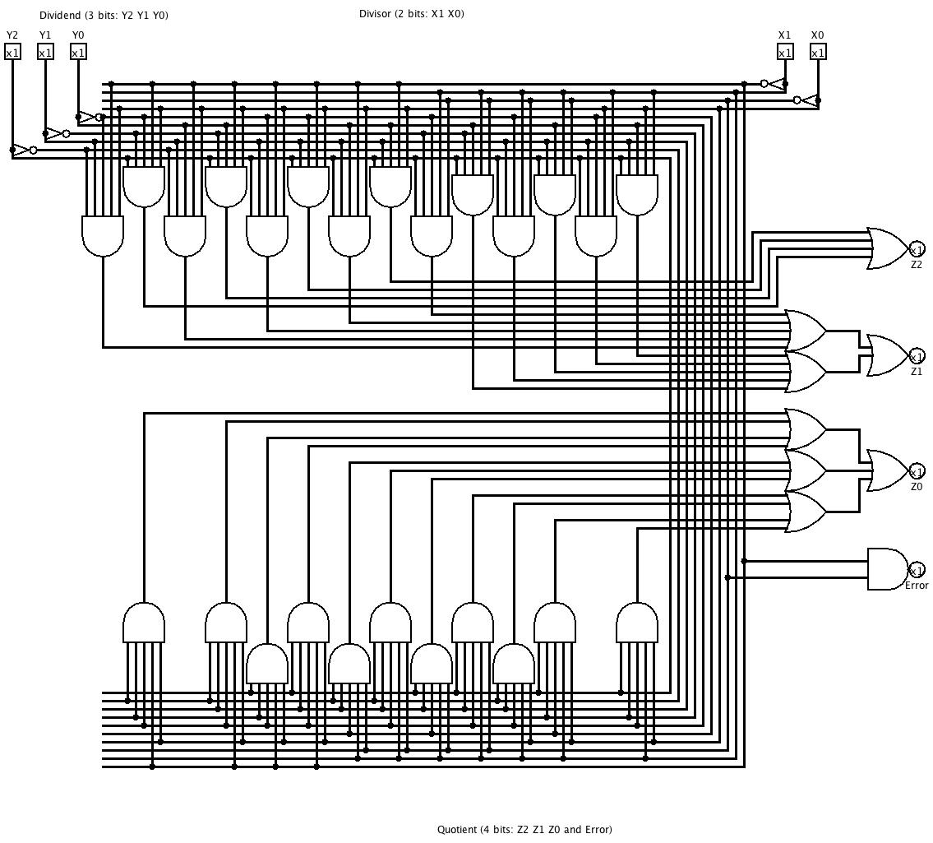
Minterm Expansion!
jrael

Slide 122
Midterm feedback…
Don't put your name
We'd love to know any thoughts you have about CS 5 thus far in the semester… in partcular, how you feel about the time and effort CS 5 expects:
On average how much time per week do you spend on CS 5?
How does CS 5's workload compare to other classes you're taking this term?
How would you judge the pace of CS 5?
much lighter
about the same
much heavier
much too slow
about right
much too fast
What is something you'd keep about CS5…?
What is something you'd change about / get rid of / add to CS5…?
Other thoughts are optional, but 142% welcome:

Slide 123
Loopy thinking
0
1
2
3
4
5
6
7
8
9
10
11
12
13
14
15
16
17
18
s = 'gattacaaggtaaaatgca'
How could we find the longest sequence of 'a's ?
Notes:
Electric: from www.staticfreesoftware.com
My tutorial is at:
http://odin.ac.hmc.edu/~harris/class/chipdesign/electric.pdf
Lasergene (a molecular biology suite of programs for aligning and comparing
DNA sequences, etc.)
Statview (statistical analysis)
KaleidaGraph (plotting & graphing)
Populus (programs that simulate ecological and evolutionary processes)

Slide 124
Planning in "pseudocode"
0
1
2
3
4
5
6
7
8
9
10
11
12
13
14
15
16
17
18
s = 'gattacaaggtaaaatgca'
Keep track of CurRun, MaxRun
Loop through the string:
if we do see an 'a'
if the PREVIOUS letter is NOT an 'a'
if the PREVIOUS letter IS an 'a'
Notes:
Electric: from www.staticfreesoftware.com
My tutorial is at:
http://odin.ac.hmc.edu/~harris/class/chipdesign/electric.pdf
Lasergene (a molecular biology suite of programs for aligning and comparing
DNA sequences, etc.)
Statview (statistical analysis)
KaleidaGraph (plotting & graphing)
Populus (programs that simulate ecological and evolutionary processes)

Slide 125
Planning in "pseudocode"
0
1
2
3
4
5
6
7
8
9
10
11
12
13
14
15
16
17
18
s = 'gattacaaggtaaaatgca'
Keep track of CurRun, MaxRun
Loop through the string:
if we do see an 'a'
if the PREVIOUS letter is NOT an 'a'
Start a Run! CurRun = 1
if the PREVIOUS letter IS an 'a'
Continue our run! CurRun = CurRun + 1
Check for a new maximum…
Notes:
Electric: from www.staticfreesoftware.com
My tutorial is at:
http://odin.ac.hmc.edu/~harris/class/chipdesign/electric.pdf
Lasergene (a molecular biology suite of programs for aligning and comparing
DNA sequences, etc.)
Statview (statistical analysis)
KaleidaGraph (plotting & graphing)
Populus (programs that simulate ecological and evolutionary processes)

Slide 126
Planning in "pseudocode"
0
1
2
3
4
5
6
7
8
9
10
11
12
13
14
15
16
17
18
s = 'gattacaaggtaaaatgca'
Keep track of CurRun, MaxRun
MAX = 0
cur = 0
for i in range(0,len(s)):
if s[i] == 'a':
if s[i-1] != 'a':
cur = 1
else:
cur = cur + 1
if cur > MAX:
MAX = cur
print 'Max is', MAX
Loop through the string:
if we do see an 'a'
if the PREVIOUS letter is NOT an 'a'
Start a Run!
if the PREVIOUS letter IS an 'a'
Continue our run!
Check for a new maximum…
Notes:
Electric: from www.staticfreesoftware.com
My tutorial is at:
http://odin.ac.hmc.edu/~harris/class/chipdesign/electric.pdf
Lasergene (a molecular biology suite of programs for aligning and comparing
DNA sequences, etc.)
Statview (statistical analysis)
KaleidaGraph (plotting & graphing)
Populus (programs that simulate ecological and evolutionary processes)

Slide 127
Challenge
Print the first N numbers in this series…
>>> fib(11)
Example:
1 1 2 3 5 8 13 21 34 55 89

Slide 128
Give me a break !
import random
escape = 0
while escape != 42:
print 'Help! Let me out!'
escape = random.choice([41,42,43])
print 'At last!'
I'll figure out later how to get out of this loop!
OK – I'll stop when the guess is correct!
Every while loop can be a while True: loop!
how could we count the number of loops we run?
Try it!
how could we make it easier/harder to escape?

Slide 129
The boolean type
The human race, from the individual on up, is split into two camps: the bullies and the bullied.
Giacomo Leopardi (1798-1837), young Italian philosopher
I've always thought there were indeed two kinds of people in the world - those who divide the world into two kinds of people, and those who don't.
There are 10 kinds of people in the world: those who know binary, and those who don't.

Slide 130
Jotto finale?
acdet - acted cadet 2
cenop - copen ponce 2
efory - foyer 1
errty - retry terry 2
ertwy - twyer 1
our guesses
M/W's guesses
diner 3
reaps 2
savvy 1
Jesus 1
sines 2
diner 2
irony 2
south 1
dicey 2
cheer 2
5 "words" left
river 3
hyena 2
7 "words" left

Slide 131


The boolean type
is either True or False .
It's needed in if and while statements:
these both have to be boolean.
if test:
print 'test was True!'
do something more …
while test:
print 'test was True!'
do something more …
You can even convert to the boolean type with bool
bool(42)
not to be confused with "Zool"
bool('hi')
bool([1,2,3])

Slide 132
A guessing game…
import random
myNumber = random.randrange(0,1000)
yourGuess = -1
while yourGuess != myNumber:
yourGuess = input('Guess my number: ')
print 'You got it! It was', myNumber
Notice – we don't know how many times we need to loop!
This is too difficult!

Slide 133
Give me a break !
import random
myNumber = random.randrange(0,1000)
while True:
yourGuess = input('Guess my number: ')
if yourGuess == myNumber:
break
print 'You got it! It was', myNumber
I'll figure out later how to get out of this loop!
OK – I'll stop when the guess is correct!
Every while loop can be a while True: loop!
Try it!

Slide 134
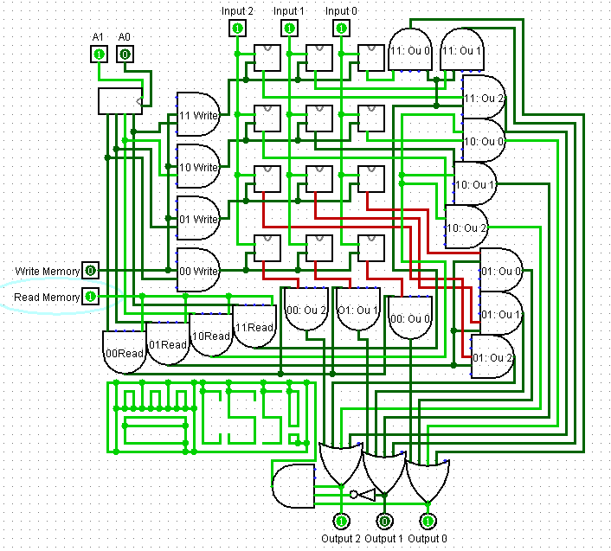
Memory…
When does this set of wires turn on?

Slide 135
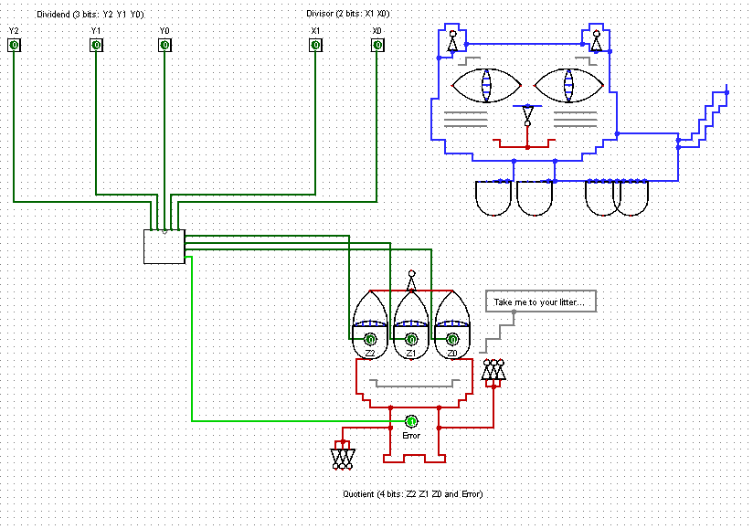
Dividers!
Sibinee J.

Slide 136
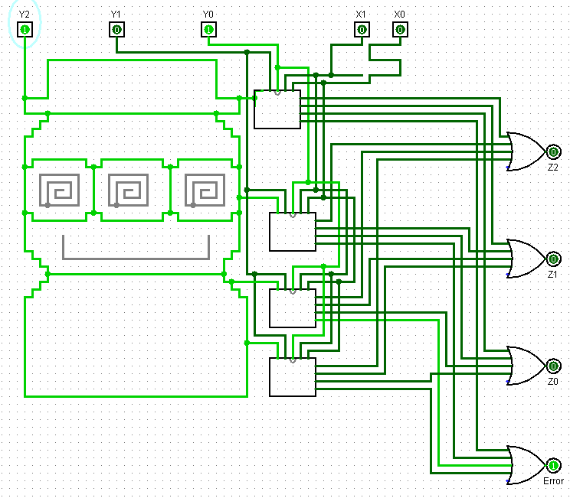

Slide 137
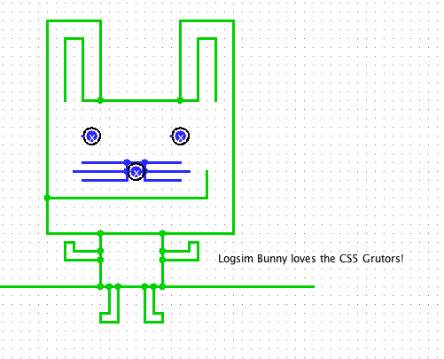

Slide 138
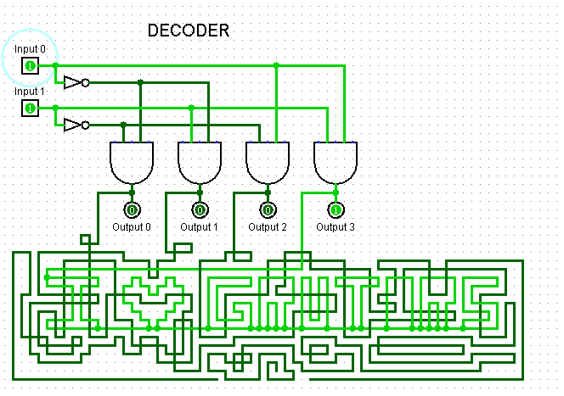

Slide 139
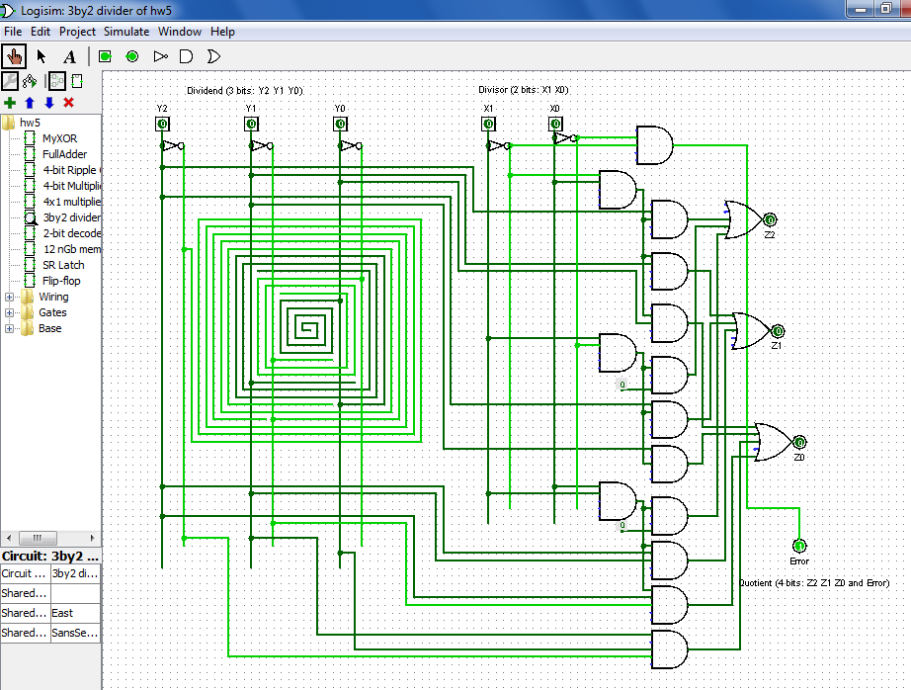
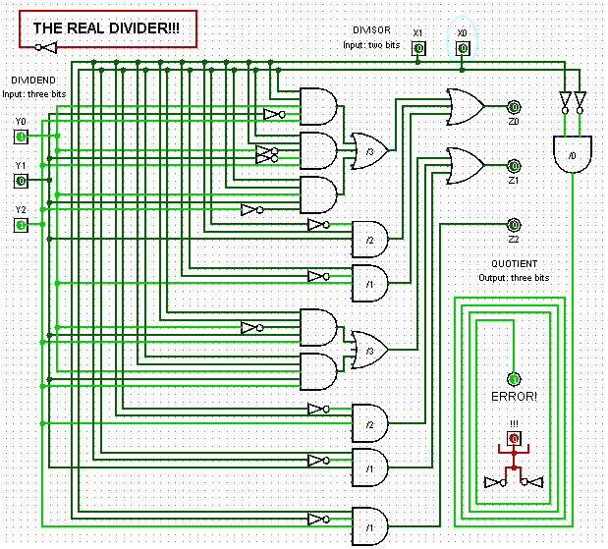
Dividers!
Melody S.

Slide 140
When does this set of wires turn on?

Slide 141
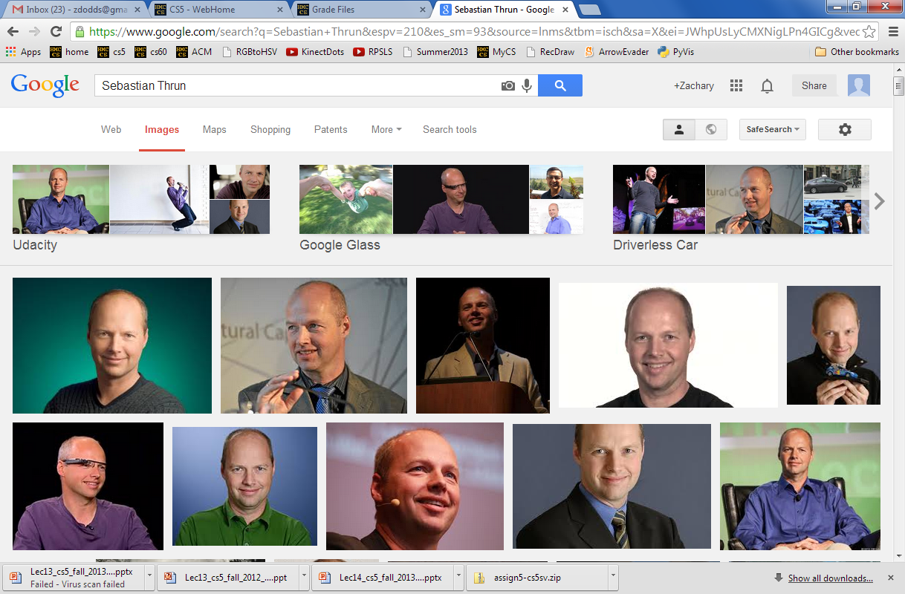
Frosh prank day…

Slide 142

Hey, could you change the channel?
And some more chips would be nice… .
Loops!
A three-line program…
you can use any variable name you want!
this can be ANY list, even a variable!
this is a for loop
for c in 'a gratuitously big string':
print 'I see a(n) ', c
print 'Phew! Can I go watch TV now?'
c will become each item in the list
once for each value of c, the computer does everything in the loop (the indented block)
This will not happen until after the for loop is finished.

Slide 143
Hey, could you change the channel?
And some more chips would be nice… .
Loops!
Who (or what) should be doing most of the work around here ?!!
reply = raw_input('Enter a string and I\'ll tell you what I see.')
for c in reply:
print 'I see a(n) ', c
this can be ANY list, even a variable!
What if we input a list here?
(and not just a string…)

Slide 144
Accumulating an answer…
Suppose we want to find and print the sum of an arbitrary list:
[ 9, 42, 1, 77, 15, 76, 100, -5, 3.14 ]
L = input('Enter a list ')
How could we use a loop? Try it out!
Notes:
Electric: from www.staticfreesoftware.com
My tutorial is at:
http://odin.ac.hmc.edu/~harris/class/chipdesign/electric.pdf
Lasergene (a molecular biology suite of programs for aligning and comparing
DNA sequences, etc.)
Statview (statistical analysis)
KaleidaGraph (plotting & graphing)
Populus (programs that simulate ecological and evolutionary processes)

Slide 145
Accumulating an answer…
Finding the sum of a list:
L = input('Enter a list ')
sumSoFar = 0
for x in L:
sumSoFar = sumSoFar + x
print 'sum is', sumSoFar
Accumulator!
No return needed if you are just printing the value!
shortcut available!
Notes:
Electric: from www.staticfreesoftware.com
My tutorial is at:
http://odin.ac.hmc.edu/~harris/class/chipdesign/electric.pdf
Lasergene (a molecular biology suite of programs for aligning and comparing
DNA sequences, etc.)
Statview (statistical analysis)
KaleidaGraph (plotting & graphing)
Populus (programs that simulate ecological and evolutionary processes)

Slide 146
Slowing down
import time
print 'It keeps on'
while True:
print 'going and'
time.sleep(1)
print 'Phew! I\'m done!'
“while” loop

Slide 147
Typing trouble!
print 'Please input a number of meters'
meters = raw_input() # get input from user
cm = meters * 100 # convert to centimeters
print 'That is', cm, 'cm.' # print out the result
Variables are registers or storage spaces…
'1'
'111…11'
(100 of them!)
The type of variable (box) matters!
name: meters type: string
name: cm
type: string
how to fix this?

Slide 148
Smaller of Two…
print 'Please input two numbers'
n1 = input()
n2 = input()
if n1 > n2:
print 'The smaller number is', n2
else:
print 'The smaller number is', n1
for the visually minded… ?
Notes:
Electric: from www.staticfreesoftware.com
My tutorial is at:
http://odin.ac.hmc.edu/~harris/class/chipdesign/electric.pdf
Lasergene (a molecular biology suite of programs for aligning and comparing
DNA sequences, etc.)
Statview (statistical analysis)
KaleidaGraph (plotting & graphing)
Populus (programs that simulate ecological and evolutionary processes)

Slide 149
minOf2
print 'Please input two numbers'
n1 = input()
n2 = input()
if n1 > n2:
print 'The smaller number is', n2
else:
print 'The smaller number is', n1
print a message
get n1
get n2
TRUE
FALSE
is n1>n2 ?
if
else
print that n2 is the min
print that n1 is the min
Flow Chart
Notes:
Electric: from www.staticfreesoftware.com
My tutorial is at:
http://odin.ac.hmc.edu/~harris/class/chipdesign/electric.pdf
Lasergene (a molecular biology suite of programs for aligning and comparing
DNA sequences, etc.)
Statview (statistical analysis)
KaleidaGraph (plotting & graphing)
Populus (programs that simulate ecological and evolutionary processes)

Slide 150
Accumulate!
print 'Please input two numbers'
n1 = input()
n2 = input()
if n1 > n2:
min = n2
else:
min = n1
print 'The minOf2 is', min
min
Accumulator
what's different here?
Notes:
Electric: from www.staticfreesoftware.com
My tutorial is at:
http://odin.ac.hmc.edu/~harris/class/chipdesign/electric.pdf
Lasergene (a molecular biology suite of programs for aligning and comparing
DNA sequences, etc.)
Statview (statistical analysis)
KaleidaGraph (plotting & graphing)
Populus (programs that simulate ecological and evolutionary processes)

Slide 151
Smaller of Two…
print a message
print 'Please input two numbers'
n1 = input()
n2 = input()
if n1 > n2:
min = n2
else:
min = n1
print 'The minOf2 is', min
get n1
get n2
TRUE
FALSE
is n1>n2 ?
if
else
set min to be n1
set min to be n1
min
Accumulator
print min
Notes:
Electric: from www.staticfreesoftware.com
My tutorial is at:
http://odin.ac.hmc.edu/~harris/class/chipdesign/electric.pdf
Lasergene (a molecular biology suite of programs for aligning and comparing
DNA sequences, etc.)
Statview (statistical analysis)
KaleidaGraph (plotting & graphing)
Populus (programs that simulate ecological and evolutionary processes)

Slide 152
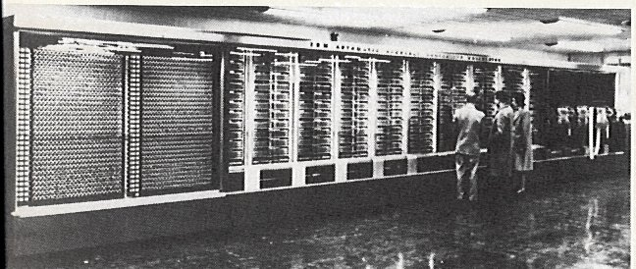
The Mark 1
Grace Hopper, Howard Aiken at Harvard
relay-based computer
ran at 0.00001 MHz
http://www-03.ibm.com/ibm/history/exhibits/markI/markI_reference.html
Addition: 0.6 seconds
Multiplication: 5.7 seconds
Division: 15.3 seconds
5 tons, 530 miles of wiring
765,299 distinct parts!

Slide 153
One problem Two algorithms
Both are correct.
Which is easier to extend to minOf3 ?
print a message
print a message
get n1
get n1
get n2
get n2
TRUE
FALSE
is n1>n2 ?
TRUE
FALSE
is n1>n2 ?
if
else
if
else
set min to be n1
set min to be n1
print that n2 is the min
print that n1 is the min
print min
Notes:
Electric: from www.staticfreesoftware.com
My tutorial is at:
http://odin.ac.hmc.edu/~harris/class/chipdesign/electric.pdf
Lasergene (a molecular biology suite of programs for aligning and comparing
DNA sequences, etc.)
Statview (statistical analysis)
KaleidaGraph (plotting & graphing)
Populus (programs that simulate ecological and evolutionary processes)

Slide 154

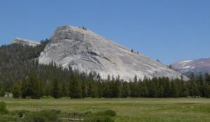
Freefalling?
Lembert Dome, Yosemite

Slide 155
def fall( dt, n ):
""" physics sim. """
t = 0.0 # start time
for i in range(n):
print i, t
t = t + dt
Freefalling
incremental design
v = at
d = ?
www.ambromley.co.uk/fizz.html
Physics simulation

Slide 156
Hw 8 Pr 1
Create functions that print and sum the first N elements of several sequences…
Sequences !
fib(8)
1 1 2 3 5 8 13 21
sum: 54
10 15 20 25 30 35 40
sum: 175
11 22 33 44 55 66 77 88 99 110 121
sum: 726
1 2 4 8 16 32 64 128 256 512 1024 2048
sum: 4095
0 3 9 12 36 39 117 120 360 363 1089
sum: 2148
1 22 333 4444 55555
sum: 60355
1 11 21 1211 111221 312211
sum: 424676
ten(7)
elev(11)
two(12)
three(11)
help(5)
weep(6)
with two extras…

Slide 157
Write an index-based loop to print the first N terms of
Write any loop to print the first N terms of
N terms total
N terms total
7 9 11 13 15 17 …
0 1 2 3 6 7 14 15 30
def seven(N):
for i in range(N):
feel free to add an accumulator, if you'd like!
Quiz, part 2

Slide 158
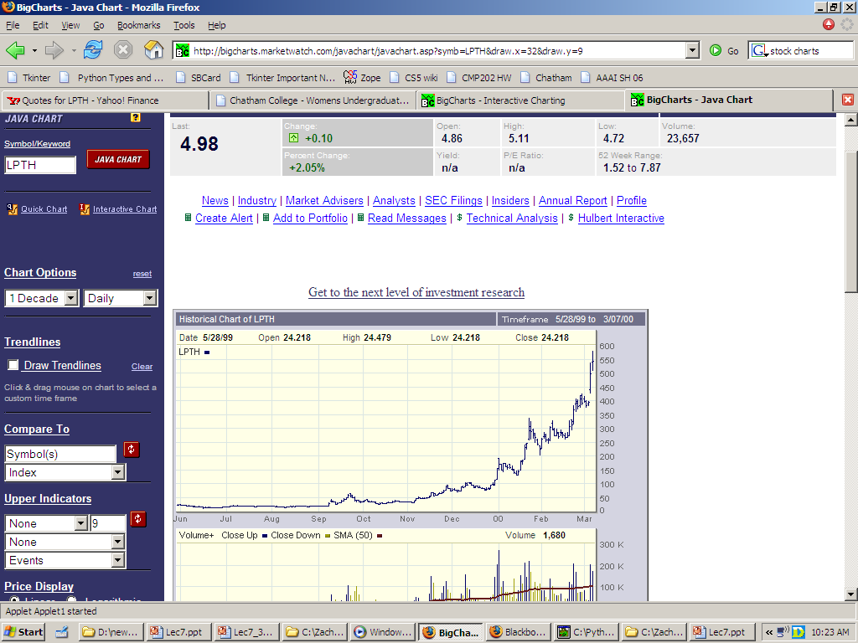
List applications: hw8pr2
"broker than before"
LightPath, late 1999
Notes:
Electric: from www.staticfreesoftware.com
My tutorial is at:
http://odin.ac.hmc.edu/~harris/class/chipdesign/electric.pdf
Lasergene (a molecular biology suite of programs for aligning and comparing
DNA sequences, etc.)
Statview (statistical analysis)
KaleidaGraph (plotting & graphing)
Populus (programs that simulate ecological and evolutionary processes)

Slide 159
List applications: hw8pr2
LightPath, early 2000
Notes:
Electric: from www.staticfreesoftware.com
My tutorial is at:
http://odin.ac.hmc.edu/~harris/class/chipdesign/electric.pdf
Lasergene (a molecular biology suite of programs for aligning and comparing
DNA sequences, etc.)
Statview (statistical analysis)
KaleidaGraph (plotting & graphing)
Populus (programs that simulate ecological and evolutionary processes)

Slide 160

broker than before…
LightPath, 2006…
Notes:
Electric: from www.staticfreesoftware.com
My tutorial is at:
http://odin.ac.hmc.edu/~harris/class/chipdesign/electric.pdf
Lasergene (a molecular biology suite of programs for aligning and comparing
DNA sequences, etc.)
Statview (statistical analysis)
KaleidaGraph (plotting & graphing)
Populus (programs that simulate ecological and evolutionary processes)

Slide 161
T. T. Securities
The future of securities trading and analysis!

Slide 162
T. T. Securities
Input stock prices for a number of days in a row, and then analyze that data… .
Stock-price Analysis
Software
maximum price
day of the max price
minimum price
day of the min price
sum of all of them
average of all of them
standard deviation of all of them
find the best T.T.S. strategy…
mode (most common value - extra)

Slide 163

T. T. Securities
Input stock prices for a number of days in a row, and then analyze that data… .
Stock-price Analysis
Software
maximum price
day of the max price
minimum price
day of the min price
sum of all of them
average of all of them
standard deviation of all of them
find the best T.T.S. strategy…
mode (most common value - extra)
Hardware

Slide 164
hw8 pr2
Given a list of stock prices
L = [ 20, 21, 22, 100, 570, 35, 10, 3.5 ]
Print them nicely…
Day: 0 Price: 20
Day: 1 Price: 21
Day: 2 Price: 22
Day: 3 Price: 100
Day: 4 Price: 570
Day: 5 Price: 35
Day: 6 Price: 10
Day: 7 Price: 3.5
And print the following data:
maximum price
day of the max price
minimum price
day of the min price
sum of all of them
average of all of them
standard deviation of all of them
find the best T.T.S. strategy…
mode (most common value - extra)
Notes:
Electric: from www.staticfreesoftware.com
My tutorial is at:
http://odin.ac.hmc.edu/~harris/class/chipdesign/electric.pdf
Lasergene (a molecular biology suite of programs for aligning and comparing
DNA sequences, etc.)
Statview (statistical analysis)
KaleidaGraph (plotting & graphing)
Populus (programs that simulate ecological and evolutionary processes)

Slide 165
Accumulating a max…
Remember the work of max/min?
Suppose we have to find the max of a HUGE list …
[ 20, 21, 22, 100, 570, 35, 10, 3.5 ]
Notes:
Electric: from www.staticfreesoftware.com
My tutorial is at:
http://odin.ac.hmc.edu/~harris/class/chipdesign/electric.pdf
Lasergene (a molecular biology suite of programs for aligning and comparing
DNA sequences, etc.)
Statview (statistical analysis)
KaleidaGraph (plotting & graphing)
Populus (programs that simulate ecological and evolutionary processes)

Slide 166
Accumulating an answer…
Finding the max of a list:
L = input('Enter a list ')
maxSoFar = 0
for x in L:
if x > maxSoFar:
maxSoFar = x
print 'max is', maxSoFar
printing one's mind!
something's wrong!
Notes:
Electric: from www.staticfreesoftware.com
My tutorial is at:
http://odin.ac.hmc.edu/~harris/class/chipdesign/electric.pdf
Lasergene (a molecular biology suite of programs for aligning and comparing
DNA sequences, etc.)
Statview (statistical analysis)
KaleidaGraph (plotting & graphing)
Populus (programs that simulate ecological and evolutionary processes)

Slide 167
Accumulating an answer…
Finding the max of a list:
L = input('Enter a list ')
maxSoFar = L[0]
for x in L[1:]:
if x > maxSoFar:
maxSoFar = x
print 'max is', maxSoFar
Indexing
Slicing
what day?
Notes:
Electric: from www.staticfreesoftware.com
My tutorial is at:
http://odin.ac.hmc.edu/~harris/class/chipdesign/electric.pdf
Lasergene (a molecular biology suite of programs for aligning and comparing
DNA sequences, etc.)
Statview (statistical analysis)
KaleidaGraph (plotting & graphing)
Populus (programs that simulate ecological and evolutionary processes)

Slide 168
Accumulating an answer…
Finding the maximum
[ 20, 21, 22, 100, 570, 35, 10, 3.5 ]
accumulator variable
L = input('Enter a list ')
maxSoFar = L[0]
for x in L[1:]:
if x > maxSoFar:
maxSoFar = x
print 'max is', maxSoFar
how many times will this happen?
Notes:
Electric: from www.staticfreesoftware.com
My tutorial is at:
http://odin.ac.hmc.edu/~harris/class/chipdesign/electric.pdf
Lasergene (a molecular biology suite of programs for aligning and comparing
DNA sequences, etc.)
Statview (statistical analysis)
KaleidaGraph (plotting & graphing)
Populus (programs that simulate ecological and evolutionary processes)

Slide 169
Determine the max's day …
Finding the day of the max of a list:
L = input('Enter a list ')
maxSoFar = L[0]
for x in L[1:]:
if x > maxSoFar:
maxSoFar = x
print 'max is', maxSoFar
print 'the day of the max is',
Notes:
Electric: from www.staticfreesoftware.com
My tutorial is at:
http://odin.ac.hmc.edu/~harris/class/chipdesign/electric.pdf
Lasergene (a molecular biology suite of programs for aligning and comparing
DNA sequences, etc.)
Statview (statistical analysis)
KaleidaGraph (plotting & graphing)
Populus (programs that simulate ecological and evolutionary processes)

Slide 170
Slow… Accumulation …
Printing a list of days and prices
[ 20, 21, 22, 100, 570, 35, 10, 3.5 ]
desired output
Day: 0 Price: 20
Day: 1 Price: 21
Day: 2 Price: 22
Day: 3 Price: 100
Day: 4 Price: 570
Day: 5 Price: 35
Day: 6 Price: 10
Day: 7 Price: 3.5
what's accumulating here?
Notes:
Electric: from www.staticfreesoftware.com
My tutorial is at:
http://odin.ac.hmc.edu/~harris/class/chipdesign/electric.pdf
Lasergene (a molecular biology suite of programs for aligning and comparing
DNA sequences, etc.)
Statview (statistical analysis)
KaleidaGraph (plotting & graphing)
Populus (programs that simulate ecological and evolutionary processes)

Slide 171
Slow Accumulation …
[ 20, 21, 22, 100, 570, 35, 10, 3.5 ]
Printing a list of days and prices
L = input('Enter a list ')
day = 0
for x in L:
print 'Day:', day, 'Price:', x
something's wrong here!
Notes:
Electric: from www.staticfreesoftware.com
My tutorial is at:
http://odin.ac.hmc.edu/~harris/class/chipdesign/electric.pdf
Lasergene (a molecular biology suite of programs for aligning and comparing
DNA sequences, etc.)
Statview (statistical analysis)
KaleidaGraph (plotting & graphing)
Populus (programs that simulate ecological and evolutionary processes)

Slide 172
Slow Accumulation …
[ 20, 21, 22, 100, 570, 35, 10, 3.5 ]
Printing a list of days and prices
L = input('Enter a list ')
day = 0
for x in L:
print 'Day:', day, 'Price:', x
day = day + 1
This reminds me of another 90's breakout album…
Notes:
Electric: from www.staticfreesoftware.com
My tutorial is at:
http://odin.ac.hmc.edu/~harris/class/chipdesign/electric.pdf
Lasergene (a molecular biology suite of programs for aligning and comparing
DNA sequences, etc.)
Statview (statistical analysis)
KaleidaGraph (plotting & graphing)
Populus (programs that simulate ecological and evolutionary processes)

Slide 173

A good reason not to be a computer!
Finding the standard deviation of a list …
Σ
(L[i] - L_{av})²
len(L)
(1) find the average, L_{av}
(2) find the sum of (x-L_{av})² for x in L
URL
(3) divide by the length of L
(4) import math
math.sqrt(…)
hw8pr2: quantifying VOLATILITY
Notes:
Electric: from www.staticfreesoftware.com
My tutorial is at:
http://odin.ac.hmc.edu/~harris/class/chipdesign/electric.pdf
Lasergene (a molecular biology suite of programs for aligning and comparing
DNA sequences, etc.)
Statview (statistical analysis)
KaleidaGraph (plotting & graphing)
Populus (programs that simulate ecological and evolutionary processes)

Slide 174

TTS ?
Find the most profitable strategy for buying and selling the stock among the prices in the array...
This is the old 23rd-century model !
Day 0 Price is 90.0
Day 1 Price is 10.0
Day 2 Price is 60.0
Day 3 Price is 42.0
Day 4 Price is 75.0
Day 5 Price is 5.0
Buy on ANY day…
Sell on ANY day…
(but, to be realistic, we have to sell AFTER we buy!)
L = [ 90, 10, 60, 42, 75, 5]

Slide 175
Perspective on for loops
At the top of a project file …
// Name: CS5App
// Author: Matt Beaumont
// Purpose: To get me out of CS5...
// ...no, really...
// Purpose: To create and maintain a list
// of films and directors
/* Notes:
* I haven't liked for-loops since the day I met them.
* They bother me for some reason. Hence, no for-loops…
*/
class CS5App
{
...

Slide 176


Extreme Looping
What does this code do?
print 'It keeps on'
while True:
print 'going and'
print 'Phew! I\'m done!'
“while” loop

Slide 177
Extreme Looping
Slowing things down…
import time
print 'It keeps on'
while True:
print 'going and'
time.sleep(1)
print 'Phew! I\'m done!'
the loop keeps on running as long as this is True
“while” loop

Slide 178

Making our escape!
the loop keeps on running as long as this is True
import random
print 'It keeps on'
escape = 0
while escape != 42:
print 'going and'
escape = random.choice([41,42,43])
print 'Phew! I\'m done!'
“while” loop
how could we count the number of loops we run?
how could we make it easier/harder to escape?

Slide 179
The boolean type
The human race, from the individual on up, is split into two camps: the bullies and the bullied.
Giacomo Leopardi (1798-1837), young Italian philosopher
I've always thought there were indeed two kinds of people in the world - those who divide the world into two kinds of people, and those who don't.
There are 10 kinds of people in the world: those who know binary, and those who don't.

Slide 180
The boolean type
is either True or False .
It's needed in if and while statements:
these both have to be boolean.
if test:
print 'test was True!'
do something more …
while test:
print 'test was True!'
do something more …
You can even convert to the boolean type with bool
bool(42)
not to be confused with "Zool"
bool('hi')
bool([1,2,3])

Slide 181
A guessing game…
import random
myNumber = random.randrange(0,1000)
yourGuess = -1
while yourGuess != myNumber:
yourGuess = input('Guess my number: ')
print 'You got it! It was', myNumber
Notice – we don't know how many times we need to loop!
This is too difficult!

Slide 182
Give me a break !
import random
myNumber = random.randrange(0,1000)
while True:
yourGuess = input('Guess my number: ')
if yourGuess == myNumber:
break
print 'You got it! It was', myNumber
I'll figure out later how to get out of this loop!
OK – I'll stop when the guess is correct!
Every while loop can be a while True: loop!
Try it!

Slide 183

Do you remember?
Loops repeat an action:
most crucial
for each list element
for each item index
use break to escape from a loop any time!
while a test is True
Loops can run by element or by index:
for x in L:
sumSoFar = sumSoFar + x
for i in range(0,len(L)):
sumSoFar = sumSoFar + L[i]
An accumulator is a variable that may update each iteration.
least crucial
Use input()for processed values; raw_input()for strings.
Notes:
rip it off, but don’t take it quite yet – after all, it wouldn’t be particularly fair

Slide 184

Who writes assembly?
a few people…

Slide 185


jump is a "goto"
jump 42
basic computational building block ~ the function

Slide 186
Lab
Assembly Language Questions?
Working on loops…
Notes:
rip it off, but don’t take it quite yet – after all, it wouldn’t be particularly fair

Slide 187
"Quiz"
import random
myNumber = random.randrange(0,1000)
while True:
yourGuess = input('Guess my number: ')
if yourGuess == myNumber:
break
print 'You got it! It was', myNumber
starting with the guessing game code…
(1) Add an "escape hatch" that stops the game if the user types the number 42.
(2) Add a note at the end that tells the user how many total guesses they made.
(3) Provide a hint to the user - whether the guess was too low or too high
Then you should be able to guess it – even out of 1000 or 1,000,000!
(Ex) Reverse the program so that the computer guesses your secret number (with hints)!

Slide 188
"Quiz"
What do these loops print? What do they do?
1
s = 'gattacaaggtaaaatgca'
N = 0
for i in range(0,len(s)):
if s[i] == 'a':
N = N + 1
print 'N is', N
2
s = 'gattacaaggtaaaatgca'
N = 0
for i in range(0,len(s)):
if s[i] == 'a' or s[i] == 't':
N = N + 1
print 'N is', N
4
s = 'gattacaaggtaaaatgca'
MAX = 0
cur = 0
for i in range(0,len(s)):
if s[i] == 'a':
if s[i-1] != 'a':
cur = 1
else:
cur = cur + 1
if cur > MAX:
MAX = cur
print 'Max is', MAX
3
s = 'gattacaaggtaaaatgca'
N = 0
for i in range(1,len(s)):
if s[i] == 'a' and s[i-1] == 't':
N = N + 1
print 'N is', N
Notes:
Electric: from www.staticfreesoftware.com
My tutorial is at:
http://odin.ac.hmc.edu/~harris/class/chipdesign/electric.pdf
Lasergene (a molecular biology suite of programs for aligning and comparing
DNA sequences, etc.)
Statview (statistical analysis)
KaleidaGraph (plotting & graphing)
Populus (programs that simulate ecological and evolutionary processes)

Slide 189
Loopy thinking
0
1
2
3
4
5
6
7
8
9
10
11
12
13
14
15
16
17
18
s = 'gattacaaggtaaaatgca'
How could we find the number of 'a's ? How about 'a's and 't's?
How could we find the number of 'ta's ?
How could we find the longest sequence of 'a's ?
Notes:
Electric: from www.staticfreesoftware.com
My tutorial is at:
http://odin.ac.hmc.edu/~harris/class/chipdesign/electric.pdf
Lasergene (a molecular biology suite of programs for aligning and comparing
DNA sequences, etc.)
Statview (statistical analysis)
KaleidaGraph (plotting & graphing)
Populus (programs that simulate ecological and evolutionary processes)

Slide 190
Loopy thinking
0
1
2
3
4
5
6
7
8
9
10
11
12
13
14
15
16
17
18
s = 'gattacaaggtaaaatgca'
s = 'gattacaaggtaaaatgca'
N = 0
for i in range(0,len(s)):
if s[i] == 'a':
N = N + 1
print 'N is', N
How could we find the number of 'a's ? How about 'a's and 't's?
How could we find the number of 'ta's ?
How could we find the longest sequence of 'a's ?
Notes:
Electric: from www.staticfreesoftware.com
My tutorial is at:
http://odin.ac.hmc.edu/~harris/class/chipdesign/electric.pdf
Lasergene (a molecular biology suite of programs for aligning and comparing
DNA sequences, etc.)
Statview (statistical analysis)
KaleidaGraph (plotting & graphing)
Populus (programs that simulate ecological and evolutionary processes)

Slide 191
Loopy thinking
0
1
2
3
4
5
6
7
8
9
10
11
12
13
14
15
16
17
18
s = 'gattacaaggtaaaatgca'
s = 'gattacaaggtaaaatgca'
N = 0
for i in range(0,len(s)):
if s[i] == 'a' or s[i] == 't':
N = N + 1
print 'N is', N
How could we find the number of 'a's ? How about 'a's and 't's?
How could we find the number of 'ta's ?
How could we find the longest sequence of 'a's ?
Notes:
Electric: from www.staticfreesoftware.com
My tutorial is at:
http://odin.ac.hmc.edu/~harris/class/chipdesign/electric.pdf
Lasergene (a molecular biology suite of programs for aligning and comparing
DNA sequences, etc.)
Statview (statistical analysis)
KaleidaGraph (plotting & graphing)
Populus (programs that simulate ecological and evolutionary processes)

Slide 192
Loopy thinking
0
1
2
3
4
5
6
7
8
9
10
11
12
13
14
15
16
17
18
s = 'gattacaaggtaaaatgca'
s = 'gattacaaggtaaaatgca'
N = 0
for i in range(1,len(s)):
if s[i] == 'a' and s[i-1] == 't':
N = N + 1
print 'N is', N
How could we find the number of 'a's ? How about 'a's and 't's?
How could we find the number of 'ta's ?
How could we find the longest sequence of 'a's ?
Notes:
Electric: from www.staticfreesoftware.com
My tutorial is at:
http://odin.ac.hmc.edu/~harris/class/chipdesign/electric.pdf
Lasergene (a molecular biology suite of programs for aligning and comparing
DNA sequences, etc.)
Statview (statistical analysis)
KaleidaGraph (plotting & graphing)
Populus (programs that simulate ecological and evolutionary processes)

Slide 193
Loopy thinking
0
1
2
3
4
5
6
7
8
9
10
11
12
13
14
15
16
17
18
s = 'gattacaaggtaaaatgca'
How could we find the longest sequence of 'a's ?
Notes:
Electric: from www.staticfreesoftware.com
My tutorial is at:
http://odin.ac.hmc.edu/~harris/class/chipdesign/electric.pdf
Lasergene (a molecular biology suite of programs for aligning and comparing
DNA sequences, etc.)
Statview (statistical analysis)
KaleidaGraph (plotting & graphing)
Populus (programs that simulate ecological and evolutionary processes)

Slide 194
Planning in "pseudocode"
0
1
2
3
4
5
6
7
8
9
10
11
12
13
14
15
16
17
18
s = 'gattacaaggtaaaatgca'
Keep track of CurRun, MaxRun
Loop through the string:
if we do see an 'a'
if the PREVIOUS letter is NOT an 'a'
if the PREVIOUS letter IS an 'a'
Notes:
Electric: from www.staticfreesoftware.com
My tutorial is at:
http://odin.ac.hmc.edu/~harris/class/chipdesign/electric.pdf
Lasergene (a molecular biology suite of programs for aligning and comparing
DNA sequences, etc.)
Statview (statistical analysis)
KaleidaGraph (plotting & graphing)
Populus (programs that simulate ecological and evolutionary processes)

Slide 195
Planning in "pseudocode"
0
1
2
3
4
5
6
7
8
9
10
11
12
13
14
15
16
17
18
s = 'gattacaaggtaaaatgca'
Keep track of CurRun, MaxRun
Loop through the string:
if we do see an 'a'
if the PREVIOUS letter is NOT an 'a'
Start a Run! CurRun = 1
if the PREVIOUS letter IS an 'a'
Continue our run! CurRun = CurRun + 1
Check for a new maximum…
Notes:
Electric: from www.staticfreesoftware.com
My tutorial is at:
http://odin.ac.hmc.edu/~harris/class/chipdesign/electric.pdf
Lasergene (a molecular biology suite of programs for aligning and comparing
DNA sequences, etc.)
Statview (statistical analysis)
KaleidaGraph (plotting & graphing)
Populus (programs that simulate ecological and evolutionary processes)

Slide 196
Planning in "pseudocode"
0
1
2
3
4
5
6
7
8
9
10
11
12
13
14
15
16
17
18
s = 'gattacaaggtaaaatgca'
Keep track of CurRun, MaxRun
MAX = 0
cur = 0
for i in range(0,len(s)):
if s[i] == 'a':
if s[i-1] != 'a':
cur = 1
else:
cur = cur + 1
if cur > MAX:
MAX = cur
print 'Max is', MAX
Loop through the string:
if we do see an 'a'
if the PREVIOUS letter is NOT an 'a'
Start a Run!
if the PREVIOUS letter IS an 'a'
Continue our run!
Check for a new maximum…
Notes:
Electric: from www.staticfreesoftware.com
My tutorial is at:
http://odin.ac.hmc.edu/~harris/class/chipdesign/electric.pdf
Lasergene (a molecular biology suite of programs for aligning and comparing
DNA sequences, etc.)
Statview (statistical analysis)
KaleidaGraph (plotting & graphing)
Populus (programs that simulate ecological and evolutionary processes)

Slide 197
Do you remember?
Loops repeat an action for each list element.
most crucial
Loops can run by element or by index:
for x in L:
sumSoFar = sumSoFar + x
for i in range(0,len(L)):
sumSoFar = sumSoFar + L[i]
The range function creates (possibly) big lists fast!
range(0,100)
is [0, 1, 2, … , 99]
An accumulator is a variable that may update each iteration.
least crucial
Use input()for processed values; raw_input()for strings.
Notes:
rip it off, but don’t take it quite yet – after all, it wouldn’t be particularly fair

Slide 198


Do you remember?
All data is stored in memory as a list.
most crucial
Loops repeat an action for each list element.
An accumulator is a variable that may update each iteration.
Lists can be indexed and sliced into pieces.
Indexing starts at 0 (zero). L[0] is the first list item.
- This alters the usual numeric notions of "first," "second," "third," etc.!
Slicing includes the left side but excludes the right side.
least crucial
Use input()for processed values; raw_input()for strings.
Notes:
rip it off, but don’t take it quite yet – after all, it wouldn’t be particularly fair

Slide 199
Getting loopy!
with hw4pr1.py
(1) Write a program that asks the user for a list of numbers.
(2) Find the MAXIMUM and print it out.
(3) Find the MINIMUM and print it out.
(Just use the same list again in another loop. Don't ask for a new list!)
(4) Find the SUM of all the numbers and print it out.
(Ditto)
(5) Find the AVERAGE of all the numbers and print it out.
(Is there an easy way to do this?)
include standard deviation to finish it up!
http://www.800score.com/guidec9b.html
Notes:
Electric: from www.staticfreesoftware.com
My tutorial is at:
http://odin.ac.hmc.edu/~harris/class/chipdesign/electric.pdf
Lasergene (a molecular biology suite of programs for aligning and comparing
DNA sequences, etc.)
Statview (statistical analysis)
KaleidaGraph (plotting & graphing)
Populus (programs that simulate ecological and evolutionary processes)

Slide 200



What’s 7 plus five more 7’s?
Thinking like python…
human input
the official flowchart
prompt
>>> 7 + 7x5
human’s thoughts/actions in green
python’s thoughts/actions in blue
parsing
I don’t get it…!
Do I get
I “understand”
what you are talking
barfing
about ??!
compiling
File "<stdin>", line 1
7 + 7x5
^
SyntaxError: invalid syntax
0 LOAD_CONST 1 (7)
3 LOAD_CONST 1 (7)
6 LOAD_CONST 2 (5)
9 BINARY_MULTIPLY
10 BINARY_ADD
11 RETURN_VALUE
Convert to something my processor can handle
This is my best explanation of what I don’t understand…
running
Excellent !
Maybe I’ll try something else…
42
returning value
I knew that!
reads the output
Notes:
Electric: from www.staticfreesoftware.com
My tutorial is at:
http://odin.ac.hmc.edu/~harris/class/chipdesign/electric.pdf
Lasergene (a molecular biology suite of programs for aligning and comparing
DNA sequences, etc.)
Statview (statistical analysis)
KaleidaGraph (plotting & graphing)
Populus (programs that simulate ecological and evolutionary processes)

Slide 201
Jotto
Jessica's word
my word
1916 words remaining
diner 2
diner 1
2319 words remaining
952 words remaining
ghost 1
ghoul 1
1129 words remaining
quack 0
brown 3
56 words remaining
363 words remaining
badge 1
190 words remaining
wacky 0
9 words remaining
world 3
possibilities
error
xenon
rhyme
moxie…

Slide 202


Silicon Dreams
How does a machine think ?
How many problems am I facing in five weeks with two per week ?
Algorithms
Programming Language
p = 5*2
Machine Instructions
loadn r0 5 # p
loadn r1 2 # pr/wk
mul r0 r0 r1 # answer!
Movement of electrons
its great- great-… grand-child
layers of abstraction
Shockley’s first transistor
Notes:
So, how does a machine think?
Given how different machines and people are, I feel like it’s surprising that this question is so similar to asking “how do people think?”
And reason they’re similar is that the question can be answered on many levels… what’s your opinion?
what factors do you consider when making a particular decision?
how do you arrange things so that you can get some thinking or particular problem solving done?
how do your neurons conspire to reach conclusions?
one of the beautiful things about computer science is that – despite the complexity involved, every detail _is_ knowable and, in fact, known. The task of knowing it all is pretty daunting, so in this
This picture shows the workbench of John Bardeen and Walter Brattain at Bell Laboratories. They were supposed to be doing fundamental research about crystal surfaces. The experimental results hadn't been very good, though, and there's a rumor that their boss, William Shockley, came near to cancelling the project. But in 1947, they switched to using tremendously pure materials. And it dawned on them that they could build the circuit in the picture. It was an amplifier!
The three shared a Nobel Prize. Bardeen and Brattain continued in research (and Bardeen later won another Nobel). Shockley quit to start a semiconductor company in Palo Alto. It folded, but its staff went on to invent the integrated circuit (the "chip") and to found Intel Corporation.
By 1960, all important computers used transistors for logic, and ferrite cores for memory. Memory chips replaced core in the 1970's.

Slide 203
Silicon Dreams
How does a machine think ?
How many problems am I facing in five weeks with two per week ?
Algorithms
our tasks
Programming Language
Python
p = 5*2
Machine Instructions
loadn r0 5 # p
loadn r1 2 # pr/wk
mul r0 r0 r1 # answer!
computer’s tasks
Movement of electrons
its great- great-… grand-child
layers of abstraction
Shockley’s first transistor
Notes:
So, how does a machine think?
Given how different machines and people are, I feel like it’s surprising that this question is so similar to asking “how do people think?”
And reason they’re similar is that the question can be answered on many levels… what’s your opinion?
what factors do you consider when making a particular decision?
how do you arrange things so that you can get some thinking or particular problem solving done?
how do your neurons conspire to reach conclusions?
one of the beautiful things about computer science is that – despite the complexity involved, every detail _is_ knowable and, in fact, known. The task of knowing it all is pretty daunting, so in this
This picture shows the workbench of John Bardeen and Walter Brattain at Bell Laboratories. They were supposed to be doing fundamental research about crystal surfaces. The experimental results hadn't been very good, though, and there's a rumor that their boss, William Shockley, came near to cancelling the project. But in 1947, they switched to using tremendously pure materials. And it dawned on them that they could build the circuit in the picture. It was an amplifier!
The three shared a Nobel Prize. Bardeen and Brattain continued in research (and Bardeen later won another Nobel). Shockley quit to start a semiconductor company in Palo Alto. It folded, but its staff went on to invent the integrated circuit (the "chip") and to found Intel Corporation.
By 1960, all important computers used transistors for logic, and ferrite cores for memory. Memory chips replaced core in the 1970's.

Slide 204
Silicon Dreams
How does a machine think ?
How many problems am I facing in five weeks with two per week ?
Algorithms
our tasks
program
Programming Language
Python
p = 5*2
compile
Machine Instructions
loadn r0 5 # p
loadn r1 2 # pr/wk
mul r0 r0 r1 # answer!
run
computer’s tasks
Movement of electrons
its great- great-… grand-child
layers of abstraction
Shockley’s first transistor
Notes:
So, how does a machine think?
Given how different machines and people are, I feel like it’s surprising that this question is so similar to asking “how do people think?”
And reason they’re similar is that the question can be answered on many levels… what’s your opinion?
what factors do you consider when making a particular decision?
how do you arrange things so that you can get some thinking or particular problem solving done?
how do your neurons conspire to reach conclusions?
one of the beautiful things about computer science is that – despite the complexity involved, every detail _is_ knowable and, in fact, known. The task of knowing it all is pretty daunting, so in this
This picture shows the workbench of John Bardeen and Walter Brattain at Bell Laboratories. They were supposed to be doing fundamental research about crystal surfaces. The experimental results hadn't been very good, though, and there's a rumor that their boss, William Shockley, came near to cancelling the project. But in 1947, they switched to using tremendously pure materials. And it dawned on them that they could build the circuit in the picture. It was an amplifier!
The three shared a Nobel Prize. Bardeen and Brattain continued in research (and Bardeen later won another Nobel). Shockley quit to start a semiconductor company in Palo Alto. It folded, but its staff went on to invent the integrated circuit (the "chip") and to found Intel Corporation.
By 1960, all important computers used transistors for logic, and ferrite cores for memory. Memory chips replaced core in the 1970's.

Slide 205
Fast Accumulation …
Finding the sum of a list
[ 20, 21, 22, 100, 570, 35, 10, 3.5 ]
L = input('Enter a list ')
sumSoFar = 0
for x in L:
sumSoFar = sumSoFar + x
print 'sum is', sumSoFar
ave.? st. dev.?
Notes:
Electric: from www.staticfreesoftware.com
My tutorial is at:
http://odin.ac.hmc.edu/~harris/class/chipdesign/electric.pdf
Lasergene (a molecular biology suite of programs for aligning and comparing
DNA sequences, etc.)
Statview (statistical analysis)
KaleidaGraph (plotting & graphing)
Populus (programs that simulate ecological and evolutionary processes)

Slide 206
Recursive Factorial!
input x
00 read r1
01 loadn r15 42
02 call r14 5
03 jump 21
04 nop
05 jnez r1 8
06 loadn r13 1
07 jumpi r14
08 storei r1 r15
09 addn r15 1
10 storei r14 r15
11 addn r15 1
12 addn r1 -1
13 call r14 5
14 addn r15 -1
15 loadi r14 r15
16 addn r15 -1
17 loadi r1 r15
18 mul r13 r13 r1
19 jumpi r14
20 nop
21 write r13
22 halt
input, setup, call
setup for call to fac(x)
y = fac(x)
if x == 0: return 1
else:
setup for call to fac(x-1)
fac
REC = fac(x-1)
unpack after call to fac(x-1)
return x*REC
REC is now in r3
print y
print

Slide 207
Factorial in Slo-Mo!
Write down what happens in the registers and memory (the stack) as this program runs…
Program (low RAM)
The input is 2.
CPU Registers
00 read r1
01 loadn r15 42
02 call r14 5
03 jump 21
04 nop
05 jnez r1 8
06 loadn r13 1
07 jumpi r14
08 storei r1 r15
09 addn r15 1
10 storei r14 r15
11 addn r15 1
12 addn r1 -1
13 call r14 5
14 addn r15 -1
15 loadi r14 r15
16 addn r15 -1
17 loadi r1 r15
18 mul r13 r13 r1
19 jumpi r14
20 nop
21 write r13
22 halt
Memory (high RAM)
with labels
"the stack"
always-0 register
r0
Yesterday I couldn't spell "Recursive Assembler," but now I r1.
42
43
Input: x
44
r1
45
result, return value
46
r13
47
48
return address (line #)
r14
49
50
Stack Pointer
51
r15
52

Slide 208
Hmmm Detectives
Hmmm, I'm not sure about this game
00 read r1 # get an integer from the user
# and hold it in register r1
01 load r2 2 # put 2 in r2
02 mul r1 r2 r1 # r1 = r1 * r2
03 loadn r3 42 # put 42 in r3
04 storei r1 r3 # store the value of r1 at memory
# location 42
05 load r4 42 # load the value from memory
# location 42 into r4
06 write r4 # write out (print) the contents of r4
07 halt # stop here.
Hmmm says:
Invalid load target at pc 1: 2
Halting program execution.

Slide 209
Hmmm Detectives
Hmmm, I'm not sure about this game
00 read r1 # get an integer from the user
# and hold it in register r1
01 loadn r2 2 # put 2 in r2
02 mul r1 r2 r1 # r1 = r1 * r2
03 load r3 42 # put 42 in r3
04 storei r1 r3 # store the value of r1 at
# memory location 42
05 load r4 42 # load the value from memory
# location 42 into r4
06 write r4 # write out (print) the contents of r4
07 halt # stop here.
Hmmm says:
Invalid store target at pc 4: 0
Halting program execution.

Slide 210
Hmmm Detectives
Hmmm, I'm not sure about this game
00 read r1 # get an integer from the user
# and hold it in register r1
01 loadn r2 2 # put 2 in r2
02 mul r1 r2 r1 # r1 = r1 * r2
03 load r3 42 # put 42 in r3
04 store r1 r3 # store the value of r1 at
# memory location 42
05 load r4 42 # load the value from memory
# location 42 into r4
06 write r4 # write out (print) the contents of r4
07 halt # stop here.
ARGUMENT ERROR:
'r3' IS NOT A VALID NUMBER.
***** ASSEMBLY TERMINATED UNSUCCESSFULLY *****
ASSEMBLY RESULTS:
0 : 0000 0001 0000 0001 00 read r1 # get an integer from
1 : 0001 0010 0000 0010 01 loadn r2 2 # put 2 in r2
2 : 1000 0001 0010 0001 02 mul r1 r2 r1 # r1 = r1 * r2
3 : 0001 0011 0010 1010 03 loadn r3 42 # put 42 in r3
4 : ***ARGUMENT ERROR HERE*** 04 store r1 r3 # store the value of
5 : 0010 0100 0010 1010 05 load r4 42 # load the value from
6 : 0000 0100 0000 0010 06 write r4 # write out (print)
7 : 0000 0000 0000 0000 07 halt # stop here.

Slide 211
Hmmm Detectives
Hmmm, I'm not sure about this game
00 read r1 # get an integer from the user
# and hold it in register r1
01 loadn r2 2 # put 2 in r2
02 mul r1 r2 r1 # r1 = r1 * r2
03 load r3 42 # put 42 in r3
04 storei r1 r3 # store the value of r1 at
# memory location 42
05 load r4 42 # load the value from memory
# location 42 into r4
06 write r4 # write out (print) the contents of r4
07 halt # stop here.
Hmmm says:
Invalid store target at pc 4: 6
Halting program execution.

Slide 212

iPhone, geohot, and Von Neumann
geohot's iPhone

Slide 213

iPhone, geohot, and Von Neumann
George Hotz
George Hotz's iPhone

Slide 214

iPhone, geohot, and Von Neumann
George Hotz
George Hotz's iPhone
George Hotz's Nemesis
first unlocked iPhone, Summer '07

Slide 215

iPhone, geohot, and Von Neumann
When starting, the phone checks 4 specific spots in read-only memory.
Those locations hold values that tell it the locations in read-only memory from which to load its software.
inside George Hotz's iPhone
There's not much you can do to change what's in read-only memory.
But, to make it easy to load software at the factory, if nothing is at those locations, then the phone defaults to loading its operating software from ordinary read/write memory.
In red: one wire in the phone's memory bus
hex
binary
These are the 4 32-bit memory locations it checks on start-up:
0xA0000030
0xA000A5A0
0xA0015C58
0xA0017370
10100000000000000000000000110000
10100000000000001010010110100000
10100000000000010101110001011000
10100000000000010111001101110000

Slide 216


iPhone, geohot, and Von Neumann
Before
After
There's not much you can do to change read-only memory.
Instead, the idea was to change that address line while the phone check those four locations!
The altered locations are in read/write memory -- so, they can be written to the "reset" signal. This reloads the phone's start-up software from read/write memory -- allowing arbitrary network access, not just AT&T.
The bit in red, soldered to be +1.8v (1)
hex
binary
0xA0000030
0xA000A5A0
0xA0015C58
0xA0017370
10100000010000000000000000110000
10100000010000001010010110100000
10100000010000010101110001011000
10100000010000010111001101110000
The altered memory locations the phone checks are these:

Slide 217

iPhone, geohot, and Von Neumann
George Hotz's iPhone
the trade

Slide 218
Factorial with Recursion
def factorial( n ):
if n == 0:
return 1
else
answer = factorial( n – 1 )
return n * answer
factorial( 3 )
RAM
Code
What is the maximum number of n's (on the stack or in the register) at
any time for factorial(3)?
stack
n (r1)
answer (r13)
Notes:
The idea on this slide is to step through this example showing how n gets copied over and over again. It’s not actually the same n, but many different copies, because you never really change the value of n, just keep using the name n over and over again.

Slide 219
CS5 thinking in circles…
This week's HmmmWork #6 due Mon.
tutoring hours available through the week(end)…
Thinking loopily and cumulatively
for a while
+=
sounds natural enough to me!
Today: Loops: Imperative programming has arrived!
Next week: putting loops to good use..

Slide 220
strobe for next instruction
D in
strobe
PC
0
0
0
0
0
1
0
1
Q out
8 address bits
read enable
flip-flop
RAM
strobe for all IR bits
1
0
0
1
1
1
0
0
IR
8 bit instruction
Line 05 is loaded nto the instruction register. Its bits are
1
clock
2
3
4
5
IR
1
0
0
1
1
1
0
0
addn r3 4
The instruction
Argument 1
Argument 2
the register
the constant
Reg3
4
Why is this 4 and not r4?
10 = add a constant (addn)

Slide 221

Other circuit parts? David Endy

Slide 222



7:30 pm in Galileo Macalester
1974 TTL Cookbook
Biology's TTL library...

Slide 223
Loops?
Looping Hmmm factorial, like hw6pr2 and 3
Recursive Hmmm factorial, hw6pr4
00 read r1
01 loadn r15 42
02 call r14 5
03 jump 21
04 nop
05 jnez r1 8
06 loadn r13 1
07 jumpi r14
08 storei r1 r15
09 addn r15 1
10 storei r14 r15
11 addn r15 1
12 addn r1 -1
13 call r14 5
14 addn r15 -1
15 loadi r14 r15
16 addn r15 -1
17 loadi r1 r15
18 mul r13 r13 r1
19 jumpi r14
20 nop
21 write r13
22 halt
Hmmm… I think I'll take Python!
00 read r1
01 loadn r13 1
02 jeqz r1 6
03 mul r13 r13 r1
04 addn r1 -1
05 jump 02
06 write r13
07 halt
Imperative programming
Functional programming

Slide 224
Hmmm ideas in Python
Iteration in Python
Iteration in Hmmm
def fac(r1):
r13 = 1
while r1 != 0:
r13 *= r1
r1 -= 1
return r13
00 read r1
01 loadn r13 1
02 jeqz r1 6
03 mul r13 r13 r1
04 addn r1 -1
05 jump 02
06 write r13
07 halt
And it looks a lot better in Python!

Slide 225
I'm at Python's command.
Imperative! ideas…
Loops, not recursion!
Variables change
a lot!
for x in [1,2,3]:
print x
the initial value is often not the one we want in the end
x = 41
x = x + 1
while x != 0:
print x
But we change it as we go…
Loops ~ jump, jeqz…
Variables ~ registers

Slide 226
Why they're called variables
Only in Python can one's new age be older than one's old age… !
age = 41
age = age + 1
The "old" value (41)
age += 1
The "new" value (42)
shortcuts
amoebas = 100000;
amoebas = amoebas * 2
hwToGo = 7;
hwToGo = hwToGo - 1
u235 = 10000000000000
u235 = u235 / 2;
amoebas
hwToGo
u235

Slide 227
for loops
In the interest of efficiency, these are only three loops!
for x in [2,4,6,8]:
print x
for c in 'donuts':
print c
How could get this loop to run 42 times?
for n in :
print n
There are a range of answers to this one…
Notes:
explain what's happening to x -- rather, as what's happening!!!
can take just the for part !!

Slide 228

fore!
1
x is assigned each value from this sequence
for x in [2,4,6,8]:
print 'x is', x
print 'Done!'
3
LOOP back to step 1 for EACH value in the list
This is the #1 for-loop error! (what? why?)
2
the BODY or BLOCK of the for loop runs with that x
Code AFTER the loop will not run until the loop is finished.
anatomy?
empty?
x unused?
4
Notes:
the programmer takes on more responsibility -- for keeping track of what's happening to the variables
throughout the program's execution
part of the elegance of recursion is that you can specify how to obtain the result, and the machine will
make sure to change values as needed -- while storing and loading old values so that nothing is lost…

Slide 229
four on for
for x in [1,2,3,4,5,6,7]:
print 'x is', x
avoid writing the whole list?
find the sum of the list?
factorial function?
finding the sum of any list?
Notes:
the programmer takes on more responsibility -- for keeping track of what's happening to the variables
throughout the program's execution
part of the elegance of recursion is that you can specify how to obtain the result, and the machine will
make sure to change values as needed -- while storing and loading old values so that nothing is lost…

Slide 230
Fac with for!
def fac( n ):
answer = 1
for x in range(1,n+1):
answer = answer * x
return answer
Hey! That's not the answer!
Notes:
the programmer takes on more responsibility -- for keeping track of what's happening to the variables
throughout the program's execution
part of the elegance of recursion is that you can specify how to obtain the result, and the machine will
make sure to change values as needed -- while storing and loading old values so that nothing is lost…

Slide 231
sum?
def sum( L ):
answer = 0
for x in L:
answer = answer + x
return answer
Hey! That's not the answer!
Notes:
the programmer takes on more responsibility -- for keeping track of what's happening to the variables
throughout the program's execution
part of the elegance of recursion is that you can specify how to obtain the result, and the machine will
make sure to change values as needed -- while storing and loading old values so that nothing is lost…

Slide 232
for a challenge…
for x in range(1,5):
print x
x += 1
A
1
3
B
1
2
3
C
1
3
5
D
1
2
3
4
E
1
2
3
4
5

Slide 233
Extreme Looping
Anatomy of a while loop:
print 'It keeps on'
while True:
print 'going and'
print 'Phew! I\'m done!'
the loop keeps on running as long as this test is True
“while” loop
This won't print until the while loop finishes - in this case, never!
alternative tests?
Notes:
use 1==1
use 'cs in physics'

Slide 234
Making our escape!
import random
escape = 0
while escape != 42:
print 'Help! Let me out!'
escape = random.choice([41,42,43])
print 'At last!'
how could we count the number of loops we run?
how could we make it easier/harder to escape?

Slide 235
x = 1
while x < 5:
if x%2 == 1:
print x
x += 1
while we're here…
A
1
3
B
2
4
C
1
3
5
D
1
2
3
4
E
1
2
3
4
5

Slide 236

twoodbury

Slide 237

aruiz

Slide 238
Fac with while?
I haven't liked for-loops since the day I met them.
def fac( n ):
while :
return

Slide 239
Easy as π
(1,1)
Visualize:
Pie
Pi ?
(-1,-1)

Slide 240

No silicon left behind!
sseepun

Slide 241
Good luck with Hmmmwork #6!
Extra-credit challenge:
(worth +γ points)
use Hmmm code to answer part of the upcoming chemistry exam …

