Slide 1
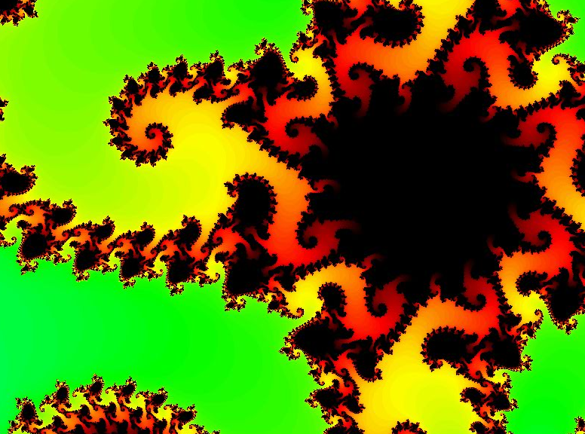
CS 5 Today
Seems more like two-thirds term to me...
infinitely nested structure…
CS Midterm
Thursday Nov. 7
In-class, written
Page of notes is OK
Recursion in Python
Function composition
Circuit design
Hmmm assembly code
Loops in Python
Topics
from finitely nested loops
See online practice…
Homework 8 Loops! due 11/4

Slide 2
Homework 8 preview
#0
Computer modeling: the good and bad
#1 ~ lab
The Mandelbrot Set
#2
Pi from Pie
TTS Securities
#3
Loopy thinking
(Extra)
ASCII Art

Slide 3
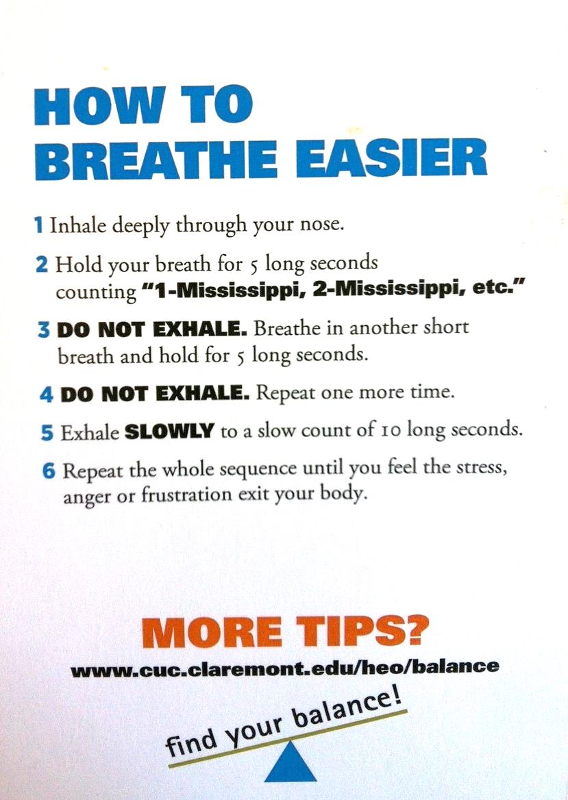
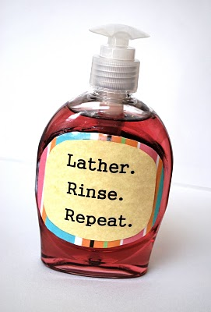
Loops!
Thanks, Melody!
classic.

Slide 4
Hw8 Pr2
Extreme Engineering?
Executives from CBS* have stranded several teams of Mudders on a sandy desert island with only Dominos delivery #, and $7.99. The teams compete to see who can estimate pi more accurately before being consumed by carnivorous slugs!
*The Claremont Broadcasting Station
* Note: $7.99 is not enough to get you the meat-lovers pizza, which would distract the carnivorous slugs… .

Slide 5
(1,1)
Hw8 Pr2
Pie
Estimating π from pie?
Box
(-1,-1)

Slide 6
(1,1)
Hw8 Pr2
Pie
Estimating π from pie!
area
π
=
area
4
4
*
hits
Box
π
~
hits
(-1,-1)

Slide 7
Loops: for or while?
pi_one(e)
e == how close to π we need to get
pi_two(n)
n == number of darts to throw
Which function will use which kind of loop?

Slide 8
Thinking in loops
for
while
x = 1
while x < 42:
print x
x *= 2
for x in range(42):
print x
What are the design differences between these two types of Python loops?

Slide 9
Thinking in loops
for
while
definite iteration
indefinite iteration
For a known number/list of iterations
For an unknown number of iterations

Slide 10
Homework 8 preview
#0
Computer modeling: the good and bad
#1 ~ lab
The Mandelbrot Set
#2
Pi from Pie
TTS Securities
#3
Nested looping structures!
(Extra)
ASCII Art

Slide 11
Nested loops
for y in range(84):
for m in range(12):
for d in range(f(m,y)):
for h in range(24):
for mn in range(60):
for s in range(60):
tick()

Slide 12
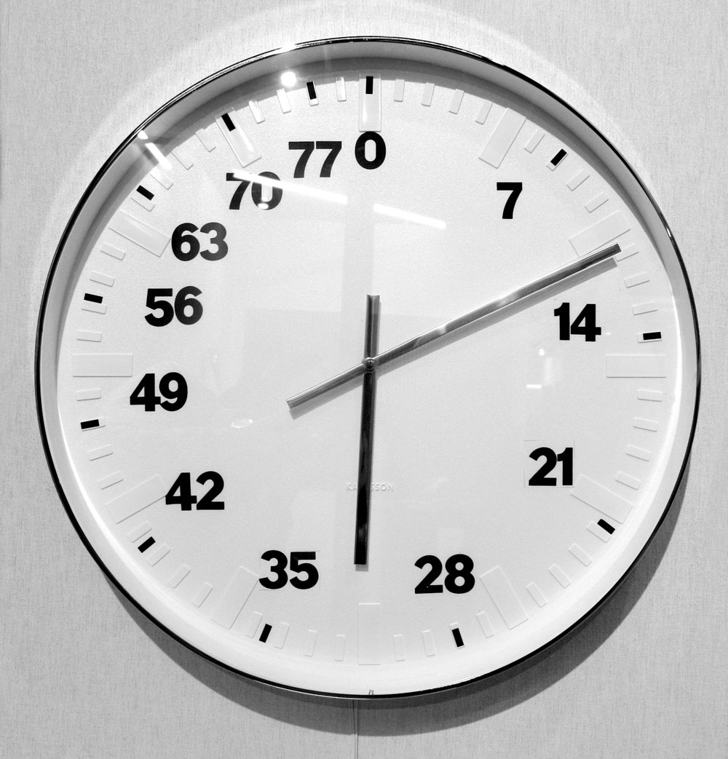
Nested loops
for y in range(84):
for m in range(12):
for d in range(f(m,y)):
for h in range(24):
for mn in range(60):
for s in range(60):
tick()

Slide 13
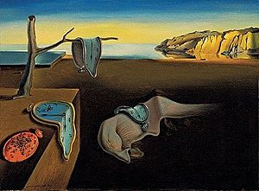
Nested loops!
for y in range(84):
for m in range(12):
for d in range(f(m,y)):
for h in range(24):
for mn in range(60):
for s in range(60):
tick()

Slide 14
Nested loops' 2d structure
rectangular vs. circular
One hour:
for mn in range(60):
for s in range(60):
tick()

Slide 15
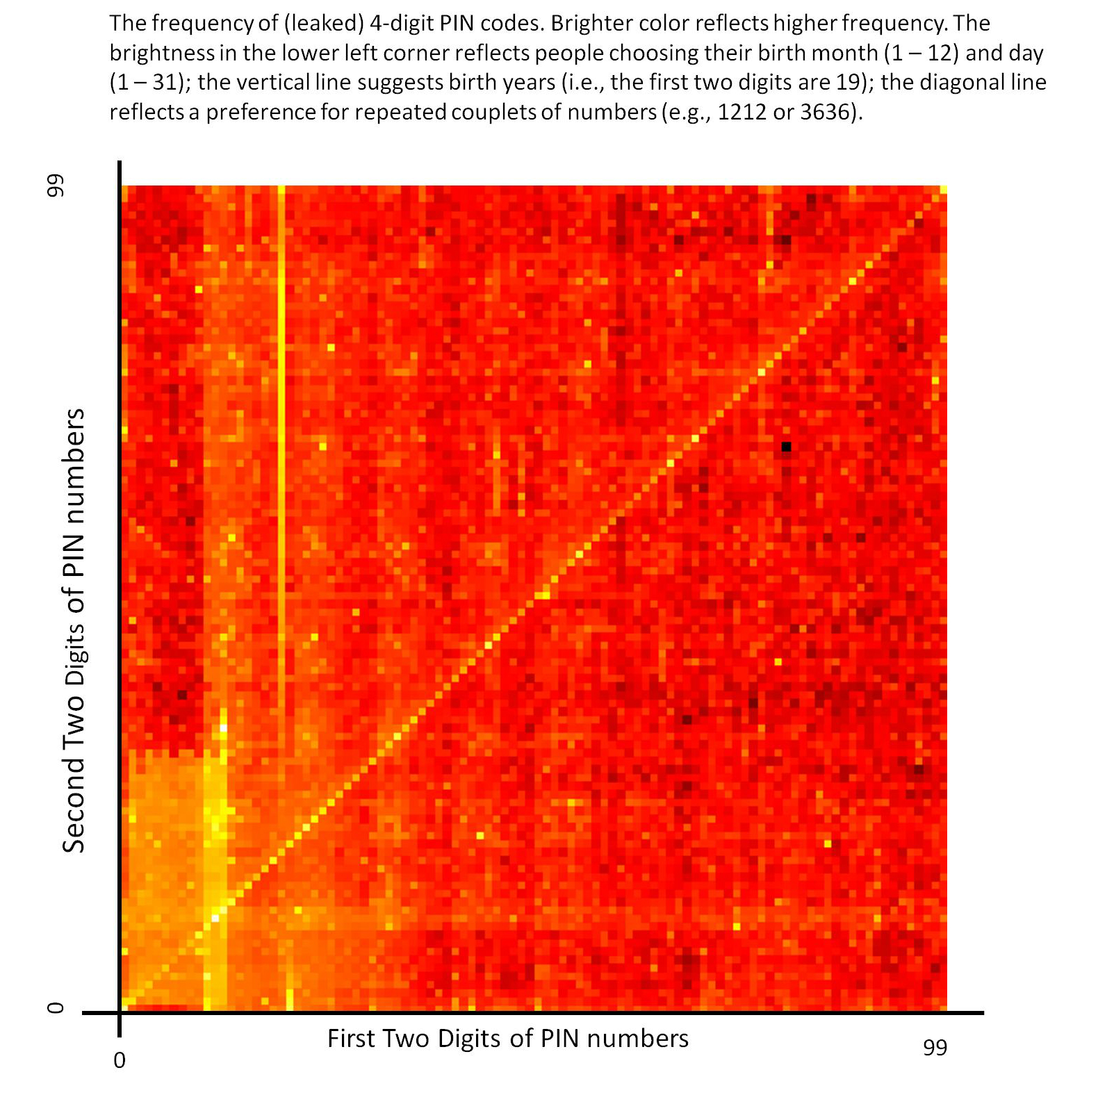
Nested loops' 2d structure
Nested loops ~ 2d structure
for x in range(100):
for y in range(100):
pin = str(x)+str(y)
Thanks, Brett W.

Slide 16
Nested loops' 2d structure
for m in range(12):
for d in range(f(m)):
num_bdays(m,d)
vizwiz.blogspot.com/2012/05/how-common-is-your-birthday-find-out.html

Slide 17
ASCII Art
did someone say my name?

Slide 18
Nested loops' 2d structure
for row in range(3):
for col in range(4):
print "#"
col
0
1
2
3
# # # #
# # # #
# # # #
0
row
1
2
Is this really the output?

Slide 19
Nested loops' 2d structure
[0,1,2]
for row in range(3):
for col in range(4):
print '#',
print
row =
[0,1,2,3]
col =
col =
col =
col =
row =
col
col =
col =
col =
col =
0
1
2
3
0
row =
row
1
col =
col =
col =
col =
2

Slide 20
Quiz
Nested Loops ~ 2d
Name(s): ________________________________
for row in range( 3 ):
for col in range( 6 ):
print ______,
print
cols
2
3
4
1
5
0
0
0 1 2 3 4 5
0 1 2 3 4 5
0 1 2 3 4 5
1
2
rows
What is being printed in each of these cases?
for row in range( 3 ):
for col in range( 6 ):
print ____________,
print
for row in range( 3 ):
for col in range( 6 ):
print ____________,
print
for row in range( 3 ):
for col in range( 6 ):
print ____________,
print
0 0 0 0 0 0
1 1 1 1 1 1
2 2 2 2 2 2
0 1 2 3 4 5
1 2 3 4 5 6
2 3 4 5 6 7
0 1 0 1 0 1
1 0 1 0 1 0
0 1 0 1 0 1

Slide 21
Nested loops: Rows vs. columns
For these loops, let side=5:
columns
0 1 2 3 4
for row in range(side):
for col in range(side):
if row >= col:
print row,
else:
print ' ',
print
0
1
2
3
4
What does this print?
rows
0 1 2 3 4
for row in range(side):
for col in range(side):
if
print row,
else:
print ' ',
print
0 0 0 0 0
1 1 1 1
2 2 2
3 3
4
0
1
2
3
4
What if tests print these?
0 1 2 3 4
for row in range(side):
for col in range(side):
if
print row,
else:
print ' ',
print
0
1
2
3
4
0 0 0 0 0
1 1 1 1
2 2 2
3 3 3 3
4 4 4 4 4
Extra! how about this hourglass?
0 0 0 0 0
1 1 1
2
3 3 3
4 4 4 4 4

Slide 22
columns
B
0 1 2 3 4
for row in range(side):
for col in range(side):
if row >= col:
print row,
else:
print ' ',
print
0
1
2
3
4
0
1 1
2 2 2
3 3 3 3
4 4 4 4 4
rows
A
0 1 2 3 4
for row in range(side):
for col in range(side):
if
print row,
else:
print ' ',
print
0 0 0 0 0
1 1 1 1
2 2 2
3 3
4
0
1
2
3
4
C
0 1 2 3 4
for row in range(side):
for col in range(side):
if
print row,
else:
print ' ',
print
0
1
2
3
4
0 0 0 0 0
1 1 1 1
2 2 2
3 3 3 3
4 4 4 4 4
Extra! how about this hourglass?
0 0 0 0 0
1 1 1
2
3 3 3
4 4 4 4 4

Slide 23
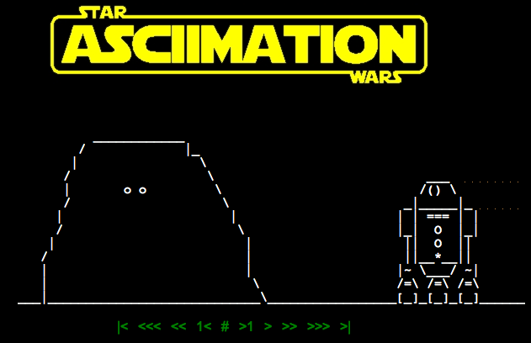
ASCII art...? How about ASCII video !
http://www.asciimation.co.nz/

Slide 24
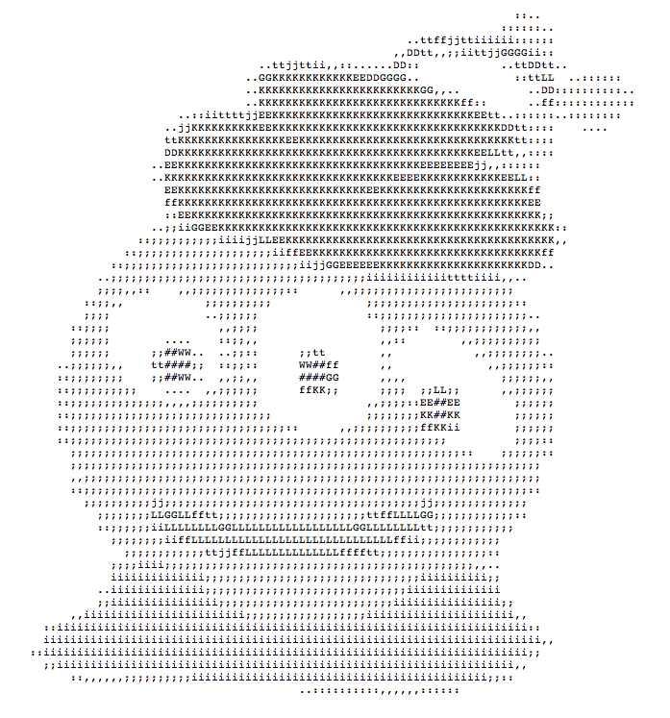
From ASCII to real images...
or maybe complex images?

Slide 25
Python and images
from cs5png import *
inputs are width and height
image = PNGImage( 300, 200 )
image.plotPixel( 10, 100 )
image.plotPixel( 42, 42, (0,0,255) )
image.saveFile( )
These functions are clearly plotting something – if only I knew what they were up to...

Slide 26
Python and images
from cs5png import *
inputs are width and height
image = PNGImage( 300, 200 )
objects are variables that can contain their own functions, often called methods
image.plotPixel( 10, 100 )
image.plotPixel( 42, 42, (0,0,255) )
image.saveFile( )
These functions are clearly plotting something – if only I knew what they were up to...

Slide 27
Imagining Images
from cs5png import *
def testImage():
""" image demonstration """
WD = 200
HT = 200
image = PNGImage( WD, HT )
for row in range(HT):
for col in range(WD):
if col == row:
image.plotPoint( col, row )
image.saveFile()
thicker line?
other diagonal?
stripes ?
thicker stripes?
thatching?

Slide 28
Lab 8: the Mandelbrot Set
z₀ = 0
z_{n+1} = z_{n}² + c
Consider an update rule for all complex numbers c
>>> c = 3 + 4j
>>> c.real
3.0
>>> c.imag
4.0
Nothing's too complex for Python!
>>> abs(c)
5.0

Slide 29
Lab 8: the Mandelbrot Set
z₀ = 0
z_{n+1} = z_{n}² + c
Consider an update rule for all complex numbers c
Small values of c keep the sequence near the origin, 0+0j.
z₃
c
z₁
z₂
z₄
z₀
Real axis
Imaginary axis

Slide 30
Lab 8: the Mandelbrot Set
z₀ = 0
z_{n+1} = z_{n}² + c
Consider an update rule for all complex numbers c
Which c's
stick around?
Small values of c keep the sequence near the origin, 0+0j.
Benoit B. Mandelbrot 1924 – 2010
c
Real axis
c
Large values of c make the sequence head to infinity.
Imaginary axis

Slide 31
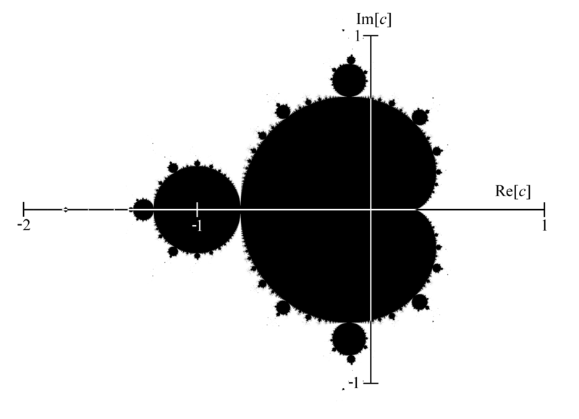
Lab 8: the Mandelbrot Set ~ low-res version
The shaded area are points that do not diverge for z = z**2 + c

Slide 32
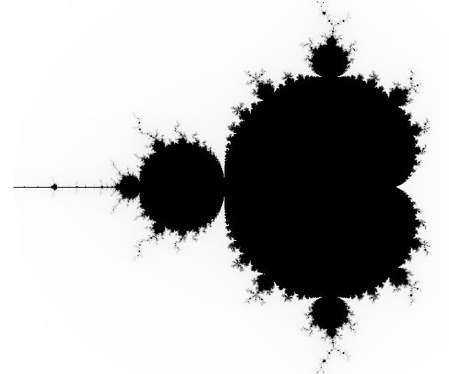
Higher-resolution Mandelbrot Set
-2 + 1j
1 + 1j
-2 - 1j
1 - 1j
The black pixels are points that do not diverge for z = z**2 + c

Slide 33
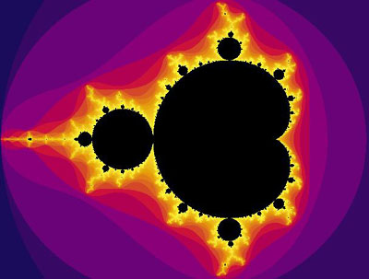
What are these colors?
The black pixels are points that do not diverge for z = z**2 + c

Slide 34
The Mandelbrot Set
The set is connected: all points are reachable w/o leaving
Not perfectly self-similar, but contains many close copies:
not 100% self-similar but quasi-self-similar:
http://www.youtube.com/watch?v=0jGaio87u3A
The set's boundary is a fractal of dimension 2 (!!!)

Slide 35
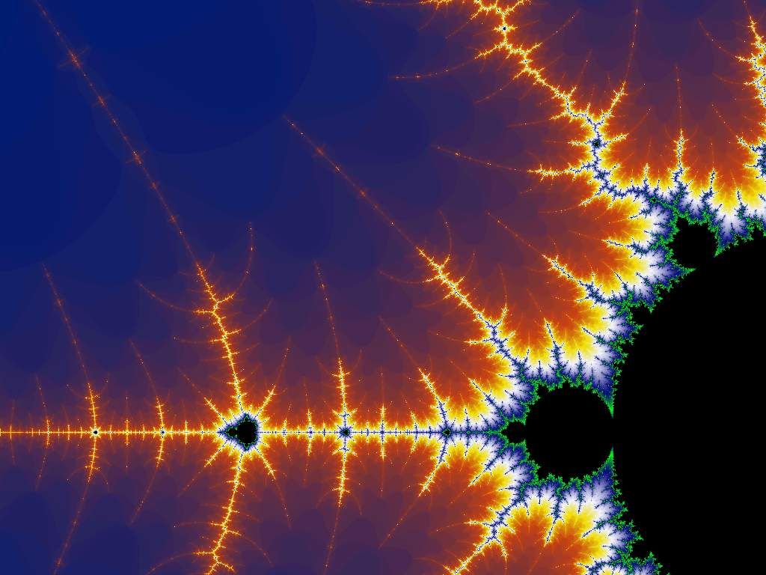
Happy Mandelbrotting!
www.cs.hmc.edu/~jgrasel/projects

Slide 37
A engineering challenge: estimate π using everyday items...
Hw8 Pr2
(1,1)
Pie
Box
(-1,-1)

Slide 38
Tracking rows and columns
for row in range(3):
for col in range(4):
print '$',
print
row =
col =
col =
col =
col =
row =
col =
col =
col =
col =
0
1
2
3
col
0
row =
1
col =
col =
col =
col =
2
row

Slide 39
Name(s): ______________________________
for row in range( 3 ):
for col in range( 6 ):
print ______,
print
cols
2
3
4
1
5
0
0
0 1 2 3 4 5
0 1 2 3 4 5
0 1 2 3 4 5
1
2
rows
Change each block of code so that it will print the examples below:
for row in range( 3 ):
for col in range( 6 ):
print ____________,
print
for row in range( 3 ):
for col in range( 6 ):
print ____________,
print
for row in range( 3 ):
for col in range( 6 ):
print ____________,
print
0 0 0 0 0 0
1 1 1 1 1 1
2 2 2 2 2 2
0 1 2 3 4 5
1 2 3 4 5 6
2 3 4 5 6 7
0 1 0 1 0 1
1 0 1 0 1 0
0 1 0 1 0 1

Slide 40
Nested loops: Rows vs. columns
Name(s): ______________________________
For these loops, let side=5:
columns
0 1 2 3 4
for row in range(side):
for col in range(side):
if row >= col:
print row,
else:
print ' ',
print
0
1
2
3
4
What does this print?
rows
for row in range(side):
for col in range(side):
if
print row,
else:
print ' ',
print
0 0 0 0 0
1 1 1 1
2 2 2
3 3
4
What if tests print these two?
for row in range(side):
for col in range(side):
if
print row,
else:
print ' ',
print
0 0 0 0 0
1 1 1 1
2 2 2
3 3 3 3
4 4 4 4 4
Extra! how about the hourglass?
0 0 0 0 0
1 1 1
2
3 3 3
4 4 4 4 4

Slide 41
Nested loops: Rows vs. columns
Name(s): ______________________________
For these loops, let side=5:
columns
0 1 2 3 4
for row in range(side):
for col in range(side):
if row >= col:
print row,
else:
print ' ',
print
0
1
2
3
4
What does this print?
rows
for row in range(side):
for col in range(side):
if
print row,
else:
print ' ',
print
0 0 0 0 0
1 1 1 1
2 2 2
3 3
4
What if tests print these two?
for row in range(side):
for col in range(side):
if
print row,
else:
print ' ',
print
0 0 0 0 0
1 1 1 1
2 2 2
3 3 3 3
4 4 4 4 4
Extra! how about the hourglass?
0 0 0 0 0
1 1 1
2
3 3 3
4 4 4 4 4

Slide 42
fractal CAT ?
infinitely nested structure…
CS Midterm
Thursday Nov. 3
Seems more like two-thirds term to me...
In-class, written
Page of notes is OK
Recursion in Python
Software design
Circuit design
Hmmm assembly code
Loops in Python
Topics
from finite nested loops
Homework 8: due eve. of 10/31
LAC hrs: Friday, 2-4pm

Slide 43
www.cs.hmc.edu/~jgrasel/mandelbrot

Slide 44
fractal NYAN cat!

Slide 45
A engineering challenge: estimate π using everyday items...
Hw8 Pr2
(1,1)
Pie
(-1,-1)

Slide 46
A engineering challenge: estimate π using everyday items...
Hw8 Pr2
(1,1)
Pie
Box
(-1,-1)

Slide 47
Loops: for or while?
pi_one(e)
e == how close to π we need to get
pi_two(n)
n == number of darts to throw
Which function will use which kind of loop?

Slide 48
Tracking rows and columns
for row in range(3):
for col in range(4):
print '$',
print
0
1
2
3
cols
0
1
2
rows

Slide 49
for row in range( 3 ):
for col in range( 6 ):
print ______,
print
cols
2
3
4
1
5
0
0
0 1 2 3 4 5
0 1 2 3 4 5
0 1 2 3 4 5
1
2
rows
Change each block of code so that it will print the examples below:
for row in range( 3 ):
for col in range( 6 ):
print ____________,
print
for row in range( 3 ):
for col in range( 6 ):
print ____________,
print
for row in range( 3 ):
for col in range( 6 ):
print ____________,
print
0 0 0 0 0 0
1 1 1 1 1 1
2 2 2 2 2 2
0 1 2 3 4 5
1 2 3 4 5 6
2 3 4 5 6 7
0 1 0 1 0 1
1 0 1 0 1 0
0 1 0 1 0 1

Slide 50
Nested loops: Rows vs. columns
Name(s): ______________________________
For these loops, let side=5:
columns
0 1 2 3 4
for row in range(side):
for col in range(side):
if row >= col:
print row,
else:
print ' ',
print
0
1
2
3
4
What does this print?
rows
for row in range(side):
for col in range(side):
if
print row,
else:
print ' ',
print
0 0 0 0 0
1 1 1 1
2 2 2
3 3
4
What if tests print these two?
for row in range(side):
for col in range(side):
if
print row,
else:
print ' ',
print
0 0 0 0 0
1 1 1 1
2 2 2
3 3 3 3
4 4 4 4 4
Extra! how about the hourglass?
0 0 0 0 0
1 1 1
2
3 3 3
4 4 4 4 4

Slide 51
Feedback ... on feedback!

Slide 52
Images and 2d loops
How could you change this code (the if test) to produce this triangle image?
What 2d loops would create a checkerboard image, pixel-by-pixel?
def test():
""" demonstrating images """
width = 200
height = 200
image = PNGImage( width, height )
for col in range(width):
for row in range(height):
if col == row:
image.plotPoint( col, row )
image.saveFile( )
def test():
""" demonstrating images """
width = 8
height = 6
image = PNGImage( width, height )
for col in range(width):
for row in range(height):
image.saveFile( )

Slide 53
How could you change this code so that it produces an triangle like this?
def triangle():
""" demonstrating images """
width = 200
height = 200
image = PNGImage( width, height )
# a 2d loop over each pixel
for col in range(width):
for row in range(height):
if
image.plotPoint( col, row )

Slide 54
What 2d loops would create a checkerboard image?
def checkerboard():
… usual image stuff here …
# loop over each pixel
for col in range(width):
for row in range(height):
image.plotPoint( col, row )

Slide 55
Loops: for or while?
pi_one(e)
e == how close to π we need to get
pi_two(n)
n == number of darts to throw
Which function will use which kind of loop?

Slide 56
Images and 2d loops
How could you change this code (the if test) to produce this triangle image?
What 2d loops would create a checkerboard image, pixel-by-pixel?
def test():
""" demonstrating images """
width = 200
height = 200
image = PNGImage( width, height )
for col in range(width):
for row in range(height):
if col == row:
image.plotPoint( col, row )
image.saveFile( )
def test():
""" demonstrating images """
width = 8
height = 6
image = PNGImage( width, height )
for col in range(width):
for row in range(height):
image.saveFile( )

Slide 57
Mandelbrot Set: issues
Consider the following update rule for all complex numbers c:
z₀ = 0
z_{n+1} = z_{n}² + c
The shaded area are points that do not diverge.
What concerns might arise in generating this image?

Slide 58
Pixels vs. "real" values
1.0
-2.0
1.0
-1.0
Drawing happens in pixel-coords. Mandelbrot testing happens in real coords.

Slide 59
Nature > Imagination?

Slide 60
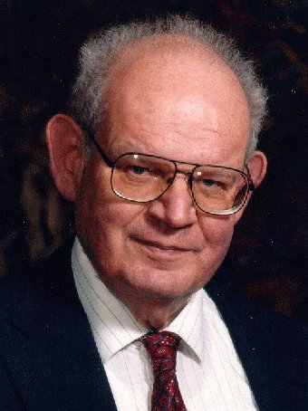
Lab 9: the Mandelbrot Set
Consider the following update rule for all complex numbers c:
z₀ = 0
z_{n+1} = z_{n}² + c
If c does not diverge, it's in the M. Set.
Benoit M.
Imaginary axis
z₃
c
z₁
z₂
z₄
Real axis
z₀

Slide 61
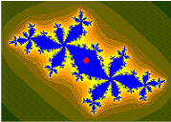
Lab 9: the Mandelbrot Set
Consider the following update rule for all complex numbers c:
z₀ = 0
z_{n+1} = z_{n}² + c
If c does not diverge, it's in the M. Set.
Benoit M.
Imaginary axis
z₃
c
z₁
z₂
z₄
z₀
Real axis
example of a non-diverging cycle

Slide 62
Lab 9: the Mandelbrot Set
Consider the following update rule for all complex numbers c:
z₀ = 0
z_{n+1} = z_{n}² + c
The shaded area are points that do not diverge.

Slide 63
Python and images
import bmp.py
for creating and saving images
Eco-friendly bitmps !
image = BitMap( 300, 200, Color.GREEN )
creates a bitmap object
and names it image

Slide 64
Python and images
import bmp.py
for creating and saving images
Eco-friendly bitmps !
image = BitMap( 300, 200, Color.GREEN )
creates a bitmap object
and names it image
objects are software abstractions containing structured information

Slide 65
Python and images and objects
import bmp.py
image = BitMap( 300, 200, Color.GREEN )
here, a bitmap object named image
is calling an internal method named saveFile
image.saveFile( "test.bmp" )
objects are variables that can contain their own functions, often called methods

Slide 66
Python and images and objects
import bmp.py
image = BitMap( 300, 200, Color.GREEN )
image.setPenColor( Color.Red )
two more internal methods
image.plotPixel( 150, 100 )
image.saveFile( "test.bmp" )
objects are variables that can contain their own functions, often called methods

Slide 67
Mandelbrot Set: properties
The set is connected.
The set's boundary is a fractal of dimension 2 (!)
"infinite detail"
The points nearer the set escape to ∞ more slowly.
can color points based on how quickly they escape…
not 100% self-similar but quasi-self-similar:
Jonathan Coulton wrote a song about it
http://www.youtube.com/watch?v=gEw8xpb1aRA

Slide 68
Mandelbrot Set: song
chorus
chorus…
Jonathan Coulton wrote a song about it

Slide 69
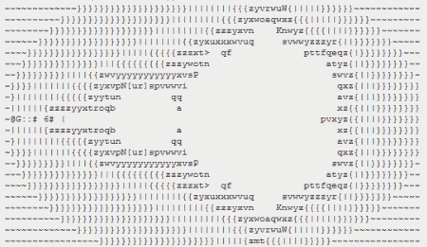
An image alternative…
http://www.asciimation.co.nz/

Slide 70
ASCII Images
Print 4 rows
for i in range(4):
print “#”*8
print automatically adds a newline
Creates line to print
Who are you calling simple?
########
########
########
########
Output

Slide 71
ASCII Images
Print 4 rows
for i in range(4):
print “#”*8
print automatically adds a newline
Creates line to print
Who are you calling simple?
########
########
########
########
For this problem, string multiplication is not allowed.
Output

Slide 72
Without string multiplication…
Print 4 rows
for i in range(4):
for j in range(8):
print “#”
print 8 chars on each line
?
Output ?
Any problems???

Slide 73
Without string multiplication…
for i in range(4):
for j in range(8):
print “#”,
Comma suppresses newline
Output ?
Now OK???

Slide 74
Try it!
What code would print this “ASCII quilt”
with height rows and width columns ?
cols
1
2
3
4
5
6
7
0
8
rows
# # * # # * # # *
* * # * * # * * #
# # * # # * # # *
* * # * * # * * #
# # * # # * # # *
* * # * * # * * #
for row in range(height):
0
for col in range(width):
1
2
3
4
5

Slide 75
Without string multiplication…
for i in range(4):
for j in range(8):
print “#”,
print
comma adds spaces
just prints a newline
# # # # # # # #
# # # # # # # #
# # # # # # # #
# # # # # # # #
Output
Close enough!

Slide 76
Without extra spaces…
import sys
for i in range(4):
for j in range(8):
sys.stdout.write('#')
print
method (function) that prints only its input
software object representing the screen's standard output
########
########
########
########
Output

Slide 77
Try it!
What code would print this “ASCII flag” ?
-- first, with 6 rows and 9 columns, then
with height rows and width columns.
# * * # * * # * *
* * * * * * * * *
# * * # * * # * *
* * * * * * * * *
# * * # * * # * *
* * * * * * * * *

Slide 78
Objects, objects, everywhere!
>>> L = [] # create a list, L
>>> dir(L) # see all of L's methods
all list methods appear -- lots of them including append, index, remove, and sort
>>> help(L.sort) # I wonder…
>>> help(L.index) # What does this do?
integers?
operators?

Slide 79
Another mini method
I guess you really can't beat the stock index !
def mini( L ):
""" returns the DAY of the
lowest-priced stock """
use L.index
integers?
operators?
strings?

Slide 80
An image alternative…
http://www.asciimation.co.nz/

Slide 81
ASCII Images
Print 4 rows
for i in range(4):
print “#”*8
print automatically adds a newline
Creates line to print
Who are you calling simple?
########
########
########
########
Output

Slide 82
ASCII Images
Print 4 rows
for i in range(4):
print “#”*8
print automatically adds a newline
Creates line to print
Who are you calling simple?
########
########
########
########
For this problem, string multiplication is not allowed.
Output

Slide 83
Without string multiplication…
Print 4 rows
for i in range(4):
for j in range(8):
print “#”
print 8 chars on each line
?
Output ?
Any problems???

Slide 84
Without string multiplication…
for i in range(4):
for j in range(8):
print “#”,
Comma suppresses newline
Output ?
Now OK???

Slide 85
Try it!
What code would print this “ASCII quilt”
with height rows and width columns ?
cols
1
2
3
4
5
6
7
0
8
rows
# # * # # * # # *
* * # * * # * * #
# # * # # * # # *
* * # * * # * * #
# # * # # * # # *
* * # * * # * * #
for row in range(height):
0
for col in range(width):
1
2
3
4
5

Slide 86
Without string multiplication…
for i in range(4):
for j in range(8):
print “#”,
print
comma adds spaces
just prints a newline
# # # # # # # #
# # # # # # # #
# # # # # # # #
# # # # # # # #
Output
Close enough!

Slide 87
Without extra spaces…
import sys
for i in range(4):
for j in range(8):
sys.stdout.write('#')
print
method (function) that prints only its input
software object representing the screen's standard output
########
########
########
########
Output

Slide 88
Try it!
What code would print this “ASCII flag” ?
-- first, with 6 rows and 9 columns, then
with height rows and width columns.
# * * # * * # * *
* * * * * * * * *
# * * # * * # * *
* * * * * * * * *
# * * # * * # * *
* * * * * * * * *

Slide 89
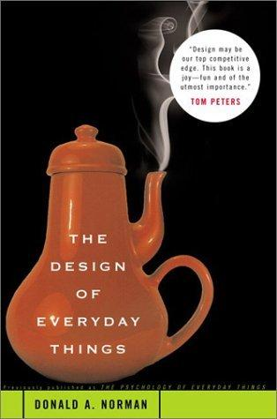
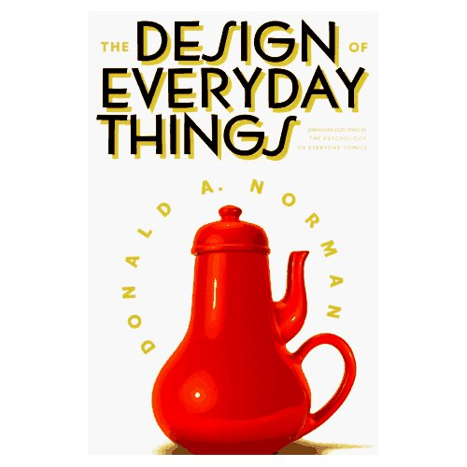
Design - not just software
Please see instructions on HW 9. You have some choice on what parts of this chapter to read.

Slide 90
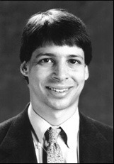
Design guidelines
No magic numbers!
Keep constants together at top with meaningful names…
def test():
""" demonstrating images """
width = 200
height = 200
image = BitMap( width, height )
# a 2d loop over each pixel
for col in range(width):
for row in range(height):
if col == row:
image.plotPoint( col, row )
image.saveFile( "test.bmp" )
What! No magic??
self-documenting design

Slide 91
Design guidelines
Anticipate change
swapping arguments and hand-set values
def test(
""" demonstrating images """
width = 200
height = 200
image = BitMap( width, height )
# a 2d loop over each pixel
for col in range(width):
for row in range(height):
if col == row:
image.plotPoint( col, row )
image.saveFile( "test.bmp" )
default arguments

Slide 92
Design guidelines
Modularity: composing small pieces

Slide 93
Design guidelines
Modularity: composing small pieces
functions!

Slide 94
See you in lab!

Slide 95
Design

Slide 96
An iterative image
import bmp.py

Slide 97
“Quiz” Part 1
Write the code to print this piece of “ASCII art” (with or without the spaces)
$ # & # & # & #
& # & # & # & #
& # & # & # & #
& # & # & # & #

Slide 98
An iterative image
import bmp.py

Slide 99
Fix #1: use a type converter
meters = float(raw_input('How many m? '))
cm = meters * 100
print 'That is', cm, 'cm.'
check out my newly installed float converter!
1.0
100.0
The type of variable (box) matters!
name: meters type: float
name: cm
type: float
Notes:
Electric: from www.staticfreesoftware.com
My tutorial is at:
http://odin.ac.hmc.edu/~harris/class/chipdesign/electric.pdf
Lasergene (a molecular biology suite of programs for aligning and comparing
DNA sequences, etc.)
Statview (statistical analysis)
KaleidaGraph (plotting & graphing)
Populus (programs that simulate ecological and evolutionary processes)

Slide 100
Fix #2: use input()
# gets processed input from user
meters = input('How many m? ')
cm = meters * 100
print 'That is', cm, 'cm.'
I always use input -- but don't quote me on that.
Notes:
why not always use input
note that inputting strings is more difficult…

Slide 101
Fix #2: use input()
# gets processed input from user
meters = input('How many m? ')
cm = meters * 100
print 'That is', cm, 'cm.'
I always use input -- but don't quote me on that.
raw_input always returns input as a string!
input processes the input as if typed into Python
both allow you to specify a prompt string

Slide 102
Procrastination Programming
Every while loop can be a while True: loop!
- just be sure to break!

Slide 103
Give me a break !
import random
escape = 0
while True:
print 'Help! Let me out!'
escape = random.choice([41,42,43])
if escape == 42:
break
print 'At last!'
I'll figure out later how to get out of this loop!
OK – I'll stop the loop now and continue with the code after the loop
compare return

Slide 104
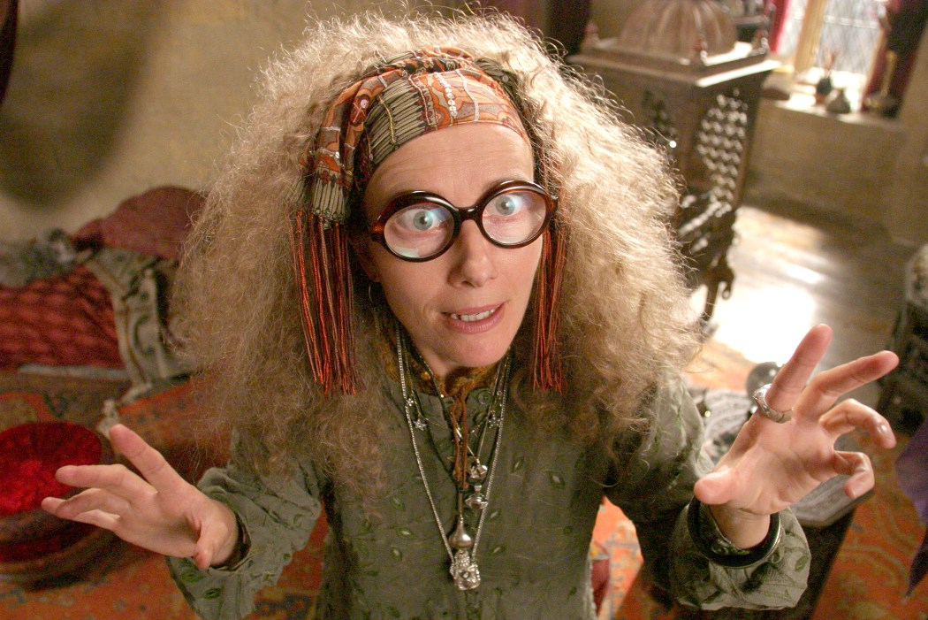
Seeing into the future…
def menu():
""" prints our menu of options """
print "(1) Input a list of numbers"
print "(2) Guess the next element"
print "(9) Quit"
def seer():
""" handles user input for our menu """
while True:
menu()
uc = input('Which option? ')
print 'The inner eye does not see upon command!'

Slide 105
Clearer Vision
def seer():
""" handles user input for our menu """
while True:
menu()
uc = input('Which option? ')
print 'The inner eye does not see upon command!'
if uc ==

Slide 106
the gift…
LightPath, September 1999

Slide 107
watching the charts…
LightPath, six months later…

Slide 108
"brokerage" seems apt…
LightPath, now…

Slide 109
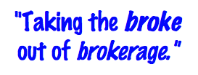
T. T. Securities (TTS)
Input stock prices for a number of days in a row, and then analyze that data… .

Slide 110
T. T. Securities (TTS)
Input stock prices for a number of days in a row, and then analyze that data… .
Menu
(0) Input a new list
(1) Print the current list
(2) Find the average price
(3) Find the standard deviation
(4) Find the min and its day
(5) Find the max and its day
(6) Your TTS investment plan
(9) Quit
Enter your choice:
Software

Slide 111
Functions
There are a number of formulas, but we will use this one:
functions
def average( L )
def stdev( L )
Menu
def mini( L )
(0) Input a new list
(1) Print the current list
(2) Find the average price
(3) Find the standard deviation
(4) Find the min and its day
(5) Find the max and its day
(6) Your TTS investment plan
(9) Quit
Enter your choice:
def maxi( L )

Slide 112
Standard Deviation
There are a number of formulas, but we will use this one:
functions
Menu
def stdev( L ):
(0) Input a new list
(1) Print the current list
(2) Find the average price
(3) Find the standard deviation
(4) Find the min and its day
(5) Find the max and its day
(6) Your TTS investment plan
(9) Quit
Enter your choice:
Σ
(L[i] - L_{av})²
i
len(L)

Slide 113
T. T. Securities (TTS)
Investment analysis for the 21st century…
Hardware
Menu
(0) Input a new list
(1) Print the current list
(2) Find the average price
(3) Find the standard deviation
(4) Find the min and its day
(5) Find the max and its day
(6) Your TTS investment plan
(9) Quit
Enter your choice:
Software

Slide 114
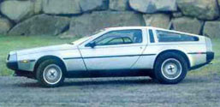
T. T. Securities (TTS)
Investment analysis for the 21st century…
Hardware
Menu
(0) Input a new list
(1) Print the current list
(2) Find the average price
(3) Find the standard deviation
(4) Find the min and its day
(5) Find the max and its day
(6) Your TTS investment plan
(9) Quit
Enter your choice:
Software

Slide 115
The TTS advantage!
Your stock's prices:
L = [ 40, 80, 10, 30, 27, 52, 5, 15 ]
The TTS investment strategy:
Day Price
0 40.0
1 80.0
2 10.0
3 30.0
4 27.0
5 52.0
6 5.0
7 15.0
but, you must sell after you buy.

Slide 116
"Quiz"
Return the min difference between one value from X and one value from Y.
Alter this code to return the index of L's minimum.
Example:
Example:
>>> mini( [9,8,1,7] )
2
>>> diff( [7,3],[0,6] )
1
What does this code print?
Only consider unsigned differences.
consider "accumulating" the minimum index in addition to the minimum value.
for x in range(3):
for y in range(3):
print x, y
X and Y will be lists of numbers
Hint: adapt this code
def mini( L ):
min = L[0]
for x in L:
if x < min:
min = x
return
def diff( X, Y ):
You may want to change the loop!

Slide 117
Alter this code to return the index of L's minimum.
Example:
>>> mini( [9,8,1,7] )
2
def mini( L ):
min = L[0]
for x in L:
if x < min:
min = x
return
def mini( L ):
min = L[0]
for :
if < min:
min =
return
SAME LOOP
INDEX-BASED LOOP
returning both??

Slide 118
What does this code print?
for x in range(3):
for y in range(3):
print x, y

Slide 119
for x in range(3):
for y in range(3):
print x, y
Example:
Hint: adapt this code
>>> diff( [7,3],[0,6] )
1
Return the minimum difference between one value from X and one value from Y.
def diff( X, Y ):
Only consider unsigned differences.
X and Y will be lists of numbers

Slide 120
Monte Carlo π
Hw8 Pr3
A engineering challenge: to estimate π using everyday items...

Slide 121
Easy as π
(1,1)
Visualize:
(-1,-1)

Slide 122
to inf. and beyond!
2d, 3d Loops
More efficient, but also more to keep track of with each additional dimension
definite iteration
indefinite iteration
while

Slide 123
Extra (!) funky series
Harmonic Sequence:
1/1 + 1/2 + 1/3 + 1/4 + 1/5 + 1/6 + …
Without composites (primes only):
1/1 + 1/2 + 1/3 + 1/4 + 1/5 + 1/6 + 1/7 +…
Without 9’s…
1/1 + 1/2 + … + 1/8 + 1/9 + … +1/18 + 1/19 + … + 1/88 + 1/89 + 1/90 + 1/91 + …
Diverges!
???
???
Notes:
The harmonic series diverges (slowly); it's in today's lab. The primes-only series also diverges. But the no-9's series doesn't diverge. Why? Because as you get to big numbers, almost everything contains a 9, so the terms become sparse!

Slide 124
Have a great weekend!

Slide 125
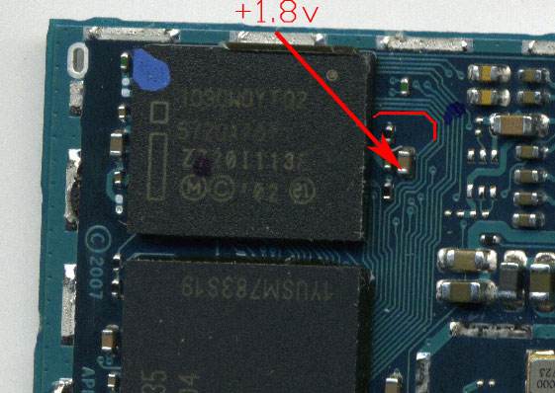
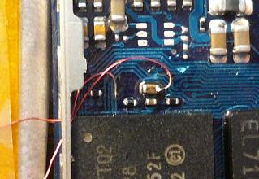
iPhone, geohot, and Von Neumann
George Hotz's iPhone
Before
After
In red: one memory-access bit
soldered to be +1.8v (1)

Slide 126
iPhone, geohot, and Von Neumann
When starting up, the phone checks 4 locations in memory to see if its software is already there. Only if it sees the software is NOT there, does the phone use software from general-purpose memory to start. Otherwise, it loads its software from read-only memory.
hex
binary
0xA0000030
0xA000A5A0
0xA0015C58
0xA0017370
10100000000000000000000000110000
10100000000000001010010110100000
10100000000000010101110001011000
10100000000000010111001101110000
George Hotz's iPhone
The 4 32-bit memory locations it checks are
1
There's not much you can do to change what is in those areas of read-only memory. Instead, the idea was to change one of the address lines to be high while it checked these four locations.
The memory locations it actually checks are thus
10100000000001000000000000110000
10100000000001001010010110100000
10100000000001010101110001011000
10100000000001010111001101110000
All of these locations are in a read/write (accessible) portion of the phone's memory -- so, they can be written to the "reset" signal. This reloads the phone's start-up software from read/write memory -- allowing arbitrary network access, not just AT&T.

Slide 127
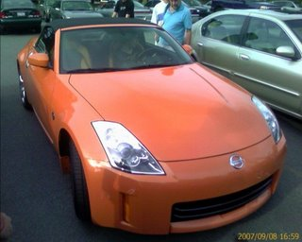
iPhone, geohot, and Von Neumann
George Hotz's iPhone
the trade

Slide 128
“Quiz”
Finish these two methods…
This method returns the sum of the elements in the input array.
public static double sum(double[] A)
{
double s = 0.0;
for (
{
}
return s;
}
This method returns the average of the elements in the input array.
public static double average(double[] A)
“Extra Credit”: How concise can this method be?

Slide 129
This method returns the maximum element from the input array.
public static double max(double[] A)
Extra: What is something unusual and unrelated to CS 5 that you & the person next to you have in common ?!

Slide 130
Loopy thinking
0
1
2
3
4
5
6
7
8
9
10
11
12
13
14
15
16
17
18
s = 'gattacaaggtaaaatgca'
How could we find the number of 'a's ? How about 'a's and 't's?
How could we find the number of 'ta's ?
How could we find the longest sequence of 'a's ?
Notes:
ctg repeats…

Slide 131
Loopy thinking
0
1
2
3
4
5
6
7
8
9
10
11
12
13
14
15
16
17
18
s = 'gattacaaggtaaaatgca'
s = 'gattacaaggtaaaatgca'
N = 0
for i in range(0,len(s)):
if s[i] == 'a':
N = N + 1
print 'N is', N
How could we find the number of 'a's ? How about 'a's and 't's?
How could we find the number of 'ta's ?
How could we find the longest sequence of 'a's ?
Notes:
Electric: from www.staticfreesoftware.com
My tutorial is at:
http://odin.ac.hmc.edu/~harris/class/chipdesign/electric.pdf
Lasergene (a molecular biology suite of programs for aligning and comparing
DNA sequences, etc.)
Statview (statistical analysis)
KaleidaGraph (plotting & graphing)
Populus (programs that simulate ecological and evolutionary processes)

Slide 132
Loopy thinking
0
1
2
3
4
5
6
7
8
9
10
11
12
13
14
15
16
17
18
s = 'gattacaaggtaaaatgca'
s = 'gattacaaggtaaaatgca'
N = 0
for i in range(0,len(s)):
if s[i] == 'a' or s[i] == 't':
N = N + 1
print 'N is', N
How could we find the number of 'a's ? How about 'a's and 't's?
How could we find the number of 'ta's ?
How could we find the longest sequence of 'a's ?
Notes:
Electric: from www.staticfreesoftware.com
My tutorial is at:
http://odin.ac.hmc.edu/~harris/class/chipdesign/electric.pdf
Lasergene (a molecular biology suite of programs for aligning and comparing
DNA sequences, etc.)
Statview (statistical analysis)
KaleidaGraph (plotting & graphing)
Populus (programs that simulate ecological and evolutionary processes)

Slide 133
Loopy thinking
0
1
2
3
4
5
6
7
8
9
10
11
12
13
14
15
16
17
18
s = 'gattacaaggtaaaatgca'
s = 'gattacaaggtaaaatgca'
N = 0
for i in range(1,len(s)):
if s[i] == 'a' and s[i-1] == 't':
N = N + 1
print 'N is', N
How could we find the number of 'a's ? How about 'a's and 't's?
How could we find the number of 'ta's ?
How could we find the longest sequence of 'a's ?
Notes:
Electric: from www.staticfreesoftware.com
My tutorial is at:
http://odin.ac.hmc.edu/~harris/class/chipdesign/electric.pdf
Lasergene (a molecular biology suite of programs for aligning and comparing
DNA sequences, etc.)
Statview (statistical analysis)
KaleidaGraph (plotting & graphing)
Populus (programs that simulate ecological and evolutionary processes)

Slide 134
Loopy thinking
0
1
2
3
4
5
6
7
8
9
10
11
12
13
14
15
16
17
18
s = 'gattacaaggtaaaatgca'
How could we find the longest sequence of 'a's ?
Notes:
Electric: from www.staticfreesoftware.com
My tutorial is at:
http://odin.ac.hmc.edu/~harris/class/chipdesign/electric.pdf
Lasergene (a molecular biology suite of programs for aligning and comparing
DNA sequences, etc.)
Statview (statistical analysis)
KaleidaGraph (plotting & graphing)
Populus (programs that simulate ecological and evolutionary processes)

Slide 135
Planning in "pseudocode"
0
1
2
3
4
5
6
7
8
9
10
11
12
13
14
15
16
17
18
s = 'gattacaaggtaaaatgca'
Keep track of CurRun, MaxRun
Loop through the string:
if we do see an 'a'
if the PREVIOUS letter is NOT an 'a'
if the PREVIOUS letter IS an 'a'
Notes:
Electric: from www.staticfreesoftware.com
My tutorial is at:
http://odin.ac.hmc.edu/~harris/class/chipdesign/electric.pdf
Lasergene (a molecular biology suite of programs for aligning and comparing
DNA sequences, etc.)
Statview (statistical analysis)
KaleidaGraph (plotting & graphing)
Populus (programs that simulate ecological and evolutionary processes)

Slide 136
Planning in "pseudocode"
0
1
2
3
4
5
6
7
8
9
10
11
12
13
14
15
16
17
18
s = 'gattacaaggtaaaatgca'
Keep track of CurRun, MaxRun
Loop through the string:
if we do see an 'a'
if the PREVIOUS letter is NOT an 'a'
Start a Run! CurRun = 1
if the PREVIOUS letter IS an 'a'
Continue our run! CurRun = CurRun + 1
Check for a new maximum…
Notes:
Electric: from www.staticfreesoftware.com
My tutorial is at:
http://odin.ac.hmc.edu/~harris/class/chipdesign/electric.pdf
Lasergene (a molecular biology suite of programs for aligning and comparing
DNA sequences, etc.)
Statview (statistical analysis)
KaleidaGraph (plotting & graphing)
Populus (programs that simulate ecological and evolutionary processes)

Slide 137
Planning in "pseudocode"
0
1
2
3
4
5
6
7
8
9
10
11
12
13
14
15
16
17
18
s = 'gattacaaggtaaaatgca'
Keep track of CurRun, MaxRun
MAX = 0
cur = 0
for i in range(0,len(s)):
if s[i] == 'a':
if s[i-1] != 'a':
cur = 1
else:
cur = cur + 1
if cur > MAX:
MAX = cur
print 'Max is', MAX
Loop through the string:
if we do see an 'a'
if the PREVIOUS letter is NOT an 'a'
Start a Run!
if the PREVIOUS letter IS an 'a'
Continue our run!
Check for a new maximum…
Notes:
Electric: from www.staticfreesoftware.com
My tutorial is at:
http://odin.ac.hmc.edu/~harris/class/chipdesign/electric.pdf
Lasergene (a molecular biology suite of programs for aligning and comparing
DNA sequences, etc.)
Statview (statistical analysis)
KaleidaGraph (plotting & graphing)
Populus (programs that simulate ecological and evolutionary processes)

Slide 138
Challenge
Print the first N numbers in this series…
>>> fib(11)
Example:
1 1 2 3 5 8 13 21 34 55 89

Slide 139
Illustration of
scale( pix, pixMax, floatMin, floatMax )
Image
pixel column range
0
pix
pixMax
real range
floatMin
output of scale
floatMax

Slide 140
input vs. raw_input
reply = raw_input('Enter a string and I\'ll tell you what I see.')
for c in reply:
print 'I see a(n) ', c
interprets what the user types as a string of characters
reply = input('Enter any list and I\'ll tell you what I see.')
for c in reply:
print 'I see a(n) ', c
processes what the user types just as python would

Slide 141
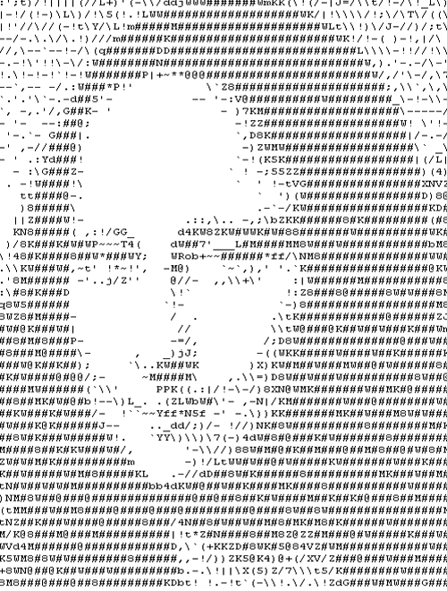
ASCII Art
Print 3 rows
for row in range(3):
print '#'*4
print automatically adds a newline
Creates line to print
####
####
####
Output

Slide 142
A closer look…
for row in range(3):
print '$'*4
$$$$
$$$$
$$$$
Output

Slide 143
No string * !
for row in range(3):
print '$'*4
$$$$
$$$$
$$$$
For these problems, string multiplication is not allowed.
Output
What else could be done?

Slide 144
Without string multiplication…
Print 3 rows
for row in range(3):
for col in range(4):
print '$'
nested loops!
print 4 chars on each line
(columns)
Output ?

Slide 145
Without string multiplication…
Print 3 rows
for row in range(3):
for col in range(4):
print '$',
nested loops!
print 4 chars on each line
(columns)
Comma suppresses newline
Output ?

Slide 146
Without string multiplication…
Print 3 rows
for row in range(3):
for col in range(4):
print '$',
print
nested loops!
print 4 chars on each line
(columns)
$ $ $ $
$ $ $ $
$ $ $ $
Comma suppresses newline
plain print produces newline
tracking cols and rows!

Slide 147
Variations!
def rectangle( width, height ):
""" prints a rectangle of $ """
for row in range( ):
for col in range( ):
print '$',
print

Slide 148
Beyond boxes…
cols
2
3
4
1
5
0
rows
0
0 1
0 1 2
0 1 2 3
0 1 2 3 4
0 1 2 3 4 5
0
What code will print this triangle with H rows… ?
1
2
3
4
def tri( H ):
5
for row in range(H):
for col in range( ):
print col,
print

Slide 149
Python and images: Natural nesting!
from cs5png import *
image = PNGImage( 30, 20 )
creates an image object
inputs are width and height
and names it image

Slide 150
Python and images: Natural nesting!
from cs5png import *
image = PNGImage( 30, 20 )
creates an image object
inputs are width and height
and names it image
I guess these images are objectionable!
objects are software abstractions containing structured information

