Slide 1
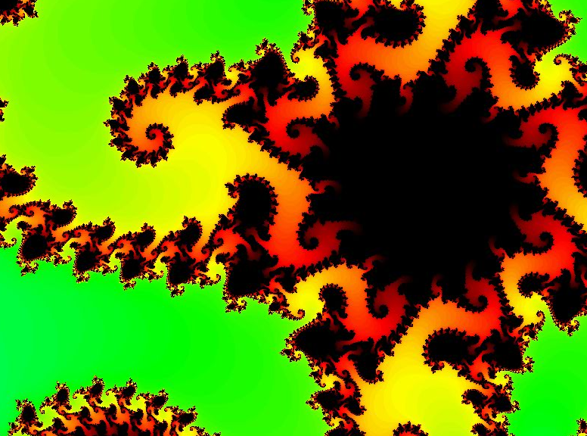
CS 5 Today
Seems more like two-thirds term to me...
infinitely nested structure…
CS Midterm
Thursday, Nov. 5
In-class, written
Page of notes is OK
Recursion in Python
Function composition
Circuit design
Hmmm assembly code
Loops in Python
Topics
from finitely nested loops
See online practice…
Homework 8 Loops! due 11/2

Slide 2
Next Thursday, 11/5 will be the CS 5 in-class midterm
Un-warnings:
only 5 minutes?
concerns? acc.? See me…
five problems, written
worth 1 hw assignment
score worries? Extra extra-credit in hw9 and beyond
Suggestions:
go over in-class exercises and hwk problems
create a page of notes, 2-sided is OK
consider small variations of the problems – and how they would change the solutions…
that's our approach…

Slide 3
Next Thursday, 11/5 will be the CS 5 in-class midterm
Un-warnings:
only 5 minutes?
concerns? acc.? See me…
Try list comprehensions & LoL !
five problems, written
worth 1 hw assignment
score worries? Extra extra-credit in hw9 and beyond
Suggestions:
go over in-class exercises and hwk problems
create a page of notes, 2-sided is OK
consider small variations of the problems – and how they would change the solutions…
Loops will appear, as well..

Slide 4
Homework 8 preview
#0
Computer modeling: the good and bad
#1 ~ lab
The Mandelbrot Set
#2
Pi from Pie
TTS Securities
#3
Loopy thinking
(Extra)
ASCII Art

Slide 5
Thinking in loops
for
while
x = 1
while x < 42:
print x
x *= 2
for x in range(42):
print x
What are the design differences between these two types of Python loops?

Slide 6
Thinking in loops
for
while
definite iteration
indefinite iteration
For a known list or # of iterations
For an unknown number of iterations

Slide 7
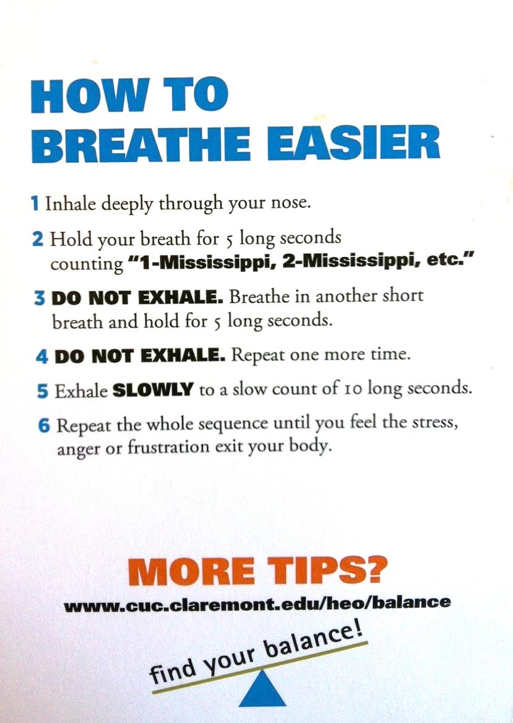
Loops are familiar ?
Careful here!
Table tent…

Slide 8
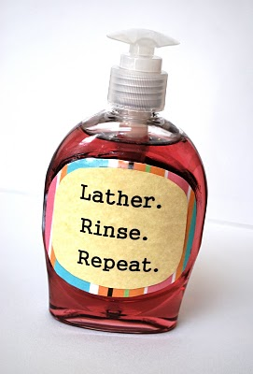
Loops are familiar ?

Slide 9
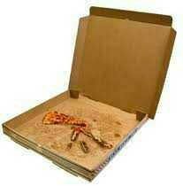
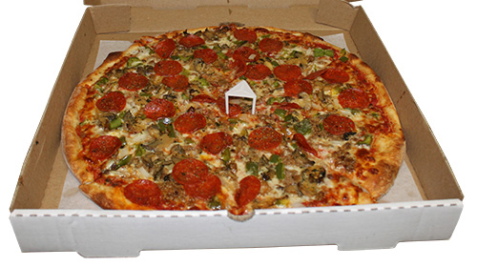
Hw8 Pr2
Pi from Pie?
π
Pizza is the universal constant, after all…

Slide 10
(1,1)
Hw8 Pr2
Estimating π from pie?
Pie
(1) Suppose you throw 100 darts at the square (all of them hit the square)
(2) Suppose 75 of the 100 hit inside the circle.
(0,0)
(3) How could you estimate π from these throws?
Hints
How big is a side of the square? its area?
How big is the radius of the circle? its area?
How do these help!?
Box
(-1,-1)

Slide 11
(1,1)
Hw8 Pr2
Pie
Estimating π from pie!
area
π
=
area
4
4
*
hits
Box
π
~
hits
(-1,-1)

Slide 12
Loops: for or while?
pi_one(e)
e == how close to π we need to get
pi_two(n)
n == number of darts to throw
Which function will use which kind of loop?

Slide 13
Loops: for or while?
pi_one(e)
e == how close to π we need to get
while
pi_two(n)
n == number of darts to throw
for

Slide 14
Homework 8 preview
#0
Computer modeling: the good and bad
#1 ~ lab
The Mandelbrot Set
#2
Pi from Pie
TTS Securities
#3
Nested looping structures!
(Extra)
ASCII Art

Slide 15
Nested loops are familiar, too!
for mn in range(60):
for s in range(60):
tick()

Slide 16
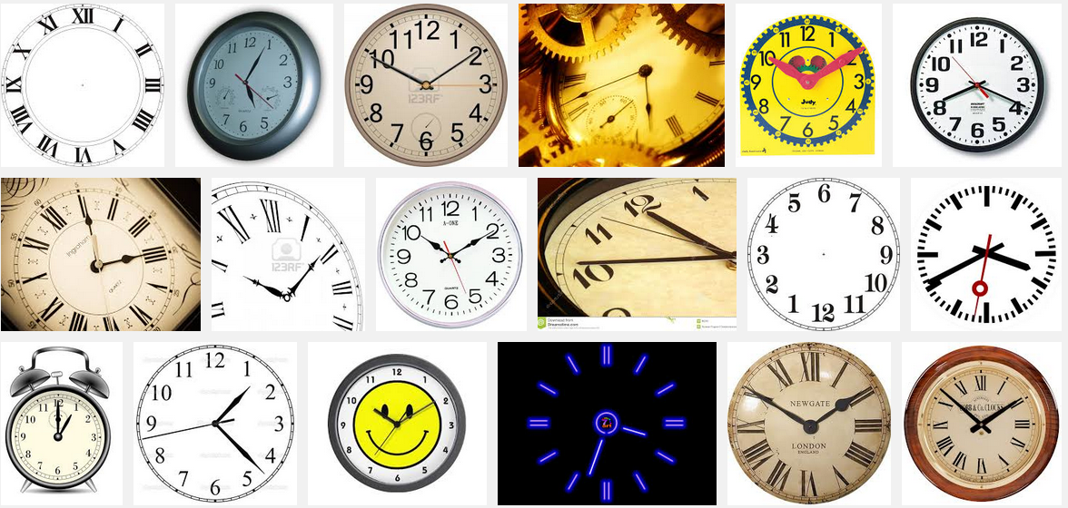
Nested loops are familiar, too!
So close!

Slide 17
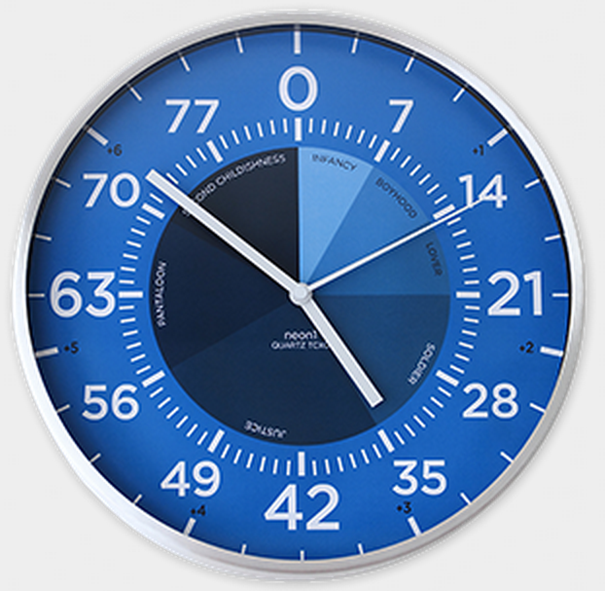
Nested loops
Life clock
for y in range(84):
for m in range(12):
for d in range(f(m,y)):
for h in range(24):
for mn in range(60):
for s in range(60):
tick()

Slide 18
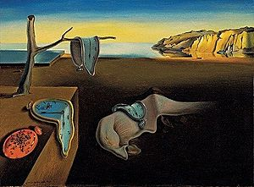
Nested loops!
for y in range(84):
for m in range(12):
for d in range(f(m,y)):
for h in range(24):
for mn in range(60):
for s in range(60):
tick()
Claremont College time

Slide 19
s == 0
s == 59
mn == 0
Nested loops' 2d structure
One hour ~ 3600 seconds
mn == 42
mn == 59
for mn in range(60):
for s in range(60):
tick()

Slide 20
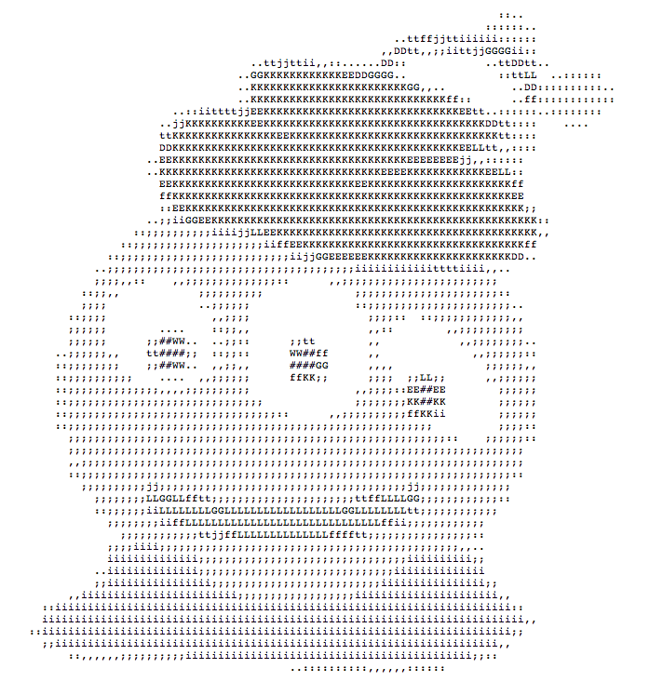
Nested loops via ASCII Art
That's my type of alien!

Slide 21
Creating 2d structure
col
0
1
2
3
# # # #
# # # #
# # # #
0
row
1
2
for row in range(3):
for col in range(4):
print "#"
Wait! this needs something more…

Slide 22
Creating 2d structure
[0,1,2]
for row in range(3):
for col in range(4):
print '#',
print
row =
[0,1,2,3]
col =
col =
col =
col =
row =
col
col =
col =
col =
col =
0
1
2
3
0
row =
row
1
col =
col =
col =
col =
2

Slide 23
Creating 2d structure
for row in range(3):
for col in range(4):
if col == row:
print '#',
else:
print ' ',
print
0
row =
0
col =
col =
col =
col =
1
2
3
1
row =
0
col =
col =
col =
col =
1
col
2
0
1
2
3
3
2
0
row =
0
row
1
col =
col =
col =
col =
1
2
2
3

Slide 24
Match!
+ what code creates the fourth one?
Quiz
Name(s): ____________________________
[0,1,2]
for r in range(3):
for c in range(6):
if c%2 == 1:
print '#',
else:
print ' ',
print
for r in range(3):
for c in range(6):
if r%2 == c%2:
print '#',
else:
print ' ',
print
for r in range(3):
for c in range(6):
if c > r:
print '#',
else:
print ' ',
print
[0,1,2,3,4,5]
A
B
C
1
cols
2
cols
2
3
4
2
5
3
4
1
5
1
0
0
0
# # # #
# # #
# #
0
# # #
# # #
# # #
1
1
2
2
rows
rows
3
cols
4
cols
2
3
4
2
1
5
3
4
1
5
0
0
0
# # # # #
# # # #
# # #
0
# # #
# # #
# # #
1
1
2
2
rows
rows

Slide 25
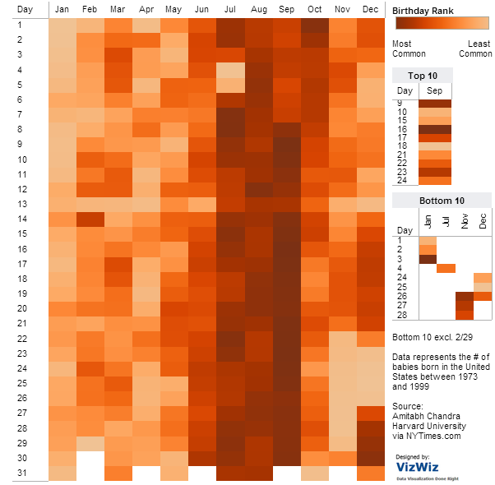
Nested loops' 2d structure
for d in range(f(m)):
for m in range(1,13):
num_bdays(m,d)
What trends appear in this birthday data?
how many shared birthdays are in CS5?
vizwiz.blogspot.com/2012/05/how-common-is-your-birthday-find-out.html

Slide 26
Birthday paradox?!
L
[]
unique(L) == True
[ 17 ]
[ 17, 42 ]
[ 17, 42, 5 ]
[ 17, 42, 5, 204 ]
[ 17, 42, 5, 204, 42 ]
unique(L) NOT True!
def bday():
L = []
while unique(L) == True:
guess = choice( range(365) )
L = L + [guess]
return len(L)

Slide 27
From ASCII to real images...
or maybe complex images?

Slide 28
Python and images
from cs5png import *
inputs are width and height
image = PNGImage( 300, 200 )
image.plotPixel( 10, 100 )
image.plotPixel( 42, 42, (255,0,0) )
image.saveFile( )
These functions are clearly plotting something – if only I knew what they were up to...

Slide 29
Python and images
from cs5png import *
inputs are width and height
image = PNGImage( 300, 200 )
objects are variables that can contain their own functions, often called methods
image.plotPixel( 10, 100 )
image.plotPixel( 42, 42, (255,0,0) )
image.saveFile( )
These functions are clearly plotting something – if only I knew what they were up to...

Slide 30
Imagining Images
from cs5png import *
def testImage():
""" image demonstration """
WD = 200
HT = 200
image = PNGImage( WD, HT )
for row in range(HT):
for col in range(WD):
if col == row:
image.plotPoint( col, row )
image.saveFile()
thicker line?
other diagonal?
stripes ?
thicker stripes?
thatching?

Slide 31
Lab 8: the Mandelbrot Set
z₀ = 0
z_{n+1} = z_{n}² + c
Consider an update rule for all complex numbers c
4j
c = 3 + 4j
3
Real axis
Imaginary axis

Slide 32
Python's complex #s
>>> c = 3 + 4j
>>> c.real
3.0
>>> c.imag
4.0
>>> abs(c)
5.0
Nothing's too complex for Python!

Slide 33
Mandelbrot Definition
z₀ = 0
z_{n+1} = z_{n}² + c
Consider an update rule for all complex numbers c
Imaginary axis
Small values of c keep the sequence near the origin, 0+0j.
z₃
c
z₁
z₂
z₄
z₀
Real axis
z₅
some "stick around": oscillate or converge

Slide 34
Mandelbrot Definition
z₀ = 0
z_{n+1} = z_{n}² + c
Consider an update rule for all complex numbers c
Which c's
stick around?
Small values of c keep the sequence near the origin, 0+0j.
Benoit B. Mandelbrot 1924 – 2010
c
Real axis
c
Other values of c make the sequence head to infinity.
Imaginary axis

Slide 35
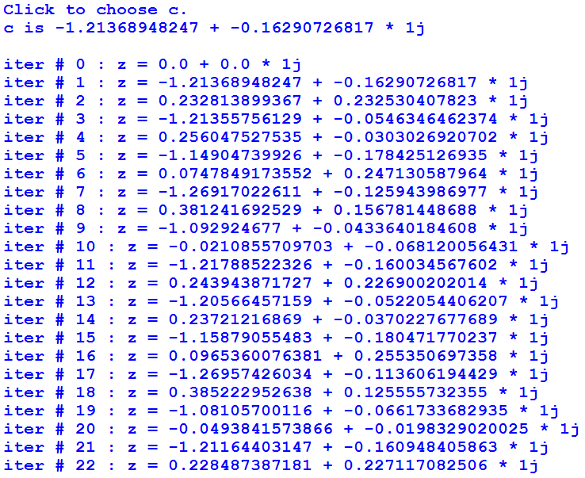
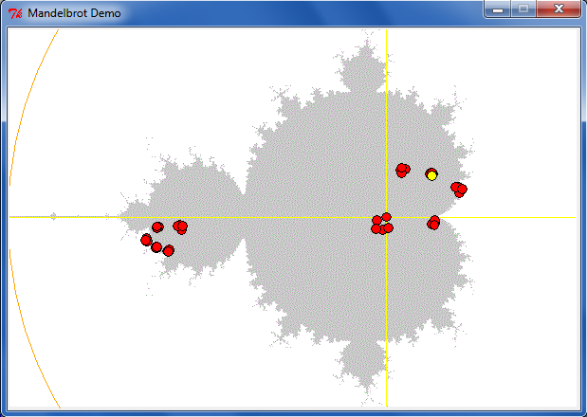
Lab 8: the Mandelbrot Set
z₀ = 0
z_{n+1} = z_{n}² + c
Consider an update rule for all complex numbers c
some c's stick around

Slide 36
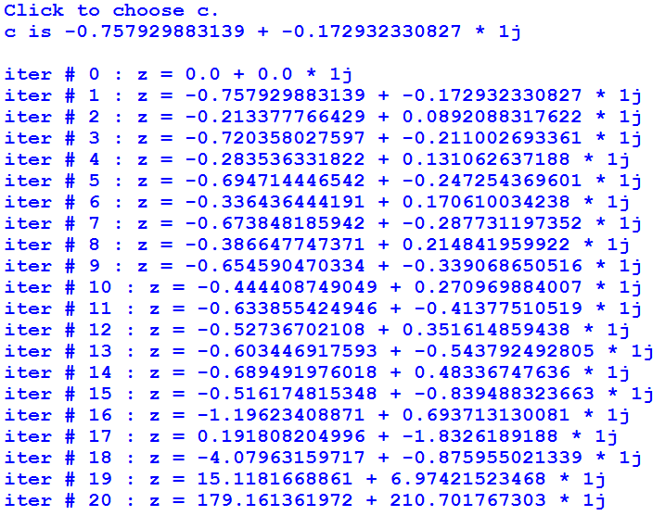
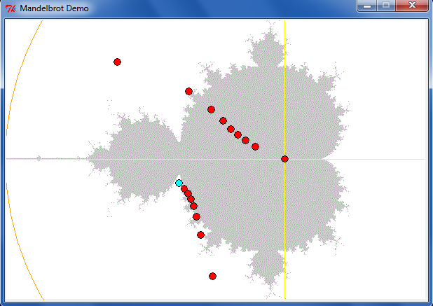
Lab 8: the Mandelbrot Set
z₀ = 0
z_{n+1} = z_{n}² + c
Consider an update rule for all complex numbers c
other c's diverge

Slide 37
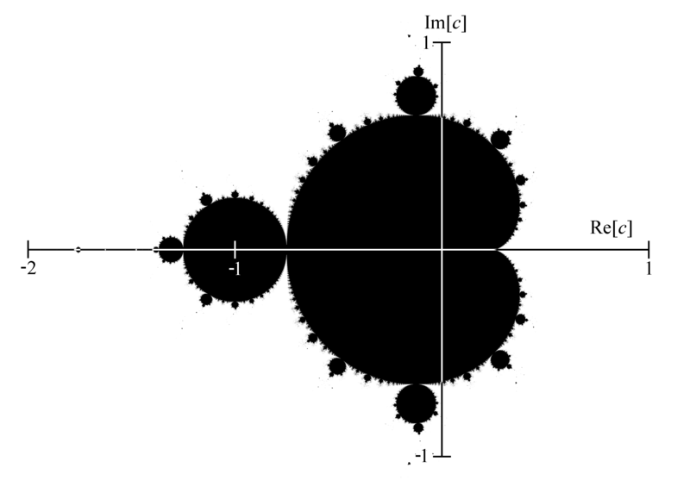
Mandelbrot Set ~ points that stick around
mid 70's resolution
The shaded area are points that do not diverge for z = z**2 + c

Slide 38
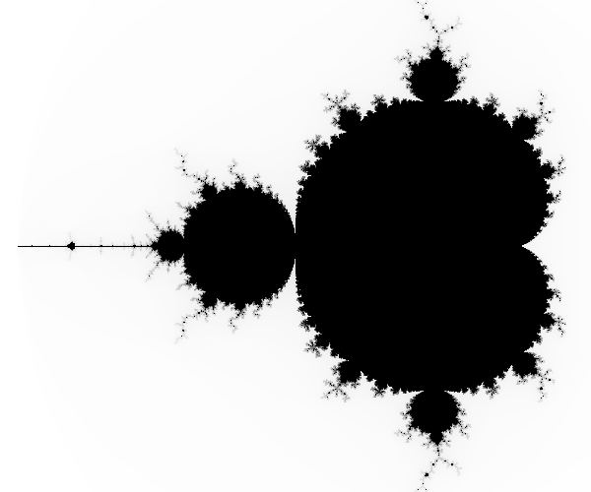
Higher-resolution M. Set
-2 + 1j
1 + 1j
connected
finite area
∞ perimeter!
-2 - 1j
1 - 1j
The black pixels are points that do not diverge for z = z**2 + c

Slide 39
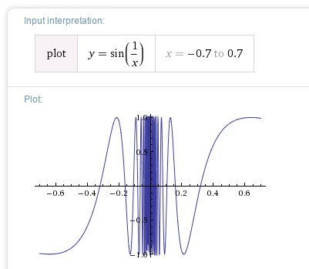
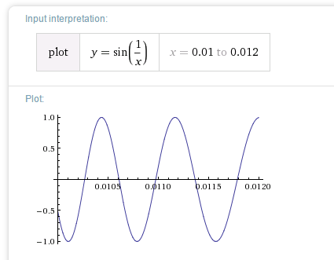
Chaos?
Complex things always consisted of simple parts…

Slide 40
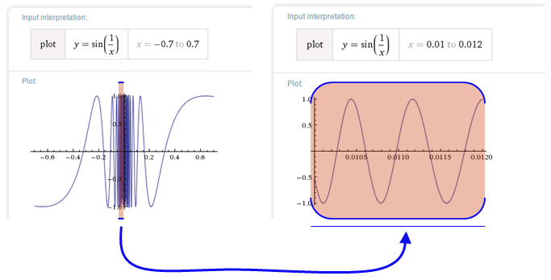

Before the M. Set, complex things were made of simple parts:
Chaos!
This was a "naturally occurring" object where zooming uncovers more detail, not less:
not self-similar but quasi-self-similar
http://www.youtube.com/watch?v=0jGaio87u3A

Slide 41
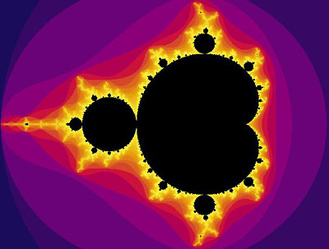
The black pixels are points that do not diverge for z = z**2 + c
What are these colors?

Slide 42
The black pixels are points that do not diverge for z = z**2 + c
escape velocities
What are these colors?

Slide 43
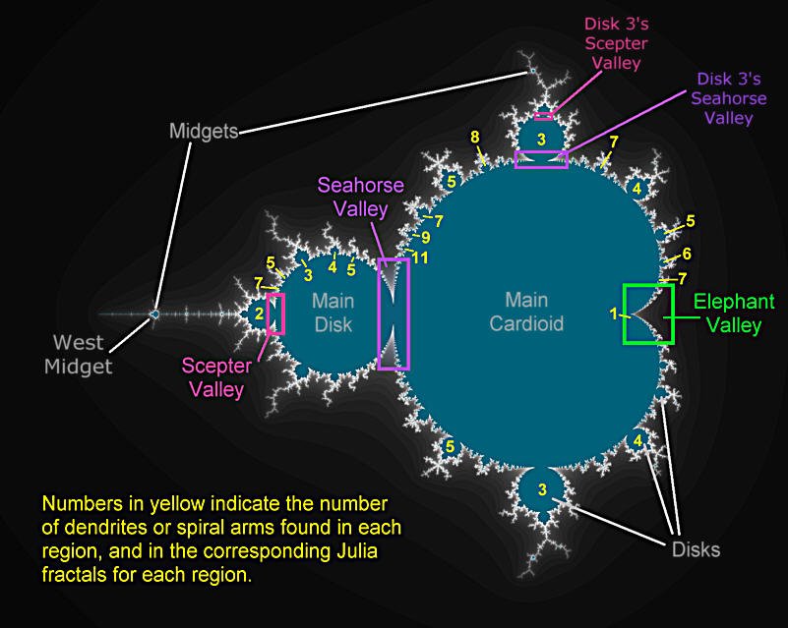
Atlas of the M. Set

Slide 44
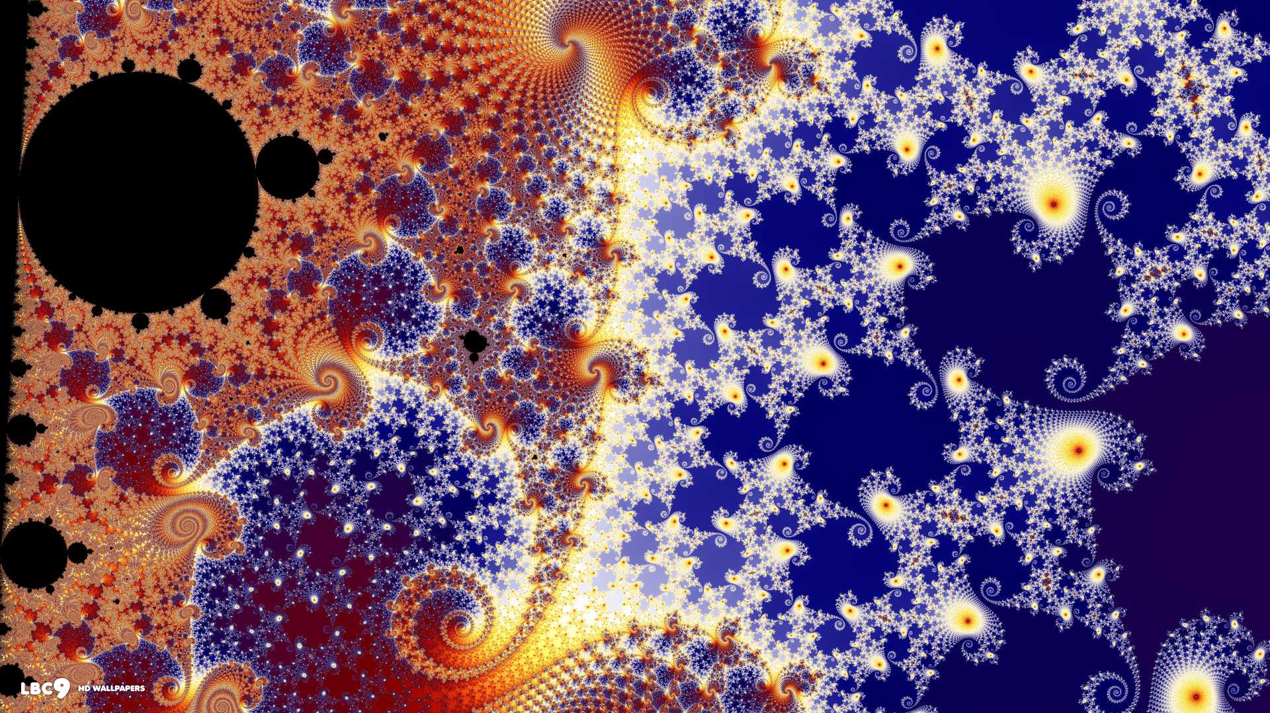
In the Seahorse Valley….

Slide 45
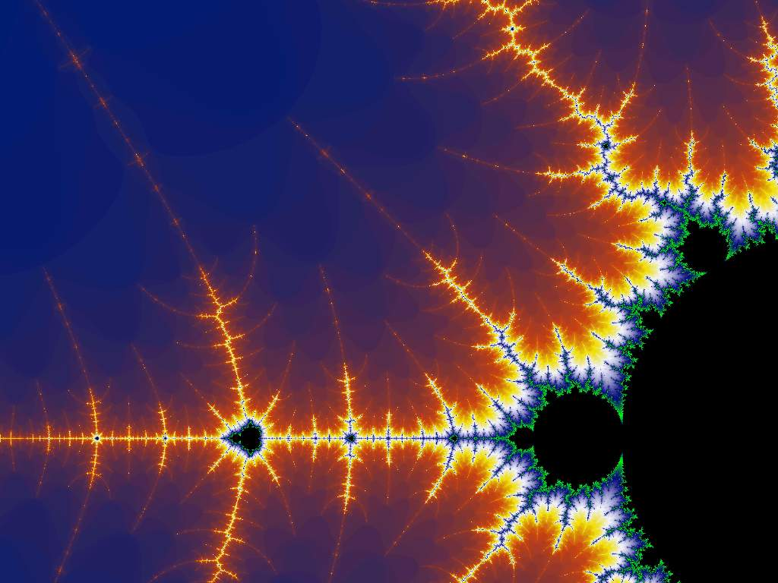
Happy Mandelbrotting!
www.cs.hmc.edu/~jgrasel/projects
http://www.youtube.com/watch?v=0jGaio87u3A

Slide 47
Creating 2d structure
[0,1,2]
for row in range(3):
for col in range(4):
print '#',
print
row =
[0,1,2,3]
col =
col =
col =
col =
row =
col
col =
col =
col =
col =
0
1
2
3
0
row =
row
1
col =
col =
col =
col =
2

Slide 48
Creating 2d structure
[0,1,2]
for row in range(3):
for col in range(4):
print '#',
print
row =
[0,1,2,3]
col =
col =
col =
col =
row =
col
col =
col =
col =
col =
0
1
2
3
0
row =
row
1
col =
col =
col =
col =
2

Slide 49
Creating 2d structure
for row in range(3):
for col in range(4):
if col == row:
print '#',
else:
print ' ',
print
0
row =
0
col =
col =
col =
col =
1
2
3
1
row =
0
col =
col =
col =
col =
1
col
2
0
1
2
3
3
2
0
row =
0
row
1
col =
col =
col =
col =
1
2
2
3

Slide 50
Match!
Quiz
Name(s): _____________________
Birthday(s) ______________ !
+ what code creates the fourth one?
[0,1,2]
for r in range(3):
for c in range(6):
if c%2 == 1:
print '#',
else:
print ' ',
print
for r in range(3):
for c in range(6):
if r%2 == c%2:
print '#',
else:
print ' ',
print
for r in range(3):
for c in range(6):
if c > r:
print '#',
else:
print ' ',
print
[0,1,2,3,4,5]
cols
cols
2
3
4
2
5
3
4
1
5
1
0
0
0
# # # # #
# # # #
# # #
0
# # #
# # #
# # #
1
1
2
2
rows
rows
cols
cols
2
3
4
2
1
5
3
4
1
5
0
0
0
# # # #
# # #
# #
0
# # #
# # #
# # #
1
1
2
2
rows
rows

Slide 51
Creating 2d structure
col
0
1
2
3
# # # #
# # # #
# # # #
0
row
1
2
This doesn't work!
for row in range(3):
for col in range(4):
print "#"

Slide 52
Creating 2d structure
col
0
1
2
3
# # # #
# # # #
# # # #
0
row
1
2
This doesn't work!
for row in range(3):
for col in range(4):
print "#"

Slide 53
Creating 2d structure
[0,1,2]
for row in range(3):
for col in range(4):
print '#',
print
row =
[0,1,2,3]
col =
col =
col =
col =
row =
col
col =
col =
col =
col =
0
1
2
3
0
row =
row
1
col =
col =
col =
col =
2

Slide 54
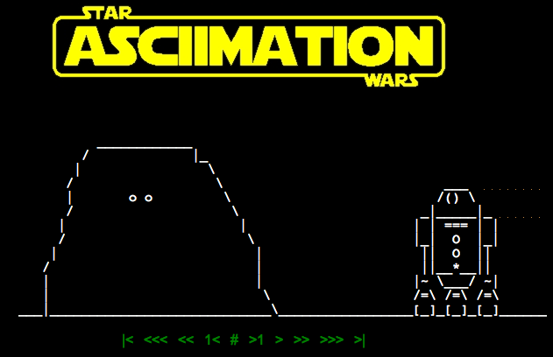
ASCII art...? How about ASCII video !
http://www.asciimation.co.nz/

Slide 55
Quiz
Nested Loops ~ 2d
Name(s): ________________________________
for row in range( 3 ):
for col in range( 6 ):
print ______,
print
cols
2
3
4
1
5
0
0
0 1 2 3 4 5
0 1 2 3 4 5
0 1 2 3 4 5
1
2
rows
What is being printed in each of these cases?
for row in range( 3 ):
for col in range( 6 ):
print ____________,
print
for row in range( 3 ):
for col in range( 6 ):
print ____________,
print
for row in range( 3 ):
for col in range( 6 ):
print ____________,
print
0 0 0 0 0 0
1 1 1 1 1 1
2 2 2 2 2 2
0 1 2 3 4 5
1 2 3 4 5 6
2 3 4 5 6 7
0 1 0 1 0 1
1 0 1 0 1 0
0 1 0 1 0 1

Slide 56
Nested loops: Rows vs. columns
For these loops, let side=5:
columns
0 1 2 3 4
for row in range(side):
for col in range(side):
if row >= col:
print row,
else:
print ' ',
print
0
1
2
3
4
What does this print?
rows
0 1 2 3 4
for row in range(side):
for col in range(side):
if
print row,
else:
print ' ',
print
0 0 0 0 0
1 1 1 1
2 2 2
3 3
4
0
1
2
3
4
What if tests print these?
0 1 2 3 4
for row in range(side):
for col in range(side):
if
print row,
else:
print ' ',
print
0
1
2
3
4
0 0 0 0 0
1 1 1 1
2 2 2
3 3 3 3
4 4 4 4 4
Extra! how about this hourglass?
0 0 0 0 0
1 1 1
2
3 3 3
4 4 4 4 4

Slide 57
columns
B
Extra! how about this hourglass?
0 1 2 3 4
for row in range(side):
for col in range(side):
if row >= col:
print row,
else:
print ' ',
print
0
1
2
3
4
0
1 1
2 2 2
3 3 3 3
4 4 4 4 4
0 0 0 0 0
1 1 1
2
3 3 3
4 4 4 4 4
rows
A
C
0 1 2 3 4
for row in range(side):
for col in range(side):
if
print row,
else:
print ' ',
print
0 0 0 0 0
1 1 1 1
2 2 2
3 3
4
0
1
2
3
4
D
0 1 2 3 4
for row in range(side):
for col in range(side):
if
print row,
else:
print ' ',
print
0
1
2
3
4
0 0 0 0 0
1 1 1 1
2 2 2
3 3 3 3
4 4 4 4 4

Slide 58
Creating 2d structure
[0,1,2]
for row in range(3):
for col in range(4):
print '#',
print
row =
[0,1,2,3]
col =
col =
col =
col =
row =
col
col =
col =
col =
col =
0
1
2
3
0
row =
row
1
col =
col =
col =
col =
2

Slide 59
Quiz
Nested Loops ~ 2d
Name(s): ________________________________
for row in range( 3 ):
for col in range( 6 ):
print ______,
print
cols
2
3
4
1
5
0
0
0 1 2 3 4 5
0 1 2 3 4 5
0 1 2 3 4 5
1
2
rows
What is being printed in each of these cases?
for row in range( 3 ):
for col in range( 6 ):
print ____________,
print
for row in range( 3 ):
for col in range( 6 ):
print ____________,
print
for row in range( 3 ):
for col in range( 6 ):
print ____________,
print
0 0 0 0 0 0
1 1 1 1 1 1
2 2 2 2 2 2
0 1 2 3 4 5
1 2 3 4 5 6
2 3 4 5 6 7
0 1 0 1 0 1
1 0 1 0 1 0
0 1 0 1 0 1

Slide 60
Nested loops: Rows vs. columns
For these loops, let side=5:
columns
0 1 2 3 4
for row in range(side):
for col in range(side):
if row >= col:
print row,
else:
print ' ',
print
0
1
2
3
4
What does this print?
rows
0 1 2 3 4
for row in range(side):
for col in range(side):
if
print row,
else:
print ' ',
print
0 0 0 0 0
1 1 1 1
2 2 2
3 3
4
0
1
2
3
4
What if tests print these?
0 1 2 3 4
for row in range(side):
for col in range(side):
if
print row,
else:
print ' ',
print
0
1
2
3
4
0 0 0 0 0
1 1 1 1
2 2 2
3 3 3 3
4 4 4 4 4
Extra! how about this hourglass?
0 0 0 0 0
1 1 1
2
3 3 3
4 4 4 4 4

Slide 61
columns
B
Extra! how about this hourglass?
0 1 2 3 4
for row in range(side):
for col in range(side):
if row >= col:
print row,
else:
print ' ',
print
0
1
2
3
4
0
1 1
2 2 2
3 3 3 3
4 4 4 4 4
0 0 0 0 0
1 1 1
2
3 3 3
4 4 4 4 4
rows
A
C
0 1 2 3 4
for row in range(side):
for col in range(side):
if
print row,
else:
print ' ',
print
0 0 0 0 0
1 1 1 1
2 2 2
3 3
4
0
1
2
3
4
D
0 1 2 3 4
for row in range(side):
for col in range(side):
if
print row,
else:
print ' ',
print
0
1
2
3
4
0 0 0 0 0
1 1 1 1
2 2 2
3 3 3 3
4 4 4 4 4

Slide 62
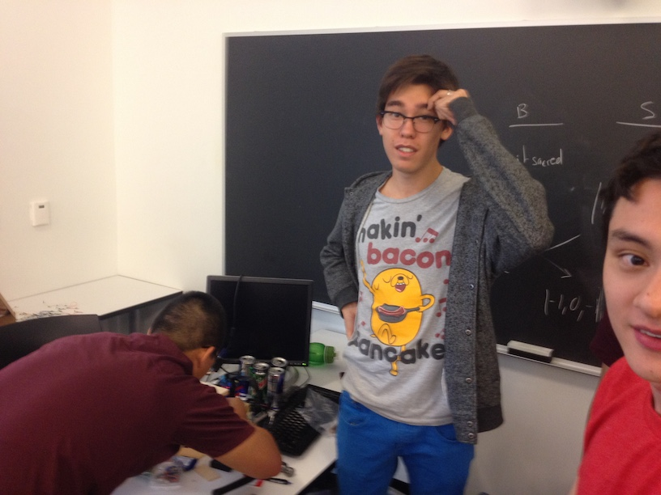
Hw Hackathon

Slide 63
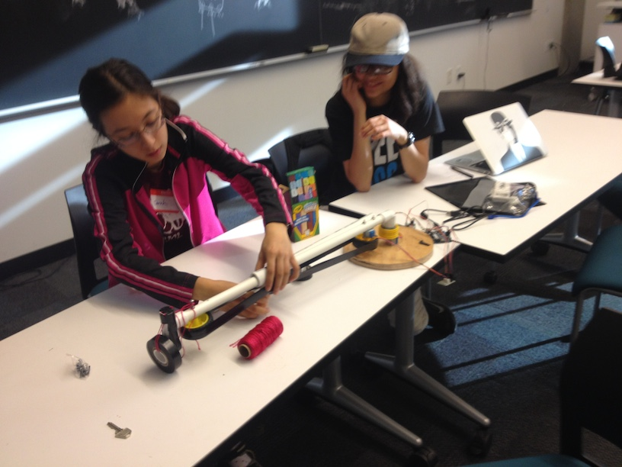
Hw Hackathon

Slide 64
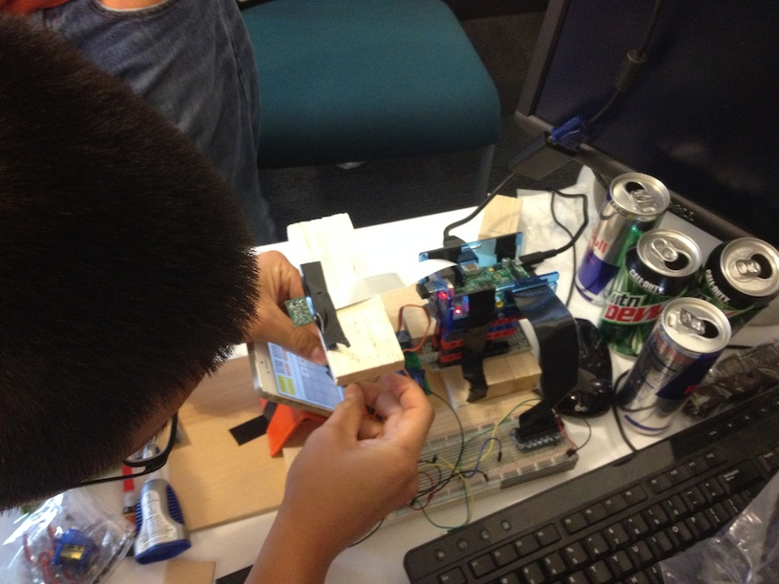
Hw Hackathon

Slide 65
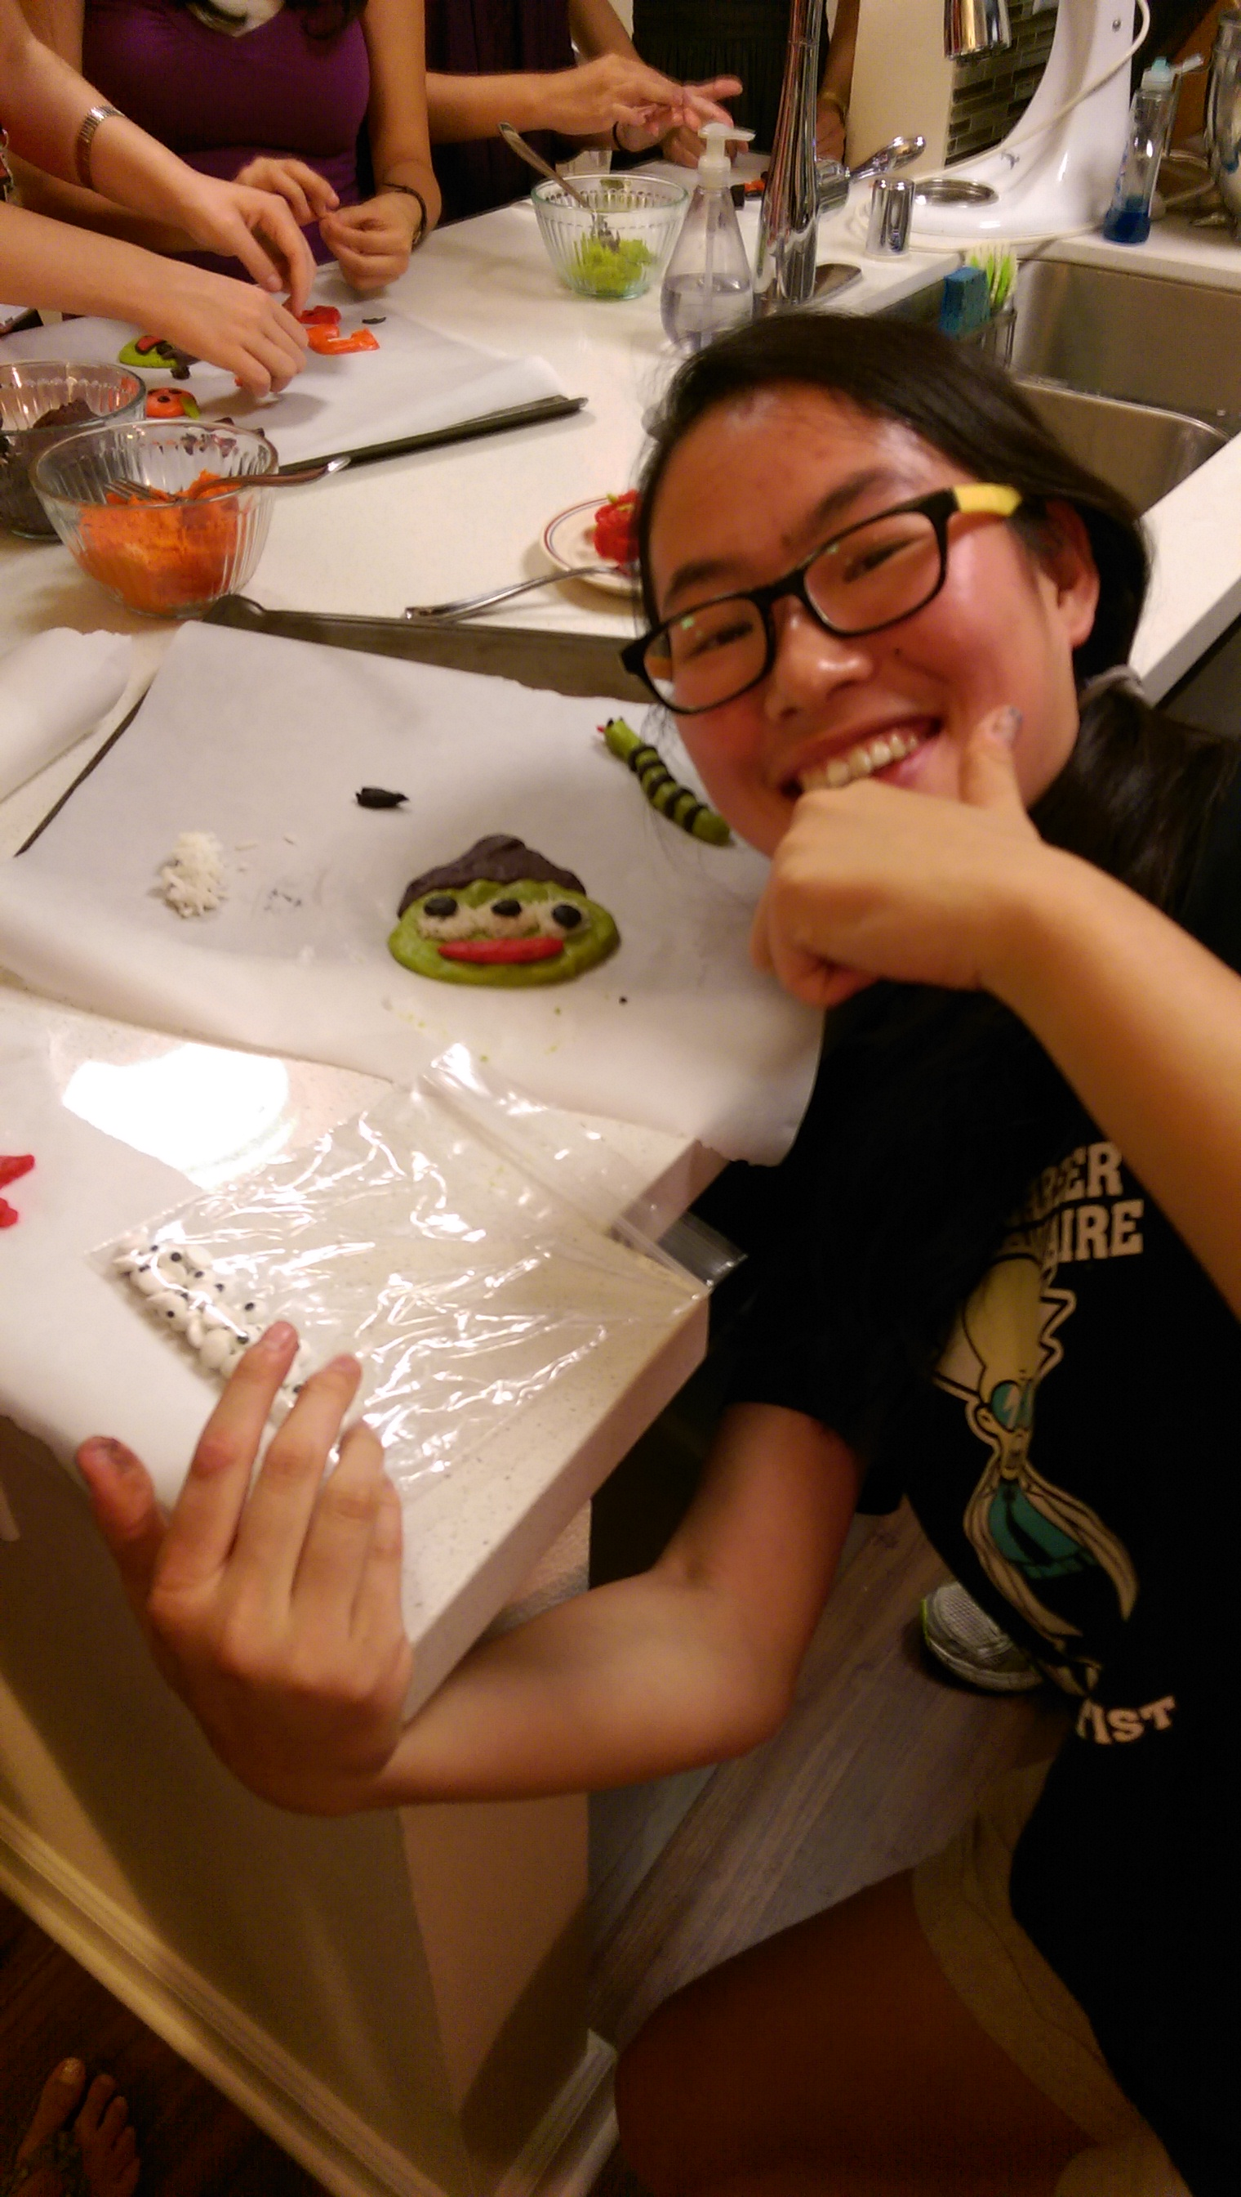
Aliens!!!

Slide 66
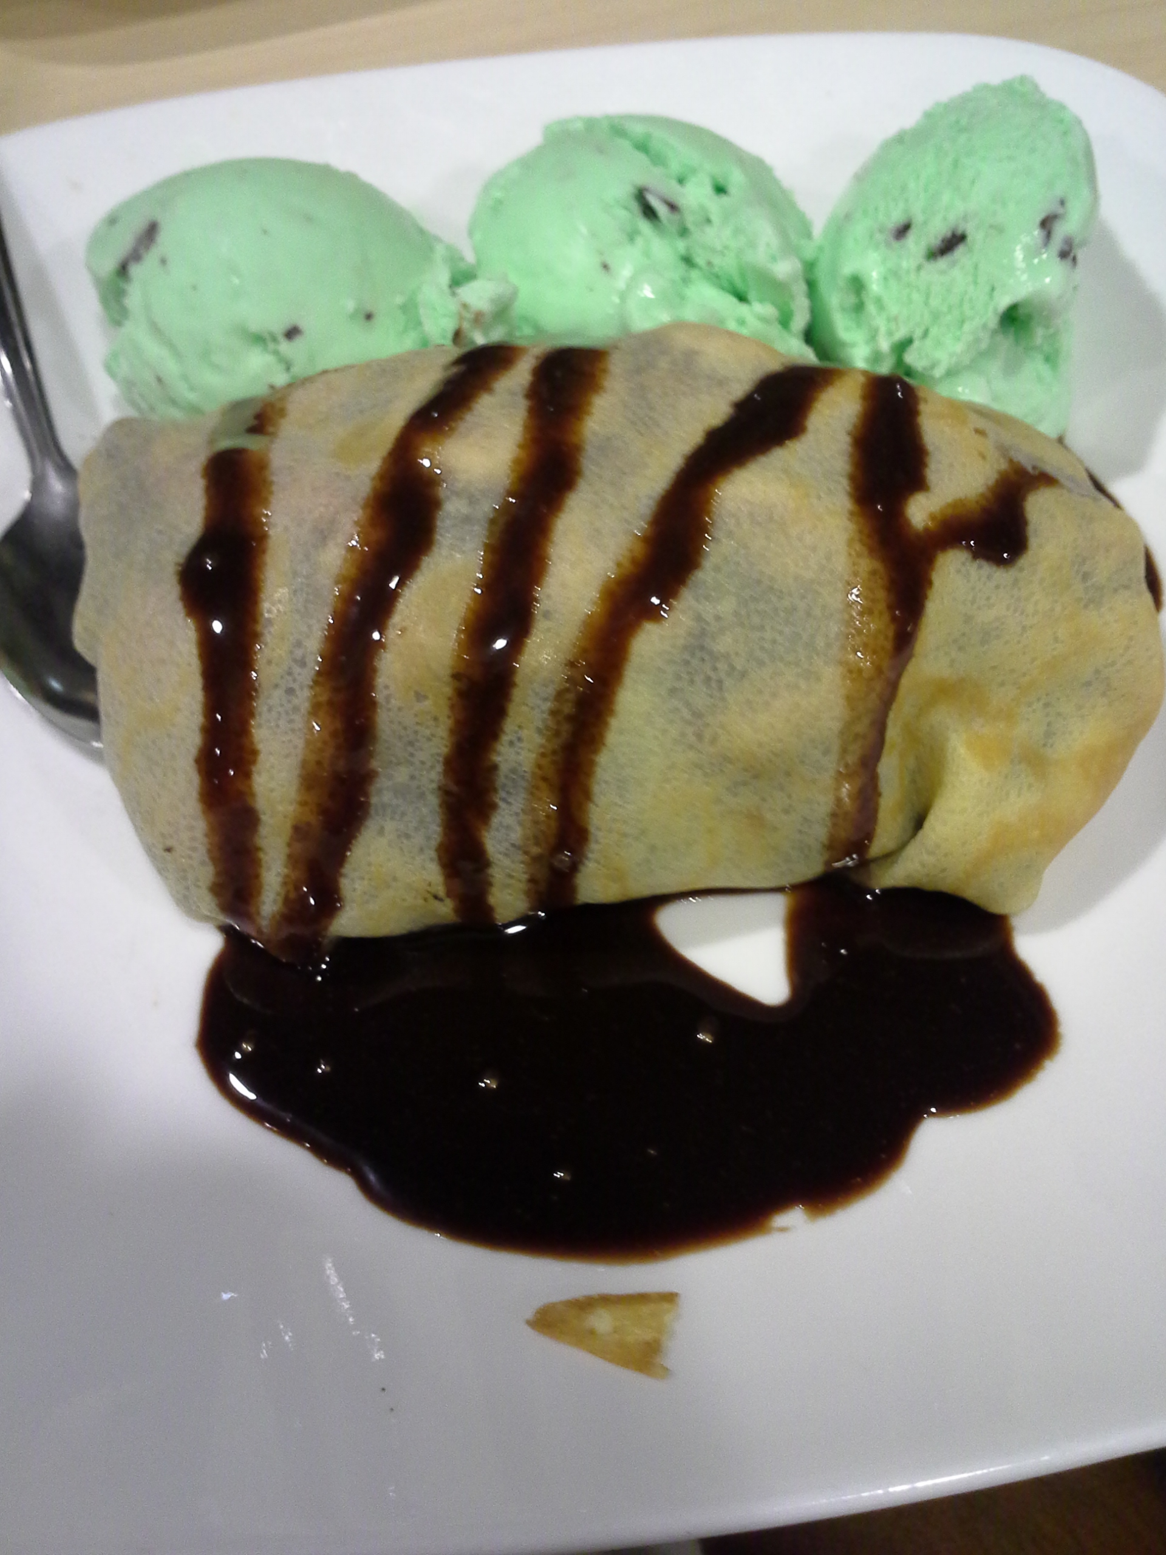

Aliens!!!

Slide 67
One hour:
Nested loops' 2d structure
rectangular vs. circular
for mn in range(60):
for s in range(60):
tick()

Slide 68
Nested loops' 2d structure
for m in range(12):
for d in range(f(m)):
num_bdays(m,d)
vizwiz.blogspot.com/2012/05/how-common-is-your-birthday-find-out.html

Slide 69
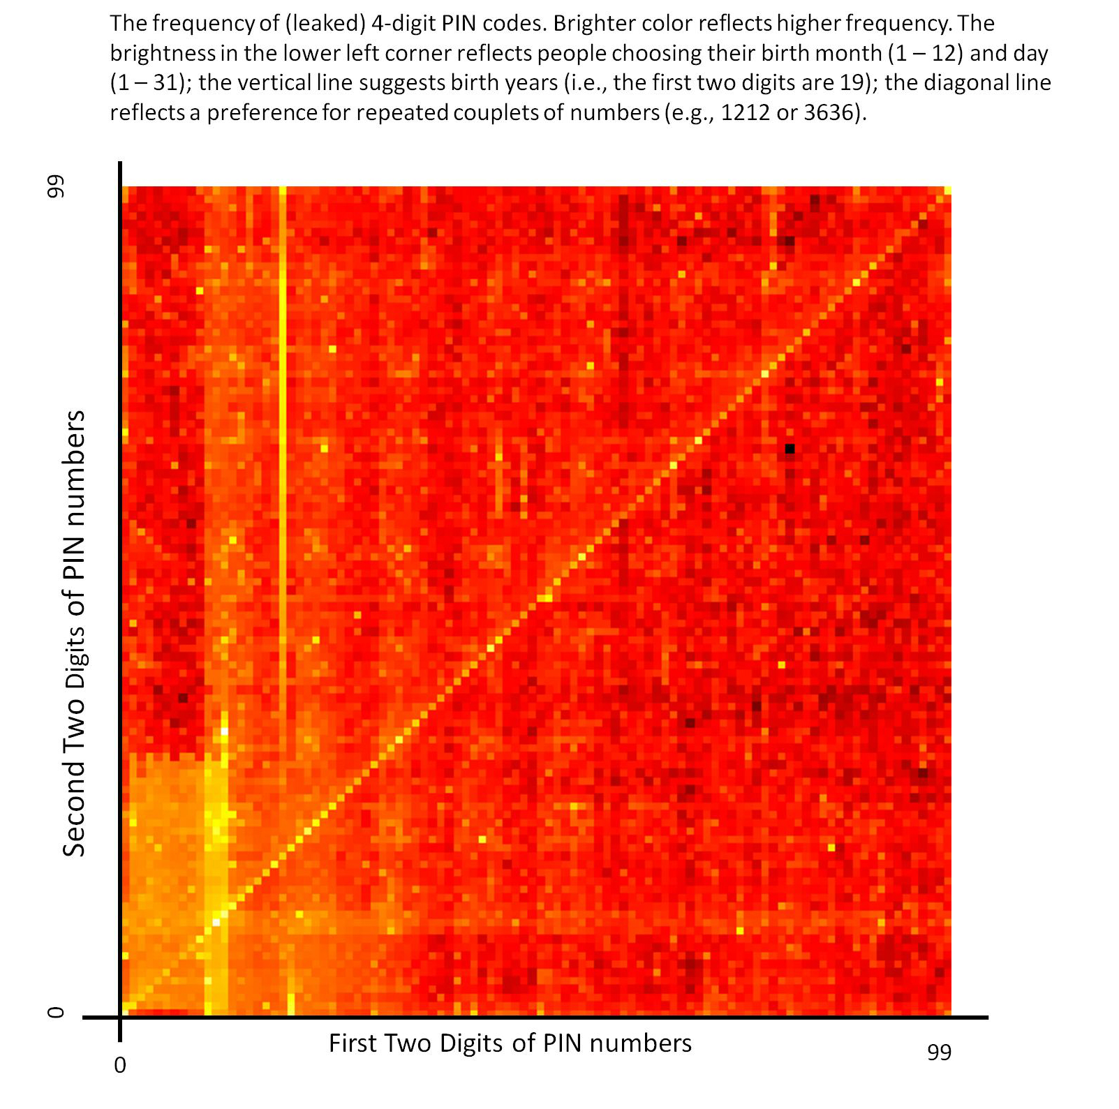
many leaked PINs
Nested loops ~ 2d structure
for x in range(100):
for y in range(100):
pin = str(x)+str(y)
Nested loops' 2d structure
Thanks, Brett W.

Slide 70
Nested loops' 2d structure
for x in range(100):
for y in range(100):
pin = str(x)+str(y)
Thanks, Brett W.

Slide 71
A engineering challenge: estimate π using everyday items...
Hw8 Pr2
(1,1)
Pie
Box
(-1,-1)

Slide 72
Creating 2d structure
[0,1,2]
for row in range(3):
for col in range(4):
print '#',
print
row =
[0,1,2,3]
col =
col =
col =
col =
row =
col
col =
col =
col =
col =
0
1
2
3
0
row =
row
1
col =
col =
col =
col =
2

Slide 73
Tracking rows and columns
for row in range(3):
for col in range(4):
print '$',
print
row =
col =
col =
col =
col =
row =
col =
col =
col =
col =
0
1
2
3
col
0
row =
1
col =
col =
col =
col =
2
row

Slide 74
Name(s): ______________________________
for row in range( 3 ):
for col in range( 6 ):
print ______,
print
cols
2
3
4
1
5
0
0
0 1 2 3 4 5
0 1 2 3 4 5
0 1 2 3 4 5
1
2
rows
Change each block of code so that it will print the examples below:
for row in range( 3 ):
for col in range( 6 ):
print ____________,
print
for row in range( 3 ):
for col in range( 6 ):
print ____________,
print
for row in range( 3 ):
for col in range( 6 ):
print ____________,
print
0 0 0 0 0 0
1 1 1 1 1 1
2 2 2 2 2 2
0 1 2 3 4 5
1 2 3 4 5 6
2 3 4 5 6 7
0 1 0 1 0 1
1 0 1 0 1 0
0 1 0 1 0 1

Slide 75
Nested loops: Rows vs. columns
Name(s): ______________________________
For these loops, let side=5:
columns
0 1 2 3 4
for row in range(side):
for col in range(side):
if row >= col:
print row,
else:
print ' ',
print
0
1
2
3
4
What does this print?
rows
for row in range(side):
for col in range(side):
if
print row,
else:
print ' ',
print
0 0 0 0 0
1 1 1 1
2 2 2
3 3
4
What if tests print these two?
for row in range(side):
for col in range(side):
if
print row,
else:
print ' ',
print
0 0 0 0 0
1 1 1 1
2 2 2
3 3 3 3
4 4 4 4 4
Extra! how about the hourglass?
0 0 0 0 0
1 1 1
2
3 3 3
4 4 4 4 4

Slide 76
Nested loops: Rows vs. columns
Name(s): ______________________________
For these loops, let side=5:
columns
0 1 2 3 4
for row in range(side):
for col in range(side):
if row >= col:
print row,
else:
print ' ',
print
0
1
2
3
4
What does this print?
rows
for row in range(side):
for col in range(side):
if
print row,
else:
print ' ',
print
0 0 0 0 0
1 1 1 1
2 2 2
3 3
4
What if tests print these two?
for row in range(side):
for col in range(side):
if
print row,
else:
print ' ',
print
0 0 0 0 0
1 1 1 1
2 2 2
3 3 3 3
4 4 4 4 4
Extra! how about the hourglass?
0 0 0 0 0
1 1 1
2
3 3 3
4 4 4 4 4

Slide 77
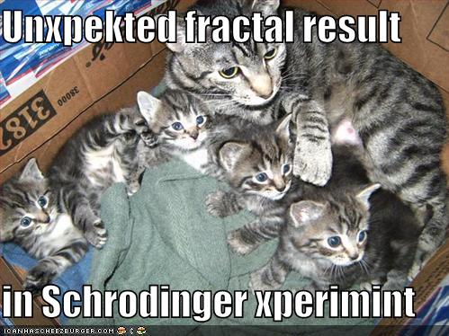
fractal CAT ?
infinitely nested structure…
CS Midterm
Thursday Nov. 3
Seems more like two-thirds term to me...
In-class, written
Page of notes is OK
Recursion in Python
Software design
Circuit design
Hmmm assembly code
Loops in Python
Topics
from finite nested loops
Homework 8: due eve. of 10/31
LAC hrs: Friday, 2-4pm

Slide 78
www.cs.hmc.edu/~jgrasel/mandelbrot

Slide 79
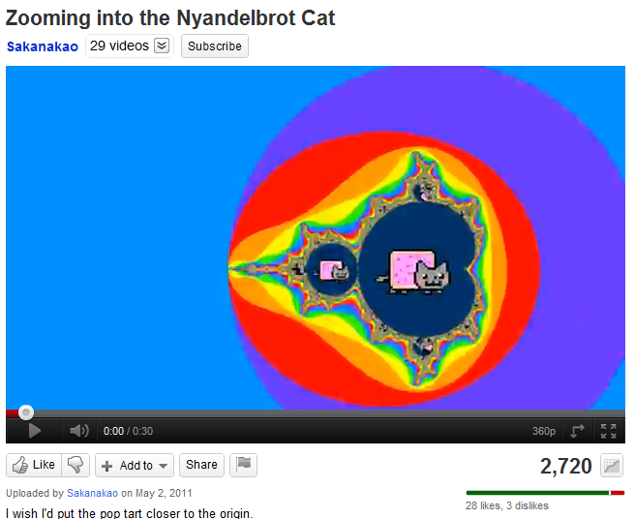
fractal NYAN cat!

Slide 80
A engineering challenge: estimate π using everyday items...
Hw8 Pr2
(1,1)
Pie
(-1,-1)

Slide 81
A engineering challenge: estimate π using everyday items...
Hw8 Pr2
(1,1)
Pie
Box
(-1,-1)

Slide 82
Loops: for or while?
pi_one(e)
e == how close to π we need to get
pi_two(n)
n == number of darts to throw
Which function will use which kind of loop?

Slide 83
Tracking rows and columns
for row in range(3):
for col in range(4):
print '$',
print
0
1
2
3
cols
0
1
2
rows

Slide 84
for row in range( 3 ):
for col in range( 6 ):
print ______,
print
cols
2
3
4
1
5
0
0
0 1 2 3 4 5
0 1 2 3 4 5
0 1 2 3 4 5
1
2
rows
Change each block of code so that it will print the examples below:
for row in range( 3 ):
for col in range( 6 ):
print ____________,
print
for row in range( 3 ):
for col in range( 6 ):
print ____________,
print
for row in range( 3 ):
for col in range( 6 ):
print ____________,
print
0 0 0 0 0 0
1 1 1 1 1 1
2 2 2 2 2 2
0 1 2 3 4 5
1 2 3 4 5 6
2 3 4 5 6 7
0 1 0 1 0 1
1 0 1 0 1 0
0 1 0 1 0 1

Slide 85
Nested loops: Rows vs. columns
Name(s): ______________________________
For these loops, let side=5:
columns
0 1 2 3 4
for row in range(side):
for col in range(side):
if row >= col:
print row,
else:
print ' ',
print
0
1
2
3
4
What does this print?
rows
for row in range(side):
for col in range(side):
if
print row,
else:
print ' ',
print
0 0 0 0 0
1 1 1 1
2 2 2
3 3
4
What if tests print these two?
for row in range(side):
for col in range(side):
if
print row,
else:
print ' ',
print
0 0 0 0 0
1 1 1 1
2 2 2
3 3 3 3
4 4 4 4 4
Extra! how about the hourglass?
0 0 0 0 0
1 1 1
2
3 3 3
4 4 4 4 4

Slide 86
Feedback ... on feedback!

Slide 87
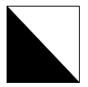
Images and 2d loops
How could you change this code (the if test) to produce this triangle image?
What 2d loops would create a checkerboard image, pixel-by-pixel?
def test():
""" demonstrating images """
width = 200
height = 200
image = PNGImage( width, height )
for col in range(width):
for row in range(height):
if col == row:
image.plotPoint( col, row )
image.saveFile( )
def test():
""" demonstrating images """
width = 8
height = 6
image = PNGImage( width, height )
for col in range(width):
for row in range(height):
image.saveFile( )

Slide 88
How could you change this code so that it produces an triangle like this?
def triangle():
""" demonstrating images """
width = 200
height = 200
image = PNGImage( width, height )
# a 2d loop over each pixel
for col in range(width):
for row in range(height):
if
image.plotPoint( col, row )

Slide 89
What 2d loops would create a checkerboard image?
def checkerboard():
… usual image stuff here …
# loop over each pixel
for col in range(width):
for row in range(height):
image.plotPoint( col, row )

Slide 90
Loops: for or while?
pi_one(e)
e == how close to π we need to get
pi_two(n)
n == number of darts to throw
Which function will use which kind of loop?

Slide 91
Images and 2d loops
How could you change this code (the if test) to produce this triangle image?
What 2d loops would create a checkerboard image, pixel-by-pixel?
def test():
""" demonstrating images """
width = 200
height = 200
image = PNGImage( width, height )
for col in range(width):
for row in range(height):
if col == row:
image.plotPoint( col, row )
image.saveFile( )
def test():
""" demonstrating images """
width = 8
height = 6
image = PNGImage( width, height )
for col in range(width):
for row in range(height):
image.saveFile( )

Slide 92
Mandelbrot Set: issues
Consider the following update rule for all complex numbers c:
z₀ = 0
z_{n+1} = z_{n}² + c
The shaded area are points that do not diverge.
What concerns might arise in generating this image?

Slide 93
Pixels vs. "real" values
1.0
-2.0
1.0
-1.0
Drawing happens in pixel-coords. Mandelbrot testing happens in real coords.

Slide 94

Nature > Imagination?

Slide 95
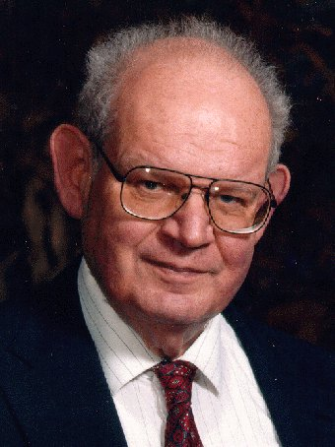
Lab 9: the Mandelbrot Set
Consider the following update rule for all complex numbers c:
z₀ = 0
z_{n+1} = z_{n}² + c
If c does not diverge, it's in the M. Set.
Benoit M.
Imaginary axis
z₃
c
z₁
z₂
z₄
Real axis
z₀

Slide 96
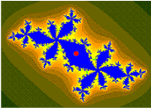
Lab 9: the Mandelbrot Set
Consider the following update rule for all complex numbers c:
z₀ = 0
z_{n+1} = z_{n}² + c
If c does not diverge, it's in the M. Set.
Benoit M.
Imaginary axis
z₃
c
z₁
z₂
z₄
z₀
Real axis
example of a non-diverging cycle

Slide 97
Lab 9: the Mandelbrot Set
Consider the following update rule for all complex numbers c:
z₀ = 0
z_{n+1} = z_{n}² + c
The shaded area are points that do not diverge.

Slide 98
Python and images
import bmp.py
for creating and saving images
Eco-friendly bitmps !
image = BitMap( 300, 200, Color.GREEN )
creates a bitmap object
and names it image

Slide 99
Python and images
import bmp.py
for creating and saving images
Eco-friendly bitmps !
image = BitMap( 300, 200, Color.GREEN )
creates a bitmap object
and names it image
objects are software abstractions containing structured information

Slide 100
Python and images and objects
import bmp.py
image = BitMap( 300, 200, Color.GREEN )
here, a bitmap object named image
is calling an internal method named saveFile
image.saveFile( "test.bmp" )
objects are variables that can contain their own functions, often called methods

Slide 101
Python and images and objects
import bmp.py
image = BitMap( 300, 200, Color.GREEN )
image.setPenColor( Color.Red )
two more internal methods
image.plotPixel( 150, 100 )
image.saveFile( "test.bmp" )
objects are variables that can contain their own functions, often called methods

Slide 102
Mandelbrot Set: properties
The set is connected.
The set's boundary is a fractal of dimension 2 (!)
"infinite detail"
The points nearer the set escape to ∞ more slowly.
can color points based on how quickly they escape…
not 100% self-similar but quasi-self-similar:
Jonathan Coulton wrote a song about it
http://www.youtube.com/watch?v=gEw8xpb1aRA

Slide 103
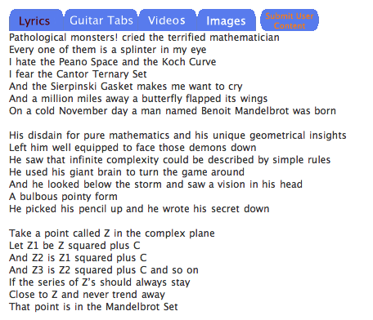
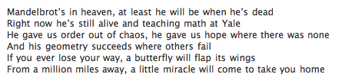
Mandelbrot Set: song
chorus
chorus…
Jonathan Coulton wrote a song about it

Slide 104

Hw8 Pr2
Pi from Pie?
Executives from CBS* have stranded several teams of CS5ers on a sandy desert island with only Dominos' delivery #, and $7.99. The teams then compete to see who can estimate pi more accurately before being consumed by carnivorous slugs…
*The Claremont Broadcasting Station
* Note: $7.99 is not enough to get you the meat-lovers pizza, which would distract the carnivorous slugs… .

Slide 105
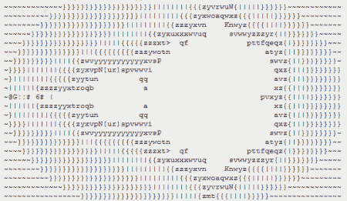
An image alternative…
http://www.asciimation.co.nz/

Slide 106
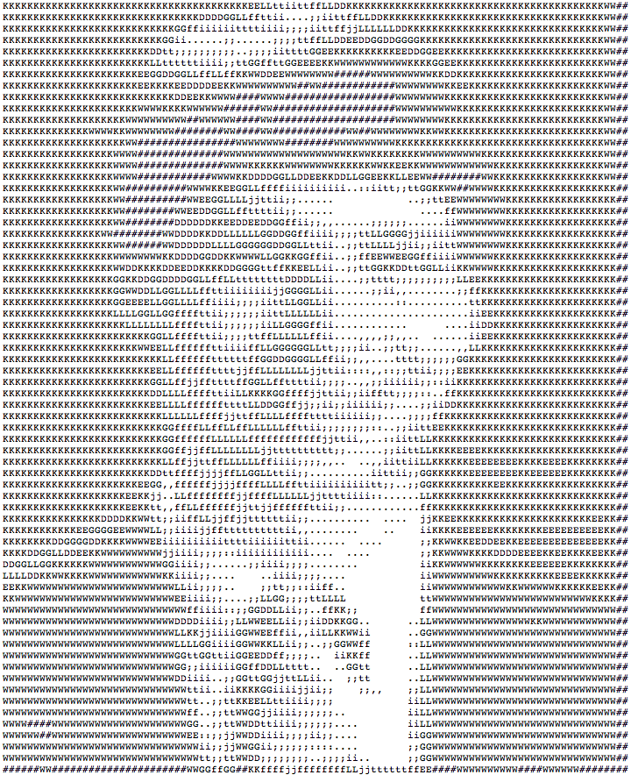
ASCII Images
Print 4 rows
for i in range(4):
print “#”*8
print automatically
adds a newline
Creates line to print
Who are you calling simple?
########
########
########
########
Output

Slide 107
ASCII Images
Print 4 rows
for i in range(4):
print “#”*8
print automatically
adds a newline
Creates line to print
Who are you calling simple?
########
########
########
########
For this problem, string multiplication is not allowed.
Output

Slide 108
Without string multiplication…
Print 4 rows
for i in range(4):
for j in range(8):
print “#”
print 8 chars on each line
?
Output ?
Any problems???

Slide 109
Without string multiplication…
for i in range(4):
for j in range(8):
print “#”,
Comma suppresses newline
Output ?
Now OK???

Slide 110
Try it!
What code would print this “ASCII quilt”
with height rows and width columns ?
cols
1
2
3
4
5
6
7
0
8
rows
# # * # # * # # *
* * # * * # * * #
# # * # # * # # *
* * # * * # * * #
# # * # # * # # *
* * # * * # * * #
for row in range(height):
0
for col in range(width):
1
2
3
4
5

Slide 111
Without string multiplication…
for i in range(4):
for j in range(8):
print “#”,
print
comma adds spaces
just prints a newline
# # # # # # # #
# # # # # # # #
# # # # # # # #
# # # # # # # #
Output
Close enough!

Slide 112
Without extra spaces…
import sys
for i in range(4):
for j in range(8):
sys.stdout.write('#')
print
method (function) that prints only its input
software object representing the screen's standard output
########
########
########
########
Output

Slide 113
Try it!
What code would print this “ASCII flag” ?
-- first, with 6 rows and 9 columns, then
with height rows and width columns.
# * * # * * # * *
* * * * * * * * *
# * * # * * # * *
* * * * * * * * *
# * * # * * # * *
* * * * * * * * *

Slide 114
Objects, objects, everywhere!
>>> L = [] # create a list, L
>>> dir(L) # see all of L's methods
all list methods appear -- lots of them including append, index, remove, and sort
>>> help(L.sort) # I wonder…
>>> help(L.index) # What does this do?
integers?
operators?

Slide 115
Another mini method
I guess you really can't beat the stock index !
def mini( L ):
""" returns the DAY of the
lowest-priced stock """
use L.index
integers?
operators?
strings?

Slide 116
An image alternative…
http://www.asciimation.co.nz/

Slide 117
ASCII Images
Print 4 rows
for i in range(4):
print “#”*8
print automatically
adds a newline
Creates line to print
Who are you calling simple?
########
########
########
########
Output

Slide 118
ASCII Images
Print 4 rows
for i in range(4):
print “#”*8
print automatically
adds a newline
Creates line to print
Who are you calling simple?
########
########
########
########
For this problem, string multiplication is not allowed.
Output

Slide 119
Without string multiplication…
Print 4 rows
for i in range(4):
for j in range(8):
print “#”
print 8 chars on each line
?
Output ?
Any problems???

Slide 120
Without string multiplication…
for i in range(4):
for j in range(8):
print “#”,
Comma suppresses newline
Output ?
Now OK???

Slide 121
Try it!
What code would print this “ASCII quilt”
with height rows and width columns ?
cols
1
2
3
4
5
6
7
0
8
rows
# # * # # * # # *
* * # * * # * * #
# # * # # * # # *
* * # * * # * * #
# # * # # * # # *
* * # * * # * * #
for row in range(height):
0
for col in range(width):
1
2
3
4
5

Slide 122
Without string multiplication…
for i in range(4):
for j in range(8):
print “#”,
print
comma adds spaces
just prints a newline
# # # # # # # #
# # # # # # # #
# # # # # # # #
# # # # # # # #
Output
Close enough!

Slide 123
Without extra spaces…
import sys
for i in range(4):
for j in range(8):
sys.stdout.write('#')
print
method (function) that prints only its input
software object representing the screen's standard output
########
########
########
########
Output

Slide 124
Try it!
What code would print this “ASCII flag” ?
-- first, with 6 rows and 9 columns, then
with height rows and width columns.
# * * # * * # * *
* * * * * * * * *
# * * # * * # * *
* * * * * * * * *
# * * # * * # * *
* * * * * * * * *

Slide 125
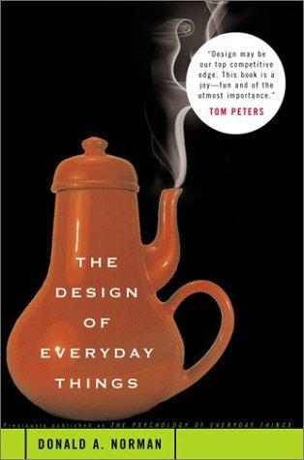
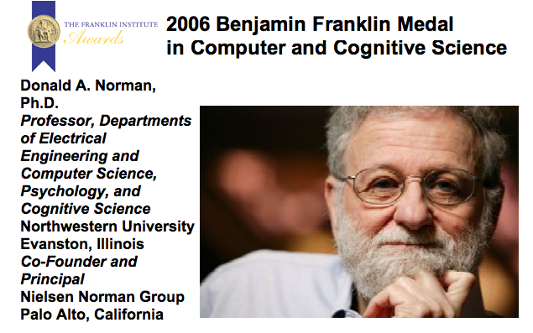
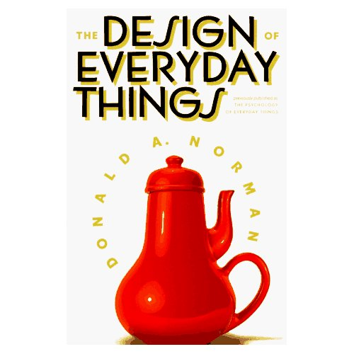
Design - not just software
Please see instructions on HW 9. You have some choice on what parts of this chapter to read.

Slide 126

Design guidelines
No magic numbers!
Keep constants together at top with meaningful names…
def test():
""" demonstrating images """
width = 200
height = 200
image = BitMap( width, height )
# a 2d loop over each pixel
for col in range(width):
for row in range(height):
if col == row:
image.plotPoint( col, row )
image.saveFile( "test.bmp" )
What! No magic??
self-documenting design

Slide 127
Design guidelines
Anticipate change
swapping arguments and hand-set values
def test(
""" demonstrating images """
width = 200
height = 200
image = BitMap( width, height )
# a 2d loop over each pixel
for col in range(width):
for row in range(height):
if col == row:
image.plotPoint( col, row )
image.saveFile( "test.bmp" )
default arguments

Slide 128
Design guidelines
Modularity: composing small pieces

Slide 129
Design guidelines
Modularity: composing small pieces
functions!

Slide 130
See you in lab!

Slide 131
Design

Slide 132
An iterative image
import bmp.py

Slide 133
“Quiz” Part 1
Write the code to print this
piece of “ASCII art” (with or
without the spaces)
$ # & # & # & #
& # & # & # & #
& # & # & # & #
& # & # & # & #

Slide 134
An iterative image
import bmp.py

Slide 135
Fix #1: use a type converter
meters = float(raw_input('How many m? '))
cm = meters * 100
print 'That is', cm, 'cm.'
check out my newly installed float converter!
1.0
100.0
The type of variable (box) matters!
name: meters type: float
name: cm
type: float
Notes:
Electric: from www.staticfreesoftware.com
My tutorial is at:
http://odin.ac.hmc.edu/~harris/class/chipdesign/electric.pdf
Lasergene (a molecular biology suite of programs for aligning and comparing
DNA sequences, etc.)
Statview (statistical analysis)
KaleidaGraph (plotting & graphing)
Populus (programs that simulate ecological and evolutionary processes)

Slide 136
Fix #2: use input()
# gets processed input from user
meters = input('How many m? ')
cm = meters * 100
print 'That is', cm, 'cm.'
I always use input -- but don't quote me on that.
Notes:
why not always use input
note that inputting strings is more difficult…

Slide 137
Fix #2: use input()
# gets processed input from user
meters = input('How many m? ')
cm = meters * 100
print 'That is', cm, 'cm.'
I always use input -- but don't quote me on that.
raw_input always returns input as a string!
input processes the input as if typed into Python
both allow you to specify a prompt string

Slide 138
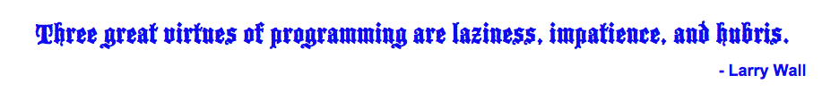
Procrastination Programming
Every while loop can be a while True: loop!
- just be sure to break!

Slide 139
Give me a break !
import random
escape = 0
while True:
print 'Help! Let me out!'
escape = random.choice([41,42,43])
if escape == 42:
break
print 'At last!'
I'll figure out later how to get out of this loop!
OK – I'll stop the loop now and continue with the code after the loop
compare return

Slide 140
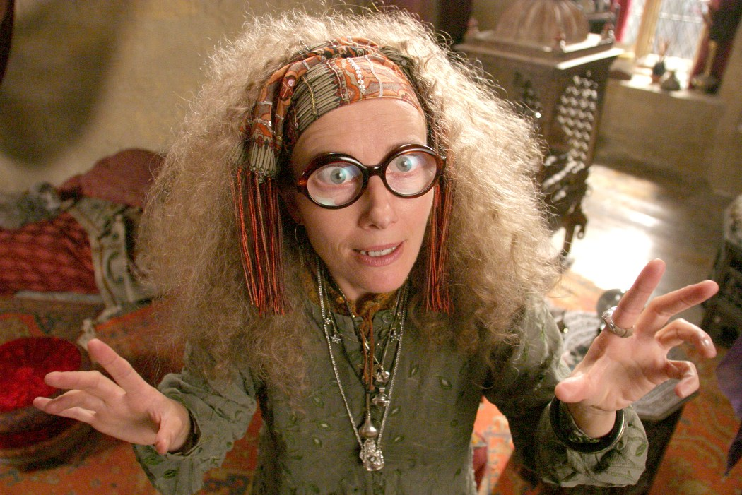
Seeing into the future…
def menu():
""" prints our menu of options """
print "(1) Input a list of numbers"
print "(2) Guess the next element"
print "(9) Quit"
def seer():
""" handles user input for our menu """
while True:
menu()
uc = input('Which option? ')
print 'The inner eye does not see upon command!'

Slide 141
Clearer Vision
def seer():
""" handles user input for our menu """
while True:
menu()
uc = input('Which option? ')
print 'The inner eye does not see upon command!'
if uc ==

Slide 142
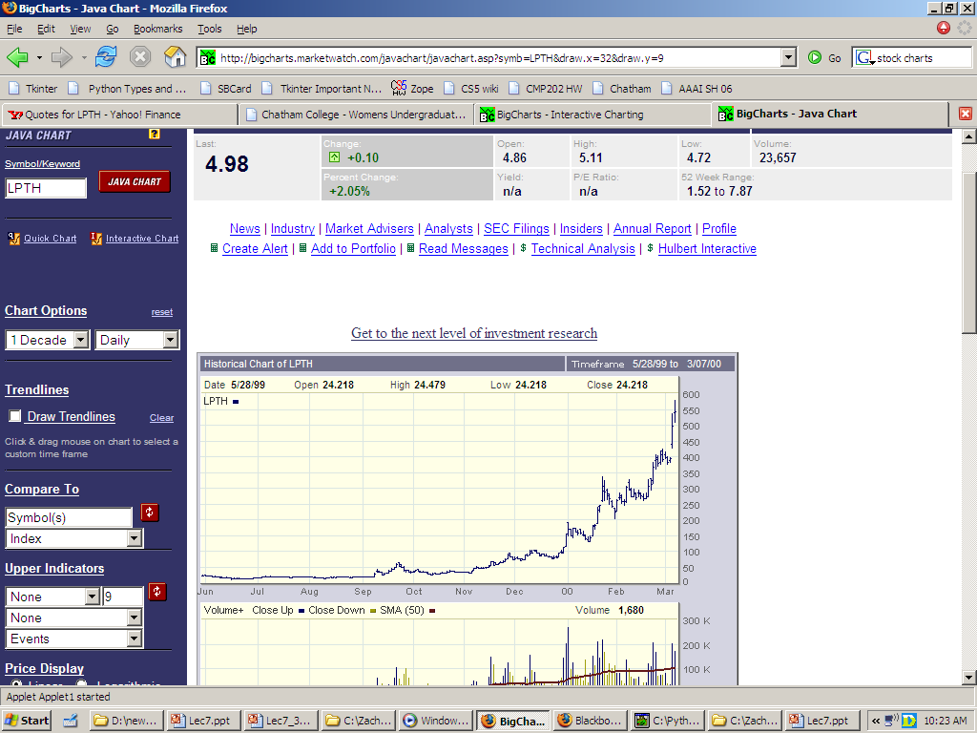
the gift…
LightPath, September 1999

Slide 143
watching the charts…
LightPath, six months later…

Slide 144
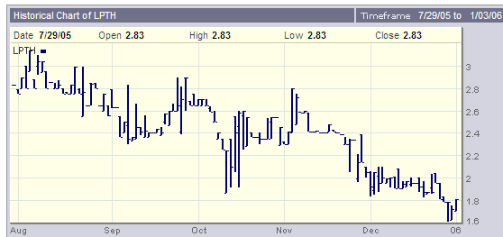
"brokerage" seems apt…
LightPath, now…

Slide 145
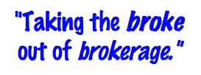
T. T. Securities (TTS)
Input stock prices for a number of days in a row, and then analyze that data… .

Slide 146
T. T. Securities (TTS)
Input stock prices for a number of days in a row, and then analyze that data… .
Menu
(0) Input a new list
(1) Print the current list
(2) Find the average price
(3) Find the standard deviation
(4) Find the min and its day
(5) Find the max and its day
(6) Your TTS investment plan
(9) Quit
Enter your choice:
Software

Slide 147
Functions
There are a number of formulas, but we will use this one:
functions
def average( L )
def stdev( L )
Menu
def mini( L )
(0) Input a new list
(1) Print the current list
(2) Find the average price
(3) Find the standard deviation
(4) Find the min and its day
(5) Find the max and its day
(6) Your TTS investment plan
(9) Quit
Enter your choice:
def maxi( L )

Slide 148
Standard Deviation
There are a number of formulas, but we will use this one:
functions
Menu
def stdev( L ):
(0) Input a new list
(1) Print the current list
(2) Find the average price
(3) Find the standard deviation
(4) Find the min and its day
(5) Find the max and its day
(6) Your TTS investment plan
(9) Quit
Enter your choice:
Σ
(L[i] - L_{av})²
i
len(L)

Slide 149
T. T. Securities (TTS)
Investment analysis for the 21st century…
Hardware
Menu
(0) Input a new list
(1) Print the current list
(2) Find the average price
(3) Find the standard deviation
(4) Find the min and its day
(5) Find the max and its day
(6) Your TTS investment plan
(9) Quit
Enter your choice:
Software

Slide 150
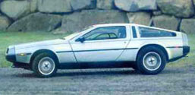
T. T. Securities (TTS)
Investment analysis for the 21st century…
Hardware
Menu
(0) Input a new list
(1) Print the current list
(2) Find the average price
(3) Find the standard deviation
(4) Find the min and its day
(5) Find the max and its day
(6) Your TTS investment plan
(9) Quit
Enter your choice:
Software

Slide 151
The TTS advantage!
Your stock's prices:
L = [ 40, 80, 10, 30, 27, 52, 5, 15 ]
The TTS investment strategy:
Day Price
0 40.0
1 80.0
2 10.0
3 30.0
4 27.0
5 52.0
6 5.0
7 15.0
but, you must sell after you buy.

Slide 152
"Quiz"
Return the min difference between one value from X and one value from Y.
Alter this code to return the index of L's minimum.
Example:
Example:
>>> mini( [9,8,1,7] )
2
>>> diff( [7,3],[0,6] )
1
What does this code print?
Only consider unsigned differences.
consider "accumulating" the minimum index in addition to the minimum value.
for x in range(3):
for y in range(3):
print x, y
X and Y will be lists of numbers
Hint: adapt this code
def mini( L ):
min = L[0]
for x in L:
if x < min:
min = x
return
def diff( X, Y ):
You may want to change the loop!

Slide 153
Alter this code to return the index of L's minimum.
Example:
>>> mini( [9,8,1,7] )
2
def mini( L ):
min = L[0]
for x in L:
if x < min:
min = x
return
def mini( L ):
min = L[0]
for :
if < min:
min =
return
SAME LOOP
INDEX-BASED LOOP
returning both??

Slide 154
What does this code print?
for x in range(3):
for y in range(3):
print x, y

Slide 155
for x in range(3):
for y in range(3):
print x, y
Example:
Hint: adapt this code
>>> diff( [7,3],[0,6] )
1
Return the minimum difference between one value from X and one value from Y.
def diff( X, Y ):
Only consider unsigned differences.
X and Y will be lists of numbers

Slide 156
Monte Carlo π
Hw8 Pr3
A engineering challenge: to estimate π using everyday items...

Slide 157
Easy as π
(1,1)
Visualize:
(-1,-1)

Slide 158
to inf. and beyond!
2d, 3d Loops
More efficient, but also more to keep track of with each additional dimension
definite iteration
indefinite iteration
while

Slide 159
Extra (!) funky series
Harmonic Sequence:
1/1 + 1/2 + 1/3 + 1/4 + 1/5 + 1/6 + …
Without composites (primes only):
1/1 + 1/2 + 1/3 + 1/4 + 1/5 + 1/6 + 1/7 +…
Without 9’s…
1/1 + 1/2 + … + 1/8 + 1/9 + … +1/18 + 1/19 + … + 1/88 + 1/89 + 1/90 + 1/91 + …
Diverges!
???
???
Notes:
The harmonic series diverges (slowly); it's in today's lab. The primes-only series also diverges. But the no-9's series doesn't diverge. Why? Because as you get to big numbers, almost everything contains a 9, so the terms become sparse!

Slide 160
Have a great weekend!

Slide 161
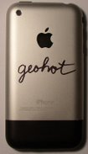
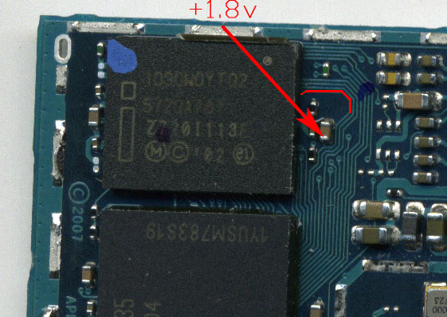

iPhone, geohot, and Von Neumann
George Hotz's iPhone
Before
After
In red: one memory-access bit
soldered to be +1.8v (1)

Slide 162
iPhone, geohot, and Von Neumann
When starting up, the phone checks 4 locations in memory to see if its software is already there. Only if it sees the software is NOT there, does the phone use software from general-purpose memory to start. Otherwise, it loads its software from read-only memory.
hex
binary
0xA0000030
0xA000A5A0
0xA0015C58
0xA0017370
10100000000000000000000000110000
10100000000000001010010110100000
10100000000000010101110001011000
10100000000000010111001101110000
George Hotz's iPhone
The 4 32-bit memory locations it checks are
1
There's not much you can do to change what is in those areas of read-only memory. Instead, the idea was to change one of the address lines to be high while it checked these four locations.
The memory locations it actually checks are thus
10100000000001000000000000110000
10100000000001001010010110100000
10100000000001010101110001011000
10100000000001010111001101110000
All of these locations are in a read/write (accessible) portion of the phone's memory -- so, they can be written to the "reset" signal. This reloads the phone's start-up software from read/write memory -- allowing arbitrary network access, not just AT&T.

Slide 163

iPhone, geohot, and Von Neumann
George Hotz's iPhone
the trade

Slide 164
“Quiz”
Finish these two methods…
This method returns the sum of the elements in the input array.
public static double sum(double[] A)
{
double s = 0.0;
for (
{
}
return s;
}
This method returns the average of the elements in the input array.
public static double average(double[] A)
“Extra Credit”: How concise can this method be?

Slide 165
This method returns the maximum element from the input array.
public static double max(double[] A)
Extra: What is something unusual and unrelated to CS 5 that you & the person next to you have in common ?!

Slide 166
Loopy thinking
0
1
2
3
4
5
6
7
8
9
10
11
12
13
14
15
16
17
18
s = 'gattacaaggtaaaatgca'
How could we find the number of 'a's ? How about 'a's and 't's?
How could we find the number of 'ta's ?
How could we find the longest sequence of 'a's ?
Notes:
ctg repeats…

Slide 167
Loopy thinking
0
1
2
3
4
5
6
7
8
9
10
11
12
13
14
15
16
17
18
s = 'gattacaaggtaaaatgca'
s = 'gattacaaggtaaaatgca'
N = 0
for i in range(0,len(s)):
if s[i] == 'a':
N = N + 1
print 'N is', N
How could we find the number of 'a's ? How about 'a's and 't's?
How could we find the number of 'ta's ?
How could we find the longest sequence of 'a's ?
Notes:
Electric: from www.staticfreesoftware.com
My tutorial is at:
http://odin.ac.hmc.edu/~harris/class/chipdesign/electric.pdf
Lasergene (a molecular biology suite of programs for aligning and comparing
DNA sequences, etc.)
Statview (statistical analysis)
KaleidaGraph (plotting & graphing)
Populus (programs that simulate ecological and evolutionary processes)

Slide 168
Loopy thinking
0
1
2
3
4
5
6
7
8
9
10
11
12
13
14
15
16
17
18
s = 'gattacaaggtaaaatgca'
s = 'gattacaaggtaaaatgca'
N = 0
for i in range(0,len(s)):
if s[i] == 'a' or s[i] == 't':
N = N + 1
print 'N is', N
How could we find the number of 'a's ? How about 'a's and 't's?
How could we find the number of 'ta's ?
How could we find the longest sequence of 'a's ?
Notes:
Electric: from www.staticfreesoftware.com
My tutorial is at:
http://odin.ac.hmc.edu/~harris/class/chipdesign/electric.pdf
Lasergene (a molecular biology suite of programs for aligning and comparing
DNA sequences, etc.)
Statview (statistical analysis)
KaleidaGraph (plotting & graphing)
Populus (programs that simulate ecological and evolutionary processes)

Slide 169
Loopy thinking
0
1
2
3
4
5
6
7
8
9
10
11
12
13
14
15
16
17
18
s = 'gattacaaggtaaaatgca'
s = 'gattacaaggtaaaatgca'
N = 0
for i in range(1,len(s)):
if s[i] == 'a' and s[i-1] == 't':
N = N + 1
print 'N is', N
How could we find the number of 'a's ? How about 'a's and 't's?
How could we find the number of 'ta's ?
How could we find the longest sequence of 'a's ?
Notes:
Electric: from www.staticfreesoftware.com
My tutorial is at:
http://odin.ac.hmc.edu/~harris/class/chipdesign/electric.pdf
Lasergene (a molecular biology suite of programs for aligning and comparing
DNA sequences, etc.)
Statview (statistical analysis)
KaleidaGraph (plotting & graphing)
Populus (programs that simulate ecological and evolutionary processes)

Slide 170
Loopy thinking
0
1
2
3
4
5
6
7
8
9
10
11
12
13
14
15
16
17
18
s = 'gattacaaggtaaaatgca'
How could we find the longest sequence of 'a's ?
Notes:
Electric: from www.staticfreesoftware.com
My tutorial is at:
http://odin.ac.hmc.edu/~harris/class/chipdesign/electric.pdf
Lasergene (a molecular biology suite of programs for aligning and comparing
DNA sequences, etc.)
Statview (statistical analysis)
KaleidaGraph (plotting & graphing)
Populus (programs that simulate ecological and evolutionary processes)

Slide 171
Planning in "pseudocode"
0
1
2
3
4
5
6
7
8
9
10
11
12
13
14
15
16
17
18
s = 'gattacaaggtaaaatgca'
Keep track of CurRun, MaxRun
Loop through the string:
if we do see an 'a'
if the PREVIOUS letter is NOT an 'a'
if the PREVIOUS letter IS an 'a'
Notes:
Electric: from www.staticfreesoftware.com
My tutorial is at:
http://odin.ac.hmc.edu/~harris/class/chipdesign/electric.pdf
Lasergene (a molecular biology suite of programs for aligning and comparing
DNA sequences, etc.)
Statview (statistical analysis)
KaleidaGraph (plotting & graphing)
Populus (programs that simulate ecological and evolutionary processes)

Slide 172
Planning in "pseudocode"
0
1
2
3
4
5
6
7
8
9
10
11
12
13
14
15
16
17
18
s = 'gattacaaggtaaaatgca'
Keep track of CurRun, MaxRun
Loop through the string:
if we do see an 'a'
if the PREVIOUS letter is NOT an 'a'
Start a Run! CurRun = 1
if the PREVIOUS letter IS an 'a'
Continue our run! CurRun = CurRun + 1
Check for a new maximum…
Notes:
Electric: from www.staticfreesoftware.com
My tutorial is at:
http://odin.ac.hmc.edu/~harris/class/chipdesign/electric.pdf
Lasergene (a molecular biology suite of programs for aligning and comparing
DNA sequences, etc.)
Statview (statistical analysis)
KaleidaGraph (plotting & graphing)
Populus (programs that simulate ecological and evolutionary processes)

Slide 173
Planning in "pseudocode"
0
1
2
3
4
5
6
7
8
9
10
11
12
13
14
15
16
17
18
s = 'gattacaaggtaaaatgca'
Keep track of CurRun, MaxRun
MAX = 0
cur = 0
for i in range(0,len(s)):
if s[i] == 'a':
if s[i-1] != 'a':
cur = 1
else:
cur = cur + 1
if cur > MAX:
MAX = cur
print 'Max is', MAX
Loop through the string:
if we do see an 'a'
if the PREVIOUS letter is NOT an 'a'
Start a Run!
if the PREVIOUS letter IS an 'a'
Continue our run!
Check for a new maximum…
Notes:
Electric: from www.staticfreesoftware.com
My tutorial is at:
http://odin.ac.hmc.edu/~harris/class/chipdesign/electric.pdf
Lasergene (a molecular biology suite of programs for aligning and comparing
DNA sequences, etc.)
Statview (statistical analysis)
KaleidaGraph (plotting & graphing)
Populus (programs that simulate ecological and evolutionary processes)

Slide 174
Challenge
Print the first N numbers in this series…
>>> fib(11)
Example:
1 1 2 3 5 8 13 21 34 55 89

Slide 175
Illustration of
scale( pix, pixMax, floatMin, floatMax )
Image
pixel column range
0
pix
pixMax
real range
floatMin
output of scale
floatMax

Slide 176
input vs. raw_input
reply = raw_input('Enter a string and I\'ll tell you what I see.')
for c in reply:
print 'I see a(n) ', c
interprets what the user types as a string of characters
reply = input('Enter any list and I\'ll tell you what I see.')
for c in reply:
print 'I see a(n) ', c
processes what the user types just as python would

Slide 177

ASCII Art
Print 3 rows
for row in range(3):
print '#'*4
print automatically
adds a newline
Creates line to print
####
####
####
Output

Slide 178
A closer look…
for row in range(3):
print '$'*4
$$$$
$$$$
$$$$
Output

Slide 179
No string * !
for row in range(3):
print '$'*4
$$$$
$$$$
$$$$
For these problems, string multiplication is not allowed.
Output
What else could be done?

Slide 180
Without string multiplication…
Print 3 rows
for row in range(3):
for col in range(4):
print '$'
nested loops!
print 4 chars on each line
(columns)
Output ?

Slide 181
Without string multiplication…
Print 3 rows
for row in range(3):
for col in range(4):
print '$',
nested loops!
print 4 chars on each line
(columns)
Comma suppresses newline
Output ?

Slide 182
Without string multiplication…
Print 3 rows
for row in range(3):
for col in range(4):
print '$',
print
nested loops!
print 4 chars on each line
(columns)
$ $ $ $
$ $ $ $
$ $ $ $
Comma suppresses newline
plain print produces newline
tracking cols and rows!

Slide 183
Variations!
def rectangle( width, height ):
""" prints a rectangle of $ """
for row in range( ):
for col in range( ):
print '$',
print

Slide 184
Beyond boxes…
cols
2
3
4
1
5
0
rows
0
0 1
0 1 2
0 1 2 3
0 1 2 3 4
0 1 2 3 4 5
0
What code will print this triangle with H rows… ?
1
2
3
4
def tri( H ):
5
for row in range(H):
for col in range( ):
print col,
print

Slide 185
Python and images: Natural nesting!
from cs5png import *
image = PNGImage( 30, 20 )
creates an image object
inputs are width and height
and names it image

Slide 186
Python and images: Natural nesting!
from cs5png import *
image = PNGImage( 30, 20 )
creates an image object
inputs are width and height
and names it image
I guess these images are objectionable!
objects are software abstractions containing structured information

