Slide 1
CS 5: Putting Loops to Work
[ -35, -24, -13, -2, 9, 20, 31, ? ]
[ 26250, 5250, 1050, 210, ? ]
[ 1, 11, 21, 1211, 111221, ? ]
[ 2, 22, 222, ? ]
[ 90123241791111 , 93551622, 121074, 3111, ? ]
What's next?
Homework 8: due Mon., 11/4 by midnight
Exam review: on the CS 5 homepage
Final exam: 12/16 or 12/18 at 2pm
LAC hours: Friday 2-4; tutoring also...
I'm glad you asked!

Slide 2
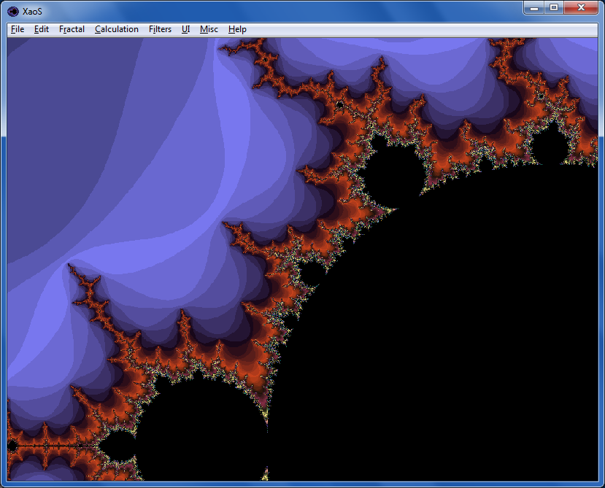
Fractals…
XaoS
fractal explorer
Python vs. C
Madi
Nova program on fractals:
Max

Slide 3
Loops
Basic design strategies
Recursion

Slide 4
def fac( N ):
result = 1
for x in range(1,N+1):
result *= x
return result
Loops
Which is more "reasonable"?
def fac( N ):
if N == 1:
return 1
else:
return N*fac(N-1)
Recursion

Slide 5
def fac( N ):
result = 1
for x in range(1,N+1):
result *= x
return result
Loops
Design strategy: look for repetition + describe it… .
Basic design strategies
Design strategy: look for self-similarity + describe it… .
def fac( N ):
if N == 1:
return 1
else:
return N*fac(N-1)
Recursion

Slide 6
for: two types
L = [3, 15, 17, 7]
x
for x in L:
print x
element-based loops

Slide 7
for: two types
L[0]
L[1]
L[2]
L[3]
L = [3, 15, 17, 7]
0
1
2
3
i
for i in range(len(L))
print L[i]
index-based loops
for x in L:
print x
element-based loops

Slide 8
elements vs. indices
L = [3, 15, 17, 7]
x
def sum(L):
total = 0
for x in L:
total += x
return total
element-based loops

Slide 9
elements vs. indices
L = [3, 15, 17, 7]
0
1
2
3
i
def sum(L):
total = 0
for x in L:
total += x
return total
def sum(L):
total = 0
for i in range(len(L))
total += L[i]
return total
element-based loops
index-based loops

Slide 10
hw8pr3: T. T. Securities (TTS)
Analyzes a sequence of stock prices
day
0
day
1
day
2
day
3
day
4
day
5
day
6
day
7
L = [ 40, 80, 10, 30, 27, 52, 5, 15 ]
(0) Input a new list
(1) Print the current list
(2) Find the average price
(3) Find the standard deviation
(4) Find the min and its day
(5) Find the max and its day
(6) Your TTS investment plan
(9) Quit
Enter your choice:
The menu to implement:

Slide 11
User input
meters = raw_input('How many m? ')
cm = meters * 100
print 'That is', cm, 'cm.'
What will Python think?
I think I like these units better than light years per year!

Slide 12
User input
meters = raw_input('How many m? ')
cm = meters * 100
print 'That is', cm, 'cm.'
raw_input ALWAYS returns a string – no matter what has been typed!
What will Python think?
I think I like these units better than light years per year!

Slide 13
Fix #1: convert to the right type
meters_str = raw_input('How many m? ')
meters = float( meters_str )
cm = meters * 100
print 'That is', cm, 'cm.'
'42'
42.0
4200.0
name: meters_str type: string
name: meters type: float
name: cm
type: float
Notes:
Electric: from www.staticfreesoftware.com
My tutorial is at:
http://odin.ac.hmc.edu/~harris/class/chipdesign/electric.pdf
Lasergene (a molecular biology suite of programs for aligning and comparing
DNA sequences, etc.)
Statview (statistical analysis)
KaleidaGraph (plotting & graphing)
Populus (programs that simulate ecological and evolutionary processes)

Slide 14
Fix #2: use input
meters = input('How many m? ')
cm = meters * 100
print 'That is', cm, 'cm.'
input interprets its input
raw_input always returns a string
I always use input -- but don't "quote" me on that.

Slide 15
A larger application
def menu():
""" prints our menu of options """
print "(1) Input a new list of numbers"
print "(2) I will divine the next element"
print "(9) Quit"
def main():
""" handles user input for our menu """
while True:
menu()
uc = input('Which option? ')
Calls a helper function
Perhaps uc the reason for this?

Slide 16
def main():
""" handles user input for our menu """
L = [2,22,222,2222] # a starting list
while True:
menu() # print menu
uc = input('Which option? ')
if uc == 9:
elif uc == 1:
elif uc == 2:
(9) Quit!
(1) Get new list
(2) other…

Slide 17
def main():
""" handles user input for our menu """
L = [2,22,222,2222] # a starting list
while True:
menu() # print menu
uc = input('Which option? ')
if uc == 9:
elif uc == 1:
elif uc == 2:
break exits the loop
(9) Quit!
use input to get a new L
(1) Get new list
(2) other…
other functions, as needed

Slide 18
Functions you'll write
All use loops…
Menu
def average( L )
def stdev( L )
(0) Input a new list
(1) Print the current list
(2) Find the average price
(3) Find the standard deviation
(4) Find the min and its day
(5) Find the max and its day
(6) Your TTS investment plan
(9) Quit
Enter your choice:
Σ
(L[i] - L_{av})²
i
len(L)
def minday( L )
def maxday( L )

Slide 19
Min price
Just call min ?
What's the idea for finding the smallest (minimum) price?
day
0
day
1
day
2
day
3
day
4
day
5
day
6
day
7
L = [ 40, 80, 10, 30, 27, 52, 5, 15 ]
m =
m is the "min so far"
track the value of the minimum so far as you loop over L

Slide 20
Min price vs. min day
Just call min ??
day
0
day
1
day
2
day
3
day
4
day
5
day
6
day
7
L = [ 40, 80, 10, 30, 27, 52, 5, 15 ]
m = 40
m = 10
m = 5
5 is returned
def minprice( L ):
m = L[0]
for x in L:
if x < m:
m = x
return m
What about the day of the minimum price?

Slide 21
Mid-term feedback…
Don't put your name
I would love to know any thoughts you have about CS5 thus far in the term. In particular, how you feel about the time and effort CS5 requires…
On average, how much time per week do you spend on CS5 outside class + lab?
How does CS5's workload compare to other classes you're taking this term?
How would you judge the pace of CS5?
much lighter
about the same
much heavier
much too slow
about right
much too fast
Circle your year: First-year Sophomore Junior Senior Other
Something you'd keep about CS5 …?
Something you'd change about / get rid of / add to CS5 …?
To start
Other thoughts optional, but 142% welcome:

Slide 22
Alter this code to return the index of L's minimum.
What does this code print?
Write diff to return the smallest abs. diff. between any value from L and any value from R.
L
for x in range(3):
for y in range(3):
print x, y
L
R
>>> minday( [9, 8, 5, 7, 42] )
2
0
1
2
3
4
index
>>> diff( [42,3,7] , [6,0,-5] )
1
Only consider absolute differences.
def minday( L ):
m = L[0]
mndy = 0 # minday!
for x in L:
if x < m:
m = x
return mndy
L and R will be lists of numbers.
Hint: Adapt the nested loops at left!
def diff( L, R ):
You might change this loop, but it's up to you…
Quiz, p.2
Hint: keep track of the min AND the day of the min (mndy)

Slide 23
Mid-term feedback …
Don't put your name
I would love to know any thoughts you have about CS5 thus far in the term. In particular, how you feel about the time and effort CS5 requires…
On average, how much time per week do you spend on CS5 outside class + lab?
How does CS5's workload compare to other classes you're taking this term?
How would you judge the pace of CS5?
much lighter
about the same
much heavier
much too slow
about right
much too fast
Circle your year: First-year Sophomore Junior Senior Other
Something you'd keep about CS5 …?
Something you'd change about / get rid of / add to CS5 …?
Other thoughts optional, but 142% welcome:

Slide 24
L
minday
return the index of L's minimum.
>>> minday( [9, 8, 5, 7, 42] )
2
0
1
2
3
4
index
def minday( L ):
m = L[0]
mndy = 0
day = 0
for x in L:
if x < m:
m = x
mndy = day
day += 1
return mndy
Create a "counter" that will keep track of the current day.
IF we find a smaller min, save which day it was in mndy
Regardless, we add 1 to day so that we're keeping track!
element-based loop

Slide 25
L
minday
return the index of L's minimum.
>>> minday( [9, 8, 5, 7, 42] )
2
0
1
2
3
4
index
def minday( L ):
m = L[0]
mndy = 0
for :
if < m:
m =
return mndy
How do we loop through the INDEX of each element?
How do we ensure m keeps track of the minimum?
How and where should we update mndy?
index-based loop

Slide 26
What does this code print?
x
y
0 0
0 1
0 2
1 0
1 1
1 2
2 0
2 1
2 2
for x in range(3):
for y in range(3):
print x, y

Slide 27
L
R
Write diff to return the smallest abs. diff. between any value from L and any value from R.
>>> diff( [42,3,7] , [6,0,-5] )
1
Only consider absolute differences.
L and R will be lists of numbers.
Hint: Adapt the nested loops below!
def diff( L, R ):
for x in range(3):
for y in range(3):
print x, y
Aha! Track the value of the minimum so far as you loop over L and R…

Slide 28
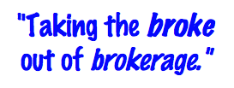
T. T. Securities
(0) Input a new list
(1) Print the current list
(2) Find the average price
(3) Find the standard deviation
(4) Find the min and its day
(5) Find the max and its day
(6) Your TTS investment plan
(9) Quit
Enter your choice:
Software side …
Hardware side…
Investment analysis for the 21st century … and beyond!

Slide 29
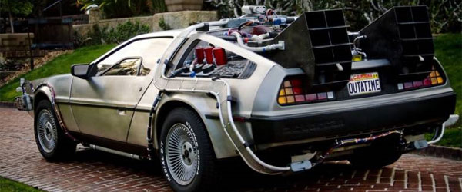
T. T. Securities
(0) Input a new list
(1) Print the current list
(2) Find the average price
(3) Find the standard deviation
(4) Find the min and its day
(5) Find the max and its day
(6) Your TTS investment plan
(9) Quit
Enter your choice:
Software side …
Hardware side…
Investment analysis for the 21st century … and beyond!

Slide 30
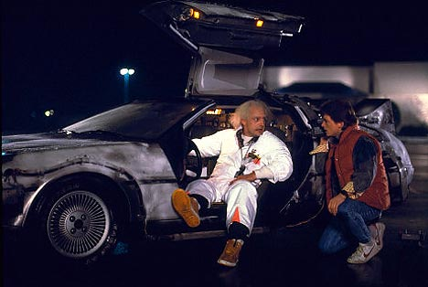
T. T. Securities
(0) Input a new list
(1) Print the current list
(2) Find the average price
(3) Find the standard deviation
(4) Find the min and its day
(5) Find the max and its day
(6) Your TTS investment plan
(9) Quit
Enter your choice:
Back to the future
Software side …
Hardware side…
Investment analysis for the 21st century … and beyond!

Slide 31
The TTS advantage!
L = [ 40, 80, 10, 30, 27, 52, 5, 15 ]
Your stock's prices:
What is the best TTS investment strategy here?
Day Price
0 40.0
1 80.0
2 10.0
3 30.0
4 27.0
5 52.0
6 5.0
7 15.0
To be realistic, however (for our VC backers and the SEC), you may only sell after you buy.

Slide 32
The read it and weep sequence
1
11
21
1211
111221
312211
??
str vs. int
When does the first 4 appear?
How fast do these terms grow?
Notes:
Next is: 13112221

Slide 33
Growth determined empirically…
1
11
21
1211
111221
312211
13112221
In the limit, the length of the Nth term of the read-it-and-weep sequence is
(1.303577...)
exponential growth
N
this base was found computationally by taking repeated ratios of term lengths...
Notes:
Next is: 13112221

Slide 34
Growth determined analytically…
λ = 1.30357726034296…
"Conway’s Constant" has an analytic definition!
It is the largest real root of this 71st-degree polynomial !!
the 71 roots (in the complex plane)
Notes:
Next is: 13112221

Slide 35
Have a great weekend!

Slide 36
Halloween == pop-tarts!

Slide 37
T. T. Securities (TTS)
Analyze a list of stock prices (given for a # of days in a row)
What's the idea for finding the smallest (minimum) price?
day
0
day
1
day
2
day
3
day
4
day
5
day
6
day
7
L = [ 40, 80, 10, 30, 27, 52, 5, 15 ]
m =
m is the "min so far"
track the value of the minimum so far as you loop over L

Slide 38
Just call min ?
Min price vs. min day
day
0
day
1
day
2
day
3
day
4
day
5
day
6
day
7
L = [ 40, 80, 10, 30, 27, 52, 5, 15 ]
def minprice( L ):
m = L[0]
for x in L:
if x < m:
m = x
return m
What about the day of the minimum price?

Slide 39
Quiz
Return the smallest difference between one value from L and one value from R.
Alter this code to return the index of L's minimum.
Example:
L
Example:
L
R
>>> minday( [9,8,5,7,42] )
2
>>> diff( [7,3],[0,6] )
1
What does this code print?
HINT: track the day of the min in addition to the min value itself.
Only consider absolute differences.
for x in range(0,4):
for y in range(x,4):
print x, y
L and M will be lists of numbers
Hint: adapt the code at left...
def minday( L ):
m = L[0]
dom = 0 # day of min
for x in L:
if x < m:
m = x
return dom
def diff( L, R ):
You may want to change this loop!

Slide 40
>>> minday( [9,8,5,7,42] )
2
minday
def minday( L ):
m = L[0]
dom = 0
for x in L:
if x < m:
m = x
return dom
def minday( L ):
m = L[0]
dom = 0
for :
if < m:
m =
return dom
element-based loop
index-based loop

Slide 41
What does this code print?
for x in range(0,4):
for y in range(x,4):
print x, y

Slide 42
for x in range(0,4):
for y in range(x,4):
print x, y
Example:
L
R
Hint: adapt this code
>>> diff( [7,3],[0,6] )
1
Return the minimum difference between one value from L and one value from M.
def diff( L, R ):
Only consider absolute differences.
L and M will be lists of numbers
SAME IDEA: track the value of the minimum so far as you loop over L

Slide 43
The TTS advantage!
Your stock's prices:
L = [ 40, 80, 10, 30, 27, 52, 5, 15 ]
The TTS investment strategy:
Day Price
0 40.0
1 80.0
2 10.0
3 30.0
4 27.0
5 52.0
6 5.0
7 15.0
to be realistic (for our VC backers), you must sell after you buy.

Slide 44
Have a great fall weekend!
extra_hour in [sleep,work,fun]:
True

Slide 45
Mid-term feedback …
Don't put your name
I would love to know any thoughts you have about CS5 thus far in the term. In particular, how you feel about the time and effort CS5 requires…
On average, how much time per week do you spend on CS5 outside class + lab?
How does CS5's workload compare to other classes you're taking this term?
How would you judge the pace of CS5?
much lighter
about the same
much heavier
much too slow
about right
much too fast
Circle your year: First-year Sophomore Junior Senior Other
Later on today…
Something you'd keep about CS5 …?
Something you'd change about / get rid of / add to CS5 …?
Other thoughts optional, but 142% welcome:

Slide 46
feedback feedback
see 2012 feedback for a guide
Notes:
Next is: 13112221

Slide 47
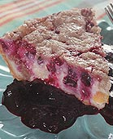
Homework 8
#2
Pi from Pie!
TT Securities Analysis, Inc.
#3
User-interaction
List-handling
Both for and while loops…
ASCII Art (extra)
#4

Slide 48
Extra (!) funky series
Harmonic Sequence:
1/1 + 1/2 + 1/3 + 1/4 + 1/5 + 1/6 + …
Without composites (primes only):
1/1 + 1/2 + 1/3 + 1/4 + 1/5 + 1/6 + 1/7 +…
Without 9’s…
1/1 + 1/2 + … + 1/8 + 1/9 + … +1/18 + 1/19 + … + 1/88 + 1/89 + 1/90 + 1/91 + …
Diverges!
???
???
Notes:
The harmonic series diverges (slowly); it's in today's lab. The primes-only series also diverges. But the no-9's series doesn't diverge. Why? Because as you get to big numbers, almost everything contains a 9, so the terms become sparse!

Slide 49
Quiz
Return the min difference between one value from X and one value from Y.
Alter this code to return the index of L's minimum.
Example:
Example:
>>> minday( [9,8,5,42] )
2
What does this code print?
>>> diff( [7,3],[0,6] )
1
HINT: track the index of the min in addition to the min value itself.
Only consider absolute differences.
for x in range(3):
for y in range(3):
print x, y
X and Y will be lists of numbers
Hint: adapt this code
def minday( L ):
min = L[0]
for x in L:
if x < min:
min = x
return
def diff( X, Y ):
You may want to change the loop!

Slide 50
Alter this code to return the index of L's minimum.
Example:
>>> mini( [9,8,1,7] )
2
def mini( L ):
min = L[0]
for x in L:
if x < min:
min = x
return
def mini( L ):
min = L[0]
for :
if < min:
min =
return
SAME LOOP
INDEX-BASED LOOP
returning both??

Slide 51
What does this code print?
for x in range(3):
for y in range(3):
print x, y

Slide 52
for x in range(3):
for y in range(3):
print x, y
Example:
Hint: adapt this code
>>> diff( [7,3],[0,6] )
1
Return the minimum difference between one value from X and one value from Y.
def diff( X, Y ):
Only consider absolute differences.
X and Y will be lists of numbers

Slide 53
“Quiz”
Finish these two methods…
This method returns the sum of the elements in the input array.
public static double sum(double[] A)
{
double s = 0.0;
for (
{
}
return s;
}
This method returns the average of the elements in the input array.
public static double average(double[] A)
“Extra Credit”: How concise can this method be?

Slide 54
Procrastination Programming
Every while loop can be a while True: loop!
- just be sure to break!

Slide 55
Give me a break !
import random
escape = 0
while True:
print 'Help! Let me out!'
escape = random.choice([41,42,43])
if escape == 42:
break
print 'At last!'
I'll figure out later how to get out of this loop!
OK – I'll stop the loop now and continue with the code after the loop
compare return

Slide 56
This method returns the maximum element from the input array.
public static double max(double[] A)
Extra: What is something unusual and unrelated to CS 5 that you & the person next to you have in common ?!

Slide 57
Loopy thinking
0
1
2
3
4
5
6
7
8
9
10
11
12
13
14
15
16
17
18
s = 'gattacaaggtaaaatgca'
How could we find the number of 'a's ? How about 'a's and 't's?
How could we find the number of 'ta's ?
How could we find the longest sequence of 'a's ?
Notes:
ctg repeats…

Slide 58
Loopy thinking
0
1
2
3
4
5
6
7
8
9
10
11
12
13
14
15
16
17
18
s = 'gattacaaggtaaaatgca'
s = 'gattacaaggtaaaatgca'
N = 0
for i in range(0,len(s)):
if s[i] == 'a':
N = N + 1
print 'N is', N
How could we find the number of 'a's ? How about 'a's and 't's?
How could we find the number of 'ta's ?
How could we find the longest sequence of 'a's ?
Notes:
Electric: from www.staticfreesoftware.com
My tutorial is at:
http://odin.ac.hmc.edu/~harris/class/chipdesign/electric.pdf
Lasergene (a molecular biology suite of programs for aligning and comparing
DNA sequences, etc.)
Statview (statistical analysis)
KaleidaGraph (plotting & graphing)
Populus (programs that simulate ecological and evolutionary processes)

Slide 59
Loopy thinking
0
1
2
3
4
5
6
7
8
9
10
11
12
13
14
15
16
17
18
s = 'gattacaaggtaaaatgca'
s = 'gattacaaggtaaaatgca'
N = 0
for i in range(0,len(s)):
if s[i] == 'a' or s[i] == 't':
N = N + 1
print 'N is', N
How could we find the number of 'a's ? How about 'a's and 't's?
How could we find the number of 'ta's ?
How could we find the longest sequence of 'a's ?
Notes:
Electric: from www.staticfreesoftware.com
My tutorial is at:
http://odin.ac.hmc.edu/~harris/class/chipdesign/electric.pdf
Lasergene (a molecular biology suite of programs for aligning and comparing
DNA sequences, etc.)
Statview (statistical analysis)
KaleidaGraph (plotting & graphing)
Populus (programs that simulate ecological and evolutionary processes)

Slide 60
Loopy thinking
0
1
2
3
4
5
6
7
8
9
10
11
12
13
14
15
16
17
18
s = 'gattacaaggtaaaatgca'
s = 'gattacaaggtaaaatgca'
N = 0
for i in range(1,len(s)):
if s[i] == 'a' and s[i-1] == 't':
N = N + 1
print 'N is', N
How could we find the number of 'a's ? How about 'a's and 't's?
How could we find the number of 'ta's ?
How could we find the longest sequence of 'a's ?
Notes:
Electric: from www.staticfreesoftware.com
My tutorial is at:
http://odin.ac.hmc.edu/~harris/class/chipdesign/electric.pdf
Lasergene (a molecular biology suite of programs for aligning and comparing
DNA sequences, etc.)
Statview (statistical analysis)
KaleidaGraph (plotting & graphing)
Populus (programs that simulate ecological and evolutionary processes)

Slide 61
Loopy thinking
0
1
2
3
4
5
6
7
8
9
10
11
12
13
14
15
16
17
18
s = 'gattacaaggtaaaatgca'
How could we find the longest sequence of 'a's ?
Notes:
Electric: from www.staticfreesoftware.com
My tutorial is at:
http://odin.ac.hmc.edu/~harris/class/chipdesign/electric.pdf
Lasergene (a molecular biology suite of programs for aligning and comparing
DNA sequences, etc.)
Statview (statistical analysis)
KaleidaGraph (plotting & graphing)
Populus (programs that simulate ecological and evolutionary processes)

Slide 62
Planning in "pseudocode"
0
1
2
3
4
5
6
7
8
9
10
11
12
13
14
15
16
17
18
s = 'gattacaaggtaaaatgca'
Keep track of CurRun, MaxRun
Loop through the string:
if we do see an 'a'
if the PREVIOUS letter is NOT an 'a'
if the PREVIOUS letter IS an 'a'
Notes:
Electric: from www.staticfreesoftware.com
My tutorial is at:
http://odin.ac.hmc.edu/~harris/class/chipdesign/electric.pdf
Lasergene (a molecular biology suite of programs for aligning and comparing
DNA sequences, etc.)
Statview (statistical analysis)
KaleidaGraph (plotting & graphing)
Populus (programs that simulate ecological and evolutionary processes)

Slide 63
Planning in "pseudocode"
0
1
2
3
4
5
6
7
8
9
10
11
12
13
14
15
16
17
18
s = 'gattacaaggtaaaatgca'
Keep track of CurRun, MaxRun
Loop through the string:
if we do see an 'a'
if the PREVIOUS letter is NOT an 'a'
Start a Run! CurRun = 1
if the PREVIOUS letter IS an 'a'
Continue our run! CurRun = CurRun + 1
Check for a new maximum…
Notes:
Electric: from www.staticfreesoftware.com
My tutorial is at:
http://odin.ac.hmc.edu/~harris/class/chipdesign/electric.pdf
Lasergene (a molecular biology suite of programs for aligning and comparing
DNA sequences, etc.)
Statview (statistical analysis)
KaleidaGraph (plotting & graphing)
Populus (programs that simulate ecological and evolutionary processes)

Slide 64
Planning in "pseudocode"
0
1
2
3
4
5
6
7
8
9
10
11
12
13
14
15
16
17
18
s = 'gattacaaggtaaaatgca'
Keep track of CurRun, MaxRun
MAX = 0
cur = 0
for i in range(0,len(s)):
if s[i] == 'a':
if s[i-1] != 'a':
cur = 1
else:
cur = cur + 1
if cur > MAX:
MAX = cur
print 'Max is', MAX
Loop through the string:
if we do see an 'a'
if the PREVIOUS letter is NOT an 'a'
Start a Run!
if the PREVIOUS letter IS an 'a'
Continue our run!
Check for a new maximum…
Notes:
Electric: from www.staticfreesoftware.com
My tutorial is at:
http://odin.ac.hmc.edu/~harris/class/chipdesign/electric.pdf
Lasergene (a molecular biology suite of programs for aligning and comparing
DNA sequences, etc.)
Statview (statistical analysis)
KaleidaGraph (plotting & graphing)
Populus (programs that simulate ecological and evolutionary processes)

Slide 65
Challenge
Print the first N numbers in this series…
>>> fib(11)
Example:
1 1 2 3 5 8 13 21 34 55 89

Slide 66
Write an index-based loop to print the first N terms of
Write any loop to print the first N terms of
N terms total
N terms total
7 9 11 13 15 17 …
0 1 2 3 6 7 14 15 30
def seven(N):
for i in range(N):
feel free to add an accumulator, if you'd like!
Quiz, part 2

Slide 67
Looping inside loops!

Slide 68
input vs. raw_input
reply = raw_input('Enter a string and I\'ll tell you what I see.')
for c in reply:
print 'I see a(n) ', c
interprets what the user types as a string of characters
reply = input('Enter any list and I\'ll tell you what I see.')
for c in reply:
print 'I see a(n) ', c
processes what the user types just as python would

Slide 69
Monte Carlo π
Hw8 Pr3
A engineering challenge: to estimate π using everyday items...

Slide 70
Easy as π
(1,1)
Visualize:
(-1,-1)

Slide 71
CS 5: Putting Loops to Work
A
[ -35, -24, -13, -2, 9, 20, 31, ? ]
B
[ 26250, 5250, 1050, 210, ? ]
C
[ 1, 11, 21, 1211, 111221, ? ]
D
[ 2, 22, 222, ? ]
E
[ 90123241791111 , 93551622, 121074, 3111, ? ]
Which ? is unlike the others?

Slide 72
CS 5: Putting Loops to Work
A
[ -35, -24, -13, -2, 9, 20, 31, ? ]
B
[ 26250, 5250, 1050, 210, ? ]
C
[ 1, 11, 21, 1211, 111221, ? ]
D
[ 2, 22, 222, ? ]
E
[ 90123241791111 , 93551622, 121074, 3111, ? ]
Which sequences act numeric -- and which ones act like strings ?

Slide 73
User Input
meters = raw_input('How many m? ')
cm = meters * 100
print 'That is', cm, 'cm.'
If we type 42, what will python print for this # of cm ?
A
D
something < 0
something > 42
B
C
E
0
42
an error

