Slide 1

CS 5: Putting Loops to Work
[ -35, -24, -13, -2, 9, 20, 31, ? ]
[ 26250, 5250, 1050, 210, ? ]
[ 90123241791111 , 93551622, 121074, 3111, ? ]
[ 1, 11, 21, 1211, 111221, ? ]
Homework 8: due Mon., 11/3 by midnight
MTerm on Th. review on the CS 5 homepage
Final exam: Tuesday, 12/16 at 9am
No office hrs Mon. but lots of LAC tutoring...
What's next?
I'm glad you asked!

Slide 2
Next Thursday will be the CS 5 in-class midterm
Un-warnings:
class will meet with CS5 black on Tuesday, 11/4
accommodations? concerns? See me…
five problems, written
worth 1 hw assignment
score worries? Extra extra-credit in hw9 and beyond
Suggestions:
only 5 minutes? Try list comprehensions & LoL!
go over in-class exercises and hwk problems
create a page of notes, 2-sided is OK
consider small variations of the problems – and how they would change the solutions…
that's our approach…

Slide 3

Pop tarts > candy
Official CS5 snack inequality

Slide 4
Pop tarts > candy
Official CS5 snack inequality

Slide 5
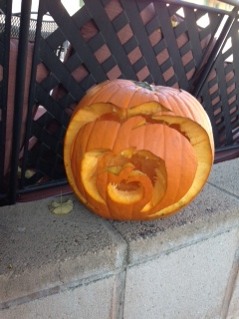
Halloween Recursion!

Slide 6

Happy Oct 31!

Slide 7
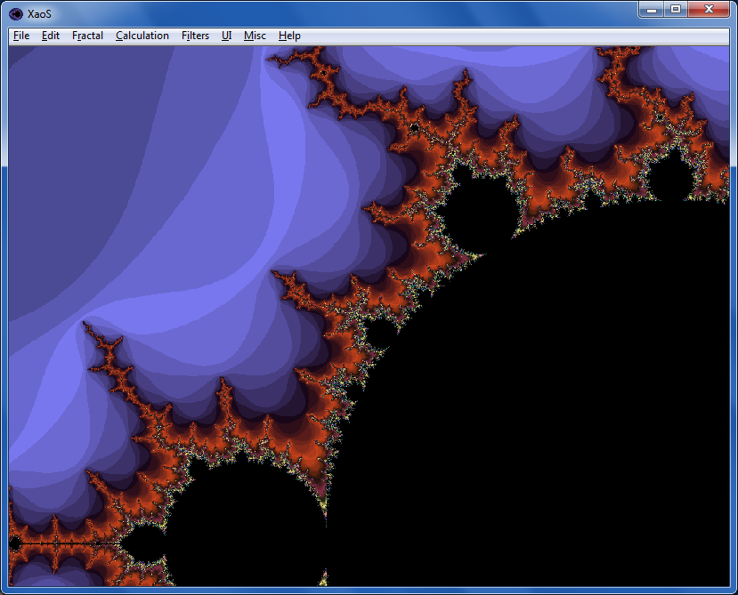

Fractals…
XaoS
fractal explorer
Python vs. C
Madi
Nova program on fractals:
Max

Slide 8

Google?

Slide 9
Mid-term feedback…
Don't put your name
I would love to know any thoughts you have about CS5 thus far in the term. In particular, how you feel about the time and effort CS5 requires…
On average, how much time per week do you spend on CS5 outside class + lab?
How does CS5's workload compare to other classes you're taking this term?
How would you judge the pace of CS5?
much lighter
about the same
much heavier
much too slow
about right
much too fast
Circle your year: First-year Sophomore Junior Senior Other
Something you'd keep about CS5 …?
Today
Something you'd change about / get rid of / add to CS5 …?
Other thoughts optional, but 142% welcome:

Slide 10
CS 5: Putting Loops to Work
[ -35, -24, -13, -2, 9, 20, 31, ? ]
[ 26250, 5250, 1050, 210, ? ]
[ 90123241791111 , 93551622, 121074, 3111, ? ]
[ 1, 11, 21, 1211, 111221, ? ]
Homework 8: due Mon., 11/3 by midnight
MTerm on Th. review on the CS 5 homepage
Final exam: Tuesday, 12/16 at 9am
No office hrs Mon. but lots of LAC tutoring...
What's next?
I'm glad you asked!

Slide 11
Loops
Basic design strategies
Is one more reasonable than the other?
Recursion

Slide 12
def fac( N ):
result = 1
for x in range(1,N+1):
result *= x
return result
Loops
Is one more reasonable than the other?
def fac( N ):
if N == 1:
return 1
else:
return N*fac(N-1)
Recursion

Slide 13
def fac( N ):
result = 1
for x in range(1,N+1):
result *= x
return result
Loops
Design strategy: look for repetition + describe it… .
Design strategy: look for self-similarity + describe it… .
def fac( N ):
if N == 1:
return 1
else:
return N*fac(N-1)
Recursion

Slide 14
for: two types
L = [3, 15, 17, 7]
x
for x in L:
print x
element-based loops

Slide 15
for: two types
L[0]
L[1]
L[2]
L[3]
L = [3, 15, 17, 7]
0
1
2
3
i
for i in range(len(L))
print L[i]
index-based loops
for x in L:
print x
element-based loops

Slide 16
elements vs. indices
L = [3, 15, 17, 7]
x
def sum(L):
total = 0
for x in L:
total += x
return total
element-based loops

Slide 17
elements vs. indices
L = [3, 15, 17, 7]
0
1
2
3
i
def sum(L):
total = 0
for x in L:
total += x
return total
def sum(L):
total = 0
for i in range(len(L))
total += L[i]
return total
element-based loops
index-based loops

Slide 18
hw8pr3: T. T. Securities (TTS)
Analyzes a sequence of stock prices
day
0
day
1
day
2
day
3
day
4
day
5
day
6
day
7
L = [ 40, 80, 10, 30, 27, 52, 5, 15 ]
(0) Input a new list
(1) Print the current list
(2) Find the average price
(3) Find the standard deviation
(4) Find the min and its day
(5) Find the max and its day
(6) Your TTS investment plan
(9) Quit
Enter your choice:
The menu to implement:

Slide 19
User input
meters = raw_input('How many m? ')
cm = meters * 100
print 'That is', cm, 'cm.'
What will Python think?
I think I like these units better than light years per year!

Slide 20
User input
meters = raw_input('How many m? ')
cm = meters * 100
print 'That is', cm, 'cm.'
raw_input ALWAYS returns a string – no matter what has been typed!
What will Python think?
I think I like these units better than light years per year!

Slide 21
Fix #1: convert to the right type
meters_str = raw_input('How many m? ')
meters = float( meters_str )
cm = meters * 100
print 'That is', cm, 'cm.'
'42'
42.0
4200.0
name: meters_str type: string
name: meters type: float
name: cm
type: float
Notes:
Electric: from www.staticfreesoftware.com
My tutorial is at:
http://odin.ac.hmc.edu/~harris/class/chipdesign/electric.pdf
Lasergene (a molecular biology suite of programs for aligning and comparing
DNA sequences, etc.)
Statview (statistical analysis)
KaleidaGraph (plotting & graphing)
Populus (programs that simulate ecological and evolutionary processes)

Slide 22
Fix #2: use input
meters = input('How many m? ')
cm = meters * 100
print 'That is', cm, 'cm.'
input interprets its input
raw_input always returns a string
I always use input -- but don't "quote" me on that.

Slide 23
A larger application
def menu():
""" prints our menu of options """
print "(1) Input a new list of numbers"
print "(2) I will divine the next element"
print "(9) Quit"
def main():
""" handles user input for our menu """
while True:
menu()
uc = input('Which option? ')
Calls a helper function
Perhaps uc the reason for this?

Slide 24
def main():
""" handles user input for our menu """
L = [2,22,222,2222] # a starting list
while True:
menu() # print menu
uc = input('Which option? ')
if uc == 9:
elif uc == 1:
elif uc == 2:
(9) Quit!
(1) Get new list
(2) other…

Slide 25
def main():
""" handles user input for our menu """
L = [2,22,222,2222] # a starting list
while True:
menu() # print menu
uc = input('Which option? ')
if uc == 9:
elif uc == 1:
elif uc == 2:
break exits the loop
(9) Quit!
use input to get a new L
(1) Get new list
(2) other…
other functions, as needed

Slide 26
def main():
""" handles user input for our menu """
L = [2,22,222,2222] # a starting list
while True:
menu() # print menu
uc = input('Which option? ')
if uc == 9:
elif uc == 1:
elif uc == 2:
#1 security "gotcha"
break exits the loop
(9) Quit!
use input to get a new L
(1) Get new list
(2) other…
other functions, as needed

Slide 27
Functions you'll write
All use loops…
Menu
def average( L )
def stdev( L )
(0) Input a new list
(1) Print the current list
(2) Find the average price
(3) Find the standard deviation
(4) Find the min and its day
(5) Find the max and its day
(6) Your TTS investment plan
(9) Quit
Enter your choice:
Σ
(L[i] - L_{av})²
i
len(L)
def minday( L )
def maxday( L )
webbrowser.open_new_tab(url)

Slide 28
Min price
Just call min ?
What's the idea for finding the smallest (minimum) price?
day
0
day
1
day
2
day
3
day
4
day
5
day
6
day
7
L = [ 40, 80, 10, 30, 27, 52, 5, 15 ]
m =
m is the "min so far"
track the value of the minimum so far as you loop over L

Slide 29
Min price vs. min day
day
0
day
1
day
2
day
3
day
4
day
5
day
6
day
7
L = [ 40, 80, 10, 30, 27, 52, 5, 15 ]
m = 40
m = 10
m = 5
5 is returned
def minprice( L ):
m = L[0]
for x in L:
if x < m:
m = x
return m
What about the day of the minimum price?

Slide 30
Finish this code to return the index (day) of L's minimum.
What does this code print?
Write mindiff to return the smallest abs. diff. between any two elements from L.
L
for y in range(4):
for x in range(4):
print abs(x-y),
print
L
>>> minday( [9, 8, 5, 7, 42] )
2
0
1
2
3
4
index
>>> mindiff( [42,3,7,100,-9])
4
Only consider absolute differences.
def minday( L ):
minval = L[0]
minday = 0 # minday!
RNG = range(len(L))
for i in RNG:
if < minval:
return minday
L will be a list of numbers.
Hint: Use nested loops!
def mindiff( L ):
Try an index-based loop!
Quiz, p.2
Hint: keep track of the min m AND the day of the min mndy
Extra: How could we save more than half of this computation!?

Slide 31
Mid-term feedback …
Don't put your name
I would love to know any thoughts you have about CS5 thus far in the term. In particular, how you feel about the time and effort CS5 requires…
On average, how much time per week do you spend on CS5 outside class + lab?
How does CS5's workload compare to other classes you're taking this term?
How would you judge the pace of CS5?
much lighter
about the same
much heavier
much too slow
about right
much too fast
Circle your year: First-year Sophomore Junior Senior Other
Something you'd keep about CS5 …?
Something you'd change about / get rid of / add to CS5 …?
Other thoughts optional, but 142% welcome:

Slide 32
L
minday
return the index of L's minimum.
>>> minday( [9, 8, 5, 7, 42] )
2
0
1
2
3
4
index
def minday( L ):
minval = L[0]
minday = 0
RNG = range(len(L))
for i in RNG:
if < minval:
return minday
We loop through the INDEX of each element
How do we ensure minval tracks the minimum?
How and where should we update minday?
index-based loop

Slide 33
L
minday
return the index of L's minimum.
>>> minday( [9, 8, 5, 7, 42] )
2
0
1
2
3
4
index
Awkward!
def minday( L ):
mnvl = L[0]
mndy = 0
day = 0
for x in L:
if x < mnvl:
mnvl = x
mndy = day
day += 1
return mndy
Create a "counter" that will keep track of the current day.
IF we find a smaller min, save which day it was in mndy
Regardless, we add 1 to day so that we're keeping track!
element-based loop

Slide 34
What does this code print?
for y in range(4):
for x in range(4):
print abs(x-y),
print
x
y
0
1
2
3
0
0 1 2 3
1
1 0 1 2
2
2 1 0 1
3
3 2 1 0

Slide 35
Write mindiff to return the smallest abs. diff. between any two elements from L.
mindiff( [42,3,7,100,-9])
4
L
def diff( L, R ):
for y in L:
for x in L:
Hint: Use nested loops:
for y in range(4):
for x in range(4):
print abs(x-y),
Track the value of the minimum so far as you loop over L and R…

Slide 36
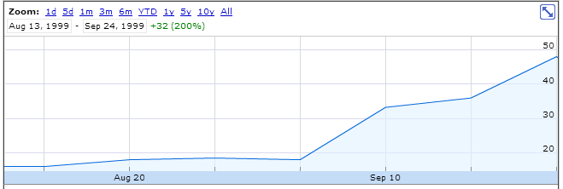
personal motivation for TT securities…
LightPath, Summer 1999 ~ wedding gift…

Slide 37
LightPath, Summer 1999

Slide 38
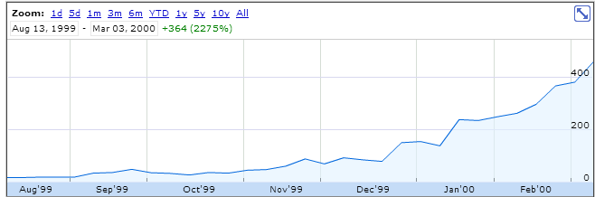
LightPath, Spring 2000

Slide 39
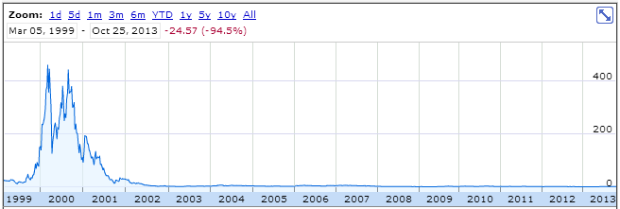
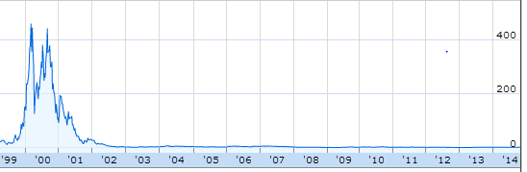
Why it's called a brokerage
LightPath, Fall 2014

Slide 40
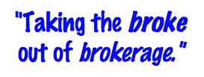
T. T. Securities
(0) Input a new list
(1) Print the current list
(2) Find the average price
(3) Find the standard deviation
(4) Find the min and its day
(5) Find the max and its day
(6) Your TTS investment plan
(9) Quit
Enter your choice:
Software side …
Hardware side…
Investment analysis for the 21st century … and beyond!

Slide 41
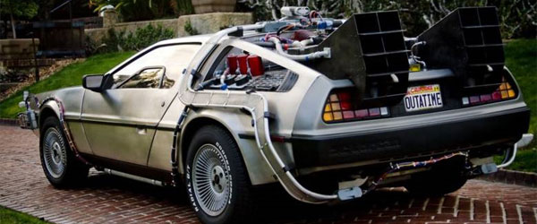
T. T. Securities
(0) Input a new list
(1) Print the current list
(2) Find the average price
(3) Find the standard deviation
(4) Find the min and its day
(5) Find the max and its day
(6) Your TTS investment plan
(9) Quit
Enter your choice:
Software side …
Hardware side…
Investment analysis for the 21st century … and beyond!

Slide 42
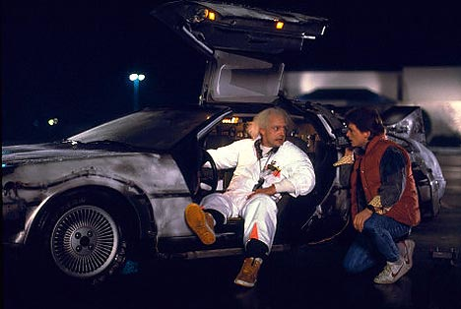
T. T. Securities
(0) Input a new list
(1) Print the current list
(2) Find the average price
(3) Find the standard deviation
(4) Find the min and its day
(5) Find the max and its day
(6) Your TTS investment plan
(9) Quit
Enter your choice:
Back to the future
Software side …
Hardware side…
Investment analysis for the 21st century … and beyond!

Slide 43

T. T. Securities
(0) Input a new list
(1) Print the current list
(2) Find the average price
(3) Find the standard deviation
(4) Find the min and its day
(5) Find the max and its day
(6) Your TTS investment plan
(9) Quit
Enter your choice:
Back to the future
Software side …
Hardware side…
Investment analysis for the 21st century … and beyond!

Slide 44
The TTS advantage!
L = [ 40, 80, 10, 30, 27, 52, 5, 15 ]
Your stock's prices:
What is the best TTS investment strategy here?
Day Price
0 40.0
1 80.0
2 10.0
3 30.0
4 27.0
5 52.0
6 5.0
7 15.0
Important fine print:
To make our business plan realistic, however, we only allow selling after buying.

Slide 45
Have a great weekend!

Slide 47
Halloween == pop-tarts!

Slide 48
The TTS advantage!
Your stock's prices:
L = [ 40, 80, 10, 30, 27, 52, 5, 15 ]
The TTS investment strategy:
Day Price
0 40.0
1 80.0
2 10.0
3 30.0
4 27.0
5 52.0
6 5.0
7 15.0
to be realistic (for our VC backers), you must sell after you buy.

Slide 49
L
minday
return the index of L's minimum.
>>> minday( [9, 8, 5, 7, 42] )
2
0
1
2
3
4
index
def minday( L ):
m = L[0]
mndy = 0
for :
if < m:
m =
return mndy
How do we loop through the INDEX of each element?
How do we ensure m keeps track of the minimum?
How and where should we update mndy?
index-based loop

Slide 50
L
R
Write diff to return the smallest abs. diff. between any value from L and any value from R.
>>> diff( [42,3,7] , [6,0,-5] )
1
Only consider absolute differences.
L and R will be lists of numbers.
Hint: Adapt the nested loops below!
def diff( L, R ):
for x in range(3):
for y in range(3):
print x, y
Aha! Track the value of the minimum so far as you loop over L and R…

Slide 51
Min price
Just call min ?
What's the idea for finding the smallest (minimum) price?
day
0
day
1
day
2
day
3
day
4
day
5
day
6
day
7
L = [ 40, 80, 10, 30, 27, 52, 5, 15 ]
m =
m is the "min so far"
track the value of the minimum so far as you loop over L

Slide 52
Write mindiff to return the smallest abs. diff. between any two elements from L.
mindiff( [42,3,7,100,-9])
4
L
def diff( L, R ):
Hint: Use nested loops:
for x in range(4):
for y in range(4):
print abs(x-y),
Track the value of the minimum so far as you loop over L and R…

Slide 53
The read it and weep sequence
1
11
21
1211
111221
312211
??
str vs. int
When does the first 4 appear?
How fast do these terms grow?
Notes:
Next is: 13112221

Slide 54
Growth determined empirically…
1
11
21
1211
111221
312211
13112221
In the limit, the length of the Nth term of the read-it-and-weep sequence is
(1.303577...)
exponential growth
N
this base was found computationally by taking repeated ratios of term lengths...
Notes:
Next is: 13112221

Slide 55
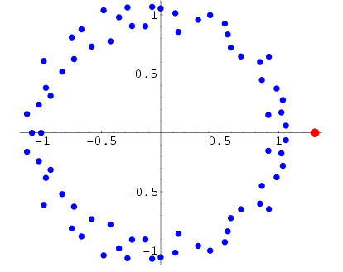
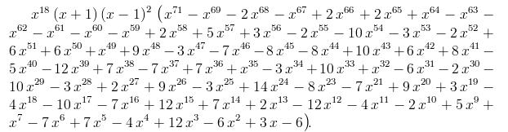
Growth determined analytically…
λ = 1.30357726034296…
"Conway’s Constant" has an analytic definition!
It is the largest real root of this 71st-degree polynomial !!
the 71 roots (in the complex plane)
Notes:
Next is: 13112221

Slide 56
T. T. Securities (TTS)
Analyze a list of stock prices (given for a # of days in a row)
What's the idea for finding the smallest (minimum) price?
day
0
day
1
day
2
day
3
day
4
day
5
day
6
day
7
L = [ 40, 80, 10, 30, 27, 52, 5, 15 ]
m =
m is the "min so far"
track the value of the minimum so far as you loop over L

Slide 57
Just call min ?
Min price vs. min day
day
0
day
1
day
2
day
3
day
4
day
5
day
6
day
7
L = [ 40, 80, 10, 30, 27, 52, 5, 15 ]
def minprice( L ):
m = L[0]
for x in L:
if x < m:
m = x
return m
What about the day of the minimum price?

Slide 58
Quiz
Return the smallest difference between one value from L and one value from R.
Alter this code to return the index of L's minimum.
Example:
L
Example:
L
R
>>> minday( [9,8,5,7,42] )
2
>>> diff( [7,3],[0,6] )
1
What does this code print?
HINT: track the day of the min in addition to the min value itself.
Only consider absolute differences.
for x in range(0,4):
for y in range(x,4):
print x, y
L and M will be lists of numbers
Hint: adapt the code at left...
def minday( L ):
m = L[0]
dom = 0 # day of min
for x in L:
if x < m:
m = x
return dom
def diff( L, R ):
You may want to change this loop!

Slide 59
>>> minday( [9,8,5,7,42] )
2
minday
def minday( L ):
m = L[0]
dom = 0
for x in L:
if x < m:
m = x
return dom
def minday( L ):
m = L[0]
dom = 0
for :
if < m:
m =
return dom
element-based loop
index-based loop

Slide 60
What does this code print?
for x in range(0,4):
for y in range(x,4):
print x, y

Slide 61
for x in range(0,4):
for y in range(x,4):
print x, y
Example:
L
R
Hint: adapt this code
>>> diff( [7,3],[0,6] )
1
Return the minimum difference between one value from L and one value from M.
def diff( L, R ):
Only consider absolute differences.
L and M will be lists of numbers
SAME IDEA: track the value of the minimum so far as you loop over L

Slide 62
The TTS advantage!
Your stock's prices:
L = [ 40, 80, 10, 30, 27, 52, 5, 15 ]
The TTS investment strategy:
Day Price
0 40.0
1 80.0
2 10.0
3 30.0
4 27.0
5 52.0
6 5.0
7 15.0
to be realistic (for our VC backers), you must sell after you buy.

Slide 63
Have a great fall weekend!
extra_hour in [sleep,work,fun]:
True

Slide 64
Mid-term feedback …
Don't put your name
I would love to know any thoughts you have about CS5 thus far in the term. In particular, how you feel about the time and effort CS5 requires…
On average, how much time per week do you spend on CS5 outside class + lab?
How does CS5's workload compare to other classes you're taking this term?
How would you judge the pace of CS5?
much lighter
about the same
much heavier
much too slow
about right
much too fast
Circle your year: First-year Sophomore Junior Senior Other
Later on today…
Something you'd keep about CS5 …?
Something you'd change about / get rid of / add to CS5 …?
Other thoughts optional, but 142% welcome:

Slide 65
feedback feedback
see 2012 feedback for a guide
Notes:
Next is: 13112221

Slide 66
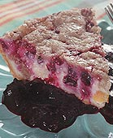

Homework 8
#2
Pi from Pie!
TT Securities Analysis, Inc.
#3
User-interaction
List-handling
Both for and while loops…
ASCII Art (extra)
#4

Slide 67
Extra (!) funky series
Harmonic Sequence:
1/1 + 1/2 + 1/3 + 1/4 + 1/5 + 1/6 + …
Without composites (primes only):
1/1 + 1/2 + 1/3 + 1/4 + 1/5 + 1/6 + 1/7 +…
Without 9’s…
1/1 + 1/2 + … + 1/8 + 1/9 + … +1/18 + 1/19 + … + 1/88 + 1/89 + 1/90 + 1/91 + …
Diverges!
???
???
Notes:
The harmonic series diverges (slowly); it's in today's lab. The primes-only series also diverges. But the no-9's series doesn't diverge. Why? Because as you get to big numbers, almost everything contains a 9, so the terms become sparse!

Slide 68
Quiz
Return the min difference between one value from X and one value from Y.
Alter this code to return the index of L's minimum.
Example:
Example:
>>> minday( [9,8,5,42] )
2
What does this code print?
>>> diff( [7,3],[0,6] )
1
HINT: track the index of the min in addition to the min value itself.
Only consider absolute differences.
for x in range(3):
for y in range(3):
print x, y
X and Y will be lists of numbers
Hint: adapt this code
def minday( L ):
min = L[0]
for x in L:
if x < min:
min = x
return
def diff( X, Y ):
You may want to change the loop!

Slide 69
Alter this code to return the index of L's minimum.
Example:
>>> mini( [9,8,1,7] )
2
def mini( L ):
min = L[0]
for x in L:
if x < min:
min = x
return
def mini( L ):
min = L[0]
for :
if < min:
min =
return
SAME LOOP
INDEX-BASED LOOP
returning both??

Slide 70
What does this code print?
for x in range(3):
for y in range(3):
print x, y

Slide 71
for x in range(3):
for y in range(3):
print x, y
Example:
Hint: adapt this code
>>> diff( [7,3],[0,6] )
1
Return the minimum difference between one value from X and one value from Y.
def diff( X, Y ):
Only consider absolute differences.
X and Y will be lists of numbers

Slide 72
“Quiz”
Finish these two methods…
This method returns the sum of the elements in the input array.
public static double sum(double[] A)
{
double s = 0.0;
for (
{
}
return s;
}
This method returns the average of the elements in the input array.
public static double average(double[] A)
“Extra Credit”: How concise can this method be?

Slide 73
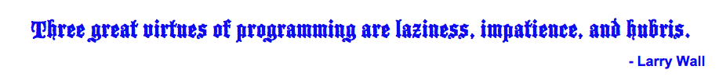
Procrastination Programming
Every while loop can be a while True: loop!
- just be sure to break!

Slide 74
Give me a break !
import random
escape = 0
while True:
print 'Help! Let me out!'
escape = random.choice([41,42,43])
if escape == 42:
break
print 'At last!'
I'll figure out later how to get out of this loop!
OK – I'll stop the loop now and continue with the code after the loop
compare return

Slide 75
This method returns the maximum element from the input array.
public static double max(double[] A)
Extra: What is something unusual and unrelated to CS 5 that you & the person next to you have in common ?!

Slide 76
Loopy thinking
0
1
2
3
4
5
6
7
8
9
10
11
12
13
14
15
16
17
18
s = 'gattacaaggtaaaatgca'
How could we find the number of 'a's ? How about 'a's and 't's?
How could we find the number of 'ta's ?
How could we find the longest sequence of 'a's ?
Notes:
ctg repeats…

Slide 77
Loopy thinking
0
1
2
3
4
5
6
7
8
9
10
11
12
13
14
15
16
17
18
s = 'gattacaaggtaaaatgca'
s = 'gattacaaggtaaaatgca'
N = 0
for i in range(0,len(s)):
if s[i] == 'a':
N = N + 1
print 'N is', N
How could we find the number of 'a's ? How about 'a's and 't's?
How could we find the number of 'ta's ?
How could we find the longest sequence of 'a's ?
Notes:
Electric: from www.staticfreesoftware.com
My tutorial is at:
http://odin.ac.hmc.edu/~harris/class/chipdesign/electric.pdf
Lasergene (a molecular biology suite of programs for aligning and comparing
DNA sequences, etc.)
Statview (statistical analysis)
KaleidaGraph (plotting & graphing)
Populus (programs that simulate ecological and evolutionary processes)

Slide 78
Loopy thinking
0
1
2
3
4
5
6
7
8
9
10
11
12
13
14
15
16
17
18
s = 'gattacaaggtaaaatgca'
s = 'gattacaaggtaaaatgca'
N = 0
for i in range(0,len(s)):
if s[i] == 'a' or s[i] == 't':
N = N + 1
print 'N is', N
How could we find the number of 'a's ? How about 'a's and 't's?
How could we find the number of 'ta's ?
How could we find the longest sequence of 'a's ?
Notes:
Electric: from www.staticfreesoftware.com
My tutorial is at:
http://odin.ac.hmc.edu/~harris/class/chipdesign/electric.pdf
Lasergene (a molecular biology suite of programs for aligning and comparing
DNA sequences, etc.)
Statview (statistical analysis)
KaleidaGraph (plotting & graphing)
Populus (programs that simulate ecological and evolutionary processes)

Slide 79
Loopy thinking
0
1
2
3
4
5
6
7
8
9
10
11
12
13
14
15
16
17
18
s = 'gattacaaggtaaaatgca'
s = 'gattacaaggtaaaatgca'
N = 0
for i in range(1,len(s)):
if s[i] == 'a' and s[i-1] == 't':
N = N + 1
print 'N is', N
How could we find the number of 'a's ? How about 'a's and 't's?
How could we find the number of 'ta's ?
How could we find the longest sequence of 'a's ?
Notes:
Electric: from www.staticfreesoftware.com
My tutorial is at:
http://odin.ac.hmc.edu/~harris/class/chipdesign/electric.pdf
Lasergene (a molecular biology suite of programs for aligning and comparing
DNA sequences, etc.)
Statview (statistical analysis)
KaleidaGraph (plotting & graphing)
Populus (programs that simulate ecological and evolutionary processes)

Slide 80
Loopy thinking
0
1
2
3
4
5
6
7
8
9
10
11
12
13
14
15
16
17
18
s = 'gattacaaggtaaaatgca'
How could we find the longest sequence of 'a's ?
Notes:
Electric: from www.staticfreesoftware.com
My tutorial is at:
http://odin.ac.hmc.edu/~harris/class/chipdesign/electric.pdf
Lasergene (a molecular biology suite of programs for aligning and comparing
DNA sequences, etc.)
Statview (statistical analysis)
KaleidaGraph (plotting & graphing)
Populus (programs that simulate ecological and evolutionary processes)

Slide 81
Planning in "pseudocode"
0
1
2
3
4
5
6
7
8
9
10
11
12
13
14
15
16
17
18
s = 'gattacaaggtaaaatgca'
Keep track of CurRun, MaxRun
Loop through the string:
if we do see an 'a'
if the PREVIOUS letter is NOT an 'a'
if the PREVIOUS letter IS an 'a'
Notes:
Electric: from www.staticfreesoftware.com
My tutorial is at:
http://odin.ac.hmc.edu/~harris/class/chipdesign/electric.pdf
Lasergene (a molecular biology suite of programs for aligning and comparing
DNA sequences, etc.)
Statview (statistical analysis)
KaleidaGraph (plotting & graphing)
Populus (programs that simulate ecological and evolutionary processes)

Slide 82
Planning in "pseudocode"
0
1
2
3
4
5
6
7
8
9
10
11
12
13
14
15
16
17
18
s = 'gattacaaggtaaaatgca'
Keep track of CurRun, MaxRun
Loop through the string:
if we do see an 'a'
if the PREVIOUS letter is NOT an 'a'
Start a Run! CurRun = 1
if the PREVIOUS letter IS an 'a'
Continue our run! CurRun = CurRun + 1
Check for a new maximum…
Notes:
Electric: from www.staticfreesoftware.com
My tutorial is at:
http://odin.ac.hmc.edu/~harris/class/chipdesign/electric.pdf
Lasergene (a molecular biology suite of programs for aligning and comparing
DNA sequences, etc.)
Statview (statistical analysis)
KaleidaGraph (plotting & graphing)
Populus (programs that simulate ecological and evolutionary processes)

Slide 83
Planning in "pseudocode"
0
1
2
3
4
5
6
7
8
9
10
11
12
13
14
15
16
17
18
s = 'gattacaaggtaaaatgca'
Keep track of CurRun, MaxRun
MAX = 0
cur = 0
for i in range(0,len(s)):
if s[i] == 'a':
if s[i-1] != 'a':
cur = 1
else:
cur = cur + 1
if cur > MAX:
MAX = cur
print 'Max is', MAX
Loop through the string:
if we do see an 'a'
if the PREVIOUS letter is NOT an 'a'
Start a Run!
if the PREVIOUS letter IS an 'a'
Continue our run!
Check for a new maximum…
Notes:
Electric: from www.staticfreesoftware.com
My tutorial is at:
http://odin.ac.hmc.edu/~harris/class/chipdesign/electric.pdf
Lasergene (a molecular biology suite of programs for aligning and comparing
DNA sequences, etc.)
Statview (statistical analysis)
KaleidaGraph (plotting & graphing)
Populus (programs that simulate ecological and evolutionary processes)

Slide 84
Challenge
Print the first N numbers in this series…
>>> fib(11)
Example:
1 1 2 3 5 8 13 21 34 55 89

Slide 85
Write an index-based loop to print the first N terms of
Write any loop to print the first N terms of
N terms total
N terms total
7 9 11 13 15 17 …
0 1 2 3 6 7 14 15 30
def seven(N):
for i in range(N):
feel free to add an accumulator, if you'd like!
Quiz, part 2

Slide 86

Looping inside loops!

Slide 87
input vs. raw_input
reply = raw_input('Enter a string and I\'ll tell you what I see.')
for c in reply:
print 'I see a(n) ', c
interprets what the user types as a string of characters
reply = input('Enter any list and I\'ll tell you what I see.')
for c in reply:
print 'I see a(n) ', c
processes what the user types just as python would

Slide 88
Monte Carlo π
Hw8 Pr3
A engineering challenge: to estimate π using everyday items...

Slide 89
Easy as π
(1,1)
Visualize:
(-1,-1)

Slide 90
CS 5: Putting Loops to Work
A
[ -35, -24, -13, -2, 9, 20, 31, ? ]
B
[ 26250, 5250, 1050, 210, ? ]
C
[ 1, 11, 21, 1211, 111221, ? ]
D
[ 2, 22, 222, ? ]
E
[ 90123241791111 , 93551622, 121074, 3111, ? ]
Which ? is unlike the others?

Slide 91
CS 5: Putting Loops to Work
A
[ -35, -24, -13, -2, 9, 20, 31, ? ]
B
[ 26250, 5250, 1050, 210, ? ]
C
[ 1, 11, 21, 1211, 111221, ? ]
D
[ 2, 22, 222, ? ]
E
[ 90123241791111 , 93551622, 121074, 3111, ? ]
Which sequences act numeric -- and which ones act like strings ?

Slide 92
User Input
meters = raw_input('How many m? ')
cm = meters * 100
print 'That is', cm, 'cm.'
If we type 42, what will python print for this # of cm ?
A
D
something < 0
something > 42
B
C
E
0
42
an error

