Slide 1
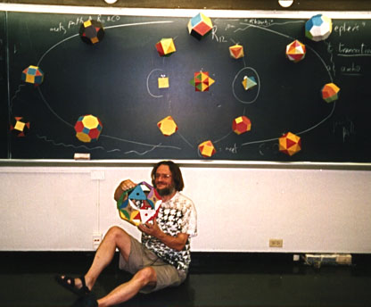
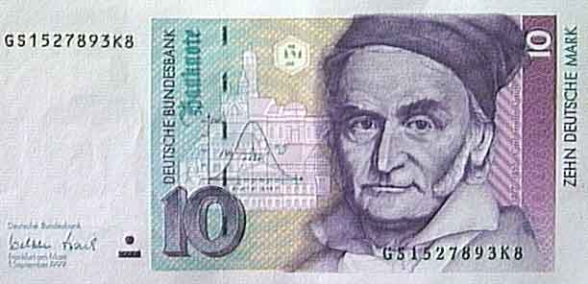
CS 5 Rules
Two mathematicians - two rules each
z = z ² + c
John Conway
HW 9 (lab + 1 problem)
Simple rules can yield complex results!
due Mon. 11/11
Rule #1: Don't follow this rule.
Carl Gauss
review problems online
accommodations?
we have a separate room (B442) or see me…
I guess you could say Carl Gauss was money!
Midterm

Slide 2
This Thursday will be the CS 5 in-class midterm
Un-warnings:
accommodations? concerns? See me…
five problems, written
worth 1 hw assignment
score worries? Extra extra-credit in hw9 and beyond
Suggestions:
go over in-class exercises and hwk problems
create a page of notes, 2-sided is OK
consider small variations of the problems – and how they would change the solutions…
that's our approach…

Slide 3
The 5C Hackathon is two weeks away and if possible I'd like to make an announcement in your two intro CS classes at the start of class Tuesday or later next week. In addition to the hackathon, we're holding an informal hack week series of tutorials that is designed to get beginners excited about CS and to introduce them to web programming! Thanks, Joe (jnewbry14@students.claremontmckenna.edu)

Slide 4
In CS, rules rule!
(1a) Numbers and strings are handled "by value"
(1b) Lists are handled "by reference"
The contents of the variable's "box" in memory are copied.
(2) Inputs pass to functions "by value"

Slide 5
In CS, rules rule!
Reference
Pointer
id
L = [5,42,'hi']
s = 'hi'
5
42
'hi'
'hi'
L
L[0]
L[1]
L[2]
s
(1a) Numbers and strings are handled "by value"
(1b) Lists are handled "by reference"
The contents of the variable's "box" in memory are copied.
(2) Inputs pass to functions "by value"
7
copy of fav
7
fav
f( fav )
fav

Slide 6
Reference vs. Value
Python's two methods for handling data
L = [5,42,'hi']
s = 'hi'
Reference
Pointer
id
Whee!
'hi'
L
5
42
'hi'
s
L[0]
L[1]
L[2]
Lists are handled by reference (the variables really hold a memory address)
Primitive data and strings are handled by value: imagine they hold the data

Slide 7
Python functions: pass by value
def conform(fav)
fav = 42
return fav
fav
def main()
print " Welcome to Conformity, Inc.! "
fav = 7
fav = conform(fav)
print " My favorite # is", fav
7
fav
But what if the underlined part were absent… ?

Slide 8
Python functions: pass by value
def conform(fav)
fav = 42
return fav
7
fav
copy of fav
"pass by value" means the contents of fav are copied to fav
def main()
print " Welcome! "
fav = 7
fav = conform(fav)
print " My favorite # is", fav
7
fav
But what if the underlined part were absent… ?

Slide 9
Quiz
Rules rule!?
Try this on the back page first…
Trace each f'n. What will main1, main2, and main3 print?
def conform1(fav)
fav = 42
return fav
def conform2(L)
L = [42,42]
return L
def conform3(L)
L[0] = 42
L[1] = 42
fav
L
L
7
7
11
7
11
fav
L
L[0]
L[1]
L
L[0]
L[1]
def main1()
fav = 7
conform1(fav)
print fav
def main2()
L = [7,11]
conform2(L)
print L
def main3()
L = [7,11]
conform3(L)
print L
Notice that there are NO assignment statements after these function calls! The return values aren't being used…

Slide 10
Quiz
Rules rule!?
Name(s) ______________________________
Trace each f'n. What will main1, main2, and main3 print?
def conform1(fav)
fav = 42
return fav
def conform2(L)
L = [42,42]
return L
def conform3(L)
L[0] = 42
L[1] = 42
fav
L
L
7
7
11
7
11
fav
L
L[0]
L[1]
L
L[0]
L[1]
def main1()
fav = 7
conform1(fav)
print fav
def main2()
L = [7,11]
conform2(L)
print L
def main3()
L = [7,11]
conform3(L)
print L
Notice that there are NO assignment statements after these function calls! The return values aren't being used…

Slide 11
Lists are Mutable
You can change the contents of lists in functions that take those lists as input.
- Lists are MUTABLE objects
Those changes will be visible everywhere.
Numbers, strings, etc. are IMMUTABLE – they can't be changed, only reassigned.

Slide 12
Differing approaches to rules …
Engineers believe equations approximate reality;
Physicists believe reality approximates equations…
Mathematicians?
CS?

Slide 13
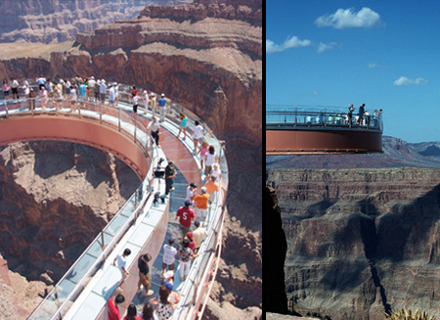
"the rules"
Engineers believe equations approximate reality;
Grand Canyon Skywalk

Slide 14
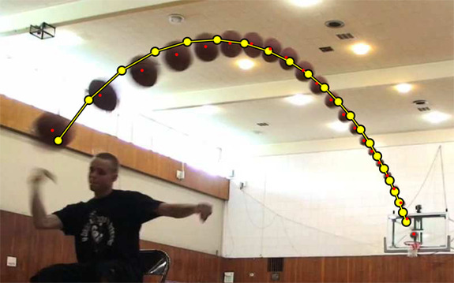
Engineers believe equations approximate reality;
Physicists believe reality approximates equations…
"the rules"
Not a parabola, so not a real shot!
http://www.youtube.com/watch?feature=player_embedded&v=WbaH52JI3So
http://www.fourandsix.com/blog/2011/8/29/seriously-amazing-beer-pong-shots.html

Slide 15
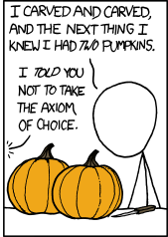
Engineers believe equations approximate reality;
Physicists believe reality approximates equations…
Mathematicians don't care either way!
A solid sphere can be split into 5 parts and reassembled into two spheres the same size as the original (Banach-Tarski paradox)
In CS?

Slide 16
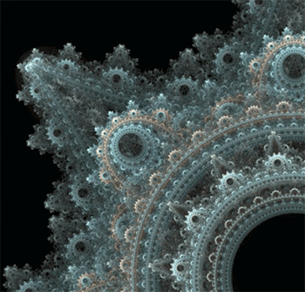
Engineers believe equations approximate reality;
Physicists believe reality approximates equations…
Mathematicians don't care either way!
In CS?
Don't like reality? Build your own…

Slide 17
Engineers believe equations approximate reality;
Physicists believe reality approximates equations…
Mathematics reasons about structural rules…
… and CS reasons about procedural ones.
for
lists
while
variables
Axioms
arithmetic operations
Definitions
if/else
proofs
programs
Insights, tools, truths
Insights, tools, algorithms
math worldview
CS worldview

Slide 18
hw9pr2: 2D data
Menu
Functions
(1) Enter the size and values of an array
(2) Print the array
(3) Multiply an array row by a constant
(4) Add one row into another
(5) Add a multiple of one row to another
(6) Solve!
(9) Quit
Which choice would you like?
printMenu
enterValues
print
multRow
addRowSIntoRowD
addMofRowSIntoRowD
solve
S ~ source row index
D ~ destination row index
M ~ a multiplier
Demo…

Slide 19
Gaussian Elimination
Goal: to find x, y, and z:
2x + 3y + -1z = -8
-3x + -1y + 2z = 42
1x + -9y + 4z = 56
Aargh!

Slide 20
Gaussian Elimination
Goal: to find x, y, and z:
2x + 3y + -1z = -8
-3x + -1y + 2z = 42
1x + -9y + 4z = 56
some sets of equations are easier than others!
1x + 0y + 0z = 1
0x + 1y + 0z = 5
0x + 0y + 1z = 25
I like this one!

Slide 21
Gauss's idea:
Goal: to find x, y, and z:
2x + 3y + -1z = -8
-3x + -1y + 2z = 42
1x + -9y + 4z = 56
multiply any row by a constant
nonzero constant!
Use two rules:
add a multiple of any row to another
Notice that these rules don't change the solutions!

Slide 22
Gauss's idea:
Goal: to find x, y, and z:
2x + 3y + -1z = -8
-3x + -1y + 2z = 42
1x + -9y + 4z = 56
multiply any row by a constant
nonzero constant!
Use two rules:
add a multiple of any row to another
1x + 0y + 0z = 1
0x + 1y + 0z = 5
0x + 0y + 1z = 25
until it looks like:

Slide 23
2D data!

Slide 24
2D data!
Note that
2x + 3y + -1z = -8
-3x + -1y + 2z = 42
1x + -9y + 4z = 56
is really just the 2D matrix:
2 3 -1 -8
-3 -1 2 42
1 -9 4 56
…the variables aren't needed at all!

Slide 25
Lists ~ 2D data
A = [ 42, 75, 70 ]
42
75
70
list
int
int
int
A
1D lists are familiar – but lists can hold ANY kind of data – including lists!

Slide 26
Lists ~ 2D data
A = [ [1,2,3,4], [5,6], [7,8,9,10,11] ]
1
2
3
4
list
list
A[0][0]
A[0][1]
A[0][3]
A
A[0]
?
5
6
list
A[1][0]
A[1][1]
A[1]
7
8
9
10
11
list
A[2]
A[2][0]
A[2][1]
A[2][2]
A[2][3]
A[2][4]
Where's 3?
len(A[0])
len(A)
Replace 10 with 42.

Slide 27
Rectangular 2D data
A = [ [1,2,3,4], [5,6,7,8], [9,0,1,2] ]
1
2
3
4
list
list
A
A[0]
A[0][0]
5
6
7
8
list
A[1]
9
0
1
2
list
A[2]
A[2][3]
To try…
What is A[1][2]?
What does each component of A[1][2] mean ?
How many rows does A have, in general ?
How many columns does A have, in general ?

Slide 28
Try it…
Starting with the 2d array A shown here, what are the values in A after running this code?
A = [ [1, 2, 3, 4],
[5, 6, 7, 8],
[9,10,11,12] ]
A
Before
def mystery(A):
""" what happens to A ? """
NROWS = len(A)
NCOLS = len(A[0])
for row in range( 0,NROWS ):
for col in range( 0,NCOLS ):
if row == col:
A[row][col] = 42
else:
A[row][col] += 1
row 0
1 2 3 4
5 6 7 8
9 10 11 12
row 1
row 2
col 0
col 1
col 2
col 3
A
After
What are the resulting values in A?

Slide 29
Part 2
A
before
Write a method that adds five times the values in row #1 into row #2.
row 0
0.00 1.00 0.00 1.00
3.00 0.50 0.50 3.00
10.00 20.00 30.00 27.00
row 1
row 2
The values in row 1
should not change
row 0
0.00 1.00 0.00 1.00
3.00 0.50 0.50 3.00
25.00 22.50 32.50 42.00
Only row 2's values change.
row 1
row 2
A
after
def add5ofRow1IntoRow2( A ):
for ____ in range( ):
+=
You need only one line in the loop!
What if 5, 1, and 2 were the variables: m, s, and d?

Slide 30
Sizing up arrays…
How could we create this rectangular array of 0s?
[[0,0,0,0,0],
[0,0,0,0,0],
[0,0,0,0,0]]
A = 3*[ 5*[0] ]
or
A = 5*[ 3*[0] ]

Slide 31
Neither!
inner = 5*[0]
A = 3*[ 5*[0] ]
A = 3*[inner]
list
list
A
inner
list
inner
list
inner
Inner-esting!
"shallow copy"
copies the list reference, not the list data

Slide 32
hw9pr2: 2D data
Menu
Functions
(1) Enter the size and values of an array
(2) Print the array
(3) Multiply an array row by a constant
(4) Add one row into another
(5) Add a multiple of one row to another
(6) Solve!
(9) Quit
Which choice would you like?
printMenu
enterValues
print
multRow
addRowSIntoRowD
addMofRowSIntoRowD
solve
S ~ source row index
D ~ destination row index
M ~ a multiplier

Slide 33
2.00 3.00 -1.00 -8.00
-3.00 -1.00 2.00 42.00
1.00 -9.00 4.00 56.00
First: fix A[0][0]
What row operation can we perform to make A[0][0], the upper-left entry, equal to 1.0 ?
Get 1's on the diagonal
Solve?
Get 0's elsewhere
1.00 0.00 0.00 1.00
0.00 1.00 0.00 5.00
0.00 0.00 1.00 25.00
Goal

Slide 34
2.00 3.00 -1.00 -8.00
-3.00 -1.00 2.00 42.00
1.00 -9.00 4.00 56.00
First: fix A[0][0]
1.00 1.50 -0.50 -4.00
-3.00 -1.00 2.00 42.00
1.00 -9.00 4.00 56.00
fixed, by … multiplying Row 0 by 0.5
Get 1's on the diagonal
Solve?
Get 0's elsewhere
1.00 0.00 0.00 1.00
0.00 1.00 0.00 5.00
0.00 0.00 1.00 25.00
Goal

Slide 35
Go one column at a time
1.00 1.50 -0.50 -4.00
-3.00 -1.00 2.00 42.00
1.00 -9.00 4.00 56.00
multiply Row 0 by 0.5
1.00 1.50 -0.50 -4.00
0.00 3.50 0.50 30.00
0.00 -10.50 4.50 44.00
add 3 times Row 0 to Row 1 add -1 times Row 0 to Row 2
1.00 0.00 -0.71 -16.85
0.00 1.00 0.14 30.00
0.00 0.00 6.00 150.00
multiply Row 1 by 1/3.5 add a multiple of Row 1 to Row 0 add a multiple of Row 1 to Row 2
1.00 0.00 0.00 1.00
0.00 1.00 0.00 5.00
0.00 0.00 1.00 25.00
same for other columns
as far as possible...

Slide 36
Lab Problem: Conway's Life
Geometer @ Princeton
?
20˚
10˚
John Conway
60˚
70˚
(no trig)
Solution: www.cs.yale.edu/homes/toyama/tri/sol.html
simple rules ~ surprising behavior
1970

Slide 37
Lab Problem: Conway's Life
Grid World
Evolutionary rules
red cells are "alive"
Everything depends on a cell's eight neighbors
Exactly 3 neighbors give birth to a new, live cell.
Exactly 2 or 3 neighbors keep an existing cell alive.
Only 3 rules
Any other # of neighbors and the central cell dies…
white cells are empty

Slide 38
Lab Problem: Conway's Life
Grid World
Evolutionary rules
red cells are "alive"
Everything depends on a cell's eight neighbors
Exactly 3 neighbors give birth to a new, live cell.
Exactly 2 or 3 neighbors keep an existing cell alive.
Any other # of neighbors and the central cell dies…
white cells are empty

Slide 39
Lab Problem: Conway's Life
Grid World
Evolutionary rules
red cells are "alive"
Everything depends on a cell's eight neighbors
Exactly 3 neighbors give birth to a new, live cell.
Exactly 2 or 3 neighbors keep an existing cell alive.
Any other # of neighbors and the central cell dies…
white cells are empty

Slide 40
Lab Problem: Conway's Life
Grid World
Evolutionary rules
red cells are alive
Everything depends on a cell's eight neighbors
Exactly 3 neighbors give birth to a new, live cell.
Exactly 2 or 3 neighbors keep an existing cell alive.
What's next?
Any other # of neighbors and the central cell dies…
white cells are empty

Slide 41
Lab Problem: Creating life
next_life_generation( A )
For each cell…
3 live neighbors – life!
2 live neighbors – same
0, 1, 4, 5, 6, 7, or 8 live neighbors – death
computed all at once, not cell-by-cell: the ? at left does NOT come to life!
?
http://www.math.com/students/wonders/life/life.html

Slide 42
Lab Problem: Creating life
next_life_generation( A )
old generation is the input, A
returns the next generation
0
1
2
3
4
5
0
1
2
3
4
5
0
0
1
1
2
2
3
3
4
4
5
5

Slide 43
Lab Problem: Creating life
next_life_generation( A )
old generation is the input, A
returns the next generation
0
1
2
3
4
5
0
1
2
3
4
5
0
0
1
1
2
2
3
3
4
4
5
5

Slide 44
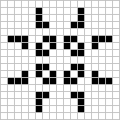
Lab Problem: Creating life
Stable configurations:
"rocks"
Periodic
"plants"
period 2
period 3
Self-propagating
"animals"
glider

Slide 45
Lab Problem: Creating life
Many life configurations expand forever…
"Gosper glider gun"
"glider"
What is the largest amount of the life universe that can be filled with cells?
How sophisticated can Life-structures get?
www.ibiblio.org/lifepatterns/

Slide 46
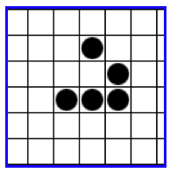
Today you'll be
Lifing it up
in lab!
so
on over…
glide

Slide 47
A
4
B
5
C
6
D
7
E
8
next_life_generation( A )
returns new generation or "array"
old generation or "array"
0
1
2
3
4
5
0
1
2
3
4
5
0
0
1
1
2
2
3
3
4
4
5
5
How many will there be?

Slide 48
Lab Problem: Creating life
next_life_generation( A )
returns new generation or "array"
old generation or "array"
0
1
2
3
4
5
0
1
2
3
4
5
0
0
1
1
2
2
3
3
4
4
5
5

Slide 49
Rectangular arrays
A[1][2] = 42
list
list
A
A[0]
A[0][0]
list
A[1]
list
A[2]
A[2][3]
What does each component of A[1][2] mean ?
How many rows does A have, in general ?
How many columns does A have, in general ?

Slide 50
Quiz
A = [ [1,2,3,4],
[5,6,7,8],
[9,10,11,12] ]
Starting with the 2d array A shown here, what are the values in A after running this code?
A
Before
def mystery(A):
""" what happens to A ? """
NUM_ROWS = len(A)
NUM_COLS = len(A[0])
for row in range( 0,NUM_ROWS ):
for col in range( 0,NUM_COLS ):
if row == col:
A[row][col] = 42
else:
A[row][col] += 1
row 0
1 2 3 4
5 6 7 8
9 10 11 12
row 1
row 2
col 0
col 1
col 2
col 3
A
After
What are the resulting values in A?

Slide 51
Quiz, part 2
A
before
five of row 1 will be added to row 2
row 0
0.00 1.00 0.00 1.00
3.00 0.50 0.50 3.00
10.00 20.00 30.00 27.00
Write a method that adds five times the values in row #1 into the values in row #2.
row 1
row 2
The values in row 1
should not change
row 0
0.00 1.00 0.00 1.00
3.00 0.50 0.50 3.00
25.00 22.50 32.50 42.00
You may assume that A has at least three rows!
row 1
Only row 2's values change.
row 2
A
after
def add5ofRow1IntoRow2( A ):
for ____ in range( ):
+=
Extra! How could you make the multipier, the source row number, and the destination row number into inputs to this function – and then use those inputs?

Slide 52
2.00 3.00 -1.00 -8.00
-3.00 -1.00 2.00 42.00
1.00 -9.00 4.00 56.00
ORIGINAL: fix A[0][0]
1.00 1.50 -0.50 -4.00
-3.00 -1.00 2.00 42.00
1.00 -9.00 4.00 56.00
by … multiplying Row 0 by 0.5
GOAL: to get this side to look like the identity matrix.
RESULT: this column will be our solution!
Which term should we fix next !?!

Slide 53
Gaussian Elimination
2p + 3n + -1q = -8.00
-3p + -1n + 2q = 42.00
1p + -9n + 4q = 56.00
Goal:
get 1s along the diagonal
Find p,n,q
get 0s elsewhere on the left
What rules can we use without changing the meaning of these equations?

Slide 54
Gaussian Elimination
2p + 3n + -1q = -8.00
-3p + -1n + 2q = 42.00
1p + -9n + 4q = 56.00
Goal:
get 1s along the diagonal
Find p,n,q
get 0s elsewhere on the left
1p + 0n + 0q = 1.00
0p + 1n + 0q = 5.00
0p + 0n + 1q = 25.00
Using only row operations (our methods) !
Just the array is necessary !
We can get rid of the variables...
where to start?

Slide 55
Gaussian Elimination
Goal: to find x, y, and z:
2x + 3y + -1z = -8.00
-3x + -1y + 2z = 42.00
1x + -9y + 4z = 56.00
Goal:
get 1s along the diagonal
Find p,n,q
get 0s elsewhere on the left
What rules can we use without changing the meaning of these equations?

Slide 56
Gaussian Elimination
2p + 3n + -1q = -8.00
-3p + -1n + 2q = 42.00
1p + -9n + 4q = 56.00
Goal:
get 1s along the diagonal
Find p,n,q
get 0s elsewhere on the left
1p + 0n + 0q = 1.00
0p + 1n + 0q = 5.00
0p + 0n + 1q = 25.00
Using only row operations (our methods) !
Just the array is necessary !
We can get rid of the variables...
where to start?

Slide 57
Lists ~ flexibility
Lists can hold ANY type of data
A = [ 42, 75, 70 ]
42
75
70
list
int
int
int
A
they don't have to be horizontal
It looks vertical to me!

Slide 58
Lists' flexibility
Lists can hold ANY type of data
A = [ 42, 75, 70 ]
42
75
70
list
int
int
int
A
We can equally well imagine them as vertical structures.
42
list
int
A
75
int
70
int
or diagonal...

Slide 59
Lists' flexibility
Lists can hold ANY type of data
42.0
75.0
70.0
list
double
double
double
A
42
7
-11
list
int
int
int
A
“O”
“hi”
“O!”
list
String
String
String
A

Slide 60
2d lists or arrays
Lists can hold ANY type of data -- including lists !
A = [ [1,2,3,4], [5,6], [7,8,9,10,11] ]
list
A

Slide 61
2d arrays
Lists can hold ANY type of data -- including lists !
A = [ [1,2,3,4], [5,6], [7,8,9,10,11] ]
list
list
A
A[0]
list
A[1]
list
A[2]

Slide 62
Jagged arrays
Lists can hold ANY type of data -- including lists !
A = [ [1,2,3,4], [5,6], [7,8,9,10,11] ]
list
list
A
A[0]
list
A[1]
list
A[2]
Rows within 2d arrays need not be the same length…

Slide 63
No "jagged" arrays for us…
at least not in hw 9
A = [ [1,2,3,4], [5,6], [7,8,9,10,11] ]
May all your arrays be memory-aligned!
list
list
A
A[0]
list
A[1]
list
A[2]
Rows within 2d arrays need not be the same length…

Slide 64
Rectangular arrays
A = [ [1,2,3,4],
[5,6,7,8],
[9,0,1,2] ]
1
2
3
4
list
list
A
A[0]
A[0][0]
5
6
7
8
list
A[1]
9
0
1
2
list
A[2]
A[2][3]
To try…
Set A[1][2] = 42
What does each component of A[1][2] mean ?
How many rows does A have, in general ?
How many columns does A have, in general ?

Slide 65
Quiz
Rules rule!?
Name(s) ______________________________
def conform1(fav)
fav = 42
return fav
def main1()
fav = 7
conform1(fav)
print "Fave:", fav
def conform2(faves)
faves = [42,42]
return faves
def main2()
faves = [7,11]
conform2(faves)
print "Faves:", faves
def conform3(faves)
faves[0] = 42
faves[1] = 42
def main3()
faves = [7,11]
conform3(faves)
print "Faves:", faves
fav
faves
faves
fav
faves
faves
What will main1, main2, and main3 end up printing?

Slide 66
Sizing up arrays…
How could we create this rectangular array of 0s?
A = 3*[ 5*[0] ]
NEITHER ONE works!
[[0,0,0,0,0],
[0,0,0,0,0],
[0,0,0,0,0]]
or
because lists are handled by reference !
A = 5*[ 3*[0] ]

Slide 67
Safely creating arrays…
def createOneRow( width ):
""" does just that """
row = [] # start with nothing
for col in range( width ):
row = row + [0]
return row
# loop and add!
adding lists with lists!
So, how would you create a list of rows!?

Slide 68
Safely creating arrays…
def create2dArray( width, height ):
""" does just that """
A = [] # start with nothing
for row in range( height ):
row = createOneRow( width )
A = A + [row]
return A
the same approach as before; now, adding lists of rows with lists of rows!

Slide 69
hw9pr2: 2D data
Menu
Functions
(1) Enter the size and values of an array
(2) Print the array
(3) Multiply an array row by a constant
(4) Add one row into another
(5) Add a multiple of one row to another
(6) Solve!
(9) Quit
Which choice would you like?
printMenu
enterValues
print
multRow
addRowSIntoRowD
addMofRowSIntoRowD
solve
S ~ source row index
D ~ destination row index
M ~ a multiplier

Slide 70
Engineers believe equations approximate reality;
Physicists believe reality approximates equations…
Mathematics reasons about structural rules…
… and CS reasons about procedural ones.
(without using trig)
Creating structure from a few simple facts...
?
Axioms
Definitions
20˚
10˚
Proof
60˚
70˚
Solution and proof at http://www.cs.yale.edu/homes/toyama/tri/sol.htmll

Slide 71
A
John Conway's Challenge….
D
?
E
20˚
10˚
60˚
70˚
B
C
(without using trig)
Solution and proof at cs-www.cs.yale.edu/homes/toyama/tri/sol.html

Slide 72
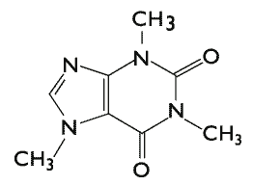
CS 5 Today
Rules: emphasize the elegance of 2 interacting rules…
2 rules: data by ref. vs. value: only show lists vs. ints
then, quiz
then, the advantage of ref. == lists' flexibility
2 rules: multiply by non-zero or add a multiple to another
2 rules: coming to life, staying alive
Coming up in CS 5:
Midterm exam
Anyone choose Gauss or Conway for Halloween?
Carl Gauss
in-class on Thu. 11/8
HW 9 (lab + 1 prob.)
due Monday, 11/12 at midnight
This week's credits:
I give you all the credit!
John Conway
Today's honorees: mathematicians…
Lecture 17

