Slide 1
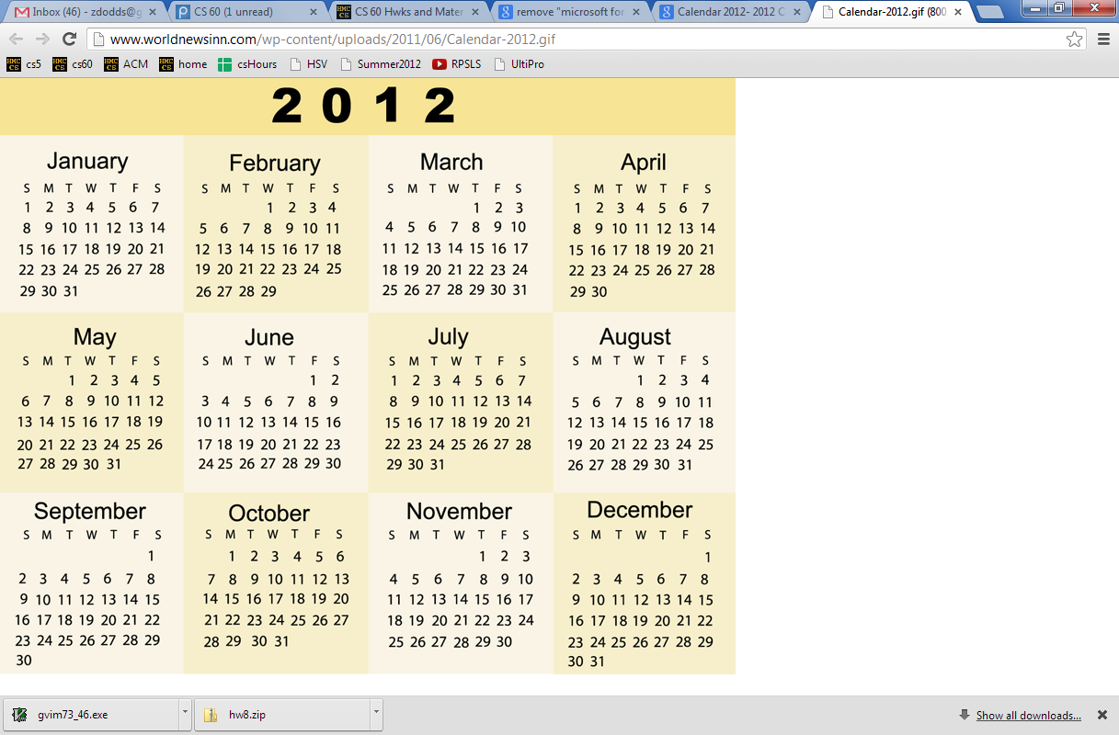
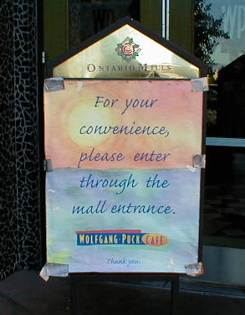
A whole new class of programming
CS 5 overview
Composing functions
Exams...
CS's building blocks
Designing Data!
The Date class
Theory & practice
whose convenience?

Slide 2
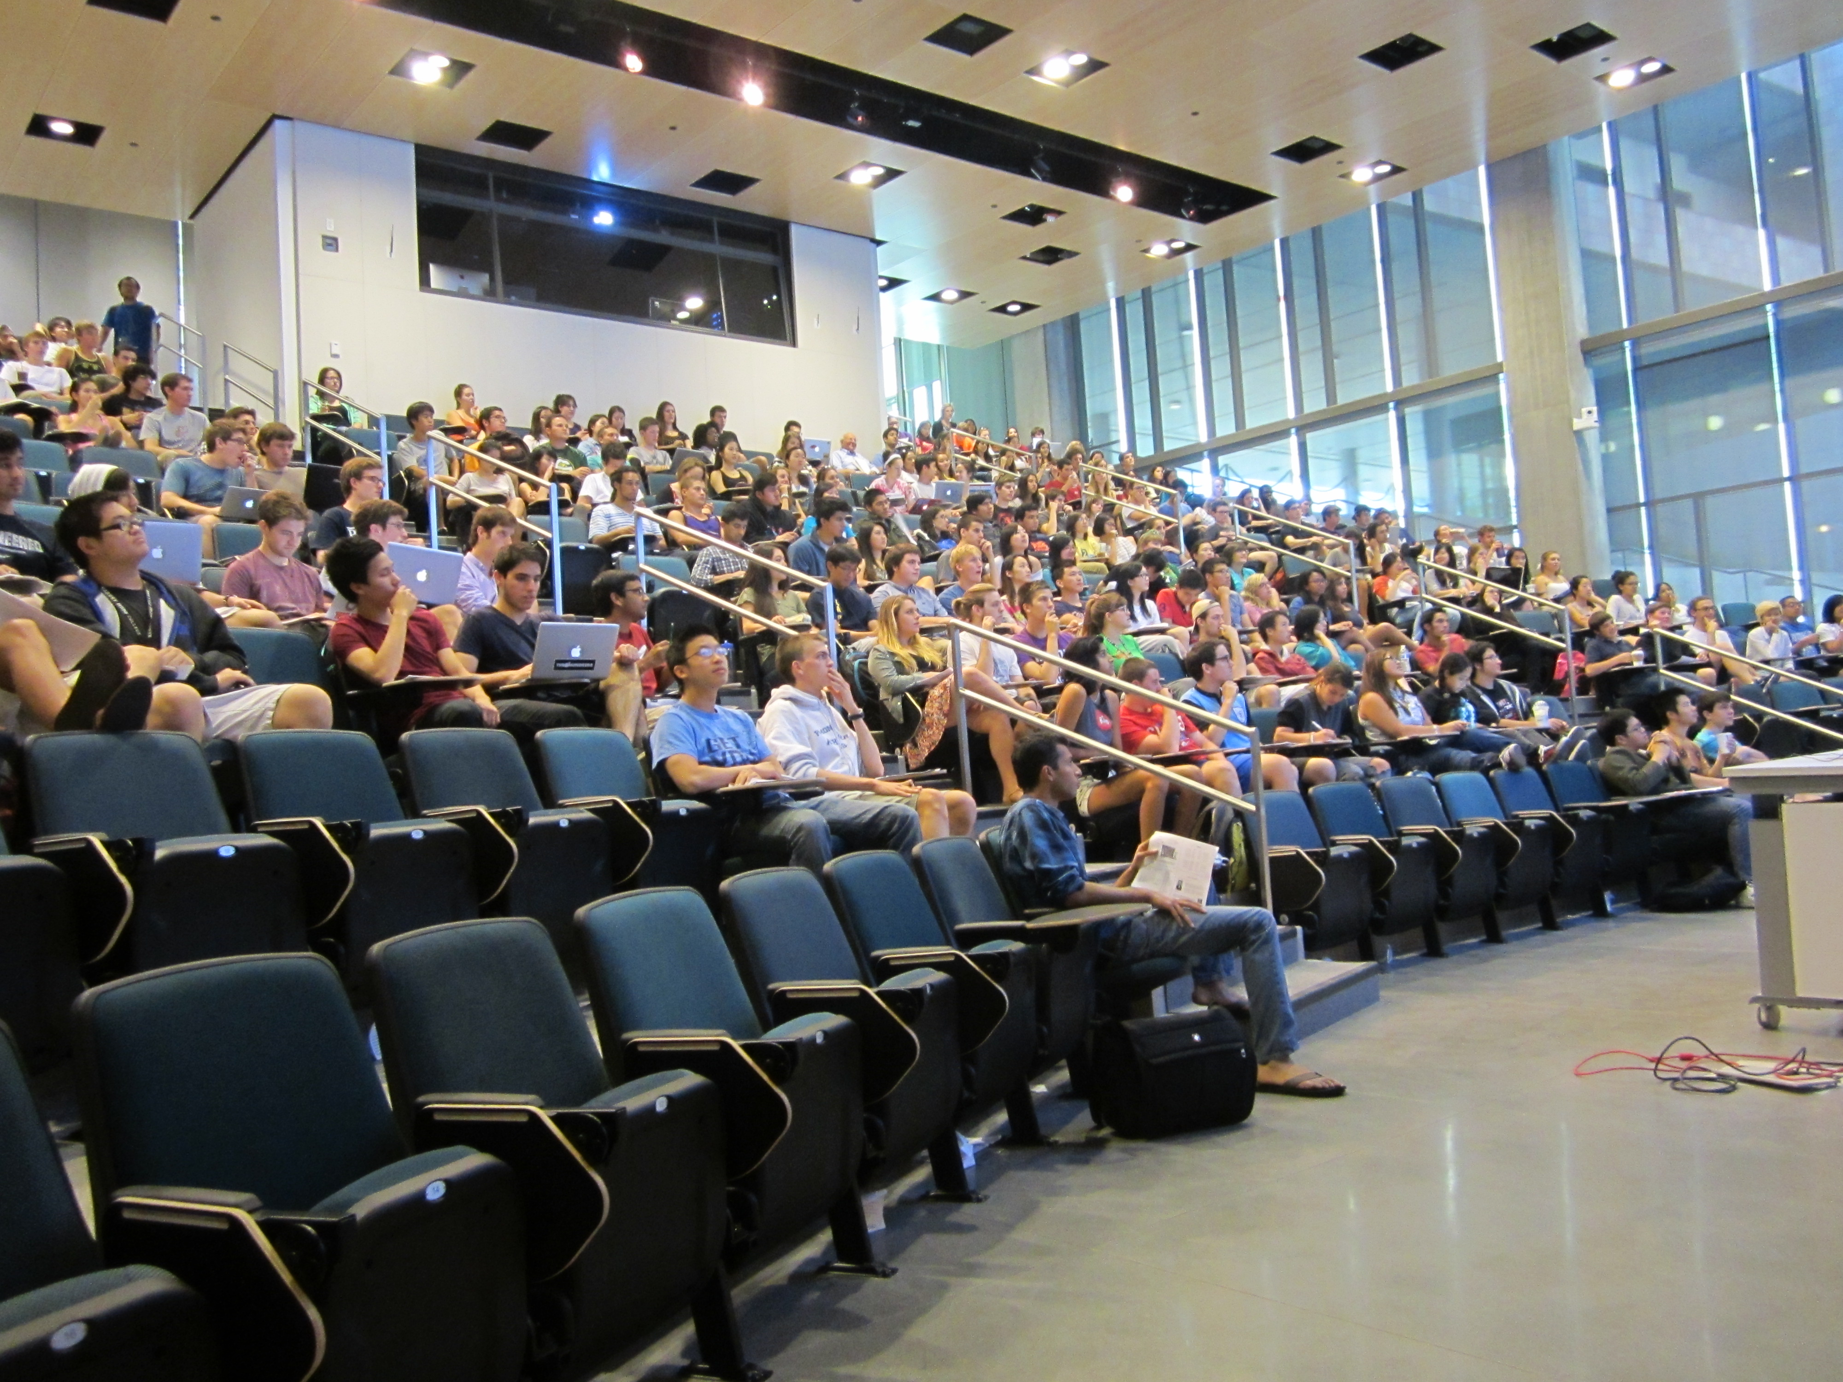
Thursday's AM class: in Shanahan
Lots of seats available!

Slide 3
A whole new class of programming
CS 5 overview
Composing functions
CS's building blocks
Designing Data!
The Date class
Theory & practice
whose convenience?

Slide 4
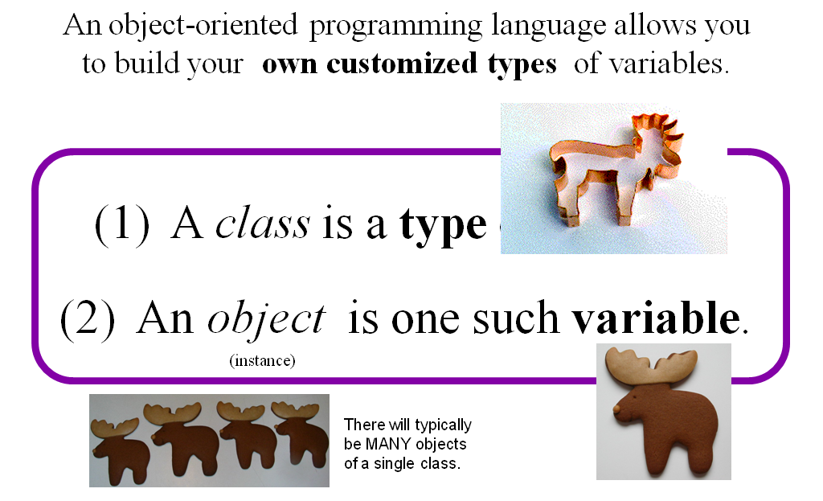
Classes and Objects

Slide 5
Everything in Python is an object!
Its capabilities depend on its class.
functions
type
"methods"
what's more, you can build your own...

Slide 6
Everything is an object?
Take strings, for example:
>>> s = str( 42 )
>>> type(s)
<type 'str'>
>>> dir(s)
['__add__', '__class__', '__contains__', '__delattr__', '__doc__', '__eq__', '__format__', '__ge__', '__getattribute__', '__getitem__', '__getnewargs__', '__getslice__', '__gt__', '__hash__', '__init__', '__le__', '__len__', '__lt__', '__mod__', '__mul__', '__ne__', '__new__', '__reduce__', '__reduce_ex__', '__repr__', '__rmod__', '__rmul__', '__setattr__', '__sizeof__', '__str__', '__subclasshook__', '_formatter_field_name_split', '_formatter_parser', 'capitalize', 'center', 'count', 'decode', 'encode', 'endswith', 'expandtabs', 'find', 'format', 'index', 'isalnum', 'isalpha', 'isdigit', 'islower', 'isspace', 'istitle', 'isupper', 'join', 'ljust', 'lower', 'lstrip', 'partition', 'replace', 'rfind', 'rindex', 'rjust', 'rpartition', 'rsplit', 'rstrip', 'split', 'splitlines', 'startswith', 'strip', 'swapcase', 'title', 'translate', 'upper', 'zfill']
This calls the str constructor.
Shows the type of s is str
Shows all of the methods (functions) of s
Let's try some!

Slide 7
Objects
Like a list, an object is a container, but much more customizable:
(1) Its data elements have names chosen by the programmer.
(2) An object contains its own functions, called methods
(3) In its methods, objects refer to themselves as self
(4) Python signals special methods with two underscores:
__init__ is called the constructor; it creates new objects
__repr__ tells Python how to print its objects
I guess we should doubly underscore these two methods!

Slide 8
A Date object, d
d
12
11
2013
day
month
year
memory location ~ 42042778

Slide 9
A Date object, d
d
12
11
2013
day
month
year
memory location ~ 42042778

Slide 10
class Date:
""" a blueprint (class) for objects
that represent calendar days
"""
def __init__( self, mo, dy, yr ):
""" the Date constructor """
self.month = mo
self.day = dy
self.year = yr
The Date class
This is the start of a new type called Date
It begins with the keyword class
This is the constructor for Date objects
As is typical, it assigns input data to the data members.
These are data members – they are the information inside every Date object.

Slide 11
Date
This is a class. It is a user-defined datatype that you'll build in Lab 9 this week…
>>> d = Date(11,12,2013)
>>> d.month
11
>>> d.day
12
add a print statement to see that this is OUR OWN code…
Constructor!
d contains data members named day, month, and year
>>> d
11/12/2013
The repr!
the representation of an object of type Date
The isLeapYear method returns True or False. How does it know what year to check?
>>> d.isLeapYear()
True

Slide 12
class Date:
""" a blueprint (class) for objects
that represent calendar days
"""
def __init__( self, mo, dy, yr ):
""" the Date constructor """
self.month = mo
self.day = dy
self.year = yr
def __repr__( self ):
""" used for printing Dates """
s = "%02d/%02d/%04d" % (self.month, self.day, self.year)
return s
The Date class
Why is everyone so far away?!
This is the repr for Date objects
It tells Python how to print these objects.
Why self instead of d ?

Slide 13
self
is the variable calling a method
>>> d = Date(11,12,2013)
>>> d
11/12/2013
>>> d.isLeapYear()
False
These methods need access to the object that calls them: it's self
>>> d2 = Date(1,1,2016)
>>> d2
01/01/2016
>>> d2.isLeapYear()
True

Slide 14
class Date:
""" a blueprint (class) for objects
that represent calendar days
"""
def __init__( self, mo, dy, yr ):
""" the Date constructor """
self.month = mo
self.day = dy
self.year = yr
def __repr__( self ):
""" used for printing Dates """
s = "%02d/%02d/%04d" % (self.month, self.day, self.year)
return s
def isLeapYear( self ):
""" anyone know the rule? """
The Date class
Why is everyone so far away?!
which are leap years?

Slide 15
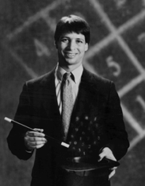
Lab today – or tomorrow
Add these to your Date class!
yesterday(self)
tomorrow(self)
addNDays(self, N)
subNDays(self, N)
isBefore(self, d2)
isAfter(self, d2)
diff(self, d2)
dow(self)
Prof. Benjamin !
no computer required…
and use your Date class to analyze our calendar a bit…

Slide 16
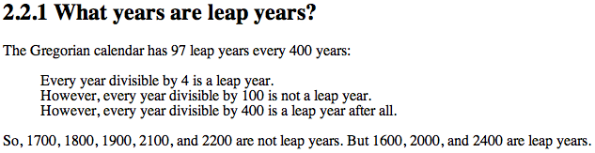
class Date:
def __init__( self, mo, dy, yr ): (constructor)
def __repr__(self): (for printing)
def isLeapYear( self ):
""" here it is """
if self.year%400 == 0: return True
if self.year%100 == 0: return False
if self.year%4 == 0: return True
return False

Slide 17
Date
>>> d = Date(12,31,2013)
>>> d
12/31/2013
always create with the CONSTRUCTOR …
the tomorrow method returns nothing at all. Is it doing anything?
>>> d.tomorrow()
>>> d
01/01/2014
>>> d.subNDays(50)
lots of printing, but no return value!
d has changed!
Why is this important?
Some methods return a value; others change the object that call it!

Slide 18
== != equals
UFO license
Area 51, CA
What id is on your Date?
>>> d = Date(11,12,2013)
>>> d
11/12/2013
>>> d2 = Date(11,12,2012)
>>> d2
11/12/2013
this constructs a different Date
>>> d == d2
False
How can this be False ?

Slide 19
== != equals
UFO license
Area 51, CA
What id is on your Date?
>>> d = Date(11,12,2013)
>>> d
11/12/2013
>>> d2 = Date(11,12,2012)
>>> d2
11/12/2013
this constructs a different Date
Python objects are handled by reference…
== compares references!
>>> d == d2
False
How can this be False ?

Slide 20
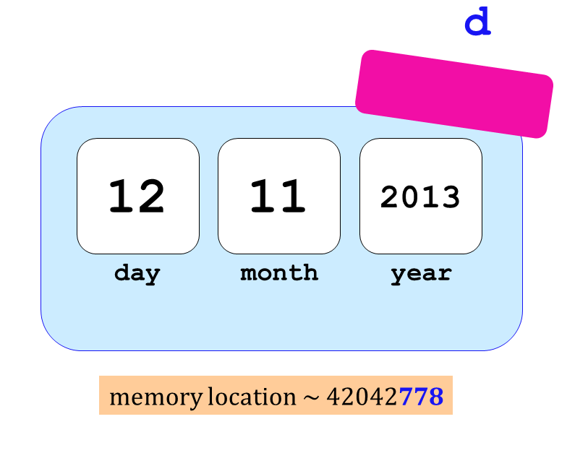

Two Date objects:
d
12
11
2013
day
month
year
memory location ~ 42042778
== compares memory locations, not contents
originals underneath…

Slide 21
== vs. equals
UFO license
Area 51, CA
What date is on your id?
What id is on your Date?
>>> d = Date(11,12,2013)
>>> d
11/12/2013
>>> d2 = Date(11,12,2013)
>>> d2
11/12/2013
this constructs a different Date
Python objects are handled by reference…
.equals compares contents
>>> d.equals(d2)
True

Slide 22
class Date:
def __init__( self, mo, dy, yr ):
def __repr__(self):
def isLeapYear(self):
def equals(self, d2):
""" returns True if they represent
the same date; False otherwise
"""
if
return True
else:
return False
equals
How many Dates are here?
Which one is selfish?

Slide 23
copy
class Date:
def __init__( self, mo, dy, yr ):
def __repr__(self):
def isLeapYear(self):
def equals(d,d2):
def copy(self):
""" returns a DIFFERENT object w/SAME date value! """
newd = Date( self.month, self.day, self.year )
return newd
Whenever you want to create a brand-new object, use the appropriate CONSTRUCTOR

Slide 24
Quiz
Name(s) _____________________________
class Date:
def isBefore(self, d2):
""" True if self is before d2, else False """
if self.year < d2.year:
return True
if self.month < d2.month:
return True
if self.day < d2.day:
return True
return False
(1) There's a bug here – what is it!?
>>> d = Date(1,1,2014)
>>> d2 = Date(11,12,2013)
>>> d.isBefore( d2 )
True
(2) How could we fix it?
Bug!

Slide 25
Quiz
class Date:
def tomorrow(self):
""" moves the date ahead 1 day """
DIM = [0,31,28,31,30,31,30,31,31,30,31,30,31]
Implement tomorrow !
Don't return anything. This CHANGES the date object that calls it.
first, add 1 to self.day
DIM looks pretty bright to me!
then, adjust the month and year, only if needed
Extra: how could you make this work in leap years!?

Slide 26
>>> d = Date(1,1,2014)
>>> d2 = Date(11,12,2013)
>>> d.isBefore( d2 )
True
class Date:
def isBefore(self, d2):
""" if self is before d2, this should
return True; else False """
if self.year < d2.year:
return True
if self.month < d2.month and
return True
if self.day < d2.day and
return True
return False
Bug!

Slide 27
I want even LESS !
class Date:
def isBefore(self, d2):
""" if self is before d2, this should
return True; else False """
if [self.year,self.month,self.day] <
[ d2.year, d2.month, d2.day]
return True
else:
return False
Whoa!

Slide 28

class Date:
def tomorrow(self):
""" moves the date ahead 1 day """
fdays = 28 + self.isLeapYear() # What ?!
DIM = [0,31,fdays,31,30,31,30,31,31,30,31,30,31]
self.day += 1 # add 1 to the day!
if self.day >

Slide 29
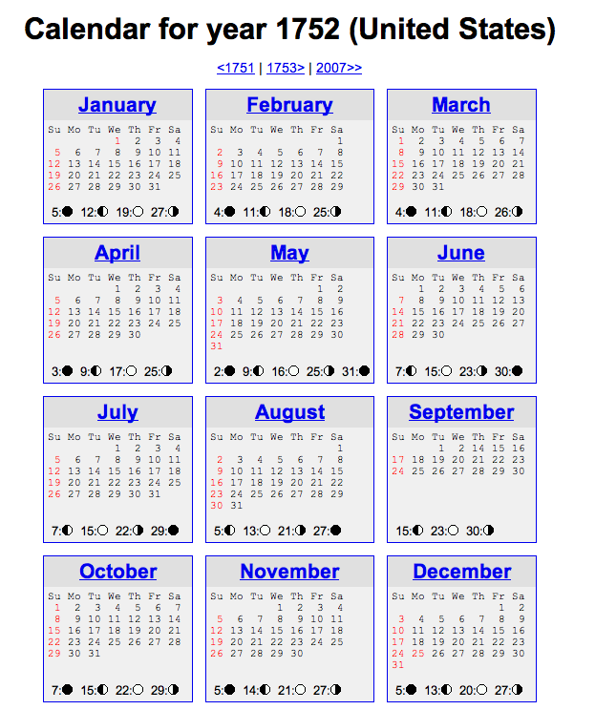
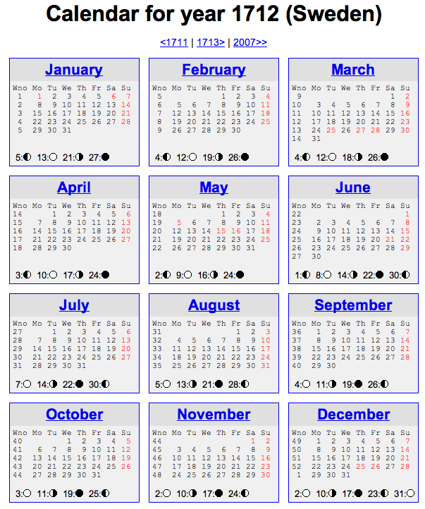
Unusual calendar years…

Slide 30
See you @ this week's lab …
… it's a Date!

Slide 31
class Date:
def tomorrow(self):
""" moves the date ahead 1 day """
fdays = 28 + self.isLeapYear() # What ?!
DIM = [0,31,fdays,31,30,31,30,31,31,30,31,30,31]

Slide 32
What's wrong?
d = Date(1,1,2012)
d2 = Date(11,8,2011)
d.isBefore( d2 )
True
class Date:
def isBefore(self, d2):
""" if self is before d2, this should
return True; else False """
if self.year < d2.year:
return True
if self.month < d2.month and
return True
if self.day < d2.day and
return True
return False

Slide 33
class Date:
def tomorrow(self):
""" moves the date that calls it ahead 1 day """
DIM = [0,31,28,31,30,31,30,31,31,30,31,30,31]

Slide 34
Everything in Python is an object!

Slide 35
class Date:
""" a blueprint (class) for objects
that represent calendar days
"""
def __init__( self, mo, dy, yr ):
""" the Date constructor """
self.month = mo
self.day = dy
self.year = yr
def __repr__( self ):
""" used for printing Dates """
s = "%02d/%02d/%04d" % (self.month, self.day, self.year)
return s
def isLeapYear( self ):
""" anyone know the rule? """
The Date class
See docs.python.org/library/string.html
Why is everyone so far away?!

Slide 36
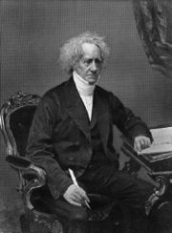
a Leap of faith….
class Date:
def __init__( self, mo, dy, yr ): (constructor)
def __repr__(self): (for printing)
def isLeapYear( self ):
""" here it is """
if self.year%400 == 0: return True
if self.year%100 == 0: return False
if self.year%4 == 0: return True
return False
How about a 4000-year rule?
John Herschel

Slide 37
More Date
class Date:
def __init__( self, mo, dy, yr ):
def __repr__(self):
def isLeapYear(self):
def copy(self):
""" returns a DIFFERENT object w/SAME date! """
def equals(self, d2):
""" returns True if they represent
the same date; False otherwise
"""
How many Dates are here?
Would two be selfish?

Slide 38
class Date:
def isBefore(self, d2):
""" if self is before d2, this should
return True; else False """
if self.year < d2.year: return True
if self.month < d2.month: return True
if self.day < d2.day: return True
return False
def tomorrow(self):
""" moves the date that calls it ahead 1 day """
DIM = [0,31,28,31,30,31,30,31,31,30,31,30,31]
Quiz
Name: ______________
This method is WRONG! Find why … and suggest how you could fix it!
Hint:
d = Date(1,1,2012)
d2 = Date(11,8,2011)
d.isBefore( d2 )
True
DIM looks pretty bright to me!
Write this tomorrow method.
It does not return anything. It just CHANGES the date object that calls it.

Slide 39
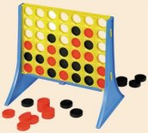
Designing classes
1) What data? (Data Members)
Not limited to 7x6!
2) What are the key capabilities? (Methods)

Slide 40
Connect Four: the object b
list
str
str
str
str
Board
b
data
str
str
str
str
?
str
str
str
str
4
int
width
3
int
height
Starting from b, how would you access the string marked by the ?

Slide 41
Object example: strings
Constructor!
s = str('harvey mudd college')
dir(s)
s.split()
s.__len__() # I should underscore this point!
s.title() # an entitlement?
20*'spam'.title() # how many capital S's?
('spam'*20).title()

Slide 42
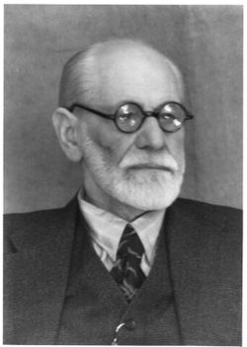

Everything in python is an object
Demo!
x = 20
y = 22
x.__add__(y) # either way!
# even this!
(19).__add__(23)
id(x)
id(y)
Hey! No other aliens allowed!
You mean superego?
My ego approves!

Slide 43
A complex object:
It seems clear enough to me!
>>> z = complex(3,4)
>>> z
(3+4j)
>>> dir(z)
all of the data members and methods of the complex class (and thus the object z !)
>>> z.imag
4.0
>>> z.conjugate()
3-4j
a data member of all objects of class complex
its value for this object, z
a method (function) within all objects of class complex
its return value for this object, z

Slide 44
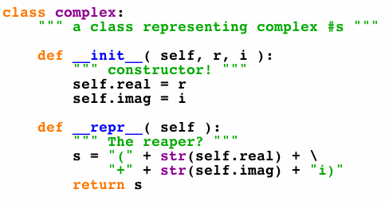
A complex class:
will have more methods (functions), too...
defines the type of our complex-number objects

Slide 45
Connect Four: constructor
class Board:
""" a datatype representing a C4 board
with an arbitrary number of rows and cols
"""
def __init__( self, width, height ):
""" the constructor for objects of type Board """
self.width = width
self.height = height
self.data = [] # this will be the board
self.data = [ [' ']*self.width for row in range(self.height) ]
What was this called again… ?
Notes:
45

Slide 46
Objects ~ DOTs !
Constructor!
s = str('harvey mudd college')
dir(s)
s.spit()
s.__len__() # I should underscore this point!
s.title() # an entitlement?
20*'spam'.title() # how many capital S's?
('spam'*20).title()
What, the L ?

Slide 47
Everything in python is an object
Demo!
x = 20
y = 22
x.__add__(y) # either way!
# even this!
(19).__add__(23)
id(x)
id(y)
Hey! No other aliens allowed!
You mean superego?
My ego approves!

Slide 48
dir and help !
provide all of the methods and data members available to an object
dir('any string')
help(''.count)
dir(42)
dir( [] )
No memorizing! Just use dir & help…
try sort!

Slide 49
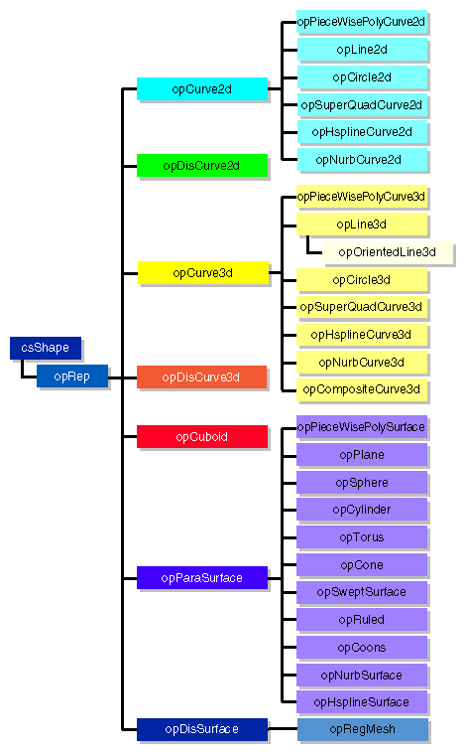
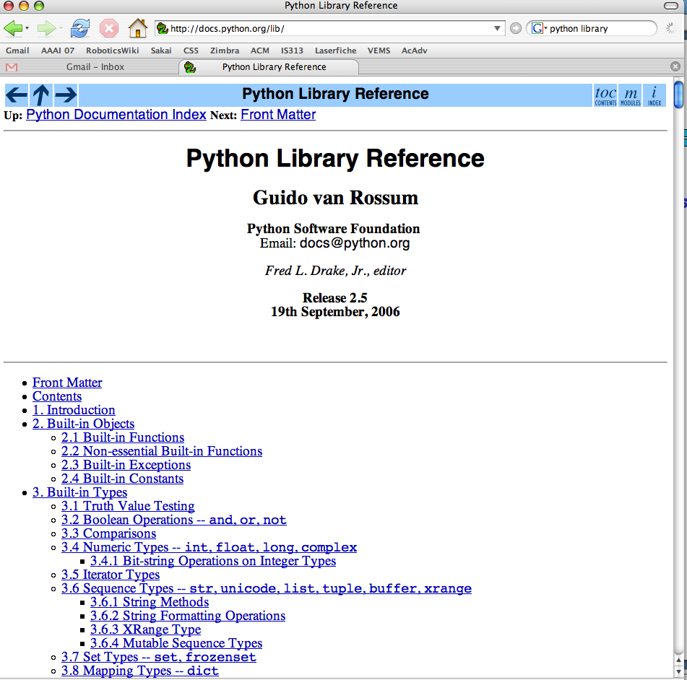
Examples…
Graphics libraries
Python's class libraries…
Do reference libraries have library references?
http://docs.python.org/lib/

Slide 50
Lists: the good and bad...
+
lots of computer work for little programmer work!
Here's a list for Feb. 29, 2010:
A = [ 2, 29, 2010 ]
2
29
2010
list
int
int
int
A
A[0]
A[1]
A[2]

Slide 51
Lists: the good and bad...
+
lots of computer work for little programmer work!
only generic capabilities, e.g., len, print
-
only square-bracket naming, e.g.,
A[i]
no data consistency checks
A = [ 2, 29, 2010 ]
2
29
Something is wrong with this date!
2010
list
int
int
int
A
A[0]
A[1]
A[2]
Classes and Objects take care of all 3 drawbacks...

Slide 52
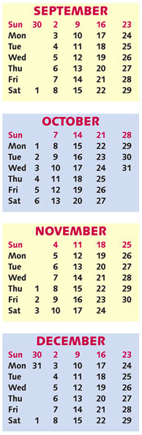
CS 5 today
A whole new class of programming
Composing functions
CS's building blocks
Designing Data!
The Date class
whose convenience?
Exams?

Slide 53
Objects ~ DOTs !
Constructor!
s = str('harvey mudd college')
dir(s)
s.spit()
s.__len__() # I should underscore this point!
s.title() # an entitlement?
20*'spam'.title() # how many capital S's?
('spam'*20).title()
What, the L ?

Slide 54
Everything in python is an object
Demo!
x = 20
y = 22
x.__add__(y) # either way!
# even this!
(19).__add__(23)
id(x)
id(y)
Hey! No other aliens allowed!
You mean superego?
My ego approves!

Slide 55
Lists: the good and bad...
+
lots of computer work for little programmer work!
only generic capabilities, e.g., len, print
-
only square-bracket naming, e.g.,
A[i]
no data consistency checks
A = [ 2, 29, 2010 ]
2
29
Something is wrong with this date!
2010
list
int
int
int
A
A[0]
A[1]
A[2]
Classes and Objects take care of all 3 drawbacks...

Slide 56
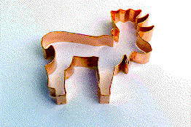

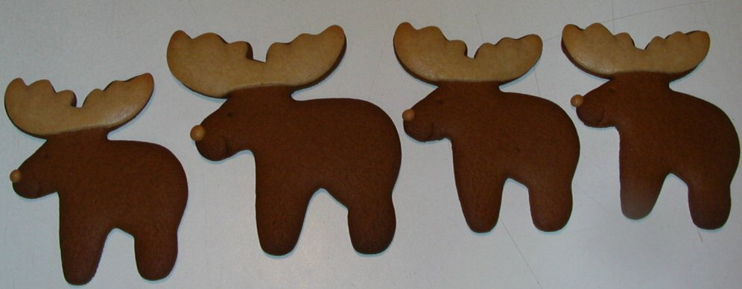
Classes & Objects
An object-oriented programming language allows you to build your own customized types of variables.
(1) A class is a type of variable.
(2) An object is one such variable.
(instance)
There will typically be MANY objects of a single class.

Slide 57
A complex object:
It seems clear enough to me!
>>> z = complex(3,4)
>>> z
(3+4j)
>>> dir(z)
all of the data members and methods of the complex class (and thus the object z !)
>>> z.imag
4.0
>>> z.conjugate()
3-4j
a data member of all objects of class complex
its value for this object, z
a method (function) within all objects of class complex
its return value for this object, z

Slide 58
A complex class:
will have more methods (functions), too...
defines the type of our complex-number objects

Slide 59
Objects
An object is a container data structure - like a list - except
(1) Its data elements have names chosen by the programmer.
(2) An object contains its own functions that it can call!
usually called "methods" instead of functions:
__init__
__repr__
the constructor
the repr (for printing)
(3) Thus, an object can take care of itself !
I guess he wants to underscore these two methods!

Slide 60
Date
This is a class. It is a user-defined datatype (that you'll build in Lab this week!)
>>> d = Date(10,9,2010)
>>> d
10/09/2010
this is a CONSTRUCTOR …
What does it do?
this is an object of type Date
the representation of a particular object of type Date
>>> d.isLeapYear()
False
the isLeapYear method returns True or False. How does it know what year to check?
>>> d2 = Date(1,1,2012)
>>> d2
01/01/2012
>>> d2.isLeapYear()
True
Another object of type Date - again, from the constructor.
How does it know to return True, instead of False in this case ??

Slide 61
class Date:
""" a blueprint (class) for objects
that represent calendar days
"""
def __init__( self, mo, dy, yr ):
""" the Date constructor """
self.month = mo
self.day = dy
self.year = yr
def __repr__( self ):
""" used for printing Dates """
s = "%02d/%02d/%04d" % (self.month, self.day, self.year)
return s
def isLeapYear( self ):
""" anyone know the rule? """
The Date class
See docs.python.org/library/string.html
Why is everyone so far away?!

Slide 62
self
is the specific OBJECT THAT CALLS A METHOD
>>> d = Date(11,9,2010)
>>> d
11/09/2010
These methods need access to the object that calls them
>>> d.isLeapYear()
True
>>> d2 = Date(1,1,2012)
>>> d2
12/31/2007
>>> d2.isLeapYear()
False
These methods need access to the object that calls them

Slide 63
a Leap of faith….
class Date:
def __init__( self, mo, dy, yr ): (constructor)
def __repr__(self): (for printing)
def isLeapYear( self ):
""" here it is """
if self.year%400 == 0: return True
if self.year%100 == 0: return False
if self.year%4 == 0: return True
return False
John Herschel
How about a 4000-year rule?

Slide 64
Date
>>> d = Date(1,1,2011)
>>> d
1/1/2011
always created with the CONSTRUCTOR …
>>> d.yesterday()
>>> d
12/31/2010
>>> d.subNDays(52)
lots of printing, but no return value!
>>> d
the yesterday method returns nothing at all. Is it doing anything?
d has changed!
Why is this important?
Some methods return a value; others change the object that call it!

Slide 65
Date ids
What date is on your id?
What id is on your Date?
UFO license
Area 51, CA
>>> d = Date(11,9,2010)
>>> d
11/09/2010
>>> d2 = Date(11,10,2010)
>>> d2
11/10/2010
this initializes a different Date!
>>> d == d2
?
>>> d2.yesterday()
>>> d == d2
?

Slide 66
Excuse me -- ids please!
Double Date
>>> d2 = d
>>> d
11/09/2010
>>> d.yesterday()
>>> d2
?
>>> d2 = d.copy()
>>> d2 == d
?
>>> d.equals(d2)
?
How many Dates are here?

Slide 67
More Date
class Date:
def __init__( self, mo, dy, yr ):
def __repr__(self):
def isLeapYear(self):
def copy(self):
""" returns a DIFFERENT object w/SAME date! """
def equals(self, d2):
""" returns True if they represent
the same date; False otherwise
"""
How many Dates are here?
Would two be selfish?

Slide 68
What's wrong?
d = Date(1,1,2011)
d2 = Date(11,9,2010)
d.isBefore( d2 )
True
class Date:
def isBefore(self, d2):
""" if self is before d2, this should
return True; else False """
if self.year < d2.year:
return True
if self.month < d2.month:
return True
if self.day < d2.day:
return True
return False

Slide 69
class Date:
def tomorrow(self):
""" moves the date that calls it ahead 1 day """
DIM = [0,31,28,31,30,31,30,31,31,30,31,30,31]

Slide 70
Lab today – or tomorrow
Add to Date these methods:
no computer required…
yesterday(self)
tomorrow(self)
addNDays(self, N)
subNDays(self, N)
isBefore(self, d2)
isAfter(self, d2)
diff(self, d2)
dow(self)
Prof. Art Benjamin
and use your Date class to analyze our calendar a bit…

Slide 71
Unusual calendar years…

Slide 72
Designing classes
1) What data? (Data Members)
Not limited to 7x6!
2) What are the key capabilities? (Methods)

Slide 73
Connect Four: the object b
list
str
str
str
str
Board
b
data
str
str
str
str
?
str
str
str
str
4
int
width
3
int
height
Starting from b, how would you access the string marked by the ?

Slide 74
Classes & Objects
An object-oriented programming language allows you to build your own customized types of variables.
(1) A class is a type of variable.
(2) An object is one such variable.
(instance)
There will typically be MANY objects of a single class.

Slide 75
Connect Four: constructor
class Board:
""" a datatype representing a C4 board
with an arbitrary number of rows and cols
"""
def __init__( self, width, height ):
""" the constructor for objects of type Board """
self.width = width
self.height = height
self.data = [] # this will be the board
self.data = [ [' ']*self.width for row in range(self.height) ]
What was this called again… ?
Notes:
75

