Slide 1
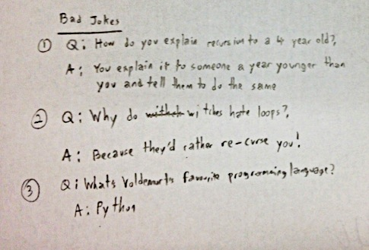
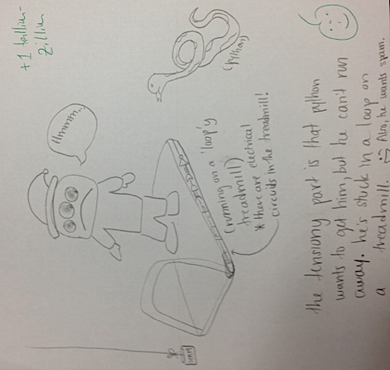
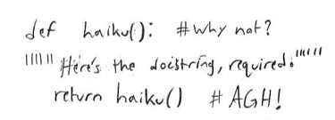
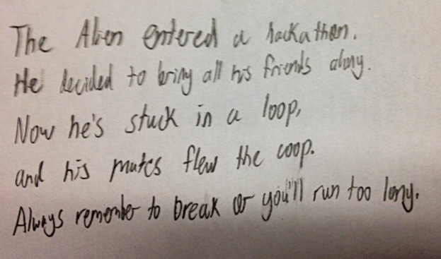
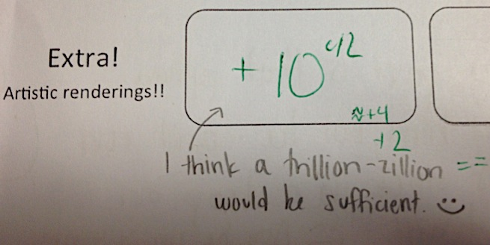
Sangheetha N.
Angelica V.
Patrick S.

Slide 2
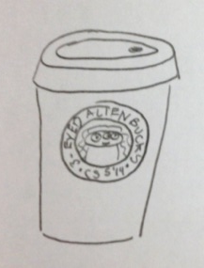
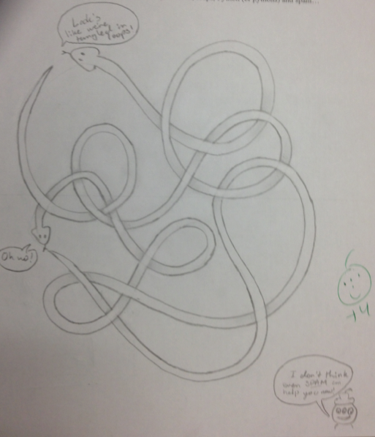
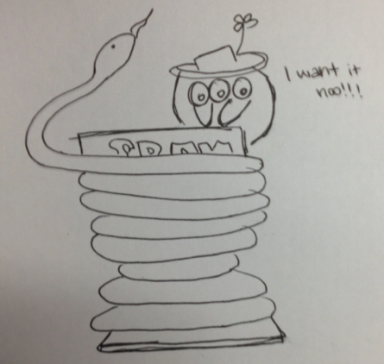
Isabel M.-R.
Lupe M.

Slide 3
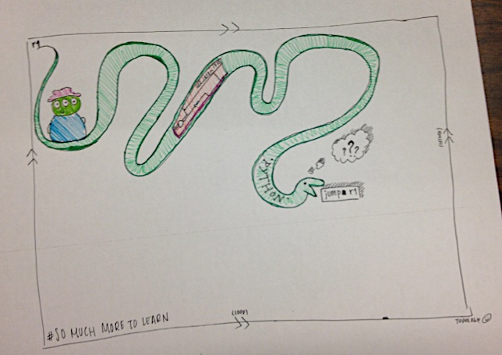
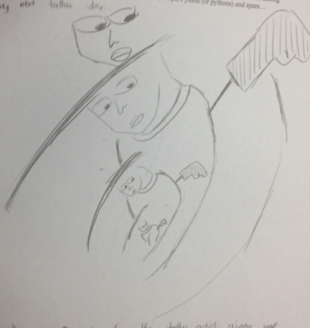
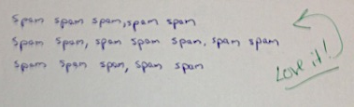
Richard N.
Hana S.
Jacob R.

Slide 4
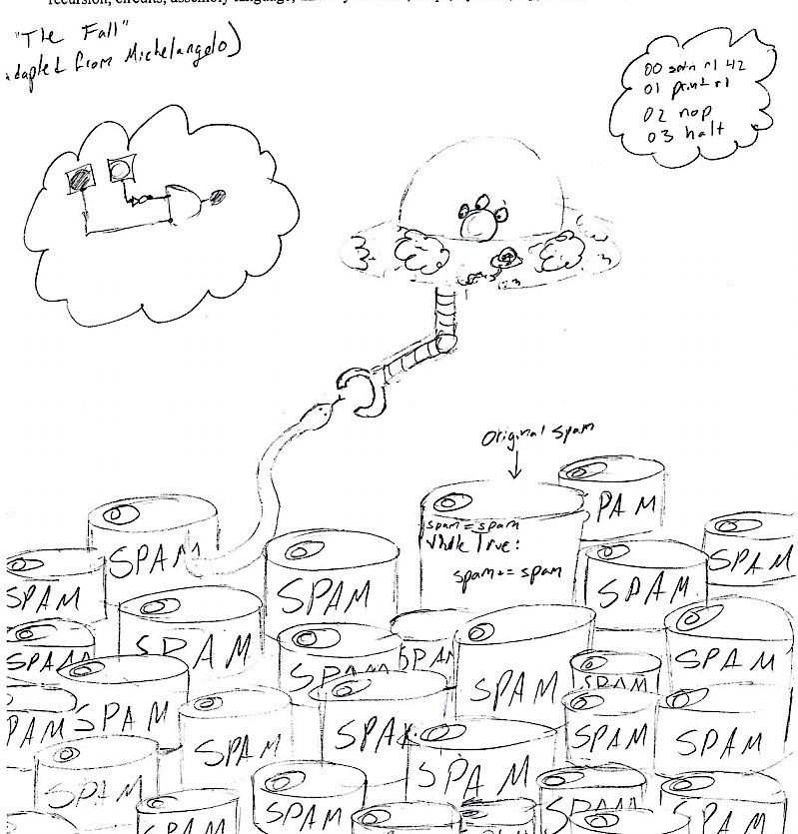
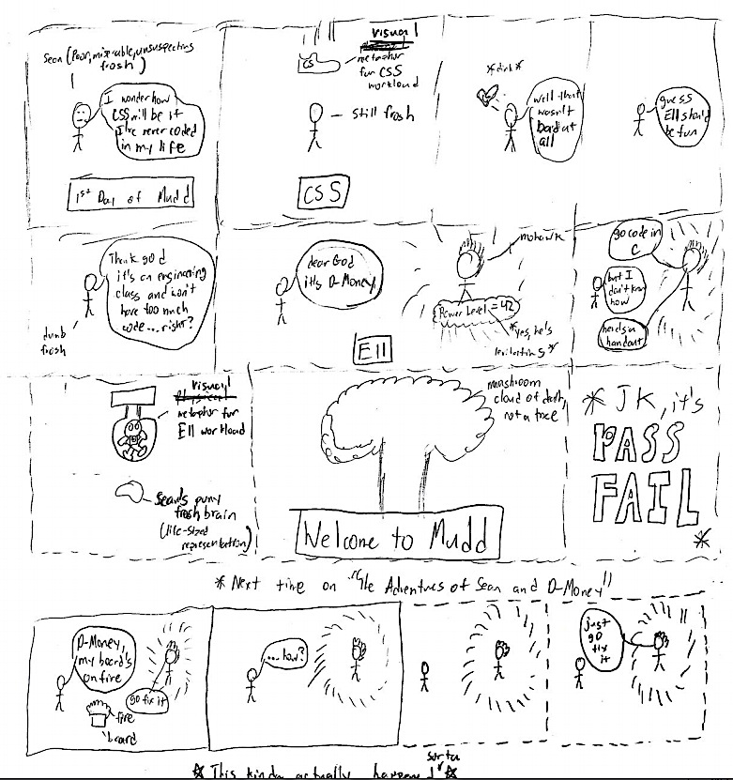
Michelangelo and XKCD would be proud!
Randall Monroe
Annie L.
Sean N.

Slide 5
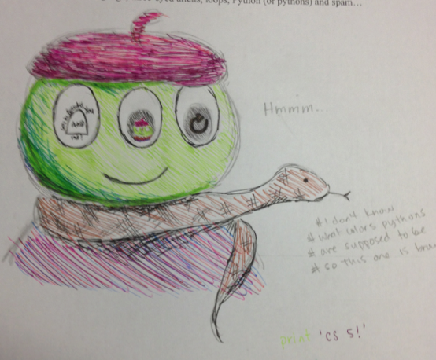
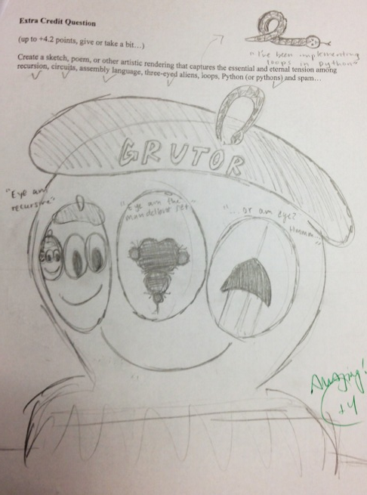
Some recursive (happy) aliens…
Sally C.
Kristin L.

Slide 6
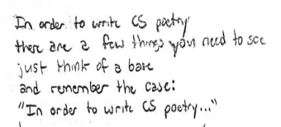
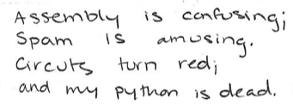
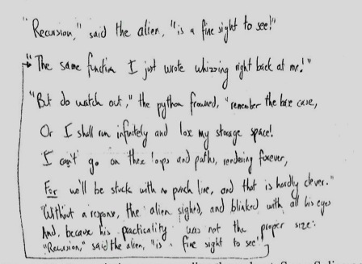
Aaron F.
Ashley G.
Julia C.

Slide 7
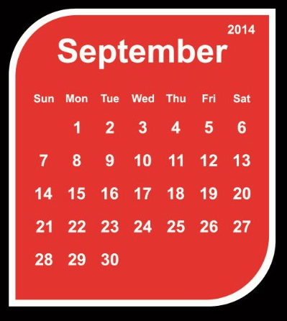
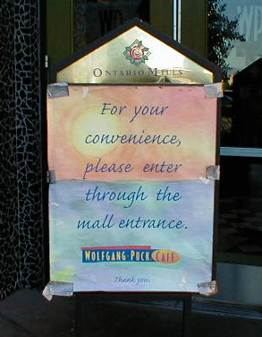
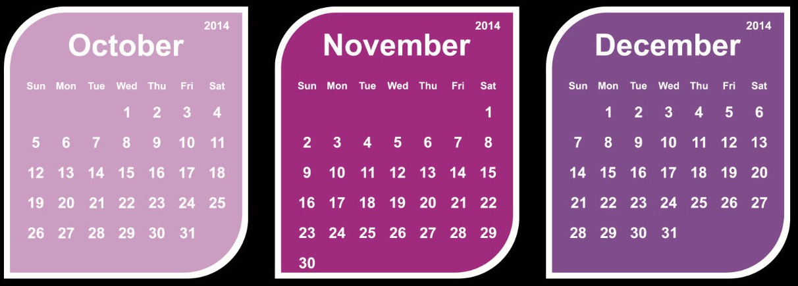
A whole new class of programming
CS 5 overview
Composing functions
Exams...
CS's building blocks
The Date class
Designing Data!
CS: Theory & practice
Solutions… (Keep within this term's CS5)
whose convenience?

Slide 8
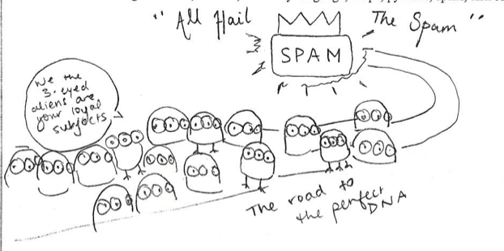
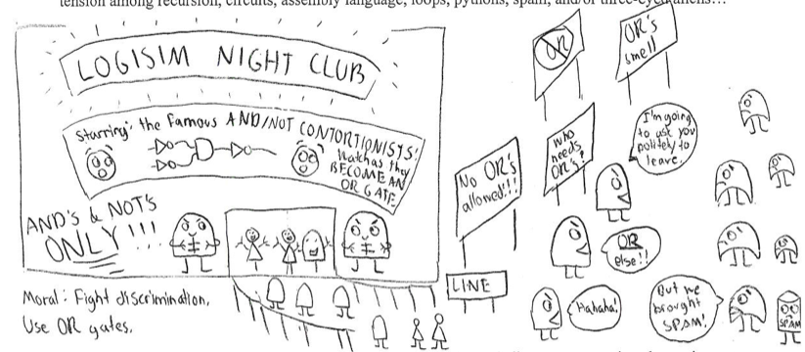
Aish S.
Alicia M.

Slide 9
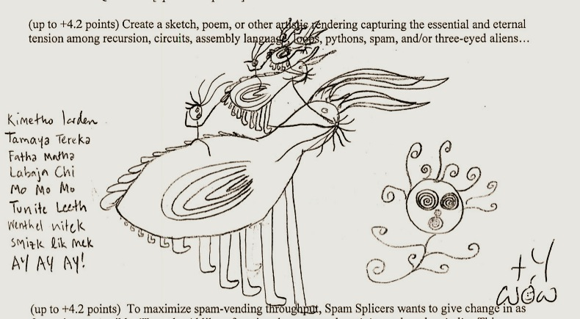
Nicki M.

Slide 10
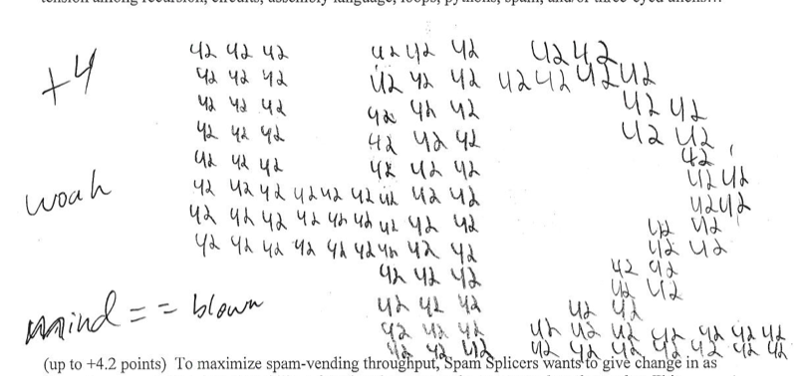
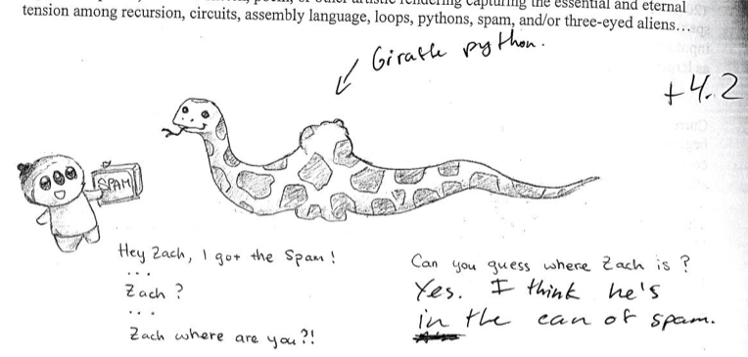
Charles McG.
Hope Y.

Slide 11
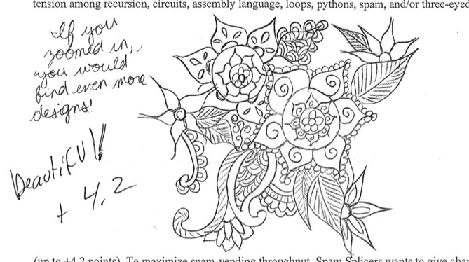
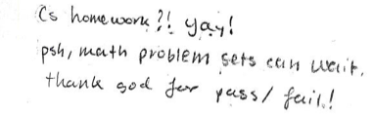
Carli L.
Jared G.
Dylan B.

Slide 12
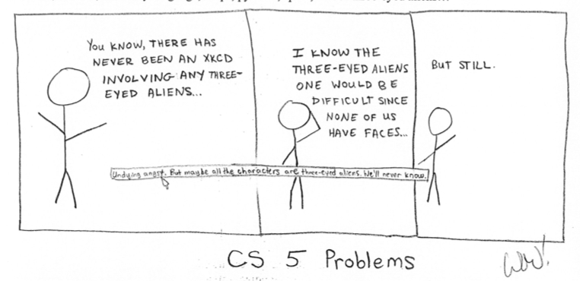
XKCD would be proud!
Randall Monroe

Slide 13
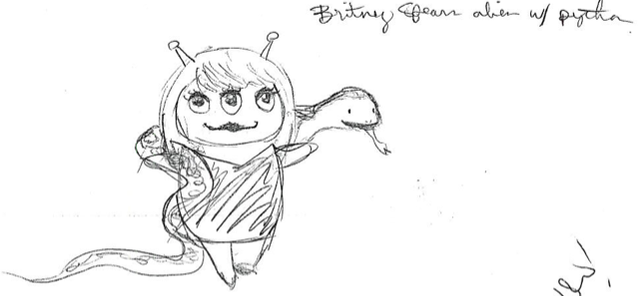
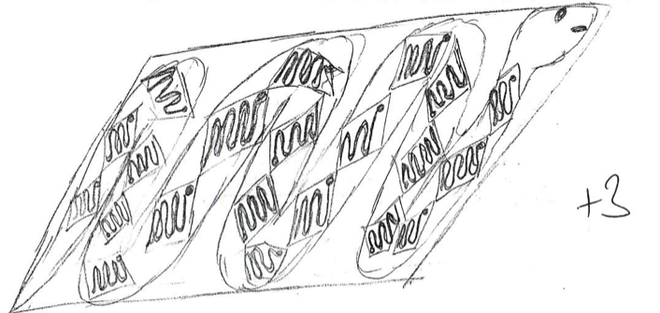
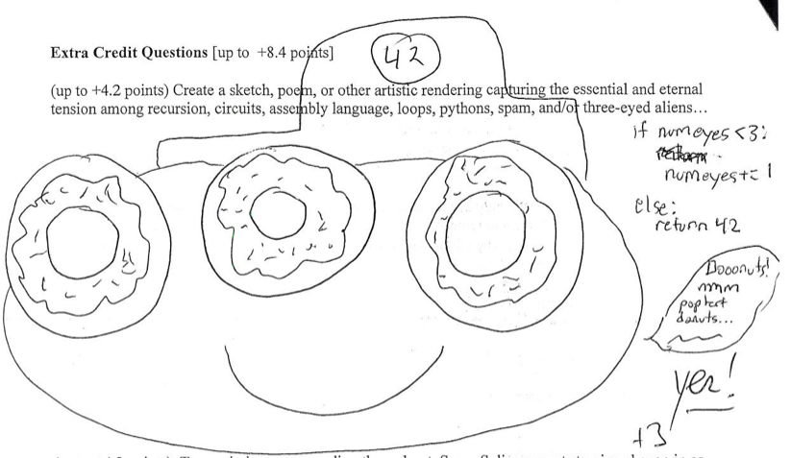
Hannah K.
Olivia S.
Luke S.

Slide 14
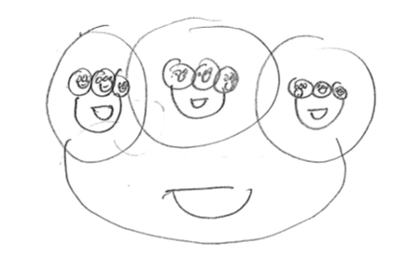
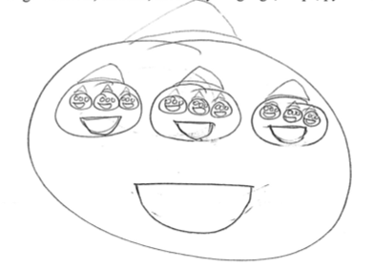
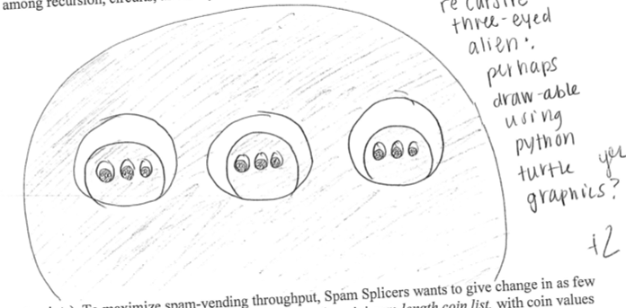
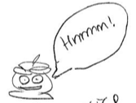
Some recursive (happy) aliens…
two eyes?

Slide 15
A whole new class of programming
CS 5 overview
Composing functions
CS's building blocks
The Date class
Designing Data!
CS: Theory & practice
whose convenience?

Slide 16
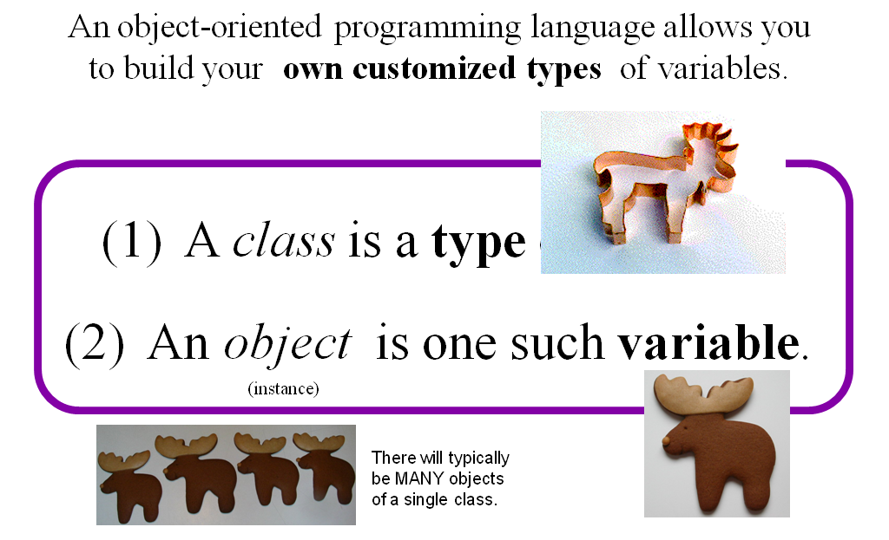
Classes and Objects

Slide 17
Everything in Python is an object!
Its capabilities depend on its class.
functions
type
"methods"
what's more, you can build your own...

Slide 18
Everything is an object?
Take strings, for example:
>>> s = str( 42 )
>>> type(s)
<type 'str'>
>>> dir(s)
['__add__', '__class__', '__contains__', '__delattr__', '__doc__', '__eq__', '__format__', '__ge__', '__getattribute__', '__getitem__', '__getnewargs__', '__getslice__', '__gt__', '__hash__', '__init__', '__le__', '__len__', '__lt__', '__mod__', '__mul__', '__ne__', '__new__', '__reduce__', '__reduce_ex__', '__repr__', '__rmod__', '__rmul__', '__setattr__', '__sizeof__', '__str__', '__subclasshook__', '_formatter_field_name_split', '_formatter_parser', 'capitalize', 'center', 'count', 'decode', 'encode', 'endswith', 'expandtabs', 'find', 'format', 'index', 'isalnum', 'isalpha', 'isdigit', 'islower', 'isspace', 'istitle', 'isupper', 'join', 'ljust', 'lower', 'lstrip', 'partition', 'replace', 'rfind', 'rindex', 'rjust', 'rpartition', 'rsplit', 'rstrip', 'split', 'splitlines', 'startswith', 'strip', 'swapcase', 'title', 'translate', 'upper', 'zfill']
This calls the str constructor.
Shows the type of s is str
Shows all of the methods (functions) of s
Let's try some!

Slide 19
Objects
Like a list, an object is a container, but much more customizable:
(1) Its data elements have names chosen by the programmer.
(2) An object contains its own functions, called methods
(3) In its methods, objects refer to themselves as self
(4) Python signals special methods with two underscores:
__init__ is called the constructor; it creates new objects
__repr__ tells Python how to print its objects
I guess we should doubly underscore these two methods!

Slide 20
A Date object, d
d
11
11
2014
day
month
year
memory location ~ 42042778

Slide 21
A Date object, d
d
11
11
2014
day
month
year
memory location ~ 42042778

Slide 22
class Date:
""" a blueprint (class) for objects
that represent calendar days
"""
def __init__( self, mo, dy, yr ):
""" the Date constructor """
self.month = mo
self.day = dy
self.year = yr
The Date class
what?!

Slide 23
class Date:
""" a blueprint (class) for objects
that represent calendar days
"""
def __init__( self, mo, dy, yr ):
""" the Date constructor """
self.month = mo
self.day = dy
self.year = yr
The Date class
This is the start of a new type called Date
It begins with the keyword class
This is the constructor for Date objects
As is typical, it assigns input data to the data members.
These are data members – they are the information inside every Date object.

Slide 24
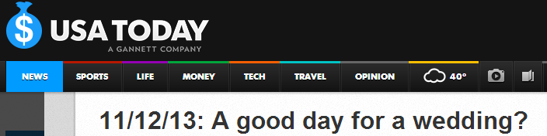
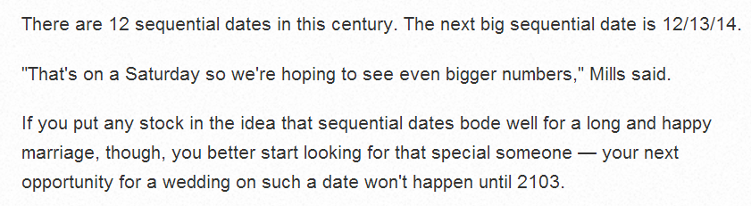
Today? 11/11/14

Slide 25
Date
This is a class. It is a user-defined datatype that you'll build in Lab 10 this week…
>>> d = Date(11,11,2014)
>>> d.month
11
>>> d.day
11
add a print statement to see that this is OUR OWN code…
Constructor!
d contains data members named day, month, and year
>>> d
11/11/2014
The repr!
the representation of an object of type Date
The isLeapYear method returns True or False. How does it know what year to check?
>>> d.isLeapYear()
False

Slide 26
class Date:
""" a blueprint (class) for objects
that represent calendar days
"""
def __init__( self, mo, dy, yr ):
""" the Date constructor """
self.month = mo
self.day = dy
self.year = yr
def __repr__( self ):
""" used for printing Dates """
s = "%02d/%02d/%04d" % (self.month, self.day, self.year)
return s
The Date class
Why is everyone so far away?!
This is the repr for Date objects
It tells Python how to print these objects.
Why self instead of d ?

Slide 27
self
is the variable calling a method
>>> d = Date(11,11,2014)
>>> d
11/11/2014
>>> d.isLeapYear()
False
These methods need access to the object that calls them: it's self
>>> d2 = Date(1,1,2016)
>>> d2
01/01/2016
>>> d2.isLeapYear()
True

Slide 28
class Date:
""" a blueprint (class) for objects
that represent calendar days
"""
def __init__( self, mo, dy, yr ):
""" the Date constructor """
self.month = mo
self.day = dy
self.year = yr
def __repr__( self ):
""" used for printing Dates """
s = "%02d/%02d/%04d" % (self.month, self.day, self.year)
return s
def isLeapYear( self ):
""" anyone know the rule? """
The Date class
Why is everyone so far away?!
which are leap years?

Slide 29
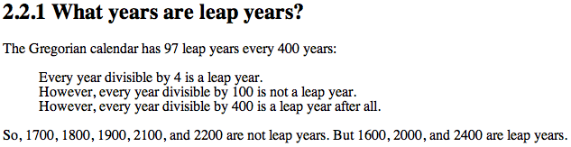
class Date:
def __init__( self, mo, dy, yr ): (constructor)
def __repr__(self): (for printing)
def isLeapYear( self ):
""" here it is """
if self.year%400 == 0: return True
if self.year%100 == 0: return False
if self.year%4 == 0: return True
return False

Slide 30
== vs. equals
UFO license
Area 51, CA
What id is on your Date?
>>> d = Date(11,12,2013)
>>> d
11/12/2013
>>> d2 = Date(11,12,2013)
>>> d2
11/12/2013
this constructs a different Date
Python objects are handled by reference…
== compares references!
>>> d == d2
False
How can this be False ?

Slide 31
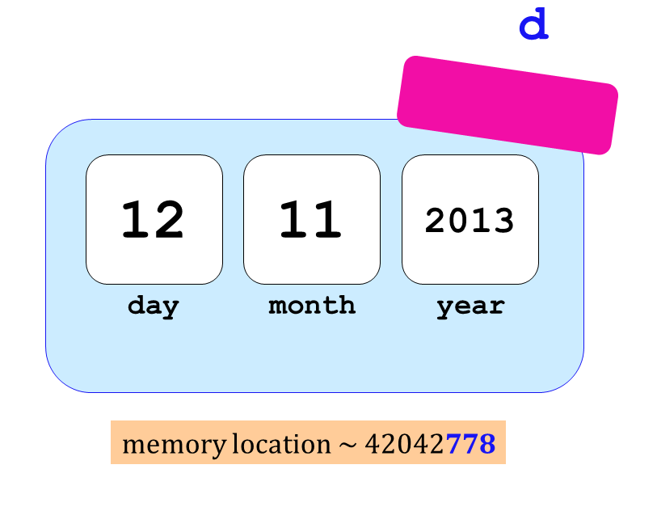

Two Date objects:
d
12
11
2013
day
month
year
memory location ~ 42042778
== compares memory locations, not contents
originals underneath…

Slide 32
== vs. equals
UFO license
Area 51, CA
What date is on your id?
What id is on your Date?
>>> d = Date(11,12,2013)
>>> d
11/12/2013
>>> d2 = Date(11,12,2013)
>>> d2
11/12/2013
this constructs a different Date
Python objects are handled by reference…
.equals compares contents
>>> d.equals(d2)
True

Slide 33
class Date:
def __init__( self, mo, dy, yr ):
def __repr__(self):
def isLeapYear(self):
def equals(self, d2):
""" returns True if they represent
the same date; False otherwise
"""
if
return True
else:
return False
equals
How many Dates are here?
Which one is selfish?

Slide 34
>>> d = Date(1,1,2014)
>>> d2 = Date(11,12,2013)
>>> d.isBefore( d2 )
False
isBefore
class Date:
def isBefore(self, d2):
""" if self is before d2, this should
return True; else False """
if self.year < d2.year: return True
if self.year > d2.year: return False
# here, the years are EQUAL!
if self.month < d2.month: return True
if self.month > d2.month: return False
# here, the years and months are EQUAL!
if self.day < d2.day: return True
return False
too much code, perhaps!

Slide 35
I want even LESS !
isBefore
class Date:
def isBefore(self, d2):
""" if self is before d2, this should
return True; else False """
if [self.year,self.month,self.day] <
[ d2.year, d2.month, d2.day]
return True
else:
return False
Whoa!

Slide 36
Date's purpose…?!
>>> d = Date(12,31,2014)
>>> d
12/31/2014
always create with the CONSTRUCTOR …
the tomorrow method returns nothing at all. Is it doing anything?
>>> d.tomorrow()
>>> d
01/01/2015
>>> d.subNDays(50)
lots of printing, but no return value!
d has changed!
Why is this important?
Some methods return a value; others change the object that call it!

Slide 37
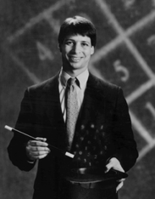
Lab today – or tomorrow
Add these to your Date class!
yesterday(self)
tomorrow(self)
addNDays(self, N)
subNDays(self, N)
isBefore(self, d2)
isAfter(self, d2)
diff(self, d2)
dow(self)
Prof. Benjamin !
no computer required…
and use your Date class to analyze our calendar a bit…

Slide 38
Quiz
class Date:
def tomorrow(self):
""" moves the date ahead 1 day """
DIM = [0,31,28,31,30,31,30,31,31,30,31,30,31]
Name(s) _____________________________
Don't return anything. This CHANGES the date object that calls it.
first, add 1 to self.day
DIM looks pretty bright to me!
then, adjust the month and year, only if needed
Implement tomorrow !
Extra: how could you make this work for leap years, too?

Slide 39

class Date:
def tomorrow(self):
""" moves the date ahead 1 day """
DIM = [0,31,fdays,31,30,31,30,31,31,30,31,30,31]
self.day += 1 # add 1 to the day!
if self.day > DIM[self.month]: # check day
self.month += 1
self.day = 1
if self.month > 12: # check month
self.year += 1
self.month = 1
better as a variable!

Slide 40
class Date:
def tomorrow(self):
""" moves the date ahead 1 day """
fdays = 28 + self.isLeapYear() # What ?!
DIM = [0,31,fdays,31,30,31,30,31,31,30,31,30,31]
self.day += 1
if self.day > DIM[self.month]:
self.month += 1
self.day = 1
if self.month > 12:
self.year += 1
self.month = 1

Slide 41
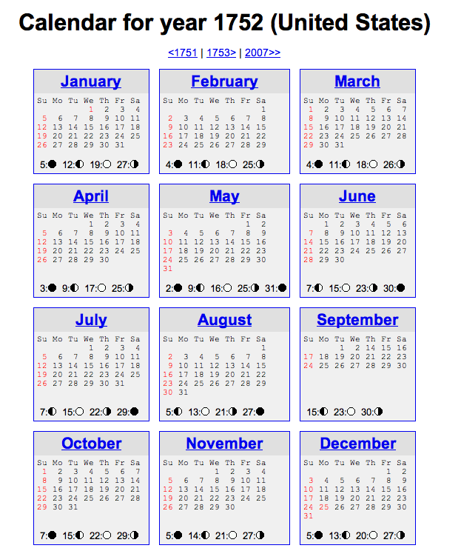
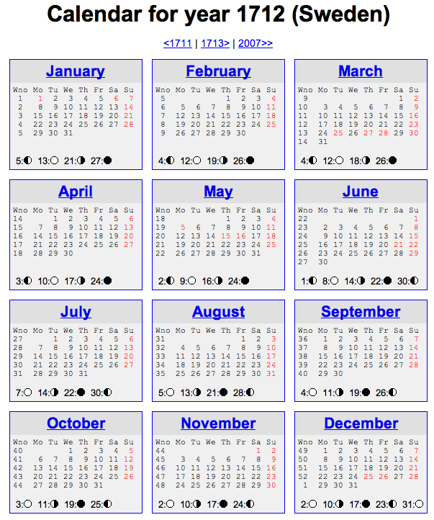
Not all years are the same!

Slide 42
See you @ this week's lab …
… it's a Date!

Slide 43
Quiz
Name(s) _____________________________
class Date:
def isBefore(self, d2):
""" True if self is before d2, else False """
if self.year < d2.year:
return True
# what other
if self.month < d2.month:
return True
if self.day < d2.day:
return True
return False
(1) There's a bug here – what is it!?
Redo this somehow!
>>> d = Date(1,1,2014)
>>> d2 = Date(11,12,2013)
>>> d.isBefore( d2 )
True
(2) How could we fix it?
Bug!

Slide 44
class Date:
def tomorrow(self):
""" moves the date ahead 1 day """
fdays = 28 + self.isLeapYear() # What ?!
DIM = [0,31,fdays,31,30,31,30,31,31,30,31,30,31]

Slide 45
What's wrong?
d = Date(1,1,2012)
d2 = Date(11,8,2011)
d.isBefore( d2 )
True
class Date:
def isBefore(self, d2):
""" if self is before d2, this should
return True; else False """
if self.year < d2.year:
return True
if self.month < d2.month and
return True
if self.day < d2.day and
return True
return False

Slide 46
class Date:
def tomorrow(self):
""" moves the date that calls it ahead 1 day """
DIM = [0,31,28,31,30,31,30,31,31,30,31,30,31]

Slide 47
copy
class Date:
def __init__( self, mo, dy, yr ):
def __repr__(self):
def isLeapYear(self):
def equals(d,d2):
def copy(self):
""" returns a DIFFERENT object w/SAME date value! """
newd = Date( self.month, self.day, self.year )
return newd
Whenever you want to create a brand-new object, use the appropriate CONSTRUCTOR

Slide 48
Everything in Python is an object!

Slide 49
class Date:
""" a blueprint (class) for objects
that represent calendar days
"""
def __init__( self, mo, dy, yr ):
""" the Date constructor """
self.month = mo
self.day = dy
self.year = yr
def __repr__( self ):
""" used for printing Dates """
s = "%02d/%02d/%04d" % (self.month, self.day, self.year)
return s
def isLeapYear( self ):
""" anyone know the rule? """
The Date class
See docs.python.org/library/string.html
Why is everyone so far away?!

Slide 50
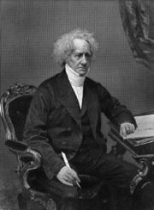
a Leap of faith….
class Date:
def __init__( self, mo, dy, yr ): (constructor)
def __repr__(self): (for printing)
def isLeapYear( self ):
""" here it is """
if self.year%400 == 0: return True
if self.year%100 == 0: return False
if self.year%4 == 0: return True
return False
How about a 4000-year rule?
John Herschel

Slide 51
More Date
class Date:
def __init__( self, mo, dy, yr ):
def __repr__(self):
def isLeapYear(self):
def copy(self):
""" returns a DIFFERENT object w/SAME date! """
def equals(self, d2):
""" returns True if they represent
the same date; False otherwise
"""
How many Dates are here?
Would two be selfish?

Slide 52
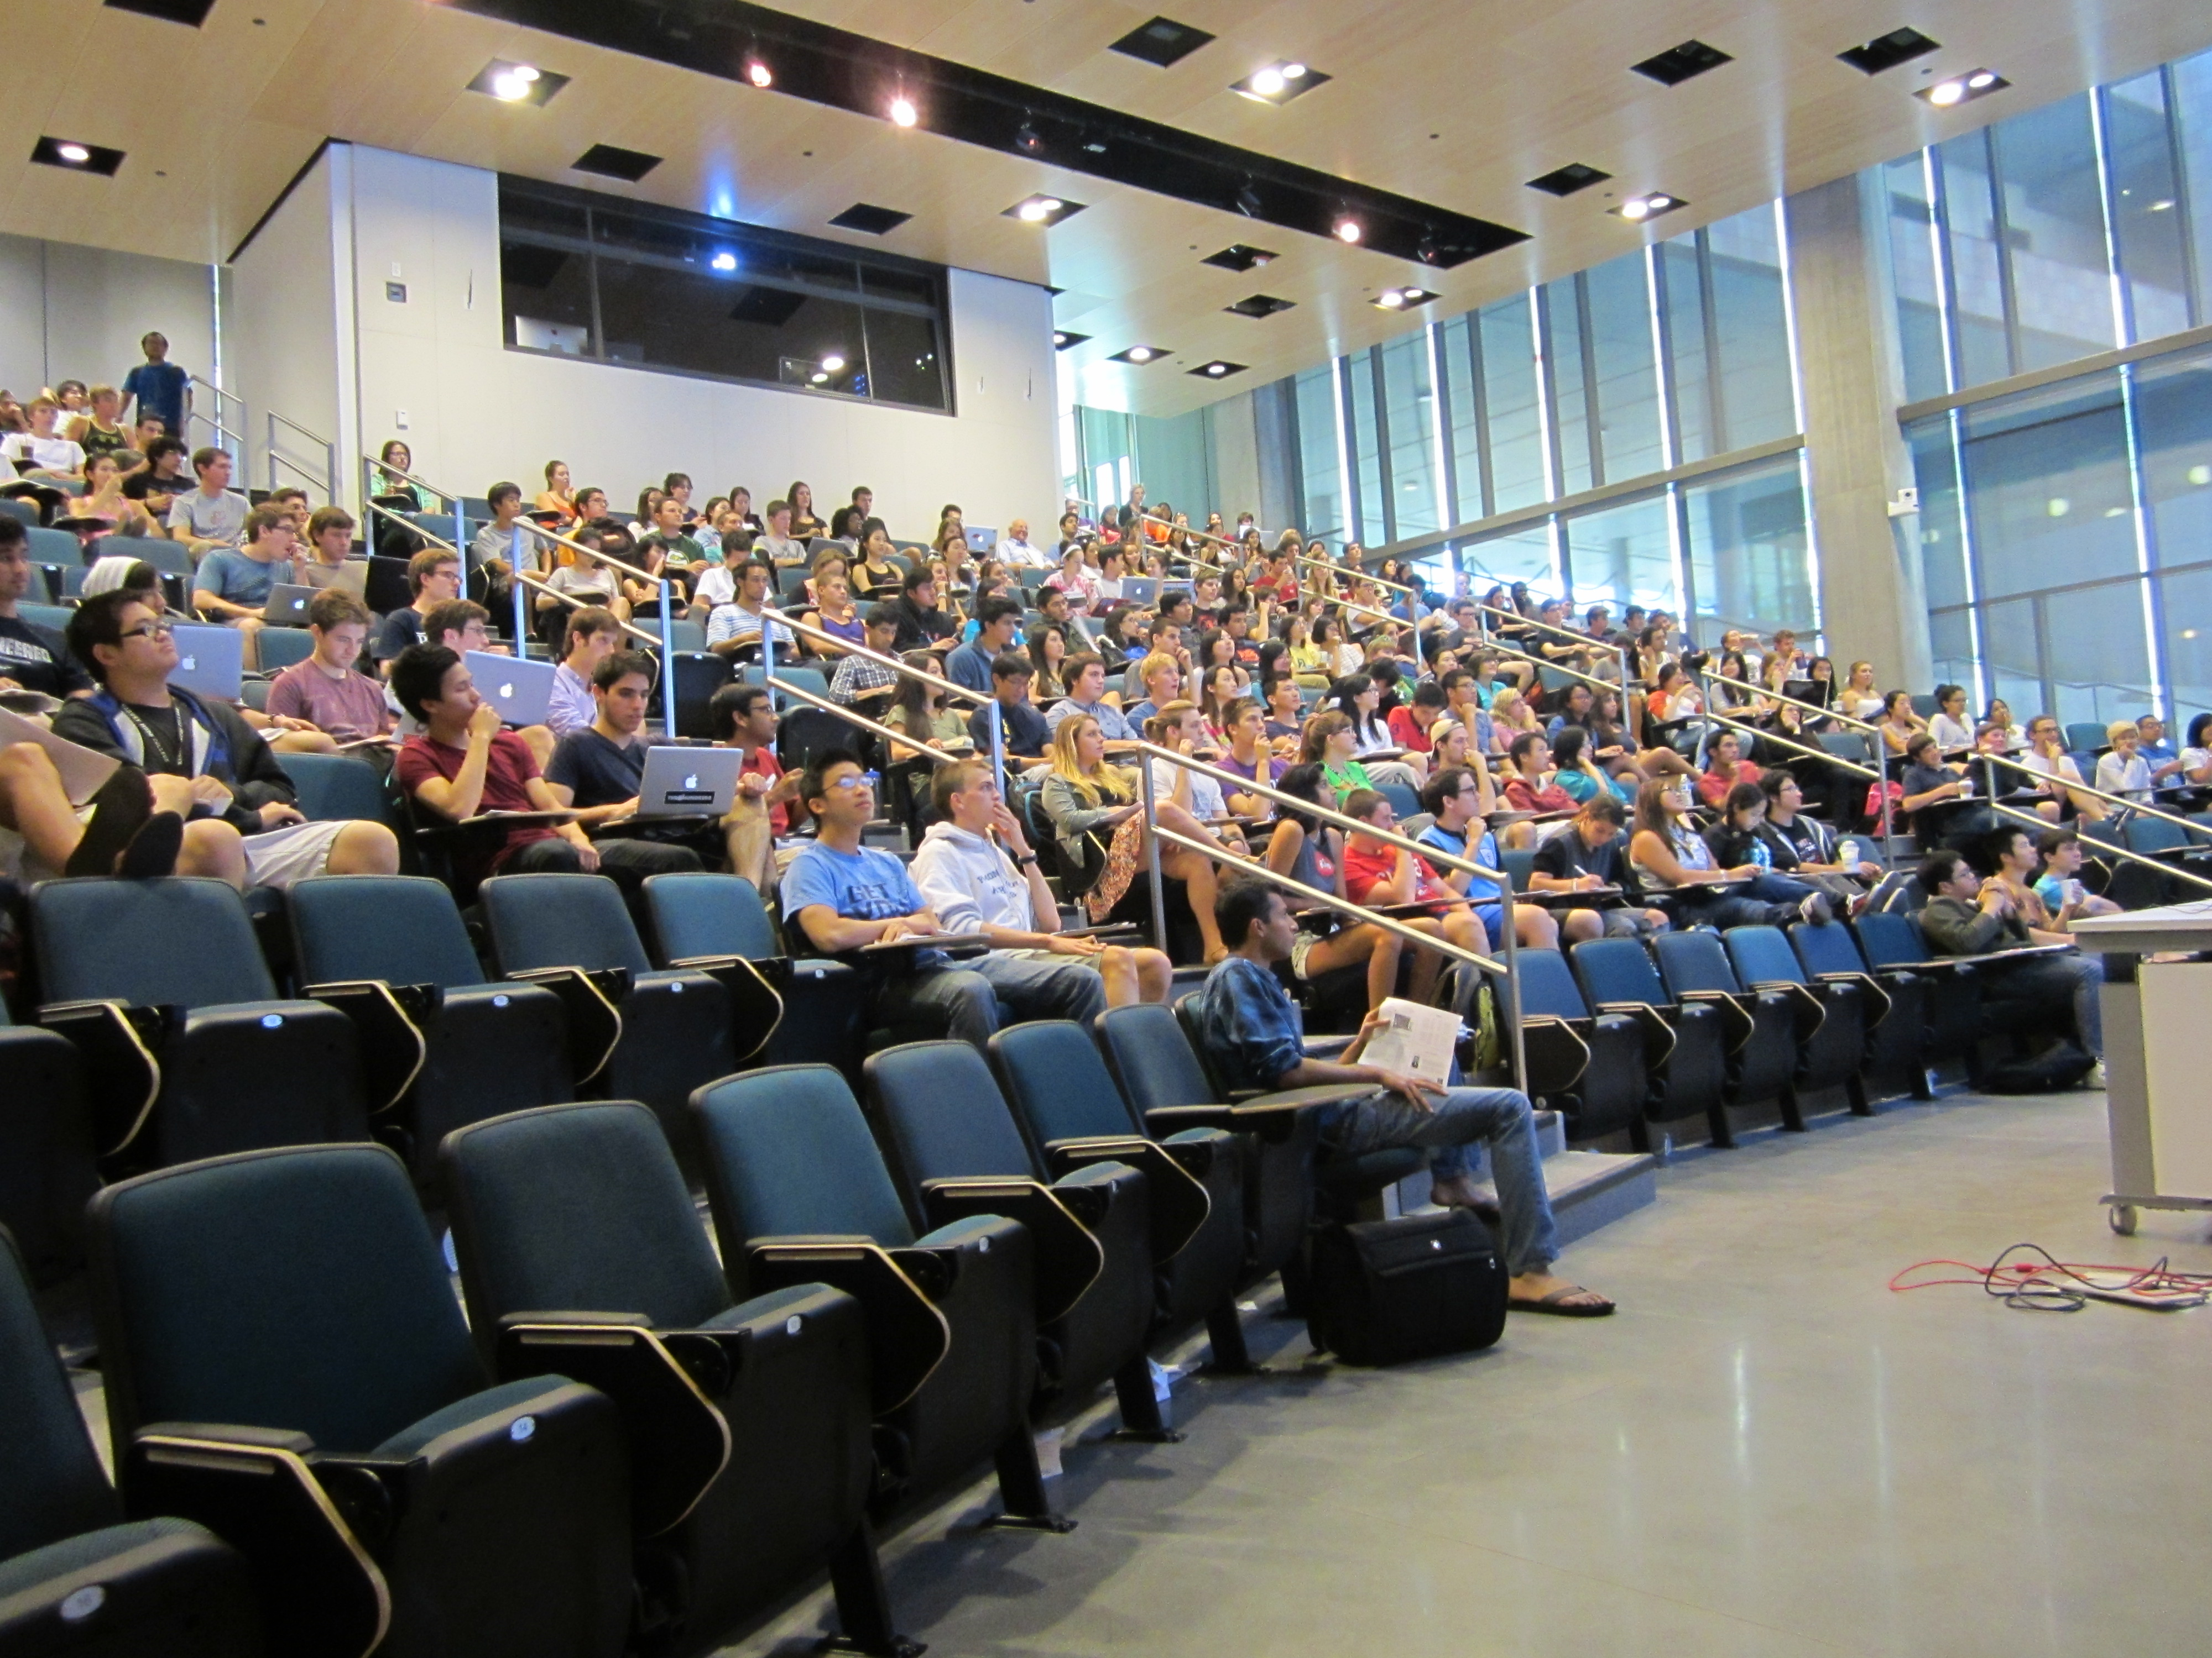
Thursday's AM class: in Shanahan
Lots of seats available!
Solutions… (Keep within this term's CS5)

Slide 53
class Date:
def isBefore(self, d2):
""" if self is before d2, this should
return True; else False """
if self.year < d2.year: return True
if self.month < d2.month: return True
if self.day < d2.day: return True
return False
def tomorrow(self):
""" moves the date that calls it ahead 1 day """
DIM = [0,31,28,31,30,31,30,31,31,30,31,30,31]
Quiz
Name: ______________
This method is WRONG! Find why … and suggest how you could fix it!
Hint:
d = Date(1,1,2012)
d2 = Date(11,8,2011)
d.isBefore( d2 )
True
DIM looks pretty bright to me!
Write this tomorrow method.
It does not return anything. It just CHANGES the date object that calls it.

Slide 54
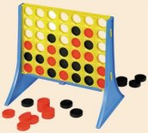
Designing classes
1) What data? (Data Members)
Not limited to 7x6!
2) What are the key capabilities? (Methods)

Slide 55
Connect Four: the object b
list
str
str
str
str
Board
b
data
str
str
str
str
?
str
str
str
str
4
int
width
3
int
height
Starting from b, how would you access the string marked by the ?

Slide 56
Object example: strings
Constructor!
s = str('harvey mudd college')
dir(s)
s.split()
s.__len__() # I should underscore this point!
s.title() # an entitlement?
20*'spam'.title() # how many capital S's?
('spam'*20).title()

Slide 57
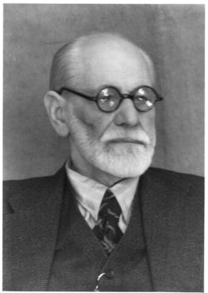

Everything in python is an object
Demo!
x = 20
y = 22
x.__add__(y) # either way!
# even this!
(19).__add__(23)
id(x)
id(y)
Hey! No other aliens allowed!
You mean superego?
My ego approves!

Slide 58
A complex object:
It seems clear enough to me!
>>> z = complex(3,4)
>>> z
(3+4j)
>>> dir(z)
all of the data members and methods of the complex class (and thus the object z !)
>>> z.imag
4.0
>>> z.conjugate()
3-4j
a data member of all objects of class complex
its value for this object, z
a method (function) within all objects of class complex
its return value for this object, z

Slide 59
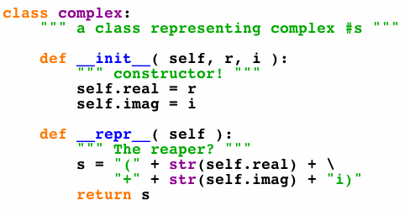
A complex class:
will have more methods (functions), too...
defines the type of our complex-number objects

Slide 60
Connect Four: constructor
class Board:
""" a datatype representing a C4 board
with an arbitrary number of rows and cols
"""
def __init__( self, width, height ):
""" the constructor for objects of type Board """
self.width = width
self.height = height
self.data = [] # this will be the board
self.data = [ [' ']*self.width for row in range(self.height) ]
What was this called again… ?
Notes:
60

Slide 61
Objects ~ DOTs !
Constructor!
s = str('harvey mudd college')
dir(s)
s.spit()
s.__len__() # I should underscore this point!
s.title() # an entitlement?
20*'spam'.title() # how many capital S's?
('spam'*20).title()
What, the L ?

Slide 62
Everything in python is an object
Demo!
x = 20
y = 22
x.__add__(y) # either way!
# even this!
(19).__add__(23)
id(x)
id(y)
Hey! No other aliens allowed!
You mean superego?
My ego approves!

Slide 63
dir and help !
provide all of the methods and data members available to an object
dir('any string')
help(''.count)
dir(42)
dir( [] )
No memorizing! Just use dir & help…
try sort!

Slide 64
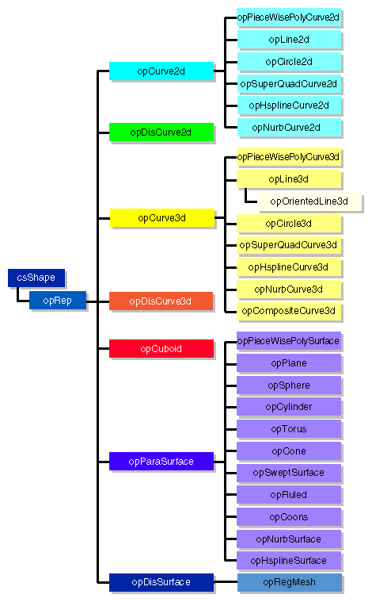

Examples…
Graphics libraries
Python's class libraries…
Do reference libraries have library references?
http://docs.python.org/lib/

Slide 65
Lists: the good and bad...
+
lots of computer work for little programmer work!
Here's a list for Feb. 29, 2010:
A = [ 2, 29, 2010 ]
2
29
2010
list
int
int
int
A
A[0]
A[1]
A[2]

Slide 66
Lists: the good and bad...
+
lots of computer work for little programmer work!
only generic capabilities, e.g., len, print
-
only square-bracket naming, e.g.,
A[i]
no data consistency checks
A = [ 2, 29, 2010 ]
2
29
Something is wrong with this date!
2010
list
int
int
int
A
A[0]
A[1]
A[2]
Classes and Objects take care of all 3 drawbacks...

Slide 67

CS 5 today
A whole new class of programming
Composing functions
CS's building blocks
Designing Data!
The Date class
whose convenience?
Exams?

Slide 68
Objects ~ DOTs !
Constructor!
s = str('harvey mudd college')
dir(s)
s.spit()
s.__len__() # I should underscore this point!
s.title() # an entitlement?
20*'spam'.title() # how many capital S's?
('spam'*20).title()
What, the L ?

Slide 69
Everything in python is an object
Demo!
x = 20
y = 22
x.__add__(y) # either way!
# even this!
(19).__add__(23)
id(x)
id(y)
Hey! No other aliens allowed!
You mean superego?
My ego approves!

Slide 70
Lists: the good and bad...
+
lots of computer work for little programmer work!
only generic capabilities, e.g., len, print
-
only square-bracket naming, e.g.,
A[i]
no data consistency checks
A = [ 2, 29, 2010 ]
2
29
Something is wrong with this date!
2010
list
int
int
int
A
A[0]
A[1]
A[2]
Classes and Objects take care of all 3 drawbacks...

Slide 71



Classes & Objects
An object-oriented programming language allows you to build your own customized types of variables.
(1) A class is a type of variable.
(2) An object is one such variable.
(instance)
There will typically be MANY objects of a single class.

Slide 72
A complex object:
It seems clear enough to me!
>>> z = complex(3,4)
>>> z
(3+4j)
>>> dir(z)
all of the data members and methods of the complex class (and thus the object z !)
>>> z.imag
4.0
>>> z.conjugate()
3-4j
a data member of all objects of class complex
its value for this object, z
a method (function) within all objects of class complex
its return value for this object, z

Slide 73
A complex class:
will have more methods (functions), too...
defines the type of our complex-number objects

Slide 74
Objects
An object is a container data structure - like a list - except
(1) Its data elements have names chosen by the programmer.
(2) An object contains its own functions that it can call!
usually called "methods" instead of functions:
__init__
__repr__
the constructor
the repr (for printing)
(3) Thus, an object can take care of itself !
I guess he wants to underscore these two methods!

Slide 75
Date
This is a class. It is a user-defined datatype (that you'll build in Lab this week!)
>>> d = Date(10,9,2010)
>>> d
10/09/2010
this is a CONSTRUCTOR …
What does it do?
this is an object of type Date
the representation of a particular object of type Date
>>> d.isLeapYear()
False
the isLeapYear method returns True or False. How does it know what year to check?
>>> d2 = Date(1,1,2012)
>>> d2
01/01/2012
>>> d2.isLeapYear()
True
Another object of type Date - again, from the constructor.
How does it know to return True, instead of False in this case ??

Slide 76
class Date:
""" a blueprint (class) for objects
that represent calendar days
"""
def __init__( self, mo, dy, yr ):
""" the Date constructor """
self.month = mo
self.day = dy
self.year = yr
def __repr__( self ):
""" used for printing Dates """
s = "%02d/%02d/%04d" % (self.month, self.day, self.year)
return s
def isLeapYear( self ):
""" anyone know the rule? """
The Date class
See docs.python.org/library/string.html
Why is everyone so far away?!

Slide 77
self
is the specific OBJECT THAT CALLS A METHOD
>>> d = Date(11,9,2010)
>>> d
11/09/2010
These methods need access to the object that calls them
>>> d.isLeapYear()
True
>>> d2 = Date(1,1,2012)
>>> d2
12/31/2007
>>> d2.isLeapYear()
False
These methods need access to the object that calls them

Slide 78
a Leap of faith….
class Date:
def __init__( self, mo, dy, yr ): (constructor)
def __repr__(self): (for printing)
def isLeapYear( self ):
""" here it is """
if self.year%400 == 0: return True
if self.year%100 == 0: return False
if self.year%4 == 0: return True
return False
John Herschel
How about a 4000-year rule?

Slide 79
Date
>>> d = Date(1,1,2011)
>>> d
1/1/2011
always created with the CONSTRUCTOR …
>>> d.yesterday()
>>> d
12/31/2010
>>> d.subNDays(52)
lots of printing, but no return value!
>>> d
the yesterday method returns nothing at all. Is it doing anything?
d has changed!
Why is this important?
Some methods return a value; others change the object that call it!

Slide 80
Date ids
What date is on your id?
What id is on your Date?
UFO license
Area 51, CA
>>> d = Date(11,9,2010)
>>> d
11/09/2010
>>> d2 = Date(11,10,2010)
>>> d2
11/10/2010
this initializes a different Date!
>>> d == d2
?
>>> d2.yesterday()
>>> d == d2
?

Slide 81
Excuse me -- ids please!
Double Date
>>> d2 = d
>>> d
11/09/2010
>>> d.yesterday()
>>> d2
?
>>> d2 = d.copy()
>>> d2 == d
?
>>> d.equals(d2)
?
How many Dates are here?

Slide 82
More Date
class Date:
def __init__( self, mo, dy, yr ):
def __repr__(self):
def isLeapYear(self):
def copy(self):
""" returns a DIFFERENT object w/SAME date! """
def equals(self, d2):
""" returns True if they represent
the same date; False otherwise
"""
How many Dates are here?
Would two be selfish?

Slide 83
What's wrong?
d = Date(1,1,2011)
d2 = Date(11,9,2010)
d.isBefore( d2 )
True
class Date:
def isBefore(self, d2):
""" if self is before d2, this should
return True; else False """
if self.year < d2.year:
return True
if self.month < d2.month:
return True
if self.day < d2.day:
return True
return False

Slide 84
class Date:
def tomorrow(self):
""" moves the date that calls it ahead 1 day """
DIM = [0,31,28,31,30,31,30,31,31,30,31,30,31]

Slide 85
Lab today – or tomorrow
Add to Date these methods:
no computer required…
yesterday(self)
tomorrow(self)
addNDays(self, N)
subNDays(self, N)
isBefore(self, d2)
isAfter(self, d2)
diff(self, d2)
dow(self)
Prof. Art Benjamin
and use your Date class to analyze our calendar a bit…

Slide 86
Unusual calendar years…

Slide 87
Designing classes
1) What data? (Data Members)
Not limited to 7x6!
2) What are the key capabilities? (Methods)

Slide 88
Connect Four: the object b
list
str
str
str
str
Board
b
data
str
str
str
str
?
str
str
str
str
4
int
width
3
int
height
Starting from b, how would you access the string marked by the ?

Slide 89
Classes & Objects
An object-oriented programming language allows you to build your own customized types of variables.
(1) A class is a type of variable.
(2) An object is one such variable.
(instance)
There will typically be MANY objects of a single class.

Slide 90
Connect Four: constructor
class Board:
""" a datatype representing a C4 board
with an arbitrary number of rows and cols
"""
def __init__( self, width, height ):
""" the constructor for objects of type Board """
self.width = width
self.height = height
self.data = [] # this will be the board
self.data = [ [' ']*self.width for row in range(self.height) ]
What was this called again… ?
Notes:
90

