Slide 1
A whole new class of programming
CS 5 overview
CS building blocks: functions and composition
behind the CS curtain: circuits, assembly, loops
The Date class
Designing Data!
whose convenience?
CS: theory + practice
http://www.desktophdphotos.com/colorful-calendar-year-2015-2.html

Slide 2
Classes and Objects

Slide 3
Everything in Python is an object!
Its capabilities depend on its class.
functions
type
"methods"
what's more, you can build your own...

Slide 4
Everything is an object?
Take strings, for example:
>>> s = str( 42 )
>>> type(s)
<type 'str'>
>>> dir(s)
['__add__', '__class__', '__contains__', '__delattr__', '__doc__', '__eq__', '__format__', '__ge__', '__getattribute__', '__getitem__', '__getnewargs__', '__getslice__', '__gt__', '__hash__', '__init__', '__le__', '__len__', '__lt__', '__mod__', '__mul__', '__ne__', '__new__', '__reduce__', '__reduce_ex__', '__repr__', '__rmod__', '__rmul__', '__setattr__', '__sizeof__', '__str__', '__subclasshook__', '_formatter_field_name_split', '_formatter_parser', 'capitalize', 'center', 'count', 'decode', 'encode', 'endswith', 'expandtabs', 'find', 'format', 'index', 'isalnum', 'isalpha', 'isdigit', 'islower', 'isspace', 'istitle', 'isupper', 'join', 'ljust', 'lower', 'lstrip', 'partition', 'replace', 'rfind', 'rindex', 'rjust', 'rpartition', 'rsplit', 'rstrip', 'split', 'splitlines', 'startswith', 'strip', 'swapcase', 'title', 'translate', 'upper', 'zfill']
This calls the str constructor.
Shows the type of s is str
Shows all of the methods (functions) of s
Let's try some!

Slide 5
Objects
Like a list, an object is a container, but much more customizable:
(1) Its data elements have names chosen by the programmer.
(2) An object contains its own functions, called methods
(3) In its methods, objects refer to themselves as self
(4) Python signals special methods with two underscores:
__init__ is called the constructor; it creates new objects
__repr__ tells Python how to print its objects
I guess we should doubly underscore these two methods!

Slide 6
A Date object, d
d
11
10
2015
month
day
year
memory location ~ 42042778

Slide 7
A Date object, d
d
11
10
2015
month
day
year
memory location ~ 42042778
It's an alien date!

Slide 8
class Date:
""" a blueprint (class) for objects
that represent calendar days
"""
def __init__( self, mo, dy, yr ):
""" the Date constructor """
self.month = mo
self.day = dy
self.year = yr
The Date class
what?!

Slide 9
class Date:
""" a blueprint (class) for objects
that represent calendar days
"""
def __init__( self, mo, dy, yr ):
""" the Date constructor """
self.month = mo
self.day = dy
self.year = yr
The Date class
This is the start of a new type called Date
It begins with the keyword class
This is the constructor for Date objects
As is typical, it assigns input data to the data members.
These are data members – they are the information inside every Date object.

Slide 10
Date
This is a class. It is a user-defined datatype that you'll build in Lab 10 this week…
>>> d = Date(4,6,2015)
>>> d.month
4
>>> d.day
6
add a print statement to see that this is OUR OWN code…
Constructor!
d contains data members named day, month, and year
>>> d
04/06/2015
The repr!
the representation of an object of type Date
The isLeapYear method returns True or False. How does it know what year to check?
>>> d.isLeapYear()
False

Slide 11
class Date:
""" a blueprint (class) for objects
that represent calendar days
"""
def __init__( self, mo, dy, yr ):
""" the Date constructor """
self.month = mo
self.day = dy
self.year = yr
def __repr__( self ):
""" used for printing Dates """
s = "%02d/%02d/%04d" % (self.month, self.day, self.year)
return s
The Date class
Why is everyone so far away?!
This is the repr for Date objects
It tells Python how to print these objects.
Why self instead of d ?

Slide 12
self
is the variable calling a method
>>> d = Date(4,6,2015)
>>> print d
04/06/2015
>>> d.isLeapYear()
False
These methods need access to the object that calls them: it's self
>>> d2 = Date(1,1,2016)
>>> print d2
01/01/2016
>>> d2.isLeapYear()
True

Slide 13
class Date:
""" a blueprint (class) for objects
that represent calendar days
"""
def __init__( self, mo, dy, yr ):
""" the Date constructor """
self.month = mo
self.day = dy
self.year = yr
def __repr__( self ):
""" used for printing Dates """
s = "%02d/%02d/%04d" % (self.month, self.day, self.year)
return s
def isLeapYear( self ):
""" anyone know the rule? """
The Date class
Why is everyone so far away?!
which are leap years?

Slide 14
class Date:
def __init__( self, mo, dy, yr ): (constructor)
def __repr__(self): (for printing)
def isLeapYear( self ):
""" here it is """
if self.year%400 == 0: return True
if self.year%100 == 0: return False
if self.year%4 == 0: return True
return False

Slide 15
Special Dates?

Slide 16
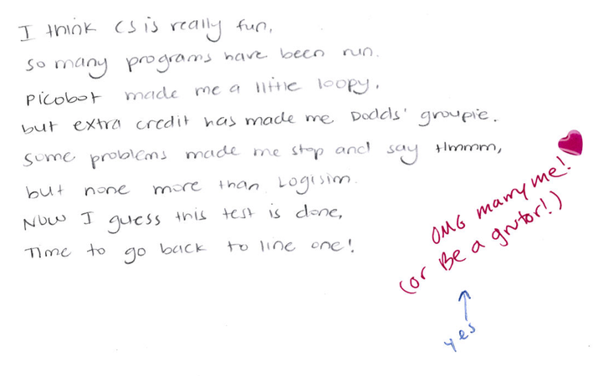
Emily M

Slide 17
== vs. equals
UFO license
Area 51, CA
What id is on your Date?
>>> d = Date(11,12,2013)
>>> d
11/12/2013
>>> d2 = Date(11,12,2013)
>>> d2
11/12/2013
this constructs a different Date
Python objects are handled by reference…
== compares references!
>>> d == d2
False
How can this be False ?

Slide 18
Two Date objects:
d
12
11
2013
day
month
year
memory location ~ 42042778
== compares memory locations, not contents
originals underneath…

Slide 19
== vs. equals
UFO license
Area 51, CA
What date is on your id?
What id is on your Date?
>>> d = Date(11,12,2013)
>>> d
11/12/2013
>>> d2 = Date(11,12,2013)
>>> d2
11/12/2013
this constructs a different Date
Python objects are handled by reference…
.equals compares contents
>>> d.equals(d2)
True

Slide 20
class Date:
def __init__( self, mo, dy, yr ):
def __repr__(self):
def isLeapYear(self):
def equals(self, d2):
""" returns True if they represent
the same date; False otherwise
"""
if
return True
else:
return False
equals
How many Dates are here?
Which one is selfish?

Slide 21
I want == to work!
equals
class Date:
def equals(self, d2):
""" if self is the same Date as d2,
return True; else False """
if [self.year,self.month,self.day] ==
[ d2.year, d2.month, d2.day]
return True
else:
return False
Whoa!
To use this, write d.equals(d2)

Slide 22
equals
This is Python's function name for the == operator!
class Date:
def __eq__(self, d2):
""" if self is the same Date as d2,
return True; else False """
if [self.year,self.month,self.day] ==
[ d2.year, d2.month, d2.day]
return True
else:
return False
Some == are more equal than others
To use this, write d == d2

Slide 23
DIY operators …
__eq__(self, other) defines the equality operator, ==
__ne__(self, other) defines the inequality operator, !=
__lt__(self, other) defines the less-than operator, <
__gt__(self, other) defines the greater-than operator, >
__le__(self, other) defines the less-or-equal-to operator, <=
__ge__(self, other) defines the gr.-or-equal-to operator, >=
__add__(self, other) defines the addition operator, +
__sub__(self, other) defines the subtraction operator, -
… and many more! Use dir('')
there are two under-scores on each side here
I should underscore the unusual syntax here!

Slide 24
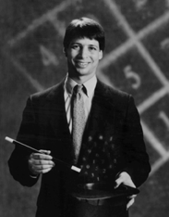
Lab today – or tomorrow
Add these to your Date class!
yesterday(self)
tomorrow(self)
addNDays(self, N)
subNDays(self, N)
isBefore(self, d2)
isAfter(self, d2)
diff(self, d2)
dow(self)
Prof. Benjamin !
no computer required…
and use your Date class to analyze our calendar a bit…

Slide 25
I want even LESS !
isBefore
class Date:
def isBefore(self, d2):
""" if self is before d2, this should
return True; else False """
if [self.year,self.month,self.day] <
[ d2.year, d2.month, d2.day]
return True
else:
return False

Slide 26
Date's purpose…?!
>>> d = Date(11,10,2015)
>>> print d
05/14/2015
always create with the CONSTRUCTOR …
the tomorrow method returns nothing at all. Is it doing anything?
>>> d.tomorrow()
>>> print d
11/11/2015
>>> d.addNDays(38)
lots of printing, but no return value!
d has changed!
Why is this important?
Some methods return a value; others change the object that call it!

Slide 27
Quiz
class Date:
def tomorrow(self):
""" moves the date ahead 1 day """
DIM = [0,31,28,31,30,31,30,31,31,30,31,30,31]
Name(s) _____________________________
Don't return anything. This CHANGES the date object that calls it.
self.day += 1
first, add 1 to self.day
DIM looks pretty bright to me!
if
test if we have gone "out of bounds!"
then, adjust the month and year, only if needed
Implement tomorrow !
Extra: how could you make this work for leap years, too?

Slide 28
class Date:
def tomorrow(self):
""" moves the date ahead 1 day """
DIM = [0,31,fdays,31,30,31,30,31,31,30,31,30,31]
self.day += 1 # add 1 to the day!
if self.day > DIM[self.month]: # check day
self.month += 1
self.day = 1
if self.month > 12: # check month
self.year += 1
self.month = 1
better as a variable!

Slide 29
class Date:
def tomorrow(self):
""" moves the date ahead 1 day """
if self.isLeapYear() == True: fdays = 29
else: fdays = 28
DIM = [0,31,fdays,31,30,31,30,31,31,30,31,30,31]
self.day += 1 # add 1 to the day!
if self.day > DIM[self.month]: # check day
self.month += 1
self.day = 1
if self.month > 12: # check month
self.year += 1
self.month = 1

Slide 30
class Date:
def tomorrow(self):
""" moves the date ahead 1 day """
fdays = 28 + self.isLeapYear() # What ?!
DIM = [0,31,fdays,31,30,31,30,31,31,30,31,30,31]
self.day += 1 # add 1 to the day!
if self.day > DIM[self.month]: # check day
self.month += 1
self.day = 1
if self.month > 12: # check month
self.year += 1
self.month = 1
the "Luke trick"!

Slide 31
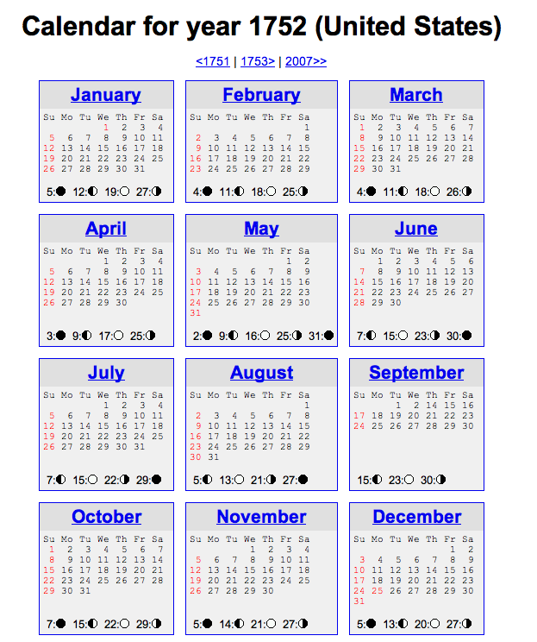
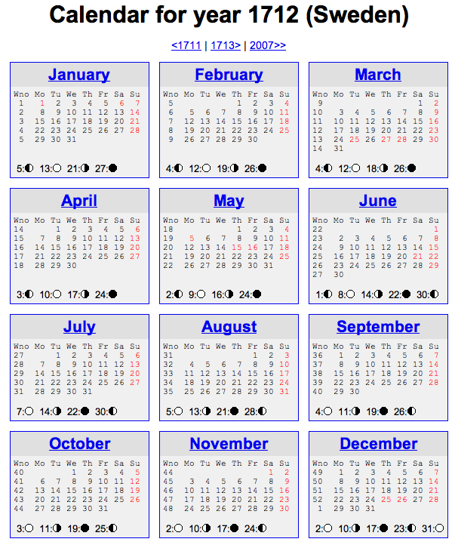
Not all years are the same!

Slide 32
See you @ this week's lab …
… it's a Date!
class-y
^

Slide 33
Quiz
class Date:
def tomorrow(self):
""" moves the date ahead 1 day """
DIM = [0,31,28,31,30,31,30,31,31,30,31,30,31]
self.day _________
if self.day > ____________:
Name(s) _____________________________
Don't return anything. This CHANGES the date object that calls it.
first, add 1 to self.day
DIM looks pretty bright to me!
then, adjust the month and year, but only if needed
Implement tomorrow !
Extra: how could you make this work for leap years, too?

Slide 34
Quiz
class Date:
def tomorrow(self):
""" moves the date ahead 1 day """
DIM = [0,31,28,31,30,31,30,31,31,30,31,30,31]
Name(s) _____________________________
Don't return anything. This CHANGES the date object that calls it.
first, add 1 to self.day
DIM looks pretty bright to me!
then, adjust the month and year, only if needed
Implement tomorrow !
Extra: how could you make this work for leap years, too?

Slide 35
class Date:
def tomorrow(self):
""" moves the date ahead 1 day """
DIM = [0,31,fdays,31,30,31,30,31,31,30,31,30,31]
self.day += 1 # add 1 to the day!
if self.day > DIM[self.month]: # check day
self.month += 1
self.day = 1
if self.month > 12: # check month
self.year += 1
self.month = 1
better as a variable!

Slide 36
class Date:
def tomorrow(self):
""" moves the date ahead 1 day """
if self.isLeapYear() == True: fdays = 29
else: fdays = 28
DIM = [0,31,fdays,31,30,31,30,31,31,30,31,30,31]
self.day += 1 # add 1 to the day!
if self.day > DIM[self.month]: # check day
self.month += 1
self.day = 1
if self.month > 12: # check month
self.year += 1
self.month = 1

Slide 37
class Date:
def tomorrow(self):
""" moves the date ahead 1 day """
fdays = 28 + self.isLeapYear() # What ?!
DIM = [0,31,fdays,31,30,31,30,31,31,30,31,30,31]
self.day += 1 # add 1 to the day!
if self.day > DIM[self.month]: # check day
self.month += 1
self.day = 1
if self.month > 12: # check month
self.year += 1
self.month = 1
the "Luke trick"!

Slide 38
class Date:
def __init__( self, mo, dy, yr ):
def __repr__(self):
def isLeapYear(self):
def equals(self, d2):
""" returns True if they represent
the same date; False otherwise
"""
if
return True
else:
return False
equals
How many Dates are here?
Which one is selfish?

Slide 39
class Date:
def tomorrow(self):
""" moves the date ahead 1 day """
DIM = [0,31,fdays,31,30,31,30,31,31,30,31,30,31]
self.day += 1 # add 1 to the day!
if self.day > DIM[self.month]: # check day
self.month += 1
self.day = 1
if self.month > 12: # check month
self.year += 1
self.month = 1
better as a variable!

Slide 40
class Date:
def tomorrow(self):
""" moves the date ahead 1 day """
fdays = 28 + self.isLeapYear() # What ?!
DIM = [0,31,fdays,31,30,31,30,31,31,30,31,30,31]
self.day += 1
if self.day > DIM[self.month]:
self.month += 1
self.day = 1
if self.month > 12:
self.year += 1
self.month = 1

Slide 41
Quiz
Name(s) _____________________________
class Date:
def isBefore(self, d2):
""" True if self is before d2, else False """
if self.year < d2.year:
return True
# what other
if self.month < d2.month:
return True
if self.day < d2.day:
return True
return False
(1) There's a bug here – what is it!?
Redo this somehow!
>>> d = Date(1,1,2014)
>>> d2 = Date(11,12,2013)
>>> d.isBefore( d2 )
True
(2) How could we fix it?
Bug!

Slide 42
class Date:
def tomorrow(self):
""" moves the date ahead 1 day """
fdays = 28 + self.isLeapYear() # What ?!
DIM = [0,31,fdays,31,30,31,30,31,31,30,31,30,31]

Slide 43
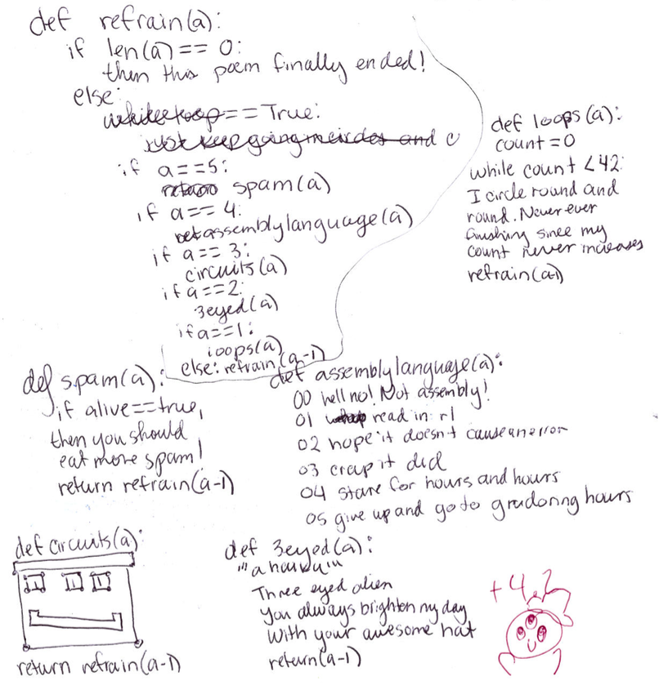
Cosette D

Slide 44
What's wrong?
d = Date(1,1,2012)
d2 = Date(11,8,2011)
d.isBefore( d2 )
True
class Date:
def isBefore(self, d2):
""" if self is before d2, this should
return True; else False """
if self.year < d2.year:
return True
if self.month < d2.month and
return True
if self.day < d2.day and
return True
return False

Slide 45
class Date:
def tomorrow(self):
""" moves the date that calls it ahead 1 day """
DIM = [0,31,28,31,30,31,30,31,31,30,31,30,31]

Slide 46
copy
class Date:
def __init__( self, mo, dy, yr ):
def __repr__(self):
def isLeapYear(self):
def equals(d,d2):
def copy(self):
""" returns a DIFFERENT object w/SAME date value! """
newd = Date( self.month, self.day, self.year )
return newd
Whenever you want to create a brand-new object, use the appropriate CONSTRUCTOR

Slide 47
Everything in Python is an object!

Slide 48
class Date:
""" a blueprint (class) for objects
that represent calendar days
"""
def __init__( self, mo, dy, yr ):
""" the Date constructor """
self.month = mo
self.day = dy
self.year = yr
def __repr__( self ):
""" used for printing Dates """
s = "%02d/%02d/%04d" % (self.month, self.day, self.year)
return s
def isLeapYear( self ):
""" anyone know the rule? """
The Date class
See docs.python.org/library/string.html
Why is everyone so far away?!

Slide 49
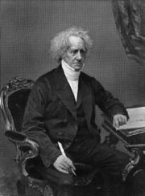
a Leap of faith….
class Date:
def __init__( self, mo, dy, yr ): (constructor)
def __repr__(self): (for printing)
def isLeapYear( self ):
""" here it is """
if self.year%400 == 0: return True
if self.year%100 == 0: return False
if self.year%4 == 0: return True
return False
How about a 4000-year rule?
John Herschel

Slide 50
More Date
class Date:
def __init__( self, mo, dy, yr ):
def __repr__(self):
def isLeapYear(self):
def copy(self):
""" returns a DIFFERENT object w/SAME date! """
def equals(self, d2):
""" returns True if they represent
the same date; False otherwise
"""
How many Dates are here?
Would two be selfish?

Slide 51
class Date:
def isBefore(self, d2):
""" if self is before d2, this should
return True; else False """
if self.year < d2.year: return True
if self.month < d2.month: return True
if self.day < d2.day: return True
return False
def tomorrow(self):
""" moves the date that calls it ahead 1 day """
DIM = [0,31,28,31,30,31,30,31,31,30,31,30,31]
Quiz
Name: ______________
This method is WRONG! Find why … and suggest how you could fix it!
Hint:
d = Date(1,1,2012)
d2 = Date(11,8,2011)
d.isBefore( d2 )
True
DIM looks pretty bright to me!
Write this tomorrow method.
It does not return anything. It just CHANGES the date object that calls it.

