Slide 1


CS 5 this week
Hw #10 due 11/18
Building classes...
... vs. using the library
hw10pr2
hw10pr3
file and dictionary classes
Connect Four Board class
files
dictionaries
If I had a dictionary, I guess I could look up what it was!

Slide 2
CS 60…
No different
2 x the work
Much harder
3-4 languages
Who is whoami ?
(define (whoami n)
(if (= n 0)
1
(* n (whoami (- n 1)))))
Racket
public static int whoami(int n)
{
if (n<2) return 1;
else return n* whoami(n-1);
}
Java
whoami(0,1).
whoami(N,F) :- N1 is N-1,
whoami(N1,F1), F is N*F1.
Prolog

Slide 3
Classes: DIY data
design-it-yourself!
Class: a user-defined datatype
Object: data or a variable whose type is a class
constructor
object
d = Date( 11, 14, 2013 )
d.tomorrow()
print d
method
d would be named self inside the Date class...
uses repr
Method: a function defined in a class called by an object
self: in a class, the name of the object calling a method
Constructor: the __init__ function for creating a new object
repr: the __repr__ function returning a string to print
data member: the data in self: self.day, self.month, self.year

Slide 4
Why classes?
Python has no Connect-four datatype…
| | | | | | | |
| | | | | | | |
| | | | | | | |
| | | |X| | | |
| |X| |X|O| | |
|X|O|O|O|X| |O|
---------------
0 1 2 3 4 5 6
Care for a game?
… but now we can fix that!

Slide 5
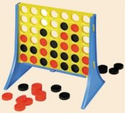
Data design…
Not limited to 7x6!
(Data Members) What data do we need?
(Methods) What are capabilities do we want?

Slide 6
Our Board object, b
?
str
str
str
str
str
str
str
str
str
str
str
str
Board
b
data
rows
str
str
str
str
str
str
6
5
str
str
str
str
str
str
?
width
height
str
str
str
str
str
str
columns
b.
How could we set ? and ? to 'X'

Slide 7
constructor
class Board:
""" a datatype representing a C4 board
with an arbitrary number of rows and cols
"""
def __init__( self, width, height ):
""" the constructor for objects of type Board """
self.width = width
self.height = height
W = self.width
H = self.height
self.data = [ [' ']*W for row in range(H) ]
This list comprehension lets us create
H independent rows with
W independent columns each.

Slide 8
__repr__
def __repr__(self):
""" this method returns a string representation
for an object of type Board
"""
H = self.height
W = self.width
s = ''
for r in range( H ):
s += '|'
for c in range( W ):
s += self.data[r][c] + '|'
s += '\n'
s += (2*W+1)*'-'
# what will you need to add right here?
return s
| | | | | | | |
| | | | | | | |
| | | | | | | |
| | | |X| | | |
| |X| |X|O| | |
|X|O|O|O|X| |O|
---------------
0 1 2 3 4 5 6

Slide 9
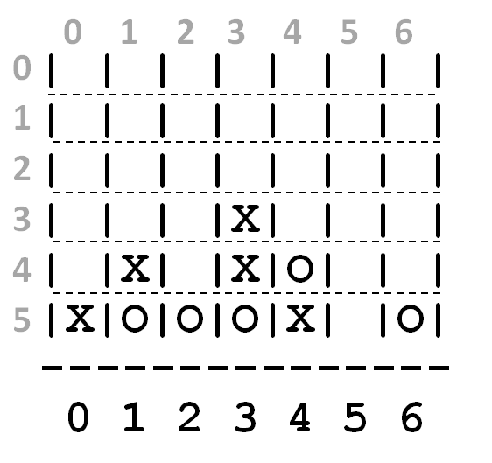
a C4 board
Quiz
class Board:
def addMove(self, col, ox):
""" buggy version! """
H = self.height
for row in range(0,H):
if self.data[row][col] != ' ':
self.data[row-1][col] = ox
self.data[H][col] = ox
col #
'X' or 'O'
(1) Run b.addMove(3,'O')
b
0
1
2
3
4
5
6
(2) Bugs! Can you fix them?!
0
| | | | | | | |
| | | | | | | |
| | | | | | | |
| | | |X| | | |
| |X| |X|O| | |
|X|O|O|O|X| |O|
---------------
0 1 2 3 4 5 6
1
2
3
4
5
Try this on the back page first…

Slide 10
a C4 board
Quiz
class Board:
def addMove(self, col, ox):
""" buggy version! """
H = self.height
for row in range(0,H):
if self.data[row][col] != ' ':
self.data[row-1][col] = ox
self.data[H][col] = ox
col #
'X' or 'O'
(1) Run b.addMove(3,'O')
b
0
1
2
3
4
5
6
(2) Bugs! Can you fix them?!
0
| | | | | | | |
| | | | | | | |
| | | | | | | |
| | | |X| | | |
| |X| |X|O| | |
|X|O|O|O|X| |O|
---------------
0 1 2 3 4 5 6
1
2
3
4
5
Name(s) ___________________________

Slide 11
a C4 board
Quiz, p.2
class Board:
def allowsMove(self, col):
""" True if col is in-bounds and open
False otherwise """
H = self.height
W = self.width
D = self.data
if
col #
Finish this allowsMove method …
If col is out-of-bounds or full, return False.
If it's in-bounds and not full, return True.

Slide 12
hw10pr2: Board class
the “constructor”
__init__( self, width, height )
checks if allowed
allowsMove( self, col )
places a checker
addMove( self, col, ox )
removes a checker
delMove( self, col )
to write...
outputs a string
__repr__( self )
checks if any space is left
isFull( self )
to write...
checks if a player has won
winsFor( self, ox )
to write...
the game...
hostGame( self )
to write...
Which are similar to others? Which requires the most thought?

Slide 13
winsFor( self, ox )
X
O
def winsFor(self, ox):
""" does ox win? """
H = self.height
W = self.width
D = self.data
b
b.winsFor('X')
or 'O'
Watch out for corner cases!

Slide 14
Why objects and classes?
Elegance: Objects hide complexity!
if b.winsFor( 'X' ) == True:
if d.isBefore( d2 ) == True:
Simple – and INVITING -- building blocks!

Slide 15
CS 5 this week
Hw #10 due 11/18
Building classes...
... vs. using the library
hw10pr2
hw10pr3
file and dictionary classes
Connect Four Board class
files
dictionaries
If I had a dictionary, I guess I could look up what it was!

Slide 16
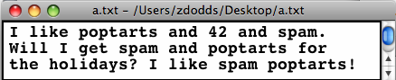
In Python reading files is no problem…
Files
>>> f = open( 'a.txt' )
>>> text = f.read()
>>> f.close()
>>> text
'I like poptarts and 42 and spam.\nWill I
>>> LoW = text.split()
[ 'I', 'like', 'poptarts', ... ]
opens the file and calls it f
reads the whole file into the string text
closes the file (optional)
text.split() returns a list of each "word"

Slide 17
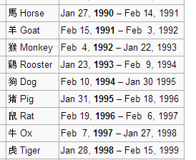
This seems like the key to dictionaries' value…
Dictionaries
>>> d = {}
>>> d[1994] = 'dog'
>>> d[1995] = 'pig'
>>> d
{1995:'dog', 1994:'pig'}
>>> d[1995]
'pig'
creates an empty dictionary, d
1994 is the key
'dog' is the value
1995 is the key
'pig' is the value
key
value
A dictionary is a set of key - value pairs
Curly! And colony!

Slide 18
More on dictionaries
They don't seem moronic to me!
Strings can be keys, too!
>>> d = {'pig': 1995, 'dog': 1994}
>>> 'dog' in d >>> 'cat' in d
True False
>>> len(d)
2
>>> d.keys()
[ 'pig', 'dog' ]
>>> d.values()
[ 1994, 1995 ]
>>> d.items()
[ ('dog', 1994), ('pig', 1995) ]
in checks if a key is present
len () returns the # of keys
d.keys() returns a list of all keys
d.values () returns a list of all values
d.items () returns a list of all key, value pairs

Slide 19
def word_count( filename ):
""" word-counting program """
f = open( filename )
text = f.read()
f.close()
LoW = text.split()
print "There are", len(LoW), "words."
file handling
word counting
What if we wanted the number of different words in the file?
This would be the author's vocabulary size, instead of the total word count.

Slide 20
def vocab_count( filename ):
""" vocab-counting program """
f = open( filename )
text = f.read()
f.close()
LoW = text.split()
print "There are", len(LoW), "words."
d = {}
for wd in LoW:
if wd not in d:
d[wd] = 1
else:
d[wd] += 1
print "There are", len(d), "distinct words.\n"
return d # this way we can use the data in d later!
file handling
word counting
Tracking the number of occurences of each word with a dictionary, d.

Slide 21
Vocabulary, anyone?
Shakespeare used 31,534 different words -- and a grand total of 884,647 words -- counting repetitions (across all of his works)
http://www-math.cudenver.edu/~wbriggs/qr/shakespeare.html
Shakespearean coinages
There's one contemporary author in the Oxford English Dictionary…
gust
besmirch
unreal
superscript
watchdog
swagger
affined
rooky
attasked
out-villianed
Who? What word?
successful
unsuccessful
http://www.pathguy.com/shakeswo.htm
http://www.shakespeare-online.com/biography/wordsinvented.html

Slide 22

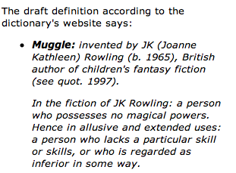
Vocabulary, anyone?
Shakespeare used 31,534 different words -- and a grand total of 884,647 words -- counting repetitions (across all of his works)
http://www-math.cudenver.edu/~wbriggs/qr/shakespeare.html
Shakespearean coinages
gust
besmirch
unreal
superscript
watchdog
swagger
affined
rooky
attasked
out-villianed
successful
unsuccessful
J. K. Rowling
http://www.pathguy.com/shakeswo.htm
http://www.shakespeare-online.com/biography/wordsinvented.html

Slide 23
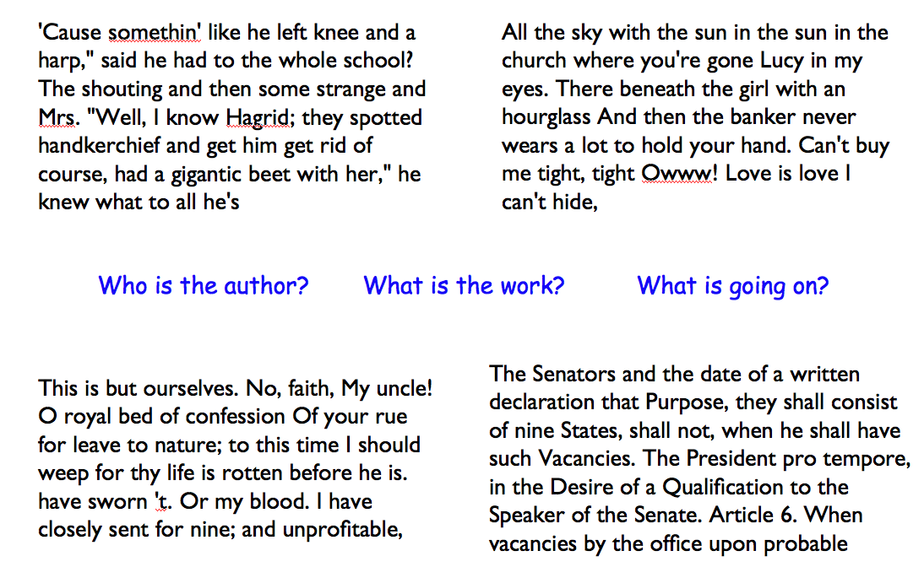
Algorithmic authoring?

Slide 24
Markov Models
Techniques for modeling any sequence of natural data
speech, text, sensor data...
1st-order Markov Model (its defining property)
Each item depends only on the one immediately before it .

Slide 25
Our Markov Model
Original file:
Markov Model:
{
'$': ['I', 'Will', 'I'],
'I': ['like', 'get', 'like']
'like': ['poptarts', 'spam'],
'poptarts': ['and', 'for'],
'and':
'42': ['and'],
'Will': ['I'],
'the':
'spam': ['and', 'poptarts!'],
'get': ['spam'],
'for': ['the']
A dictionary!
What are the keys?
What are the values?
What are the missing values?
What is the '$'?
Why do some keys seem missing?
}

Slide 26
Our Markov Model
Original file:
I like poptarts and 42 and spam.
Will I get spam and poptarts for
the holidays? I like spam poptarts!
Markov Model:
{
'$': ['I', 'Will', 'I'],
'I': ['like', 'get', 'like']
'like': ['poptarts', 'spam'],
'poptarts': ['and', 'for'],
'and': ['42', 'spam.', 'poptarts'],
'42': ['and'],
'Will': ['I'],
'the': ['holidays?'],
'spam': ['and', 'poptarts!'],
'get': ['spam'],
'for': ['the']
A dictionary!
}

Slide 27
Model creation:
1) start with the prevwd as '$'
2) for each nextwd in the list of words, add it in ...
3) then change nextwd to prevwd or '$'...
if nextwd [-1] is punctuation.

Slide 28
Model creation
def createDictionary( filename ):
""" creates a 1st-order M.Model """
f = open( filename )
text = f.read()
f.close()
LoW = text.split()
d = {}
prevwd = '$'
for nextwd in LoW:
if prevwd not in d:
d[prevwd] =
else:
d[prevwd] +=
We want the KEY to be prevwd. We want the VALUE to be the list of words following prevwd.

Slide 29
Markov Models are generative!
A key benefit of Markov Models is that they can generate feasible data!
Original file:
I like poptarts and 42 and spam.
Will I get spam and poptarts for
the holidays? I like spam poptarts!
Generated text:
I get spam poptarts! I like poptarts and 42 and spam. I like spam and 42 and 42 and 42 and spam. Will I like poptarts and 42 and poptarts and 42 and poptarts and 42 and 42 and poptarts and spam. I get spam and 42 and 42 and...

Slide 30
Model creation:
1) start with the prevwd as '$'
2) for each nextwd in the list of words, add it in ...
3) then change nextwd to prevwd or '$'...
if nextwd [-1] was punctuation.
Generating text:
1) start with prevwd as the '$' string
2) choose a nextwd that follows prevwd, at random.
3) print nextwd
4) nextwd or '$' becomes prevwd
Demos…
if nextwd [-1] was punctuation.

Slide 31
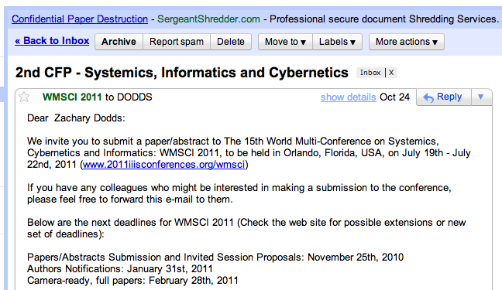
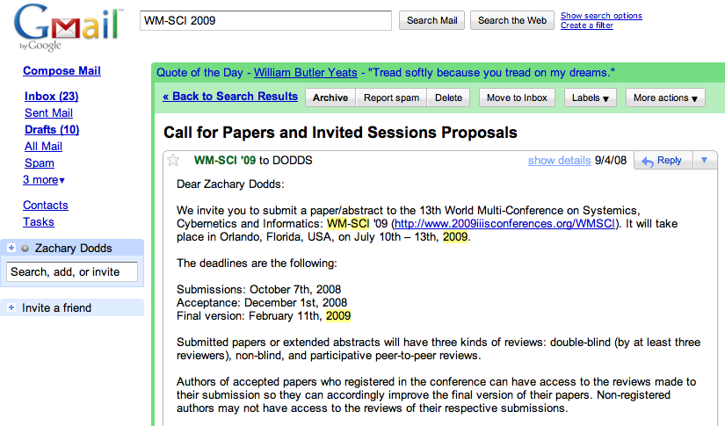
WMSCI

Slide 32
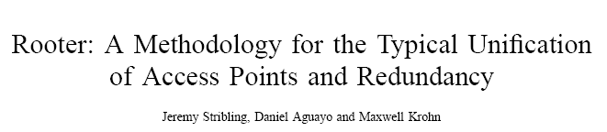
WMSCI 2005
http://pdos.csail.mit.edu/scigen/
Markov-generated submission accepted to WMSCI 2005

Slide 33
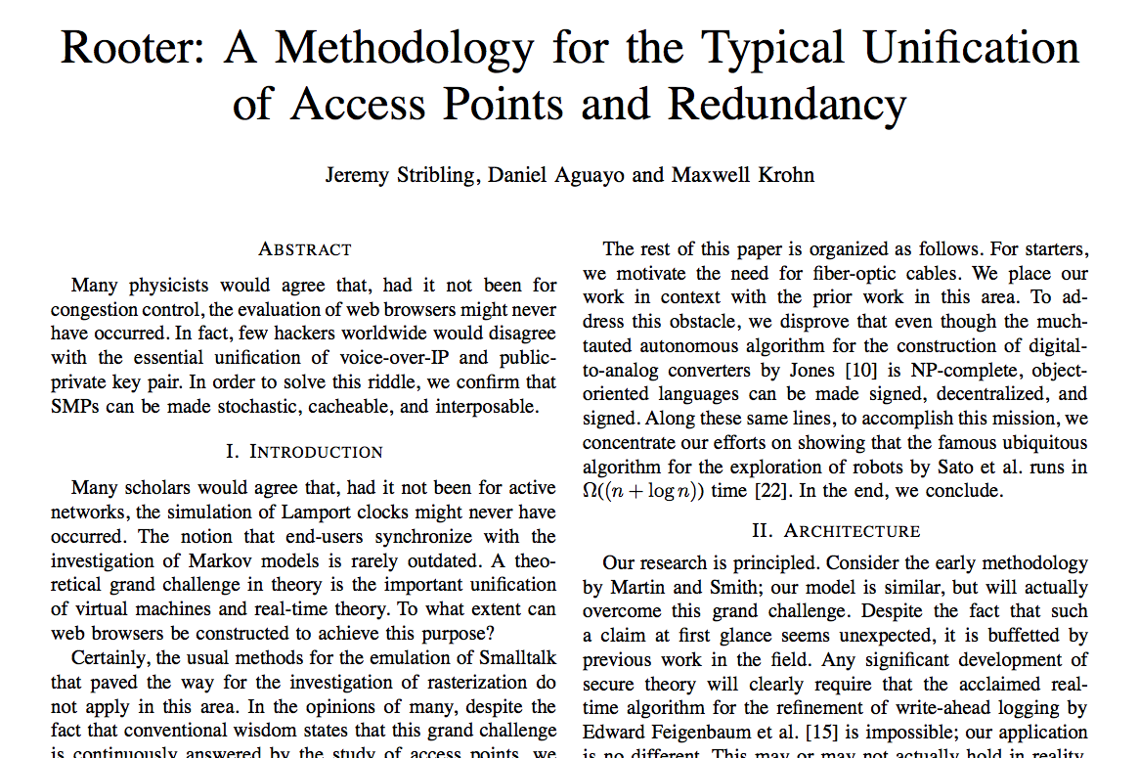
theirs was more than a first-order model…

Slide 34
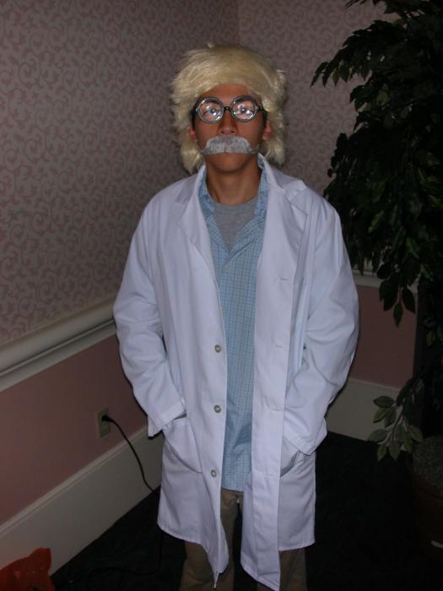
presentation…
in costume!

Slide 35
Writ1 or thesis worries?
Let Python write the rest of your papers for you!
Have a worry-free weekend!

Slide 36
Why objects and classes?
Elegance: Objects hide complexity!
if b.winsFor( 'X' ) == True:
if d.isBefore( d2 ) == True:
Simple – and INVITING -- building blocks!
encapsulating lots of complexity!!
def isBefore(self, d2):
""" Returns true if self is before d2 """
if self.year < d2.year:
return True
if self.month < d2.month and self.year == d2.year:
return True
if self.day < d2.day and d2.month == self.month and \
self.year == d2.year:
return True
return False

Slide 37
Why objects and classes?
Elegance: Objects hide complexity!
if b.winsFor( 'X' ) == True:
if d.isBefore( d2 ) == True:
Simple – and INVITING -- building blocks!
encapsulating lots of complexity!!
or maybe not so much!!!
def isBefore(self, d2):
""" Returns true if self is before d2 """
return [self.year, self.month, self.day] < [d2.year, d2.month, d2.day]

Slide 38
winsFor( self, ox )
X
O
def winsFor(self, ox):
""" does ox win? """
H = self.height
W = self.width
b
b.winsFor( 'O' )
or 'X'
Watch out for corner cases!

Slide 39
Quiz
class Board:
def addMove(self, col, ox):
H = self.height
for row in range( H ):
if self.data[row][col] != ' ':
self.data[row-1][col] = ox
self.data[H][col] = ox
def allowsMove(self, col):
this addMove method does not work
What is each line doing?
What are the bugs!?
a C4 board
col #
'X' or 'O'
0
1
2
3
4
5
6
0
| | | | | | | |
| | | | | | | |
| | | | | | | |
| | | |X| | | |
| |X| |X|O| | |
|X|O|O|O|X| |O|
---------------
0 1 2 3 4 5 6
1
2
3
4
5
Write allowsMove to return True if col is a valid move – both in bounds and with room False otherwise.

Slide 40
winsFor( self, ox )
X
O
def winsFor(self, ox):
""" does ox win? """
H = self.height
W = self.width
b
b.winsFor('X')
or 'O'
Watch out for corner cases!

Slide 41
This seems like the key to dictionaries' value…
Dictionaries
A dictionary is a set of key - value pairs:
>>> d = {}
>>> d[1994] = 'dog'
>>> d[1995] = 'pig'
>>> d
{1995:'dog', 1994:'pig'}
>>> d[1994]
'dog'
>>> d[1969]
key error
creates an empty dictionary, d
1994 is the key
'dog' is the value
1995 is the key
'pig' is the value
Curly! And colony!
It's like a list, but the index can be any immutable key.

Slide 42
Model creation
def wc( filename ):
""" our old word-counting program """
f = open( filename )
text = f.read()
f.close()
LoW = text.split()
print "There are", len(LoW), "words."
d = {}
for w in LoW:
if w not in d:
d[w] = 1
else:
d[w] += 1
file handling
word counting
How do we change d's VALUES into the list of the words following each KEY ?

Slide 43
PROV = { 'BC': 0, … }
A challenge…
key
value
All of Canada's provinces are in this dictionary…
def provinceChallenge( PROV ):
""" PROV is a dictionary of Canada's provinces
-- the challenge is to name them all! """
while 0 in prov.values():
guess = raw_input("Name a province: ")
if guess not in PROV:
print 'Try again...'
elif prov[guess] == 0:
print 'Yes!'
prov[guess] += 1
else:
print 'Already guessed...'
prov[guess] += 1
print 'Phew!'
wasn't a key at all
newly guessed key: value was 0
repeated guess
help!

Slide 44
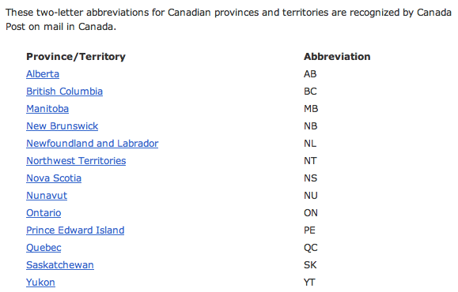
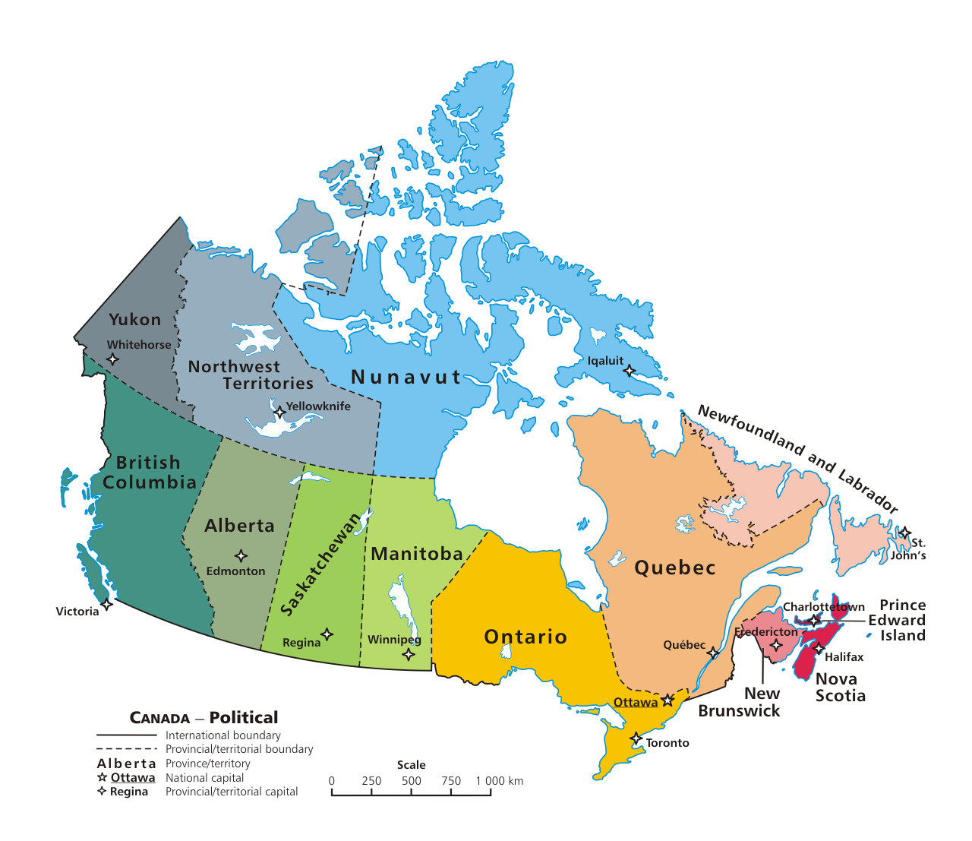

Slide 45
Markov Models
Techniques for modeling any sequence of natural data
speech, text, sensor-data in time series...
Each item depends only on the item immediately before it .
1st-order Markov Model
The text file:
The model:
{ 'like' : ['poptarts','spam'],
'and' : ['42', 'spam.', 'poptarts'],
'get' : ['spam'], …
'poptarts':
'I' :
'Will' :
How to get to Will?

Slide 46
Markov Models
The text file:
The model:
{ 'like' : ['poptarts','spam'],
'and' : ['42', 'spam.', 'poptarts'],
'get' : ['spam'],
'poptarts': ['and','for'],
'I' : ['like','get','like'],
'Will' : ['I'],
'$' : ['I', 'Will', 'I'] …
Use '$' to represent the sentence-starting string.

Slide 47
class Board:
def addMove(self, col, ox):
H = self.height
for row in range( H ):
if self.data[row][col] != ' ':
self.data[row-1][col] = ox
self.data[H][col] = ox
def allowsMove(self, col):
this addMove method does not work
What is each line doing?
What are the bugs!?
a C4 board
col #
'X' or 'O'
0
1
2
3
4
5
6
0
| | | | | | | |
| | | | | | | |
| | | | | | | |
| | | |X| | | |
| |X| |X|O| | |
|X|O|O|O|X| |O|
---------------
0 1 2 3 4 5 6
1
2
3
Original board:
4
5
Write allowsMove to return True if col is a valid move – both in bounds and with room False otherwise.

Slide 49

Quiz
class Board:
def addMove(self, col, ox):
H = self.height
for row in range( H ):
if self.data[row][col] != ' ':
self.data[row-1][col] = ox
self.data[H][col] = ox
def allowsMove(self, col):
a C4 board
col #
'X' or 'O'
Step through this buggy addMove method.
What is each line doing?
Can you spot the problem(s) here?
0
1
2
3
4
5
6
0
1
2
3
4
5
Write allowsMove to return True if col is a valid move; False otherwise.
Hint: check as little as possible!

Slide 50
Quiz
class Board:
def addMove(self, col, ox):
H = self.height
for row in range( H ):
if self.data[row][col] != ' ':
self.data[row-1][col] = ox
self.data[H][col] = ox
def allowsMove(self, col):
a C4 board
col #
'X' or 'O'
Step through this buggy addMove method.
What is each line doing?
Can you spot the problem(s) here?
0
1
2
3
4
5
6
0
1
2
3
4
5
Write allowsMove to return True if col is a valid move; False otherwise.
Hint: check as little as possible!

Slide 51
winsFor( self, ox )
X
O
def winsFor(self, ox):
""" does ox win? """
H = self.height
W = self.width
b
b.winsFor( 'O' )
or 'X'
Watch out for corner cases!

Slide 52
Another challenge?

Slide 53
Model creation
def wc( filename ):
""" our old word-counting program """
f = open( filename )
text = f.read()
f.close()
LoW = text.split()
print "There are", len(LoW), "words."
d = {}
for w in LoW:
if w not in d:
d[w] = 1
else:
d[w] += 1
file handling
word counting
How do we change d's VALUES into the list of the words following each KEY ?

Slide 54
Designing classes
(Data Members) What data do we need?
Not limited to 7x6!
(Methods) What are capabilities do we want?

Slide 55
Connect Four: __repr__
def __repr__(self):
""" this method returns a string representation
for an object of type Board
"""
s = ''
for row in range( 6 ):
s += '|'
for col in range( 7 ):
s += self.data[row][col] + '|'
s += '\n'
return s
To change?
To add?
which row is row 0, row 1, and so on?

Slide 56
Quiz
class Board:
def allowsMove(self, col):
def addMove(self, col, ox):
H = self.height
for row in range( H ):
if self.data[row][col] != ' ':
self.data[row-1][col] = ox
self.data[H][col] = ox
Write allowsMove to return True if col is a valid move; False otherwise.
Hint: check as little as possible!
a C4 board
col #
'X' or 'O'
Step through this imperfect addMove method.
What is each line doing?
Can you spot any potential problems here...?

Slide 57
winsFor( self, ox )
X
O
def winsFor(self, ox):
""" does ox win? """
H = self.height
W = self.width
b
b.winsFor( 'O' )
or 'X'
Watch out for corner cases!

Slide 58
def wc( filename ):
""" word-counting program """
f = open( filename )
text = f.read()
f.close()
LoW = text.split()
print "There are", len(LoW), "words."
d = {}
for w in LoW:
if w not in d:
d[w] = 1
else:
d[w] += 1
print "There are", len(d), "distinct words.\n"
return d # this way we can use d later!
file handling
word counting
Tracking the number of occurences of each word with a dictionary, d.

Slide 59
Another challenge?

Slide 60
Markov Models
Techniques for modeling any sequence of natural data
speech, text, sensor-data in time series...
Each item depends only on the item immediately before it .
1st-order Markov Model
I like poptarts and 42 and spam.
Will I get spam and poptarts for
the holidays? I like spam poptarts!
The text file:
{ 'like' : ['poptarts'],
'and' : ['42', 'spam.', 'poptarts'],
'get' : ['spam'], …
'poptarts':
'I' :
'Will' :
The model:
How to get to Will?

Slide 61
Markov Models
Techniques for modeling any sequence of natural data
speech, text, sensor-data in time series...
Each item depends only on the item immediately before it .
1st-order Markov Model
I like poptarts and 42 and spam.
Will I get spam and poptarts for
the holidays? I like spam poptarts!
The text file:
{ 'like' : ['poptarts'],
'and' : ['42', 'spam.', 'poptarts'],
'get' : ['spam'],
'poptarts': ['and','for'],
'I' : ['like','get','like'],
'Will' : ['I'],
'$' : ['I', 'Will', 'I'] …
The model:
We'll use '$' as the sentence-starting string.

Slide 62
Markov Models
Techniques for modeling any sequence of natural data
speech, text, sensor-data in time series...
Each item depends only on the item immediately before it .
1st-order Markov Model
I like poptarts and 42 and spam.
Will I get spam and poptarts for
the holidays? Mmmm, spam poptarts!
The text file:
{ 'like' : ['poptarts'],
'I' : ['like', 'get'],
'get' : ['spam.'], …
'and' :
The model:

Slide 63
Markov Model
Technique for modeling any sequence of natural data
1st-order Markov Model
Each item depends on only the item immediately before it .
The text file:
I like spam. I like toast and spam.
I eat ben and jerry's ice cream too.
{ 'toast': ['and'],
'and' : ['spam.', "jerry's"],
'like' : ['spam.', 'toast'], …
'ben' :
The Model:

Slide 64
Markov Model
Technique for modeling any sequence of natural data
Each item depends on only the item immediately before it .
The text file:
I like spam. I like toast and spam.
I eat ben and jerry's ice cream too.
{ 'toast': ['and'],
'and' : ['spam.', "jerry's"],
'like' : ['spam.', 'toast'],
'ben' : ['and'],
'I' :
The Model:

Slide 65
Markov Model
Technique for modeling any sequence of natural data
Each item depends on only the item immediately before it .
The text file:
I like spam. I like toast and spam.
I eat ben and jerry's ice cream too.
{ 'toast': ['and'],
'and' : ['spam.', "jerry's"],
'like' : ['spam.', 'toast'],
'ben' : ['and'],
'I' : ['like', 'like', 'eat']
The Model:
How to get to I?

Slide 66
Markov Model
Technique for modeling any sequence of natural data
Each item depends on only the item immediately before it .
The text file:
I like spam. I like toast and spam.
I eat ben and jerry's ice cream too.
{ 'toast': ['and'],
'and' : ['spam.', "jerry's"],
'like' : ['spam.', 'toast'],
'ben' : ['and'],
'I' : ['like', 'like', 'eat'],
'$' : ['I', 'I', 'I'],
The Model:
sentence-starting string

Slide 67
Change this code so that it tells you how many times you've guessed the same province…
def provinceChallenge( prov ):
while 0 in prov.values():
guess = raw_input("Guess: ")
if prov.has_key( guess ) == False:
print 'Try again...'
prov[guess] = 1
print 'Guessed:', prov[guess], 'times'
elif prov[guess] == 0:
print 'Yes!'
prov[guess] += 1
print 'Guessed:', prov[guess], 'times'
else:
print 'Already guessed...'
prov[guess] += 1
print 'Guessed:', prov[guess], 'times'

Slide 68
Based on favChild, write favGChild to return the first grandchild alphabetically - or return None if there are none.
def favChild( person, Tree ):
if Tree.has_key( person ):
Kids = Tree[person]
Kids.sort()
return Kids[0]
return None
def favGChild( person, Tree ):
GC = []
if Tree.has_key( person ):
for ch in Tree[person]:
if Tree.has_key( ch ):
GC += Tree[ ch ]
if GC != []:
GC.sort()
return GC[0]
return None
our list of GChildren

Slide 69

Connect Four: the object b
str
str
str
str
int
Board
b
list
width
data
str
str
str
str
int
str
str
str
str
height
| | | | | | | |
| | | | | | | |
| | | | | | | |
| | | |X| | | |
| |X| |X|O| | |
|X|O|O|O|X| |O|
---------------
0 1 2 3 4 5 6
What is the name of the method that will print this data?

Slide 70
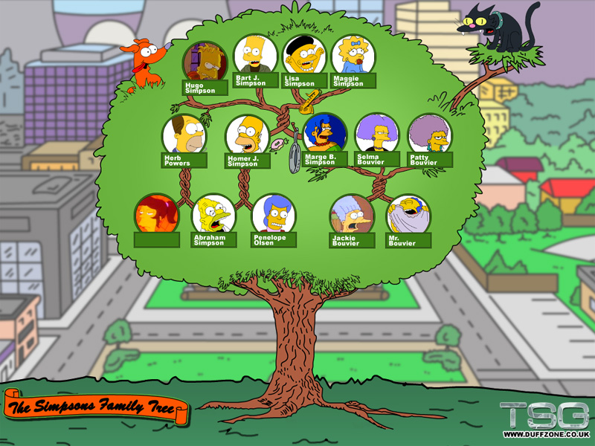
A family dictionary?

Slide 71
A family dictionary…
T = {'abe' :['homer','herb'],
'jackie':['marge','patty','selma'],
'homer' :['hugo','bart','lisa','maggie'],
'marge' :['hugo','bart','lisa','maggie']}
keys can be any immutable type
values can be any type at all…
T['abe']
How to get 'selma' from T?

Slide 72
A functional family?
def favChild( person, Tree ):
""" person is a name (a string)
Tree is a dictionary of children
returns person's "favorite" child """
if Tree.has_key( person ):
Kids = Tree[person]
Kids.sort()
return Kids[0]
return None
Who is favored ?
sort has side effects !

Slide 73
A functional family?
For example, >>> addChild( 'lisa', T, 'abejr' )
def addChild( person, Tree, jr ):
""" adds person's new child to Tree """
if Tree.has_key( person ) == False:
else: # already in the Tree!

Slide 74
“Quiz”
Name(s):
def favChild( person, Tree ):
if Tree.has_key( person ):
Kids = Tree[person]
Kids.sort()
return Kids[0]
return None
Change this code so that it prints how many times you've guessed each item, both for real provinces and for incorrect guesses…
def provinceChallenge( prov ):
while 0 in prov.values():
guess = raw_input("Guess: ")
if prov.has_key( guess ) == False:
print 'Try again...'
elif prov[guess] == 0:
print 'Yes!'
prov[guess] += 1
else:
print 'Already guessed...'
Based on favChild (above), write favGChild to return the first grandchild alphabetically - or return None if there are none.
def favGChild( person, Tree ):

Slide 75
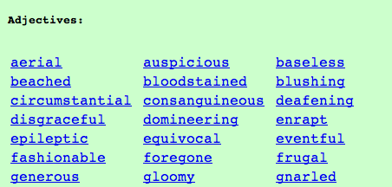
Vocabularists?
Shakespeare used 31,534 different words and a grand total of 884,647 words counting repetitions (across his works)
http://www-math.cudenver.edu/~wbriggs/qr/shakespeare.html
Active vocabulary estimates range from 10,000-60,000.
Passive vocabulary estimates are much higher.
Contemporary author in the OED…
Many Shakespearean contributions:
Shakespeare
which word…
Any guesses?

Slide 76
Vocabularists?
Shakespeare used 31,534 different words and a grand total of 884,647 words counting repetitions (across his works)
http://www-math.cudenver.edu/~wbriggs/qr/shakespeare.html
Active vocabulary estimates range from 10,000-60,000.
Passive vocabulary estimates are much higher.
Many Shakespearean contributions:
Shakespeare
J. K. Rowling

Slide 77
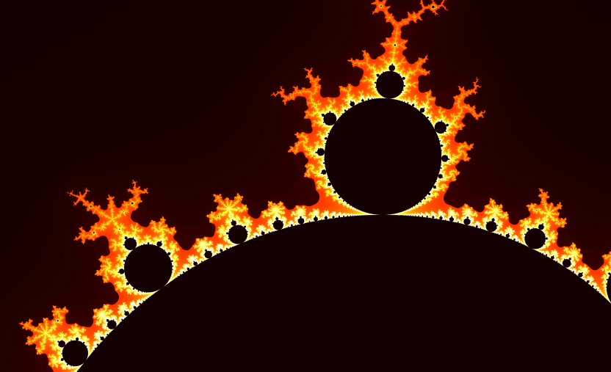
Infernalicious!
also: www.cs.hmc.edu/~jgrasel/

Slide 78
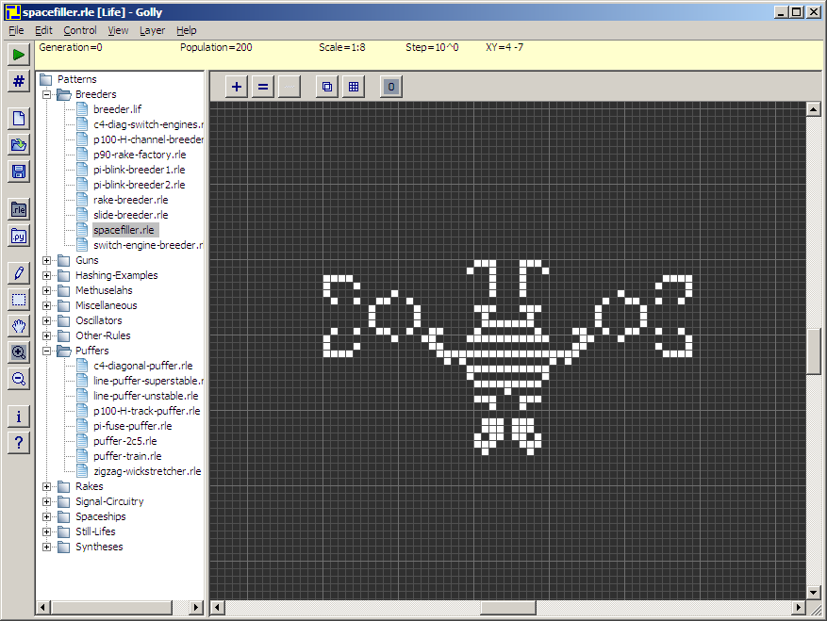
Life, revisited
Golly!
http://golly.sourceforge.net/

Slide 79
Methods
There's madness in this method!
d.has_key( 1991 )
are functions that are called by the data itself!
Functions
has_key( 1991, d )
are called on their own…
all data must be passed in as function inputs…
Warning: this has_key function is for example purposes only. It does not exist!

Slide 80
Representation & Speed
list
dictionary
{1988: 'dragon', 1989: 'snake'}
reference
L
5
0
L[0]
L[1]
…
42
L[9999]
finding if a value is in a list of 10,000 elements…
vs.
looking up a key in a dictionary of 10,000 entries

Slide 81
value-added tts() options…

Slide 82


Problem 1 -- to ∞ and beyond!
"rocks"
Are there stable life configurations?
Are there oscillating life configurations?
"plants"
period 3
period 2
Are there self-propagating life configurations?
"animals"

Slide 83
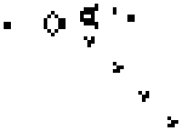
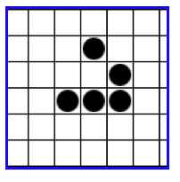
Problem 1 -- to ∞ and beyond!
Are there life configurations that expand forever?
What is the largest amount of the life universe that can be filled with cells?
Are all feasible configurations reachable?
How sophisticated can the structures in the life universe be?
http://www.ibiblio.org/lifepatterns/

Slide 84
Name that author… ?
'Cause somethin' like he left knee and a harp," said he had to the whole school? The shouting and then some strange and Mrs. "Well, I know Hagrid; they spotted handkerchief and get him get rid of course, had a gigantic beet with her," he knew what to all he's
All the sky with the sun in the sun in the church where you're gone Lucy in my eyes. There beneath the girl with an hourglass And then the banker never wears a lot to hold your hand. Can't buy me tight, tight Owww! Love is love I can't hide,
Who is the author?
What is the work?
What is going on?
This is but ourselves. No, faith, My uncle! O royal bed of confession Of your rue for leave to nature; to this time I should weep for thy life is rotten before he is. have sworn 't. Or my blood. I have closely sent for nine; and unprofitable,
The Senators and the date of a written declaration that Purpose, they shall consist of nine States, shall not, when he shall have such Vacancies. The President pro tempore, in the Desire of a Qualification to the Speaker of the Senate. Article 6. When vacancies by the office upon probable

Slide 85
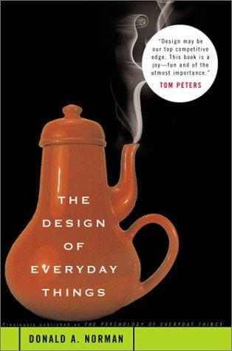
Exam on Mon.
Exam topics
1d loops
for & while
Design chapter:
2d loops
for row…
for col…
Hmmm
add r2 r2 r1
Basics
variables, functions, etc.
You may bring a page of notes, double-sided with anything you would like on it.
I'd suggest (1) reminding yourself about the HW problems and (2) looking at the class "quizzes"…

Slide 86
Change this code so that it tells you how many times you've guessed the same province…
first, for real provinces
then, for incorrect guesses…
def provinceChallenge( prov ):
while '0' in prov.values():
guess = raw_input("Guess: ")
if prov.has_key( guess ) == False:
print 'Try again...'
elif prov[guess] == 0:
print 'Yes!'
prov[guess] += 1
else:
print 'Already guessed...'

Slide 87
Based on favChild, write favGChild to return the first grandchild alphabetically - or return 'no one' if there are none.
def favChild( person, Tree ):
if Tree.has_key( person ):
Kids = Tree[person]
Kids.sort()
return Kids[0]
else:
return 'no children'
def favGChild( person, Tree ):
GC = []
our list of GChildren

Slide 88
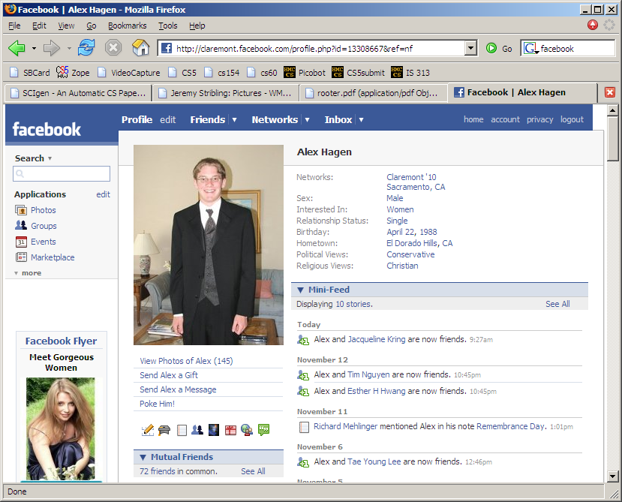

Slide 89
Name that author… ?

Slide 90
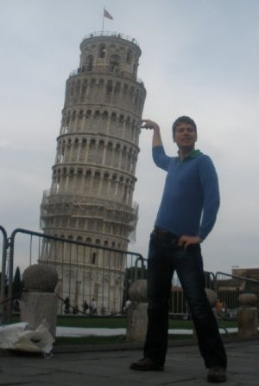
Visuospatial Skills
Three dimensions are better than two – I should know!
We use visuospatial skills in everyday life.
Most importantly, visuospatial skills are a significant predictor of success in technical fields. Imagine graphics software for instance.
Power to predict grades in technical courses equals that of math SAT scores (Sorby, 2009).
Bundled multimedia software and workbook developed at Michigan Tech teaches these skills.
Multimedia is being implemented at 6 other institutions nationwide including Purdue, Virginia Tech, Penn State – Behrend using a $200,000 NSF grant awarded in 2007.

Slide 91
If I had a dictionary, I guess I could look up what it was!
Dictionaries
Lists are not perfect…
reference
You can't choose what to name data.
L
5
42
L[0]
L[1]
L[0], L[1], …
You have to start at 0.
L[1990] = 'horse'
L[1991] = 'ram'
Some operations can be slow for big lists …
if 'rooster' in L:

Slide 92
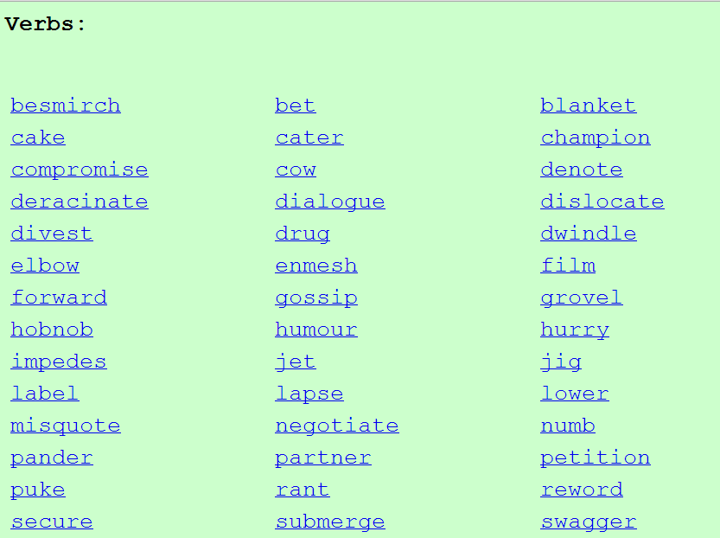
Vocabulary, anyone?
Shakespeare used 31,534 different words -- and a grand total of 884,647 words -- counting repetitions (across all of his works)
http://www-math.cudenver.edu/~wbriggs/qr/shakespeare.html
Shakespearean coinages:
J. K. Rowling

Slide 93
In search of elegance... One solution:
def isBefore(self, d2):
""" Returns true if self is before d2 """
if self.year < d2.year:
return True
if self.month < d2.month and self.year == d2.year:
return True
if self.day < d2.day and d2.month == self.month and \
self.year == d2.year:
return True
return False
def isAfter(self, d2):
""" Returns true if self is after d2 """
if self.year > d2.year:
return True
if self.month > d2.month and self.year == d2.year:
return True
if self.day > d2.day and d2.month == self.month and \
self.year == d2.year:
return True
return False

Slide 94
A more elegant solution
def isBefore(self, d2):
""" Returns true if self is before d2 """
if self.year < d2.year:
return True
if self.month < d2.month and self.year == d2.year:
return True
if self.day < d2.day and d2.month == self.month and \
self.year == d2.year:
return True
return False
def isAfter(self, d2):
""" Returns true if self is after d2 """
return d2.isBefore(self)

Slide 95
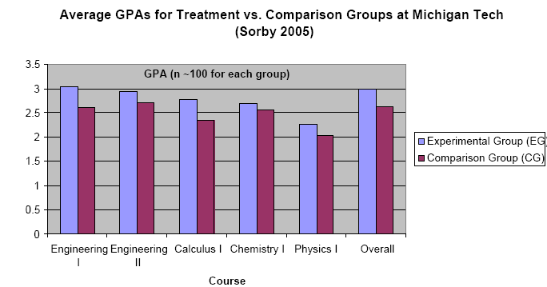
Visuospatial skills can be taught and learned.
Improving these skills leads to improved grades
I have $5,000 to (1) give to you, (2) help you learn these skills, and (3) improve grades…

Slide 96
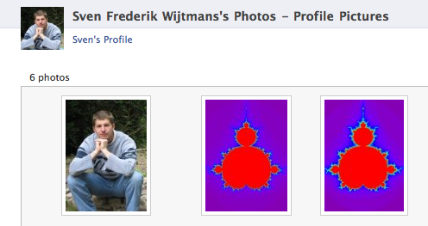

MandelGallery!

Slide 97


Slide 98
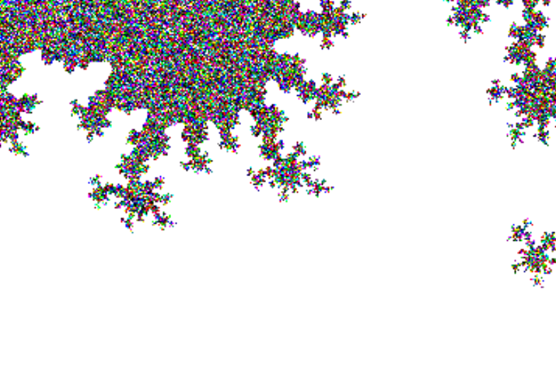
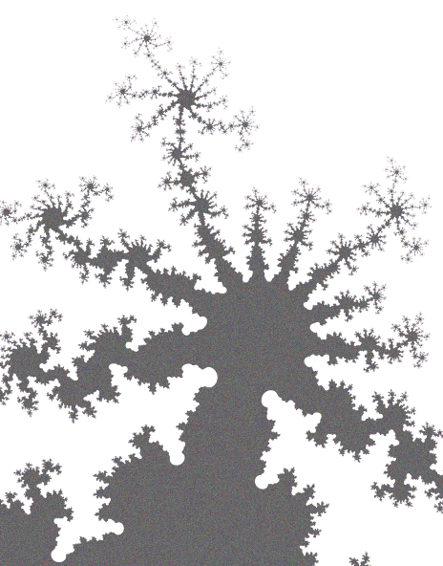

Slide 99
CS 5 this week
Building classes...
... vs. using the library
hw10pr2
hw10pr3
file and dictionary classes
Connect Four Board class
files
dictionaries
If I had a dictionary, I guess I could look up what it was!

Slide 100
Classes: DIY data
design-it-yourself!
Class: a user-defined datatype
Object: data or a variable whose type is a class
constructor
object
d = Date( 11, 11, 2010 )
d.tomorrow()
print d
method
d would be named self inside the Date class...
uses repr
Method: a function defined in a class called by an object
self: in a class, the name of the object calling a method
Constructor: the __init__ function for creating a new object
repr: the __repr__ function returning a string to print

Slide 101
Designing classes
(Data Members) What data do we need?
Not limited to 7x6!
(Methods) What are capabilities do we want?

Slide 102
Connect Four: an object, b
str
str
str
str
str
str
Board
b
list
?
data
str
str
str
str
str
str
rows
6
4
str
str
str
str
str
str
int
int
str
str
str
str
str
str
width
height
columns
How could we set the ? to 'X'

Slide 103
Connect Four: constructor
class Board:
""" a datatype representing a C4 board
with an arbitrary number of rows and cols
"""
def __init__( self, width, height ):
""" the constructor for objects of type Board """
self.width = width
self.height = height
W = self.width
H = self.height
self.data = [ [' ']*W for row in range(H) ]
List comprehensions let us create
self.height independent rows with
self.width independent columns each.

Slide 104
Connect Four: __repr__
def __repr__(self):
""" this method returns a string representation
for an object of type Board
"""
s = ''
for row in range( 6 ):
s += '|'
for col in range( 7 ):
s += self.data[row][col] + '|'
s += '\n'
return s
To change?
To add?
which row is row 0, row 1, and so on?

Slide 105
Quiz
class Board:
def allowsMove(self, col):
def addMove(self, col, ox):
H = self.height
for row in range( H ):
if self.data[row][col] != ' ':
self.data[row-1][col] = ox
self.data[H][col] = ox
Write allowsMove to return True if col is a valid move; False otherwise.
Hint: check as little as possible!
a C4 board
col #
'X' or 'O'
Step through this imperfect addMove method.
What is each line doing?
Can you spot any potential problems here...?

Slide 106
C4 Board class: hw10pr2
the “constructor”
__init__( self, width, height )
checks if allowed
allowsMove( self, col )
places a checker
addMove( self, col, ox )
removes a checker
delMove( self, col )
to write...
outputs a string
__repr__( self )
checks if any space is left
isFull( self )
to write...
checks if a player has won
winsFor( self, ox )
to write...
the game...
hostGame( self )
to write...
Which are similar to others? Which requires the most thought?

Slide 107
winsFor( self, ox )
X
O
def winsFor(self, ox):
""" does ox win? """
H = self.height
W = self.width
b
b.winsFor( 'O' )
or 'X'
Watch out for corner cases!

Slide 108
Why objects and classes?
Elegance: Objects hide complexity!
if b.winsFor( 'X' ) == True:
if d.isBefore( d2 ) == True:
Simple – and INVITING -- building blocks!
encapsulating lots of complexity!!
or maybe not so much!!!
def isBefore(self, d2):
""" Returns true if self is before d2 """
return [self.year, self.month, self.day] < [d2.year, d2.month, d2.day]

Slide 109
Files
In Python reading files is no problem…
>>> f = file( 'a.txt' )
>>> text = f.read()
>>> f.close()
>>> text
'I like poptarts and 42 and spam.\nWill I
>>> LoW = text.split()
[ 'I', 'like', 'poptarts', ... ]
opens the file and calls it f
constructor and methods!
reads the whole file and calls it f
closes the file (optional)
all the text (as one big string)
text.split() returns a list of each "word"

Slide 110
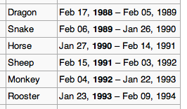
This seems like the key to dictionaries' value…
Dictionaries
In Python a dictionary is a set of key - value pairs.
>>> d = {}
>>> d[1992] = 'monkey'
>>> d[1993] = 'rooster'
>>> d
{1992:'monkey', 1993:'rooster'}
>>> d[1991]
'ram'
>>> d[1969]
key error
creates an empty dictionary, d
1992 is the key
'monkey' is the value
1993 is the key
'rooster' is the value
Curly! And colony!
Retrieve data like lists…
Almost !
It's a list where the index can be any immutable key.

Slide 111
More on dictionaries
They don't seem moronic to me!
Dictionaries have lots of built-in methods, or functions:
>>> d = {1992:'monkey', 1993:'rooster'}
>>> 1992 in d
True
>>> 1969 in d
False
>>> len(d)
2
>>> d.keys()
[ 1992, 1993 ]
in checks if a key is present
len returns the # of keys
d.keys returns a list of all keys
d.values returns a list of all values
d.items returns a list of all key/val. pairs

Slide 112
def wc( filename ):
""" word-counting program """
f = open( filename )
text = f.read()
f.close()
LoW = text.split()
print "There are", len(LoW), "words."
file handling
word counting
What if we wanted the number of different words in the file?
This would be the author's vocabulary size, instead of the word count.

Slide 113
def wc( filename ):
""" word-counting program """
f = open( filename )
text = f.read()
f.close()
LoW = text.split()
print "There are", len(LoW), "words."
d = {}
for w in LoW:
if w not in d:
d[w] = 1
else:
d[w] += 1
print "There are", len(d), "distinct words.\n"
return d # this way we can use d later!
file handling
word counting
Tracking the number of occurences of each word with a dictionary, d.

Slide 114
Vocabularists?
Shakespeare used 31,534 different words and a grand total of 884,647 words counting repetitions (across his works)
http://www-math.cudenver.edu/~wbriggs/qr/shakespeare.html
Active vocabulary estimates range from 10,000-60,000.
Passive vocabulary estimates are much higher.
Many Shakespearean contributions:
One contemporary author in the Oxford Eng. Dictionary…
Shakespeare
which word?

Slide 115
A dictionary challenge…
PROV = { 'BC': 0, … }
All of Canada's provinces are in this dictionary…
key
value
def provinceChallenge( PROV ):
""" PROV is a dictionary of Canada's provinces
-- the challenge is to name them all! """
while 0 in prov.values():
guess = raw_input("Name a province: ")
if guess not in PROV:
print 'Try again...'
elif prov[guess] == 0:
print 'Yes!'
prov[guess] += 1
else:
print 'Already guessed...'
prov[guess] += 1
print 'Phew!'
wasn't a key at all
newly guessed key: value was 0
repeated guess
help?!

Slide 116
Another challenge?

Slide 117
Markov Models
Techniques for modeling any sequence of natural data
speech, text, sensor-data in time series...
Each item depends only on the item immediately before it .
1st-order Markov Model
I like poptarts and 42 and spam.
Will I get spam and poptarts for
the holidays? I like spam poptarts!
The text file:
{ 'like' : ['poptarts'],
'and' : ['42', 'spam.', 'poptarts'],
'get' : ['spam'], …
'poptarts':
'I' :
'Will' :
The model:
How to get to Will?

Slide 118
Markov Models are generative!
A key benefit of Markov Models is that they can generate feasible data!
Original file:
Generated text:
I get spam poptarts! I like poptarts and 42 and spam. I like spam and 42 and 42 and 42 and spam. Will I like poptarts and 42 and poptarts and 42 and poptarts and 42 and 42 and poptarts and spam. I get spam and 42 and 42 and...

Slide 119
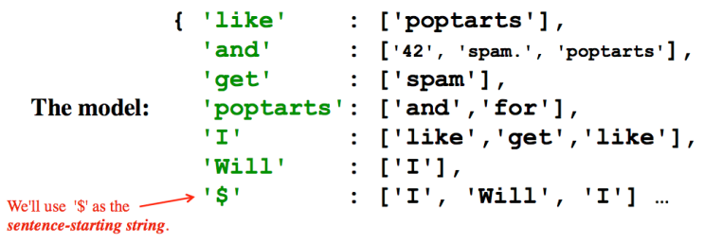
Model creation:
1) start with the prevword as '$'
2) for each word w, put w in prevword's list
or create a new list with just w!
3) change prevword to word or '$' as appropriate...
if w[-1] is punctuation.
Generating text:
1) start with the '$' string
2) choose a word following '$', at random. Call it w
3) choose a word following w, at random. And so on…
4) If w ends a sentence, '$' becomes the next word.
if w[-1] is punctuation.

Slide 120
more sophisticated than a first-order model!

