Slide 1
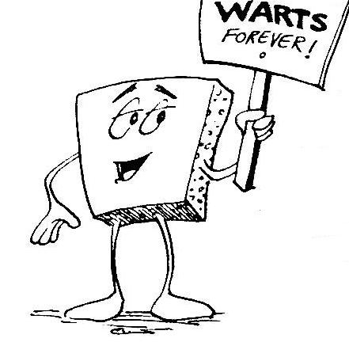
Welcome to CS 5 !
Grab these lecture notes…
Introduction to CS
Wally Wart, a protrusive advocate of concrete computing
We don't have words strong enough to describe this class.
- US News and Course Report
Everyone will get out of this course – a lot!
- NYTimes Review of Courses
1 handout…
We give this course two thumbs…
slides & syllabus
- Metametacritic

Slide 2
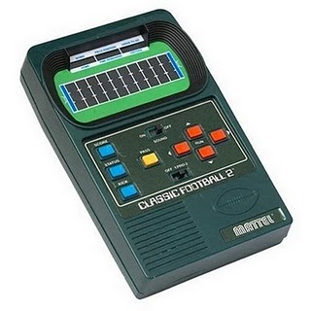
Introductions...
Zach Dodds
Olin B163
dodds@cs.hmc.edu
pursuer of low-level AI
taker of low-quality photos
fan of low-tech games
Daniel, Zhang
Speaking of introductions

Slide 3
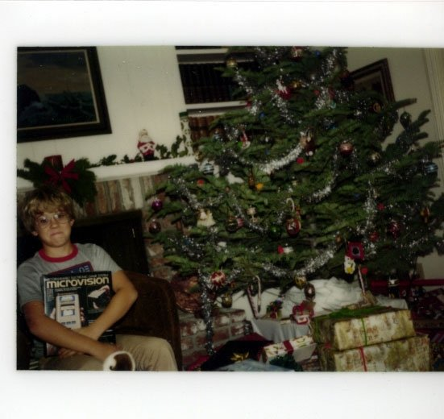
… and who is this Mudder, 35 years later?

Slide 4
… and who is this Mudder, 35 years later?
Jon “Dean” Jacobsen, 1979

Slide 5
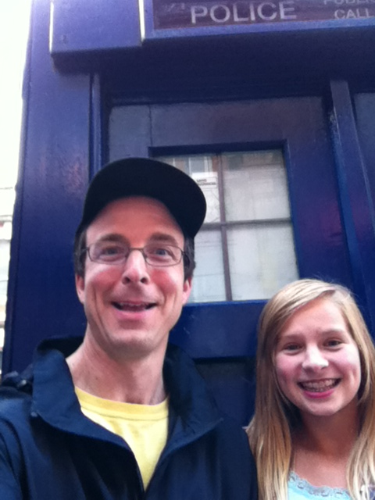
Introductions...
Zach Dodds
Olin B163
dodds@cs.hmc.edu
pursuer of low-level AI
taker of low-quality photos
fan of low-tech games
Daniel, Zhang
Speaking of introductions

Slide 6
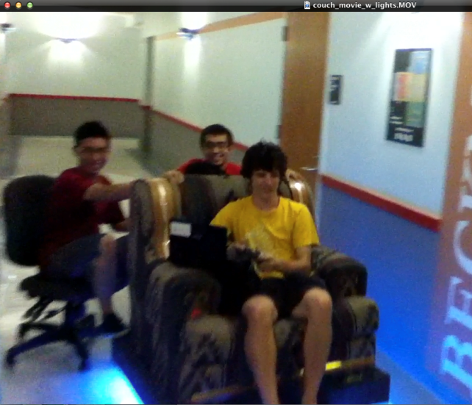
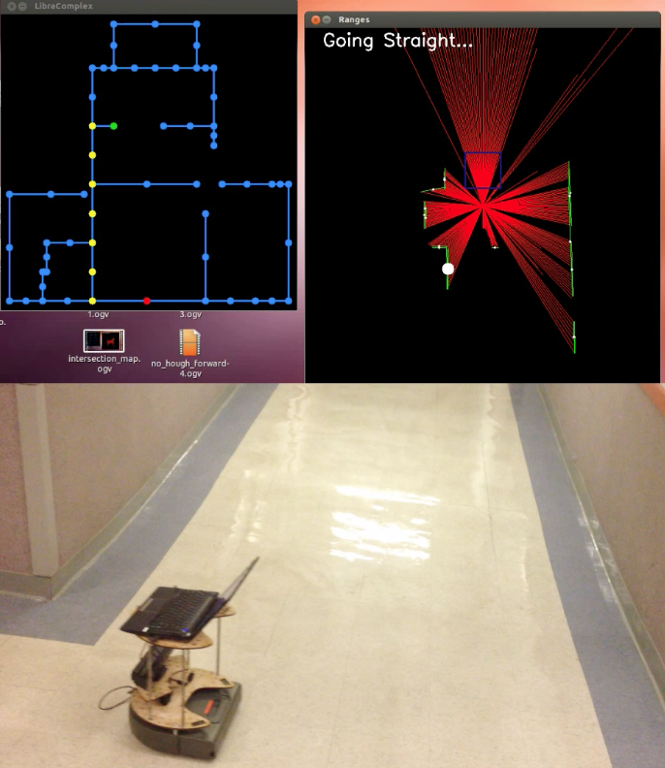
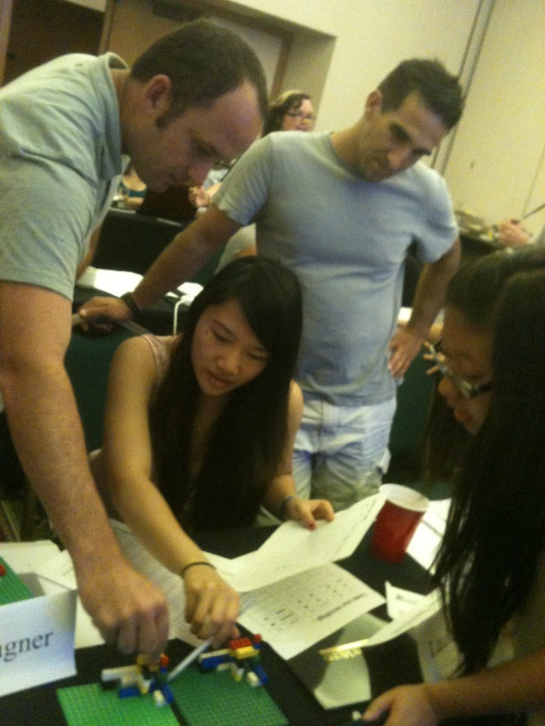
How I spend my summers...
actually, this "I" is not quite accurate…
Chairs?
Robots
Hawaii?

Slide 7


Today in CS5…
2) How CS 5 runs…
3) Python?!
Shouldn’t there be an alien in this game?
CS is just programming, right?
1) What is CS?
I'm not so sure…
Whatever it is, it's definitely alien!

Slide 8
CS != programming
So, what is CS?
Punctuation matters!
So what? is CS

Slide 9
CS != programming
"not equal to"

Slide 10
CS != programming
programming : CS ::
freelines : HMC
machine shop : engineering
CS
equations : mathematics
Programming
chemistry : biology
programs are a vehicle, not the destination

Slide 11
What is CS a science of ?
the study of complexity:
How can it be done?
it ~ information
How well can it be done?
Can it be done at all?
or, more precisely, a process transforming
information from one form to another
Notes:
creative side ~ dreamworks, game companies, google, microsoft, soc. networking <-- the design and creation of original algorithms and software
and a commodity side ~ application use, configuration, customization, certification, your favorite acronym here…
our department pays only about 5-10% of its attention to the commodity side
it pays 90-95% of its attention to the creative side… Why?
robotics? taught yourself to build or create something… game levels, etc.?

Slide 12
What is CS a science of ?
the study of complexity:
How can it be done?
it ~ information
How well can it be done?
Can it be done at all?
or, more precisely, a process transforming
information from one form to another
We'll look at 3 examples – each of which you'll construct in CS 5 …at least to some extent!
3 examples? That's it for me!
Notes:
creative side ~ dreamworks, game companies, google, microsoft, soc. networking <-- the design and creation of original algorithms and software
and a commodity side ~ application use, configuration, customization, certification, your favorite acronym here…
our department pays only about 5-10% of its attention to the commodity side
it pays 90-95% of its attention to the creative side… Why?
robotics? taught yourself to build or create something… game levels, etc.?

Slide 13
'HUMAN'
What is CS?
'CHIMPANZEE'
How can it be done?
What is the Longest Common Subsequence between 2 strings?
How well can it be done?
biology's string-matching problem, "LCS"
Can it be done at all?
'CGCTGAGCTAGGCA...'
Can you solve the problem?
'ATCCTAGGTAACTG...'
Can you create a process to solve such problems?
+10⁹more
Eye oneder if this haz othur aplications?
Notes:
creative side ~ dreamworks, game companies, google, microsoft, soc. networking <-- the design and creation of original algorithms and software
and a commodity side ~ application use, configuration, customization, certification, your favorite acronym here…
our department pays only about 5-10% of its attention to the commodity side
it pays 90-95% of its attention to the creative side… Why?
robotics? taught yourself to build or create something… game levels, etc.?

Slide 14
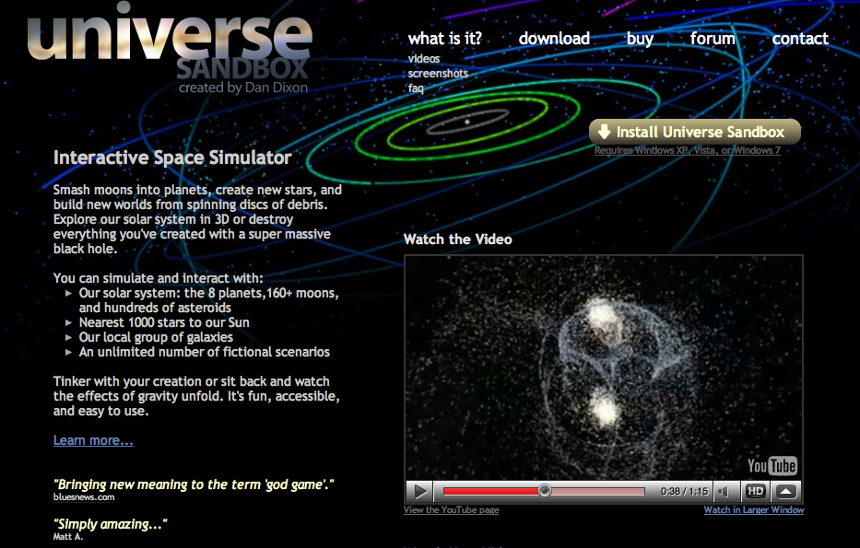
Feels like home!
What is CS?
How can it be done?
How well can it be done?
Can it be done at all?
How quickly can you find a solution?
How much work is needed to simulate N stars?
Is your solution the "best" possible?
physics's "N-body" problem
what if N is a billion-and-one…?
Notes:
creative side ~ dreamworks, game companies, google, microsoft, soc. networking <-- the design and creation of original algorithms and software
and a commodity side ~ application use, configuration, customization, certification, your favorite acronym here…
our department pays only about 5-10% of its attention to the commodity side
it pays 90-95% of its attention to the creative side… Why?
robotics? taught yourself to build or create something… game levels, etc.?

Slide 15
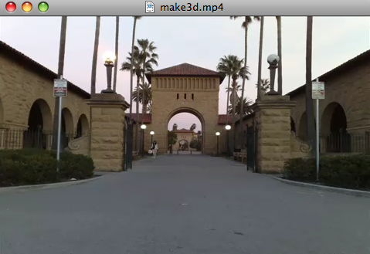
What is CS?
How can it be done?
How well can it be done?
Can it be done at all?
Can we build a 3d model from one 2d image?
Is your problem solvable?
Andrew Ng's "Make3d"
How can you tell !?
many problems are uncomputable… … and you'll prove this!
All three eyes tell me that Make3d has just failed ~ epically!
Notes:
creative side ~ dreamworks, game companies, google, microsoft, soc. networking <-- the design and creation of original algorithms and software
and a commodity side ~ application use, configuration, customization, certification, your favorite acronym here…
our department pays only about 5-10% of its attention to the commodity side
it pays 90-95% of its attention to the creative side… Why?
robotics? taught yourself to build or create something… game levels, etc.?

Slide 16
What is CS?
Can you solve this problem?
CS is the study of complexity
Can you create a process to solve such problems?
How can it be done?
How well can it be done?
How quickly can you find solutions?
Can it be done at all?
Do you have the “best” solution?
CS's 6 big questions are here.
Is every problem solvable?
But only one is
programming.
Do you see which?
Is there a way to tell?
There isn’t always!
Notes:
programming is only about 1/6th of computer science as a science – it is perhaps more of the commodity side of the field – but that’s a good thing!

Slide 17
What is CS?
CS
Can you solve this problem?
CS is the study of complexity
Can you create a process to solve such problems?
programming
+ CS
How can it be done?
How well can it be done?
How quickly can you find solutions?
CS
Can it be done at all?
Do you have the “best” solution?
CS
CS's 6 big questions are here.
CS
Is every problem solvable?
But only one is
programming.
Do you see which?
Is there a way to tell?
CS
There isn’t always!
Notes:
programming is only about 1/6th of computer science as a science – it is perhaps more of the commodity side of the field – but that’s a good thing!

Slide 18
CS 5’s philosophy:
Whatever you are, be a good one.
- Abraham Lincoln
More and more, CS can help!

Slide 19
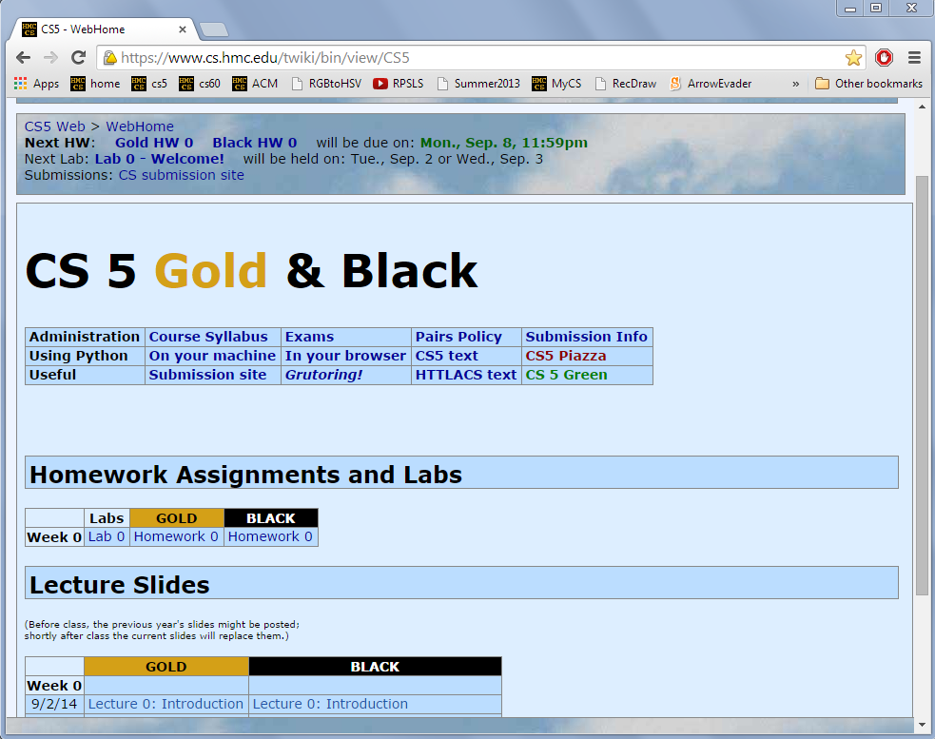
Take-home message…
depending on where "home" is, perhaps…
New in 2014!
Just Google for hmc cs5
www.cs.hmc.edu/cs5

Slide 20
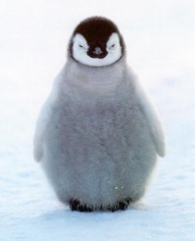
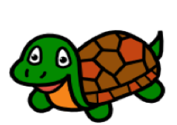

Why here?
official alien of CS 5 Gold
official mascot of CS 5 Black
Placement based on experience, not ability:
  Gold is for students mostly new to CS,
  Black for students with a good amount of previous CS
  Tradeoff: more careful coverage – a few more applications
  Green is for those who'd like biology-flavored CS!
  All of Gold Black and Green will prepare you well for
    CS 60
    Future computational work
    A happy and fulfilling life :-)
official turtle of CS 5 Green
switching?

Slide 21
You're here ~ what's next?
2) How CS 5 runs…
3) Python?!
Shouldn’t there be an alien in this game?
this week's Python HW is choice!
CS is just programming, right?
1) What is CS?
I'm not so sure…
Whatever it is, it's definitely alien!

Slide 22
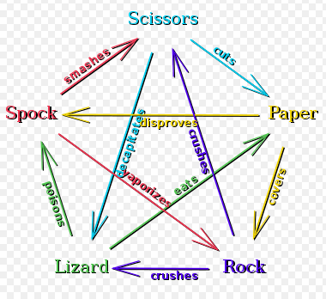
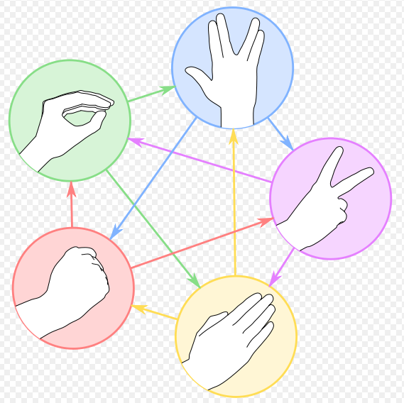

rock – paper – scissors – lizard – Spock!
Logically, I've got game!
http://www.youtube.com/watch?v=fqlDc2VICZ0 start at about :28

Slide 23
Soundbite syllabus
TTh: 9:35 - 11:50 am
Lectures
Key skills, topics, and their motivation
Come to Lectures!
Insight into the HW problems (what, why, how)
We’d like to see you! Let us know if you’ll be sick…
Lab
T or W: 2:45 - 4:45 pm or 6:00 - 8:00 pm
recommended by 4 out of 5 HMC sophomores!
Guided progress for the hw
Come to Labs!
Not required, but encouraged (full credit for probs)
Will SAVE you time and effort in CS 5!
Office hrs
M: 2:00-4:00 pm, LAC lab
Lots of help is available!
feel free to work on HW or just stop by
or, come to any of the many tutoring hrs!
HW
Hw is due on Monday nights...
Monday nights: due by 11:59 pm
Notes:
still before the quiz… (syllabus is in the back of your handout…)

Slide 24
Syllabus, briefly
TTh: 9:35 - 11:50 am
Lectures
Key skills, topics, and their motivation
Insight into the HW problems (what, why, how)
We’d like to see you! Let us know if you’ll be sick…
Lab
T or W: 2:45 - 4:45 pm or 6:00 - 8:00 pm
recommended by 4 out of 5 HMC sophomores!
Guided progress on the class's hw
Not required, but encouraged (full credit for probs)
Will SAVE you time and effort in CS 5!
Office hrs
M: 2:00-4:00 pm, LAC lab
feel free to work on HW, to just stop by,
or, come to any of the many tutoring hrs!
HW
Monday nights: due by 11:59 pm
Notes:
still before the quiz… (syllabus is in the back of your handout…)

Slide 25
Map to CS Lab
TLB
coffee
Koi
Edwards
Macalister
Pryne
Physicists, chemists & other parenthesis-needing individuals,
cool machines - drills, lathes, etc.
Your account for CS
submissions?
Laptop? Bring it!
Galileo
passwd:
other keyboard-free machines
B102
B100
Beckman
CS Hallway and Labs
Big Beckman (B126)
B105
Biologists, bees, spiders and other arachnophiles
to Olin (Bio + CS)

Slide 26
This week's lab…
0) Find the lab! Sign in…
1) Get Python running…
2) Run and submit a file…
demo
Encouraged: bring your laptop

Slide 27
Homework
Assignments
~ 5 problems/week
Due Monday evenings by 11:59 pm.
Eur-ollowed to use one Euro for up to three hwks. No need to let us know, even.
Extra credit is usually available…
You have 3 CS 5 Euros to use…
"Late Days"
Some problems are specified “individual-only.”
Others offer the option of working as pairs/partners:
Collaborate!
You don’t have to work in pairs/partners (that said, it's fun!)
You must share the work equally - typing and coaching
Be sure to indicate who your partner was at the submission site!
Put your name(s) in the code, as well! (differs from 60 + 42)

Slide 28

Pairs
Partners
one computer
two computers
tradeoff typing/debugging ~ about every 20 minutes
both partners type/debug ~ provide help as needed
Standard is the same either way:
After finishing the hw, (a) each person has contributed equally and (b) both could complete the problems on their own

Slide 29
Honor Code
You're encouraged to discuss problems with other students – or tutors - or any instructors.
You may not share written, electronic or verbal solutions with other students, present or past:
Even with three eyes, I need to borrow others' to find the syntax errors here!
Please do use the internet for Python language references.
Pleas do use other's eyes for finding syntax erorrs.
Do not use the internet (or intranet) to (try to) find solutions…
If you work as a pair/partners, the rules apply for the group.
Sign & submit CS's honesty policy online in lab this week.

Slide 30
Grading
if perc > .95:
print 'A'
elif perc > .90:
print 'A-'
elif perc > .70:
print 'Pass'
~ 65% Assignments
~ 30% Exams
most take CS5 P/NC
~ 5% Participation/“quizzes”
see online syllabus for the full grade list...
Exams
Midterm
Th, November 6 in-class
using a page of notes is OK on exams
Final
T, December 16 "in-class"
All 3
To pass CS 5 P/NC, you need a passing grade on each of the course components: HW, exams, and participation/“quizzes”. Failing one component results in NC'ing CS 5, even with a passing average.
Don’t sleep through the exam!
Notes:
homework really comprises the key skills I hope that everyone takes away from this class…
weighted accordingly!
if you never submit anything before 11:59pm on Wednesday – I have complete sympathy!

Slide 31
Choices, choices!
Suppose we set the value of perc to 0.91...
perc = 0.91
if perc > 0.95:
print 'A'
elif perc > 0.90:
print 'A-'
elif perc > 0.70:
print 'Pass'
else:
print 'Aargh!'
What will this program print, if perc is 0.91?
# of BLOCKS here:
# of TESTS here:
Notes:
Useful skill
Important tool
Window into corners of everyday life

Slide 32
Choices, choices!
perc = 0.80
if perc > 0.95:
print 'A'
elif perc > 0.90:
print 'A-'
elif perc > 0.70:
print 'Pass'
else:
print 'Aargh!'
perc = 0.80
if perc > 0.00:
print 'Aargh!'
elif perc > 0.70:
print 'Pass'
elif perc > 0.90:
print 'A-'
else:
print 'A'
What does each of these programs print out, if perc is 0.8?
What value of perc gives an 'A-' on the right?
How can you get a better grade on the right than the left?
Notes:
Useful skill
Important tool
Window into corners of everyday life

Slide 33
Exclusive Choices
if ... elif ... else
if perc > .95:
print 'A'
elif perc > .90:
print 'A-'
elif perc > .70:
print 'Pass'
else:
print 'Aargh!'
4 mutually exclusive blocks
in a single control structure
When using
if . elif … . else
at most one block will run: the first whose test is True. If all fail, the else will run
elif and else are optional
Notes:
Useful skill
Important tool
Window into corners of everyday life

Slide 34
What's the difference?
mutually exclusive blocks
nonexclusive blocks
if perc > .95:
print 'A'
elif perc > .90:
print 'A-'
elif perc > .70:
print 'Pass'
if perc > .95:
print 'A'
if perc > .90:
print 'A-'
if perc > .70:
print 'Pass'
What if perc == .99 ? (How would we set it?)
How many separate control structures does each side have?
Notes:
Useful skill
Important tool
Window into corners of everyday life

Slide 35
Does this program print the correct RPS result this time? Does it always?
in a fiercely contested game of RPS...
comp = 'rock'
user = 'paper'
if comp == 'paper' and user == 'paper':
print 'We tie. Try again?'
elif comp == 'rock':
if user == 'scissors':
print 'I win! *_*'
else:
print 'You win. Aargh!'
# of BLOCKS here:
# of TESTS here:
Notes:
Useful skill
Important tool
Window into corners of everyday life

Slide 36
Does this program print the correct RPS result this time? Does it always?
in a fiercely contested game of RPS...
comp = 'rock'
user = 'paper'
if comp == 'paper' and user == 'paper':
print 'We tie. Try again?'
elif comp == 'rock':
if user == 'scissors':
print 'I win! *_*'
else:
print 'You win. Aargh!'
# of BLOCKS here:
# of TESTS here:
Notes:
Useful skill
Important tool
Window into corners of everyday life

Slide 37
"Quiz"
Pair up with someone nearby – answer these questions together…
Name ______________________
Your favorite __________ is ____________.
Your least favorite ____________ is ____________.
Name ______________________
Your favorite __________ is ____________.
Your least favorite ____________ is ____________.
People
Paper
What is something non-Claremont-collegey you have in common?
Then, try these Python q's:
(0) How many tests and blocks are here?
(2) As written, what output does this print?
(3) Change these inputs to produce a completely correct RPS output here.
(1) What output does this code print?
Python
comp = 'rock'
user = 'rock'
if comp == 'rock':
print 'I win *_*!'
if user == 'paper':
print 'You win.'
else:
print 'Tie.'
comp = 'rock'
user = 'rock'
if comp == 'rock':
if user == 'paper':
print 'I win *_*!'
elif user == 'scissors':
print 'You win.'
else:
print 'Tie.'
(4) How many RPS cases are there? How many of them are correctly handled by this code?
(5) What is the smallest number of tests and blocks of code you'll need to correctly handle a full game of RPS?
(Extra) What if it were RPS-5, with Lizard and Spock? RPS-101?

Slide 38
"Quiz"
Pair up with someone nearby – answer these questions together…
Name ______________________
Your favorite __________ is ____________.
Your least favorite ____________ is ____________.
Name ______________________
Your favorite __________ is ____________.
Your least favorite ____________ is ____________.
What is something non-Claremont-collegey you have in common?
Then, try these Python q's:
(0) How many tests and blocks are here?
(2) As written, what output does this print?
(3) Change these inputs to produce a completely correct RPS output here.
(1) What output does this code print?
comp = 'rock'
user = 'rock'
if comp == 'rock':
print 'I win *_*!'
if user == 'paper':
print 'You win.'
else:
print 'Tie.'
comp = 'rock'
user = 'rock'
if comp == 'rock':
if user == 'paper':
print 'I win *_*!'
elif user == 'scissors':
print 'You win.'
else:
print 'Tie.'
(4) How many RPS cases are there? How many of them are correctly handled by this code?
(5) What is the smallest number of tests and blocks of code you'll need to correctly handle a full game of RPS?
(Extra) What if it were RPS-5, with Lizard and Spock? RPS-101?

Slide 39
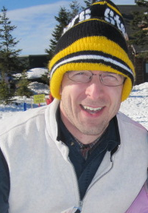
"Quiz"
Name
Your favorite _____ is ________________.
Your least favorite _______ is ______________.
Zach Dodds
tv show
Project Runway
+
Dr. Who
coffee
decaffeinated
Name
Your favorite _________ is _______.
Your least favorite _______ is ________.
T. E. Alien
canned-meat food product
spam
#
41.999
Something in common?
Our taste in hats!

Slide 40
"Quiz"
Pair up with someone nearby – answer these questions together…
Please pass these to the aisles…
Turn back to the notes.
Name ______________________
Your favorite __________ is ____________.
Your least favorite ____________ is ____________.
Name ______________________
Your favorite __________ is ____________.
Your least favorite ____________ is ____________.
What is something non-Claremont-collegey you have in common?
Then, try these Python q's:
(0) How many tests and blocks are here?
(2) As written, what output does this print?
(3) Change these inputs to produce a completely correct RPS output here.
(1) What output does this code print?
comp = 'rock'
user = 'rock'
if comp == 'rock':
print 'I win *_*!'
if user == 'paper':
print 'You win.'
else:
print 'Tie.'
comp = 'rock'
user = 'rock'
if comp == 'rock':
if user == 'paper':
print 'I win *_*!'
elif user == 'scissors':
print 'You win.'
else:
print 'Tie.'
(4) How many RPS cases are there? How many of them are correctly handled by this code?
(5) What is the smallest number of tests and blocks of code you'll need to correctly handle a full game of RPS?
(Extra) What if it were RPS-5, with Lizard and Spock? RPS-101?

Slide 41
Counting...
comp = 'rock'
user = 'rock'
if comp == 'rock':
if user == 'paper':
print 'I win *_*!'
elif user == 'scissors':
print 'You win.’
else:
print 'Tie.'
print 'Ties go to the runner!'
print ' - and I'm running.'
# of BLOCKS
# of TESTS
Printing…
... what if the else were indented?

Slide 42
What does this print?
How many possible “inputs” are there?
For how many is this program correct?
comp = 'rock'
user = 'rock'
if comp == 'rock':
print 'I win *_*!'
if user == 'paper':
print 'You win.'
else:
print 'An awful tie'

Slide 43
What does this print?
How many possible “inputs” are there?
For how many is this program correct?
comp
'rock'
'paper'
'scissors'
comp = 'rock'
user = 'rock'
if comp == 'rock':
print 'I win *_*!'
if user == 'paper':
print 'You win.'
else:
print 'An awful tie'
user
'rock'
'paper'
'scissors'
… how efficiently can RPS be represented by program?
  Fewest number of blocks?
  Fewest number of tests?

Slide 44
In lab ~ Python and RPS!
See you in lab this week, everyone!!
Alien defeats everything – even Alien
How about a sneak peek at Th's CS… ?
… you must mean sneak Pic !

Slide 46
Choices, choices!
Suppose that the value of perc is 0.91...
perc = 0.91
if perc > 0.95:
print 'A'
elif perc > 0.90:
print 'A-'
elif perc > 0.70:
print 'Pass'
else:
print 'Aargh!'
What will this program print, if perc is 0.91?
# of BLOCKS here:
# of TESTS here:
Notes:
Useful skill
Important tool
Window into corners of everyday life

Slide 47
Choices, choices!
perc = 0.80
if perc > 0.95:
print 'A'
elif perc > 0.90:
print 'A-'
elif perc > 0.70:
print 'Pass'
else:
print 'Aargh!'
perc = 0.80
if perc > 0.00:
print 'Aargh!'
elif perc > 0.70:
print 'Pass'
elif perc > 0.90:
print 'A-'
else:
print 'A'
What does each of these programs print out, if perc is 0.8?
What value of perc gives an 'A-' on the right?
How can you get a better grade on the right than the left?
Notes:
Useful skill
Important tool
Window into corners of everyday life

Slide 48
What's the difference?
mutually exclusive blocks
nonexclusive blocks
if perc > .95:
print 'A'
elif perc > .90:
print 'A-'
elif perc > .70:
print 'Pass'
if perc > .95:
print 'A'
if perc > .90:
print 'A-'
if perc > .70:
print 'Pass'
What if perc == .99 ?
How many separate control structures does each side have?
Notes:
Useful skill
Important tool
Window into corners of everyday life

Slide 49
Does this program print the correct RPS result this time? Does it always?
in a fiercely contested game of RPS...
comp = 'rock'
user = 'paper'
if comp == 'paper' and user == 'paper':
print 'We tie. Try again?'
elif comp == 'rock':
if user == 'scissors':
print 'I win! *_*'
else:
print 'You win. Aargh!'
# of BLOCKS here:
# of TESTS here:
Notes:
Useful skill
Important tool
Window into corners of everyday life

Slide 50
First: Pick up your CS lab login + password and look up your submission-site login
"Quiz"
Pair up with someone nearby – and answer these questions together…
Name ______________________
Your favorite __________ is ____________.
Your least favorite ____________ is ____________.
Name ______________________
Your favorite __________ is ____________.
Your least favorite ____________ is ____________.
What is something non-Claremont-collegey you have in common?
Then, try these Python q's:
(2) As written, what output does this print?
(0) How many tests and blocks are here?
(1) What output does this code print?
(3) Change these inputs to produce a completely correct RPS output here.
comp = 'rock'
user = 'rock'
if comp == 'rock':
print 'I win *_*!'
if user == 'paper':
print 'You win.'
else:
print 'Tie.'
comp = 'rock'
user = 'rock'
if comp == 'rock':
if user == 'paper':
print 'I win *_*!'
elif user == 'scissors':
print 'You win.'
else:
print 'Tie.'
(4) How many RPS cases are there? How many of them does this code handle correctly?
(5) What is the smallest number of tests and blocks of code you'll need to correctly handle a full game of RPS?
(Extra) What if it were RPS-5, with Lizard and Spock? RPS-101?

Slide 51
Counting...
comp = 'rock'
user = 'rock'
if comp == 'rock':
if user == 'paper':
print 'I win *_*!'
elif user == 'scissors':
print 'You win.’
else:
print 'Tie.'
print 'Ties go to the runner!'
print ' - and I'm running.'
# of BLOCKS
# of TESTS
... what if the else were indented?

Slide 52
What does this print?
How many possible “inputs” are there?
For how many is this program correct?
comp = 'rock'
user = 'rock'
if comp == 'rock':
print 'I win *_*!‘
if user == 'paper':
print 'You win.‘
else:
print 'An awful tie'
… how efficiently can RPS be represented?
  Fewest number of blocks?
  Fewest number of tests?

Slide 53
'HUMAN'
What is CS?
'CHIMPANZEE'
How can it be done?
What is the Longest Common Subsequence between 2 strings?
How well can it be done?
biology's string-matching problem, "LCS"
Can it be done at all?
'CGCTGAGCTAGGCA...'
Can you solve the problem?
'ATCCTAGGTAACTG...'
Can you create a process to solve such problems?
+10⁹more
Eye oneder if this haz othur aplications?
Notes:
creative side ~ dreamworks, game companies, google, microsoft, soc. networking <-- the design and creation of original algorithms and software
and a commodity side ~ application use, configuration, customization, certification, your favorite acronym here…
our department pays only about 5-10% of its attention to the commodity side
it pays 90-95% of its attention to the creative side… Why?
robotics? taught yourself to build or create something… game levels, etc.?

Slide 54
Feels like home!
What is CS?
How can it be done?
How well can it be done?
Can it be done at all?
How quickly can you find a solution?
How much work is needed to simulate N stars?
Is your solution the "best" possible?
physics's "N-body" problem
Notes:
creative side ~ dreamworks, game companies, google, microsoft, soc. networking <-- the design and creation of original algorithms and software
and a commodity side ~ application use, configuration, customization, certification, your favorite acronym here…
our department pays only about 5-10% of its attention to the commodity side
it pays 90-95% of its attention to the creative side… Why?
robotics? taught yourself to build or create something… game levels, etc.?

Slide 55
Notes:
my foreign language teachers always tried to convince me that the skill of speaking, reading and writing a foreign language…
I didn’t believe them then and I don’t believe them now -- but I do believe that reading and writing a computer language is the way to get a strong intuitive understanding of how machines think -- it’s also important for getting them to do what you want them to, but even if you forget everything this course (hopefully) teaches about Java (compiler, datatypes, Classes and Objects), the real goal is that you take away a deeper insight into how machines think
familiar and sometimes not so familiar… deceptively easy
you mean I have to type all that!!

Slide 56
What is programming ?
Programming as "recipe-writing"
vs.
Programming as learning a foreign language
Notes:
my foreign language teachers always tried to convince me that the skill of speaking, reading and writing a foreign language…
I didn’t believe them then and I don’t believe them now -- but I do believe that reading and writing a computer language is the way to get a strong intuitive understanding of how machines think -- it’s also important for getting them to do what you want them to, but even if you forget everything this course (hopefully) teaches about Java (compiler, datatypes, Classes and Objects), the real goal is that you take away a deeper insight into how machines think
familiar and sometimes not so familiar… deceptively easy
you mean I have to type all that!!

Slide 57
What is programming ?
Programming as "recipe-writing"
vs.
Programming as learning a foreign language
Baggage !
1) Expect it to be different!
2) Don’t feel you need to memorize it
3) Immersion == Experimentation
go/went
Notes:
my foreign language teachers always tried to convince me that the skill of speaking, reading and writing a foreign language…
I didn’t believe them then and I don’t believe them now -- but I do believe that reading and writing a computer language is the way to get a strong intuitive understanding of how machines think -- it’s also important for getting them to do what you want them to, but even if you forget everything this course (hopefully) teaches about Java (compiler, datatypes, Classes and Objects), the real goal is that you take away a deeper insight into how machines think
familiar and sometimes not so familiar… deceptively easy
you mean I have to type all that!!

Slide 58
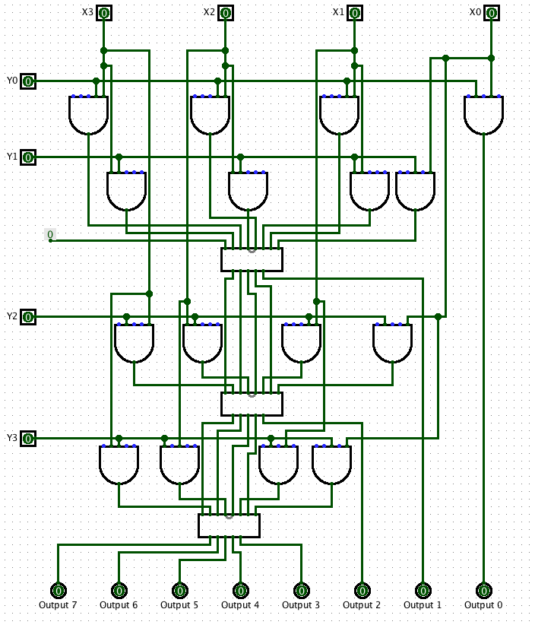
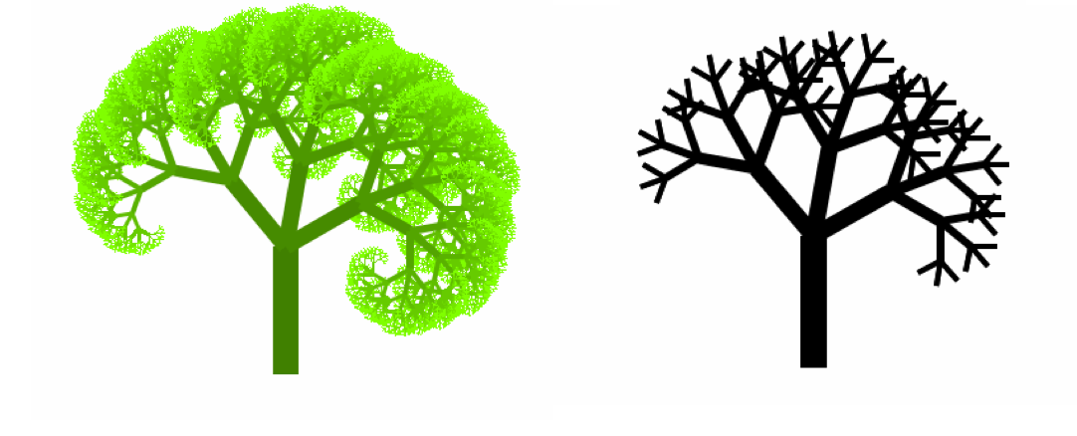
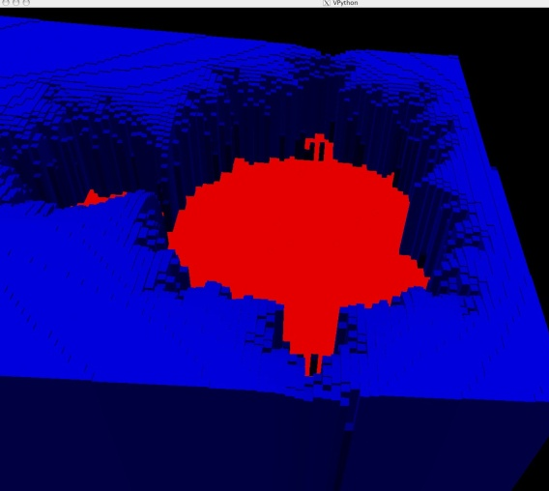
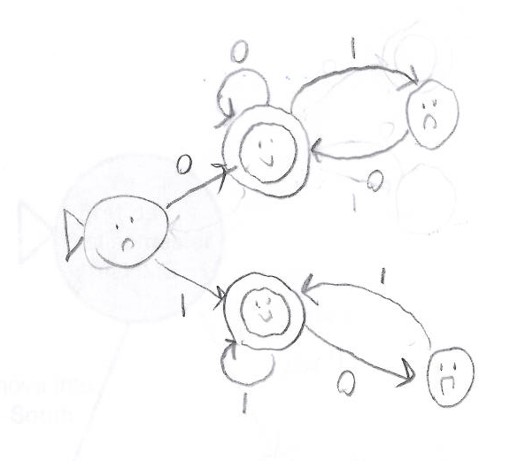
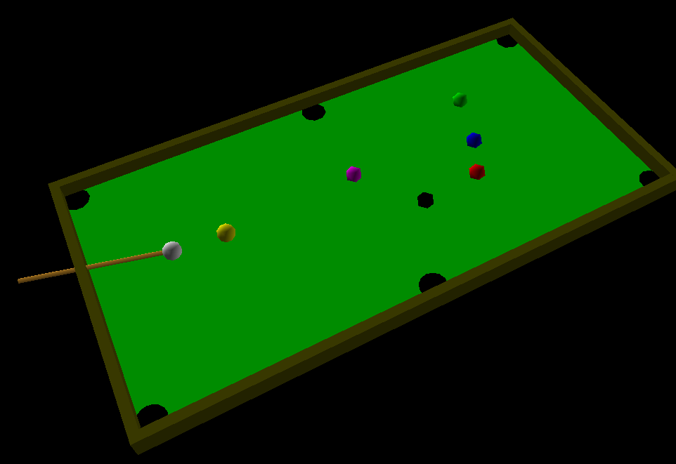
Why CS 5 ?
2
Broad, constructive tour in CS
semester abroad
1
design
recursion
simulation
3
5
4
Notes:
so, while this is an appealing argument to someone who is interested in AI

Slide 59
Python Programming?
in pictures?
Notes:
my foreign language teachers always tried to convince me that the skill of speaking, reading and writing a foreign language…
I didn’t believe them then and I don’t believe them now -- but I do believe that reading and writing a computer language is the way to get a strong intuitive understanding of how machines think -- it’s also important for getting them to do what you want them to, but even if you forget everything this course (hopefully) teaches about Java (compiler, datatypes, Classes and Objects), the real goal is that you take away a deeper insight into how machines think
familiar and sometimes not so familiar… deceptively easy
you mean I have to type all that!!

Slide 60
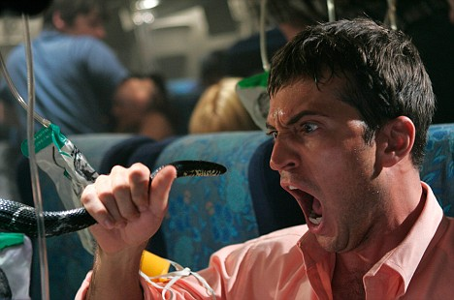
Python Programming?
One possibility...
Notes:
my foreign language teachers always tried to convince me that the skill of speaking, reading and writing a foreign language…
I didn’t believe them then and I don’t believe them now -- but I do believe that reading and writing a computer language is the way to get a strong intuitive understanding of how machines think -- it’s also important for getting them to do what you want them to, but even if you forget everything this course (hopefully) teaches about Java (compiler, datatypes, Classes and Objects), the real goal is that you take away a deeper insight into how machines think
familiar and sometimes not so familiar… deceptively easy
you mean I have to type all that!!

Slide 61
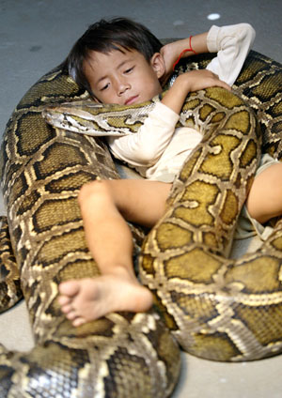
Python Programming?
One possibility...
Happy co-existence! It can even be comfy!
Notes:
my foreign language teachers always tried to convince me that the skill of speaking, reading and writing a foreign language…
I didn’t believe them then and I don’t believe them now -- but I do believe that reading and writing a computer language is the way to get a strong intuitive understanding of how machines think -- it’s also important for getting them to do what you want them to, but even if you forget everything this course (hopefully) teaches about Java (compiler, datatypes, Classes and Objects), the real goal is that you take away a deeper insight into how machines think
familiar and sometimes not so familiar… deceptively easy
you mean I have to type all that!!

Slide 62

Python Programming?
Python (language) and IDLE (editor)
open-source, free, powerful, and common
We will be using Python 2.7.3
~ the “Enthought” distribution
Plain old Python 2.7.x is certainly OK, too.
Don't get 3.1 or 3.x!
Notes:
my foreign language teachers always tried to convince me that the skill of speaking, reading and writing a foreign language…
I didn’t believe them then and I don’t believe them now -- but I do believe that reading and writing a computer language is the way to get a strong intuitive understanding of how machines think -- it’s also important for getting them to do what you want them to, but even if you forget everything this course (hopefully) teaches about Java (compiler, datatypes, Classes and Objects), the real goal is that you take away a deeper insight into how machines think
familiar and sometimes not so familiar… deceptively easy
you mean I have to type all that!!

Slide 63
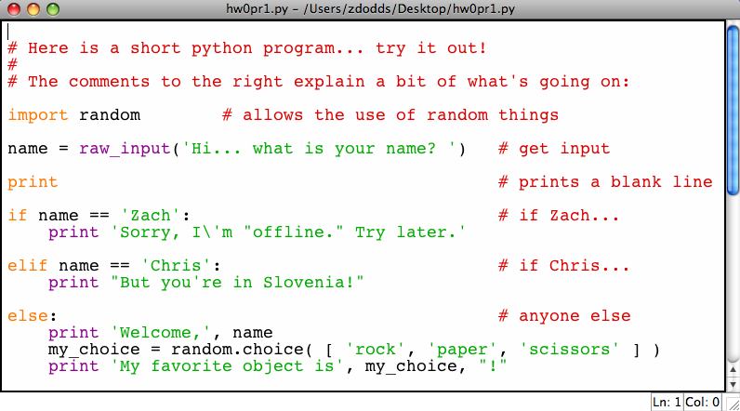
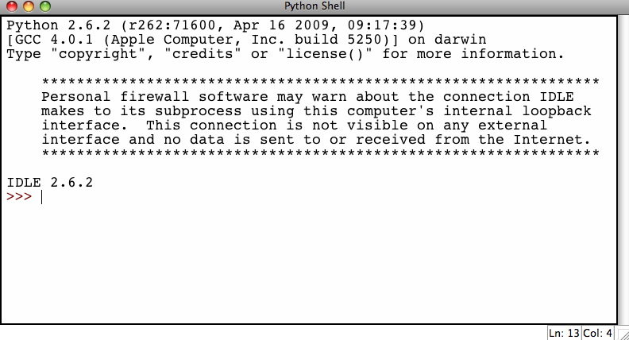
"Editor" and "Shell"
Editor (IDLE): typing code
Shell window: running code
Here, you can save and change programs. Hitting F5 runs your program over in the shell
Here, you can try things out at the command prompt >>>
Notes:
my foreign language teachers always tried to convince me that the skill of speaking, reading and writing a foreign language…
I didn’t believe them then and I don’t believe them now -- but I do believe that reading and writing a computer language is the way to get a strong intuitive understanding of how machines think -- it’s also important for getting them to do what you want them to, but even if you forget everything this course (hopefully) teaches about Java (compiler, datatypes, Classes and Objects), the real goal is that you take away a deeper insight into how machines think
familiar and sometimes not so familiar… deceptively easy
you mean I have to type all that!!

Slide 64
The foreign language of python…
name = raw_input('Hi... what is your name? ')
print # prints a blank line
if name == 'Eliot' or name == 'Ran':
print 'I\'m "offline." Try later.'
elif name == 'Zach': # is it Zach?
print 'Zach Quinto...?', 'No?', 'Oh.'
else: # in all other cases...
print 'Welcome', name, '!'
my_choice = random.choice( [ 'R','P','S' ] )
print 'My favorite object is', my_choice, "!"
Lab 0 – Tues. / Wed. is to run and submit “this” program
Notes:
my foreign language teachers always tried to convince me that the skill of speaking, reading and writing a foreign language…
I didn’t believe them then and I don’t believe them now -- but I do believe that reading and writing a computer language is the way to get a strong intuitive understanding of how machines think -- it’s also important for getting them to do what you want them to, but even if you forget everything this course (hopefully) teaches about Java (compiler, datatypes, Classes and Objects), the real goal is that you take away a deeper insight into how machines think
familiar and sometimes not so familiar… deceptively easy
you mean I have to type all that!!

Slide 65
The foreign language of python…
syntax
semantics
intent
How it looks
What it does
What it should do
name = raw_input('Hi... what is your name? ')
print # prints a blank line
if name == 'Eliot' or name == 'Ran':
print 'I\'m "offline." Try later.'
elif name == 'Zach': # is it Zach?
print 'Zach Quinto...?', 'No?', 'Oh.'
else: # in all other cases...
print 'Welcome', name, '!'
my_choice = random.choice( [ 'R','P','S' ] )
print 'My favorite object is', my_choice, "!"
Notes:
my foreign language teachers always tried to convince me that the skill of speaking, reading and writing a foreign language…
I didn’t believe them then and I don’t believe them now -- but I do believe that reading and writing a computer language is the way to get a strong intuitive understanding of how machines think -- it’s also important for getting them to do what you want them to, but even if you forget everything this course (hopefully) teaches about Java (compiler, datatypes, Classes and Objects), the real goal is that you take away a deeper insight into how machines think
familiar and sometimes not so familiar… deceptively easy
you mean I have to type all that!!

Slide 66
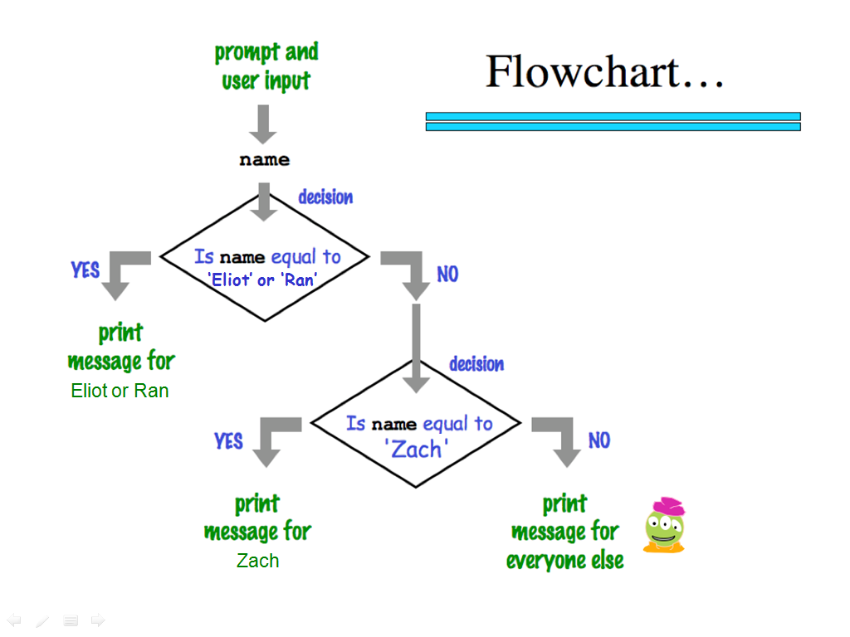
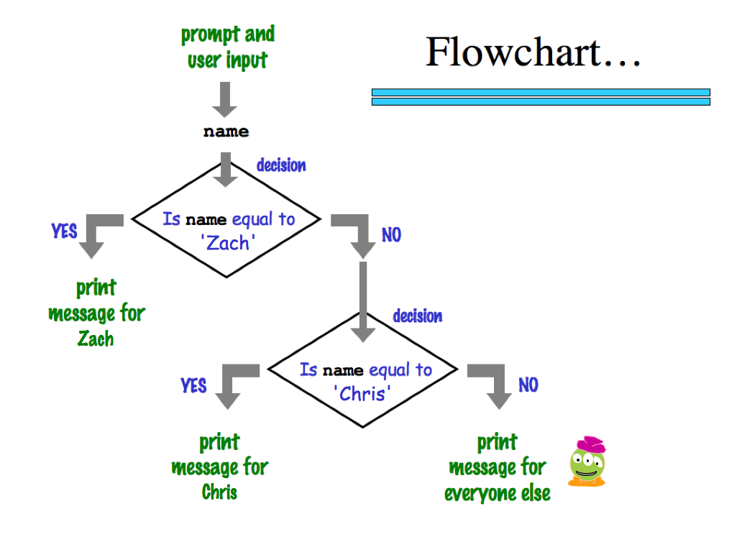
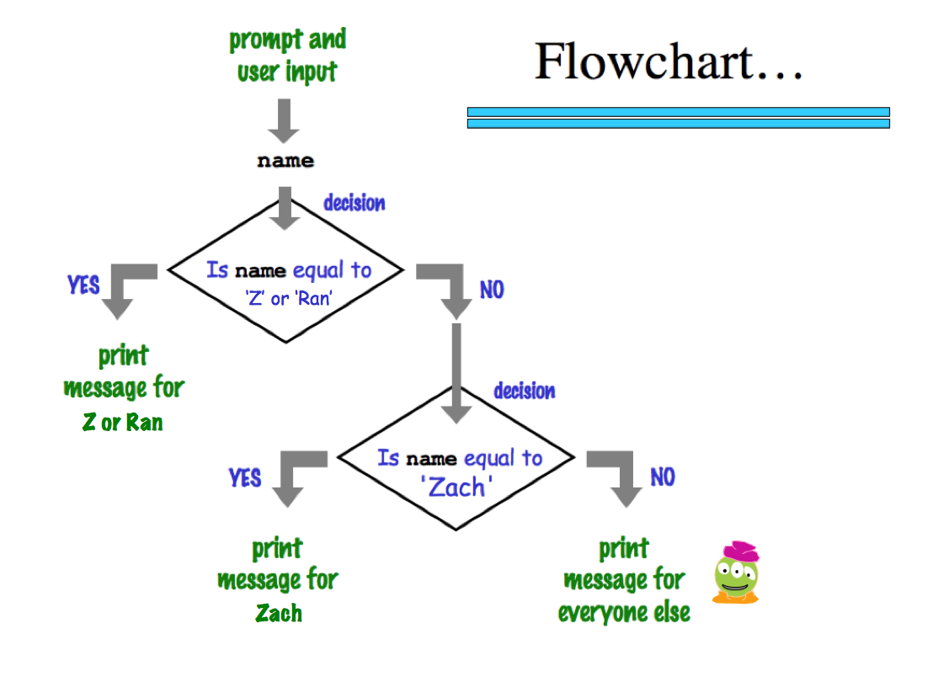
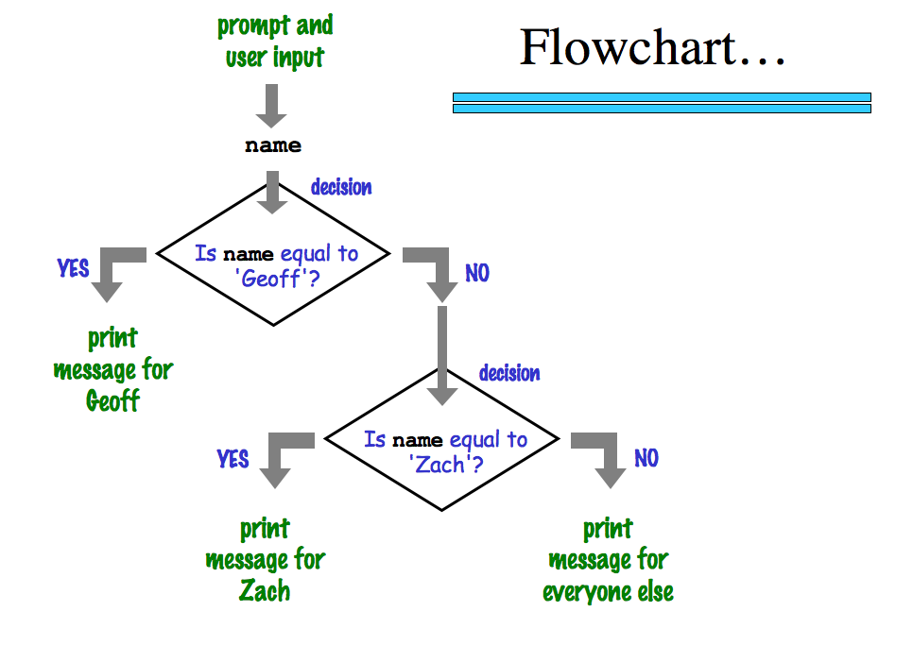

'Zach'
‘Eliot’ or ‘Ran’
Zach
Eliot or Ran
'Chris'
Chris
Zach
What about me?
Notes:
my foreign language teachers always tried to convince me that the skill of speaking, reading and writing a foreign language…
I didn’t believe them then and I don’t believe them now -- but I do believe that reading and writing a computer language is the way to get a strong intuitive understanding of how machines think -- it’s also important for getting them to do what you want them to, but even if you forget everything this course (hopefully) teaches about Java (compiler, datatypes, Classes and Objects), the real goal is that you take away a deeper insight into how machines think
familiar and sometimes not so familiar… deceptively easy
you mean I have to type all that!!

Slide 67
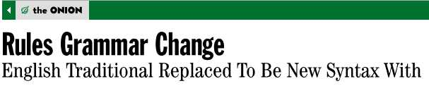
The foreign language of python…
syntax
semantics
intent
How it looks
What it does
What it should do
www.theonion.com
Syntax
how punctuation is used
the language keywords that are used
use of whitespace
peculiarities of formatting
how behavior is affected …
How Python looks!
Notes:
my foreign language teachers always tried to convince me that the skill of speaking, reading and writing a foreign language…
I didn’t believe them then and I don’t believe them now -- but I do believe that reading and writing a computer language is the way to get a strong intuitive understanding of how machines think -- it’s also important for getting them to do what you want them to, but even if you forget everything this course (hopefully) teaches about Java (compiler, datatypes, Classes and Objects), the real goal is that you take away a deeper insight into how machines think
familiar and sometimes not so familiar… deceptively easy
you mean I have to type all that!!

Slide 68
Language is language...?
Intercal
v
>v"Hello world!"0<
,:
^_25*,@
PLEASE DO ,1 <- #13
DO ,1 SUB #1 <- #238
DO ,1 SUB #2 <- #112
DO ,1 SUB #3 <- #112
DO ,1 SUB #4 <- #0
DO ,1 SUB #5 <- #64
DO ,1 SUB #6 <- #238
DO ,1 SUB #7 <- #26
DO ,1 SUB #8 <- #248
DO ,1 SUB #9 <- #168
DO ,1 SUB #10 <- #24
DO ,1 SUB #11 <- #16
DO ,1 SUB #12 <- #158
DO ,1 SUB #13 <- #52
PLEASE READ OUT ,1
PLEASE GIVE UP
Befunge
(DEFUN HELLO-WORLD ()
(PRINT (LIST 'HELLO 'WORLD)))
LISP
Scheme
int main()
{
printf("%s\n", "Hello, world!");
}
C
C++
HAI
CAN HAS STDIO?
VISIBLE "HAI WORLD!"
KTHXBYE
LOLCODE
print 'Hello, World!'
Python
Notes:
ZACH
my foreign language teachers always tried to convince me that the skill of speaking, reading and writing a foreign language…
I didn’t believe them then and I don’t believe them now -- but I do believe that reading and writing a computer language is the way to get a strong intuitive understanding of how machines think -- it’s also important for getting them to do what you want them to, but even if you forget everything this course (hopefully) teaches about any particular language, the real goal is that you take away a deeper insight into how machines think
really no scarier than being raised to learn English, Swedish, or whatever

Slide 69
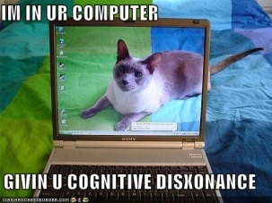

Language is language...?
Intercal
v
>v"Hello world!"0<
,:
^_25*,@
PLEASE DO ,1 <- #13
DO ,1 SUB #1 <- #238
DO ,1 SUB #2 <- #112
DO ,1 SUB #3 <- #112
DO ,1 SUB #4 <- #0
DO ,1 SUB #5 <- #64
DO ,1 SUB #6 <- #238
DO ,1 SUB #7 <- #26
DO ,1 SUB #8 <- #248
DO ,1 SUB #9 <- #168
DO ,1 SUB #10 <- #24
DO ,1 SUB #11 <- #16
DO ,1 SUB #12 <- #158
DO ,1 SUB #13 <- #52
PLEASE READ OUT ,1
PLEASE GIVE UP
Befunge
(DEFUN HELLO-WORLD ()
(PRINT (LIST 'HELLO 'WORLD)))
LISP
Scheme
int main()
{
printf("%s\n", "Hello, world!");
}
C
C++
HAI
CAN HAS STDIO?
VISIBLE "HAI WORLD!"
KTHXBYE
LOLCODE
print 'Hello, World!'
Python
Notes:
ZACH
my foreign language teachers always tried to convince me that the skill of speaking, reading and writing a foreign language…
I didn’t believe them then and I don’t believe them now -- but I do believe that reading and writing a computer language is the way to get a strong intuitive understanding of how machines think -- it’s also important for getting them to do what you want them to, but even if you forget everything this course (hopefully) teaches about any particular language, the real goal is that you take away a deeper insight into how machines think
really no scarier than being raised to learn English, Swedish, or whatever

Slide 70
Second looks?
name = raw_input('Hi... what is your name? ')
print # prints a blank line
if name == 'Eliot' or name == 'Ran':
print 'I\'m "offline." Try later.'
elif name == 'Zach': # is it Zach?
print 'Zach Quinto...?', 'No?', 'Oh.'
else: # in all other cases...
print 'Welcome', name, '!'
my_choice = random.choice( [ 'R','P','S' ] )
print 'My favorite object is', my_choice, "!"
Punctuation? Spacing? Color information? Strings? Variables?
Notes:
my foreign language teachers always tried to convince me that the skill of speaking, reading and writing a foreign language…
I didn’t believe them then and I don’t believe them now -- but I do believe that reading and writing a computer language is the way to get a strong intuitive understanding of how machines think -- it’s also important for getting them to do what you want them to, but even if you forget everything this course (hopefully) teaches about Java (compiler, datatypes, Classes and Objects), the real goal is that you take away a deeper insight into how machines think
familiar and sometimes not so familiar… deceptively easy
you mean I have to type all that!!

Slide 71
CS’s motto ?
details are temporary…
…but CS thinking isn’t !
print 'hv',
print 'dcle\naemdoe'
print 'ryu',
print 'lg!'
print 'whteo'
print 'aerub\nv',
print 'aeo\nyraoo'
print 'egdne'
Notes:
Useful skill
Important tool
Window into corners of everyday life

Slide 72
CS’s motto ?
details are temporary…
…but CS thinking isn’t !
hv dcle
aemdoe
ryu lg!
whteo
aerub
v aeo
yraoo
egdne
print 'hv',
print 'dcle\naemdoe'
print 'ryu',
print 'lg!'
print 'whteo'
print 'aerub\nv',
print 'aeo\nyraoo'
print 'egdne'
Notes:
Useful skill
Important tool
Window into corners of everyday life

Slide 73
We agree...
Whatever you are, be a good one.
- Abraham Lincoln
... more and more, CS can help!

Slide 74

(0) Be sure to sign in!
Lab 0!
(1) Pick up this page
(2) Login to your own laptop OR a CS machine
(with your CS account)
and open a browser, e.g., Safari
anything but IE
(3) Go to Lab 0 and work through it...
Google for "HMC CS" – click "Schedule" – then CS5 . Or, type www.cs.hmc.edu/twiki/bin/view/CS5/
(a) (or later) Change your CS password
(b) Try Python & its "shell"
(c) Submit hw0pr1 of the assignment
(d) Complete the CS policy forms
(e) Finish hw0pr2 (if you'd like...)
(4) Either before or after changing your CS password,
feel free to use your own laptop instead...
Questions? Ask us!

Slide 75
comp = 'rock'
user = 'rock'
if comp == 'rock':
if user == 'paper':
print 'I win *_*!'
elif user == 'scissors':
print 'You win.'
else:
print 'Tie.'
print 'Ties go to the runner!'
print 'I'm running - are you?'
What does this print?

Slide 76
How many RPS-legal inputs are there?
For how many is this program correct?
comp = ???
user = ???
if comp == 'rock':
print 'I win *_*!'
if user == 'paper':
print 'You win.'
else:
print 'Tie.'
print '-- a horrible tie!'
What does this print?

Slide 77
Why CS ?
Information is life’s fundamental building block.
Genetic Code: DNA
Our senses and experiences
GTAGCACAITTAGC…
More coffee required…
us
CS is a set of fundamental techniques for understanding and leveraging this information…
“constructing with”
Notes:
so, while this is an appealing argument to someone who is interested in AI

Slide 78
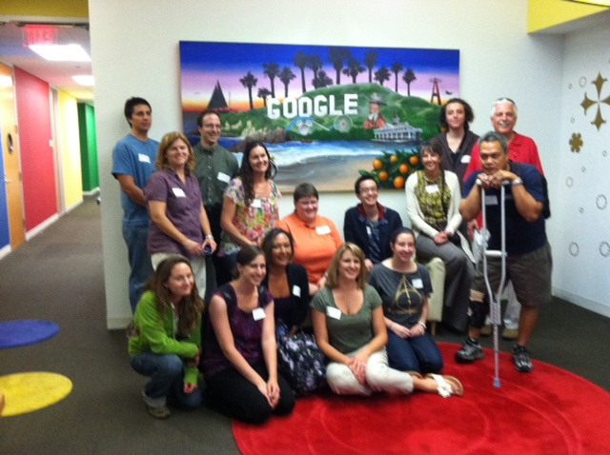
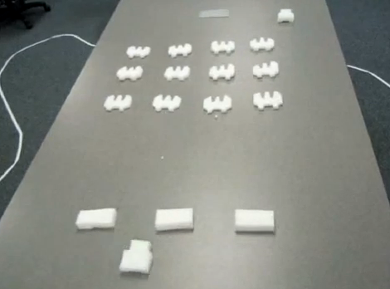
How I spent my summer vacation...
serving as a historical consultant!
visiting Google Irvine
... and programming flying robots, too...

Slide 79
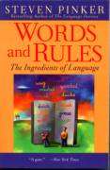
No worries...
CS is deceptively easy.

Slide 80
What is CS?
creativity / design
commodity skills
It's a big span
Notes:
creative side ~ dreamworks, game companies, google, microsoft, soc. networking <-- the design and creation of original algorithms and software
and a commodity side ~ application use, configuration, customization, certification, your favorite acronym here…
our department pays only about 5-10% of its attention to the commodity side
it pays 90-95% of its attention to the creative side… Why?
robotics? taught yourself to build or create something… game levels, etc.?

Slide 81
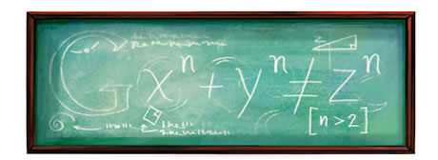

What is CS?
creativity / design
commodity skills
It's a big span
Notes:
creative side ~ dreamworks, game companies, google, microsoft, soc. networking <-- the design and creation of original algorithms and software
and a commodity side ~ application use, configuration, customization, certification, your favorite acronym here…
our department pays only about 5-10% of its attention to the commodity side
it pays 90-95% of its attention to the creative side… Why?
robotics? taught yourself to build or create something… game levels, etc.?

Slide 82
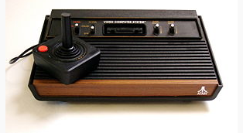

The Atari 2600 game, Adventure!

Slide 83
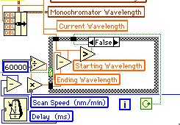
Why Python ?
Python is a general-purpose computer language
skills apply to all special-purpose languages
Physics: LabView
Biology: Lasergene, DNA*
Engineering: Matlab
Mathematics: Maple, Mathematica
ALL of these seem alien at first!
You’re telling me!
Notes:
Electric: from www.staticfreesoftware.com
My tutorial is at:
http://odin.ac.hmc.edu/~harris/class/chipdesign/electric.pdf
Lasergene (a molecular biology suite of programs for aligning and comparing
DNA sequences, etc.)
Statview (statistical analysis)
KaleidaGraph (plotting & graphing)
Populus (programs that simulate ecological and evolutionary processes)

Slide 84
Language is language ?
Perls of wisdom ?
eval evalq.q>trd!Uj:%L<061:%C<csnvo:%f<fsddo0:%c<cmtd:%x<xdmmnv:%I<011:%u<251:%bs<bsd`udSdbu`ofmd:%w<lnwd:%U<2:%t<L`hoVhoenv,?
odv),idhfiu<?314-,vheui<?254(:%b<%t,?B`ow`r:%b,?bnoghftsd),vheui<?%u-,idhfiu<?311(:%b,?q`bj)(:s)3-3-%u-001-%c(:s)3-081-%u-311
-%f(:s)3-001-%u-031-%f(:s)3-1-%u-34-%f(:gns)%{<1:%{=%u:%{*<71(zs)%{-01-%{*51-54-%f-%f(:|s)3-1-%u-04-cm`bj(:%b,?%bs)3-1-%u-311
(:%G<,041:v)1-%L-31-C-%x(:v)%G-%L-,021-C-%x(:%B<,91:v),31-041-,4-B-%c(:v),91-041-,74-B-%c(:%E<,%I:v)1-021-31-E-%x(:v),%I-021-,
91-E-%x(:%K<,231:v),71-81-,31-@-%C(:v),301-81-,%L-@-%C(:v),%u-81-,211-@-%C(:%M<,%u:v),51-61-1-F-%C(:v),%L-61-,021-F-%C(:v),%u
-61-,211-F-%C(:%J<%u:v)751-41-791-[-%C(:v)401-41-441-[-%C(:v)%u-41-291-[-%C(:%b,?bsd`udNw`m)063-080-091-088-,u`fr<?G-,ghmm<?f
sddo5(:S)1(:%b,?sdqd`u)%I-]'t(:%t,?choe)&=Envo?&<?rtczS),0(:'V:%b,?%w)G-1-31(hg)%x=081(:|(:%t,?choe)&=Tq?&<?rtczS)0(:%b,?%w)G
-1-,31(:|(:%t,?choe)&=Mdgu?&<?rtcz'V:%b,?%w)G-,31-1(hg)%y?31(:|(:%t,?choe)&=Shfiu?&<?rtcz'V:%b,?%w)G-31-1(hg)%Y=%u,31(:|(:L`h
oMnnq)(:dyhu:rtc!vz%b,?%bs)%^Z1\-%^Z0\-%^Z3\-%^Z0\*8-,u`fr<?%^Z2\-,ghmm<?%^Z5\(:|rtc!tzhg)%G?%u(z%G*<%L:%d<,%G:%G<,%L:|dmrdz%
G*<01:%d<01:|%b,?%w)C-%d-1(:hg)%B?%u(z%B*<%I:%d<,%B:%B<,%I:|dmrdz%B*<01:%d<01:|%b,?%w)B-%d-1(:hg)%E?%u(z%E*<031:%d<,%E:%E<,03
1:|dmrdz%E*<01:%d<01:|%b,?%w)E-%d-1(:hg)%K?%u(z%K*<229:%d<,%K:%K<,251:|dmrdz%K*<7:%d<7:|%b,?%w)@-%d-1(:hg)%M?%u(z%M*<271:%d<,
%M:%M<,271:|dmrdz%M*<9:%d<9:|%b,?%w)F-%d-1(:hg)%J=,%u(z%J,<%u:%d<,%J:%J<%u:|dmrdz%J,<7:%d<,7:|%b,?%w)[-%d-1(:'V:hg)%x=081(zhg
))%x?031(}})%x=001((zAn<%b,?ghoe)nwdsm`qqhof-%y-%x-%Y-%X(:hg)%x?031(zhg)%"n(z'R:||dmrdzhg)%x?58(zhg)%"n?0(z%n<7:%n*<3hg)%x=81
(:%n<,7hg)%x=61(:%b,?%w)G-%n-1(:|dmrdz'R:||dmrdzhg)%"n?0(z'R:|dmrdzS)00(:%U**:%O**:'R:v)%y-%x-%Y-Q-%f(:%b,?edmdud)&Q&(hg))%O$
4((:||||rmddq)4(''Uj;;dyhu)1(hg)%U=0(:||rtc!Rz%U,,:qshou#]`#:%b,?%w)G-063,%y-081,%x(:|rtc!SzP)cm`bj(:%R*<%^Z1\:P)sde(: |rtc!P
z%b,?bsd`udUdyu)%L-9,udyu<?%R/1-,ghmm<?%^Z1\(:|rtc!sz%b,?%bs)%^Z1\-%^Z0\-%^Z3\-%^Z2\-,ghmm<?%^Z5\-,ntumhod<?%^Z4\(:|rtc!Vz)%y
-%x-%Y-%X(<%b,?bnnser)G(:|>^chr($$/$$)x2016.
Perl might be a little bit TOO flexible a language!
Goal: expression, not language details.
Notes:
my foreign language teachers always tried to convince me that the skill of speaking, reading and writing a foreign language…
I didn’t believe them then and I don’t believe them now -- but I do believe that reading and writing a computer language is the way to get a strong intuitive understanding of how machines think -- it’s also important for getting them to do what you want them to, but even if you forget everything this course (hopefully) teaches about Java (compiler, datatypes, Classes and Objects), the real goal is that you take away a deeper insight into how machines think

Slide 85
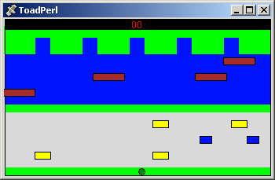
The results
back to Python
Notes:
my foreign language teachers always tried to convince me that the skill of speaking, reading and writing a foreign language…
I didn’t believe them then and I don’t believe them now -- but I do believe that reading and writing a computer language is the way to get a strong intuitive understanding of how machines think -- it’s also important for getting them to do what you want them to, but even if you forget everything this course (hopefully) teaches about Java (compiler, datatypes, Classes and Objects), the real goal is that you take away a deeper insight into how machines think

Slide 86
What Google thinks I look like
First 4 Google Image hits (8/29/10) for a search of
"Zach Dodds HMC"

Slide 87
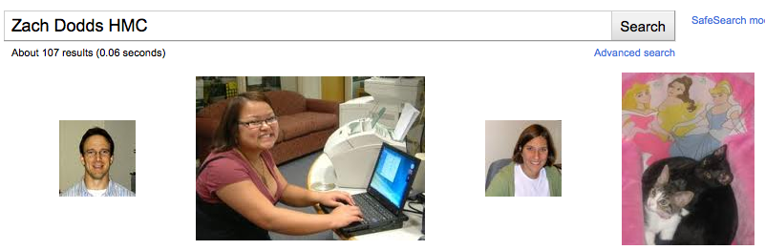
What Google thinks I look like
First 4 Google Image hits (8/29/10) for a search of
"Zach Dodds HMC"

Slide 88

What Google thought I looked like…
First Google Image hit (8/30/09) for a search of
"Zach Dodds"
Images are difficult!

Slide 89
coffee
See you in Lab!
CIS + Labs
Edwards
Macalister
Physicists and other parenthesis-needing individuals, e.g. chemists
Pryne
Parsons
cool machines - drills, lathes, etc.
Map to CS Labs
more cool, keyboardless machines
CS Hallway
B102
B100
B105
CS Hallway
Big Beckman (B126)
Beckman B102, B105
Get your CS account.
Laptop is OK, with wireless.
Olin (math, bio, CS)

Slide 90
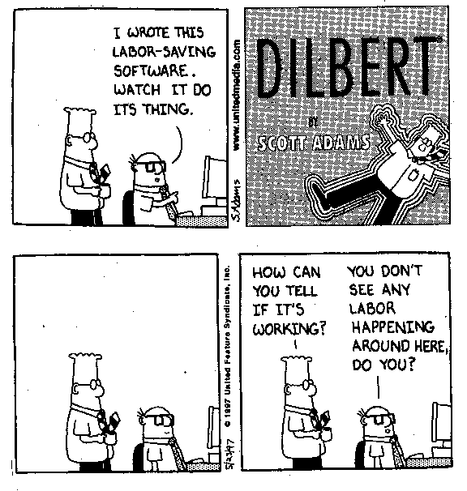
CS? Not why...
Python is the ultimate programming language
Programming will solve problems for you
Programming will save
time and effort

Slide 93
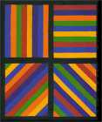
Abstraction
Artists are mystics rather than rationalists. They leap to conclusions that logic cannot reach.
-- Sol LeWitt,
conceptual artist
Simplicity does not precede complexity, but follows it.
-- Alan Perlis, early CS-ist.
Notes:
dealing with code in which you don’t know everything that’s going on, you need to abstract away details and keep a bigger picture in mind

Slide 95
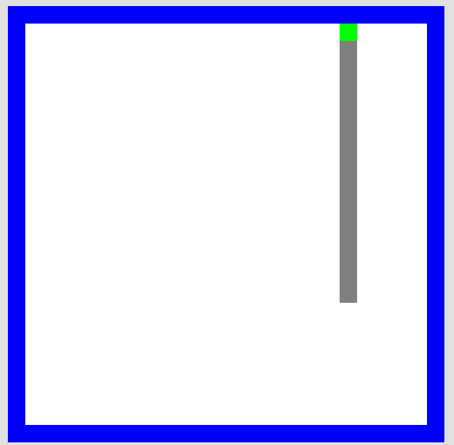
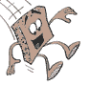
HW problems 3 and 4
walls
Picobot
Picobot
area not covered (yet!)
area already covered
Picobot
as envisioned by an HMC clinic
Goal: whole-environment coverage with only local sensing…
inspiration?

Slide 96
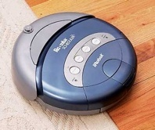
Picobot
walls
Picobot
area not covered (yet!)
area already covered
Goal: whole-environment coverage with only local sensing…
iRobot's Roomba vacuum
inspiration!

Slide 97
Surroundings
N
Picobot can only sense things directly to the N, E, W, and S
W
E
S
For example, here its surroundings are
NxWx
Surroundings are always in NEWS order.
N E W S

Slide 98
Surroundings
N
How many distinct surroundings are there?
W
E
S

Slide 99
Surroundings
N
How many distinct surroundings are there?
W
E
S
2⁴
== 16 possible …
xxxx
Nxxx
xExx
xxWx
xxxS
NExx
NxWx
NxxS
xEWx
xExS
xxWS
NEWx
NExS
NxWS
xEWS
NEWS
(won’t happen)

Slide 100
State
I am in state 0.
My surroundings
are xxWS.
Picobot's memory is a single number, called its state.
State is the internal context of computation.
Picobot always starts in state 0.
State and surroundings represent everything the robot knows about the world

Slide 101
Rules
I am in state 0.
My surroundings
are xxWS.
Aha!
I should move N.
I should enter state 0.
Picobot moves according to a set of rules:
state
surroundings
direction
new state
0
xxWS
N
0
If I'm in state 0 seeing xxWS,
Then I move North, and change to state 0.

Slide 102
Wildcards
I am in state 0.
My surroundings
are xxWS.
Aha! This matches x***
Asterisks * are wild cards. They match walls or empty space:
state
surroundings
direction
new state
0
x***
N
0
and EWS may be wall or empty space
N must be empty

Slide 103
What will this set of rules do to Picobot?
state
surroundings
direction
new state
0
x***
->
N
0
0
N***
->
X
0
how can we get back down the screen?
Picobot checks its rules from the top each time.
When it finds a matching rule, that rule runs.
Only one rule is allowed per state and surroundings.

Slide 104
What will this set of rules do to Picobot?
state
surroundings
direction
new state
0
x***
->
N
0
0
N***
->
X
1
1
***x
->
S
1
1
***S
->
X
0
Picobot checks its rules from the top each time.
When it finds a matching rule, that rule runs.
Only one rule is allowed per state and surroundings.

Slide 105

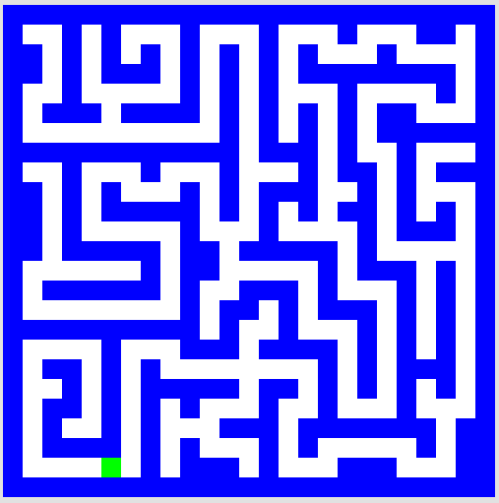
To do
Write rules that will always cover these two rooms.
(separate sets of rules are encouraged…)
hw0, Problem #3
hw0, Problem #4
but your rules should work regardless of Picobot's starting location

Slide 106
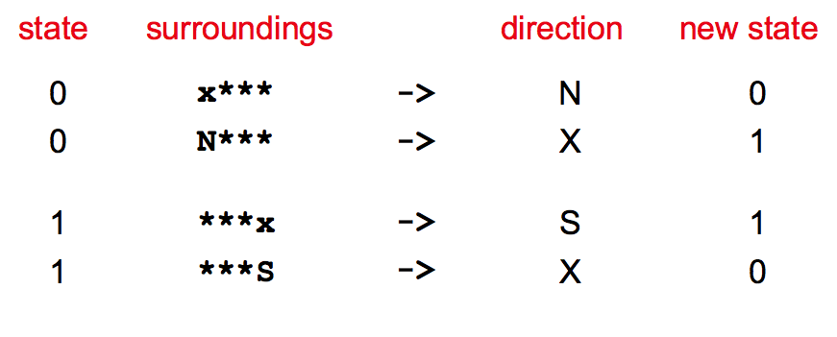
Alter these "up & down" rules so that Picobot will traverse the empty room…
"Quiz" #2
the empty room

Slide 107
Ideas for the maze?
the maze

Slide 108
Computer Science
Information is intrinsic to every system…
How can we benefit from this information?
“create with”
Representing it … Applying it … Measuring it
Efficiently? Effectively? Possibly?
Notes:
ZACH:
fundamentally creative

Slide 109
Computer Science
Information is intrinsic to every system…
How can we benefit from this information?
“create with”
Representing it … Applying it … Measuring it
Efficiently? Effectively? Possibly?
How to measure these rooms' complexity?
Notes:
ZACH:
fundamentally creative

Slide 110
Computer Science
Information is intrinsic to every system…
How can we benefit from this information?
“create with”
Representing it … Applying it … Measuring it
Efficiently? Effectively? Possibly?
How to measure these rooms' complexity?
How many states and rules are really necessary ?
How much information does each system contain ?
our best: 3 states, 7 rules
our best: 4 states, 8 rules
Notes:
ZACH:
information isn't just something that has appeared in the last 50 years as computers have become ubiquitous…
despite its name, computer science doesn't require a computer at all

Slide 111
Computer Science
Information is intrinsic to every system…
How can we benefit from this information?
“create with”
Representing it … Applying it … Measuring it
Efficiently? Effectively? Possibly?
How to measure these rooms' complexity?
How many states and rules are really necessary ?
How much information does each system contain ?
This image: 5 kilobytes
This image: 20 kilobytes!
Notes:
ZACH:
information isn't just something that has appeared in the last 50 years as computers have become ubiquitous…
despite its name, computer science doesn't require a computer at all

Slide 112
Happy Picobotting!
Remember
Office hours at the CS labs: Friday 2:00-4:00
Tutoring hours all weekend in LAC lab & CS labs…
Email me with any account/web/other problems.
dodds@cs.hmc.edu

Slide 114
Abstraction
Artists are mystics rather than rationalists. They leap to conclusions that logic cannot reach.
-- Sol LeWitt,
conceptual artist
Simplicity does not precede complexity, but follows it.
-- Alan Perlis,
creator of the first compiler
Notes:
dealing with code in which you don’t know everything that’s going on, you need to abstract away details and keep a bigger picture in mind

Slide 115
What is programming ?
Programming as "recipe-writing"
vs.
Programming as learning a foreign language
but ... let's start with the foundation!
What is CS?
Notes:
my foreign language teachers always tried to convince me that the skill of speaking, reading and writing a foreign language…
I didn’t believe them then and I don’t believe them now -- but I do believe that reading and writing a computer language is the way to get a strong intuitive understanding of how machines think -- it’s also important for getting them to do what you want them to, but even if you forget everything this course (hopefully) teaches about Java (compiler, datatypes, Classes and Objects), the real goal is that you take away a deeper insight into how machines think
familiar and sometimes not so familiar… deceptively easy
you mean I have to type all that!!

Slide 116
"Quiz"
Pair up with someone nearby – and answer these questions together…
Name ______________________
Birthday ____________
A place you considered home __________
Your favorite __________ is ____________.
Your least favorite ____________ is ____________.
Name ______________________
Birthday ____________
A place you considered home __________
Your favorite __________ is ____________.
Your least favorite ____________ is ____________.
What is something non-Claremont-collegey you have in common?
comp = 'rock'
user = 'rock'
if comp == 'rock':
if user == 'paper':
print 'I win *_*!'
elif user == 'scissors':
print 'You win.'
else:
print 'Tie.'
comp = 'rock'
user = 'rock'
if comp == 'rock':
print 'I win *_*!'
if user == 'paper':
print 'You win.'
else:
print 'Tie.'
(3) Change these inputs to produce a completely correct RPS output here.
(4) What is the smallest number of tests and blocks of code that are needed to play RPS?
(0) How many tests and blocks are here?
(2) As written, what output does this print?
Get your CS lab accounts, too!
(1) What output does this print?

Slide 117
'HUMAN'
What is CS?
'CHIMPANZEE'
the study of complexity
What is the longest common subsequence between 2 'strings'
How can it be done?
How well can it be done?
Can it be done at all?
'CGCTGAGCTAGGCA...'
Can you solve this problem?
'ATCCTAGGTAACTG...'
Can you create a process to solve such problems?
The "LCS" problem
Eye oneder if LCS haz othur aplications?
Notes:
creative side ~ dreamworks, game companies, google, microsoft, soc. networking <-- the design and creation of original algorithms and software
and a commodity side ~ application use, configuration, customization, certification, your favorite acronym here…
our department pays only about 5-10% of its attention to the commodity side
it pays 90-95% of its attention to the creative side… Why?
robotics? taught yourself to build or create something… game levels, etc.?

Slide 118
"Quiz"
Pair up with someone nearby – and answer these questions together…
Name ______________________
Your favorite __________ is ____________.
Your least favorite ____________ is ____________.
Name ______________________
Your favorite __________ is ____________.
Your least favorite ____________ is ____________.
What is something non-Claremont-collegey you have in common?
(0) How many tests and blocks are here?
(2) As written, what output does this print?
(1) What output does this code print?
comp = 'rock'
user = 'rock'
if comp == 'rock':
print 'I win *_*!'
if user == 'paper':
print 'You win.'
else:
print 'Tie.'
(3) Change these inputs to produce a completely correct RPS output here.
comp = 'rock'
user = 'rock'
if comp == 'rock':
if user == 'paper':
print 'I win *_*!'
elif user == 'scissors':
print 'You win.'
else:
print 'Tie.'
(4) What is the smallest number of tests and blocks of code you'll need to play full RPS?
Get your CS lab accounts, too!

