Slide 1
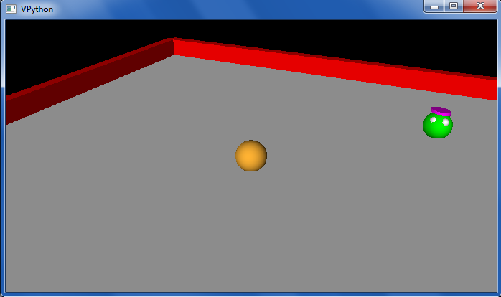
This week's classes
Homework #11, due 11/24
Notice that the value of (dimension + eyes) is conserved!
Three-eyed? This week, we're 3d-ed!
Connect 4 Player

Slide 2
Python objects used in VPython…
Tuples are similar to lists, but they're parenthesized:
T = (4,2)
V = (1,0,0)
example of a two-element tuple named T and a three-element tuple named V

Slide 3
Tuples!
Lists that use parentheses are called tuples:
>>> T = ( 4, 2 )
>>> T
(4, 2)
>>> T[0]
4
>>> T[0] = 42
Error!
>>> T = ('a',2,'z')
>>>
Tuples are immutable lists: you can't change their elements...
...but you can always redefine the whole variable, if you want!
+ Tuples are more memory + time efficient
+ Tuples can be dictionary keys; lists can't
- But you can't change tuples' elements...

Slide 4
Tuple problems…
Creating 1-tuples would seem like a problem!
A bug from yesterday's Board class:
W = 4
s = " ",
for col in range(W):
s += str(col), " "
yields a surprising result for s:
Notes:
without the first comma, it's an error

Slide 5
Tuple problems…
Creating 1-tuples would seem like a problem!
A bug from yesterday's Board class:
W = 4
s = " ",
for col in range(W):
s += str(col), " "
yields a surprising result for s:
(' ', '0', ' ', '1', ' ', '2', ' ', '3', ' ')
Notes:
without the first comma, it's an error

Slide 6
Python details used in VPython…
Functions can have default input values and can take named inputs
def f(x=9, y=33):
return x + y
example of default input values for x and y
f(9,33)
Function inputs look like tuples, but they're not quite the same…

Slide 7
Python details used in VPython…
Functions can have default input values and can take named inputs
def f(x=9, y=33):
return x + y
example of default input values for x and y
f()
f(1)
example of a named input
f(y=1)

Slide 8
Named inputs
def f(x=2, y=11):
return x+3*y
Try this on the back page first…
None is 42!
What will these function calls to f return?
f(3,1)
f(3)
f()
f(y=2,x=1)
Extras!
What is f((3,2),(1,0)) ?
What is a call to f that returns 42? What is the shortest call to f returning 42?
fewest # of characters

Slide 9
Named inputs
def f(x=2, y=11):
return x+3*y
Input your name(s) = ___________________________
None is 42!
What will these function calls to f return?
f(3,1)
f(3)
f()
f(y=2,x=1)
Extras!
What is f((3,2),(1,0)) ?
What is a call to f that returns 42? What is the shortest call to f returning 42?
fewest # of characters

Slide 10
feedback feedback
Notes:
Next is: 13112221

Slide 11
feedback feedback
Notes:
Next is: 13112221

Slide 12
feedback feedback
Notes:
Next is: 13112221

Slide 13
feedback feedback
Notes:
Next is: 13112221

Slide 14
feedback feedback
Notes:
Next is: 13112221

Slide 15
feedback feedback
Notes:
Next is: 13112221

Slide 16
feedback ?
Notes:
Next is: 13112221

Slide 17
feedback ?
Notes:
Next is: 13112221

Slide 18
feedback feedback
3.9 hrs.
2.7
2.96
1.8 st dev.
0.7 st dev.
0.4 st dev.
Notes:
Next is: 13112221

Slide 19
feedback feedback
3.9 hrs.
2.7
2.96
1.8 st dev.
0.7 st dev.
0.4 st dev.
Notes:
Next is: 13112221

Slide 20
feedback feedback
3.9 hrs.
2.7
2.96
1.8 st dev.
0.7 st dev.
0.4 st dev.
Notes:
Next is: 13112221

Slide 21
feedback feedback
3.9 hrs.
2.7
2.96
1.8 st dev.
0.7 st dev.
0.4 st dev.
Notes:
Next is: 13112221

Slide 22
feedback feedback
3.9 hrs.
2.7
2.96
1.8 st dev.
0.7 st dev.
0.4 st dev.
Notes:
Next is: 13112221

Slide 23
feedback feedback
3.9 hrs.
2.7
2.96
1.8 st dev.
0.7 st dev.
0.4 st dev.
Notes:
Next is: 13112221

Slide 24
feedback feedback
3.9 hrs.
2.7
2.96
1.8 st dev.
0.7 st dev.
0.4 st dev.
Notes:
Next is: 13112221

Slide 25
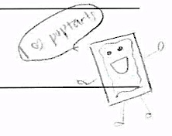
feedback feedback
3.9 hrs.
2.7
2.96
1.8 st dev.
0.7 st dev.
0.4 st dev.
Notes:
Next is: 13112221

Slide 26
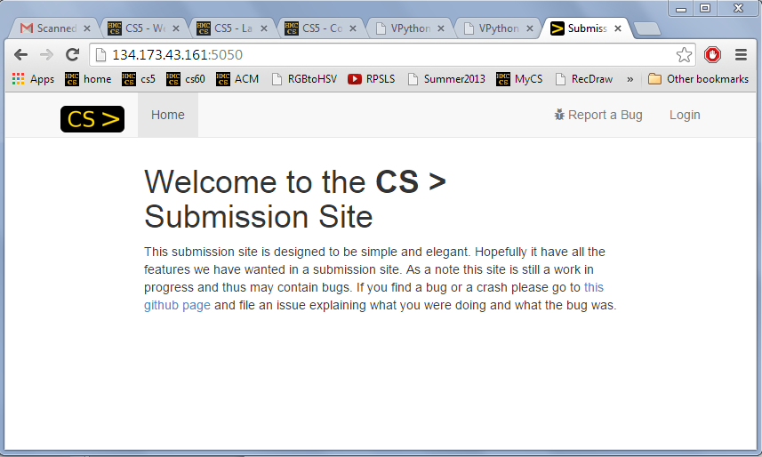
feedback feedback feedback
Notes:
Next is: 13112221

Slide 27
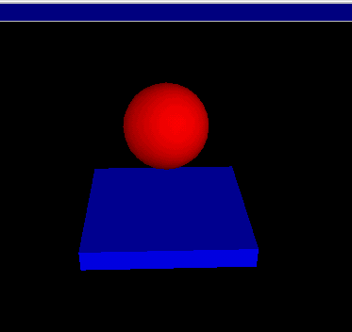
VPython
www.vpython.org
stonehenge.py
built by and for physicists to simplify 3d simulations
bounce.py
lots of available classes, objects and methods in its API
Easily installable for windows… and mostly easy on Macs.

Slide 28
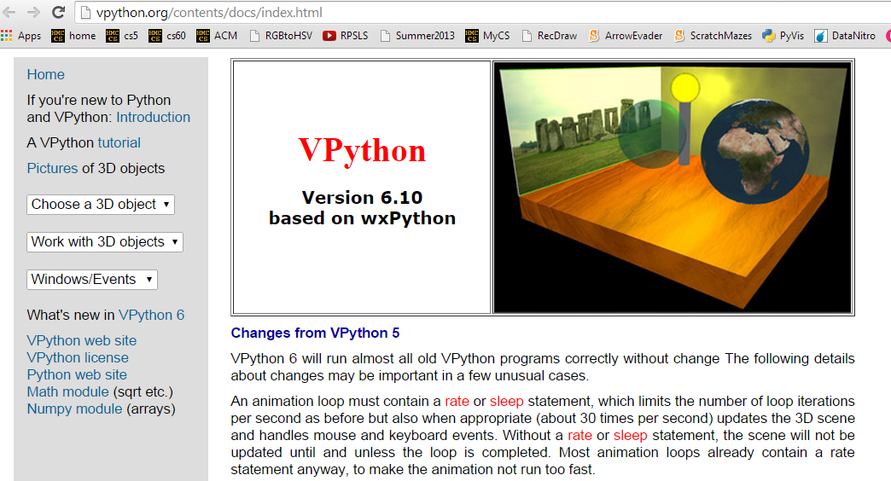
Installing VPython
or, use the lab's machines…
Windows & Mac OS
Tutorials and documentation…

Slide 29
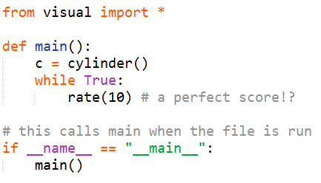
API
... stands for Application Programming Interface
a description of how to use a software library
A demo of VPython's API:
What's cylinder?
What's visual?
What's c?
at least it's not Visual C…
VPython example API calls: must be from a file

Slide 30
Set up the world with 3d objects…
VPython
c = cylinder()
print "c.color is", c.color
while True:
print "c.pos is", c.pos
# set the color to color.blue or a tuple
# change the pos… hard to tell what's happening…
scene.autoscale = False
b = box(pos=(4,0,0))
a = sphere(pos=(0,0,4))
Then, run a simulation using those objects…
more example API calls
(called before while True!)
all of the API calls and their explanation!

Slide 31
vPython!
(1) How many vPython classes are used in this code? ____
(2) How many vPython objects are used here? ________
(3) What line of code handles collisions ?
(4) How does physics work? Where is it?
(5) Tricky! How many tuples are here?
Look over this VPython program to determine
I'm glad you asked.
from visual import *
def main():
""" docstring! """
floor = box(length=4,width=4,height=0.5,color=(0,0,1))
ball = sphere(pos=(0,8,0),radius=1,color=color.red)
ball.vel = vector(0,-1,0)
RATE = 100
dt = 1.0/RATE
while True:
rate(RATE)
ball.pos += ball.vel*dt
if ball.pos.y < ball.radius:
ball.vel.y *= -1.0
else:
ball.vel.y += -9.8*dt
what is this += doing?
what is this if/else doing?

Slide 32
vectors
act like vectors!
vel = vector(0,-1,0)
vel.z
named components
vel.y
vel.x
vel += 0.01*vector(0,-9.8,0)
multiplication by a scalar – finally!
pos = pos + vel*0.01
component-by-component addition

Slide 33
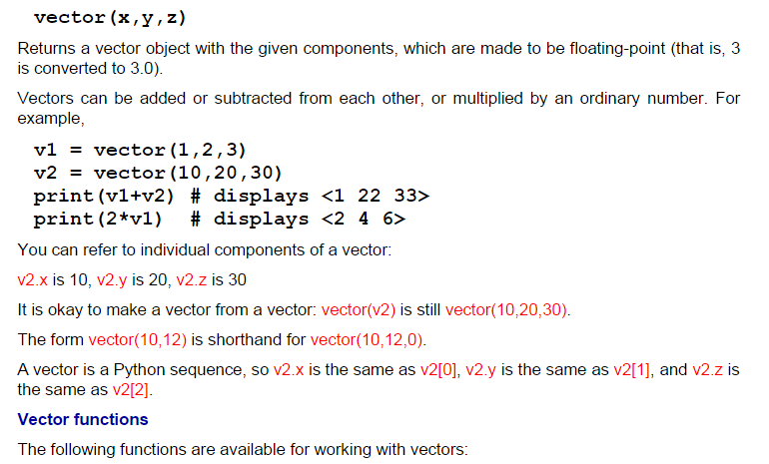
vectors
act like vectors!
http://vpython.org/contents/docs/vector.html

Slide 34
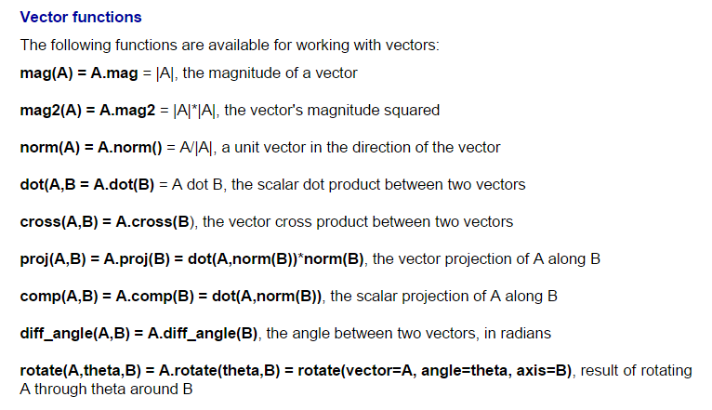
vectors
act like vectors!
http://vpython.org/contents/docs/vector.html

Slide 35
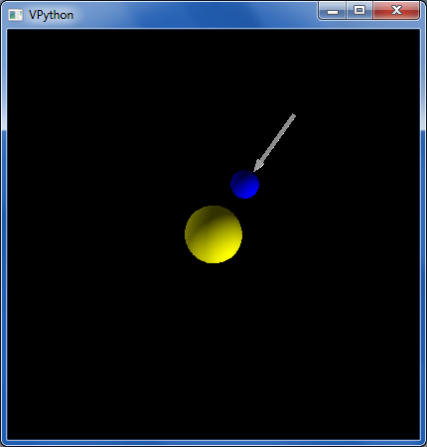
Orbiting example
"force arrow" in example code…
from visual import *
e = sphere(pos=(0,0,10),color=color.blue) #earth
s = sphere(color=color.yellow,radius=2) #sun
e.vel = vector(5,0,0) # initial velocity
RATE = 50
dt = 1.0/RATE
k = 70.0 # G!
while True:
rate(RATE)
diff = s.pos - e.pos # vector difference
force = k*diff/(mag(diff)**2) # mag
e.vel += dt*force # acceleration d.e.
e.pos += dt*e.vel # velocity d.e.
now, with vectors!

Slide 36
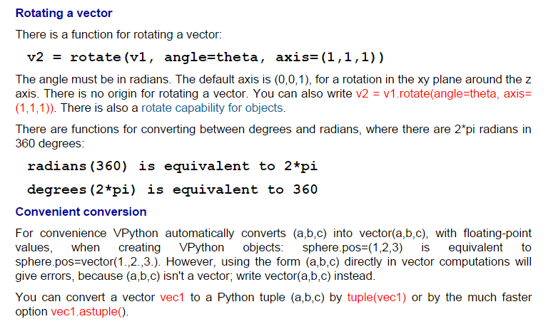
vpython.org/contents/docs
Documentation!

Slide 37
Lab goals
(0) Try out VPython!
(1) Make a few changes to the starter code
(2) Implement walls and wall-collisions…
(3) Improve your alien!
(4) Add scoring, enemies, or a moving target, hoops, traps, holes, etc. ~ your own game…

Slide 38
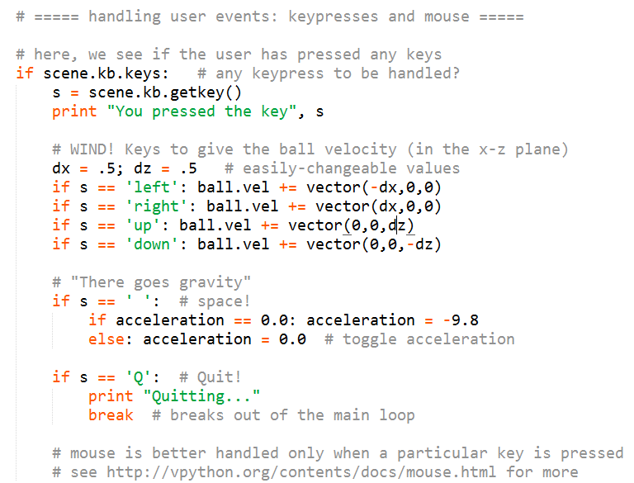
Keyboard events…
billiard_bounce.py

Slide 39
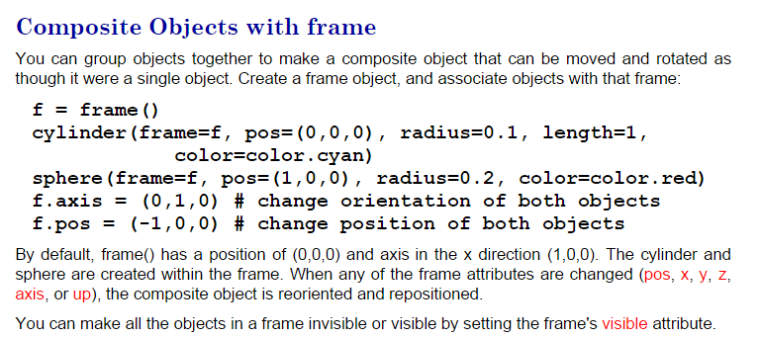
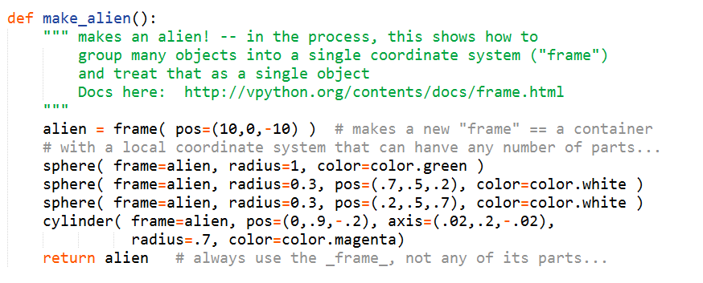
frames

Slide 40
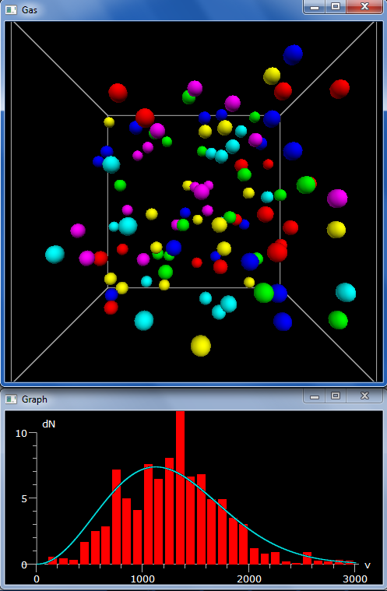
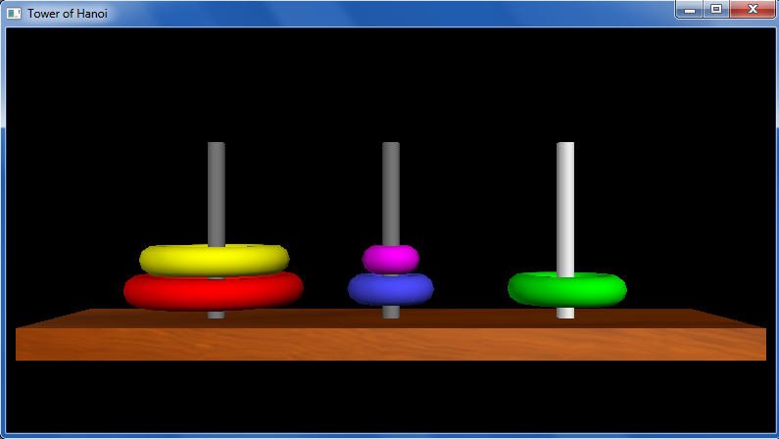
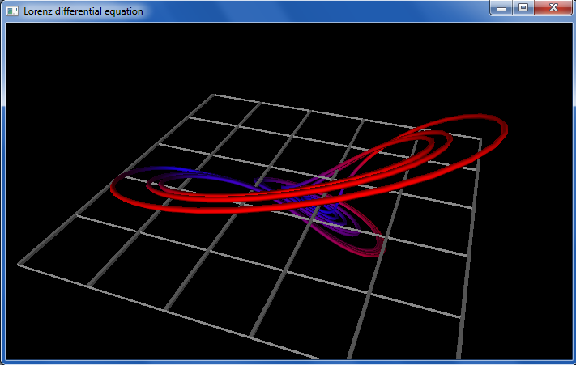
vPython examples…

Slide 41
Next time!
An AI for Connect Four

Slide 42
from visual import *
class Alien:
""" This class represents a three-eyed alien object...
"""
# The constructor, named __init__ (as always in Python)
def __init__(self, init_framepos):
""" The constructor creates a frame (container)
at initial location init_framepos
"""
# a frame is VPython's collection of shapes
# within a single coordinate system
self.f = frame(pos=init_framepos)
# all of these parts are within the frame self.f
self.body = sphere(pos=vector(0,0,0),
radius=1,
color=color.green,
frame=self.f)
self.left_eye = sphere(pos=self.body.pos + vector(.35,.5,.6),
radius=0.20,
color=color.white,
frame=self.f)
self.right_eye = sphere(pos=self.body.pos + vector(-.35,.5,.6),
radius=0.20,
color=color.white,
frame=self.f)
frames

Slide 43
Keyboard events…
if scene.kb.keys: # is there a keyevent?
s = scene.kb.getkey() # get keypress
if s == "p":
print alien
# things the alien(s) can do!
if s == 'J': # JUMP!
alien.f.pos = vector(0,HEIGHT,0)
alien.vel = vector(0,0,0) # stop the alien!
run_gravity = not run_gravity # fun!
print "run_gravity is", run_gravity
# move the alien around
if s == "i":
alien.f.pos += vector(0,0,1)
if s == "k":
alien.f.pos += vector(0,0,-1)
if s == "j":
alien.f.pos += vector(-1,0,0)
if s == "l":
alien.f.pos += vector(1,0,0)
Note that the frame is being moved here ~ this moves all of the parts!

Slide 44
while True:
rate(RATE)
# Here begins PHYSICS!
if run_gravity == True:
alien.update(dt)
alien.check_beach( beach )
# Here ends physics...
Phunky Physics!
in main()
def update(self, dt):
""" this defines the physics...
"""
gravity = -9.8*10
self.vel += dt*vector(0,gravity,0)
self.f.pos += dt*self.vel
in the Alien class
def check_beach(self, beach):
""" checks for a bounce!
"""
bottom_of_self = self.f.pos.y - self.body.radius
if bottom_of_self < beach.pos.y:
self.f.pos.y = beach.pos.y + self.body.radius
self.vel.y *= -1.0

Slide 45
feedback ?
Notes:
Next is: 13112221

Slide 46
feedback feedback
Notes:
Next is: 13112221

