Slide 1
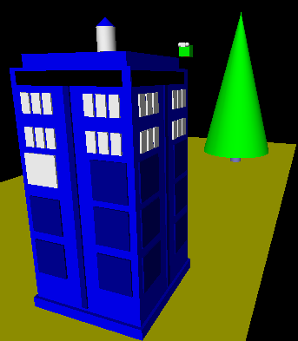
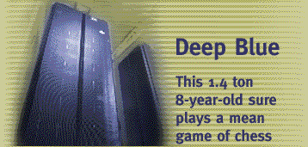
Intelligent CS 5 ?
Hw 11 due next Monday night @ 11:59pm
Next week: no labs
An object is structured data that is alive, responsible, and intelligent.
Sound too friendly?
This week's objects will be more adversarial…
X to move.
Is there a way to ensure a win?
If so, how far ahead?
| | | | | | | |
| | | | | | | |
| | | | | | | |
| | | |X| | | |
| |X| |X|O| | |
|X|O|O|O|X|O| |
---------------
0 1 2 3 4 5 6

Slide 2
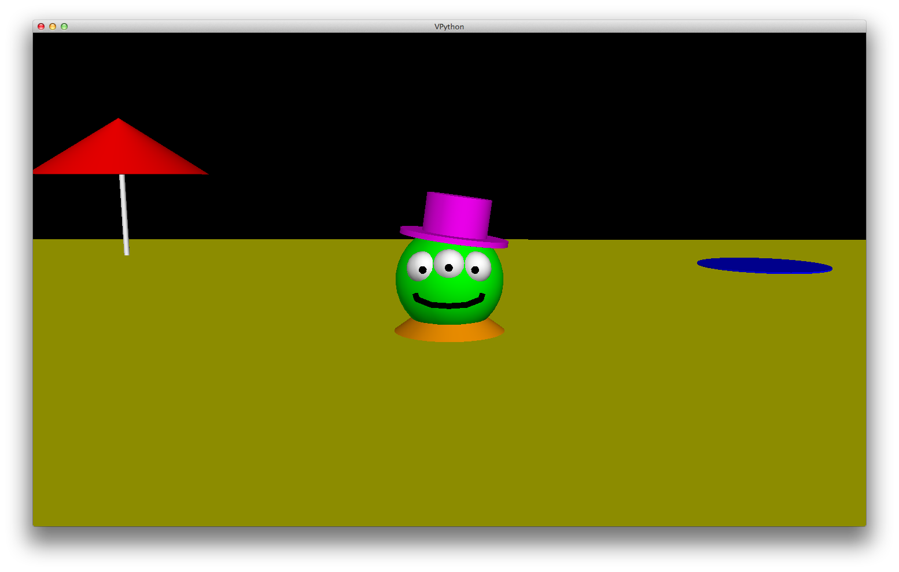
VPython is alien!
Want vPython to work on your Win64 machine? Come by/ask…

Slide 3
hw11: Strategic thinking!
Python had no Connect-four datatype…
I feel ahead of the game here...
| | | | | | | |
| | | | | | | |
| | | | | | | |
| | | |X| | | |
| |X| |X|O| | |
|X|O|O|O|X| |O|
---------------
0 1 2 3 4 5 6
How many moves ahead might we have to look?
… but you've already corrected that!
Now, may the best machine win!

Slide 4
The Player class
What data does a computer AI player need?
DATA MEMBERS
'X'
'LEFT'
2
Player
pForX
string
ox
string
tbt
int
ply
Ply?
checker, O or X
tiebreakType
moves to look ahead
surprisingly little!
How about knowledge about its opponent?

Slide 7
Ply it!
|O|O|O| | | | |
|X|X|X| | | | |
|O|O|O| | | | |
|X|X|X| | | | |
|O|O|O| | | | |
|X|X|X|X| | | |
---------------
0 1 2 3 4 5 6
X: 0-ply, LEFT tbk
|O|O| | | | | |
|X|X| | | | | |
|O|O| | | | | |
|X|X| | | | | |
|O|O|O| | | | |
|X|X|X|X| | | |
---------------
0 1 2 3 4 5 6
Name(s): ____________________
X: 1-ply, LEFT tbk
bA
bB
bC
bD
| | | | | | | |
| | | | | | | |
|O| | | | | | |
|X|O|X|O| | | |
|O|X|O|O| | | |
|X|X|O|X| | | |
---------------
0 1 2 3 4 5 6
| | | | | | | |
| | | | | | | |
|X|O| | | | | |
|O|X| | | | | |
|O|O| | | | | |
|X|X| | | | | |
---------------
0 1 2 3 4 5 6
|X|O|O| | | | |
|X|X|X| | | | |
|O|X|O| | | | |
|O|X|X| | | | |
|O|O|O| | | | |
|X|X|O| | | | |
---------------
0 1 2 3 4 5 6
| | | | | | | |
| | | | | | | |
|O|X| | | | | |
|X|X| | | | | |
|O|O|O| | | | |
|X|O|X|O| | | |
---------------
0 1 2 3 4 5 6
Ply?
Ply?
Ply?
Ply?
In all of these boards, X will move to column 3, even if tiebreaking to the LEFT. How many moves ahead (ply) is X looking in each case? 0, 1, 2, or 3?
|O|O| | | | | |
|X|X| | | | | |
|O|O| | | | | |
|X|X| | | | | |
|O|O| | | | | |
|X|X| | | | | |
---------------
0 1 2 3 4 5 6
Crazy challenge: Who will win – and in what column? – if you run X at 1 ply and O at 2 ply, each tiebreaking LEFT?
This is the start of the match, and it's now X's turn:

Slide 8
After Deep Blue…

Slide 9
In reality?
Humans adapt!

Slide 10
The Player class
Board
Player
__init__( self, width, height )
__init__(self, ox, tbt, ply)
allowsMove( self, col )
__repr__(self)
addMove( self, col, ox )
oppCh(self)
delMove( self, col )
Demos?
scoreBoard(self, b)
__repr__( self )
scoresFor(self, b)
isFull( self )
tiebreakMove(self, scores)
winsFor( self, ox )
nextMove(self, b)
hostGame( self )
playGame( self, pForX, pForO )

Slide 11
Why AI is challenging:
Make no mistake about it: computers process numbers - not symbols.
Computers can only help us to the extent that we can arithmetize an activity.
- paraphrasing Alan Perlis

Slide 12
For example,
Computers can only help us to the extent that we can arithmetize an activity.
… Microsoft has tried arithmetizing both English and Chinese

Slide 13
scoreBoard(self,b)
‘X’
‘O’
Assigns a score to any board, b
A simple system:
100.0
50.0
0.0
for a win
for anything else
for a loss
Score for
Score for
Score for
Score for

Slide 14
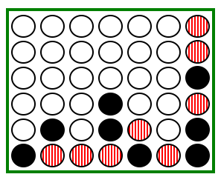
scoreBoard(self,b)
Assigns a score to any board, b
A simple system:
100.0
50.0
0.0
for a win
for anything else
for a loss
Who's this self?
Implementing…
scoreBoard(self, b)
if b.winsFor(
How can there be no 'X' or 'O' input?
What methods that already exist will come in handy?
This isn't looking very far ahead !

Slide 15
Giving each board a score is useful, but …
… ultimately, we want to give a score to each possible move.

Slide 16
scoreBoard vs. scoresFor
scoreBoard(self,b) looks ahead 0 moves
0-ply
only
it scores the board as it stands now
scoresFor(self,b) returns a LIST of scores: one for each column a player might move next…
0-ply
1-ply
it gives a separate score for each column and considers future moves up to n-ply
2-ply
…

Slide 17
scoreBoard vs. scoresFor
scoreBoard(self,b) looks ahead 0 moves
0-ply
only
it scores the board as it stands now
scoresFor(self,b) returns a LIST of scores: one for each column a player might move next…
0-ply
1-ply
it gives a separate score for each column and considers future moves up to n-ply
This is the AI.
2-ply
…

Slide 18
Scoring moves at 0 ply
"Ply" is the number of moves to look ahead…
0-ply scores for
What would the 0-ply scores be for each column (move)?
x
x
x
x
x
x
x
0 ply is a Zen-like approach: exist only in the present
0-ply means 0 moves are made!
to move
We use -1 as the score into a full column.
0 ply!
o0.scoreBoard( b42 )
o0.scoresFor( b42 )

Slide 19
Scoring moves at 1 ply
1-ply scores for
What would the 1-ply scores be for each column (move)?
A 1-ply lookahead player will "see" an impending victory.
1-ply means 1 move is made!
"Gotcha!"
to move
I try 1 ply!
o1.scoresFor( b42 )

Slide 20
Scoring moves at 2 ply
2-ply scores for
What would the 2-ply scores be for each column (move)?
A 2-ply lookahead player will see a way to win or block the opponent's win
2-ply means 2 moves are made!
"Gotcha!" + "Uh Oh…"
to move
What about 3-ply?

Slide 21
Scoring moves at 2 ply for
2-ply scores for
What would the 2-ply scores be for each column (move)?
A 2-ply lookahead player will see a way to win or block the opponent's win
2-ply means 2 moves are made!
"Gotcha!" + "Uh Oh…"
to move
What about 3-ply?

Slide 22
Quiz
Name(s) _______________________
b
Fill in the score for each column at each ply up to 3.
'O'
The same move is evaluated at each ply... it's just evaluated farther into the future!
you - self - is playing 'O'
Each row is different in at least 1 score…
'X'
col 0
col 1
col 2
col 3
col 4
col 5
col 6
0-ply scores for 'O':
Looks 0 moves into the future
col 0
col 1
col 2
col 3
col 4
col 5
col 6
1-ply scores for 'O':
Looks 1 move into the future
col 0
col 1
col 2
col 3
col 4
col 5
col 6
2-ply scores for 'O':
Looks 2 moves into the future
col 0
col 1
col 2
col 3
col 4
col 5
col 6
3-ply scores for 'O':
Looks 3 moves into the future

Slide 23
Quiz
Try this on the back first!
b
Fill in the score for each column at each ply up to 3.
'O'
The same move is evaluated at each ply... it's just evaluated farther into the future!
you - self - is playing 'O'
Each row is different in at least 1 score…
'X'
col 0
col 1
col 2
col 3
col 4
col 5
col 6
0-ply scores for 'O':
Looks 0 moves into the future
col 0
col 1
col 2
col 3
col 4
col 5
col 6
1-ply scores for 'O':
Looks 1 move into the future
col 0
col 1
col 2
col 3
col 4
col 5
col 6
2-ply scores for 'O':
Looks 2 moves into the future
col 0
col 1
col 2
col 3
col 4
col 5
col 6
3-ply scores for 'O':
Looks 3 moves into the future

Slide 24
Quiz
Name(s) _______________________
b
Fill in the score for each column at each ply up to 3.
'O'
The same move is evaluated at each ply... it's just evaluated farther into the future!
you - self - is playing 'O'
Each row is different in at least 1 score…
'X'
col 0
col 1
col 2
col 3
col 4
col 5
col 6
0-ply scores for 'O':
Looks 0 moves into the future
col 0
col 1
col 2
col 3
col 4
col 5
col 6
1-ply scores for 'O':
Looks 1 move into the future
col 0
col 1
col 2
col 3
col 4
col 5
col 6
2-ply scores for 'O':
Looks 2 moves into the future
col 0
col 1
col 2
col 3
col 4
col 5
col 6
3-ply scores for 'O':
Looks 3 moves into the future

Slide 25
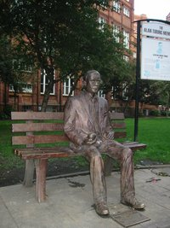
?
Strategic thinking == intelligence
Two-player games have been a key focus of AI as long as computers have been around…
In 1945, Alan Turing predicted that computers would be better chess players than people in ~ 50 years…
and thus would have achieved intelligence.
Alan Turing memorial Manchester, England

Slide 26
Strategic thinking != intelligence
computers
humans
good at looking to find winning combinations of moves
good at evaluating the strength of a board for a player
… humans and computers have different relative strengths in these games.

Slide 27
Humans play via "look-up"
An experiment (by A. deGroot) was performed in which chess positions were shown to novice and expert players…
- experts could reconstruct these perfectly
- novice players did far worse…
Adriaan de Groot

Slide 28
Humans play via "look-up"
An experiment (by A. deGroot) was performed in which chess positions were shown to novice and expert players…
- experts could reconstruct these perfectly
- novice players did far worse…
Random chess positions (not legal ones) were then shown to the two groups
- experts and novices did equally well/badly
at reconstructing them!
Adriaan de Groot

Slide 29
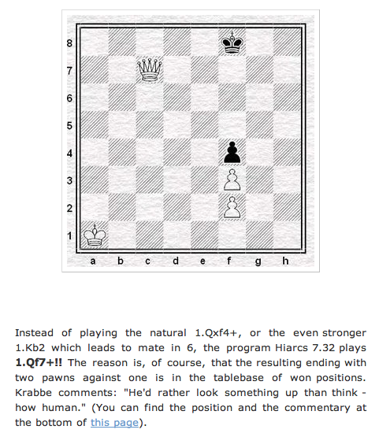
Computers can look up positions, too… !
though sometimes with surprising results!

Slide 30
Extra this week
scoreBoard4Tourney
scoring like a human…
Idea: use more than just 0, 50, and 100
don't give this board a 50.0 !
We run a C4 round-robin tournament using your scoring f'ns.

Slide 31
NOT Extra this week
scoresFor
scoring like a machine…
Idea: Find the score (0,50,100) for each column at the current ply.
This board == 50.0 until ply 5!
We run a C4 round-robin tournament using your scoring f'ns.

Slide 32
def scoresFor(self, b):
(0) Start all scores at 50.
(1) For each col to move:
(2a) If not possible…
(2b) If game already over…
(2c) Else add the move to b
(3) Ask an opponent (!!!) for its scoresFor at ply-1
(4) compute self's score
""" MUST return a list of 7 scores!!
"""
scores = [50,50,50,50,50,50,50]
for col in range( 0, 7 ):
Needs to return a list of seven scores!
This is the AI.
return scores

Slide 33
scoresFor's idea
(self) 'X'
(0) Suppose you're playing at 2 ply...
(1) Make ALL moves!
b

Slide 34
scoresFor's idea
(self) 'X'
(0) Suppose you're playing at 2 ply...
(1) Make ALL moves!
new 'X'
b
Col 0
Col 6
Col 1
Col 5
Col 2
Col 3
Col 4

Slide 35
scoresFor's idea
(self) 'X'
(0) Suppose you're playing at 2 ply...
(1) Make ALL moves!
(2) Ask OPPONENT its scoresFor at ply-1
(3) Compute which score the opp. will take
(4) Compute what score you get…
new 'X'
b
Opponent's scoresFor
[50,50,50,50,50,100,50]
[ 0, 0, 0, 0, 0, 0, 0 ]
[50,50,50,50,50,100,50]
Col 0
Col 6
Col 1
Col 5
Col 2
Col 3
Col 4
[50,50,50,50,50,100,50]
[50,50,50,50,50,50,50]
[ 0, 0, 0, 0, 0, 0, 0 ]
[ 0, 0, 0, 0, 0, 0, 0 ]
[ 0, 0, 0, 0, 0, 0, 0 ]
these are all of the opponent's calls to scoresFor !

Slide 36
scoresFor's idea
(self) 'X'
(0) Suppose you're playing at 2 ply...
(1) Make ALL moves!
(2) Ask OPPONENT its scoresFor at ply-1
(3) Compute which score the opp. will take
(4) Compute what score you get…
new 'X'
b
What score will the opponent choose?
What score does self get as a result?
[ 0, 0, 0, 0, 0, 0, 0 ]
[50,50,50,50,50,100,50]
max(S) = 0
Col 0
Col 6
max(S) = 100
100
0
Col 1
Col 5
Col 2
max(S) = 100
Col 3
Col 4
max(S) = 0
max(S) = 50
0
max(S) = 0
max(S) = 0
50
100
100
100
[50,50,50,50,50,100,50]
[50,50,50,50,50,50,50]
[ 0, 0, 0, 0, 0, 0, 0 ]
[ 0, 0, 0, 0, 0, 0, 0 ]
[ 0, 0, 0, 0, 0, 0, 0 ]
these are all of the opponent's calls to scoresFor !

Slide 37
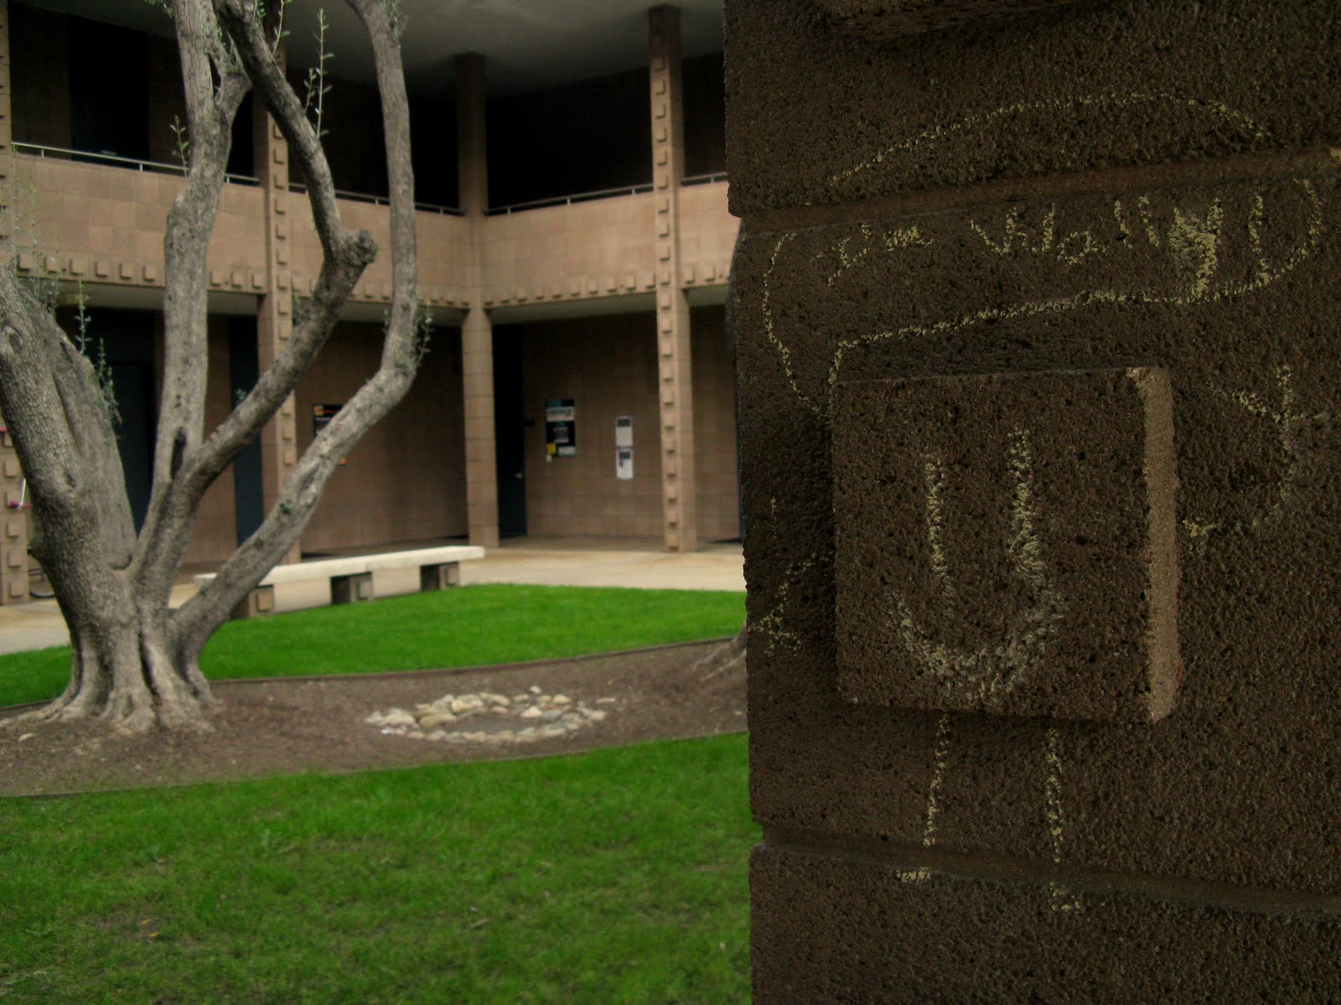
Less concept,
more concrete...

Slide 38
def scoresFor(self, b):
(0) Start all scores at 50.
(1) For each col to move:
(2a) If not possible…
(2b) If game already over…
(2c) Else add the move to b
(3) Ask an opponent (!!!) for its scoresFor at ply-1
(4) compute self's score
""" MUST return a list of 7 scores!!
"""
scores = [50,50,50,50,50,50,50]
for col in range( 0, 7 ):
return scores

Slide 39
def scoresFor(self, b):
(0) Start all scores at 50.
(1) For each col to move:
(2a) If not possible…
(2b) If game already over…
(2c) Else add the move to b
(3) Ask an opponent (!!!) for its scoresFor at ply-1
(4) compute self's score
""" MUST return a list of 7 scores!!
"""
scores = [50,50,50,50,50,50,50]
for col in range( 0, 7 ):
return scores

Slide 40
Games' Branching Factors
0 Ply
On average, Connect 4 players have seven choices per move.
Chess players have more, perhaps around 40, possible choices in a given move.
1 Ply
2 Ply
Branching Factors
for different two-player games
“solved” games
Tic-tac-toe 4
Connect Four 7
Checkers 10
Othello 30
Chess 40
Go 300
Boundaries for qualitatively different games…
computer-dominated
human-dominated

Slide 41
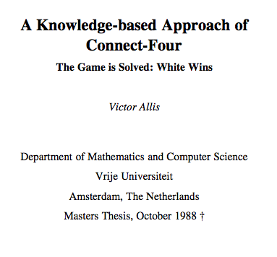
Connect 4 was solved in 1988.

Slide 42
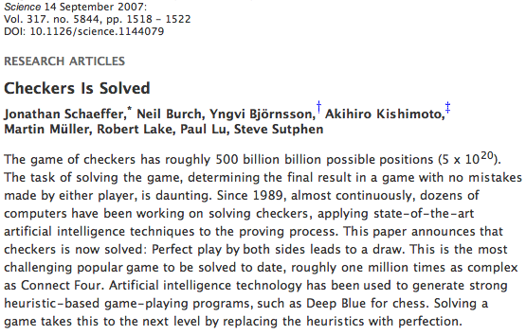
Checkers was solved in 2007.

Slide 43
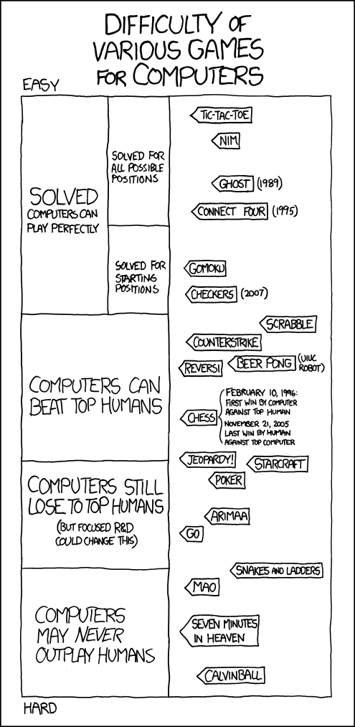
Games' Branching Factors

Slide 44
(Games' Branching Factors)

Slide 45
(Games' Branching Factors)

Slide 46
Suppose
def tiebreakMove(self, S):
if self.tbt == 'LEFT':
S = [-1,0,50,50,0,0,50]
col
0
1
2
3
4
5
6
b = max(S)
bLocList = []
First, how could you create bLocList, a list of all of the column #s (locations) of the highest score inside the list S
Hint: use a for or a LC!
Then, how could you return the leftmost out of all of those column numbers that are in bLocList ?
How would 'RANDOM' and 'RIGHT' work differently?

Slide 47
Connect Four continues…

Slide 48
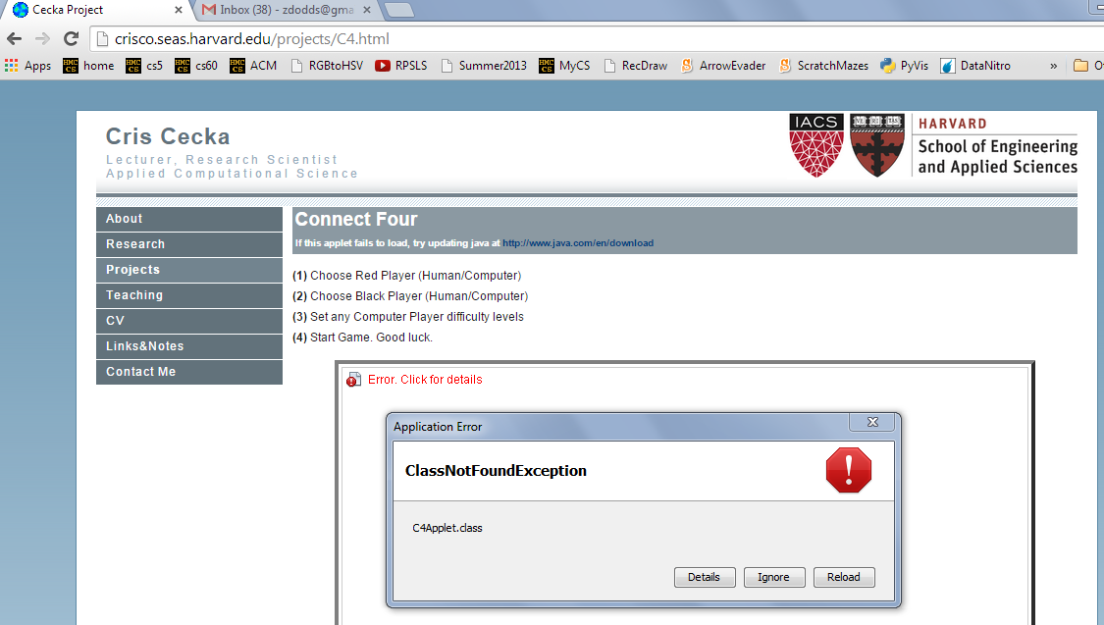
Aargh!

Slide 49
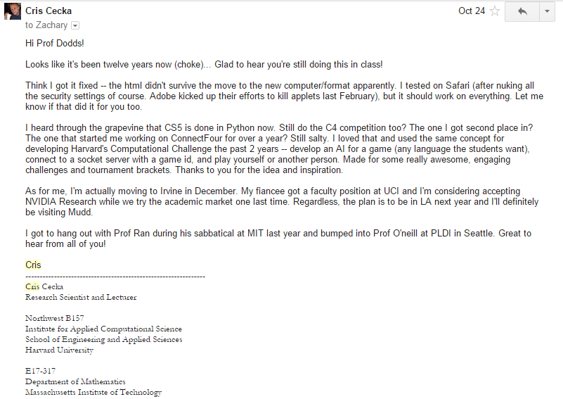
This year's Cris Cecka award…

Slide 50
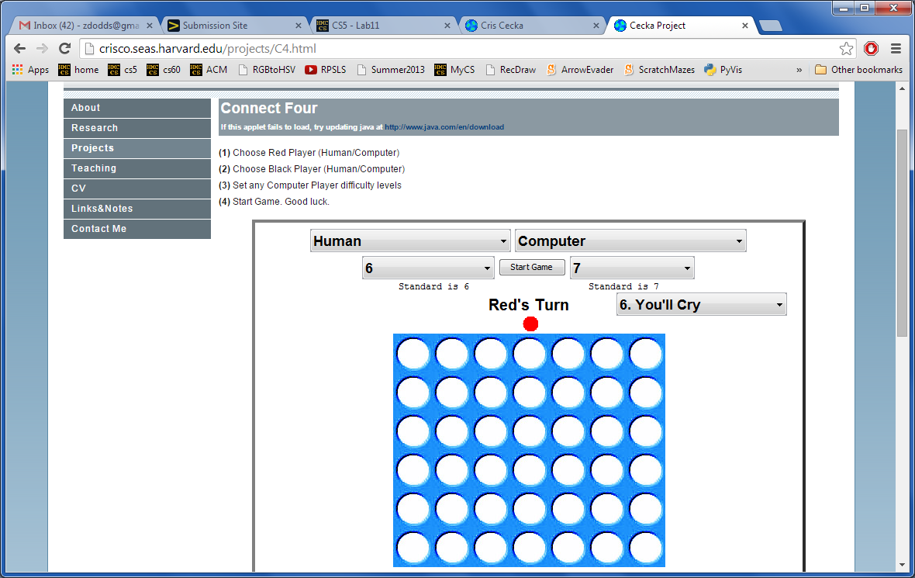
Good luck -- against your own program!
Looking for a game… ?
http://crisco.seas.harvard.edu/projects/C4.html

Slide 52
scoreBoard(self,b)
Assigns a score to any board, b
A simple system:
100.0
50.0
0.0
for a win
for anything else
for a loss
Implementing…
scoreBoard(self, b)
Who's this self?
How can there be no 'X' or 'O' input?
What methods that already exist will come in handy?
This isn't looking very far ahead !

Slide 53
Scoring moves at 0 ply
"Ply" is the number of moves to look ahead…
0-ply scores for
What would the 0-ply scores be for each column (move)?
x
x
x
x
x
x
x
0 ply is a Zen-like approach: exist only in the present
0-ply means 0 moves are made!
to move
We use -1 as the score into a full column.
0 ply!
o0.scoreBoard( b42 )
o0.scoresFor( b42 )

Slide 54
Scoring moves at 1 ply
1-ply scores for
What would the 1-ply scores be for each column (move)?
A 1-ply lookahead player will "see" an impending victory.
1-ply means 1 move is made!
"Gotcha!"
to move
I try 1 ply!
o1.scoresFor( b42 )

Slide 55
Scoring moves at 2 ply
2-ply scores for
What would the 2-ply scores be for each column (move)?
A 2-ply lookahead player will see a way to win or block the opponent's win
2-ply means 2 moves are made!
"Gotcha!" + "Uh Oh…"
to move
What about 3-ply?

Slide 56
Scoring moves at 2 ply for
2-ply scores for
What would the 2-ply scores be for each column (move)?
A 2-ply lookahead player will see a way to win or block the opponent's win
2-ply means 2 moves are made!
"Gotcha!" + "Uh Oh…"
to move
What about 3-ply?

Slide 57
Quiz
Name(s) _______________________
b
Fill in the score for each column at each ply up to 3.
'O'
The same move is evaluated at each ply... it's just evaluated farther into the future!
you - self - is playing 'O'
Each row is different in at least 1 score…
'X'
col 0
col 1
col 2
col 3
col 4
col 5
col 6
0-ply scores for 'O':
Looks 0 moves into the future
col 0
col 1
col 2
col 3
col 4
col 5
col 6
1-ply scores for 'O':
Looks 1 move into the future
col 0
col 1
col 2
col 3
col 4
col 5
col 6
2-ply scores for 'O':
Looks 2 moves into the future
col 0
col 1
col 2
col 3
col 4
col 5
col 6
3-ply scores for 'O':
Looks 3 moves into the future

Slide 58
def scoresFor(self, b):
(0) Start all scores at 50.
(1) For each col to move:
(2a) If not possible…
(2b) If game already over…
(2c) Else add the move to b
(3) Ask an opponent (!!!) for its scoresFor at ply-1
(4) compute self's score
""" MUST return a list of 7 scores!!
"""
scores = [50,50,50,50,50,50,50]
for col in range( 0, 7 ):
return scores

Slide 59
def scoresFor(self, b):
(0) Start all scores at 50.
(1) For each col to move:
(2a) If not possible…
(2b) If game already over…
(2c) Else add the move to b
(3) Ask an opponent (!!!) for its scoresFor at ply-1
(4) compute self's score
""" MUST return a list of 7 scores!!
"""
scores = [50,50,50,50,50,50,50]
for col in range( 0, 7 ):
return scores

Slide 60
scoreBoard(self,b)
Assigns a score to any board, b
A simple system:
100.0
50.0
0.0
for a win
for anything else
for a loss
Implementing…
scoreBoard(self, b)
How can there be no 'X' or 'O' input?
What methods that already exist will come in handy?
This isn't looking very far ahead !

Slide 61
Scoring moves at 0 ply
"Ply" is the number of moves to look ahead…
0-ply scores for
What would the 0-ply scores be for each column (move)?
x
x
x
x
x
x
x
0 ply is a Zen-like approach: exist only in the present
0-ply means 0 moves are made!
to move
We use -1 as the score into a full column.
0 ply!
o0.scoreBoard( b42 )
o0.scoresFor( b42 )

Slide 62
Scoring moves at 2 ply
2-ply scores for
What would the 2-ply scores be for each column (move)?
A 2-ply lookahead player will see a way to win or block the opponent's win
2-ply means 2 moves are made!
"Gotcha!" + "Uh Oh…"
to move
What about 3-ply?

Slide 63
Scoring moves at 2 ply for
2-ply scores for
What would the 2-ply scores be for each column (move)?
A 2-ply lookahead player will see a way to win or block the opponent's win
2-ply means 2 moves are made!
"Gotcha!" + "Uh Oh…"
to move
What about 3-ply?

Slide 64
Quiz
Name(s) _______________________
b
Fill in the score for each column at each ply up to 3.
'O'
you - self - is playing 'O'
The same move is evaluated at each ply... it's just evaluated farther into the future!
'X'
Each row is different in at least 1 score…
col 0
col 1
col 2
col 3
col 4
col 5
col 6
0-ply scores for 'O':
Looks 0 moves into the future
col 0
col 1
col 2
col 3
col 4
col 5
col 6
1-ply scores for 'O':
Looks 1 move into the future
col 0
col 1
col 2
col 3
col 4
col 5
col 6
2-ply scores for 'O':
Looks 2 moves into the future
col 0
col 1
col 2
col 3
col 4
col 5
col 6
3-ply scores for 'O':
Looks 3 moves into the future

Slide 65
def scoresFor(self, b):
""" MUST return a list of 7 scores!!
"""
scores = [50,50,50,50,50,50,50]
(0) Start all scores at 50.
(1) For each col to move:
(2a) If not possible…
(2b) If game already over…
(2c) Else add the move to b
(3) Ask an opponent (!!!) for its scoresFor at ply-1
(4) compute self's score
for col in range( 0, 7 ):
return scores

Slide 66
scoreBoard(self,b)
‘X’
‘O’
Assigns a score to any board, b
A simple system:
100.0
50.0
0.0
for a win
for anything else
for a loss
Score for
Score for
Score for
Score for

Slide 67
scoreBoard
Assigns a score to any board, b
A simple system:
100.0
50.0
0.0
for a win
for anything else
for a loss
Implementation ideas…
Why do we need to pass in the board? We never had to do that before!
scoreBoard(self, b)
How can there be no 'X' or 'O' input?
What methods that already exist will come in handy?
This doesn't seem to be looking very far ahead !

Slide 68
Scoring moves, not boards...
scoresFor returns a list of 7 scores!
0-ply
What would the 0-ply scores be for each column (move)
scores
The "Zen" approach
The Player object's ply tells how far ahead to look.
to go
0 ply!
We will use -1 as the score for a full column.
o0.scoreBoard( b42 )
o0.scoresFor( b42 )

Slide 69
scoresFor at 1 ply
1-ply
What would the 1-ply scores be for each column (move)
scores
The "I win!" approach
A 1-ply lookahead player will "see" an impending victory.
to go
I try 1 ply!
o1.scoresFor( b42 )

Slide 70
Two moves ahead… ?
0-ply
-1
50
50
50
50
50
50
scores
What about 3-ply?
Try it!
's
turn
1-ply
scores
A 2-ply lookahead player can also "see" an opponent's impending victory.
2-ply
The "Uh Oh!" approach
scores

Slide 71
scoreBoard vs. scoresFor
scoreBoard(b) looks ahead 0 moves
The "Zen" approach -- we are excellent at this!
0-ply
only
it scores the board as it stands now
scoresFor( self, b ) returns a LIST of scores, one for each column you might choose to move next…
0-ply
it gives a separate score for each column and considers future moves up to n-ply
1-ply
2-ply
…

Slide 72
Name(s) _______________________
b
'X'
Quiz
Fill in the score for a move to each column.
'O'
you - self - is playing 'O'
The same move is evaluated at each ply... it's just evaluated farther into the future!
Each row is different in at least 1 score…
col 0
col 1
col 2
col 3
col 4
col 5
col 6
0-ply scores for 'O':
Looks 0 moves into the future
col 0
col 1
col 2
col 3
col 4
col 5
col 6
1-ply scores for 'O':
Looks 1 move into the future
col 0
col 1
col 2
col 3
col 4
col 5
col 6
2-ply scores for 'O':
Looks 2 moves into the future
col 0
col 1
col 2
col 3
col 4
col 5
col 6
3-ply scores for 'O':
Looks 3 moves into the future

Slide 73
Solutions
b
‘X’
‘O’
col 0
col 1
col 2
col 3
col 4
col 5
col 6
0-ply scores for O:
-1
50
50
50
50
50
50
col 0
col 1
col 2
col 3
col 4
col 5
col 6
1-ply scores for O:
-1
50
50
100
50
50
50
col 0
col 1
col 2
col 3
col 4
col 5
col 6
2-ply scores for O:
-1
0
0
100
0
0
50
col 0
col 1
col 2
col 3
col 4
col 5
col 6
3-ply scores for O:
-1
0
0
100
0
0
100

Slide 74
(0) Start all scores at 50.
(1) For each possible move
(2) If needed +possible, add the move to the board b
(3) Ask an OPPONENT its scoresFor at ply-1 (!!!)
(4) compute self's score
def scoresFor(self, b):
""" MUST return a list of 7 scores!!
"""
scores = [50,50,50,50,50,50,50]
for col in range( 0, 7 ):
return scores

Slide 75
(0) Start all scores at 50.
(1) For each possible move
(2) If needed +possible, add the move to the board b
(3) Ask an OPPONENT its scoresFor at ply-1 (!!!)
(4) compute self's score
def scoresFor(self, b):
""" MUST return a list of 7 scores!!
"""
scores = [50,50,50,50,50,50,50]
for col in range( 0, 7 ):

Slide 76
scoreBoard
Assigns a score to any board, b
A simple system:
100.0
50.0
0.0
for a win
for anything else
for a loss
Implementation ideas…
Why do we need to pass in the board? We never had to do that before!
scoreBoard(self, b)
How can there be no 'X' or 'O' input?
What methods that already exist will come in handy?
This doesn't seem to be looking very far ahead !

Slide 77
Scoring moves, not boards...
scoresFor returns a list of 7 scores!
0-ply
What would the 0-ply scores be for each column (move)
scores
The "Zen" approach
The Player object's ply tells how far ahead to look.
to go
0 ply!
We will use -1 as the score for a full column.
o0.scoreBoard( b42 )
o0.scoresFor( b42 )

Slide 78
scoresFor at 1 ply
1-ply
What would the 1-ply scores be for each column (move)
scores
The "I win!" approach
A 1-ply lookahead player will "see" an impending victory.
to go
I try 1 ply!
o1.scoresFor( b42 )

Slide 79
Two moves ahead… ?
0-ply
-1
50
50
50
50
50
50
scores
What about 3-ply?
Try it!
's
turn
1-ply
scores
A 2-ply lookahead player can also "see" an opponent's impending victory.
2-ply
The "Uh Oh!" approach
scores

Slide 80
scoreBoard vs. scoresFor
scoreBoard(b) looks ahead 0 moves
The "Zen" approach -- we are excellent at this!
0-ply
only
it scores the board as it stands now
scoresFor( self, b ) returns a LIST of scores, one for each column you might choose to move next…
0-ply
it gives a separate score for each column and considers future moves up to n-ply
1-ply
2-ply
…

Slide 81
Name(s) _______________________
b
'X'
Quiz
Fill in the score for a move to each column.
'O'
you - self - is playing 'O'
The same move is evaluated at each ply... it's just evaluated farther into the future!
Each row is different in at least 1 score…
col 0
col 1
col 2
col 3
col 4
col 5
col 6
0-ply scores for 'O':
Looks 0 moves into the future
col 0
col 1
col 2
col 3
col 4
col 5
col 6
1-ply scores for 'O':
Looks 1 move into the future
col 0
col 1
col 2
col 3
col 4
col 5
col 6
2-ply scores for 'O':
Looks 2 moves into the future
col 0
col 1
col 2
col 3
col 4
col 5
col 6
3-ply scores for 'O':
Looks 3 moves into the future

Slide 82
?
Strategic thinking == intelligence
Two-player games have been a key focus of AI as long as computers have been around…
computers
humans
good at looking ahead in the game to find winning combinations of moves
good at evaluating the strength of a board for a player
hw11 pr2
ex. credit
building a Connect 4 AI by looking ahead in the game
emulating a human by evaluating board positions
… humans and computers have different relative strengths in these games.

Slide 83
Extra examples: 1-ply and 2-ply scoresFor
It is O’s move. What scores does a 1-ply lookahead for O assign to each move?
|O| | | | | | |
|X| | | |O| |X|
|O| | | |X|O|X|
|X| | | |O|O|X|
|X| |X| |X|O|O|
|X| |O|O|O|X|X|
---------------
0 1 2 3 4 5 6
col 0
col 1
col 2
col 3
col 4
col 5
col 6
Which change at 2-ply?
| | | | | | |O|
| | | | | | |O|
| | | | | | |X|
|X| |X|O| | |O|
|X|O|O|X| |X|X|
|X|O|O|O| |O|X|
---------------
0 1 2 3 4 5 6
It is X’s move. What scores does a 2-ply lookahead for X assign to each move?
col 0
col 1
col 2
col 3
col 4
col 5
col 6
Which change at 3-ply?

Slide 84
Answers to example scoresFor scores
It is O’s move. What scores does a 1-ply lookahead for O assign to each move?
|O| | | | | | |
|X| | | |O| |X|
|O| | | |X|O|X|
|X| | | |O|O|X|
|X| |X| |X|O|O|
|X| |O|O|O|X|X|
---------------
0 1 2 3 4 5 6
col 0
col 1
col 2
col 3
col 4
col 5
col 6
-1
100
50
100
50
100
50
Which change at 2-ply?
0
0
| | | | | | |O|
| | | | | | |O|
| | | | | | |X|
|X| |X|O| | |O|
|X|O|O|X| |X|X|
|X|O|O|O| |O|X|
---------------
0 1 2 3 4 5 6
It is X’s move. What scores does a 2-ply lookahead for X assign to each move?
be careful!
col 0
col 1
col 2
col 3
col 4
col 5
col 6
100
0
0
0
50
0
-1
0
Which change at 3-ply?

Slide 85
Looking further ahead …
0 ply:
Zen choice of move: here and now
1 ply:
2 ply:
3 ply:
X’s move
X’s move
X‘s move
| | | | | | | |
| | | | | | | |
| | | | | | | |
| | | | | | | |
| |O|X| | | | |
|O|X|X|X| |O|O|
---------------
0 1 2 3 4 5 6
| | | | | | | |
| | | | | | | |
|O| | | | | | |
|X| | | | | | |
|X|O|O| | |X| |
|O|X|X|O|X|O| |
---------------
0 1 2 3 4 5 6
| | | | | | | |
| | | | | | | |
| | | | |X| | |
| | | | |O|O| |
| |X|X| |X|O| |
|O|X|O| |O|X| |
---------------
0 1 2 3 4 5 6
(1) Player will win
(2) Player will avoid losing
(3) Player will set up a win by forcing the opponent to avoid losing

Slide 86
It is O’s move. What scores does a 1-ply lookahead for O assign to each move?
|O| | | | | | |
|X| | | |O| |X|
|O| | | |X|O|X|
|X| | | |O|O|X|
|X| |X| |X|O|O|
|X| |O|O|O|X|X|
---------------
0 1 2 3 4 5 6
col 0
col 1
col 2
col 3
col 4
col 5
col 6
Which change at 2-ply?

Slide 87
‘X’
scoresFor each column
‘O’
new‘X’
b
(1) For each possible move
(2) Add it to the board
(3) Ask OPPONENT to score each board
(4) Which score will the opponent choose?
What, then, should assign for your score? (self's score)
0.0
50.0
Col 0
Col 6
Col 1
Col 5
Col 2
Col 3
Col 4
50.0
50.0
0.0
0.0
0.0

Slide 88
‘X’
Choosing the best move
‘O’
new‘X’
b
(1) For each possible move
(2) Add it to the board
(3) Ask OPPONENT to score each board - ply?
(4) Reverse the scores
100.0
50.0
Col 0
Col 6
Col 1
Col 5
Col 2
Col 3
Col 4
50.0
50.0
100.0
100.0
100.0

Slide 89
‘X’
Choosing the best move
‘O’
new‘X’
(1) For each possible move
(2) Add it to the board
(3) Ask OPPONENT to score each board - ply?
(4) Reverse the scores
(5) Find one max - that's it!
b
100.0
50.0
Col 0
Col 6
Col 1
Col 5
Col 2
Col 3
Col 4
50.0
50.0
100.0
100.0
100.0

Slide 90
Connect Four
For your convenience, the creators of Python’s library have included a Board class that can represent any size of Connect Four board... !
| | | | | | | |
| | | | | | | |
| | | | | | | |
| | | |X| | | |
| |X| |X|O| | |
|X|O|O|O|X| |O|
---------------
0 1 2 3 4 5 6
Suppose our Board class's 2d list of lists is named self.data. What is the name of this single spot?

Slide 91
Connect Four: the object b
This is true for sufficiently broad definitions of “the creators of Python’s library” ...
data members
int
list
char
char
char
char
NROWS
data
Board
b
char
char
char
char
int
NCOLS
char
char
char
char
What is player ?
def addMove(self, col, player)
def allowsMove(self, col)
def winsFor(self, player)
methods

Slide 92
Connect Four: the object b
This is true for sufficiently broad definitions of “the creators of Python’s library” ...
data members
int
list
char
char
char
char
NROWS
data
Board
b
char
char
char
char
int
NCOLS
char
char
char
char
def addMove(self, col, player)
Which methods will alter b? Which leave it alone?
def allowsMove(self, col)
def winsFor(self, player)
methods

Slide 93
Connect Four: Board
class Board:
def __init__( self, numRows, numCols ):
""" our Board's constructor """
self.NROWS = numRows
self.NCOLS = numCols
self.data = []
for r in range(self.NROWS):
onerow = [' ']*self.NCOLS
self.data += [onerow]
def __repr__(self):
""" thoughts? """
look familiar?
Starting code for the Board class

Slide 94
Connect Four: Board
class Board:
def __init__( self, numRows, numCols ):
""" our Board's constructor """
self.NROWS = numRows
self.NCOLS = numCols
self.data = []
for r in range(self.NR):
onerow = [' ']*self.NC
self.data += [onerow]
def __repr__(self):
""" thoughts? """
s = '\n'
for r in range(self.NROWS):
s += '|'
for c in range(self.NCOLS):
s += self.data[r][c] + '|'
return s
look familiar?
a bit more to go !

Slide 95
Problem 2
Hw11 Pr2: Connect Four Board
class Board
__init__
the “constructor”
allowsMove
checks if allowed
addMove
places a checker
__repr__
outputs to screen
isFull
checks if space left
winsFor
checks if a player has won
hostGame
play!
What's trickiest here?

Slide 96
Problem 2
Hw11 Pr2: Connect Four Board
class Board
__init__
the “constructor”
allowsMove
checks if allowed
addMove
places a checker
__repr__
outputs to screen
isFull
checks if space left
winsFor
checks if a player has won
hostGame
play!
What's trickiest here?

Slide 97
What's wrong here?
def winsForHoriz(self, player):
inarow = 0
for r in range(self.NROWS):
for c in range(self.NCOLS):
if self.data[r][c] == player:
inarow += 1
else:
inarow = 0
if inarow == 4:
return True
return False
| | | | | | | |
| | | | | | | |
| | | | | | | |
| | | |O|O| | |
|X|X| |O|X|X|X|
|X|O|O|O|O|X|X|
---------------
0 1 2 3 4 5 6

Slide 98
Strategies?
horizontals
verticals
diagonals ??
| | | | | | | |
| | | | | | | |
| | | | | | | |
| | | |O|O| | |
|X|X| |O|X|X|X|
|X|O|O|O|O|X|X|
---------------
0 1 2 3 4 5 6

Slide 99
class Board
{
# __init__ and __repr__ methods here…
# 3 data members:
# self.NR == number of rows
# self.NC == number of cols
# self.data == the 2d list of lists of chars
def mysteryMethod(self, col, ox):
r = 0
while r < self.NR and self.data[r][col] == ' ':
r += 1
self.data[r-1][col] = ox
def allowsMove(self, col):
}
“Quiz”
Briefly, what is each line of the mysteryMethod doing? Which method is it?
1
2
3
Could it go wrong?
Write allowsMove to return whether the input col is a valid column to move. (True or False)

Slide 100
Problem 2
Hw11 Pr2: Connect Four Board
class Board
__init__
the “constructor”
allowsMove
checks if allowed
addMove
places a checker
__repr__
outputs to screen
isFull
checks if space left
winsFor
checks if a player has won
hostGame
play!
What's trickiest here?

Slide 101
(1) For each possible move
(2) Add it to the board
(3) Ask OPPONENT to score each board at ply-1
(4) self's score is 100-max
def scoresFor(self, b):

Slide 102
Problem 2
Hw11 Pr2: Connect Four Board
class Board
__init__
the “constructor”
allowsMove
checks if allowed
addMove
places a checker
__repr__
outputs to screen
isFull
checks if space left
winsFor
checks if a player has won
hostGame
play!
What's trickiest here?

Slide 103
Strategies?
horizontals
verticals
diagonals ??
| | | | | | | |
| | | | | | | |
| | | | | | | |
| | | |X| | | |
| |X| |X|O| | |
|X|O|O|O|O| |O|
---------------
0 1 2 3 4 5 6

Slide 104
Example 1-ply and 2-ply lookahead scores
It is O’s move. What scores does a 1-ply lookahead for O assign to each move?
|O| | | | | | |
|X| | | |O| |X|
|O| | | |X|O|X|
|X| | | |O|O|X|
|X| |X| |X|O|O|
|X| |O|O|O|X|X|
---------------
0 1 2 3 4 5 6
col 0
col 1
col 2
col 3
col 4
col 5
col 6
Which change at 2-ply?

Slide 105
Solutions
b
‘X’
‘O’
col 0
col 1
col 2
col 3
col 4
col 5
col 6
0-ply scores for O:
-1
50
50
50
50
50
50
col 0
col 1
col 2
col 3
col 4
col 5
col 6
1-ply scores for O:
-1
50
50
100
50
50
50
col 0
col 1
col 2
col 3
col 4
col 5
col 6
2-ply scores for O:
-1
0
0
100
0
0
50
col 0
col 1
col 2
col 3
col 4
col 5
col 6
3-ply scores for O:
-1
0
0
100
0
0
100

Slide 106
(1) For each possible move
(2) Add it to the board b
(3) Ask OPPONENT its scoresFor each b at ply-1
(4) self's score is 100-max!
def scoresFor(self, b):
""" MUST return a 7-score list! """
S = 7*[50]
default values!
return S

Slide 107
Connect Four: the object b
str
str
str
str
int
Board
b
list
width
data
str
str
str
str
int
str
str
str
str
height
data
What is the name of the method that will construct this data?

Slide 108
Connect Four: constructor
class Board:
""" a datatype representing a C4 board
with an arbitrary number of rows and cols
"""
def __init__( self, width, height ):
""" the constructor for objects of type Board """
self.width = width
self.height = height
self.data = [] # this will be the board
for row in range( 6 ):
boardRow = []
for col in range( 7 ):
boardRow += [' '] # add a space to this row
self.data += [boardRow]
Bad magic?

Slide 109
Connect Four: the object b
str
str
str
str
int
Board
b
list
width
data
str
str
str
str
int
str
str
str
str
height
| | | | | | | |
| | | | | | | |
| | | | | | | |
| | | |X| | | |
| |X| |X|O| | |
|X|O|O|O|X| |O|
---------------
0 1 2 3 4 5 6
What is the name of the method that will print this data?

Slide 110
Connect Four: __repr__
def __repr__(self):
""" this method returns a string representation
for an object of type Board
"""
s = ''
for row in range( 6 ):
s += '|'
for col in range( 7 ):
s += self.data[row][col] + '|'
s += '\n'
return s
which row is row 0, row 1, and so on?
To remove?
To add?

Slide 111
def addMove(self, col, ox):
row = self.height-1
while True:
if self.data[row][col] == ' ':
self.data[row][col] = ox
row -= 1
def allowsMove(self, col):
Examples
a C4 board
col #
'X' or 'O'
Step through this addMove method.
How does it work?
What's wrong?
allowsMove should return True if col is a valid move; False otherwise.

Slide 112
C4 Board class: methods
the “constructor”
__init__( self, width, height )
checks if allowed
allowsMove( self, col )
places a checker
addMove( self, col, ox )
removes a checker
delMove( self, col )
outputs a string
__repr__( self )
checks if any space is left
isFull( self )
checks if a player has won
winsFor( self, ox )
play!
hostGame( self )
Which is trickiest… ?

Slide 113
Checking wins… ?
b
X
O
Thoughts?
corner cases?

Slide 114
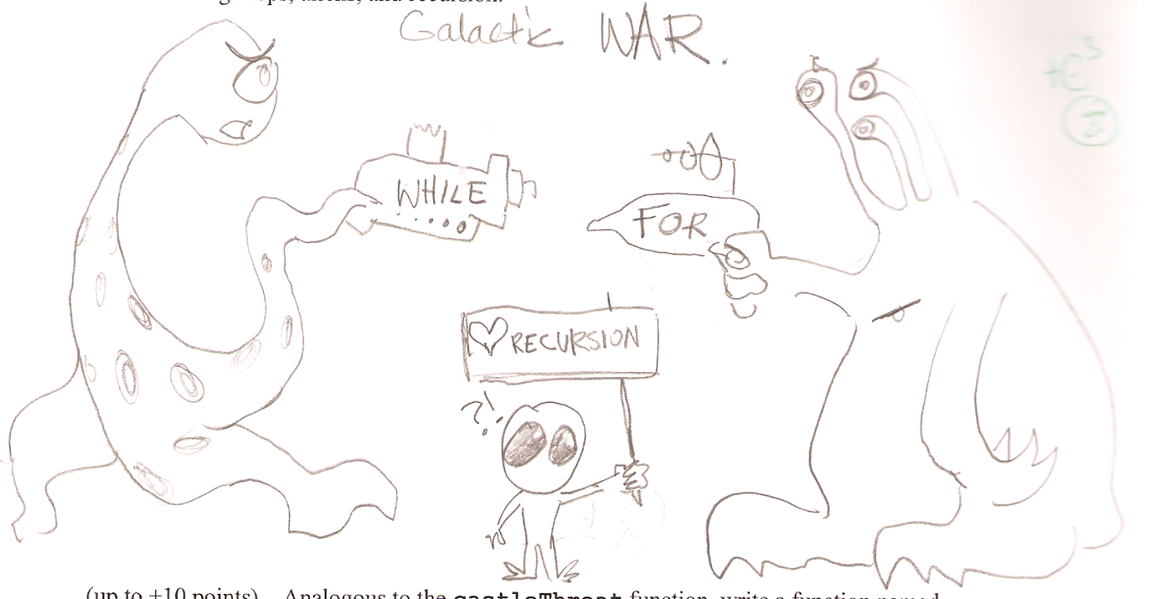
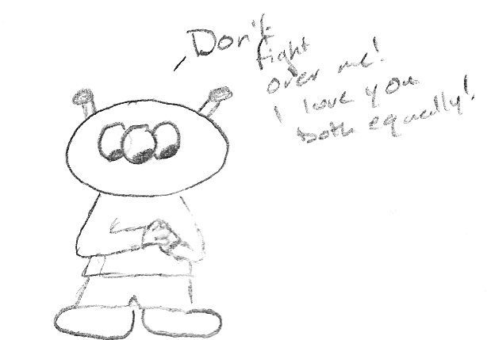
CS 5 today
A whole new class of programming
Choose your side…
Python's Date class
Lab and HW #11
Exam review
Hey! How did you get a body?
Software Engineering
Final projects
TheoComp !
Mon., 11/26
Wed., 12/5
Mon., 12/3
Wed., 11/28
Mon., 12/10

Slide 115
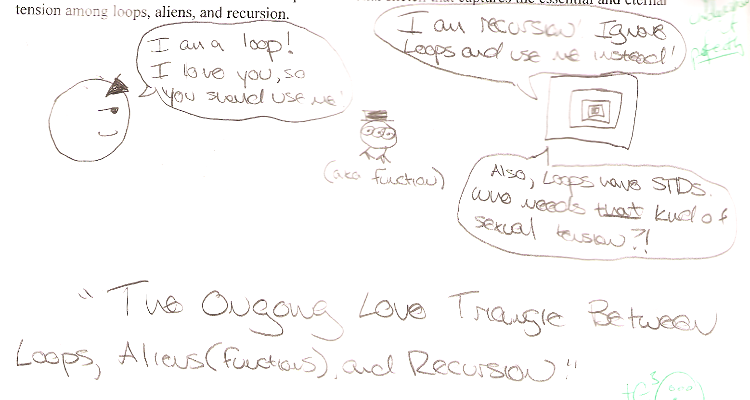
Exam 2

Slide 116
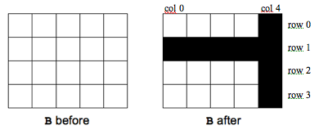
Exam 2
Problem 1b
Problem 2
def zerospan( L, hi, low ):
for i in range(len(L)):
if low <= L[i] <= hi:
L[i] = 0.0
def ROOKnotcastle( B, r, c ):
for row in range(len(B)):
for col in range(len(B[0])):
if row == r or col == c:
B[row][col] = 1
def zerospan( L, hi, low ):
for x in L:
if low <= x <= hi:
x = 0.0
This does not change L!

Slide 117
Sets values between low and hi to 0.0.
def zerospan( L, hi, low ):
for x in L:
if low <= x <= hi:
x = 0.0
CAUTION: This does not change L!

Slide 118
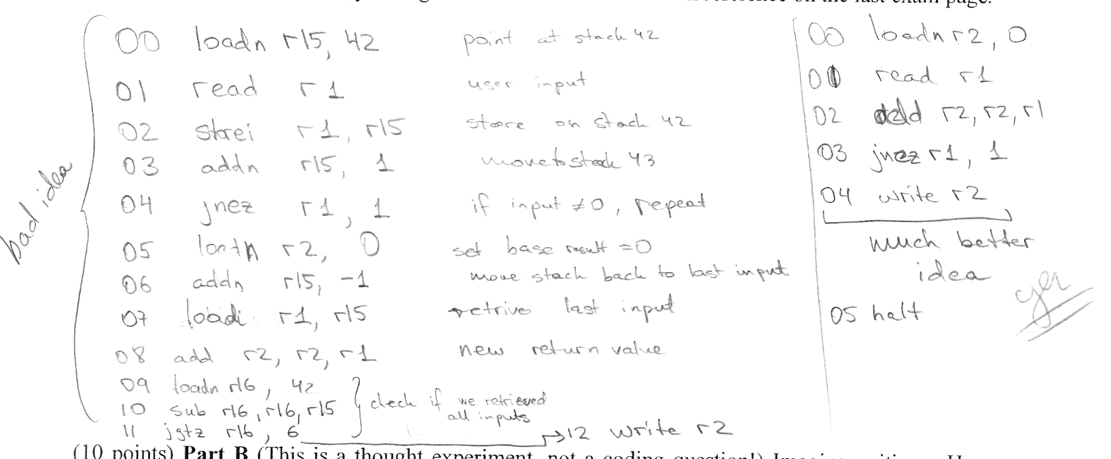
Exam 2
00 read r1 # input to r1
01 add r2 r2 r1 # add into r2
02 jnez r1 00 # if r1 != 0: goto 00
03 write r2 # else: write the sum
Problem 3
adding in place :-)
using the stack -- Aargh!

Slide 119
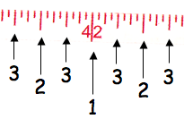
Exam 2
def ruler( n ):
s = ''
for i in range(n,0,-1):
s += str(i) + s
return s
Problem 5
ruler( 1 )
'1'
ruler( 2 )
'212'
ruler( 3 )
'3231323'
ruler( 4 )
'434243414342434'
s
s
i

Slide 120
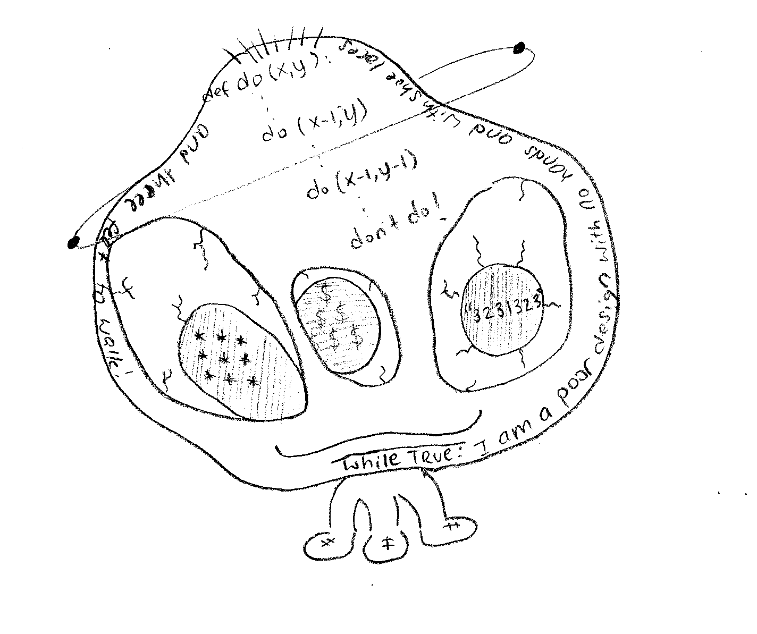
Exam 2

Slide 121
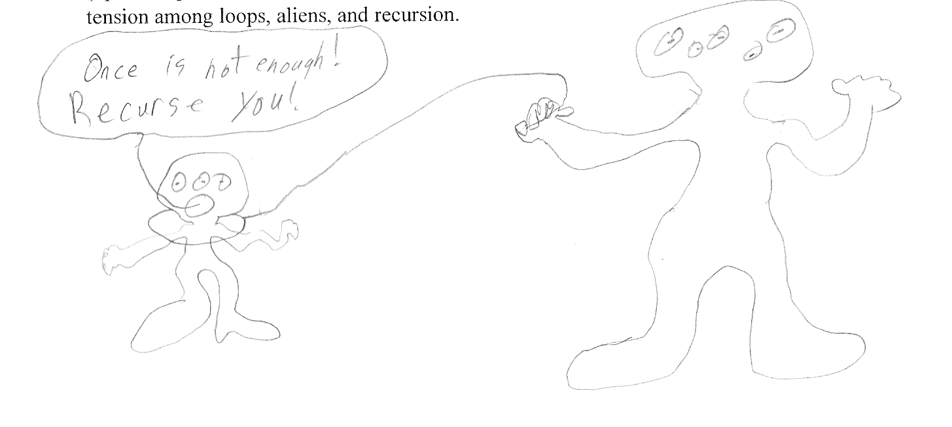
Exam 2

Slide 122
CS 5 today
A whole new class of programming
Choose your side…
Python's Date class
Lab and HW #11
Exam review
Hey! How did you get a body?
Software Engineering
Final projects
TheoComp !
Mon., 11/26
Wed., 12/5
Mon., 12/3
Wed., 11/28
Mon., 12/10

Slide 123
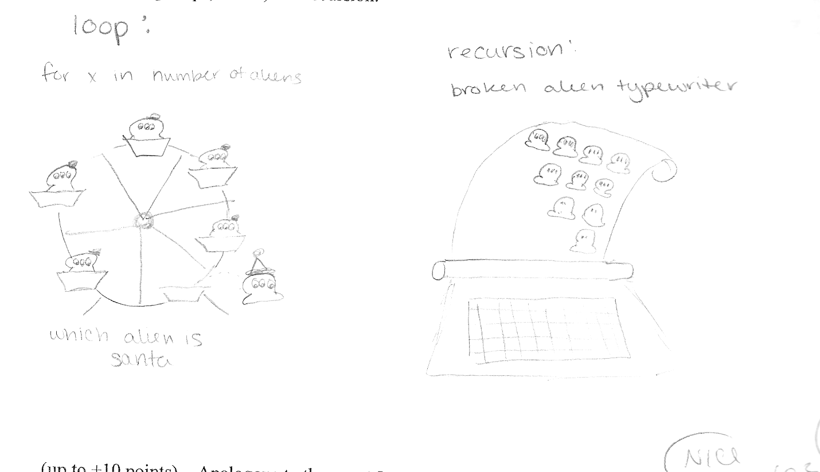
Exam 2

Slide 124
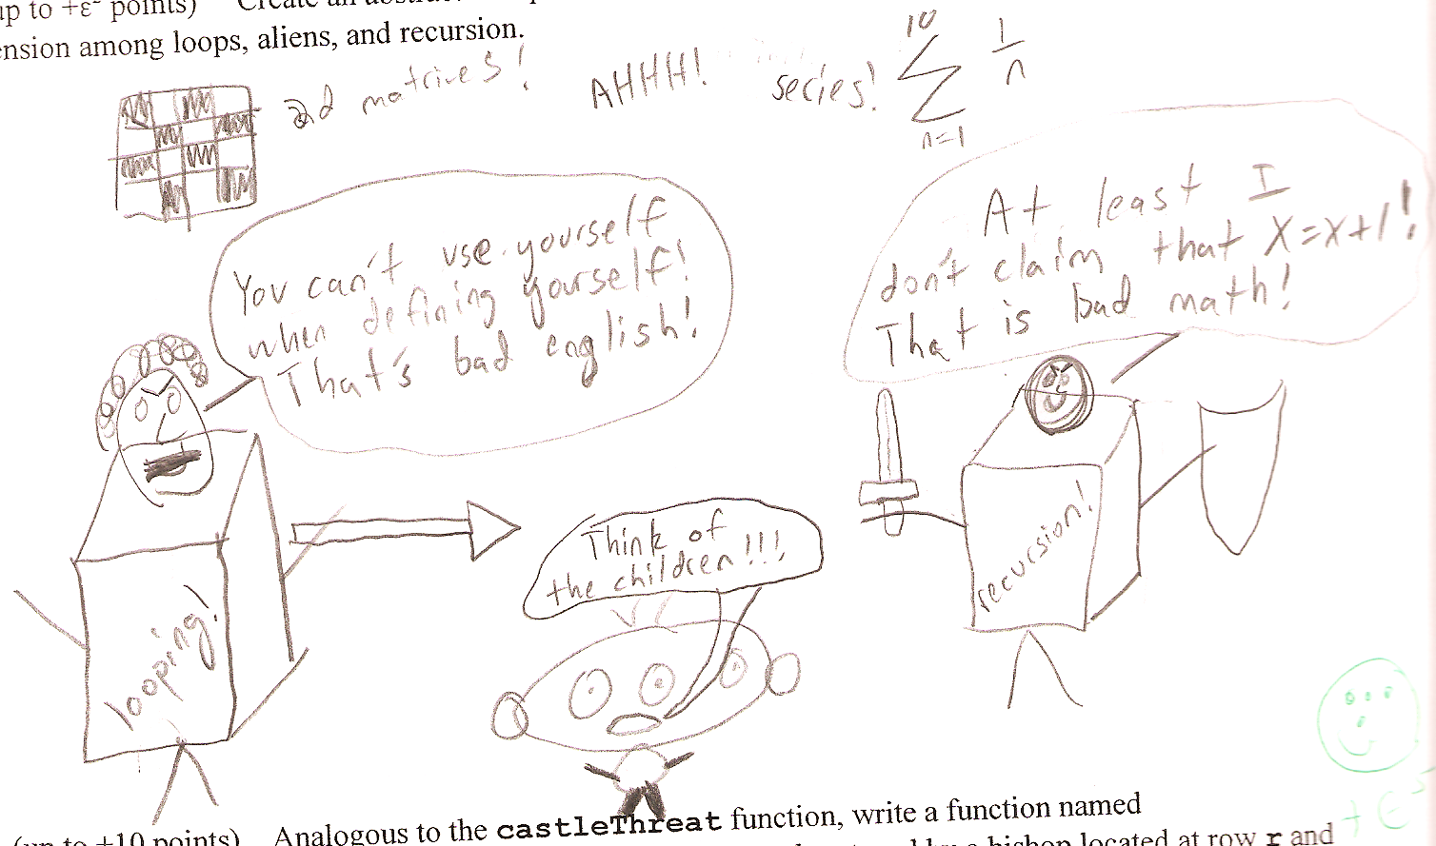
Exam 2

Slide 125
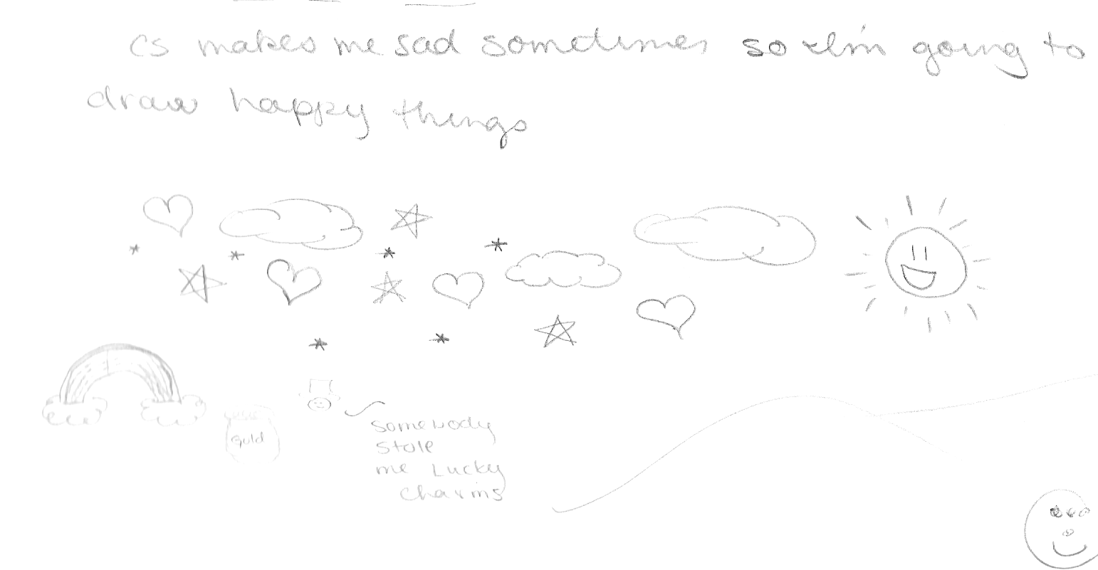
Exam 2

Slide 127
?
Strategic thinking == intelligence
Two-player games have been a key focus of AI as long as computers have been around…
computers
humans
good at looking ahead in the game to find winning combinations of moves
good at evaluating the strength of a board for a player
… humans and computers have different relative strengths in these games.

Slide 128
‘X’
scoresFor each column
‘O’
new‘X’
b
(1) For each possible move
(2) Add it to the board
Col 0
Col 6
Col 1
Col 5
Col 2
Col 3
Col 4

Slide 129
Friday 2-4, LAC
"Intelligent" CS 5 ?
Hw 11 due 11/22
office hours
An object is structured data that is alive, responsible, and intelligent.
Sound too friendly?
This week’s objects and classes will be the opposite ...
| | | | | | | |
| | | | | | | |
| | | | | | | |
| | | |X| | | |
| |X| |X|O| | |
|X|O|O|O|X|O| |
---------------
0 1 2 3 4 5 6
X to move.
Is there a way to win?

Slide 130
Player's methods
Board
Player
__init__( self, width, height )
allowsMove( self, col )
__init__(self, ox, tbt, ply)
addMove( self, col, ox )
__repr__(self)
delMove( self, col )
oppCh(self)
Demos?
__repr__( self )
scoreBoard(self, b)
isFull( self )
scoresFor(self, b)
winsFor( self, ox )
tiebreakMove(self, scores)
hostGame( self )
nextMove(self, b)
set( self, movestring )

Slide 131
Strategic thinking!
Python had no Connect-four datatype…
I feel ahead of the game here...
| | | | | | | |
| | | | | | | |
| | | | | | | |
| | | |X| | | |
| |X| |X|O| | |
|X|O|O|O|X| |O|
---------------
0 1 2 3 4 5 6
… but you've already corrected that!
Now, may the best machine win!

Slide 132
?
Strategic thinking == intelligence
Two-player games have been a key focus of AI as long as computers have been around…
In 1945, Alan Turing predicted that computers would be better chess players than people in ~ 50 years…
and thus would have achieved intelligence.
Alan Turing memorial Manchester, England

Slide 133
?
Strategic thinking == intelligence
Two-player games have been a key focus of AI as long as computers have been around…
computers
humans
good at looking ahead in the game to find winning combinations of moves
good at evaluating the strength of a board for a player
… humans and computers have different relative strengths in these games.

Slide 134
How humans play games…
An experiment (by A. deGroot) was performed in which chess positions were shown to novice and expert players…
- experts could reconstruct these perfectly
- novice players did far worse…
Random chess positions (not legal ones) were then shown to the two groups
- experts and novices did equally
well (badly) at reconstructing them!

Slide 135
Playing Chess like a computer…

Slide 136
The Player class
What data does a computer AI player need?
DATA MEMBERS
'X'
'LEFT'
0
Player
pForX
string
ox
string
tbt
int
ply
Ply?
checker, O or X
tiebreakType
moves to look ahead
surprisingly little!
How about knowledge about its opponent?

Slide 137
Why AI is challenging:
Make no mistake about it: computers process numbers - not symbols.
Computers can only help us to the extent that we can arithmetize an activity.
- paraphrasing Alan Perlis

Slide 138
scoreBoard(self,b)
‘X’
‘O’
Assigns a score to any board, b
A simple system:
100.0
50.0
0.0
for a win
for anything else
for a loss
Score for
Score for
Score for
Score for

Slide 139
scoreBoard
Assigns a score to any board, b
A simple system:
100.0
50.0
0.0
for a win
for anything else
for a loss
Implementation ideas…
scoreBoard(self, b)
How can there be no 'X' or 'O' input?
What methods that already exist will come in handy?
This doesn't seem to be looking very far ahead !
What class is this method in?

Slide 140
Scoring moves, not boards...
scoresFor returns a list of 7 scores!
0-ply
What would the 0-ply scores be for each column (move)
scores
The "Zen" approach
The Player object's ply tells how far ahead to look.
to go
0 ply!
We will use -1 as the score for a full column.
o0.scoreBoard( b42 )
o0.scoresFor( b42 )

Slide 141
scoresFor at 1 ply
1-ply
What would the 1-ply scores be for each column (move)
scores
The "Zen" approach
A 1-ply lookahead player will "see" an impending victory.
to go
I try 1 ply!
o1.scoresFor( b42 )

Slide 142
Two moves ahead… ?
0-ply
-1
50
50
50
50
50
50
A 2-ply lookahead player can also "see" an opponent's impending victory.
scores
's
turn
1-ply
scores
2-ply
What about 3-ply?
scores
Try it!

Slide 143
scoreBoard vs. scoresFor
scoreBoard looks ahead 0 moves
The "Zen" approach -- we are excellent at this!
0-ply
only
scoresFor( self, b ) returns a LIST of scores, one for each column you might choose to move next…
0-ply
1-ply
2-ply
…

Slide 144
"Quiz"
b
'X'
Fill in the score for a move to each column.
'O'
you - or self - is playing 'O'
The same move is evaluated at each ply... it's just evaluated farther into the future!
col 0
col 1
col 2
col 3
col 4
col 5
col 6
0-ply scores for 'O':
Looks 0 moves into the future
col 0
col 1
col 2
col 3
col 4
col 5
col 6
1-ply scores for 'O':
Looks 1 move into the future
col 0
col 1
col 2
col 3
col 4
col 5
col 6
2-ply scores for 'O':
Looks 2 moves into the future
col 0
col 1
col 2
col 3
col 4
col 5
col 6
3-ply scores for 'O':
Looks 3 moves into the future

Slide 145
Example 1-ply and 2-ply lookahead scores
It is O’s move. What scores does a 1-ply lookahead for O assign to each move?
|O| | | | | | |
|X| | | |O| |X|
|O| | | |X|O|X|
|X| | | |O|O|X|
|X| |X| |X|O|O|
|X| |O|O|O|X|X|
---------------
0 1 2 3 4 5 6
col 0
col 1
col 2
col 3
col 4
col 5
col 6
Which change at 2-ply?
| | | | | | |O|
| | | | | | |O|
| | | | | | |X|
|X| |X|O| | |O|
|X|O|O|X| |X|X|
|X|O|O|O| |O|X|
---------------
0 1 2 3 4 5 6
It is X’s move. What scores does a 2-ply lookahead for X assign to each move?
col 0
col 1
col 2
col 3
col 4
col 5
col 6
Which change at 3-ply?

Slide 146
Answers to example lookahead scores
It is O’s move. What scores does a 1-ply lookahead for O assign to each move?
|O| | | | | | |
|X| | | |O| |X|
|O| | | |X|O|X|
|X| | | |O|O|X|
|X| |X| |X|O|O|
|X| |O|O|O|X|X|
---------------
0 1 2 3 4 5 6
col 0
col 1
col 2
col 3
col 4
col 5
col 6
-1
100
50
100
50
100
50
Which change at 2-ply?
0
0
| | | | | | |O|
| | | | | | |O|
| | | | | | |X|
|X| |X|O| | |O|
|X|O|O|X| |X|X|
|X|O|O|O| |O|X|
---------------
0 1 2 3 4 5 6
It is X’s move. What scores does a 2-ply lookahead for X assign to each move?
be careful!
col 0
col 1
col 2
col 3
col 4
col 5
col 6
100
0
0
0
50
0
-1
0
Which change at 3-ply?

Slide 147
Looking further ahead …
0 ply:
Zen choice of move: here and now
1 ply:
2 ply:
3 ply:
X’s move
X’s move
X‘s move
| | | | | | | |
| | | | | | | |
| | | | | | | |
| | | | | | | |
| |O|X| | | | |
|O|X|X|X| |O|O|
---------------
0 1 2 3 4 5 6
| | | | | | | |
| | | | | | | |
|O| | | | | | |
|X| | | | | | |
|X|O|O| | |X| |
|O|X|X|O|X|O| |
---------------
0 1 2 3 4 5 6
| | | | | | | |
| | | | | | | |
| | | | |X| | |
| | | | |O|O| |
| |X|X| |X|O| |
|O|X|O| |O|X| |
---------------
0 1 2 3 4 5 6
(1) Player will win
(2) Player will avoid losing
(3) Player will set up a win by forcing the opponent to avoid losing

Slide 148
scoresFor's idea
(self) 'X'
(0) Suppose you're playing at 3 ply...
(1) For each of your possible moves
(2) Add it to the board
(3) Ask OPPONENT its scoresFor each board!
At what ply?
new 'X'
b
'O'
What score will the opponent give each?
[ 0, 0, 0, 0, 0, 0, 0 ]
[50,50,50,50,50,100,50]
Col 0
Col 6
Col 1
Col 5
Col 2
Col 3
Col 4
[50,50,50,50,50,100,50]
[50,50,50,50,50,50,50]
[ 0, 0, 0, 0, 0, 0, 0 ]
[ 0, 0, 0, 0, 0, 0, 0 ]
[ 0, 0, 0, 0, 0, 0, 0 ]
these are all of the opponent's calls to scoresFor !

Slide 149
scoresFor's idea
(self) 'X'
(0) Suppose you're playing at 3 ply...
(1) For each of your possible moves
(2) Add it to the board
(3) Ask OPPONENT its scoresFor each board!
At what ply?
new 'X'
b
'O'
What score will the opponent give each?
What score does self give each?
[ 0, 0, 0, 0, 0, 0, 0 ]
[50,50,50,50,50,100,50]
max(S) = 0
Col 0
Col 6
max(S) = 100
100
0
Col 1
Col 5
Col 2
max(S) = 100
Col 3
Col 4
max(S) = 0
max(S) = 50
0
max(S) = 0
max(S) = 0
50
100
100
100
[50,50,50,50,50,100,50]
[50,50,50,50,50,50,50]
[ 0, 0, 0, 0, 0, 0, 0 ]
[ 0, 0, 0, 0, 0, 0, 0 ]
[ 0, 0, 0, 0, 0, 0, 0 ]
these are all of the opponent's calls to scoresFor !

Slide 150
(0) Start all scores at 50.
(1) For each possible move
(2) If needed +possible, add the move to the board b
(3) Ask an OPPONENT its scoresFor at ply-1 (!)
(4) compute self's score
def scoresFor(self, b):
""" MUST return a list of 7 scores!!
"""
scores = [50,50,50,50,50,50,50]
for col in range( 0, 7 ):

Slide 151
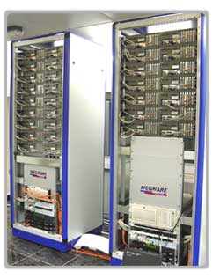
Game Difficulty == Branching Factor
On average, Connect 4 players have seven choices per move.
Chess players have more, perhaps around 40, possible choices in a given move.
0 Ply
1 Ply
2 Ply
Branching Factor Estimates
for different two-player games
Tic-tac-toe 4
Connect Four 7
Checkers 10
Othello 30
Chess 40
Go ?
Hydra looks
ahead 18 ply...
Hydra at home in the UAE…

Slide 152
Games’ Branching Factors
On average, Connect 4 players have seven choices per move.
Chess players have more, perhaps around 40, possible choices in a given move.
0 Ply
1 Ply
2 Ply
Branching Factor Estimates
for different two-player games
Tic-tac-toe 4
Connect Four 7
Checkers 10
Othello 30
Chess 40
Go ?
Boundaries for qualitatively different games…

Slide 153
Connect 4 was solved in 1988.

Slide 154
Checkers was solved in 2007.

Slide 155
Suppose
def tiebreakMove(self, S):
if self.tbt == 'LEFT':
S = [-1,0,50,50,0,0,50]
col
0
1
2
3
4
5
6
Write tiebreakMove to return the leftmost best score inside the list scores
How would 'RANDOM' and 'RIGHT' work differently?

Slide 156
Extra this week
scoreBoard4Tourney and a CS 5 C4 round-robin
Using more scores than 0, 50, and 100 !
don't give this board a 50.0 !
Good luck – against your own program!
http://www.stanford.edu/~ccecka/research/C4.html

