Slide 1
Dec. in CS 5
(0,0,0)
(110,102,0)
(220,205,0)
Mon., 12/9 – Milestone due
final project
Fri., 12/13 5pm – Final proj. due
final exam
Sun., 12/15 7 pm – review
Mon., 12/16 2 pm – final #1
Wed., 12/18 2 pm – final #2
hw11pr3.py due Tuesday, 11/26
hw11pr1-2.py (VPython) due Monday, 12/9

Slide 2
Homework 11
(1) VPython lab: 3d game
Due: Mon. 12/9
(2) VPython lab: 3d model
There are older version of VPython that will run on Mac OS 10.6.x. I haven't yet found a machine to try them out…
(3) Connect Four AI
Due: Tue. 11/26

Slide 3
def scoresFor(self, b):
(0) Start all scores at 50.
(1) For each col to move:
(2a) If not possible…
(2b) If game already over…
(2c) Else add the move to b
(3) Ask an opponent (!!!) for its scoresFor at ply-1
(4) compute self's score
""" MUST return a list of 7 scores!! """
scores = [50,50,50,50,50,50,50]
for col in range( 7 ):
if
elif
Base cases…
elif
elif
else:
drop a checker
opp = Player( self.oppCh(),
self.tbt,
self.ply-1 )
s = opp.scoresFor(b)
compute scores[col] and delete that checker!
return scores

Slide 4
Suppose
def tiebreakMove(self, sc):
sc = [-1, 0, 50, 50, 50, 0, 0]
col
0
1
2
3
4
5
6
How do we get a list L of the max-score cols?
We'd postponed this…

Slide 5
Suppose
def tiebreakMove(self, sc):
m = max(sc)
L = []
for col in range(7):
if _________ == m:
L += _______
if self.tbt == 'RIGHT':
sc = [-1, 0, 50, 50, 50, 0, 0]
col
0
1
2
3
4
5
6
How do we get a list L of the max-score cols?
How do 'RIGHT', 'RANDOM', and 'LEFT' then work?

Slide 6
On the subject of tiebreaking…
scoreBoard would give each of these 50.0
but which board is really better for black?
Ex. Cr.: write a scoreBoard4Tourney f'n.
example from 2012 tourney…

Slide 7
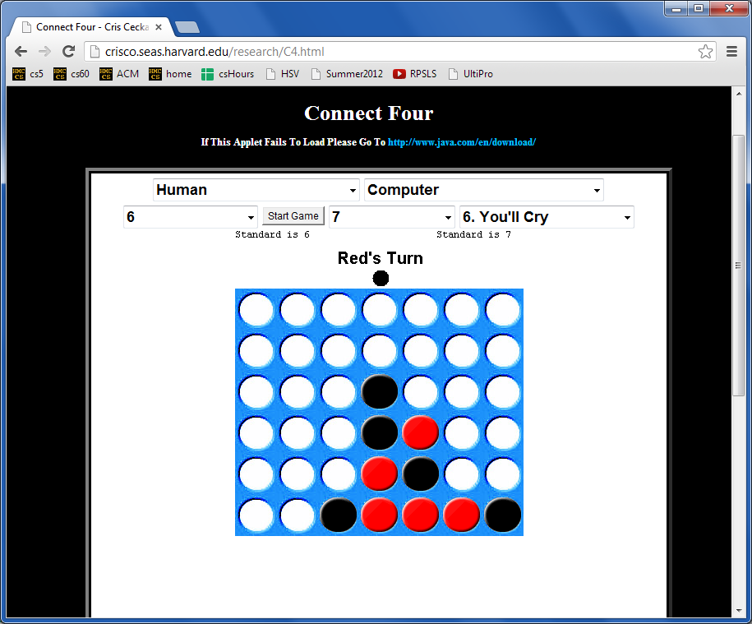
More Connect Four?
Looking for a game… ?
crisco.seas.harvard.edu/research/
Anyone defeated by their own program yet?

Slide 8
After Deep Blue…

Slide 9
In reality?
Humans adapt!
Xiaoyu Y.'s C4 game…

Slide 10
Tis the season for final projects…
Today is about the CS 5 final projects
+ it's a sales pitch for the three possible options:
vPool
TextID
Picobot
I've got my eyes on some of these projects!
Eye'll bet !

Slide 11
Final projects
open-ended
comprehensive
Final CS assignment
same projects for black/gold
three choices…
Working solo or in a pair is OK
Eye, eye!
Pairs need to work together - in the same place - and they need to share the work equally...
Black/gold pairs are welcome and encouraged...

Slide 12
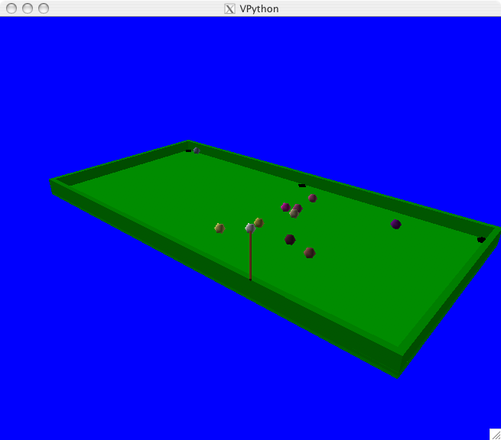
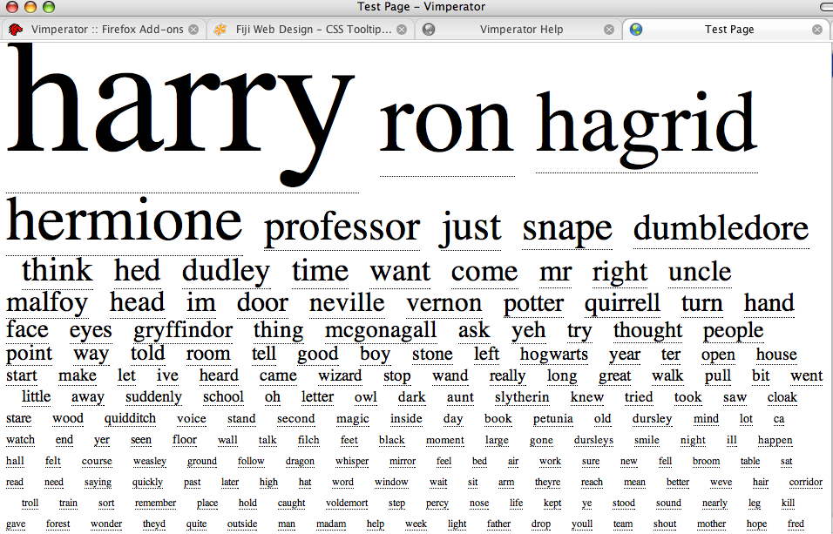
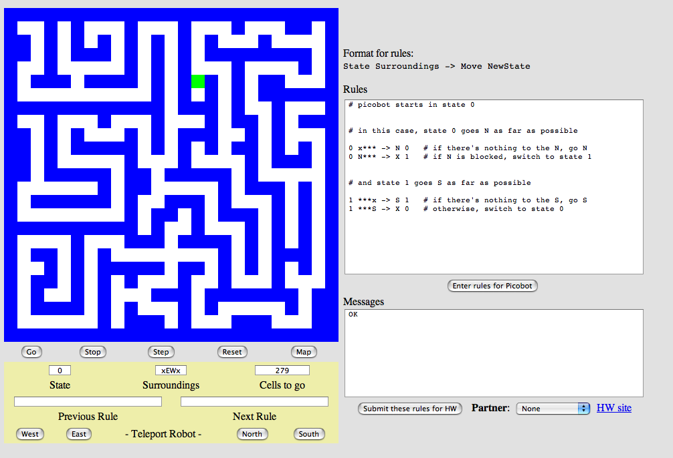
Project options…
VPool
…VPython
TextID
…Markov
Picobot!
…CFour

Slide 13
The Picobot project
Big ideas:
(1) Implement Picobot in Python
(2) Train Python to write successful Picobot programs!
talk about going full circle...

Slide 14
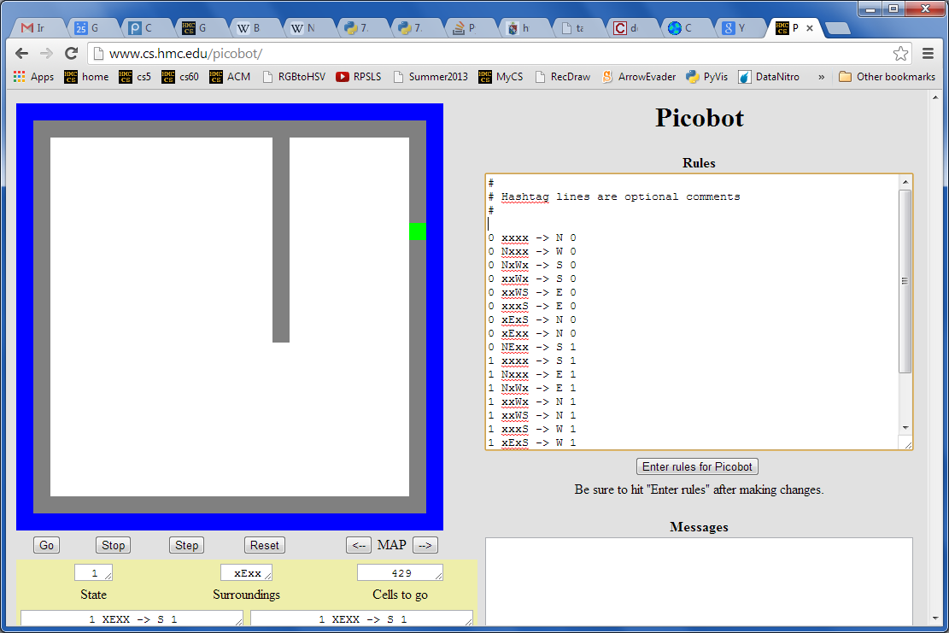
Picobot returns!
What data structures (classes) might be helpful in implementing Picobot?

Slide 15
Picobot's classes
0 xxxx -> N 0
0 Nxxx -> W 0
0 NxWx -> S 0
0 xxWx -> S 0
0 xxWS -> E 0
0 xxxS -> E 0
0 xExS -> N 0
0 xExx -> N 0
0 NExx -> S 1
1 xxxx -> S 1
1 Nxxx -> E 1
1 NxWx -> E 1
1 xxWx -> N 1
1 xxWS -> N 1
1 xxxS -> W 1
1 xExS -> W 1
1 xExx -> S 1
1 NExx -> W 0
class Program:
What in Python could most usefully hold all of these rules?
What type should self.rules be?

Slide 16
Picobot's classes
0 xxxx -> N 0
0 Nxxx -> W 0
0 NxWx -> S 0
0 xxWx -> S 0
0 xxWS -> E 0
0 xxxS -> E 0
0 xExS -> N 0
0 xExx -> N 0
0 NExx -> S 1
1 xxxx -> S 1
1 Nxxx -> E 1
1 NxWx -> E 1
1 xxWx -> N 1
1 xxWS -> N 1
1 xxxS -> W 1
1 xExS -> W 1
1 xExx -> S 1
1 NExx -> W 0
class Program:
What in Python could most usefully hold all of these rules?
What type should self.rules be?
Python dictionary
key
value
self.rules[ (1,"NExx") ] = ("W",0)

Slide 17
Picobot's classes
+++++++++++++++++++++++++
+oooooPooooooooooooooooo+
+o o o+
+o o o+
+o o o+
+o o o+
+o o o+
+o o o+
+o o o+
+o o o+
+o o+
+o o+
+o o+
+o o+
+o o+
+o o+
+o o+
+o o+
+o o+
+o o+
+o o+
+o o+
+o o+
+ooooooooooooooooooooooo+
+++++++++++++++++++++++++
class World:
What in Python could most usefully hold the environment?
What type should self.room be?
Wall:
+
o
Visited:
Picobot:
P

Slide 18
Picobot's classes
+++++++++++++++++++++++++
+oooooPooooooooooooooooo+
+o o o+
+o o o+
+o o o+
+o o o+
+o o o+
+o o o+
+o o o+
+o o o+
+o o+
+o o+
+o o+
+o o+
+o o+
+o o+
+o o+
+o o+
+o o+
+o o+
+o o+
+o o+
+o o+
+ooooooooooooooooooooooo+
+++++++++++++++++++++++++
class World:
What in Python could most usefully hold the environment?
What type should self.room be?
Wall:
+
o
Visited:
The same as your Connect-Four board's self.data!
Picobot:
P

Slide 19
The Picobot project
Current State: 1
Current Rule: 1 N*W* -> X 2
++++++++++
+o++o+o+++
+oooooo ++
++++o++ +
+oooo+++++
++++o +
+oooo+++ +
++++o+++++
+Pooo +
++++++++++
Picobot started here…
First build an ASCII simulation
and is now here…

Slide 20
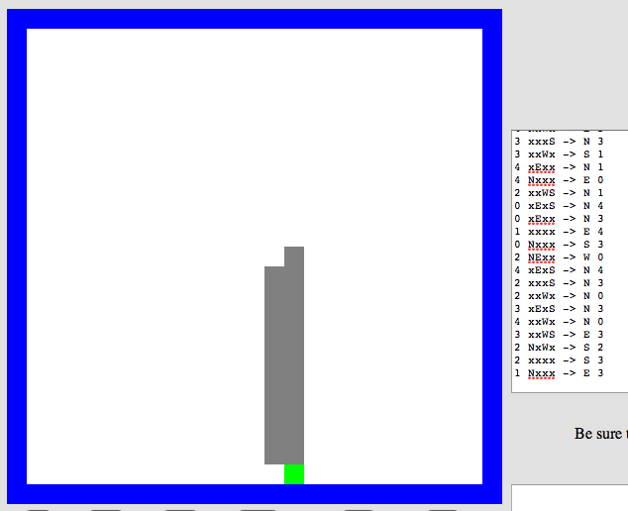
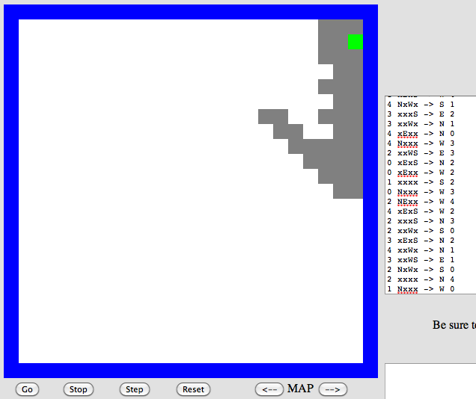
Program evolution
An example of genetic algorithms, used for optimizing hard-to-describe functions.
program p1
program p2
Start with a population of, say, ~200 random Picobot programs…

Slide 21
Program evolution
An example of genetic algorithms, used for optimizing hard-to-describe functions.
program p1
fitness = 0.03
program p2
fitness = 0.05
Then, evaluate the fitness of all of those programs
Evaluate? How??

Slide 22
program p1
fitness = 0.03
program p2
fitness = 0.05
mate + mutate the fittest rulesets
to create a new generation of ~200 programs…
program c1
fitness = 0.19

Slide 23
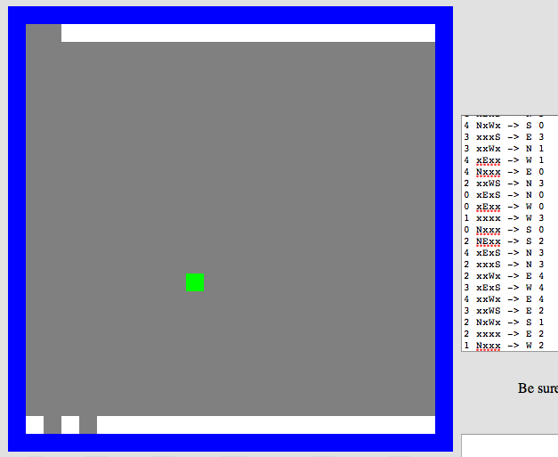
Repeat this "survival of the fittest" process for many generations…
… and by the end, your Python code should have evolved a much more capable Picobot program!
fitness = 0.90

Slide 24
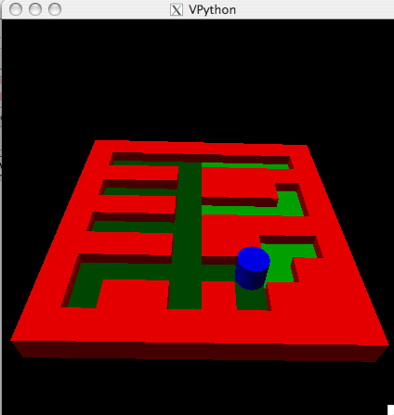
Extra: Picobot graphics…
Choice of graphical packages
2d: graphics.py from C4
3d: VPython
Mine's going to be in 5d!
3d version…
2d version…
Hey! Picobot's in 3d…

Slide 25
Project options...
VPool
TextID
Picobot!

Slide 26
the TextID project
Though Robin Ellacott’s twenty-five years of life had seen their moments of drama and incident, she had never before woken up in the certain knowledge that she would remember the coming day for as long as she lived.
First paragraph of The Cuckoo's Calling by R. Galbraith

Slide 27
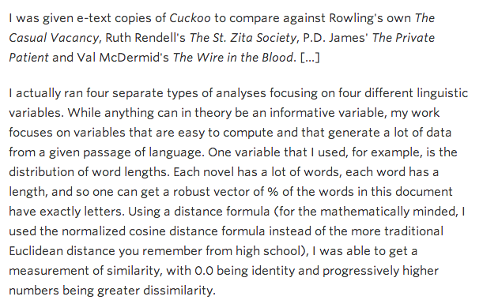
kottke.org/13/08/how-jk-rowling-was-found-to-be-robert-galbraith

Slide 28
the TextID project
Big ideas:
(1) Build lexical models of bodies of text…
(2) Create a similarity score that defines Rowlingness
vs.
Shakepearity
NYTimes-iness
vs.
WSJournalicity
Big Bang Theory?
vs.
Arrested Development
your own choice of two comparisons…

Slide 29
TextID model
class TextModel
WS: { "love": 50, "spell": 8, … }
word-frequencies
JKR: { "love": 11, "spell": 277, … }
stem-frequencies
WS: { "lov": 612, "spell": 9, … }
JKR: { "lov": 98, "spell": 306, … }
word-length-freq.'s /
WS: { 4: 7042, 5: 6203, … }
sentence-length-freq.'s
JKR: { 4: 980, 5: 42005, … }
all will be Python dictionaries…

Slide 30
Processing steps: one idea
This looks familiar...
Split the text into words…
Clean the words …
Remove all non-alphabetic characters
Find sentence lengths using punctuation
Create dictionaries of the words and their lengths
Stem the words
Create a dictionary of word stems
You're ready to match against another model!

Slide 31
Stemming
stem( "party" )
"parti"
stem( "parties" )
"parti"
An algorithm that outputs the root of the input word.
Or tries to output the root!
stem( "love" )
"lov"
stem( "loving" )
"lov"
these don't have to be words, just stems…

Slide 32
Stemming
getting to the root of the problem…
Name(s): ____________________
def stem( w ):
if w[-3:] == 'ies':
return w[:-2]
This works for
parties -> parti
it fails for
elif w[-3:] == 'ing' and \
w[-4:-3] == w[-5:-4]:
return w[:-4]
What's this doing?
What's an example where it works?
What's an example where it fails?
elif
Write a rule to handle plurals ...
(1) What is a case where it will fail?
(2) How could you fix that case?
elif
Choose any other stemming rule and implement it here!

Slide 33
Model matching
Suppose we have two dictionaries:
WS: { "love": 50,
"spell": 8,
"thou": 42 }
JKR: { "love": 25,
"spell": 275,
"potter": 700 }
"potter" is not here.
"thou" is not here.

Slide 34
Model matching
Suppose we have two dictionaries:
WS: { "love": 50,
"spell": 8,
"thou": 42 }
JKR: { "love": 25,
"spell": 275,
"potter": 700 }
"potter" is not here.
"thou" is not here.
New: { "love": 3, "thou": 1,
"potter": 2, "spam": 4 }
How could we give a match score for this New dictionary against each one above?

Slide 35
Naïve Bayes classification
multiply each word's probability as if they were all independent
WS: { "love": 50,
"spell": 8,
"thou": 42 }
JKR: { "love": 25,
"spell": 275,
"potter": 700 }
"potter" is not here.
"thou" is not here.
score vs. WS
score vs. JKR
50
50
50
42
0
25
25
25
0
700
100
100
100
100
100
1000
1000
1000
1000
1000
love
love
love
thou
potter
love
love
love
thou
potter
score = 0
score = 0
New: { "love": 3, "thou": 1,
"potter": 2, "spam": 4 }
problems?
solutions?

Slide 36
Naïve Bayes classification
multiply each word's probability as if they were all independent
WS: { "love": 50,
"spell": 8,
"thou": 42 }
JKR: { "love": 25,
"spell": 275,
"potter": 700 }
"potter" is not here.
"thou" is not here.
Ignore zeros!
score vs. WS
score vs. JKR
50
50
50
42
0
25
25
25
0
700
100
100
100
100
100
1000
1000
1000
1000
1000
love
love
love
thou
potter
love
love
love
thou
potter
score = 0.0525
score = 0.000011
New: { "love": 3, "thou": 1,
"potter": 2, "spam": 4 }
problems?
solutions?

Slide 37
Naïve Bayes classification
multiply each word's probability as if they were all independent
fix example to handle words that appear in one but not the other – give some low (non-zero) probability, e.g., the min frequency across all words in that model or all models (or just some small number)
WS: { "love": 50,
"spell": 8,
"thou": 42 }
JKR: { "love": 25,
"spell": 275,
"potter": 700 }
"potter" is not here.
"thou" is not here.
Ignore zeros!
score vs. WS
score vs. JKR
50
50
50
42
0
25
25
25
0
700
100
100
100
100
100
Use log!
1000
1000
1000
1000
1000
love
love
love
thou
potter
love
love
love
thou
potter
score = -1.27
score = -4.96
New: { "love": 3, "thou": 1,
"potter": 2, "spam": 4 }
problems?
solutions?

Slide 38
Naïve Bayes classification
done!

Slide 39
Naïve Bayes classification
Don't take these formulas too seriously…
done!

Slide 40
Extra: Text Clouds
text cloud
Summary of the words in a body of text, sized according to their frequency.
this doesn't look nearly colorful enough…
demos… ?

Slide 41
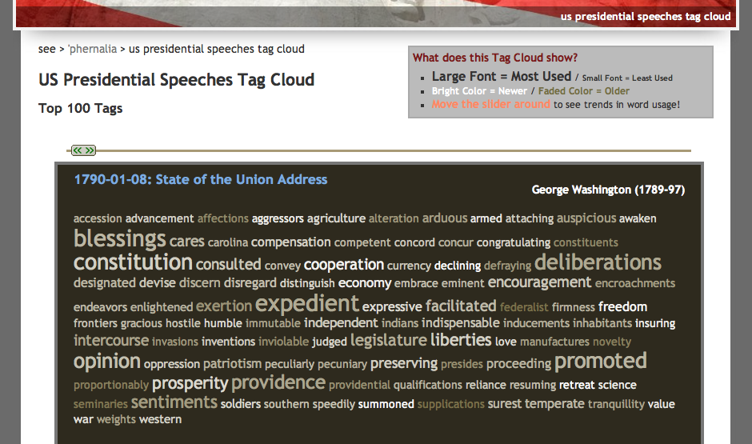
Text-cloud history
http://chir.ag/phernalia/preztags/

Slide 42
Project options...
VPool
TextID
Picobot!

Slide 43
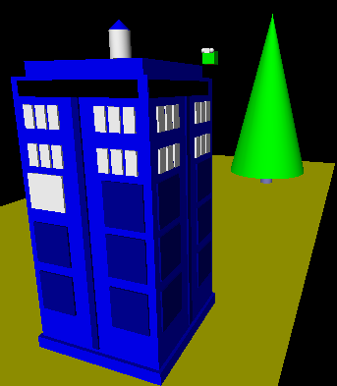
vPool
3d graphics-based game using VPython
I'll take your cue...
Let's play!
not really very constrained at all!
A few constraints
physically interacting "pool balls"
must detect some collisions and model their results on the motion
allow the user to direct 1+ objects
needs a game goal + be winnable!

Slide 44
The vPool project
VPython was designed to make 3d physics simulations simpler to program
Funky Physics is OK… !
Collisions with walls should be handled...
Collisions with other pool balls should be handled...
You need pockets – or some other game objective
A few examples to get you thinking…
So far, VPython has eventually worked for everyone...

Slide 45
Collisions and velocities
+z
x = 10
ball.vel = vector(1,0,1)
while True:
ball.pos += dt*ball.vel
if ball.pos.x > 10:
ball.vel.x
ball.pos.x
At least some of the game is about detecting collisions and changing velocities
+x
What's the black line doing?
How to bounce?
What else to do?

Slide 46
"Spherical" collisions
Zeroth approximation:
Stop q.
Make r.vel = q.vel.
r
q
q.vel

Slide 47
"Spherical" collisions
Zeroth approximation:
Stop q.
Make r.vel = q.vel.
d
r
First approximation:
q
Stop q.
Compute d = r.pos – q.pos
Make r.vel = d
q.vel

Slide 48
"Spherical" collisions
Zeroth approximation:
Stop q.
Make r.vel = q.vel.
d⊥
d
r
First approximation:
q
Stop q.
Compute d = r.pos – q.pos
Make r.vel = d
q.vel
Second approximation:
Same as first, but
Make q.vel = d ⊥ , at 90° from d

Slide 49
vPool – physics?
http://en.wikipedia.org/wiki/Elastic_collision

Slide 50
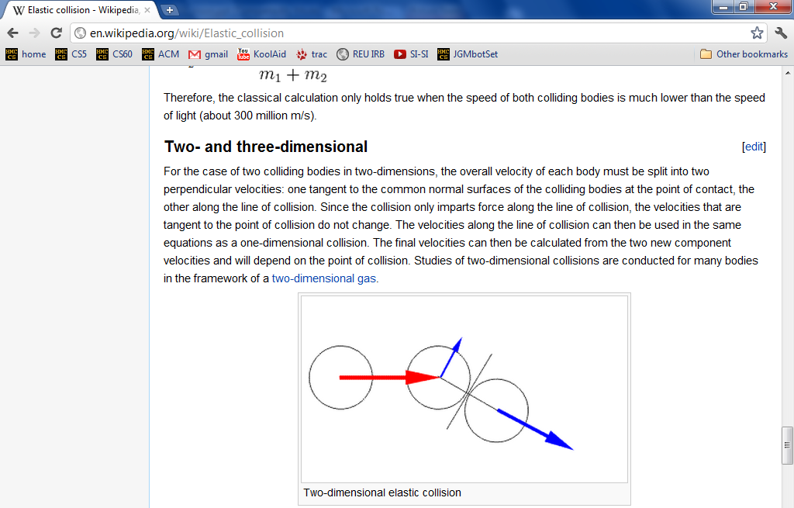
vPool – physics?
http://en.wikipedia.org/wiki/Elastic_collision
equations below...

Slide 51
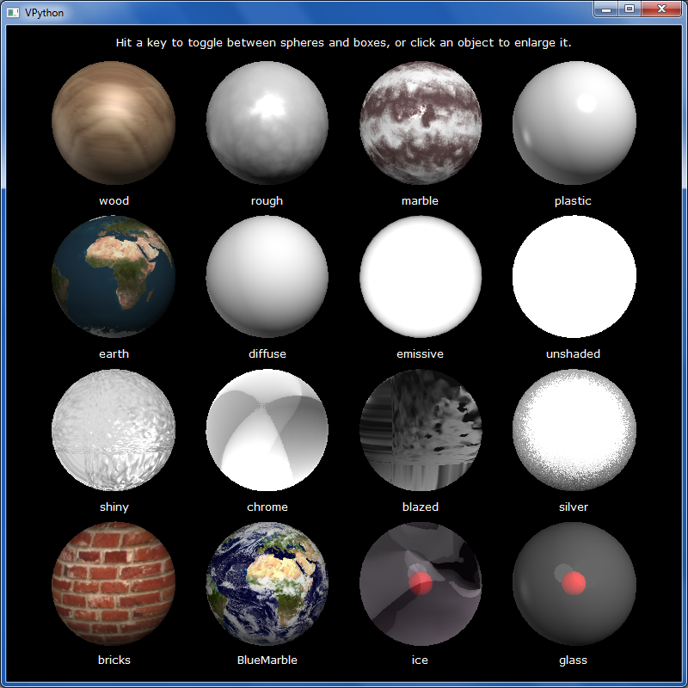
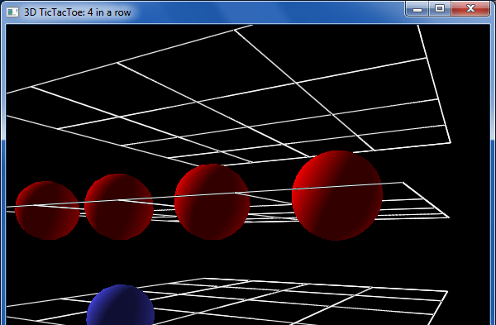
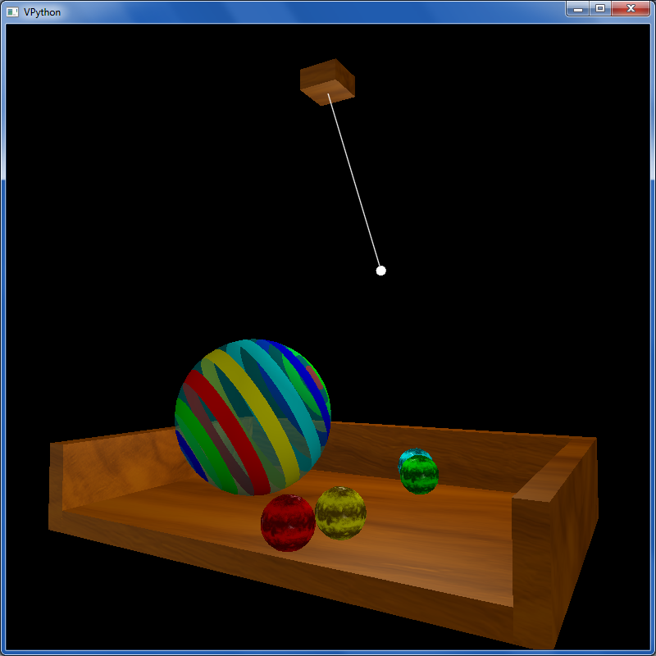
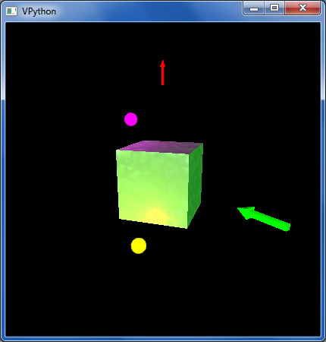
other VPython examples
tictac.py – a 3d game of tic-tac-toe
material_test.py – lots of materials
texture_and_lighting.py – fancier textures, opacity and a pendulum example
boxlighttest.py – very short + simple rotation and lighting example

Slide 52
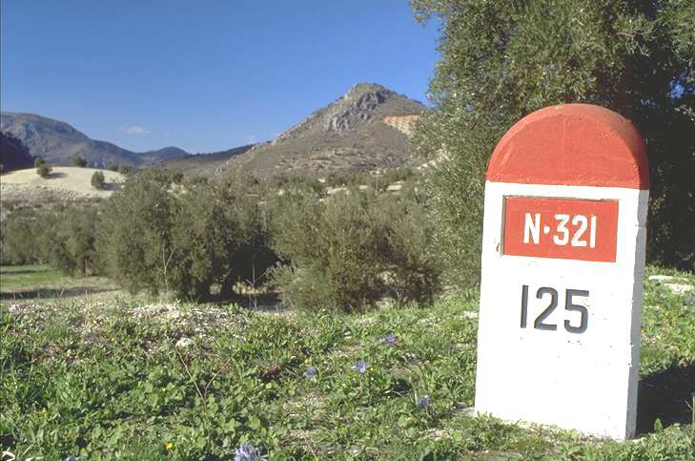
What's due?
Mon. 12/9
Fri. 12/13
The "milestone"
The "final"
project-specific progress ~ really to ensure everyone's gotten started!
A zip file with everything to run your final project + a .txt file describing how!
It’s actually a kilometer stone.
Nice milestone!

Slide 53
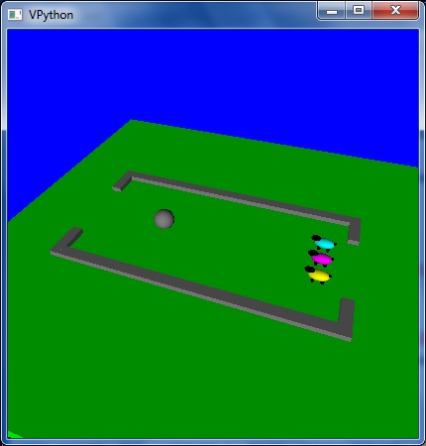
Enjoy the projects!
An unusual variation on VPool
… the graders certainly do!

Slide 54
Enjoy the projects!
An unusual variation on VPool
Have a relaxing long weekend!
… the graders certainly do!

Slide 55
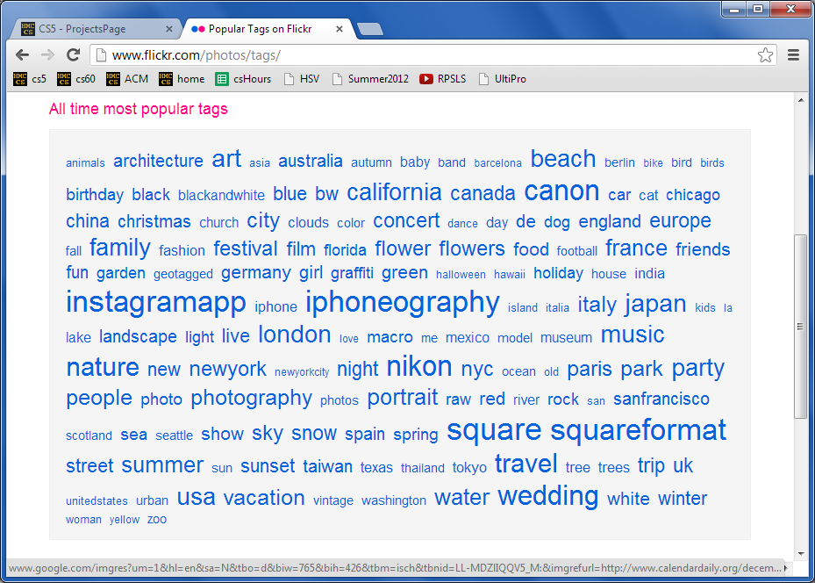
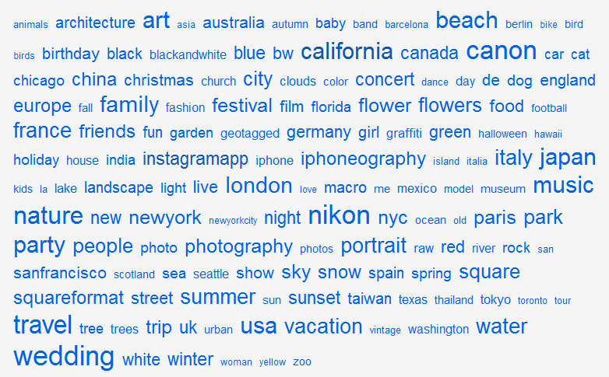
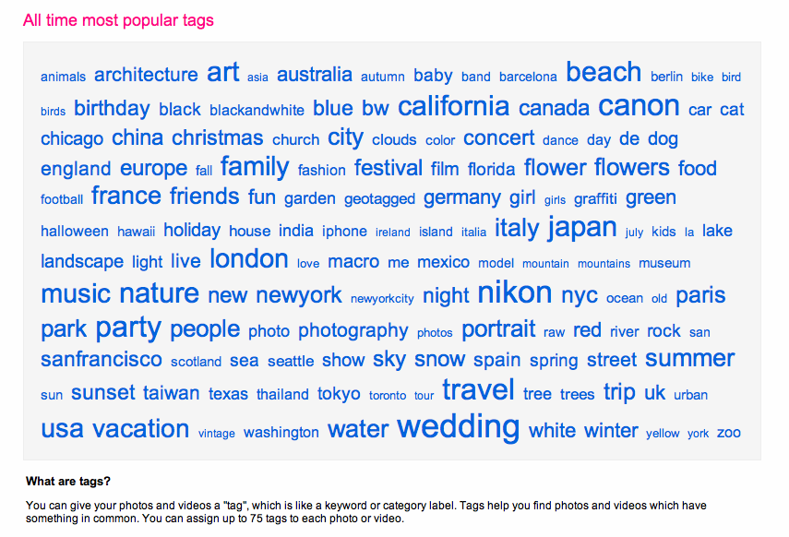
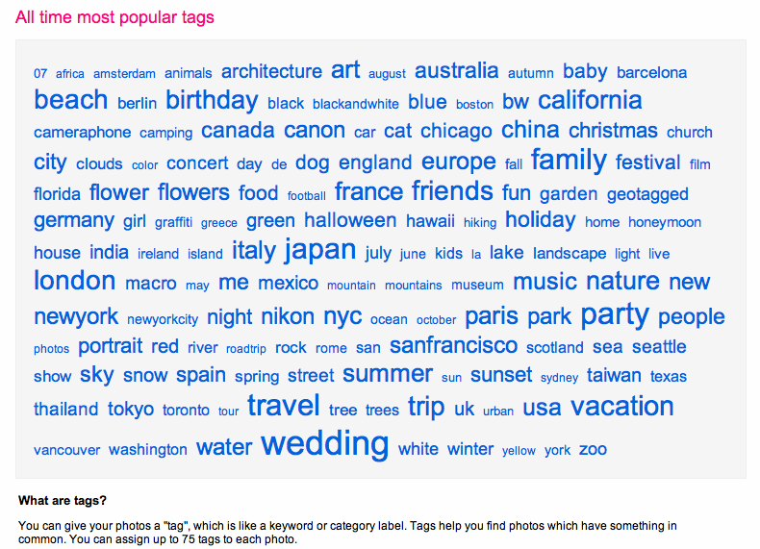
TextID project
2012
tag cloud
merges?

Slide 56
Text Clouds project
text cloud
this doesn't look nearly colorful enough…
Summary of the words in a body of text, sized according to their frequency.

Slide 57
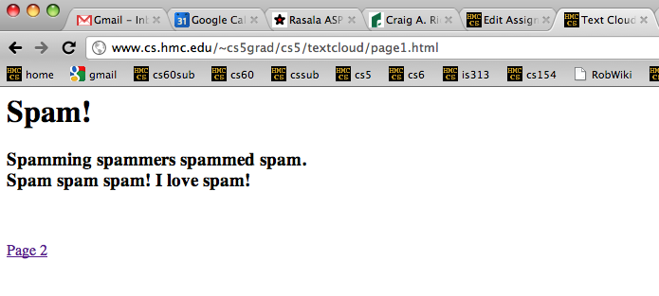
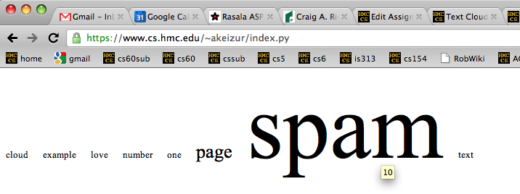
Text Clouds project
Input
http://www.cs.hmc.edu/~cs5grad/cs5/textcloud/page1.html
http://www.cs.hmc.edu/~cs5grad/cs5/textcloud/textcloud.html
Hey! Where did these come from?
Output
I think spam should go to 11!

Slide 58
Text Clouds project
http://www.cs.hmc.edu/~cs5grad/cs5/textcloud/page1.html
Spamming spammers spammed spam. Spam spam spam! I love spam!
['spamming', 'spammers', spammed', 'spam.', 'spam', 'spam', 'spam!',
'I', 'love', 'spam!', 'page', '2']
What happened here?
['spamming', 'spammers', spammed', 'spam', 'spam', 'spam', 'spam',
'love', 'spam', 'page', '2']
And here?
['spam', 'spam', spam', 'spam', 'spam', 'spam', 'spam',
'love', 'spam', 'page', '2']
What's next?

Slide 59
Text Clouds project
From text…
Start with text…
Split it into words…
With the list of words
Clean the words
Stem the words
Count the words
Return a string with frequencies
Add advanced features…
This looks familiar...
So does this!
… to cloud

Slide 60
What is a word for which each of these rules "works" and "fails." Then, add a new rule that handles one of the failures – or an entirely new case!
Stemming
def stem( w ):
if w[-3:] == 'ing':
w = w[:-4]
This works for
Stemming
it fails for _________
elif w[-3:] == 'ies':
w = w[:-3] + 'y'
This works for _________
it fails for _________
elif w[-2:] == 'er':
w = w[:-3]
This works for _________
it fails for _________
Write a rule to handle plurals ...
(1) What might go wrong?
(2) How might you fix it?
return w
It's easy to miss cases!

Slide 61
Text Clouds project
Develop the basic text-processing in Python+IDLE.
After that works, use a webpage to deploy it...
First:
Then:
Use the provided code to read HTML + process the results into ordered lists of words…
Once you have things working, move on to
writing HTML
following links beyond depth 1
Building a web crawler ...
Finally:
What will you need to look out for?
Personalize - There are lots of ways to do this!

Slide 62
Text-cloud history
http://chir.ag/phernalia/preztags/

Slide 63
The pyRobot project
Robots typically cycle through several states :
States represent current subtasks
other keys...
Arrows represent transitions, through sensor or keybd feedback
KBD
FWD
keyboard control
's' key pressed
go forward
This triangle indicates the "start state"
How do we get out of FWD?
"a finite state machine"

Slide 64
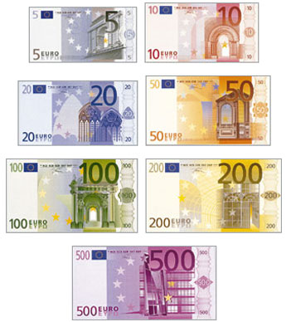
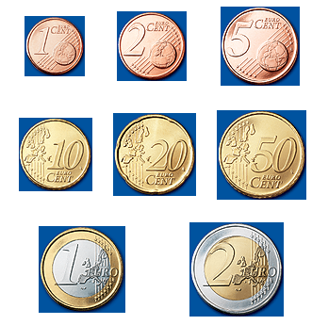
CS 5 currency…
Final project: 1 Euro for each deadline
as long as one partner has a Euro left....
Also ask about our Euro "buy-back" plan: convert your unused Euros to more valuable currency (like M&Ms)

Slide 65
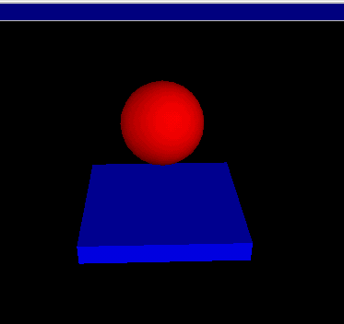
Getting familiar with VPython's API...
(0) How many tuples appear in this code? ________
(1) How many classes are used here? ________
(2) How many objects are used here? ________
(3) How are the collisions working?
Look over this VPython program to determine
from visual import *
floor = box( pos=(0,0,0), length=4, height=0.5,
width=4, color=color.blue)
ball = sphere( pos=(0,4,0), radius=1, color=color.red)
ball.velocity = vector(0,-1,0)
dt = 0.01
while True:
rate(100)
ball.pos = ball.pos + ball.velocity*dt
if ball.pos.y < ball.radius:
ball.velocity.y = -ball.velocity.y
else:
ball.velocity.y = ball.velocity.y - 9.8*dt
What's this if/else doing?

Slide 66
What is a word for which each of these rules "works" and "fails." Then, add a new rule that handles one of the failures – or an entirely new case!
Stemming
def stem( wd ):
if wd[-3:] == 'ing':
wd = wd[:-3]
This works for _________
it fails for _________
elif wd[-3:] == 'ies':
wd = wd[:-3] + 'y'
This works for _________
it fails for _________
elif wd[-2:] == 'er':
wd = wd[:-3]
This works for _________
it fails for _________
Write a rule to handle plurals ...
(1) What might go wrong?
(2) How might you fix it?
return wd
It's easy to miss cases!

Slide 67
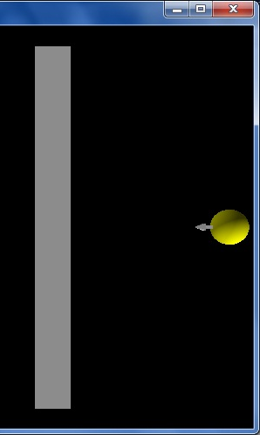
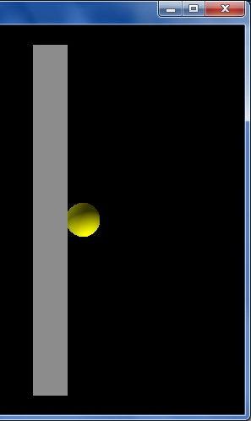
vPool collisions
I guess I'll watch out for VPython collisions...!
from visual import *
wall = box( ... )
ball = sphere( pos=(10,0,0), radius=1 )
ball.velocity = vector(-2,0,0)
RATE = 30
dt = 1/RATE
while True:
rate(RATE)
ball.pos += ball.velocity * dt
if ball.pos.x < 2.0:
print "Collide!"
ball.velocity = -ball.velocity
Start...
this is x == 2
Stuck!
What errors – in coding or logic or both – are here?

Slide 68
vPool collisions
I guess I'll watch out for VPython collisions...!
from visual import *
wall = box( ... )
ball = sphere( pos=(10,0,0), radius=1 )
ball.velocity = vector(-2,0,0)
RATE = 30
dt = 1/RATE
while True:
rate(RATE)
ball.pos += ball.velocity * dt
if ball.pos.x < 2.0:
print "Collide!"
ball.velocity = -ball.velocity
Start...
this is x == 2
Stuck!
What errors – in coding or logic or both – are here?

Slide 69
Labs?
(this week is VPython)
December's labs are final-project based:
optional, but helpful! (even more optional than usual...)
a natural opportunity to work in a pair
work on your laptop or the CS machines
easy access to help
and some of the CS machines do need work!
unspeakably fun!
Don't say it!

Slide 70
Is this a computer?
transition on 0
transition on 0
transition on 1
State 0
State 1
transition on 1
an input sequence
0010111
What does each state MEAN ?
always left-to-right
What does this FSM do overall?

Slide 71
Another example
0
1
s1
s0
0
1
s2
0,1
Specifically?
What inputs does this FSM accept?
Generally?
Fewer states?
What does each state MEAN ?

Slide 72
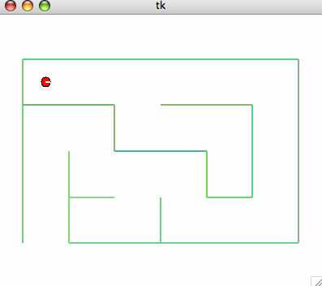
Project options...
VPool
TextClouds
PyRobot
Picobot!

Slide 73
Project options...
VPool
TextClouds
PyRobot
Picobot!

Slide 74
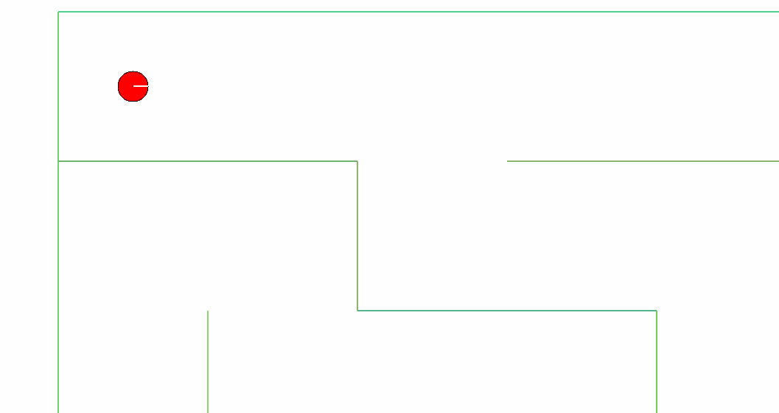
The pyRobot project
Hey! Watch where you're going!
Pt A
How do I control this robot !?!
2d simulator
Goal: get from Pt A to Pt B
Pt B

Slide 75
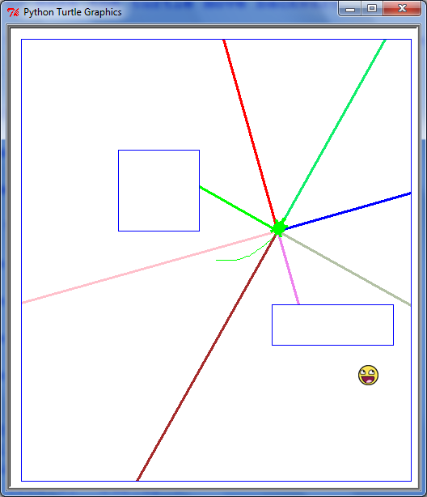
The pyRobot project
Robot control continuously loops through three things:
while True:
SENSE
PLAN
ACT
Sounds refreshing to me!
Robots almost always use the SPA approach!

Slide 76
The pyRobot project
Robots typically cycle through several states :
States represent current subtasks
other keys...
Arrows represent transitions, through sensor or keybd feedback
KBD
FWD
keyboard control
's' key pressed
go forward
This triangle indicates the "start state"
How do we get out of FWD?
"a finite state machine"

Slide 77
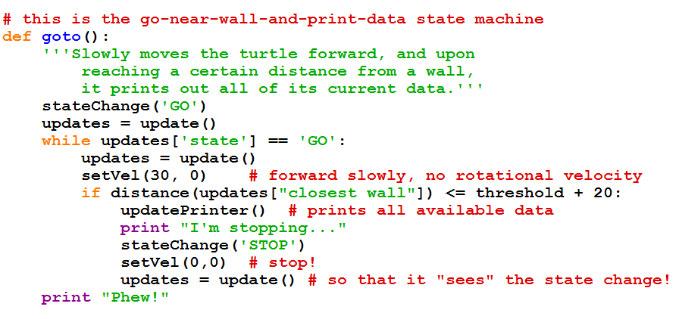
The pyRobot project
while True:
Robot control continuously runs three things:
SENSE
PLAN
ACT

Slide 78
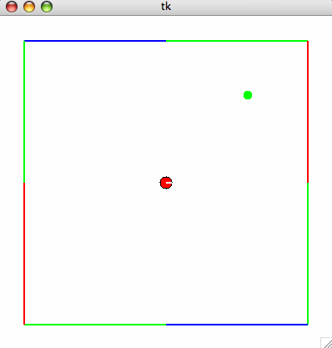
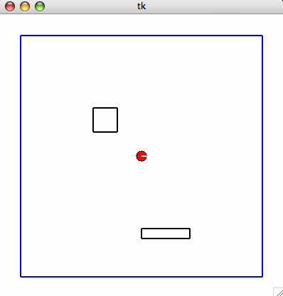
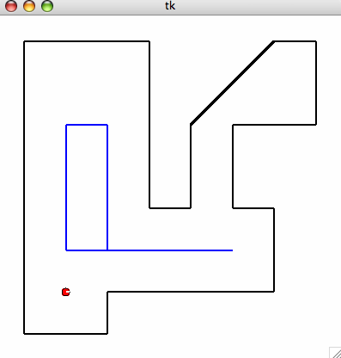
Maps
are set by hitting the '8' key...
Required
Extra

Slide 80
The pyRobot project
Robots typically cycle through several states :
States represent current subtasks
other keys...
Arrows represent transitions, through sensor or keybd feedback
KBD
FWD
keyboard control
's' key pressed
go forward
This triangle indicates the "start state"
How do we get out of FWD?
"a two-state state machine"

Slide 81
What is a word for which each of these rules "works" and "fails." Then, add a new rule that handles one of the failures – or an entirely new case!
Stemming
def stem( wd ):
if wd[-3:] == 'ing':
wd = wd[:-3]
This works for _________
it fails for _________
elif wd[-3:] == 'ies':
wd = wd[:-3] + 'y'
This works for _________
it fails for _________
elif wd[-5:] == 'ement':
wd = wd[:-4]
This works for _________
it fails for _________
Fix one of these rules – or write another one... .
return wd
Maybe stemming stemming?

Slide 82
What will CS 5 be about... ?
What
Theoretical results in CS...

Slide 83
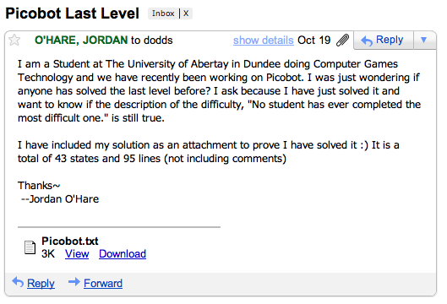
Picobot lives!
Your simulator will be able to run these rules just like any others!

Slide 84
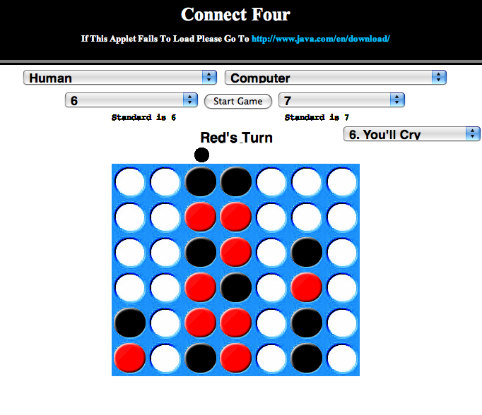
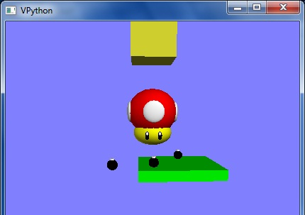
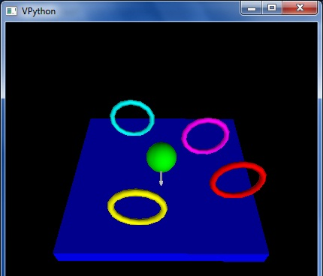
Previously cool submissions...
You mean these no longer qualify as cool?
http://stanford.edu/~ccecka/research/C4.html
Creativity + Physics = vPool !

Slide 85
The pyRobot project ~ additions
Main
Goal: get from Pt A to Pt B
Optional
Start in an unknown location on the map…
Implement a niftier interface…
I'm lost!
vPython Robot?
Use only the bump sensors… (no range sensing)
Use noisy (realistic) data

Slide 86
The pyRobot project ~ additions
Main
Goal: get from Pt A to Pt B
Optional
Start in an unknown location on the map…
Implement a niftier interface…
I'm found!
vPython Robot?
Use only the bump sensors… (no range sensing)
Use noisy (realistic) data
Try your code for a "spin"…

Slide 87
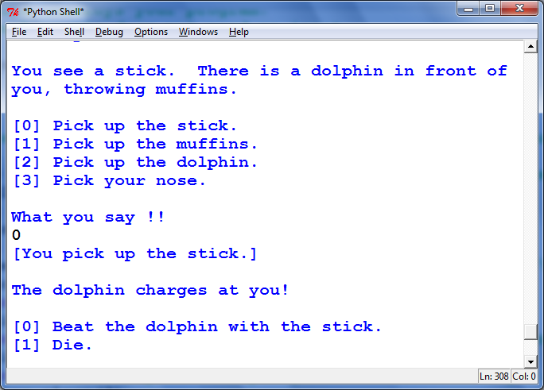
More cool submissions?
Thanks, Alex!

Slide 88
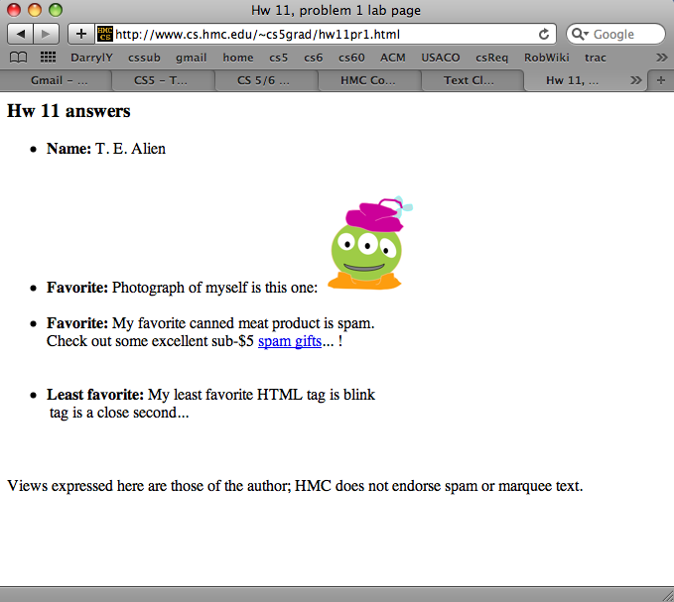
Command-line commands
pwd
ls
cd
nano
cp
chmod
wc
prints the current directory
lists the current directory
changes directory
edits files
copies files
changes file permissions
Hey - that's me!
counts the words, lines, and characters

Slide 89
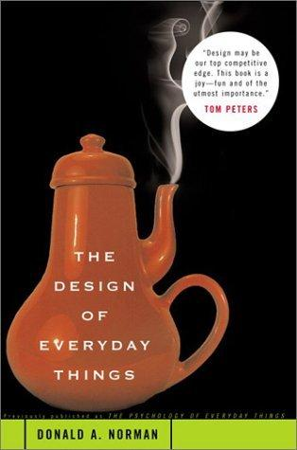
Design for software and beyond
Don Norman's key principles:
0. Conceptual models
1. Mapping
Visibility
Feedback
Affordances

Slide 90
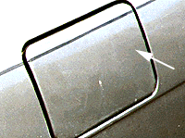
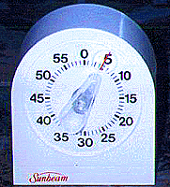
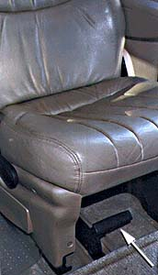
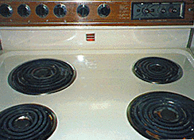
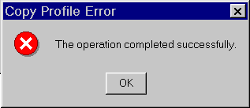
Where do these go wrong?
Mapping
Visibility
Feedback
Affordances
Set to 5 minutes?
How to open this gas cap?
This handle unfastens the seat from the floor.
Win NT Dialog
How to turn on this stove?

Slide 91
CS 5 Mudd…
(0,0,0)
(110,102,0)
(220,205,0)
CS 5's winter weeks:
final project
computational models
uncomputability
No regular labs this week
Ex. Cr. labs are scheduled
Tue. (today): 2:45-4:45
Wed. (tomorrow): 2:45-4:45
Tue., 12/14 2 pm – Exam option #1
more later on, too ...
Thu., 12/16 9 am – Exam option #2

Slide 92
Final-project season
congratulations to all E11ers!
Today is about the CS 5 Term Projects
Sales pitch for the four possible options...
A sneak peek at "December in CS 5"
vPool
Picobot
pyRobot
Text Clouds
I’ve got my eyes on some of these projects!
Eye'll bet!

Slide 93
Final projects
open-ended
comprehensive
Final CS assignment
same projects for black/gold
several choices…
Working solo or duo is OK
Pairs need to work together (in the same place) and to share the work equally...
Eye, eye!

Slide 94
Cool submissions!
http://stanford.edu/~ccecka/research/C4.html
Room for creativity...

Slide 95
The vPool project
Phunky Fisicks is welcome!
VPython was designed to make 3d physics simulations simpler to program
Collisions with walls should be handled...
Collisions with other pool balls should be handled...
Pockets – or some other game objective
A few examples to get you thinking…
Linux users are welcome!
But they should use another OS…

Slide 96
Text Clouds project
2010
tag cloud
merges?

Slide 97
Text Clouds project
Input
http://www.cs.hmc.edu/~cs5grad/cs5/textcloud/page1.html
http://www.cs.hmc.edu/~akeizur/
Hey! Where did these come from?
Output
I think spam should go to 11!

Slide 98
Text Clouds project
http://www.cs.hmc.edu/~cs5grad/cs5/textcloud/page1.html
Spamming spammers spammed spam. Spam spam spam! I love spam!
['spamming', 'spammers', spammed', 'spam.', 'spam', 'spam', 'spam!',
'I', 'love', 'spam!', 'page', '2']
What happened here?
['spamming', 'spammers', spammed', 'spam', 'spam', 'spam', 'spam',
'love', 'spam', 'page', '2']
And here?
['spam', 'spam', spam', 'spam', 'spam', 'spam', 'spam',
'love', 'spam', 'page', '2']
What's next?

Slide 99
Text Clouds project
From text…
Start with a webpage (URL)
Read in text
Create a list of words
Clean the words
Stem the words
Count the words
Return a string with frequencies
Add advanced features…
This looks familiar...
So does this!
… to cloud

Slide 100
Text Clouds project
Develop the basic application using IDLE.
After it works, make it a webpage...
The Approach:
Use the provided code to read HTML
Make sure that you can process the files appropriately into ordered lists of words…
Once you have things working, move on to
writing HTML
following links beyond depth 1
Building a web crawler ...
Once you have everything working,
transfer your files to your webspace.
set up the HTML wrapper files & go…
What will you need to look out for?
Personalize - There are lots of ways to do this!
Alexa's ...

Slide 101
Text-cloud history
http://chir.ag/phernalia/preztags/

Slide 102
The pyRobot project
Robots typically cycle through several states :
States represent current subtasks
other keys...
Arrows represent transitions, through sensor or keybd feedback
KBD
FWD
keyboard control
's' key pressed
go forward
This triangle indicates the "start state"
How do we get out of FWD?
"a two-state state machine"

Slide 103
The pyRobot project
Robots typically cycle through several states :
other keys...
KBD
FWD
keyboard control
's' key pressed
go forward
Finish drawing the state machine for the random robot...

Slide 104
The pyRobot project
while True:
Robot control continuously runs three things:
SENSE
PLAN
ACT
[x,y,thd], bump = self.getData()
if bump[0] == True or bump[1] == True:
print 'BUMP!',
print ' [Left bump sensor:', bump[0], '] ',
print ' [Right bump sensor:', bump[1], '] '
robotTask = STOP
STOP is one of the robot's states. Every 40th of a second, the robot runs through this loop, sets the robot's state and sets the velocities accordingly. Don't sleep!
if robotTask == STOP:
self.setVels(0,0)
robotTask = KBD

Slide 105
Maps
are set at the very bottom of the main.py file:
Required
Extra

Slide 106
The Picobot project
Basic idea: implement Picobot (the hw problem from Week 1)
Picobot is also a finite-state machine!
talk about full circle...

Slide 107
The Picobot project
Basic idea: implement Picobot (the hw problem from Week 1)
Requirements:
Picobot is also a finite-state machine!
Text and graphical output
Read Picobot program from a file
Read maze description from a file
Keep track of visited/unvisited squares
Prohibit illegal moves – unless they're legal...

Slide 108
Picobot returns!
What data structures (classes) might be helpful in implementing Picobot?

Slide 109
The Picobot project
Current State: 1
Current Rule: 1 N*W* -> X 2
++++++++++
+o++o+o+++
+oooooo ++
++++o++ +
+oooo+++++
++++o +
+oooo+++ +
++++o+++++
+Rooo +
++++++++++
First, prototype it as ASCII-bot
Picobot started here…
and is now here…

Slide 110
The Picobot project
Graphical picobot:
turtle version…
Choice of graphical packages
VPython for 3d
turtle for 2d
Start/stop/step feature
Maze editing
Pebble dropping
Be inventive!
Lots of options…

Slide 111
What’s due?
Mon., 12/6 – Interim milestones due (11:59 pm)
milestone.txt
milestone.py
Name(s)
Project chosen
Your project description:
What is your plan.
What is your approach.
A start at an implementation.
Classes and functions
Docstrings
60-80+ lines of working, tested code
Nice milestone!
It’s actually a kilometer stone.

Slide 112
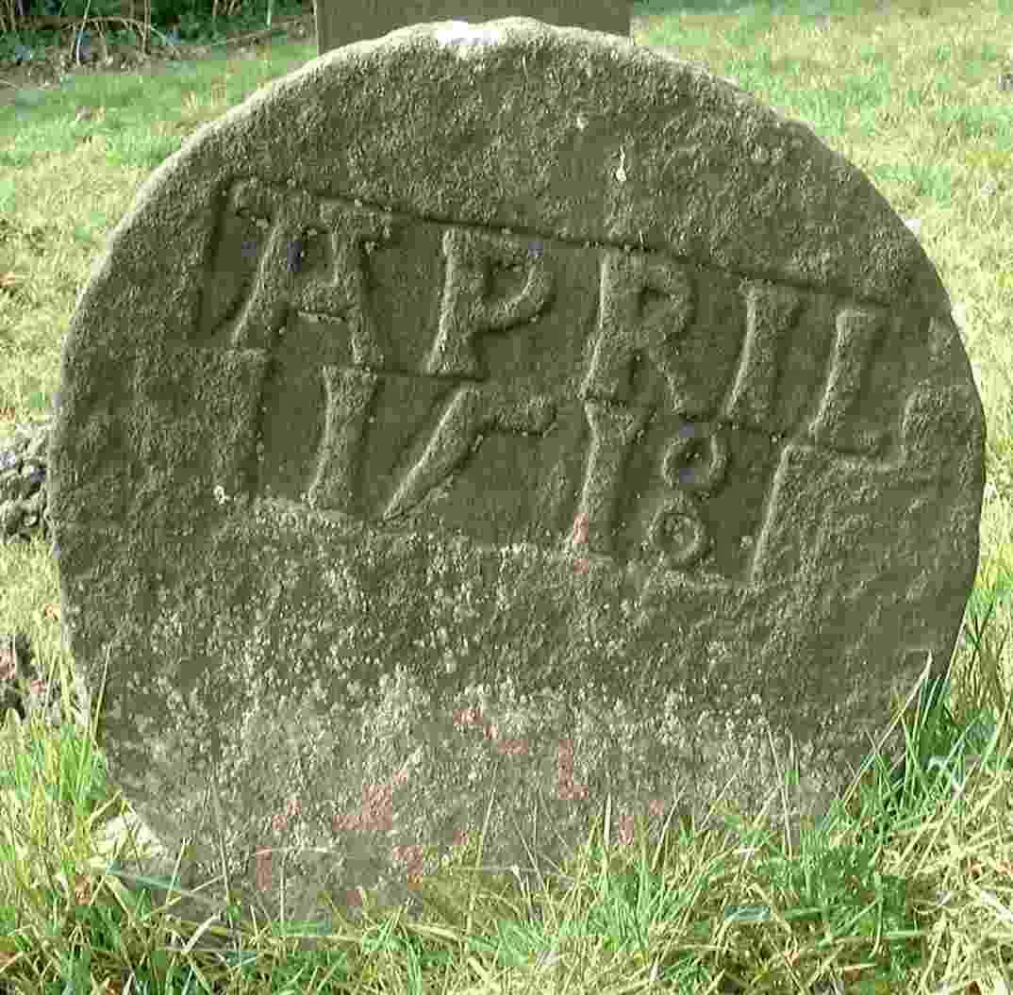
What’s due?
Fri., 12/10 – Final deliverables due (by 5:00 pm)
final.txt
final.py
Name(s)
Project chosen
Description of user interface:
How do we run / play your project.
What features did you implement.
What was your approach & plan.
Classes and functions with documentation/docstrings
Working, tested code
A final milestone?

Slide 113
CS 5 currency…
Final project: 1 Euro for each deadline
as long as one partner has a Euro left....
Ask Prof. Ran about his Euro "buy-back" plan!

Slide 114
Labs?
December's labs are final-project based:
optional, but helpful!
a natural opportunity to work in a pair
and some of the CS machines do need work!
work on your laptop or the CS machines
easy access to help
HTML set up for the TextClouds project
unspeakably fun!
Don't say it!
optional labs?

Slide 115
CS 5 Today
(0,0,0)
(110,102,0)
(220,205,0)
CS 5's final three weeks:
final project
w/Euro
CS labs this week: VPython
25
CS hwk this week: C4 AI
Hwk 11 due: Dec. 3
final exam
Mon., 12/17 2 pm – Exam option #1
Wed., 12/19 9 am – Exam option #2

Slide 116
def scoresFor(self, b):
""" MUST return a list of 7 scores!! """
scores = [50,50,50,50,50,50,50]
(0) Start all scores at 50.
(1) For each col to move:
(2a) If not possible…
(2b) If game already over…
(2c) Else add the move to b
(3) Ask an opponent (!!!) for its scoresFor at ply-1
(4) compute self's score
for col in range( 0, 7 ):
return scores

Slide 118
XKCD's take…

