Slide 1
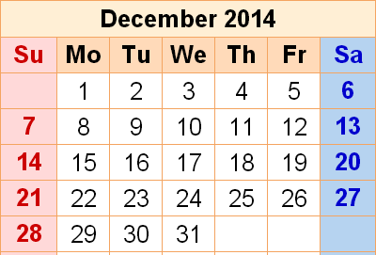
Dec. in CS 5
(0,0,0)
(110,102,0)
(220,205,0)
Mon., 12/8 – Milestone due
Fri., 12/12 8pm – Fin. proj. due
final project
10:15 demo. – great!
final exam
Mon., 12/15 7 pm – review
Tue., 12/16 9 am – final

Slide 2
Connect-4 tiebreaking…
scoreBoard would give each of these 50.0
but which board is really better for black?
Ex. Cr.: write a scoreBoard4Tourney f'n.
taken beyond the extreme…

Slide 3
Games' Branching Factors
0 Ply
On average, Connect 4 players have seven choices per move.
Chess players have more, perhaps around 40, possible choices in a given move.
1 Ply
2 Ply
Branching Factors
for different two-player games
“solved” games
Tic-tac-toe 4
Connect Four 7
Checkers 10
Othello 30
Chess 40
Go 300
Boundaries for qualitatively different games…
computer-dominated
human-dominated

Slide 4
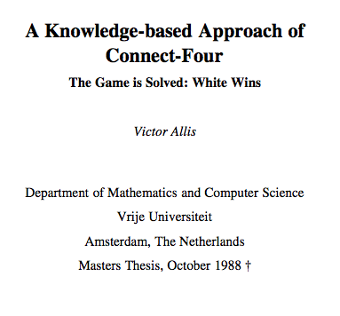
draw/tie with perfect play
first-player losses (with perfect play)
first-player win (with perfect play)
Connect 4 was solved in 1988.

Slide 5
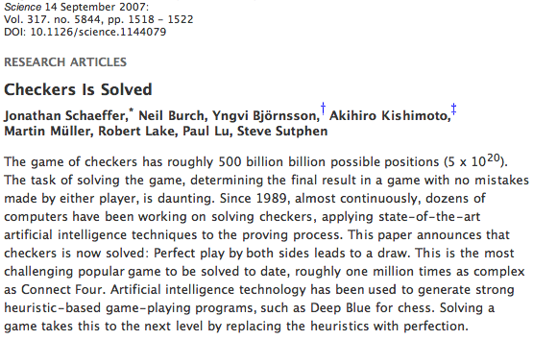
Checkers was solved in 2007.

Slide 6
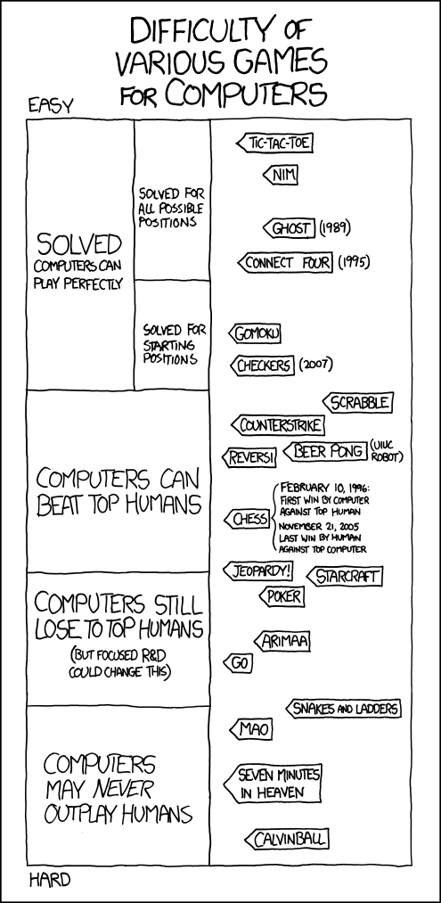
Games' Branching Factors

Slide 7
(Games' Branching Factors)

Slide 8
(Games' Branching Factors)

Slide 9
Connect-4 tiebreaking…
scoreBoard would give each of these 50.0
but which board is really better for black?
Ex. Cr.: write a scoreBoard4Tourney f'n.
taken beyond the extreme…

Slide 10
Connect Four continues…

Slide 11
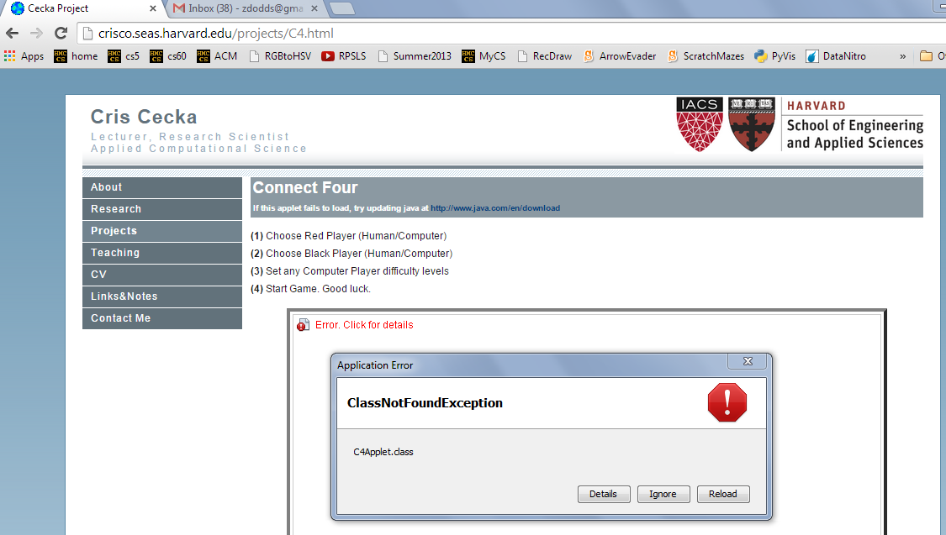
Aargh!

Slide 12
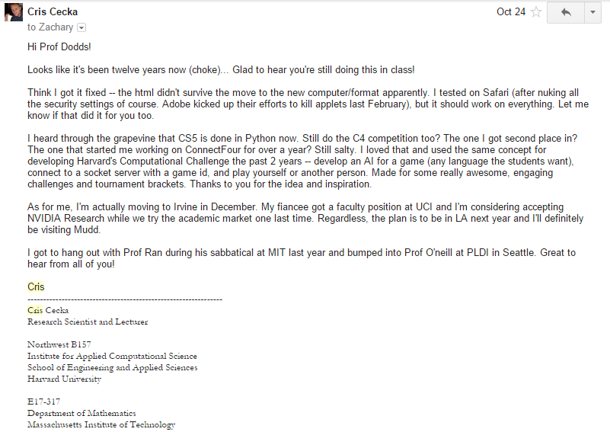
This year's Cris Cecka award…

Slide 13
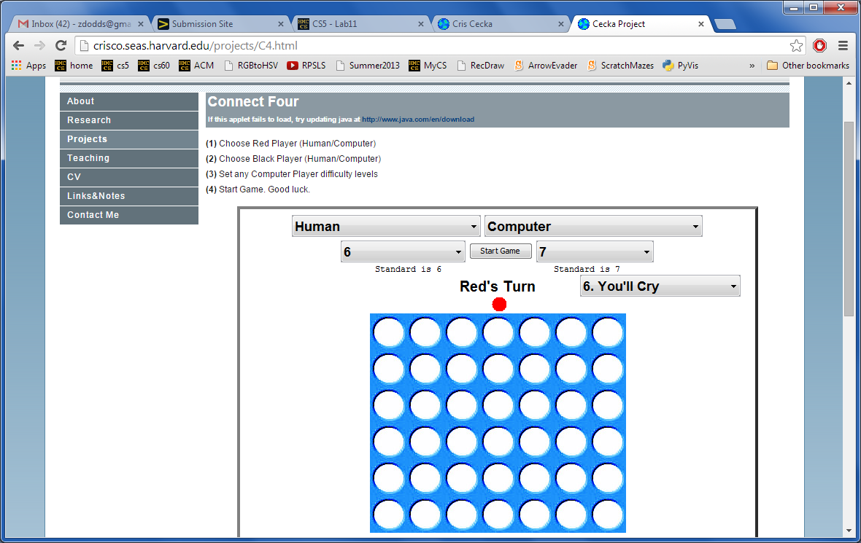
Give it a try… !
Looking for a game… ?
http://crisco.seas.harvard.edu/projects/C4.html

Slide 14
'tis the season for final projects…
Today is about the CS 5 final projects
+ it's a sales pitch for the three possible options:
vPool
TextID
Picobot
I've got my eyes on some of these projects!
Eye'll bet !

Slide 15
Final projects
open-ended
comprehensive
Final CS hw
same projects for black/gold
three choices…
Working solo or in a pair is OK
Eye, eye!
Pairs need to work together - in the same place - and they need to share the work equally...
Black/gold pairs are welcome...
Pairing is extra-encouraged on the final project!

Slide 16
Final lab days…
No lab meetings this week…
Labs will meet the first 2 weeks of Dec.
these lab meetings are extra-optional
final projects: get started and assistance
there are theocomp problems, too…
-2i
or two!
Now we're in a state!
+2i

Slide 17
Extra-credit lab?
On Wed. Dec. 3
If you can come for the 6-8pm lab…
… whether or not it's your regular lab,
to participate in a parallel-programming study
a video introduction
a few small Python programming-challenges
with help from students
Prof. Stone, Savannah Baron, and others will provide food, guidance, and challenges…
We can also provide +8 points of exam ex. cr.
Many alternative ex. cr. opportunities are available in the final week's CS hwks
Email me ~ this can handle up to 24 people…

Slide 18
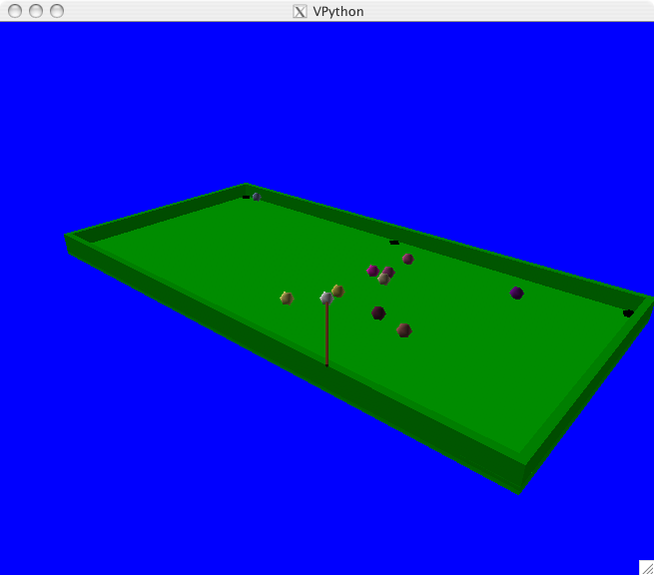
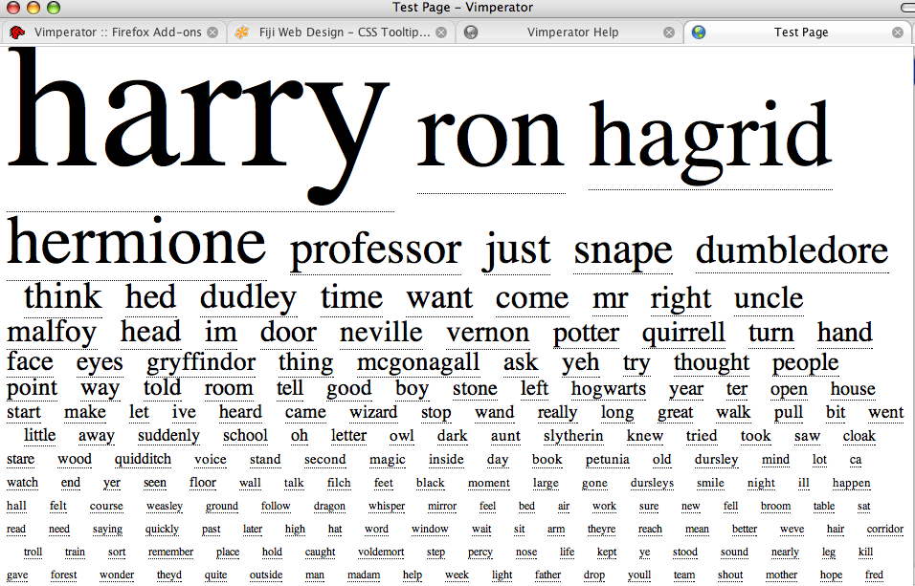
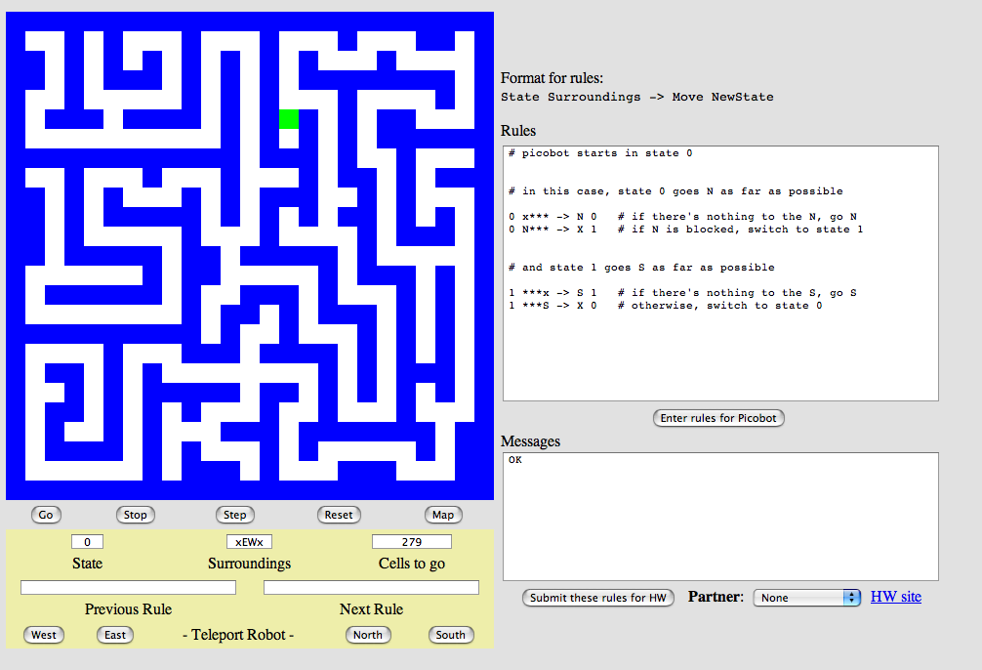
Project options…
VPool
…VPython
TextID
…Markov
Picobot!
…CFour

Slide 19
The Picobot project
Big ideas
(1) Implement Picobot in Python
(2) Train Python to write successful Picobot programs!
talk about going full circle...

Slide 20
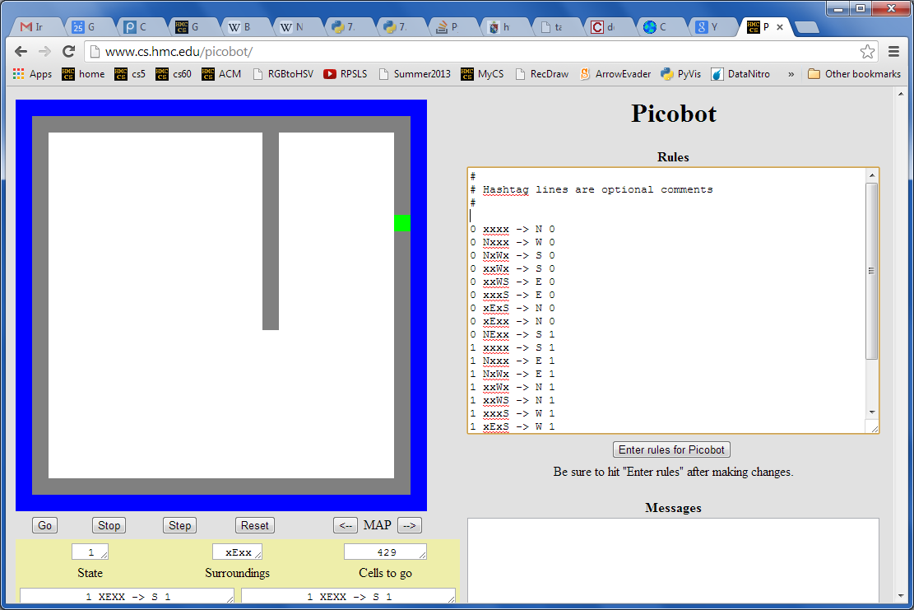
Picobot returns!
What data structures (classes) might be helpful in implementing Picobot?

Slide 21
Picobot's classes
0 xxxx -> N 0
0 Nxxx -> W 0
0 NxWx -> S 0
0 xxWx -> S 0
0 xxWS -> E 0
0 xxxS -> E 0
0 xExS -> N 0
0 xExx -> N 0
0 NExx -> S 1
1 xxxx -> S 1
1 Nxxx -> E 1
1 NxWx -> E 1
1 xxWx -> N 1
1 xxWS -> N 1
1 xxxS -> W 1
1 xExS -> W 1
1 xExx -> S 1
1 NExx -> W 0
class Program:
What in Python could most usefully hold all of these rules?
What type should self.rules be?

Slide 22
Picobot's classes
0 xxxx -> N 0
0 Nxxx -> W 0
0 NxWx -> S 0
0 xxWx -> S 0
0 xxWS -> E 0
0 xxxS -> E 0
0 xExS -> N 0
0 xExx -> N 0
0 NExx -> S 1
1 xxxx -> S 1
1 Nxxx -> E 1
1 NxWx -> E 1
1 xxWx -> N 1
1 xxWS -> N 1
1 xxxS -> W 1
1 xExS -> W 1
1 xExx -> S 1
1 NExx -> W 0
class Program:
What in Python could most usefully hold all of these rules?
What type should self.rules be?
both tuples
Python dictionary
key
value
self.rules[ (1,"NExx") ] = ("W",0)

Slide 23
Picobot's classes
+++++++++++++++++++++++++
+oooooPooooooooooooooooo+
+o o o+
+o o o+
+o o o+
+o o o+
+o o o+
+o o o+
+o o o+
+o o o+
+o o+
+o o+
+o o+
+o o+
+o o+
+o o+
+o o+
+o o+
+o o+
+o o+
+o o+
+o o+
+o o+
+ooooooooooooooooooooooo+
+++++++++++++++++++++++++
class World:
What in Python could most usefully hold the environment?
What type should self.room be?
Wall:
+
o
Visited:
Picobot:
P

Slide 24
Picobot's classes
+++++++++++++++++++++++++
+oooooPooooooooooooooooo+
+o o o+
+o o o+
+o o o+
+o o o+
+o o o+
+o o o+
+o o o+
+o o o+
+o o+
+o o+
+o o+
+o o+
+o o+
+o o+
+o o+
+o o+
+o o+
+o o+
+o o+
+o o+
+o o+
+ooooooooooooooooooooooo+
+++++++++++++++++++++++++
class World:
What in Python could most usefully hold the environment?
What type should self.room be?
Wall:
+
o
Visited:
The same as your Connect-Four board's self.data!
Picobot:
P
a list-of-lists-of-one-character-strings….

Slide 25
The Picobot project
Current State: 1
Current Rule: 1 N*W* -> X 2
++++++++++
+o++o+o+++
+oooooo ++
++++o++ +
+oooo+++++
++++o +
+oooo+++ +
++++o+++++
+Pooo +
++++++++++
First, build an ASCII simulation
Picobot started here…
and is now here…
Your actual ASCII is likely to be more monochromatic!

Slide 26
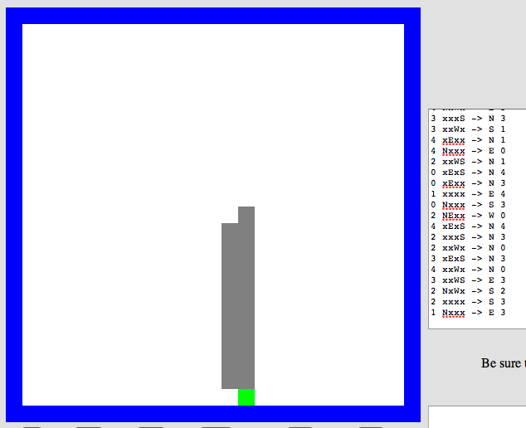
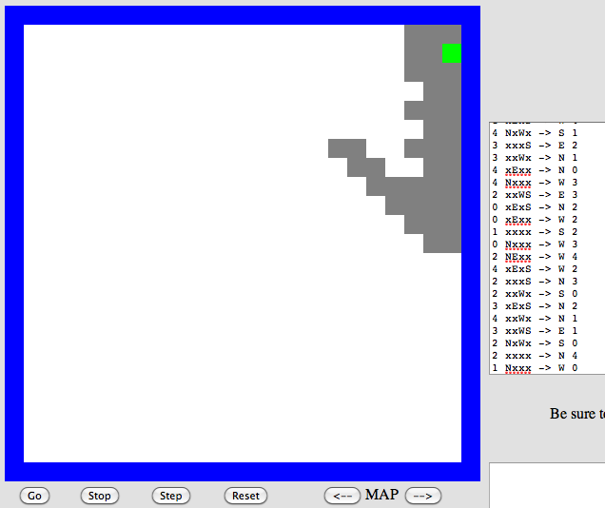
Program evolution
An example of genetic algorithms, which are used for optimizing hard-to-describe functions with easily-splittable solutions.
program p1
program p2
Start with a population of, say, ~200 random Picobot programs…

Slide 27
Program evolution
An example of genetic algorithms, which are used for optimizing hard-to-describe functions with easily-splittable solutions.
program p1
fitness = 0.03
program p2
fitness = 0.05
Then, evaluate the fitness of all of those programs
Evaluate? How??

Slide 28
program p1
fitness = 0.03
program p2
fitness = 0.05
mate + mutate the fittest rulesets
to create a new generation of ~200 programs…
program c1
fitness = 0.19
Where's the project?

Slide 29
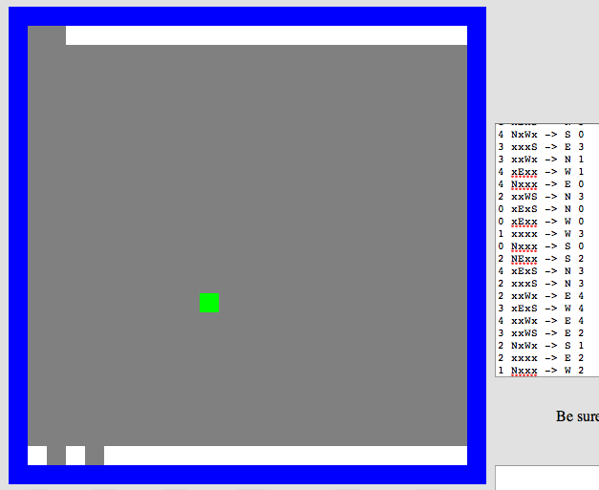
Repeat this "survival of the fittest" process for many generations…
… and by the end, your Python code should have evolved a much more capable Picobot program!
fitness = 0.90

Slide 30
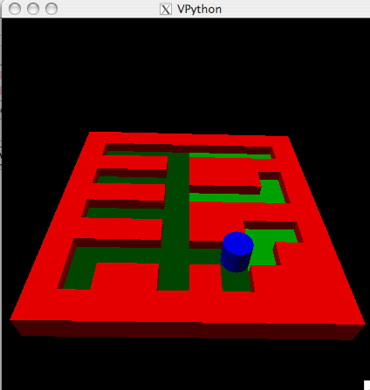
Extra: Picobot graphics…
Choice of graphical packages
2d: graphics.py from C4
3d: VPython
Mine's going to be in 5d!
3d version…
2d version…
Hey! Picobot is in 3d…

Slide 31
Project options…
VPool
…VPython
TextID
…Markov
Picobot!
…CFour

Slide 32
the TextID project
Though Robin Ellacott’s twenty-five years of life had seen their moments of drama and incident, she had never before woken up in the certain knowledge that she would remember the coming day for as long as she lived.
First paragraph of The Cuckoo's Calling by R. Galbraith

Slide 33
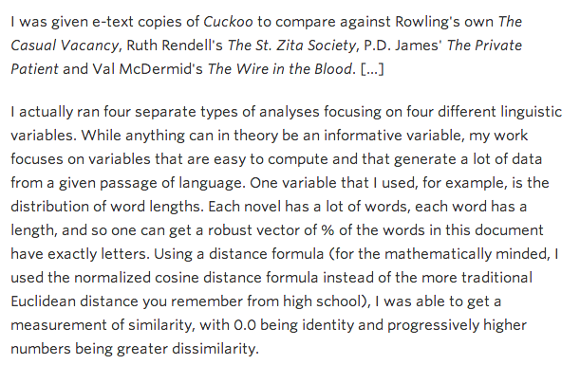
kottke.org/13/08/how-jk-rowling-was-found-to-be-robert-galbraith

Slide 34
the TextID project
Big ideas:
(1) Build lexical models of bodies of text…
(2) Use a similarity score to measure Rowlingness
vs.
Shakepearity
NYTimes-iness
vs.
WSJournalicity
Big Bang Theory?
vs.
Arrested Development
even better: your own choice of two or more comparisons…

Slide 35
TextID model
class TextModel
Surely you're joking, Mr. Feynman! Aren't poptarts and spam always quantum-entangled? Dr. G. Kuenning jokes that spam poptarts don't exist. That's no joke!
file w/text:
algorithmic building blocks
{'and': 1, 'no': 1, 'jokes': 1, 'quantumentangled': 1, 'joking': 1, 'spam': 2, 'always': 1, 'youre': 1, 'g': 1, 'joke': 1, 'thats': 1, 'feynman': 1, 'that': 1, 'surely': 1, 'arent': 1, 'mr': 1, 'dont': 1, 'exist': 1, 'kuenning': 1, 'dr': 1, 'poptarts': 2}
{1: 1, 2: 3, 3: 1, 4: 5, 5: 5, 6: 3, 7: 1, 8: 3, 16: 1}
{'and': 1, 'alwai': 1, 'sure': 1, 'quantumentangl': 1, 'dont': 1, 'g': 1, 'spam': 2, 'joke': 3, 'that': 2, 'poptart': 2, 'feynman': 1, 'kuen': 1, 'arent': 1, 'mr': 1, 'no': 1, 'exist': 1, 'dr': 1, 'your': 1}
{9: 1, 3: 1, 5: 1, 6: 1}
{'!': 2, "'": 4, '-': 1, ',': 1, '.': 4, '?': 1}
the model!
at least 5 Python dictionaries…
here are the five for the above "Feynman" file:

Slide 36
TextID's building blocks… ?
I don't see a difference!

Slide 37
TextID's building blocks…
This looks familiar...
Get text from file…
You're ready to score against your model!

Slide 38
TextID's building blocks…
This looks familiar...
Get text from file…
(1) Clean up the text (first pass)
(2) Model punctuation marks, i.e. count them
(3) Model sentence lengths (using .!?)
(4) Split into words
(5) Clean up the words (second pass)
(6) Model words and word lengths
(7) Stem words and model those stems
You're ready to score against your model!

Slide 39
File:
Surely you're joking, Mr. Feynman! Aren't poptarts and spam always quantum-entangled? Dr. G. Kuenning jokes that spam poptarts don't exist. That's no joke!
class TextModel
Model:
words
{'and': 1, 'no': 1, 'jokes': 1, 'quantumentangled': 1, 'joking': 1, 'spam': 2, 'always': 1, 'youre': 1, 'g': 1, 'joke': 1, 'thats': 1, 'feynman': 1, 'that': 1, 'surely': 1, 'arent': 1, 'mr': 1, 'dont': 1, 'exist': 1, 'kuenning': 1, 'dr': 1, 'poptarts': 2}
{1: 1, 2: 3, 3: 1, 4: 5, 5: 5, 6: 3, 7: 1, 8: 3, 16: 1}
{'and': 1, 'alwai': 1, 'sure': 1, 'quantumentangl': 1, 'dont': 1, 'g': 1, 'spam': 2, 'joke': 3, 'that': 2, 'poptart': 2, 'feynman': 1, 'kuen': 1, 'arent': 1, 'mr': 1, 'no': 1, 'exist': 1, 'dr': 1, 'your': 1}
{9: 1, 3: 1, 5: 1, 6: 1}
{'!': 2, "'": 4, '-': 1, ',': 1, '.': 4, '?': 1}
word lengths
stems
sentence lengths
mine has 5 Python dictionaries…
punc

Slide 40
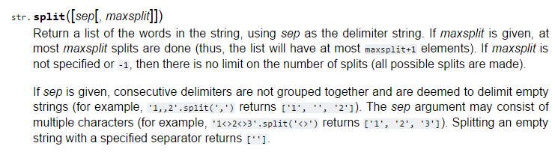
I bet they told you the age of the library was over…
but It's just begun!
TextID's library resources

Slide 41
Stemming
stem( "party" )
"parti"
stem( "parties" )
"parti"
An algorithm that outputs the root of the input word.
stem( "love" )
"lov"
stem( "loving" )
"lov"
Or tries to output the root!
these don't have to be words, just stems…

Slide 42
Stemming!
getting to the root of the problem…
def stem( w ):
Name(s): ______________________________
Find an English exception to each of these stemming patterns:
stem('parties')
'parti'
ends in ies
stem('party')
'parti'
ends in cons + y
stem('love')
'lov'
ends in vow + cons + e
stem('loving')
'lov'
ends in vow + cons + ing
stem('quickly')
'quick'
ends in ly
stem('quickest')
'quick'
ends in est
stem('stems')
'stem'
ends in s
stem('stemming')
'stem'
ends in vow + 2*cons + ing
stem(__________)
_______
create your own stemming rule

Slide 43
Model matching
Suppose we have two dictionaries:
Unknown file: { "love": 3,
"thou": 1,
"potter": 2,
"spam": 4 }
WS: { "love": 50,
"spell": 8,
"thou": 42 }
These must have been some really avant-garde texts!

Slide 44
Model matching
Suppose we have two dictionaries:
Unknown file: { "love": 3,
"thou": 1,
"potter": 2,
"spam": 4 }
WS: { "love": 50,
"spell": 8,
"thou": 42 }
What's the probability that the Unknown file came from the WS distribution?

Slide 45
Model matching
Suppose we have two dictionaries:
Unknown file: { "love": 3,
"thou": 1,
"potter": 2,
"spam": 4 }
WS: { "love": 50,
"spell": 8,
"thou": 42 }
let's just pretend that the words are all independent of each other, with WS as the source…
What's the probability that the Unknown file came from the WS distribution?

Slide 46
Model matching
Suppose we have two dictionaries:
Unknown file: { "love": 3,
"thou": 1,
"potter": 2,
"spam": 4 }
WS: { "love": 50,
"spell": 8,
"thou": 42 }
the WS-based probability of each word in Unknown File
=
50
50
50
42
0.0525
100
100
100
100
love
love
love
thou
potter
potter
spam
spam
spam
spam
What's the probability that the Unknown file came from the WS distribution?

Slide 47
Model matching
Suppose we have two dictionaries:
Unknown file: { "love": 3,
"thou": 1,
"potter": 2,
"spam": 4 }
WS: { "love": 50,
"spell": 8,
"thou": 42 }
the WS-based probability of each word in Unknown File
correct, but not helpful!
=
50
50
50
42
0
0
0
0
0
0
0.0
100
100
100
100
100
100
100
100
100
100
love
love
love
thou
potter
potter
spam
spam
spam
spam
What's the probability that the Unknown file came from the WS distribution?

Slide 48
Model matching
Suppose we have two dictionaries:
Unknown file: { "love": 3,
"thou": 1,
"potter": 2,
"spam": 4 }
WS: { "love": 50,
"spell": 8,
"thou": 42 }
the WS-based probability of each word in Unknown File
correct + helpful, but not intuitive!
=
50
50
50
42
1
1
1
1
1
1
5.25e-14
100
100
100
100
100
100
100
100
100
100
love
love
love
thou
potter
potter
spam
spam
spam
spam
What's the probability that the Unknown file came from the WS distribution?

Slide 49
Model matching
Suppose we have two dictionaries:
Unknown file: { "love": 3,
"thou": 1,
"potter": 2,
"spam": 4 }
WS: { "love": 50,
"spell": 8,
"thou": 42 }
the WS-based probability of each word in Unknown File
can think of this as an "error" ~ closer to zero is better
=
50
50
50
42
1
1
1
1
1
1
-30.6
100
100
100
100
100
100
100
100
100
100
love
love
love
thou
potter
potter
spam
spam
spam
spam
take math.log of this value…
What's the probability that the Unknown file came from the WS distribution?

Slide 50
Suppose we have two TextModels:
Naïve Bayes classifier
WS: { "love": 50,
"spell": 8,
"thou": 42 }
-30.6
Unk. file: { "love": 3,
"thou": 1,
"potter": 2,
"spam": 4 }
It looks like it was close!
JKR: { "love": 25,
"spell": 275,
"potter": 700 }
-34.8
if you use 1/100 for missing values

Slide 51
Naïve Bayes classification
Don't take these formulas too seriously…
done!

Slide 52
Naïve Bayes classification
Don't take these formulas too seriously…
done!

Slide 53
Project options…
VPool
…VPython
TextID
…Markov
Picobot!
…CFour

Slide 54
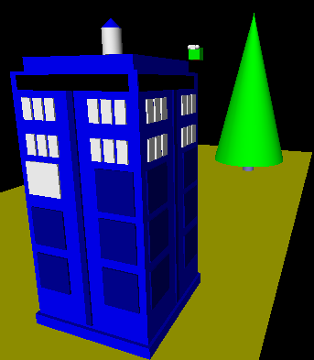
3d graphics-based game using VPython
vPool
I'll take your cue...
Let's play!
… it's not really very constrained at all!
A few constraints…
need ≥4 physically interacting objects
allow the user to direct 1+ objects, either key keyboard or mouse
needs a game goal + be winnable!
must detect some "linear" and some "spherical" collisions and implement their results on the motion

Slide 55
The vPool project
VPython was designed to make 3d physics simulations simpler to program – as a result, the library is physics-free!
⇒ Phunky Physics is welcome!
To now, VPython has eventually worked for everyone. See us for help!
Linear collisions should be somewhere ("walls")
Spherical collisions should be somewhere ("points")
You need "pockets" – or some other game objective
You need user control of at least one object (mouse/kbd)
A few examples to get you thinking…

Slide 56
"linear" collisions
+z
x = 10
At least some of the game needs to be about detecting collisions and changing velocities
ball.vel = vector(1,0,1)
while True:
ball.pos += dt*ball.vel
if ball.pos.x > 10:
ball.vel.x
ball.pos.x
ball.pos += dt*ball.vel
+x
Line ~ wall at x=10
How to bounce?
What else to do?

Slide 57
"Spherical" collisions
r.vel
() Zeroth approximation:
Stop q. Undo any overlap.
Make r.vel = q.vel.
r
q
q.vel
Reality is just one eye away!

Slide 58
"Spherical" collisions
() Zeroth approximation:
r.vel
Stop q. Undo any overlap.
Make r.vel = q.vel.
d
r
(i) First approximation:
q
Stop q. Undo any overlap.
Compute d = r.pos – q.pos
Make r.vel = d
q.vel
Reality is just one eye away!

Slide 59
"Spherical" collisions
() Zeroth approximation:
r.vel
new q.vel
Stop q. Undo any overlap.
Make r.vel = q.vel.
d⊥
d
r
(i) First approximation:
q
Stop q. Undo any overlap.
Compute d = r.pos – q.pos
Make r.vel = d
old q.vel
(ii) Second approximation:
Same as first, but
Make q.vel = d ⊥ , at 90° from d
Reality is just one eye away!

Slide 60
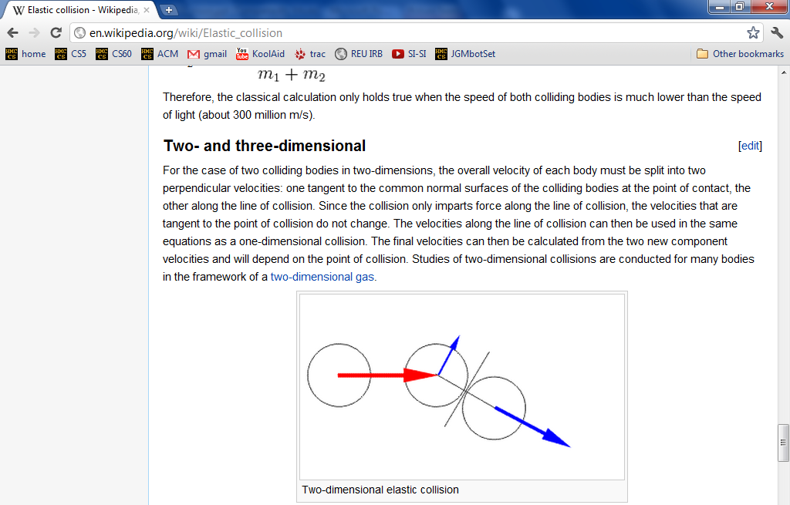
vPool – physics?
http://en.wikipedia.org/wiki/Elastic_collision
equations below...

Slide 61
vPool – physics?
http://en.wikipedia.org/wiki/Elastic_collision

Slide 62
vector library!
This is how I like my vectors: well done!
(or, at least, already done…)

Slide 63
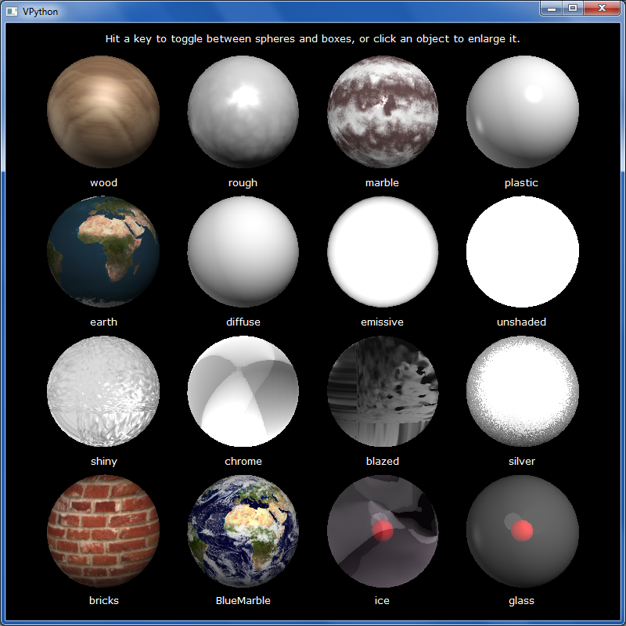
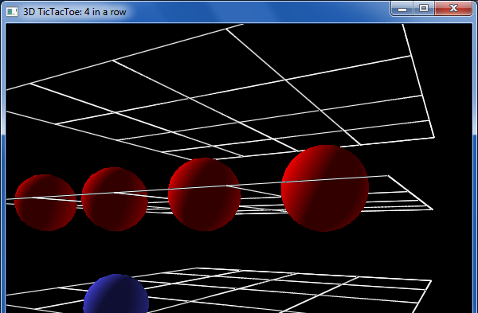
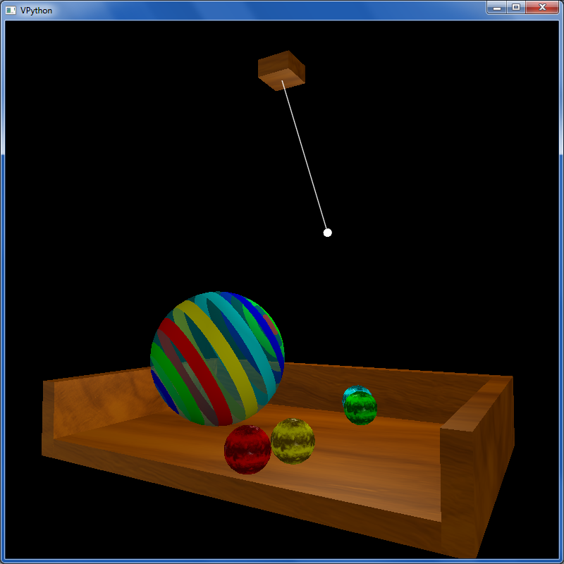
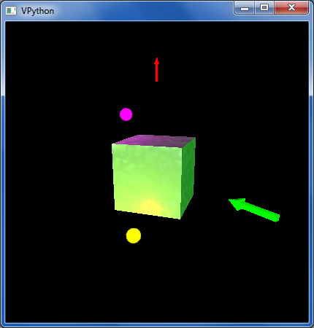
other VPython examples
tictac.py – a 3d game of tic-tac-toe
material_test.py – lots of materials
texture_and_lighting.py – fancier textures, opacity and a pendulum example
boxlighttest.py – very short + simple rotation and lighting example

Slide 64
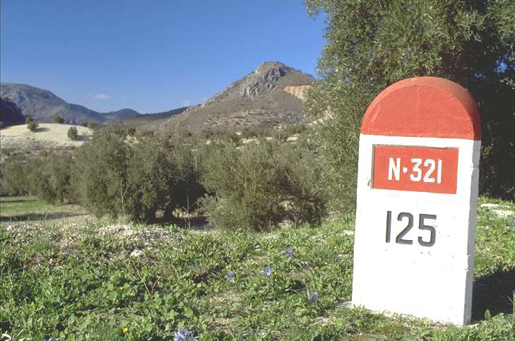
What's due?
Mon. 12/8
Fri. 12/12
The "milestone"
The "final" @ 8:00pm
project-specific tasks ~ ensuring that everyone's started!
(we can't grade these in time)
A zip file with everything needed to run your final project and a .txt file describing how to do so!
Nice milestone!
It's a kilometer stone, actually!

Slide 65
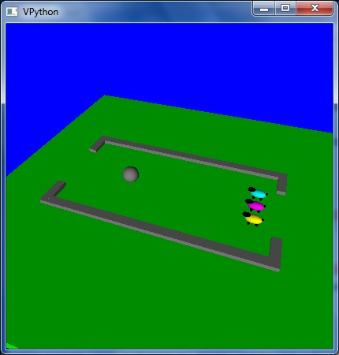
Enjoy the projects!
An unusual variation on VPool
… the graders certainly do!

Slide 66
Enjoy the projects!
An unusual variation on VPool
Have a relaxing long weekend!
… the graders certainly do!

Slide 67
After Deep Blue…

Slide 68
In reality?
Xiaoyu Y.'s C4 game…
Humans adapt!

Slide 69
Model matching
Suppose we have two dictionaries:
WS: { "love": 50,
"spell": 8,
"thou": 42 }
JKR: { "love": 25,
"spell": 275,
"potter": 700 }
"potter" is not here.
"thou" is not here.
New: { "love": 3, "thou": 1,
"potter": 2, "spam": 4 }
How could we give a match score for this New dictionary against each one above?

Slide 70
Stemming
getting to the root of the problem…
Name(s): ____________________
def stem( w ):
thought experiments…
if w[-3:] == 'ies':
return w[:-2]
This works for
parties -> parti
it fails for
elif w[-3:] == 'ing' and \
w[-4:-3] == w[-5:-4]:
return w[:-4]
What's this doing?
What's an example where it works?
What's an example where it fails?
elif
Write a rule to handle plurals ...
(1) What is a case where it will fail?
(2) How could you fix that case?
elif
Choose any other stemming rule and implement it here!

Slide 71
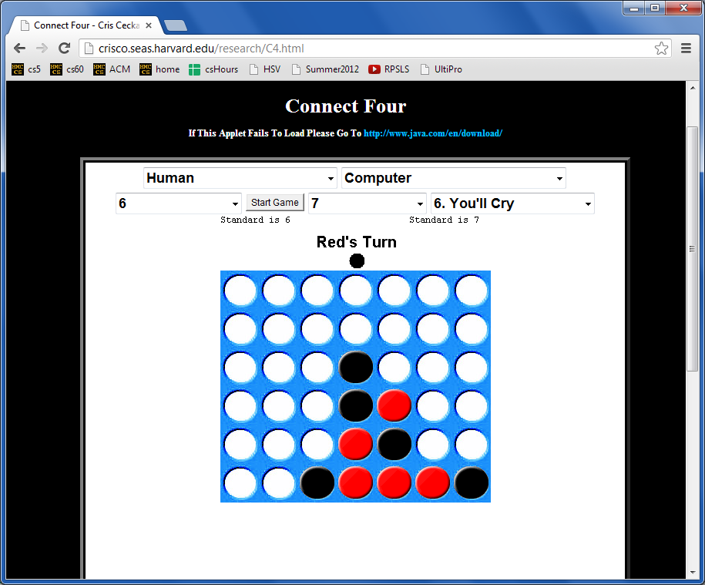
More Connect Four?
Looking for a game… ?
crisco.seas.harvard.edu/projects
Anyone defeated by their own program yet?

Slide 72
Naïve Bayes classification
multiply each word's probability as if they were all independent
WS: { "love": 50,
"spell": 8,
"thou": 42 }
JKR: { "love": 25,
"spell": 275,
"potter": 700 }
"potter" is not here.
"thou" is not here.
score vs. WS
score vs. JKR
50
50
50
42
0
25
25
25
0
700
100
100
100
100
100
1000
1000
1000
1000
1000
love
love
love
thou
potter
love
love
love
thou
potter
score = 0
score = 0
New: { "love": 3, "thou": 1,
"potter": 2, "spam": 4 }
problems?
solutions?

Slide 73
Naïve Bayes classification
multiply each word's probability as if they were all independent
WS: { "love": 50,
"spell": 8,
"thou": 42 }
JKR: { "love": 25,
"spell": 275,
"potter": 700 }
"potter" is not here.
"thou" is not here.
Ignore zeros!
score vs. WS
score vs. JKR
50
50
50
42
0
25
25
25
0
700
100
100
100
100
100
1000
1000
1000
1000
1000
love
love
love
thou
potter
love
love
love
thou
potter
score = 0.0525
score = 0.000011
New: { "love": 3, "thou": 1,
"potter": 2, "spam": 4 }
problems?
solutions?

Slide 74
Naïve Bayes classification
multiply each word's probability as if they were all independent
fix example to handle words that appear in one but not the other – give some low (non-zero) probability, e.g., the min frequency across all words in that model or all models (or just some small number)
WS: { "love": 50,
"spell": 8,
"thou": 42 }
JKR: { "love": 25,
"spell": 275,
"potter": 700 }
"potter" is not here.
"thou" is not here.
Ignore zeros!
score vs. WS
score vs. JKR
50
50
50
42
0
25
25
25
0
700
100
100
100
100
100
Use log!
1000
1000
1000
1000
1000
love
love
love
thou
potter
love
love
love
thou
potter
score = -1.27
score = -4.96
New: { "love": 3, "thou": 1,
"potter": 2, "spam": 4 }
problems?
solutions?

Slide 75
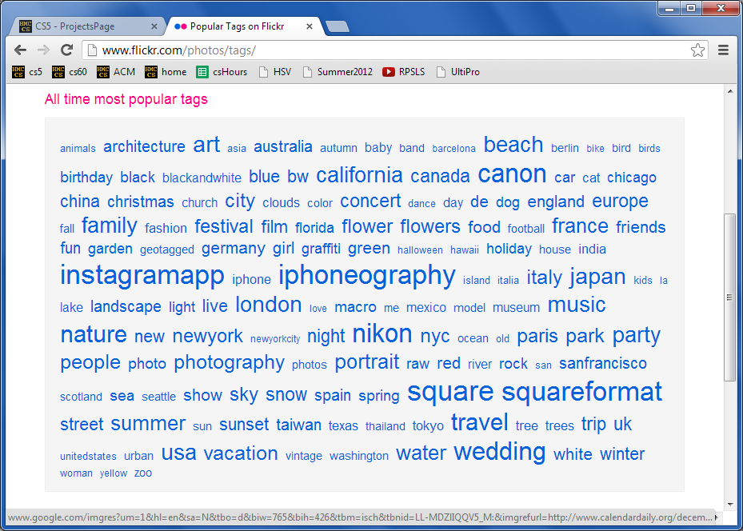
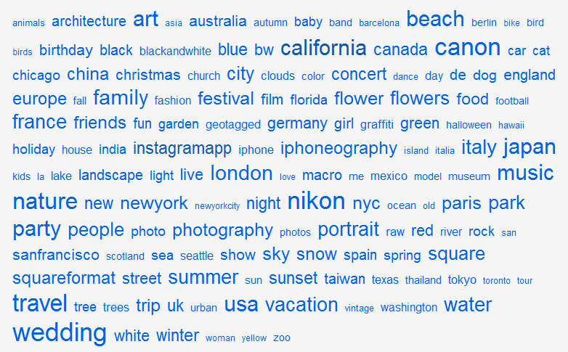
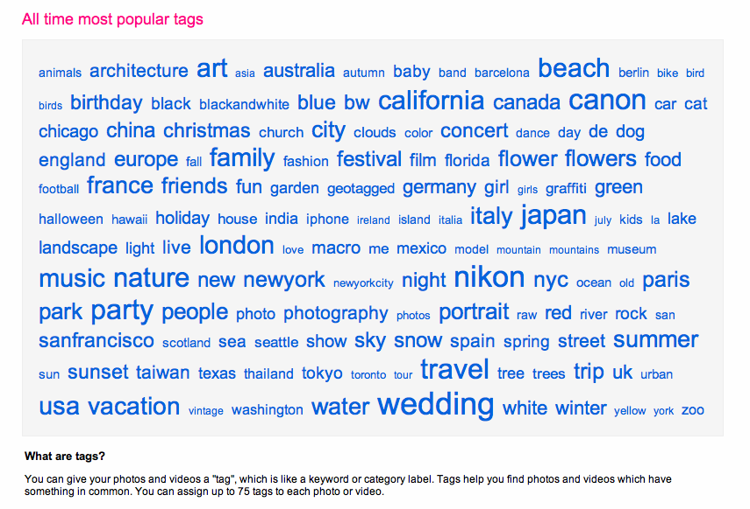
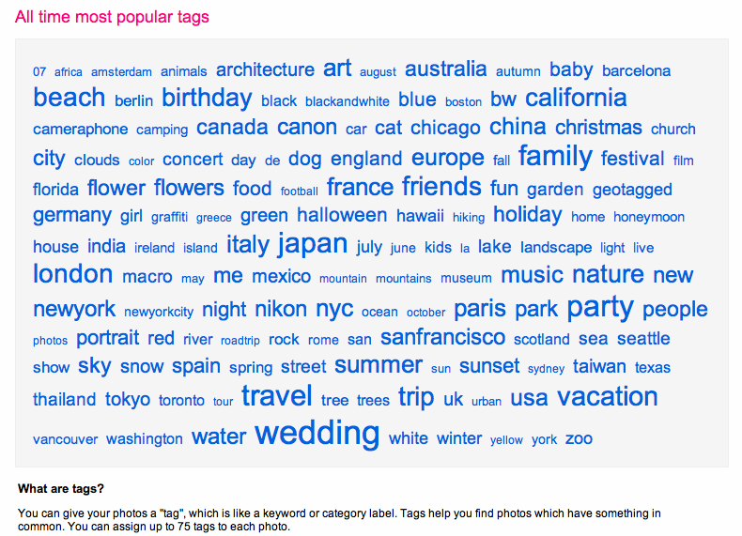
TextID project
2012
tag cloud
merges?

Slide 76
Text Clouds project
text cloud
this doesn't look nearly colorful enough…
Summary of the words in a body of text, sized according to their frequency.

Slide 77
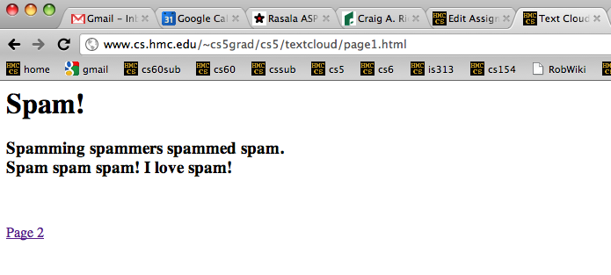
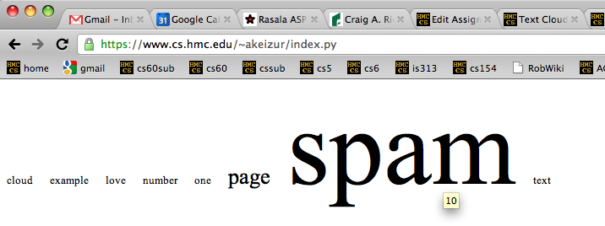
Text Clouds project
Input
http://www.cs.hmc.edu/~cs5grad/cs5/textcloud/page1.html
http://www.cs.hmc.edu/~cs5grad/cs5/textcloud/textcloud.html
Hey! Where did these come from?
Output
I think spam should go to 11!

Slide 78
Text Clouds project
http://www.cs.hmc.edu/~cs5grad/cs5/textcloud/page1.html
Spamming spammers spammed spam. Spam spam spam! I love spam!
['spamming', 'spammers', spammed', 'spam.', 'spam', 'spam', 'spam!',
'I', 'love', 'spam!', 'page', '2']
What happened here?
['spamming', 'spammers', spammed', 'spam', 'spam', 'spam', 'spam',
'love', 'spam', 'page', '2']
And here?
['spam', 'spam', spam', 'spam', 'spam', 'spam', 'spam',
'love', 'spam', 'page', '2']
What's next?

Slide 79
Text Clouds project
From text…
Start with text…
Split it into words…
With the list of words
Clean the words
Stem the words
Count the words
Return a string with frequencies
Add advanced features…
This looks familiar...
So does this!
… to cloud

Slide 80
What is a word for which each of these rules "works" and "fails." Then, add a new rule that handles one of the failures – or an entirely new case!
Stemming
def stem( w ):
if w[-3:] == 'ing':
w = w[:-4]
This works for
Stemming
it fails for _________
elif w[-3:] == 'ies':
w = w[:-3] + 'y'
This works for _________
it fails for _________
elif w[-2:] == 'er':
w = w[:-3]
This works for _________
it fails for _________
Write a rule to handle plurals ...
(1) What might go wrong?
(2) How might you fix it?
return w
It's easy to miss cases!

Slide 81
Text Clouds project
Develop the basic text-processing in Python+IDLE.
After that works, use a webpage to deploy it...
First:
Then:
Use the provided code to read HTML + process the results into ordered lists of words…
Once you have things working, move on to
writing HTML
following links beyond depth 1
Building a web crawler ...
Finally:
What will you need to look out for?
Personalize - There are lots of ways to do this!

Slide 82
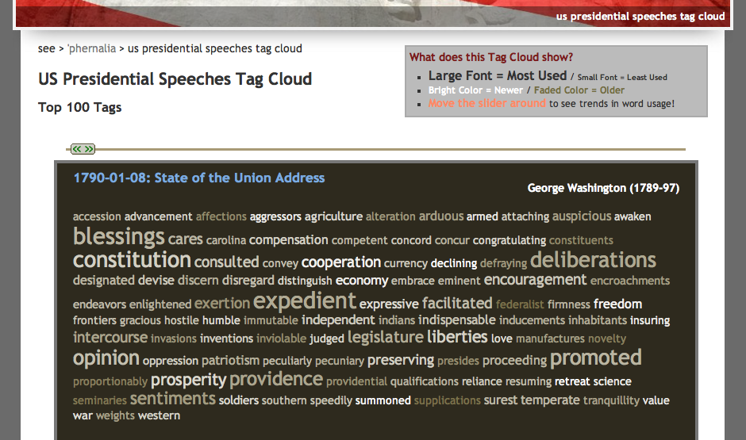
Text-cloud history
http://chir.ag/phernalia/preztags/

Slide 83
The pyRobot project
Robots typically cycle through several states :
States represent current subtasks
other keys...
Arrows represent transitions, through sensor or keybd feedback
KBD
FWD
keyboard control
's' key pressed
go forward
This triangle indicates the "start state"
How do we get out of FWD?
"a finite state machine"

Slide 84
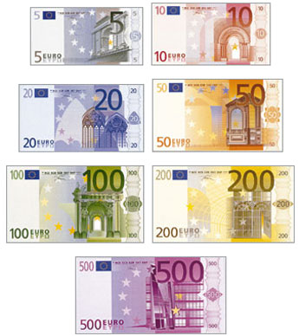
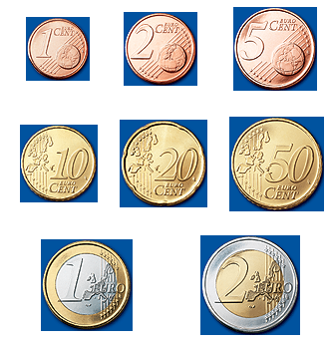
CS 5 currency…
Final project: 1 Euro for each deadline
as long as one partner has a Euro left....
Also ask about our Euro "buy-back" plan: convert your unused Euros to more valuable currency (like M&Ms)

Slide 85
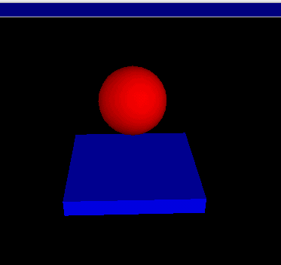
Getting familiar with VPython's API...
(0) How many tuples appear in this code? ________
(1) How many classes are used here? ________
(2) How many objects are used here? ________
(3) How are the collisions working?
Look over this VPython program to determine
from visual import *
floor = box( pos=(0,0,0), length=4, height=0.5,
width=4, color=color.blue)
ball = sphere( pos=(0,4,0), radius=1, color=color.red)
ball.velocity = vector(0,-1,0)
dt = 0.01
while True:
rate(100)
ball.pos = ball.pos + ball.velocity*dt
if ball.pos.y < ball.radius:
ball.velocity.y = -ball.velocity.y
else:
ball.velocity.y = ball.velocity.y - 9.8*dt
What's this if/else doing?

Slide 86
What is a word for which each of these rules "works" and "fails." Then, add a new rule that handles one of the failures – or an entirely new case!
Stemming
def stem( wd ):
if wd[-3:] == 'ing':
wd = wd[:-3]
This works for _________
it fails for _________
elif wd[-3:] == 'ies':
wd = wd[:-3] + 'y'
This works for _________
it fails for _________
elif wd[-2:] == 'er':
wd = wd[:-3]
This works for _________
it fails for _________
Write a rule to handle plurals ...
(1) What might go wrong?
(2) How might you fix it?
return wd
It's easy to miss cases!

Slide 87
Extra: Text Clouds
text cloud
Summary of the words in a body of text, sized according to their frequency.
this doesn't look nearly colorful enough…
demos… ?

Slide 88
Text-cloud history
http://chir.ag/phernalia/preztags/

Slide 89
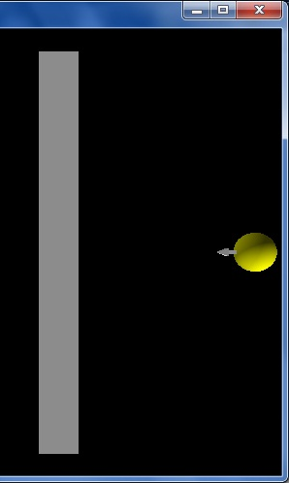
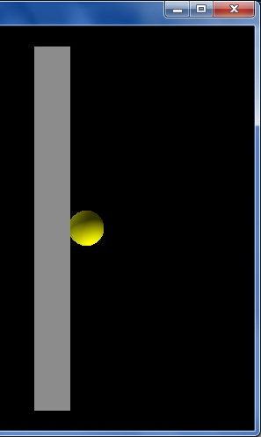
vPool collisions
I guess I'll watch out for VPython collisions...!
from visual import *
wall = box( ... )
ball = sphere( pos=(10,0,0), radius=1 )
ball.velocity = vector(-2,0,0)
RATE = 30
dt = 1/RATE
while True:
rate(RATE)
ball.pos += ball.velocity * dt
if ball.pos.x < 2.0:
print "Collide!"
ball.velocity = -ball.velocity
Start...
this is x == 2
Stuck!
What errors – in coding or logic or both – are here?

Slide 90
vPool collisions
I guess I'll watch out for VPython collisions...!
from visual import *
wall = box( ... )
ball = sphere( pos=(10,0,0), radius=1 )
ball.velocity = vector(-2,0,0)
RATE = 30
dt = 1/RATE
while True:
rate(RATE)
ball.pos += ball.velocity * dt
if ball.pos.x < 2.0:
print "Collide!"
ball.velocity = -ball.velocity
Start...
this is x == 2
Stuck!
What errors – in coding or logic or both – are here?

Slide 91
Labs?
(this week is VPython)
December's labs are final-project based:
optional, but helpful! (even more optional than usual...)
a natural opportunity to work in a pair
work on your laptop or the CS machines
easy access to help
and some of the CS machines do need work!
unspeakably fun!
Don't say it!

Slide 92
Is this a computer?
transition on 0
transition on 0
transition on 1
State 0
State 1
transition on 1
an input sequence
0010111
What does each state MEAN ?
always left-to-right
What does this FSM do overall?

Slide 93
Another example
0
1
s1
s0
0
1
s2
0,1
Specifically?
What inputs does this FSM accept?
Generally?
Fewer states?
What does each state MEAN ?

Slide 94
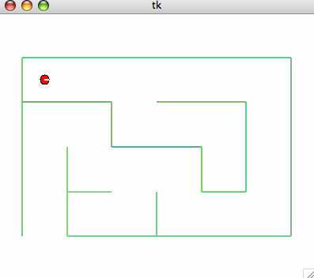
Project options...
VPool
TextClouds
PyRobot
Picobot!

Slide 95
Project options...
VPool
TextClouds
PyRobot
Picobot!

Slide 96
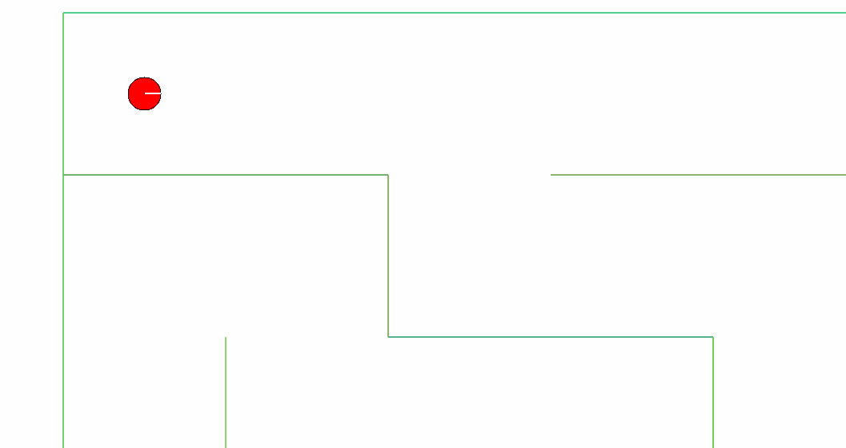
The pyRobot project
Hey! Watch where you're going!
Pt A
How do I control this robot !?!
2d simulator
Goal: get from Pt A to Pt B
Pt B

Slide 97
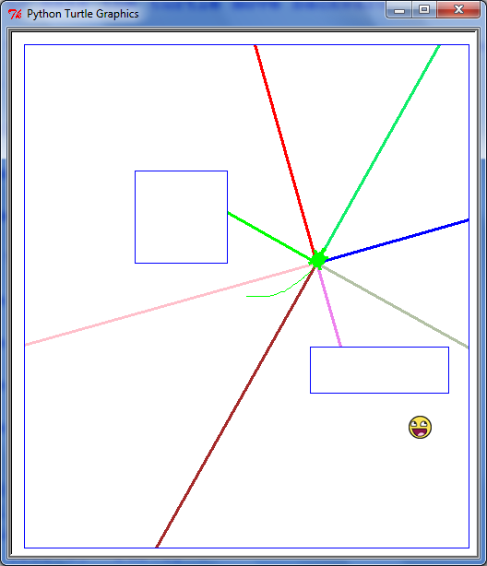
The pyRobot project
Robot control continuously loops through three things:
while True:
SENSE
PLAN
ACT
Sounds refreshing to me!
Robots almost always use the SPA approach!

Slide 98
The pyRobot project
Robots typically cycle through several states :
States represent current subtasks
other keys...
Arrows represent transitions, through sensor or keybd feedback
KBD
FWD
keyboard control
's' key pressed
go forward
This triangle indicates the "start state"
How do we get out of FWD?
"a finite state machine"

Slide 99
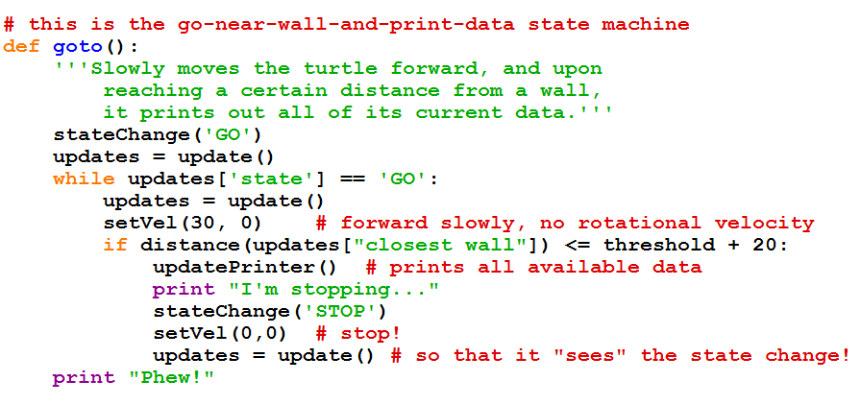
The pyRobot project
while True:
Robot control continuously runs three things:
SENSE
PLAN
ACT

Slide 100
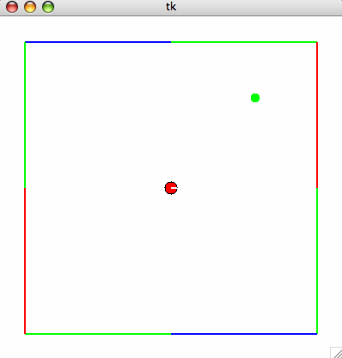
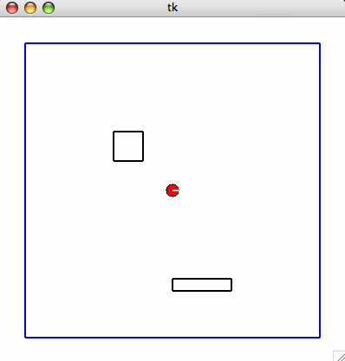
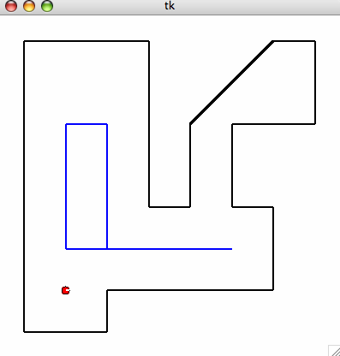
Maps
are set by hitting the '8' key...
Required
Extra

Slide 102
The pyRobot project
Robots typically cycle through several states :
States represent current subtasks
other keys...
Arrows represent transitions, through sensor or keybd feedback
KBD
FWD
keyboard control
's' key pressed
go forward
This triangle indicates the "start state"
How do we get out of FWD?
"a two-state state machine"

Slide 103
What is a word for which each of these rules "works" and "fails." Then, add a new rule that handles one of the failures – or an entirely new case!
Stemming
def stem( wd ):
if wd[-3:] == 'ing':
wd = wd[:-3]
This works for _________
it fails for _________
elif wd[-3:] == 'ies':
wd = wd[:-3] + 'y'
This works for _________
it fails for _________
elif wd[-5:] == 'ement':
wd = wd[:-4]
This works for _________
it fails for _________
Fix one of these rules – or write another one... .
return wd
Maybe stemming stemming?

Slide 104
What will CS 5 be about... ?
What
Theoretical results in CS...

Slide 105
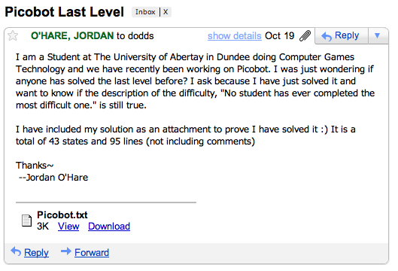
Picobot lives!
Your simulator will be able to run these rules just like any others!

Slide 106
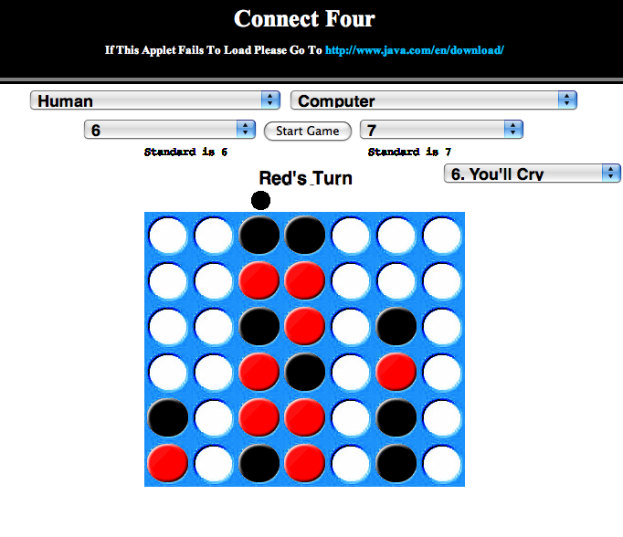
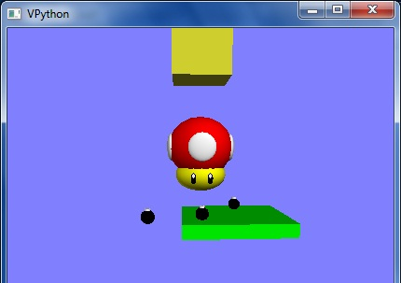
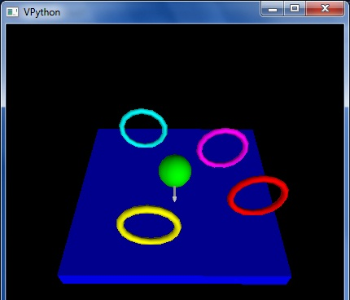
Previously cool submissions...
You mean these no longer qualify as cool?
http://stanford.edu/~ccecka/research/C4.html
Creativity + Physics = vPool !

Slide 107
The pyRobot project ~ additions
Main
Goal: get from Pt A to Pt B
Optional
Start in an unknown location on the map…
Implement a niftier interface…
I'm lost!
vPython Robot?
Use only the bump sensors… (no range sensing)
Use noisy (realistic) data

Slide 108
The pyRobot project ~ additions
Main
Goal: get from Pt A to Pt B
Optional
Start in an unknown location on the map…
Implement a niftier interface…
I'm found!
vPython Robot?
Use only the bump sensors… (no range sensing)
Use noisy (realistic) data
Try your code for a "spin"…

Slide 109
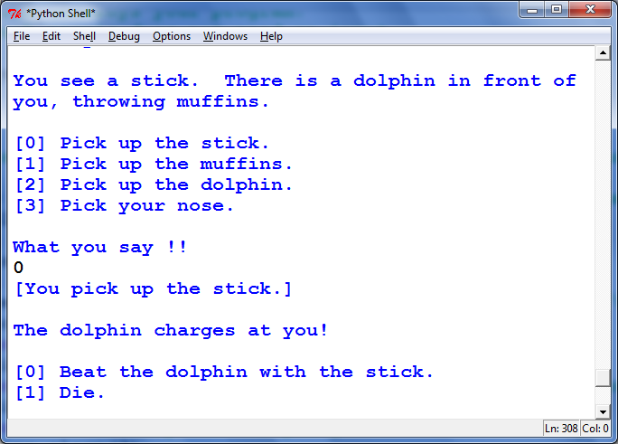
More cool submissions?
Thanks, Alex!

Slide 110
Command-line commands
pwd
ls
cd
nano
cp
chmod
wc
prints the current directory
lists the current directory
changes directory
edits files
copies files
changes file permissions
Hey - that's me!
counts the words, lines, and characters

Slide 111
Design for software and beyond
Don Norman's key principles:
0. Conceptual models
1. Mapping
Visibility
Feedback
Affordances

Slide 112
Where do these go wrong?
Mapping
Visibility
Feedback
Affordances
Set to 5 minutes?
How to open this gas cap?
This handle unfastens the seat from the floor.
Win NT Dialog
How to turn on this stove?

Slide 113
CS 5 Mudd…
(0,0,0)
(110,102,0)
(220,205,0)
CS 5's winter weeks:
final project
computational models
uncomputability
No regular labs this week
Ex. Cr. labs are scheduled
Tue. (today): 2:45-4:45
Wed. (tomorrow): 2:45-4:45
Tue., 12/14 2 pm – Exam option #1
more later on, too ...
Thu., 12/16 9 am – Exam option #2

Slide 114
Final-project season
congratulations to all E11ers!
Today is about the CS 5 Term Projects
Sales pitch for the four possible options...
A sneak peek at "December in CS 5"
vPool
Picobot
pyRobot
Text Clouds
I’ve got my eyes on some of these projects!
Eye'll bet!

Slide 115
Final projects
open-ended
comprehensive
Final CS assignment
same projects for black/gold
several choices…
Working solo or duo is OK
Pairs need to work together (in the same place) and to share the work equally...
Eye, eye!

Slide 116
Cool submissions!
http://stanford.edu/~ccecka/research/C4.html
Room for creativity...

Slide 117
The vPool project
Phunky Fisicks is welcome!
VPython was designed to make 3d physics simulations simpler to program
Collisions with walls should be handled...
Collisions with other pool balls should be handled...
Pockets – or some other game objective
A few examples to get you thinking…
Linux users are welcome!
But they should use another OS…

Slide 118
Text Clouds project
2010
tag cloud
merges?

Slide 119
Text Clouds project
Input
http://www.cs.hmc.edu/~cs5grad/cs5/textcloud/page1.html
http://www.cs.hmc.edu/~akeizur/
Hey! Where did these come from?
Output
I think spam should go to 11!

Slide 120
Text Clouds project
http://www.cs.hmc.edu/~cs5grad/cs5/textcloud/page1.html
Spamming spammers spammed spam. Spam spam spam! I love spam!
['spamming', 'spammers', spammed', 'spam.', 'spam', 'spam', 'spam!',
'I', 'love', 'spam!', 'page', '2']
What happened here?
['spamming', 'spammers', spammed', 'spam', 'spam', 'spam', 'spam',
'love', 'spam', 'page', '2']
And here?
['spam', 'spam', spam', 'spam', 'spam', 'spam', 'spam',
'love', 'spam', 'page', '2']
What's next?

Slide 121
Text Clouds project
From text…
Start with a webpage (URL)
Read in text
Create a list of words
Clean the words
Stem the words
Count the words
Return a string with frequencies
Add advanced features…
This looks familiar...
So does this!
… to cloud

Slide 122
Text Clouds project
Develop the basic application using IDLE.
After it works, make it a webpage...
The Approach:
Use the provided code to read HTML
Make sure that you can process the files appropriately into ordered lists of words…
Once you have things working, move on to
writing HTML
following links beyond depth 1
Building a web crawler ...
Once you have everything working,
transfer your files to your webspace.
set up the HTML wrapper files & go…
What will you need to look out for?
Personalize - There are lots of ways to do this!
Alexa's ...

Slide 123
Text-cloud history
http://chir.ag/phernalia/preztags/

Slide 124
The pyRobot project
Robots typically cycle through several states :
States represent current subtasks
other keys...
Arrows represent transitions, through sensor or keybd feedback
KBD
FWD
keyboard control
's' key pressed
go forward
This triangle indicates the "start state"
How do we get out of FWD?
"a two-state state machine"

Slide 125
The pyRobot project
Robots typically cycle through several states :
other keys...
KBD
FWD
keyboard control
's' key pressed
go forward
Finish drawing the state machine for the random robot...

Slide 126
The pyRobot project
while True:
Robot control continuously runs three things:
SENSE
PLAN
ACT
[x,y,thd], bump = self.getData()
if bump[0] == True or bump[1] == True:
print 'BUMP!',
print ' [Left bump sensor:', bump[0], '] ',
print ' [Right bump sensor:', bump[1], '] '
robotTask = STOP
STOP is one of the robot's states. Every 40th of a second, the robot runs through this loop, sets the robot's state and sets the velocities accordingly. Don't sleep!
if robotTask == STOP:
self.setVels(0,0)
robotTask = KBD

Slide 127
Maps
are set at the very bottom of the main.py file:
Required
Extra

Slide 128
The Picobot project
Basic idea: implement Picobot (the hw problem from Week 1)
Picobot is also a finite-state machine!
talk about full circle...

Slide 129
The Picobot project
Basic idea: implement Picobot (the hw problem from Week 1)
Requirements:
Picobot is also a finite-state machine!
Text and graphical output
Read Picobot program from a file
Read maze description from a file
Keep track of visited/unvisited squares
Prohibit illegal moves – unless they're legal...

Slide 130
Picobot returns!
What data structures (classes) might be helpful in implementing Picobot?

Slide 131
The Picobot project
Current State: 1
Current Rule: 1 N*W* -> X 2
++++++++++
+o++o+o+++
+oooooo ++
++++o++ +
+oooo+++++
++++o +
+oooo+++ +
++++o+++++
+Rooo +
++++++++++
First, prototype it as ASCII-bot
Picobot started here…
and is now here…

Slide 132
The Picobot project
Graphical picobot:
turtle version…
Choice of graphical packages
VPython for 3d
turtle for 2d
Start/stop/step feature
Maze editing
Pebble dropping
Be inventive!
Lots of options…

Slide 133
What’s due?
Mon., 12/6 – Interim milestones due (11:59 pm)
milestone.txt
milestone.py
Name(s)
Project chosen
Your project description:
What is your plan.
What is your approach.
A start at an implementation.
Classes and functions
Docstrings
60-80+ lines of working, tested code
Nice milestone!
It’s actually a kilometer stone.

Slide 134
What’s due?
Fri., 12/10 – Final deliverables due (by 5:00 pm)
final.txt
final.py
Name(s)
Project chosen
Description of user interface:
How do we run / play your project.
What features did you implement.
What was your approach & plan.
Classes and functions with documentation/docstrings
Working, tested code
A final milestone?

Slide 135
CS 5 currency…
Final project: 1 Euro for each deadline
as long as one partner has a Euro left....
Ask Prof. Ran about his Euro "buy-back" plan!

Slide 136
Labs?
December's labs are final-project based:
optional, but helpful!
a natural opportunity to work in a pair
and some of the CS machines do need work!
work on your laptop or the CS machines
easy access to help
HTML set up for the TextClouds project
unspeakably fun!
Don't say it!
optional labs?

Slide 137
CS 5 Today
(0,0,0)
(110,102,0)
(220,205,0)
CS 5's final three weeks:
final project
w/Euro
CS labs this week: VPython
25
CS hwk this week: C4 AI
Hwk 11 due: Dec. 3
final exam
Mon., 12/17 2 pm – Exam option #1
Wed., 12/19 9 am – Exam option #2

Slide 138
def scoresFor(self, b):
""" MUST return a list of 7 scores!! """
scores = [50,50,50,50,50,50,50]
(0) Start all scores at 50.
(1) For each col to move:
(2a) If not possible…
(2b) If game already over…
(2c) Else add the move to b
(3) Ask an opponent (!!!) for its scoresFor at ply-1
(4) compute self's score
for col in range( 0, 7 ):
return scores

Slide 140
XKCD's take…

