Slide 1
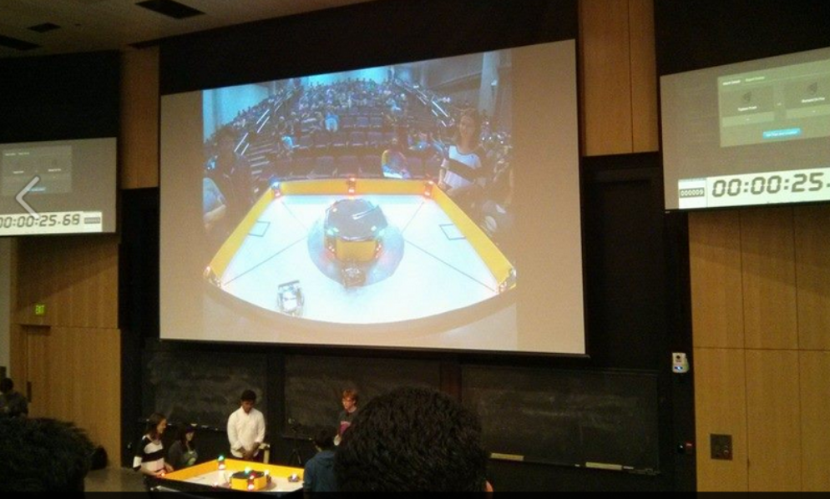
CS5 in Dec. ~ an overview
I've got all my eyes on this view!
CS Practice
The view from here…
Final Projects
Picobot
vPool
TextID
E11 finale!

Slide 2
Homework 12
Due: Mon. 12/8
mathematical foundations of CS
(1) Building finite-state machines
50 points; up to +32 ex. cr. pts
(2) project milestone ~ "progress report"
vpython_milestone.zip
picobot_milestone.zip
textid_milestone.zip
For the milestone, you’ll submit a zip file

Slide 3
Labs in week 12-13
Labs: T and W 2:45 and 6pm
These are entirely optional meeting times:
no signing in
to work on your milestone/final projects
to work on hw 12's finite-state machines
Wed. 6-8pm: Extra-credit lab in parallel programming
Room for 12 more people – email me if you’re interested
Worth +10 extra-credit points (on the exam); plus food…
Please bring a laptop + earbuds/headphones

Slide 4
Labs in week 12-13
Labs: T and W 2:45 and 6pm
we won't be able to get you feedback on the milestone – so join us for lab!
These are entirely optional meeting times:
no signing in
to work on your milestone/final projects
to work on hw 12's finite-state machines
Wed. 6-8pm: Extra-credit lab in parallel programming
Room for 12 more people – email me if you’re interested
Worth +10 extra-credit points (on the exam); plus food…
Please bring a laptop + earbuds/headphones

Slide 5
CS5 in Dec. ~ Big picture
I've got all my eyes on this view!
CS in practice
The view from here…
Final Projects
Picobot
vPool
TextID
CS Applications
populationanalysis + algorithms
graphics / media / games ...
feature-based modeling + classification
robots and other fun stuff (today…)
recursion
variables
loops
circuits and memory
data: classes and objects
functions
CS 5
CS Theory
is over here:
CS Foundations
What can be computed...
... and how efficiently?

Slide 6
CS5 in Dec. ~ Big picture
Final Projects
Picobot
vPool
TextClouds
CS 5 ~ all corners of CS
CS Applications
biological analysis + algorithms
graphics media games ...
robots and computer vision
search and the web
recursion
variables
loops
circuits and memory
data: classes and objects
functions
CS 5
CS Theory
CS Foundations
CS Foundations
What can be computed...
... and how efficiently?

Slide 7
The next two weeks in CS5…
(1) define "computer" precisely
(2) define "compute" precisely
(3) see what computers provably can't compute
(4) go to step (1) and define things better…
(5) … or, time will run out.
Aargh!
CS Foundations

Slide 8
Unifying idea: State
0 NEWx -> S 1
previous state
next state
external input
next step
The state of a computation is
all the internal information needed to take the next step
and for Picobot, next step is taken literally!

Slide 9
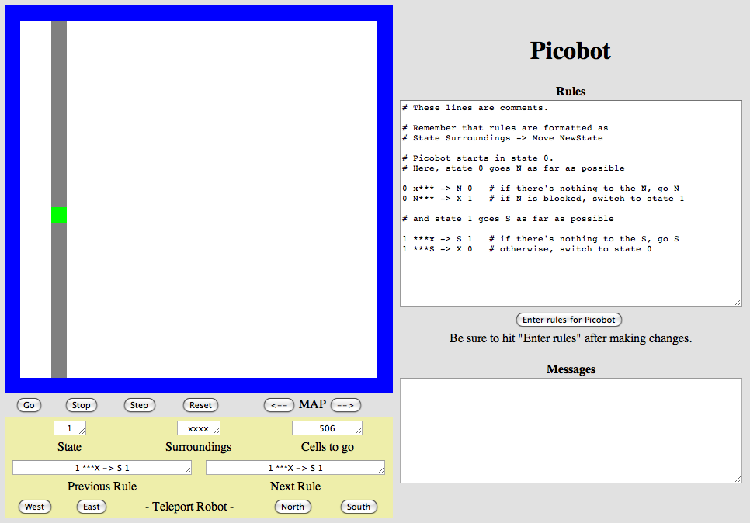
states as subtasks
each circle represents a different robot state
x***
***x
N***
state pattern -> move new state
starting funnel
state 0
state 1
0 x*** -> N 0
0 N*** -> X 1
1 ***x -> S 1
1 ***S -> X 0
the "go North" state
the "go South" state
***S
transitions move from state to state

Slide 10
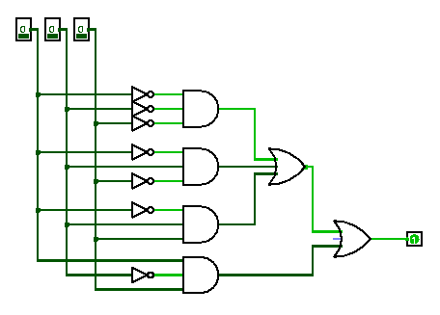
Computation is a deliberate sequence of state-changes
this doesn't seem very meaningful
0110110101011010010001
0110110101000000001110
bits before
bits after

Slide 11
A model of computation: FSM
Finite State Machine
Example input
100101
input sequence
read left-to-right
Example FSM
0
0
1
s0
s1
1
start state
transitions
accepting states
“input funnel”
“where to go”
double circled
labeled by input !

Slide 12
FSM: Finite state machine
transition on 0
transition on 0
transition on 1
State 0
State 1
transition on 1
another input sequence
0010111
What does each state MEAN ?
always left-to-right
What does this FSM do overall?

Slide 13
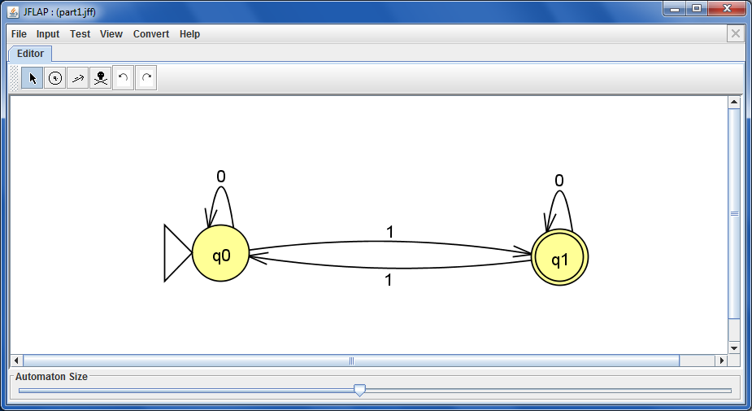
JFLAP !
graphical state-machine builder for hw12

Slide 14
Quiz!
Name(s) _____________________________
0
1
1
s1
s0
1
0
0
1
s3
s2
0
List three different inputs that this FSM accepts:
List three different inputs that this FSM rejects:
In general, what English phrase describes the accepted inputs?
This machine accepts strings that…
What does each state say about the current state of the input?!?
s0 means…
s2 means…
s1 means…
s3 means…
Could you get the same behavior with fewer states? What's the minimum # possible? How do you know?
Hint: find a string that has to be in each state!
Extra!

Slide 15
Quiz!
Try this on the back page first…
0
1
1
s1
s0
1
0
0
1
s3
s2
0
List three different inputs that this FSM accepts:
List three different inputs that this FSM rejects:
In general, what English phrase describes the accepted inputs?
This machine accepts strings that…
What does each state say about the current state of the input?!?
s0 means…
s2 means…
s1 means…
s3 means…
Could you get the same behavior with fewer states? What's the minimum # possible? How do you know?
Hint: find a string that has to be in each state!
Extra!

Slide 16
State ~ fate
Strings with different possible fates must be in different states.
0
1
1
s1
s0
1
0
0
1
s3
s2
0
Can we find three strings – all with different possible fates? 4?
If so, then three states are necessary! If not, fewer are OK.

Slide 17
Build-your-own FSMs
Draw a FSM accepting strings in which the number of zeros (0s) is a multiple of 3, so there are 0, 3, 6, … zeros. 1s don't matter.
Draw a FSM that accepts strings that don't contain the pattern 110 anywhere.
Accepted: 110101110, 11, 0000010
Rejected: 101, 0000, 111011101111
Accepted: 1010001 Rejected: 101001100
Hint: modify the first FSM we considered!
Hint: modify this starter FSM:
Requires at least 4 states
Minimum possible # of states?
Draw a FSM accepting strings in which the third digit (from the left) is a 1.
Draw a FSM accepting strings whose third-to-last digit (from the right) is a 1.
Accepted: 1010001 Rejected: 11000100 and 11
Accepted: 0100 and 01101 Rejected: 101001 and 11
Minimum possible # of states?
Minimum possible # of states?

Slide 18
No occurrences of 110
Draw a FSM accepting strings that do NOT anywhere contain the pattern 110
start
0
end w/1
end w/11
fail!
1
1
0
Minimum number of states?

Slide 19
No occurrences of 110?
0
1
0,1
1
0
Why doesn't this machine work?
Could we prove 4 states are required?

Slide 20
Number of 0s is div. by 3
Draw a FSM accepting strings in which the number of zeros (0s) is a multiple of 3, so there are 0, 3, 6, … zeros. 1s don't matter.
Accepted: 110101110, 11, 0000010
Rejected: 101, 0000, 111011101111
Minimum number of states?

Slide 21
Third character is a 1
Draw a FSM accepting strings in which the third digit (from the left) is a 1.
Accepted: 1010001
Rejected: 11000100 and 11
Minimum number of states?

Slide 22
Third-to-last character is a 1?
Draw a FSM accepting strings whose third-to-last digit (from the right) is a 1.
Accepted: 0100 and 01101
Rejected: 101001 and 11
Minimum number of states?

Slide 23
Third-to-last character is a 1
s000
s001
s010
s011
s100
s101
s110
s111
8 states?
How could we prove that 8 states are required?

Slide 24
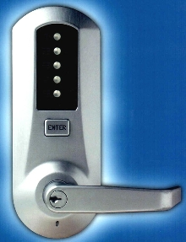
12
5
34
FSMs are everywhere!
q_{start}
q₁
q₂
q₃
q₄
q₅
Locks
q₁₂
q₁₃
q₁₄
q₁₅
q₂₃
q_{12,3}
q_{12,4}
q_{12,5}
q_{12,5,34}

Slide 25
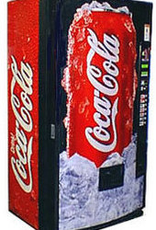
FSMs are everywhere!
penny, fifty cent piece,
silver dollar, Canadian
currency, CS 5 Euro, ….
q_{start}
nickel
dime
quarter
q_{5 cents}
q_{10 cents}
q_{25 cents}
nickel
mechanical
vending machine
dime
nickel
nickel
q_{15 cents}
q_{20 cents}
nickel
(some transitions not shown)

Slide 26
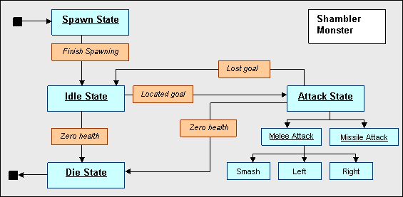
FSM ~ Game AI
The state-machine that controls Quake's Shambler monsters…
I'm Quaking in my AstroBoots

Slide 27
Towel-folding states!

Slide 28
All robots use FSM control
50x

Slide 29
Towel-folding?
singled out as a questionable use of dollars...

Slide 30
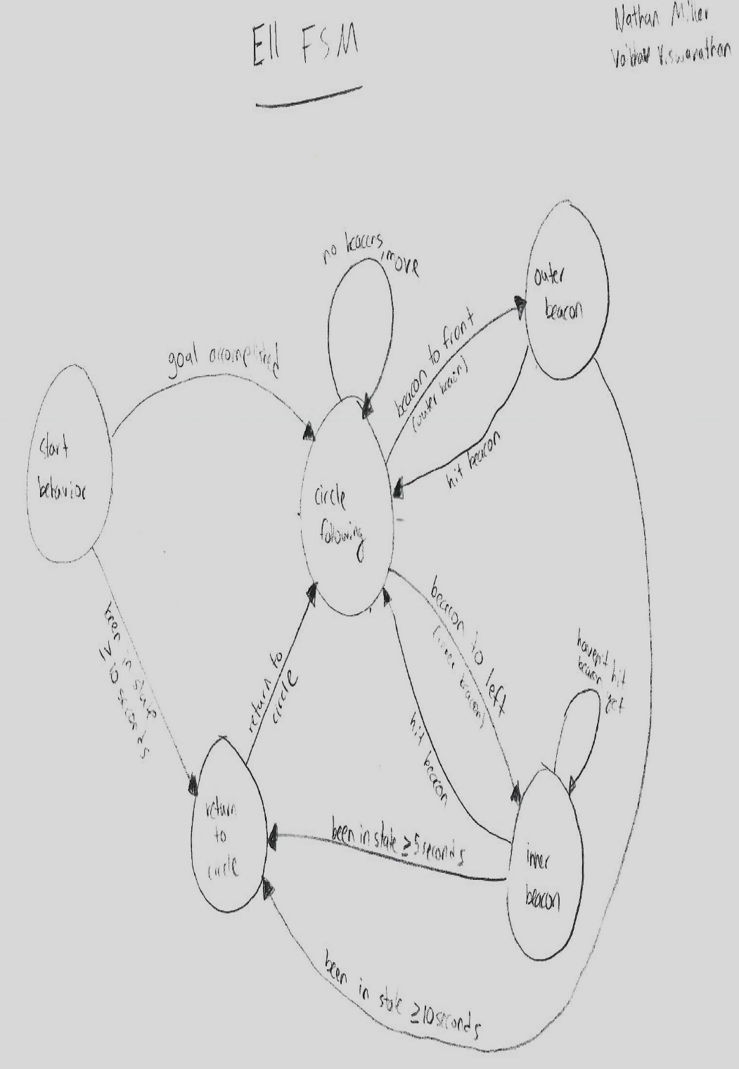
All robots use FSM control

Slide 31
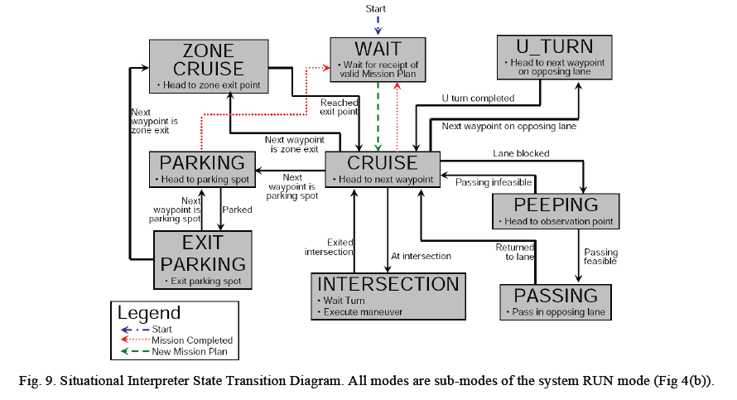
An autonomous vehicle's FSM

Slide 32
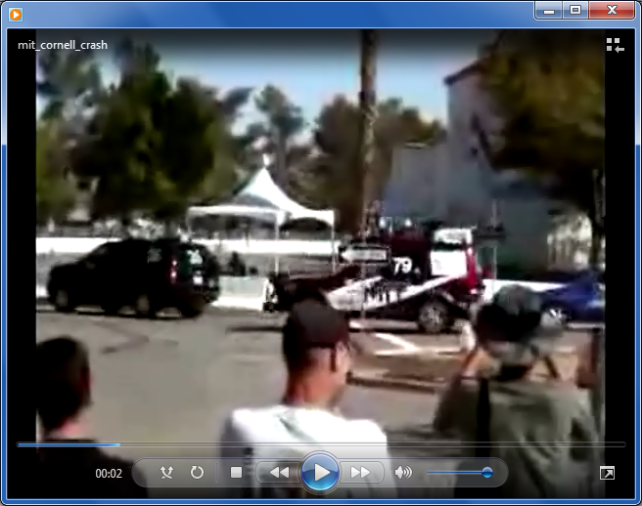
FSMs driving robots...
MIT's car, Talos

Slide 33
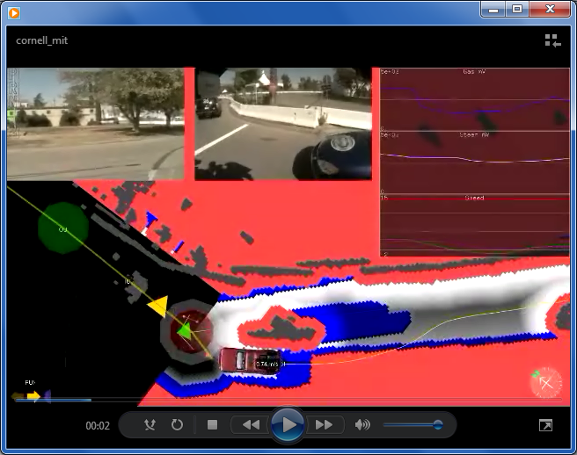
FSMs driving robots...
MIT's car, Talos - and its sensor suite

Slide 34
State-machine limits?
Are there limits to what FSMs can do?
they can't necessarily drive safely...
But are there any binary-string problems that FSMs can't solve?

Slide 35
State-machine limits?
accepted
011001
0110
10
λ
this last string is empty
rejected
01100
01110
0100
Let's build a FSM that accepts bit strings with the SAME NUMBER of 0s as 1s
000

Slide 36
State-machines are limited.
FSMs can't count
at least not arbitrarily high...
We need a more powerful model than FSMs...
What do we need to add?

Slide 37
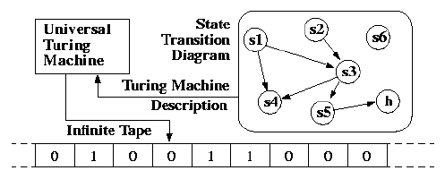
Thursday: Turing Machines
state machines + memory!
Lab! Work on FSMs or final projects…
Wed. Lab Email me if you’d like to join the excr. parallel- programming lab Wed. eve.!

Slide 39
Quiz!
Try this on the back page first…
0
1
s1
s0
0
1
s2
0,1
List three different inputs that this FSM accepts:
List three different inputs that this FSM rejects:
In general, what English phrase describes the accepted inputs?
This machine accepts strings that…
What does each state say about the current state of the input?!?
s0 means the input…
s1 means the input…
s2 means the input…

Slide 40
A model of computation: FSM
Finite State Machine
Example input
100101
input sequence
read left-to-right
Example FSM
0
0
1
s0
s1
1
start state
transitions
accepting states
“input funnel”
“where to go”
double circled
labeled by input !

Slide 41
FSM: Finite state machine
transition on 0
transition on 0
transition on 1
State 0
State 1
transition on 1
another input sequence
0010111
What does each state MEAN ?
always left-to-right
What does this FSM do overall?

Slide 42
Quiz!
Name(s) ________________________
0
1
s1
s0
0
1
s2
0,1
List three different inputs that this FSM accepts:
List three different inputs that this FSM rejects:
In general, what English phrase describes the accepted inputs?
This machine accepts strings that…
What does each state say about the current state of the input?!?
s0 means the input…
s1 means the input…
s2 means the input…

Slide 43
No occurrences of 110
Draw a FSM accepting strings that do NOT anywhere contain the pattern 110
start
0
end w/1
end w/11
fail!
1
1
0
Minimum possible number of states?

Slide 44
Number of 0s is div. by 3
Draw a FSM accepting strings in which the number of zeros (0s) is a multiple of 3, so there are 0, 3, 6, … zeros. 1s don't matter.
Accepted: 110101110, 11, 0000010
Rejected: 101, 0000, 111011101111
Minimum number of states?

Slide 45
Third character is a 1
Draw a FSM accepting strings in which the third digit (from the left) is a 1.
Accepted: 1010001
Rejected: 11000100 and 11
Minimum possible number of states?

Slide 46
Third-to-last character is a 1?
Draw a FSM accepting strings whose third-to-last digit (from the right) is a 1.
Accepted: 0100 and 01101
Rejected: 101001 and 11
Minimum number of states?

Slide 47
Third-to-last character is a 1
0
s∅
1
s0
s1
1
0
1
0
s00
s01
s10
s11
0
1
0
1
0
1
0
1
s000
s001
s010
s011
s100
s101
s110
s111
Something seems missing here…
Proof that we need 15 states?

Slide 48
State-machine limits?
Let's build a FSM that accepts bit strings with the SAME NUMBER of 0s as 1s

Slide 49
A model of computation: FSM
Finite State Machine
Example input
100101
input sequence
read left-to-right
Example FSM
0
0
1
s0
s1
1
start state
transitions
accepting states
“input funnel”
“where to go”
double circled
labeled by input !

Slide 50
FSM: Finite state machine
transition on 0
transition on 0
transition on 1
State 0
State 1
transition on 1
another input sequence
0010111
What does each state MEAN ?
always left-to-right
What does this FSM do overall?

Slide 51
Third character is a 1
Draw a FSM accepting those strings in which the third digit (from the left) is a 1.
The minimum possible number of states?

Slide 52
Third-to-last character is a 1
Draw a FSM accepting strings whose third-to-last digit (from the right) is a 1.
0
s∅
1
s0
s1
1
0
1
0
s00
s01
s10
s11
0
1
0
1
0
1
0
1
s000
s001
s010
s011
s100
s101
s110
s111
Something seems missing…
I don't accept this solution!
The minimum possible number of states?

Slide 53
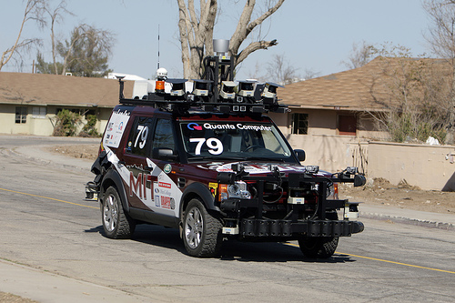
FSMs for physical AI, a.k.a. robots
An autonomous vehicle
A towel-folding robot

Slide 54
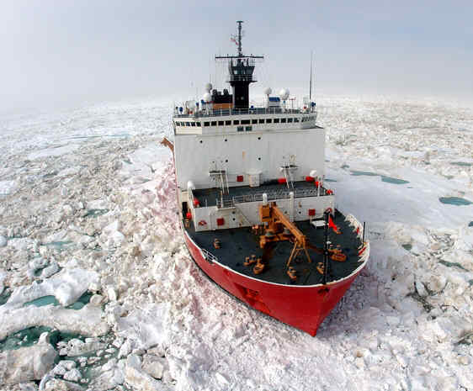
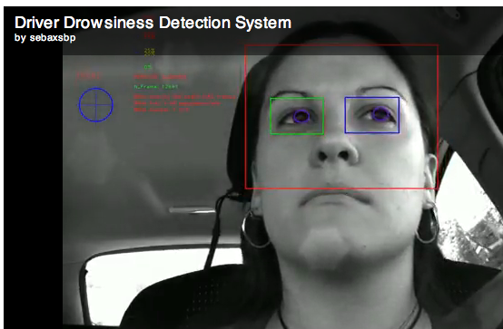
What happens in Vegas... ?
Perhaps the saying isn't always true...
reconstructing ice fields
drivers watching out for cars...
... or vice versa!

Slide 55
CS5: an overview
I've got all my eyes on this view!
CS Practice
The view from here…
Final Projects
Picobot
vPool
TextID
CS stuff!
www.amazon.com/b?ie=UTF8&node=8037720011
gizmodo.com/heres-how-to-win-every-time-at-connect-four-1474572099
CS Theory
is over here:
CS Foundations
What can be computed...
... and how efficiently?

Slide 56
Another FSM ?
What FSM accepts inputs that are palindromes ?
Yottabytes are a LOTTA bytes!
Computers > FSMs ?
Notes:
metric prefixes…

Slide 57
A "view" of CS 5
I've got all my eyes on this view!
CS Practice
Final Projects
Picobot
vPool
TextClouds
The view from here…
CS Applications
biological analysis + algorithms
graphics media games ...
robots and computer vision
search and the web
recursion
variables
loops
circuits and memory
data: classes and objects
functions
CS 5
CS Theory
is over here:
CS Foundations
What can be computed...
... and how efficiently?

Slide 58
?
Computers ~ state machines
Instruction Pointer (Program Counter)
01001000
11001000
00000000
01001000
Other
Registers
10010011
CPU (Processor)
RAM (Memory)

Slide 59
?
Computers ~ state machines
Instruction Pointer (Program Counter)
01001000
11001000
00000000
01001000
Other
Registers
10010011
CPU (Processor)
RAM (Memory)
Focusing on the computation not its implementation.

Slide 60
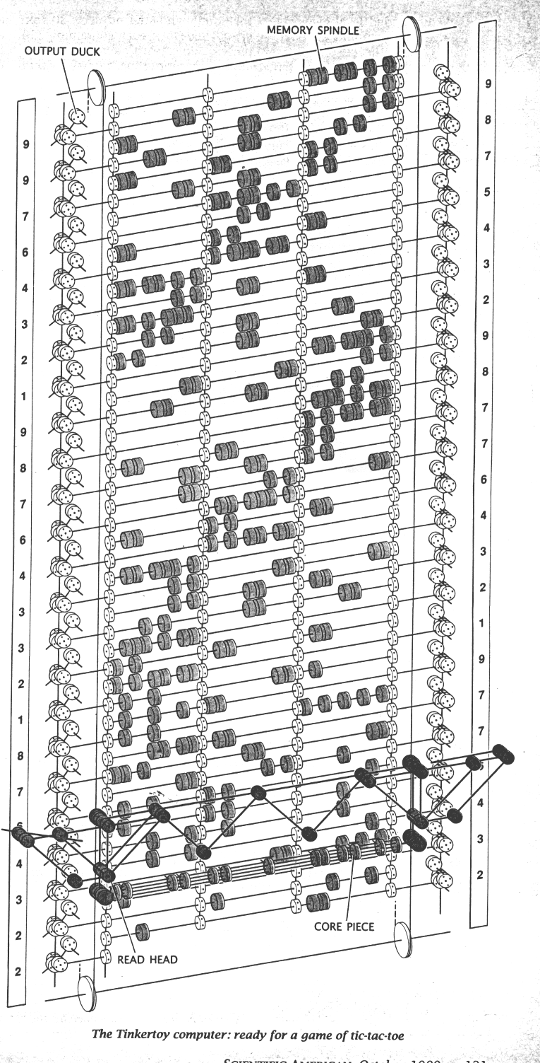
Computation, without the machine!
Quantum computation
http://www.cs.caltech.edu/~westside/quantum-intro.html
Molecular computation
http://www.arstechnica.com/reviews/2q00/dna/dna-1.html
Parallel computers
Integrated circuits
Tinkertoy computation
Electromechanical computation

Slide 61
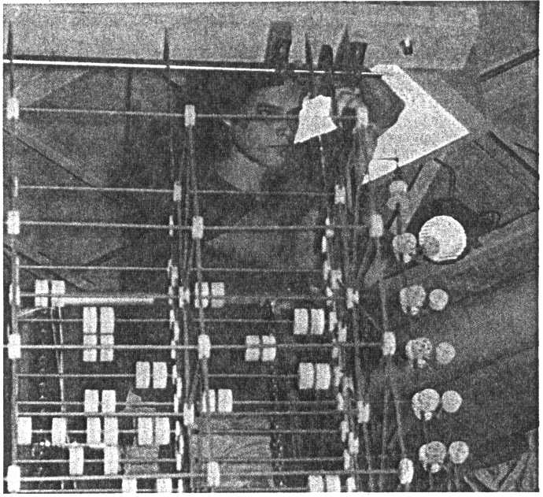
Tinkertoy computing
Edward Hardebeck assembling the Tinkertoy computer

Slide 62
DNA computing
Uses human-engineered DNA strands to represent, compute, and solve a computational problem…
a
S0, a → S1
S0, b → S0
S1, a → S0
S1, b → S1
b
S0
S1
b
a
Two-states, two-symbol automaton
Initial example …

Slide 63
DNA computing
Uses human-engineered DNA strands to represent, compute, and solve a computational problem…
a
S0, a → S1
S0, b → S0
S1, a → S0
S1, b → S1
b
S0
S1
b
a
Determining the parity of as in a list
Two-states, two-symbol automaton
Initial example …

Slide 64
Why should life get to use all the DNA?

Slide 65
See you in Lab!
Wednesday:
Black and Gold meet separately…

Slide 66
Homework 11
Due: Mon. 12/3
(1) VPython lab: 3d game
(2) Connect Four AI
(3) Building finite-state machines

Slide 67
Connect Four ~ reminders…
What score does this board get?

Slide 68
Scoring moves
At 1 ply, what does each move score for red?

Slide 69
Scoring moves
At 2 ply, what does each move score for red?

Slide 70
def scoresFor(self, b):
""" MUST return a list of 7 scores!! """
scores = [50,50,50,50,50,50,50]
(0) Start all scores at 50.
(1) For each col to move:
(2a) If not possible…
(2b) If game already over…
(2c) Else add the move to b
(3) Ask an opponent (!!!) for its scoresFor at ply-1
(4) compute self's score
for col in range( 0, 7 ):
return scores

Slide 71
def scoresFor(self, b):
""" MUST return a list of 7 scores!! """
scores = [50,50,50,50,50,50,50]
(0) Start all scores at 50.
(1) For each col to move:
(2a) If not possible…
(2b) If game already over…
(2c) Else add the move to b
(3) Ask an opponent (!!!) for its scoresFor at ply-1
(4) compute self's score
for col in range( 0, 7 ):
op = Player( self.oppCh(),
self.tbt,
self.ply-1 )
opsc = op.scoresFor(b)
return scores

Slide 72
Suppose
def tiebreakMove(self, sc):
if self.tbt == 'LEFT':
sc = [-1,0,50,50,50,0,0]
col
0
1
2
3
4
5
6
We'll look at this after Thanksgiving…
Write tiebreakMove to return the leftmost best score inside the list scores
How would 'RANDOM' and 'LEFT' work differently?

Slide 73
Suppose
def tiebreakMove(self, sc):
if self.tbt == 'RIGHT':
col = _____
while sc[col] < ______ :
col -= 1
return col
sc = [-1,0,50,50,50,0,0]
col
0
1
2
3
4
5
6
Which column number do we want to return here?
At which col do we start?
How do we know if the col is NOT the one we want?
How would 'RANDOM' and 'LEFT' work differently?

Slide 74
FSM: Finite state machine
transition on 0
transition on 0
transition on 1
State 0
State 1
transition on 1
another input sequence
0010111
What does each state MEAN ?
always left-to-right
What does this FSM do overall?

Slide 75
Another example
0
1
s1
s0
0
1
s2
0,1
Specifically?
What inputs does this FSM accept?
Generally?
Fewer states?
What does each state MEAN ?

Slide 76
No occurrences of 110
Draw a FSM accepting strings that do NOT anywhere contain the pattern 110
start
0
end w/1
end w/11
fail!
1
1
0
The minimum possible number of states?

Slide 77
Number of 0s is div. by 3
Draw a FSM accepting those strings in which the number of zeros (0s) is a multiple of 3. (0, 3, 6, … zeros).
Accepted: 110101110, 11, 0000010
Rejected: 101, 0000, 111011101111
The minimum possible number of states?

Slide 78
Third character is a 1
Draw a FSM accepting those strings in which the third digit (from the left) is a 1.
The minimum possible number of states?

Slide 79
Third-to-last character is a 1
Draw a FSM accepting strings whose third-to-last digit (from the right) is a 1.
The minimum possible number of states?

Slide 80
Third-to-last character is a 1
Draw a FSM accepting strings whose third-to-last digit (from the right) is a 1.
0
s∅
1
s0
s1
1
0
1
0
s00
s01
s10
s11
0
1
0
1
0
1
0
1
s000
s001
s010
s011
s100
s101
s110
s111
Something seems missing…
I don't accept this solution!
The minimum possible number of states?

Slide 81
Mon., 12/6 – Interim milestones due
CS 5 Today
Fri., 12/10 – Final projects due
I've got all my eyes on this view!
Tue., 12/14 2pm – Exam option #1
Thu., 12/16 9am – Exam option #2
The view from here…
Friday: 2-4 office hours in CS labs; ExCr lab option
other weekend/week tutoring hours as usual...
CS Theory
is over here:
CS Foundations
What can be computed...
... and how efficiently?

Slide 82
DNA computing
Uses human-engineered DNA strands to represent, compute, and solve a computational problem…
a
S0, a → S1
S0, b → S0
S1, a → S0
S1, b → S1
b
S0
S1
b
a
Two-states, two-symbol automaton
Initial example …

Slide 83
DNA computing
Uses human-engineered DNA strands to represent, compute, and solve a computational problem…
Initial example …
Determining the parity of elements in a list

Slide 84
Finite automaton: an example
An even number of a’s
a
S0, a → S1
S0, b → S0
S1, a → S0
S1, b → S1
b
S0
S1
b
a
Two-states, two-symbols automaton

Slide 85
Automaton A1
An even number of a’s ?
S0, a → S1
S0, b → S0
S1, a → S0
S1, b → S1
S0
a
b
a

Slide 86
Automaton A1
An even number of a’s ?
S0, a → S1
S0, a → S1
S0, b → S0
S1, a → S0
S1, b → S1
S0
a
b
a

Slide 87
Automaton A1
An even number of a’s ?
S0, a → S1
S0, b → S0
S1, a → S0
S1, b → S1
S1
b
a

Slide 88
Automaton A1
An even number of a’s ?
S1, b → S1
S0, a → S1
S0, b → S0
S1, a → S0
S1, b → S1
S1
b
a

Slide 89
Automaton A1
An even number of a’s ?
S0, a → S1
S0, b → S0
S1, a → S0
S1, b → S1
S1
a

Slide 90
Automaton A1
An even number of a’s ?
S1, a → S0
S0, a → S1
S0, b → S0
S1, a → S0
S1, b → S1
S1
a

Slide 91
Automaton A1
An even number of a’s ?
S0, a → S1
S0, b → S0
S1, a → S0
S1, b → S1
S0
The output

Slide 92
FSM via DNA ?
Bio / Chem

Slide 93
Finite State Machines are Everywhere!
Enter
q_{start}
q₁
q₂
q₃
q₄
q₅
q₁₂
q₁₃
q₁₄
q₁₅
q₂₃
There’s a lot missing in this picture!
q_{12,3}
q_{12,4}
q_{12,5}
How many states total in this kind of lock?
q_{12,5,34}

Slide 94
No occurrences of 110
Draw a FSM accepting strings that do NOT anywhere contain the pattern 110
Draw a FSM accepting those strings in which the number of zeros (0s) is a multiple of 3. (0, 3, 6, … zeros).
Draw a FSM accepting those strings in which the third digit (from the left) is a 1.
Draw a FSM accepting strings whose third-to-last digit (from the right) is a 1.
Extra: Do your solutions use the minimum possible number of states?

Slide 95
?
Computers ~ state machines
Instruction Pointer (Program Counter)
“States”
01001000
10101010001000
10001010101010
00101010101010
10101011010100
00000010010000
11110000000010
00000101011101
00000000
11001000
10101010001000
10001010101010
00101010101010
10101011010100
00000010010000
11110000000010
00000101011101
01001000
10101010001000
10001010101010
00101010101010
10101011010100
00000010010000
11110000000010
00000101011101
Other
Registers
10101010001000
10001010101010
00101010101010
10101011010100
00000010010000
11110000000010
00000101011101
10010011
CPU (Processor)
RAM (Memory)
Time
10110
⬆
External input
Focusing on the computation not its implementation.

Slide 96
Computers as FSMs
Focusing on the computation not its implementation.

Slide 97
DFA Examples
What DFA accepts L = { w | w is a binary # that’s even }
What DFA accepts L = { w | w does not contain the substring 101 }
binary even numbers are sort of cheating…

Slide 98
DFAs can do anything !?
What DFA accepts L = { w | w is a binary # that’s divisible by 3 }
JFLAP

Slide 99
FSM Capabilities
Draw a FSM accepting those strings which are palindromes (they are the same forward and backward).
Draw a FSM accepting those strings in which the first and last digits are the same.
Extra: Do your solutions use the minimum possible number of states?

Slide 100
DFA “Quiz”
(1) Draw a DFA that accepts
L = { w | w’s third character is a 1}
Extra Credit: do your solutions use the minimum possible number of states?
(2) (Watch out!) Draw a DFA accepting
L = { w | w’s third-to-last character (from the right) is a 1}

Slide 101
Try These!
Draw a FSM that accepts any string that does not contain the pattern “110” anywhere
Draw a FSM that accepts exactly those strings in which the number of 1’s is a multiple of 3.
Draw a FSM that accepts exactly those strings in which the first and last digit are the same.
As an extra challenge, try to use as few states as possible for each problem.
Keep the meaning of each state in mind… .

Slide 102
Try These!
Draw a FSM that accepts any string that does not contain the pattern “110”.
0
1
q_{no}
_{worries}
q_{Oh, oh!}
_{a 1!}
0
Aren’t you missing some stuff here, profdude?

Slide 103
Try These!
Draw a FSM that accepts any string that does not contain the pattern “110”.
0
?
1
1
q_{no}
_{worries}
q_{Oh, oh!}
_{a 1!}
q_{Two 1’s!}
1
0
?
0

Slide 104
Try These!
Draw a FSM that accepts any string that does not contain the pattern “110”.
0
1
1
q_{no}
_{worries}
q_{Oh, oh!}
_{a 1!}
q_{Two 1’s!}
0
0
1
0,1
q_{Barf!}

Slide 105
Try These!
Draw a FSM that accepts exactly those strings in which the number of 1’s is a multiple of 3.
0
0
q₀
1
q₁
1
1
0
q₂

Slide 106
Try These!
Draw a FSM that accepts exactly those strings in which the number of 1’s is odd and the number of 0’s is even.
This is an odd problem!
It’s fun, even so!

Slide 107
Now, try these!
Draw a FSM that accepts its input if and only if the third digit from the left is a 1.
Draw a FSM that accepts its input if and only if the third digit from the right is a 1.
Remember, the input is read from left to right!
1010000: Accept!
000101: Reject!
Hmmm… That sounds a lot harder!
How do I predict that the digit that I’m seeing is the third digit from the end?!
1010000: Reject!
000101: Accept!

Slide 108
Now, try these!
Draw a FSM that accepts its input if and only if the third digit from the left is a 1.
1010000: Accept!
000101: Reject!
0, 1
0,1
q_{I’ve seen one digit}
0,1
q_{I’ve seen two digits}
1
q_{nothing}
q_{Happy!}
0
0, 1
qEat the rest of the input and die!

Slide 109
Now, try these!
Draw a FSM that accepts its input if and only if the third digit from the right is a 1.

Slide 110
Now, try these!
Draw a FSM that accepts its input if and only if the third digit from the right is a 1.
Cool, but can you do it with fewer states?
q_{start}
0
1
q₀
q₁
0
1
0
1
q₀₀
q₀₁
q₁₀
q₁₁
0
1
0
1
0
1
0
1
q₀₀₀
q₀₀₁
q₀₁₀
q₀₁₁
q₁₀₀
q₁₀₁
q₁₁₀
q₁₁₁
0
0
(some transitions not shown)
1
1
1

Slide 111
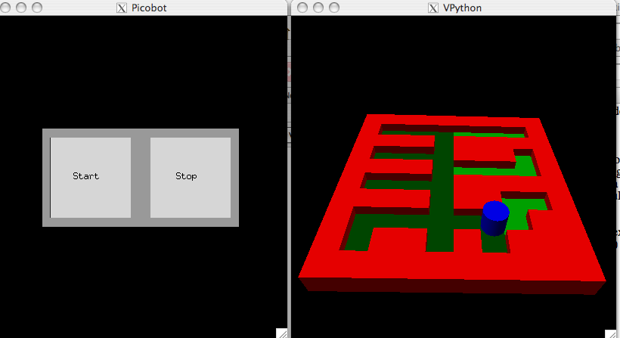
Finite State Machines are Everywhere!
Picobot!
state pattern -> move new state
0 x*** -> N 0
0 N*** -> S 1
1 ***x -> S 1
1 ***N -> N 0

Slide 112
Finite State Machines are Everywhere!
x*** (move North)
Picobot!
state pattern -> move new state
N*** (move South)
0 x*** -> N 0
0 N*** -> S 1
1 ***x -> S 1
1 ***N -> N 0
q₀
q₁

Slide 113
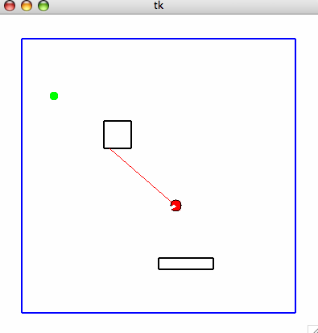
Finite State Machines are Everywhere!
q_{keyboard control state}
pyRobot!
q_{TURN}
q_{FORWARD}

Slide 114
Finite State Machines are Everywhere!
q_{keyboard control state}
pyRobot!
q_{TURN}
q_{FORWARD}

Slide 115
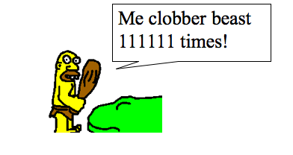
Unary Finite State Machines
6 in base 10 = 1111111 in “unary”

Slide 116
Unary Finite State Machines
6 in base 10 = 1111111 in “unary”
Me clobber beast 111111 times!

Slide 117
Unary Finite State Machines
6 in base 10 = 111111 in “unary”
A FSM for multiples of 3 in unary…

Slide 118
Unary Finite State Machines
6 in base 10 = 111111 in “unary”
A FSM for multiples of 3 in unary…
q₀
1
q₁
1
1
q₂

Slide 119
A Closer Examination of Uncomputability…
Can a FSM be constructed to determine if its input is the unary representation of:
A multiple of 5? (11111, 11111111111, …)
A power of 2? (1, 11, 1111, 11111111, …)
A perfect square? (1, 1111, 111111111, …)
A prime? (11, 111, 11111, 1111111, …)

Slide 120
Friday…
Black back in its regular classroom, Gold here!
Wrap-up, exam practice problems, final logistics and information, and course evaluations.

Slide 121
Famous CS Quotes…
“I believe there is a market for perhaps 5 computers in
the entire world” - Thomas J. Watson, Founder of IBM, 1943
“In the future, computers will weigh no more than 1.5 tons”
Popular Mechanics, 1949
“There is no reason why anyone would want to have a
computer in his home” - Ken Olson, Digital Equipment Corp. 1977
“640K ought to be enough for anybody” - Bill Gates (?)

Slide 122
Real Headlines (or “Why AI is SO hard!”)…

Slide 123
Real Headlines (or “Why AI is SO hard!”)…
Teachers Strike Idle Kids

Slide 124
Real Headlines…
Teachers Strike Idle Kids
Police Begin Campaign to Run Down Jaywalkers

Slide 125
Real Headlines…
Teachers Strike Idle Kids
Police Begin Campaign to Run Down Jaywalkers
Two Sisters Reunited after 18 Years in Checkout
Counter

Slide 126
Real Headlines…
Teachers Strike Idle Kids
Police Begin Campaign to Run Down Jaywalkers
Two Sisters Reunited after 18 Years in Checkout
Counter
Red Tape Holds Up New Bridges

Slide 127
Real Headlines…
Teachers Strike Idle Kids
Police Begin Campaign to Run Down Jaywalkers
Two Sisters Reunited after 18 Years in Checkout
Counter
Red Tape Holds Up New Bridges
Local High School Dropouts Cut in Half

Slide 128
Real Headlines…
Teachers Strike Idle Kids
Police Begin Campaign to Run Down Jaywalkers
Two Sisters Reunited after 18 Years in Checkout
Counter
Red Tape Holds Up New Bridges
Local High School Dropouts Cut in Half
Kids Make Nutritious Snacks

Slide 129
Developing a Model of a Computer…
Instruction Pointer (Program Counter)
01001000
Instruction
Register
00000000
11001000
01001000
Other
Registers
10010011
CPU (Processor)
RAM (Memory)

Slide 130
Developing a Model of a Computer…
Instruction Pointer (Program Counter)
01001000
10101010001000
10001010101010
00101010101010
10101011010100
00000010010000
11110000000010
00000101011101
Instruction
Register
00000000
11001000
10101010001000
10001010101010
00101010101010
10101011010100
00000010010000
11110000000010
00000101011101
10101010001000
10001010101010
00101010101010
10101011010100
00000010010000
11110000000010
00000101011101
01001000
10101010001000
10001010101010
00101010101010
10101011010100
00000010010000
11110000000010
00000101011101
Other
Registers
10010011
CPU (Processor)
Time
RAM (Memory)

Slide 131
But what is computation ?
The fundamental model:
01
A string is a sequence of legal characters:
0011
characters from some “alphabet” Σ = {0,1}
000111
A language is a set of strings
{ 01, 0011, 000111 }
{ w | w contains 01 somewhere }
{ w | w consists of N 0s followed by N 1s }
We would like to know whether a particular string is in or out of a particular language.
Input?
Output?

Slide 132
Finite State Machines (in “Engineering”) Deterministic Finite Automata (in “CS”)
0
11101010001000
11111110101010
00101010101010
10101011010100
00000010010000
11110000000010
00000101011101
1
q₀
1
q₁
1
0
0
00101000001000
00001000101010
00101010101010
10101011010100
00000010010000
11110000000010
00000101011101
q₂
Input: 10110
⬆
Finite number of states
Unique start state
One or more states are designated “accepting”
At each state, one transition per possible input
At end of input, “accept” if in an accepting state

Slide 133
Finite State Machines (in “Engineering”) Deterministic Finite Automata (in “CS”)
0
1
q₀
1
q₁
1
0
0
q₂
Input: 10110
⬆
Finite number of states
Unique start state
One or more states are designated “accepting”
At each state, one transition per possible input
At end of input, “accept” if in an accepting state

Slide 134
Finite State Machines (in “Engineering”) Deterministic Finite Automata (in “CS”)
0
1
q₀
1
q₁
1
0
0
q₂
Input: 10110
⬆
Finite number of states
Unique start state
One or more states are designated “accepting”
At each state, one transition per possible input
At end of input, “accept” if in an accepting state

Slide 135
Finite State Machines (in “Engineering”) Deterministic Finite Automata (in “CS”)
0
1
q₀
1
q₁
1
0
0
q₂
Input: 10110
⬆
Finite number of states
Unique start state
One or more states are designated “accepting”
At each state, one transition per possible input
At end of input, “accept” if in an accepting state

Slide 136
Finite State Machines (in “Engineering”) Deterministic Finite Automata (in “CS”)
0
1
q₀
1
q₁
1
0
0
q₂
Input: 10110
⬆
Finite number of states
Unique start state
One or more states are designated “accepting”
At each state, one transition per possible input
At end of input, “accept” if in an accepting state

Slide 137
Finite State Machines (in “Engineering”) Deterministic Finite Automata (in “CS”)
0
1
q₀
1
q₁
1
0
0
q₂
Accept Input!
Input: 10110
⬆
Finite number of states
Unique start state
One or more states are designated “accepting”
At each state, one transition per possible input
At end of input, “accept” if in an accepting state

Slide 138
CS 5 Today
About the final exam:
Next Monday, 2-5pm - covers all of CS 5
May bring two 2-sided pages of notes…
Practice problems given out on Wed/Thu.
Review session next Sunday evening
About the final projects:
Due Wed. evening, 11:59 pm
Labs this week: final-project work (milestone points)
Grutors will be @ the LAC
Tuesday 8:30-10pm
Wednesday 8-10 & 10-12
Kaylin Spitz
Bob Chen
Marty Field
Andrew Glass
Steven Ehrlich

Slide 139
black - gold
Circle one of each of these, but don't include your name
Final feedback
female - male
Assess these HW problems:
skip any you did not do…
HOW
WORTHWHILE?
HOW
DIFFICULT?
How is the class's pace?
too slow
just right
too fast
not
very!
not
very!
Hmmm Assembly
1
4
7
1
4
7
How many hours per week do you spend on CS --outside of lab/class?
Physics relativity prob.
not
very!
not
very!
1
4
7
1
4
7
Mandelbrot Set
not
very!
not
very!
1
4
7
1
4
7
Readability Syllable counting
not
very!
not
very!
1
4
7
1
4
7
Is there something we DON'T cover in CS 5 that we should?
not
very!
not
very!
generating markov text
1
4
7
1
4
7
Connect-Four Board
not
very!
not
very!
1
4
7
1
4
7
Connect-Four Player
not
very!
not
very!
1
4
7
1
4
7
Final project
not
very!
not
very!
1
4
7
1
4
7
Which one did you do?

Slide 140
FSM computability
Most functions are uncomputable.
Geoff
In particular, any statement about how other programs function is uncomputable.
• autograder is impossible
• an -loop checker is impossible

Slide 141
Mon., 12/6 – Interim milestones due
CS 5 Today
Fri., 12/10 – Final projects due
I've got all my eyes on this view!
Tue., 12/14 2pm – Exam option #1
Thu., 12/16 9am – Exam option #2
The view from here…
Friday: 2-4 office hours in CS labs; ExCr lab option
other weekend/week tutoring hours as usual...
CS Applications
biological analysis + algorithms
graphics media games ...
robots and computer vision
search and the web
recursion
variables
loops
circuits and memory
data: classes and objects
functions
CS 5
CS Theory
is over here:
CS Foundations
What can be computed...
... and how efficiently?

Slide 142
What happens in Vegas... ?
Perhaps the saying isn't always true...
reconstructing ice fields
drivers watching out for cars...
... or vice versa!

Slide 143
Final Project notes
vPool is cool !
What is this? Rhyme time?
No, but it's assignment alignment!
vPython seems happier…
Anthony Corso & Claire Murphy: 64-bit Windows
small bugs exist: workarounds always possible
be careful not to have ∞-loops in the main loop!
Text Clouds
- An online webpage is required.
- but get the webpage working in IDLE first!

Slide 144
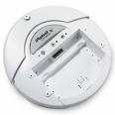
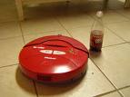
Robot final projects
Picobot
pyRobot
A state machine is provided. You'll need to improve it!
Maze class
Rules class
Robot class
Not required, but one possible way to organize everything.
You need to choose a location in which to run the overall state machine.
iRobot's vacuums

Slide 145
pyRobot == state machine
_{keyboard control state}
transition on 's' key
pyRobot
_{turn-to-goal state}
_{go-forward state}
facing goal!
while NOT facing goal
while NOT at goal

Slide 146
State?
The state of a computation is
all the internal information needed to take the next step
0 NEWx -> S 1
previous state
next state
external input data
literal next step

Slide 147
Picobot == state machine
each circle represents a different robot state
x***
N***
state pattern -> move new state
starting funnel
state 0
state 1
0 x*** -> N 0
0 N*** -> X 1
1 ***x -> S 1
1 ***N -> X 0
the "go North" state
the "go South" state
transitions move from state to state

Slide 148
Our model of computation: FSMs
FSM or Finite State Machine
Example:
0
0
1
s0
s1
1
start state
transitions
accepting states
“input funnel”
“where to go”
double circled
labeled by input !
How it runs:
100101
input sequence
read left-to-right

Slide 149
FSM: Finite state machine
transition on 0
transition on 0
transition on 1
State 0
State 1
transition on 1
another input sequence
0010111
What does each state MEAN ?
always left-to-right
What does this FSM do overall?

Slide 150
Another example
0
1
s1
s0
0
1
s2
0,1
Specifically?
What inputs does this FSM accept?
Generally?
Fewer states?
What does each state MEAN ?

Slide 151
Building FSMs
Draw a FSM accepting those strings in which the number of zeros (0s) is a multiple of 3. (0, 3, 6, … zeros). 1s don't matter.
Draw a FSM accepting strings that don't contain the pattern 110 anywhere.
Accepted: 110101110, 11, 0000010
Rejected: 101, 0000, 111011101111
Hint: modify two slides ago!
Accepted: 1010001 Rejected: 101001100
Hint: modify the previous slide!
Draw a FSM accepting those strings in which the third digit (from the left) is a 1.
Draw a FSM accepting strings whose third-to-last digit (from the right) is a 1.
Accepted: 1010001 Rejected: 11000100
Accepted: 11000100 Rejected: 11010001
Extra: Do your solutions use the minimum possible number of states?

Slide 152
No occurrences of 110
Draw a FSM accepting strings that do NOT anywhere contain the pattern 110
0
1
1
0
The minimum possible number of states?

Slide 153
Number of 0s is div. by 3
Draw a FSM accepting those strings in which the number of zeros (0s) is a multiple of 3. (0, 3, 6, … zeros).
Accepted: 110101110, 11, 0000010
Rejected: 101, 0000, 111011101111
The minimum possible number of states?

Slide 154
Third character is a 1
Draw a FSM accepting those strings in which the third digit (from the left) is a 1.
The minimum possible number of states?

Slide 155
Third-to-last character is a 1
Draw a FSM accepting strings whose third-to-last digit (from the right) is a 1.
The minimum possible number of states?

Slide 156
Third-to-last character is a 1
Draw a FSM accepting strings whose third-to-last digit (from the right) is a 1.
0
s∅
1
s0
s1
1
0
1
0
s00
s01
s10
s11
0
1
0
1
0
1
0
1
s000
s001
s010
s011
s100
s101
s110
s111
Something seems missing…
I don't accept this solution!
The minimum possible number of states?

Slide 157
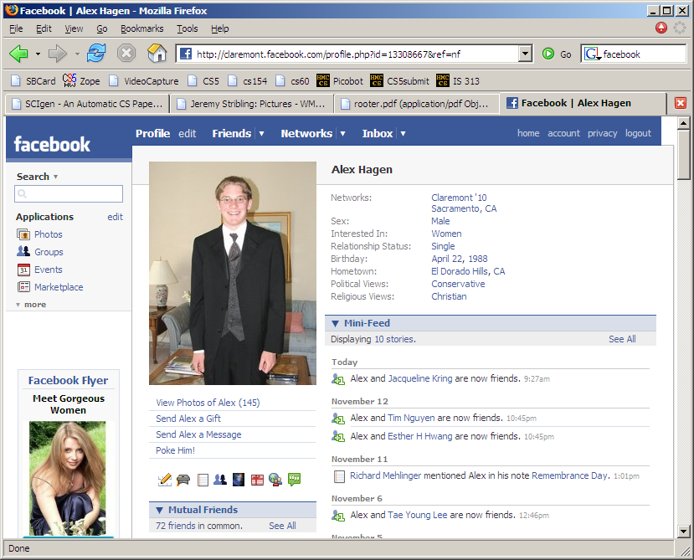
Thanks to Alex Hagen !
Do it yourself data-structures...

Slide 158
Third-to-last character is a 1
Draw a FSM accepting strings whose third-to-last digit (from the right) is a 1.
s000
s001
s010
s011
s100
s101
s110
s111
Where does this go?
8 states suffice!

Slide 159
FSMs are everywhere!
penny, fifty cent piece,
silver dollar, Canadian
currency, CS 5 Euro, ….
q_{start}
nickel
select drink
dime
quarter
q_{5 cents}
q_{10 cents}
q_{25 cents}
nickel
mechanical
vending machine
dime
nickel
nickel
q_{15 cents}
q_{20 cents}
(some transitions not shown)

Slide 160
FSMs are everywhere!
q_{start}
q₁
q₂
q₃
q₄
q₅
Locks
q₁₂
q₁₃
q₁₄
q₁₅
q₂₃
q_{12,3}
q_{12,4}
q_{12,5}
There’s a lot missing here!
q_{12,5,34}

Slide 161
FSM ~ Game AI
The state-machine controlling Shambler monsters…
I'm Quaking in my AstroBoots

Slide 162
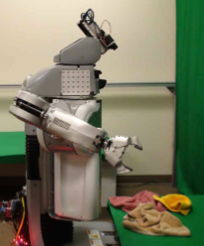
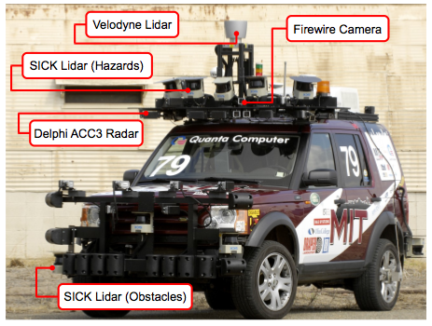
FSMs driving robots...
Cal's towel-folding robot...
MIT's car, Talos

Slide 163
State-machine limits?
Are there limits to what FSMs' can do?
Are there any binary-string problems that FSMs can't solve?
What FSM accepts inputs whose first character is the same as the last character?
Is this even possible?

Slide 164
Another FSM ?
What FSM accepts inputs that are palindromes ?
Yottabytes are a LOTTA bytes!
Computers > FSMs ?
Notes:
metric prefixes…

Slide 165
State-machine limits?
There are limits to what FSMs' can do.
Are there any binary-string problems that FSMs can't solve?
Are computers more powerful than FSMs?
only 1s and 0s?
OUTPUT ?
variables, lists, memory?
Are there any binary-string problems that computers can't solve?

