Slide 1
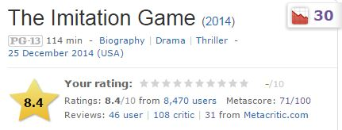
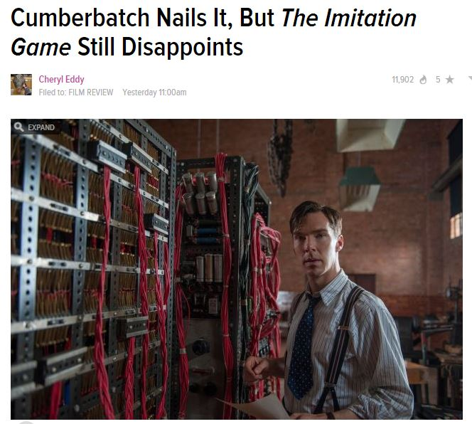
CS 5 spokesperson of the day!
Alan Turing
I want a 1950's network!
not everyone loved it…

Slide 2
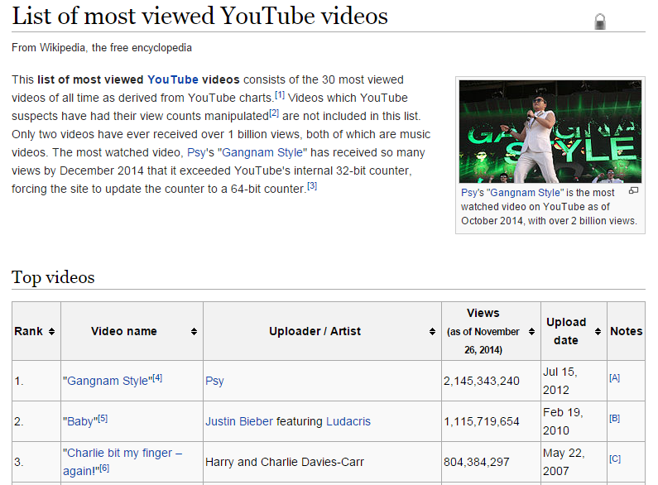
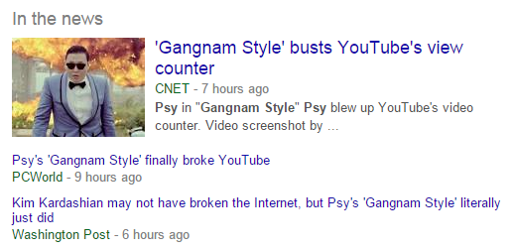
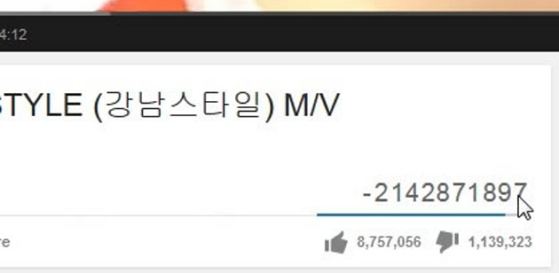
CS 5 spokessinger of the day!

Slide 3
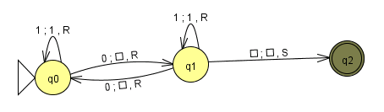
CS 5 today: the limits of computing
Turing Machines and the MANY things computers can't compute... !
Final ideas...
This machine doesn't look all-powerful to me!
usual office hours in LAC on Monday...
Final projects...
tutoring hours through the weekend + beyond
milestone due on Monday evening, 10/8
Turing machines extra!
5 finite-state machines also due on Mon.

Slide 4
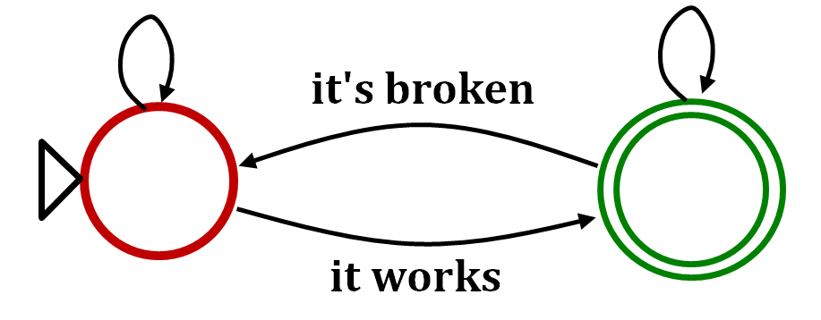
Final project FSM!
still broken
still works
it's broken
stop adding features + start adding print statements
comment out print statements + start adding more features
it works

Slide 5
Simplest model of computation: FSMs
Finite State Machines
0
0
1
s0
s1
1
start state
transitions
accepting states
“input funnel”
“where to go”
double circled
labeled by input !
Are there limits to what FSMs can do?

Slide 6
State-machine limits?
Let's build a FSM that accepts bit strings with the SAME NUMBER of 0s as 1s
0
1
zero 0s
zero 1s

Slide 7
State-machine limits?
Let's build a FSM that accepts bit strings with the SAME NUMBER of 0s as 1s
0
0
1
1
one 0
zero 1s
zero 0s
zero 1s
zero 0s
one 1
1
1
0
0

Slide 8
FSMs can't count...
Because they're finite, FSMs can only count finitely high !
They can handle modulo arithmetic.
Computable with FSMs
Uncomputable with FSMs
even/odd sums or differences
same # of 0s and 1s
multiples of other integers
are there more 0s than 1s?
finite input constraints:
infinite input constraints:
third digit is a 1
third-to-last digit is a 1
third digit == third-to-last digit
etc.
palindromes
anything modeled by an unknown-length while loop
Our computers should be able to handle while loops!
Notes:
metric prefixes…

Slide 9
State-machines are limited.
FSMs can't count
at least, not arbitrarily high...
We need a more powerful model than FSMs...
so, "we" add memory !
where "we" == Turing

Slide 10
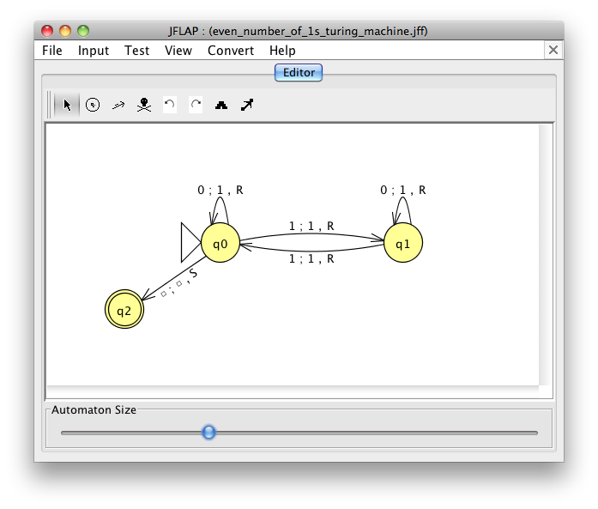
FSMs can't count...
So, let's build a better machine!
Shiny!
Turing Machine
Notes:
metric prefixes…

Slide 11
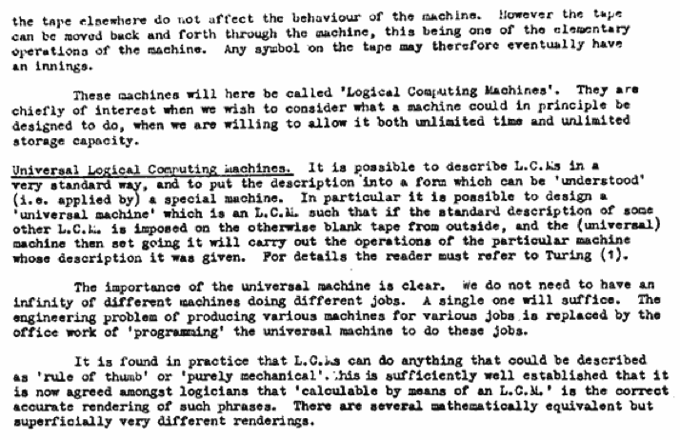
Can TMs compute everything?
Alan Turing says yes...
Turing called them Logical Computing Machines
Turing’s Intelligent Machines, 1948
http://www.alanturing.net/turing_archive/archive/l/l32/L32-005.html

Slide 12
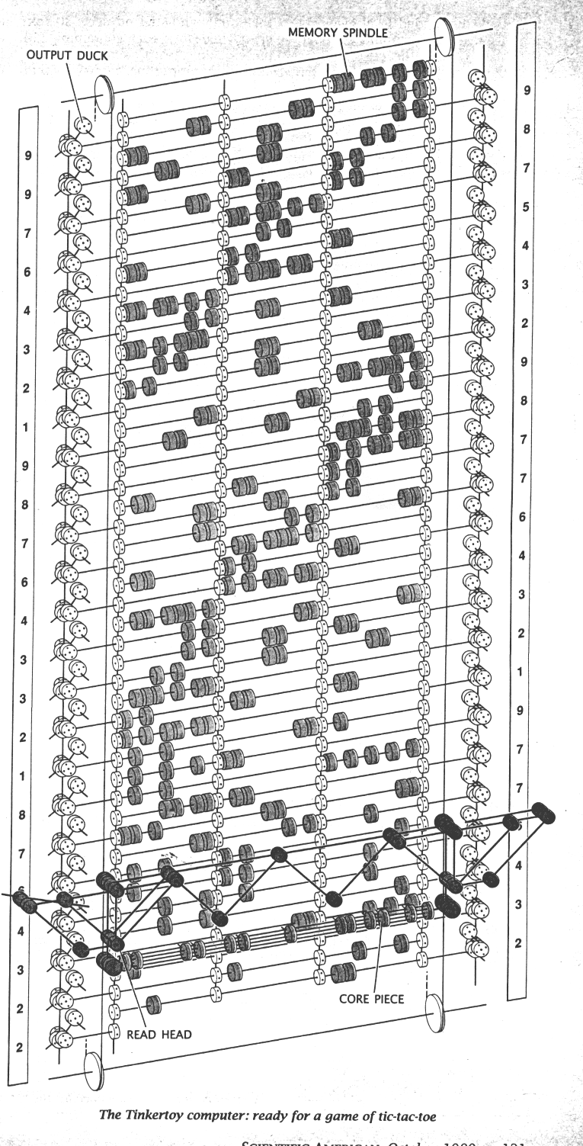

So far, all known computational devices can compute only what Turing Machines can...
some are faster than others…
Quantum computation
http://www.cs.virginia.edu/~robins/The_Limits_of_Quantum_Computers.pdf
Molecular computation
http://www.arstechnica.com/reviews/2q00/dna/dna-1.html
Parallel computers
Integrated circuits
Electromechanical computation
Water-based computation
Tinkertoy computation
Turing machine

Slide 13
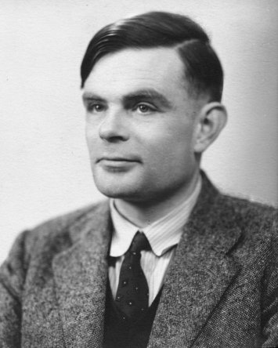
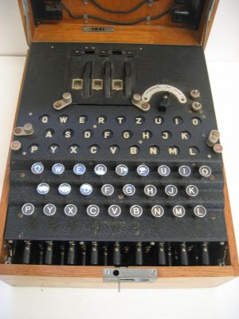
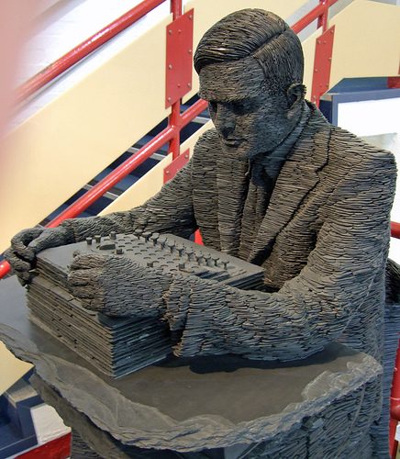
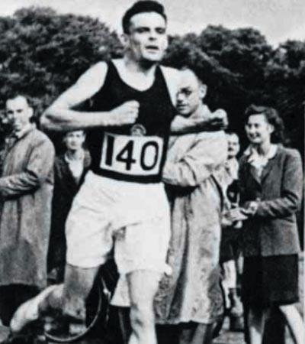
Alan Turing
AI!
1912-1954
WWII
Enigma machine ~ The axis's encryption engine
2007
1946
Bletchley Park

Slide 14
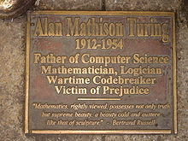
Alan Turing
AI!
1912-1954
WWII
Enigma machine ~ The axis's encryption engine
2007
1946
Bletchley Park

Slide 15
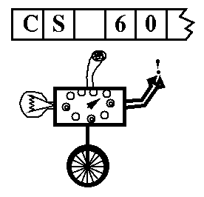
Turing Machine
A simple model of universal computation.
Starts on the leftmost character
The tape: an expandable amount of memory made of of cells, each with exactly one character: 0, 1, blank…
Read/write head for the tape
The control: a finite state machine
Ability to move left and right
The control state
The symbol now under the head
The symbols to the right of the head
The symbols to the left of the head
The complete state of a TM is determined by:

Slide 16
the input
0
1
0
1
0
the tape
R/W head
"blanks" are everywhere else
an accepting state always halts -- then basks in its success!
if a transition is missing, the input FAILS!
0
;
1
,
a Turing Machine rule:
R
READ
WRITE
MOTION
try it in JFLAP...
Notes:
metric prefixes…

Slide 17
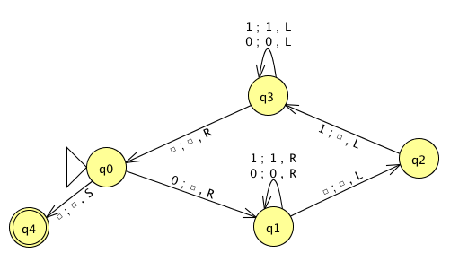
Name(s) __________________________________ Quiz
Run this TM on this input:
0
0
1
1
1
Is this input accepted or rejected?
What inputs are accepted in general? How does it work?
Extra: How could you change this to accept palindromes?
(just a thought experiment)
Notes:
metric prefixes…

Slide 18
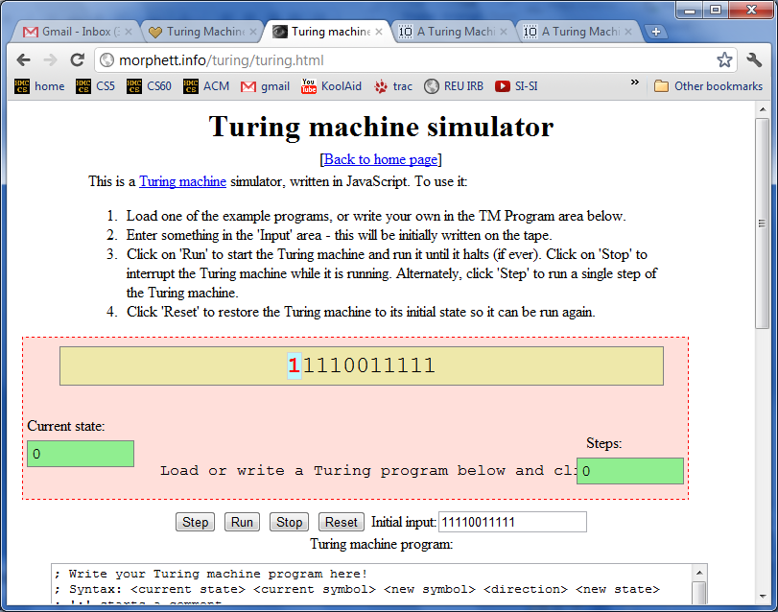
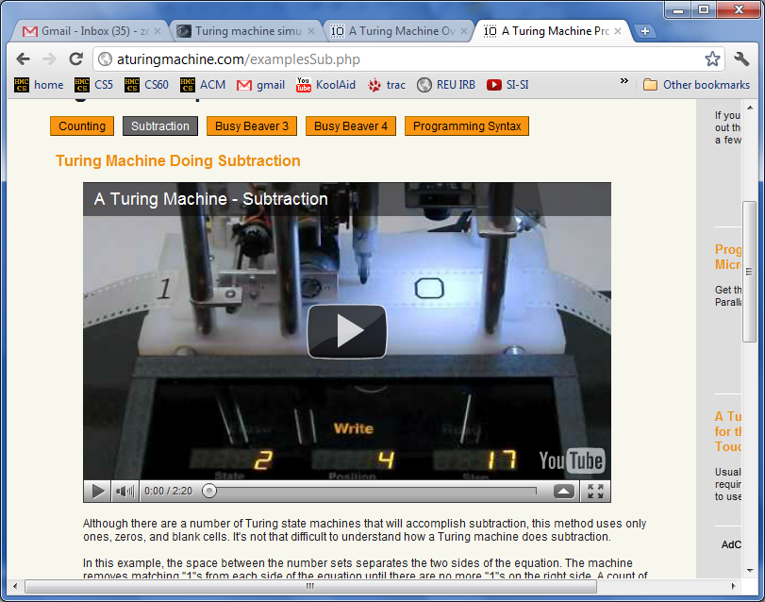
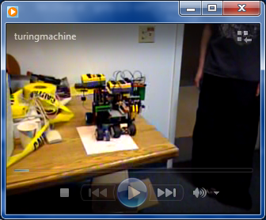
Turing Machine machines!

Slide 19
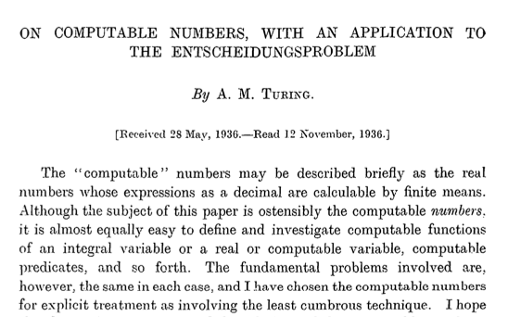
computers
Can TMs compute everything?
Alan Turing says No!
http://www.cs.virginia.edu/~robins/Turing_Paper_1936.pdf

Slide 20
There are many problems computers can't solve at all !
Perhaps this is not that surprising…
global warming
What!?
disbelief in aliens
losing to your own Connect4 (at 0 ply!)
anything (if using Internet Explorer)

Slide 21
Uncomputable functions?
well-defined computational problems
computer program
There are
that no
can solve
even with any amount of memory!

Slide 22

Uncomputable functions?
well-defined computational problems
computer program
There are
that no
can solve
even with any amount of memory!
Pico-
bot
CS 5 homework
def is_even(x):
return x%2 == 0
Video
games
Int-bool functions
def is_three(x):
return x == 3
Team Fortress
Well-defined computational tasks
Programs
These programs are both int-bool functions

Slide 23
IN: a pos. integer x OUT: a 0/1 bool value
functions
f₁(x) = 1
These are "int-bool" mathematical functions.
Input is one positive integer
Output is 0/1 (a boolean; a bit)
They're also sometimes called "integer predicates."
1 if x is odd
f₂(x) =
0 if x is even
1 if x is 1 or 2
f₃(x) =
0 otherwise
1 if x is < 3
f₄(x) =
0 otherwise

Slide 24
IN: a pos. integer x OUT: a 0/1 bool value
functions
programs
f₁(x) = 1
def prog1(x):
return x%2
1 if x is odd
f₂(x) =
def prog2(x):
return x<3
0 if x is even
1 if x is 1 or 2
def prog3(x):
return 1
f₃(x) =
0 otherwise
def prog4(x):
return len(str(x+42))>1
1 if x is < 3
f₄(x) =
0 otherwise
def prog5(x):
if x in [1,2]: return 1
else: return 0
Match each program with the function it computes.
def prog6(x):
if x<2: return x
else: return prog2(x-2)
How many different math. functions are in the left column?
How many different programs are in the right column?
Which set has more different items: functions or programs? Or are there the same amount of each?

Slide 25
IN: a pos. integer x OUT: a 0/1 bool value
functions
programs
f₁(x) = 1
def prog1(x):
return x%2
1 if x is odd
f₂(x) =
def prog2(x):
return x<3
0 if x is even
There are many more of these …
than these!
1 if x is 1 or 2
def prog3(x):
return 1
f₃(x) =
0 otherwise
def prog4(x):
return len(str(x+42))>1
1 if x is < 3
programs
f₄(x) =
mathematical functions
0 otherwise
def prog5(x):
if x in [1,2]: return 1
else: return 0
Match each program with the function it computes.
def prog6(x):
if x<2: return x
else: return prog2(x-2)
How many different math. functions are in the left column?
How many different programs are in the right column?
Which set has more different items: functions or programs? Or are there the same amount of each?

Slide 26

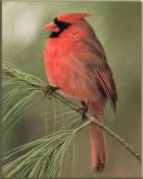

More??
There are infinitely many of both….
…but not all infinities are created equal!
{ , , }
{ 1 , 2 , 3 }
Two sets have equal size if
their elements have a
one-to-one matching
This matching is called a bijection.
These sets have the same cardinality

Slide 27

Bijections also define equal-sized infinite sets, but the results are surprising!
Positive
evens
E = { 2, 4, 6, 8, 10, … }
Positive integers
N = { 1, 2, 3, 4, 5, … }
ALL
integers
Z = {…, -3, -2, -1, 0, 1, 2, 3, …}
With no negative repercussions!
E and N and Z all have the same size!

Slide 28
That's my line!
This seems irrational !
Are these sets equal-sized?
Positive integers
the Rationals
1
84
22
13
{ … }
,
,
,
,
{ 1, 2, 3, 4, 5, … }
1
2
7
15

Slide 29
That's my line!
This seems irrational
They are the same size!
Positive integers
the Rationals
1
84
22
13
{ … }
,
,
,
,
{ 1, 2, 3, 4, 5, … }
1
2
7
15
1/1
1/2
1/3
1/4
1/5
1/6
…
2/1
2/2
2/3
2/4
2/5
2/6
…
Numerator
3/1
3/2
3/3
3/4
3/5
3/6
…
4/1
4/2
4/3
4/4
4/5
4/6
…
…
Denominator

Slide 30


Let's get real
That's my .2!
the Reals from 0 to 1
Are these sets equal-sized?
Positive integers
{ 0.0 <= r <= 1.0 }
{ 1, 2, 3, 4, 5, … }

Slide 31
Let's get real
That's my .2!
the Reals from 0 to 1
Are these sets equal-sized?
Positive integers
{ 0.0 <= r <= 1.0 }
{ 1, 2, 3, 4, 5, … }
.1
1
.2
2
.3
3
…
Why is this NOT a valid matching?
…
.11
11
.12
12
…
…

Slide 32
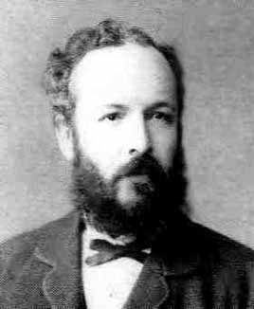
Georg Cantor
1845-1918
Cantor Diagonalization
There are always real #s missing from any list!
the Reals from 0 to 1
Positive integers
real #s are always missing
r =
0
regardless of the matching…
r = .333333333333333…
1
1
r = .424242424242424…
2
2
r = .314159426535897…
3
3
r = .090909090909090…
4
4

Slide 33
To infinity - and beyond
Pixar owes Cantor for this one!
strictly larger
>
the Reals from 0 to 1
Positive integers
Uncountably infinite
>
Countably infinite
>

Slide 34
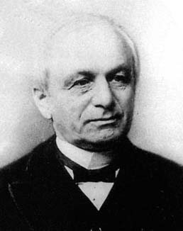
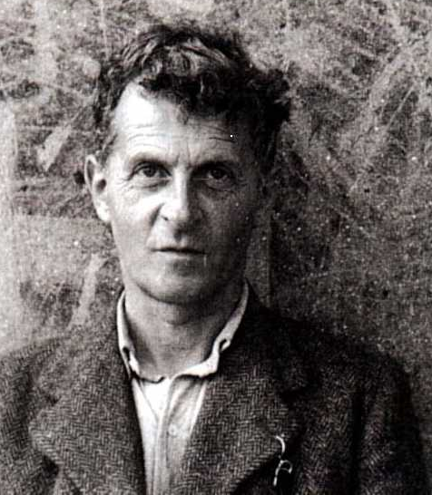
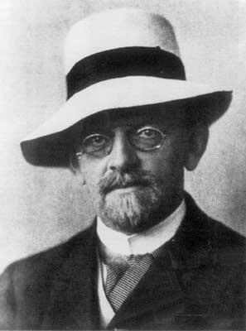
Cantor and "friends"
Whom would you trust?
Leopold Kronecker 1823-1891
Lugwig Wittgenstein
1889-1951
David Hilbert 1862-1943

Slide 35
Cantor and "friends"
"Charlatan"
"Renegade"
"Laughable and wrong"
"Utter nonsense"
No one shall expel us from the paradise that Cantor has created.
Ouch!
Leopold Kronecker 1823-1891
Lugwig Wittgenstein
1889-1951
David Hilbert 1862-1943

Slide 36
Cantor and "friends"
"Charlatan"
"Renegade"
"Corrupter of Youth"
"Laughable and wrong"
"Utter nonsense"
No one shall expel us from the paradise that Cantor has created.
And this was before 1900!
Leopold Kronecker 1823-1891
Lugwig Wittgenstein
1889-1951
David Hilbert 1862-1943

Slide 37
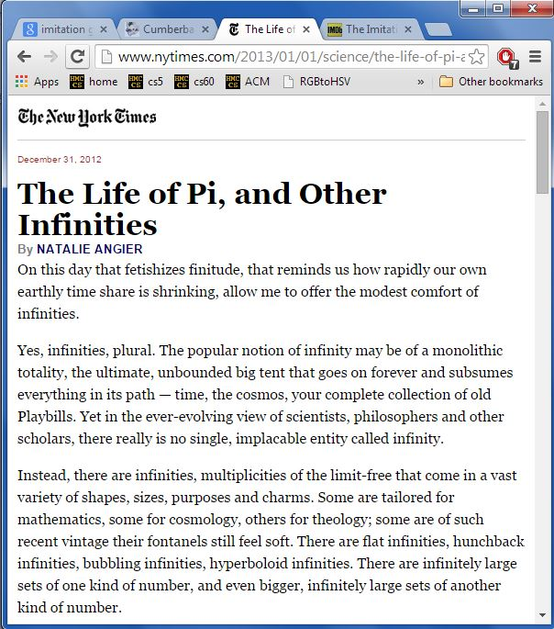
Cantor and "friends"
"Charlatan"
"Renegade"
"Corrupter of Youth"
"Laughable and wrong"
"Utter nonsense"
No one shall expel us from the paradise that Cantor has created.
And this was before 1900!
Leopold Kronecker 1823-1891
Lugwig Wittgenstein
1889-1951
David Hilbert 1862-1943

Slide 38
What about functions... and programs?
the Reals from 0 to 1
Positive integers
Uncountably infinite
>
Countably infinite
This is how many int-bool functions there are.
This is how many programs there are.

Slide 39
Programs are countably infinite
def alien( x ):
if x == 42:
return True
else:
return not \ alien(x+1)
programs
=
Positive integers
Countably infinite
Why?
This is how many programs there are.

Slide 40
Programs are countably infinite
def alien( x ):
if x == 42:
return True
else:
return not \ alien(x+1)
programs
=
Positive integers
Countably infinite
Every program is a string.
Every string is just a bitstring.
This is how many programs there are.
Every bitstring is just an int.

Slide 41
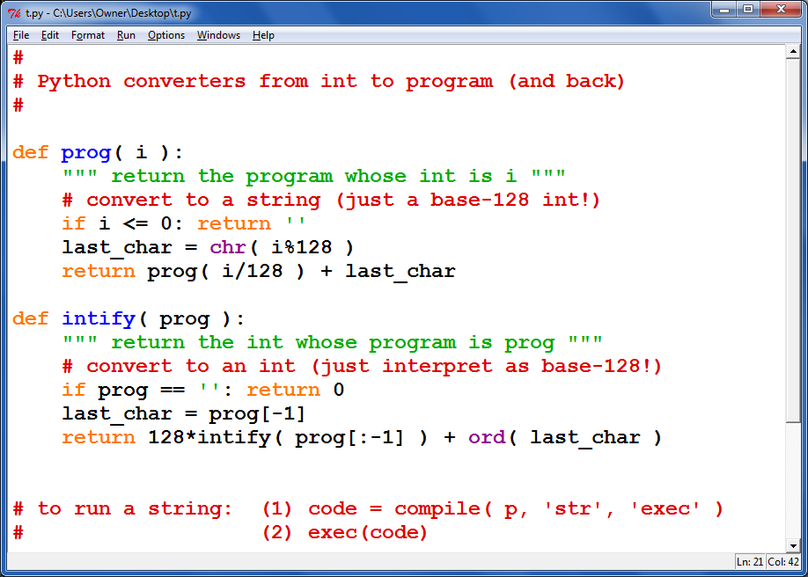
Python, converting from programs to ints - and back.

Slide 42
int-bool functions are uncountable
(integer predicates)
the Reals from 0 to 1
=
functions
This margin is too small to hold my marvelous proof!
Uncountably infinite
This is how many functions there are – in fact, just f'ns from integers to booleans!
input
output

Slide 43
functions are uncountable
the Reals from 0 to 1
=
functions
IN: a pos. integer x OUT: a 0/1 bool value
f₁(x) = 1
any real # from 0-1
written out in binary
1
2
3
4
5
6
7
8
1 if x is odd
f₂(x) =
r₁ = .11111111 ...
0 if x is even
r₂ = .10101010 ...
1 if x is 1 or 2
f₃(x) =
0 otherwise
r₃ = .11000000 ...
1 otherwise
r₄ = .10010101 ...
f₄(x) =
0 if x is prime
6 is not prime, so this digit is 1
2 is prime, so this digit is 0

Slide 44
functions are uncountable
the Reals from 0 to 1
=
functions
IN: a pos. integer x OUT: a 0/1 bool value
f₁(x) = 1
any real # from 0-1
written out in binary
1
2
3
4
5
6
7
8
1 if x is odd
f₂(x) =
r₁ = .11111111 ...
0 if x is even
r₂ = .10101010 ...
1 if x is 1 or 2
f₃(x) =
0 otherwise
r₃ = .11000000 ...
1 otherwise
r₄ = .10010101 ...
f₄(x) =
0 if x is prime
r₅ =
1 if x is div. by 3
f₅(x) =
r₆ = .00000000 ...
0 otherwise
f₆(x) =

Slide 45
functions are uncountable
the Reals from 0 to 1
=
functions
IN: a pos. integer x OUT: a 0/1 bool value
f₁(x) = 1
any real # from 0-1
written out in binary
1
2
3
4
5
6
7
8
1 if x is odd
f₂(x) =
r₁ = .11111111 ...
0 if x is even
r₂ = .10101010 ...
1 if x is 1 or 2
f₃(x) =
0 otherwise
r₃ = .11000000 ...
1 otherwise
r₄ = .10010101 ...
f₄(x) =
0 if x is prime
r₅ =
For each real number, there's a different function!
1 if x is div. by 3
f₅(x) =
r₆ = .00000000 ...
0 otherwise
f₆(x) =

Slide 46
What about functions... and programs?
the Reals from 0 to 1
Positive integers
>
functions
programs
Uncountably infinite
Countably infinite

Slide 47


There are lots of functions
uncountably many
Well-defined mathematical functions (uncountable)
What's swimming around out here?
Wow ~ I can't even describe this stuff!
Programs (countable)
There are "a few" programs
countably many

Slide 48
Philosophically thinking…
Well-defined mathematical functions
Human-describable things…
Programs
<
How big is the set of the human-describable things... ?

Slide 49
Does it include all functions? (No…)
Well-defined mathematical functions
Programs
<
Human-describable things…

Slide 50
Does it include all programs? (No…)
Well-defined mathematical functions
Human-describable things…
Programs
<

Slide 51
It overlaps incompletely – but also goes further... !
Well-defined mathematical functions
So, what is all this stuff out here?!?
Programs
kc
hc
<
Next time !
Human-describable things…

Slide 53
the input
0
1
0
1
0
the tape
R/W head
"blanks" are everywhere else
an accepting state always halts -- then basks in its success!
if a transition is missing, the input FAILS!
0
;
1
,
a Turing Machine rule:
R
READ
WRITE
MOTION
try it in JFLAP...
Notes:
metric prefixes…

Slide 54
Name(s) __________________________________ Quiz
Run this TM on this input:
0
0
1
1
1
Is this input accepted or rejected?
What inputs are accepted in general? How does it work?
Extra: How could you change this to accept palindromes?
(just a thought experiment)
Notes:
metric prefixes…

Slide 55
the input
0
1
0
1
1
the tape
"blanks" are everywhere else
R/W head
an accepting state always halts and then basks in its success!
if a transition is missing, the input FAILS!
0
;
1
,
a Turing Machine rule:
R
READ SYMBOL
WRITE SYMBOL
MOTION
try it in JFLAP...
Notes:
metric prefixes…

Slide 56
Bijections also define equal-sized infinite sets, but the results are surprising!
Positive
evens
E = { 2, 4, 6, 8, 10, … }
Positive integers
N = { 1, 2, 3, 4, 5, … }
ALL
integers
Z = {…, -3, -2, -1, 0, 1, 2, 3, …}
With no negative repercussions!
E and N and Z all have the same size!

Slide 57
That's my line!
This seems irrational
Are these sets equal-sized?
Positive integers
the Rationals
1
84
22
13
{ … }
,
,
,
,
{ 1, 2, 3, 4, 5, … }
1
2
7
15
1/1
1/2
1/3
1/4
1/5
1/6
…
2/1
2/2
2/3
2/4
2/5
2/6
…
Numerator
3/1
3/2
3/3
3/4
3/5
3/6
…
4/1
4/2
4/3
4/4
4/5
4/6
…
…
Denominator

Slide 58
Georg Cantor
1845-1918
Cantor Diagonalization
There are always real #s missing from any list!
the Reals from 0 to 1
Positive integers
consider any matching…
r = .333333333333333…
1
1
r = .424242424242424…
2
2
r = .314159426535897…
3
3
r = .090909090909090…
4
4

Slide 59
functions are uncountable
mathematical
the Reals from 0 to 1
functions
input: int
output: T or F
any real # from 0-1
written out in binary
1 2 3 4 5 6 7 8 ...
r₁ = .01100000 ...
A(n): return isPrime(n)
r₂ = .10101010 ...
B(n): return n in [2, 3]
r₃ = .01101010 ...
C(n): return n >= 42
r₄ = .11010001 ...
D(n): return isPowerOf2(n)
r₅ = .00000000 ...
E(n): return True
r₆ =
Curse you, cursive!
F(n): return n%2 == 1

Slide 60
functions are uncountable
the Reals from 0 to 1
functions
input: int
output: T or F
any real # from 0-1
written out in binary
1 2 3 4 5 6 7 8 ...
r₁ = .01100000 ...
A(n): return isPrime(n)
r₂ = .10101010 ...
B(n): return n in [2, 3]
r₃ = .01101010 ...
C(n): return n >= 42
r₄ = .11010001 ...
D(n): return isPowerOf2(n)
r₅ = .00000000 ...
E(n): return True
r₆ = .11111111 ...
Curse you, cursive!
F(n): return n%2 == 1

Slide 61
functions are uncountable
the Reals from 0 to 1
functions
input: int
output: T or F
For each real number, there's a unique function!
any real # from 0-1
written out in binary
1 2 3 4 5 6 7 8 ...
r₁ = .01100000 ...
A(n): return isPrime(n)
r₂ = .10101010 ...
B(n): return n in [2, 3]
r₃ = .01101010 ...
C(n): return n >= 42
r₄ = .11010001 ...
D(n): return isPowerOf2(n)
r₅ = .00000000 ...
E(n): return True
r₆ = .11111111 ...
F(n): return n%2 == 1

Slide 62
There are lots of functions
uncountably many
Well-defined mathematical functions (uncountable)
What's swimming around out here?
Programs (countable)
There are "a few" programs
countably many

Slide 63
There are lots of functions
uncountably many
Well-defined mathematical functions (uncountable)
What's swimming around out here?
I can't even describe it!
Programs (countable)
kc
hc
Next time...
There are "a few" programs
countably many

Slide 64
How big is the set of the human-describable things... ?
Well-defined mathematical functions
Human-describable things…
Programs
<
Philosophical thinking…

Slide 65
Does it include all functions? (No…)
Well-defined mathematical functions
Programs
<
Human-describable things…

Slide 66
Does it include all programs? (No…)
Well-defined mathematical functions
Human-describable things…
Programs
<

Slide 67
It overlaps incompletely – and goes beyond... !
Well-defined mathematical functions
So, what is all this stuff out here?!?
Programs
kc
hc
<
Next time...
Human-describable things…

Slide 68
Uncomputable functions?
well-defined computational problems
computer program
can solve
There are
that no
even with ∞ memory!
There are more of these …
CS 5 homework
def is_even(x):
return x%2 == 0
than these!
Video
games
Pico-
bot
Int-bool functions
Team Fortress
Well-defined computational tasks
Programs
These programs are both int-bool functions

Slide 69
Or does it do something else?
Well-defined mathematical functions
Programs
Human-describable things…

Slide 70
How big is the set of the human-describable functions... ?
Well-defined mathematical functions (uncountable)
Human-describable functions…
Programs (countable)
(any method at all)

Slide 71
Blue set: human-describable functions
Well-defined computational functions (uncountable)
Describable functions (uncountable or countable?)
Programs (countable)
What is the size of the blue set?
What's an example in each piece?

Slide 72
functions are uncountable
the Reals from 0 to 1
functions
input: int
output: T or F
any real # from 0-1
written out in binary
1 2 3 4 5 6 7 8 ...
r₁ = .01100000 ...
A(n): return isPrime(n)
r₂ = .10101010 ...
B(n): return n in [2, 3]
r₃ = .01101010 ...
C(n): return n >= 42
r₄ = .11010001 ...
D(n): return isPowerOf2(n)
r₅ = .00000000 ...
E(n): return True
r₆ = .11111111 ...
Curse you, cursive!
F(n): return n%2 == 1

Slide 73
functions are uncountable
the Reals from 0 to 1
functions
input: int
output: T or F
For each real number, there's a unique function!
any real # from 0-1
written out in binary
1 2 3 4 5 6 7 8 ...
r₁ = .01100000 ...
A(n): return isPrime(n)
r₂ = .10101010 ...
B(n): return n in [2, 3]
r₃ = .01101010 ...
C(n): return n >= 42
r₄ = .11010001 ...
D(n): return isPowerOf2(n)
r₅ = .00000000 ...
E(n): return True
r₆ = .11111111 ...
F(n): return n%2 == 1

Slide 74
Well-defined computational functions (uncountable)
We can’t say!
Describable functions (countable)
All software
kc
Programs (countable)
hc
O
Today: Two describable, but uncomputable functions

Slide 75
int-bool functions are uncountable
Write your real number from 0 to 1 in binary :
What int-bool function could each number represent?
real number
index of each digit
1 2 3 4 5 6 7 8 9 10 11 12 13 14 15 …
r = .001000000000000...
r = .110110110110110...
What real number would represent is_even(x) ?

Slide 76
This proof seems disappointing…
There are strictly more int-bool functions than programs.
Thus, there are functions with no program to compute them!
Positive integers
the Reals
from 0 to 1
{ real numbers, 0-1 }
{ 1, 2, 3, 4, 5, … }
Uncountably infinite
>
Countably infinite
This is how many functions from integers to booleans there are.
This is how many programs there are.

Slide 77
There are lots of functions of integers
There are "a few" computer programs
(uncountably many ~ real #s)
(countably many ~ integers)
Well-defined computational functions
Programs
So this must be the seashore of uncomputability. Let's dive out!

Slide 78
There are lots of functions of integers
There are "a few" computer programs
(uncountably many ~ real #s)
(countably many ~ integers)
Well-defined computational functions
Describable
Programs
computational problems!
What are the sizes of these sets?
What's an example in each?
Consider the English-describable functions...

Slide 79
There are lots of functions of integers
There are "a few" computer programs
(uncountably many ~ real #s)
(countably many ~ integers)
Well-defined computational functions
I can’t say!
???
Describable
Programs
computational problems!
All software
O
except maybe IOCCC winners
This is indescribably odd...
What are the sizes of these sets?
What's an example in each?
Consider the English-describable functions...

Slide 80
There are lots of functions of integers
There are "a few" computer programs
Next time: some actual uncomputable functions…
(uncountably many ~ real #s)
(countably many ~ integers)
Well-defined computational functions
I can’t say!
???
Describable
Programs
computational problems!
All software
O
except maybe IOCCC winners
This is indescribably odd...
What are the sizes of these sets?
What's an example in each?
Consider the English-describable functions...

Slide 82
functions are uncountable
the Reals from 0 to 1
functions
input: int
output: T or F
For each real number, there's a unique function!
any real # from 0-1
written out in binary
1 2 3 4 5 6 7 8 ...
r₁ = .01100000 ...
A(n): return isPrime(n)
r₂ = .10101010 ...
B(n): return n in [2, 3]
r₃ = .01101010 ...
C(n): return n >= 42
r₄ = .11010001 ...
D(n): return isPowerOf2(n)
r₅ = .00000000 ...
E(n): return True
r₆ = .11111111 ...
F(n): return n%2 == 1

Slide 83
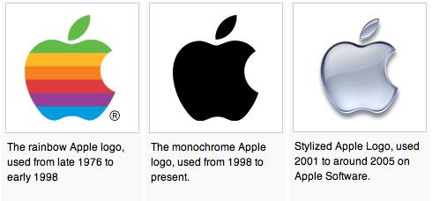
Alan Turing
AI !
1912-1954
WWII
Enigma machine ~ The axis's encryption engine
too neat, perhaps…?
2007
Bletchley Park
1946

Slide 84
Not being constructive…
One "failure" of this proof is that it doesn't construct a full example of an uncomputable problem!
But it's still useful!
What are the chances that a randomly-selected function will have a program that solves it?
functions are uncountable
(as numerous as the reals)
programs are countable
(as numerous as the integers)

Slide 85
A Strategy* for CS Programming HW**
or “How to succeed in CS 60 without programming at all !”
For each programming assignment, note that the desired program’s behavior can be rephrased as functions of integers by encoding the input and output appropriately.
1
2
Point out that with 100% probability a function of integers is not computable by any program at all.
3
Proceed to your choice of (A) Amnesia, (B) Breaking Bad, or (C) Writ1.
4
Consult fine print for disclaimers.
* Please do not cite Prof. Dodds when using this strategy
** This strategy not applicable for CS 5 assignments.

Slide 86
Describing "Complexity"
Consider two integers:
lots of zeros
100000000000000000000000000…00000
Each has 5001 digits
lots of digits
170117684200068728224888577…85601
Which "feels like" the more complex number... Why ?

Slide 87
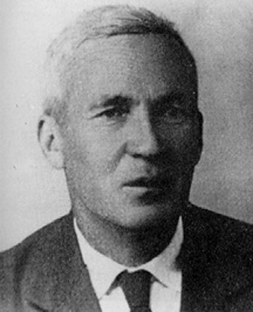
Kolmogorov Complexity
Andrei Kolmogorov
1903-1987
kcomp( k ) =
the length of the shortest zero-input program that produces k
k = 100000000000000000000000000…00000
A length-5017 program producing k:
def a(): return 10000…0000
k = 170117684200068728224888577…85601
A length-5017 program producing k:
def b(): return 17011…5601

Slide 88
Kolmogorov Complexity
Andrei Kolmogorov
1903-1987
kcomp( k ) =
the length of the shortest zero-input program that produces k
k = 100000000000000000000000000…00000
length of 24 !
def a(): return 10**5000
k = 170117684200068728224888577…85601
length of 5017 (or less)
def b(): return 17011…5601
Maybe we can do even better?

Slide 89
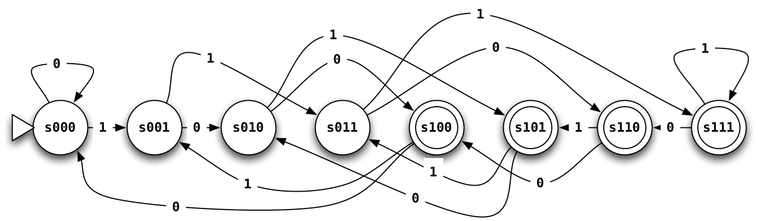
Third-to-last character is a 1
How many states would a 100th-to-last-character FSM have?

Slide 90
State-machine reminders...
Draw a FSM that accepts strings whose first bit is a 0 and whose last bit is a 1
01
01011
001011
0
00110
100111
101010
Accept:
Reject:
Draw a FSM that accepts strings that start with some number of 0s followed by the same number of 1s.
01
0011
000111
00110
011111
101010
Accept:
Reject:
42 is rejected?!
Notes:
metric prefixes…

Slide 91
State-machine reminders...
Draw a FSM that accepts strings whose first bit is a 0 and whose last bit is a 1
01
01011
001011
0
00110
100111
101010
Accept:
Reject:
can be done in four states...
Draw a FSM that accepts strings that start with some number of 0s followed by the same number of 1s.
01
0011
000111
00110
011111
101010
Accept:
Reject:
42 is rejected?!
Impossible to do with finite states!
Another impossible task:
detecting palindromes
Notes:
metric prefixes…

Slide 92
Kolmogorov Complexity
Andrei Kolmogorov
1903-1987
kcomp( k ) =
the length of the shortest zero-input program that produces k
For each input k, there is a well-defined, unambiguous value for kcomp(k).
k = 100000000000000000000000000…00000
kcomp( k ) = 24 or so
k = 170117684200068728224888577…85601
kcomp( k ) = some other integer
Does kcomp(k) always exist?

Slide 93
What are the uncomputable problems?
Here's an uncomputable function:
positive integer input, k
the positive integer output that is k's complexity
kcomp( k ) =
with a name like kcomp, this function was doomed !

Slide 94
Complexity isn't computable!
def kcomp( k ):
do stuff…
return answer
Proof strategy
I guess you'd call this part of the code a GRAY AREA…
proof by contradiction
(1) Presume that kcomp exists (as a program).
(2) We show this results in a contradiction…
(3) Thus, the presumption "kcomp exists" is false.
(4) So, the program/function kcomp can not exist!

Slide 95
def kcomp( k ):
do stuff…
return answer
Presume that kcomp exists, it works, and it's 42,000 characters long
Contradict!
def Ouch():
x = 0
while kcomp(x) < 50000:
x += 1
return x
def kcomp( k ):
do stuff…
return answer
Note:
it's OK to define a function inside another function – both theoretically and in real Python syntax
Will this loop stop when x is less than, equal to, or greater than 50,000?
Question 1:
Hey! That's not a question!
Question 2:
This function returns an integer.
Question 3:
If x is the integer returned, what is kcomp(x) (the K. complexity of x)?
Ouch hurts!
Question 4:
What is the contradiction here?

Slide 96
Others?
Where did kcomp go wrong?
They involve infinity.
Many potentially useful problems are impossible to compute!
They involve self-reference.
Or they can be interpreted as such.

Slide 97
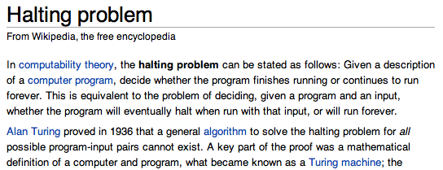
Others…? Haltchecking is impossible.
Any Python function
Any input at all!
def HC( f, inp ):
if f(inp) halts:
return True
else:
return False
This grey area is the tricky part!!
HC checks for infinite loops.
in finite time

Slide 98
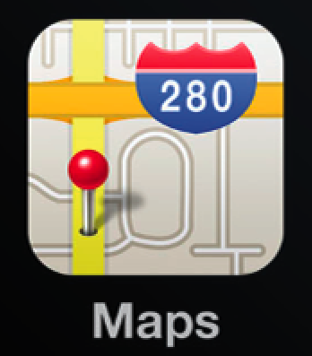
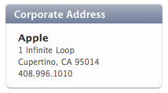
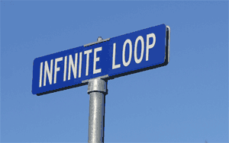
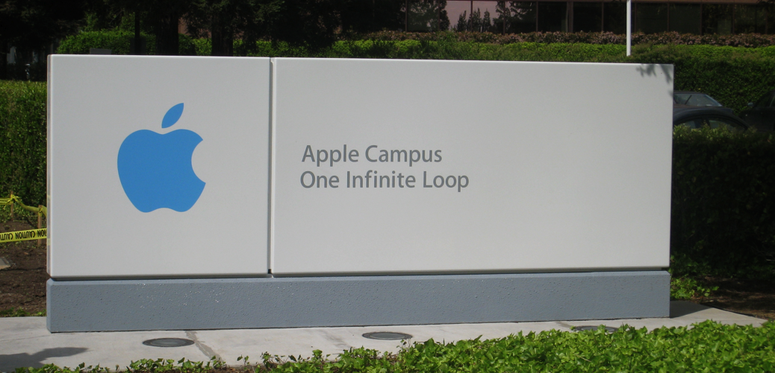
the iPhone's icon for Google Maps …

Slide 99
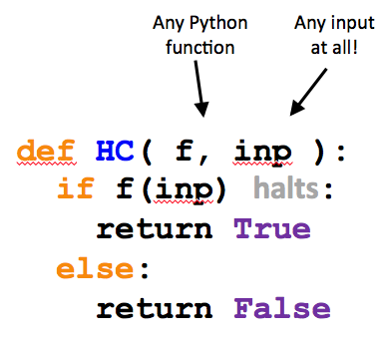
Examples of HC in action:
Here are two Python functions:
def g( x ):
if x == 42:
while True:
x += 0
else:
return 42
def h( x ):
if x == h:
while True:
print "Spam!"
else:
return g(x)
What does HC return in these calls?
HC(g, 41)
HC(g, 42)
HC(g, g)
HC(g, h)
HC(h, 41)
HC(h, 42)
HC(h, g)
HC(h, h)

Slide 100
Proof strategy: Assume HC exists
Any Python function
Any input at all!
We show that this results in a contradiction…
def HC( f, inp ):
if f(inp) halts:
return True
else:
return False
Thus, the presumption "HC exists" is false.
So, HC can not exist.
HC checks for infinite loops.
in finite time

Slide 101
Proof strategy: Assume HC exists
We build a new function, cant
Cant takes only one input, a function.
Does the following call halt or does it run forever?
Any Python function
cant( cant )
def cant( f ):
if HC(f,f):
while True:
print "Ha!"
else:
return 42
This name Cant be a coincidence!

Slide 102
Thus…
can not be programmed…
HC( f, inp )
can not be computed…
though, as a mathematical function, it does exist!
Haltchecking can not be done by computer.
The "Halting problem" is uncomputable.
or undecidable

Slide 103
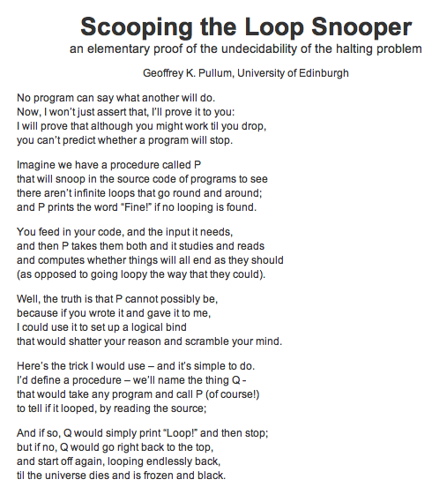
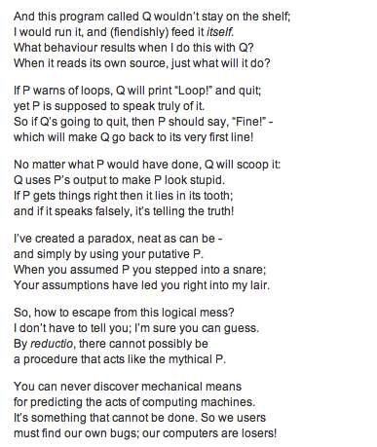
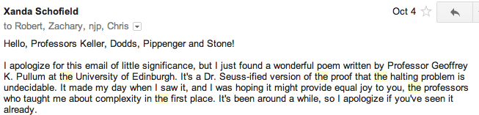

Slide 104
Cantor and "friends"
Who would you trust?
Leopold Kronecker 1823-1891
Lugwig Wittgenstein
1889-1951
David Hilbert 1862-1943

Slide 105
Cantor and "friends"
"Charlatan"
"Renegade"
No one shall expel us from the paradise that Cantor has created.
"Laughable and wrong"
"Utter nonsense"
And this was before 1900!
Leopold Kronecker 1823-1891
Lugwig Wittgenstein
1889-1951
David Hilbert 1862-1943

Slide 106
Cantor and "friends"
"Charlatan"
"Renegade"
"Corrupter of Youth"
No one shall expel us from the paradise that Cantor has created.
"Laughable and wrong"
"Utter nonsense"
And this was before 1900!
Leopold Kronecker 1823-1891
Lugwig Wittgenstein
1889-1951
David Hilbert 1862-1943

Slide 107
What about functions... and programs ?
Positive integers
the Reals
from 0 to 1
{ real numbers, 0-1 }
{ 1, 2, 3, 4, 5, … }
Uncountably infinite
>
Countably infinite
This is how many functions from integers to booleans there are.
This is how many programs there are.

Slide 108
What about functions... and programs ?
Uncountably infinite
Proof?
{ real numbers, 0-1 }
This is how many functions from integers to booleans there are.
Why are there more int-bool functions than real numbers from zero to one?
This margin looks better!

Slide 109
What about functions... and programs ?
Uncountably infinite
Proof?
{ real numbers, 0-1 }
This is how many functions from integers to booleans there are.
Why are there more int-bool functions than real numbers from zero to one?
(1) Choose any real x, 0-1
(2) Write it in binary
(3) The function that maps each positive integer k to the kth bit in x is unique to only that real number.
(4) QED!
* Technical note: some numbers x have more than one function...
real number
which bit?
1 2 3 4 5 6 7 ...
x = .0100000...
See, it worked!

Slide 110
What about functions... and programs ?
Uncountably infinite
Proof?
{ real numbers, 0-1 }
This is how many functions from integers to booleans there are.
Why are there more int-bool functions than real numbers from zero to one?
0.00000...
0.10000...
0.01000...
0.11000...
... all real #s from 0 to 1 ...
0.11111...
(1) Choose any real number, 0-1
(2) Write it in binary
(3)

Slide 111
well-defined computational problems
no computer program
can solve
There are
that
at any speed
Proof strategy
How many of each are there?
There are more of these …
Bio/CS 6 homework
def is_even(X):
return X%2 == 0
than these.
Video
games
Pico
bot
Positive Integer
Predicates ~ PIPs
def is_three(X):
return X == 3
Mario Kart
Well-defined computational tasks
Programs

Slide 112
well-defined computational problems
no computer program
can solve
There are
that
even with ∞ memory
Show that there are UNCOUNTABLY many of these!
Strategy?
Show that there are COUNTABLY many of these!
There are more of these …
Bio/CS 6 homework
def is_even(X):
return X%2 == 0
than these!
Video
games
String matching
Positive Integer
Predicates ~ PIPs
def is_three(X):
return X == 3
Mario Kart
Well-defined computational tasks
Programs
They look the same to me!

Slide 113
Programs are countable
There are as many programs as positive integers…
How to show this?
def is_even(X):
return X%2 == 0
def is_three(X):
return X == 3
Programs

Slide 114
Problems are uncountable
at least!
There are as many problems as real numbers from [0,1]…
How to show this?
CS 5 homework
Video
games
Pico
bot
Positive Integer
Predicates ~ PIPs
Mario Kart
Well-defined computational tasks

Slide 115
PIPs: Positive Integer Predicates
input
output
PIPs are functions mapping positive integers to boolean values
1,2,…
True or False
PIP
each PIP is a different computational "problem"
CS 5 homework
Video
games
Pico
bot
Positive Integer
Predicates ~ PIPs
Mario Kart
Well-defined computational tasks

Slide 116
PIPs: Positive Integer Predicates
input
output
PIPs are functions mapping positive integers to boolean values
1,2,…
True or False
PIP
each PIP is a different computational "problem"
Input
 | 1 | 2 | 3 | 4 | 5 | 6 | 7 | 8 | 9
A? | T | T | T | T | T | T | T | T | T
B? | F | T | F | T | F | T | F | T | F
C? | T | F | T | F | T | F | T | F | T
D? | F | T | T | F | T | F | T | F | F
E? | T | T | F | F | F | F | F | F | F
PIP
…

Slide 117
PIPs: Positive Integer Predicates
input
output
PIPs are functions mapping positive integers to boolean values
1,2,…
True or False
PIP
each PIP is a different computational "problem"
Input
 | 1 | 2 | 3 | 4 | 5 | 6 | 7 | 8 | 9
True | T | T | T | T | T | T | T | T | T
Even | F | T | F | T | F | T | F | T | F
Odd | T | F | T | F | T | F | T | F | T
Prime | F | T | T | F | T | F | T | F | F
<3 | T | T | F | F | F | F | F | F | F
PIP
…

Slide 118
PIPs are uncountable?
Input
 | 1 | 2 | 3 | 4 | 5 | 6 | 7 | 8 | 9
True | T | T | T | T | T | T | T | T | T
Even | F | T | F | T | F | T | F | T | F
Odd | T | F | T | F | T | F | T | F | T
Prime | F | T | T | F | T | F | T | F | F
<3 | T | T | F | F | F | F | F | F | F
PIP
…

Slide 119
Not being constructive…
One "failure" of this proof is that it doesn't construct a full example of an uncomputable problem!
So, where are all these uncomputable problems?
The problem is, most are indescribable…
(in English)
I guess that would be a problem!
... but a few can be described

Slide 120
Defining Complexity
Consider two integers:
lots of zeros
100000000000000000000000000…00000
Each has 5001 digits
lots of digits
170117684200068728224888577…85601
Which "feels like" the more complex number? Why?

Slide 121
Kolmogorov Complexity
Andrei Kolmogorov
1903-1987
Complexity( k ) =
the length of the shortest zero-input program that produces k
k = 100000000000000000000000000…00000
A length-5017 program producing k:
def a(): return 10000…0000
k = 170117684200068728224888577…85601
A length-5017 program producing k:
def b(): return 17011…5601

Slide 122
Kolmogorov Complexity
Andrei Kolmogorov
1903-1987
Complexity( k ) =
the length of the shortest zero-input program that produces k
k = 100000000000000000000000000…00000
length of 24 !
def a(): return 10**5000
k = 170117684200068728224888577…85601
length of 5017
def b(): return 17011…5601
Maybe we can do even better?

Slide 123
Kolmogorov Complexity
Andrei Kolmogorov
1903-1987
Complexity( k ) =
the length of the shortest zero-input program that produces k
For each input N, there is a well-defined, unambiguous value for Complexity(k).
N = 100000000000000000000000000…00000
Complexity( N ) = 24 or so
N = 170117684200068728224888577…85601
Complexity( N ) = some other integer
Does Complexity(N) always exist?

Slide 124
What are the uncomputable problems?
Here's an uncomputable function:
positive integer input, k
the positive integer output that is k's complexity
Complexity( k ) =
with a name like Complexity, this function was doomed !

Slide 125
Complexity isn't computable!
def Complexity( N ):
do stuff…
return answer
Proof strategy
I guess you'd call this part of the code a GRAY AREA…
proof by contradiction
(1) Presume that Complexity exists.
(2) We show this results in a contradiction…
(3) Thus, the presumption "Complexity exists" is false.
(4) So, the program/function Complexity can not exist!

Slide 126
Proof by contradiction?
(1) Presume something: there are a finite # of primes
(2) Show a contradiction…
(3) Thus, the something must have been false!
That's it!

Slide 127
def Complexity( N ):
do stuff…
return answer
Presume that Complexity exists, it works, and it's 42,000 characters long
Try it!
def Ouch():
k = 0
while Complexity(k) < 50000:
k += 1
return k
def Complexity( N ):
do stuff…
return answer
Note:
it's OK to define a function inside another function
Will this loop stop when k is less than, equal to, or greater than 50,000?
Question 1:
Hey! That's not a question!
Question 2:
This function returns an integer.
Question 3:
What is the Complexity of the integer returned?
Ouch hurts!
Question 4:
What is the contradiction here?

Slide 128
Others?
They involve infinity.
Many potentially useful problems are impossible to compute!
They involve self-reference.
Or they can be interpreted as such.
Where did Complexity go wrong?

Slide 129
Others?
They involve infinity.
Many potentially useful problems are impossible to compute!
They involve self-reference.
Or they can be interpreted as such.
A string containing a Python function
Any string
Inf checks for infinite loops.
def Inf( fs, input ):
if fs(inp) runs forever:
return True
else:
return False
in finite time

Slide 130
the iPhone's icon for Google Maps …

Slide 131
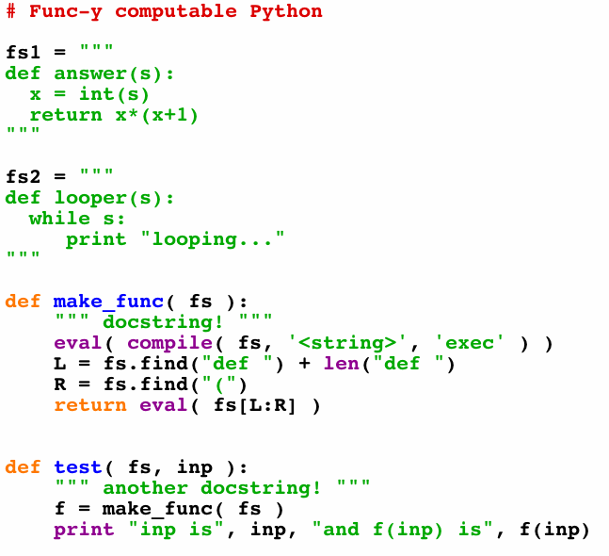
make_func ?
These Python strings look decidedly func-y
Strings and functions are one and the same…
Python creates Python!
What's this doing?
Python runs Python!
f is the function in fs
Let's test it!

Slide 132
A working Inf
Inf does exist - and does work - if given infinite time…
A string containing a Python function
Any string
def Inf( fs, inp ):
f = make_func(fs)
if f(inp) or not f(inp):
return False
else:
return True
This Inf checks for infinite loops.
but can use infinite time!
And, to be fair, it never really returns True !

Slide 133
Proof strategy
Presume that Inf exists.
A string containing a Python function
We show that this results in a contradiction…
Any string
def Inf( fs, inp ):
f = make_func(fs)
if f(inp) runs forever:
return True
else:
return False
Thus, the presumption "Inf exists" is false.
So, Inf can not exist.
Inf checks for infinite loops.
in finite time

Slide 134
Presume:
Inf( fs, inp ) works…
We build a new function, Cant
A string containing a Python function
def Cant( fs ):
if Inf(fs,fs):
return 42
else:
while True:
print "ha!"
Cant stubbornly reverses the predictive power of Inf !
Cant takes only one input, a string containing a Python function.
This name Cant be a coincidence!

Slide 135
Presume:
Inf( fs, inp ) works…
We build Cant:
Consider…
A string containing a Python function
fs2 = """
def Cant( fs ):
if Inf(fs,fs):
return 42
else:
while True:
print "ha!"
"""
def Cant( fs ):
if Inf(fs,fs):
return 42
else:
while True:
print "ha!"
>>> Cant( fs2 )

Slide 136
Thus…
can not exist…
Inf( fs, inp )
can not be written…
can not be programmed…
Infinite-loop checking can not be done by computer.
The "Halting problem" is uncomputable.
can it be done biologically?

Slide 137
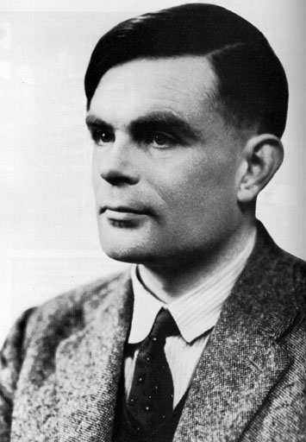
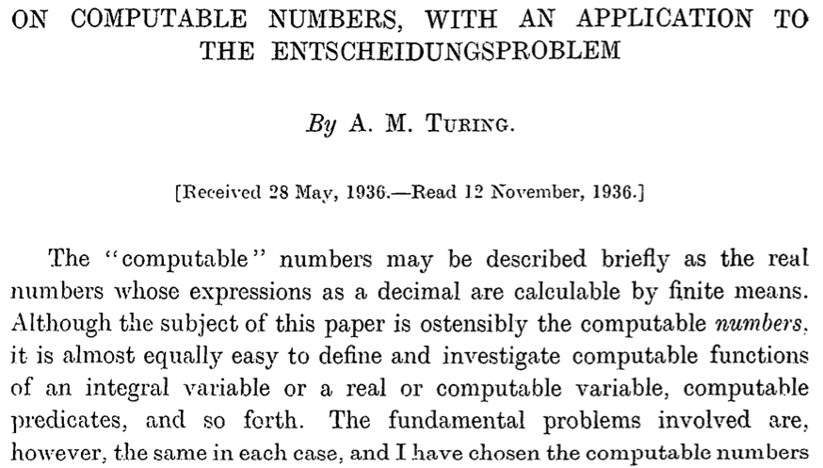
Turing's proof
Alonzo Church, too
+ 36 more pages

Slide 138
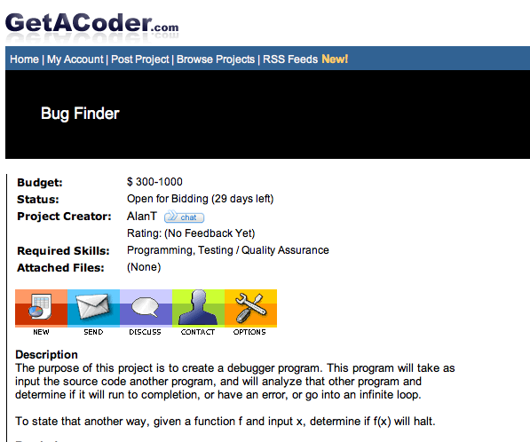

Slide 139
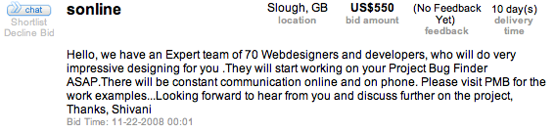


Slide 140
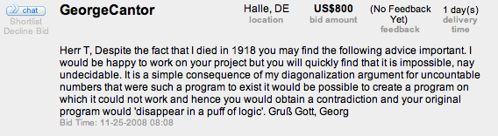

Slide 141
Beyond computation
"All" problems are impossible to solve by computer program.
But "a few" are solvable by computer program.
(uncountably many)
(countably many)
Well-defined computational problems
Programs
So this must be the seashore of uncomputability. Let's dive in!

Slide 142
Beyond computation
"All" problems are impossible to solve by computer program.
But "a few" are solvable by computer program.
(uncountably many)
(countably many)
Well-defined computational problems
Programs
Describable computational problems!
This may seem indescribably odd...

Slide 143
All exam questions will be at most NP-complete.
(This is an advantage of paper coding!!)
Tell me about it!

Slide 144
Thus…
can not exist…
Inf( fs, inp )
can not be written…
can not be programmed…
Infinite-loop checking can not be done by computer.
The "Halting problem" is uncomputable.
can it be done biologically?

Slide 145
More computation?
well beyond the CS department…
E85 ~ digital electronics (probably E4 next term, however)
E155 ~ microp's
Math 55 ~ discrete mathematics
Physics 170 ~ computational physics (Phys 52 first)
Music 88 ~ computer music (HSA course)
CS 124a ~ user interfaces (any-major course)
CS 60 ~ principles of CS (a major course, nonmajors welcome)

Slide 146
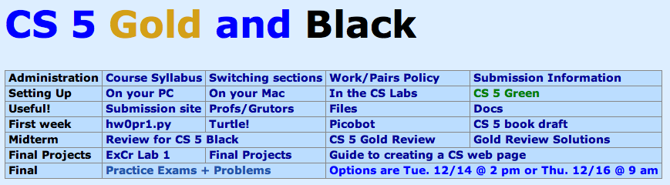
CS 5 Today: Beyond FSMs
The review from here…
Final exam review
Review session
Monday, 12/13
7-8pm, here in Pryne
Questions + go over the CS 5 Gold practice exam
Project progress... ?
Milestone due last night (tonight with Euro)
Labs today and tomorrow for final project work/help
Friday hours in the CS labs, too
Final version due this Friday...
-- grading is scheduled for Monday!

Slide 147

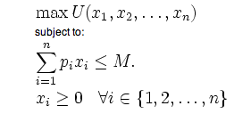
What computers can't do !
In order to really examine this issue, we need to have a precise model of a computer…
Physics: Model of a particle in a potential field
Economics: Model of a rational consumer

Slide 148
Simplest model of computation: FSMs
Finite State Machines
Example:
0
0
1
s0
s1
1
start state
transitions
accepting states
“input funnel”
“where to go”
double circled
labeled by input !

Slide 149
Third-to-last character is a 1
How many states would a 100th-to-last-character FSM have?

Slide 150
FSMs can't count...
Because they're finite, FSMs can only count finitely high !
Computable with FSMs
Uncomputable with FSMs
even/odd sums or differences
equal numbers of two values
multiples of other integers
a specified difference between two values
finite constraints on the input:
palindromes
third digit is a 1
third-to-last digit is a 1
third digit == third-to-last digit
etc.
anything modeled by a potentially unbounded while loop
They can handle modulo, but not arbitrary, arithmetic
Can computers handle arbitrary arithmetic?
Notes:
metric prefixes…

Slide 151
Uncomputable problems?
There are many problems computers can't solve at all !
Perhaps this is not all that surprising…
losing to the Oakland Raiders
global warming
disbelief in aliens
Surely you jest!!!
anything, if using Vista
Warning: these problems may appear on the CS 5 final!

Slide 152
Proof strategy ?
well-defined computational problems
no computer program
can solve
There are
that
even with ∞ memory
There are more of these …
Bio/CS 6 homework
def is_even(X):
return X%2 == 0
than these!
Video
games
String matching
Positive Integer
Predicates ~ PIPs
def is_three(X):
return X == 3
Mario Kart
Well-defined computational tasks
Programs
They look the same to me!

Slide 153

equal-size sets
There are infinitely many of both….
…but not all infinities are created equal!
{ , , }
{ 1 , 2 , 3 }
Two sets have equal size if
their elements have a
one-to-one matching
This matching is called a bijection.
I'd say these sets share the same cardinality

Slide 154
Bijections define equality for infinite sets, too!
Positive
evens
E = { 2, 4, 6, 8, 10, … }
Positive integers
N = { 1, 2, 3, 4, 5, … }
ALL
integers
Z = {…, -3, -2, -1, 0, 1, 2, 3, …}
With no negative repercussions!
E and N and Z all have the same size!

Slide 155
This seems irrational !
That's my line!
the Rationals
Are these sets equal-sized?
Positive integers
1
84
22
13
{ … }
,
,
,
,
{ 1, 2, 3, 4, 5, … }
1
2
7
15

Slide 156
Georg Cantor
1845-1918
Cantor Diagonalization
There is NO matching from reals to integers!
Positive integers
the Reals
from 0 to 1
{ real numbers, 0-1 }
{ 1, 2, 3, 4, 5, … }

Slide 157
To infinity - and beyond
Pixar owes Cantor for this one!
Positive integers
the Reals
from 0 to 1
{ real numbers, 0-1 }
{ 1, 2, 3, 4, 5, … }
Uncountably infinite
>
Countably infinite
sets equal-sized with the real numbers
strictly larger
sets equal-sized with the positive integers

Slide 158
Cantor and "friends"
Who would you trust?
Leopold Kronecker 1823-1891
Lugwig Wittgenstein
1889-1951
David Hilbert 1862-1943

Slide 159
Programs are countable
There are as many programs as positive integers…
How to show this?
def is_even(X):
return X%2 == 0
def is_three(X):
return X == 3
Programs

Slide 160
PIPs: Positive Integer Predicates
input
output
PIPs are functions mapping positive integers to boolean values
1,2,…
True or False
PIP
each PIP is a different computational "problem"
Input
 | 1 | 2 | 3 | 4 | 5 | 6 | 7 | 8 | 9
A? | T | T | T | T | T | T | T | T | T
B? | F | T | F | T | F | T | F | T | F
C? | T | F | T | F | T | F | T | F | T
D? | F | T | T | F | T | F | T | F | F
E? | T | T | F | F | F | F | F | F | F
PIP
…

Slide 161
Not being constructive…
One "failure" of this proof is that it doesn't construct a full example of an uncomputable problem!
So, where are all these uncomputable problems?
The problem is, most are indescribable…
(in English)
I guess that would be a problem!
... but a few can be described

Slide 162
Defining Complexity
Consider two integers:
lots of zeros
100000000000000000000000000…00000
Each has 5001 digits
lots of digits
170117684200068728224888577…85601
Which "feels like" the more complex number? Why?

Slide 163
Kolmogorov Complexity
Andrei Kolmogorov
1903-1987
Complexity( k ) =
the length of the shortest zero-input program that produces k
k = 100000000000000000000000000…00000
A length-5017 program producing k:
def a(): return 10000…0000
k = 170117684200068728224888577…85601
A length-5017 program producing k:
def b(): return 17011…5601

Slide 164
Kolmogorov Complexity
Andrei Kolmogorov
1903-1987
Complexity( k ) =
the length of the shortest zero-input program that produces k
k = 100000000000000000000000000…00000
length of 24 !
def a(): return 10**5000
k = 170117684200068728224888577…85601
length of 5017
def b(): return 17011…5601
Maybe we can do even better?

Slide 165
Kolmogorov Complexity
Andrei Kolmogorov
1903-1987
Complexity( k ) =
the length of the shortest zero-input program that produces k
For each input N, there is a well-defined, unambiguous value for Complexity(k).
N = 100000000000000000000000000…00000
Complexity( N ) = 24 or so
N = 170117684200068728224888577…85601
Complexity( N ) = some other integer
Does Complexity(N) always exist?

Slide 166
What are the uncomputable problems?
Here's an uncomputable function:
positive integer input, k
the positive integer output that is k's complexity
Complexity( k ) =
with a name like Complexity, this function was doomed !

Slide 167
Complexity isn't computable!
def Complexity( N ):
do stuff…
return answer
Proof strategy
I guess you'd call this part of the code a GRAY AREA…
proof by contradiction
(1) Presume that Complexity exists.
(2) We show this results in a contradiction…
(3) Thus, the presumption "Complexity exists" is false.
(4) So, the program/function Complexity can not exist!

Slide 168
Proof by contradiction?
(1) Presume something: there are a finite # of primes
(2) Show a contradiction…
(3) Thus, the something must have been false!
That's it!

Slide 169
def Complexity( N ):
do stuff…
return answer
Presume that Complexity exists, it works, and it's 42,000 characters long
Try it!
def Ouch():
k = 0
while Complexity(k) < 50000:
k += 1
return k
def Complexity( N ):
do stuff…
return answer
Note:
it's OK to define a function inside another function
Will this loop stop when k is less than, equal to, or greater than 50,000?
Question 1:
Hey! That's not a question!
Question 2:
This function returns an integer.
Question 3:
What is the Complexity of the integer returned?
Ouch hurts!
Question 4:
What is the contradiction here?

Slide 170
Others?
They involve infinity.
Many potentially useful problems are impossible to compute!
They involve self-reference.
Or they can be interpreted as such.
Where did Complexity go wrong?

Slide 171
Others?
They involve infinity.
Many potentially useful problems are impossible to compute!
They involve self-reference.
Or they can be interpreted as such.
A string containing a Python function
Any string
Inf checks for infinite loops.
def Inf( fs, input ):
if fs(inp) runs forever:
return True
else:
return False
in finite time

