Slide 1
exec( CS 5 today )
Describing uncomputable functions…
These are fun f'ns!
kc
hc
… they're surprisingly useful - especially hc!
office hours in LAC Fri. + CS Labs
Final projects...
tutors will be around all week…
final.zip is due this Friday…
printing is a great debugging strategy!
Project notes...
trick yourself (!) into tackling one bit at a time…

Slide 2
Final project notes: VPool
http://dbkcues.ru/articles-2/collision-of-billiard-balls/?lang=en
Creativity vs. accuracy?

Slide 3
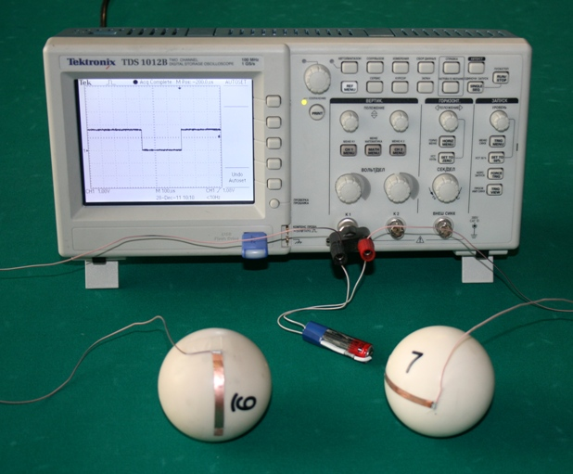
Final project notes: VPool
Creativity vs. accuracy?

Slide 4
Final project notes: VPool
First, define all of your objects - and classes, if you wish.
Note that you only need classes if you want composite objects. Otherwise, VPython's sphere, box, etc. are good enough!
b0 = sphere()
b0.vel = vector(0,0,0)
b1 = sphere()
b1.vel = vector(1,0,0)
while True:
b0.pos += dt*b0.vel
b1.pos += dt*b1.vel
key/mouse handling…
collision handling… etc.
Then, the whole game lives in a single, infinite, while True loop!
Don't run any more timing loops or waiting loops anywhere else – just use this one!!

Slide 5
Computation's models…
Useful, but limited ~ can't count
Finite State Machines
0
0
1
s0
s1
1
Universal definition of what can be computed
Turing Machines
Extra ™ !

Slide 6
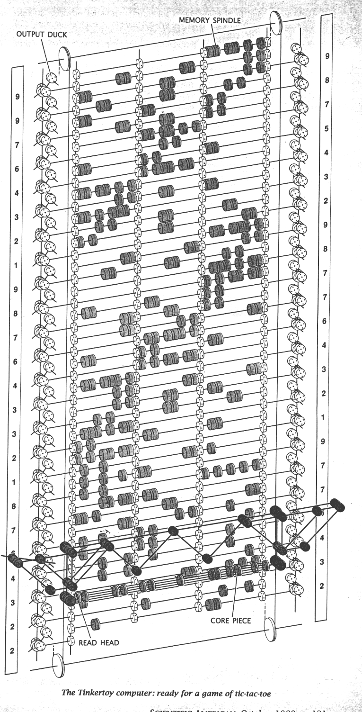
All known and imagined computers can compute only what Turing Machines can...
some are faster than others…
Quantum computation
http://www.cs.virginia.edu/~robins/The_Limits_of_Quantum_Computers.pdf
Molecular computation
http://www.arstechnica.com/reviews/2q00/dna/dna-1.html
Parallel computers
Integrated circuits
Electromechanical computation
Water-based computation
Tinkertoy computation

Slide 7
But some things can't be computed ~ by any machine or any program …
provably!

Slide 8
Uncomputable functions?
well-defined computational problems
computer program
can solve
There are
that no
even with ∞ memory!
CS 5 homework
def is_even(x):
return x%2 == 0
Video
games
Pico-
bot
Int-bool functions
def is_three(x):
return x == 3
Team Fortress
Well-defined computational tasks
Programs
These programs are both int-bool functions

Slide 9
Uncomputable functions?
well-defined computational problems
computer program
can solve
There are
that no
even with ∞ memory!
There are more of these …
CS 5 homework
def is_even(x):
return x%2 == 0
than these!
Video
games
Pico-
bot
Int-bool functions
Team Fortress
Well-defined computational tasks
Programs
These programs are both int-bool functions

Slide 10
What about functions... and programs?
the Reals from 0 to 1
Positive integers
Uncountably infinite
>
Countably infinite
This is how many int-bool functions there are.
This is how many programs there are.

Slide 11
Programs are countable
class Alien:
def __init__( …
Positive integers
Countably infinite
Every program is a string.
Every string is just a bitstring.
This is how many programs there are.
Every bitstring is just an int.

Slide 12
int-bool functions are uncountable
the Reals from 0 to 1
This margin is too small to hold my marvelous proof!
Uncountably infinite
This is how many functions there are – in fact, only f'ns from integers to booleans!
input
output

Slide 13
functions are uncountable
mathematical
the Reals from 0 to 1
functions
input: int
output: T or F
any real # from 0-1
written out in binary
1 2 3 4 5 6 7 8 ...
r₁ = .01100000 ...
A(n): return isPrime(n)
r₂ = .10101010 ...
B(n): return n in [2, 3]
r₃ = .01101010 ...
C(n): return n >= 42
r₄ = .11010001 ...
D(n): return isPowerOf2(n)
r₅ = .00000000 ...
E(n): return True
r₆ =
Curse you, cursive!
F(n): return n%2 == 1

Slide 14
functions are uncountable
mathematical
the Reals from 0 to 1
functions
input: int
output: T or F
any real # from 0-1
written out in binary
1 2 3 4 5 6 7 8 ...
r₁ = .01100000 ...
A(n): return isPrime(n)
r₂ = .10101010 ...
B(n): return n in [2, 3]
r₃ = .01101010 ...
C(n): return n >= 42
r₄ = .11010001 ...
D(n): return isPowerOf2(n)
r₅ = .00000000 ...
E(n): return True
r₆ = .11111111 ...
F(n): return n%2 == 1

Slide 15
functions are uncountable
mathematical
the Reals from 0 to 1
functions
input: int
output: T or F
For each real number, there's a unique function!
any real # from 0-1
written out in binary
1 2 3 4 5 6 7 8 ...
r₁ = .01100000 ...
A(n): return isPrime(n)
r₂ = .10101010 ...
B(n): return n in [2, 3]
r₃ = .01101010 ...
C(n): return n >= 42
r₄ = .11010001 ...
D(n): return isPowerOf2(n)
r₅ = .00000000 ...
E(n): return True
r₆ = .11111111 ...
F(n): return n%2 == 1

Slide 16
There are lots of functions
uncountably many
Well-defined mathematical functions (uncountable)
What's swimming around out here?
Programs (countable)
There are "a few" programs
countably many

Slide 17
How big is the set of the human-describable things... ?
Well-defined mathematical functions
Human-describable things…
Programs
<
Philosophical thinking…

Slide 18
Does it include all functions? (No…)
Well-defined mathematical functions
Programs
<
Human-describable things…

Slide 19
Does it include all programs? (No…)
Well-defined mathematical functions
Human-describable things…
Programs
<

Slide 20
It overlaps incompletely – and goes beyond... !
Well-defined mathematical functions
So, what is all this stuff out here?!?
Programs
kc
hc
<
This time…
Human-describable things…

Slide 21
Two useful functions that we prove can't be computed…
Kolmogorov Complexity
kc( x )
~ the complexity of an integer x
Halt Checking
hc( f, x )
~ does f(x) halt or loop forever?

Slide 22
What might the complexity of an integer be?
59049 zeros total
100000000000000000000000000…00000
each of these integers has 59050 digits
170117684200068728224888577…85601
same number of total digits as above
Which one "feels like" the more complex number... Why ?

Slide 23
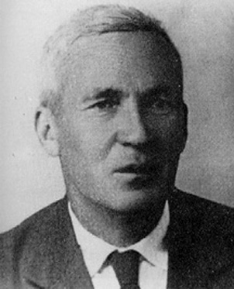
The complexity of x is the length of the shortest zero-input function that outputs x.
Andrei Kolmogorov
1903-1987
Kolmogorov Complexity
kc( 42 ) = 18
The int 42 has a complexity of 18.
Why 18 ?

Slide 24
The complexity of x is the length of the shortest zero-input function that outputs x.
Andrei Kolmogorov
1903-1987
Kolmogorov Complexity
kc( 42 ) = 18
def f(): return 42
1
2
3
4
5
6
7
8
9
10
11
12
13
14
15
16
17
18
… because Python has 16 characters of overhead

Slide 25
What's the complexity of 1000…000 ?
59049 zeros
There are lots of 0-input functions that output that number:
function length
def f(): return 1000…000
59066
59049 zeros
def f(): return
def f(): return
The shortest defines the complexity.
1e59049 ~ wow!

Slide 26
What's the complexity of 1000…000 ?
59049 zeros
There are lots of 0-input functions that output that number:
function length
def f(): return 1000…000
59066
59049 zeros
25
def f(): return 10**59049
def f(): return
The shortest defines the complexity.
1e59049 ~ wow!

Slide 27
What's the complexity of 1000…000 ?
24
59049 zeros
There are lots of 0-input functions that output that number:
function length
def f(): return 1000…000
59066
59049 zeros
25
def f(): return 10**59049
def f(): return 10**9**5
24
The shortest defines the complexity.
1e59049 ~ wow!

Slide 28
What's the complexity of 1000…000 ?
24
59049 zeros
There are lots of 0-input functions that output that number:
function length
Challenge: what is the complexity of 59049 ?
def f(): return 1000…000
59066
It's NOT 24.
59049 zeros
25
def f(): return 10**59049
def f(): return 10**9**5
24
The shortest defines the complexity.
1e59049 ~ wow!

Slide 29
What's the complexity of 1000…000 ?
24
59049 zeros
There are lots of 0-input functions that output that number:
function length
Challenge: what is the complexity of 59049 ?
def f(): return 1000…000
59066
It's NOT 24.
59049 zeros
25
def f(): return 10**59049
def f(): return 10**9**5
24
The shortest defines the complexity.
1e59049 ~ wow!

Slide 30
Kolmogorov Complexity
Quiz
Name(s) ____________________
example
Python has 16 chars of setup
+2
more
kc( 42 ) =
18
1
2
3
4
5
6
7
8
9
10
11
12
13
14
15
16
17
18
def f(): return 42
kc( 999999999 ) =
this one is less than 25
nine 9s
kc( 100…000 ) =
100 zeros
Try to find the exact Kolmogorov complexity values of these first four.
kc( 100…000 ) =
a googol zeros
kc( 1010…1010 ) =
2 billion total digits
kc( 31415926… ) =
Just estimate this last one.
2 billion digits of pi

Slide 31
Kolmogorov Complexity
Quiz
Name(s) ____________________
example
Python has 16 chars of setup
+2
more
kc( 42 ) =
18
1
2
3
4
5
6
7
8
9
10
11
12
13
14
15
16
17
18
def f(): return 42
kc( 999999999 ) =
23 = 16+7
10**9-1
nine 9s
kc( 100…000 ) =
23 = 16+7
10**100
100 zeros
kc( 100…000 ) =
27 = 16+11
10**10**100
a googol zeros
kc( 1010…1010 ) =
26 = 16+10
'10'*10**9
2 billion total digits
kc( 31415926… ) =
< 200
use your pi-estimating program!
2 billion digits of pi

Slide 32
Although kc(x) has a well-defined output for every integer input x,
kc(x)
is not a computable function.
what does this mean?

Slide 33
Although kc(x) has a well-defined output for every integer input x,
kc(x)
is not a computable function.
This means every implementation of kc(x) contains a bug!
provably!

Slide 34
Proof idea
(1) Consider a possible program for kc(x):
Try it on 42!
def kc( x ):
return x/2 - 3
The correct complexity of 10 is 18.
But kc(10) outputs 2, not 18.
That's a bug!
(2) Find a bug:

Slide 35
Proof idea
(1) Consider a possible program for kc(x):
Try it on 42!
def kc( x ):
return x/2 - 3
The challenge: we have to find a bug in any possible version of kc(x)!
The correct complexity of 10 is 18.
But kc(10) outputs 2, not 18.
That's a bug!
(2) Find a bug:

Slide 36
Any version…
(1) Consider any possible kc(x):
def kc( x ):
do stuff…
return answer
I guess you'd call this part of the code a GRAY AREA…
(2) Find a bug:
???

Slide 37
kc insights
Which is larger: x or kc(x) ?
Are there ints x > y
but with kc(x) < kc(y) ?

Slide 38
Key Question:
Does every integer x have kc(x) <= 50000?
or, do there exist integers x with kc(x) > 50000?

Slide 39
Try it
def kc( x ):
do stuff…
return answer
Let's presume that this version of kc is 42,000 characters long…
Questions
#0:
How does the previous slide prove that BOOM's while loop does stop eventually?
def BOOM():
x = 0
while kc(x) <= 50000:
x += 1
return x
#1:
Will that loop stop when x is less than 50,000,
x is equal to 50,000, or
x is greater than 50,000?
Try completing this thought: BOOM returns the smallest integer whose complexity is
______________________________________ .
#2:
bug = BOOM()
About how many characters are in all of the code on this slide? Don't forget to include the 42,000 in kc!
#3:
kc(bug)
#4:
How does question #3 help estimate kc(bug)?
#5:
Why is bug a bug in kc?
Hint: How was kc defined…
Why is the proof complete?!

Slide 40
Try it
def kc( x ):
do stuff…
return answer
Let's presume that this version of kc is 42,000 characters long…
Questions
#0:
How does the previous slide prove that BOOM's while loop does stop eventually?
def BOOM():
x = 0
while kc(x) <= 50000:
x += 1
return x
#1:
Will that loop stop when x is less than 50,000,
x is equal to 50,000, or
x is greater than 50,000?
Try completing this thought: BOOM returns the smallest integer whose complexity is
______________________________________ .
BOOM returns an int with complexity >50,000 using only 42,100 characters!
#2:
bug = BOOM()
About how many characters are in all of the code on this slide? Don't forget to include the 42,000 in kc!
#3:
kc(bug)
#4:
How does question #3 help estimate kc(bug)?
#5:
Why is bug a bug in kc?
Hint: How was kc defined…
Why is the proof complete?!

Slide 41
Although kc(x) has a well-defined output for every integer input x,
kc(x)
is not a computable function.
Every implementation of kc(x) contains a bug!
proven!

Slide 42
XkcD

Slide 43
Best possible compression?
The best-compressed version of any data D is the shortest program that generates D.
Which text has been compressed here?

Slide 44
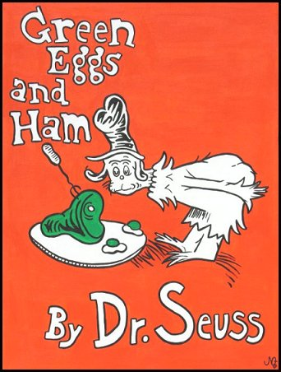
Best possible compression?
The best-compressed version of any data D is the shortest program that generates D.
Which text has been compressed here?

Slide 45
Wait! What about this:
How about this approach to computing kc(x):
Only finitely many programs could be the shortest to return x!
fewer than 128^{16+x} of them
The program is at most 16+x characters long.
Check all of them to see which one(s) return x.
Of all that do return x, take the shortest. You're finished!
Is there a bug here? Or in our proof?

Slide 46
Wait! What about this:
How about this approach to computing kc(x):
Only finitely many programs could be the shortest to return x!
fewer than 128^{16+x} of them
The program is at most 16+x characters long!
Check all of them to see which one(s) return x.
Of all that do return x, take the shortest. You're finished!
Checking what programs do is also uncomputable!
What!?!

Slide 47
Haltchecking is uncomputable.
Halt Checking
hc( f, x )
~ returns whether f(x) halts or not
hc can't be written well, not without bugs

Slide 48
Haltchecking is uncomputable.
Any Python function
Any input at all!
def hc( f, x ):
It is impossible to write a bug-free function hc(f,x) that determines if function f halts when run on x:
(1) that returns True if f(x) halts and
(2) and returns False if f(x) loops infinitely

Slide 49
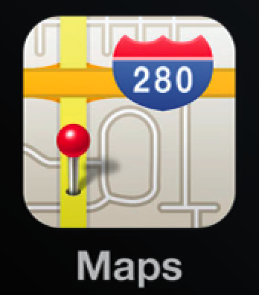
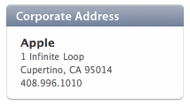
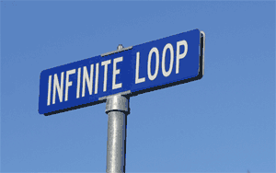
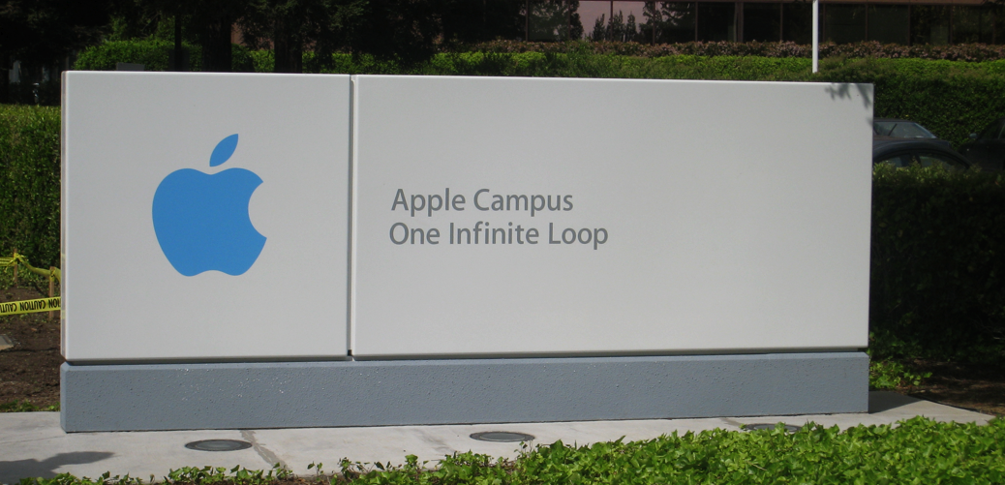
the iPhone's icon for Google Maps …

Slide 50
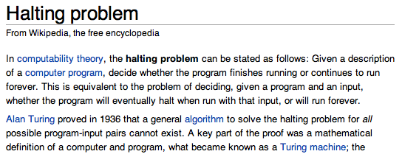
the iPhone's icon for Google Maps …

Slide 51
Good luck with final projects!
They will halt all too soon!!
Tutoring hours and labs through the week…

Slide 52
Kolmogorov Complexity
Quiz
Name(s) ____________________
example
1
2
3
4
5
6
7
8
9
10
11
12
13
14
15
16
17
18
Python has 16 chars of setup
kc( 42 ) =
18
def f(): return 42
kc( 100…000 ) =
100 zeros
Try to find exact values for the first three.
kc( 100…000 ) =
googol zeros
kc( 1010…1010 ) =
2 billion total digits
kc( 31415926… ) =
Just estimate this last one.
2 billion digits of pi
For what x is x <= kc(x) ?
If x <= y, is kc(x) <= kc(y) ?

Slide 53
Kolmogorov Complexity
Quiz
Name(s) ____________________
example
1
2
3
4
5
6
7
8
9
10
11
12
13
14
15
16
17
18
Python has 16 chars of setup
kc( 42 ) =
18
def f(): return 42
kc( 100…000 ) =
100 zeros
Try to find exact values for the first three.
kc( 100…000 ) =
googol zeros
kc( 1010…1010 ) =
2 billion total digits
kc( 31415926… ) =
Just estimate this last one.
2 billion digits of pi
For what x is x <= kc(x) ?
If x <= y, is kc(x) <= kc(y) ?

Slide 54
Kolmogorov Complexity
Quiz
Name(s) ____________________
example
1
2
3
4
5
6
7
8
9
10
11
12
13
14
15
16
17
18
Python has 16 chars of setup
kc( 42 ) =
18
def f(): return 42
kc( 100…000 ) =
23 = 16+7
10**100
100 zeros
27 = 16+11
10**10**100
kc( 100…000 ) =
googol zeros
26 = 16+10
'10'*10**9
kc( 1010…1010 ) =
2 billion total digits
about ~200
kc( 31415926… ) =
your pi-estimating program
2 billion digits of pi
For what x is x <= kc(x) ?
If x <= y, is kc(x) <= kc(y) ?
for x up to 18
NO

Slide 55
Kolmogorov Complexity
Quiz
Name(s) ____________________
example
1
2
3
4
5
6
7
8
9
10
11
12
13
14
15
16
17
18
Python has 16 chars of setup
kc( 42 ) =
18
def f(): return 42
kc( 100…000 ) =
23 = 16+7
10**100
100 zeros
27 = 16+11
10**10**100
kc( 100…000 ) =
googol zeros
26 = 16+10
'10'*10**9
kc( 1010…1010 ) =
2 billion total digits
about ~200
kc( 31415926… ) =
your pi-estimating program
2 billion digits of pi
For what x is x <= kc(x) ?
If x <= y, is kc(x) <= kc(y) ?
for x up to 18
NO

Slide 56
Suppose you throw a dart at the number line…
integers
-1
0
1
2
3
π
e
reals
… what are your chances of hitting an integer?

Slide 57
How about this (pseudocode) approach to computing kc(x):
Wait! How about this?!
def kc(x):
i = 0 # i will just count upwards, one at a time…
while True:
A. convert i's bits to an ASCII string, p = prog(i)
B. test if p is a legal Python function of 0 inputs
C. if p is a legal Python function of 0 inputs:
D. run p() and see if its output == x
E. If its output == x, we found it! Return len(p)
F. i = i + 1

Slide 58
How about this (pseudocode) approach to computing kc(x):
Wait! How about this?!
def kc(x):
i = 0 # i will just count upwards, one at a time…
while True:
A. convert i's bits to an ASCII string, p = prog(i)
B. test if p is a legal Python function of 0 inputs
C. if p is a legal Python function of 0 inputs:
D. run p() and see if its output == x
E. If its output == x, we found it! Return len(p)
F. i = i + 1

Slide 59
How about this (pseudocode) approach to computing kc(x):
Wait! How about this?!
def kc(x):
i = 0 # i will just count up, one at a time…
while True:
A. i = i + 1
B. convert i's bits to an ASCII string, p = prog(i)
C. test if p is a legal Python function of 0 inputs
D. if p is not legal, continue with this while loop
E. else run p and see if its output == x
F. if the output isn't x, continue with this while loop
G. otherwise we've found it! So, just return len(p)
Step E is ALSO uncomputable

Slide 60
Not being constructive…
One "failure" of this proof is that it doesn't construct a full example of an uncomputable problem!
But it's still useful!
What are the chances that a randomly-selected function will have a program that solves it?
functions are uncountable
(as numerous as the reals)
programs are countable
(as numerous as the integers)

Slide 61
A Strategy* for CS Programming HW**
or “How to succeed in CS 60 without programming at all !”
For each programming assignment, note that the desired program’s behavior can be rephrased as functions of integers by encoding the input and output appropriately.
1
2
Point out that with 100% probability a function of integers is not computable by any program at all.
3
Proceed to your choice of (A) Amnesia, (B) Breaking Bad, or (C) Writ1.
4
Consult fine print for disclaimers.
* Please do not cite Prof. Dodds when using this strategy
** This strategy not applicable for CS 5 assignments.

Slide 62
functions are uncountable
Uncountably infinite
Each real number defines a unique int-bool functions (from ints to bits)
the Reals
from 0 to 1
any real # from 0-1
written out in binary
1 2 3 4 5 6 7 8 ...
def r1(n):
return n==2 or n == 3
r₁ = .01100000 ...
def r2(n):
return n%2 == 1
r₂ = .10101010 ...
def r3(n):
return isPrime(n)
r₃ = .01101010 ...
r₄ = .11010001 ...
def r4(n):
return isPowerOfTwo(n)
r₅ = .00000000 ...
def r5(n):
return n >= 42

Slide 63
functions are uncountable
Uncountably infinite
Each real number defines a unique int-bool functions (from ints to bits)
the Reals
from 0 to 1
any real # from 0-1
written out in binary
1 2 3 4 5 6 7 8 ...
def r1(n):
return n==2 or n == 3
r₁ = .01100000 ...
def r2(n):
return n%2 == 1
these five real #s have programs – but ALMOST ALL real #s don't!
r₂ = .10101010 ...
def r3(n):
return isPrime(n)
r₃ = .01101010 ...
r₄ = .11010001 ...
def r4(n):
return isPowerOfTwo(n)
r₅ = .00000000 ...
def r5(n):
return n >= 42

Slide 64
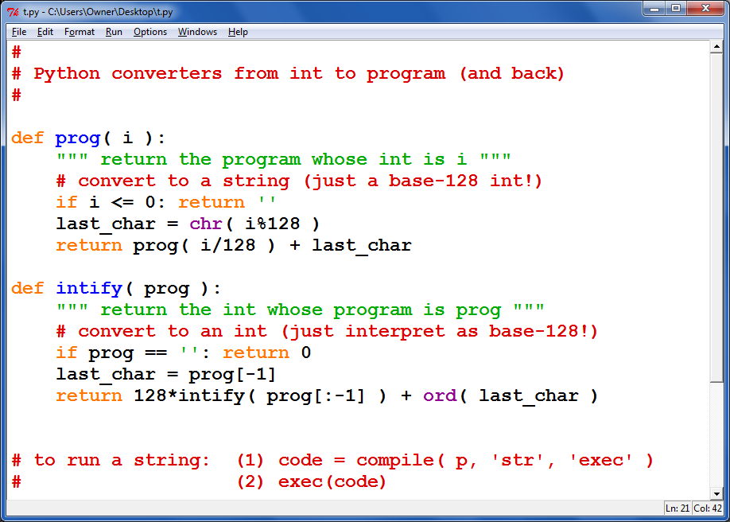
Python can even convert from programs to ints – and back…

Slide 65
functions vs. programs?
Positive integers
the Reals
from 0 to 1
{ real numbers, 0-1 }
{ 1, 2, 3, 4, 5, … }
Uncountably infinite
>
Countably infinite
This is how many int-bool functions there are.
This is how many programs there are.

Slide 66
Last time:
… different-sized infinities ~ Georg Cantor et al. …

Slide 67
Last time:
… different-sized infinities ~ Georg Cantor et al. …
This time:
empathy for L. Wittgenstein?

Slide 68
There are lots of int-bool functions
There are "a few" computer programs
(uncountably many ~ real #s)
(countably many ~ integers)
Well-defined computational functions (uncountable)
What's swimming around out here?
Programs (countable)
So this must be the seashore of uncomputability. Let's dive out!

Slide 69
Where are the human-describable functions... ?
Well-defined computational functions (uncountable)
Programs (countable)

Slide 70
Blue set: human-describable functions
Well-defined computational functions (uncountable)
Describable functions (uncountable or countable?)
Programs (countable)
What is the size of the blue set?
What's an example in each piece?

Slide 71
Well-defined computational functions (uncountable)
We can’t say!
Describable functions (countable)
All software
kc
Programs (countable)
hc
O
Today: Two describable, but uncomputable functions

Slide 72
CS 5 today:
Two uncomputable functions
kc
hc
These are fun f'ns!
Final exam...
review topics & problems...
Final exam review session...
Sunday evening @ 7pm (to 8)
office hours in LAC + CS Labs on Friday...
Final projects...
lab times this week – a chance to make progress
Using a Euro is Ok on the final project...
TextClouds: Create your webpage in lab!
pyRobot: ex. credit map...

Slide 73
Others?
Where did kc go wrong?
Many potentially useful problems are impossible to compute!
It involved self-reference.

Slide 74
the iPhone's icon for Google Maps …

Slide 75
the iPhone's icon for Google Maps …

Slide 76
Watch out for this infinite loop!
CS 5 finale on Thu. ...

Slide 77
CS 5 today:
Describing uncomputable functions…
These are fun f'ns!
kc
hc
… they're surprisingly useful (especially hc)!
office hours in LAC + CS Labs on Friday...
Final projects...
tutors will be around this weekend, as well…
milestone.zip is due this weekend
more independent than weekly assignments
Project notes...
printing is a great debugging strategy!
trick yourself (!) into tackling one bit at a time…

Slide 78
Others…? Haltchecking is impossible.
Any Python function
Any input at all!
def HC( f, inp ):
if f(inp) halts:
return True
else:
return False
This grey area is the tricky part!!
HC checks for infinite loops.
in finite time

Slide 79
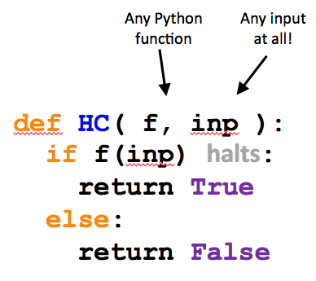
Examples of HC in action:
Here are two Python functions:
def g( x ):
if x == 42:
while True:
x += 0
else:
return 42
def h( x ):
if x == h:
while True:
print "Spam!"
else:
return g(x)
What does HC return in these calls?
HC(g, 41)
HC(g, 42)
HC(g, g)
HC(g, h)
HC(h, 41)
HC(h, 42)
HC(h, g)
HC(h, h)

Slide 80
Examples of HC in action:
Here are two Python functions:
def g( x ):
if x == 42:
while True:
x += 0
else:
return 42
def h( x ):
if x == h:
while True:
print "Spam!"
else:
return g(x)
What does HC return in these calls?
HC(g, 41)
HC(g, 42)
HC(g, g)
HC(g, h)
HC(h, 41)
HC(h, 42)
HC(h, g)
HC(h, h)

Slide 81
Proof strategy: Assume HC exists
Any Python function
Any input at all!
We show that this results in a contradiction…
def HC( f, inp ):
if f(inp) halts:
return True
else:
return False
Thus, the presumption "HC exists" is false.
So, HC can not exist.
HC checks for infinite loops.
in finite time

Slide 82
Proof strategy: Assume HC exists
We build a new function, cant
This name Cant be a coincidence!
Any Python function
def cant( f ):
if HC(f,f):
while True:
print "Ha!"
else:
return 42
Cant takes only one input, a function.

Slide 83
Proof strategy: Assume HC exists
We build a new function, cant
This name Cant be a coincidence!
Any Python function
(1) What if cant(cant)
runs forever?
def cant( f ):
if HC(f,f):
while True:
print "Ha!"
else:
return 42
(2) What if cant(cant)
halts (doesn't run forever)?
Cant takes only one input, a function.

Slide 84
Thus…
can not be programmed…
HC( f, inp )
can not be computed…
though, as a mathematical function, it does exist!
Haltchecking can not be done by computer.
The "Halting problem" is uncomputable.
or undecidable

Slide 85
Haltchecking is uncomputable.
Any Python function
Any input at all!
def HC( f, x ):
Halt Checking
It is impossible to write this function so it
(1) returns True if f(x) halts and
(2) returns False if f(x) loops infinitely.

Slide 86
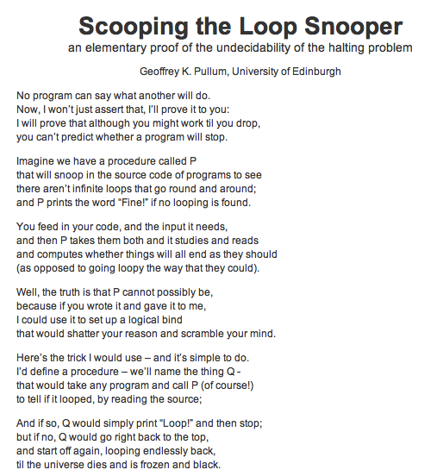
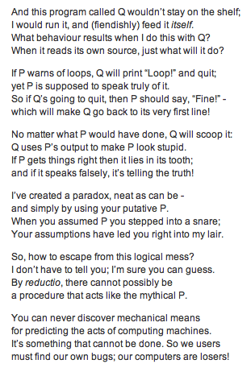

Slide 87
This proof is considered mathematically rigorous, but one "failure" of this proof is that it doesn't construct an example of an uncomputable problem!
or, rather, it COULD be rigorous, if we really wanted to...
But it's still useful...
What are the chances that a randomly-selected problem will have a program that solves it?
problems are uncountable
(as numerous as the reals)
programs are countable
(as numerous as the integers)
Almost all functions are uncomputable!

Slide 88
A Strategy* for CS Programming HW**
or “How to succeed in CS 60 without programming at all !”
For each programming assignment, note that the desired program’s behavior can be rephrased as functions of integers by encoding the input and output appropriately.
1
2
Point out that with 100% probability a function of integers is not computable by any program at all.
3
Proceed to your choice of (A) mountains, (B) beach, or (C) sleep.
4
Consult fine print for disclaimers.
* Please do not cite Prof. Dodds when using this strategy
** This strategy not applicable for CS 5 assignments.

Slide 90
Quiz
Kolmogorov Complexity
Name(s) ____________________
example
1
2
3
4
6
8
10
12
14
16
Python's overhead is 16 characters
kcomp( 42 ) = 18
def a(): return 42
kcomp( 100…000 ) =
100 zeros
A googol is 100...000
100 zeros
kcomp( 100…000 ) =
googol zeros
Estimate the complexity of each of these large numbers...
kcomp( 1010…1010 ) =
2 billion total digits
kcomp( 31415926… ) =
2 billion digits of pi
For what values of k is k < kcomp(k) ?
Extra! Two thought experiments...
If x <= y, is kcomp(x) <= kcomp(y) ?

Slide 91
There are lots of functions of integers
There are "a few" computer programs
(uncountably many ~ real #s)
(countably many ~ integers)
Well-defined computational functions
What's swimming around out here?
Programs
So this must be the seashore of uncomputability. Let's dive out!

Slide 92
There are lots of functions of integers
There are "a few" computer programs
(uncountably many ~ real #s)
(countably many ~ integers)
Well-defined computational functions
Describable
Programs
functions
This is indescribably odd...
What are the sizes of these sets?
What's an example in each?
Consider the English-describable functions...

Slide 93
There are lots of functions of integers
There are "a few" computer programs
(uncountably many ~ real #s)
(countably many ~ integers)
Well-defined computational functions
I can’t say!
???
Describable
Programs
computational problems!
All software
O
except maybe IOCCC winners
This is indescribably odd...
What are the sizes of these sets?
What's an example in each?
Consider the English-describable functions...

Slide 97
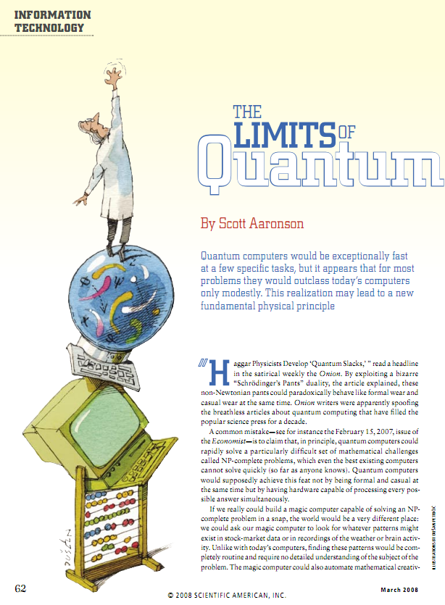
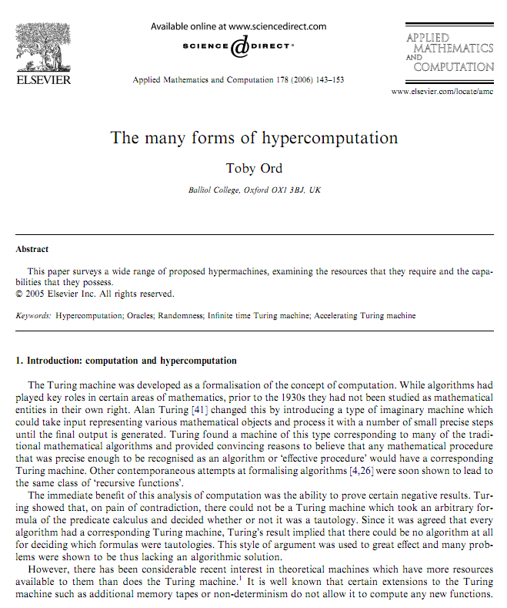
Hyper-turing computation?
HyperTuring computation is easy – just add coffee to your TM!
http://www.amirrorclear.net/academic/papers/many-forms.pdf
http://www.cs.virginia.edu/~robins/The_Limits_of_Quantum_Computers.pdf
Notes:
elementary proof: Mary Cartwright -- simplest proof, asked as a problem on an examination at Cambridge University… ~ 1947 (Girton College within Cambridge)

Slide 98
Hyper-turing computation?
HyperTuring computation is easy – just add coffee to your TM!
http://www.amirrorclear.net/academic/papers/many-forms.pdf
http://www.cs.virginia.edu/~robins/The_Limits_of_Quantum_Computers.pdf
Notes:
elementary proof: Mary Cartwright -- simplest proof, asked as a problem on an examination at Cambridge University… ~ 1947 (Girton College within Cambridge)

Slide 99
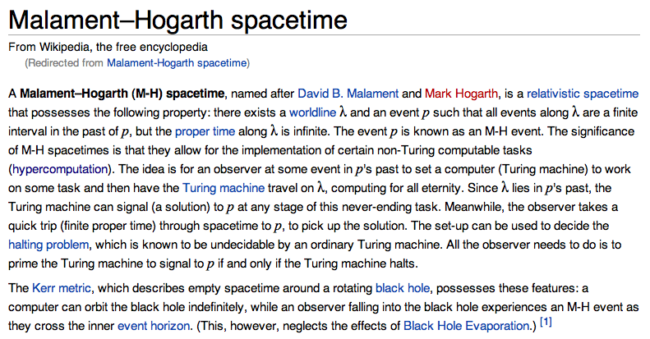
Hyper-turing computation?
HyperTuring computation is easy – just add coffee to your TM!
http://www.amirrorclear.net/academic/papers/many-forms.pdf
http://www.cs.virginia.edu/~robins/The_Limits_of_Quantum_Computers.pdf
Notes:
elementary proof: Mary Cartwright -- simplest proof, asked as a problem on an examination at Cambridge University… ~ 1947 (Girton College within Cambridge)

Slide 100
Take advantage of lab this week!
CS 5 finale on Wed. ...

Slide 101
There are lots of functions of integers
There are "a few" computer programs
(uncountably many ~ real #s)
(countably many ~ integers)
Well-defined computational functions
Describable
Programs
computational problems!
What are the sizes of these sets?
What's an example in each?
Consider the English-describable functions...

Slide 102
There are lots of functions of integers
There are "a few" computer programs
(uncountably many ~ real #s)
(countably many ~ integers)
Well-defined computational functions
I can’t say!
???
Describable
Programs
computational problems!
All software
O
except maybe IOCCC winners
This is indescribably odd...
What are the sizes of these sets?
What's an example in each?
Consider the English-describable functions...

Slide 103
def kcomp( k ):
do stuff…
return answer
Presume that kcomp exists, it works, and it's 42,000 characters long
Questions…
def Ouch():
x = 0
while kcomp(x) < 50000:
x += 1
return x
Question 0:
does the while loop run forever?
Will this loop stop when x is less than, equal to, or greater than 50,000?
Question 1:
returns a number with complexity >= 50000 using only about 42,100 characters!
Hey! That's not a question!
Question 2:
This function returns an integer.
Question 3:
If x is the integer returned, what is the kcomp(x) (the. Kolmogorov complexity of x)?
Ouch hurts!
Question 4:
What is the contradiction here?

Slide 104
There are lots of functions of integers
There are "a few" computer programs
Next time: some actual uncomputable functions…
(uncountably many ~ real #s)
(countably many ~ integers)
Well-defined computational functions
I can’t say!
???
Describable
Programs
computational problems!
All software
O
except maybe IOCCC winners
This is indescribably odd...
What are the sizes of these sets?
What's an example in each?
Consider the English-describable functions...

Slide 105
def kcomp( k ):
do stuff…
return answer
Presume that kcomp exists, it works, and it's 42,000 characters long
Contradict!
def Ouch():
x = 0
while kcomp(x) < 50000:
x += 1
return x
def kcomp( k ):
do stuff…
return answer
Note:
it's OK to define a function inside another function – both theoretically and in real Python syntax
Will this loop stop when x is less than, equal to, or greater than 50,000?
Question 1:
Hey! That's not a question!
Question 2:
This function returns an integer.
Question 3:
If x is the integer returned, what is kcomp(x) (the K. complexity of x)?
Ouch hurts!
Question 4:
What is the contradiction here?

Slide 106
def kcomp( k ):
do stuff…
return answer
Presume that kcomp exists, it works, and it's 42,000 characters long
returns a number of complexity >= 50000 in less than 50000 characters!
Contradict!
def Ouch():
x = 0
while kcomp(x) < 50000:
x += 1
return x
def kcomp( k ):
do stuff…
return answer
Note:
it's OK to define a function inside another function – both theoretically and in real Python syntax
Will this loop stop when x is less than, equal to, or greater than 50,000?
Question 1:
Hey! That's not a question!
Question 2:
This function returns an integer.
Question 3:
If x is the integer returned, what is kcomp(x) (the K. complexity of x)?
Ouch hurts!
Question 4:
What is the contradiction here?

Slide 108
Proof strategy: Assume HC exists
We build a new function, cant
Cant takes only one input, a function.
Does the following call halt or does it run forever?
Any Python function
cant( cant )
def cant( f ):
if HC(f,f):
while True:
print "Ha!"
else:
return 42
This name Cant be a coincidence!

Slide 109
Examples of HC in action:
Here are two Python functions:
def g( x ):
if x == 42:
while True:
x += 0
else:
return 42
def h( x ):
if x == h:
while True:
print "Spam!"
else:
return g(x)
What does HC return in these calls?
HC(g, 41)
HC(g, 42)
HC(g, g)
HC(g, h)
HC(h, 41)
HC(h, 42)
HC(h, g)
HC(h, h)

Slide 110
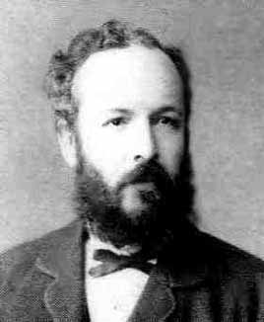
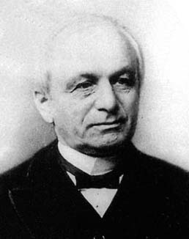
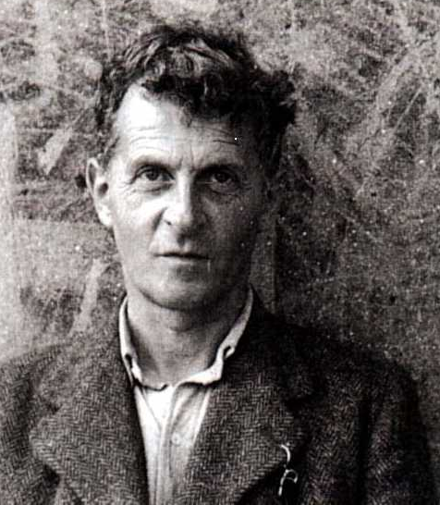
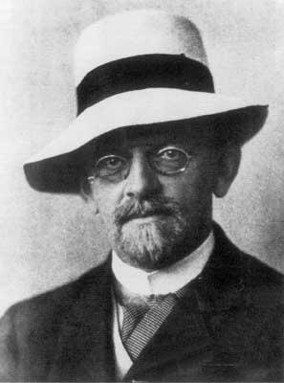
Cantor and "friends"
"Charlatan"
"Renegade"
No one shall expel us from the paradise that Cantor has created.
"Laughable and wrong"
"Utter nonsense"
And this was before 1900!
Leopold Kronecker 1823-1891
Lugwig Wittgenstein
1889-1951
David Hilbert 1862-1943

Slide 111
Cantor and "friends"
"Charlatan"
"Renegade"
"Corrupter of Youth"
No one shall expel us from the paradise that Cantor has created.
"Laughable and wrong"
"Utter nonsense"
And this was before 1900!
Leopold Kronecker 1823-1891
Lugwig Wittgenstein
1889-1951
David Hilbert 1862-1943

Slide 112
What about functions... and programs ?
Uncountably infinite
Proof?
{ real numbers, 0-1 }
This is how many functions from integers to booleans there are.
Why are there more int-bool functions than real numbers from zero to one?
0.00000...
0.10000...
0.01000...
0.11000...
... all real #s from 0 to 1 ...
0.11111...
(1) Choose any real number, 0-1
(2) Write it in binary
(3)

Slide 113
well-defined computational problems
no computer program
can solve
There are
that
at any speed
Proof strategy
How many of each are there?
There are more of these …
Bio/CS 6 homework
def is_even(X):
return X%2 == 0
than these.
Video
games
Pico
bot
Positive Integer
Predicates ~ PIPs
def is_three(X):
return X == 3
Mario Kart
Well-defined computational tasks
Programs

Slide 114
well-defined computational problems
no computer program
can solve
There are
that
even with ∞ memory
Show that there are UNCOUNTABLY many of these!
Strategy?
Show that there are COUNTABLY many of these!
There are more of these …
Bio/CS 6 homework
def is_even(X):
return X%2 == 0
than these!
Video
games
String matching
Positive Integer
Predicates ~ PIPs
def is_three(X):
return X == 3
Mario Kart
Well-defined computational tasks
Programs
They look the same to me!

Slide 115
Programs are countable
There are as many programs as positive integers…
How to show this?
def is_even(X):
return X%2 == 0
def is_three(X):
return X == 3
Programs

Slide 116
Problems are uncountable
at least!
There are as many problems as real numbers from [0,1]…
How to show this?
CS 5 homework
Video
games
Pico
bot
Positive Integer
Predicates ~ PIPs
Mario Kart
Well-defined computational tasks

Slide 117
PIPs: Positive Integer Predicates
input
output
PIPs are functions mapping positive integers to boolean values
1,2,…
True or False
PIP
each PIP is a different computational "problem"
CS 5 homework
Video
games
Pico
bot
Positive Integer
Predicates ~ PIPs
Mario Kart
Well-defined computational tasks

Slide 118
Quiz on Kolmogorov Complexity
kcomp( k ) =
the length of the shortest zero-input function that produces k
1000…000
googol
1000…000
googolplex
1010…1010
2 billion total digits
31415926…
2 billion total digits
estimate
For what values of k is k < kcomp(k)?
if x <= y, is kcomp(x) <= kcomp(y) ?

Slide 119
Kolmogorov Complexity
kcomp( k ) =
the length of the shortest zero-input function that outputs k
1
2
3
4
6
8
10
12
14
16
Python carries an overhead of 16 characters
kcomp( 42 ) = 18
def a(): return 42
kcomp( 100…000 ) = _____
kcomp( 100…000 ) = _____

Slide 120
Kolmogorov Complexity
Andrei Kolmogorov
1903-1987
kcomp( k ) =
the length of the shortest zero-input program that produces k
k = 100000000000000000000000000…00000
length of 24 !
def a(): return 10**5000
k = 170117684200068728224888577…85601
length of 5017 (or less)
def b(): return 17011…5601
Maybe we can do even better?

Slide 121
Kolmogorov Complexity
Andrei Kolmogorov
1903-1987
kcomp( k ) =
the length of the shortest zero-input program that produces k
For each input k, there is a well-defined, unambiguous value for kcomp(k).
k = 100000000000000000000000000…00000
kcomp( k ) = 24 or so
k = 170117684200068728224888577…85601
kcomp( k ) = some other integer
Does kcomp(k) always exist?

Slide 122
PIPs: Positive Integer Predicates
input
output
PIPs are functions mapping positive integers to boolean values
1,2,…
True or False
PIP
each PIP is a different computational "problem"
Input
 | 1 | 2 | 3 | 4 | 5 | 6 | 7 | 8 | 9
A? | T | T | T | T | T | T | T | T | T
B? | F | T | F | T | F | T | F | T | F
C? | T | F | T | F | T | F | T | F | T
D? | F | T | T | F | T | F | T | F | F
E? | T | T | F | F | F | F | F | F | F
PIP
…

Slide 123
PIPs: Positive Integer Predicates
input
output
PIPs are functions mapping positive integers to boolean values
1,2,…
True or False
PIP
each PIP is a different computational "problem"
Input
 | 1 | 2 | 3 | 4 | 5 | 6 | 7 | 8 | 9
True | T | T | T | T | T | T | T | T | T
Even | F | T | F | T | F | T | F | T | F
Odd | T | F | T | F | T | F | T | F | T
Prime | F | T | T | F | T | F | T | F | F
<3 | T | T | F | F | F | F | F | F | F
PIP
…

Slide 124
PIPs are uncountable?
Input
 | 1 | 2 | 3 | 4 | 5 | 6 | 7 | 8 | 9
True | T | T | T | T | T | T | T | T | T
Even | F | T | F | T | F | T | F | T | F
Odd | T | F | T | F | T | F | T | F | T
Prime | F | T | T | F | T | F | T | F | F
<3 | T | T | F | F | F | F | F | F | F
PIP
…

Slide 125
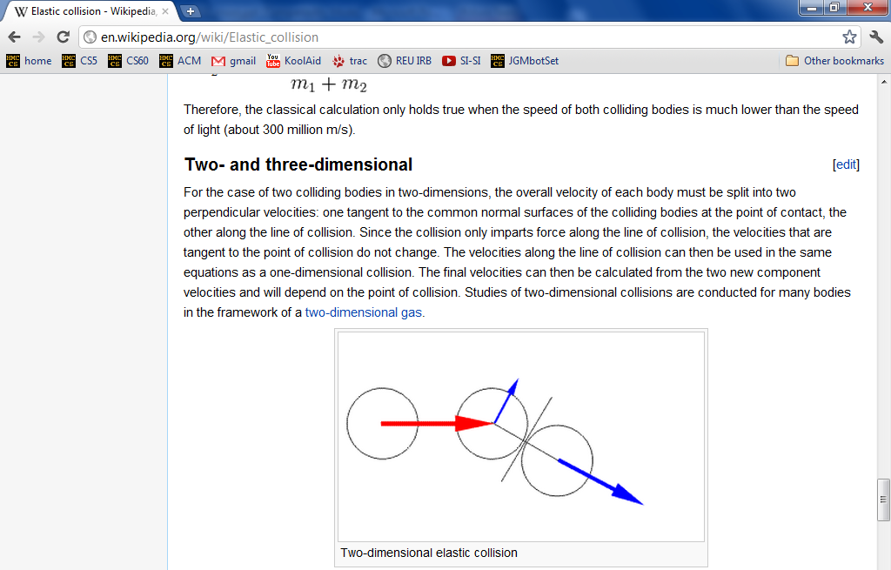
vPool – physics?
http://en.wikipedia.org/wiki/Elastic_collision
equations below...

Slide 126
vPool – physics?
http://en.wikipedia.org/wiki/Elastic_collision

Slide 127
Project notes...
pyRobot - many more examples/strategies available...
(1) No crashing into walls! (2) If blocked, move in ONLY x or ONLY y ...
picobot - __repr__ underscores!
text clouds - HMC urls are the only ones grabbed
(1) Start by getting those working (2) Add your own later...
add more print statements
comment out your print statements
run this state machine:
vPool -
it's broken!
it works !

Slide 128
Not being constructive…
One "failure" of this proof is that it doesn't construct a full example of an uncomputable problem!
So, where are all these uncomputable problems?
The problem is, most are indescribable…
(in English)
I guess that would be a problem!
... but a few can be described

Slide 129
Defining Complexity
Consider two integers:
lots of zeros
100000000000000000000000000…00000
Each has 5001 digits
lots of digits
170117684200068728224888577…85601
Which "feels like" the more complex number? Why?

Slide 130
Kolmogorov Complexity
Andrei Kolmogorov
1903-1987
Complexity( k ) =
the length of the shortest zero-input program that produces k
k = 100000000000000000000000000…00000
A length-5017 program producing k:
def a(): return 10000…0000
k = 170117684200068728224888577…85601
A length-5017 program producing k:
def b(): return 17011…5601

Slide 131
Kolmogorov Complexity
Andrei Kolmogorov
1903-1987
Complexity( k ) =
the length of the shortest zero-input program that produces k
k = 100000000000000000000000000…00000
length of 24 !
def a(): return 10**5000
k = 170117684200068728224888577…85601
length of 5017
def b(): return 17011…5601
Maybe we can do even better?

Slide 132
Kolmogorov Complexity
Andrei Kolmogorov
1903-1987
Complexity( k ) =
the length of the shortest zero-input program that produces k
For each input N, there is a well-defined, unambiguous value for Complexity(k).
N = 100000000000000000000000000…00000
Complexity( N ) = 24 or so
N = 170117684200068728224888577…85601
Complexity( N ) = some other integer
Does Complexity(N) always exist?

Slide 133
What are the uncomputable problems?
Here's an uncomputable function:
positive integer input, k
the positive integer output that is k's complexity
Complexity( k ) =
with a name like Complexity, this function was doomed !

Slide 134
Complexity isn't computable!
def Complexity( N ):
do stuff…
return answer
Proof strategy
I guess you'd call this part of the code a GRAY AREA…
proof by contradiction
(1) Presume that Complexity exists.
(2) We show this results in a contradiction…
(3) Thus, the presumption "Complexity exists" is false.
(4) So, the program/function Complexity can not exist!

Slide 135
Proof by contradiction?
(1) Presume something: there are a finite # of primes
(2) Show a contradiction…
(3) Thus, the something must have been false!
That's it!

Slide 136
def Complexity( N ):
do stuff…
return answer
Presume that Complexity exists, it works, and it's 42,000 characters long
Try it!
def Ouch():
k = 0
while Complexity(k) < 50000:
k += 1
return k
def Complexity( N ):
do stuff…
return answer
Note:
it's OK to define a function inside another function
Will this loop stop when k is less than, equal to, or greater than 50,000?
Question 1:
Hey! That's not a question!
Question 2:
This function returns an integer.
Question 3:
What is the Complexity of the integer returned?
Ouch hurts!
Question 4:
What is the contradiction here?

Slide 137
Others?
They involve infinity.
Many potentially useful problems are impossible to compute!
They involve self-reference.
Or they can be interpreted as such.
Where did Complexity go wrong?

Slide 138
Others?
They involve infinity.
Many potentially useful problems are impossible to compute!
They involve self-reference.
Or they can be interpreted as such.
A string containing a Python function
Any string
Inf checks for infinite loops.
def Inf( fs, input ):
if fs(inp) runs forever:
return True
else:
return False
in finite time

Slide 139
the iPhone's icon for Google Maps …

Slide 140
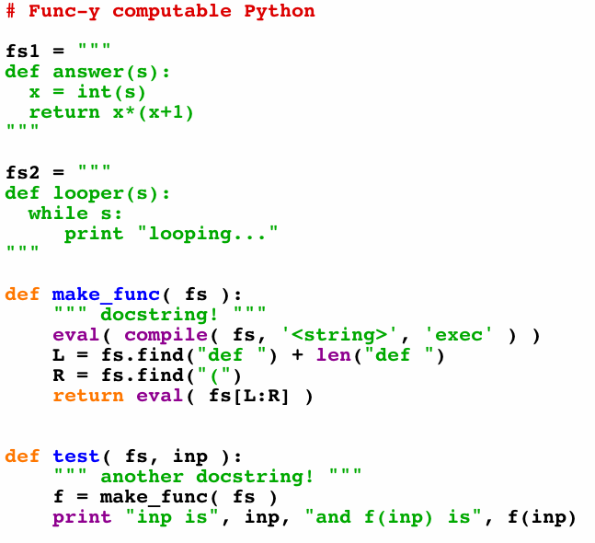
make_func ?
These Python strings look decidedly func-y
Strings and functions are one and the same…
Python creates Python!
What's this doing?
Python runs Python!
f is the function in fs
Let's test it!

Slide 141
A working Inf
Inf does exist - and does work - if given infinite time…
A string containing a Python function
Any string
def Inf( fs, inp ):
f = make_func(fs)
if f(inp) or not f(inp):
return False
else:
return True
This Inf checks for infinite loops.
but can use infinite time!
And, to be fair, it never really returns True !

Slide 142
Proof strategy
Presume that Inf exists.
A string containing a Python function
We show that this results in a contradiction…
Any string
def Inf( fs, inp ):
f = make_func(fs)
if f(inp) runs forever:
return True
else:
return False
Thus, the presumption "Inf exists" is false.
So, Inf can not exist.
Inf checks for infinite loops.
in finite time

Slide 143
Presume:
Inf( fs, inp ) works…
We build a new function, Cant
A string containing a Python function
def Cant( fs ):
if Inf(fs,fs):
return 42
else:
while True:
print "ha!"
Cant stubbornly reverses the predictive power of Inf !
Cant takes only one input, a string containing a Python function.
This name Cant be a coincidence!

Slide 144
Presume:
Inf( fs, inp ) works…
We build Cant:
Consider…
A string containing a Python function
fs2 = """
def Cant( fs ):
if Inf(fs,fs):
return 42
else:
while True:
print "ha!"
"""
def Cant( fs ):
if Inf(fs,fs):
return 42
else:
while True:
print "ha!"
>>> Cant( fs2 )

Slide 145
Thus…
can not exist…
Inf( fs, inp )
can not be written…
can not be programmed…
Infinite-loop checking can not be done by computer.
The "Halting problem" is uncomputable.
can it be done biologically?

Slide 146
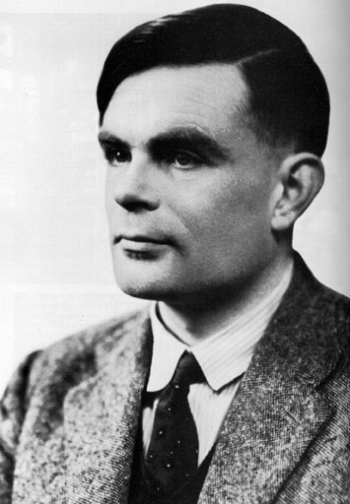
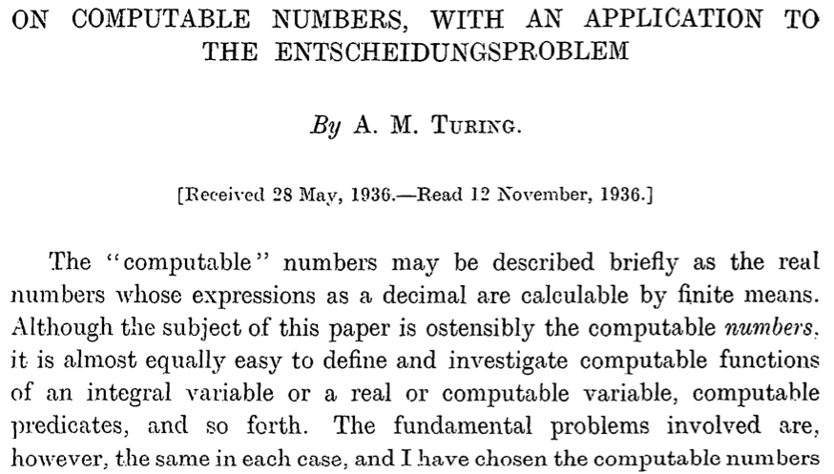
Turing's proof
Alonzo Church, too
+ 36 more pages

Slide 150
Beyond computation
"All" problems are impossible to solve by computer program.
But "a few" are solvable by computer program.
(uncountably many)
(countably many)
Well-defined computational problems
Programs
So this must be the seashore of uncomputability. Let's dive in!

Slide 151
Beyond computation
"All" problems are impossible to solve by computer program.
But "a few" are solvable by computer program.
(uncountably many)
(countably many)
Well-defined computational problems
Programs
Describable computational problems!
This may seem indescribably odd...

Slide 152
All exam questions will be at most NP-complete.
(This is an advantage of paper coding!!)
Tell me about it!

Slide 153
Thus…
can not exist…
Inf( fs, inp )
can not be written…
can not be programmed…
Infinite-loop checking can not be done by computer.
The "Halting problem" is uncomputable.
can it be done biologically?

Slide 154
More computation?
well beyond the CS department…
E85 ~ digital electronics (probably E4 next term, however)
E155 ~ microp's
Math 55 ~ discrete mathematics
Physics 170 ~ computational physics (Phys 52 first)
Music 88 ~ computer music (HSA course)
CS 124a ~ user interfaces (any-major course)
CS 60 ~ principles of CS (a major course, nonmajors welcome)

Slide 155
CS 5 Today: Beyond FSMs
The review from here…
Final exam review
Review session
Monday, 12/13
7-8pm, here in Pryne
Questions + go over the CS 5 Gold practice exam
Project progress... ?
Milestone due last night (tonight with Euro)
Labs today and tomorrow for final project work/help
Friday hours in the CS labs, too
Final version due this Friday...
-- grading is scheduled for Monday!

Slide 156
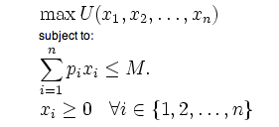
What computers can't do !
In order to really examine this issue, we need to have a precise model of a computer…
Physics: Model of a particle in a potential field
Economics: Model of a rational consumer

Slide 157
Simplest model of computation: FSMs
Finite State Machines
Example:
0
0
1
s0
s1
1
start state
transitions
accepting states
“input funnel”
“where to go”
double circled
labeled by input !

Slide 158
Third-to-last character is a 1
How many states would a 100th-to-last-character FSM have?

Slide 159
FSMs can't count...
Because they're finite, FSMs can only count finitely high !
Computable with FSMs
Uncomputable with FSMs
even/odd sums or differences
equal numbers of two values
multiples of other integers
a specified difference between two values
finite constraints on the input:
palindromes
third digit is a 1
third-to-last digit is a 1
third digit == third-to-last digit
etc.
anything modeled by a potentially unbounded while loop
They can handle modulo, but not arbitrary, arithmetic
Can computers handle arbitrary arithmetic?
Notes:
metric prefixes…

Slide 160
Uncomputable problems?
There are many problems computers can't solve at all !
Perhaps this is not all that surprising…
losing to the Oakland Raiders
global warming
disbelief in aliens
Surely you jest!!!
anything, if using Vista
Warning: these problems may appear on the CS 5 final!

Slide 161
Proof strategy ?
well-defined computational problems
no computer program
can solve
There are
that
even with ∞ memory
There are more of these …
Bio/CS 6 homework
def is_even(X):
return X%2 == 0
than these!
Video
games
String matching
Positive Integer
Predicates ~ PIPs
def is_three(X):
return X == 3
Mario Kart
Well-defined computational tasks
Programs
They look the same to me!

Slide 162
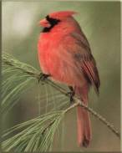
equal-size sets
There are infinitely many of both….
…but not all infinities are created equal!
{ , , }
{ 1 , 2 , 3 }
Two sets have equal size if
their elements have a
one-to-one matching
This matching is called a bijection.
I'd say these sets share the same cardinality

Slide 163
Bijections define equality for infinite sets, too!
Positive
evens
E = { 2, 4, 6, 8, 10, … }
Positive integers
N = { 1, 2, 3, 4, 5, … }
ALL
integers
Z = {…, -3, -2, -1, 0, 1, 2, 3, …}
With no negative repercussions!
E and N and Z all have the same size!

Slide 164
This seems irrational !
That's my line!
the Rationals
Are these sets equal-sized?
Positive integers
1
84
22
13
{ … }
,
,
,
,
{ 1, 2, 3, 4, 5, … }
1
2
7
15

Slide 165
Georg Cantor
1845-1918
Cantor Diagonalization
There is NO matching from reals to integers!
Positive integers
the Reals
from 0 to 1
{ real numbers, 0-1 }
{ 1, 2, 3, 4, 5, … }

Slide 166
To infinity - and beyond
Pixar owes Cantor for this one!
Positive integers
the Reals
from 0 to 1
{ real numbers, 0-1 }
{ 1, 2, 3, 4, 5, … }
Uncountably infinite
>
Countably infinite
sets equal-sized with the real numbers
strictly larger
sets equal-sized with the positive integers

Slide 167
Cantor and "friends"
Who would you trust?
Leopold Kronecker 1823-1891
Lugwig Wittgenstein
1889-1951
David Hilbert 1862-1943

Slide 168
Programs are countable
There are as many programs as positive integers…
How to show this?
def is_even(X):
return X%2 == 0
def is_three(X):
return X == 3
Programs

Slide 169
PIPs: Positive Integer Predicates
input
output
PIPs are functions mapping positive integers to boolean values
1,2,…
True or False
PIP
each PIP is a different computational "problem"
Input
 | 1 | 2 | 3 | 4 | 5 | 6 | 7 | 8 | 9
A? | T | T | T | T | T | T | T | T | T
B? | F | T | F | T | F | T | F | T | F
C? | T | F | T | F | T | F | T | F | T
D? | F | T | T | F | T | F | T | F | F
E? | T | T | F | F | F | F | F | F | F
PIP
…

Slide 170
Not being constructive…
One "failure" of this proof is that it doesn't construct a full example of an uncomputable problem!
So, where are all these uncomputable problems?
The problem is, most are indescribable…
(in English)
I guess that would be a problem!
... but a few can be described

Slide 171
Defining Complexity
Consider two integers:
lots of zeros
100000000000000000000000000…00000
Each has 5001 digits
lots of digits
170117684200068728224888577…85601
Which "feels like" the more complex number? Why?

Slide 172
Kolmogorov Complexity
Andrei Kolmogorov
1903-1987
Complexity( k ) =
the length of the shortest zero-input program that produces k
k = 100000000000000000000000000…00000
A length-5017 program producing k:
def a(): return 10000…0000
k = 170117684200068728224888577…85601
A length-5017 program producing k:
def b(): return 17011…5601

Slide 173
Kolmogorov Complexity
Andrei Kolmogorov
1903-1987
Complexity( k ) =
the length of the shortest zero-input program that produces k
k = 100000000000000000000000000…00000
length of 24 !
def a(): return 10**5000
k = 170117684200068728224888577…85601
length of 5017
def b(): return 17011…5601
Maybe we can do even better?

Slide 174
Kolmogorov Complexity
Andrei Kolmogorov
1903-1987
Complexity( k ) =
the length of the shortest zero-input program that produces k
For each input N, there is a well-defined, unambiguous value for Complexity(k).
N = 100000000000000000000000000…00000
Complexity( N ) = 24 or so
N = 170117684200068728224888577…85601
Complexity( N ) = some other integer
Does Complexity(N) always exist?

Slide 175
What are the uncomputable problems?
Here's an uncomputable function:
positive integer input, k
the positive integer output that is k's complexity
Complexity( k ) =
with a name like Complexity, this function was doomed !

Slide 176
Complexity isn't computable!
def Complexity( N ):
do stuff…
return answer
Proof strategy
I guess you'd call this part of the code a GRAY AREA…
proof by contradiction
(1) Presume that Complexity exists.
(2) We show this results in a contradiction…
(3) Thus, the presumption "Complexity exists" is false.
(4) So, the program/function Complexity can not exist!

Slide 177
Proof by contradiction?
(1) Presume something: there are a finite # of primes
(2) Show a contradiction…
(3) Thus, the something must have been false!
That's it!

Slide 178
def Complexity( N ):
do stuff…
return answer
Presume that Complexity exists, it works, and it's 42,000 characters long
Try it!
def Ouch():
k = 0
while Complexity(k) < 50000:
k += 1
return k
def Complexity( N ):
do stuff…
return answer
Note:
it's OK to define a function inside another function
Will this loop stop when k is less than, equal to, or greater than 50,000?
Question 1:
Hey! That's not a question!
Question 2:
This function returns an integer.
Question 3:
What is the Complexity of the integer returned?
Ouch hurts!
Question 4:
What is the contradiction here?

Slide 179
Others?
They involve infinity.
Many potentially useful problems are impossible to compute!
They involve self-reference.
Or they can be interpreted as such.
Where did Complexity go wrong?

Slide 180
Others?
They involve infinity.
Many potentially useful problems are impossible to compute!
They involve self-reference.
Or they can be interpreted as such.
A string containing a Python function
Any string
Inf checks for infinite loops.
def Inf( fs, input ):
if fs(inp) runs forever:
return True
else:
return False
in finite time

