Slide 1
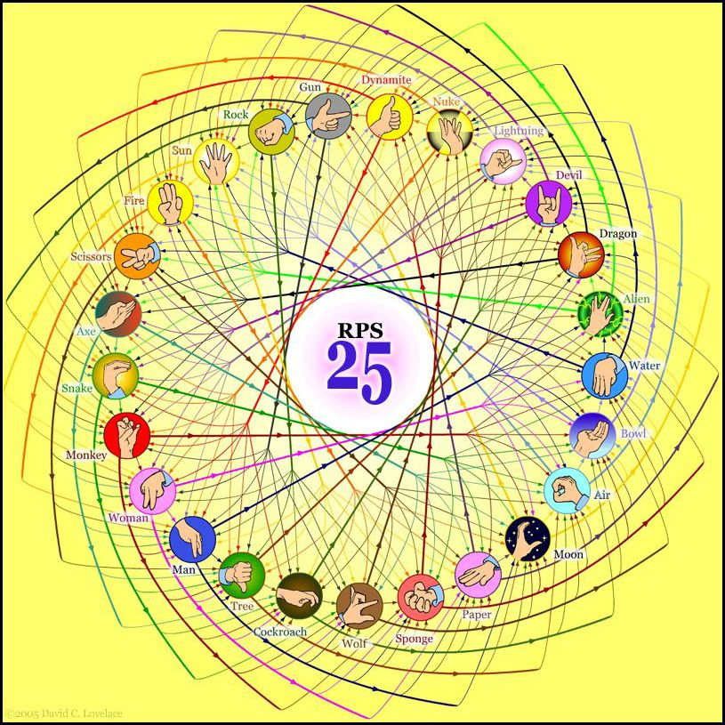
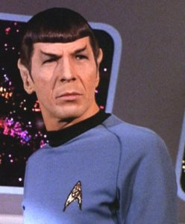
Extreme RPS!?
They call that an alien?
Spock mind-melds three-eyed aliens!
Provably.
http://www.youtube.com/watch?v=iapcKVn7DdY
http://www.youtube.com/watch?v=yuEZEyDdmvQ

Slide 2
Lab 0 lessons…
Our lesson == to lessen self-hosted installers!
Yes, we Can·opy
Four fours is ~
sometimes too many…
othertimes too few…
but never enough!
Wow!
print "Five is", (4**4)/44

Slide 5
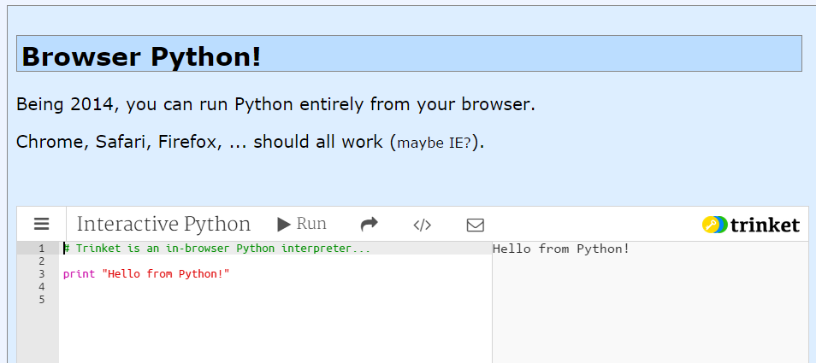
Online Python?
Several options
For text programs, trinket seems the easiest.

Slide 6
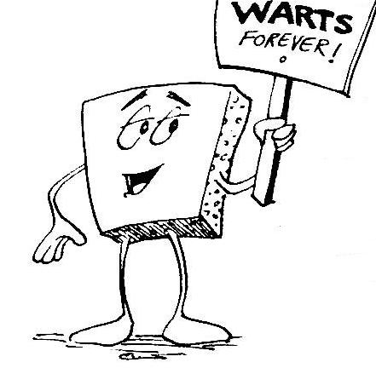
Welcome (back) to CS 5 !
Average of these two?
Alien
Wally
Problem 0: "Reading" and response...
Problem 1: Welcome program (Done in lab...)
Homework 0
Problem 2: Rock-paper-scissors program (Maybe done in lab)
due Mon. night (11:59pm)
Problems 3-4: Picobot! empty room (3) and maze (4)
HW page

Slide 7
Welcome (back) to CS 5 !
Wow – I see the resemblance
Alien
Picobot!
Wally
Problem 0: "Reading" and response...
Problem 1: Welcome program (Done in lab...)
Homework 0
Problem 2: Rock-paper-scissors program (Maybe done in lab)
due Mon. night (11:59pm)
Problems 3-4: Picobot! empty room (3) and maze (4)
HW page

Slide 8
Problem 0 ?
Typically an article on CS or an application...
A few sentences that raise or address questions, using the article as a guide.
Submit a one-paragraph response
5 – insightful, careful
4 – thoughtful
3 – complete, on topic
0-2 – less than complete
Small part (5 pts)
This week's article might not seem like CS at first…

Slide 9
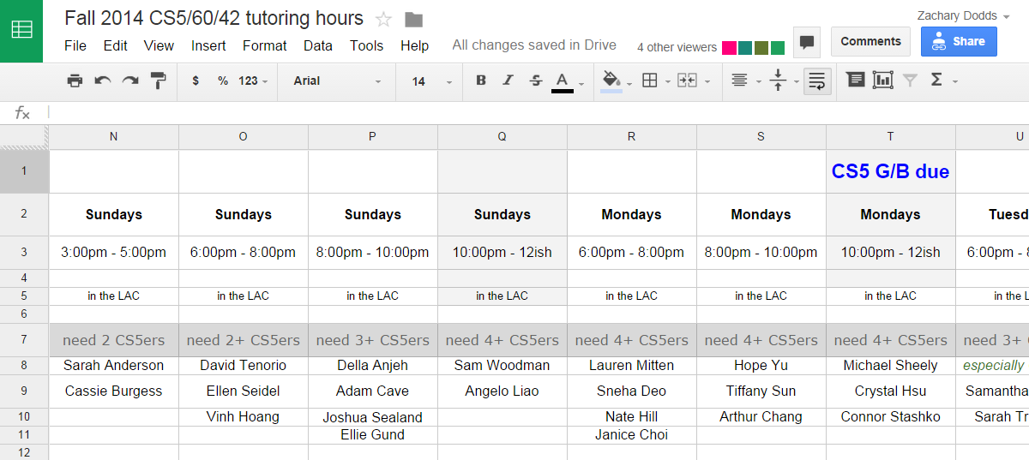
Ask for help…
Graders + Tutors = Grutors
see page
every day there are tutoring hours in the LAC computer lab
Linde Activities Center
Office hours: I join the tutors on Mondays @ 2pm
Piazza: Use this for whole-class and individual Q's

Slide 10
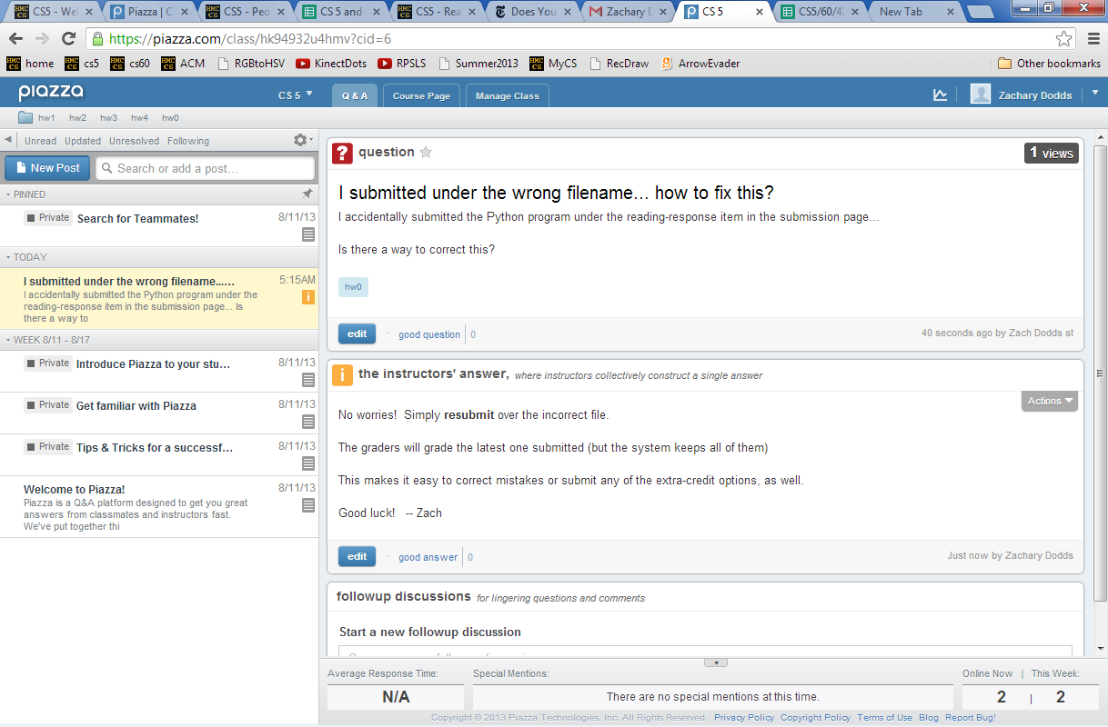
Piazza
for all CS5 concerns/questions
public: post to whole class

Slide 11
Piazza
you'll get a welcome email…
sign-in + choose your message frequency

Slide 12
Piazza
for all CS5 concerns/questions
individual concerns or your source code / bugs?
In-person + pair programming are better strategies for bugs.
But we'll try to take a look…
private: post to instructors
Account problems?
Piazza us!

Slide 13
Last time…
CS != Programming

Slide 14
What is programming ?
Programming as recipe-writing
vs.
Programming as learning a foreign language
Notes:
my foreign language teachers always tried to convince me that the skill of speaking, reading and writing a foreign language…
I didn’t believe them then and I don’t believe them now -- but I do believe that reading and writing a computer language is the way to get a strong intuitive understanding of how machines think -- it’s also important for getting them to do what you want them to, but even if you forget everything this course (hopefully) teaches about Java (compiler, datatypes, Classes and Objects), the real goal is that you take away a deeper insight into how machines think
familiar and sometimes not so familiar… deceptively easy
you mean I have to type all that!!

Slide 15
What is programming ?
Programming as recipe-writing
vs.
Programming as learning a foreign language
Baggage !
1) Expect it to be different!
2) Don’t feel you need to memorize it
3) Immersion == Experimentation
go/went
Notes:
my foreign language teachers always tried to convince me that the skill of speaking, reading and writing a foreign language…
I didn’t believe them then and I don’t believe them now -- but I do believe that reading and writing a computer language is the way to get a strong intuitive understanding of how machines think -- it’s also important for getting them to do what you want them to, but even if you forget everything this course (hopefully) teaches about Java (compiler, datatypes, Classes and Objects), the real goal is that you take away a deeper insight into how machines think
familiar and sometimes not so familiar… deceptively easy
you mean I have to type all that!!

Slide 16
What about the Python programming language ?
Notes:
my foreign language teachers always tried to convince me that the skill of speaking, reading and writing a foreign language…
I didn’t believe them then and I don’t believe them now -- but I do believe that reading and writing a computer language is the way to get a strong intuitive understanding of how machines think -- it’s also important for getting them to do what you want them to, but even if you forget everything this course (hopefully) teaches about Java (compiler, datatypes, Classes and Objects), the real goal is that you take away a deeper insight into how machines think
familiar and sometimes not so familiar… deceptively easy
you mean I have to type all that!!

Slide 17
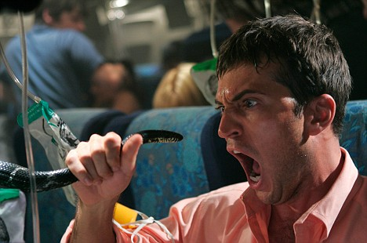
Python ?
One possibility...
Notes:
my foreign language teachers always tried to convince me that the skill of speaking, reading and writing a foreign language…
I didn’t believe them then and I don’t believe them now -- but I do believe that reading and writing a computer language is the way to get a strong intuitive understanding of how machines think -- it’s also important for getting them to do what you want them to, but even if you forget everything this course (hopefully) teaches about Java (compiler, datatypes, Classes and Objects), the real goal is that you take away a deeper insight into how machines think
familiar and sometimes not so familiar… deceptively easy
you mean I have to type all that!!

Slide 18
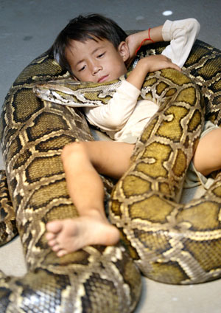
Python !
One possibility...
Happy co-existence… It can even be comfy!
Notes:
my foreign language teachers always tried to convince me that the skill of speaking, reading and writing a foreign language…
I didn’t believe them then and I don’t believe them now -- but I do believe that reading and writing a computer language is the way to get a strong intuitive understanding of how machines think -- it’s also important for getting them to do what you want them to, but even if you forget everything this course (hopefully) teaches about Java (compiler, datatypes, Classes and Objects), the real goal is that you take away a deeper insight into how machines think
familiar and sometimes not so familiar… deceptively easy
you mean I have to type all that!!

Slide 19
The foreign language of python…
syntax
semantics
intent
How it looks
What it does
What it should do
name = raw_input('Hi... what is your name? ')
print # prints a blank line
if name == 'Eliot' or name == 'Ran':
print 'I\'m "offline." Try later.'
elif name == 'Zach': # is it Zach?
print 'Zach Quinto...?', 'No?', 'Oh.'
else: # in all other cases...
print 'Welcome', name, '!'
my_choice = random.choice( [ 'R','P','S' ] )
print 'My favorite object is', my_choice, "!"
This program should greet its user appropriately.
Notes:
my foreign language teachers always tried to convince me that the skill of speaking, reading and writing a foreign language…
I didn’t believe them then and I don’t believe them now -- but I do believe that reading and writing a computer language is the way to get a strong intuitive understanding of how machines think -- it’s also important for getting them to do what you want them to, but even if you forget everything this course (hopefully) teaches about Java (compiler, datatypes, Classes and Objects), the real goal is that you take away a deeper insight into how machines think
familiar and sometimes not so familiar… deceptively easy
you mean I have to type all that!!

Slide 20
The foreign language of python…
syntax
semantics
intent
How it looks
What it does
What it should do
name = raw_input('Hi... what is your name? ')
print # prints a blank line
if name == 'Eliot' or name == 'Ran':
print 'I\'m "offline." Try later.'
elif name == 'Zach': # is it Zach?
print 'Zach Quinto...?', 'No?', 'Oh.'
else: # in all other cases...
print 'Welcome', name, '!'
my_choice = random.choice( [ 'R','P','S' ] )
print 'My favorite object is', my_choice, "!"
Notes:
my foreign language teachers always tried to convince me that the skill of speaking, reading and writing a foreign language…
I didn’t believe them then and I don’t believe them now -- but I do believe that reading and writing a computer language is the way to get a strong intuitive understanding of how machines think -- it’s also important for getting them to do what you want them to, but even if you forget everything this course (hopefully) teaches about Java (compiler, datatypes, Classes and Objects), the real goal is that you take away a deeper insight into how machines think
familiar and sometimes not so familiar… deceptively easy
you mean I have to type all that!!

Slide 21
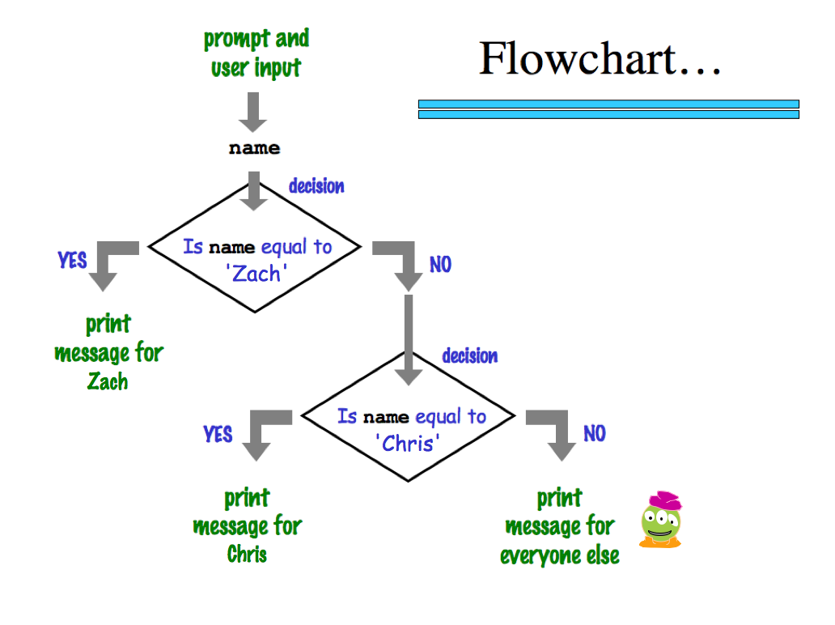
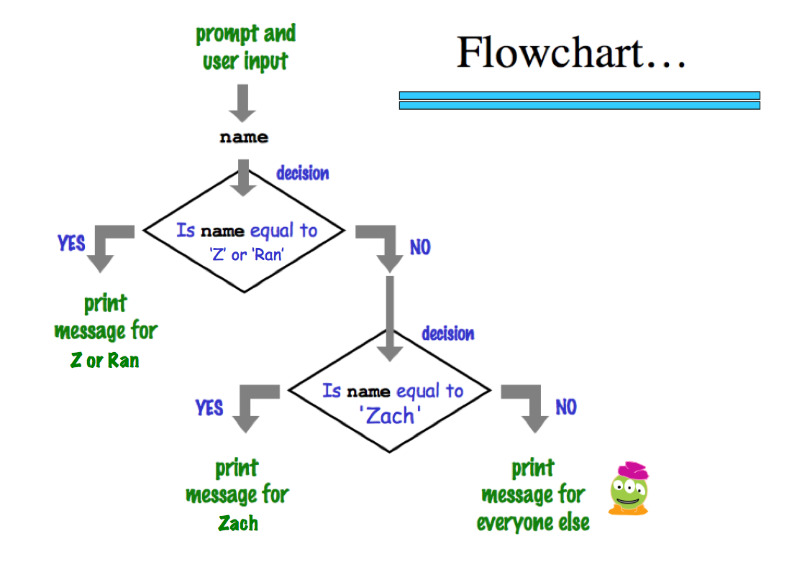
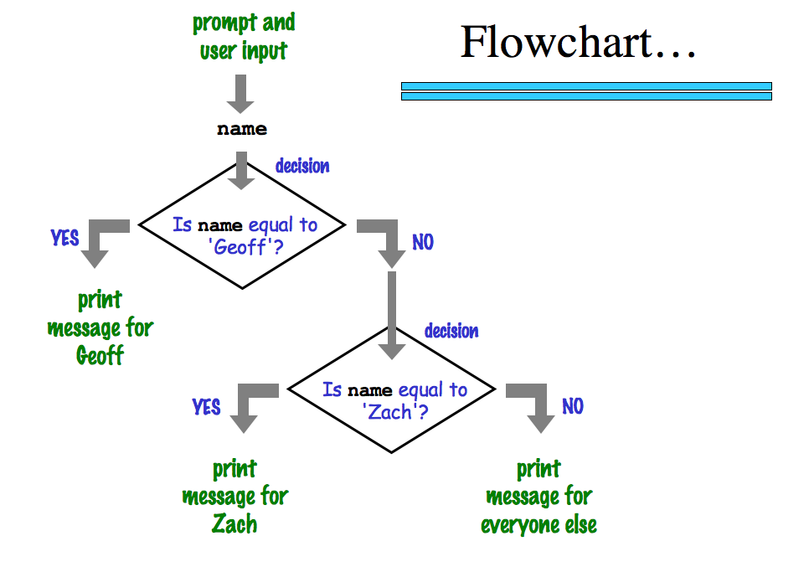
graphical view of a program's semantics
'Zach'
‘Eliot’ or ‘Ran’
Zach
Eliot or Ran
'Chris'
Chris
Zach
What about me?
Notes:
my foreign language teachers always tried to convince me that the skill of speaking, reading and writing a foreign language…
I didn’t believe them then and I don’t believe them now -- but I do believe that reading and writing a computer language is the way to get a strong intuitive understanding of how machines think -- it’s also important for getting them to do what you want them to, but even if you forget everything this course (hopefully) teaches about Java (compiler, datatypes, Classes and Objects), the real goal is that you take away a deeper insight into how machines think
familiar and sometimes not so familiar… deceptively easy
you mean I have to type all that!!

Slide 22
The foreign language of python…
syntax
semantics
intent
How it looks
What it does
What it should do
www.theonion.com
How Python looks!
how punctuation is used
the language keywords used
use of whitespace
peculiarities of formatting
how behavior is affected …
Notes:
my foreign language teachers always tried to convince me that the skill of speaking, reading and writing a foreign language…
I didn’t believe them then and I don’t believe them now -- but I do believe that reading and writing a computer language is the way to get a strong intuitive understanding of how machines think -- it’s also important for getting them to do what you want them to, but even if you forget everything this course (hopefully) teaches about Java (compiler, datatypes, Classes and Objects), the real goal is that you take away a deeper insight into how machines think
familiar and sometimes not so familiar… deceptively easy
you mean I have to type all that!!

Slide 23
Quiz
Name ______________
Name _______________
(1) Find and correct as many errors as you can here…
(2) This line is doing three things… what are they?
import random
user = raw_input( "Choose your weapon! " )
comp = random.choice( ['rock','paper','scissors") ]
print 'user (you) chose:', 'user'
print 'comp (me!) chose:' comp
if user == rock and comp = 'paper'
print 'The result is, YOU LOSE!'
print 'unless you're a CS 5 grader, then YOU WIN!'
(3) How many different uses of punctuation can you find?

Slide 24
Quiz
Name ______________
Name ______________
(1) Find and correct as many errors as you can here…
(2) This line is doing three things… what are they?
import random
user = raw_input( "Choose your weapon! " )
comp = random.choice( ['rock','paper','scissors") ]
print 'user (you) chose:', 'user'
print 'comp (me!) chose:' comp
if user == rock and comp = 'paper'
print 'The result is, YOU LOSE!'
print 'unless you're a CS 5 grader, then YOU WIN!'
(3) How many different uses of punctuation can you find?

Slide 25
Tear off that page
Pass those to the aisles + Eastward…
only 1 "quiz" is needed per pair
… then turn back into the packet

Slide 26
Quiz
Try the one on the back of the notes – with a partner – first…
(1) Find and correct as many errors as you can here…
(2) This line is doing three things… what are they?
import random
user = raw_input( "Choose your weapon! " )
comp = random.choice( ['rock','paper','scissors") ]
print 'user (you) chose:', 'user'
print 'comp (me!) chose:' comp
if user == rock and comp = 'paper'
print 'The result is, YOU LOSE!'
print 'unless you're a CS 5 grader, then YOU WIN!'
(3) How many different uses of punctuation can you find?

Slide 27
Python's syntax?
(1) Find and correct any errors... !
(2) This line is doing three things… what are they?
import random
(1) prints the "weapon" prompt
(2) gets user's input from the kbd
(3) assigns that input to the variable user
set-equals always uses ONE equals sign
user = raw_input( "Choose your weapon! " )
comp = random.choice( ['rock','paper','scissors'] )
print 'user (you) chose:', user
print 'comp (me!) chose:', comp
every block of code must line up!
match brackets and quotes !
test-equals uses TWO equals signs
The comma prints a space and does NOT go to the next line.
if user == rock and comp == 'paper':
print 'The result is, YOU LOSE!'
print 'unless you\'re a CS 5 grader, then YOU WIN!'
a colon starts a new block
every block of code must line up!
flattering - or flouting - graders is encouraged!
a backslash handles special characters
(3) See how many different uses of punctuation you can find.

Slide 28
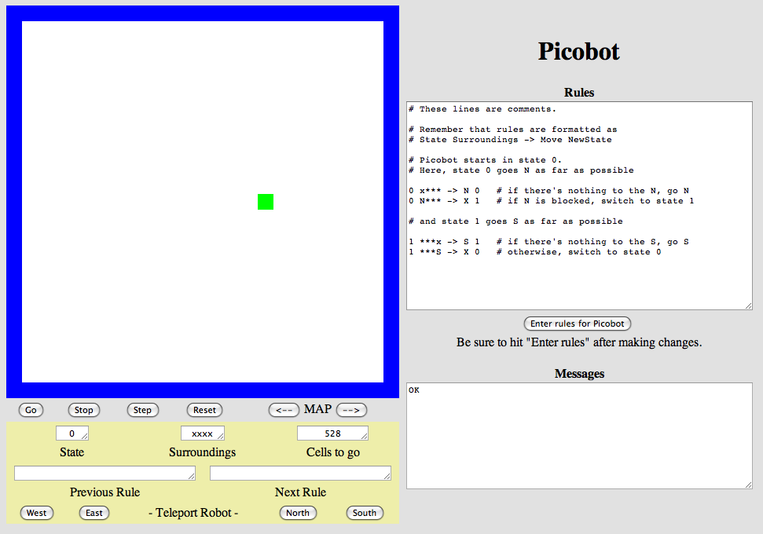
Another language already?
Picobot!
Python
General-purpose language
you might see 50% by the end of the term
even then, <1% of its libraries!
Picobot
Special-purpose language
you'll see 100% in the next 10 minutes
The Picobot simulator
www.cs.hmc.edu/picobot

Slide 29
HW problems 3 and 4: Picobot!
Goal: full-room coverage with only local sensing…
walls
Picobot
area not covered (yet!)
area already covered
Picobot can't tell…
Inspiration?

Slide 30
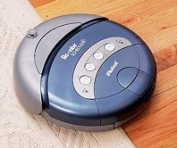
HW problems 3 and 4: Picobot!
Goal: full-room coverage with only local sensing…
walls
Picobot
area not covered (yet!)
area already covered
Picobot can't tell…
Roomba!
can't tell "vacuumed" from "unvacuumed" area
Let's see it!

Slide 31
Surroundings
N
Picobot can only sense things directly to the N, E, W, and S
W
E
S
For example, here its surroundings are
NxWx
N E W S
Surroundings are always in NEWS order.

Slide 32
What are these surroundings?
Surroundings are always in NEWS order.
N E W S
NxWx
Wow - this one is disgusting!

Slide 33
Surroundings
N
How many distinct surroundings are there?
W
E
S

Slide 34
Surroundings
N
How many distinct surroundings are there?
W
E
2⁴
== 16 possible
S
xxxx
Nxxx
xExx
xxWx
xxxS
NExx
NxWx
NxxS
xEWx
xExS
xxWS
NEWx
NExS
NxWS
xEWS
NEWS
(won’t happen)

Slide 35
State
I am in state 0.
My surroundings
are xxWS.
Picobot's memory is a single number, called its state.
State is the internal context of a computation, i.e., the subtask.
0
Picobot always starts in state 0.
State and surroundings represent everything Picobot knows about the world
self-contained
but not simplistic

Slide 36
Rules
I am in state 0.
My surroundings
are xxWS.
Picobot acts through a set of rules:
state
surroundings
direction
new state
0
xxWS
N
0
Picobot checks its rules from the top each time.
Notes
When it finds a matching rule, that rule runs.

Slide 37
Rules
I am in state 0.
My surroundings
are xxWS.
Picobot acts through a set of rules
Each rule expresses your intent for Picobot!
state
surroundings
direction
new state
0
xxWS
N
0
If I'm now in state 0 seeing xxWS,
Then I move North, and "change" to state 0.
Let's try it! (on board)

Slide 38
Wildcards
I only care about NORTH being EMPTY
Asterisks * are wild cards. They match walls or empty space:
state
surroundings
direction
new state
0
x***
N
0
EWS may be wall or empty space
N must be empty
that's it!

Slide 39
(A) A rule that sends Picobot to the North as far as it can go:
state
surroundings
direction
new state
0
x***
->
N
0
(B) What does this next rule do?
0
N***
->
W
1
(C) What about this one?
1
***x
->
S
1
(D) How could we stop at the bottom and return up through the same column?

Slide 40
Be Picobot!
(1) How many times does the 1st rule run? _________
(2) How many times does the 2nd rule run? _________
(3) How many times does the 3rd rule run? _________
(4) In English, what does state 0 do?
In this small world:
(5) How could this help clear the empty room? … just a thought experiment
"Run" this Picobot program:
state
surr
dir
newstate
P
0
***x
->
S
0
1st rule
0
*x*S
->
E
0
2nd rule
top of stalagmite
0
*E*S
->
X
1
3rd rule
(6) Add two rules that will, in state 1, get Picobot to the top of the stalagmite, then stop.
(Extra!) What approach could get Picobot to travel around the whole outer edge?

Slide 41
Be Picobot!
(1) How many times does the 1st rule run? _________
(2) How many times does the 2nd rule run? _________
(3) How many times does the 3rd rule run? _________
(4) In English, what does state 0 do?
In this small world:
(5) How could this help clear the empty room? … just a thought experiment
"Run" this Picobot program:
state
surr
dir
newstate
P
0
***x
->
S
0
1st rule
0
*x*S
->
E
0
2nd rule
top of stalagmite
0
*E*S
->
X
1
3rd rule
(6) Add two rules that will, in state 1, get Picobot to the top of the stalagmite, then stop.
(Extra!) What approach could get Picobot to travel around the whole outer edge?

Slide 42
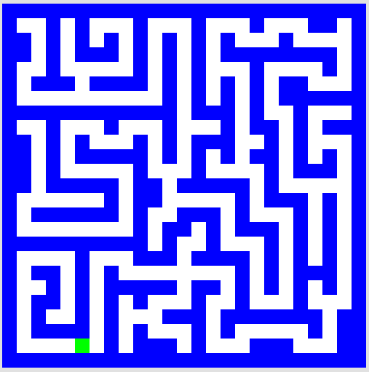
Picobot hw problems
problem 3
problem 4
Extra! (#5)
Your rules must work regardless of Picobot's starting position… !

Slide 43
Maze strategies?

Slide 44
Maze strategies?
Right Hand Rule
Keep your "right hand" on the wall, Picobot!

Slide 45
Maze strategies?
Right Hand Rule
facing
Keep your "right hand" on the wall, Picobot!
State 0
State 1
State 2
State 3
We'll need to use state to represent the direction Picobot is facing.

Slide 46
Suppose Picobot wants to traverse a maze with its right hand always on the wall.
We use state 0 to represent that “Picobot is facing North”
(A) Here is a single rule that tells Picobot:
If you're facing N using the RHR with space ahead then go forward”
0
xE**
->
N
0
0
(A)
(B) Let's write a single rule that tells Picobot:
“If you're facing North and lose the wall, then get over to the wall now!”
0
0
->
(B)
(C) (for HW) Write 1 or 2 rules to tell Picobot to do the right thing if it hits a dead end.
0
(C)
Repeat this IDEA for all four states, representing all four facing directions.

Slide 47
Programming as recipe-writing
vs.
Programming as learning a foreign language
1) Expect it to be different!
2) Don’t feel you need to memorize it
3) Immersion ~ Experimentation
Notes:
my foreign language teachers always tried to convince me that the skill of speaking, reading and writing a foreign language…
I didn’t believe them then and I don’t believe them now -- but I do believe that reading and writing a computer language is the way to get a strong intuitive understanding of how machines think -- it’s also important for getting them to do what you want them to, but even if you forget everything this course (hopefully) teaches about Java (compiler, datatypes, Classes and Objects), the real goal is that you take away a deeper insight into how machines think
familiar and sometimes not so familiar… deceptively easy
you mean I have to type all that!!

Slide 48
and I thought my language was alien!
Seventy years ago, in 1940, a popular science magazine published a short article that set in motion one of the trendiest intellectual fads of the 20th century. At first glance, there seemed little about the article to augur its subsequent celebrity. Neither the title, “Science and Linguistics,” nor the magazine, M.I.T.’s Technology Review, was most people’s idea of glamour. And the author, a chemical engineer who worked for an insurance company and moonlighted as an anthropology lecturer at Yale University, was an unlikely candidate for international superstardom. And yet Benjamin Lee Whorf let loose an alluring idea about language’s power over the mind, and his stirring prose seduced a whole generation into believing that our mother tongue restricts what we are able to think.

Slide 49
and I thought my language was alien!
Seventy years ago, in 1940, a popular science magazine published a short article that set in motion one of the trendiest intellectual fads of the 20th century. At first glance, there seemed little about the article to augur its subsequent celebrity. Neither the title, “Science and Linguistics,” nor the magazine, M.I.T.’s Technology Review, was most people’s idea of glamour. And the author, a chemical engineer who worked for an insurance company and moonlighted as an anthropology lecturer at Yale University, was an unlikely candidate for international superstardom. And yet Benjamin Lee Whorf let loose an alluring idea about language’s power over the mind, and his stirring prose seduced a whole generation into believing that our mother tongue restricts what we are able to think.

Slide 50
CS ~ complexity science
problem 3
problem 4
Extra! (5)
Shortest Picobot program:
6 rules
Shortest Picobot program:
8 rules
Shortest Picobot program:
? rules
Can it simply be done!?

Slide 51
Reminder
You are not alone!
I can attest to that!
Tutoring hours all weekend afternoons in the LAC lab -
also, Sunday and Monday evenings @ LAC lab.
My office hours at the LAC lab: Monday 2:00-4:00
Piazza us with any account/web/other problems.
Lead on! I will follow.
Happy Picobotting!

Slide 53
Quiz
Name ______________
Name ______________
(1) Find and correct as many errors as you can here…
(2) This line is doing three things… what are they?
import random
user = raw_input( "Choose your weapon! " )
comp = random.choice( ['rock','paper','scissors") ]
print 'user (you) chose:', 'user'
print 'comp (me!) chose:' comp
if user == rock and comp = 'paper'
print 'The result is, YOU LOSE!'
print 'unless you're a CS 5 grader, then YOU WIN!'
(3) How many different uses of punctuation can you find?

Slide 54
Surroundings
N
Picobot can only sense things directly to the N, E, W, and S
W
E
S
For example, here its surroundings are
NxWx
N E W S
Surroundings are always in NEWS order.

Slide 55
What are these surroundings?
Surroundings are always in NEWS order.
N E W S
NxWx
Wow - this one is disgusting!

Slide 56
(A) A rule that sends Picobot to the North as far as it can go:
state
surroundings
direction
new state
0
x***
->
N
0
(B) What does this next rule do?
0
N***
->
W
1
(C) What about this one?
1
***x
->
S
1
(D) How could we stop at the bottom and return up through the same column?

Slide 57
Be Picobot!
(1) How many times does the 1st rule run? _________
(2) How many times does the 2nd rule run? _________
(3) How many times does the 3rd rule run? _________
(4) In English, what does state 0 do?
In this small world:
(5) How could this help clear the empty room? … just a thought experiment
"Run" this Picobot program:
state
surr
dir
newstate
P
0
***x
->
S
0
1st rule
0
*x*S
->
E
0
2nd rule
top of stalagmite
0
*E*S
->
X
1
3rd rule
(6) Add two rules that will, in state 1, get Picobot to the top of the stalagmite, then stop.
(Extra!) What approach could get Picobot to travel around the whole outer edge?

Slide 58
Maze strategies?
Right Hand Rule
facing
Keep your "right hand" on the wall, Picobot!
State 0
State 1
State 2
State 3
We'll need to use state to represent the direction Picobot is facing.

Slide 59
Suppose Picobot wants to traverse a maze with its right hand always on the wall.
We use state 0 to represent that “Picobot is facing North”
(A) Here is a single rule that tells Picobot:
If you're facing N using the RHR with space ahead then go forward”
0
xE**
->
N
0
0
(A)
(B) Let's write a single rule that tells Picobot:
“If you're facing North and lose the wall, then get over to the wall now!”
0
0
->
(B)
(C) (for HW) Write 1 or 2 rules to tell Picobot to do the right thing if it hits a dead end.
0
(C)
Repeat this IDEA for all four states, representing all four facing directions.

Slide 60
Pass those quizzes to the East... !
Turn back inside the packet...

Slide 61
For four 4's
0 = 4 + 4 - 4 - 4
1 = 44 / 44
2 = 4
...
8 = sqrt( .4 ) * (4+4+4)
...
19 = ???
20 = 4! + 4 - 4 - 4
4/(4+4)
Ask around the math department…

Slide 62
From lots of four-fours work in Prolog... !

Slide 63
I will be astonished to even cover up to this point…

Slide 64
Create a program that will get picobot to the SOUTHEAST corner of the empty room.
Your rules should work regardless of Picobot's starting position… !
How could you combine the previous example with this one to cover the whole room from any starting position?
How few states could be used?
How few total rules can be used?
How would you solve these rooms?

Slide 65
Quiz, continued…
What different set of rules would guide Picobot through this "maze" environment?
What algorithm will work?
What will each state mean?
How many states?
How many rules per state?
Thinking about the CS questions before diving into the programming will help!
Algorithm:
States:

Slide 66
Quiz
· Suppose Picobot want to traverse a maze with its right hand always on the wall.
· Suppose the starting state, state 0, will represent the fact that “Picobot is facing North”
part 2
(A) Write a single rule that tells Picobot:
“Continue North as long as there’s room to move and a wall on your right”
0
(A)
(B) Write a single rule that tells Picobot:
“If you lose the wall when facing North, return to it immediately!”
0
(B)
(C) Write 1-2 rules to tell Picobot to do the right thing if it hits a dead end.
0
(C)

Slide 67
Be Picobot!
(1) "Run" this Picobot program
Your rules should work regardless of Picobot's starting position… !
How could you combine the previous example with this one to cover the whole room from any starting position?
Extras!
How few states could be used?
Create a program that will initially get picobot to the SOUTHEAST corner of the empty room.
How few total rules can be used?
How would you solve these rooms?

Slide 68
CS is deceptively easy.

Slide 69
Python + Mac ==
Happy, even if alien…
Freezing Mac? Run with Shift-Command-F5
Thanks, Patrick!
Still freezing? Swim away with 2.7.2
Lion+ users: 2.7.2 is ok.

Slide 70
CS’s motto ?
details are temporary…
…but CS thinking isn’t !
print 'hv',
print 'dcle\naemdoe'
print 'ryu',
print 'lg!'
print 'whteo'
print 'aerub\nv',
print 'aeo\nyraoo'
print 'egdne'
Notes:
Useful skill
Important tool
Window into corners of everyday life

Slide 71
CS’s motto ?
details are temporary…
…but CS thinking isn’t !
hv dcle
aemdoe
ryu lg!
whteo
aerub
v aeo
yraoo
egdne
print 'hv',
print 'dcle\naemdoe'
print 'ryu',
print 'lg!'
print 'whteo'
print 'aerub\nv',
print 'aeo\nyraoo'
print 'egdne'
Notes:
Useful skill
Important tool
Window into corners of everyday life

Slide 72
Whatever you are, be a good one.
- Abraham Lincoln
… CS will help!

Slide 73
Ideas for the maze?
the maze
I need more Picobot!

Slide 74
Today's theme:
Models of Computation?

Slide 75
CS ~ complexity science
Information is intrinsic to every system…
How can we benefit from this information?
“construct with”
Representing it … Transforming it … Measuring it
efficiently? effectively? possibly?
How might we measure these rooms' complexity?
Notes:
ZACH:
information isn't just something that has appeared in the last 50 years as computers have become ubiquitous…
despite its name, computer science doesn't require a computer at all

Slide 76
CS ~ complexity science
Information is intrinsic to many systems…
CS analyzes, measures, and leverages it!
Representing it … Transforming it … Measuring it
efficiently? effectively? possibly?
How might we measure these rooms' complexity?
How many states and rules are necessary ?
How much information does each room contain ?
our best: 3 states, 6 rules
our best: 4 states, 8 rules
Notes:
ZACH:
information isn't just something that has appeared in the last 50 years as computers have become ubiquitous…
despite its name, computer science doesn't require a computer at all

Slide 77
CS ~ complexity science
Information is intrinsic to every system…
How can we benefit from this information?
“construct with”
Representing it … Transforming it … Measuring it
efficiently? effectively? possibly?
How might we measure these rooms' complexity?
How many states and rules are necessary ?
How much information does each room contain ?
As a file: ~5000 bytes
As a file: ~20,000 bytes!
Notes:
ZACH:
information isn't just something that has appeared in the last 50 years as computers have become ubiquitous…
despite its name, computer science doesn't require a computer at all

Slide 78
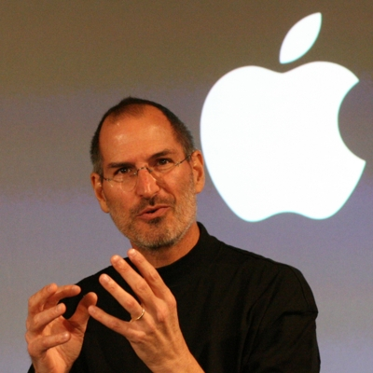
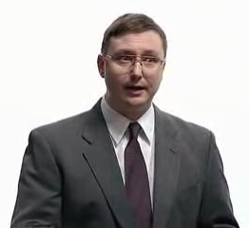
Models of Computation?

Slide 79
Models of Computation
A computational model is simply
"how a particular machine/language works"
or
"what the machine is thinking?!"
Some choice words might go here, at times.
This is the "baggage" of each foreign language...

Slide 80
Abstraction
Artists are mystics rather than rationalists. They leap to conclusions that logic cannot reach.
-- Sol LeWitt, conceptual artist
Simplicity does not precede complexity, but follows it.
-- Alan Perlis, early CS-ist.
Notes:
dealing with code in which you don’t know everything that’s going on, you need to abstract away details and keep a bigger picture in mind

Slide 81
Python syntax highlights
for homework 0
import random
assignment statements always read right-to-left and use ONE equals sign
user_choice = raw_input('Enter something: ')
every block of code must line up!!
comp_choice = random.choice( ['rock','paper','scissors'] )
comparisons use TWO equals signs
if user_choice == 'rock' and comp_choice == 'paper':
print 'You chose', user_choice
print 'I chose', comp_choice
print 'The result is',
print 'YOU LOSE!'
print 'unless you\'re a CS 5 grader,\n then YOU WIN!'
colons begin a new block!
The comma prints a space and does NOT go to the next line.
every block of code must line up!!
a backslash shows special cases or characters
flattering or flouting CS graders is encouraged!
elif test goes here:
else:
as many as you want – zero or more – all mutually exclusive
optional – NO test – still needs a colon

Slide 82
Computer Science
Information is intrinsic to every system…
How can we create with this information?
“benefit from”
Representing it...
What information will we need?
Interpreting it...
How will we know who won?
Evaluating it...
Is it as efficient as possible?
Notes:
ZACH:
fundamentally creative

Slide 83
Python's model?
How does this program execute?
import random
How many things is this line doing?
user_choice = raw_input('Enter something: ')
comp_choice = random.choice( ['rock','paper','scissors'] )
if user_choice == 'rock' and comp_choice == 'paper':
print 'You chose', user_choice
print 'I chose', comp_choice
print 'The result is',
print 'YOU LOSE!'
print 'unless you\'re a CS 5 grader,\n then YOU WIN!'
How many more if/elif/else blocks do we need?

Slide 84
Models of Computation
A computational model is simply
"how a particular machine/language works"
or
"what the machine is thinking?!"
sequential execution
variables store values
conditionals make decisions
loops loop
functions function
and so on...
GP language!

Slide 85
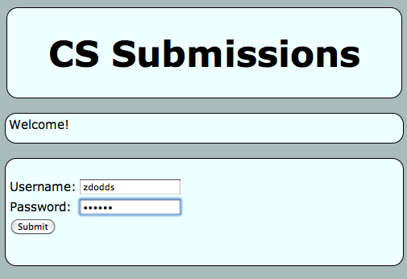
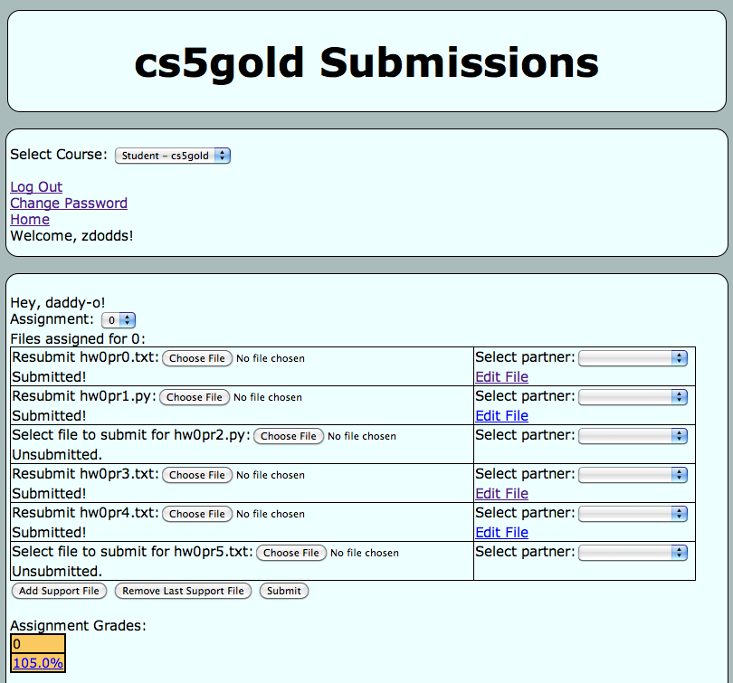
Submitting...
and transferring!
Sometimes I've needed to login twice…
One time, the browser needed to be restarted (or a different browser used)

Slide 86
Python's syntax?
(1) See if you can find and correct any errors here... !
import random
(2) This line is doing three things… what are they?
(1) prints the "weapon" prompt
(2) gets user's input from the kbd
(3) assigns that input to the variable user
assignment statements always use ONE equals sign – more on these next week
user = raw_input( 'Choose your weapon! ' )
every block of code must line up!!
comp = random.choice( ['rock','paper','scissors'] )
print '(You): user chose', user
print '(Me!): comp chose', comp
The comma prints a space and does NOT go to the next line.
comparisons use TWO equals signs
if user == 'rock' and comp == 'paper':
print 'The result is, YOU LOSE!'
print 'unless you\'re a CS 5 grader, then YOU WIN!'
a colon starts a new block
every block of code must line up!!
a backslash handles special cases or characters
flattering or flouting CS graders is encouraged!
quotes delimit text
(3) See how many different uses of punctuation you can find…

Slide 87
Language is language?
Intercal
v
>v"Hello world!"0<
,:
^_25*,@
PLEASE DO ,1 <- #13
DO ,1 SUB #1 <- #238
DO ,1 SUB #2 <- #112
DO ,1 SUB #3 <- #112
DO ,1 SUB #4 <- #0
DO ,1 SUB #5 <- #64
DO ,1 SUB #6 <- #238
DO ,1 SUB #7 <- #26
DO ,1 SUB #8 <- #248
DO ,1 SUB #9 <- #168
DO ,1 SUB #10 <- #24
DO ,1 SUB #11 <- #16
DO ,1 SUB #12 <- #158
DO ,1 SUB #13 <- #52
PLEASE READ OUT ,1
PLEASE GIVE UP
Befunge
(DEFUN HELLO-WORLD ()
(PRINT (LIST 'HELLO 'WORLD)))
LISP
Scheme
int main()
{
printf("%s\n", "Hello, world!");
}
C
C++
HAI
CAN HAS STDIO?
VISIBLE "HAI WORLD!"
KTHXBYE
LOLCODE
print 'Hello, World!'
Python
Notes:
ZACH
my foreign language teachers always tried to convince me that the skill of speaking, reading and writing a foreign language…
I didn’t believe them then and I don’t believe them now -- but I do believe that reading and writing a computer language is the way to get a strong intuitive understanding of how machines think -- it’s also important for getting them to do what you want them to, but even if you forget everything this course (hopefully) teaches about any particular language, the real goal is that you take away a deeper insight into how machines think
really no scarier than being raised to learn English, Swedish, or whatever

