Slide 1
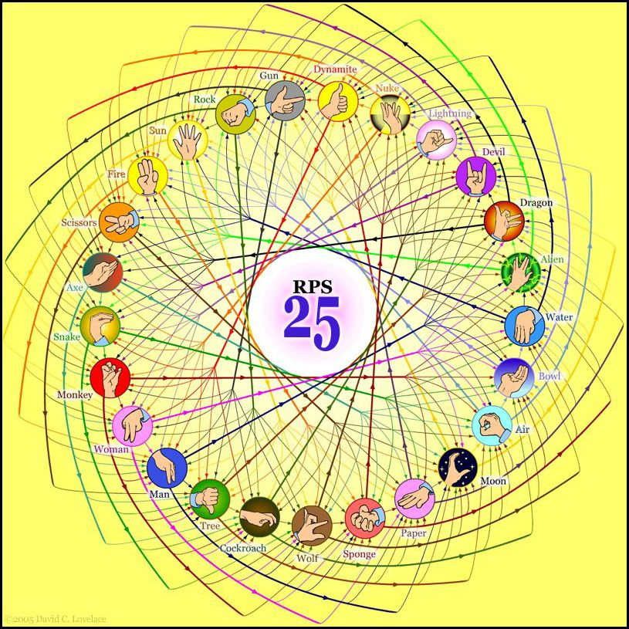
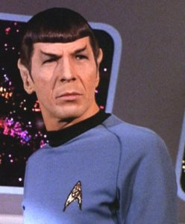
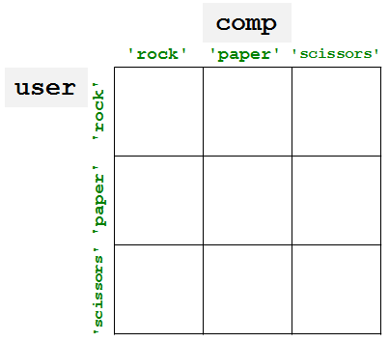
Spock mind-melds three-eyed aliens!
http://www.youtube.com/watch?v=iapcKVn7DdY
http://www.youtube.com/watch?v=yuEZEyDdmvQ
They call that an alien?
Provably.
RPS-25 ?!
comp = 'rock'
user = 'rock'
if comp == 'rock':
print 'I win *_*!'
if user == 'paper':
print 'You win.'
else:
print 'Tie.'
no
no
no
no
no
no
(5) What is the smallest number of blocks and tests you'd need for a full game of RPS?
(Extra) What if it were RPS-5, which includes Lizard and Spock? How about RPS-25? 101?
no
no
yes

Slide 2
Lab lookback…
Get things working
Lab goal:
Complete 25-50% of the hw
Virgil rule…
Finished with lab? OK! No need to stay longer
print "Five is", (4**4)/44
Wow!?
Four fours is ~
sometimes too many…
othertimes too few…
and never enough! -- Prof. Su

Slide 5
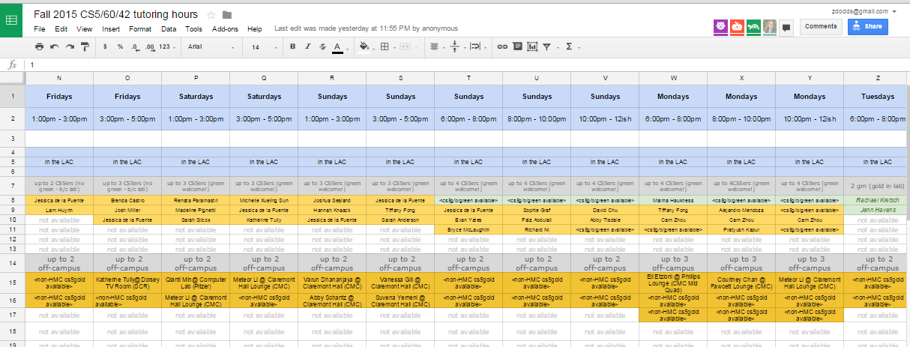
Help outside of lab…
Linde Activities Center
every day there are tutoring hours in the LAC lab
many days there are tutoring hours at other campuses
this link:
this page:

Slide 6
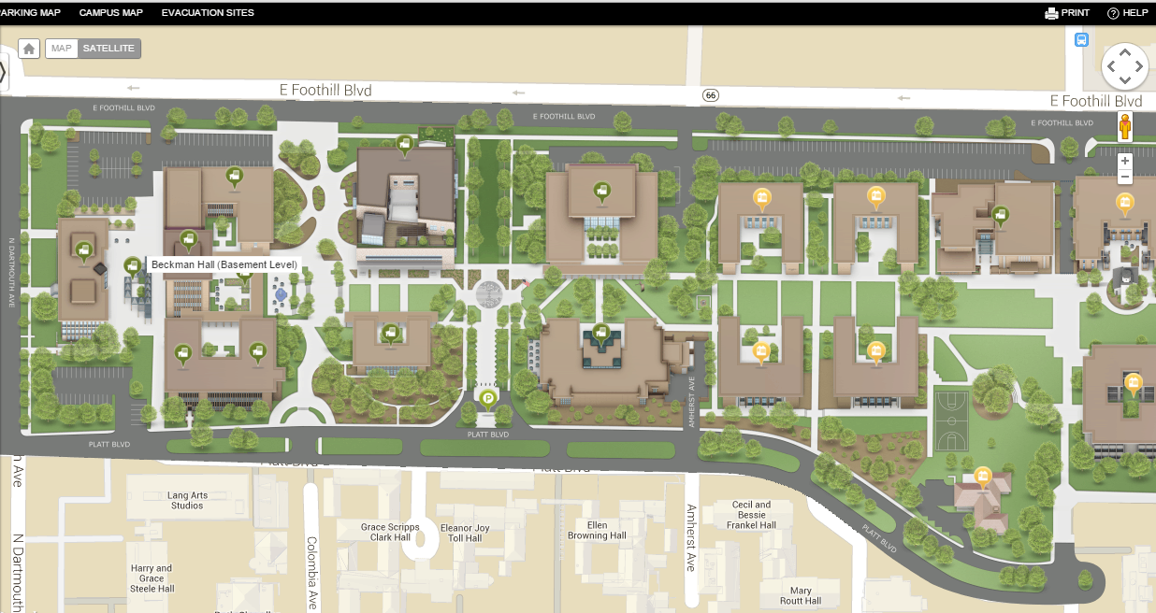
CS5 tutoring location: LAC
Tutoring hours are in the Linde Activities Center computer lab (LAC lab)
west-side entrance
Come by!
My office hours are Friday 2:30-4:30
LOTS of tutoring hours, as well…

Slide 7
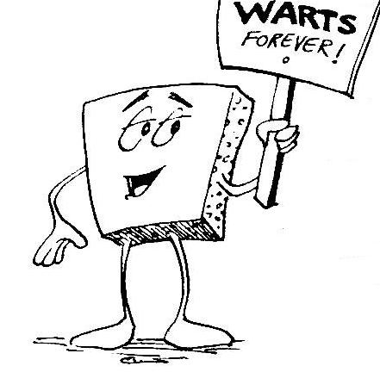
Welcome back to CS 5 !
Average of these two?
Alien
Wally
Problem 0: Reading + response…
Homework 0
Problem 1: Four-fours program: Can be done for lab...
due Mon. night (11:59pm)
Problem 2: Rock-paper-scissors program (Maybe done already!)
Problems 3-4: Picobot! empty room (3) maze (4)

Slide 8
Welcome back to CS 5 !
Yes! I see the resemblance
Picobot!
Alien
Wally
Problem 0: Reading + response…
Homework 0
Problem 1: Four-fours program: Can be done for lab...
due Mon. night (11:59pm)
Problem 2: Rock-paper-scissors program (Maybe done already!)
Problems 3-4: Picobot! empty room (3) maze (4)

Slide 9
Problem 0 ?
Typically an article on CS or an application...
A few sentences that raise or address questions, using the article as a guide.
Submit a one-paragraph response
5 – insightful, careful
4 – thoughtful
3 – complete, on topic
0-2 – less than complete
Small part (5 pts)
This week's article might not seem like CS at first…

Slide 10
Last time…
CS != Programming

Slide 11
What is programming ?
Programming as recipe-writing
vs.
Programming as learning a foreign language
Baggage!
1) Expect it to be different!
2) Don't memorize anything!
3) Immerse == Experiment!
ser/estar
go/went
Notes:
my foreign language teachers always tried to convince me that the skill of speaking, reading and writing a foreign language…
I didn’t believe them then and I don’t believe them now -- but I do believe that reading and writing a computer language is the way to get a strong intuitive understanding of how machines think -- it’s also important for getting them to do what you want them to, but even if you forget everything this course (hopefully) teaches about Java (compiler, datatypes, Classes and Objects), the real goal is that you take away a deeper insight into how machines think
familiar and sometimes not so familiar… deceptively easy
you mean I have to type all that!!

Slide 12
What about the Python programming language ?
Notes:
my foreign language teachers always tried to convince me that the skill of speaking, reading and writing a foreign language…
I didn’t believe them then and I don’t believe them now -- but I do believe that reading and writing a computer language is the way to get a strong intuitive understanding of how machines think -- it’s also important for getting them to do what you want them to, but even if you forget everything this course (hopefully) teaches about Java (compiler, datatypes, Classes and Objects), the real goal is that you take away a deeper insight into how machines think
familiar and sometimes not so familiar… deceptively easy
you mean I have to type all that!!

Slide 13
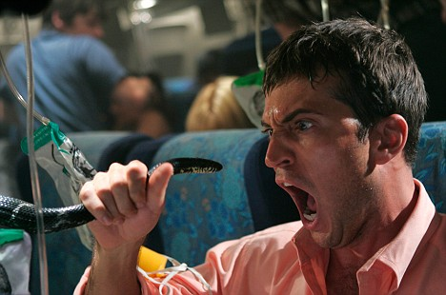
Python ?
One possible relationship...
Notes:
my foreign language teachers always tried to convince me that the skill of speaking, reading and writing a foreign language…
I didn’t believe them then and I don’t believe them now -- but I do believe that reading and writing a computer language is the way to get a strong intuitive understanding of how machines think -- it’s also important for getting them to do what you want them to, but even if you forget everything this course (hopefully) teaches about Java (compiler, datatypes, Classes and Objects), the real goal is that you take away a deeper insight into how machines think
familiar and sometimes not so familiar… deceptively easy
you mean I have to type all that!!

Slide 14
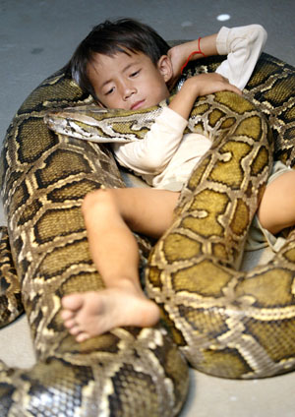
Python !
One possible relationship...
Happy co-existence… It can even be comfy!
Notes:
my foreign language teachers always tried to convince me that the skill of speaking, reading and writing a foreign language…
I didn’t believe them then and I don’t believe them now -- but I do believe that reading and writing a computer language is the way to get a strong intuitive understanding of how machines think -- it’s also important for getting them to do what you want them to, but even if you forget everything this course (hopefully) teaches about Java (compiler, datatypes, Classes and Objects), the real goal is that you take away a deeper insight into how machines think
familiar and sometimes not so familiar… deceptively easy
you mean I have to type all that!!

Slide 15
The foreign language of python…
syntax
semantics
intent
How it looks
What it does
What it should do
Notes:
my foreign language teachers always tried to convince me that the skill of speaking, reading and writing a foreign language…
I didn’t believe them then and I don’t believe them now -- but I do believe that reading and writing a computer language is the way to get a strong intuitive understanding of how machines think -- it’s also important for getting them to do what you want them to, but even if you forget everything this course (hopefully) teaches about Java (compiler, datatypes, Classes and Objects), the real goal is that you take away a deeper insight into how machines think
familiar and sometimes not so familiar… deceptively easy
you mean I have to type all that!!

Slide 16
The foreign language of python…
syntax
semantics
intent
How it looks
What it does
What it should do
name = raw_input('Hi... what is your name? ')
print # prints a blank line
if name == 'Eliot' or name == 'Ran':
print 'I\'m "offline." Try later.'
elif name == 'Zach': # is it Zach?
print 'Zach Quinto...?', 'No?', 'Oh.'
else: # in all other cases...
print 'Welcome', name, '!'
my_choice = random.choice( [ 'R','P','S' ] )
print 'My favorite object is', my_choice, "!"
This program should greet its user appropriately.
Notes:
my foreign language teachers always tried to convince me that the skill of speaking, reading and writing a foreign language…
I didn’t believe them then and I don’t believe them now -- but I do believe that reading and writing a computer language is the way to get a strong intuitive understanding of how machines think -- it’s also important for getting them to do what you want them to, but even if you forget everything this course (hopefully) teaches about Java (compiler, datatypes, Classes and Objects), the real goal is that you take away a deeper insight into how machines think
familiar and sometimes not so familiar… deceptively easy
you mean I have to type all that!!

Slide 17
The foreign language of python…
syntax
semantics
intent
How it looks
What it does
What it should do
name = raw_input('Hi... what is your name? ')
print # prints a blank line
if name == 'Eliot' or name == 'Ran':
print 'I\'m "offline." Try later.'
elif name == 'Zach': # is it Zach?
print 'Zach Quinto...?', 'No?', 'Oh.'
else: # in all other cases...
print 'Welcome', name, '!'
my_choice = random.choice( [ 'R','P','S' ] )
print 'My favorite object is', my_choice, "!"
This program should greet its user appropriately.
human-desired output
Notes:
my foreign language teachers always tried to convince me that the skill of speaking, reading and writing a foreign language…
I didn’t believe them then and I don’t believe them now -- but I do believe that reading and writing a computer language is the way to get a strong intuitive understanding of how machines think -- it’s also important for getting them to do what you want them to, but even if you forget everything this course (hopefully) teaches about Java (compiler, datatypes, Classes and Objects), the real goal is that you take away a deeper insight into how machines think
familiar and sometimes not so familiar… deceptively easy
you mean I have to type all that!!

Slide 18
The foreign language of python…
syntax
semantics
intent
How it looks
What it does
What it should do
name = raw_input('Hi... what is your name? ')
print # prints a blank line
if name == 'Eliot' or name == 'Ran':
print 'I\'m "offline." Try later.'
elif name == 'Zach': # is it Zach?
print 'Zach Quinto...?', 'No?', 'Oh.'
else: # in all other cases...
print 'Welcome', name, '!'
my_choice = random.choice( [ 'R','P','S' ] )
print 'My favorite object is', my_choice, "!"
Notes:
my foreign language teachers always tried to convince me that the skill of speaking, reading and writing a foreign language…
I didn’t believe them then and I don’t believe them now -- but I do believe that reading and writing a computer language is the way to get a strong intuitive understanding of how machines think -- it’s also important for getting them to do what you want them to, but even if you forget everything this course (hopefully) teaches about Java (compiler, datatypes, Classes and Objects), the real goal is that you take away a deeper insight into how machines think
familiar and sometimes not so familiar… deceptively easy
you mean I have to type all that!!

Slide 19
The foreign language of python…
syntax
semantics
intent
How it looks
What it does
What it should do
machine-producedoutput
name = raw_input('Hi... what is your name? ')
print # prints a blank line
if name == 'Eliot' or name == 'Ran':
print 'I\'m "offline." Try later.'
elif name == 'Zach': # is it Zach?
print 'Zach Quinto...?', 'No?', 'Oh.'
else: # in all other cases...
print 'Welcome', name, '!'
my_choice = random.choice( [ 'R','P','S' ] )
print 'My favorite object is', my_choice, "!"
Notes:
my foreign language teachers always tried to convince me that the skill of speaking, reading and writing a foreign language…
I didn’t believe them then and I don’t believe them now -- but I do believe that reading and writing a computer language is the way to get a strong intuitive understanding of how machines think -- it’s also important for getting them to do what you want them to, but even if you forget everything this course (hopefully) teaches about Java (compiler, datatypes, Classes and Objects), the real goal is that you take away a deeper insight into how machines think
familiar and sometimes not so familiar… deceptively easy
you mean I have to type all that!!

Slide 20
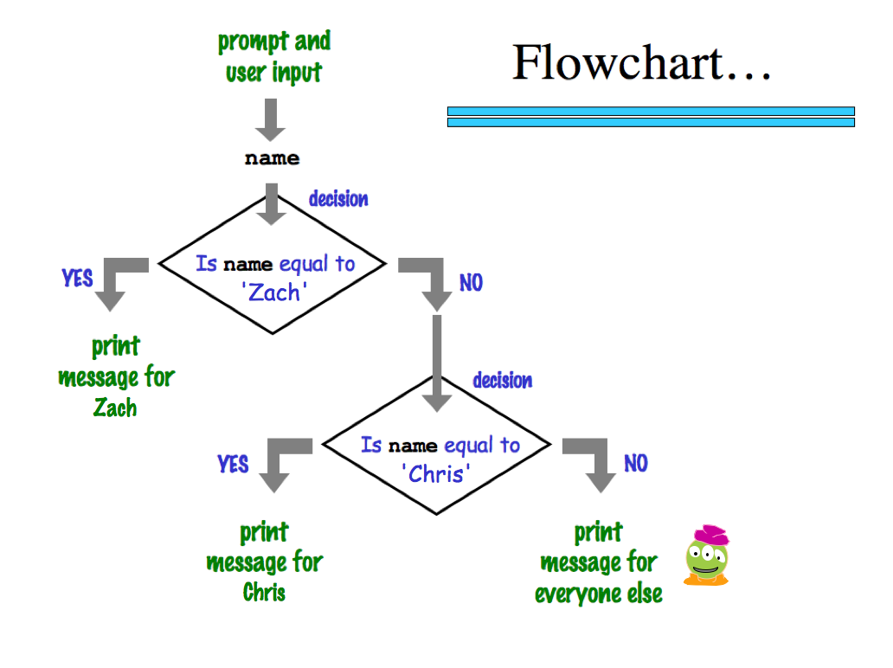
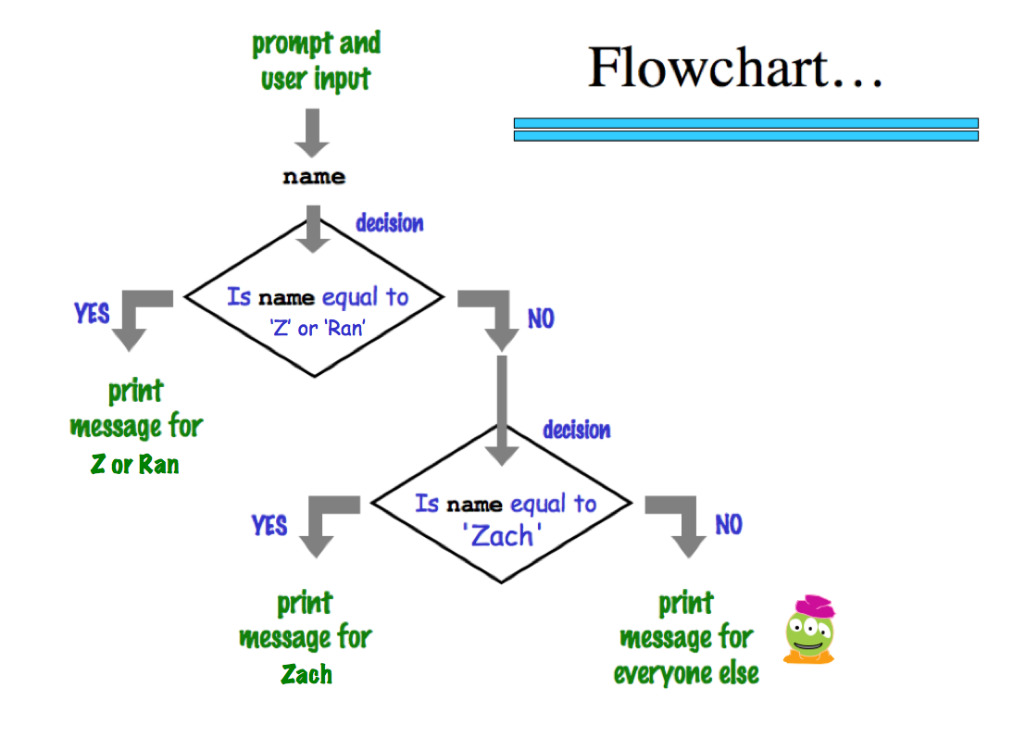
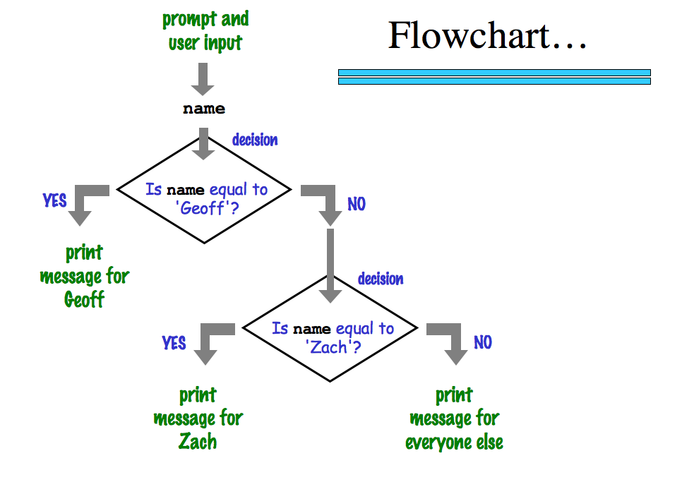
a graphical view of a program's semantics
'Zach'
machine-producedoutput
‘Eliot’ or ‘Ran’
Zach
Eliot or Ran
'Chris'
Chris
Zach
What about me?
Notes:
my foreign language teachers always tried to convince me that the skill of speaking, reading and writing a foreign language…
I didn’t believe them then and I don’t believe them now -- but I do believe that reading and writing a computer language is the way to get a strong intuitive understanding of how machines think -- it’s also important for getting them to do what you want them to, but even if you forget everything this course (hopefully) teaches about Java (compiler, datatypes, Classes and Objects), the real goal is that you take away a deeper insight into how machines think
familiar and sometimes not so familiar… deceptively easy
you mean I have to type all that!!

Slide 21
The foreign language of python…
syntax
semantics
intent
How it looks
What it does
What it should do
www.theonion.com
How Python looks!
how punctuation is used
the language keywords used
use of whitespace
peculiarities of formatting
how behavior is affected …
Notes:
my foreign language teachers always tried to convince me that the skill of speaking, reading and writing a foreign language…
I didn’t believe them then and I don’t believe them now -- but I do believe that reading and writing a computer language is the way to get a strong intuitive understanding of how machines think -- it’s also important for getting them to do what you want them to, but even if you forget everything this course (hopefully) teaches about Java (compiler, datatypes, Classes and Objects), the real goal is that you take away a deeper insight into how machines think
familiar and sometimes not so familiar… deceptively easy
you mean I have to type all that!!

Slide 22
The foreign language of python…
syntax
semantics
intent
How it looks
What it does
What it should do
human-typed input
www.theonion.com
How Python looks!
how punctuation is used
the language keywords used
use of whitespace
peculiarities of formatting
how behavior is affected …
Notes:
my foreign language teachers always tried to convince me that the skill of speaking, reading and writing a foreign language…
I didn’t believe them then and I don’t believe them now -- but I do believe that reading and writing a computer language is the way to get a strong intuitive understanding of how machines think -- it’s also important for getting them to do what you want them to, but even if you forget everything this course (hopefully) teaches about Java (compiler, datatypes, Classes and Objects), the real goal is that you take away a deeper insight into how machines think
familiar and sometimes not so familiar… deceptively easy
you mean I have to type all that!!

Slide 23
The challenge of programming…
syntax
semantics
intent
How it looks
What it does
What it should do
www.theonion.com
human-typed input
machine-producedoutput
human-desired output
?
Notes:
my foreign language teachers always tried to convince me that the skill of speaking, reading and writing a foreign language…
I didn’t believe them then and I don’t believe them now -- but I do believe that reading and writing a computer language is the way to get a strong intuitive understanding of how machines think -- it’s also important for getting them to do what you want them to, but even if you forget everything this course (hopefully) teaches about Java (compiler, datatypes, Classes and Objects), the real goal is that you take away a deeper insight into how machines think
familiar and sometimes not so familiar… deceptively easy
you mean I have to type all that!!

Slide 24
Syntax challenge!
(1) Find and correct as many errors as you can here…
(2) This line is doing three things… what are they?
import random
user = raw_input( "Choose your weapon! " )
comp = random.choice( ['rock','paper','scissors") ]
print 'user (you) chose:', 'user'
print 'comp (me!) chose:' comp
if user == rock and comp = 'paper'
print 'The result is, YOU LOSE!'
print 'unless you're a CS 5 grader, then YOU WIN!'
(3) What are the 6-7 punctuation marks used in more than one way here?

Slide 25
Syntax challenge!
(1) Find and correct as many errors as you can here…
(2) This line is doing three things… what are they?
import random
user = raw_input( "Choose your weapon! " )
comp = random.choice( ['rock','paper','scissors") ]
print 'user (you) chose:', 'user'
print 'comp (me!) chose:' comp
if user == rock and comp = 'paper'
print 'The result is, YOU LOSE!'
print 'unless you're a CS 5 grader, then YOU WIN!'
(3) What are the 6-7 punctuation marks used in more than one way here?

Slide 26
Syntax challenge!
(1) Find and correct as many errors as you can here…
(2) This line is doing three things… what are they?
import random
(1) prints the "weapon" prompt
(2) gets user's input from the kbd
(3) assigns that input to the variable user
set-equals always uses ONE equals sign
user = raw_input( "Choose your weapon! " )
comp = random.choice( ['rock','paper','scissors'] )
print 'user (you) chose:', user
print 'comp (me!) chose:', comp
every block of code must line up!
match brackets and quotes !
test-equals uses TWO equals signs
The comma prints a space and does NOT go to the next line.
if user == rock and comp == 'paper':
print 'The result is, YOU LOSE.'
print 'unless you\'re a CS 5 grader, then YOU WIN!'
a colon starts a new block
every block of code must line up!
flattering - or flouting - graders is encouraged!
a backslash handles special characters
(3) Punctuation used in more than one way: ().'=,:

Slide 27
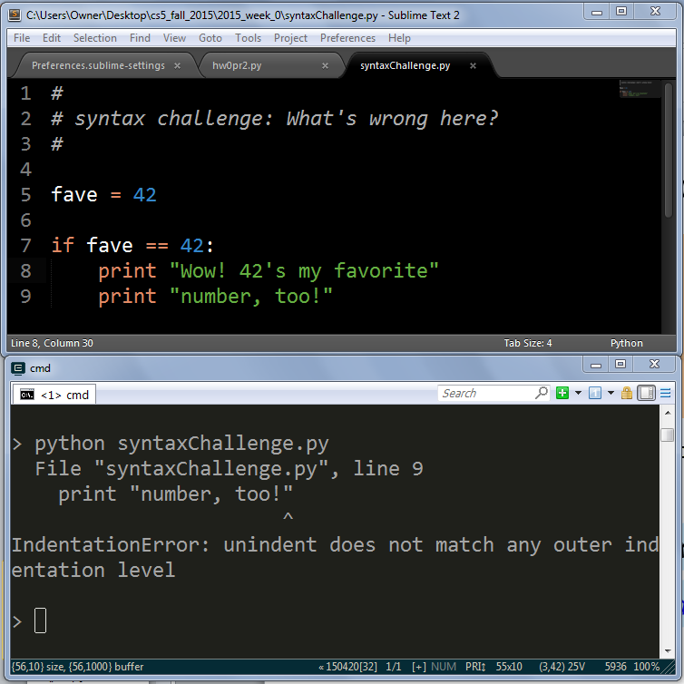
Syntax challenge!
3
1
2

Slide 28
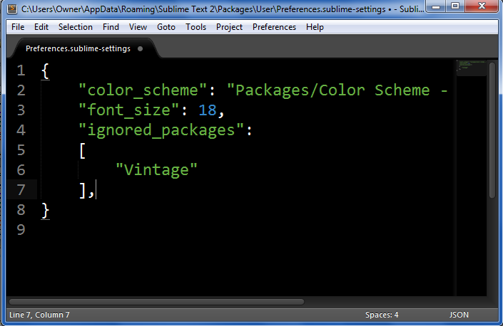
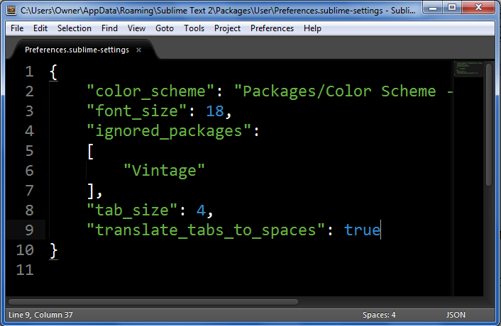
Go to the Preferences menu
Choose Settings - User
Add these two lines at the bottom
above the final closing curly brace:
"tab_size": 4,
"translate_tabs_to_spaces": true
Please do this!
so that tabs + spaces will always work correctly…
Convert to spaces…
Once & you're set!
Before
After

Slide 29
Another language!
Let's not only add another language…
… but also make it half the hw!
Even with three eyes, I must be misreading this!

Slide 30
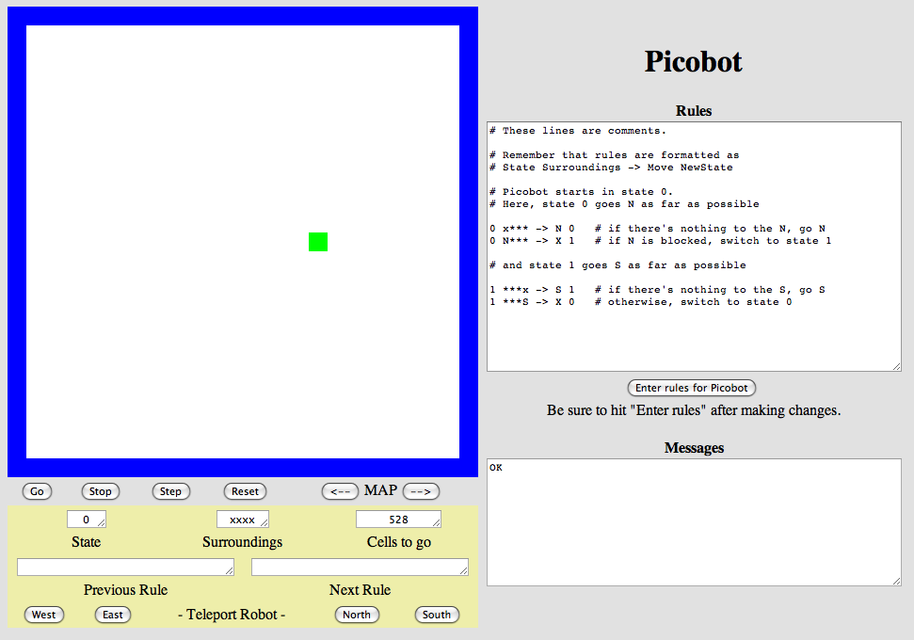
Another language already?
Picobot!
Python
General-purpose language
you might see 50% by the end of the term
even then, <1% of its libraries!
Picobot
Special-purpose language
you'll see 100% in the next 10 minutes
The Picobot simulator
www.cs.hmc.edu/picobot

Slide 31
HW problems 3 and 4: Picobot!
Goal: full-room coverage with only local sensing…
walls
Picobot
area not covered (yet!)
area already covered
Picobot can't tell…
Inspiration?

Slide 32
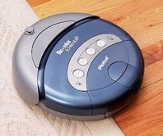
HW problems 3 and 4: Picobot!
Goal: full-room coverage with only local sensing…
walls
Picobot
area not covered (yet!)
area already covered
Picobot can't tell…
The Roomba!
can't tell "vacuumed" from "unvacuumed" area
Let's see it!

Slide 33
Surroundings
N
Picobot can only sense things directly to the N, E, W, and S
W
E
S
For example, here its surroundings are
NxWx
N E W S
Surroundings are always in NEWS order.

Slide 34
What are these surroundings?
Surroundings are always in NEWS order.
N E W S
NxWx
Wow - this one is disgusting!

Slide 35
Surroundings
N
How many distinct surroundings are there?
W
E
S

Slide 36
Surroundings
N
How many distinct surroundings are there?
W
E
2⁴
== 16 possible
S
xxxx
Nxxx
xExx
xxWx
xxxS
NExx
NxWx
NxxS
xEWx
xExS
xxWS
NEWx
NExS
NxWS
xEWS
NEWS
(won’t happen)

Slide 37
State
I am in state 0.
My surroundings
are xxWS.
Picobot's memory is a single number, called its state.
State is the internal context of a computation, i.e., its subtask.
0
Picobot always starts in state 0.
State and surroundings represent everything Picobot knows about the world
self-contained
but not simplistic

Slide 38
Picobot programming ~ rules
state
surroundings
direction
new state
0
Nxxx
S
0
0
xxxx
N
0
these two rules are a complete Picobot program – though not necessarily useful!
Picobot checks its rules from the top each time.
Notes
When it finds a matching rule, that rule runs.
Start
Step 1
Step 2
Step 3
Step 4
…
?

Slide 39
Picobot programming ~ rules
state
surroundings
direction
new state
0
Nxxx
S
0
0
xxxx
N
0
these two rules are a complete Picobot program – though not necessarily useful!
Picobot checks its rules from the top each time.
Notes
When it finds a matching rule, that rule runs.
Start
Step 1
Step 2
Step 3
Step 4
…
?

Slide 40
Picobot programming ~ rules
state
surroundings
direction
new state
0
Nxxx
S
0
0
xxxx
N
0
these two rules are a complete Picobot program – though not necessarily useful!
Picobot checks its rules from the top each time.
Notes
When it finds a matching rule, that rule runs.
Start
Step 1
Step 2
Step 3
Step 4
…
?

Slide 41
Picobot programming ~ rules
state
surroundings
direction
new state
0
Nxxx
S
0
0
xxxx
N
0
these two rules are a complete Picobot program – though not necessarily useful!
Picobot checks its rules from the top each time.
Notes
When it finds a matching rule, that rule runs.
Start
Step 1
Step 2
Step 3
Step 4
?

Slide 42
Picobot programming ~ rules
state
surroundings
direction
new state
0
Nxxx
S
0
0
xxxx
N
0
these two rules are a complete Picobot program – though not necessarily useful!
Picobot checks its rules from the top each time.
Notes
When it finds a matching rule, that rule runs.
Start
Step 1
Step 2
Step 3
Step 4
…
?

Slide 43
Picobot programming ~ rules
state
surroundings
direction
new state
0
Nxxx
S
0
0
xxxx
N
0
these two rules are a complete Picobot program – though not necessarily useful!
Picobot checks its rules from the top each time.
Notes
When it finds a matching rule, that rule runs.
Start
Step 1
Step 2
Step 3
Step 4
these cycle back and forth…

Slide 44
Rules
I am in state 0.
My surroundings
are xxWS.
0
Picobot acts through a set of rules
Each rule expresses your intent for Picobot!
state
surroundings
direction
new state
0
xxWS
N
0
If I'm now in state 0 seeing xxWS,
Then I move North, and "change" to state 0.

Slide 45
Wildcards
I only care about NORTH being EMPTY
Asterisks * are wild cards. They match walls or empty space:
state
surroundings
direction
new state
0
x***
N
0
EWS may be wall or empty space
N must be empty
that's it!

Slide 46
Quiz
One rule to rule them all?
Names:
The Rule is
One step per rule
This is precious!
state
surr.
move
new state
0 N*** -> W 1
0 x*** -> N 0
1 ***x -> S 1
rule (A)
rule (B)
P
rule (C)
more rules
Picobot's world
1. Which of the rules A, B, or C runs first? ______________
2. Picobot stops when no rule matches. Where does it stop?
3. How many times has rule (A) run? __________
Once Picobot stops,
4. How many times has rule (B) run? __________
5. How many times has rule (C) run? __________
Extra! Add rules to finish exploring the empty room… Can you do it in 6 rules total?
6. Add a 4th rule so that Picobot can continue westward.

Slide 47
Warning ~ what's wrong here?
state
surroundings
direction
new state
0
x***
S
0
0
***x
N
0
these two rules are a broken Picobot program!
Picobot checks its rules from the top each time.
Notes
When it finds a matching rule, that rule runs.

Slide 48
Warning ~ what's wrong here!
state
surroundings
direction
new state
0
x***
S
0
These two situations COULD BE the same!
0
***x
N
0
these two rules are a broken Picobot program!
Picobot checks its rules from the top each time.
Notes
When it finds a matching rule, that rule runs.
There can only be ONE rule per situation!
and a "situation" is state and surroundings

Slide 49
Tear off that page
Pass those to the aisles + Eastward…
only 1 "quiz" is needed per pair
take a picture if you'd like to keep it
… then turn back into the packet

Slide 50
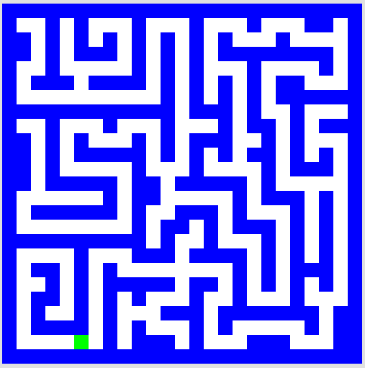
CS ~ Complexity Science
problem 3
problem 4
Extra! (5)
Shortest Picobot program:
6 rules
Shortest Picobot program:
8 rules
Shortest Picobot program:
? rules
Can it be done at all!?

Slide 51
CS ~ Complexity Science
problem 3
problem 4
Extra! (5)
Shortest Picobot program:
6 rules
Shortest Picobot program:
8 rules
Shortest Picobot program:
? rules
Can it be done at all!?

Slide 52
Maze strategies?

Slide 53
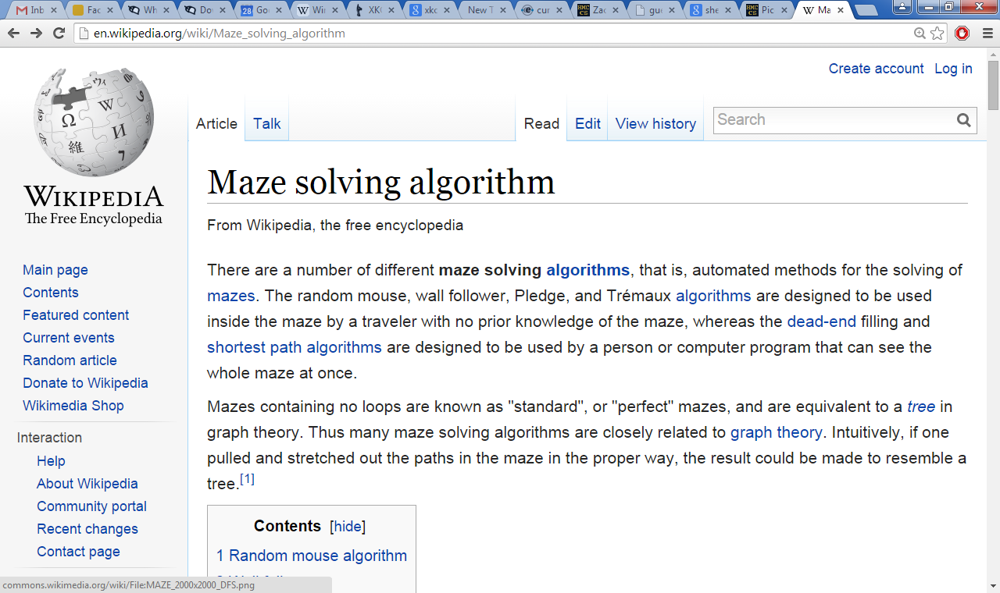
Right Hand Rule

Slide 54
Maze strategies?
Right Hand Rule
Keep your "right hand" on the wall, Picobot!
Why might this be difficult for Picobot?

Slide 55
Maze strategies?
Right Hand Rule
facing
Keep your "right hand" on the wall, Picobot!
State 0
State 1
State 2
State 3
We'll need to use state to represent the direction Picobot is facing.

Slide 56
Suppose Picobot wants to traverse a maze with its right hand always on the wall.
We use state 0 to represent that “Picobot is facing North”
(A) Here is a single rule that tells Picobot:
If you're facing N with a wall at right and space ahead then go forward”
0
xE**
->
N
0
0
(A)
(B) Let's write a single rule that tells Picobot:
“If you're facing North and lose the wall, then get over to the wall now!”
0
0
->
(B)
(C) (for HW) Write 1 or 2 rules to tell Picobot to do the right thing if it hits a dead end.
0
(C)
Repeat this IDEA for all four states, representing all four facing directions.

Slide 57
Suppose Picobot wants to traverse a maze with its right hand always on the wall.
We use state 0 to represent that “Picobot is facing North”
(A) Here is a single rule that tells Picobot:
If you're facing N with a wall at right and space ahead then go forward”
0
xE**
->
N
0
0
(A)
(B) Let's write a single rule that tells Picobot:
“If you're facing North and lose the wall, then get over to the wall now!”
0
0
->
(B)
(C) (for HW) Write 1 or 2 rules to tell Picobot to do the right thing if it hits a dead end.
0
(C)
Repeat this IDEA for all four states, representing all four facing directions.

Slide 58
Problem 0 this week…
Typically an article on CS or an application...
A few sentences that raise or address questions, using the article as a guide.
Submit a one-paragraph response
5 – insightful, careful
4 – thoughtful
3 – complete, on topic
0-2 – less than complete
Small part (5 pts)
This week's article might not seem like CS at first…

Slide 59
and I thought my language was alien!
Seventy years ago, in 1940, a popular science magazine published a short article that set in motion one of the trendiest intellectual fads of the 20th century. At first glance, there seemed little about the article to augur its subsequent celebrity. Neither the title, “Science and Linguistics,” nor the magazine, M.I.T.’s Technology Review, was most people’s idea of glamour. And the author, a chemical engineer who worked for an insurance company and moonlighted as an anthropology lecturer at Yale University, was an unlikely candidate for international superstardom. And yet Benjamin Lee Whorf let loose an alluring idea about language’s power over the mind, and his stirring prose seduced a whole generation into believing that our mother tongue restricts what we are able to think.

Slide 60
and I thought my language was alien!
Seventy years ago, in 1940, a popular science magazine published a short article that set in motion one of the trendiest intellectual fads of the 20th century. At first glance, there seemed little about the article to augur its subsequent celebrity. Neither the title, “Science and Linguistics,” nor the magazine, M.I.T.’s Technology Review, was most people’s idea of glamour. And the author, a chemical engineer who worked for an insurance company and moonlighted as an anthropology lecturer at Yale University, was an unlikely candidate for international superstardom. And yet Benjamin Lee Whorf let loose an alluring idea about language’s power over the mind, and his stirring prose seduced a whole generation into believing that our mother tongue restricts what we are able to think.

Slide 61
As you head west-wards…
You are not alone!
I can attest to that!
Lead on! I will follow.
Office hours Fri. afternoon…
Tutoring hours all weekend + Monday evenings @ LAC lab and across all 5Cs…
Happy Picobotting!

Slide 63
The Rule: One step per rule
One rule to rule them all?
Using the ruleset above…
This is precious!
Picobot's world
How many times does rule (A) run? ___________________
How many times does rule (B) run? ___________________
How many times does rule (C) run? ___________________
How many times does rule (D) run? ___________________
P
In a phrase, what do state 0 and state 1 do?
Where does Picobot stop? Why?
Extra! What additional rules would be needed in order to ensure that Picobot fully explores the empty room (not this crazy room) from any starting spot? (this is problem 3…)
Quiz!
Name _________________
Name __________________

Slide 64
CS ~ complexity science
See you in lab… soon!
problem 3
problem 4
Extra! (5)
Shortest Picobot program:
6 rules
Shortest Picobot program:
8 rules
Shortest Picobot program:
? rules
Can it simply be done!?

Slide 65
Tear off that page
Pass those to the aisles + Southward…
only 1 "quiz" is needed per pair
… then turn back into the packet

Slide 66
The Rule: One step per rule
One rule to rule them all?
Using the ruleset above…
This is precious!
Picobot's world
How many times does rule (A) run? ___________________
How many times does rule (B) run? ___________________
How many times does rule (C) run? ___________________
How many times does rule (D) run? ___________________
P
In a phrase, what do state 0 and state 1 do?
Where does Picobot stop? Why?
Extra! What additional rules would be needed in order to ensure that Picobot fully explores the empty room (not this crazy room) from any starting spot? (this is problem 3…)
Quiz!
Solve this on the back page first…

Slide 67
Picobot hw problems
problem 3
problem 4
Extra! (#5)
Your rules must work regardless of Picobot's starting position… !

Slide 68
Picobot hw problems
problem 3
problem 4
Extra! (#5)
Your rules must work regardless of Picobot's starting position… !

Slide 69
Last time's quiz!?

Slide 70
Sign in…
Be sure to sign in to lab!

Slide 71
Lab rooms
Laptops encouraged!

Slide 72
Programming as recipe-writing
vs.
Programming as learning a foreign language
1) Expect it to be different!
2) Don’t feel you need to memorize it
3) Immersion ~ Experimentation ~ Mindset
go/went
Notes:
my foreign language teachers always tried to convince me that the skill of speaking, reading and writing a foreign language…
I didn’t believe them then and I don’t believe them now -- but I do believe that reading and writing a computer language is the way to get a strong intuitive understanding of how machines think -- it’s also important for getting them to do what you want them to, but even if you forget everything this course (hopefully) teaches about Java (compiler, datatypes, Classes and Objects), the real goal is that you take away a deeper insight into how machines think
familiar and sometimes not so familiar… deceptively easy
you mean I have to type all that!!

Slide 73
Problem 6 this week…
Typically an article on CS or an application...
A few sentences that raise or address questions, using the article as a guide.
Submit a one-paragraph response
5 – insightful, careful
4 – thoughtful
3 – complete, on topic
0-2 – less than complete
Small part (5 pts)
This week's article might not seem like CS at first…

Slide 74
and I thought my language was alien!
Seventy years ago, in 1940, a popular science magazine published a short article that set in motion one of the trendiest intellectual fads of the 20th century. At first glance, there seemed little about the article to augur its subsequent celebrity. Neither the title, “Science and Linguistics,” nor the magazine, M.I.T.’s Technology Review, was most people’s idea of glamour. And the author, a chemical engineer who worked for an insurance company and moonlighted as an anthropology lecturer at Yale University, was an unlikely candidate for international superstardom. And yet Benjamin Lee Whorf let loose an alluring idea about language’s power over the mind, and his stirring prose seduced a whole generation into believing that our mother tongue restricts what we are able to think.

Slide 75
and I thought my language was alien!
Seventy years ago, in 1940, a popular science magazine published a short article that set in motion one of the trendiest intellectual fads of the 20th century. At first glance, there seemed little about the article to augur its subsequent celebrity. Neither the title, “Science and Linguistics,” nor the magazine, M.I.T.’s Technology Review, was most people’s idea of glamour. And the author, a chemical engineer who worked for an insurance company and moonlighted as an anthropology lecturer at Yale University, was an unlikely candidate for international superstardom. And yet Benjamin Lee Whorf let loose an alluring idea about language’s power over the mind, and his stirring prose seduced a whole generation into believing that our mother tongue restricts what we are able to think.

Slide 76
Reminder
You are not alone!
I can attest to that!
Tutoring hours all weekend afternoons in the LAC lab -
also, Sunday and Monday evenings @ LAC lab.
My office hours: Wednesday 3-5pm
Lead on! I will follow.
Happy Picobotting!

Slide 77
Be Picobot!
(1) How many times does the 1st rule run? _________
(2) How many times does the 2nd rule run? _________
(3) How many times does the 3rd rule run? _________
(4) In English, what does state 0 do?
A different picobot world
(5) How could this help clear the empty room? … just a thought experiment
"Run" this Picobot program:
P
state
surr
dir
newstate
0
***x
->
S
0
1st rule
top of stalagmite
0
*x*S
->
E
0
2nd rule
0
*E*S
->
X
1
3rd rule
(6) Add 1 or 2 rules that will, in state 1, get Picobot to the top of the stalagmite, then stop.
(Extra!) What approach could get Picobot to travel around the whole outer edge?

Slide 78
Be Picobot!
(1) How many times does the 1st rule run? _________
(2) How many times does the 2nd rule run? _________
(3) How many times does the 3rd rule run? _________
(4) In English, what does state 0 do?
In this small world:
(5) How could this help clear the empty room? … just a thought experiment
"Run" this Picobot program:
state
surr
dir
newstate
P
0
***x
->
S
0
1st rule
0
*x*S
->
E
0
2nd rule
top of stalagmite
0
*E*S
->
X
1
3rd rule
(6) Add two rules that will, in state 1, get Picobot to the top of the stalagmite, then stop.
(Extra!) What approach could get Picobot to travel around the whole outer edge?

Slide 79
Maze strategies?

Slide 80
Maze strategies?
Right Hand Rule
Keep your "right hand" on the wall, Picobot!

Slide 81
Maze strategies?
Right Hand Rule
facing
Keep your "right hand" on the wall, Picobot!
State 0
State 1
State 2
State 3
We'll need to use state to represent the direction Picobot is facing.

Slide 82
Suppose Picobot wants to traverse a maze with its right hand always on the wall.
We use state 0 to represent that “Picobot is facing North”
(A) Here is a single rule that tells Picobot:
If you're facing N with a wall at right and space ahead then go forward”
0
xE**
->
N
0
0
(A)
(B) Let's write a single rule that tells Picobot:
“If you're facing North and lose the wall, then get over to the wall now!”
0
0
->
(B)
(C) (for HW) Write 1 or 2 rules to tell Picobot to do the right thing if it hits a dead end.
0
(C)
Repeat this IDEA for all four states, representing all four facing directions.

Slide 83
Reminder
You are not alone!
I can attest to that!
Tutoring hours all weekend afternoons in the LAC lab -
also, Sunday and Monday evenings @ LAC lab.
My office hours at the LAC lab: Wednesday 3-5pm
Piazza us with any account/web/other problems.
Lead on! I will follow.
Happy Picobotting!

Slide 84
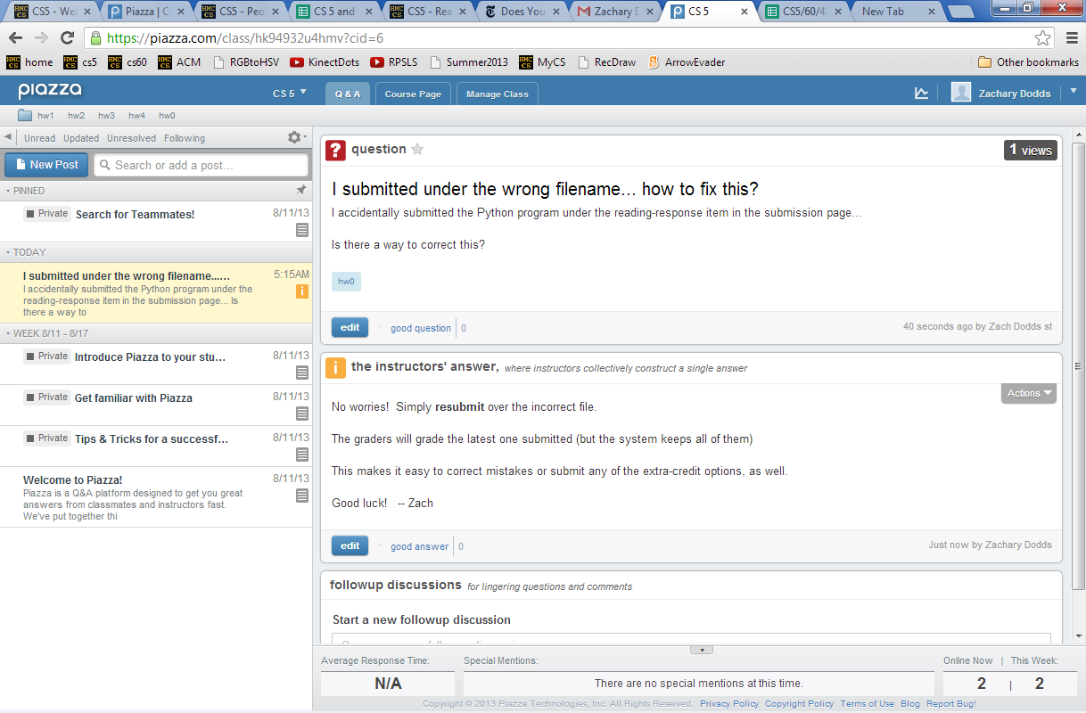
Piazza
for all CS5 concerns/questions
public: post to whole class

Slide 85
Piazza
you'll get a welcome email…
sign-in + choose your message frequency

Slide 86
Piazza
for all CS5 concerns/questions
individual concerns or your source code / bugs?
In-person + pair programming are better strategies for bugs.
But we'll try to take a look…
private: post to instructors
Account problems?
Piazza us!

Slide 87
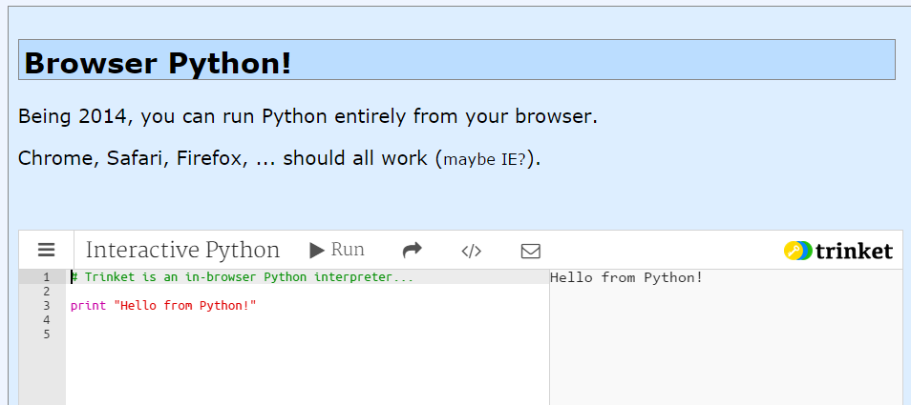
Online Python?
Several options
For text programs, trinket seems the easiest.

Slide 88
in Platt
Evening lab? You can pickup a keycard from HMC's F&M dep't.
Shanahan
coffee
Koi
Map to CS Lab
Edwards
Macalister
Pryne
Physicists, chemists & other parenthesis-needing individuals,
Laptop? Bring it!
cool machines - drills, lathes, etc.
Galileo
other keyboard-free machines
Your account for
CS submissions:
B102
B100
Beckman
passwd:
CS Hallway and Labs
Big Beckman (B126)
B105
Biologists, bees, spiders and other arachnophiles
or Olin
to Olin (Bio + CS)

Slide 89
Evening lab?
You can get a keycard from F&M in Platt
Enter through Olin building
Platt building. F&M is in the basement.
Beckman B102, B105, B126

Slide 90
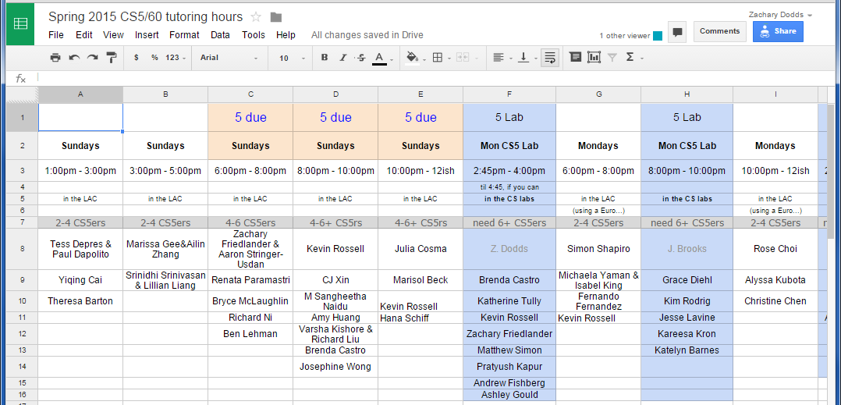
Graders + Tutors = Grutors
Ask for help…
see page
every day there are tutoring hours in the LAC computer lab
Linde Activities Center
Office hours: After class on Wed. (~3-5pm)
Piazza ~ next time

Slide 91
Quiz
Name ______________
Name ______________
(1) Find and correct as many errors as you can here…
(2) This line is doing three things… what are they?
import random
user = raw_input( "Choose your weapon! " )
comp = random.choice( ['rock','paper','scissors") ]
print 'user (you) chose:', 'user'
print 'comp (me!) chose:' comp
if user == rock and comp = 'paper'
print 'The result is, YOU LOSE!'
print 'unless you're a CS 5 grader, then YOU WIN!'
(3) How many different uses of punctuation can you find?

Slide 92
Quiz
Try the one on the back of these notes – with a partner – first…
(1) Find and correct as many errors as you can here…
(2) This line is doing three things… what are they?
import random
user = raw_input( "Choose your weapon! " )
comp = random.choice( ['rock','paper','scissors") ]
print 'user (you) chose:', 'user'
print 'comp (me!) chose:' comp
if user == rock and comp = 'paper'
print 'The result is, YOU LOSE.'
print 'unless you're a CS 5 grader, then YOU WIN!'
(3) I count ,()'=. : 6 or 7 punctuation characters which are being used in two different ways. Which ones are they? _____________________

Slide 93
Surroundings
N
Picobot can only sense things directly to the N, E, W, and S
W
E
S
For example, here its surroundings are
NxWx
N E W S
Surroundings are always in NEWS order.

Slide 94
What are these surroundings?
Surroundings are always in NEWS order.
N E W S
NxWx
Wow - this one is disgusting!

Slide 95
(A) A rule that sends Picobot to the North as far as it can go:
state
surroundings
direction
new state
0
x***
->
N
0
(B) What does this next rule do?
0
N***
->
W
1
(C) What about this one?
1
***x
->
S
1
(D) How could we stop at the bottom and return up through the same column?

Slide 96
Be Picobot!
(1) How many times does the 1st rule run? _________
(2) How many times does the 2nd rule run? _________
(3) How many times does the 3rd rule run? _________
(4) In English, what does state 0 do?
In this small world:
(5) How could this help clear the empty room? … just a thought experiment
"Run" this Picobot program:
state
surr
dir
newstate
P
0
***x
->
S
0
1st rule
0
*x*S
->
E
0
2nd rule
top of stalagmite
0
*E*S
->
X
1
3rd rule
(6) Add two rules that will, in state 1, get Picobot to the top of the stalagmite, then stop.
(Extra!) What approach could get Picobot to travel around the whole outer edge?

Slide 97
Maze strategies?
Right Hand Rule
facing
Keep your "right hand" on the wall, Picobot!
State 0
State 1
State 2
State 3
We'll need to use state to represent the direction Picobot is facing.

Slide 98
Suppose Picobot wants to traverse a maze with its right hand always on the wall.
We use state 0 to represent that “Picobot is facing North”
(A) Here is a single rule that tells Picobot:
If you're facing N using the RHR with space ahead then go forward”
0
xE**
->
N
0
0
(A)
(B) Let's write a single rule that tells Picobot:
“If you're facing North and lose the wall, then get over to the wall now!”
0
0
->
(B)
(C) (for HW) Write 1 or 2 rules to tell Picobot to do the right thing if it hits a dead end.
0
(C)
Repeat this IDEA for all four states, representing all four facing directions.

Slide 99
Pass those quizzes to the East... !
Turn back inside the packet...

Slide 100
For four 4's
0 = 4 + 4 - 4 - 4
1 = 44 / 44
2 = 4
...
8 = sqrt( .4 ) * (4+4+4)
...
19 = ???
20 = 4! + 4 - 4 - 4
4/(4+4)
Ask around the math department…

Slide 101
From lots of four-fours work in Prolog... !

Slide 102
I will be astonished to even cover up to this point…

Slide 103
Create a program that will get picobot to the SOUTHEAST corner of the empty room.
Your rules should work regardless of Picobot's starting position… !
How could you combine the previous example with this one to cover the whole room from any starting position?
How few states could be used?
How few total rules can be used?
How would you solve these rooms?

Slide 104
Quiz, continued…
What different set of rules would guide Picobot through this "maze" environment?
What algorithm will work?
What will each state mean?
How many states?
How many rules per state?
Thinking about the CS questions before diving into the programming will help!
Algorithm:
States:

Slide 105
Quiz
· Suppose Picobot want to traverse a maze with its right hand always on the wall.
· Suppose the starting state, state 0, will represent the fact that “Picobot is facing North”
part 2
(A) Write a single rule that tells Picobot:
“Continue North as long as there’s room to move and a wall on your right”
0
(A)
(B) Write a single rule that tells Picobot:
“If you lose the wall when facing North, return to it immediately!”
0
(B)
(C) Write 1-2 rules to tell Picobot to do the right thing if it hits a dead end.
0
(C)

Slide 106
Be Picobot!
(1) "Run" this Picobot program
Your rules should work regardless of Picobot's starting position… !
How could you combine the previous example with this one to cover the whole room from any starting position?
Extras!
How few states could be used?
Create a program that will initially get picobot to the SOUTHEAST corner of the empty room.
How few total rules can be used?
How would you solve these rooms?

Slide 107
CS is deceptively easy.

Slide 108
Python + Mac ==
Happy, even if alien…
Freezing Mac? Run with Shift-Command-F5
Thanks, Patrick!
Still freezing? Swim away with 2.7.2
Lion+ users: 2.7.2 is ok.

Slide 109
CS’s motto ?
details are temporary…
…but CS thinking isn’t !
print 'hv',
print 'dcle\naemdoe'
print 'ryu',
print 'lg!'
print 'whteo'
print 'aerub\nv',
print 'aeo\nyraoo'
print 'egdne'
Notes:
Useful skill
Important tool
Window into corners of everyday life

Slide 110
CS’s motto ?
details are temporary…
…but CS thinking isn’t !
hv dcle
aemdoe
ryu lg!
whteo
aerub
v aeo
yraoo
egdne
print 'hv',
print 'dcle\naemdoe'
print 'ryu',
print 'lg!'
print 'whteo'
print 'aerub\nv',
print 'aeo\nyraoo'
print 'egdne'
Notes:
Useful skill
Important tool
Window into corners of everyday life

Slide 111
Whatever you are, be a good one.
- Abraham Lincoln
… CS will help!

Slide 112
Ideas for the maze?
the maze
I need more Picobot!

Slide 113
Today's theme:
Models of Computation?

Slide 114
CS ~ complexity science
Information is intrinsic to every system…
How can we benefit from this information?
“construct with”
Representing it … Transforming it … Measuring it
efficiently? effectively? possibly?
How might we measure these rooms' complexity?
Notes:
ZACH:
information isn't just something that has appeared in the last 50 years as computers have become ubiquitous…
despite its name, computer science doesn't require a computer at all

Slide 115
CS ~ complexity science
Information is intrinsic to many systems…
CS analyzes, measures, and leverages it!
Representing it … Transforming it … Measuring it
efficiently? effectively? possibly?
How might we measure these rooms' complexity?
How many states and rules are necessary ?
How much information does each room contain ?
our best: 3 states, 6 rules
our best: 4 states, 8 rules
Notes:
ZACH:
information isn't just something that has appeared in the last 50 years as computers have become ubiquitous…
despite its name, computer science doesn't require a computer at all

Slide 116
CS ~ complexity science
Information is intrinsic to every system…
How can we benefit from this information?
“construct with”
Representing it … Transforming it … Measuring it
efficiently? effectively? possibly?
How might we measure these rooms' complexity?
How many states and rules are necessary ?
How much information does each room contain ?
As a file: ~5000 bytes
As a file: ~20,000 bytes!
Notes:
ZACH:
information isn't just something that has appeared in the last 50 years as computers have become ubiquitous…
despite its name, computer science doesn't require a computer at all

Slide 117
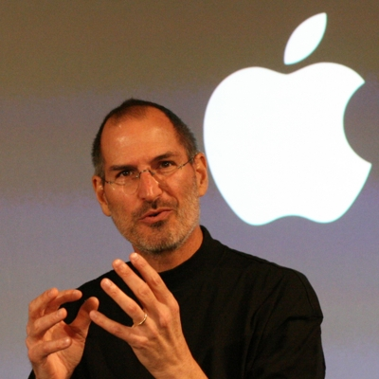
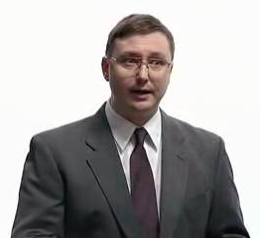
Models of Computation?

Slide 118
Models of Computation
A computational model is simply
"how a particular machine/language works"
or
"what the machine is thinking?!"
Some choice words might go here, at times.
This is the "baggage" of each foreign language...

Slide 119
Abstraction
Artists are mystics rather than rationalists. They leap to conclusions that logic cannot reach.
-- Sol LeWitt, conceptual artist
Simplicity does not precede complexity, but follows it.
-- Alan Perlis, early CS-ist.
Notes:
dealing with code in which you don’t know everything that’s going on, you need to abstract away details and keep a bigger picture in mind

Slide 120
Python syntax highlights
for homework 0
import random
assignment statements always read right-to-left and use ONE equals sign
user_choice = raw_input('Enter something: ')
every block of code must line up!!
comp_choice = random.choice( ['rock','paper','scissors'] )
comparisons use TWO equals signs
if user_choice == 'rock' and comp_choice == 'paper':
print 'You chose', user_choice
print 'I chose', comp_choice
print 'The result is',
print 'YOU LOSE!'
print 'unless you\'re a CS 5 grader,\n then YOU WIN!'
colons begin a new block!
The comma prints a space and does NOT go to the next line.
every block of code must line up!!
a backslash shows special cases or characters
flattering or flouting CS graders is encouraged!
elif test goes here:
else:
as many as you want – zero or more – all mutually exclusive
optional – NO test – still needs a colon

Slide 121
Computer Science
Information is intrinsic to every system…
How can we create with this information?
“benefit from”
Representing it...
What information will we need?
Interpreting it...
How will we know who won?
Evaluating it...
Is it as efficient as possible?
Notes:
ZACH:
fundamentally creative

Slide 122
Python's model?
How does this program execute?
import random
How many things is this line doing?
user_choice = raw_input('Enter something: ')
comp_choice = random.choice( ['rock','paper','scissors'] )
if user_choice == 'rock' and comp_choice == 'paper':
print 'You chose', user_choice
print 'I chose', comp_choice
print 'The result is',
print 'YOU LOSE!'
print 'unless you\'re a CS 5 grader,\n then YOU WIN!'
How many more if/elif/else blocks do we need?

Slide 123
Models of Computation
A computational model is simply
"how a particular machine/language works"
or
"what the machine is thinking?!"
sequential execution
variables store values
conditionals make decisions
loops loop
functions function
and so on...
GP language!

Slide 124
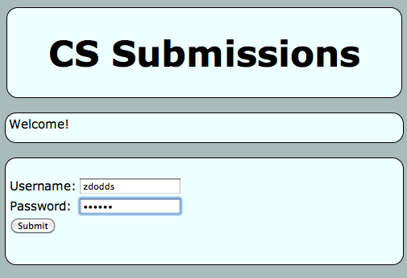
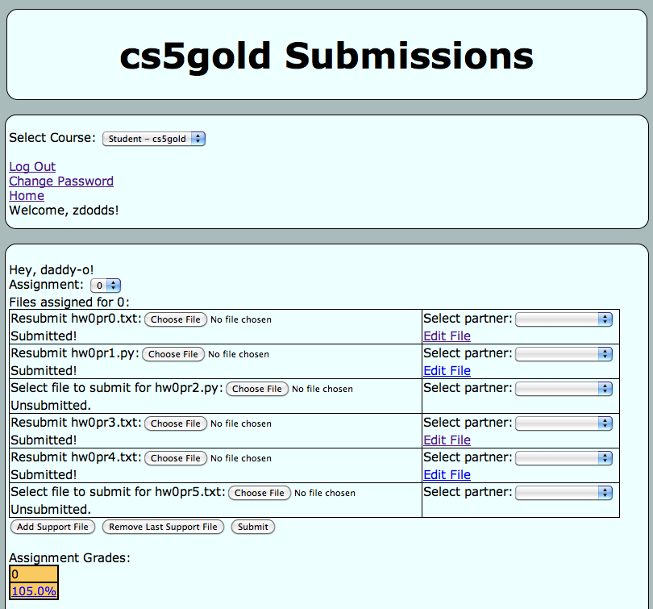
Submitting...
and transferring!
Sometimes I've needed to login twice…
One time, the browser needed to be restarted (or a different browser used)

Slide 125
Python's syntax?
(1) See if you can find and correct any errors here... !
import random
(2) This line is doing three things… what are they?
(1) prints the "weapon" prompt
(2) gets user's input from the kbd
(3) assigns that input to the variable user
assignment statements always use ONE equals sign – more on these next week
user = raw_input( 'Choose your weapon! ' )
every block of code must line up!!
comp = random.choice( ['rock','paper','scissors'] )
print '(You): user chose', user
print '(Me!): comp chose', comp
The comma prints a space and does NOT go to the next line.
comparisons use TWO equals signs
if user == 'rock' and comp == 'paper':
print 'The result is, YOU LOSE!'
print 'unless you\'re a CS 5 grader, then YOU WIN!'
a colon starts a new block
every block of code must line up!!
a backslash handles special cases or characters
flattering or flouting CS graders is encouraged!
quotes delimit text
(3) See how many different uses of punctuation you can find…

Slide 126
Language is language?
Intercal
v
>v"Hello world!"0<
,:
^_25*,@
PLEASE DO ,1 <- #13
DO ,1 SUB #1 <- #238
DO ,1 SUB #2 <- #112
DO ,1 SUB #3 <- #112
DO ,1 SUB #4 <- #0
DO ,1 SUB #5 <- #64
DO ,1 SUB #6 <- #238
DO ,1 SUB #7 <- #26
DO ,1 SUB #8 <- #248
DO ,1 SUB #9 <- #168
DO ,1 SUB #10 <- #24
DO ,1 SUB #11 <- #16
DO ,1 SUB #12 <- #158
DO ,1 SUB #13 <- #52
PLEASE READ OUT ,1
PLEASE GIVE UP
Befunge
(DEFUN HELLO-WORLD ()
(PRINT (LIST 'HELLO 'WORLD)))
LISP
Scheme
int main()
{
printf("%s\n", "Hello, world!");
}
C
C++
HAI
CAN HAS STDIO?
VISIBLE "HAI WORLD!"
KTHXBYE
LOLCODE
print 'Hello, World!'
Python
Notes:
ZACH
my foreign language teachers always tried to convince me that the skill of speaking, reading and writing a foreign language…
I didn’t believe them then and I don’t believe them now -- but I do believe that reading and writing a computer language is the way to get a strong intuitive understanding of how machines think -- it’s also important for getting them to do what you want them to, but even if you forget everything this course (hopefully) teaches about any particular language, the real goal is that you take away a deeper insight into how machines think
really no scarier than being raised to learn English, Swedish, or whatever

