Slide 1
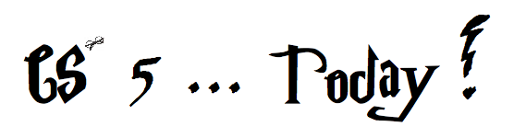


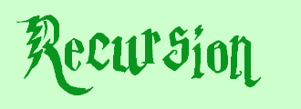


did somebody say induction?
Aye-Aye-Aye, Mateys! 9/19
a.k.a., CS's version of mathematical induction
As close as CS gets to magic
Jack Ma's Picobot "magic"
Tutoring hours: LOTS!
Hw #1 due this Monday, 9/16, at 11:59 pm
This is the last CS 5 lecture you’ll ever need!*
HMC's legal counsel requires us to include these footnotes…
On Warner Brothers' insistence, we affirm that this 'C' does not stand for 'Chamber' and 'S' does not stand for 'Secrets.'
*
Caution: do not take this statement too literally or it is possible find yourself in twice as many CS 5 lectures as you need!
Notes:
recursion -- seems like magic
Gilderoy Lockhart

Slide 2
Textbook!
Notes:
recursion -- seems like magic
Gilderoy Lockhart

Slide 3
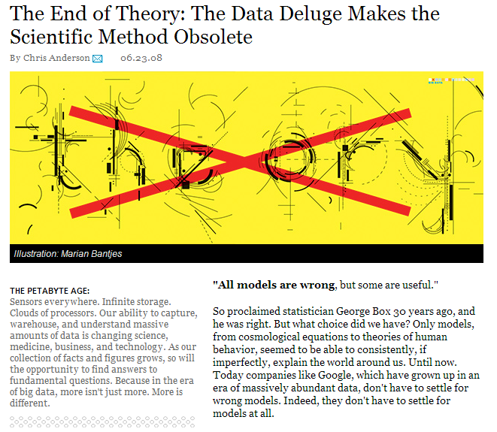
This week's reading

Slide 4
hw1
:
if you attended lab
you get credit for hw1pr1 and hw1pr2
else
:
you should complete the two lab problems, pr1 + pr2
Is this Python??
either way: complete hw1pr3

Slide 5
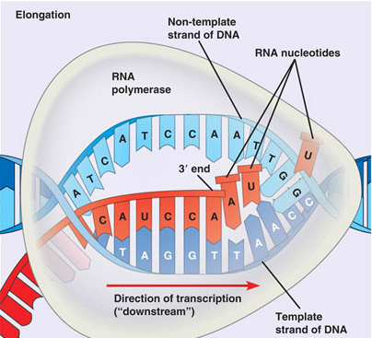
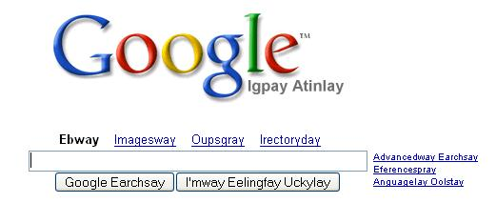
hw1
:
if you attended lab
you get credit for hw1pr1 and hw1pr2
else
:
you should complete the two lab problems, pr1 + pr2
Is this Python??
either way: complete hw1pr3
Extra Credit: Pig Latin / CodingBat
DNA transcription

Slide 6
Python is… in
I guess Python's the in thing
>>> 'i' in 'team'
False
>>> 'cs' in 'physics'
True
>>> 3*'i' in 'alien'
False
>>> 'i' in 'alien'
True
>>> 42 in [ [42], '42' ]
False
>>> 42 in [41,42,43]
True

Slide 7

Computation's Dual Identity
Computation
Data Storage
41
42
name: x
type: int
LOC: 300
name: y
type: int
LOC: 304
memory location 300
memory location 304
variables ~ boxes
Last time

Slide 8
Giving names to data
def flipside(s):
""" flipside(s): swaps s's sides!
input s: a string
"""
x = len(s)/2
return s[x:] + s[:x]
This idea is the key to your happiness!
Notes:
show help!

Slide 9

Benefits? Drawbacks?
Use variables!
def flipside(s):
x = len(s)/2
return s[x:] + s[:x]
Hey - I'm happy about this, too!
def flipside(s):
return s[len(s)/2:] + s[:len(s)/2]
Notes:
show help!

Slide 10
This program uses variables constantly!
Use variables!
def convertFromSeconds(s): # total seconds
""" convertFromSeconds(s): Converts an
integer # of seconds into a list of
[days, hours, minutes, seconds]
input s: an int
"""
seconds = s % 60 # leftover seconds
m = s / 60 # total minutes
minutes = m % 60 # leftover minutes
h = m / 60 # total hours
hours = h % 24 # leftover hours
days = h / 24 # total days
return [days, hours, minutes, seconds]
Notes:
show help!

Slide 11
How functions look…
input(s)
name
def convertFromSeconds(s): # total seconds
""" convertFromSectons(s): Converts an
integer # of seconds into a list of
[days, hours, minutes, seconds]
input s: an int
"""
seconds = s % 60 # leftover seconds
m = (s / 60) # total minutes
minutes = m % 60 # leftover minutes
h = m / 60 # total hours
hours = h % 24 # leftover hours
days = h / 24 # total days
return [days, hours, minutes, seconds]
docstring
comments –these are mostly optional in CS 5
code block
return statement
Notes:
show help!

Slide 12
Computation's Dual Identity
accessed through functions…
Computation
Data Storage
41
42
name: x
type: int
LOC: 300
name: y
type: int
LOC: 304
memory location 300
memory location 304
variables ~ boxes
This time

Slide 13
Functioning across disciplines
procedure
structure
def g(x):
return x**100
g(x) = x¹⁰⁰
CS's googler
Math's googler
defined by what it does
defined by what it is
+ how efficiently
Notes:
my foreign language teachers always tried to convince me that the skill of speaking, reading and writing a foreign language…
I didn’t believe them then and I don’t believe them now -- but I do believe that reading and writing a computer language is the way to get a strong intuitive understanding of how machines think -- it’s also important for getting them to do what you want them to, but even if you forget everything this course (hopefully) teaches about Java (compiler, datatypes, Classes and Objects), the real goal is that you take away a deeper insight into how machines think
familiar and sometimes not so familiar… deceptively easy
you mean I have to type all that!!

Slide 14
Quiz
First and last name(s):
-4
What is demo(-4) ?
def demo(x):
return x + f(x)
def f(x):
return 11*g(x) + g(x/2)
def g(x):
return -1 * x
I might have a guess…
How functions work…
Notes:
vault 713?

Slide 15
How functions work…
def demo(x):
return x + f(x)
demo
x = -4
return -4 + f(-4)
def f(x):
return 11*g(x) + g(x/2)
def g(x):
return -1 * x
>>> demo(-4) ?
Notes:
vault 713?

Slide 16
How functions work…
def demo(x):
return x + f(x)
demo
x = -4
return -4 + f(-4)
def f(x):
return 11*g(x) + g(x/2)
f
def g(x):
return -1 * x
x = -4
return 11*g(x) + g(x/2)
>>> demo(-4) ?
Notes:
vault 713?

Slide 17
How functions work…
def demo(x):
return x + f(x)
demo
x = -4
return -4 + f(-4)
def f(x):
return 11*g(x) + g(x/2)
f
def g(x):
return -1 * x
x = -4
return 11*g(x) + g(x/2)
These are different xs !
>>> demo(-4) ?
Notes:
vault 713?

Slide 18
How functions work…
def demo(x):
return x + f(x)
demo
x = -4
return -4 + f(-4)
def f(x):
return 11*g(x) + g(x/2)
f
def g(x):
return -1 * x
x = -4
return 11*g(-4) + g(-4/2)
g
x = -4
>>> demo(-4) ?
return -1.0 * x
Notes:
vault 713?

Slide 19
How functions work…
def demo(x):
return x + f(x)
demo
x = -4
return -4 + f(-4)
def f(x):
return 11*g(x) + g(x/2)
f
def g(x):
return -1 * x
x = -4
return 11* 4 + g(-4/2)
g
x = -4
>>> demo(-4) ?
return -1 * -4
4
Notes:
vault 713?

Slide 20
How functions work…
def demo(x):
return x + f(x)
demo
x = -4
return -4 + f(-4)
def f(x):
return 11*g(x) + g(x/2)
f
def g(x):
return -1 * x
x = -4
return 11* 4 + g(-4/2)
>>> demo(-4) ?
Notes:
vault 713?

Slide 21
How functions work…
def demo(x):
return x + f(x)
demo
x = -4
return -4 + f(-4)
def f(x):
return 11*g(x) + g(x/2)
f
def g(x):
return -1 * x
x = -4
return 11* 4 + g(-4/2)
g
x = -2
>>> demo(-4) ?
return -1 * -2
2
These are really different xs !
Notes:
vault 713?

Slide 22
How functions work…
def demo(x):
return x + f(x)
demo
x = -4
return -4 + f(-4)
def f(x):
return 11*g(x) + g(x/2)
f
def g(x):
return -1 * x
x = -4
return 11* 4 + 2
>>> demo(-4) ?
Notes:
vault 713?

Slide 23
How functions work…
def demo(x):
return x + f(x)
demo
x = -4
return -4 + f(-4)
def f(x):
return 11*g(x) + g(x/2)
f
def g(x):
return -1 * x
x = -4
return 11* 4 + 2
46
>>> demo(-4) ?
Notes:
vault 713?

Slide 24
How functions work…
def demo(x):
return x + f(x)
demo
x = -4
return -4 + 46
def f(x):
return 11*g(x) + g(x/2)
def g(x):
return -1 * x
>>> demo(-4)
42
42
Notes:
vault 713?

Slide 25

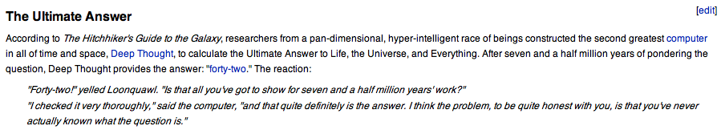
Douglas Adams's 42
Those zero-eyed aliens are a bit much…
answer: 42 question: unknown
Notes:
ZACH
show python in console

Slide 26
Function stacking
def demo(x):
return x + f(x)
demo
x = -4
return -4 + f(-4)
the stack
def f(x):
return 11*g(x) + g(x/2)
f
def g(x):
return -1 * x
x = -4
return 11* 4 + g(-4/2)
g
x = -2
return -1 * -2
2
Notes:
vault 713?

Slide 27
Function stacking
def demo(x):
return x + f(x)
demo
x = -4
return -4 + f(-4)
the stack
def f(x):
return 11*g(x) + g(x/2)
f
def g(x):
return -1 * x
x = -4
return 11* 4 + g(-4/2)
"The stack"
g
x = -2
is a memory area that
return -1 * -2
2
(1) keeps separate variables for each function call…
(2) remembers where to send results back to…
Notes:
vault 713?

Slide 28
return != print
def dbl(x):
""" dbls x? """
return 2*x
def dblPR(x):
""" dbls x? """
print 2*x
>>> ans = dbl(21)
>>> ans = dblPR(21)

Slide 29
return != print
def dbl(x):
""" dbls x? """
return 2*x
def dblPR(x):
""" dbls x? """
print 2*x
>>> ans = dbl(21)
>>> ans = dblPR(21)
print just prints stuff to the screen...
return yields the function call's value …
… which the shell will print!

Slide 30
Function design
Notes:
vault 713?

Slide 31
Thinking sequentially
factorial
5 ! = 120
5 ! = 5 * 4 * 3 * 2 * 1
N ! = N * (N-1) * (N-2) * … * 3 * 2 * 1

Slide 32
Thinking sequentially
factorial
5 ! = 120
5 ! = 5 * 4 * 3 * 2 * 1
October + beyond…
N ! = N * (N-1) * (N-2) * … * 3 * 2 * 1

Slide 33
Thinking recursively
factorial
Recursion == self-reference!
5 ! = 120
5 ! = 5 * 4 * 3 * 2 * 1
5 ! =
N ! = N * (N-1) * (N-2) * … * 3 * 2 * 1
N ! =

Slide 34
Warning: this is legal!
def fac(N):
return N * fac(N-1)
I wonder how this code will STACK up!?
Notes:
Was that Gandalf or Dumbledore that "fell forever" ?

Slide 35
but, legal != recommended
def fac(N):
return N * fac(N-1)
The calls to fac will never stop: there's no BASE CASE!
Make sure you have a base case, then worry about the recursion...

Slide 36

def fac(N):
return fac(N)
Human languages have the same pitfalls!
Roadsigns and recursion
examples of self-fulfilling danger

Slide 37

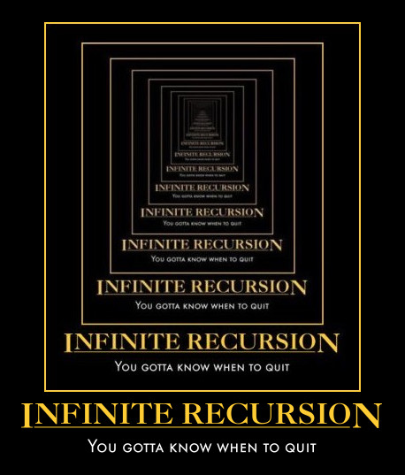
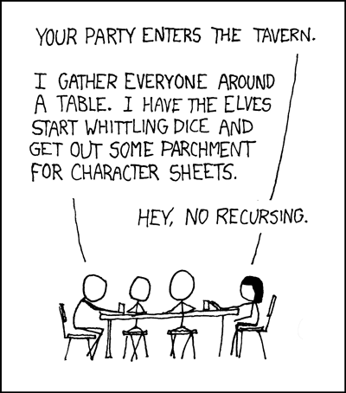
Recursion's advantage:
It handles arbitrary structural depth – all at once!
Notes:
I don’t know if this really works...

Slide 38
Thinking recursively
def fac(N):
if N <= 1:
return 1
Base case

Slide 39
Thinking recursively
def fac(N):
if N <= 1:
return 1
else:
rest = fac(N-1)
return rest * N
Base case
Recursive case
Human: Base case and 1 step
Computer: Everything else

Slide 40
Thinking recursively
def fac(N):
if N <= 1:
return 1
else:
return N*fac(N-1)
Base case
Recursive case (shorter)
Human: Base case and 1 step
Computer: Everything else

Slide 41
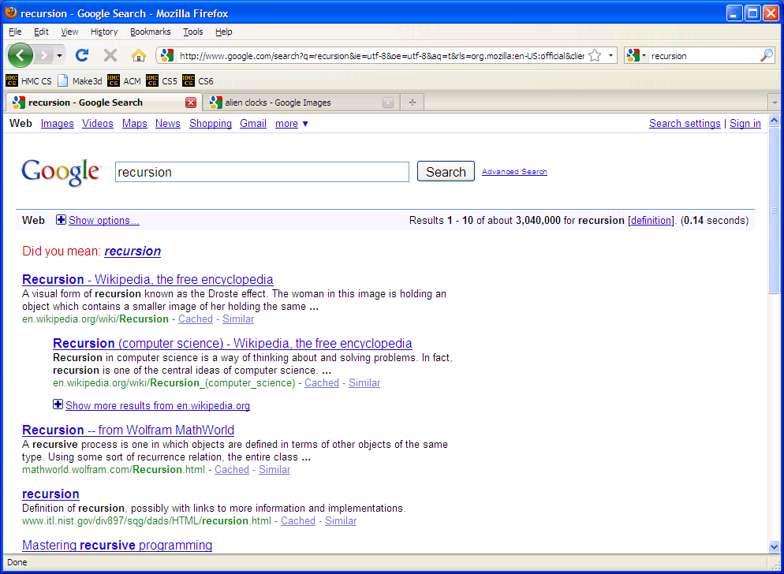

Slide 42
def fac(N):
if N <= 1:
return 1
else:
return N * fac(N-1)
Behind the curtain…
fac(5)

Slide 43
def fac(N):
if N <= 1:
return 1
else:
return N * fac(N-1)
Behind the curtain…
fac(5)
5 * fac(4)

Slide 44
def fac(N):
if N <= 1:
return 1
else:
return N * fac(N-1)
Behind the curtain…
fac(5)
5 * fac(4)
4 * fac(3)

Slide 45
def fac(N):
if N <= 1:
return 1
else:
return N * fac(N-1)
Behind the curtain…
fac(5)
5 * fac(4)
4 * fac(3)
3 * fac(2)

Slide 46
def fac(N):
if N <= 1:
return 1
else:
return N * fac(N-1)
Behind the curtain…
fac(5)
5 * fac(4)
4 * fac(3)
3 * fac(2)
2 * fac(1)

Slide 47
def fac(N):
if N <= 1:
return 1
else:
return N * fac(N-1)
Behind the curtain…
fac(5)
"The Stack"
5 * fac(4)
4 * fac(3)
3 * fac(2)
Remembers all of the individual calls to fac
2 * fac(1)
1

Slide 48
def fac(N):
if N <= 1:
return 1
else:
return N * fac(N-1)
Behind the curtain…
fac(5)
5 * fac(4)
4 * fac(3)
3 * fac(2)
2 * 1

Slide 49
def fac(N):
if N <= 1:
return 1
else:
return N * fac(N-1)
Behind the curtain…
fac(5)
5 * fac(4)
4 * fac(3)
3 * 2

Slide 50
def fac(N):
if N <= 1:
return 1
else:
return N * fac(N-1)
Behind the curtain…
fac(5)
5 * fac(4)
4 * 6

Slide 51
def fac(N):
if N <= 1:
return 1
else:
return N * fac(N-1)
Behind the curtain…
fac(5)
5 * 24

Slide 52
def fac(N):
if N <= 1:
return 1
else:
return N * fac(N-1)
Behind the curtain…
fac(5)
Result: 120
show facWPR …
and the online function tracing tool !!
0 x*** -> N 0
0 N*** -> X 1
Recursive step
Look familiar?
Base case

Slide 53
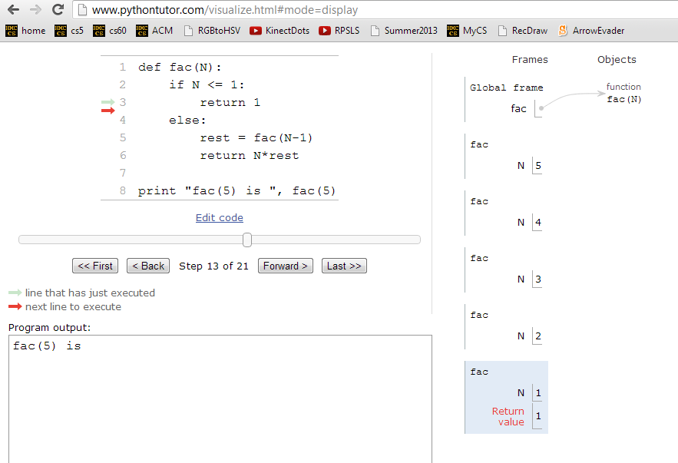
Behind the curtain…
http://www.pythontutor.com/visualize.html

Slide 54
Let recursion do the work for you.
Exploit self-similarity
Less work !
Produce short, elegant code

Slide 55
Let recursion do the work for you.
Exploit self-similarity
Less work !
Produce short, elegant code
You handle the base case – the easiest case!
def fac(N):
if N <= 1:
return 1
else:
rest = fac(N-1)
return rest * N
Recursion does almost all of the rest of the problem!
You specify one step at the end

Slide 56
But you do need to do one step yourself…
def fac(N):
if N <= 1:
return 1
else:
return fac(N)
This will not work !

Slide 57
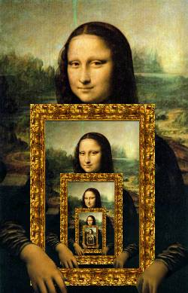

Recursion's Big Picture?
Need to see BOTH the self-similar piece AND the whole simultaneously!

Slide 58
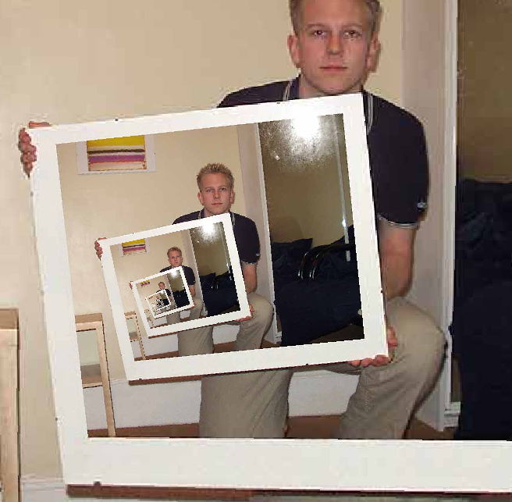
The dizzying dangers of having no base case!
Notes:
I don’t know if this really works...

Slide 59
One step?
…is easy to do with Python
s = 'aliens'
s[0]
How do we get at the initial character of s?
How do we get at ALL THE REST of s?
L = [ 42, 21 ]
How do we get at the initial element of L?
How do we get at ALL the REST of L?

Slide 60
Recursive design #1
'cs5'
def mylen(s):
""" input: any string, s
output: the number of characters in s
"""
if :
else:
base case test!

Slide 61
with lots of variables…
def mylen(s):
""" input: any string, s
output: the number of characters in s
"""
if s == '':
return 0
else:
rest = s[1:]
len_of_rest = mylen( rest )
total_len = 1 + len_of_rest
return total_len

Slide 62
def mylen(s):
""" input: any string, s
output: the number of characters in s
"""
if s == '':
return 0
else:
rest = s[1:]
len_of_rest = mylen( rest )
return 1 + len_of_rest

Slide 63
def mylen(s):
""" input: any string, s
output: the number of characters in s
"""
if s == '':
return 0
else:
rest = s[1:]
return 1 + mylen( rest )

Slide 64
Or terse.
def mylen(s):
""" input: any string, s
output: the number of characters in s
"""
if s == '':
return 0
else:
return 1 + mylen(s[1:])
There's not much len left here!

Slide 65
def mylen(s):
if s == '':
return 0
else:
return 1 + mylen(s[1:])
Behind the curtain:
how recursion works...
mylen('cs5')

Slide 66
Design #2
[1,4,3,42, 7,-100]
def mymax(L):
""" input: a NONEMPTY list, L
output: L's maximum element
"""
if :
elif :
else:
len(L)==1
base case test!
another case…

Slide 67
Design #2
def mymax(L):
""" input: a NONEMPTY list, L
output: L's maximum element
"""
if len(L) == 1:
return L[0]
elif L[0] < L[1]:
return mymax( L[1:] )
else:
return mymax( L[0:1] + L[2:] )
Hey - do I get a slice?!

Slide 68
mymax( [1,4,3,42, 7,-100] )

Slide 69

power(2,5) == 32.0
Try it!
sajak('wheel of fortune') == 6
5
4
2
==
2*
2
What about y? You decide…
def power(b,p):
def sajak(s):
""" returns b to the p power
Use recursion, not **
Inputs: int b, int p:
the base and the power
"""
""" returns the number of vowels
in the input string, s
"""
if :
Base case test
p == 0
if :
Base case test
return
return
elif
return
else:
else:
return
return
Want more power?
Handle negative values of p, too.
Want more Pat?
What 7-letter English word w maximizes sajak(w) ?
For example, power(5,-1) == 0.2

Slide 70
def power(b,p):
""" inputs: base b and power p (an int)
implements: b**p
"""
if p == 0:
return
elif p < 0:
return
else: # p > 0
return
Recursion is power!

Slide 71
sajak(s):
D
E
S
I
G
N
When there are no letters, there are ZERO vowels
Base case?
Rec. step?
Look at the initial character.
if s[0] is NOT a vowel, the answer is ...
if s[0] is a vowel, the answer is ...

Slide 72
def sajak(s):
if s == '':
return 0
elif s[0]=='a' or s[0]=='e' or…
Base Case
Checking for a vowel: Try #1

Slide 73
Python is… in
I guess Python's the in thing
>>> 'i' in 'team'
False
>>> 'cs' in 'physics'
True
>>> 3*'i' in 'alien'
False
>>> 'i' in 'alien'
True
>>> 42 in [ [42], '42' ]
False
>>> 42 in [41,42,43]
True

Slide 74
if s[0] IS a vowel, the answer is
1 + the # of vowels in the rest of s
def sajak(s):
if len(s) == 0:
return 0
elif s[0] in 'aeiou':
return 1 + sajak(s[1:])
else:
return
Base Case
Recursive Cases
if s[0] is NOT a vowel, the answer is just
the number of vowels in the rest of s

Slide 75
The key to understanding recursion is, first, to understand recursion.
- a prior CS 5 student
Good luck with Homework #1
tutors @ LAC F/Sa/Su
office hrs. Friday aft.: LAC Labs

Slide 76
def sajak(s):
if len(s) == 0:
return 0
elif s[0] in 'aeiou':
return 1 + sajak(s[1:])
else:
return sajak(s[1:])
Base Case
Rec. Steps
if it is NOT a vowel, the answer is just the number of vowels in the rest of s
if it IS a vowel, the answer is 1 + the number of vowels in the rest of s

Slide 77
behind the curtain
sajak('eerier')

Slide 78
behind the curtain
power(2,3)

Slide 79
def sajak(s):
when there are no letters, there are ZERO vowels
Base case?
Look at the initial character.
if s[0] is NOT a vowel, the answer is just the
number of vowels in the rest of s
Rec. step?
if s[0] is a vowel, the answer is
1 + the number of vowels in the rest of s

Slide 80

Recursion: not just numbers
Self-similarity elsewhere...
Natural phenomena
Relationships
how much here is leaf vs. stem?
What is an “ancestor” ?
Names / Acronyms
TTP == “The TTP Project”

Slide 81
Recursion: not just numbers
Self-similarity elsewhere...
Natural phenomena
Relationships
What is an “ancestor” ?
An ancestor is a parent OR an ancestor of a parent…
Names / Acronyms
TTP == “The TTP Project”
all stem!

Slide 82


This week's reading: the $10⁶ problem
Vinay Deolalikar, HP Labs
polynomially-checkable problems
polynomially-solvable problems
P vs. NP
factoring N-digit numbers?

Slide 84
Recursion Examples
def mylen(s):
""" input: any string, s
output: the number of characters in s
"""
if :
else:
base case test!

Slide 85
Recursion Examples
def mymax(L):
""" input: a NONEMPTY list, L
output: L's maximum element
"""
if :
elif :
else:
base case test!
another case…

Slide 86
Try it!
Do not hand this one in…
def power(b,p):
def sajak(s):
""" returns b to the p power
using recursion, not **
inputs: int b, int p
output: a float
"""
""" returns the number of vowels
in the input string, s
"""
if :
if :
Base case test
Base case test
elif
else:
power(5,2) == 25.0
sajak('wheel of fortune') == 6
What about y? You decide…
Want more power?
Handle negative values of p, as well.
What seven-letter English word w maximizes sajak(w) ?
For example, power(5,-1) == 0.2 (or so)
Want more Pat?

Slide 87
Recursion is the root of all computation since it trades description for time.
- Alan Perlis
Recursion is the secret to all happiness in writing short, powerful functional programs!

Slide 88
while we're here…
import random
comp = random.choice( range(0,100) )
while True:
user = input('Your choice: ')
print user, '?'
if user == comp:
print 'Yes!'
break
else:
print 'No...'

Slide 89
"Quiz" on recursion
Names:
def sajak(s):
def power(b,p):
""" returns the number of vowels
in the input string, s
"""
""" returns b to the p power
using recursion and not **
inputs: b and p are ints
output: should be a float
"""
sajak('wheel of fortune') == 6
power(5,2) == 25.0
What about y? You decide…
What five-letter English word w maximizes sajak(w) ?
Want more power?
Handle negative values of p, as well.
Want more Pat?
For example, power(5,-1) == 0.2 (or so)

Slide 90
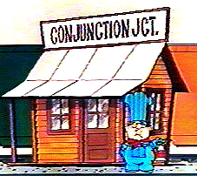
def sajak(s):
if s == '':
return 0
else:
Base Case
Checking for a vowel: Try #1
and
or
same as in English!
but each side has to be a complete boolean value!
not

Slide 91
def sajak(s):
if len(s) == 0:
return 0
else:
Base Case
if s[0] == 'a' or s[0] == 'e' or…
Checking for a vowel: Try #1
and
or
same as in English!
but each side has to be a complete boolean value!
not

Slide 92
def sajak(s):
if len(s) == 0:
return 0
else:
Base Case
Checking for a vowel: Try #2
in

