Slide 1
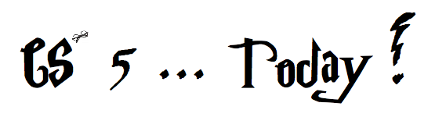




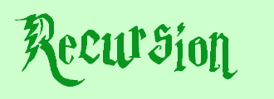


did somebody say induction?
Jack Ma's Picobot "magic"
a.k.a., CS's version of mathematical induction
Aye-Aye-Aye, Mateys! 9/19
As close as CS gets to magic
Tutoring hours: LOTS!
Hw #1 due this Monday, 9/15, at 11:59 pm
This is the last CS 5 lecture you’ll ever need!*
HMC's legal counsel requires us to include these footnotes…
On Warner Brothers' insistence, we affirm that this 'C' does not stand for 'Chamber' and 'S' does not stand for 'Secrets.'
*
Caution: do not take this statement too literally or it is possible find yourself in twice as many CS 5 lectures as you need!
Notes:
recursion -- seems like magic
Gilderoy Lockhart

Slide 2

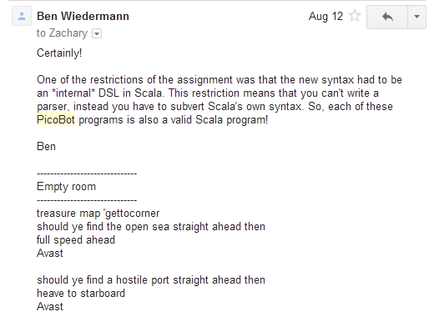
Pirate Picobot!
if open, go forth!
if blocked, go right!
this is a runnable program

Slide 3
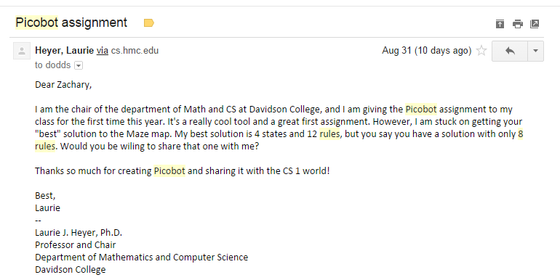
Picobot rules!
Eight rules?!
it's twice as slow!

Slide 4
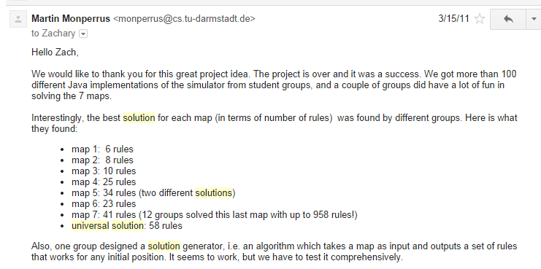
Picobot, Aargh!
show Porter's rules for this one!!
+ "universal" solution…

Slide 5
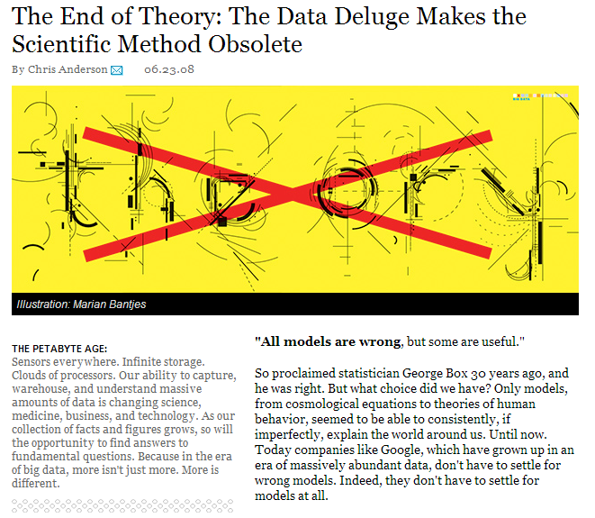
This week's reading on data…

Slide 6
hw1
:
if you attended lab
you get credit for hw1pr1 and hw1pr2
else
:
you should complete the two lab problems, pr1 + pr2
Is this Python??
either way: submit pr1 + pr2
complete and submit hw1pr3

Slide 7
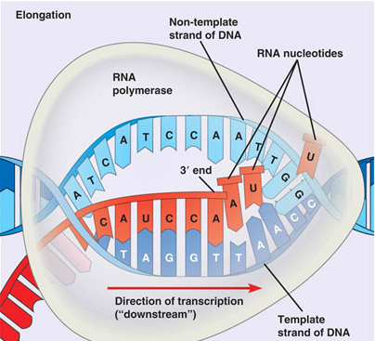
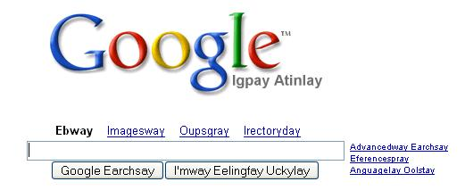
hw1
:
if you attended lab
you get credit for hw1pr1 and hw1pr2
else
:
you should complete the two lab problems, pr1 + pr2
Is this Python??
either way: submit pr1 + pr2
complete and submit hw1pr3
Extra Credit: Pig Latin / CodingBat
DNA transcription

Slide 8
Python is… in
I guess Python's the in thing
>>> 'i' in 'team'
False
>>> 'cs' in 'physics'
True
>>> 'i' in 'alien'
True
>>> 3*'i' in 'alien'
False
>>> 42 in [41,42,43]
True
>>> 42 in [[42], '42']
False

Slide 9

Computation's Dual Identity
Computation
Data Storage
41
42
name: x
type: int
LOC: 300
name: y
type: int
LOC: 304
memory location 300
memory location 304
variables ~ boxes
Last time

Slide 10
Giving names to data
def flipside(s):
""" flipside(s): swaps s's sides!
input s: a string
"""
x = len(s)/2
return s[x:] + s[:x]
This idea is the key to your happiness!
Notes:
show help!

Slide 11

Use variables!
Hey - I'm happy about this, too!
def flipside(s):
x = len(s)/2
return s[x:] + s[:x]
def flipside(s):
return s[len(s)/2:] + s[:len(s)/2]
Why would computers "prefer" the top version, too?
Notes:
show help!

Slide 12
This program uses variables constantly!
Use variables!
def convertFromSeconds(s): # total seconds
""" convertFromSeconds(s): Converts an
integer # of seconds into a list of
[days, hours, minutes, seconds]
input s: an int
"""
seconds = s % 60 # leftover seconds
m = s / 60 # total minutes
minutes = m % 60 # leftover minutes
h = m / 60 # total hours
hours = h % 24 # leftover hours
days = h / 24 # total days
return [days, hours, minutes, seconds]
Notes:
show help!

Slide 13
How functions look…
input(s)
name
def convertFromSeconds(s): # total seconds
""" convertFromSectons(s): Converts an
integer # of seconds into a list of
[days, hours, minutes, seconds]
input s: an int
"""
seconds = s % 60 # leftover seconds
m = (s / 60) # total minutes
minutes = m % 60 # leftover minutes
h = m / 60 # total hours
hours = h % 24 # leftover hours
days = h / 24 # total days
return [days, hours, minutes, seconds]
docstring
comments –these are mostly optional in CS 5
code block
return statement
Notes:
show help!

Slide 14
Computation's Dual Identity
accessed through functions…
Computation
Data Storage
41
42
name: x
type: int
LOC: 300
name: y
type: int
LOC: 304
Functions!
memory location 300
memory location 304
variables ~ boxes
It's no coincidence this starts with fun!

Slide 15
Functioning across disciplines
procedure
structure
def g(x):
return x**100
g(x) = x¹⁰⁰
CS's googolizer
Math's googolizer
defined by what it does
defined by what it is
+ how efficiently it works
Notes:
my foreign language teachers always tried to convince me that the skill of speaking, reading and writing a foreign language…
I didn’t believe them then and I don’t believe them now -- but I do believe that reading and writing a computer language is the way to get a strong intuitive understanding of how machines think -- it’s also important for getting them to do what you want them to, but even if you forget everything this course (hopefully) teaches about Java (compiler, datatypes, Classes and Objects), the real goal is that you take away a deeper insight into how machines think
familiar and sometimes not so familiar… deceptively easy
you mean I have to type all that!!

Slide 16
Quiz
First and last name(s):
-4
What is demo(-4) ?
def demo(x):
return x + f(x)
def f(x):
return 11*g(x) + g(x/2)
def g(x):
return -1 * x
I might have a guess…
How functions work…
Notes:
vault 713?

Slide 17
How functions work…
def demo(x):
return x + f(x)
demo
stack frame
x = -4
return -4 + f(-4)
def f(x):
return 11*g(x) + g(x/2)
def g(x):
return -1 * x
Hey! This must be a stack-frame frame!
>>> demo(-4) ?
Notes:
vault 713?

Slide 18
How functions work…
def demo(x):
return x + f(x)
demo
stack frame
x = -4
return -4 + f(-4)
def f(x):
return 11*g(x) + g(x/2)
f
stack frame
def g(x):
return -1 * x
x = -4
return 11*g(x) + g(x/2)
>>> demo(-4) ?
Notes:
vault 713?

Slide 19
How functions work…
def demo(x):
return x + f(x)
demo
stack frame
x = -4
return -4 + f(-4)
def f(x):
return 11*g(x) + g(x/2)
f
stack frame
def g(x):
return -1 * x
x = -4
return 11*g(x) + g(x/2)
These are distinct memory locations both holding x's.
>>> demo(-4) ?
Notes:
vault 713?

Slide 20
How functions work…
def demo(x):
return x + f(x)
demo
stack frame
x = -4
return -4 + f(-4)
def f(x):
return 11*g(x) + g(x/2)
f
stack frame
def g(x):
return -1 * x
x = -4
return 11*g(-4) + g(-4/2)
g
stack frame
x = -4
>>> demo(-4) ?
return -1.0 * x
Notes:
vault 713?

Slide 21
How functions work…
def demo(x):
return x + f(x)
demo
x = -4
return -4 + f(-4)
def f(x):
return 11*g(x) + g(x/2)
f
def g(x):
return -1 * x
x = -4
return 11* 4 + g(-4/2)
g
x = -4
>>> demo(-4) ?
return -1 * -4
4
Notes:
vault 713?

Slide 22
How functions work…
def demo(x):
return x + f(x)
demo
x = -4
return -4 + f(-4)
def f(x):
return 11*g(x) + g(x/2)
f
def g(x):
return -1 * x
x = -4
return 11* 4 + g(-4/2)
>>> demo(-4) ?
Notes:
vault 713?

Slide 23
How functions work…
def demo(x):
return x + f(x)
demo
x = -4
return -4 + f(-4)
def f(x):
return 11*g(x) + g(x/2)
f
def g(x):
return -1 * x
x = -4
return 11* 4 + g(-4/2)
g
x = -2
>>> demo(-4) ?
return -1 * -2
2
These are distinct memory locations both holding x's – and now they also have different values!!
Notes:
vault 713?

Slide 24
How functions work…
def demo(x):
return x + f(x)
demo
x = -4
return -4 + f(-4)
def f(x):
return 11*g(x) + g(x/2)
f
def g(x):
return -1 * x
x = -4
return 11* 4 + 2
>>> demo(-4) ?
Notes:
vault 713?

Slide 25
How functions work…
def demo(x):
return x + f(x)
demo
x = -4
return -4 + f(-4)
def f(x):
return 11*g(x) + g(x/2)
f
def g(x):
return -1 * x
x = -4
return 11* 4 + 2
46
>>> demo(-4) ?
Notes:
vault 713?

Slide 26
How functions work…
def demo(x):
return x + f(x)
demo
x = -4
return -4 + 46
def f(x):
return 11*g(x) + g(x/2)
def g(x):
return -1 * x
>>> demo(-4)
42
42
Notes:
vault 713?

Slide 27
Function stacking
def demo(x):
return x + f(x)
demo
stack frame
x = -4
return -4 + f(-4)
the stack
def f(x):
return 11*g(x) + g(x/2)
f
def g(x):
return -1 * x
x = -4
return 11* 4 + g(-4/2)
g
x = -2
return -1 * -2
2
Notes:
vault 713?

Slide 28
Function stacking
def demo(x):
return x + f(x)
demo
stack frame
x = -4
return -4 + f(-4)
the stack
def f(x):
return 11*g(x) + g(x/2)
f
def g(x):
return -1 * x
x = -4
return 11* 4 + g(-4/2)
"The stack"
g
x = -2
is a memory area that
return -1 * -2
2
(1) keeps separate variables for each function call…
(2) remembers where to send results back to…
Notes:
vault 713?

Slide 29
return != print
def dbl(x):
""" dbls x? """
return 2*x
def dblPR(x):
""" dbls x? """
print 2*x
>>> ans = dbl(21)
>>> ans = dblPR(21)

Slide 30
return != print
def dbl(x):
""" dbls x? """
return 2*x
def dblPR(x):
""" dbls x? """
print 2*x
>>> ans = dbl(21)
>>> ans = dblPR(21)
print just prints stuff to the screen...
… which the shell then prints!
return yields the function call's value …

Slide 31
Function design
Notes:
vault 713?

Slide 32
Thinking sequentially
factorial
5 ! = 120
5 ! = 5 * 4 * 3 * 2 * 1
N ! = N * (N-1) * (N-2) * … * 3 * 2 * 1

Slide 33
Thinking sequentially
factorial
5 ! = 120
5 ! = 5 * 4 * 3 * 2 * 1
October + beyond…
N ! = N * (N-1) * (N-2) * … * 3 * 2 * 1

Slide 34
Thinking recursively
factorial
Recursion == self-reference!
5 ! = 120
5 ! = 5 * 4 * 3 * 2 * 1
5 ! =
N ! = N * (N-1) * (N-2) * … * 3 * 2 * 1
N ! =

Slide 35
Warning: this is legal!
def fac(N):
return N * fac(N-1)
I wonder how this code will STACK up!?
Notes:
Was that Gandalf or Dumbledore that "fell forever" ?

Slide 36
legal != recommended
def fac(N):
return N * fac(N-1)
The calls to fac will never stop: there's no BASE CASE!
Make sure you have a base case, then worry about the recursion...

Slide 37

This runs ~ but does not help!
def fac(N):
return fac(N)
Roadsigns and recursion
examples of self-fulfilling danger

Slide 38

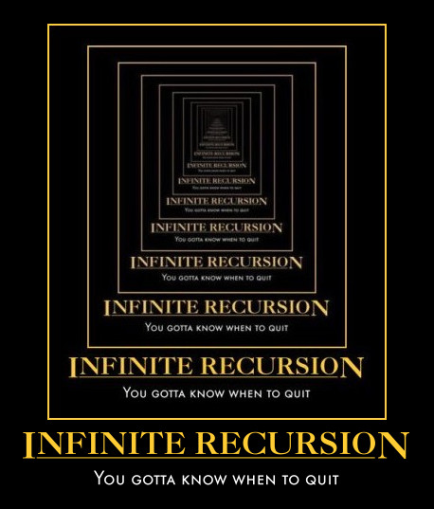
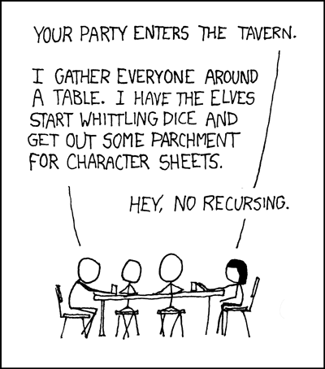
Recursion's advantage:
It handles arbitrary structural depth – all at once!
As a hat, I'm recursive, too!
Notes:
I don’t know if this really works...

Slide 39
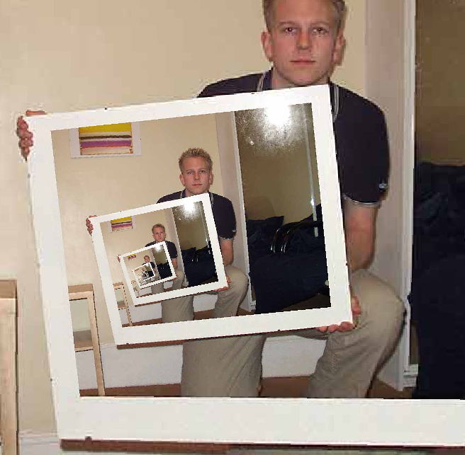
The dizzying dangers of having no base case!
Notes:
I don’t know if this really works...

Slide 40
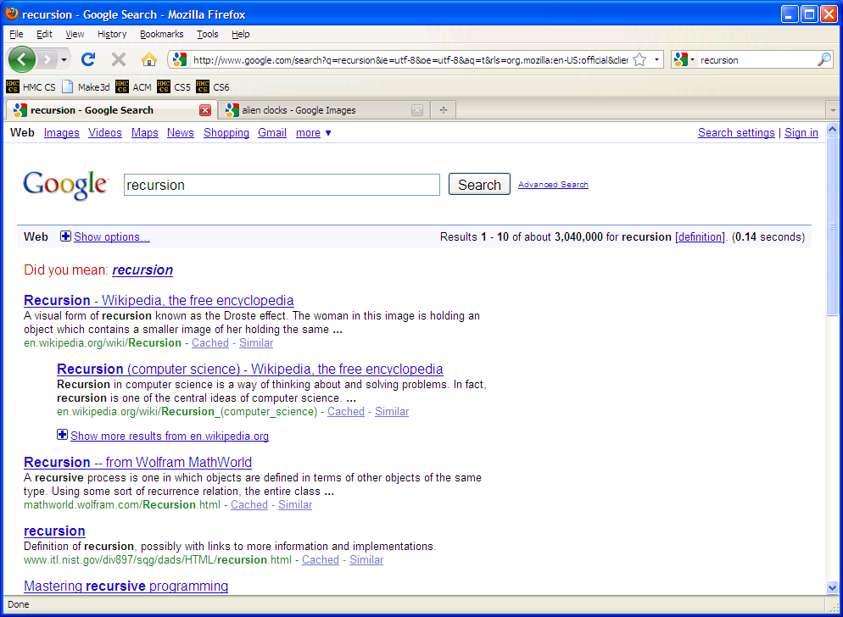

Slide 41
Thinking recursively
def fac(N):
if N <= 1:
return 1
Base case

Slide 42
Thinking recursively
def fac(N):
if N <= 1:
return 1
Base case
"How could I use the factorial of anything smaller than N?" Then do!
Ask yourself:

Slide 43
Thinking recursively
def fac(N):
if N <= 1:
return 1
else:
return N*fac(N-1)
Base case
Recursive case (shorter)
Human: Base case and 1 step
Computer: Everything else

Slide 44
Thinking recursively
def fac(N):
if N <= 1:
return 1
else:
rest = fac(N-1)
return rest * N
Base case
Recursive case
(clearer, for some)
Human: Base case and 1 step
Computer: Everything else

Slide 45
def fac(N):
if N <= 1:
return 1
else:
return N * fac(N-1)
Behind the curtain…
fac(5)

Slide 46
def fac(N):
if N <= 1:
return 1
else:
return N * fac(N-1)
Behind the curtain…
fac(5)
5 * fac(4)

Slide 47
def fac(N):
if N <= 1:
return 1
else:
return N * fac(N-1)
Behind the curtain…
fac(5)
5 * fac(4)
4 * fac(3)
5 *
Operation waiting …

Slide 48
def fac(N):
if N <= 1:
return 1
else:
return N * fac(N-1)
Behind the curtain…
fac(5)
5 * fac(4)
4 * fac(3)
5 *
5 * 4 *
3 * fac(2)
More operations waiting…

Slide 49
def fac(N):
if N <= 1:
return 1
else:
return N * fac(N-1)
Behind the curtain…
fac(5)
5 * fac(4)
4 * fac(3)
5 *
5 * 4 *
3 * fac(2)
5 * 4 * 3 *
2 * fac(1)

Slide 50
def fac(N):
if N <= 1:
return 1
else:
return N * fac(N-1)
Behind the curtain…
fac(5)
N=5
"The Stack"
5 * fac(4)
N=4
4 * fac(3)
5 *
N=3
5 * 4 *
3 * fac(2)
N=2
Remembers all of the individual calls to fac
5 * 4 * 3 *
2 * fac(1)
N=1
5 different N's are living in memory…
5 * 4 * 3 * 2 *
1

Slide 51
def fac(N):
if N <= 1:
return 1
else:
return N * fac(N-1)
Behind the curtain…
fac(5)
5 * fac(4)
4 * fac(3)
5 *
5 * 4 *
3 * fac(2)
5 * 4 * 3 *
2 * 1

Slide 52
def fac(N):
if N <= 1:
return 1
else:
return N * fac(N-1)
Behind the curtain…
fac(5)
5 * fac(4)
4 * fac(3)
5 *
5 * 4 *
3 * 2

Slide 53
def fac(N):
if N <= 1:
return 1
else:
return N * fac(N-1)
Behind the curtain…
fac(5)
5 * fac(4)
4 * 6
5 *

Slide 54
def fac(N):
if N <= 1:
return 1
else:
return N * fac(N-1)
Behind the curtain…
fac(5)
5 * 24

Slide 55
def fac(N):
if N <= 1:
return 1
else:
return N * fac(N-1)
Behind the curtain…
fac(5)
Result: 120
show facWPR …
0 x*** -> N 0
0 N*** -> X 1
Recursive step
Look familiar?
Base case

Slide 56
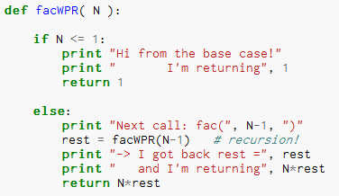
Thinking recursively…
What will print when facWPR(5) is called?

Slide 57
Let recursion do the work for you.
Exploit self-similarity
Less work !
Produce short, elegant code
You handle the base case – the easiest case!
def fac(N):
if N <= 1:
return 1
else:
rest = fac(N-1)
return rest * N
Recursion does almost all of the rest of the problem!
You specify one step at the end

Slide 58
But you do need to do one step yourself…
def fac(N):
if N <= 1:
return 1
else:
return fac(N)
This will not work !

Slide 59

Recursion's challenge?
You need to see BOTH the self-similar pieces AND the whole thing simultaneously!
Nature prefers recursion, too!

Slide 60
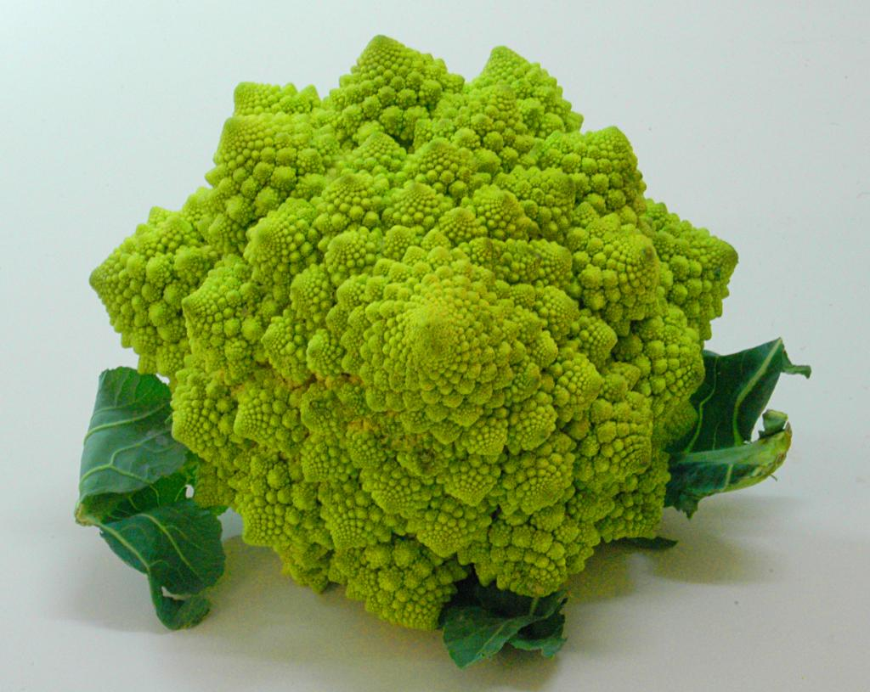

Slide 61
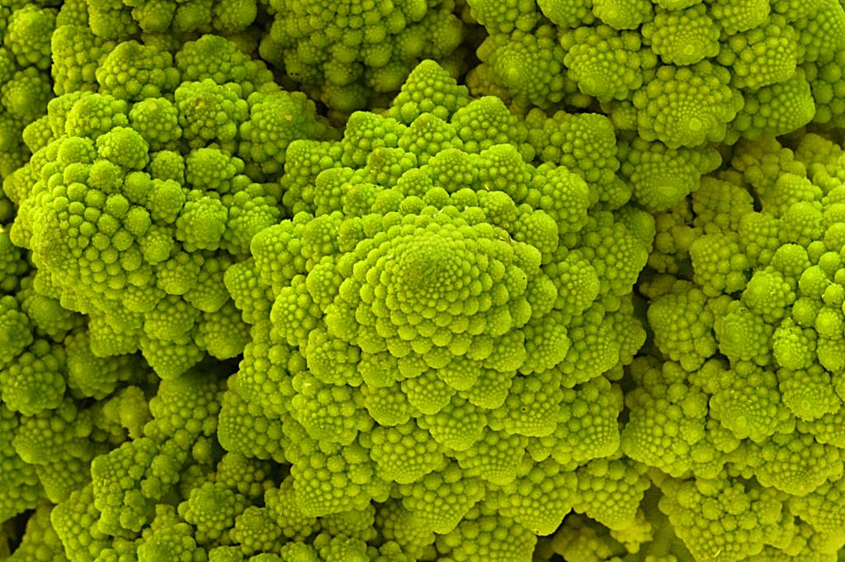
Are these rules for real?
Yes... and no.

Slide 62
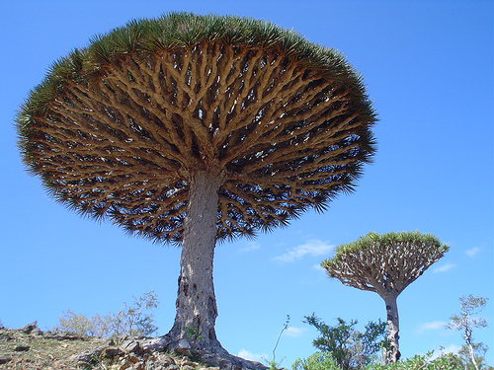

Dragon's-blood Tree

Slide 63

There still has to be a base case…

Slide 64
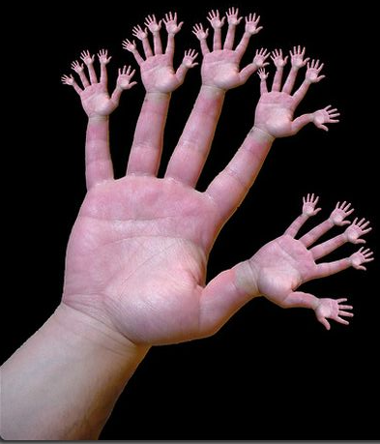
or else!

Slide 65
Recursive design…
fun! easy!?
(1) Program the base case.
(2) Find the self-similarity.
cool!
(3) Do one step!
indexing and slicing
(4) Delegate the rest to recursion…
Aha!

Slide 66
One step?
…is easy to do with Python
s = 'aliens'
s[0]
How do we get at the initial character of s?
How do we get at ALL THE REST of s?
s[ ]
L = [ 42, 21 ]
L[0]
How do we get at the initial element of L?
L[ ]
How do we get at ALL THE REST of L?

Slide 67
Recursive design #1
'cs5'
def mylen(s):
""" input: any string, s
output: the number of characters in s
"""
if :
else:
base case test!
Ask yourself:
"How could I use the length of anything smaller than s?" Then do!

Slide 68
or alone.
def mylen(s):
""" input: any string, s
output: the number of characters in s
"""
if s == '':
return 0
else:
return 1 + mylen(s[1:])
There's not much len left here!

Slide 69
def mylen(s):
if s == '':
return 0
else:
return 1 + mylen(s[1:])
Behind the curtain:
how recursion works...
mylen('cs5')
1 + mylen('s5')
1 + 1 + mylen('5')
1 + 1 + 1 + mylen('')
1 + 1 + 1 + 0

Slide 70
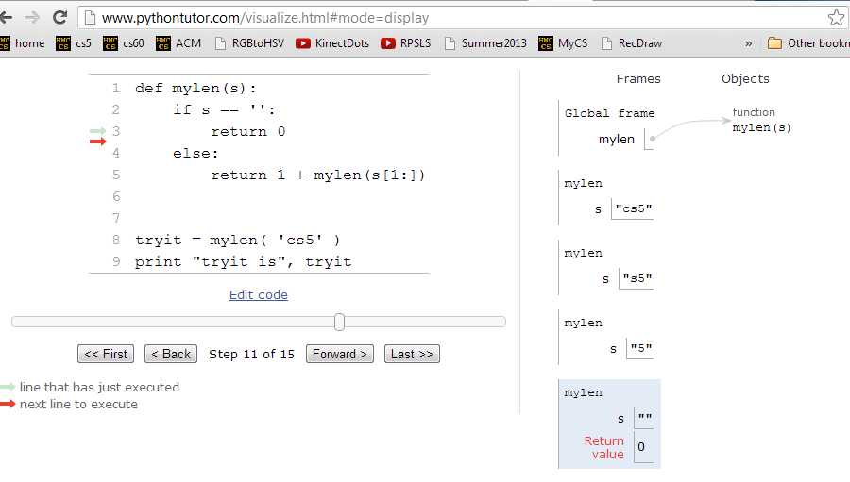
Looking behind the curtain…
http://www.pythontutor.com/visualize.html

Slide 71
Design #2
[1,4,3,42,-100,7]
def mymax(L):
""" input: a NONEMPTY list, L
output: L's maximum element
"""
if :
elif :
else:
len(L)==1
base case test!
another case…

Slide 72
Design #2
def mymax(L):
""" input: a NONEMPTY list, L
output: L's maximum element
"""
if len(L) == 1:
return L[0]
elif L[0] < L[1]:
return mymax( L[1:] )
else:
return mymax( L[0:1] + L[2:] )
Hey - do I get a slice?!

Slide 73
def mymax(L):
if len(L) == 1:
return L[0]
elif L[0] < L[1]:
return mymax( L[1:] )
else:
return mymax( L[0:1]+L[2:] )
base case
drop 1st
drop 2nd
mymax( [1,4,3,42,-100,7] )
mymax( [4,3,42,-100,7] )
mymax( [4,42,-100,7] )
mymax( [42,-100,7] )
mymax( [42,7] )
mymax( [42] )
42

Slide 74

power(2,5) == 32.0
Try it!
sajak('wheel of fortune') == 6
5
4
2
==
2*
2
What about y? You decide…
def power(b,p):
def sajak(s):
""" returns b to the p power
Use recursion, not **
Inputs: int b, int p:
the base and the power
"""
""" returns the number of vowels
in the input string, s
"""
if s == '':
Base case test
p == 0
if :
Base case test
return
return
elif
elif
return
else:
else:
return
return
Want more power?
Handle negative values of p in an elif.
Want more Pat?
What 7-letter English word w maximizes sajak(w) ?
For example, power(5,-1) == 0.2

Slide 75
def power(b,p):
""" inputs: base b and power p (an int)
implements: b**p
"""
if p == 0:
return 1.0
elif p < 0:
return ____________________
else:
return b * power(b,p-1)
Recursion is power!

Slide 76
# of vowels in s
sajak(s):
D
E
S
I
G
N
When there are no letters, there are ZERO vowels
Base case?
Rec. step?
Look at the initial character.
if s[0] is NOT a vowel, the answer is
sajak( s[1:] )
if s[0] is a vowel, the answer is
1 + sajak( s[1:] )

Slide 77
def sajak(s):
if s == '':
return 0
elif s[0]=='a' or s[0]=='e' or…
Base Case
Checking for a vowel: Try #1

Slide 78
Python is… in
I guess Python's the in thing
>>> 'i' in 'team'
False
>>> 'cs' in 'physics'
True
>>> 'i' in 'alien'
True
>>> 3*'i' in 'alien'
False
>>> 42 in [41,42,43]
True
>>> 42 in [[42], '42']
False

Slide 79
let's input 'sequoia' for s
def sajak(s):
if len(s) == 0:
return 0
elif s[0] in 'aeiou':
return 1 + sajak(s[1:])
else:
return 0 + sajak(s[1:])
Base Case
if s[0] IS a vowel, the answer is
1 + the # of vowels in the rest of s
Recursive Cases
if s[0] is NOT a vowel, the answer is just
the number of vowels in the rest of s

Slide 80
sajak( 'eerier' )
1+ sajak( 'erier' )
1+ 1+ sajak( 'rier' )
1+ 1+ 0+ sajak( 'ier' )
1+ 1+ 0+ 1+ sajak( 'er' )
1+ 1+ 0+ 1+ 1+ sajak( 'r' )
1+ 1+ 0+ 1+ 1+ 0+ sajak( '' )
1+ 1+ 0+ 1+ 1+ 0+ 0
4

Slide 81
The key to understanding recursion is, first, to understand recursion.
- a former CS 5 student
Good luck with Homework #1
It's the eeriest!
tutors @ LAC Th/F/Sa/Su/M
office hrs. Mon. aft.: LAC Labs

Slide 83
Quiz
First and last name(s):
-4
What is demo(-4) ?
def demo(x):
return x + f(x)
def f(x):
return 11*g(x) + g(x/2)
def g(x):
return -1 * x
I might have a guess…
How functions work…
Notes:
vault 713?

Slide 84
Thinking recursively
factorial
Recursion == self-reference!
5 ! = 120
5 ! = 5 * 4 * 3 * 2 * 1
5 ! =
N ! = N * (N-1) * (N-2) * … * 3 * 2 * 1
N ! =

Slide 85
Thinking recursively
def fac(N):
if N <= 1:
return 1
Base case
"How could I use the factorial of anything smaller than N?" Then do!
Ask yourself:

Slide 86
Recursive design #1
'cs5'
def mylen(s):
""" input: any string, s
output: the number of characters in s
"""
if :
else:
base case test!
Ask yourself:
"How could I use the length of anything smaller than s?" Then do!

Slide 87
Design #2
[1,4,3,42, 7,-100]
def mymax(L):
""" input: a NONEMPTY list, L
output: L's maximum element
"""
if :
elif :
else:
len(L)==1
base case test!
another case…

Slide 88
power(2,5) == 32.0
Try it!
sajak('wheel of fortune') == 6
5
4
2
==
2*
2
What about y? You decide…
def power(b,p):
def sajak(s):
""" returns b to the p power
Use recursion, not **
Inputs: int b, int p:
the base and the power
"""
""" returns the number of vowels
in the input string, s
"""
if s == '':
Base case test
p == 0
if :
Base case test
return
return
elif
return
else:
else:
return
return
Want more power?
Handle negative values of p, too.
Want more Pat?
What 7-letter English word w maximizes sajak(w) ?
For example, power(5,-1) == 0.2

Slide 91
def sajak(s):
if len(s) == 0:
return 0
elif s[0] in 'aeiou':
return 1 + sajak(s[1:])
else:
return sajak(s[1:])
Base Case
Rec. Steps
if it is NOT a vowel, the answer is just the number of vowels in the rest of s
if it IS a vowel, the answer is 1 + the number of vowels in the rest of s

Slide 92
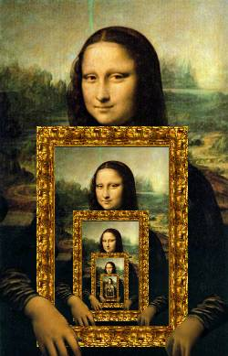

Recursion's Big Picture?
Need to see BOTH the self-similar piece AND the whole simultaneously!

Slide 93
behind the curtain
sajak('eerier')

Slide 94
behind the curtain
power(2,3)

Slide 95
def sajak(s):
when there are no letters, there are ZERO vowels
Base case?
Look at the initial character.
if s[0] is NOT a vowel, the answer is just the
number of vowels in the rest of s
Rec. step?
if s[0] is a vowel, the answer is
1 + the number of vowels in the rest of s

Slide 96

Recursion: not just numbers
Self-similarity elsewhere...
Natural phenomena
Relationships
how much here is leaf vs. stem?
What is an “ancestor” ?
Names / Acronyms
TTP == “The TTP Project”

Slide 97
Recursion: not just numbers
Self-similarity elsewhere...
Natural phenomena
Relationships
What is an “ancestor” ?
An ancestor is a parent OR an ancestor of a parent…
Names / Acronyms
TTP == “The TTP Project”
all stem!

Slide 98


This week's reading: the $10⁶ problem
Vinay Deolalikar, HP Labs
polynomially-checkable problems
polynomially-solvable problems
P vs. NP
factoring N-digit numbers?

Slide 99

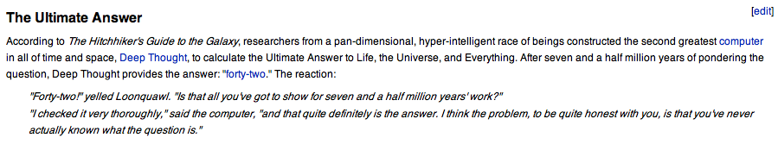
Douglas Adams's 42
Those zero-eyed aliens are a bit much…
answer: 42 question: unknown
Notes:
ZACH
show python in console

Slide 101
Recursion Examples
def mylen(s):
""" input: any string, s
output: the number of characters in s
"""
if :
else:
base case test!

Slide 102
Recursion Examples
def mymax(L):
""" input: a NONEMPTY list, L
output: L's maximum element
"""
if :
elif :
else:
base case test!
another case…

Slide 103

Try it!
Do not hand this one in…
def power(b,p):
def sajak(s):
""" returns b to the p power
using recursion, not **
inputs: int b, int p
output: a float
"""
""" returns the number of vowels
in the input string, s
"""
if :
if :
Base case test
Base case test
elif
else:
power(5,2) == 25.0
sajak('wheel of fortune') == 6
What about y? You decide…
Want more power?
Handle negative values of p, as well.
What seven-letter English word w maximizes sajak(w) ?
For example, power(5,-1) == 0.2 (or so)
Want more Pat?

Slide 104
Recursion is the root of all computation since it trades description for time.
- Alan Perlis
Recursion is the secret to all happiness in writing short, powerful functional programs!

Slide 105
while we're here…
import random
comp = random.choice( range(0,100) )
while True:
user = input('Your choice: ')
print user, '?'
if user == comp:
print 'Yes!'
break
else:
print 'No...'

Slide 106
"Quiz" on recursion
Names:
def sajak(s):
def power(b,p):
""" returns the number of vowels
in the input string, s
"""
""" returns b to the p power
using recursion and not **
inputs: b and p are ints
output: should be a float
"""
sajak('wheel of fortune') == 6
power(5,2) == 25.0
What about y? You decide…
What five-letter English word w maximizes sajak(w) ?
Want more power?
Handle negative values of p, as well.
Want more Pat?
For example, power(5,-1) == 0.2 (or so)

Slide 107
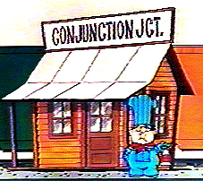
def sajak(s):
if s == '':
return 0
else:
Base Case
Checking for a vowel: Try #1
and
or
same as in English!
but each side has to be a complete boolean value!
not

Slide 108
def sajak(s):
if len(s) == 0:
return 0
else:
Base Case
if s[0] == 'a' or s[0] == 'e' or…
Checking for a vowel: Try #1
and
or
same as in English!
but each side has to be a complete boolean value!
not

Slide 109
def sajak(s):
if len(s) == 0:
return 0
else:
Base Case
Checking for a vowel: Try #2
in

