Slide 1
Jack Ma's Picobot "magic"
As close as CS gets to magic
a.k.a., CS's version of mathematical induction
Tutoring hours: LOTS!
Hw #1 due this Monday, 9/14, at 11:59 pm
This is the last CS 5 lecture you’ll ever "need"!*
HMC's legal counsel requires us to include these footnotes…
On Warner Brothers' insistence, we affirm that this 'C' does not stand for 'Chamber' and 'S' does not stand for 'Secrets.'
*
Caution: do not take this statement too literally or it is possible find yourself in twice as many CS 5 lectures as you need!
Notes:
recursion -- seems like magic
Gilderoy Lockhart

Slide 2
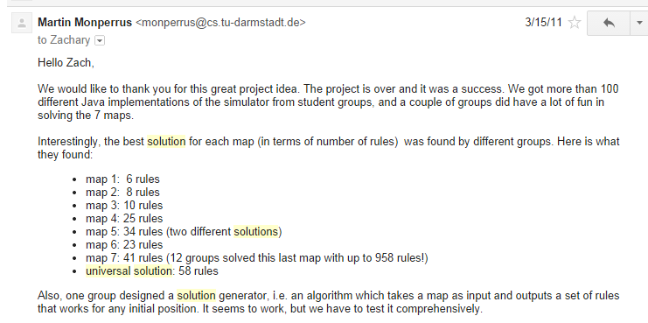
Picobot, Aargh!
+ "universal" solution…

Slide 3
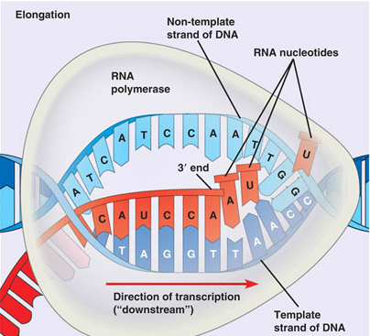
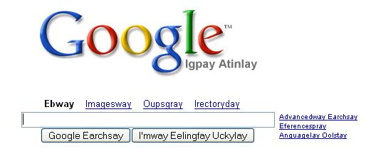
hw1
:
if you attended lab and submit pr1+pr2
you get full credit for hw1pr1 and hw1pr2
else
:
you should complete the two lab problems, pr1 + pr2
Is this Python??
either way: submit pr1 + pr2
complete and submit hw1pr3
Extra Credit: Pig Latin / CodingBat
DNA transcription

Slide 4
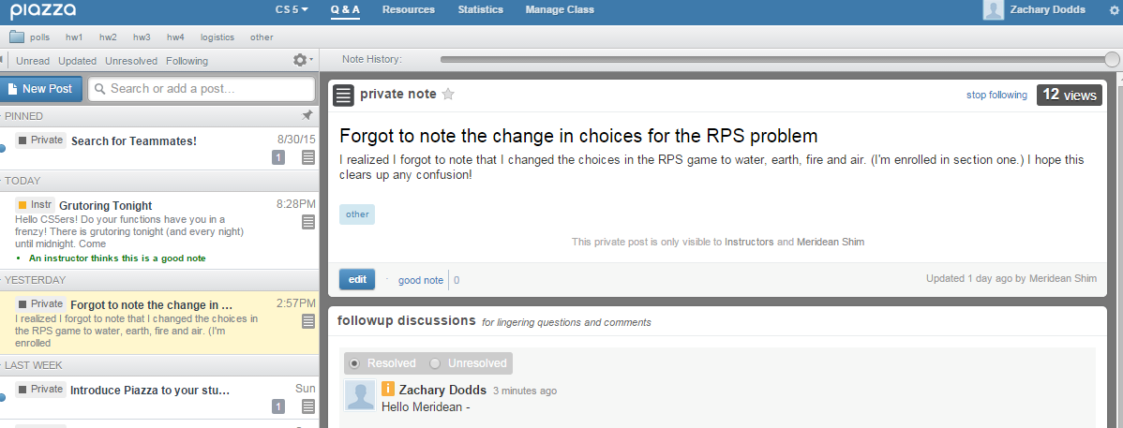
Piazza!
First Piazza post!
+ add'l Scripps grading
Sat. 1-3 w/Bailey Ahn + D. Tenorio

Slide 5
This week's reading on data…
Petabytes? This article is old-school!

Slide 6
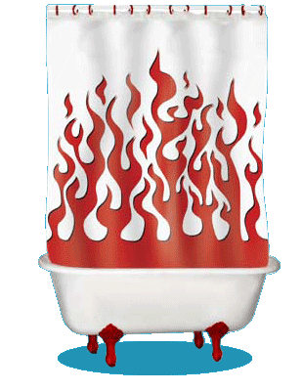
Computation's Dual Identity
Computation
Data Storage
41
42
name: x
type: int
LOC: 300
name: y
type: int
LOC: 304
memory location 300
memory location 304
variables ~ boxes
Last time
But what does all this stuff look like ?

Slide 7
Computation's Dual Identity
accessed through functions…
Computation
Data Storage
41
42
name: x
type: int
LOC: 300
name: y
type: int
LOC: 304
memory location 300
memory location 304
Functions!
variables ~ boxes
It's no coincidence this starts with fun!

Slide 8
Functioning across disciplines
procedure
structure
def g(x):
return x**100
g(x) = x¹⁰⁰
CS's googolizer
Math's googolizer
defined by what it does
defined by what it is
+ what follows behaviorally
+ what follows logically
Notes:
my foreign language teachers always tried to convince me that the skill of speaking, reading and writing a foreign language…
I didn’t believe them then and I don’t believe them now -- but I do believe that reading and writing a computer language is the way to get a strong intuitive understanding of how machines think -- it’s also important for getting them to do what you want them to, but even if you forget everything this course (hopefully) teaches about Java (compiler, datatypes, Classes and Objects), the real goal is that you take away a deeper insight into how machines think
familiar and sometimes not so familiar… deceptively easy
you mean I have to type all that!!

Slide 9
Giving names to data helps f'ns
def flipside(s):
""" flipside(s): swaps s's sides!
input s: a string
"""
x = len(s)/2
return s[x:] + s[:x]
This idea is the key to your happiness!
Notes:
show help!

Slide 10
Use variables!
Hey - I'm happy about this, too!
def flipside(s):
x = len(s)/2
return s[x:] + s[:x]
def flipside(s):
return s[len(s)/2:] + s[:len(s)/2]
Avoid this approach…
Why would computers "prefer" the top version, too?
Notes:
show help!

Slide 11
Test!
def flipside(s):
""" flipside(s): swaps s's sides!
input s: a string
"""
x = len(s)/2
return s[x:] + s[:x]
#
# Tests!
#
print "workhome ~", flipside('homework')
print " petscar ~", flipside('carpets')
print " cs5! ~", flipside('5!cs')
(1) function definition
(2) function tests
We provide tests (for now…)
control-b is Sublime!
Notes:
show help!

Slide 12
This program uses variables constantly!
Using variables…
def convertFromSeconds(s): # total seconds
""" convertFromSeconds(s): Converts an
integer # of seconds into a list of
[days, hours, minutes, seconds]
input s: an int
"""
seconds = s % 60 # leftover seconds
m = s / 60 # total minutes
minutes = m % 60 # leftover minutes
h = m / 60 # total hours
hours = h % 24 # leftover hours
days = h / 24 # total days
return [days, hours, minutes, seconds]
Notes:
show help!

Slide 13
How functions look…
input(s)
name
def convertFromSeconds(s): # total seconds
""" convertFromSectons(s): Converts an
integer # of seconds into a list of
[days, hours, minutes, seconds]
input s: an int
"""
seconds = s % 60 # leftover seconds
m = (s / 60) # total minutes
minutes = m % 60 # leftover minutes
h = m / 60 # total hours
hours = h % 24 # leftover hours
days = h / 24 # total days
return [days, hours, minutes, seconds]
docstring
comments –these are mostly optional in CS 5
code block
return statement
Notes:
show help!

Slide 14
return vs. print
def dbl(x):
""" dbls x? """
return 2*x
def dblPR(x):
""" dbls x? """
print 2*x
>>> ans = dbl(20)
>>> ans = dblPR(20)
What's the difference ?!

Slide 15
return > print
def dbl(x):
""" dbls x? """
return 2*x
def dblPR(x):
""" dbls x? """
print 2*x
>>> ans = dbl(20)+2
>>> ans = dblPR(20)+2
yes!
ouch!
print changes pixels on the screen...
… which the shell then prints!
return yields the function call's value …

Slide 16
Name(s):
Quiz
15
How f'ns work…
What is demo(15) here?
def demo(x):
y = x/3
z = g(y)
return z + y + x
def g(x):
result = 4*x + 2
return result
I might have a guess on these…
What is f(2) here?
def f(x):
if x == 0:
return 12
else:
return f(x-1) + 10*x
Notes:
vault 713?

Slide 17
How functions work…
15
"the stack"
def demo(x):
y = x/3
z = g(y)
return z + y + x
def g(x):
result = 4*x + 2
return result
they stack.
Notes:
vault 713?

Slide 18
How functions work…
15
"the stack"
def demo(x):
y = x/3
z = g(y)
return z + y + x
call: demo(15)
stack frame
local variables:
x = 15
y = 5
z = ?????
def g(x):
result = 4*x + 2
return result
they stack.
Notes:
vault 713?

Slide 19
How functions work…
15
"the stack"
def demo(x):
y = x/3
z = g(y)
return z + y + x
call: demo(15)
stack frame
local variables:
x = 15
y = 5
z = ?????
def g(x):
result = 4*x + 2
return result
call: g(5)
stack frame
local variables:
x = 5
result = 22
returns 22
they stack.
Notes:
vault 713?

Slide 20
How functions work…
15
"the stack"
def demo(x):
y = x/3
z = g(y)
return z + y + x
call: demo(15)
stack frame
local variables:
x = 15
y = 5
z = ?????
def g(x):
result = 4*x + 2
return result
call: g(5)
stack frame
local variables:
x = 5
result = 22
returns 22
they stack.
Notes:
vault 713?

Slide 21
How functions work…
15
"the stack"
def demo(x):
y = x/3
z = g(y)
return z + y + x
call: demo(15)
stack frame
local variables:
x = 15
y = 5
z = 22
def g(x):
result = 4*x + 2
return result
they stack.
Notes:
vault 713?

Slide 22
How functions work…
15
"the stack"
def demo(x):
y = x/3
z = g(y)
return z + y + x
call: demo(15)
stack frame
local variables:
x = 15
y = 5
z = 22
return 42
def g(x):
result = 4*x + 2
return result
they stack.
Notes:
vault 713?

Slide 23
How functions work…
15
"the stack"
42
def demo(x):
y = x/3
z = g(y)
return z + y + x
afterwards, the stack is empty…, but ready if another function is called
output
def g(x):
result = 4*x + 2
return result
they stack.
Notes:
vault 713?

Slide 24
How functions work…
2
what's f(2) ?
"the stack"
def f(x):
if x == 0:
return 12
else:
return f(x-1) + 10*x
Notes:
vault 713?

Slide 25
How functions work…
2
"the stack"
def f(x):
if x == 0:
return 12
else:
return f(x-1) + 10*x
call: f(2)
stack frame
local variables:
x = 2
need f(1)
Notes:
vault 713?

Slide 26
How functions work…
1
"the stack"
def f(x):
if x == 0:
return 12
else:
return f(x-1) + 10*x
call: f(2)
stack frame
local variables:
x = 2
need f(1)
call: f(1)
stack frame
local variables:
x = 1
need f(0)
Notes:
vault 713?

Slide 27
How functions work…
0
"the stack"
def f(x):
if x == 0:
return 12
else:
return f(x-1) + 10*x
call: f(2)
stack frame
local variables:
x = 2
need f(1)
call: f(1)
stack frame
local variables:
x = 1
need f(0)
call: f(0)
stack frame
local variables:
x = 0
returns 12
Notes:
vault 713?

Slide 28
How functions work…
0
"the stack"
def f(x):
if x == 0:
return 12
else:
return f(x-1) + 10*x
call: f(2)
stack frame
local variables:
x = 2
need f(1)
call: f(1)
stack frame
local variables:
x = 1
need f(0)
call: f(0)
stack frame
local variables:
x = 0
returns 12
Notes:
vault 713?

Slide 29
How functions work…
1
"the stack"
def f(x):
if x == 0:
return 12
else:
return f(x-1) + 10*x
call: f(2)
stack frame
local variables:
x = 2
need f(1)
call: f(1)
stack frame
local variables:
x = 1
f(0) = 12
result =
How do we compute the result?
Notes:
vault 713?

Slide 30
How functions work…
1
"the stack"
def f(x):
if x == 0:
return 12
else:
return f(x-1) + 10*x
call: f(2)
stack frame
local variables:
x = 2
need f(1)
call: f(1)
stack frame
local variables:
x = 1
f(0) = 12
result = 22
Where does that result go?
Notes:
vault 713?

Slide 31
How functions work…
1
"the stack"
def f(x):
if x == 0:
return 12
else:
return f(x-1) + 10*x
call: f(2)
stack frame
local variables:
x = 2
need f(1)
call: f(1)
stack frame
local variables:
x = 1
f(0) = 12
result = 22
Notes:
vault 713?

Slide 32
How functions work…
2
"the stack"
def f(x):
if x == 0:
return 12
else:
return f(x-1) + 10*x
call: f(2)
stack frame
local variables:
x = 2
f(1) = 22
result =
What's this return value?
Notes:
vault 713?

Slide 33
How functions work…
2
"the stack"
def f(x):
if x == 0:
return 12
else:
return f(x-1) + 10*x
call: f(2)
stack frame
local variables:
x = 2
f(1) = 22
result = 42
which then gets returned…
Notes:
vault 713?

Slide 34
How functions work…
2
"the stack"
def f(x):
if x == 0:
return 12
else:
return f(x-1) + 10*x
call: f(2)
stack frame
local variables:
x = 2
f(1) = 22
result = 42
the result then gets returned…
Notes:
vault 713?

Slide 35
How functions work…
2
42
"the stack"
def f(x):
if x == 0:
return 12
else:
return f(x-1) + 10*x
output
again, the stack is empty, but ready if another function is called…
functions stack.
Notes:
vault 713?

Slide 36
How functions work…
2
42
"the stack"
def f(x):
if x == 0:
return 12
else:
return f(x-1) + 10*x
output
again, the stack is empty, but ready if another function is called…
Functions are like cells: software's building blocks…
… each one, a self-contained computational unit!
functions stack.
Notes:
vault 713?

Slide 37
function design
Notes:
vault 713?

Slide 38
Thinking sequentially
factorial
5 ! = 120
math
fac(5) = 5*4*3*2*1
CS
fac(N) = N*(N-1)* … *3*2*1

Slide 39
Thinking sequentially
factorial
5 ! = 120
math
October + beyond…
fac(5) = 5*4*3*2*1
CS
fac(N) = N*(N-1)* … *3*2*1

Slide 40
Thinking recursively
factorial
5 ! = 120
fac(5) = 5*4*3*2*1
fac(5) =
can we express fac w/ a smaller version of itself?
fac(N) = N*(N-1)* … *3*2*1
fac(N) =

Slide 41
Thinking recursively
Recursion ~ self-reference
factorial
5 ! = 120
fac(5) = 5*4*3*2*1
fac(5) = 5 * fac(4)
can we express fac w/ a smaller version of itself?
fac(N) = N*(N-1)* … *3*2*1
fac(N) = N * fac(N-1)

Slide 42
Warning: this is legal!
def facBad(N):
return N * facBad(N-1)
I wonder how this code will STACK up!?
Notes:
Was that Gandalf or Dumbledore that "fell forever" ?

Slide 43
legal != recommended
def facBad(N):
return N * facBad(N-1)
calls to facBad will never stop: there's no BASE CASE
Make sure you have a base case
a.k.a. an "escape hatch"
How about an escape from recursion itself!?!

Slide 44
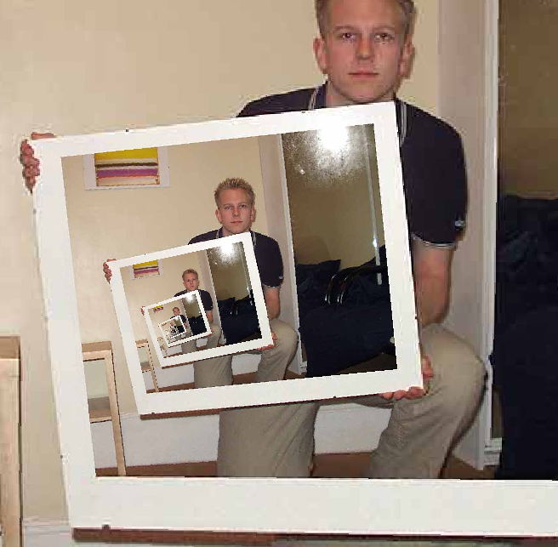
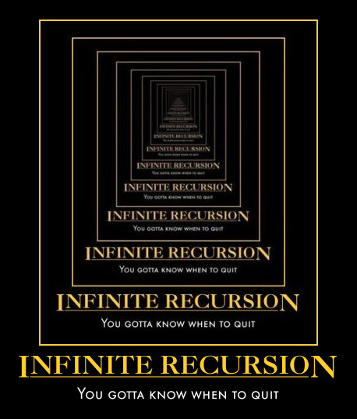
This "works" ~ but doesn't work!
def fac(N):
return fac(N)
Recursion
the dizzying dangers of having no base case!

Slide 45
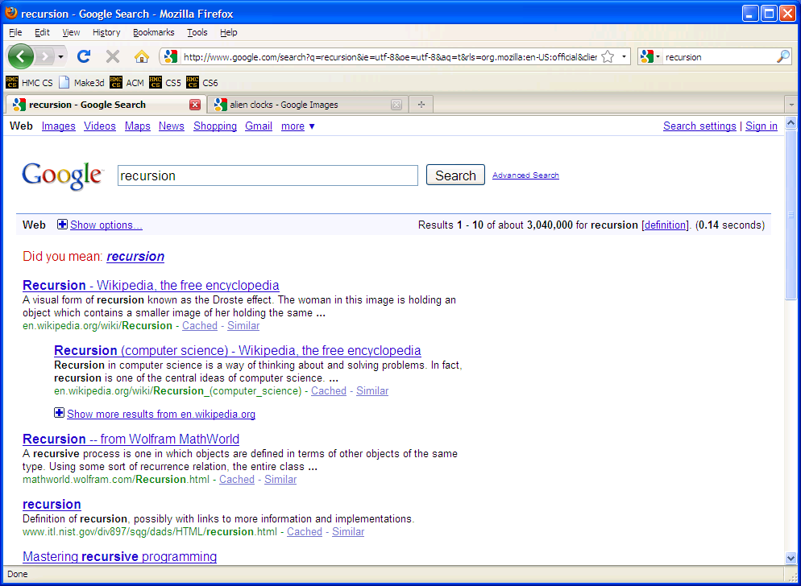

Slide 46
Thinking recursively
def fac(N):
if N <= 1:
return 1
else:
return N*fac(N-1)
Base case
Recursive case
(too short?)
Human: Base case and 1 step
Computer: Everything else

Slide 47
Thinking recursively
def fac(N):
if N <= 1:
return 1
else:
rest = fac(N-1)
return N*rest
Base case
the recursion happens first…
Recursive case (clearer?)
Human: Base case and 1 step
Computer: Everything else

Slide 48
Behind the curtain:
how recursion works...
def fac(N):
if N <= 1:
return 1.0
else:
return N * fac(N-1)
fac(5)
5 * fac(4)
4 * fac(3)
3 * fac(2)
2 * fac(1)
1.0

Slide 49
Behind the curtain:
how recursion works...
def fac(N):
if N <= 1:
return 1.0
else:
return N * fac(N-1)
fac(5)
5 * fac(4)
stack frame with N = 5
4 * fac(3)
stack frame with N = 4
3 * fac(2)
stack frame with N = 3
2 * fac(1)
stack frame with N = 2
1.0
stack frame with N = 1

Slide 50
Behind the curtain:
how recursion works...
def fac(N):
if N <= 1:
return 1.0
else:
return N * fac(N-1)
fac(5)
5 * fac(4)
stack frame with N = 5
4 * fac(3)
stack frame with N = 4
3 * fac(2)
stack frame with N = 3
2 * 1.0
stack frame with N = 2

Slide 51
Behind the curtain:
how recursion works...
def fac(N):
if N <= 1:
return 1.0
else:
return N * fac(N-1)
fac(5)
5 * fac(4)
stack frame with N = 5
4 * fac(3)
stack frame with N = 4
3 * 2.0
stack frame with N = 3

Slide 52
Behind the curtain:
how recursion works...
def fac(N):
if N <= 1:
return 1.0
else:
return N * fac(N-1)
fac(5)
5 * fac(4)
stack frame with N = 5
4 * 6.0
stack frame with N = 4

Slide 53
Behind the curtain:
how recursion works...
def fac(N):
if N <= 1:
return 1.0
else:
return N * fac(N-1)
fac(5)
5 * 24.0
stack frame with N = 5

Slide 54
Behind the curtain:
how recursion works...
def fac(N):
if N <= 1:
return 1.0
else:
return N * fac(N-1)
fac(5)
complete!
120.0

Slide 55
recursive design
Notes:
vault 713?

Slide 56
Recursive Design: the 3 i's
Eye approve!
identify
self-similarities & base cases
intuition
implement

Slide 57
Recursive Design: the 3 i's
fac(5) = 5*4*3*2*1
fac(4) = 4*3*2*1
fac(3) = 3*2*1
identify
self-similarities & base cases
fac(2) = 2*1
fac(1) = 1
fac(0) = 1
Examples!
intuition
implement

Slide 58
Recursive Design: the 3 i's
fac(5) = 5*4*3*2*1
fac(N) =
rec.
self-similarities
fac(4) = 4*3*2*1
fac(3) = 3*2*1
identify
base cases
self-similarities & base cases
fac(2) = 2*1
fac(1) = 1
fac(0) = 1
base cases
Examples!
intuit
implement

Slide 59
Recursive Design: the 3 i's
Eye approve!
fac(5) = 5*4*3*2*1
fac(N) =
rec.
self-similarities
fac(4) = 4*3*2*1
fac(3) = 3*2*1
identify
base cases
self-similarities & base cases
fac(2) = 2*1
fac(1) = 1
fac(0) = 1
base cases
intuit
implement

Slide 60
Recursive Design: the 3 i's
Eye approve!
rec.
fac(5) = 5*4*3*2*1
fac(N) =
rec.
self-similarities
fac(4) = 4*3*2*1
fac(3) = 3*2*1
identify
base cases
base cases
self-similarities & base cases
fac(2) = 2*1
fac(1) = 1
def fac(N):
if
return
else:
return
fac(0) = 1
base cases
intuit
implement

Slide 61
Recursive Design: the 3 i's
rec.
fac(5) = 5*4*3*2*1
fac(N) =
rec.
self-similarities
fac(4) = 4*3*2*1
fac(3) = 3*2*1
identify
base cases
base cases
self-similarities & base cases
fac(2) = 2*1
fac(1) = 1
base case
def fac(N):
if N <= 1:
return 1.0
else:
return N * fac(N-1)
fac(0) = 1
rec.
base cases
intuit
implement

Slide 62
Recursive Design: the 3 i's
rec.
fac(5) = 5*4*3*2*1
fac(N) =
the order of base cases and recursive cases usually does not matter!
rec.
self-similarities
fac(4) = 4*3*2*1
fac(3) = 3*2*1
identify
base cases
base cases
self-similarities & base cases
fac(2) = 2*1
fac(1) = 1
def fac(N):
if N > 1:
return N * fac(N-1)
else:
return 1.0
rec.
fac(0) = 1
base cases
base case
intuit
implement

Slide 63
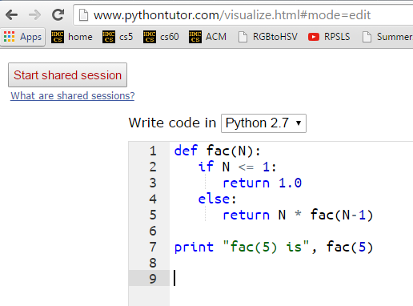
A look behind the curtain…
http://www.pythontutor.com/visualize.html

Slide 64
Recursive Design
add(m,n)
return m+n, but using only m and +1's …
m n
add(7,3) ~ 7+1+1+1
add(m,n) =
self-similarities
add(7,2) ~ 7+1+1
identify
add(7,1) ~ 7+1
base cases
self-similarities & base cases
def add(m,n):
if
return
else:
return
add(7,0) ~ 7
intuit
implement

Slide 65
def add(m,n):
if n == 0:
return m
else:
return 1 + add(m,n-1)
add(38,4)
1 + add(38,3)
stack frame with n = 4
1 + add(38,2)
stack frame with n = 3
1 + add(38,1)
stack frame with n = 2
1 + add(38,0)
stack frame with n = 1
stack frame with n = 0
38

Slide 66
Recursive Design
len(L)
return the length of the list or string L
len( [ 7,8,5 ] ) ~ 3
len(L) =
len( [ 8,5 ] ) ~ 2
self-similarities
len( [ 5 ] ) ~ 1
identify
len( [ ] ) ~ 0
base cases
self-similarities & base cases
lists
strings
def len(L):
if
return
else:
return
intuit
implement

Slide 67
def len(L):
if L == [] or L == '':
return 0
else:
return 1 + len(L[1:])
len('cs5!')
1 + len('s5!')
stack frame
1 + len('5!')
stack frame
1 + len('!')
stack frame
1 + len('')
stack frame
0
stack frame

Slide 68
Design patterns…
Recursion's a design - not a formula, BUT, these pieces are common:
Handle base cases, with if …
Do one piece of work: L[0] or s[0]
Recurse with the rest: L[1:] or s[1:]
Combine + make sure the types match!

Slide 69
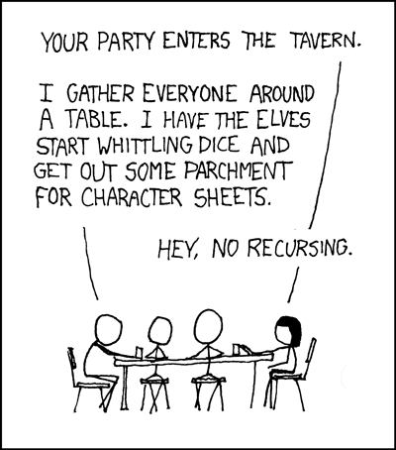
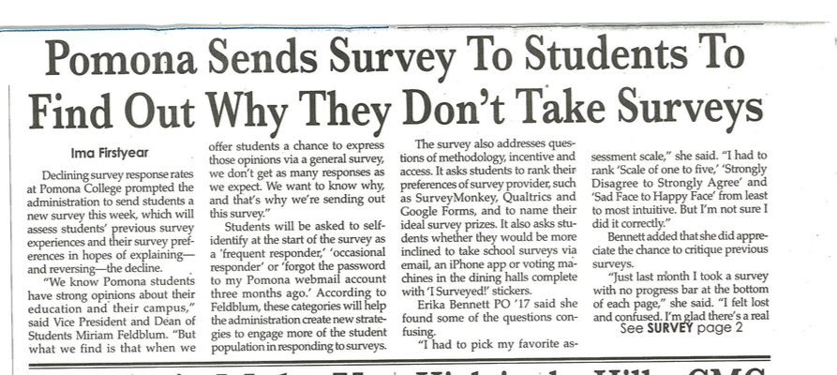
Recursion's advantage:
It handles arbitrary structural depth – all at once + on its own!
As a hat, I'm recursive, too!
Notes:
I don’t know if this really works...

Slide 70
Recursion's conceptual challenge?
You need to see BOTH the self-similar pieces AND the whole thing simultaneously!
Nature loves recursion!

Slide 71
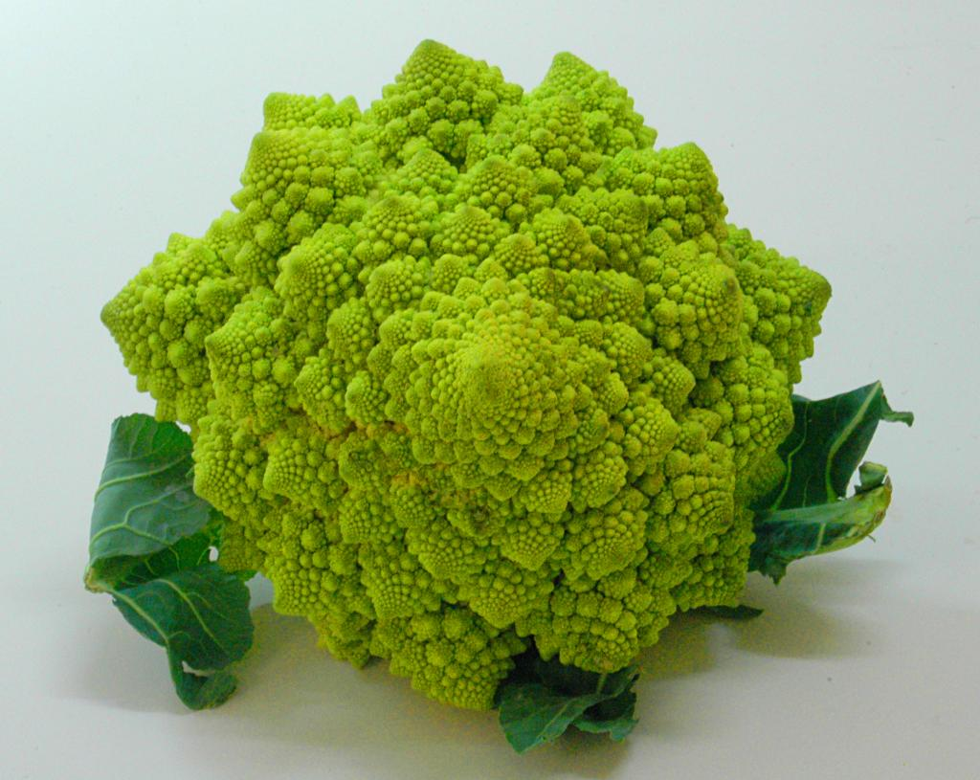
romanesco broccoli

Slide 72
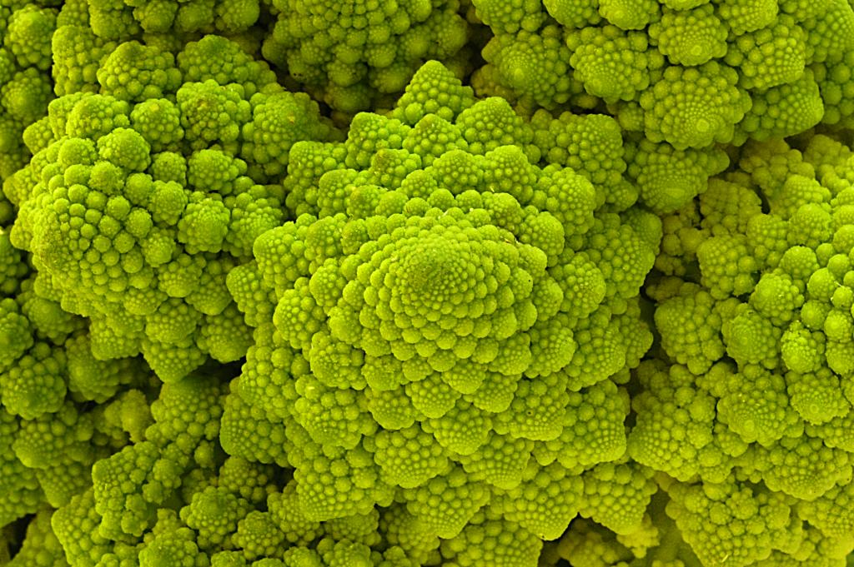
Are these rules for real?
Yes... and no.

Slide 73
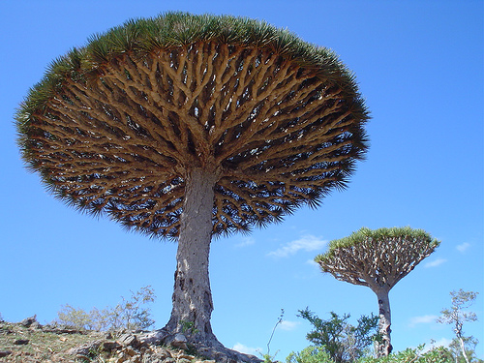
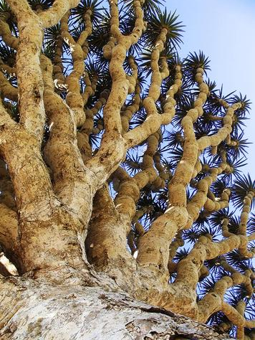
Dragon's-blood Tree

Slide 74
There still has to be a base case…

Slide 75
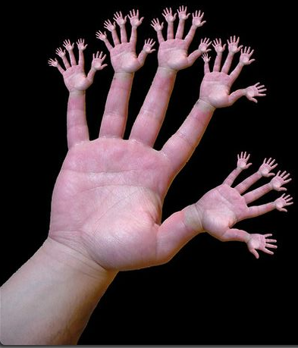
or else!

Slide 76
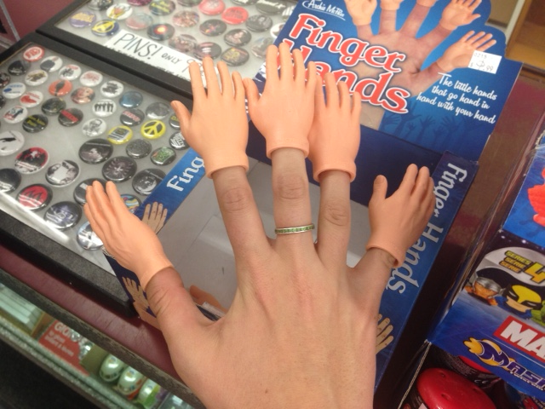
or else!

Slide 77
Recursive design…
fun! easy!?
(1) Program the base case.
(2) Find the self-similarity.
cool!
(3) Do one step!
indexing and slicing
(4) Delegate the rest to recursion…
Aha!

Slide 78
Recursive Design
max(L)
return the biggest element in L, given that L has at least one element!
max( [ 9,8,5 ] ) ~
max(L) =
max( [ 8,5 ] ) ~ 8
self-similarities
identify
max( [ 2,8,5 ] ) ~
base cases
self-similarities & base cases
def max(L):
max( [ 8,5 ] ) ~ 8
intuit
implement

Slide 79
Answer: max
max(L)
return the biggest element in L, given that L has at least one element!
max( [ 9,8,5 ] ) ~
L[0], if L[0] > max(L[1:])
max(L[1:]), otherwise
max(L) =
max( [ 8,5 ] ) ~ 8
self-similarities
max( L ) = L[0]
identify
base cases
if len(L) == 1
self-similarities & base cases
max( [ 2,8,5 ] ) ~
def max(L):
if len(L) == 1:
return L[0]
elif L[0] > max(L[1:])
return L[0]
else:
return max(L[1:])
max( [ 8,5 ] ) ~ 8
max( [ 5 ] ) ~ 5
intuit
implement

Slide 80
Try it!
pow(b,p)
return b**p, but using only multiplication times b
pow(2,4) ~ 2*2*2*2
pow(b,p) =
= 16
self-similarities
pow(2,3) ~ 2*2*2
= 8
identify
base cases
self-similarities & base cases
pow(2,2) ~ 2*2*1.0
def pow(b,p):
if
else:
pow(2,1) ~ 2*1.0
pow(2,0) ~ 1.0
anything to the zero power is 1.0
intuit
Extra! See if you can also handle negative powers...
implement

Slide 81
Answer: pow
pow(b,p)
return b**p, but using only multiplication times b
pow(2,4) ~ 2*2*2*2
pow(b,p) = pow(b,p-1) * b
= 16
self-similarities
pow(2,3) ~ 2*2*2
= 8
pow(b,0) = 1.0
identify
base cases
self-similarities & base cases
pow(2,2) ~ 2*2*1.0
def pow(b,p):
if p == 0:
return 1.0
else:
return pow(b,p-1) * b
pow(2,1) ~ 2*1.0
pow(2,0) ~ 1.0
anything to the zero power is 1.0
intuit
Extra! See if you can also handle negative powers...
implement

Slide 82
Try it!
vwl(s)
return the number of vowels in the string s, s may or may not be empty.
let's count y!
vwl( 'crazy' ) ~ 2
vwl(s) =
vwl( 'razy' ) ~ 2
self-similarities
vwl( 'azy' ) ~ 2
identify
vwl( 'zy' ) ~ 1
base cases
self-similarities & base cases
vwl( 'y' ) ~ 1
def vwl(s):
if
elif
else:
What is the really simplest base case!?
intuit
Extra! What 7-letter English word maximizes vwl(s) ?
implement

Slide 83
Answer: vwl
vwl(s)
return the number of vowels in the string s, s may or may not be empty.
let's count y!
vwl( 'crazy' ) ~ 2
vwl(s[1:]), if L[0] is not a vowel
1+vwl(s[1:]), if L[0] is a vowel
vwl(s) =
vwl( 'razy' ) ~ 2
self-similarities
vwl( 'azy' ) ~ 2
vwl( '' ) = 0
identify
vwl( 'zy' ) ~ 1
base cases
self-similarities & base cases
vwl( 'y' ) ~ 1
def vwl(s):
if s == '':
return 0
elif s[0] in 'aeiouy':
return 1+vwl( s[1:] )
else:
return vwl( s[1:] )
vwl( '' ) ~ 0
What is the really simplest base case!?
intuit
Extra! What 7-letter English word maximizes vwl(s) ?
implement

Slide 84
Python is… in
I guess Python's the in thing
>>> 'i' in 'team'
False
>>> 'cs' in 'physics'
True
>>> 'i' in 'alien'
True
>>> 3*'i' in 'alien'
False
>>> 42 in [41,42,43]
True
>>> 42 in [[42], '42']
False

Slide 85
The key to understanding recursion is, first, to understand recursion.
- former CS 5 student
It's the eeriest!
Good luck with Homework #1
tutors @ LAC + 4C's Th/F/Sa/Su/Mon.

Slide 86
Try it!
nr_zero(L)
return the element of L closest to 0; L will have at least one element
Consider these examples:
nr_zero(L)
nr_zero( [4,-3,42] ) ~
self-similarities
nr_zero( [1,-3,42] ) ~
identify
base cases
self-similarities & base cases
def nr_zero(L):
nr_zero( [-3,42] ) ~ -3
don't forget the base case!
intuit
Note: The function abs is built-in to Python….
implement

Slide 87
Try it!
nr_zero(L)
return the element of L closest to 0; L will have at least one element
Consider these examples:
L[0], if abs(L[0]) < abs(nr_zero(L[1:]))
nr_zero(L[1:]), otherwise
nr_zero( [4,-3,42] ) ~
nr_zero(L)
self-similarities
self-similarities
nr_zero( L ) = L[0]
nr_zero( [1,-3,42] ) ~
identify
base cases
if len(L) == 1
self-similarities & base cases
def nr_zero(L):
if len(L) == 1:
return L[0]
rest = nr_zero(L[1:])
if abs(L[0]) < abs(rest):
return L[0]
else:
return rest
nr_zero( [-3,42] ) ~ -3
nr_zero( [42] ) ~ 42
don't forget the base case!
intuit
Note: The function abs is built-in to Python….
implement

Slide 88
The key to understanding recursion is, first, to understand recursion.
- former CS 5 student
It's the eeriest!
Good luck with Homework #1
tutors @ LAC + 4C's Th/F/Sa/Su/Mon.

Slide 89
Notes:
I don’t know if this really works...

Slide 90
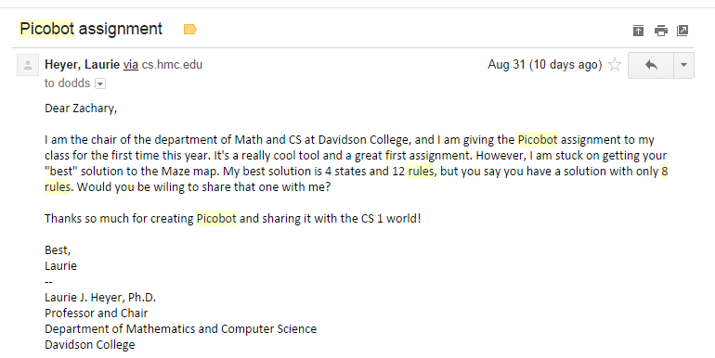
Picobot rules!
Eight rules?!
it's twice as slow!

Slide 91
Picobot, Aargh!
+ "universal" solution…

Slide 92
Jack Ma's Picobot "magic"
As close as CS gets to magic
a.k.a., CS's version of mathematical induction
Tutoring hours: LOTS!
Hw #1 due this Monday, 9/14, at 11:59 pm
This is the last CS 5 lecture you’ll ever need!*
HMC's legal counsel requires us to include these footnotes…
On Warner Brothers' insistence, we affirm that this 'C' does not stand for 'Chamber' and 'S' does not stand for 'Secrets.'
*
Caution: do not take this statement too literally or it is possible find yourself in twice as many CS 5 lectures as you need!
Notes:
recursion -- seems like magic
Gilderoy Lockhart

Slide 93
The dizzying dangers of having no base case!
Notes:
I don’t know if this really works...

Slide 94
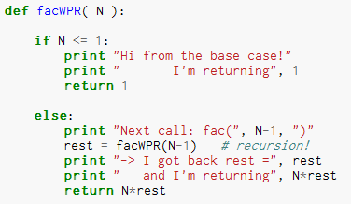
Thinking recursively…
What will print when facWPR(5) is called?

Slide 95
Let recursion do the work for you.
Exploit self-similarity
Less work !
Produce short, elegant code
You handle the base case – the easiest case!
def fac(N):
if N <= 1:
return 1
else:
rest = fac(N-1)
return rest * N
Recursion does almost all of the rest of the problem!
You specify one step at the end

Slide 96
Recursive design #1
'cs5'
def mylen(s):
""" input: any string, s
output: the number of characters in s
"""
if :
else:
base case test!
return
return
Ask yourself:
"How could I make use of the length of something smaller than s?" Then do!

Slide 97
… complete
def mylen(s):
""" input: any string, s
output: the number of characters in s
"""
if s == '':
return 0
else:
return 1 + mylen(s[1:])
There's not much len left here!

Slide 98
def mylen(s):
if s == '':
return 0
else:
return 1 + mylen(s[1:])
Behind the curtain:
how recursion works...
mylen('cs5')
1 + mylen('s5')
1 + 1 + mylen('5')
1 + 1 + 1 + mylen('')
1 + 1 + 1 + 0

Slide 99
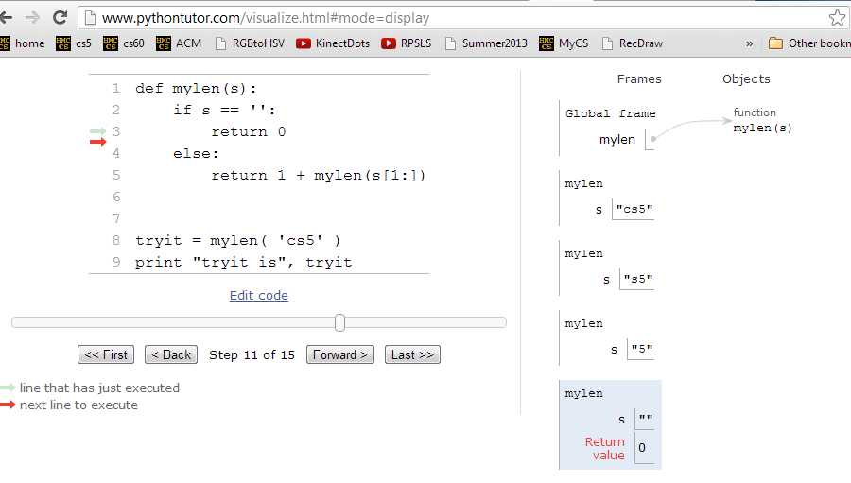
Looking behind the curtain…
http://www.pythontutor.com/visualize.html

Slide 100
Design #2
[1,4,3,42,-100,7]
def mymax(L):
""" input: a NONEMPTY list, L
output: L's maximum element
"""
if :
elif :
len(L)==1
base case test!
return
another case…
return
else:
return

Slide 101
Design #2
def mymax(L):
""" input: a NONEMPTY list, L
output: L's maximum element
"""
if len(L) == 1:
return L[0]
elif L[0] < L[1]:
return mymax( L[1:] )
else:
return mymax( L[0:1] + L[2:] )
Hey - do I get a slice?!

Slide 102
def mymax(L):
if len(L) == 1:
return L[0]
elif L[0] < L[1]:
return mymax( L[1:] )
else:
return mymax( L[0:1]+L[2:] )
base case
drop 1st
drop 2nd
mymax( [1,4,3,42,-100,7] )
mymax( [4,3,42,-100,7] )
mymax( [4,42,-100,7] )
mymax( [42,-100,7] )
mymax( [42,7] )
mymax( [42] )
42

Slide 103
power(2,5) == 32.0
Try it!
sajak('wheel of fortune') == 6
What about y? You decide…
in general:
def power(b,p):
def sajak(s):
""" returns b to the p power
Use recursion, not **
Inputs: int b, int p:
the base and the power
"""
""" returns the number of vowels
in the input string, s
"""
if s == '':
Base case test
p == 0
if :
Base case test
return
return
elif
elif
return
else:
else:
return
return
Want more power?
Handle negative values of p in an elif.
Want more Pat?
What 7-letter English word w maximizes sajak(w) ?
For example, power(5,-1) == 0.2

Slide 104
power( 2, 5 )
2* power( 2, 4 )
2* 2* power( 2, 3 )
2* 2* 2* power( 2, 2 )
2* 2* 2* 2* power( 2, 1 )
2* 2* 2* 2* 2* power( 2, 0 )
2* 2* 2* 2* 2* 1
32

Slide 105
sajak( 'eerier' )
1+ sajak( 'erier' )
1+ 1+ sajak( 'rier' )
1+ 1+ 0+ sajak( 'ier' )
1+ 1+ 0+ 1+ sajak( 'er' )
1+ 1+ 0+ 1+ 1+ sajak( 'r' )
1+ 1+ 0+ 1+ 1+ 0+ sajak( '' )
1+ 1+ 0+ 1+ 1+ 0+ 0
4

Slide 106
def power(b,p):
""" inputs: base b and power p (an int)
implements: b**p
"""
if p == 0:
return 1.0
elif p < 0:
return ____________________
else:
return b * power(b,p-1)
Recursion is power!

Slide 107
# of vowels in s
sajak(s):
D
E
S
I
G
N
When there are no letters, there are ZERO vowels
Base case?
Rec. step?
Look at the initial character.
if s[0] is NOT a vowel, the answer is
sajak( s[1:] )
if s[0] is a vowel, the answer is
1 + sajak( s[1:] )

Slide 108
def sajak(s):
if s == '':
return 0
elif s[0]=='a' or s[0]=='e' or…
Is s[0] a vowel?
but how to check for vowels?

Slide 109
Python is… in
I guess Python's the in thing
>>> 'i' in 'team'
False
>>> 'cs' in 'physics'
True
>>> 'i' in 'alien'
True
>>> 3*'i' in 'alien'
False
>>> 42 in [41,42,43]
True
>>> 42 in [[42], '42']
False

Slide 110
let's input 'eerier' for s
def sajak(s):
if len(s) == 0:
return 0
elif s[0] in 'aeiou':
return 1 + sajak(s[1:])
else:
return 0 + sajak(s[1:])
Base Case
if s[0] IS a vowel, the answer is
1 + the # of vowels in the rest of s
Recursive Cases
if s[0] is NOT a vowel, the answer is just
the number of vowels in the rest of s

Slide 111
How functions work…
2
"the stack"
def f(x):
if x == 0:
return 12
else:
return f(x-1) + 10*x
call: f(2)
stack frame
local variables:
x = 2
f(1) = 22
result = 42
the result then gets returned…
Notes:
vault 713?

Slide 112
How functions work…
"the stack"
def f(x):
if x == 0:
return 12
else:
return f(x-1) + 10*x
call: f(2)
stack frame
local variables:
x = 2
need f(1)
call: f(1)
stack frame
local variables:
x = 1
need f(0)
call: f(0)
stack frame
local variables:
x = 0
returns 12
they stack.
Notes:
vault 713?

Slide 114
def power(b,p):
""" inputs: base b and power p (an int)
implements: b**p
"""
if p == 0:
return 1.0
elif p < 0:
return ____________________
else:
return b * power(b,p-1)
Recursion is power!

Slide 115
Recursive design #1
'cs5'
def mylen(s):
""" input: any string, s
output: the number of characters in s
"""
if :
else:
base case test!
Ask yourself:
"How could I use the length of anything smaller than s?" Then do!

Slide 116
Design #2
[1,4,3,42,-100,7]
def mymax(L):
""" input: a NONEMPTY list, L
output: L's maximum element
"""
if :
elif :
else:
len(L)==1
base case test!
return
another case…
return

Slide 117
power(2,5) == 32.0
Try it!
sajak('wheel of fortune') == 6
p
p-1
2
==
2*
2
What about y? You decide…
def power(b,p):
def sajak(s):
""" returns b to the p power
Use recursion, not **
Inputs: int b, int p:
the base and the power
"""
""" returns the number of vowels
in the input string, s
"""
if s == '':
Base case test
p == 0
if :
Base case test
return
return
elif
elif
return
else:
else:
return
return
Want more power?
Handle negative values of p in an elif.
Want more Pat?
What 7-letter English word w maximizes sajak(w) ?
For example, power(5,-1) == 0.2

Slide 118
did somebody say induction?
Jack Ma's Picobot "magic"
a.k.a., CS's version of mathematical induction
Aye-Aye-Aye, Mateys!
As close as CS gets to magic
Tutoring hours: LOTS!
Hw #1 due this Sunday, 2/8, at 11:59 pm
This is the last CS 5 lecture you’ll ever need!*
HMC's legal counsel requires us to include these footnotes…
On Warner Brothers' insistence, we affirm that this 'C' does not stand for 'Chamber' and 'S' does not stand for 'Secrets.'
*
Caution: do not take this statement too literally or it is possible find yourself in twice as many CS 5 lectures as you need!
Notes:
recursion -- seems like magic
Gilderoy Lockhart

Slide 119
Overlay… Izzy; others
(1) function definition
def flipside(s):
""" flipside(s): swaps s's sides!
input s: a string
"""
x = len(s)/2
return s[x:] + s[:x]
#
# Tests!
#
print "flipside('carpets') ~", flipside('carpets')
print "flipside('carpets') ~", flipside('carpets')
print "flipside('carpets') ~", flipside('carpets')
print "flipside('carpets') ~", flipside('carpets')
print "flipside('carpets') ~", flipside('carpets')
(2) function tests
We provide these tests (for now…)
control-b in Sublime
Notes:
show help!

Slide 120
RPS results et al.
Notes:
recursion -- seems like magic
Gilderoy Lockhart

Slide 121
Aye-Aye-Aye, Mateys! 9/19
Pirate Picobot!
if open, go forth!
if blocked, go right!
this is a runnable program

Slide 122
Picobot rules!
Eight rules?!
it's twice as slow!

Slide 123
Picobot, Aargh!
show Porter's rules for this one!!
+ "universal" solution…

Slide 124
Quiz
First and last name(s):
-4
What is demo(-4) ?
def demo(x):
return x + f(x)
def f(x):
return 11*g(x) + g(x/2)
def g(x):
return -1 * x
I might have a guess…
How functions work…
Notes:
vault 713?

Slide 125
Thinking recursively
factorial
Recursion == self-reference!
5 ! = 120
5 ! = 5 * 4 * 3 * 2 * 1
5 ! =
N ! = N * (N-1) * (N-2) * … * 3 * 2 * 1
N ! =

Slide 126
Thinking recursively
def fac(N):
if N <= 1:
return 1
Base case
"How could I use the factorial of anything smaller than N?" Then do!
Ask yourself:

Slide 127
Recursive design #1
'cs5'
def mylen(s):
""" input: any string, s
output: the number of characters in s
"""
if :
else:
base case test!
Ask yourself:
"How could I use the length of anything smaller than s?" Then do!

Slide 128
Design #2
[1,4,3,42, 7,-100]
def mymax(L):
""" input: a NONEMPTY list, L
output: L's maximum element
"""
if :
elif :
else:
len(L)==1
base case test!
another case…

Slide 129
power(2,5) == 32.0
Try it!
sajak('wheel of fortune') == 6
5
4
2
==
2*
2
What about y? You decide…
def power(b,p):
def sajak(s):
""" returns b to the p power
Use recursion, not **
Inputs: int b, int p:
the base and the power
"""
""" returns the number of vowels
in the input string, s
"""
if s == '':
Base case test
p == 0
if :
Base case test
return
return
elif
return
else:
else:
return
return
Want more power?
Handle negative values of p, too.
Want more Pat?
What 7-letter English word w maximizes sajak(w) ?
For example, power(5,-1) == 0.2

Slide 132
def sajak(s):
if len(s) == 0:
return 0
elif s[0] in 'aeiou':
return 1 + sajak(s[1:])
else:
return sajak(s[1:])
Base Case
Rec. Steps
if it is NOT a vowel, the answer is just the number of vowels in the rest of s
if it IS a vowel, the answer is 1 + the number of vowels in the rest of s

Slide 133
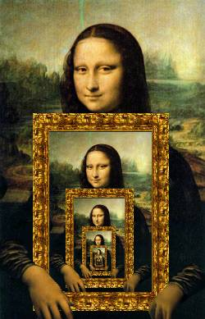
Recursion's Big Picture?
Need to see BOTH the self-similar piece AND the whole simultaneously!

Slide 134
behind the curtain
sajak('eerier')

Slide 135
behind the curtain
power(2,3)

Slide 136
def sajak(s):
when there are no letters, there are ZERO vowels
Base case?
Look at the initial character.
if s[0] is NOT a vowel, the answer is just the
number of vowels in the rest of s
Rec. step?
if s[0] is a vowel, the answer is
1 + the number of vowels in the rest of s

Slide 137
Recursion: not just numbers
Self-similarity elsewhere...
Natural phenomena
Relationships
how much here is leaf vs. stem?
What is an “ancestor” ?
Names / Acronyms
TTP == “The TTP Project”

Slide 138
Recursion: not just numbers
Self-similarity elsewhere...
Natural phenomena
Relationships
What is an “ancestor” ?
An ancestor is a parent OR an ancestor of a parent…
Names / Acronyms
TTP == “The TTP Project”
all stem!

Slide 139
This week's reading: the $10⁶ problem
Vinay Deolalikar, HP Labs
polynomially-checkable problems
polynomially-solvable problems
P vs. NP
factoring N-digit numbers?

Slide 140
Douglas Adams's 42
Those zero-eyed aliens are a bit much…
answer: 42 question: unknown
Notes:
ZACH
show python in console

Slide 142
Recursion Examples
def mylen(s):
""" input: any string, s
output: the number of characters in s
"""
if :
else:
base case test!

Slide 143
Recursion Examples
def mymax(L):
""" input: a NONEMPTY list, L
output: L's maximum element
"""
if :
elif :
else:
base case test!
another case…

Slide 144
Try it!
Do not hand this one in…
def power(b,p):
def sajak(s):
""" returns b to the p power
using recursion, not **
inputs: int b, int p
output: a float
"""
""" returns the number of vowels
in the input string, s
"""
if :
if :
Base case test
Base case test
elif
else:
power(5,2) == 25.0
sajak('wheel of fortune') == 6
What about y? You decide…
Want more power?
Handle negative values of p, as well.
What seven-letter English word w maximizes sajak(w) ?
For example, power(5,-1) == 0.2 (or so)
Want more Pat?

Slide 145
Recursion is the root of all computation since it trades description for time.
- Alan Perlis
Recursion is the secret to all happiness in writing short, powerful functional programs!

Slide 146
while we're here…
import random
comp = random.choice( range(0,100) )
while True:
user = input('Your choice: ')
print user, '?'
if user == comp:
print 'Yes!'
break
else:
print 'No...'

Slide 147
"Quiz" on recursion
Names:
def sajak(s):
def power(b,p):
""" returns the number of vowels
in the input string, s
"""
""" returns b to the p power
using recursion and not **
inputs: b and p are ints
output: should be a float
"""
sajak('wheel of fortune') == 6
power(5,2) == 25.0
What about y? You decide…
What five-letter English word w maximizes sajak(w) ?
Want more power?
Handle negative values of p, as well.
Want more Pat?
For example, power(5,-1) == 0.2 (or so)

Slide 148
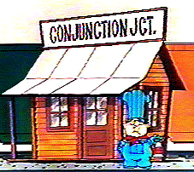
def sajak(s):
if s == '':
return 0
else:
Base Case
Checking for a vowel: Try #1
and
or
same as in English!
but each side has to be a complete boolean value!
not

Slide 149
def sajak(s):
if len(s) == 0:
return 0
else:
Base Case
if s[0] == 'a' or s[0] == 'e' or…
Checking for a vowel: Try #1
and
or
same as in English!
but each side has to be a complete boolean value!
not

Slide 150
def sajak(s):
if len(s) == 0:
return 0
else:
Base Case
Checking for a vowel: Try #2
in

